Slide 1
Diffusion (Diffusion) iyada oo loo marayo xuubka unugga (cell membrane)
Diffusion (Diffusion)

Slide 2
Sida agabkeena waxbarista loogu talagalay fasalka

Slide 3
Waxaan sharxi karaa sababta qaar ka mid ah walxaha (substances) ay u dhex mari karaan xuubka unugga (cell membrane) qaarna aysan awoodin.

Slide 4
xuubka unugga (cell membrane)
walxaha yaryar (particles)
diffusion (diffusion)
si xulasho ah u dhex mari kara (selectively-permeable)
dhaqdhaqaaq saafi ah (net movement)

Slide 5
xuubka unugga (cell membrane)
Dhammaan unugyada (cells) waxaa ku wareegsan xuub (membrane) oo xakameeya waxa geli kara unugga iyo waxa ka soo bixi kara.
walxaha yaryar (particles)
Dhammaan walxaha (substances) waxay ka samaysan yihiin walxo yaryar (particles) oo aad u yar oo aynaan arki karin.
diffusion (diffusion)
Diffusion (Diffusion) waa dhaqdhaqaaqa saafi ah (net movement) ee walxaha yaryar (particles) ee walax (substance) hoos u dhaca heerka xoojinta (concentration gradient).
si xulasho ah u dhex mari kara (selectively-permeable)
Walax (material) waa si xulasho ah u dhex mari kara (selectively-permeable) haddii qaar ka mid ah walxaha (substances) ay dhex mari karaan, qaarna aysan awoodin.
dhaqdhaqaaq saafi ah (net movement)
Dhaqdhaqaaqa saafi ah (net movement) waa dhaqdhaqaaqa guud ee walxaha yaryar (particles) oo ka yimaada meel ilaa meel kale.

Slide 6

Diffusion (Diffusion) iyada oo loo marayo xuubka unugga (cell membrane)
Walxaha (Substances) iyo xuubka unugga (cell membrane)
Gudaha iyo dibadda unugga

Slide 7
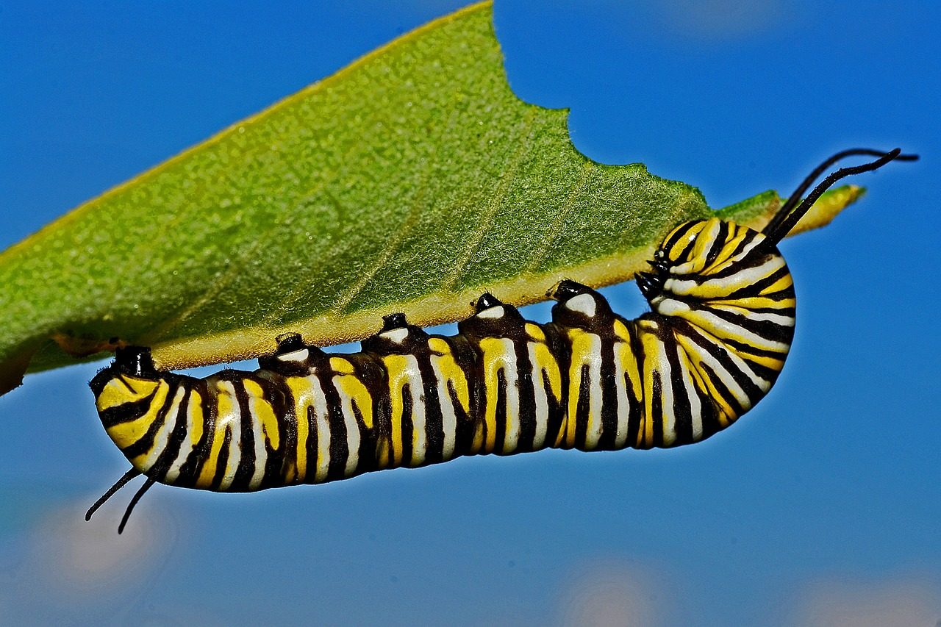
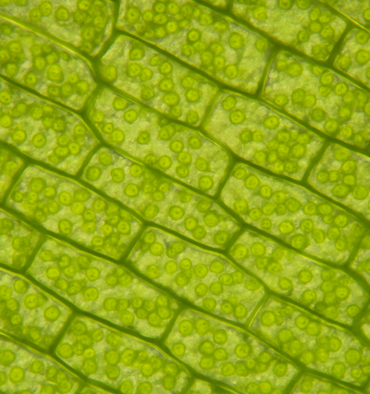
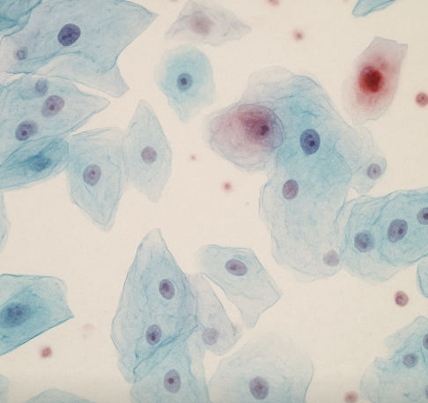
Walxaha (Substances) iyo xuubka unugga (cell membrane)
Dhammaan nooluhu (organisms) waxay ka samaysan yihiin hal ama in ka badan oo unug (cell).
unugyada dhirta (plant cells)
unugyada xayawaanka (animal cells)

Slide 8
Walxaha (Substances) iyo xuubka unugga (cell membrane)
Unugyadu (Cells) waxay ka samaysan yihiin qaybo guud (common parts).
walaxda hidaha (genetic material (DNA))
waxaa lagu kaydiyaa xudunta (nucleus) unugyada xayawaanka iyo dhirta
saytobalaasm (cytoplasm)
halka walxaha (substances) lagu kaydiyo falcelinta kiimikada (chemical reactions) ka dhacdo
xuubka unugga (cell membrane)
unug xayawaan (animal cell)
waxay xakamaysaa waxa geli kara oo ka bixi kara unugga (cell)
unug geed (plant cell)

Slide 9

Walxaha (Substances) iyo xuubka unugga (cell membrane)
Qaab dhismeedkee (structure) ayaa ku wareegsan dhammaan unugyada (cells)?
xuubka unugga (cell membrane)
saytobalaasm (cytoplasm)
xudunta (nucleus)

Slide 10
Walxaha (Substances) iyo xuubka unugga (cell membrane)
Waa maxay shaqada (function) xuubka unugga (cell membrane)?
waxay xakamaysaa waxa geli kara oo ka bixi kara unugga (cell)
kaydiya walxaha hidaha (DNA)
halkaas oo walxaha lagu kaydiyo falcelinta kiimikada ay ka dhacaan

Slide 11
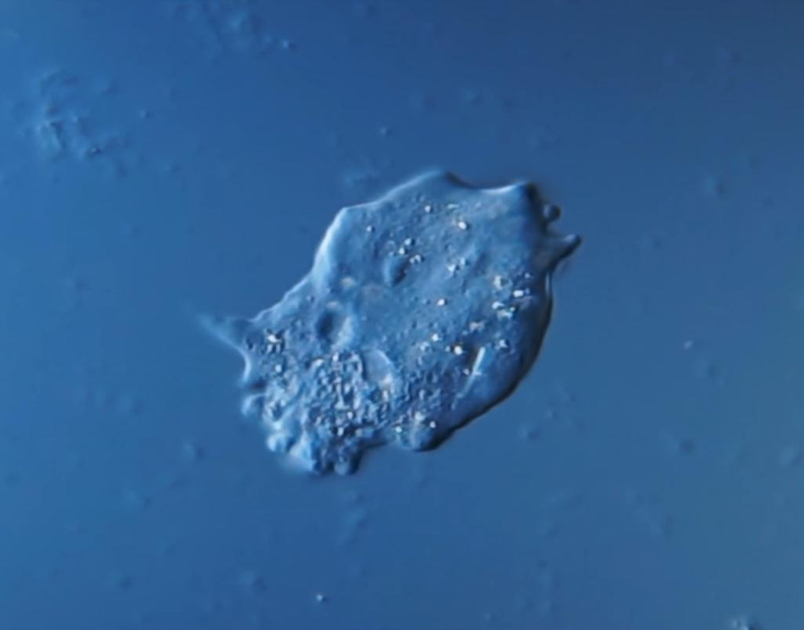

Walxaha iyo xuubka unugga (cell membrane)
Xuubka unugga (cell membrane) kuma adka sida qolofka ukunta.
Waa mid dabacsan, taas oo u oggolaanaysa unugga inuu beddelo cabbirka iyo qaabka haddii loo baahdo.
Sawirku wuxuu muujinayaa unug yar oo hal unug ah oo loo yaqaan amoeba, oo lagu arkay mikroskoob.
Daawo fiidiyowga si aad u aragto sida unugga amoeba uu u dabacsan yahay.
Amoeba mikroskoob hoostiisa, Alexander Klepnev, 2019, shatiyaysan CC BY-4.0

Slide 12
Walxaha iyo xuubka unugga (cell membrane)
Walxaha waa in lagu dhaqaajiyaa unugyada gudaha iyo dibadda.
Unugyada nool waxay u baahan yihiin oksijiin (oxygen) hawada.
Unugyada nool waxay u baahan yihiin inay ka takhalusaan kaarboon laba ogsaydh (carbon dioxide).
Waxaa loo baahan yahay habka nolosha ee neefsashada (respiration), kaas oo u isticmaala cuntada shidaal si uu u bixiyo tamar.
Waa qashin ka soo baxa neefsashada (respiration) waana sun haddii ay uruurto.
unug xayawaan (animal cell)

Slide 13
Walxaha iyo xuubka unugga (cell membrane)
Xuubka unugga (cell membrane) wuxuu leeyahay daloollo.
Tani waxay u oggolaanaysaa walxaha inay galaan unugga oo ay ka baxaan.
Daloolladu waa:
kuwa ku filan oo kaliya inay u oggolaadaan walxaha qaarkood inay dhex maraan
kuwa aan aad u weynayn oo wax kasta oo unugga ku jira ay ka baxaan.
unug xayawaan (animal cell)

Slide 14
Walxaha (Substances) iyo xuubka unugga (cell membrane)
Waa maxay hadal ku saabsan xuubka unugga (cell membrane) oo run ah?
Waxay leedahay daloollo (holes) oo dhammaan walxuhu (substances) ka dhaqaaqi karaan (move through).
Ma ogola inay walxo (substances) ka dhaqaaqaan (move through).
Waxay leedahay daloollo (holes) oo kaliya walxo (substances) qaar ka dhaqaaqi karaan (move through).

Slide 15
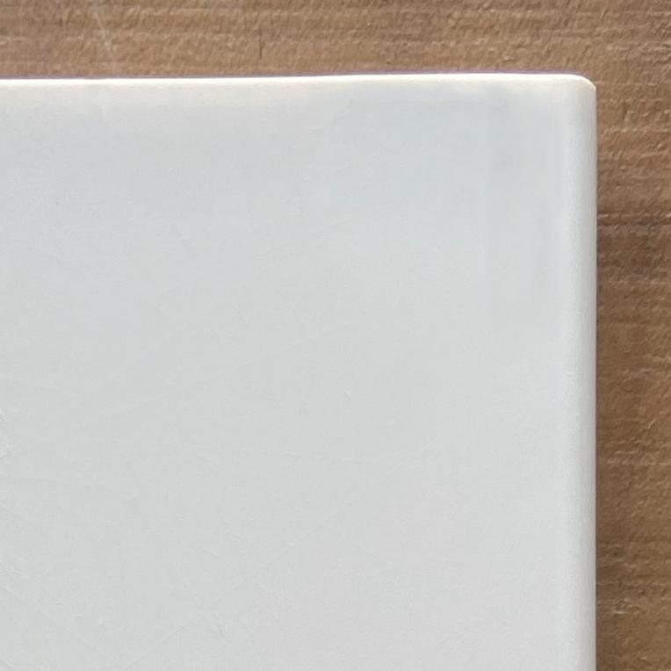
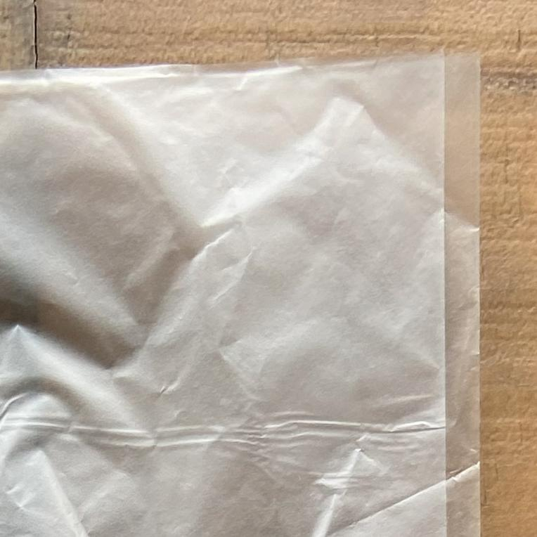
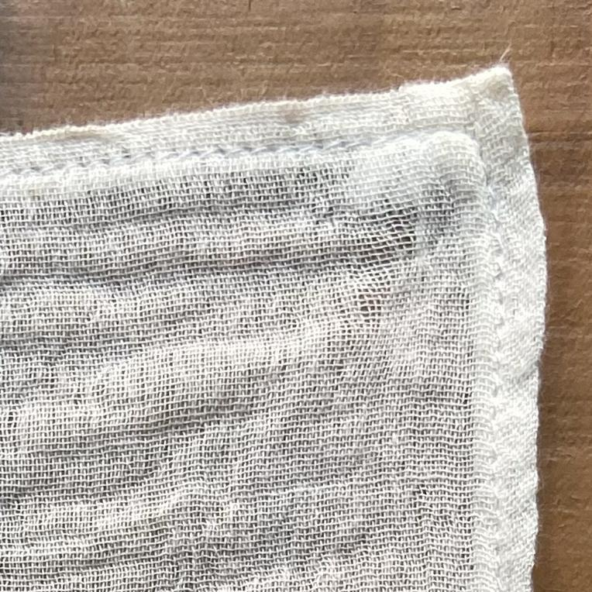
Walxaha (Substances) iyo xuubka unugga (cell membrane)
Waa maxay shay (material) oo ugu eg xuubka unugga (cell membrane)?
balastiig adag (hard plastic)
balastiig jilicsan (flexible plastic)
maro jilicsan (flexible cloth)

Slide 16




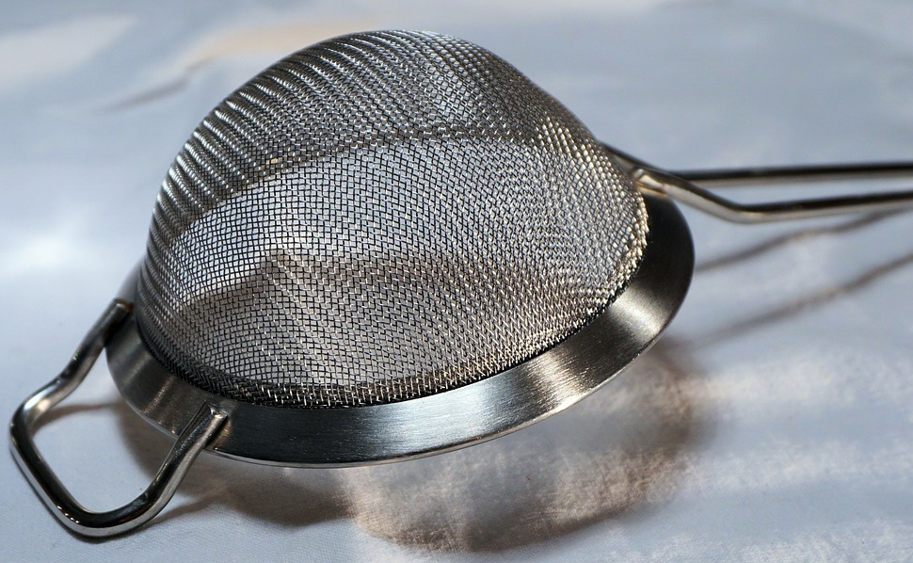




Walxaha (Substances) iyo xuubka unugga (cell membrane)
Caasha iyo Saciid ayaa la weydiiyay inay doortaan waxyaabo u eg qaabka (model) xuubka unugga (cell membrane).
Waxaan doortay shandad xadhko ah (string bag).
Waxaan doortay shaandho (sieve).
Caasha
Saciid
Sidee buu qaab kasta (model) u eg yahay xuubka unugga (cell membrane), iyo sidee buu uga duwan yahay?
Haddii xuubka unugga (cell membrane) uu sidaas ahaan lahaa, saamayn (effects) intee le'eg ayay ku yeelan lahayd unugga (cell)?
Sidee loo hagaajin karaa (improved) qaab kasta (model)?

Slide 17
Walxaha (Substances) iyo xuubka unugga (cell membrane)
shaandho (sieve)
shandad (string bag)
Sidee buu qaab kasta (model) u eg yahay xuubka unugga (cell membrane), iyo sidee buu uga duwan yahay?
Shaandhada (sieve) waxay u eg tahay xuubka unugga (cell membrane) sababtoo ah waxay leedahay daloollo yaryar (small holes), laakiin way ka duwan tahay maxaa yeelay waa adag tahay oo aan la qabsan karin (rigid and inflexible).
Shandaddu waa sida xuubka unugga (cell membrane) sababtoo ah waa mid dabacsan, laakiin way ka duwan tahay sababtoo ah waxay leedahay daloolo aad u waaweyn.

Slide 18
Maaddooyinka iyo xuubka unugga (cell membrane)
shaandho (sieve)
shandad (string bag)
Haddii xuubka unuggu (cell membrane) uu noqon lahaa sidaas, saameynno intee le'eg ayay ku yeelan lahayd unugga?
Haddii xuubka unuggu (cell membrane) uu noqon lahaa sida shaandhada (sieve), waxa uu ku fiicnaan lahaa in uu oggolaado kaliya maaddooyinka qaarkood in ay dhex maraan, laakiin unuggu ma awoodi lahaa in uu beddelo cabbirkiisa ama qaabkiisa haddii loo baahdo.
Haddii xuubka unuggu (cell membrane) uu noqon lahaa sida shandadda (string bag), waxa uu u oggolaan lahaa unugga in uu ahaado mid aad u dabacsan, laakiin waxyaabo aad u badan ayaa awoodi lahaa in ay galaan oo ka baxaan unugga.

Slide 19
Maaddooyinka iyo xuubka unugga (cell membrane)
shaandho (sieve)
shandad (string bag)
Sidee loo horumarin karaa mid kasta oo ka mid ah moodooyinka?
Moodka shaandhada (sieve) waxaa lagu horumarin karaa in uu noqdo mid ka dabacsan sida xuubka unugga (cell membrane), si unuggu u beddeli karo cabbirkiisa iyo qaabkiisa haddii loo baahdo.
Moodka shandadda (string bag) waxaa lagu horumarin karaa in uu yeesho daloolo ka yar sida xuubka unugga (cell membrane), si kaliya maaddooyinka qaarkood ay u dhex mari karaan.

Slide 20
Faafitaanka (diffusion) iyada oo loo marayo xuubka unugga (cell membrane)
Maaddooyinka iyo xuubka unugga (cell membrane)
Gelista iyo ka baxa unugga

Slide 21
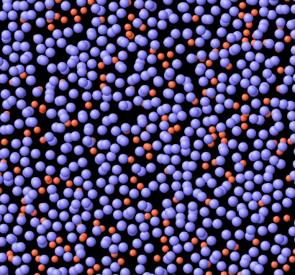
Gelista iyo ka baxa unugga
Cytoplasm-ka unuggu waa isku dhaf maaddooyin.
Maaddooyinkani waxay ka kooban yihiin qaybo (particles) si joogto ah u dhaqaaqaya dhan kasta.
cytoplasm (cytoplasm)
unug xayawaan (animal cell)
Dhaqdhaqaaq (movement) joogtada ah ee walxaha (particles) ayaa sababa faafinta (diffusion).
GIF: PhET Interactive Simulations, University of Colorado Boulder, https://phet.colorado.edu, shatiga loo oggol yahay CC BY 4.0.

Slide 22
Gudaha iyo dibadda unugga (cell)
Furaha (Key):
xuubka unugga (cell membrane)
molecule oksijiin (oxygen molecule)
molecule biyo (water molecule)
unug xayawaan (animal cell)
molecule borotiin (protein molecule)
Walxaha (particles) qaar ka mid ah ayaa ku yar oo ay ku faafi karaan (diffuse) daloollada xuubka unugga (cell membrane).
Walxaha (particles) qaar kale ayaa aad u weyn oo aan ku faafi karin (diffuse) daloollada.

Slide 23
Gudaha iyo dibadda unugga (cell)
Sababtoo ah walxaha (substances) qaar ayaa ku faafi kara (diffuse) daloollada xuubka unugga (cell membrane) qaarna ma awoodaan, xuubka unugga waxaa loo yaqaan si-duleel-oggol (selectively-permeable).
si-duleel-oggol (selectively-permeable)
oggolaada waxyaabaha qaar qaarna ma oggola
oggolaada waxyaabaha inay dhex maraan

Slide 24
Gudaha iyo dibadda unugga (cell)
Kee waa sharaxaada saxda ah ee xuubka unugga (cell membrane)?
duleel-oggol buuxa (fully-permeable)
aan duleel-oggol ahayn (impermeable)
duleel-oggol (permeable)
si xulasho leh u dhex gala (selectively-permeable)

Slide 25
Gudaha iyo dibadda unugga
Marka ay jirto kala duwanaansho xaddiga (concentration gradient) ...
qaybo badan ayaa dhaqaaqa:
laga bilaabo aagga xaddiga sare ilaa aagga xaddiga hoose.
Kani waa jihada dhaqdhaqaaqa saafiga ah.
kala duwanaanshaha xaddiga (concentration gradient)
aagga xaddiga sare
aagga xaddiga hoose
dhaqdhaqaaq saafi ah (hoos u dhaca gradient-ka xaddiga)

Slide 26
Gudaha iyo dibadda unugga
Furaha:
xuubka unugga (cell membrane)
molecule oksijiin (oxygen molecule)
unug xayawaan (animal cell)
Marka ay jirto kala duwanaansho xaddiga (concentration gradient) agagaarka xuubka unugga:
Qaybo yar ayaa ku faafa daloollada laga bilaabo xaddiga hoose ilaa xaddiga sare.
Qaybo aad u badan ayaa ku faafa laga bilaabo xaddiga sare ilaa xaddiga hoose.
Dhaqdhaqaaqa saafiga ah wuxuu ka yimaadaa xaddiga sare ilaa xaddiga hoose.

Slide 27







Gudaha iyo dibadda unugga
Yaa si sax ah u qeexaya sida molecules oksijiin (oxygen molecules) ugu galaan unugga?
Unuggu wuxuu neefsadaa molecules-ka oksijiinka (oxygen).
Unuggu wuxuu u baahan yahay oksijiin (oxygen) si uu u noolaado, marka wuxuu go'aansadaa inuu ku faafiyo (diffuse) molecules-ka gudaha.
Cali
Isra
Molecules-ka oksijiinka (oxygen) waxay ku faafaan (diffuse) xuubka unugga (cell membrane) iyagoo hoos u sii socda heerka xaddiga (concentration gradient).
Molecules-ka oksijiinka (oxygen) waxaa lagu nuugaa unugga iyada oo loo marayo faafin (diffusion).
Yacquub
Nuur

Slide 28
Gudaha iyo dibadda unugga
Dhinac kee buu ka faafi doonaa (diffuse) carbon dioxide (CO2) xuubkan unugga (cell membrane)?
dhaqdhaqaaq (movement) saafiga ah oo ka yimaada dhinaca A una socda dhinaca B
dhaqdhaqaaq (movement) saafiga ah oo ka yimaada dhinaca B una socda dhinaca A
dhinaca A
dhinaca B
Furaha:
dhaqdhaqaaq (movement) isku mid ah labada dhinac
xuubka unugga (cell membrane)
molecule-ka carbon dioxide (CO2)
molecule-ka biyaha (water)

Slide 29
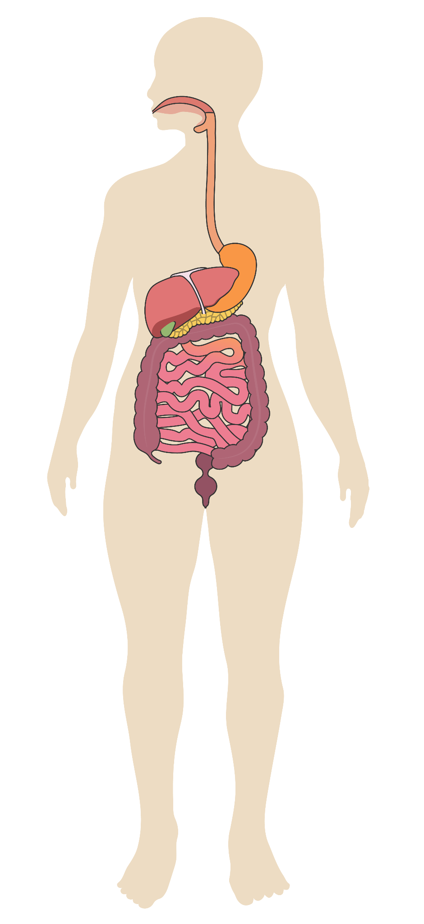
Gudaha iyo dibadda unugga
Beerku (liver) waa xubin ka mid ah habka dheefshiidka (digestive system). Unugyada beerka waxay sameeyaan wax qashin ah oo la yiraahdo urea. Waxaa qaada dhiiggu.
Dhammeystir jaantuska si aad u tusiso sida molecules urea ugu faafaan (diffuse) unugga beerka oo ay u galaan dhiigga (blood).
beer (liver)
cytoplasm-ka unugga (cell cytoplasm)
dhiig (blood)
Fure (Key):
xuubka unugga (cell membrane)
habka dheefshiidka (digestive system) ee bini'aadamka
Qor sharaxaad ku saabsan jihada dhaqdhaqaaqa (movement) saafiga ah ee molecules urea ee xuubka unugga.

Slide 30
Gudaha iyo dibadda unugga
Dhammeystir jaantuska si aad u tusiso sida molecules urea ugu faafaan (diffuse) unugga beerka oo ay u galaan dhiigga (blood).
Qor sharaxaad ku saabsan jihada dhaqdhaqaaqa (movement) saafiga ah ee molecules urea ee xuubka unugga.
cytoplasm-ka unugga (cell cytoplasm)
dhiig (blood)
Waxaa jira uruurin (concentration) sare oo molecules urea ah cytoplasm-ka unugga beerka, iyo uruurin hoose oo dhiigga (blood) ku jirta.
Dhaqdhaqaaqa (movement) saafiga ah ee molecules urea wuxuu hoos u socdaa jihada gradient-ka uruurinta (concentration gradient) laga bilaabo cytoplasm-ka, isagoo sii maraya daloollada xuubka unugga, una gudbaya dhiigga (blood).
Fure (Key):
xuubka unugga (cell membrane)
molecule urea (urea molecule)

Slide 31
Faafinta (Diffusion) iyada oo loo marayo xuubka unugga
Dhammaan unugyada waxaa ku wareegsan xuub unug (cell membrane), kaas oo leh daloollo yaryar.
Dhammaan walxaha waxay ka kooban yihiin qaybo (particles).
Qaybaha (particles) qaar ka mid ah walxaha ayaa ku filan yar yar inay dhex maraan daloollada xuubka unugga iyagoo faafaya (diffuse). Qaybaha walxaha kale ayaa aad u weyn inay ku faafaan (diffuse) daloollada.
Xuubka unugga waxaa loo yaqaan 'selectively-permeable' sababtoo ah waxaa dhex mari kara faafin (diffusion) oo keliya walxo qaar.
Dhaqdhaqaaqa (movement) saafiga ah ee qaybaha (particles) ee faafinta (diffusion) iyada oo loo marayo xuubka unugga wuxuu hoos u socdaa jihada gradient-ka uruurinta (concentration gradient).

