Slide 1
DNA, koromosoomyada, hiddo-wadayaasha iyo genome-ga
Dhaxalka iyo DNA

Slide 2
sida loo isticmaalo darasyada Oak

Slide 3
Waxaan sharxi karaa farqiga u dhexeeya DNA, koromosoomyada, hiddo-wadayaasha iyo genome-ga.

Slide 4
genome (genome)
DNA
nucleus (nucleus)
koromosoom (chromosome)
hiddo-wade (gene)

Slide 5
Genome-gu waa dhammaan maadada hidde-side ee unugga; wuxuu kaydiyaa koodhka dhammaan astaamaha iyo hababka noole (organism).
DNA waa walaxda kiimikaad ee laga sameeyo maadada hidde-side; waxay kaydisaa koodhka hidde-side.
Nucleus-ku waa meesha DNA, oo loo duubay koromosoomyo, lagu kaydiyo unugyada xayawaanka, dhirta iyo fangaska.
Koromosoomku waa xirmo DNA ah oo si adag u duuban.
Hiddo-wadayaashu waa qaybo ka mid ah DNA-ga oo codeeya astaamaha iyo hababka.

Slide 6

DNA, koromosoomyada, hiddo-wadayaasha iyo genome-ga
Genome-ga
DNA iyo koromosoomyada
Hiddo-wadayaasha iyo qaybaha kale ee genome-ga

Slide 7
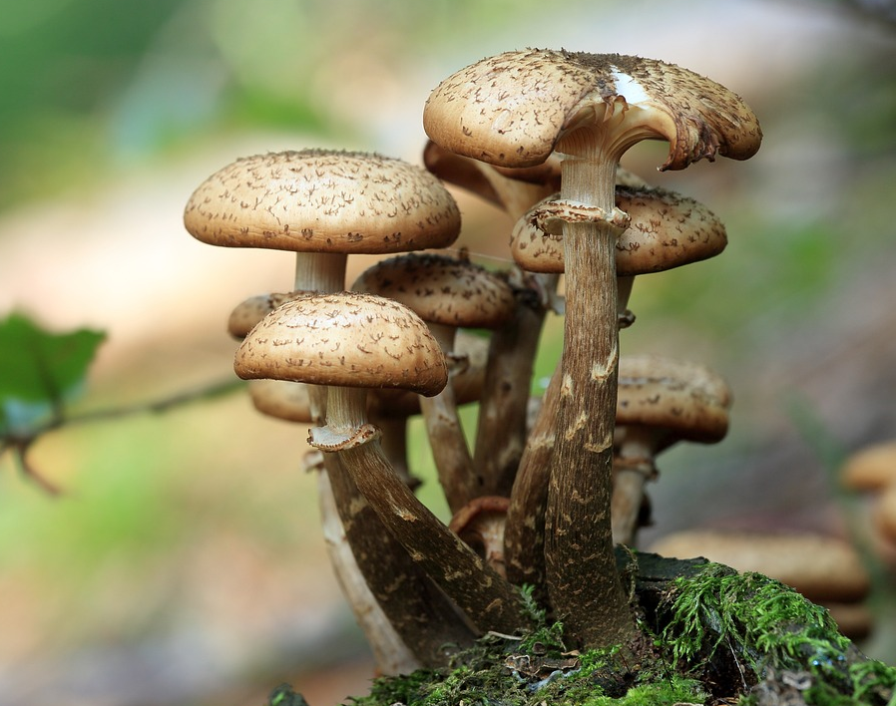
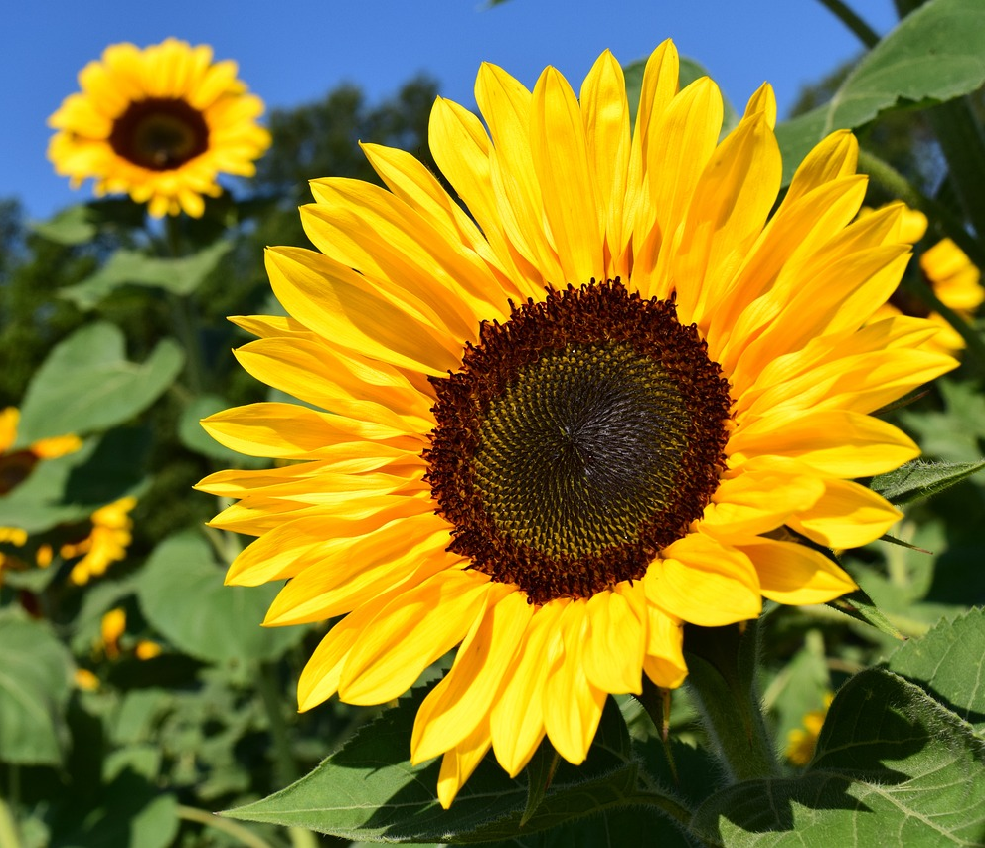
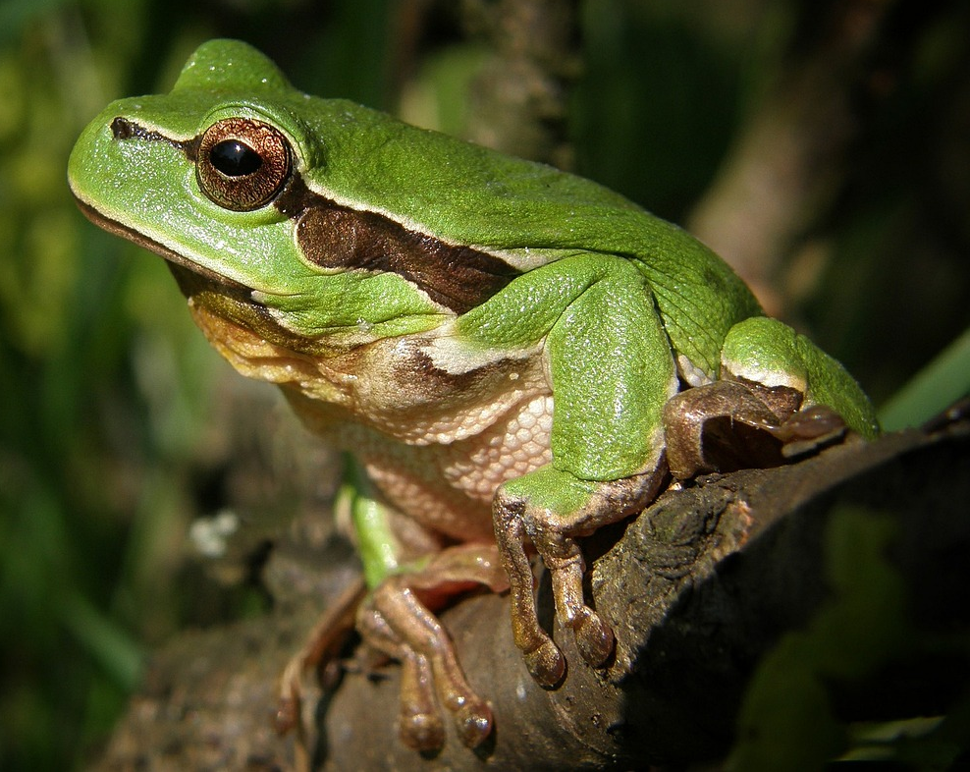
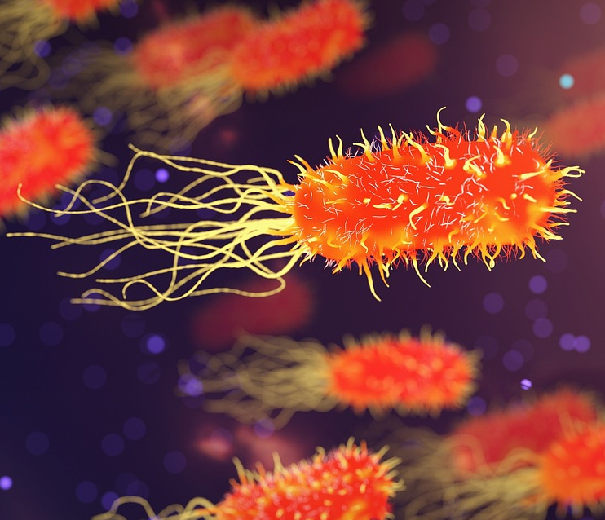
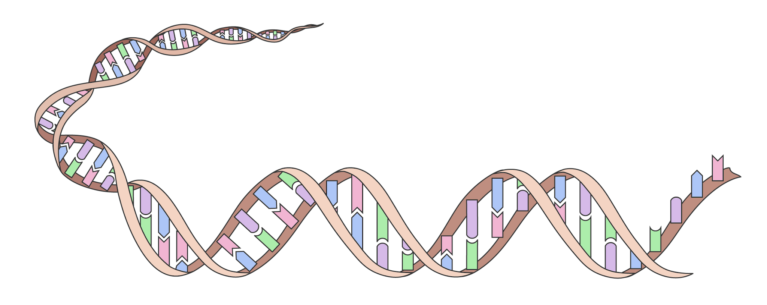
Genome-ga
Dhammaan noolayaashu (organisms) waxay leeyihiin genome.
Genome-gu waa dhammaan maadada hidde-side ee noole (organism).
Genome-ga wuxuu ka samaysan yahay molecule kiimikaad ee DNA.
unug (cell)
DNA

Slide 8

Hiddo-dhammayn (The genome)
Dhammeysti qeexida. Dhammaan walxaha hiddo-side ee unugga waxaa loo yaqaan …
hiddo-side (genes)
DNA
sifooyin (features)
hiddo-dhammayn (genome)

Slide 9
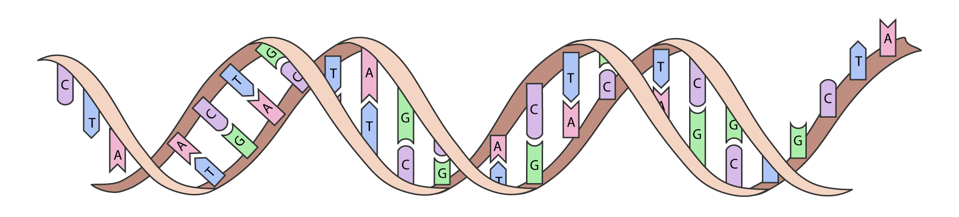
Hiddo-dhammayn (The genome)
Hiddo-dhammayn (The genome) waxay codeysaa dhammaan sifooyinka iyo hababka la dhaxlo ee noole (organism) nool.
Hiddo-dhammayn (The genome) waxay la mid tahay buug-gacmeedka tilmaamaha oo dhan ee noole (organism) nool.
koodhka hiddo-side (genetic code)
DNA waa unug kiimiko oo dheer oo ka kooban koodhka hiddo-side (genetic code).
Taxanaha A, T, C iyo G ee hiddo-dhammayn (genome) waxay bixiyaan tilmaamaha lagu dhiso sifooyinka iyo lagu xakameeyo hababka nolosha.

Slide 10
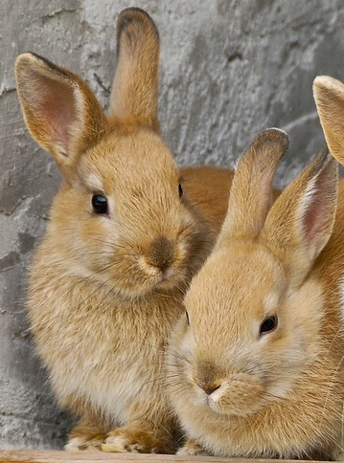
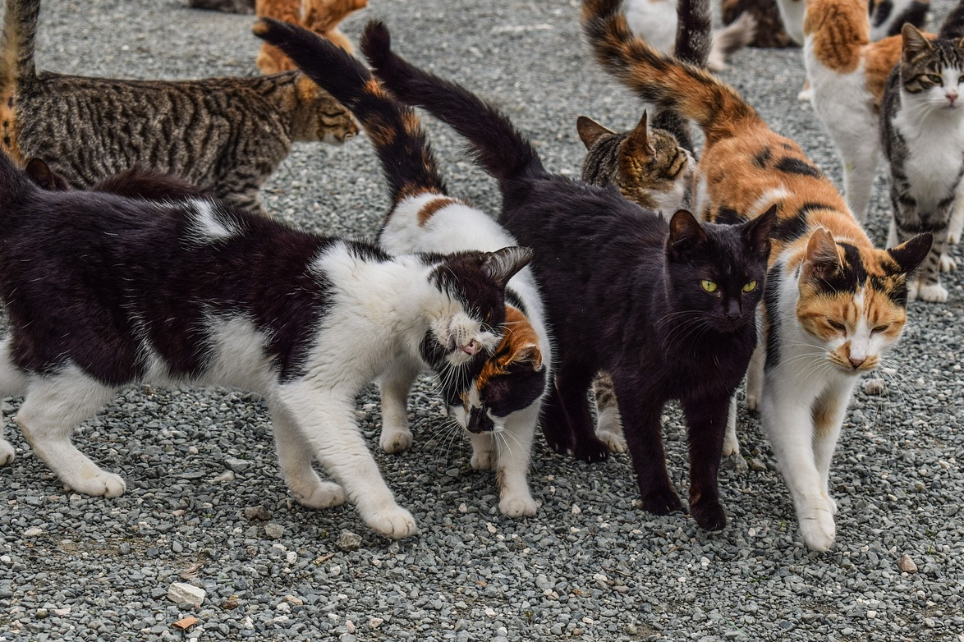
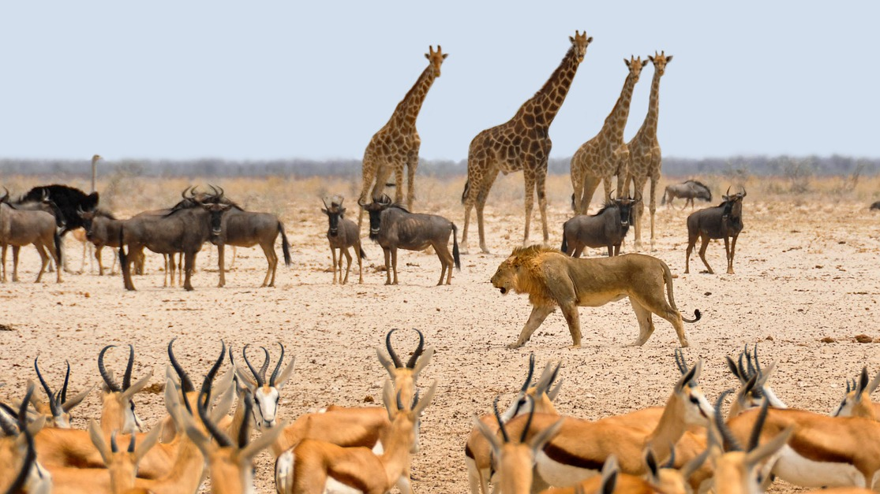
Hiddo-dhammayn (The genome)
Dhammaan noolaha (organisms) dhulka waxay leeyihiin isku ekaansho taxanaha hiddo-dhammayn (genome sequence).
Kala duwanaanshaha taxanaha hiddo-dhammayn (genome sequence) ayaa naga dhigaya kuwa gaar ah.
Xubnaha qoyska isku midka ah waxay leeyihiin isku ekaanshaha ugu badan taxanaha hiddo-dhammayn (genome sequence), iyo kala duwanaansho yar oo keliya.
Xubnaha isku nooleed (same species) ee aan qaraabada ahayn waxay leeyihiin isku ekaansho badan, laakiin kala duwanaansho yar oo dheeri ah hiddo-dhammayn (genomes) kooda.
Xubnaha noocyada (species) kala duwan waxay leeyihiin kala duwanaansho aad u badan hiddo-dhammayn (genomes) kooda.

Slide 11
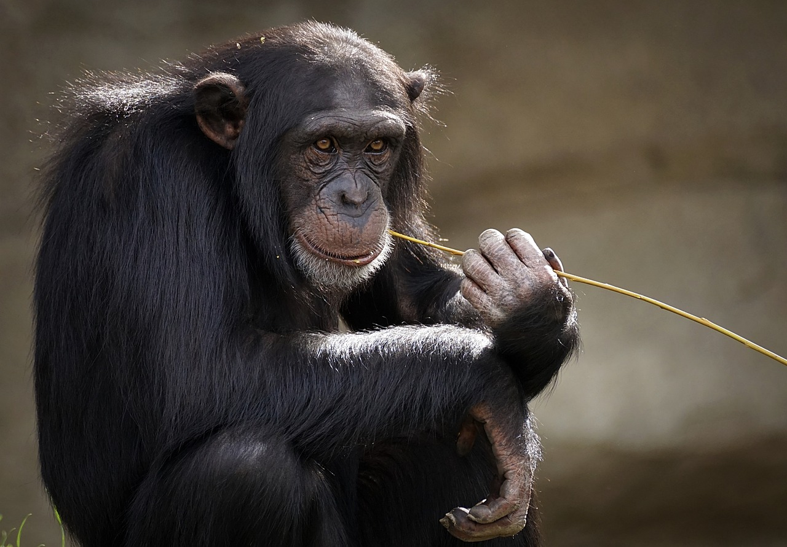
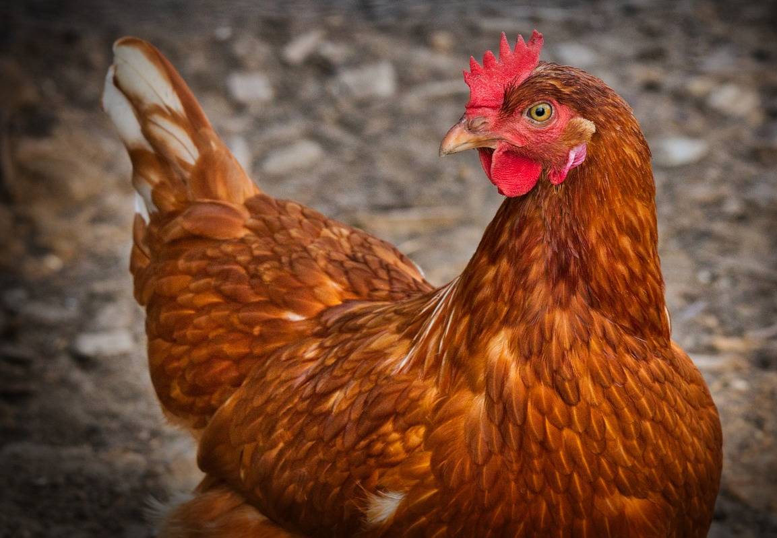
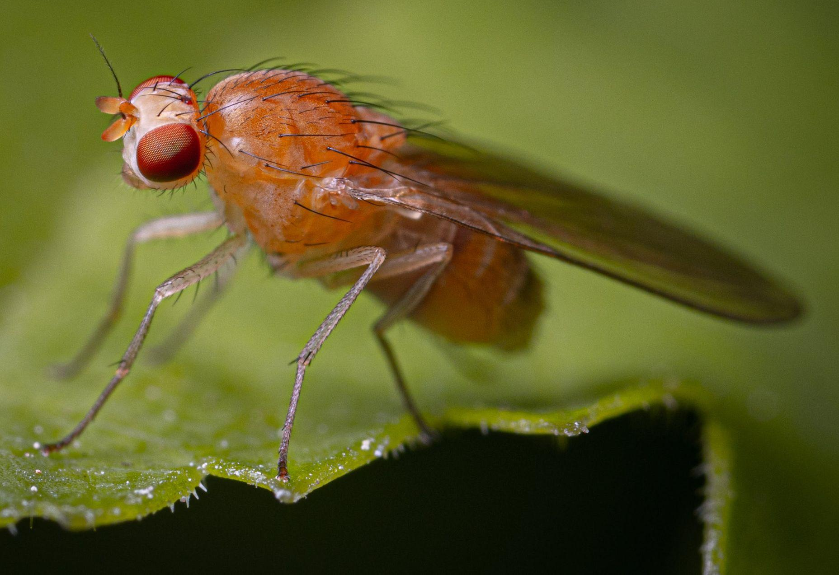
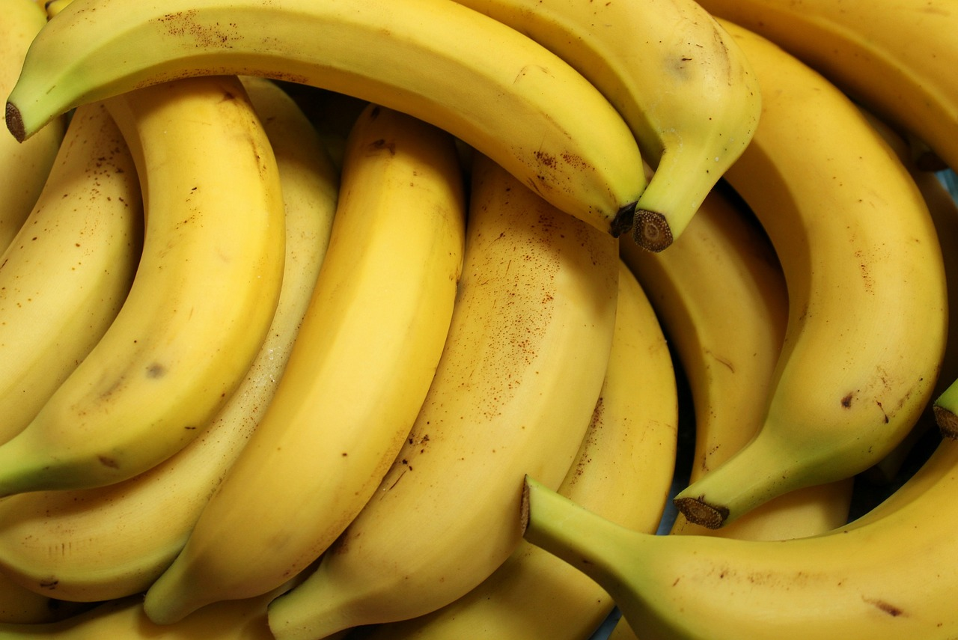

Hiddo-dhammayn (The genome)
Hiddo-dhammayn (genomes) kayagu waxay isku eg yihiin in ka badan inta aad u malaynayso:
Jawaabaha:
 | Boqolkiiba (percentage) isku midka ah ee habka hiddo-wadaha (genome sequence)
Dadka iyo dadka kale oo dhan
99.9
98
75
60
60
30
Dadka iyo daanyeerka (chimpanzees)
Dadka iyo digaagga (chickens)
Dadka iyo dhirta duqsiyada (fruit flies)
Dadka iyo mooska (bananas)
Dadka iyo ubaxa daffodil (daffodils)

Slide 12
Hiddo-wadaha (genome)
Laga bilaabo kuwa ugu isku midka badan, dhiga alaabtan sida ay u kala horreeyaan marka loo eego isku midka hiddo-wadaha (genomes).
Xubnaha noocyada kala duwan.
Xubnaha qoyska isku midka ah.
Xubnaha aan qaraabada ahayn ee isku nooca ah.
Jawaabaha:
3
1
2

Slide 13



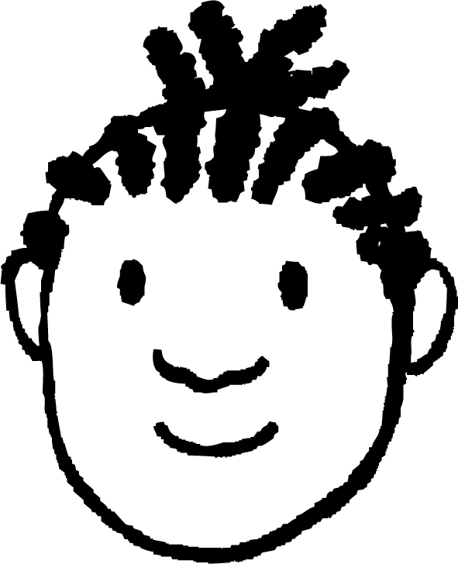





Hiddo-wadaha (genome)
Ardaydu waxay ka wada hadlayaan fahankooda hiddo-wadaha (genome).
Dhammaan xayawaanku waxay leeyihiin hiddo-wade (genome).
Nooc kasta oo kala duwan oo dhulka ku nool wuxuu leeyahay hiddo-wade (genome) isku mid ah.
Yacquub
Layla
Hiddo-wadaha (genome) waa eray kale oo loo yaqaan DNA.
Hiddo-wadaha (genome) waa koodhka hiddo-side (genetic code) ee dhammaan astaamaha dadka.
Axmed
Suad
Hagaaji fikrad kasta oo ka mid ah adigoo beddelaya ama ku daraya faahfaahin dheeri ah.

Slide 14
Genome (genome)
Hagaaji fikrad kasta oo ka mid ah fikradahooda adoo beddelaya ama ku daraya faahfaahin dheeri ah.
Layla: Dhammaan xayawaanku waxay leeyihiin genome (genome).
Yacquub: Nooc kasta oo kala duwan oo dhulka ku nool ayaa leh genome (genome) isku mid ah.
Axmed: Genome (genome) waa erey kale oo loo yaqaan DNA (DNA).
Suad: Genome (genome) waa koodhka hidde-side (genetic code) ee dhammaan astaamaha bini'aadamka.
Layla: Dhammaan noolaha (organisms) noolaha ayaa leh genome (genome), oo ay ku jiraan dhirta, bakteeriyada, fangaska iyo xayawaanka.
Yacquub: Dhammaan shakhsiyaadka noocyada kala duwan ee dhulka ayaa leh genome (genome) gaar ah. Kuwa isku nool ayaa lahaan kara isku ekaansho badan oo genome (genome) kooda ah.
Axmed: Genome (genome) waa dhammaan DNA (DNA) ee ku jira noole (organism).
Suad: Genome (genome) waa koodhka hidde-side (genetic code) ee dhammaan astaamaha iyo hababka la dhaxlo ee noolaha (organisms).

Slide 15
DNA (DNA), koromosoomyada (chromosomes), hiddo-wadayaasha (genes) iyo genome (genome)
Genome (genome)
DNA (DNA) iyo koromosoomyada (chromosomes)
Hiddo-wadayaasha (genes) iyo qaybaha kale ee genome (genome)

Slide 16
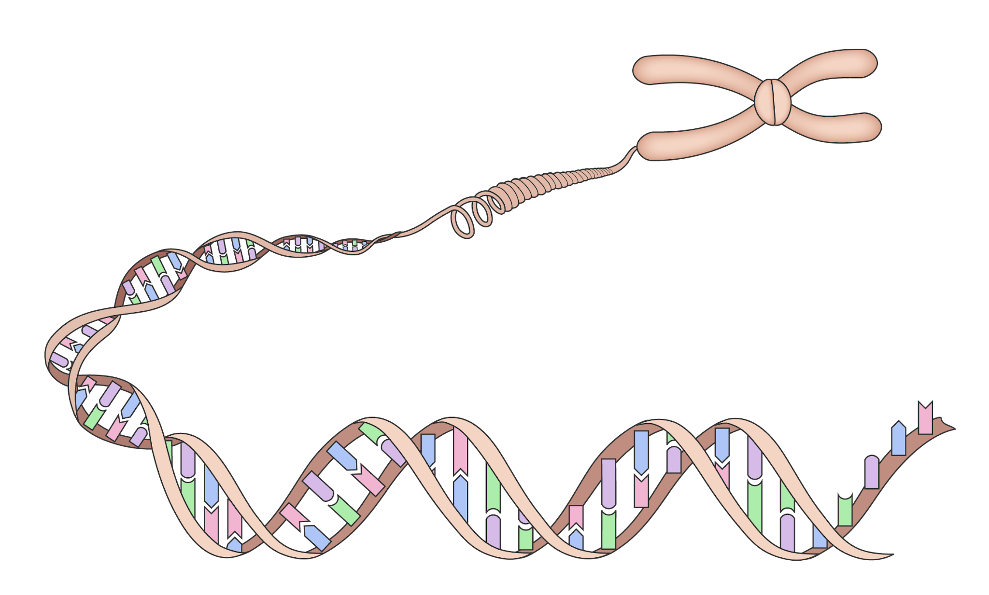
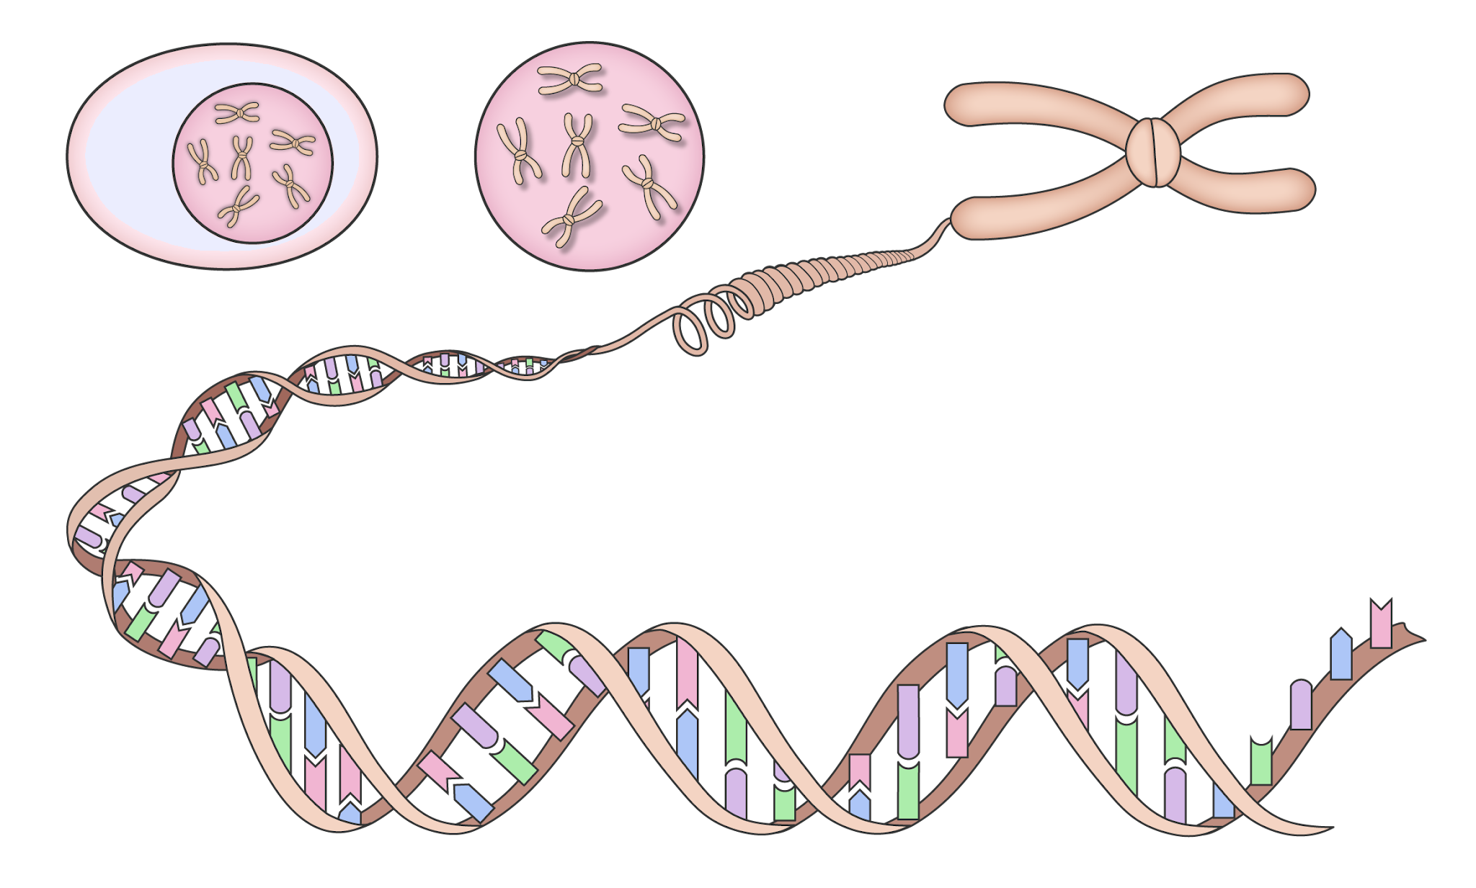
DNA (DNA) iyo koromosoomyada (chromosomes)
Unugyada xayawaanka, dhirta iyo fangaska, dhammaan DNA (DNA) ee ka kooban genome (genome) waxaa lagu kaydiyaa xudunta unugga (cell nucleus).
DNA (DNA) waxaa loo habeeyaa qaab xirmooyin (packages) loo yaqaan koromosoomyada (chromosomes).
DNA (DNA)
xudunta (nucleus)
unug xayawaan (animal cell)
koromosoomyada (chromosome)

Slide 17
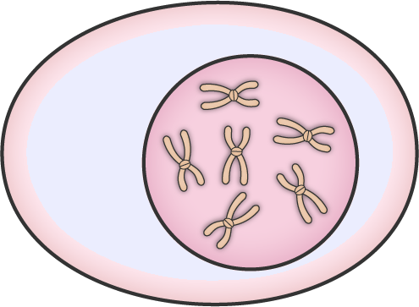
DNA iyo koromosoomyada (chromosomes)
Waxaa jira laba nuqul oo koromosoomyada (chromosomes) ah oo ku yaal nucleus-ka, hal nuqul oo ka yimid waalid kasta oo qofka.
Dadku waxay leeyihiin 23 lammaane oo koromosoomyo (chromosomes) ah.
hal lammaane oo koromosoomyo (chromosomes) ah
nucleus
afar lammaane oo koromosoomyo (chromosomes) ah

Slide 18
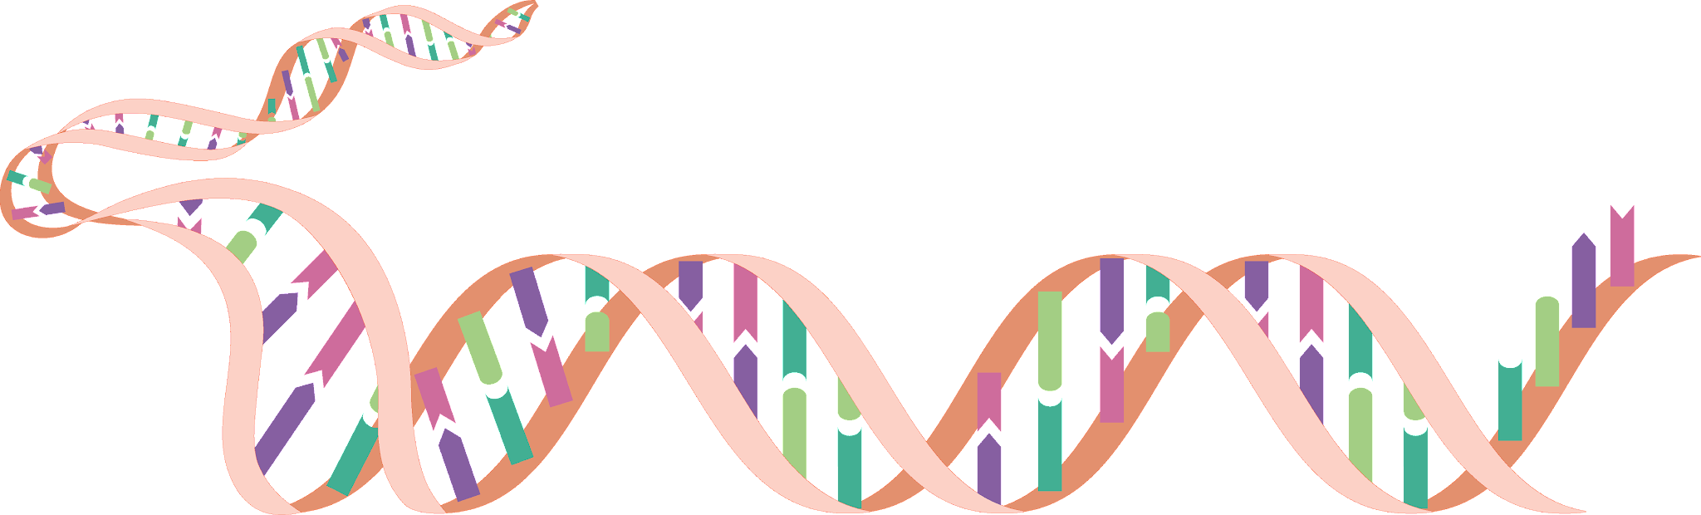
DNA iyo koromosoomyada (chromosomes)
Bakteeriyadu (bacteria) ma laha nucleus unug.
Waxay leeyihiin hal koromosoome (chromosome). Waa goobo DNA ah oo ku kaydsan cytoplasm-ka unugga.
goobo DNA ah

Slide 19
DNA iyo koromosoomyada (chromosomes)
Qaybaha DNA-da ee codeeya astaamaha iyo hababka waxaa loo yaqaan hiddo-sideyaal (genes).
DNA
koromosoome (chromosome)
hiddo-side (gene)

Slide 20
DNA iyo koromosoomyada (chromosomes)
Hiddo-sideyaasha (genes) waxay ka samaysan yihiin koromosoomyo (chromosomes).
Koromosoomyada (chromosomes) waxay u kala habaysan yihiin xirmo loo yaqaan hiddo-sideyaal (genes).
Hiddo-sideyaasha (genes) waa qaybo ka mid ah DNA-da ee ku jira koromosoome (chromosome) oo codeeya astaamaha.

Slide 21
DNA iyo koromosoomyada (chromosomes)
Ku calaamadee jaantuskan kaydinta DNA-da.
Qor sharaxaad kooban oo calaamad kasta ah.

Slide 22
DNA iyo koromosoomyada (chromosomes)
Ku calaamadee jaantuskan kaydinta DNA-da.
U qor sharaxaad kooban calaamad kasta.
Nucleus: Dhammaan unugyada xayawaanka, dhirta iyo fangaska (fungi) waxay leeyihiin nucleus.
Unug (Cell): Noole kasta (organism) wuxuu ka samaysan yahay unugyo.
Koromosoomyada (Chromosome): Mid waxaa laga dhaxlaa waalid kasta. Dadku waxay leeyihiin 23 lammaane (pairs).
DNA: Waa molecule dheer oo sidaysa koodhka hidaha (genetic code).
Hiddo (Gene): Waa qayb ka mid ah DNA-da oo koodheysa astaan ama geedi-socod.

Slide 23
DNA, koromosoomyada (chromosomes), hiddooyinka (genes) iyo genome-ka
Genome-ka
DNA iyo koromosoomyada (chromosomes)
Hiddooyinka (Genes) iyo qaybaha kale ee genome-ka

Slide 24
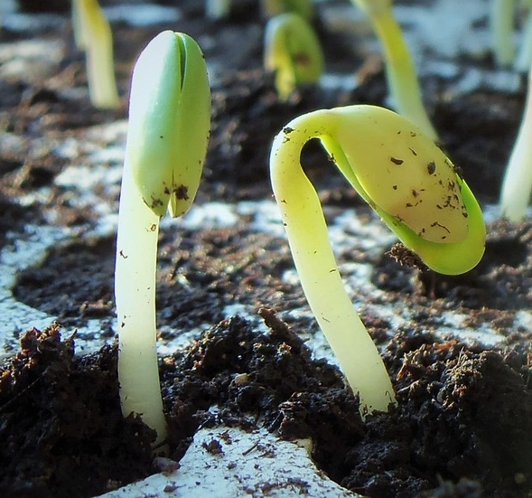
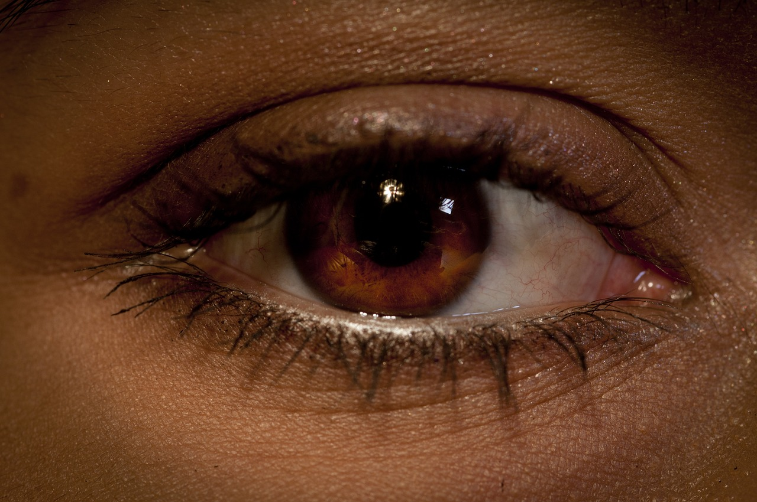
Hiddooyinka (Genes) iyo qaybaha kale ee genome-ka
Hiddooyinku (Genes) waxay koodheeyaan astaamaha aad arki karto, iyo geedi-socodka aadan arki karin, sida koritaanka (growth).
Hiddooyinku (Genes) waxay koodheeyaan geedi-socodyada, tusaale: koritaanka (growth).
Hiddooyinku (Genes) waxay koodheeyaan astaamaha, tusaale: midabka isha (eye colour).
hiddo (gene)

Slide 25
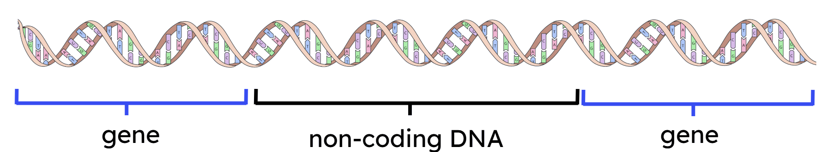
Hiddooyinka (Genes) iyo qaybaha kale ee genome-ka
Qaybaha qaarkood ee DNA-da ee genome-ka kuma koodheeyaan astaamo ama geedi-socodyo. Qaybahani ma aha hiddooyin (genes).
Qaybahan DNA-da ee aan koodheyn (non-coding) waxay ku yaalaan inta u dhaxaysa hiddooyinka (genes).
Waxay kaaliyaan xakamaynta goorta tilmaamaha ku jira hiddooyinka (genes) la isticmaalo.

Slide 26
Hiddooyinka (Genes) iyo qaybaha kale ee genome-ka
Inta badan unugyada noole (organism) waxay leeyihiin nuqul ka mid ah genome-ka.
genome (genome)
Genome-ku wuxuu ka kooban yahay dhammaan hiddo-wadeyaasha (genes) iyo qaybaha aan codeyn ee DNA-da.

Slide 27
Hiddo-wadeyaasha (genes) iyo qaybaha kale ee genome-ka
Isku xidh erayga muhiimka ah iyo qeexitaankiisa saxda ah.
DNA (DNA)
Qaybaha DNA-da ee codeeya astaamaha.
hiddo-wadeyaal (genes)
Dhammaan DNA-da coding iyo aan coding-ga ahayn ee unugga.
koromosoomyo (chromosome)
Molecule kiimiko ah oo kaydiya koodhka hidde-side.
Xirmo DNA ah oo si adag u duuban.
genome (genome)

Slide 28
Hiddo-wadeyaasha (genes) iyo qaybaha kale ee genome-ka
Barbardhigga habaynta DNA-da:
Nucleus-ku wuxuu la mid yahay… maktabad kaydisa buugaagta tilmaamaha.
Genome-ku wuxuu la mid yahay… dhammaan buugaagta tilmaamaha.
Hal koromosoomyo (chromosome) wuxuu la mid yahay… hal buug tilmaameed.
Dhammeysti isbarbardhigga (analogy):
Hiddo-wade (gene) wuxuu la mid yahay…
… cutub tilmaamo ah oo ku jira buugga.
DNA-da aan coding-ga ahayn waxay la mid tahay…
… dhammaan cutubyada buugga ee aan ku jirin tilmaamo.

Slide 29

Hiddo-sideedyada (Genes) iyo qaybaha kale ee genome-ka
Maxaad u malaynaysaa hadal kasta?
Waxaan ahay
hubaa
kani waa sax
I
u malaynayaa kani waa sax
I
u malaynayaa kani waa qalad
Waxaan ahay
hubaa
kani waa qalad
Unugyada (cells) badankood ee noole (organism) waxay leeyihiin nuqul (copy) ka mid ah genome-ka.
a
Hiddo-sideedyadaada (Genes) iyo genome-kaagu waa isku mid.
b
Hiddo-sideedyadu (Genes) waxay codeeyaan (code) kaliya sifooyinka aad arki karto.
c
Qaybaha aan codeyn (Non-coding) ee DNA-ga ma faa'iido, waa qashin (junk) kaliya.
d

Slide 30
Hiddo-sideedyada (Genes) iyo qaybaha kale ee genome-ka
Maxaad ka qabtaa hadal kasta?
Waxaan ahay
hubaa
kani waa sax
I
u malaynayaa kani waa sax
I
u malaynayaa kani waa qalad
Waxaan ahay
hubi
kani waa khalad
Inta badan unugyada noole (organism) waxay leeyihiin nuqul ka mid ah genome-ka.
a
Hiddo-wadahaaga (genes) iyo genome-kaagu waa isku mid.
b
Hiddo-waduhu (genes) waxay codeeyaan oo kaliya sifooyinka aad arki karto.
c
Qaybaha DNA-da aan codeynin ma aha kuwo waxtar leh, waa qashin.
d

Slide 31

Hiddo-wadaha (genes) iyo qaybaha kale ee genome-ka
Sidee dib ugu qori lahayd hadal kasta oo khalad?
b
Hiddo-wadahaaga (genes) iyo genome-kaagu waa isku mid.
c
Hiddo-waduhu (genes) waxay codeeyaan oo kaliya sifooyinka aad arki karto.
d
Qaybaha DNA-da aan codeynin ma aha kuwo waxtar leh, waa qashin.
d

Slide 32
Hiddo-wadaha (genes) iyo qaybaha kale ee genome-ka
Sidee dib ugu qori lahayd hadal kasta oo khalad ahaa?
b
Hiddo-wadahaaga (genes) iyo genome-kaagu waa isku mid.
Hiddo-wadahaagu (genes) waa qaybo ka mid ah genome-kaaga.
c
Hiddo-waduhu (genes) waxay codeeyaan oo kaliya sifooyinka aad arki karto.
Hiddo-waduhu (genes) waxay codeeyaan sifooyinka aad arki karto iyo hababka sida koritaanka.
Qaybaha DNA-da aan codeynin ma aha kuwo waxtar leh, waa qashin.
d
Qaybaha DNA-da aan codeynin waxay gacan ka geystaan xakamaynta marka tilmaamaha ku jira hiddo-wadaha (genes) la isticmaalo.

Slide 33
DNA (DNA), koromosoomyo (chromosomes), hiddo-wadeyaal (genes) iyo genome-ka (genome)
Dhammaan maadada hidde-side (genetic material) ee noole (organism) waa genome-kiisa.
Noolaha (organisms) isku xidhan waxay leeyihiin waxyaabo badan oo isku mid ah oo ku jira genome-yadooda; kala duwanaanshaha genome-ka ayaa inaga dhigaya kuwo gaar ah.
Genome-ku wuxuu ka samaysan yahay DNA (DNA), oo loo duubay qaabab si adag u xidhan oo loo yaqaan koromosoomyo (chromosomes).
Unugyada jidhka bini'aadamka waxay leeyihiin 23 lammaane oo koromosoomyo (chromosomes) ah, oo lagu kaydiyo xudunta unugga (cell nucleus); bakteeriyadu waxay leedahay hal koromosoome (chromosome) oo lagu kaydiyo saytobalaasmka (cytoplasm).
Qaybaha DNA (DNA) ee koromosoomyada (chromosomes) waxaa loo yaqaan hiddo-wadeyaal (genes), kuwaas oo kaydiya tilmaamaha lagu dhiso sifooyinka la dhaxlo iyo xakamaynta hab-nololeedyada (life processes).
Qaybaha kale ee koromosoomyada (chromosomes) waa DNA (DNA) aan koodh ahayn (non-coding DNA), oo ka kooban tilmaamo xakameeya goorta macluumaadka hiddo-wadeyaasha (genes) la isticmaalo.

