Slide 1
DNA ka midho
Dhaxalka iyo DNA

Slide 2
Sida qalabkeena waxbarista loogu talagalay fasalka
Darsigani wuxuu ku darayaa qalab dheeri ah oo laga soo dejin karo bogga darasga.

Slide 3
Waxaan arki karaa DNA laga soo saaray midho, waxaanan aqoonsan karaa qalabka iyo tillaabooyinka ugu muhiimsan ee habka soo saarista.

Slide 4
unug (cell)
DNA
moos iyo yarad (mortar and pestle)
shaandho (filter)
pipette

Slide 5
Unuggu waa qaybta ugu yar ee noolaha (organism) ee dhismaha, wuxuuna ka kooban yahay qalab hidde oo bixiya tilmaamaha lagu dhiso oo lagu xakameeyo noolaha.
Qalabka hidaha wuxuu ka samaysan yahay kiimiko la yiraahdo DNA, kaas oo tilmaamaha lagu kaydiyo iyadoo la adeegsanayo koodhka hidaha.
Moos iyo yarad waxaa loo isticmaalaa in lagu burburiyo oo lagu shiido muunado adag.
In la shaandheeyo isku dhaf waa in laga sooco qaybaha aan milmin ee dareeraha. Waxaa lagu samayn karaa qaafiyad iyo warqad shaandho.
Pipette waxaa loo isticmaalaa in lagu wareejiyo xaddi yar oo dareere ah.

Slide 6

DNA ka midho
Qalabka sayniska iyo farsamooyinka
Soo saarista DNA

Slide 7
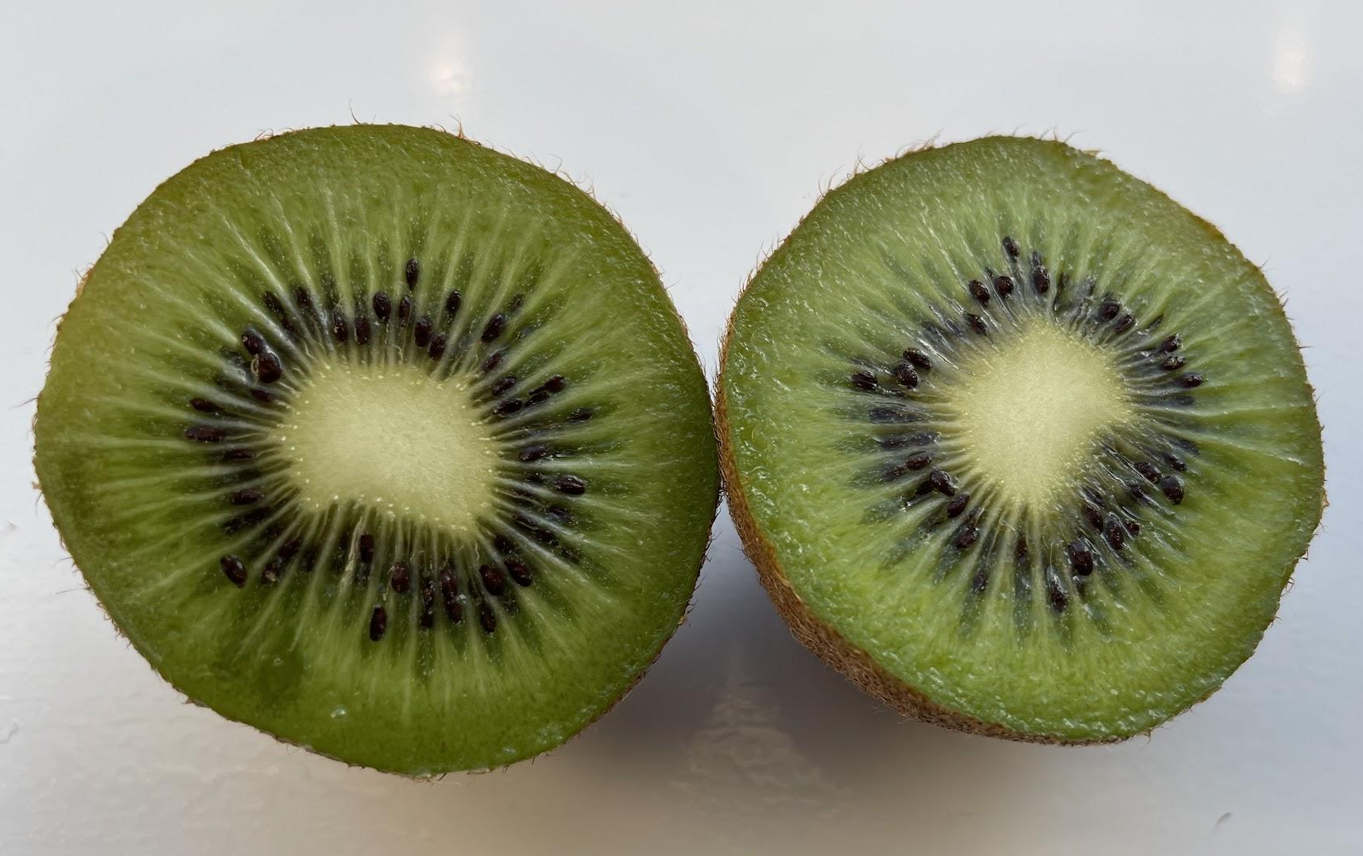
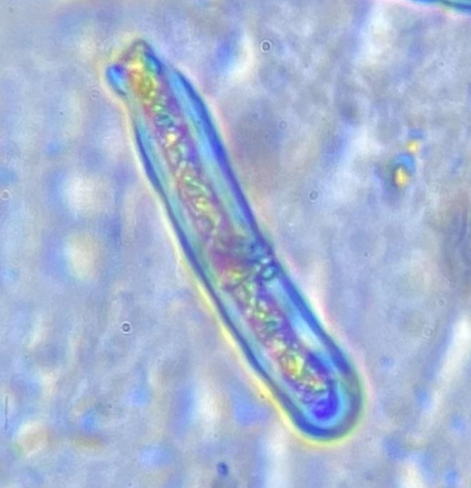
Qalabka sayniska iyo farsamooyinka
Midhaha kiwi waxay ka samaysan yihiin unugyo dhir.
unug (tissue)
unug miro kiwi ah (a kiwi fruit cell)
X 400
miro kiwi ah (a kiwi fruit)
Unugyadu waa qaybaha nool ee dhismaha unugyada kiwi.

Slide 8
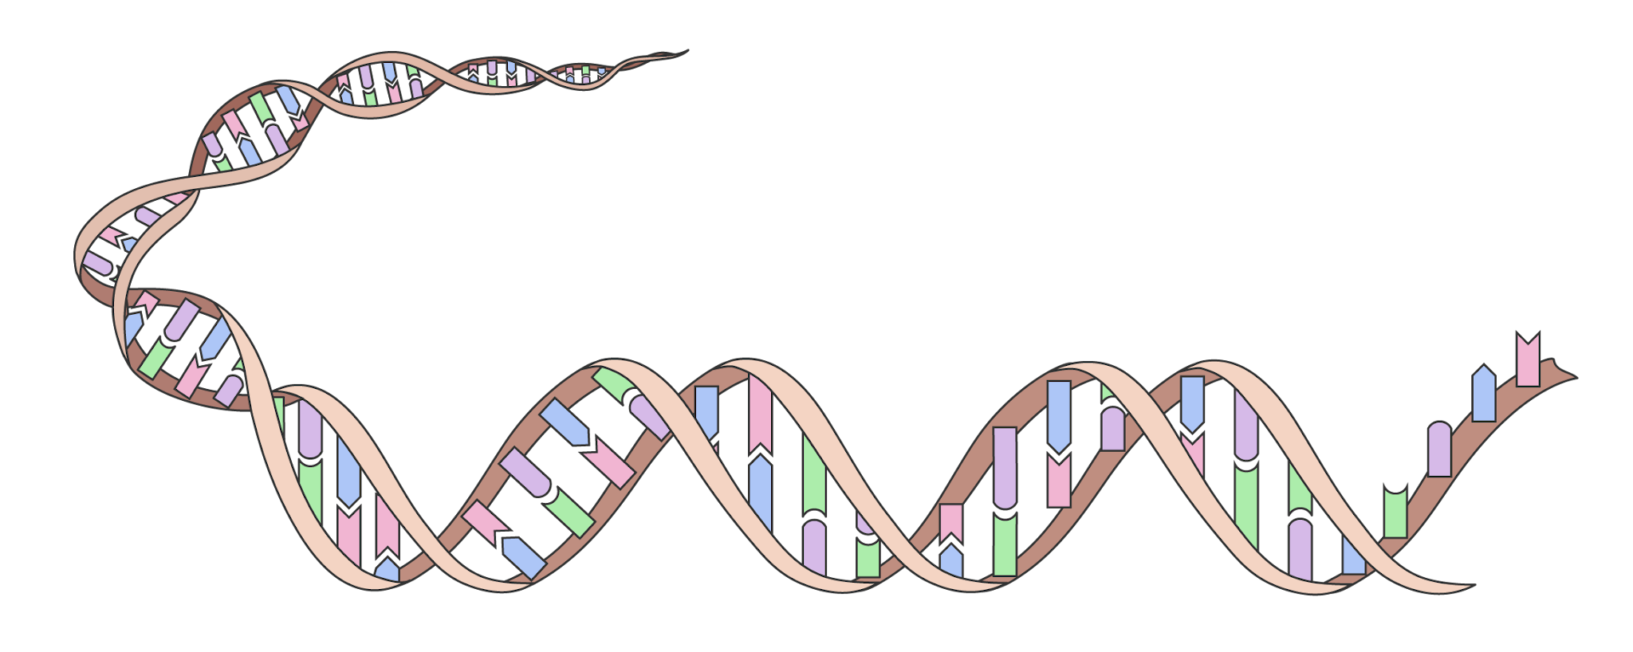
Qalabka sayniska iyo farsamooyinka (Scientific apparatus and techniques)
Dhammaan unugyadu waxay ka kooban yihiin walax hidde-side ah (genetic material) oo bixisa tilmaamaha loo isticmaalo in lagu dhiso oo lagu xakameeyo noolaha (organism).
Walaxda hidde-side (genetic material) waxay ka samaysan tahay walax kiimiko ah oo la yiraahdo DNA, kaas oo tilmaamaha lagu kaydiyo iyadoo la isticmaalayo koodhka hidde-side (genetic code).
DNA
xudunta (nucleus)
DNA waxaa lagu kaydiyaa xudunta (nucleus) unugyada dhirta.
qaybta tusaalaha ah ee unugga miro kiwi (model of kiwi fruit cell)

Slide 9
Qalabka sayniska iyo farsamooyinka (Scientific apparatus and techniques)
DNA waa walax kiimiko ah oo laga soo saari karo unugyada.
DNA inta badan aad buu u yar yahay in la arko, laakiin waa la arki karaa marka la soo saaro oo ay badan tahay oo isku urursan tahay.
unugga miro kiwi (kiwi fruit cell)
xudunta (nucleus)
DNA
qaybta tusaalaha ah ee unugga miro kiwi iyo DNA (model of a kiwi fruit cell and DNA)

Slide 10

Qalabka sayniska iyo farsamooyinka (Scientific apparatus and techniques)
Laba ka mid ah weedhahan ku saabsan DNA waa kuwa sax ah?
Waa noole (It is living)
Waxaa lagu kaydiyaa xudunta (nucleus) unugyada dhirta
Inta badan waa laga arki karaa xudunta (nucleus)
Dhammaan noolaha (living organisms) waxay leeyihiin DNA

Slide 11



Qalabka sayniska iyo farsamooyinka
Soo saarista DNA-ga unugyada miraha waxay u baahan tahay adeegsiga qalabka sayniska iyo farsamooyinka.
tumasho (pestle)
spatula
hooy (mortar)
Jar jar miraha oo ku tumsi hooyada (mortar) iyo tumashada (pestle) si unugyada looga sii daayo unugyada.
Ku dar cusbo (salt) spatula si loo furfuro DNA-ga.

Slide 12

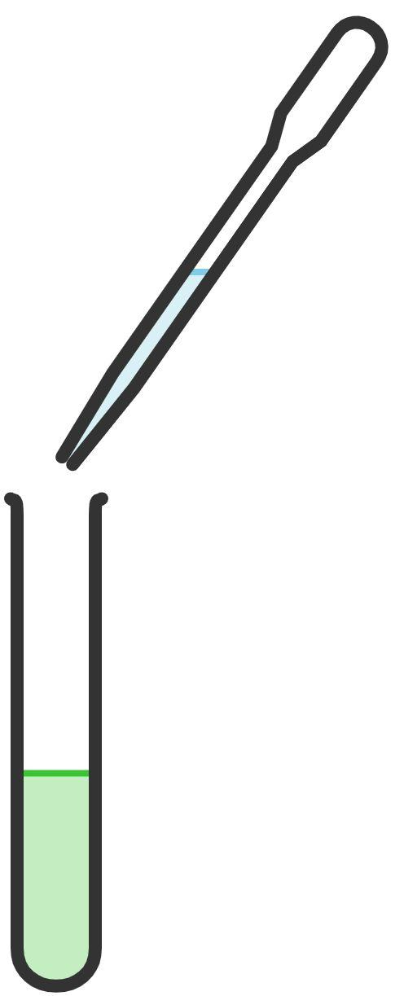
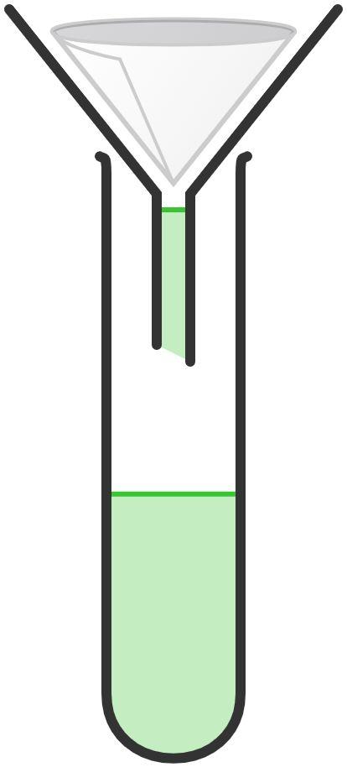
Qalabka sayniska iyo farsamooyinka
warqad shaandho (filter paper)
pipette
qaac (funnel)
pipette
tuubada tijaabada (test tube)
Ku dar saabuunta (detergent) pipette si loo furfuro xuubka unugyada dhirta.
Shaandheey (filter) gudaha tuubada tijaabada (test tube) adoo adeegsanaya warqadda shaandhada (filter paper) iyo qaac (funnel) si looga saaro saxarada iyo iniinaha (seed).
Ku dar khamriga (alcohol) pipette sababtoo ah DNA-ga wuxuu dhex sabbeyn doonaa oo isku ururin doonaa khamriga.

Slide 13
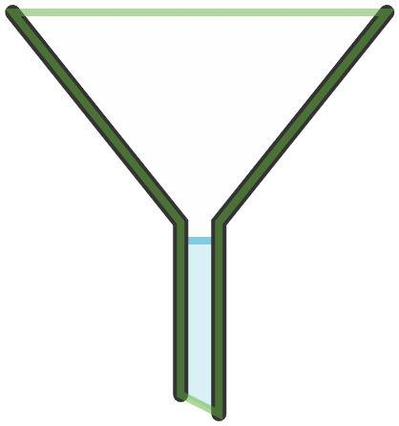

Qalabka sayniska iyo farsamooyinka
Isku dhig sawirka qalabka iyo magaca saxda ah.
hooy iyo tumasho (mortar and pestle)
qaac shaandho (filter funnel)
tuubada tijaabada (test tube)
pipette

Slide 14
Qalabka iyo farsamooyinka sayniska
Dhamaystiri weedhahan si loo sharaxo sababta farsamooyinka sayniska ee kala duwan loo isticmaalo:
Jajabi unugyada miraha (fruit cells) mooye iyo heer (mortar and pestle) …
Ku dar saabuun (detergent) milan (solution) pipette ah …
Ku dar cusbo (salt) milan (solution) spatula ah …
Shaandhee milan (solution) warqad shaandho ah si …
Ku dar aalkolo (alcohol) pipette ah …

Slide 15
Qalabka iyo farsamooyinka sayniska
Dhamaystiri weedhahan si loo sharaxo sababta farsamooyinka sayniska ee kala duwan loo isticmaalo:
Jajabi unugyada miraha (fruit cells) mooye iyo heer (mortar and pestle) si loo sii daayo unugyada (cells) unugyada jirka (tissue).
Ku dar saabuun (detergent) milan (solution) pipette ah si loo furo xuubka unugyada (cell membranes).
Ku dar cusbo (salt) milan (solution) spatula ah si loo furo DNA-ga.
Shaandhee milan (solution) warqad shaandho ah si loo saaro jidhka (pulp) iyo iniinaha (seeds).
Ku dar aalkolo (alcohol) pipette ah si DNA-ga uu u sabbeeyo oo uu u sameeyo buro (clumps).

Slide 16
DNA-ga miraha (DNA from fruit)
Qalabka iyo farsamooyinka sayniska
Soo saarista DNA-ga (DNA extraction)

Slide 17
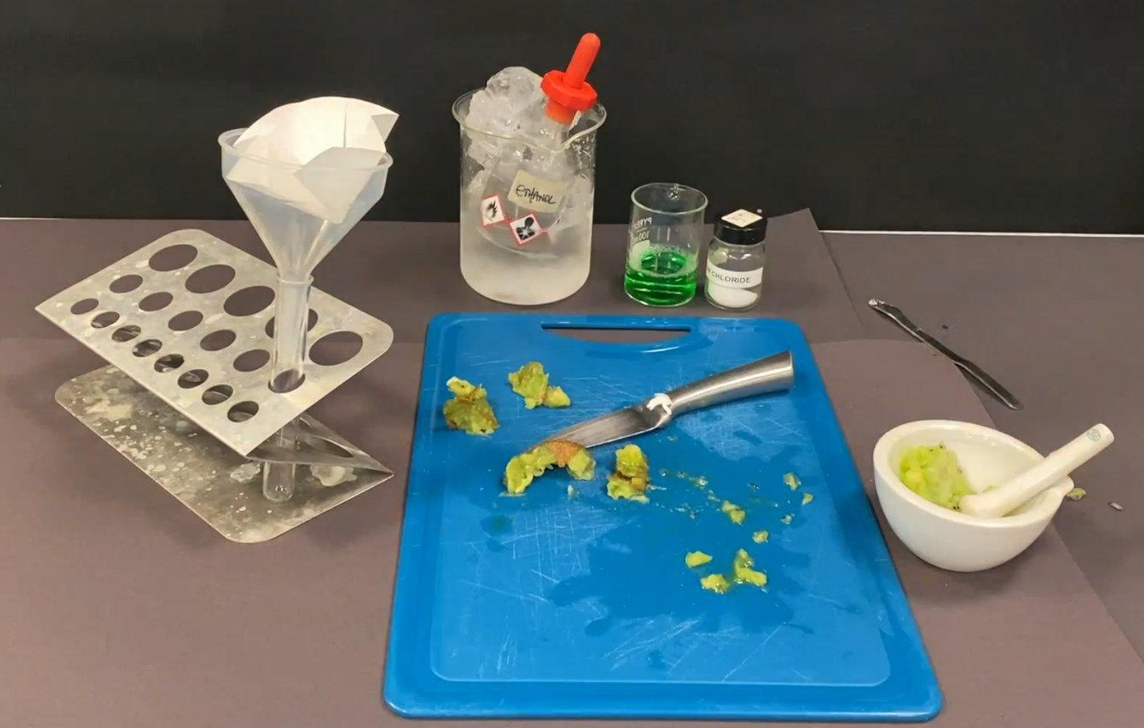

Soo saarista DNA-ga (DNA extraction)
Daawo muuqaalka (video clip) oo sharxaya habka loo soo saaro DNA-ga unugyada miraha kiwi (kiwi fruit tissue).

Slide 18


Soo saarista DNA-ga (DNA extraction)
Habka loo soo saaro DNA-ga unugyada miraha kiwi (kiwi fruit tissue) waa:
Qaado rubuc (quarter) kiwi ah oo ka saar maqaarka (skin) iyo xarunta cad (white centre) mandiil (scalpel) ah, dushiisa tiil (tile).
Jar jar qaybo, ka dibna geli hooy (mortar).
Ku dar qaado cusbo (salt) hooyga (mortar). Ku burburi oo isku qas 2 daqiiqo.
4. Isticmaal pipette, ku dar 2 cm3 saabuun (detergent) hooyga (mortar). Ka dib ku burburi oo isku qas 2 daqiiqo.

Slide 19
Soo saarista DNA (DNA extraction)
Ku rid warqad shaandho (filter paper) qaabka shaandhada (filter funnel) oo dul saar tuubo tijaabo (test tube).
Ku shub isku dhafka hooyga (mortar) warqadda shaandhada (filter paper) oo sug milanka (solution) inuu shaandheeyo.
Ka saar qaabka shaandhada (filter funnel) tuubada tijaabada (test tube).
Ku dar 2 cm3 khamri qabow oo baraf ah (ice cold alcohol) adigoo isticmaalaya pipette, isagoo ku daadanaya dhinaca tuubada tijaabada (test tube).

Slide 20
Soo saarista DNA (DNA extraction)
Dhig weedhaha sida saxda ah si aad u sharaxdo sida loo soo saaro DNA (DNA extraction) ka mid ah miraha kiwi.
2
Ku burburi kiwi cusbo (salt) iyo saabuun (detergent) hooyga (mortar).
Ku dar khamri (alcohol) milanka kiwi (kiwi solution).
4
1
Goo maqaarka iyo bartamaha kiwi.
3
Shaandhee isku dhafka kiwi warqad shaandho (filter paper) iyo qaab shaandho (funnel).

Slide 21
Soo saarista DNA (DNA extraction)
Daawo muujinta (demonstration) soo saarista DNA (DNA extraction) ee kiwi.
Isticmaal xirfadaha indho-indheynta si aad u sawirto jaantus calaamadeysan oo natiijooyinka ah.
Sharax sababta aad u arki karto DNA-ga indhahaaga.

Slide 22
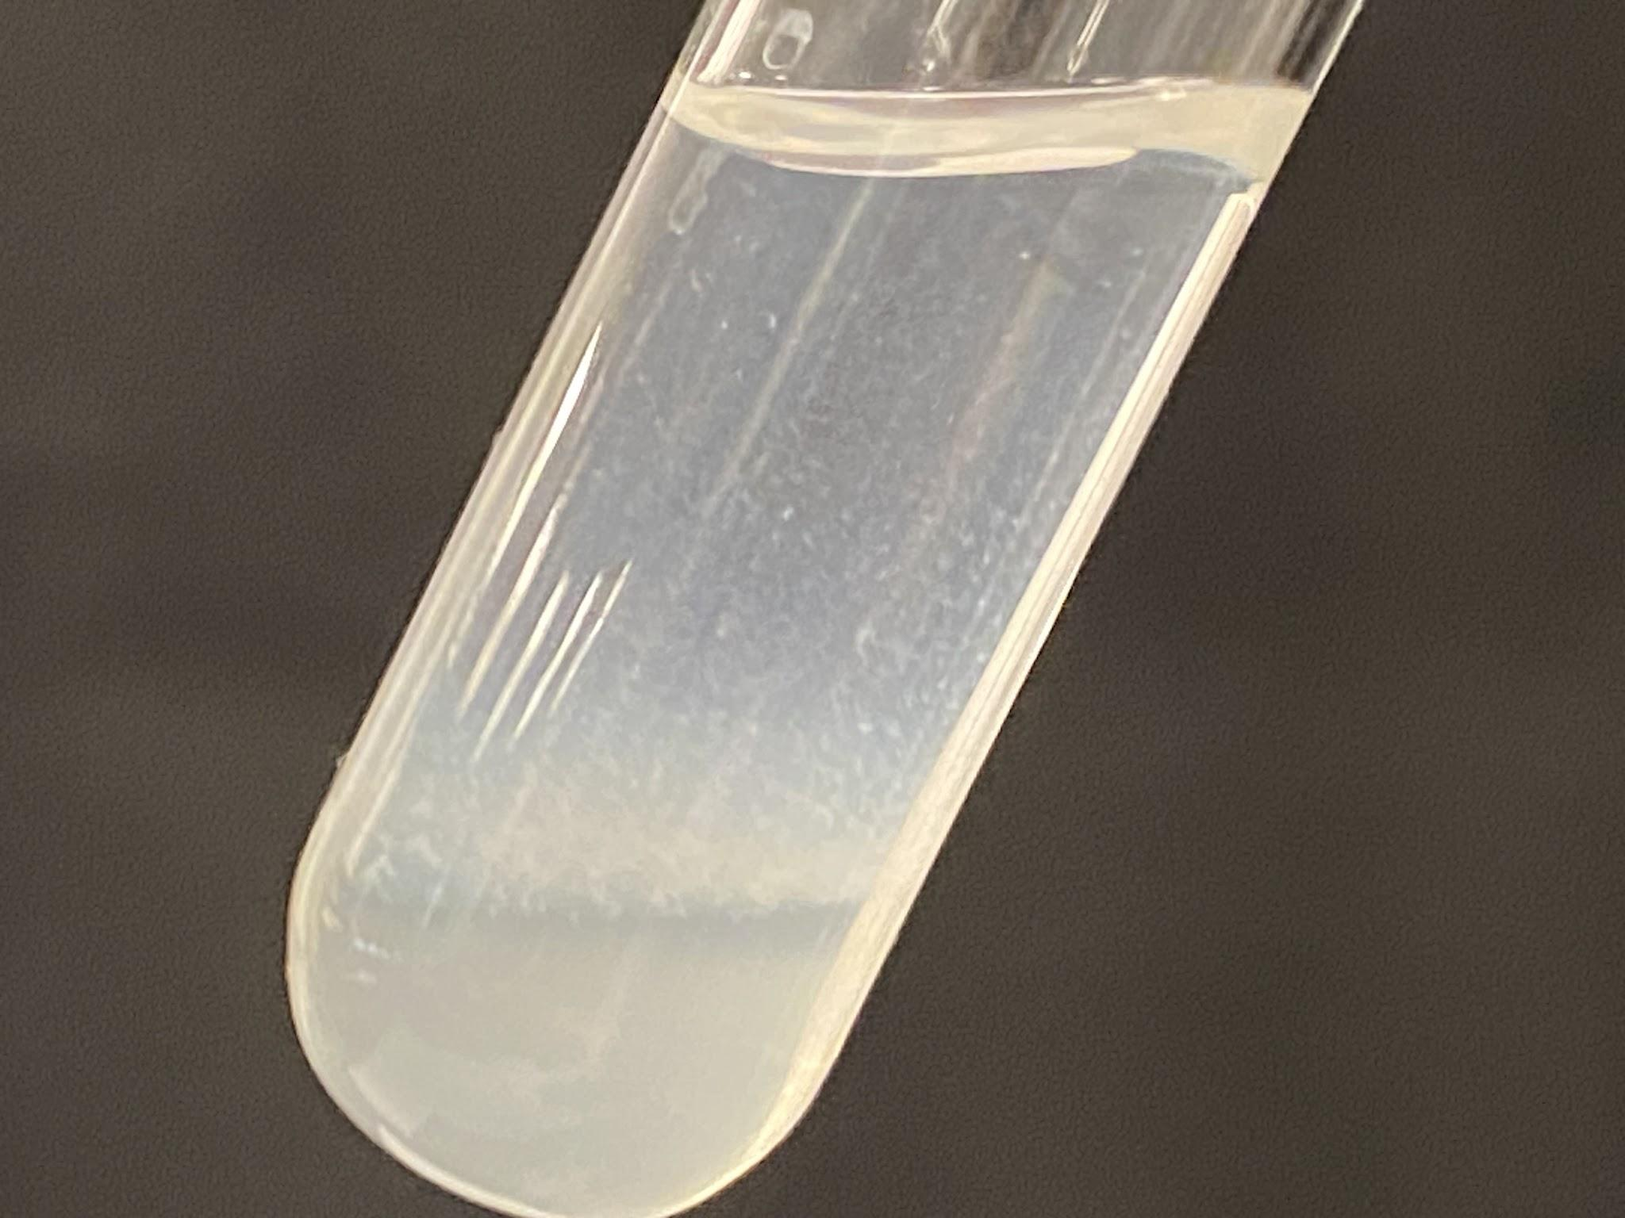
Soo saarista DNA (DNA extraction)
Waa inaad aragtay natiijo la mid ah tan:
layer of alcohol
gogo 'yo DNA (clumps of DNA)
layer of filtered fruit extract
DNA-ga waa walaxda cad ee 'cufan' ee ku dhex sabaysa gogo 'yo (clumps) lakabka khamriga (alcohol) ee tuubada tijaabada (test tube).
DNA-ga waa muuqdaa sababtoo ah waa laga soo saaray unugyada miraha waxaana jira wax badan oo isku urursan.

Slide 23
DNA from fruit
DNA waa walax kiimiko ah oo laga soo saari karo unugyada noolaha sida miraha.
Molekyuulada DNA-ga badanaa laguma arki karo indhaha qaawan, sababtoo ah way aad u yar yihiin waxaana lagu kaydiyaa nucleus-ka.
When a lot of DNA is extracted it can be seen in clumps.
Qalabka ugu muhiimsan ee loo baahan yahay si loo soo saaro DNA waa: mooyar iyo sheybiye, qaanso iyo warqad shaandho, tuubbo tijaabo iyo biibiile.
The main techniques used in extracting DNA are crushing with a mortar and pestle, filtering with filter paper and a funnel, and transferring liquids with a pipette.

