Slide 1
Tafatirka codka (Editing sound)
Matixinta xogta: sawirka iyo codka (Data representation: image and sound)

Slide 2
Sida agabkeena waxbarista loogu talagalay fasalka

Slide 3
Waxaan isticmaali karaa software-ka tafatirka codka si aan u tafatiro oo aan u maareeyo faylasha codka dijitaalka ah.

Slide 4
waveform
matixiin muuqaal ah oo faylka codka, oo muujinaya sida baaxadda codka (amplitude) u kala duwan tahay waqtiga
channel
hal qulqul oo maqal ah oo loo isticmaalo in lagu soo saaro cod
mono
wuxuu soo saaraa cod isku mid ah labada dhinac ee speakers/headphones (bidix iyo midig)
stereo
wuxuu u soo bandhigaa cod si gooni ah loogu talagalay speakers/headphones bidix iyo midig

Slide 5

Tafatirka codka (Editing sound)
Sharax isweydaarsiga (trade-off) u dhexeeya cabbirka iyo tayada
Tafatir oo maaree faylasha codka

Slide 6




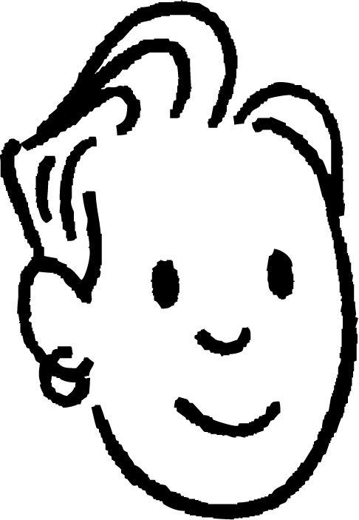
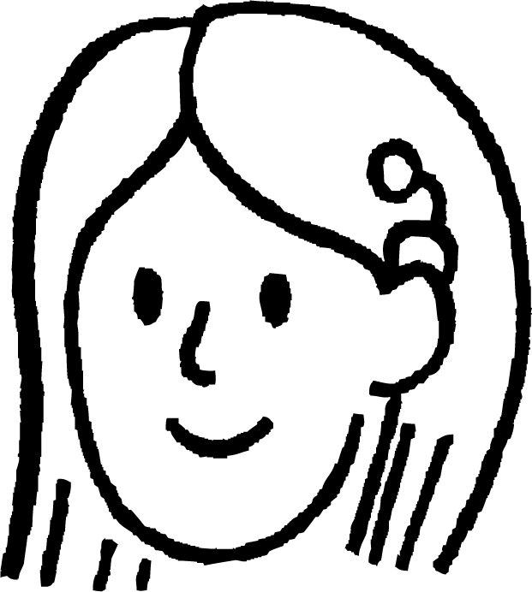


Sharax isweydaarsiga (trade-off) u dhexeeya cabbirka iyo tayada
Maxaan u baahanahay inaan baranno cabbirka iyo tayada faylasha codka? Waxay u muuqataa wax aan micno lahayn.
Saciid
Ka fikir inta jeer ee aan u isticmaalno codka nolosheena: muusig, ciyaaraha, xitaa fiidiyowyada. Fahamka sida cabbirka iyo tayada faylasha codka u saameeyaan waxa aan maqalno waxay sharxi kartaa sababta qaar ka mid ah codka u qurux badan yihiin halka kuwa kalena aysan ahayn.
Suad

Slide 7
Sharax is-dheellitirka (trade-off) u dhexeeya cabbirka iyo tayada
Haa, laakiin sidee tani i caawinaysaa shakhsi ahaan? Ma qorsheynayo inaan sameeyo muusig ama wax la mid ah.
Saciid
Ma aha oo kaliya samaynta muusig. Markaad streaming-ka ciyaar ama tafatirka fiidiyowga. Waxaad rabtaa inay u dhawaqdo fiican, sax? Barashadani waxay kaa caawinaysaa inaad doorato dejimaha saxda ah si aad u dheellitirto tayada iyo cabbirka faylka.
Suad

Slide 8

Sharax is-dheellitirka (trade-off) u dhexeeya cabbirka iyo tayada
Waa maxay faa'iidada ay leedahay in la fahmo dheellitirka u dhexeeya cabbirka iyo tayada faylalka dhawaaqa?
Waxay kaa caawinaysaa inaad samayso go'aanno ka wanaagsan markaad streaming-ka ama tafatirka audio-ga iyo fiidiyowga.
Waxay kaa caawinaysaa inaad fahamto sababta qaar ka mid ah dhawaaqyada uga qaylin yihiin kuwa kale.
Waxay kaa caawinaysaa inaad barato sidii loo ciyaari lahaa qalab muusig.

Slide 9
Sharax is-dheellitirka (trade-off) u dhexeeya cabbirka iyo tayada
Tirada muunadaha (samples) la qaado ilbiriqsi kasta waxaa loo yaqaan heerka muunadaynta (sample rate).
Qiime (value) caadi ah: 44 100 muunad/ilbiriqsi
Muunad kasta, taxane bits ah ayaa la duubaa.
Tirada bits-ka ee la duubo muunad kasta waxaa loo yaqaan xallinta muunadda (sample resolution) (qoto dheer bit-ka (bit depth)).
Qiime (value) caadi ah: 16 bits/muunad
1110110011101011

Slide 10
Sharax is-dheellitirka (trade-off) u dhexeeya cabbirka iyo tayada
Hay Suad, heestan oo aan streaming-ka ku dhageysanayno adoo isticmaalaya taleefankaaga waxay u dhawaqday si fiican!
Haa, laakiin dhageysiga heesaha waxay isticmaashaa xaddi badan oo ka mid ah ogolaanshaha xogta (data allowance) aniga toddobaad kasta.
Saciid
Dhawaaqyada tayadoodu sareeyso oo leh xallin muunad (sample resolution) sare (qoto dheer bit-ka (bit depth)) iyo heer muunad (sample rate) sare waxay qaataan xog badan, waxay u baahan yihiin awood farsamo oo badan waxayna qaataan waqti dheer si loo gudbiyo.
Suad

Slide 11
Sharax is-dheellitirka (trade-off) u dhexeeya cabbirka iyo tayada
Waxaan bedeli karaa tayada (quality) heesaha aan ka daadago adeegga muusigga si aysan u isticmaalin xog (data) badan.
Haa! Markaan aan ku jirin Wi-Fi, waxaan u bedeli karaa tayada ugu hooseysa si aan u badbaadiyo xogtayda (data).
Saciid
Codka tayadiisu hooseyso wuxuu leeyahay xallin muunad (sample resolution) hoose (qoto dheer bit-ka) iyo heerka muunad (sample rate) hoose, wuxuu qaataa xog (data) yar, wuxuu u baahan yahay awood farsamo yar, wuxuuna qaataa waqti yar in la gudbiyo.
Suad

Slide 12
Sharax is-weydaarsiga (trade-off) u dhexeeya cabbirka iyo tayada
Heerka muunadka (sample rate) waxaa loola jeedaa inta jeer ee codka la qabto ilbiriqsi kasta, sida caadiga ah lagu cabbiro Hertz (Hz).
Heerarka muunadka sare, sida 44 100 Hz (44.1 kHz), waxay qabtaan faahfaahin dheeri ah, taasoo ka dhigaysa codka mid dabiici ah.
Heerarka muunadka hoose ayaa laga yaabaa inay seegaan faahfaahinta soo noqnoqota sare, taasoo saameyn karta caddaynta codka.
Marka loo eego cabbirka faylka, heerarka muunadka sare waxay keenaan faylal waaweyn.

Slide 13
Sharax is-weydaarsiga (trade-off) u dhexeeya cabbirka iyo tayada
Kee ayaa run ah oo ku saabsan qoto dheerida bit-ka (bit depth) iyo heerka muunadka (sample rate) ee codka dhijitaalka ah?
Kordhinta qoto dheerida bit-ka (bit depth) ma saameyso cabbirka faylka.
Kordhinta heerka muunadka (sample rate) waxay qabataa faahfaahin dheeri ah laakiin ma saameyso cabbirka faylka.
Kordhinta labadaba qoto dheerida bit-ka (bit depth) iyo heerka muunadka (sample rate) waxay wanaajisaa tayada codka laakiin waxay sidoo kale kordhisaa cabbirka faylka.

Slide 14
Sharax is-weydaarsiga (trade-off) u dhexeeya cabbirka iyo tayada
Istuudiyo duubis xirfad leh ayaa soo saara muusig loogu talagalay riwaayadaha. Waa maxay sababta ay uga hormarin karaan tayada codka cabbirka faylka?
Horumariye ciyaar ayaa u baahan codadka asalka ah ee dhabarka ah ee app-ka mobilka. Sidee cabbirrada faylka waaweyn ee maqalka u saameyn karaan khibrada ciyaartoyga?
Ganacsi yar ayaa raba inuu ku daro muusig asal ah shabakaddiisa. Ma waa inay hormariyaan cabbirka faylka si ay ugu soo degdegto ama tayada?

Slide 15
Sharax is-weydaarsiga (trade-off) u dhexeeya cabbirka iyo tayada
Istuudiyo duubis xirfad leh ayaa soo saara muusig loogu talagalay riwaayadaha. Waa maxay sababta ay uga hormarin karaan tayada codka cabbirka faylka?
Istuudiyada duubista waxay hormarisaa tayada codka sababtoo ah muusigu wuxuu u baahan yahay inuu ahaado mid cad oo faahfaahsan intii suurtagal ah ee bandhigyada tooska ah. Heerka muunadka sare, sida 44 100 Hz (44.1 kHz), wuxuu qabtaa faahfaahin dheeri ah, isagoo ka dhigaya codka mid dabiici ah oo qaybo laguma lumo. In kasta oo heerarka muunadka sare ay abuuraan cabbirro fayl oo waaweyn, tani ma aha welwel ku ah istuudiyada duubista xirfadda leh halkaas oo tayadu tahay mudnaanta koowaad.

Slide 16
Sharax is-weydaarsiga (trade-off) u dhexeeya cabbirka iyo tayada
Horumarinta ciyaarta (game) waxa uu u baahan yahay dhawaaqyada (sound effects) asalka ah ee app-ka (mobile app). Sidee cabbirka weyn ee faylalka dhawaaqa (audio file sizes) u saameyn karaa khibrada ciyaartoyga (gamer’s experience)?
Faylasha dhawaaqa ee waaweyn waxay u saameyn karaan khibrada ciyaartoyga siyaabo badan. Marka hore, waxay qaataan booska kaydinta (storage space) badan ee qalabka, taas oo dhibaato u noqon karta dadka kaydintoodu xaddidan tahay.
Marka labaad, ciyaarista faylasha waaweyn waxay u baahan tahay awood habaynta (processing power) badan, taas oo hoos u dhigi karta waxqabadka app-ka (app's performance). Ugu dambeyntii, faylasha waaweyn waxay qaataan waqti dheer si loo soo dejiyo (download) ama loo daadiyo (stream), taas oo caro galin karta dadka doonaya inay si degdeg ah u bilaabaan ciyaarta.

Slide 17
Sharax isweydaarsiga (trade-off) u dhexeeya cabbirka (size) iyo tayada (quality)
Ganacsi yar (small business) ayaa doonaya inuu ku daro muusikada asalka ah (background music) boggooda (website). Miyay mudnaan siinayaan cabbirka faylka (file size) si ay ugu soo raraan (loading) degdeg badan mise tayada (quality)?
Ganacsiga yari waa inuu mudnaan siiyaa cabbirka faylka (file size) oo yar si loo hubiyo in bogga (website) uu si degdeg ah u soo raro (loading), gaar ahaan dadka isku xirka internetka (internet connections) oo gaabis ah.

Slide 18
Tafatirka dhawaaqa (editing sound)
Sharax isweydaarsiga (trade-off) u dhexeeya cabbirka (size) iyo tayada (quality).
Tafatir (edit) oo maarey (manipulate) faylasha dhawaaqa (sound files)

Slide 19
Tafatir (edit) oo maarey (manipulate) faylasha dhawaaqa (sound files)
Maxay aniga aniga oo aan xiiseynin muusikada (music) faa'iido u leedahay inaan barto tafatirka faylasha dhawaaqa (editing sound files)?
Saciid
Ma aha oo kaliya muusikyada! Ka fikir samaynta podcast-ka (podcast), tafatirka dhawaaqa (audio) mashaariicda dugsiga (school project) ama xitaa ku darista saameynta dhawaaqa (sound effects) fiidiyowga (video). Waa xirfad (skill) kaa caawinaysa inaad noqoto mid hal-abuur leh (creative) oo soo saarto shaqo nadiif ah (polished) iyo mid xirfad leh (professional), iyada oo aan loo eegin mashaariicda (project).
Suad

Slide 20
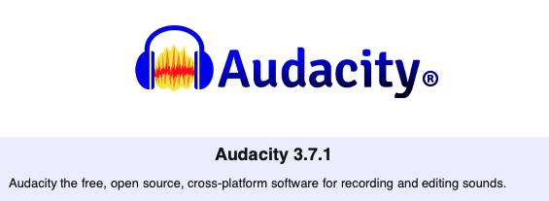
Tafatir (edit) oo maarey (manipulate) faylasha dhawaaqa (sound files)
Noocyo badan oo software-ka (software) ah ayaa loo isticmaali karaa in lagu abuuro (create), tafatir (edit) oo la maareeyo (manipulate) dhawaaqa (sound).
Audacity 3.7.1 ayaa loo isticmaali doonaa darsigan (lesson).
© Muse Group & contributors, Audacity, 2025, licensed under CC-by 4.0 https://creativecommons.org/licenses/by/4.0/

Slide 21
Tafatir oo maaree faylasha codka (sound files)
Waa maxay ujeedka (main purpose) ugu weyn ee software-ka tafatirka dhawaaqa (sound editing software) sida Audacity?
si loo abuuro (create) qoraalada (text documents) iyo soo bandhigyada (presentations)
si loo sawiro (draw) oo loo tafatir (edit) sawirada (images) iyo sawirrada (photos)
si loo duubo (record), tafatir (edit) oo loo maareeyo (manipulate) faylasha dhawaaqa (sound files)

Slide 22
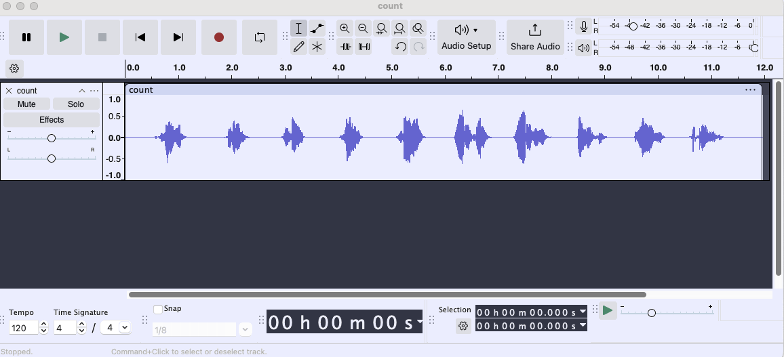
Tafatir oo maaree faylasha codka (sound files)
Faylka codka waxaa lagu muujiyaa mowjad cod (sound wave) oo loo yaqaan waveform.
Kani waa fayl cod oo mono ah oo leh hal kanaal (channel) iyo hal waveform.
© Muse Group & contributors, Audacity, 2025, licensed under CC-by 4.0 https://creativecommons.org/licenses/by/4.0/

Slide 23
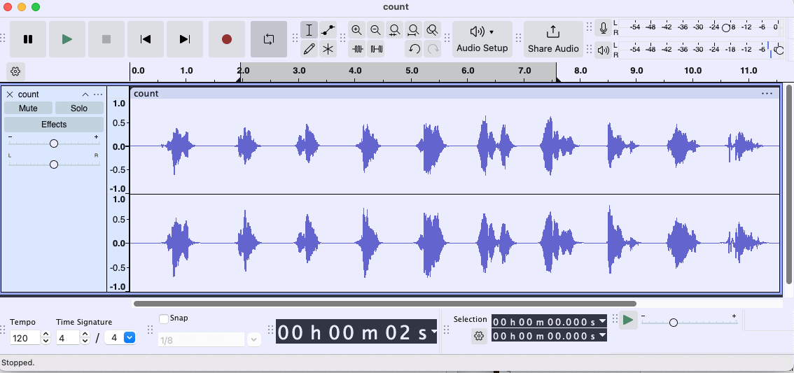
Tafatir oo maaree faylasha codka (sound files)
Kani waa fayl cod oo stereo ah oo leh laba kanaal (channels) iyo laba waveform.
© Muse Group & contributors, Audacity, 2025, licensed under CC-by 4.0 https://creativecommons.org/licenses/by/4.0/

Slide 24
Tafatir oo maaree faylasha codka (sound files)
Toolbar-ka Transport ee Audacity waxaa loo isticmaalaa in lagu hakiyo (pause), lagu ciyaaro (play), laga boodo bilowga, laga boodo dhamaadka, la duubo (record) oo lagu celceliyo (loop) faylka codka.
© Muse Group & contributors, Audacity, 2025, licensed under CC-by 4.0 https://creativecommons.org/licenses/by/4.0/

Slide 25
Tafatir oo maaree faylasha codka (sound files)
Toolbar-yada Tools iyo Edit waxaa loo isticmaali karaa in lagu xusho (select) qaybo ka mid ah faylka codka, lagu weyneeyo (zoom in) ama lagu yareeyo (zoom out), lagu gooyo (trim) oo lagu aamusiyo (silence) qaybo ka mid ah faylka codka.
© Muse Group & contributors, Audacity, 2025, licensed under CC-by 4.0 https://creativecommons.org/licenses/by/4.0/

Slide 26

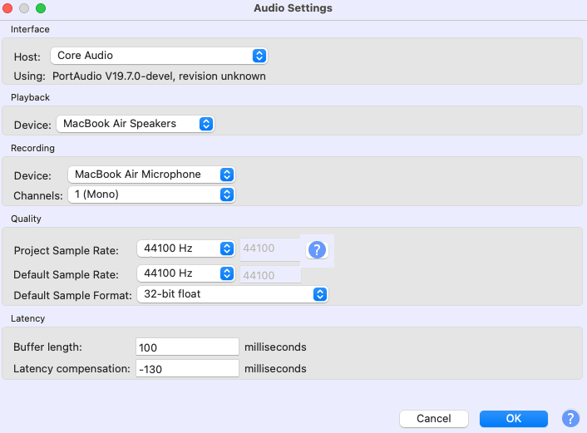
Tafatir oo maaree faylasha codka (sound files)
Goobaha maqalka (audio settings) ee menu-ga Audio Setup waxay muujinayaan:
Kanaalada (Channels) 1 (Mono)
Heerka muunada (Sample rate) (44 100 Hz)
Qaabka muunada (Sample format) — kani waa xallinta muunada (sample resolution) (32 bit)
Goobahan waa la beddeli karaa si ay ugu habboonaadaan mashruucaaga.
© Muse Group & contributors, Audacity, 2025, licensed under CC-by 4.0 https://creativecommons.org/licenses/by/4.0/

Slide 27
Tafatir oo maaree faylasha dhawaaqa (sound files)
U beddelista stereo, oo isticmaasha laba kanaal (channels), waxay labanlaabtaa cabbirka faylka (file size) laakiin waxay bixisaa khibrad cod oo qoto dheer (immersive).
Kordhinta heerka muunada (sample rate) waxay qabataa faahfaahin dheeri ah, laakiin waxay sidoo kale kordhisaa cabbirka faylka waxayna u baahan tahay awood farsamayn (processing power) badan.
Hoos u dhigista heerka muunada (sample rate) waxay ka dhigaysaa cabbirka faylka mid yar laakiin waxay keeni kartaa luminta tayada (quality loss) la dareemi karo.
© Muse Group & contributors, Audacity, 2025, licensed under CC-by 4.0 https://creativecommons.org/licenses/by/4.0/

Slide 28
Tafatir oo maaree faylasha dhawaaqa (sound files)
Qoto dheerida bit-ka (bit depth) sare waxay bixisaa faahfaahin dheeri ah laakiin sidoo kale waxay kordhisaa cabbirka faylka.
Qoto dheerida bit-ka (bit depth) hoose waxay ku habboon tahay mashaariicda tayada caadiga ah (standard-quality) sida podcasts-ka ama nuxurka internetka waxayna caawisaa badbaadinta booska kaydinta (storage space).
© Muse Group & contributors, Audacity, 2025, licensed under CC-by 4.0 https://creativecommons.org/licenses/by/4.0/

Slide 29
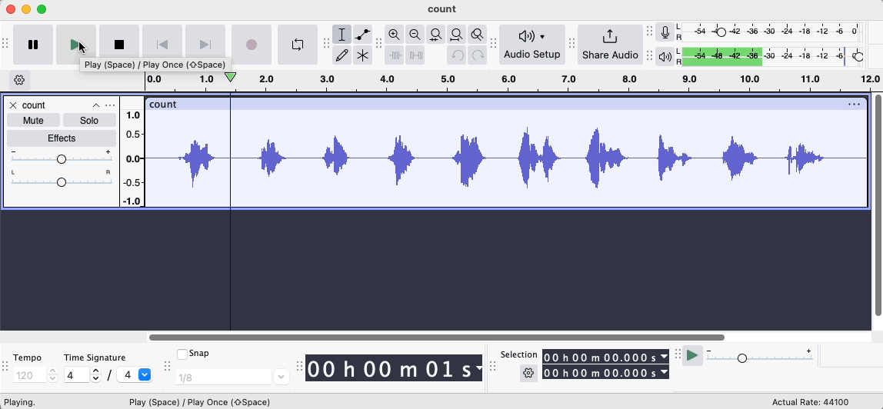
Tafatir oo maaree faylasha dhawaaqa (sound files)
Tani waxay muujinaysaa qalabka shaqada (Transport toolbar) ee Audacity oo la isticmaalayo.
Qayb ka mid ah mowjadda (waveform) waa la xushay oo la ciyaaray, tan waxaa loo yaqaan ciyaarista xulashada (selective playback).
© Muse Group & contributors, Audacity, 2025, licensed under CC-by 4.0 https://creativecommons.org/licenses/by/4.0/

Slide 30
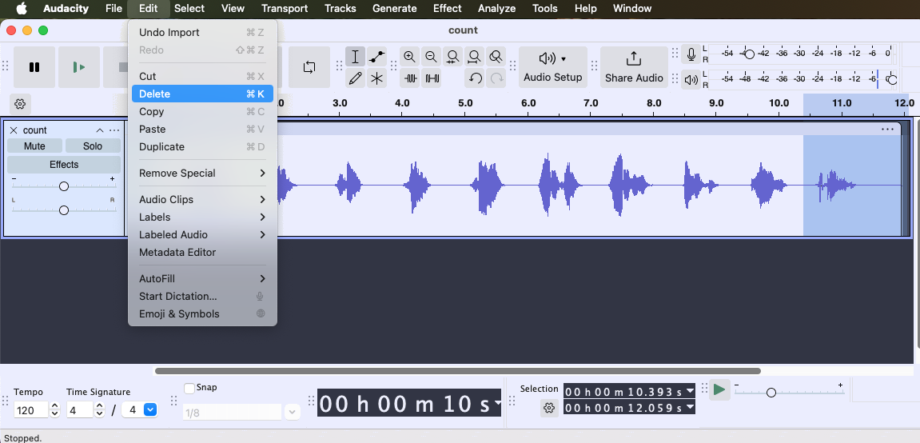
Tafatir oo maaree faylasha dhawaaqa (sound files)
Si aad u tirtirto qayb ka mid ah dhawaaqa (audio), isticmaal qalabka xulashada (selection tool) oo
guji oo jiid (click and drag) meesha aad rabto inaad ka saarto.
Kadib, dooro 'Edit' iyo 'Delete' liiska (menu), ama si fudud riix furaha delete-ka (delete key) ee keyboard-kaaga.
© Muse Group & contributors, Audacity, 2025, licensed under CC-by 4.0 https://creativecommons.org/licenses/by/4.0/

Slide 31
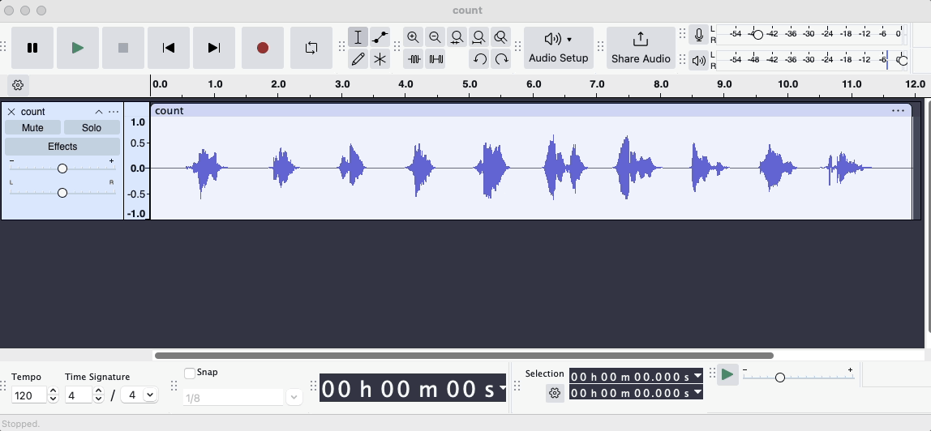
Tafatir oo maarey cod (sound) faylal
Si aad u dhaqaajiso qayb ka mid ah dhawaaqa (audio), isticmaal qalabka xulashada (selection tool) oo
guji oo jiid (click and drag) meesha aad rabto inaad dhaqaajiso.
Kadib, dooro 'Edit' iyo 'Cut' liiska (menu), ama si fudud midigta guji oo dooro 'Cut'.
Guji booska dhawaaqa (audio) halka aad rabto inaad ku gasho qaybta la jaray (cut section).
Kadib, dooro 'Edit' iyo 'Paste' liiska (menu) ama si fudud midigta guji oo dooro 'Paste'.
© Muse Group & contributors, Audacity, 2025, licensed under CC-by 4.0 https://creativecommons.org/licenses/by/4.0/

Slide 32
Tafatir oo maarey cod (sound) faylal
Mashruucyada Audacity waxaa lagu kaydiyaa qaabka .aup3 waxaana kaliya lagu furi karaa oo lagu tafatiri karaa gudaha Audacity.
Qaabkani wuxuu ku habboon yahay tafatirka socda sababtoo ah wuxuu kaydiyaa dhammaan faahfaahinta mashruuca.
Si aad shaqadaada ula wadaagto dadka kale ama ugu isticmaasho barnaamijyada kale, waxaad u baahan tahay inaad u beddesho qaab audio (sound) ah oo si ballaaran loo aqbalo.
Dhoofinta (Exporting) mashruucaaga waxay hubinaysaa in audio (sound) kaaga lagu ciyaari karo inta badan qalabka ama goobaha.

Slide 33
Tafatir oo maarey cod (sound) faylal
Laba qaab oo si ballaaran loo aqbalo waa:
WAV (.wav): Qaab tayo sare leh oo ku habboon isticmaalka xirfadeed, sida tafatirka audio (sound). Waxaa loo isticmaalaa soo saarista muusikada, mastering iyo xaaladaha ay muhiim tahay tayada audio (sound) ga.
MP3 (.mp3): Qaab isku dheeli tiraya tayada iyo cabbirka faylka oo yar si loogu wadaago khadka ama qalabka la qaadan karo. Waxaa loo isticmaalaa streaming iyo podcasts.

Slide 34
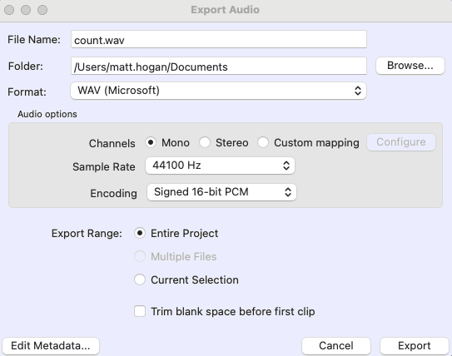
Tafatir oo maarey cod (sound) faylal
Marka audio (sound) la tafatiro, waxaad haysataa laba ikhtiyaar: inaad yarayso tayada faylka codka ama aad sii haysato tayada hadda jirta. Si aad u dhoofiso, dooro 'File' iyo 'Export' ee menu-ga.
Dooro Qaabka (Format). Dhoofinta qaabka MP3 waxay abuurtaa fayl ka yar WAV, laakiin tayada waxyar ayay hoos u dhacdaa.
Dooro heerka saamiga (Sample rate) ee Hz. Doorashada heerka saamiga hoose (tusaale 22 050 Hz halkii 44 100 Hz) waxay yaraysaa faahfaahinta codka, taasoo keentay fayl yar oo faahfaahin yar.
© Muse Group & contributors, Audacity, 2025, licensed under CC-by 4.0 https://creativecommons.org/licenses/by/4.0/

Slide 35
Tafatir oo maarey cod (sound) faylal
Kee ayaa run ah oo ku saabsan faylasha mashruuca Audacity (.aup3)?
waxaa lagu furi karaa oo lagu ciyaari karaa qalab kasta oo media (media player) ah
waxaa kaliya lagu furi karaa Audacity
waxay la mid yihiin faylasha MP3

Slide 36
Tafatir (Edit) oo maaree (manipulate) faylasha dhawaqa
Waa maxay ujeedka Toolbar-ka Transport ee Audacity?
Xaggee beddeli lahayd heerka muunada (sample rate) iyo qaabka muunada (sample format) ee Audacity?
Sidee bay u kala duwan yihiin faylasha dhawaqa dijitaalka ah ee stereo (stereo) iyo kuwa mono (mono)?

Slide 37
Tafatir (Edit) oo maaree (manipulate) faylasha dhawaqa
1) Waa maxay ujeedka qalabka shaqada ee Transport (Transport toolbar) ee Audacity?
Qalabka shaqada ee Transport (Transport toolbar) waxaa loo isticmaalaa in lagu xakameeyo dib-u-ciyaarista (playback), sida ciyaarista (playing), hakinta (pausing), joojinta (stopping), iyo duubista (recording) faylka dhawaqa.
2) Xaggee beddeli lahayd heerka muunada (sample rate) iyo qaabka muunada (sample format) ee Audacity? liiska dejinta maqalka (Audio Setup menu)
3) Sidee bay u kala duwan yihiin faylasha dhawaqa dijitaalka ah ee stereo (stereo) iyo kuwa mono (mono)? Dhawaqa dijitaalka ah ee stereo (stereo) wuxuu leeyahay laba kanaal (two channels) (laba mowjad (two waveforms)), halka dhawaqa dijitaalka ah ee mono (mono) uu leeyahay hal kanaal (one channel) (hal mowjad (one waveform)).

Slide 38
Tafatir (Edit) oo maaree (manipulate) faylasha dhawaqa
Soo deji (Download) ka dibna fur faylka count.mp3 ee Audacity.
  Gooy (Trim) faylka si uu u joogo marka uu tiriyaa ilaa 5.
  Ku dar dhamaadka faylka dhawaqa si uu uga tiriyo 5 ilaa 1.
  Beddeli heerka muunada (sample rate) iyo qoto dheerida bit-ka (bit depth) ee faylka dhawaqa.
  Dhoofso (Export) faylka dhawaqa la tafatiray (edited) labadaba qaababka WAV iyo MP3.
  Isbarbardhig cabbirrada faylasha (file sizes) ee faylasha la dhoofiyay (exported). Qaabkee (format) ayaa leh cabbir fayl (file size) ka yar? Sabab?

Slide 39
Tafatir (Edit) oo maaree (manipulate) faylasha dhawaqa
e) Isbarbardhig cabbirrada faylasha (file sizes) ee faylasha la dhoofiyay (exported). Qaabkee (format) ayaa leh cabbir fayl (file size) ka yar? Sabab?
Faylka MP3 wuxuu ka yaraan doonaa faylka WAV. Sababta oo ah MP3 waxaa loo qaabeeyey inuu dheellitiro tayada dhawaqa (sound quality) iyo cabbir fayl (file size) yar, taas oo faa'iido u leh wadaagista internetka ama kaydinta qalabka la qaadan karo.
Faylasha WAV waxay caadi ahaan ka weyn yihiin sababtoo ah waxay mudnaan siiyaan dhawaqa tayada sare leh (high-quality sound), kaas oo u baahan xog (data) badan in la kaydiyo.

Slide 40
Tafatirka (Editing) dhawaqa
Software-ka tafatirka dhawaqa (Sound editing software) wuxuu kuu oggolaanayaa inaad beddesho oo dhoofiso (export) faylasha maqalka dijitaalka ah (digital audio files).
Hagaajinta (Adjusting) sifooyinka (attributes) faylka maqalka (audio file), sida heerka muunada (sample rate) iyo qoto dheerida bit-ka (bit depth), waxay beddeshaa sida aad u dareento tayadiisa (quality).
Tusaale ahaan, waxaad u dhigi kartaa kanaalka (channel) mono hal track ama stereo laba track si aad u sahamiso sida ay kuwani u saameeyaan wax soo saarka maqalka (audio output).

