Slide 1
Doorashooyin
Fikirka qoto dheer ee xisaabta

Slide 2
Waxaan fahmi karaa sida xubnaha baarlamaanka loo doorto.

Slide 3
First Past the Post (FPTP) waa magaca nidaamka doorashada ee loo isticmaalo in lagu doorto MPs-ka Westminster.

Slide 4

Doorashooyin
Fahamka First Past the Post (FPTP)
Cilladaha FPTP

Slide 5
Fahamka First Past the Post (FPTP)
First Past the Post (FPTP) waa magaca nidaamka doorashada ee loo isticmaalo in lagu doorto MPs-ka (xubnaha baarlamaanka) Westminster.
UK waxay u qaybsantahay 650 degmo (constituency). Degmo kastaa waxay u codeysaa inay doortaan MP.
Codbixiyaha kastaa wuxuu u codeeyaa hal musharrax. Musharraxa ugu codka badan ayaa guuleysta.
Ma aha wax lagu xisaabtamo inta cod ee ay ku guuleystaan.

Slide 6

Fahamka First Past the Post (FPTP)
Imisa musharrax ayaa codbixiyuhu u codeyn karaa?
Waxba
Hal
Tani waxay noqon kartaa xaaladda doorashooyinka golaha deegaanka halkaasoo ay ka jiraan in ka badan hal boos oo banaan.
Laba

Slide 7









Fahamka First Past the Post (FPTP)
Ardayda Oak National Academy waxay u codeynayaan Kabtanka fasalkooda.
Waxaa jira saddex arday oo u taagan jagada.
Isra
Cabdi
Saciid

Slide 8
Fahanka First Past the Post (FPTP)
Toddobada arday ee kale waxay u codeeyaan qofka ay doonayaan inuu noqdo Captain-ka fasalka. Iyadoo la adeegsanayo FPTP, mid kastaa wuxuu bixin karaa hal cod oo kaliya.
Isra
Cabdi
Saciid

Slide 9
Fahanka First Past the Post (FPTP)
Waa kuwan natiijooyinka:
2 cod
3 cod
2 cod
Isra
Cabdi
Saciid

Slide 10
Fahanka First Past the Post (FPTP)
Yaa ku guuleystay doorashada? Sidee ku ogaatay?
2 cod
3 cod
2 cod
Isra
Cabdi
Saciid

Slide 11
Fahanka First Past the Post (FPTP)
Isticmaalka nidaamka First Past the Post (FPTP), waxaa suurtogal ah in la ogaado cidda ku guuleysatay doorashada ka hor inta aan dhammaan codadka la tirin.

Slide 12
Fahanka First Past the Post (FPTP)
Waxaa jira afar musharax oo ku taagan doorasho.
Waxaa jira 100 qof oo codeynaya.
Musharax A wuxuu ku guuleystay doorashada. Immisa cod ayuu heli karaa?
Waa immisa tirada ugu yar ee codadka ee A uu heli karaa?

Slide 13
Fahanka First Past the Post (FPTP)
Waxaa jira afar musharax oo ku taagan doorasho.
Waxaa jira 100 qof oo codeynaya.
Musharax A wuxuu ku guuleystay doorashada. Immisa cod ayuu heli karaa?
Tusaale: Waxaa laga yaabaa inuu helay dhammaan codadka (100).
Waxaa laga yaabaa inuu helay 97 cod (iyo musharaxiinta kale waxay heleen 1 cod midkiiba).
Waxaa jira jawaabo badan oo suurtogal ah!

Slide 14
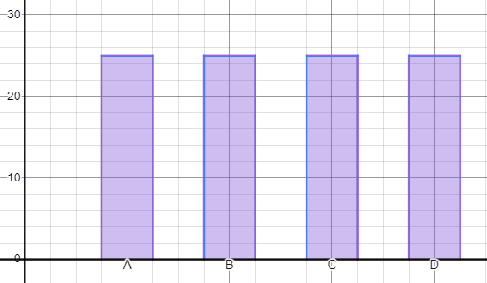
Fahanka First Past the Post (FPTP)
Waa immisa tirada ugu yar ee codadka ee A uu heli karaa?
Haddii qof kastaa helo 25 cod, waxay noqon lahayd xiriq 4-geesood ah.
A wuxuu u baahan yahay kaliya hal cod oo dheeri ah marka loo eego musharaxa ku xiga ee ugu dhow.

Slide 15
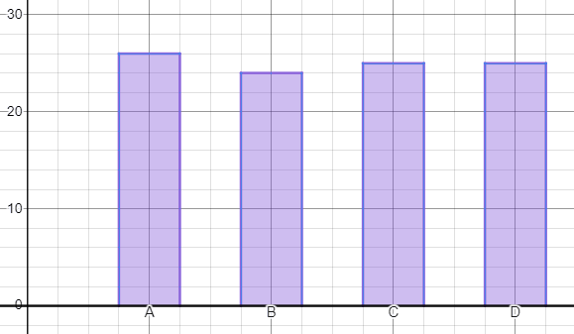
Fahanka First Past the Post (FPTP)
Waa immisa tirada ugu yar ee codadka ee A uu heli karaa?
26 cod waa tirada ugu yar ee codadka ee suurtogalka ah.
Wax kasta oo ka yar taas, A ma uu guulaysan lahaa doorashada.

Slide 16
Fahamka First Past the Post (FPTP)
Waxaa jira 500 qof oo codeynaya doorasho.
Waxaa jira 3 musharax - A, B iyo C.
Waa imisa tirada ugu yar ee codadka ee C heli karo oo weli ku guulaysan karo doorashada?

Slide 17
Fahamka First Past the Post (FPTP)
Waxaa jira 500 qof oo codeynaya doorasho.
Waxaa jira 3 musharax - A, B iyo C.
Waa imisa tirada ugu yar ee codadka ee C heli karo oo weli ku guulaysan karo doorashada?
500 ÷ 3 = 166.66…
Haddii C helo 167 cod, A iyo B waxay kala qaybsadaan codadka hadhay 167 iyo 166 sidaas darteed 167 cod kuma filna C si uu u guulaysto.

Slide 18
Fahamka First Past the Post (FPTP)
Waxaa jira 500 qof oo codeynaya doorasho.
Waxaa jira 3 musharax - A, B iyo C.
Waa imisa tirada ugu yar ee codadka ee C heli karo oo weli ku guulaysan karo doorashada?
Sidaas darteed tirada ugu yar ee codadka ee C heli karo (oo weli guulaysan karo) waa 168.

Slide 19
Fahamka First Past the Post (FPTP)
1) 200 qof ayaa codeynaya doorasho. Waxaa jira afar musharax (A, B, C, D) oo ku taagan doorashada.
a) Iyadoo la ogyahay in musharax B uu ku guulaystay doorashada, soo jeedi tiro suurtagal ah oo codad ah oo uu helay mid kasta oo musharax ah.
b) Iyadoo la ogyahay in musharax B uu ku guulaystay doorashada, waa imisa tirada ugu yar ee codadka ee musharax B heli karo?

Slide 20
Fahanka First Past the Post (FPTP)
2) 400 qof ayaa codeynaya doorasho. Waxaa jira afar musharax (A, B, C, D) oo ku taagan doorashada.
a) Iyadoo la ogyahay in musharax D uu ku guulaystay doorashada, soo jeedi tiro suurtagal ah oo codad ah oo uu helay mid kasta oo musharax ah.
b) Iyadoo la ogyahay in musharax D uu ku guulaystay doorashada, waa imisa tirada ugu yar ee codadka ee musharax D heli karo?

Slide 21
Fahanka First Past the Post (FPTP)
3) n (halkaas oo n ay tahay tiro badan oo afar ah) ayaa u codeynaya doorasho. Waxaa jira afar musharax (A, B, C, D) oo ku taagan doorashada.
a) Iyadoo la ogyahay in musharax A uu ku guuleystay doorashada, qor qaacid guud oo ku saabsan tirada ugu yar ee codadka uu musharax A heli karo.
b) Qor qaacid (expression) loogu talagalay saamiga codadka guud ee uu musharax A helay.

Slide 22
Fahanka First Past the Post (FPTP)
1) 200 qof ayaa u codeynaya doorasho. Waxaa jira afar musharax (A, B, C, D) oo ku taagan doorashada.
a) Iyadoo la ogyahay in musharax B uu ku guuleystay doorashada, soo jeedi tiro suurtagal ah oo codad ah oo uu helay mid kasta oo ka mid ah musharaxiinta.
Waxaa jira fursado badan, laakiin xalkaagu waa inuu yeeshaa musharax B oo leh tirada ugu sarreysa ee codadka, tirada codadka la bixiyayna waa inay isku xirtaa 200.

Slide 23
Fahanka First Past the Post (FPTP)
1) 200 qof ayaa u codeynaya doorasho. Waxaa jira afar musharax (A, B, C, D) oo ku taagan doorashada.
b) Iyadoo la ogyahay in musharax B uu ku guuleystay doorashada, waa immisa tirada ugu yar ee codadka uu musharax B heli karo?
51 cod.
(Musharaxiinta kale waxay heli karaan 50, 50 iyo 49 cod.)

Slide 24
Fahanka First Past the Post (FPTP)
2) 400 qof ayaa u codeynaya doorasho. Waxaa jira afar musharax (A, B, C, D) oo ku taagan doorashada.
a) Iyadoo la ogyahay in musharax D uu ku guuleystay doorashada, soo jeedi tiro suurtagal ah oo codad ah oo uu helay mid kasta oo ka mid ah musharaxiinta.
Waxaa jira fursado badan, laakiin xalkaagu waa inuu yeeshaa musharax D oo leh tirada ugu sarreysa ee codadka, tirada codadka la bixiyayna waa inay isku xirtaa 400.

Slide 25
Fahanka 'First Past the Post' (FPTP)
2) 400 qof ayaa u codeynaya doorasho. Waxaa jira afar musharax (A, B, C, D) oo ku taagan doorashada.
b) Iyadoo la ogyahay in musharax D uu ku guuleystay doorashada, waa immisa tirada ugu yar ee codadka uu musharax D heli karo?
101 cod.
(Musharaxiinta kale waxay heli karaan 100, 100 iyo 99 cod.)

Slide 26

Fahanka 'First Past the Post' (FPTP)
3) n (halkaas oo n ay tahay tiro badan oo afar ah) ayaa u codeynaya doorasho. Waxaa jira afar musharax (A, B, C, D) oo ku taagan doorashada.
a) Iyadoo la ogyahay in musharax A uu ku guuleystay doorashada, qor qaacid guud oo ku saabsan tirada ugu yar ee codadka uu musharax A heli karo.

Slide 27
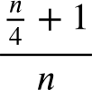
Fahanka 'First Past the Post' (FPTP)
3) n (halkaas oo n ay tahay tiro badan oo afar ah) ayaa u codeynaya doorasho. Waxaa jira afar musharax (A, B, C, D) oo ku taagan doorashada.
b) Qor qaacid (expression) ku saabsan qaybta codadka guud ee uu musharax A helay.

Slide 28
Doorashooyinka
Fahanka 'First Past the Post' (FPTP)
Cilladaha FPTP

Slide 29
Cilladaha FPTP
Hore waxaan u aragnay natiijooyinka doorashada Captain-ka ee Oak National Academy.
2 cod
3 cod
2 cod
Isra
Cabdi
Saciid

Slide 30

Cilladaha FPTP
Cabdi ayaa helay codadka ugu badan, sidaas darteed Cabdi ayaa ku guuleystay doorashada.
Waa imisa boqolkiiba (percentage) codadka guud ee uu Cabdi helay?
2 cod
3 cod
2 cod
Isra
Cabdi
Saciid

Slide 31
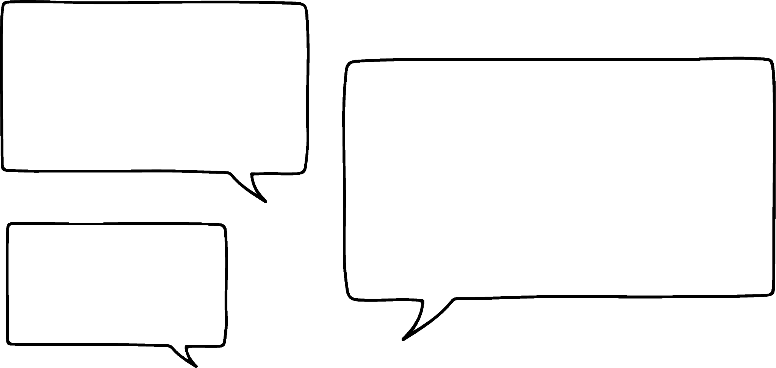
Cilladaha FPTP
Cabdi wuxuu helay qiyaastii 43% codadka.
Sug daqiiqad! Ma aad helin in ka badan 50% codka, maxaad ku guuleysatay?
Run, laakiin waxaan helay codad ka badan adiga ama Saciid, sidaa darteed waan guuleystay.
Isra
Cabdi

Slide 32
Cilladaha FPTP
Nidaamka FPTP, waxaa suurtogal ah in musharrax la doorto inkastoo dad badan ay ka codveen ka dhanka ah, halkii ay u codeyn lahaayeen.

Slide 33
Cilladaha FPTP
Nidaamka FPTP, waxaa suurtogal ah in musharrax la doorto inkastoo dad badan ay ka codveen ka dhanka ah, halkii ay u codeyn lahaayeen.
Musharrax wuxuu ku guuleystaa doorashada haddii uu helo codad ka badan musharrax kasta oo kale.

Slide 34
Cilladaha FPTP
Waxaanu tixgelin doonnaa qaab doorasho guud.
Waxaa jira afar xisbi - Xisbiga A, Xisbiga B, Xisbiga C iyo Xisbiga D.
Waxaa jira 3 degmo oo aan tixgelinayno.
Hawshani waxay eegaysaa waxa ka dhaca degmo kasta iyo sida ay saameyn ugu yeelato natiijada guud.

Slide 35
Cilladaha FPTP
1) Degmada 1 - kani waa qaybinta codka.
a) Xisbiga (Party) kee ayaa ku guuleystay doorashada degmadan?
b) Waa imisa boqolkiiba (percentage) codka guud ee xisbi kasta helay? (Ku soo wareeji boqolkiiba ugu dhow.)
Xisbiga A (Party A) | Xisbiga B (Party B) | Xisbiga C (Party C) | Xisbiga D (Party D)
5772 | 6889 | 3424 | 789

Slide 36
Xaddidaadyada FPTP
2) Degmada 2 - kani waa qaybinta codka.
a) Xisbiga (Party) kee ayaa ku guuleystay doorashada degmadan?
b) Waa imisa boqolkiiba (percentage) codka guud ee xisbi kasta helay? (Ku soo wareeji boqolkiiba ugu dhow.)
Xisbiga A (Party A) | Xisbiga B (Party B) | Xisbiga C (Party C) | Xisbiga D (Party D)
4930 | 5381 | 4729 | 1291

Slide 37
Xaddidaadyada FPTP
3) Degmada 3 - kani waa qaybinta codka.
a) Xisbiga (Party) kee ayaa ku guuleystay doorashada degmadan?
b) Waa imisa boqolkiiba (percentage) codka guud ee xisbi kasta helay? (Ku soo wareeji boqolkiiba ugu dhow.)
Xisbiga A (Party A) | Xisbiga B (Party B) | Xisbiga C (Party C) | Xisbiga D
21 953 | 7116 | 4581 | 2093

Slide 38
Cilladaha FPTP
4) Adigoo tixgelinaya jawaabahaaga su'aalaha 1-3, ka jawaab kuwan soo socda:
a) Xisbee ku guuleystay doorashada degmooyinka ugu badan?
b) Adigoo tixgelinaya wadarta codadka la dhiibtay ee saddexda degmo, waa imisa boqolkiiba codadka uu xisbi kastaa ku guuleystay? Qor cutub faallo ah oo sharxaya waxa tani macnaheedu yahay.

Slide 39
Cilladaha FPTP
1) Degmada 1 - kani waa qaybinta codadka.
a) Xisbee ku guuleystay doorashada degmadan?
Xisbiga B sababtoo ah waxay heleen codad ka badan xisbi kasta oo kale.
Xisbiga A | Xisbiga B | Xisbiga C | Xisbiga D
5772 | 6889 | 3424 | 789

Slide 40
Cilladaha FPTP
1) Degmada 1 - kani waa qaybinta codadka.
b) Waa imisa boqolkiiba wadarta codadka uu xisbi kastaa helay? (Ku soo wareeji boqolkiiba ugu dhow.)
Xisbiga A | Xisbiga B | Xisbiga C | Xisbiga D
5772 | 6889 | 3424 | 789
Xisbiga A | Xisbiga B | Xisbiga C | Xisbiga D
34% | 41% | 20% | 5%

Slide 41
Cilladaha FPTP
2) Degmada 2 - kani waa qaybinta codadka.
a) Xisbee ku guuleystay doorashada degmadan?
Xisbiga B maxaa yeelay waxay heleen codad ka badan xisbiyada kale.
Xisbiga A | Xisbiga B | Xisbiga C | Xisbiga D
4930 | 5381 | 4729 | 1291

Slide 42
Cilladaha FPTP
2) Degmada 2 - kani waa qaybinta codadka.
b) Waa imisa boqolkiiba (percentage) wadarta codadka uu helay xisbi kasta? (Ku soo wareeji boqolkiiba ugu dhow.)
Xisbiga A | Xisbiga B | Xisbiga C | Xisbiga D
4930 | 5381 | 4729 | 1291
Xisbiga A | Xisbiga B | Xisbiga C | Xisbiga D
30% | 33% | 29% | 8%

Slide 43
Cilladaha FPTP
3) Degmada 3 - kani waa qaybinta codadka.
a) Xisbiga tee ayaa ku guuleystay doorashada degmadan?
Xisbiga A sababtoo ah waxay heleen codad ka badan xisbiyada kale.
Xisbiga A | Xisbiga B | Xisbiga C | Xisbiga D
21 953 | 7116 | 4581 | 2093

Slide 44
Cabbiraadaha FPTP
3) Degmada 3 - kani waa qaybinta codadka.
b) Immisa boqolkiiba (percentage) ee wadarta codadka ayay xisbi kasta helay? (Ku soo wareeji boqolkiiba ugu dhow.)
Xisbiga A | Xisbiga B | Xisbiga C | Xisbiga D
21 953 | 7116 | 4581 | 2093
Xisbiga A | Xisbiga B | Xisbiga C | Xisbiga D
61% | 20% | 13% | 6%

Slide 45
Cabbiraadaha FPTP
4) Adigoo tixgelinaya jawaabahaaga su'aalaha 1-3, ka jawaab kuwan soo socda:
a) Xisbiga tee ayaa ku guuleystay doorashada degmooyinka ugu badan?
Xisbiga B sababtoo ah waxay ku guuleysteen laba ka mid ah saddexda degmo.

Slide 46
Xaddidaadyada FPTP
4) Adigoo tixgelinaya jawaabahaaga su'aalaha 1-3, ka jawaab kuwan soo socda:
b) Adigoo tixgelinaya wadarta codadka la dhiibtay ee saddexda deegaan, waa imisa boqolkiiba codadka ay xisbi kasta ku guuleystay? Qor cutub faallo ah oo sharxaya waxa tani macnaheedu yahay.
68 948 cod ayaa la dhiibtay. (Boqolleyda qiyaasta ah hoos ku qoran.)
Xisbiga A | Xisbiga B | Xisbiga C | Xisbiga D
47% | 28% | 18% | 6%

Slide 47
Xaddidaadyada FPTP
b) Qor cutub faallo ah oo sharxaya waxa tani macnaheedu yahay.
68 948 cod ayaa la dhiibtay.
Inkastoo Xisbiga A uu helay codadka ugu badan dhamaan deegaannada, Xisbiga B wuxuu weli ku guuleystay deegaanno badan oo gaar ah. Xisbiga A ayaa laga yaabaa inuu ka caansan yahay laakiin ma laha xubno la doortay oo badan sida Xisbiga B.
Xisbiga A | Xisbiga B | Xisbiga C | Xisbiga D
47% | 28% | 18% | 6%

Slide 48
Doorashooyinka
First Past the Post (FPTP) waa magaca nidaamka doorashada ee loo isticmaalo in lagu doorto xildhibaanada Westminster.
Tirada xildhibaanada uu xisbigu ku leeyahay baarlamaanku marar dhif ah ayay u dhigmaa caannimadooda.
Dad yar ayaa u codeyn kara xisbi laakiin waxay ku guuleysan karaan kuraasi badan.

