Slide 1
Koronto (Electric current)
Wareegyo taxane (Series circuits)

Slide 2
Sida agabkeena waxbarista loogu talagalay fasalka

Slide 3
Waxaan qeexi karaa sida unuggu u keeno koronto (current) wareegga, iyo sharaxaadda dhaqdhaqaaqa (movement) elektaroonnada.

Slide 4
unug koronto (electrical cell)
sharax (charge)
elektaroonno (electrons)
koronto (electric current)

Slide 5
Unug koronto (electrical cell) waa qayb ka shaqeysa falgal (reaction) kiimiko si ay u socodsiiyo sharax (charge) koronto wareegga.
Walxuhu waxay yeelan karaan sharax (charge) koronto oo togan ama taban. Haddii sharax (charge) uusan jirin, waa dhexdhexaad.
Elektaroonnadu (electrons) waa sharaxaadda (charge) ku jirta gudbiyeyaasha kuwaas oo socda si ay u keenaan koronto (electric current).
Koronto (electric current) waa socodka sharaxaadda (charge) koronto ee wareegga.

Slide 6

Koronto (Electric current)
Waa maxay unug koronto (electrical cell)?
Waa maxay koronto (current)?

Slide 7
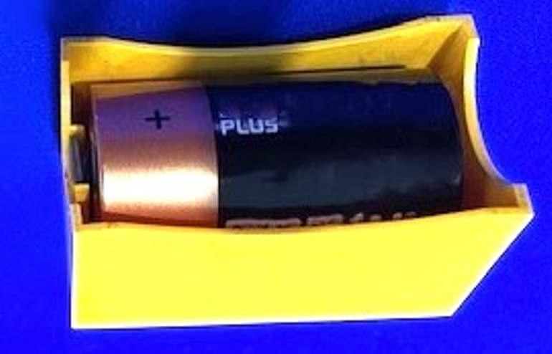
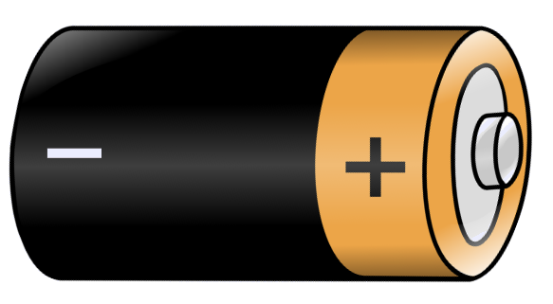
Waa maxay unug koronto (electrical cell)?
Unug koronto (electrical cell) wuxuu leeyahay dhammaad 'plus' ama togan.
togan (positive)
taban (negative)
Dhammaadka kale waa taban. Dhammaadka unugga waxaa loo yaqaan terminal-yada.

Slide 8
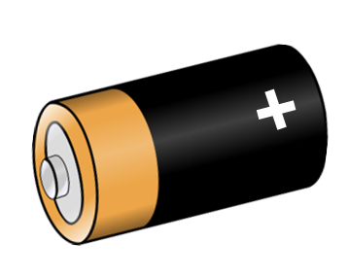
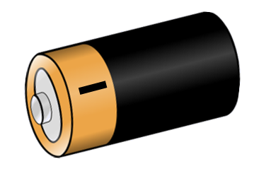
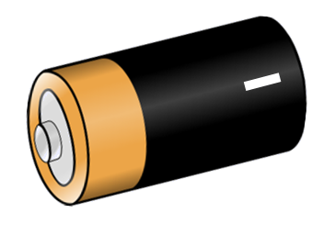

Waa maxay unug koronto (electrical cell)?
Kee unug ayaa leh terminal ku calaamadsan astaanta saxda ah?

Slide 9
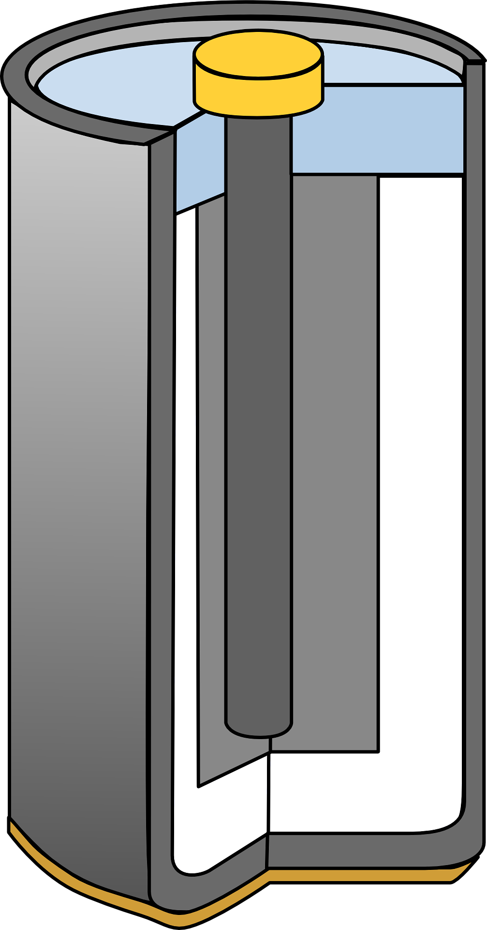
Waa maxay unug koronto (electrical cell)?
Falgal (reaction) kiimiko oo unugga (cell) dhexdiisa ah ayaa ka dhigaya terminalyasha kuwa togan (positive) iyo kuwa taban (negative).
kiimikooyin (chemicals) falgala (react)
Terminalyashani waxay riixaan shixnado (charges) wareegga (circuit) dhexdiisa.

Slide 10
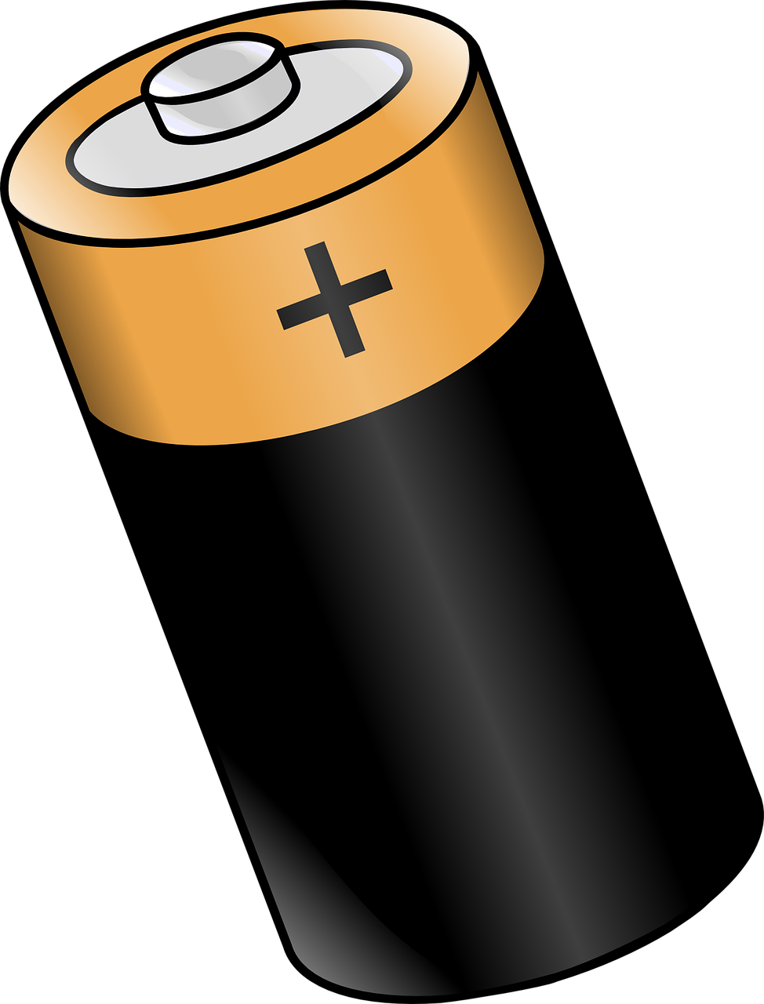
Waa maxay unug koronto (electrical cell)?
In ka badan hal unug (cell) oo la isku xiro ayaa sameeya batari (battery) unugyo ah, oo inta badan loo yaqaan batari (battery).
hal unug (cell)
batari (battery) laba unug (cell) ah

Slide 11
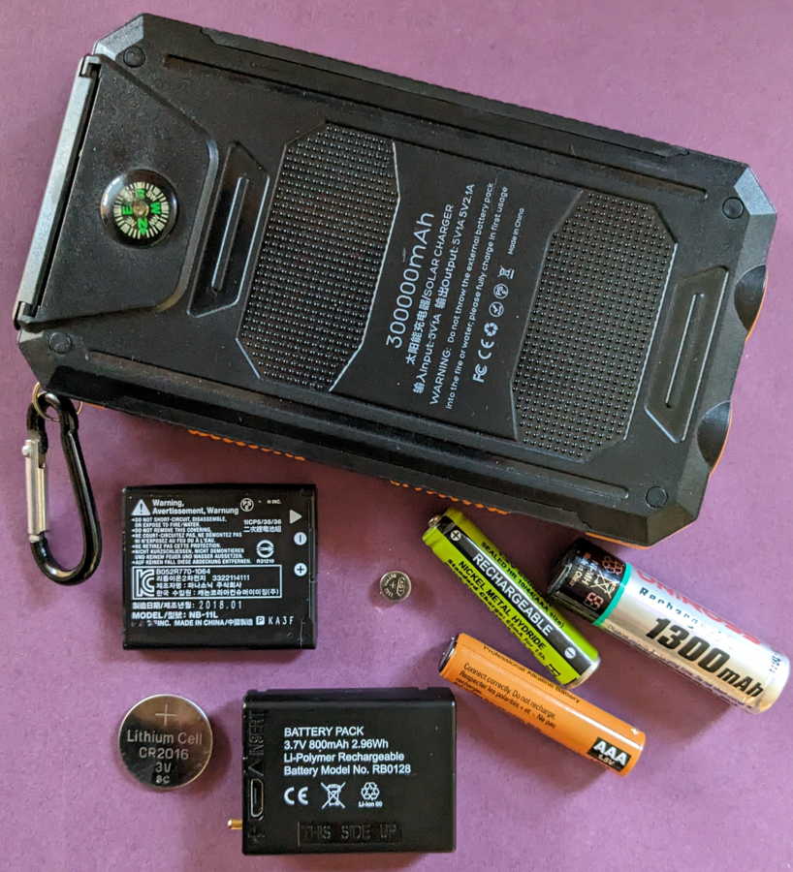
Waa maxay unug koronto (electrical cell)?
Waxaa jira unugyo (cells) iyo batariyo (batteries) oo kala duwan oo loo isticmaalo ujeedooyin kala duwan.
powerbank
batari kamarad (camera battery)
unug dib loo dallaci karo (rechargeable cell)
unug saacad (watch cell)
unug alkaline (alkaline cell)
batari toosh (torch battery)

Slide 12
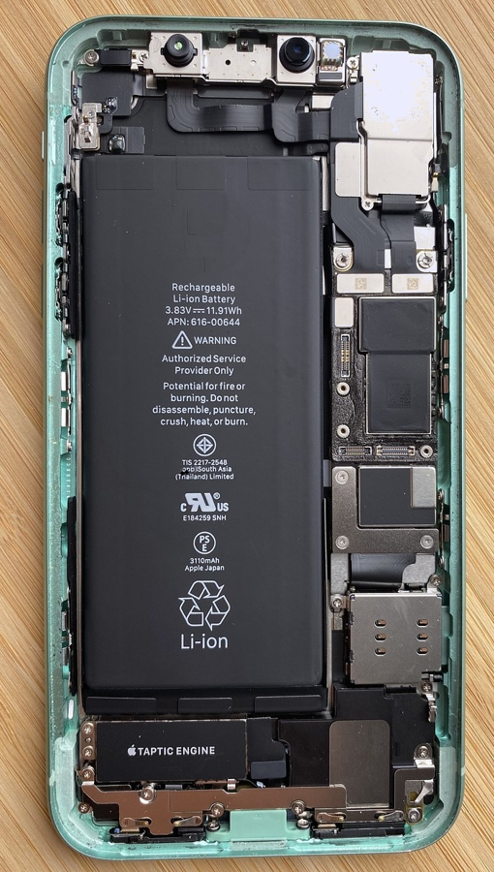
Waa maxay unug koronto (electrical cell)?
Taleefanka gacanta (mobile phone) wuxuu ku jiraa batari (battery) weyn oo dib loo dallaci karo.
Taleefanku ma shaqeyn karo haddii batarigu (battery) uusan riixin socodka (current) wareegyada (circuits) dhexdooda.
batari taleefan (phone battery)

Slide 13
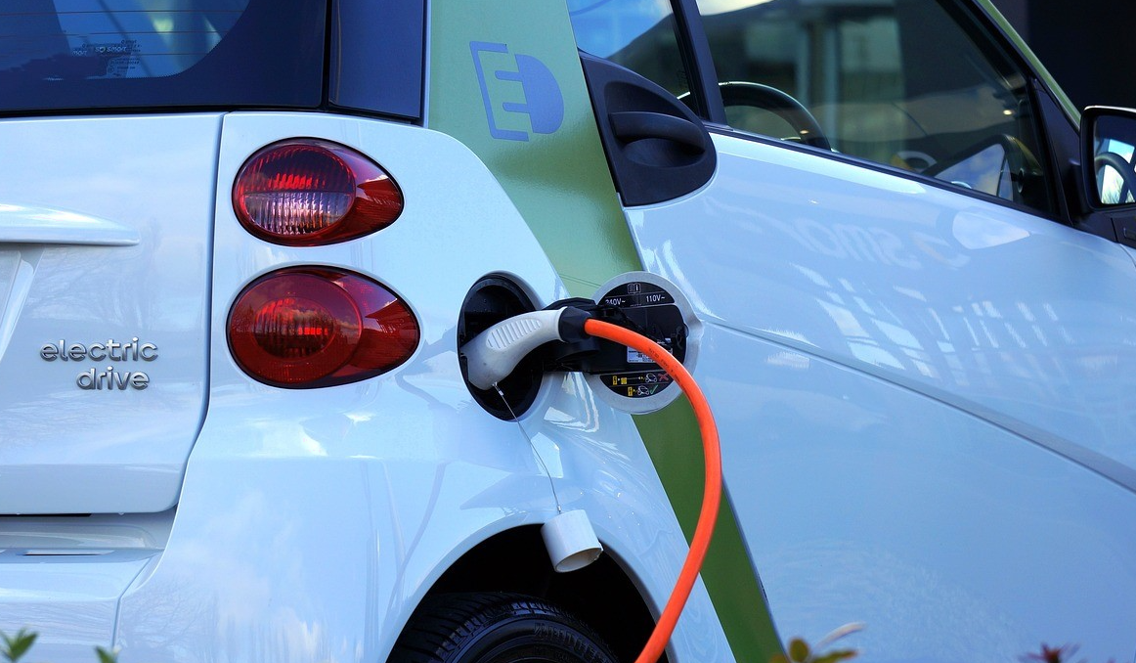
Waa maxay unug koronto (electrical cell)?
Baabuurta korontada ku shaqeeya (electric cars) waxay leeyihiin batariyo (batteries) waaweyn oo ay tahay in si joogto ah dib loo dallaco.

Slide 14
Waa maxay unug koronto (electrical cell)?
Kee ayaa ka mid ah weedho ku saabsan unugyada iyo baytariyada uu yahay mid sax ah?
Dhammaantood waa la dib u buuxin karaa (rechargeable).
Waxay ku iman karaan qaabab iyo cabbirro kala duwan.
Waxay isticmaalaan shidaal (fossil fuels) si ay u soo saaraan koronto.
Waxay leeyihiin terminal togan, taban, iyo dhexdhexaad.

Slide 15
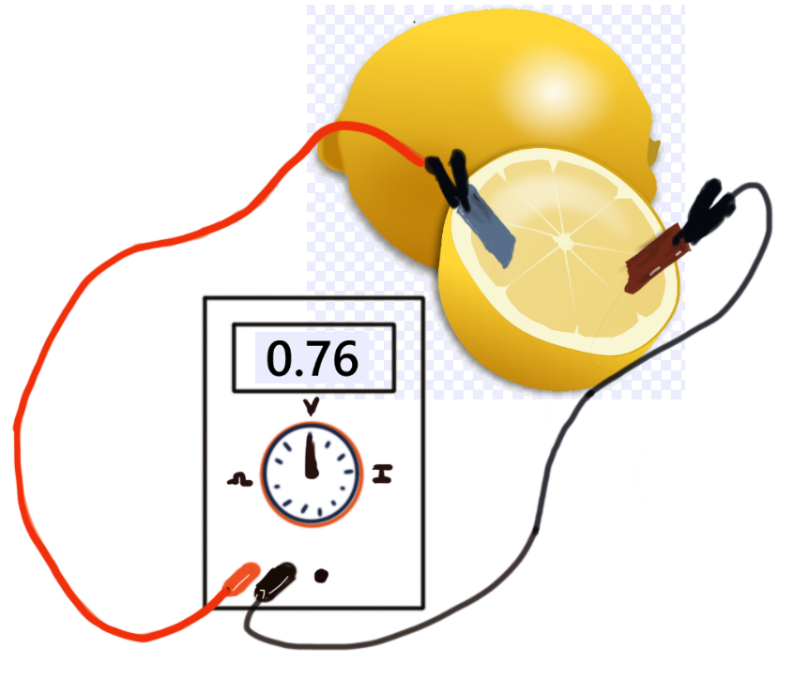
Waa maxay unug koronto (electrical cell)?
Unug fudud ayaa la samayn karaa iyadoo la isticmaalo labo bir oo kala duwan, sida zinc iyo copper, oo la geliyo liin.
Cusbada (acidic) ee ku jirta liinta waxay la falgashaa (reacts) biraha, taasoo keenta in koronto (charge) ku qulqulo wareegga (circuit).
zinc
copper

Slide 16
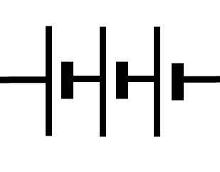
Waa maxay unug koronto (electrical cell)?
Unugyada waa in la isku xiraa si ay isku jiho ugu toosan yihiin.
Terminalyada togan waa inay ku xirmaan kuwa taban.
Dhammaan unugyadu waa inay nooc isku mid ah yihiin.

Slide 17
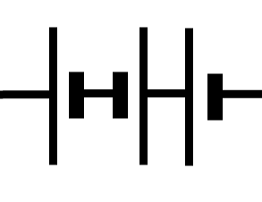
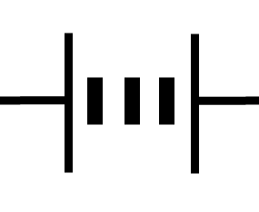
Waa maxay unug koronto (electrical cell)?
Kee ayaa ka mid ah kuwan soo socda uu yahay astaanta (symbol) saddex unug oo si sax ah isugu xiran?

Slide 18
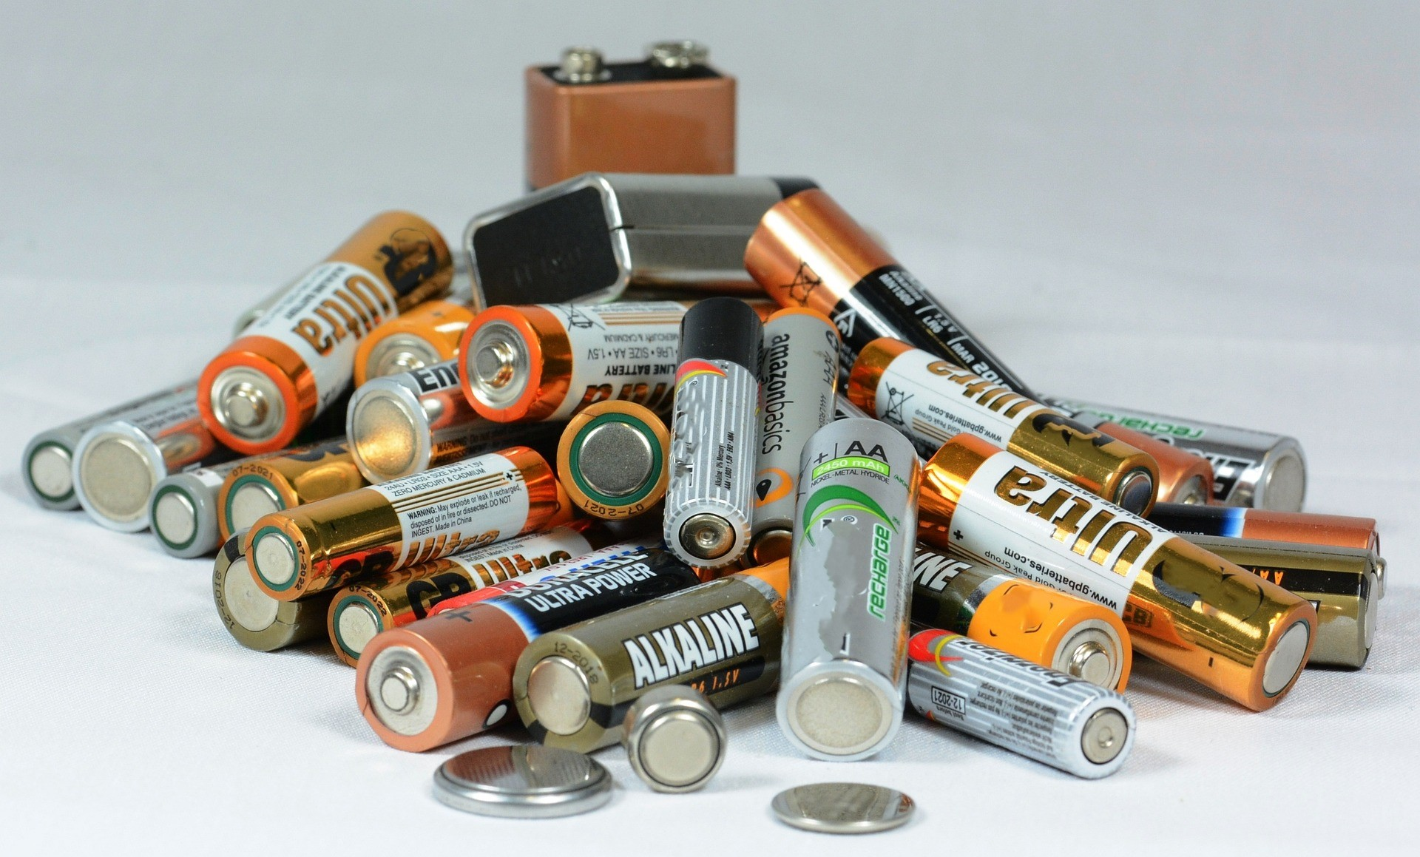
Waa maxay unug koronto (electrical cell)?
Arday qaar ayaa isku dayaya inay si fiican u shidaan laambad (lamp). Waxay haystaan unugyo iyo baytariyo kala duwan.
Sharax sida ay u samayn karaan si ammaan ah.

Slide 19
Waa maxay unug koronto (electrical cell)?
Ardayda qaar waxay isku dayayaan inay laambad (lamp) u shidaan sida ugu iftiin badan. Waxay leeyihiin noocyo kala duwan oo unugyo (cells) iyo baytariyo (batteries) ah.
Sharax sida ay si badbaado leh u sameyn karaan.
Kala saar unugyada iyo baytariyada nooc kasta.
Dooro nooca unugyada ugu badan leh, ku xidh dhamaad ilaa dhamaad, isagoo u jeedda isla jihada.
Ku xidh laambadda (lamp).
Ku celi tillaabooyinkan nooc kasta oo unug (cell) ama baytari (battery) ah, si aad u aragto qaybteeda laambadda (lamp) ugu iftiiminaysa.

Slide 20
Curiyaan koronto (Electric current)
Waa maxay unug koronto (electrical cell)?
Waa maxay curyaan (current)?

Slide 21
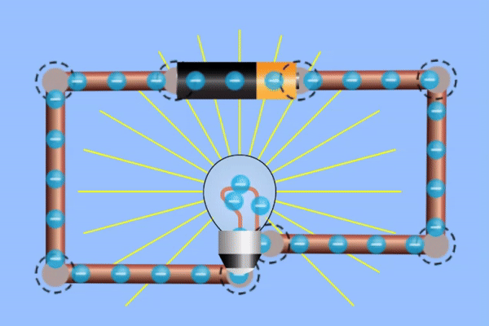
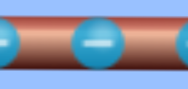
Waa maxay curyaan (current)?
Unuggu wuxuu soo saaraa culeys diidmo (negative charges) oo ka soo baxa xidhmada diidmada (negative terminal) wuxuuna soo jiitaa xagga xidhmada togan (positive terminal).
culeys diidmo (negative charge) oo silig (wire) ku jira
Culeysyadan waxaa loo yaqaan elektaroonno (electrons).
Jilitaan (Simulation) by PhET Interactive Simulations, University of Colorado Boulder, oo shatiyaysan CC-BY-4.0 (https://phet.colorado.edu).

Slide 22
Waa maxay curyaan (current)?
Midka kuwa soo socda ee ku saabsan unugga (cell) waa mid sax ah?
Culeys togan (positive charge) waxaa la soo jiitaa xidhmada diidmada (negative terminal).
Culeys diidmo (negative charge) waxaa la soo jiitaa xidhmada diidmada (negative terminal).
Culeys diidmo (negative charge) waxaa laga soo saaraa xidhmada diidmada (negative terminal).
Culeys togan (positive charge) waxaa laga soo saaraa xidhmada diidmada (negative terminal).

Slide 23
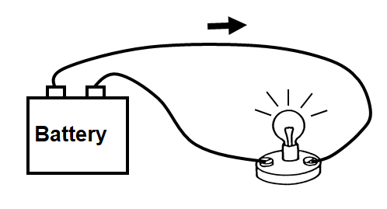
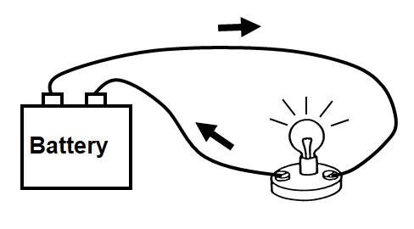
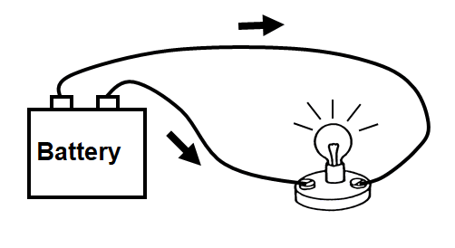
Waa maxay curyaan (current)?
Jajabka (diagram) kee ayaa ugu saxda ah jihada curyaanka (current) ee wareeggan (circuit) marka laambaddu (lamp) shidan tahay?

Slide 24
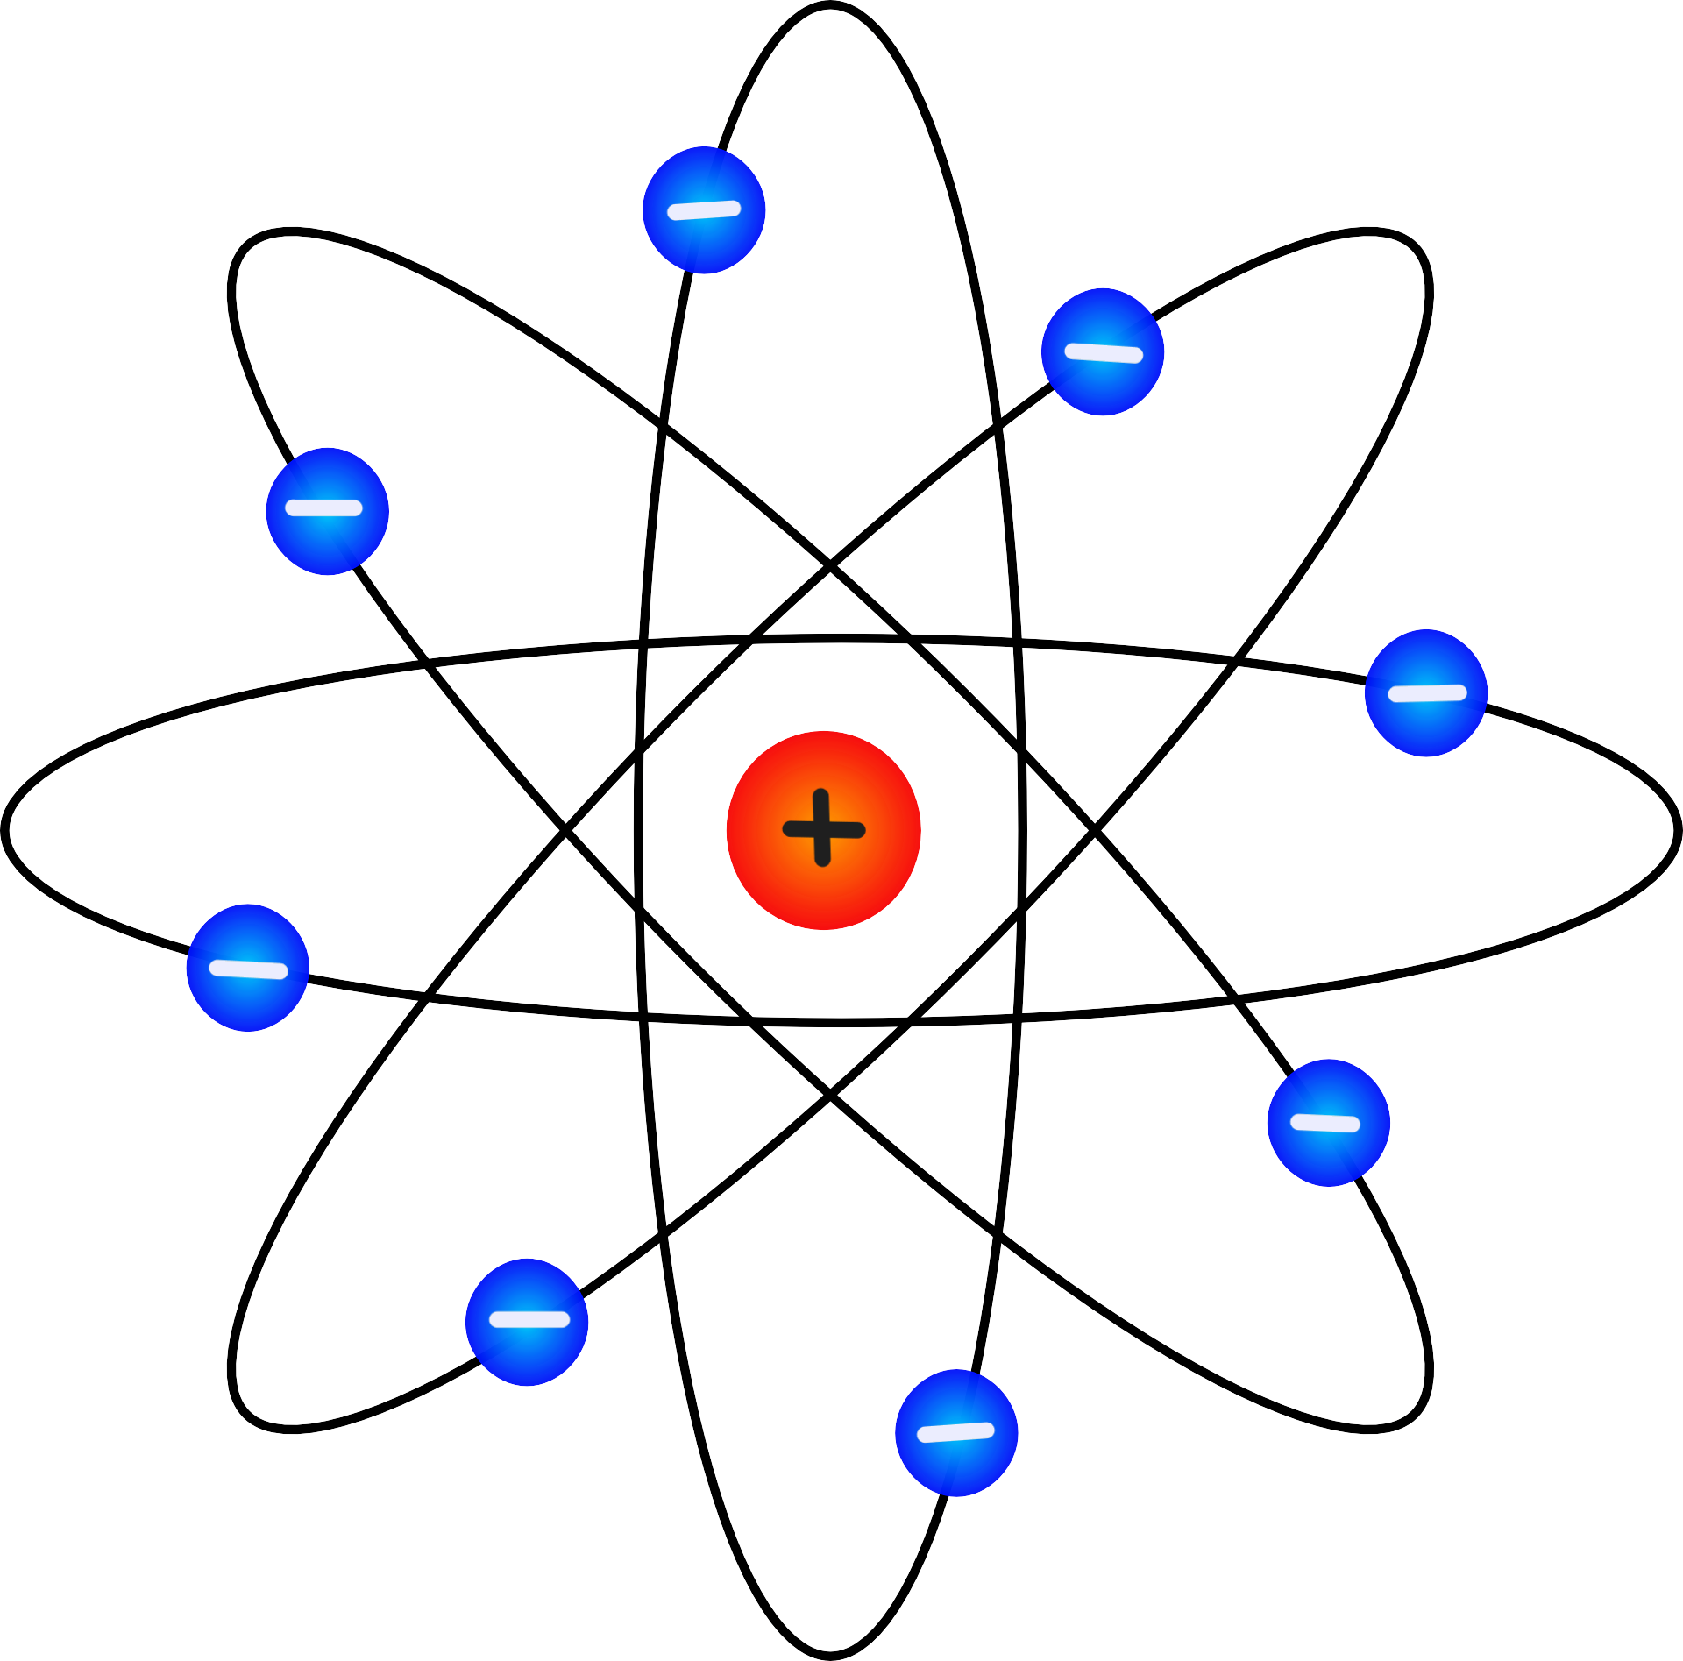
Waa maxay current?
Elektaroonnada (Electrons) aad ayey u yar yihiin, xataa mikroskoobyada (microscopes) indhaha ugu fiicanna laguma arki karo.
elektaroon (electron)
atom
Elektaroonada jaantuskan waxaa matalaya goobo buluug ah.

Slide 25
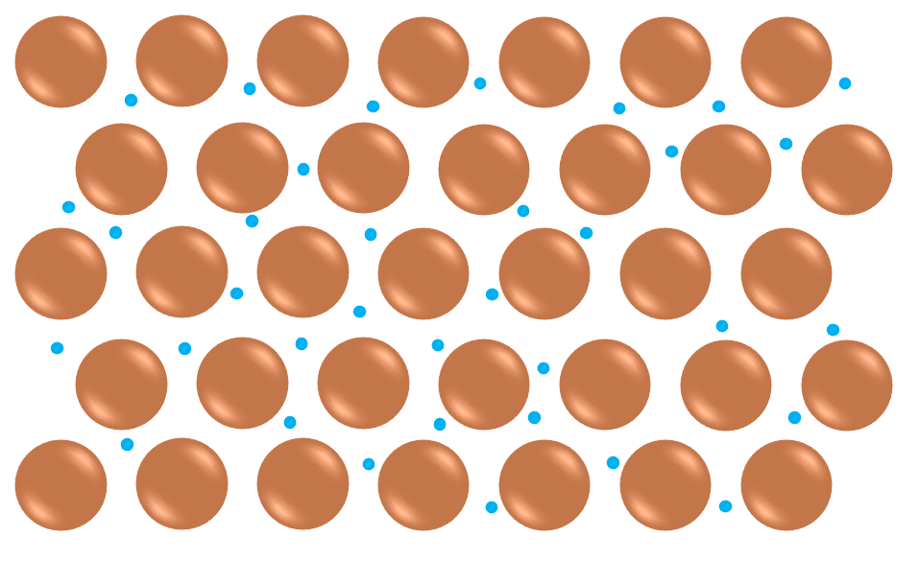
Waa maxay current?
Tani waa qaab kale oo lagu muujinayo elektaroonada birta.
elektaroon (electron)
atom
Elektaroonadu waxay si fudud u dhex mari karaan atamka birta, taasoo ka dhigaysa birta kuwo wanaagsan oo koronto qaada (conductors).

Slide 26
Waa maxay current?
Laba ka mid ah weedhahan soo socda ee ku saabsan elektaroonada waa kuwa sax ah?
waxay yihiin shixnado taban (negative charges)
waxay yihiin buluug
waxay yihiin kuwo aad u yar
waxaa laga helaa oo kaliya fiilooyinka

Slide 27
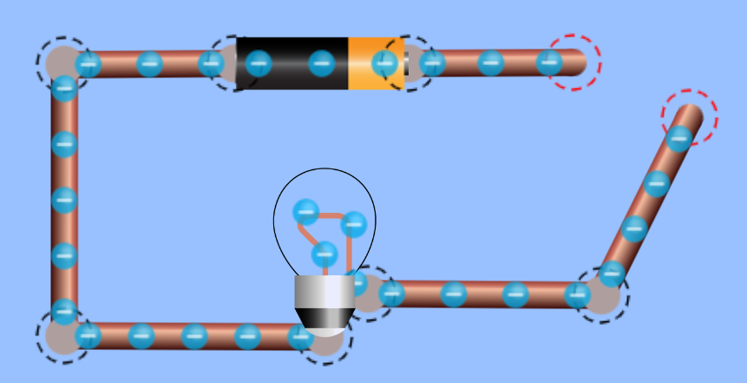
Waa maxay current?
Haddii wareeggu (circuit) 'jabo', elektaroonadu ma dhex mari karaan farqiga.
farqi (gap)
Inkastoo aysan dhaqaaqin, elektaroonadu wali waxay ku jiraan cell-ka, fiilooyinka, iyo nalka (bulb).
Sawirka PhET Interactive Simulations, University of Colorado Boulder, oo shatiyeysan CC-BY-4.0 (https://phet.colorado.edu).

Slide 28
Waa maxay current?
Xaggee, wareeg jaban, ayay jiraan elektaroono aan la heli karin inay qulqulaan?
fiilooyinka (the wires)
nalka filament-ka (the filament bulb)
unugga (the cell)
farqiga (the gap)

Slide 29
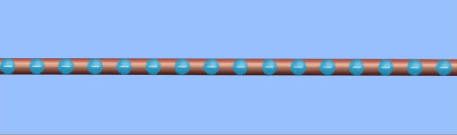

Waa maxay current (current)?
Qulqulka charges-ka (electrons) waxaa loo yaqaan current (electric current).
Tani waxay la mid tahay qulqulka biyaha (water) ee webiga.
Jilitaanka PhET Interactive Simulations, University of Colorado Boulder, oo shatiyaysan CC-BY-4.0 (https://phet.colorado.edu).

Slide 30
Waa maxay current (current)?
Macallin wuxuu isticmaalaa qaabka webiga si uu u sharaxo sida current (current) u qulqulo. Maxay qaabku u isticmaalaa inuu matalo charge (charge)?
biyaha (water) webiga ku jira
xawaaraha webiga
hirarka korka biyaha (water)

Slide 31
Waa maxay current (current)?
Marka electrons-ku ka baxaan unugga (the cell)…
…tiro isku mid ah ayaa soo gala.
Electron kasta oo nalka soo gala, mid kale ayaa ka baxa.
Jilitaanka PhET Interactive Simulations, University of Colorado Boulder, oo shatiyaysan CC-BY-4.0 (https://phet.colorado.edu).

Slide 32
Waa maxay current (current)?
Current-ka (current) wareeggan waa isku mid…
halkan,
iyo halkan.
halkan,
halkan,
halkan,
Jilitaanka PhET Interactive Simulations, Jaamacadda Colorado Boulder, shatiyey CC-BY-4.0 (https://phet.colorado.edu).

Slide 33
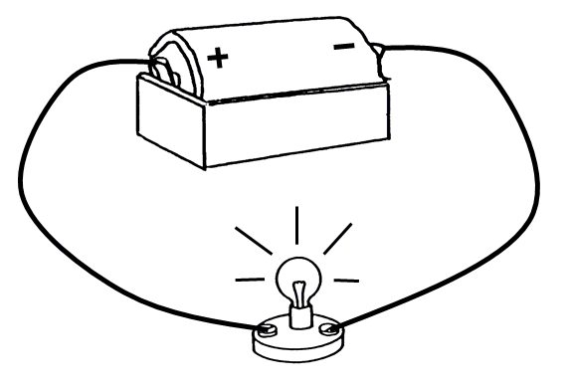
Waa maxay current?
Kee ayaa ka mid ah weedhahan soo socda uu sax yahay marka laambaddu iftiimayso?
Current-ku wuu hooseeyaa ka dib marka uu dhex maro laambadda.
Current-ku wuu sareeyaa dhinaca taban ee wareegga.
Current-ka ku jira unuggu wuu ka sareeyaa kan laambadda.
Current-ka unugga, laambadda, iyo fiilooyinka waa isku mid.

Slide 34
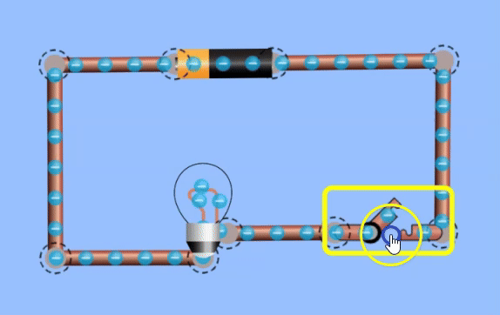
Waa maxay current?
Marka switch-ka la shido, current wuu qulqulaa oo laambaddu isla markiiba way iftiimaysaa.
Marka la damiyo, current wuu joogsadaa, oo laambaddu isla markiiba way bakhtiyaa.
Jilitaanka PhET Interactive Simulations, Jaamacadda Colorado Boulder, shatiyey CC-BY-4.0 (https://phet.colorado.edu).

Slide 35
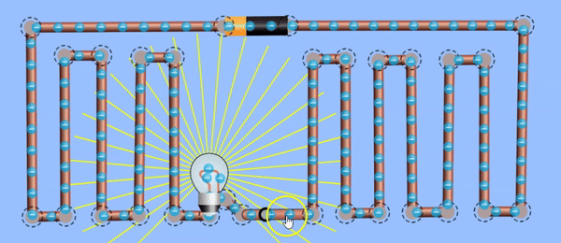
Waa maxay current?
Xataa marka wareeggu leeyahay fiilooyin aad u dhaadheer, laambaddu isla markiiba way iftiimaysaa (iyo bakhtiyaa) marka la shido (ama la damiyo).
Waxaad ogaan doontaa in tani ay la mid tahay nalalka gurigaaga.
Jilitaanka PhET Interactive Simulations, Jaamacadda Colorado Boulder, shatiyey CC-BY-4.0 (https://phet.colorado.edu).

Slide 36
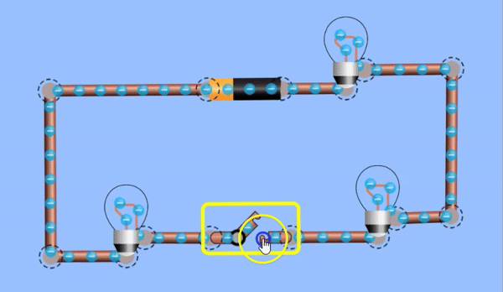
Waa maxay current?
Marka switch-ka la xiro, saddexda laambadood waxay isla waqti isku mid ah ku iftiimaan isla iftiin isku mid ah.
Electrons-ka shaqsigu waxay u dhaqaaqaan dhawr millimitir ilbiriqsi keliya, laakiin laambadaha oo dhami isla markiiba way iftiimaan.
Jilitaanka PhET Interactive Simulations, Jaamacadda Colorado Boulder, shatiyey CC-BY-4.0 (https://phet.colorado.edu).

Slide 37
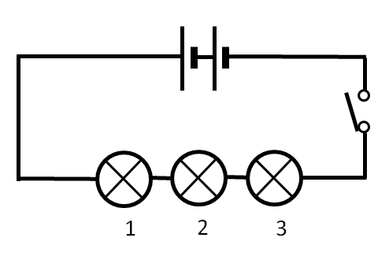
Waa maxay current (current)?
Furaha (switch) waa la xidhay wareeggan (circuit) oo nalalka (lamps) way iftiimaan.
Sheegasho (statement) intee mid ayaa run ah oo ku saabsan sida ay u iftiimaan?
nalka (lamp) 1 ayaa marka hore iftiima
dhammaantood isku mar bay iftiimaan
nalka (lamp) 3 ayaa marka hore iftiima
nalalka (lamps) 1 iyo 3 waxay iftiimaan ka hor nalka (lamp) 2

Slide 38
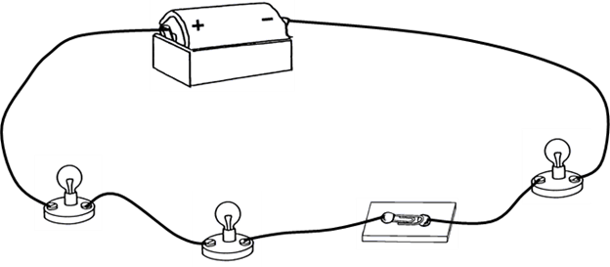
Waa maxay current (current)?
Furaha (switch) wareeggan (circuit) waa la xidhay si nalalka (lamps) loo shido. Dhammaan nalalka (bulbs) ku jira nalalka (lamps) waa isku mid.
Sharax sida nalalka (bulbs) u iftiimaan (ku dar waqtiga (timing) iyo dhalaalka (brightness)).
Sharax sababta nalalka (bulbs) u iftiimaan sidaad ku tilmaantay.

Slide 39
Waa maxay current (current)?
Furaha (switch) wareeggan (circuit) waa la xidhay si nalalka (lamps) loo shido. Dhammaan nalalka (bulbs) ku jira nalalka (lamps) waa isku mid.
Sharax sida nalalka (bulbs) u iftiimaan (ku dar waqtiga (timing) iyo dhalaalka (brightness)).
Nalalka (bulbs) dhamaantood isku mar bay iftiimi doonaan oo waxay yeelan doonaan dhalaal (brightness) isku mid ah.
Sharax sababta nalalka (bulbs) u iftiimaan sidaad ku tilmaantay.
Nalalka (bulbs) waxay iftiimaan isku mar sababtoo ah waxaa jira charges (electrons) oo ku yaal dhammaan fiilooyinka (wires).
Charges (charges) dhamaantood waxay bilaabaan dhaqdhaqaaq (movement) isku marka furaha (switch) la xidho.
Nalalka (bulbs) mid kasta wuxuu yeelan doonaa dhalaal (brightness) isku mid ah sababtoo ah isku current (current) ayaa ku qulqula dhammaantood.

Slide 40
Current (current) koronto (electric)
Unug koronto (electrical cell) wuxuu isticmaalaa falgal (reaction) kiimiko (chemical) si uu charge (charge) ugu qulqulo wareegga (circuit).
Waxay leedahay terminal (terminal) togan (positive) iyo taban (negative).
Qaybaha (components) ee wareegga (circuit) waxay ka kooban yihiin eeddo (charges) badan oo taban (negative) oo loo yaqaan elektaroonno (electrons). Marka elektaroonno (electrons) ay qulqulaan wareegga (circuit), waxaa loo yaqaan koronto qulqulaya (electric current).
Qulqulka (current) wuxuu la mid yahay meel kasta oo wareegga (circuit) ah, taasoo keenta in dhammaan qaybaha (components) ay isku mar shidaan ama damiyaan.

