Slide 1
Injineer
Xisaabta goobta shaqada

Slide 2
Sida agabkeena waxbarista loogu talagalay fasalka

Slide 3
Waxaan fahmi karaa sida xisaabta loogu isticmaalo injineerada.

Slide 4
Tiro waa qaab jajab (fraction) marka loo muujiyo hal tiro oo loo qaybiyay tiro kale.

Slide 5

Injineer
Saxnaanta injineerinka
Codsiyada kale ee xisaabta

Slide 6
Saxnaanta injineerinka
Maxaad u malaynaysaa in injineerada ay sameeyaan?
Injineeradu waxay qaadaan mabaadi'da sayniska iyo xisaabta waxayna ku dabaqaan si ay u helaan xalalka dhibaatooyinka.
Waxay dhisaan buundooyin ka gudba webiyada iyo dooxooyinka.
Waxay dhisaan tunnel hoostooda webiyada, badda, iyo magaalooyinka.
Waxay dhisaan dhismayaal aad u sarreeya meelo cidhiidhi ah.
Asal ahaan, waxay xalliyaan dhibaatooyinka aadanaha. Xallinta dhibaatada waa nuxurka xisaabta.

Slide 7
Saxnaanta injineerinka
Qodobka ugu muhiimsan ee shaqada injineerada waa saxnaanta. Haddii aysan sax ahayn, buundadu way dumi, dhismuhu wuxuu dumaa, ama diyaaraddu way ka dhacdaa cirka.
Fiiri xisaabtaada (ruler). Waa maxay cabbiraadahan yaryar ee saxda ah ee u dhexeeya sentimitir kasta?
Waa millimitir, waxaana jira toban millimitir hal sentimitir.
0
cm
1
2
3

Slide 8
Saxnaanta injineerinka
Millimitir iyo sentimitir waa cabbiraado metric ah.
U rog xajkaaga.
Maxay 'in' u taagan tahay iyo qoyskee cabbirro ayay ka tirsan tahay?
'in' waxay u taagan tahay inji (inches), cabbir Imperial. Taariikh ahaan UK waxaan isticmaalnay nidaamka cabbirka Imperial.
0
in
1
2
3

Slide 9
Saxnaanta injineerinka
Maxaad u malaynaysaa inaan ugu yeerno cabbirradan yaryar ee saxda ah ee u dhexeeya injiyada?
Maya. Ma aha milli-inji!
Ma laha magac. Waxaa lagu sifeeyaa jajab inji.
0
in
1
2
3

Slide 10


Saxnaanta injineerinka
0
in
1
2
3
"Nus inji"
"Rubuc inji"

Slide 11



Saxnaanta injineerinka
Sidee ugu yeeri lahayn cabbirradan?
0
in
1
2
3
"Sideed meelood meel inji"
"Nus inji"
"Saddex rubuc inji"
"Rubuc inji"
"Toddoba sideed meelood inji"

Slide 12

Saxnaanta injineerinka
Waxaa laga yaabaa inaad hesho xisaab (ruler) ka sax ah kan.
Maxaad u malaynaysaa inay tahay jajabkan cusub?
0
in
1
2
3
Meel saddex iyo tobnaad oo inch ah ayaa ku dhawaad sax ah sida gacanta bini'aadamku u goyn karo, sidaas darteed xisaabihii hore waxay aad u yarayd inay ka sax yihiin tan.

Slide 13
Saxnaanta injineerinka
Maxaad ka ogaataa hooseeyayaasha jajabyada?
2, 4, 8 iyo 16 dhamaantood waa awoodaha 2
0
in
1
2
3
Tani waa ula kac, sababtoo ah nus nus waa rubuc, nus rubuc waa sideed meelood meel, iyo nus sideed meelood meel waa saddex iyo tobnaad.

Slide 14
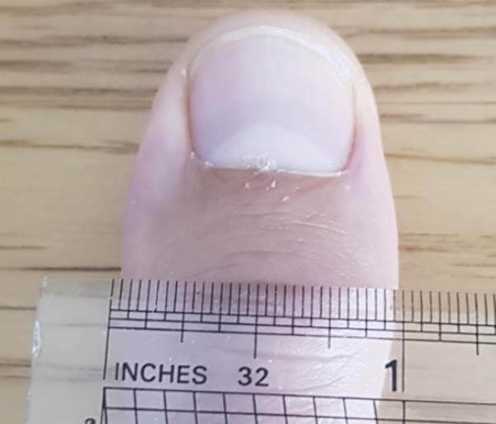
Saxnaanta injineerinka
2, 4, 8 iyo 16 dhamaantood waa awoodaha 2
Awoodahan laba, oo lagu daro hal xaqiiqo muhiim ah, ayaa u oggolaaday injineerradii hore inay si sax ah isula xiriiraan.
0
in
1
2
3
Meelaha ugu ballaadhan, suulka qof weyn wuxuu qiyaas ahaan yahay hal inch dhexroor.

Slide 15

Saxnaanta injineerinka
0
in
1
2
3
rubuc
Nus nus waa __________.
Nus __________ waa saddex iyo tobnaad.
sideed meelood meel
Nus saddex iyo tobnaad waa __________.

Slide 16
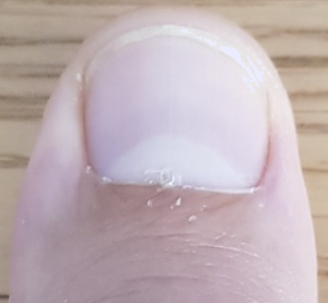
Saxnaanta injineerinka
Dhererkani wuxuu qiyaas ahaan yahay __________ dheer.
afar inji
laba iyo badh inji
Dhererkani wuxuu qiyaas ahaan yahay __________ dheer.

Slide 17



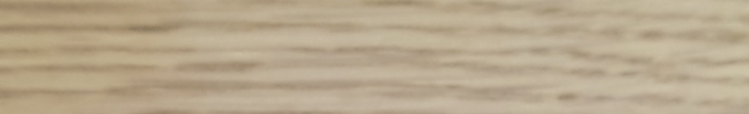
Saxnaanta injineerinka
Qaanuunkan gacanta wuxuu u oggolaaday injineerada UK inay cabbiraan, gooyaan, oo ay isgaarsiiyaan si sax ah.
1
2
Waxaan cabbiri karnaa dherer sax ah sida hal iyo shan meelood oo sideed meelood oo inji ah.

Slide 18



Saxnaanta injineerinka
Cabbir laba iyo hal meel oo sideed meelood oo inji ah.
2
3

Slide 19
Saxnaanta injineerinka
Cabbiraadaha dhaadheer, nijaariyadu waxay sitaan qalab kale oo xiiso leh.
Xaakin shan cagood oo laalaada. Tan waxaa sidoo kale loo yaqaan Xaakinta Nijaarka ama Xaakinta Dhagaxa.

Slide 20
Saxnaanta injineerinka
Dhererkani waa afar cagood.
Dhererkani waa laba iyo badh cagood. Ama, laba cagood iyo lix inji. (Waxaa jira 12 inji hal cag)

Slide 21
Saxnaanta injineerinka
shan cagood
Kani waa __________ xaakin laalaada.
laba iyo toban inji
Waxaa jira __________ hal cag.

Slide 22
Saxnaanta injineerinka
Cabbirka cagaha iyo injiyada iyo saxnaanta ilaa hal meel oo lix iyo toban meelood oo inji ah waxay ku filneyd caqabadihii hore. Dhismayaasha dhawr dabaq ah ayaa weli taagan haddii loo dhiso heerkan saxnaanta.
Si kastaba ha ahaatee, maanta waxaan dhisnaa dhismayaal dhaadheer oo ku dhow hal kiiloomitir, buundooyin ku xaniban culeys milyan oo tan, iyo diyaaradaha iyo gantaalada ku socda ku dhawaad 1000 mph. Baahiyahan casriga ah waxay ka dhigan yihiin in meel saddex iyo tobnaad oo inch ah aysan ku filnayn. Heerarka saxnaanta injineerada maanta waa inay aad uga sax badan yihiin taas.

Slide 23
Saxnaanta injineerinka
Waxaad ku arki kartaa xisaabtaada in hal millimitir uu ka yar yahay saddex iyo tobnaad oo inch ah. Taasi waxay ka dhigaysaa cabbir sax ah oo la isticmaalo. Si kastaba ha ahaatee, taasi weli kuma filna caqabadaha injineerinka casriga ah.
0
in
1
0
cm
1
2
3
Ma taqaan cabbirrada mitirka ee dhererka oo ka yar hal millimitir?

Slide 24
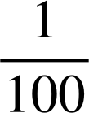
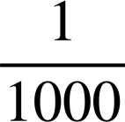
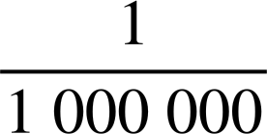
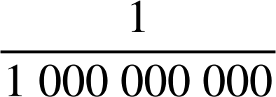
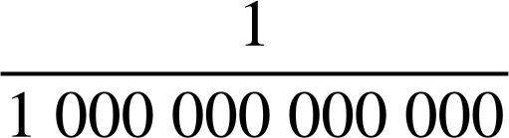
Saxnaanta injineerinka
Hal mitir
Hal sentimitir
m
Hal millimitir
m
Tignoolajiyada goynta laser-ka waxay ka dhigan tahay injineerada casriga ah inay goyn karaan ilaa 25 mikron (mikromitir) saxnaan.
Hal mikromitir
m
Hal nanomitir
m
Atomku wuxuu ku dhow yahay 100 pikomitir dhexroor.
Hal pikomitir
m

Slide 25
Saxnaanta injineerinka
Injineeradu waxay ku qeexaan cabbirradan qaab caadi ah.
Hal sentimitir
m
1 × 10⁻² m
Hal millimitir
m
1 × 10⁻³ m
Hal mikromitir
m
1 × 10⁻⁶ m
Hal nanomitir
m
Hal pikomitir
m

Slide 26
Saxnaanta injineerinka
Injineeradu waxay ku qeexaan cabbiraadahan qaab caadi ah (standard form).
Hal sentimitir
m
1 × 10⁻² m
Hal milimitir
m
1 × 10⁻³ m
Hal mikromitir
m
1 × 10⁻⁶ m
Hal nanomitir
m
1 × 10⁻⁹ m
Hal pikomitir
m
1 × 10⁻¹² m

Slide 27

Saxnaanta injineerinka
Injineeradu waxay isticmaali karaan qalabka goynta laser-ka si ay u saxaan ilaa 25 mikron. Waa maxay tan qaab caadi ah (standard form)?
Hal mikron (mikromitir) = 1 × 10−6 m
25 × 10⁻⁶ m
Adigoo isticmaalaya halbeegga caalamiga ah (SI) ee cabbirka mitirka iyo luqadda caalamiga ah ee xisaabta (standard form), injineerada adduunka oo dhan waxay si sax ah isula xiriiri karaan.
2.5 × 10⁻⁵ m
2.5 × 100⁻⁶ m

Slide 28
Saxnaanta injineerinka
1) Akhri cabbiraadahan.
a)
0
in
1
2
3
b)
0
in
1
2
3
c)
0
in
1
2
3

Slide 29
Saxnaanta injineerinka
2) Isticmaal qiyaas guud (rule of thumb) si aad u cabbirto kuwan hoose:
a) Hal iyo saddex meelood oo sideed meelood oo inji ah.
b) Laba iyo saddex meelood oo lix iyo toban meelood oo inji ah.

Slide 30
Saxnaanta injineerinka
3) a) Immisa millimitir ayaa ku jira sentimitir?
Hal sentimitir
m
1 × 10⁻² m
Hal millimitir
m
1 × 10⁻³ m
b) Immisa mikromitir ayaa ku jira millimitir?
Hal mikromitir
m
1 × 10⁻⁶ m
c) Immisa mikromitir ayaa ku jira sentimitir?
d) Injineerada waxay ku goyn karaan leysar (laser) sax ah ilaa 2.5 × 10−5 m
Waa intee qayb ee sentimitir?

Slide 31

Saxnaanta injineernimada
1) Akhri cabbiraadahan.
inji
a)
inji
0
gudaha
1
2
3
b)
inji
0
gudaha
1
2
3
c)
0
gudaha
1
2
3

Slide 32
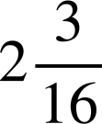

Saxnaanta injineernimada
2) U isticmaal qiyaas (rule of thumb) si aad u cabbirto kuwan hoose:
a) Hal iyo saddex meelood oo sideed inji.
b) Laba iyo saddex meelood oo lix iyo toban inji.
1
2
2
3

Slide 33
Saxnaanta injineernimada
3) a) Immisa millimitir ayaa ku jira sentimitir?
3) a) Immisa millimitir ayaa ku jira sentimitir?
Hal sentimitir
m
1 × 10⁻² m
10
Hal millimitir
m
1 × 10⁻³ m
b) Immisa mikromitir ayaa ku jira millimitir?
Hal mikromitir
m
1 × 10⁻⁶ m
(1 × 10⁻³) ÷ (1 × 10⁻⁶) = 1000
c) Immisa mikromitir ayaa ku jira sentimitir?
(1 × 10⁻²) ÷ (1 × 10⁻⁶) = 10 000

Slide 34
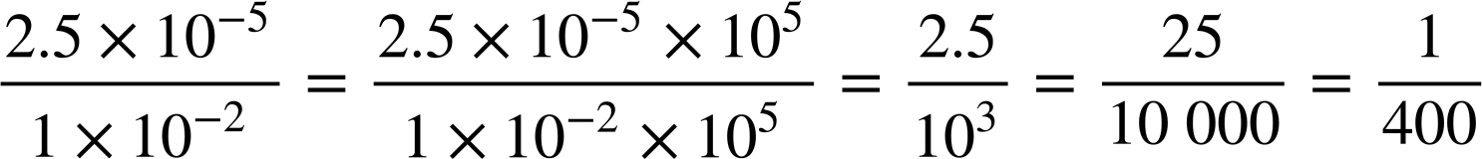
Saxnaanta injineernimada
3)
Hal sentimitir
m
1 × 10⁻² m
Hal millimitir
m
1 × 10⁻³ m
Hal mikromitir
m
1 × 10⁻⁶ m
d) Injineerada ayaa ku gooyn kara leysarka saxnaan ah 2.5 × 10−5 m
Waa imisa qayb ee sentimitir?
Ma qiyaasi kartaa rubuc boqol oo sentimitir! Kani waa saxnaanta injineeradu ku shaqeeyaan.

Slide 35
Injineer
Saxnaanta injineernimada
Codsiyada kale ee xisaabta

Slide 36
Codsiyada kale ee xisaabta
Xeerka Mason wuxuu ahaa xaakin shan-cagood ah oo la laalaabo. Afar ma aha, lixna ma aha. Shan. Tani waxay ahayd sabab.

Slide 37
Codsiyada kale ee xisaabta
Marka la dhisayo gidaar, bilowga hawsha, mason wuxuu qiyaasi jiray saddex cagood oo gidaarka kor ah, iyo afar cagood oo saldhigga ah.
Kadib waxay arki jireen haddii xaakinta shan-cagood 'ku habboon tahay'.
Maxaad u malaynaysaa inay sidaas sameeyeen?
3 ft
4 ft

Slide 38
Codsiyada kale ee xisaabta
Kani waa aragtida (Theorem) ee Pythagoras oo shaqeysa!
32 + 42 = 52, waa saddex-geesood (triplet) Pythagorean.
Tani waxay muujinaysaa in kani yahay saddex-xagal qumman (right-angled triangle). Waxaa muhiim ah, gidaarka waxaa laga dhisayaa si toos ah!
5 ft
3 ft
4 ft

Slide 39
Codsiyada kale ee xisaabta
Haddii gidaarku uusan ahayn 'qumman', sharciga shanta-cagood (five-foot rule) ma habboonaayo.
Sharcigu waa inuu la kulmaa dhibcaha 4 ft ee saldhiga iyo 3 ft ee gidaarka si loo sameeyo saddex-xagal qumman 3, 4, 5.
✖
3 ft
✖
4 ft

Slide 40
Codsiyada kale ee xisaabta
Lebedyadan waxaa la dhigayaa geeska dhismo cusub.
Sidee ku ogaanaynaa in labada gidaar aanay si qumman u toosnayn?
5 ft
Waxaa laga yaabaa inaad tidhi, 'Sharcigu ma habboona inuu sameeyo saddex-xagal qumman 3, 4, 5, marka waxaan ognahay in geesku uusan ahayn xagal qumman'.
3 ft
4 ft

Slide 41
Codsiyada kale ee xisaabta
Injineerada Masaarida qadiimiga ah waxay sameyn jireen saddex-xagal 3, 4, 5 oo xadhig ah oo lagu calaamadeeyay guntimo.
Markay saddexagalka si adag u jiideen, waxay ogaadeen inay leeyihiin xagal qumman (right angle).
Ma u malaynaysaa inay isticmaaleen cagaha (feet)?
5 ft
Masaaridii hore waxay ka horreeyaan 'cagaha' kumanaan sano, laakiin haddii aad isticmaasho halbeeg isku mid ah oo xadhigga ku dhex jira, xadhiggu wuu shaqeeyaa.
3 ft
4 ft

Slide 42
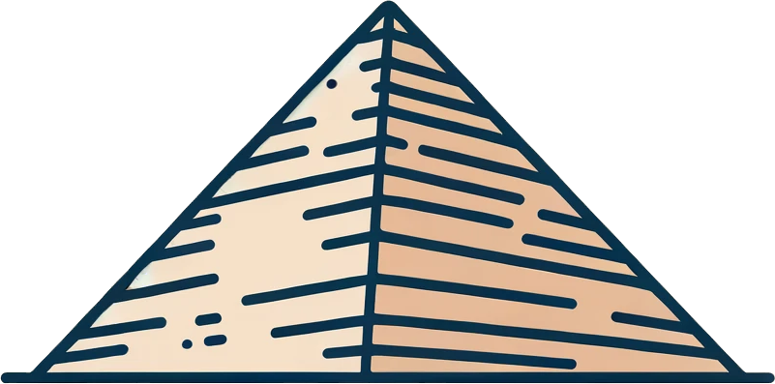
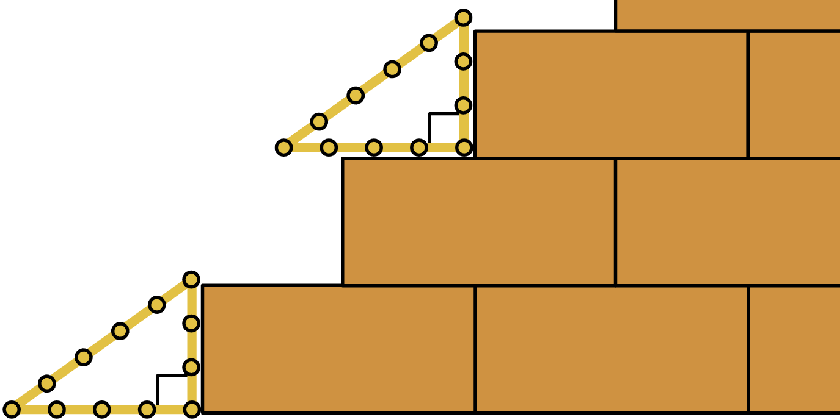
Codsiyada kale ee xisaabta
Injineerradii Masaarida ee qadiimiga ahaa waxay ahaayeen kuwa ugu horreeya ee dhisaayaasha waaweyn ee taariikhda aadanaha. Waxay isticmaaleen saddexagallo 3, 4, 5 si ay u hubiyaan in wax kasta ay 'qumman' yihiin markay dhisaan.
Waxaa xiiso leh inay tani sameeyeen laba kun sano ka hor dhalashadii Pythagoras!

Slide 43


Codsiyada kale ee xisaabta
Kee ka mid ah xadhigyadan ayay Masaaridu isticmaali karaan si ay u hubiyaan in wax 'qumman' yihiin?
6² + 8² = 10²
a
3² + 4² = 5²
4² + 5² ≠ 6²
Ma aha saddexagal 'qumman'.
c
b

Slide 44
Codsiyada kale ee xisaabta
Injineerradii Masaarida ee qadiimiga ahaa (iyo kuwa badan oo iyaga ka dambeeyay!) waxay isticmaaleen saddexagallo 3, 4, 5 sababtoo ah tani waa saddexda ugu yar, sidaas darteed waa kuwa ugu waxtarka badan in la sameeyo.
a
3² + 4² = 5²
Maxaadan u heli lahayd xadhig oo aad samaysan lahayd saddexagalkaaga 3, 4, 5 si aad u hubiso in wax 'qumman' yihiin fasalkaaga ama gurigaaga? Uma baahnid inaad isticmaasho cagaha, waxaad samayn kartaa saddexagal 3 inch, 4 inch, 5 inch. Haddii aad tani sameyso, waxaad u dhaqmi doontaa sida injineerradii ugu horreeyay ee taariikhda aadanaha!

Slide 45
Codsiyada kale ee xisaabta
1) Muuji in mid kasta oo ka mid ah darbiyadan uu taagan yahay si toos ah.
a)
b)
c)
50 cm
40 cm
13 yd
12 yd
5 ft
4 ft
30 cm
3 ft
5 yd

Slide 46
Codsiyada kale ee xisaabta
2) Sharax sida aan u ogaanay in geeskanu uusan ahayn 'mid toosan'.
5 ft
3 ft
4 ft

Slide 47
Codsiyada kale ee xisaabta
3) Injineerada maanta waxay isticmaalaan Pythagoras si ay u xisaabiyaan dhererka. Soo hel dhammaan dhererka maqan ee birta buundadan. Naqshaddu waa isku mid (symmetrical).
10 m
48 m
15 m
9 m

Slide 48
Codsiyada kale ee xisaabta
1) Muuji in mid kasta oo ka mid ah darbiyadan uu taagan yahay (upright).
a)
b)
c)
5² + 12² = 13²
3² + 4² = 5²
50 cm
40 cm
13 yd
12 yd
5 ft
4 ft
Midig
Midig
Midig
30 cm
3 ft
30² + 40² = 50²
5 yd

Slide 49
Codsiyada kale ee xisaabta
2) Sharax sida aan u ogaanay in geeskanu uusan ahayn 'midig'.
Waxaad laga yaabaa inaad tidhi, "Si loo ahaado 'midig' Xeerka Mason waa inuu 'ku habboonaado' dhibcaha lagu qiyaasay 3 ft iyo 4 ft si loo sameeyo saddexagal 'midig' 3, 4, 5".
✖
"Sababtoo ah xeerku halkan kuma 'habboona' waxaan ognahay in dhererka saddexaad uusan ahayn 5 ft sidaas darteed kani ma aha saddexagal xagal-midig; geesku ma aha xagal-midig."
5 ft
✖
3 ft
4 ft

Slide 50



Codsiyada kale ee xisaabta
3) Injineerrada maanta waxay isticmaalaan Pythagoras si ay u xisaabiyaan dhererka. Soo hel dhammaan dhererka maqan ee biraha buundadan. Naqshaddu waa siman (symmetrical).
24 m
10 m
26 m
26 m
48 m
15 m
32.3 m
15 m
12 m
12 m
12 m
12 m
32.3 m
9 m
30 m
9 m

Slide 51
Injineer
Waxaan aragnay qaar ka mid ah siyaabaha xisaabta ay u isticmaalaan injineerrada.
Waxaan fahamnay baahida loo qabo saxnaanta iyo in injineerrada ay isticmaalaan qaabka caadiga ah (standard form) si ay u gudbiyaan tirooyin aad u sax ah.
Waxaan ognahay in kumanaan sano injineerrada ay isticmaaleen aragtida Pythagoras (Pythagoras' theorem) si ay u hubiyaan xagasha midig iyo kuwa aan midig ahayn shaqadooda.

