Slide 1
Qiyaasidda mugga sambabada (Estimating lung volume)
Neefsashada iyo neefsiga (Breathing and respiration)

Slide 2
sida loo isticmaalo darasyada Oak

Slide 3
Waxaan qiyaasi karaa sida loo isticmaalo qalab fudud si loo qiyaaso mugga sambabada (lung volume).

Slide 4
mug (volume)
Qadarka booska saddex-geesoodka ah ee uu qaato walax; badanaa waxaa lagu cabbiraa cm3.
awoodda neefsashada (vital capacity)
Mugga ugu badan ee hawada laga neefsan karo ka dib neefsashada buuxda.
sax ah (accurate)
Marka cabbirku uu u dhawaado qiimaha (value) runta ah, waxaa la yiraahdaa waa sax (accurate).
meniscus
Dusha dareeraha, kaas oo u muuqan kara qalloocan.
qiyaas (estimate)
Qiime (value) qiyaas ah (ku dhawaad) oo tiro ah (oo la helay iyada oo aan la qaadin cabbirro sax ah).

Slide 5

Qiyaasidda mugga sambabada (Estimating lung volume)
Qalabka lagu cabbiro awoodda neefsashada (vital capacity)
Cabbirka fudud ee awoodda neefsashada (vital capacity)
Qiyaasidda mugga sambabada (Estimating lung volume)

Slide 6
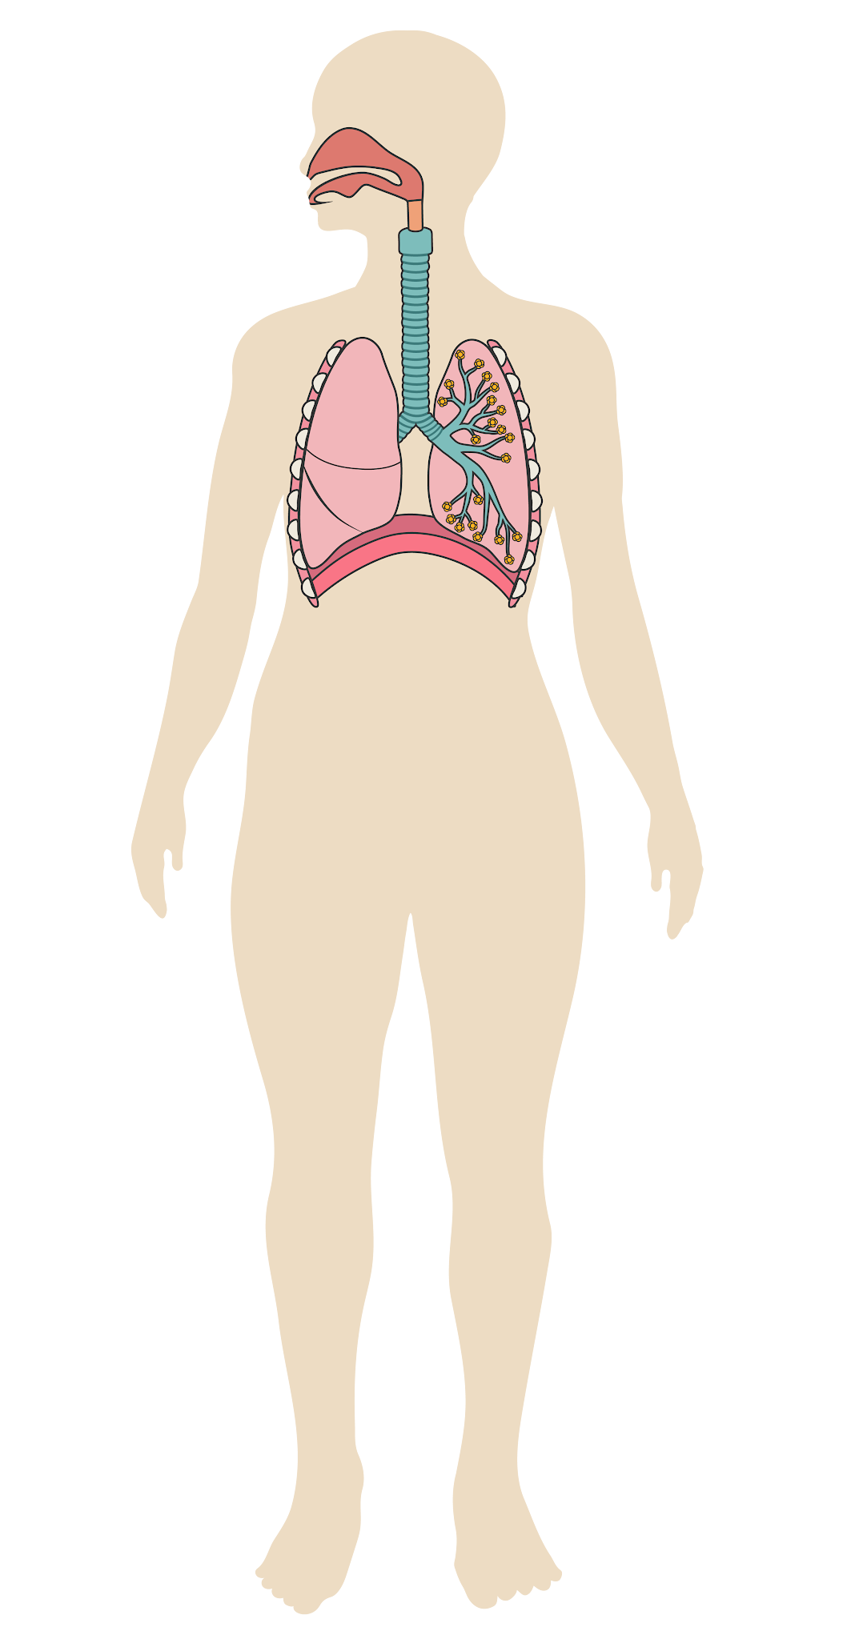
Qalabka lagu cabbiro awoodda neefsashada (vital capacity)
haw (air)
haw (air)
sambabada (lungs)
Marka aan neefsano (breathe in), hawadu waxay ku dhaqaaqdaa sambabada.
Marka aan neefsano (breathe out), hawadu waxay ka baxdaa sambabada.

Slide 7
Qalabka lagu cabbiro awoodda nolosha (vital capacity)
Markaan neefsanno (exhale), inta badan haw (air) waxaa laga saaraa sambabada (lungs), laakiin qaar baa halkaas ku hadha.
Mugga ugu weyn ee haw (air) aad neefsato ka dib markaad si buuxda u neefsato waxaa loo yaqaan awoodda nolosha (vital capacity).
Awoodda nolosha (vital capacity) waxaa saameeya arrimo ay ka mid yihiin da'da qofka, heerka dhaqdhaqaaqiisa, iyo haddii uu sigaar cabbo ama uu qabo neef-wareer (asthma).
haw (air)
sambabada (lungs)

Slide 8

Qalabka lagu cabbiro awoodda nolosha (vital capacity)
Awoodda nolosha (vital capacity) waa mugga ugu weyn ee haw (air) ee…
…sambabada (lungs) qaadi karaan.
…la neefsan karo (exhaled) ka dib marka si buuxda loo neefsado (inhaling).
…sambabada (lungs) soo jiidi karaan (inhaled).

Slide 9
Qalabka lagu cabbiro awoodda nolosha (vital capacity)
Waxaad cabbiri kartaa awoodda nolosha (vital capacity) adoo isticmaalaya qalab fudud:
dhalo weyn oo ay ku jiraan biyo (water), oo ay ku qoran yihiin xariiqyo
tuubo caag ah (plastic tube)
haan biyo (water) ah

Slide 10
Qalabka lagu cabbiro awoodda nolosha (vital capacity)
Neefsashada (exhaling) tuubada waxay haw (air) ka soo rartaa sambabada (lungs) gudaha dhalada.
Tani waxay qaar ka mid ah biyaha (water) dhalada ku jira u rartaa haanta.
Haw (air) markii hore dhalada ku jirtay
Hawada neefsashada lagu soo celiyay dhalada (Air exhaled into bottle)
neefsasho (exhale)

Slide 11

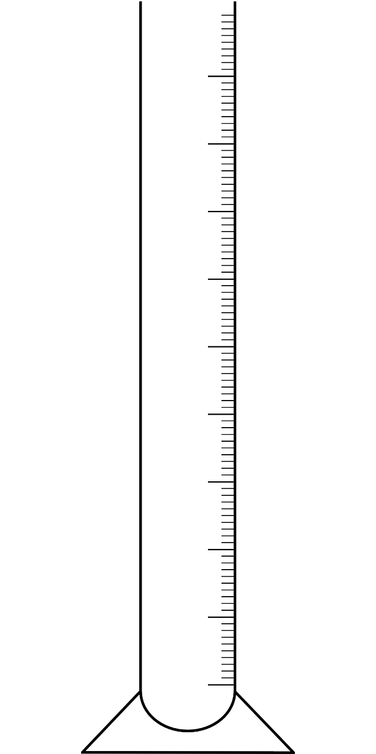
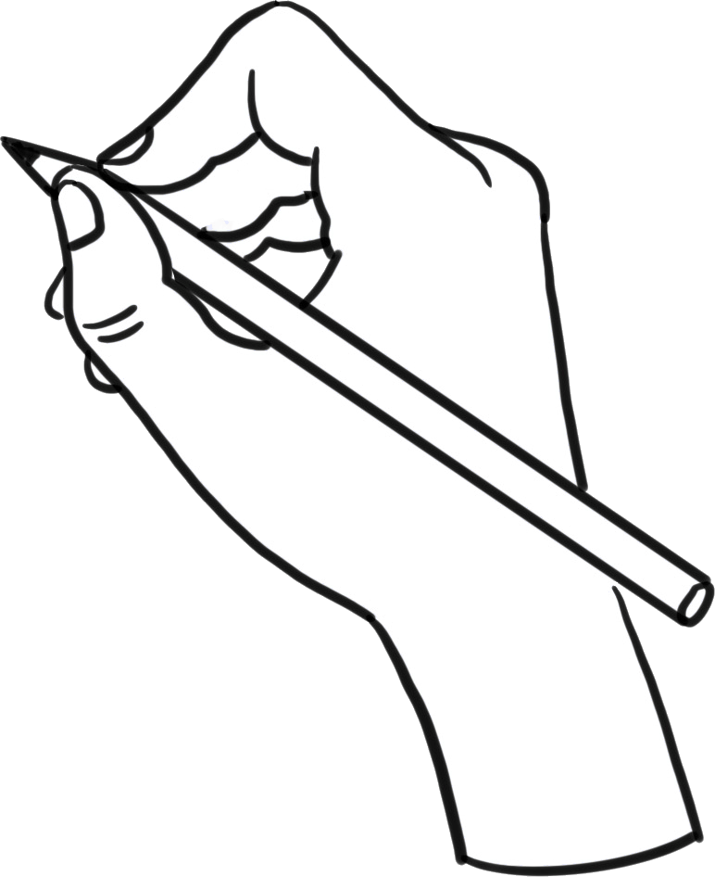
Qalabka lagu cabbiro awoodda muhiimka ah (Apparatus for measuring vital capacity)
Tilmaamaha habaynta qalabka (Instructions for setting up the apparatus):
Cabbir 200 cm3 oo biyo (water) ah galaas cabbir (measuring cylinder).
Ku shub 200 cm3 oo biyo (water) ah dhalo 5 litir (5 l) ah.
Ku calaamadee heerka biyaha (water) dusha dhalada qalinka joogtada ah (permanent marker).
Ku celi tillaabooyinka 1, 2 iyo 3 ilaa dhaladu ay ka buuxsanto biyo (water).

Slide 12
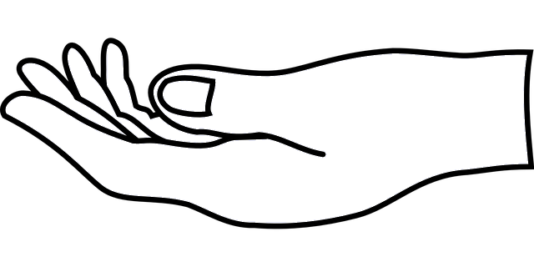
Qalabka lagu cabbiro awoodda muhiimka ah (Apparatus for measuring vital capacity)
Dabool dhammaadka furan ee dhalada, ka dibna u rog dhalada hoos u jeed.
Iska jir inaad daadiso biyaha (water)!
Dhig dhalada haan biyo (water) ah, iyadoo dhammaadka furan ee dhalada uu biyaha (water) hoostooda yahay.
Geli dhammaadka tuubada caagga ah (plastic tube) dhalada. Ka tag dhammaadka kale biyaha (water) ka baxsan.

Slide 13

Qalabka lagu cabbiro awoodda muhiimka ah (Apparatus for measuring vital capacity)
Dhig tillaabooyinka sida saxda ah si loo habeeyo qalabka.
a
4
Dhig dhalada hoos u jeed haan biyo (water) ah.
Ku shub 200 cm3 oo biyo (water) ah dhalo weyn.
b
2
c
Cabbir 200 cm3 oo biyo (water) ah galaas cabbir (measuring cylinder).
1
Ku celi oo calaamadee heerka 200 cm3 kasta oo biyo (water) ah dusha weelka.
d
3
e
5
Geli dhammaadka tuubada caagga ah (plastic tube) dhalada.

Slide 14
Qalabka lagu cabbiro awoodda muhiimka ah (Apparatus for measuring vital capacity)
Tani waxay noqon doontaa oo keliya haddii mugga biyaha (water) si sax ah loo qiyaasay iyadoo la isticmaalayo weelka qiyaasta (measuring cylinder).
Waa inay jiraan 200 cm3 oo biyo (water) ah oo u dhexeeya sadar kasta.
Marka uu muggu u dhow yahay qiimaha (value) saxda ah (200 cm3), cabbirku wuu ka saxan yahay.

Slide 15
Qalabka lagu qiyaaso awoodda neefsiga (vital capacity)
Maxay 'sax' (accurate) ka dhigan tahay?
Qiyaastu waxay u dhowdahay qiimaha (value) runta ah.
Pipette ayaa loo isticmaalay in lagu daro qaybta ugu dambeysa ee biyaha (water) si taxadar leh.
Qiyaasta waa la soo celiyey (repeated).

Slide 16
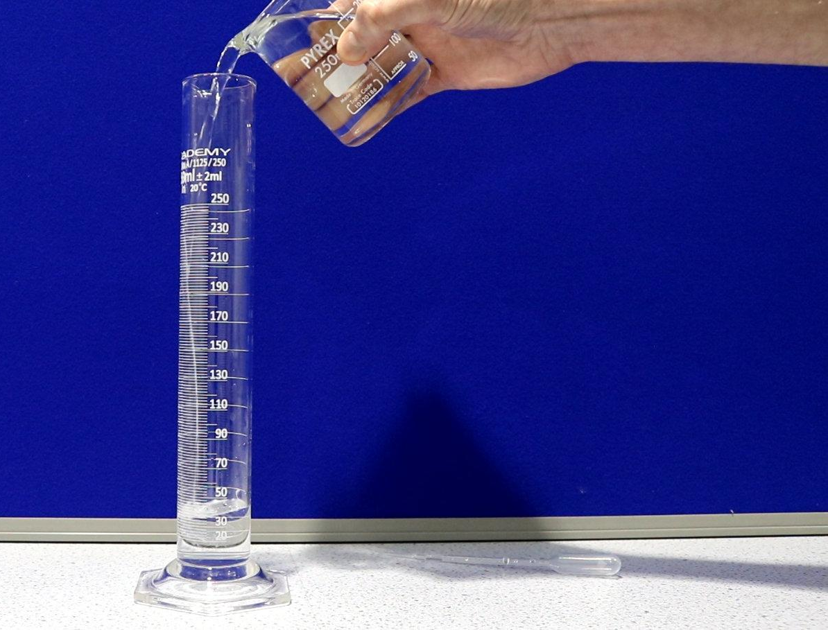

Qalabka lagu qiyaaso awoodda neefsiga (vital capacity)
Si loo qiyaaso mugga 200 cm3 oo dareere (liquid) ah sida ugu saxan ee suurtogalka ah iyadoo la isticmaalayo weelka qiyaasta (measuring cylinder):
Ka fiirso weelka qiyaasta (measuring cylinder) dhinaca. Dhig ishaada si ay u siman tahay calaamadda 200 cm3.
Isticmaal weel (beaker) si aad ugu shubto biyo (water) weelka qiyaasta (measuring cylinder) ilaa ay ku dhawaadaan calaamadda 200 cm3.
Isticmaal pipette si aad biyo (water) ugu soo dajiso gidaarka gudaha ee weelka qiyaasta (measuring cylinder) ilaa ay gaadho calaamadda 200 cm3.

Slide 17
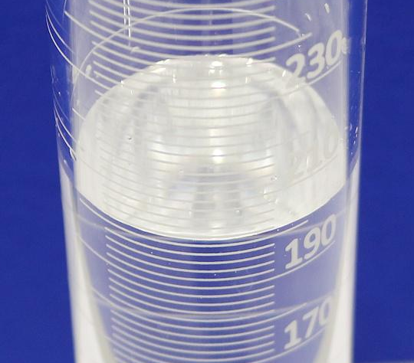
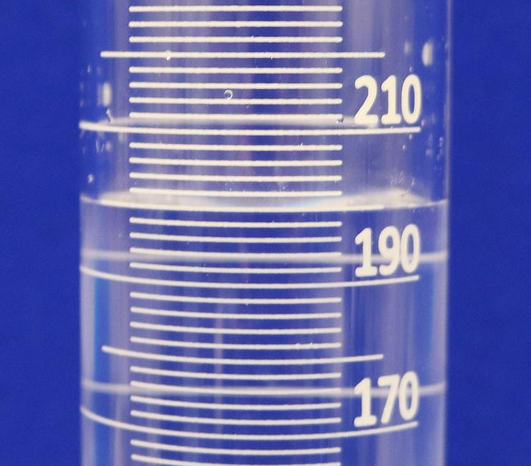

Qalabka lagu qiyaaso awoodda neefsiga (vital capacity)
Waa muhiim inaad ka fiirsato weelka qiyaasta (measuring cylinder) dhinaca oo aad ishaada u dhigto si ay u siman tahay calaamadda aad rabto inaad ku buuxiso.
Marka laga eego kor, mugga dareeraha (liquid) wuxuu u muuqdaa mid wax yar ka badan 200 cm3.
Laakiin marka laga eego dhinaca, waxaan arkaynaa inuu si sax ah ugu yaal calaamadda 200 cm3.

Slide 18
Qalabka lagu qiyaaso awoodda neefsiga (vital capacity)
Waxaa laga yaabaa inaad ogaato in dusha biyaha (water) ee weelka qiyaasta (measuring cylinder) uu qaloocan yahay.
Tan waxaa loo yaqaan meniscus.
Waxaan akhrinaynaa mugga biyaha (water) saldhigga hoose ee meniscus.

Slide 19
Qalabka lagu qiyaaso awoodda neefsiga (vital capacity)
Weele qiyaas (measuring cylinder) kee ayaa ku jira 200 cm3 oo biyo (water) ah?
200
200
200

Slide 20
Apparatus for measuring vital capacity
Raac habka ku qoran warqadda shaqada si aad u dejiso qalabka.
Sharax sababta ay muhiim u tahay inaad ka eegto dhanka dhinaca ee qiyaasaha (measuring cylinder) markaad qiyaasayso 200 cm3 oo biyo ah.

Slide 21
Apparatus for measuring vital capacity
Sharax sababta ay muhiim u tahay inaad ka eegto dhanka dhinaca ee qiyaasaha markaad qiyaasayso 200 cm3 oo biyo ah.
Ka eegista dhinaca waxay kuu ogolaaneysaa inaad isha ku hagaajiso heerka 200 cm3.
Tani waxay kuu ogolaaneysaa inaad aragto marka heerka biyuhu si sax ah ugu yaallo calaamadda 200 cm3.
Tani waxay ka dhigaysaa qiyaasta mid sax ah (ku dhow qiimaha dhabta ah ee 200 cm3).

Slide 22
Estimating lung volume
Apparatus for measuring vital capacity
Simple measurement of vital capacity
Estimating vital capacity

Slide 23
Simple measurement of vital capacity
Si aad u isticmaasho qalabka si aad u qiyaasto awoodda neefsashada (vital capacity), bilow adigoo ogaaday khadka ay biyuhu ka bilaabaan.
Kadib neefso (exhale) tuubada.
Air originally in bottle
Tiri inta khad ee heerka biyuhu hoos uga dhacay.
exhale
Farqiga kasta ee u dhexeeya khadadka wuxuu u taagan yahay 200 cm3.

Slide 24
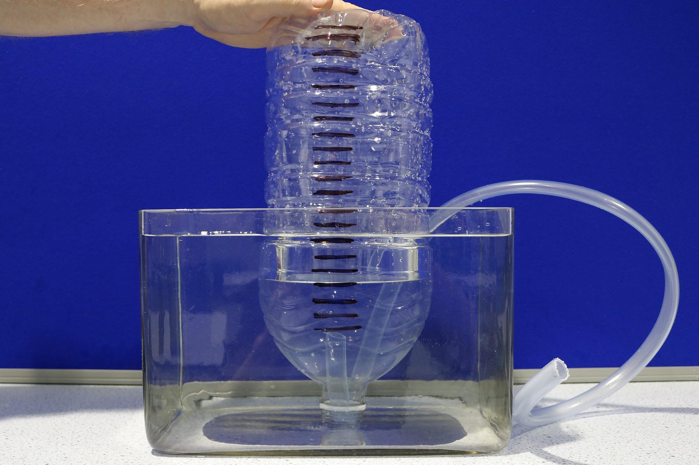
Cabbir fudud oo awoodda nolosha (vital capacity) ah
Isticmaalka qalabka lagu cabbiro awoodda nolosha (vital capacity):
Note which line the water level is at in the bottle.
Breathe in (inhale) as fully as you can.
Neefso (exhale) tuubada si buuxda oo aad awooddo.
Tiri inta xariiq oo heerka biyo (water) ee dhalada hoos uga dhacay.
Ku dhufo tirada xariiqda 200 cm3 si aad u qiyaasto awoodda noloshaada (vital capacity).

Slide 25
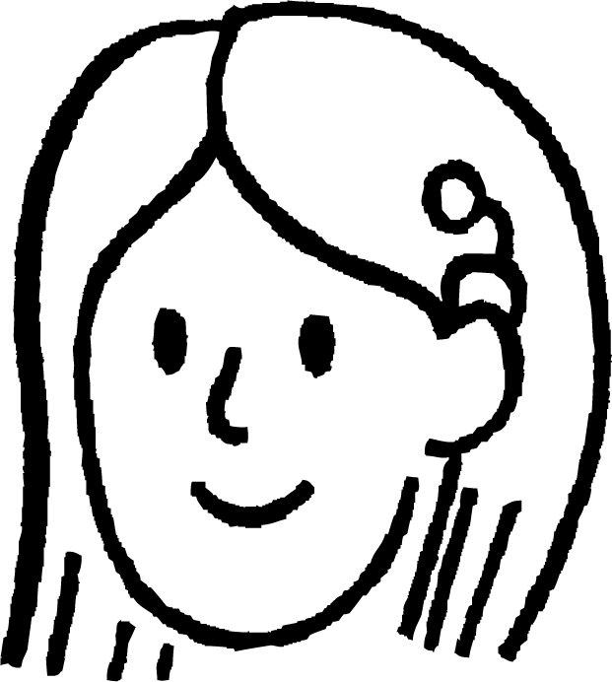

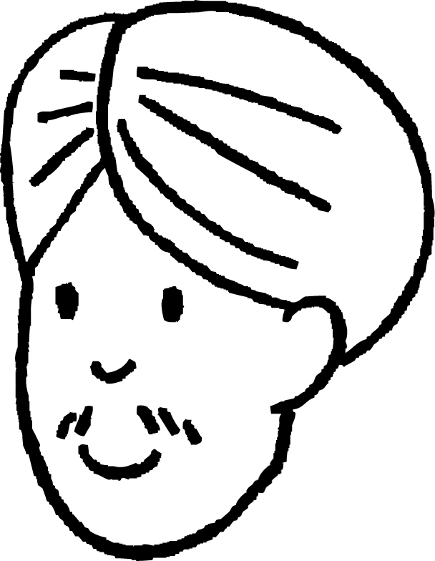
Cabbir fudud oo awoodda nolosha (vital capacity) ah
Ka dib markii Suad neefsashada ku sii daysay tuubada, heerka biyo (water) ee dhalada wuxuu hoos uga dhacay 14 xariiq.
Waa maxay awoodda nolosha (vital capacity) ee Suad?
Ka dib markii Cali neefsashada ku sii daysay tuubada, heerka biyo (water) ee dhalada wuxuu hoos uga dhacay 15.5 xariiq.
Waa maxay awoodda nolosha (vital capacity) ee Cali?
Farqiga u dhexeeya xariiq kasta wuxuu ka kooban yahay 200 cm3
200 × 14 = 2800 cm3
Farqiga u dhexeeya xariiq kasta wuxuu ka kooban yahay 200 cm3
200 × 15.5 = 3100 cm3

Slide 26
Cabbir fudud oo awoodda nolosha (vital capacity) ah
Raac habka ku qoran warqadda shaqada si aad u isticmaasho qalabka lagu cabbiro awoodda nolosha (vital capacity).
Kadib buuxi shaxda natiijadaada.
magac | tirada xariiqda | awoodda nolosha (vital capacity) (cm³)
Suad (Sofia) | 14 | 2800
Cali (Andeep) | 15.5 | 3100

Slide 27

Cabbir fudud oo awoodda nolosha (vital capacity) ah
Suad iyo Cali waxay ku bartaan dugsiga in sigaarka uu yareyn karo awoodda muhiimka ah (vital capacity).
 | awoodda muhiimka ah (vital capacity) (cm³)
Qofka A | 4100
Qofka B | 3500
Jadwalku wuxuu muujinayaa laba qof oo leh awoodo muhiim ah oo kala duwan.
Suad waxay tidhi:
Qofka B waa inuu yahay sigaar cabbe sababtoo ah awooddiisa muhiimka ah (vital capacity) waa ka hooseysaa.
Ma Suad ayaa sax ah?
Sharax sababta ama sababta aan ahayn.

Slide 28
Qiyaas fudud oo awoodda muhiimka ah (vital capacity)
Ma Suad ayaa sax ah?
Sharax sababta ama sababta aan ahayn.
Suad waxay sax tahay in sigaarku hoos u dhigo awoodda muhiimka ah (vital capacity).
Waxay khalad tahay inay tidhaahdo Qofka B waa inuu yahay sigaar cabbe.
Waxaa jiri kara sababo badan oo Qofka B uu u leeyahay awood muhiim ah oo hoose. Tusaale ahaan, waxay noqon karaan kuwa aad u yar, aad u weyn, ama kuwa aan jir ahaan u fiicnayn, ama waxay qabi karaan asthma.

Slide 29
Qiyaasidda mugga sambabada (lung volume)
Qalabka lagu qiyaaso awoodda muhiimka ah (vital capacity)
Qiyaas fudud oo awoodda muhiimka ah (vital capacity)
Qiyaasidda mugga sambabada (lung volume)

Slide 30
Qiyaasidda mugga sambabada (lung volume)
Xataa haddii 200 cm³ oo biyo (water) ah si sax ah loo qiyaaso mar kasta oo lagu daro dhalada, qiyaasta awoodda muhiimka ah (vital capacity) waxaa laga yaabaa inaysan ahayn mid sax ah (ku dhawaad qiimaha (value) dhabta ah).
Sababaha tan waxaa ka mid ah:
Qofka laga yaabaa inuusan si buuxda u neefsan (inhale) ka hor inta uusan ku neefsan (exhale) tuubada.
Qofka laga yaabaa inuusan si buuxda ugu neefsan (exhale) tuubada.
Khadadka muujinaya 200 cm3 kasta laga yaabaa inaan si sax ah loogu calaamadin dhalada.
Ka dib neefsashada (exhaling), heerka biyaha (water) wuxuu ku dhaman karaa inta u dhaxaysa laba khad.

Slide 31
Qiyaasidda mugga sambabada (Estimating lung volume)
Marka heerka biyaha (water) uu ku dhamo inta u dhaxaysa laba khad ka dib neefsashada (exhaling), waa inaan ama:
go'aansanno khadka ugu dhow oo xisaabino mugga (volume) ilaa 200 cm3 u dhow (tusaale: 6 khad x 200 cm3)
ama
isticmaalno garashadayada si aan u go'aansanno inta u dhaxaysa khadadka oo aan u isticmaalno jajab tobanle (decimal) si aan u xisaabino mugga (volume) (tusaale: 5.5 khad x 200 cm3)

Slide 32
Qiyaasidda mugga sambabada (Estimating lung volume)
Dhammaan arrimahan waxay ka dhigan yihiin in cabbirka awoodda nolosha (vital capacity) iyadoo la isticmaalayo qalabkan uu noqon karo mid aan sax ahayn, waa qiyaas (estimate).
Qiyaas (estimate) waa qiime (value) qiyaas ah (ku dhawaad) oo tiro (quantity) ah (oo la helay iyada oo aan la qaadin cabbiro sax ah).
Waxaan heli karnaa qiyaas (estimate) ka fiican adoo:
ku cabbiraya biyaha (water) dhalada qaybo ka yar 200 cm3 oo khadadka isu soo dhaweynaya
ku celcelinaya habka (procedure) dhowr jeer oo xisaabinaya celceliska (mean/average) cabbirada. Tani waxay yaraynaysaa saamaynta dadka aan si buuxda u neefsan (inhale) ama u neefsan (exhale) inta lagu jiro isku dayga.

Slide 33
Qiyaasidda mugga sambabada (Estimating lung volume)
Waa maxay qiyaas (estimate)?
cabbir sax ah (accurate measurement)
cabbir qiyaas ah (approximate measurement)
qiyaas (guess)

Slide 34
Qiyaasidda mugga sambabada (Estimating lung volume)
Dhammaan hawadu kama baxdo sambabadeena marka aan neefsano (exhale). Qaar baa hadha si ay u joojiyaan sambabada inay burburaan.
Awooddeena muhiimka ah (vital capacity) waxay caadi ahaan ku dhowdahay 80% ee mugga sambabada (lung volume).
hawada (air)
Sidaa darteed, waxaan u isticmaali karnaa cabbirka awoodda muhiimka ah (vital capacity) si aan u soo saarno qiyaasta mugga sambabada (lung volume).
Waxay noqon doontaa oo kaliya qiyaas (estimate) mugga sambabada (lung volume) sababtoo ah:
cabbirka awoodda muhiimka ah (vital capacity) wuxuu ahaa qiyaas (estimate)
awoodda muhiimka ah (vital capacity) laga yaabaa inaysan si sax ah u ahayn 80% ee mugga sambabada (lung volume).

Slide 35
Qiyaasidda mugga sambabada (Estimating lung volume)
Suad waxay cabirtay awooddeeda muhiimka ah (vital capacity) inay tahay 2800 cm3.
Qiyaas mugga sambabada (lung volume) ee Suad.
Cali wuxuu cabiray awooddiisa muhiimka ah (vital capacity) inay tahay 3100 cm3.
Qiyaas mugga sambabada (lung volume) ee Cali.
Awoodda muhiimka ah (vital capacity) waxay ku dhowdahay 80% ee mugga sambabada (lung volume).
Sidaa darteed, haddii 2800 cm3 uu yahay 80%
1% = 2800 ÷ 80 = 35 cm3
100% = 35 x 100 = 3500 cm3
Awoodda muhiimka ah (vital capacity) waxay ku dhowdahay 80% ee mugga sambabada (lung volume).
Sidaa darteed, haddii 3100 cm3 uu yahay 80%
1% = 3100 ÷ 80 = 38.75 cm3
100% = 38.75 x 100 = 3875 cm3

Slide 36
Qiyaasidda mugga sambabada (Estimating lung volume)
Neefsashada (Exhaling) qalabkan waxay bixisaa qiyaas (estimate) awoodda muhiimka ah (vital capacity) ee sambabada.
Alex wuxuu neefsadaa qalabka wuxuuna qiyaasaa awoodda neefsashadiisa inay tahay 3000 cm³.
Sharax sababta qiyaastiisu (estimate) u noqon karto cabbir aan sax ahayn ee awooddiisa muhiimka ah (vital capacity).
Sharax sida Alex u isticmaali karo qalabkan si uu u helo qiyaas ka fiican oo awoodda neefsashadiisa ah.
exhale

Slide 37
Estimating lung volume
Alex estimated his vital capacity as 3000 cm³. Estimate his lung volume.
Sharax sababta qiyaastan ee mugga sambabkiisa u noqon karto mid aan sax ahayn.
exhale

Slide 38
Estimating lung volume
Alex wuxuu neefsiiyaa qalabka oo wuxuu qiyaasaa awooddiisa neefsashada (vital capacity) inay tahay 3000 cm³.
1. Sharax sababta qiyaastiisu u noqon karto mid aan ahayn cabbir sax ah oo awoodda neefsashada (vital capacity).
Alex laga yaabaa inuusan si buuxda u neefsan ama u neefsan.
Khadadka laga yaabaa inaan si sax ah loogu calaamadin dhalada.
The water level may end up between two lines.
Mugga laga yaabaa in loo xisaabiyay khadka ugu dhow (ugu dhow 200 cm3).
Laga yaabaa in la adeegsaday go'aan qiyaas ah si loo go'aamiyo inta u dhaxaysa labada khad ee heerka biyuhu yahay.

Slide 39
Estimating lung volume
2. Sharax sida uu ugu isticmaali karo qalabkan si uu u helo qiyaas ka fiican oo awooddiisa neefsashada (vital capacity).
Khadadka isku soo dhoweey si ay u cabbiraan mugyo ka yar 200 cm3.
Ku celi habka dhowr jeer oo xisaabi celceliska (average) mugga.
3. Alex estimated his vital capacity as 3000 cm³. Estimate his lung volume.
Awoodda neefsashada (vital capacity) waxay ku dhowdahay 80% mugga sambabka.
So, if 3000 cm³ is 80%
1% = 3000 ÷ 80 = 37.5 cm3
100% = 37.5 x 100 = 3750 cm3

Slide 40
Qiyaasidda mugga sambabada (Estimating lung volume)
4. Sharax sababta qiyaastan ee mugga sambabadiisa aanu u noqon karin mid sax ah.
Waxaad u isticmaashaa awoodda muhiimka ah (vital capacity) si aad u xisaabiso mugga sambabada. Qiimihii asalka ahaa ee awooddiisa muhiimka ahaa wuxuu ahaa qiyaas, waxaan kaliya qiyaasi karnaa mugga sambabada qiimahan.
Awoodda muhiimka ah (vital capacity) daruuri ma aha inay tahay 80% mugga sambabada, maxaa yeelay tani way ku kala duwan tahay qof ilaa qof.

Slide 41
Qiyaasidda mugga sambabada (Estimating lung volume)
Awoodda muhiimka ah (vital capacity) ee sambabada waa mugga ugu weyn ee hawada (air) la neefsan karo ka dib marka si buuxda loo neefsado.
Qalab fudud ayaa loo isticmaali karaa in lagu qiyaaso awoodda muhiimka ah (vital capacity).
Marka uu qiyaas uu ku dhow yahay qiimaha saxda ah (true value), waxaa la yiraahdaa waa ka sax badan yahay.
Qalabku wuxuu bixiyaa qiyaas awoodda muhiimka ah (vital capacity).
Qiyaastu waa qiime qumman (approximate) oo ah qiime tiro (quantity) (oo la helay iyada oo aan la qaadin cabbirro sax ah).

