Slide 1
Maaraynta dhacdooyinka (Event management)
Xisaabta goobta shaqada (Xisaab in the workplace)

Slide 2
Sida agabkeena waxbarista loogu talagalay fasalka

Slide 3
Waxaan fahmi karaa sida xisaabta loogu isticmaalo maaraynta dhacdooyinka (event management).

Slide 4
Boqolkiiba (percentage) waa qayb ka mid ah guud.

Slide 5

Maaraynta dhacdooyinka (Event management)
Xirfadaha xisaabta ee qorsheynta dhacdooyinka (event planning)
Qorsheynta dhacdadaada

Slide 6
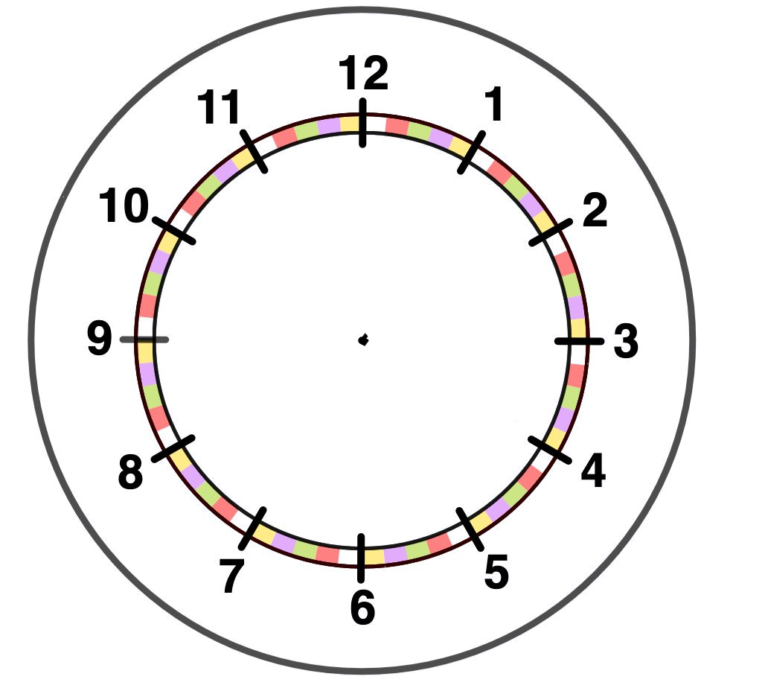


Xirfadaha xisaabta ee qorsheynta dhacdooyinka (event planning)
Waa maxay qaybaha xisaabta ee aad u malaynayso in shirkadda maaraynta dhacdooyinka (event management) ay isticmaali karto?
Bed (Area)
Isku dhufasho (Multiplication)
Qaybin (Division)
Boqolleyda (Percentages)
Lacag (Money)
Waqti (Time)
Faa'iido iyo khasaare (Profit & loss)
Saami (Ratio)
Inta lagu guda jiro darsigan waxaan eegi doonnaa qaar ka mid ah kuwan.

Slide 7
Xirfadaha xisaabta ee qorsheynta dhacdooyinka (event planning)
Mid ka mid ah xirfadaha ugu muhiimsan ee qorsheeyaha dhacdooyinka (event planner) waa inuu ku shaqeeyo miisaaniyad (budget).
Maxaad u malaynaysaa inay tahay mid ka mid ah xirfadaha ugu muhiimsan?
Dhacdooyinka waa in loo habeeyaa si ay u 'xakameeyaan (break even)' ama u sameeyaan faa'iido (profit), ma aha khasaare (loss).
Waxay ku xiran tahay nooca dhacdada inay tahay dhacdo faa'iido (profit) leh, ama dhacdo 'xakameyn (break even)' ah.
Waa maxay macnaha 'xakameyn (break even)'?
Halkaas oo aynu jirin faa'iido (profit) iyo khasaare (loss) midna.

Slide 8
Xirfadaha xisaabta (Xisaab skills) ee qorshaynta dhacdada
Ma ka fikiri kartaa tusaalooyin dhacdooyin ah?
Qorshaynta riwaayad (concert)
Qorshaynta xaflad muusik (music festival)
Qorshaynta dhacdo isboorti (sports event)
Qorshaynta dhacdo samafal (charity event)
Maxaa sababi kara in dhacdooyinkani 'xakameeyaan (break even)' halkii ay faa'iido (profit) ka samayn lahaayeen?
Iibka tigidhada ugu yar (Minimum tickets sales)
Qodob dibadeed (External factor) oo saameeya ka qaybgalka

Slide 9
Xirfadaha xisaabta (Xisaab skills) ee qorshaynta dhacdada
Qiyaas inaad qorshaynayso tartan kubadda cagta 5-a-side oo samafal (charity) ah oo loogu talagalay 10 kooxood.
Waa maxay kharashyada (costs) la xiriira abaabulka dhacdadan?
E.g.
Kiraysiga goobta (Hiring the venue)
Kiraysiga shaqaalaha (Hiring staff)
Kiraysiga musqulaha (Hiring toilets)
Iibsiga koobabka & billadaha (Buying trophies & medals)
Bixinta cuntada fudud & cabitaanka (Supplying refreshments)

Slide 10
Xirfadaha Xisaabta (Xisaab skills) ee qorsheynta dhacdada
Waxaad ku guulaysataa inaad soo hesho mutadawiciin (volunteers) si ay u shaqeeyaan dhacdada, laakiin waxyaabaha kale oo dhan waa in la qiimeeyaa (costed).
Goobta waxaa loo kiraystaa saacad kasta. Waxaad doonaysaa inaad u kiraysato waqti sax ah.
Dhacdadu waxay bilaabanaysaa 8:30 subaxnimo waxayna dhammaanaysaa 3 galabnimo.
Intee in le'eg ayay u baahan tahay inaad goobta u kiraysato?
6.5 saacadood
Qiimaha (cost) kiraysta goobta waa £250 saacad kasta, laakiin goobtu waxay bixisaa 10% dhimis (discount) maadaama ay tahay dhacdo samafal.
Immisa ayay noqon doontaa qiimaha (cost) kiraysta goobta?
7 × 250 × 0.9 = £1575

Slide 11

Xirfadaha Xisaabta (Xisaab skills) ee qorsheynta dhacdada
Qiimaha (cost) kiraysta garoonka 5-a-side waa £40 saacad kasta. (Goobtu waxay ku siisaa 10% dhimis (discount).) Qiimaha (cost) kiraysta inta u dhaxaysa 9 subaxnimo iyo 4:30 galabnimo waa £270.
Tirada saacadaha = 7.5 taas oo macneheedu yahay waxaa nalagu dallaca 8
Qiimaha (cost) = 8 × 40 × 0.9
Qiimaha (cost) = £288

Slide 12
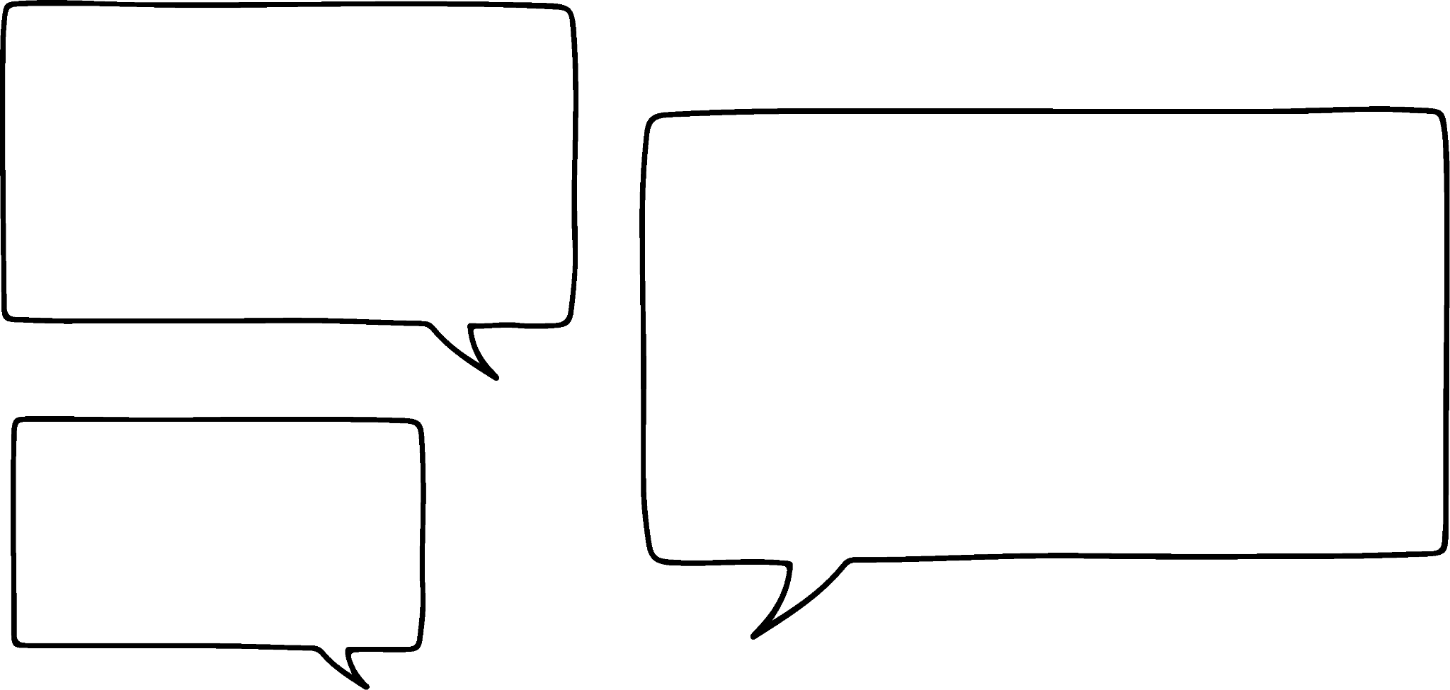


Xirfadaha Xisaabta (Xisaab skills) ee qorsheynta dhacdada
Hadda aan kirayno suuliyo (toilets) qaar.
Qiimaha (cost) kiraysta suuli guurguura (portable toilet) waa £60 nus maalin (4 saacadood) ama £100 maalin.
Dhacdadani ma u kiraysan kartaa suuliyada (toilets) nus maalin?
Maya, dhacdadu waxay socotaa 6.5 saacadood.
Sidaa darteed, waxay u baahan yihiin inay bixiyaan qiimaha (rate) maalinlaha ah.
Ma u malaynaysaa in 1 suuli (toilet) ku filan yahay dhacdadan?
Malaha ma aha.
Aan eegno qiyaas (estimate) tirada dadka imanaya.
Taasi saameyn weyn kuma yeelanayso wadarta qiimaha (total cost) dhacdada. Waa uun £100.

Slide 13
Xirfadaha xisaabta ee qorsheynta dhacdada
Dhacdadu waa tartan kubadda cagta 5-a-side ee dhalinyarada samafalka ah oo loogu talagalay 10 kooxood.
Waa maxay qiyaas macquul ah ee tirada dadka ka soo qaybgalaya tartanka?
Waxay ka koobnaan doontaa xubnaha kooxda, taageerayaashooda iyo shaqaalaha.
Immisa ciyaartoy ayaa jiri doona?
10 kooxood oo 5 ciyaartoy ah. Laakiin, koox kasta waxay u badan tahay inay keenaan ciyaartoy kayd ah.
Haddii aan u qaadanno in koox kastaa ka kooban tahay 10 ciyaartoy oo ciyaartoy kastaa uu leeyahay 1 taageere.
Immisa qof ayaa kani yahay?
10 × 10 × 2 = 200
U qaad inay jiraan 50 mutadawiciin ah.
Qiyaasta guud ee tirada dadka ka soo qaybgalaya tartanku waa 250 qof.

Slide 14
Xirfadaha xisaabta ee qorsheynta dhacdada
Ma u malaynaysaa in 1 musqul (toilet) oo loogu talagalay 250 qof ay tahay mid macquul ah?
Maya, inkasta oo tani ay u keeni doonto lacag dheeri ah samafalka, waa in la tixgeliyo badbaadada iyo raaxada.
Ka dib baaritaan internet ah waxaan ogaaday in saamiga (ratio) lagu taliyay ee musqulaha (toilets) iyo dadka ee dhacdadu yahay 1 : 100
Immisa musqulood (toilets) ayaa loo kiraysan karaa dhacdadan?
250 ÷ 100 = 2.5
3 musqulood (toilets) ayaa loo baahan yahay in loo kiraysto dhacdada.
Kharashka kiraysta musqulaha (toilets) = 3 × £100 = £300

Slide 15
Xirfadaha xisaabta ee qorsheynta dhacdada
Tirada musqulaha (toilets) loo baahan yahay dhacdada ay ka soo qaybgalaan 820 qof waa 8 iyadoo loo malaynayo in saamiga (ratio) lagu taliyay ee musqulaha (toilets) iyo dadku yahay 1 : 100.
820 ÷ 100 = 8.2
Xaaladdan waxaad u baahan tahay inaad ku soo wareejiso (round up) 9 musqulood (toilets).

Slide 16
Xirfadaha Xisaabta (Xisaab) ee qorsheynta dhacdada
Maadaama kani yahay dhacdo samafal, shirkadda bixisa cuntada iyo cabitaanka ayaa ogolaatay inay taa sameyso bilaash.
Hadda waxaan u baahanahay inaan helno kharashka koobabka (trophies) iyo billadaha (medals).
Koox kastaa waxay leedahay 10 ciyaartoy.
Kuwa guuleysta iyo kuwa kaalinta labaad hela waxay helaan koob kooxeed iyo koob ciyaartoy kasta. Dhammaan ciyaartoyda kale waxay helaan bilad ka qaybgalka.
Xisaabi wadarta qiimaha (value) iibsashada koobabka iyo biladaha.
Abaalmarinta | Qiimaha (value) shay kasta
Koobka kooxda ee labada koox ee koowaad | £12.50
Koobka kuwa guuleysta iyo kuwa kaalinta labaad | £5.50
Biladda ka qaybgalka | £1

Slide 17
Xirfadaha Xisaabta (Xisaab) ee qorsheynta dhacdada
Waxaa jira 10 kooxood, koox kastana waxay leedahay 10 ciyaartoy.
Kuwa guuleysta iyo kuwa kaalinta labaad hela waxay helaan koob kooxeed iyo koob ciyaartoy kasta. Dhammaan ciyaartoyda kale waxay helaan bilad ka qaybgalka.
Abaalmarinta | Qiimaha (value) shay kasta
Koobka kooxda ee labada koox ee koowaad | £12.50
Koobka kuwa guuleysta iyo kuwa kaalinta labaad | £5.50
Bilad ka qaybgalka (Participation medal) | £1
Xisaabi wadarta qiimaha (value) iibsashada koobabka iyo biladaha.
Maxaa loo baahan yahay in la iibsado?
2 koob oo kooxeed
20 koob oo guuleystayaasha iyo kuwa kaalinta labaad
80 biladood oo ka qaybgalka
Wadarta qiimaha (value) = 2 × £12.50 + 20 × £5.50 + 80 × £1
= £215

Slide 18
Xirfadaha xisaabta (Xisaab skills) ee qorsheynta dhacdada
Waxaa jira 8 kooxood oo koox kastaa waxay leedahay 7 ciyaartoy.
Kuwa guuleysta iyo kuwa labaad ee kusoo baxa waxay helayaan koob kooxeed iyo koob ciyaartoy kasta. Ciyaartoyda kale oo dhami waxay helayaan bilad ka qaybgalka (Participation medal).
Xisaabi wadarta qiimaha (cost) iibsiga koobyada iyo biladaha.
Abaalmarin (Award) | Qiimaha shay kasta (Cost per item)
Koob kooxeed (Team trophy) ee labada kooxood ee ugu horreeya | £12.50
Koob (Trophy) ee kuwa guuleysta iyo kuwa labaad | £5.50
Bilad ka qaybgalka (Participation medal) | £1
Maxaa loo baahan yahay in la iibsado?
2 koob oo kooxeed
14 koob oo loogu talagalay kuwa guuleysta iyo kuwa labaad
42 biladood oo ka qaybgalka (Participation medals)
Wadarta qiimaha (Total cost) = 2 × £12.50 + 14 × £5.50 + 42 × £1
= £144

Slide 19
Xirfadaha xisaabta (Xisaab skills) ee qorsheynta dhacdada
Qorsheeyaha dhacdadu wuxuu doonayaa inuu sameeyo faa'iido (profit) ugu yaraan £750.
Waa maxay celceliska qiimaha tigidhka (average ticket price) uu noqon karaa?
Wadarta qiimaha (Total cost) lagu qabto dhacdada = £1575 + £300 + £215
= £2090
Wadarta dakhliga (Total income) ee dhacdada u baahan yahay inuu noqdo = £2090 + £750
= £2840
Celceliska qiimaha tigidhka (Average ticket cost) = £2840 ÷ 250
= £11.36
Halkan waxaan ka go'aamin karnaa tigidhada kee inay noqdaan kuwa qaalisan iyo kee inay noqdaan kuwa jaban.

Slide 20
Xirfadaha Xisaabta ee qorsheynta dhacdada
1) Qiimaha (value) kiraysiga goobta waa £45 saacaddii.
Xisaabi qiimaha (value) kiraysiga goobta muddooyinka soo socda:
a) 2 pm ilaa 5 pm
b) 8:30 am ilaa 4:30 pm
c) 7:45 am ilaa 6:00 pm

Slide 21
Xirfadaha Xisaabta ee qorsheynta dhacdada
2) Si aad ugu raaxaysiiso dadka, waxaad go'aansatay inaad isticmaasho saamiga (ratio) 1 : 75 ee musqulaha ilaa dadka. Qiimaha (value) kiraysiga musqul waa £120.
Xisaabi qiimaha (value) kiraysiga musqulaha tirada dadka soo socota:
a) 1500 qof
b) 3200 qof
c) 400 qof

Slide 22
Xirfadaha Xisaabta ee qorsheynta dhacdada
3) Xisaabi qiimaha (value) abaalmarinnada iyo biladaha kuwa soo socda:
a) 7 kooxood oo 8 ciyaartoy ah
b) 12 kooxood oo 12 ciyaartoy ah
c) 10 kooxood oo 15 ciyaartoy ah
Abaalmarin | Qiimaha (value) shay kasta
Koobka kooxda ee labada koox ee koowaad | £12.50
Koobka kuwa guuleysta iyo kuwa labaad | £5.50
Biladda ka qaybgalka | £1

Slide 23
Xirfadaha xisaabta ee qorsheynta dhacdada
d) Adigoo isticmaalaya jawaabaha su'aalaha hore, xisaabi qiimaha (value) tigidhka celceliska haddii faa'iidada (profit) ay u baahan tahay ugu yaraan £1000.
7:45 subaxnimo ilaa 6:00 galabnimo oo leh 20% dhimis (discount) sababtoo ah waa dhacdo samafal.
10 kooxood oo 15 ciyaartoy ah
400 dad soo xaadira

Slide 24
Xirfadaha xisaabta ee qorsheynta dhacdada
1) Qiimaha (value) kiraysashada goobta waa £45 saacaddii.
Xisaabi qiimaha (value) kiraysashada goobta wakhtiyada soo socda:
a) 2 galabnimo ilaa 5 galabnimo 3 × £45 = £135
b) 8:30 subaxnimo ilaa 4:30 galabnimo 8 × £45 = £360
c) 7:45 subaxnimo ilaa 6:00 galabnimo 11 × £45 = £495

Slide 25
2) Si aad uga dhigto dhacdadaada mid raaxo badan dadka, waxaad go'aansataa inaad isticmaasho saamiga (ratio) 1 : 75 ee musqulaha (toilets) iyo dadka. Qiimaha (value) kiraysashada musqul waa £120.
Xisaabi qiimaha (value) kiraysashada musqulaha tirada dadka soo socota:
a) 1500 qof 1500 ÷ 75 = 20 20 × £120 = £2400
b) 3200 qof 3200 ÷ 75 = 42.666… 43 × £120 = £5160
c) 400 qof 400 ÷ 75 = 5.333… 6 × £120 = £720
c) 400 people 400 ÷ 75 = 5.333… 6 × £120 = £720

Slide 26
Xirfadaha xisaabta ee qorsheynta dhacdada
3) Xisaabi qiimaha (value) abaalmarinta (trophies) iyo billadaha (medals) kuwa soo socda:
a) 7 kooxood oo 8 ciyaartoy ah
2 × £12.50 + 16 × £5.50 + 40 × £1
= £153
b) 12 kooxood oo 12 ciyaartoy ah
2 × £12.50 + 24 × £5.50 + 120 × £1
= £277
c) 10 kooxood oo 15 ciyaartoy ah
2 × £12.50 + 30 × £5.50 + 120 × £1
= £310
Abaalmarin (Award) | Qiimaha shay kasta (Cost per item)
Koob kooxeed ee labada koox ee ugu horreeya (Team trophy for 1st two teams) | £12.50
Koobka ku guuleysta iyo kuwa kaalinta labaad (Trophy for winners and runners up) | £5.50
Bilad ka qaybgalka (Participation medal) | £1

Slide 27
Xirfadaha Xisaabta ee qorsheynta dhacdo (Xisaab skills in event planning)
d) Adigoo isticmaalaya jawaabaha su'aalaha hore, xisaabi celceliska qiimaha tigidhka haddii faa'iidada ay u baahan tahay inay tahay ugu yaraan £1000.
7:45 subaxnimo ilaa 6:00 galabnimo oo leh 20% dhimis (discount) maadaama ay tahay dhacdo samafal.
10 kooxood oo 15 ciyaartoy ah
400 ka qaybgale
Qiimaha goobta = £495 × 0.8 = £396
Qiimaha suuliyada = £720
Qiimaha koobabka iyo biladaha = £310
Wadarta dakhliga u baahan yahay = £1426 + £1000 = £2426
Celceliska qiimaha tigidhka = £2426 ÷ 400 = £6.07
Hadda waxaan go'aamin karnaa tigidhada kee qaali yahay iyo kee ka jaban yahay.

Slide 28
Maaraynta dhacdada (Event management)
Xirfadaha Xisaabta ee qorsheynta dhacdo (Xisaab skills in event planning)
Qorsheynta dhacdadaada

Slide 29
Qorsheynta dhacdadaada
Waa maxay kharashyada la xiriira qorsheynta xaflad dhalasho?
Casuumadaha (Invitations) (£4.99 xirmo 20 ah)
Kiraysiga goobta (Hool yar £25 saacaddii, hool weyn £70 saacaddii)
Madadaalada (Madadaaliye carruurta £110 saacaddii, disco £25 saacaddii, buunshii buunshiga £120 maalintii)
Cuntada (£7.50 qofkii)
Boorsooyinka xafladda (£2.70 ilmaha)

Slide 30
Qorsheynta dhacdadaada
Aynu xisaabino qiimaha (value) xaflad dhalasho ah oo loogu talagalay 30 carruur ah.
Waxay rabaan madadaaliye.
Goob yar ayaa ku filan 30 carruur ah.
Xafladdu waxay noqonaysaa 2 galabnimo ilaa 5 galabnimo.
Casuumadaha
Kiraysiga goobta
Madadaalada
Cuntada
Boorsooyinka xafladda
Xirmooyin 20 ah oo £4.99 ah, 2 × £4.99 = £9.98
3 saacadood oo goob yar ah, 3 × £25 = £75
Madadaaliye carruurta 2 saacadood = 2 × £110 = £220
30 × £7.50 = £225
30 × £2.70 = £81
Wadarta qiimaha (value) = £610.98

Slide 31
Qorsheynta dhacdadaada
Waa muhiim in la tixgeliyo iibiyeyaasha/alabada kala duwan marka la qorsheynayo dhacdo.
Waxaa laga yaabaa inaad hesho heshiis ka wanaagsan meel kale ama aad hesho siyaabo lagu badbaadiyo kharashka si aad u kordhiso faa'iidada ama u yarayso kharashka.

Slide 32
Qorsheynta dhacdadaada
1) Qorshee dhacdadaada (event) adiga.
Ka dooro kuwan soo socda:
Tartanka (tournament) samafalka (charity) oo ugu yaraan £500 ku soo ururinaya samafalka aad jeceshahay. Waa maxay qiimaha (value) tigidhka (ticket) kasta?
Dhacdo aan faa'iido (profit) lahayn, xaflad dhalasho (birthday party) carruur ah oo miisaaniyad (budget) ah £800. Immisa carruur ah ayaa la casuumi karaa?
Konsert (concert) muusik oo aad u baahan tahay inaad faa'iido (profit) 20% ka samaysato.
Ama wax aad adigu dooratay.
Waxaad internetka u isticmaali kartaa si aad u baarto qiimaha (cost) goobaha (venues), cuntada (catering), iwm. Ama isticmaal kuwa lagu bixiyay darsigan (lesson).

Slide 33
Qorshaynta dhacdadaada (event)
1) Qorshee dhacdadaada (event) adiga.
Ka dooro kuwan soo socda:
Tartanka (tournament) samafalka (charity) oo ugu yaraan £500 ku soo ururinaya samafalka aad jeceshahay. Waa maxay qiimaha (value) tigidhka (ticket) kasta?
Dhacdo aan faa'iido (profit) lahayn, xaflad dhalasho (birthday party) carruur ah oo miisaaniyad (budget) ah £800. Immisa carruur ah ayaa la casuumi karaa?
Konsert (concert) muusik oo aad u baahan tahay inaad faa'iido (profit) 20% ka samaysato.
Ama wax aad adigu dooratay.
Waxaad internetka u isticmaali kartaa si aad u baarto qiimaha (cost) goobaha (venues), cuntada (catering), iwm. Ama isticmaal kuwa lagu bixiyay darsigan (lesson).

Slide 34
Qorshaynta dhacdadaada (event)
1) Tusaale: Qorshaynta xaflad dhalasho (birthday party) oo leh jagooyin caqabad (obstacle course) ah oo loogu talagalay koox carruur ah.
Baakajka (package) heerka dahabka (gold level) - £28.50 carruur kasta
Shandad xafladeed (party bag) oo ay ku jiraan bilad (medal), xirmo gacanta (wrist band) iyo qalin (pencil) - £6.99 carruur kasta
Pizza - 1 pizza weyn oo £25.99 midkiiba (1 weyn 2 carruur ah). 45% qiimo dhimis (discount) iyo gaarsiin (delivery) bilaash ah.
Qiimaha (cost) laba carruur = 85.2745 (qiime aan la soo koobin (unrounded) heerkan)
Miisaaniyadda (budget) = £800
800 ÷ 85.2745 = 9.381… sidaas darteed sagaal lammaane oo carruur ah ayaa la casuumi karaa.
18 carruur ah ayaa loo casuumi karaa xafladda. Kharashka guud ee xafladda = £767.47

Slide 35
Maareynta dhacdooyinka (Event management)
Meelo badan oo xisaabta (maths) ah ayaa loo isticmaalaa maareynta dhacdooyinka (event management).
Inta lagu guda jiro darsigan (lesson) waxaan si weyn u diiradda saarnay kharashyada (costs) la xiriira qorsheynta dhacdo (event).
Hubinta in badbaadada (safety) iyo raaxada (comfort) la xalliyo waa arrin muhiim ah marka la go'aaminayo, tusaale ahaan, tirada musqulaha (toilets) loo baahan yahay dhacdo (event).
Dhacdooyin (events) badan ayaa yeelan doona miisaaniyad (budget) oo laga yaabo inay xaddido qaybaha qaarkood ee dhacdada (event).

