Slide 1
Tijaabooyin (experiments) si loo go'aamiyo sida ay ugu dhawdahay natiijadu
Itimaalka (Probability): natiijooyinka suurtagalka ah

Slide 2
Sida agabkeena waxbarista loogu talagalay fasalka

Slide 3
Waxaan go'aamin karaa sida ay u dhawdahay natiijadu anigoo naqshadeynaya oo samaynaya tijaabo (experiment).

Slide 4
Tijaabo (experiment) waa ku celcelin tijaabo yar (trial) marar badan si loo eego inta jeer ee natiijo kasta ay dhacdo.

Slide 5

Tijaabooyin (experiments) si loo go'aamiyo sida ay ugu dhawdahay natiijadu
Qorsheynta iyo samaynta tijaabooyinka (experiments)
Tixgelinta tirada tijaabooyinka yar (trials) ee loo baahan yahay

Slide 6

Qorsheynta iyo samaynta tijaabooyinka (experiments)
Marka la rogayo lacag (coin) cadaalad ah, waxaa jira laba natiijood oo suurtagal ah: lacagtu waxay ku soo degtaa 'madax' ama 'dabo'.
tijaabo yar (trial): rogista lacagta hal mar
ξ = {madax, dabo}
Natiijo kastaa waxay u dhacdaa si isku mid ah (equally likely).
Sababtoo ah kuwani waa labada natiijood ee kaliya ee suurtagal ah, sida ay u dhawdahay natiijo kastaa waa fursad siman (even chance).
madax dabo
aan suurtagal ahayn (impossible)
aan dhici doonin (unlikely)
fursad siman (even chance)
dhici kara (likely)
hubaal (certain)

Slide 7
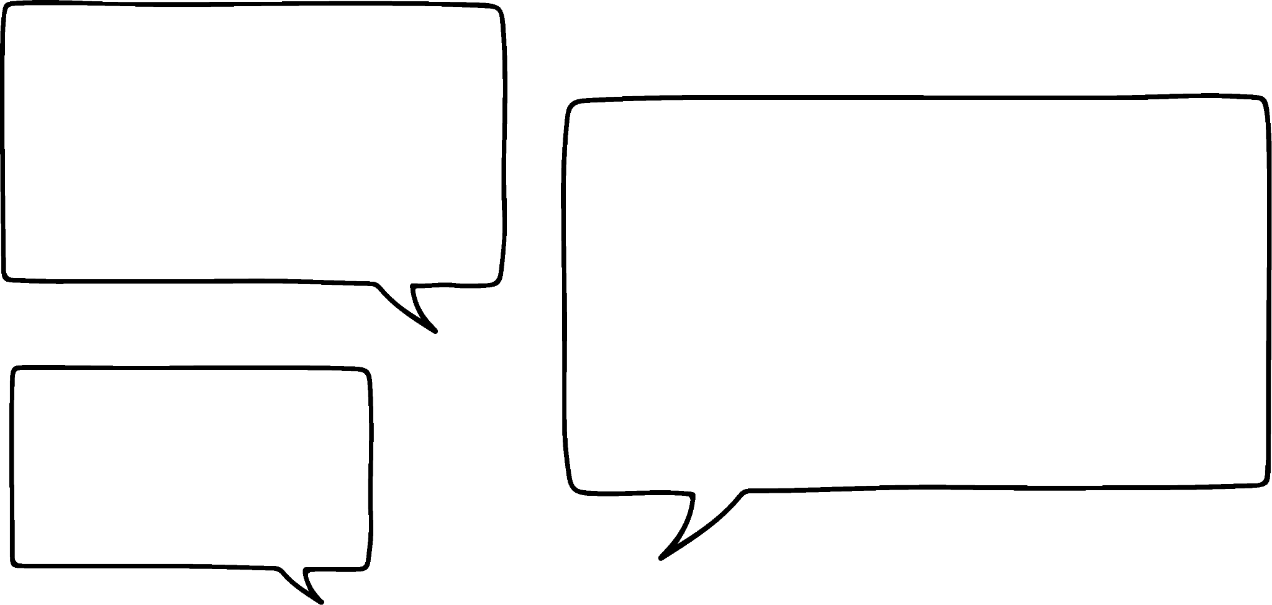
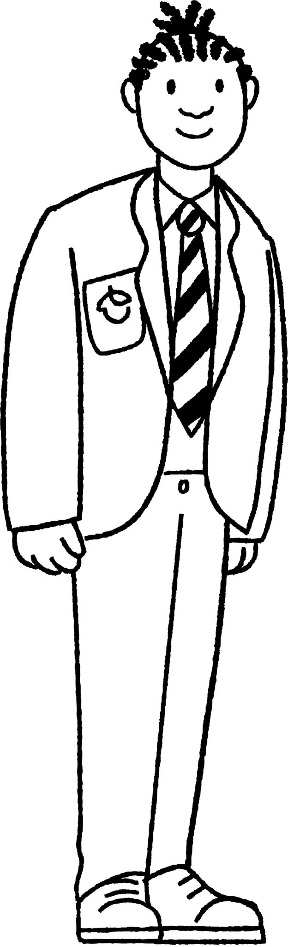
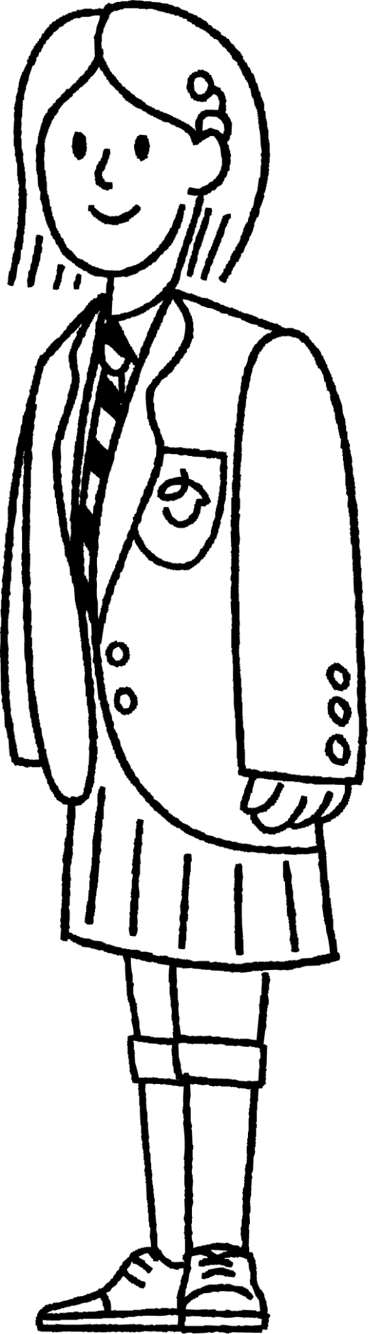

Qorshaynta iyo samaynta tijaabooyin (experiments)
Yacquub iyo Suad waxay la ciyaarayaan frisbee.
Haddii aan duuliyo frisbee-gan hawada, waxaa jira laba siyaabood oo ay uga soo degi karto.
Qaabka frisbee-gu wuxuu ka dhigan yahay in labadiisa dhinac ay kala duwan yihiin. Sidaa darteed, waxay u badan tahay inay u soo degto hal si ka badan kan kale.
Ma u malaynaysaa in labada natiijo (outcomes) ay isku egtahay (equally likely)?
tijaabo yar (trial): wareejinta frisbee ξ = { , }
Sidee bay u baari karaan (investigate) in hal natiijo (outcome) ay u badan tahay (more likely) tan kale?

Slide 8
Qorshaynta iyo samaynta tijaabooyin (experiments)
Si ay u fududaato in laga hadlo natiijooyinka (outcomes), waxaan u yeelan karnaa hal natiijo (outcome) 'heads' iyo tan kale 'tails'.
Waxaan ku duuli karnaa frisbee-ga hawada dhowr jeer oo aan aragno natiijada (outcome) ee ugu badan.
Taasi waxay ina siin kartaa tilmaan (indication) in hal natiijo (outcome) ay u badan tahay (more likely) tan kale.
tijaabo (trial): wareejinta frisbee-ga ξ = {heads, tails}
heads =
tails =

Slide 9

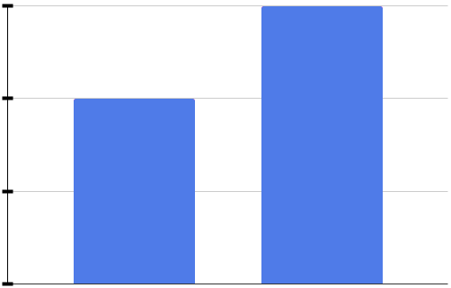


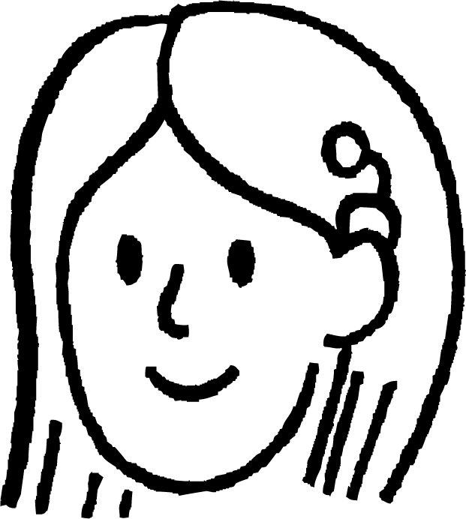
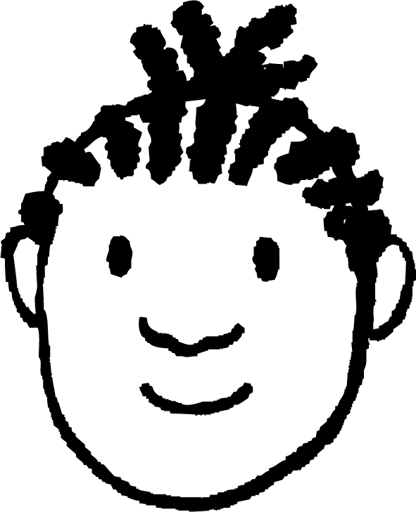
Qorshaynta iyo samaynta tijaabooyin (experiments)
Waxay ku duulaan frisbee-ga hawada 10 jeer waxayna diiwaan geliyaan natiijooyinka (results).
Natiijooyinku (results) waxay ahaayeen 4 heads iyo 6 tails.
Marka, ma ku soo gabagabeyn karnaa (conclude) in frisbee-gu u badan yahay (more likely) inuu ku soo dego tails marka loo eego heads?
6
4
joogteynta (frequency)
Hmm, suurtagal. Laakiin tijaabadan (experiment) runti iima qancin.
2
0
heads
tails
Sidee bay ugu kalsoonaan karaan (confident) gabagaboodooda (conclusion)?

Slide 10
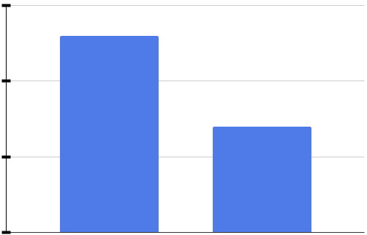
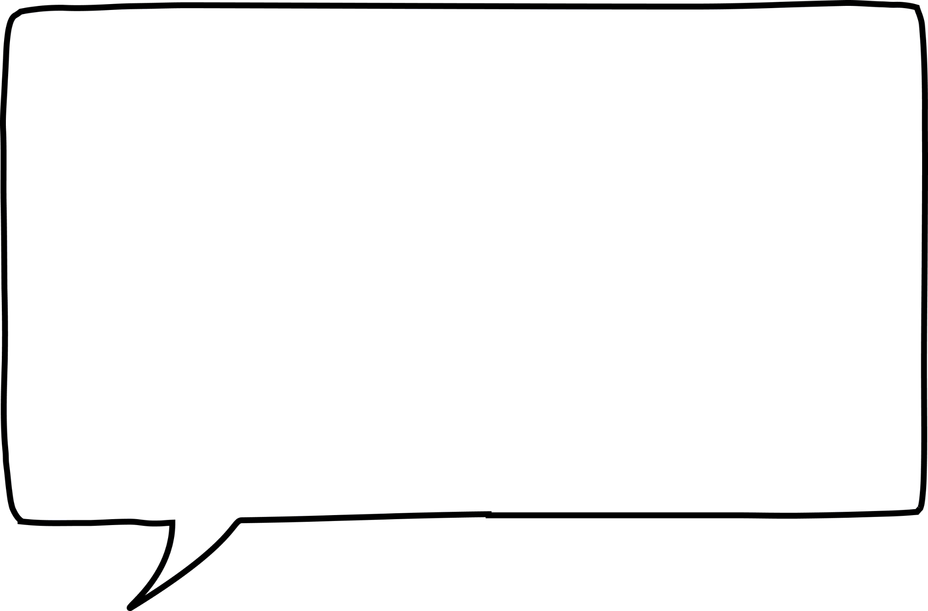
Qorsheynta iyo samaynta tijaabooyinka (experiments)
Waxay frisbee-ga ku tuuraan hawada 20 jeer waxayna diiwaan geliyaan natiijooyinka.
Markan waxaa jiray 13 madax (heads) iyo 7 dabo (tails).
Taasi waxay soo jeedinaysaa gabagabo (conclusion) ka duwan: frisbee-ga waxaa u badan inuu ku soo degto madax (heads) halkii uu ka dhigi lahaa dabo (tails).
15
10
soo noqnoqosho (frequency)
Natiijooyinkan waxay u muuqdaan kuwo aad u kalsooni badan. Laakiin weli si buuxda uma qancin.
5
0
heads
dabo (tails)
Sidee ayay u noqon karaan kuwa xitaa ka kalsoon gabagabadooda (conclusion)?

Slide 11
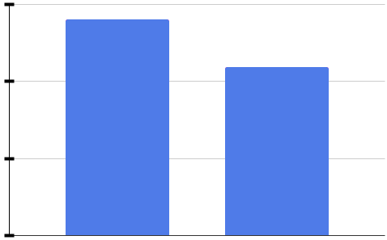
Qorsheynta iyo samaynta tijaabooyinka (experiments)
Waxay frisbee-ga ku tuuraan hawada 500 jeer waxayna diiwaan geliyaan natiijooyinka.
Natiijooyinku waxay ahaayeen 281 madax (heads) iyo 219 dabo (tails).
Ma ku soo gabagabeyn karnaa in frisbee-ga uu u badan yahay inuu ku soo degto madax (heads) halkii uu ka dhigi lahaa dabo (tails)?
300
200
soo noqnoqosho (frequency)
Ma naqaanno si qumman oo dhamaystiran, laakiin natiijooyinkan waxay noqon karaan kuwo ku filan oo lagu gaadho gabagabadaas (conclusion).
100
0
madax (heads)
dabo (tails)
Isticmaal linkiga si aad u hesho jilitaanka (simulation) Desmos oo guji 'run': Jilitaanka tuurista frisbee-ga🖇

Slide 12
Qorsheynta iyo samaynta tijaabooyinka (experiments)
Tijaabo (experiment) waa ku celcelinta tijaabo (trial) marar badan si loo eego inta jeer ee natiijo kasta ay dhacdo.
Haddii natiijo (outcome) mid ka mid ah ay leedahay soo noqnoqosho (frequency) ka badan kuwa kale, waxay soo jeedin kartaa in natiijadaas ay u badan tahay inay mar kale dhacdo mustaqbalka.
Waxaa laga yaabaa inaan awoodin inaan si qumman oo dhamaystiran u ogaanno in gabagabadeenna (conclusions) ka yimid tijaabada (experiment) ay run yihiin.
Marka tijaabooyinka (trials) ay ku badan yihiin tijaabada (experiment), waxaan noqon karnaa kuwa kalsoon oo dheeraad ah gabagabada (conclusions) laga sameeyo natiijooyinka.

Slide 13

Qorsheynta iyo samaynta tijaabooyin (experiments)
Yacquub iyo Suad waxay ka soo gabagabeeyeen tijaabo (experiment) frisbee-ga oo ku saabsan miisaanka suurtagalnimada.
tirada tijaabooyinka (trials) = 500
300
Taasi uma eka mid sax ah.
250
200
150
soo noqnoqosho (frequency)
Waa maxay sababta ugu yaraan hal iskutallaab (cross) uu ku qaldan yahay?
100
50
0
madax (heads)
dabo (tails)
dabo (tails)
madax (heads)
aan suurtagal ahayn (impossible)
aan la badin (unlikely)
fursad siman (even chance)
la badin (likely)
huban (certain)

Slide 14
Qorsheynta iyo samaynta tijaabooyin (experiments)
In ka yar kala badh tijaabooyinka (trials) ayaa ku dhacay 'dabo'.
Sidaa darteed, 'dabo' wuxuu ka horreeyaa bartamaha miisaanka.
tirada tijaabooyinka = 500
300
Taas macneheedu waa in 'dabo' uu leeyahay fursad ka yar fursad siman.
250
200
150
soo noqnoqosho (frequency)
Marka ay fursadda ugu weyn tahay in frisbee-ku ku soo degto 'madax', fursadda uu ku soo degto 'dabo' ayaa yar.
100
50
0
madax (heads)
dabo (tails)
dabo (tails)
dabo (tails)
madax (heads)
aan suurtagal ahayn (impossible)
muhiim ah (unlikely)
fursad siman (even chance)
sugan (likely)
huban (certain)

Slide 15
Qorsheynta iyo samaynta tijaabooyinka (experiments)
Leb (brick) ciyaar oo la tuuro hawada ayaa ku soo degi kara mid ka mid ah afar siyaabood.
A
B
C
D
kuwa isku xira oo kor u jeeda (connectors up)
kuwa isku xira oo hoos u jeeda (connectors down)
weji dheer (long face)
weji gaaban (short face)
Sidee baad u baari kartaa natiijooyinka kuwaas oo ka sugan kuwa kale?
Samee tijaabo (experiment) adiga oo leb-ka ciyaarta ku tuuraya hawada marar badan.

Slide 16
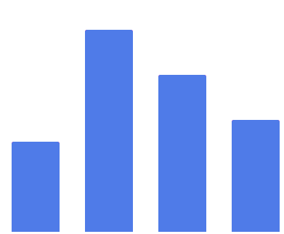
Qorsheynta iyo samaynta tijaabooyinka (experiments)
Tijaabo (experiment) waxay ka kooban tahay tuurista leb ciyaareed hawada 100 jeer. Natiijooyinka waxaa lagu muujiyey jaantuska (bar chart).
Leb-ka ciyaarta ayaa ku dhow in mar kale hawada lagu tuuro.
Iyadoo lagu salaynayo natiijooyinkan, natiijada ugu sugan (likely) waa kee?
soo noqnoqoshada (frequency)
B - isku xirka hoose (connectors down)
A
B
C
D

Slide 17

Qorsheynta iyo samaynta tijaabooyinka (experiments)
tirada tijaabooyinka (trials) = 100
Mid ka mid ah dhacdooyinku ma laha fursad ka weyn fursad siman.
40
30
20
10
0
Dhacdada leh soo noqnoqoshada (frequency) ugu sarreysa ayaa ah midka ugu suurtagalsan, sidaas darteed waxay leedahay fursad ka weyn fursad siman.
Mid ka mid ah dhacdooyinku ma laha soo noqnoqosho (frequency) ka weyn kala badh tirada tijaabooyinka (trials).

Slide 18
Qorsheynta iyo samaynta tijaabooyinka (experiments)
Calaamadaha miisaanku waxay muujinayaan fursadaha dhacdo kasta.
tirada tijaabooyinka (trials) = 100
40
30
20
Waa kee dhacdadan?
C - weji dheer (long face)
10
0
A
B
C
D
aan suurtagal ahayn (impossible)
aan suurtagal ahayn (unlikely)
fursad siman (even chance)
suurtagal (likely)
huban (certain)

Slide 19

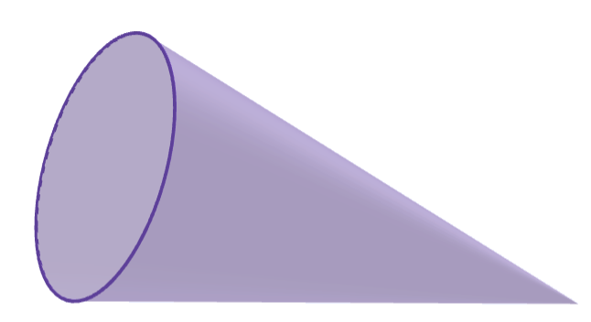
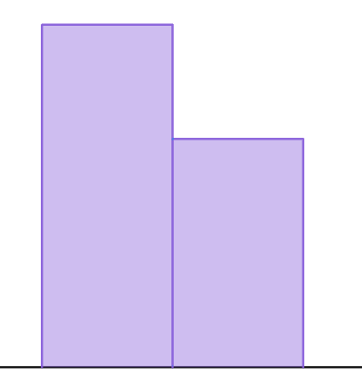
Qorsheynta iyo samaynta tijaabooyinka (experiments)
1) Koofiyadda la tuuray waxay ku dhici kartaa laba siyaabood: 'salka hoose' ama 'qalooca hoose'.
a) Qorshee tijaabo (experiment) si aad u baarto natiijada ugu suurtagalsan.
A - sal hoose (base down)
B - qalooc hoose (curve down)
b) Jaantuska tiirarka (bar chart) wuxuu muujinayaa natiijooyinka tijaabada (experiment).
Koofiyadda ayaa la doonayaa in mar kale la tuuro. Waa kee booska ugu suurtagalsan inay ku dhacdo?
6
4
soo noqnoqosho (frequency)
2
0
A
B

Slide 20
Qorsheynta iyo samaynta tijaabooyinka (experiments)
1) Koofiyad la soo tuuray waxay ku dhici kartaa laba siyaabood: 'sal hoose (base down)' ama 'qalooc hoose (curve down)'.
A - sal hoose (base down)
B - qalooc hoose (curve down)
6
c) Isticmaal linkiga si aad u hesho simulation (simulation) tijaabadan: Koofiyad simulation🖇 Riix badhanka 'run' si aad u bilowdo simulation-ka iyo badhanka 'reset' si aad mar kale u bilowdo. Ku day tano dhowr jeer oo tiro badan oo tijaabo ah mar kasta. Sidee natiijooyinku u saameeyaan jawaabahaaga qaybta (b)?
4
soo noqnoqosho (frequency)
2
0
A
B

Slide 21
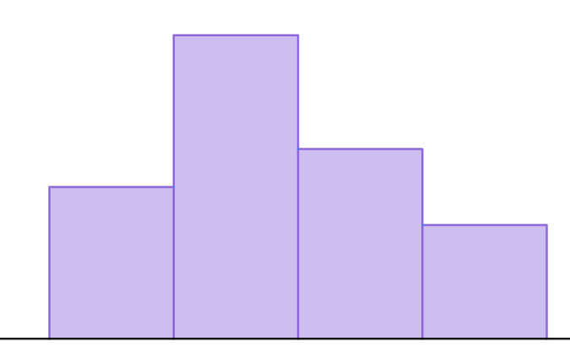
Qorsheynta iyo samaynta tijaabooyinka (experiments)
2) Lebi (toy brick) hawada lagu tuuro wuxuu ku dhici karaa afar siyaabood. Tijaabo dhexdeeda, lebiga waxaa la tuuraa 20 jeer waxaana soo baxa natiijooyinkan.
8
A - kor (up)
B - hoos (down)
6
soo noqnoqosho (frequency)
4
C - weji dheer (long face)
D - weji gaaban (short face)
2
0
A
B
C
D
a) Lebiga waa in mar kale la tuuraa. Sawir miisaan (scale) ah oo suurtogalnimo (likelihoods) ah oo adiga kuu qaabaysan, adigoo isticmaalaya natiijooyinka tijaabada si aad u muujiso suurtogalnimada natiijo kasta oo miisaanka ku taal.

Slide 22
Qorsheynta iyo samaynta tijaabooyinka (experiments)
b) Isticmaal linkiga si aad u hesho simulation (simulation) tijaabadan: Lebi simulation🖇 Riix badhanka 'run' si aad u bilowdo simulation-ka iyo badhanka 'reset' si aad mar kale u bilowdo. Ku day tano dhowr jeer oo tiro badan oo tijaabo ah mar kasta. Sidee natiijooyinku u saameeyaan jawaabahaaga qaybta (a)?

Slide 23
Qorsheynta iyo samaynta tijaabooyinka (experiments)
1) Koofiyad la soo tuuray waxay ku dhici kartaa laba siyaabood: 'sal hoose (base down)' ama 'qalooc hoose (curve down)'.
a) Qorshee tijaabo (experiment) si aad u baarto natiijooyinka ugu suurtogalnimada badan inay dhacdo.
A - salka hoos (base down)
B - qaanso hoos (curve down)
Jawaabaha tusaale -
‘Ku rid koofiyad 50 jeer.’
‘Koofiyadda dhulka kaga soo tuur isla joog 200 jeer. Qor inta jeer ee ay ku soo degto boos kasta.’
Tirada tijaabooyinka (trials) way kala duwanaan kartaa. Tirada tijaabooyinka oo badan waa la dhiirigeliyaa, laakiin waa in la tixgeliyo xaddidaadda waxqabadka tijaabada (experiment).

Slide 24
Qorshaynta iyo samaynta tijaabooyinka (experiments)
b) Jaantuska tiirka (bar chart) wuxuu muujinayaa natiijooyinka tijaabada (experiment). Koofiyadda ayaa hadda dib loo tuurayaa. Booskee ayay u badan tahay inay ku soo degto?
6
4
joogteynta (frequency)
2
0
A
B
A - salka hoos (base down)

Slide 25
Qorshaynta iyo samaynta tijaabooyinka (experiments)
c) Isticmaal xiriirka si aad u gasho jilitaanka (simulation) tijaabadan: Jilitaanka koofiyadda 🖇 Riix badhanka 'run' si aad u bilowdo jilitaanka iyo badhanka 'reset' si aad dib uga bilowdo. Tijaabi tan dhowr jeer iyadoo la isticmaalayo tiro badan oo tijaabooyin (trials) ah mar kasta. Sidee natiijooyinku u saameeyaan jawaabahaaga qaybta (b)?
Tusaale: ‘Marka la isticmaalo tiro badan oo tijaabooyin (trials) ah, koofiyaddu waxay ku soo degtaa qaanso hoos (curve down) inta badan marka loo eego salka hoos (base down). Marka qaanso hoos (curve down) waxay u egtahay natiijada ugu badan.’
Jawaabuhu way kala duwanaan karaan iyadoo ku xiran natiijooyinka jilitaanka (simulation).

Slide 26
Qorshaynta iyo samaynta tijaabooyinka (experiments)
2) Lebi carruureed (toy brick) oo hawada la tuuro ayaa ku soo degi kara mid ka mid ah afar siyaabood. Tijaabo (experiment) ahaan, lebiga carruureed waxaa la tuuraa 20 jeer oo waxay soo saartaa natiijooyinkan soo socda.
8
A - kor (up)
B - hoos (down)
6
joogteynta (frequency)
4
2
C - weji dheer (long face)
D - weji gaaban (short face)
0
A
B
C
D
a) Lebiga carruureed ayaa hadda dib loo tuurayaa. Sawir miisaan (scale) suurtagalnimada (likelihoods) oo adeegso natiijooyinka tijaabada (experiment) si aad u muujiso suurtagalnimada natiijo kasta oo miisaanka ku taal.
D
A
C
B
aan suurtagal ahayn (impossible)
sugan (unlikely)
fursad siman (even chance)
sugan (likely)
hubaal (certain)

Slide 27
Qorsheynta iyo samaynta tijaabooyinka (experiments)
b) Isticmaal linkiga si aad u hesho jilitaanka tijaabadan: Jilitaanka Toy brick🖇 Riix badhanka 'run' si aad u bilowdo jilitaanka iyo badhanka 'reset' si aad dib uga bilowdo. Ku day tani marar badan oo tiro badan oo tijaabooyin ah mar kasta. Sidee natiijooyinku u saameeyaan jawaabahaaga qaybta (a)?
Tusaale: 'Marka la isticmaalo tiro badan oo tijaabooyin ah (tusaale 1000) natiijada C ayaa inta badan dhacda, sidaas darteed waxay u muuqataa inay leedahay suurtagalnimada ugu weyn. Natiijada A ayaa ugu yar dhacda, sidaas darteed waxay u muuqataa inay leedahay suurtagalnimada ugu yar.'
Jawaabuhu way kala duwanaan karaan iyadoo ku xiran natiijooyinka jilitaanka.

Slide 28
Tijaabooyin (Experiments) lagu go'aaminayo sida ay u suurtagal tahay natiijada
Qorsheynta iyo samaynta tijaabooyinka (experiments)
Tixgelinta tirada tijaabooyinka (trials) loo baahan yahay

Slide 29

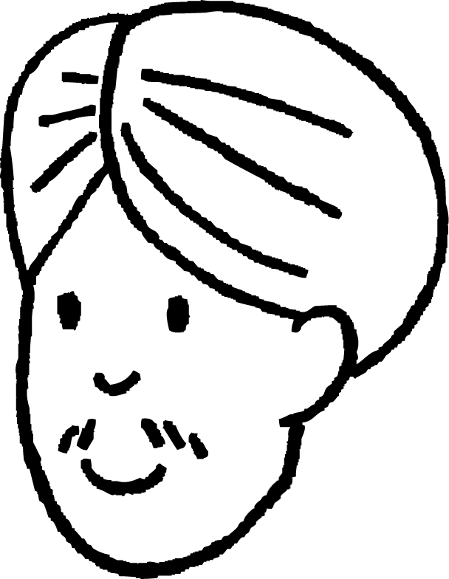

Tixgelinta tirada tijaabooyinka (trials) loo baahan yahay
Layla iyo Cali waxay ciyaarayaan ciyaar ku lug leh duubista dhextuuran lix-geesood ah.
Uma maleynayo in dhextuurkani yahay mid caadil ah. Wuxuu sii joogaa tirooyin qaar in ka badan kuwa kale.
Waxaan baari karnaa in dhextuurku yahay mid caadil ah iyo in kale adoo samaynaya tijaabo (experiment).
Waxaa laga yaabaa in aan si siman loo miisaamin dhexda dhextuurka.
Imisa jeer ayay tahay inay duubaan dhextuurka inta lagu jiro tijaabadooda?

Slide 30
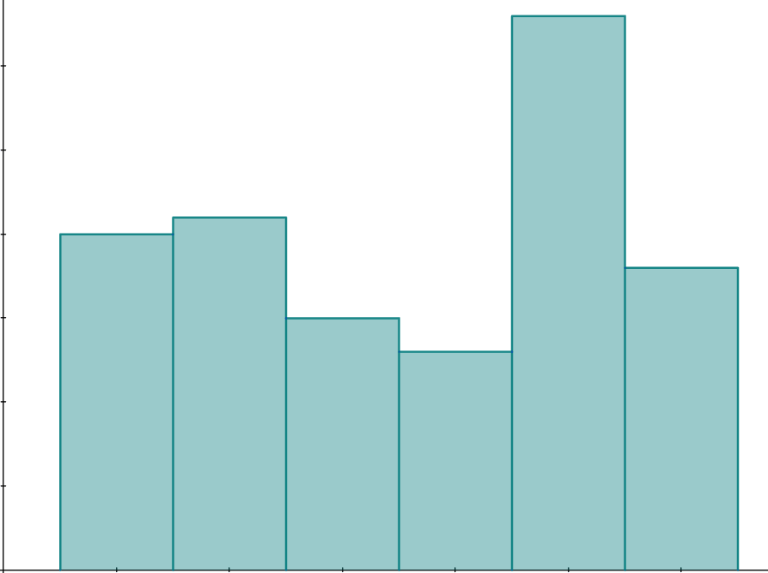
Tixgelinta tirada tijaabooyinka (trials) loo baahan yahay
Waxay sameeyaan tijaabo (experiment) iyagoo duubaya dhextuurka 120 jeer.
Laakiin xataa marka dhacdooyinku leeyihiin fursad siman, dhacdo midi waxay u dhici kartaa in ka badan mid kale.
Waxaan kuu sheegay in dhextuurku aanu ahayn mid caadil ah. Inta jeer ee 5 ayaa ka sareysa kuwa kale.
30
20
joogteynta (frequency)
10
0
1
2
3
4
5
6
lambar la rogay (number rolled)

Slide 31
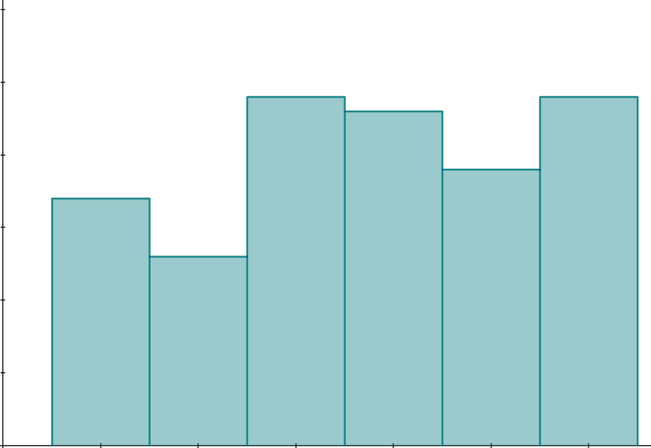
Iyadoo la tixgelinayo tirada tijaabooyinka (trials) loo baahan yahay
Waxay mar kale sameeyaan tijaabada (experiment) iyagoo rogaya lammaanaha (dice) 120 jeer.
Hmm, natiijooyinku aad bay uga duwan yihiin markan. Hadda ma hubo in lammaanuhu (dice) siman yahay.
Waxaa laga yaabaa in 120 tijaabo (trials) aysan ku filnayn go'aan lagu kalsoonaan karo.
Waxaan la yaabanahay waxa dhacaya haddii aan tijaabooyin (trials) badan ku darro.
30
20
joogteynta (frequency)
10
0
1
2
3
4
5
6
lambar la rogay (number rolled)

Slide 32
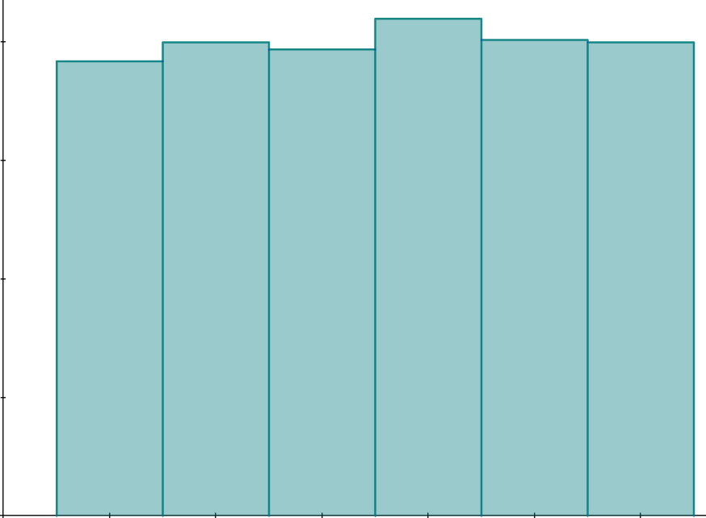
Iyadoo la tixgelinayo tirada tijaabooyinka (trials) loo baahan yahay
Waxay mar kale sameeyaan tijaabada (experiment) laakiin markan waxay rogaan lammaanaha (dice) 1200 jeer (iyagoo caawimo ka helaya saaxiibo badan).
Marka aan tijaabooyin (trials) badan ku darro tijaabada (experiment), waxay u egtahay in lambarada lammaanaha (dice) ay isku egtahay inay dhacaan.
Waxaan la yaabanahay sababta tijaabooyin (trials) badan uga dhigtay lammaanaha (dice) mid u muuqda mid siman.
200
joogteynta (frequency)
100
0
1
2
3
4
5
6
lambar la rogay (number rolled)

Slide 33
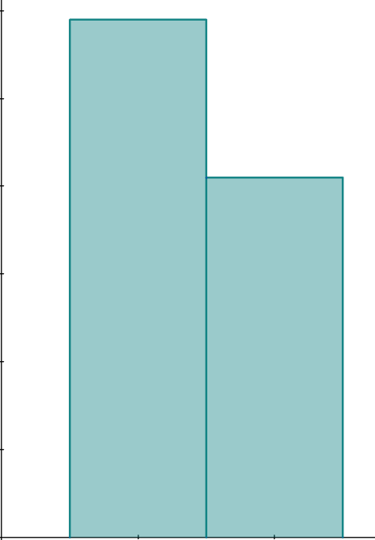
Iyadoo la tixgelinayo tirada tijaabooyinka (trials) loo baahan yahay
Xataa marka dhacdooyinku (events) isku egtahay inay dhacaan, kama dhacaan tirada isku midka ah inta lagu jiro tijaabada (experiment). Dhacdo (event) ayaa laga yaabaa inay ka dhacdo mid kale si kadis ah.
100 tijaabo (trials)
Tusaale: Markaad rogto lacag (coin) cadaalad ah, labada natiijo ('madax' iyo 'dabo') waxay leeyihiin fursad isku mid ah.
60
40
Laakiin wali waxaad heli kartaa 'madax' (heads) ka badan 'dabo' (tails).
soo noqnoqosho (frequency)
H
20
T
aan macquul ahayn (impossible)
suurtagal yar (unlikely)
fursad siman (even chance)
suurtagal (likely)
hubaal (certain)
0
madax (heads)
dabo (tails)
Isticmaal linkiga si aad u aragto natiijooyinka simulation-ka: Simulation-ka lacagta cadaaladda ah oo leh 100 tijaabo (trials)🖇 Dhaqaaji slider-ka si aad u aragto natiijooyinka tijaabooyin (experiments) kala duwan.

Slide 34
Tixgelinta tirada tijaabooyinka (trials) loo baahan yahay
Xataa marka dhacdo (event) ay u badan tahay inay dhacdo mid kale, dhacdada aan u badnayn waxay noqon kartaa mid ka badan inta lagu tijaabiyo (experiment).
Tusaale: Markaad rogto frisbee, waxaa laga yaabaa inaad u badan tahay inaad hesho 'madax' (heads) marka loo eego 'dabo' (tails).
100 tijaabo (trials)
60
Laakiin wali waxaad heli kartaa 'dabo' (tails) ka badan 'madax' (heads).
40
soo noqnoqosho (frequency)
T
H
20
aan suurtagal ahayn (impossible)
aan u badnayn (unlikely)
fursad siman (even chance)
u badan (likely)
hubaal (certain)
0
madax (heads)
dabo (tails)

Slide 35
Tixgelinta tirada tijaabooyinka (trials) loo baahan yahay
Dhacdo aan u badnayn (unlikely) waxay noqon kartaa mid ka badan dhacdo u badan (likely), si aan ula kac ahayn. Tani waxay geni badan u dhacdaa tijaabooyin (experiments) leh tiro yar oo tijaabooyin ah (trials).
Tijaabooyin (experiments) badan oo tijaabo (experiment) ah ayaa siinaya sawir sax ah oo ku saabsan suurtogalnimada (likelihoods) dhacdo kasta.
Tijaabooyin (experiments) badan oo tijaabo (experiment) ah ayaa kordhinaya kalsoonida (confidence) ku saabsan gabagabada (conclusions) laga soo qaatay tijaabada (experiment) ee ah in natiijo (outcome) mid ka mid ah ay u badan tahay midda kale.

Slide 36
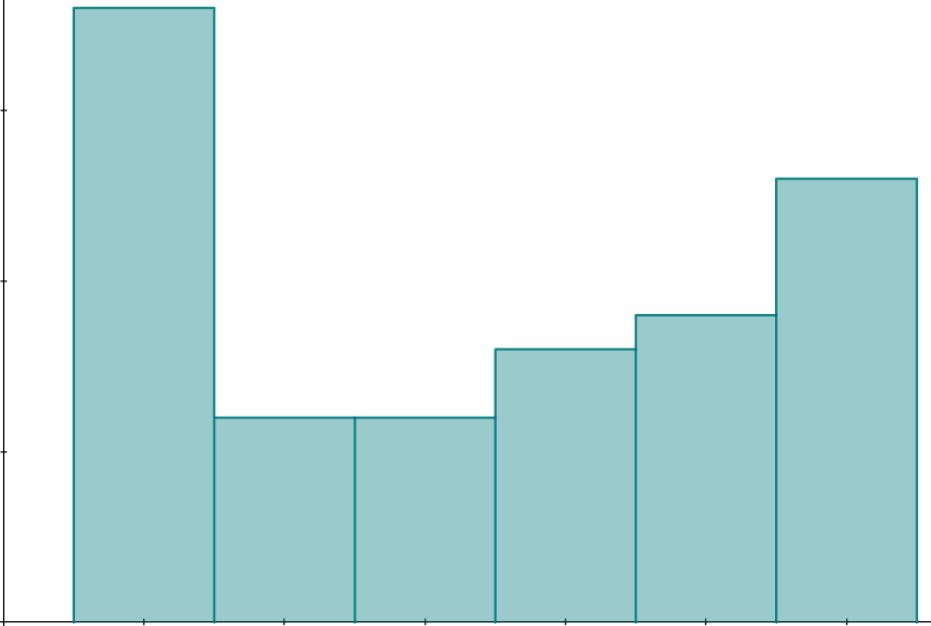
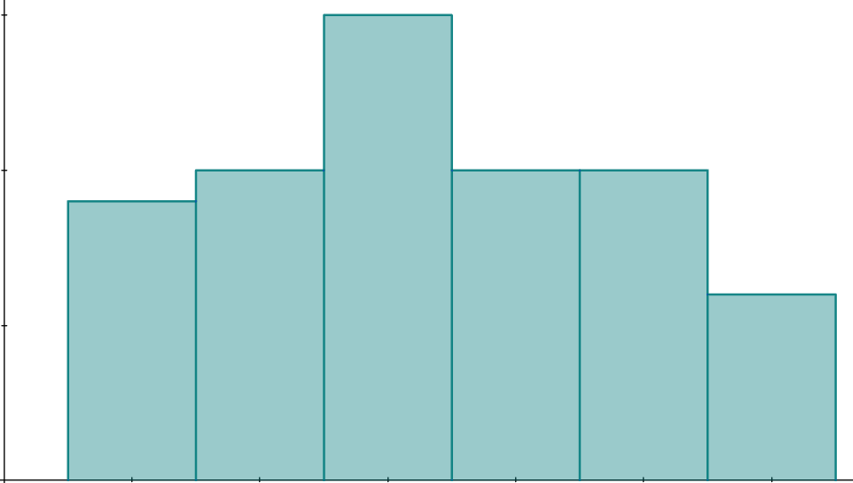
Tixgelinta tirada tijaabooyinka (trials) loo baahan yahay
Tijaabooyin (experiments) leh tiro yar oo tijaabo (trials) ah waxay soo saari karaan natiijooyin (results) aad u kala duwan.
Tusaale: rogista dice (dice) 60 jeer.
20
20
15
15
joogteynta (frequency)
joogteynta (frequency)
10
10
5
5
0
0
1
2
3
4
5
6
1
2
3
4
5
6
Isticmaal xiriirka (link) si aad u aragto qaar ka mid ah jilitaanka (simulations) tijaabooyinka (experiments) halkaas oo la rogay dice (dice) caddaalad ah 60 jeer. Dhaqaaji slider-ka (slider) si aad u aragto natiijooyinka (results) tijaabo (experiment) kasta.
Fiiri sida natiijooyinka (results) aad ugu kala duwan yihiin tijaabo (experiment) ilaa tijaabo (experiment) kale.
dice - 60 tijaabo (trials) 🖇

Slide 37
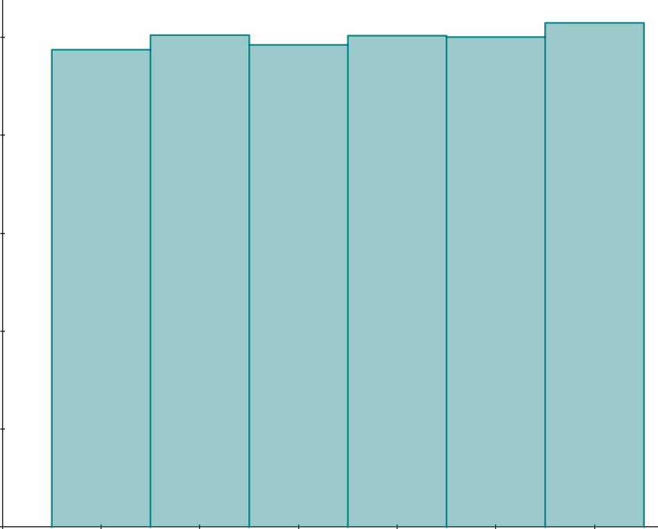
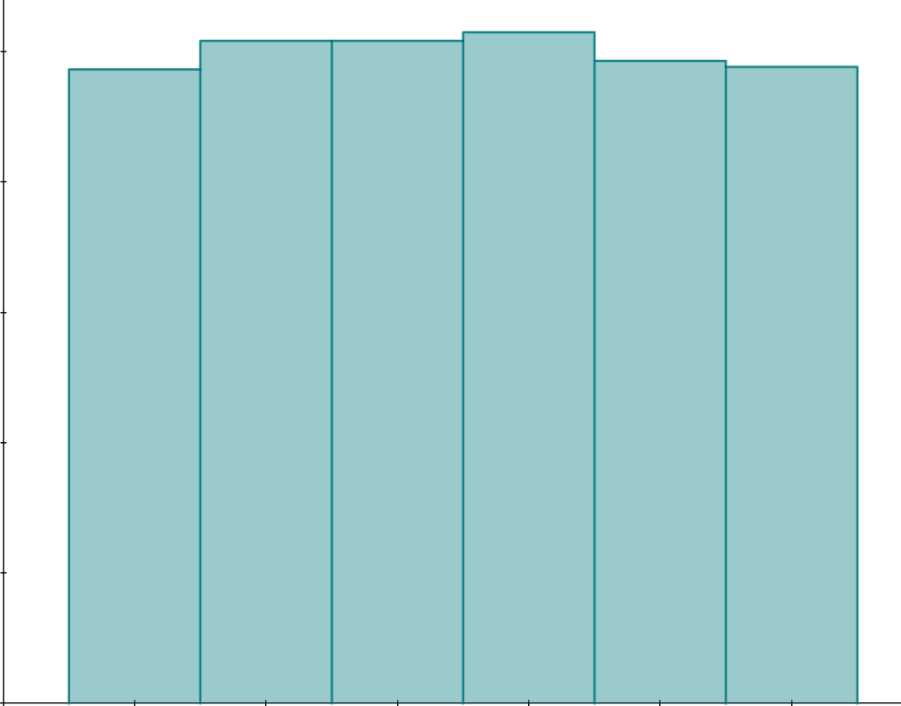
Tixgelinta tirada tijaabooyinka (trials) loo baahan yahay
Tijaabooyin (experiments) leh tiro badan oo tijaabo (trials) ah ayaa u badan inay soo saaraan natiijooyin (results) iswaafaqsan (consistent).
Tusaale: rogista dice (dice) 6000 jeer.
1000
1000
750
750
joogteynta (frequency)
joogteynta (frequency)
500
500
250
250
0
0
1
2
3
4
5
6
1
2
3
4
5
6
Isticmaal xiriirka (link) si aad u aragto qaar ka mid ah jilitaanka (simulations) tijaabooyinka (experiments) halkaas oo la rogay dice (dice) caddaalad ah 6000 jeer. Dhaqaaji slider-ka (slider) si aad u aragto natiijooyinka (results) tijaabo (experiment) kasta.
Fiiri sida natiijooyinka (results) u yar yihiin kala duwanaanshaha (variation) inta u dhaxaysa tijaabooyinka (experiments).
dice - 6000 tijaabo (trials) 🖇

Slide 38
Tixgelinta tirada tijaabooyinka (trials) loo baahan yahay
Haddii dhacdo A (event A) ay u badan tahay dhacdo B (event B), markaas A waxay had iyo jeer ku dhacdaa inta badan marka loo eego B inta lagu jiro tijaabo (experiment).
Dhacdo (event) leh suurtogalnimo (likelihood) hoose ayaa weli dhici karta inta badan si kedis ah (by chance).
Marka dhacdo (event) ay u badan tahay mid kale, waxay ka dhigan tahay inay had iyo jeer ku dhacdo inta badan.

Slide 39
Tixgelinta tirada tijaabooyinka (trials) loo baahan yahay
Haddii dhacdo A ay leedahay soo noqnoqosho (frequency) ka badan dhacdo B inta lagu jiro tijaabo (experiment), waxaad hubsan kartaa in A ay u badan tahay inay dhacdo marka loo eego B.
Dhacdo leh suurtogalnimo (likelihood) hoose ayaa weli laga yaabaa inay dhacdo si badanaa si kedis ah (by chance).
Tijaabada (experiment) waxay caddaynaysaa in dhacdo A ay u badan tahay inay mar kale dhacdo marka loo eego dhacdo B.

Slide 40
Qorsheynta iyo samaynta tijaabooyinka (experiments)
Sidee loo horumarin karaa tijaabo (experiment) si loo helo natiijooyin lagu kalsoonaan karo?
Samee tijaabo (experiment) leh tiro badan oo tijaabooyin (trials) ah.
Samee tijaabo (experiment) leh tiro yar oo tijaabooyin (trials) ah.
Tijaabo (experiment) weligeed lama horumarin karo.

Slide 41
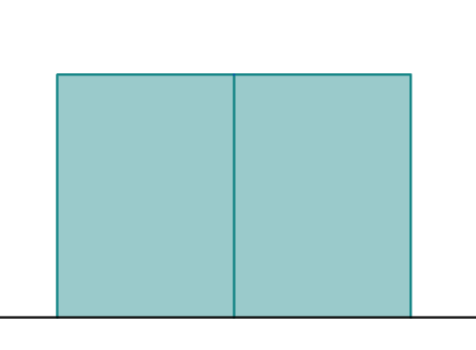
Tixgelinta tirada tijaabooyinka (trials) loo baahan yahay
1) Fasalku waxay baaraan natiijada ugu badan ee dhacda marka la rogo frisbee.
a) Tijaabo (experiment) ayaa la sameeyay iyadoo la adeegsanayo 10 tijaabo (trials). Jaantuska (bar chart) wuxuu muujinayaa natiijooyinka.
Ma waxaa jira natiijo u muuqata inay u badan tahay inay dhacdo marka loo eego midka kale? Haddii ay jirto, waa kee?
6
4
soo noqnoqosho (frequency)
2
0
madax (heads)
dabo (tails)

Slide 42
Tixgelinta tirada tijaabooyinka (trials) loo baahan yahay
b) Isticmaal linkiga si aad u gasho jilitaanka (simulation) tijaabadan: Jilitaanka rogista frisbee🖇 Sanduuqa 'count' wuxuu muujinayaa tirada tijaabooyinka (trials) la dhammeeyay. Riix badhanka 'run' si aad u bilowdo jilitaanka oo u ogolow inuu socdo ugu yaraan 500 tijaabo (trials).
Sidee natiijooyinka tijaabadan uga duwan yihiin kuwa qaybta (a)?
c) Natiijooyinka tijaabadee (experiment) ayaa u muuqda kuwo lagu kalsoonaan karo? Sharax sababta.

Slide 43
Tixgelinta tirada tijaabooyinka (trials) loo baahan yahay
1) Fasalku waxay baaraan natiijada ugu badan ee dhacda marka la rogo frisbee.
a) Tijaabo (experiment) ayaa la sameeyay 10 tijaabo (trials). Jaantuska (bar chart) wuxuu muujinayaa natiijooyinka.
Ma waxaa u muuqdaa hal natiijo (outcome) inay u badan tahay inay dhacdo marka loo eego midka kale? Haddii ay tahay, kee?
6
4
soo noqnoqosho (frequency)
2
0
Natiijooyinku waxay u muuqdaan kuwo isku mid ah oo ay u badan tahay inay dhacaan.
madax (heads)
dabo (tails)
Jawaabuhu way kala duwanaan karaan iyadoo ku xiran natiijooyinka simulation-ka.

Slide 44
Iyadoo la tixgelinayo tirada tijaabooyinka (trials) loo baahan yahay
b) Isticmaal linkiga si aad u gasho simulation-ka tijaabadan: Frisbee flip simulation🖇 Sanduuqa 'count' wuxuu muujinayaa tirada tijaabooyinka (trials) la dhammeeyay. Riix badhanka 'run' si aad u bilowdo simulation-ka oo u daa ugu yaraan 500 tijaabo (trials).
Sidee natiijooyinka tijaabadan uga duwan yihiin kuwa qaybta (a)?
Tusaale: 'Marka la isticmaalo tiro badan oo tijaabooyin (trials) ah, madax (heads) ayaa waxyar ka badan dabo (tails). Tani waxay soo jeedin kartaa in madax (heads) ay waxyar u badan tahay inay dhacdo marka loo eego dabo (tails).'
c) Natiijooyinka tijaabadee ayaa u muuqda kuwo lagu kalsoonaan karo? Sharax jawaabtaada.
Natiijooyinka tijaabada qaybta (b) ayaa lagu kalsoonaan karo sababtoo ah waxay isticmaashaa tiro aad u badan oo tijaabooyin (trials) ah.

Slide 45
Tijaabooyin (experiments) lagu go'aaminayo sida ay u badan tahay in natiijo (outcome) dhacdo
Tijaabo (experiment) ayaa loo qaabayn karaa si loo baaro in hal dhacdo (event) ay u badan tahay inay dhacdo marka loo eego mid kale.
Tijaabo (experiment) waa ku celcelinta tijaabo (trial) dhowr jeer si loo arko inta jeer ee natiijo kasta (outcome) ay dhacdo.
Natiijooyinka tijaabada (experiment) ayaa loo isticmaali karaa si loo go'aamiyo suurtogalnimada (likelihood) dhacdo kasta (event).
Tiro badan oo tijaabooyin (trials) ah ayaa laga yaabaa inay loo baahdo tijaabo (experiment) si loo soo saaro natiijooyin lagu kalsoonaan karo.

