Slide 1
Kordhinta taxanaha (Extrapolating a sequence)
Xiriirro aan toos ahayn (Non-linear relationships)

Slide 2
Sida loo isticmaalo darasyada Oak

Slide 3
Waxaan qiimeyn (value) karaa in ay jiraan taxano kale oo tirooyin ah iyo xaddidnaanta in la arko dhawr eray oo keliya oo taxane ah.

Slide 4
Taxane xisaabeed (ama toosan) (arithmetic/linear sequence) waa taxane uu farqiga u dhexeeya erayada isku xiga uu joogto yahay.
Taxane joomatari (geometric sequence) waa taxane leh xiriir isku dhufasho oo joogto ah oo u dhexeeya erayada isku xiga.

Slide 5

Kordhinta taxanaha (Extrapolating a sequence)
Taxano kale
Kordhinta taxanaha (Extrapolating a sequence)

Slide 6
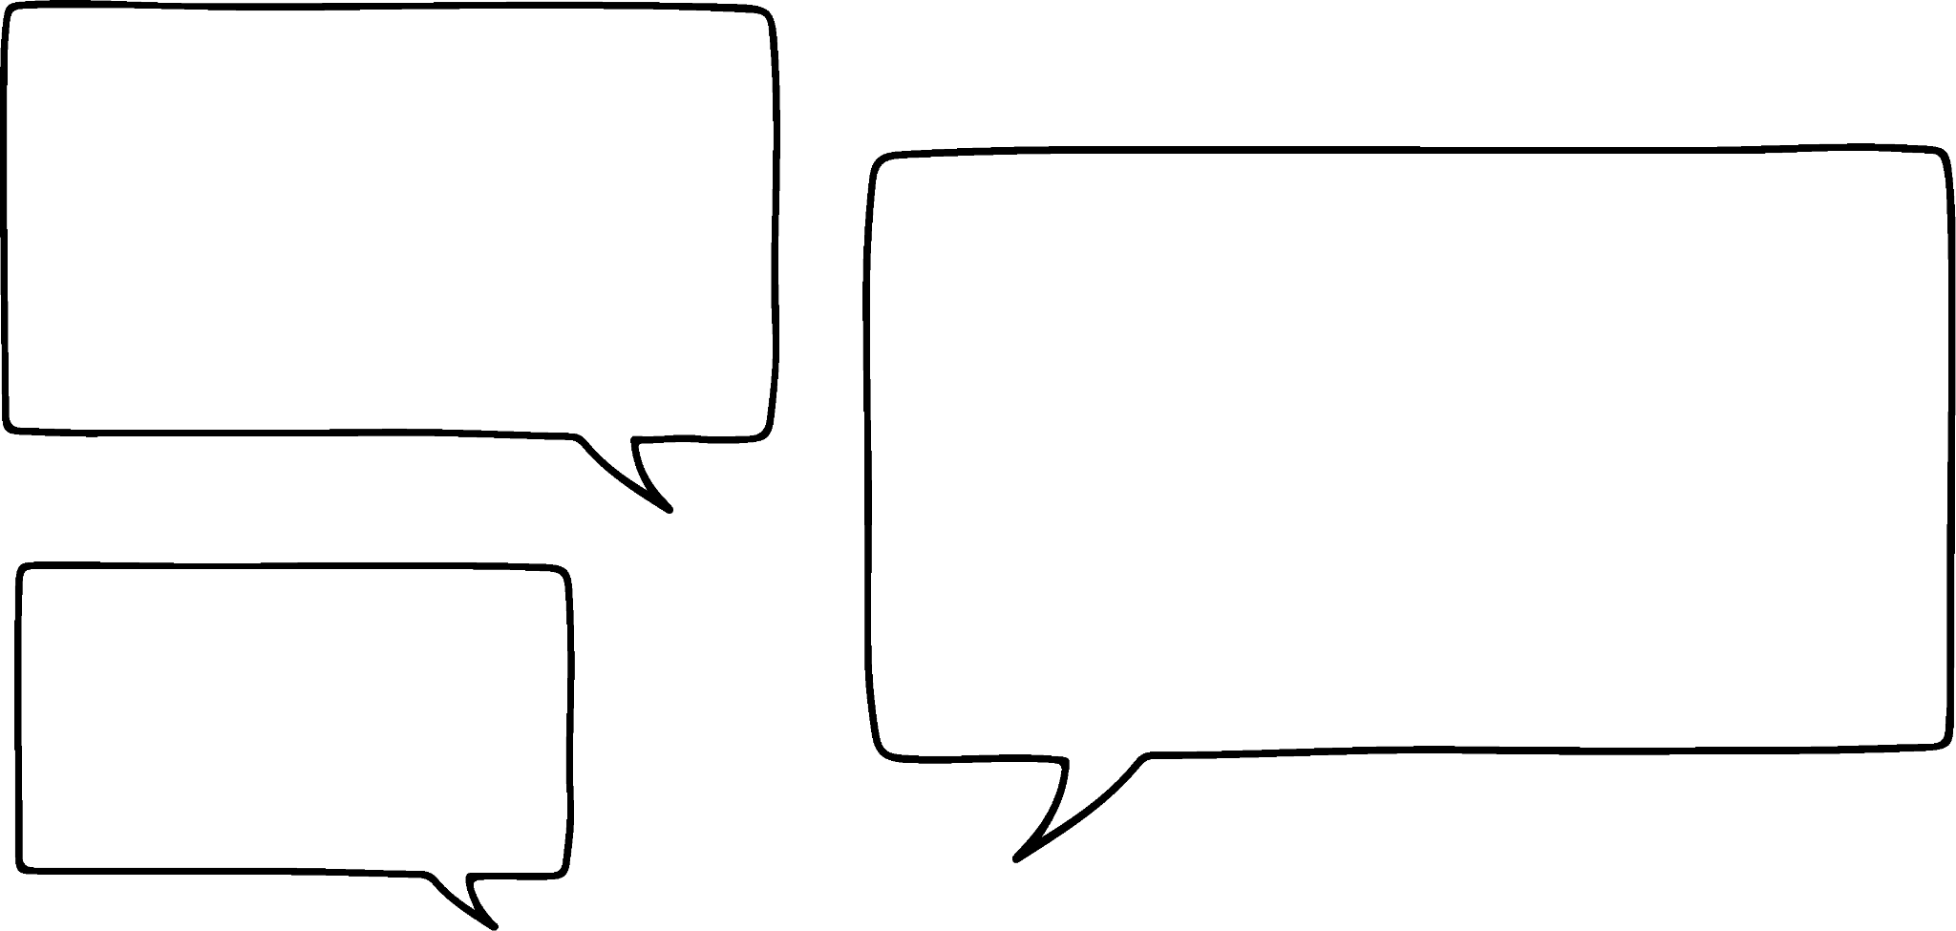


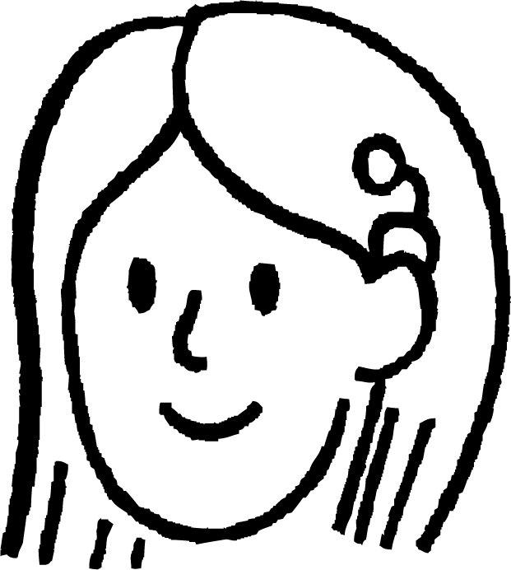



Taxano kale
Waxaan qorayaa taxane raacaya qaanuun. Waa kuwan afarta eray ee ugu horreeya: 3, 5, 7, 9, …
Taasi waa fududahay, waa taxane toosan (linear sequence) marka erayga xiga waa 11.
Axmed
Dhab ahaantii waa tirooyinka khudrada ah ee aan ku jirin lambarka 1
Suad
Maxaad u malaynaysaa inuu noqon doono erayga xiga?
Waa maxay 3da lambar ee xiga ee taxanaha Axmed?
23, 25, 27, …

Slide 7
Taxano kale
Waxaan ku xigay! Waxaan bilaabayaa taxanahayga 2, 3, 5, …
Waa maxay qawaaniinta ama qaababka aad ka fikiri karto taxanaha Suad? Waa maxay erayga xiga?
Suad
Qiyaaso wanaagsan, waxaan ula jeeday tirooyinka asaasiga ah (prime numbers) laakiin waxaan jeclahay fikradahan oo dhan.
Qaar ka mid ah soo jeedinno:
Ku dar 1, ku dar 2, ku dar 3, …. Xubnaha xiga waxay noqon doonaan 8 iyo 12.
Ku dar labada xubnood ee hore si aad u hesho xubnaha xiga. Xubnaha xiga waa 8 iyo 13.
Tirooyinka asaasiga ah (prime numbers) oo kor u kacaya. Xubnaha xiga waa 7 iyo 11.
Laba jibaar (double) kuna dar 1. Xubnaha xiga waa 9 iyo 17.

Slide 8
Taxanayaal kale (sequences)
Qaar ka mid ah xeerarka taxanayaasha tirooyinka (numerical sequences) waxay u shaqeeyaan oo keliya luqad gaar ah.
Ma garan kartaa meesha ay ka timid taxanahan tirooyinka?
3, 3, 5, 4, 4, 3, 5, 5, 4,....
Tilmaan: qor tirooyinka 1-9 oo Ingiriisi ah
Waa tirada xarfaha ee tirooyinka ka weyn eber (sida ay u kala horreeyaan)
'One' waxay leedahay 3 xaraf
'Two' waxay leedahay 3 xaraf
'Three' waxay leedahay 5 xaraf…
Inkastoo ay jiri karaan waxyaabo kale oo bixiya qiimayaal (values) isku mid ah!

Slide 9
Taxanayaal kale (sequences)
Taxanayaasha joomatari (geometric sequences) waxay leeyihiin saami (ratio) guud oo u dhexeeya xubnaha isku xiga.
Taxanayaasha xisaabeed (arithmetic sequences) waxay leeyihiin farqi (difference) guud oo u dhexeeya xubnaha isku xiga.
Waxaan la yaabanahay waxa dhici doona haddii aan isku darro fikradahan?
Axmed
Haddii aan ku bilowno xubinta 1aad oo ah 1, markaas laba jibaar (double) kuna dar 1, xubinta xiga waxay noqon doontaa 3.
Waa maxay saddexda xubnood ee xiga?
1, 3, 7, 15, 31, …
Ma arki kartaa qaabab (patterns) ku jira taxanahan?

Slide 10
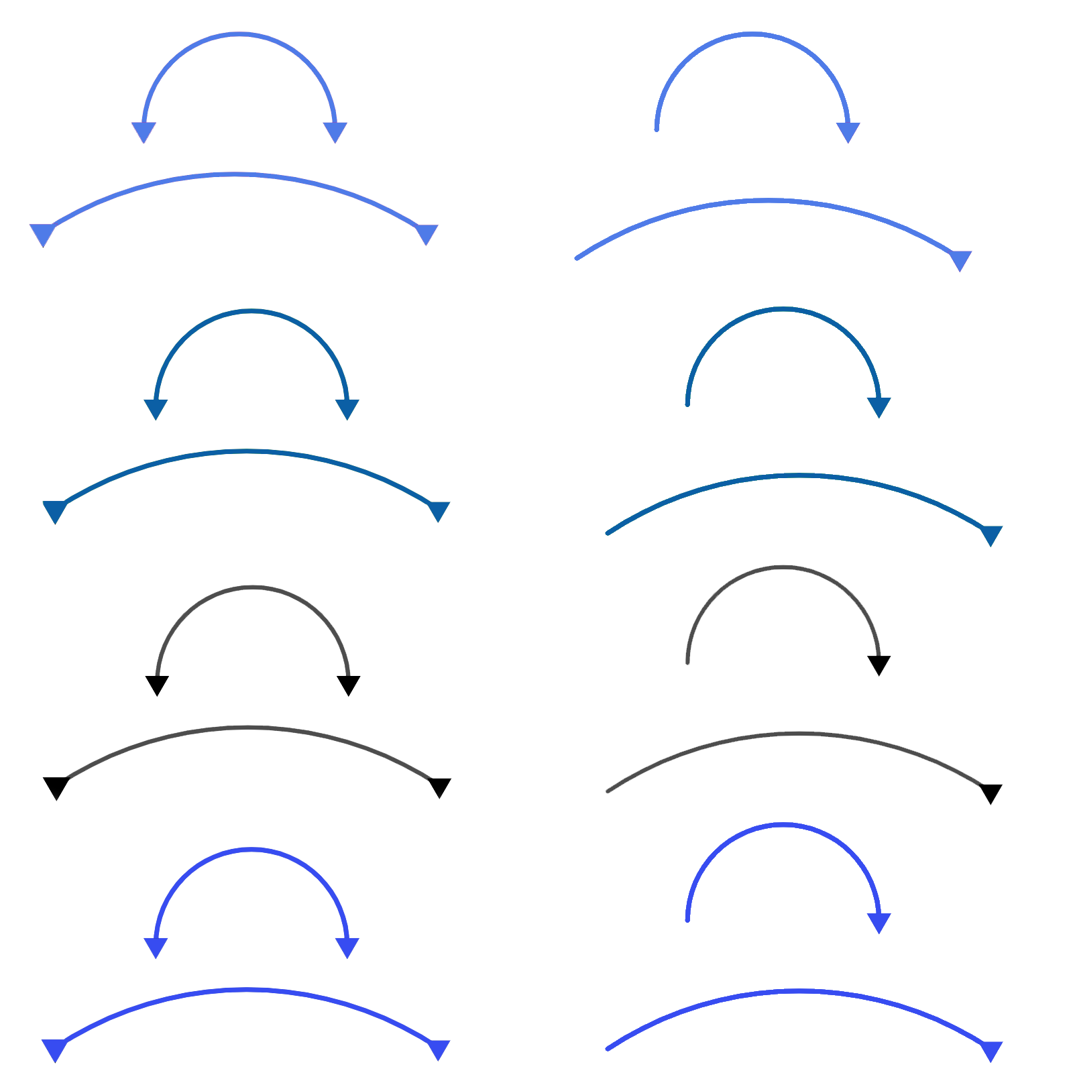

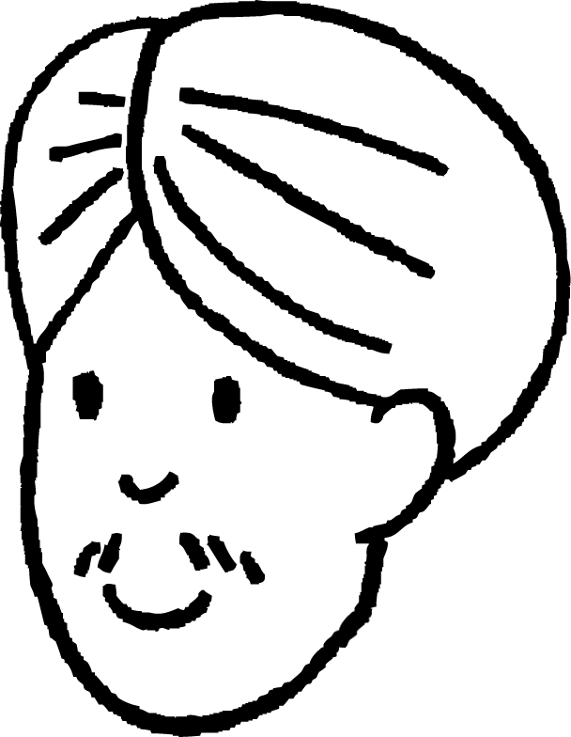

Taxanayaal kale (Other sequences)
Ma arki kartaa qaabab (patterns) taxanahan?
1, 3, 7, 15, 31, ….
Waa wax xiiso leh farqiga u dhexeeya xubnaha isku xiga waxay sameeyaan taxane joomatari (geometric sequence)….
+2
+4
+8
+16
+32
×2
×2
×2
×2
Cali
Ma heli kartaa laba siyaabood oo aad ku xisaabiso xubnaha xiga?
31 × 2 + 1 = 63
31 + 32 = 63
Ma abuuri kartaa taxane kale oo farqigu yahay taxane joomatari (geometric sequence)?

Slide 11
Taxanayaal kale (Other sequences)
Ma abuuri kartaa taxane kale oo farqigu yahay taxane joomatari (geometric sequence)?
Taxanayaasha joomatari (geometric sequences) laftoodu waxay leeyihiin sifadan
5, 15, 45, 135, …
Ama taxanayaal kale oo xeerka xubnaha isku xigga uu leeyahay tillaabo isku dhufasho (multiplicative) iyo tillaabo isku dar (additive)
2, 4, 10, 28
+10
+30
+90
+2
+6
+18
×3
×3
×3
×3
Xeerka xubnaha isku xiga 'ku dhufo 3 kana jar 2'

Slide 12

Taxanayaal kale (Other sequences)
Waa kuwan taxanayaal tiro iyo xeerar. Xeerkee ayaa u noqon kara xeer taxane kasta? Isku qiyaas?
a
1, 2, 5, 14, 41, …
Ku dar labada xubnood ee hore si aad u hesho xubnaha xiga
Ku dhufo 1, ku dhufo 2, ku dhufo 3, ku dhufo 4, ……
b
1, 2, 3, 5, 8, …
Ku dar 1, ku dhufo 1, ku dar 2, ku dhufo 2, ku dar 3, ku dhufo 3, ……
c
3, 4, 4, 7, 10, …
Saddex laab xubnaha hore (treble) kana jar 1 si aad u hesho xubnaha xiga
d
1, 2, 2, 4, 8, …
Tirada xarfaha ee higgaadda Ingiriisiga ee tirooyinka laba jibaaran (square numbers) (sida kor u kaca)
e
1, 1, 2, 6, 24, …

Slide 13
Taxanayaal kale (Other sequences)
1) Labada xubnood ee bilowga ah, sii wad taxanaha saddex siyaabood oo kala duwan. Sharax xeerka aad u adeegsatay si kasta.
2, 6, , , , …
−1, 5, , , , …
8, 3, , , , …
11, 13, , , , …

Slide 14
Taxanayaal kale (Other sequences)
2) Taxan kasta, soo jeedi waxa ay noqon karaan labada xubnood ee xiga. Sharax sababtaada.
2, 3, 8, , , …
31, 29, 31, , , …
3, 20, 190, , , …
2, 4, 16, , , …
8, 5, 4, 9, , , …

Slide 15
Taxanayaal kale (Other sequences)
1) Labada xubnood ee bilowga ah, sii wad taxanaha saddex siyaabood oo kala duwan. Sharax qaanuunka (rule) aad u adeegsatay si kasta.
Jawaabo badan ayaa su'aasha kasta jira, kuwani waa qaar ka mid ah fikradaha.
2, 6, , , , …
−1, 5, , , , …
Tusaale: 2, 6, 18, 54, 162 (isku-dhufasho guud (common multiplier) ×3 xubnaha dhexdooda)
2, 6, 10, 14, 18, … (kala-duwanaansho guud (common difference) +4 xubnaha dhexdooda)
2, 6, 12, 20, 10, … (ku dar 4, ku dar 6, ku dar 8,... Kala-duwanaansho labaad oo guud (common second difference) +2)
Tusaale: −1, 5, −25, 125, −625 (isku-dhufasho guud (common multiplier) ×−5 xubnaha dhexdooda)
−1, 5, 4, 9, 13 (ku dar labada xubnood ee hore si aad u hesho xubinta xigta)

Slide 16
Taxanayaal kale (Other sequences)
1) Labada xubnood ee bilowga ah, sii wad taxanaha saddex siyaabood oo kala duwan. Sharax qaanuunka (rule) aad u adeegsatay si kasta.
Jawaabo badan ayaa su'aasha kasta jira, kuwani waa qaar ka mid ah fikradaha.
8, 3, , , , …
11, 13, , , , …
Tusaale: 8, 3, −1, −4, −6 (ku dar −5, ku dar −4, ku dar −3, Kala-duwanaansho labaad oo guud (common second difference) +1)
8, 3, −2, −7, −12, … (kala-duwanaansho guud (common difference) +(−5) xubnaha dhexdooda)
Tusaale: 11, 13, 15, 17, 19, … (kala-duwanaansho guud (common difference) +2 xubnaha dhexdooda)
11, 13, 17, 19, 23 (Tirooyinka asaasiga ah (Prime numbers) ka weyn 10)
11, 13, 16, 20, 35 (Tirooyinka saddex-xagalka (Triangular numbers) ku dar 10)

Slide 17
Taxanayaal kale (Other sequences)
2) Taxanayaashan kasta, soo jeedi waxa labada xubnood ee xiga noqon karaan. Sharax sababtaada.
Jawaabo dhowr ah ayaa su'aasha kasta jira. Hal soo-jeedin ayaa mid kasta loo bixiyay.
2, 3, 8, 17, 30, …
31, 29, 31, 29, 31, …
3, 20, 190, 1890, 18890, …
2, 4, 16, 256, 65536, …
8, 5, 4, 9, 6, 5, …
Ku dar 1, ku dar 5, ku dar 9, kala-duwanaansho labaad oo guud (common second difference) +4
Taxane u dhexeeya 31 iyo 29 (Sequence oscillating between 31 and 29)
Ku dar 17, ku dar 170, ku dar 1700, kala-duwanaanshaha waxaa lagu dhuftay 10 mar kasta.
Ereyga hore oo labajibbaaran (squared) wuxuu siinayaa ereyga xiga
Ka jar 3, ka jar 1, ku dar 5, qaab soo noqnoqda.

Slide 18
Kordhinta taxanaha (Extrapolating a sequence)
Taxanayaal kale (Other sequences)
Kordhinta taxanaha (Extrapolating a sequence)

Slide 19
Kordhinta taxanaha (Extrapolating a sequence)
Waxaan aragnay taxanayaal ka bilaabma qiime (value) isku mid ah laakiin raacaya xeerar (rules) kala duwan.
Waxaa suurtogal ah in xeer (rule) uu u muuqdo inuu shaqeeyo tiro ereyo ah, ka dibna uu ku guuldareysto ereyada xiga.
Maxaad u malaynaysaa?
Imisa erey oo taxane ah ayaa loo baahan yahay si aan u ogaanno xeerka (rule) si hubaal ah?
Waxaan hadda sahamin doonnaa tan.
Suad

Slide 20
Kordhinta taxanaha (Extrapolating a sequence)
Waxaan helay taxane aan tijaabino. Wuxuu ku bilaabmaa lambarka 6.
Hal erey kuma filna in lagu go'aamiyo xeer (rule). Waxaan ku dabaqi karnaa xeer kasta oo erey-ka-ereyga ah lambarka 6.
Cali
Ereyga labaad waa 7.
Ma hadda waxaan go'aamin karnaa xeer (rule)?
Waxaan heli karnaa xeerar (rules) u shaqeeya labadan erey, tusaale: 6, 7, 8, 9, … farqiga guud (common difference) waa 1.
Hase yeeshee, waxaa jira tiro aan xad lahayn oo xeerar (rules) ah oo shaqeyn kara. Ma hubin karno inaan ognahay sida loo soo saaro ereyga xiga macluumaadkan.

Slide 21
Kordhinta taxanaha (Extrapolating a sequence)
Lambarka saddexaad ee taxanaha Cali waa 9. Marka taxanihiisu waa: 6, 7, 9,..
Tani ma noqon karto taxane xisaabeed (arithmetic sequence) ama joomatari (geometric sequence)
Waa taxane laba jibaaran (quadratic sequence), waxay ku dartaa 1, ka dib 2 marka xiga waxay ku dari doontaa 3
Axmed
Suad
Ma ku raacsan tahay mid ka mid ah labada hadal?
Suad waa sax, ma jiro kala duwanaansho guud (common difference) ama saami guud (common ratio) marka kuwani ma noqon karaan 3-xidhaha ugu horreeya ee taxane toosan (linear sequence) ama joomatari (geometric sequence).
Waxay noqon kartaa laba jibaaran (quadratic) si kastaba ha ahaatee ma naqaano inay hubaal tahay inay tahay laba jibaaran (quadratic).

Slide 22
Kordhinta taxanaha (Extrapolating a sequence)
Xigaalku waa 12 marka taxanaha Cali ilaa hadda wuxuu u eg yahay 6, 7, 9, 12, …
Marka waa laba jibaaran (quadratic) sababtoo ah 9 + 3 = 12
Axmed
Qaanuunka Axmed ilaa hadda wuxuu u shaqeeyay dhammaan xubnaha. Taasi ma ku filan tahay si loo hubiyo qaanuunku waa maxay?
Maya, weli ma jiro dammaanad in qaanuunka Axmed uu sii shaqeyn doono. Xaqiiqdii, iyada oo aan la garanayn qaanuun, ma aanan u qaadan karin inaan ognahay sida taxanuhu u sii socon doono xataa haddii nala siiyo xubno badan.

Slide 23
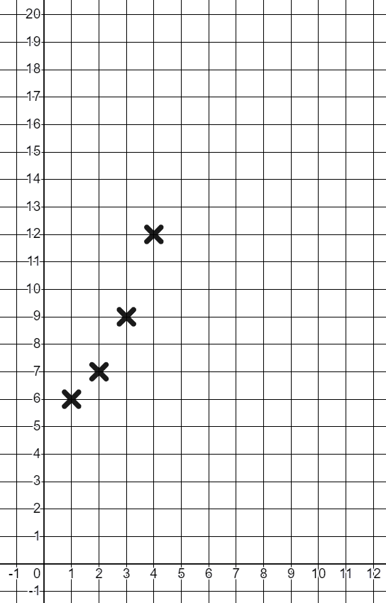
Kordhinta taxanaha (Extrapolating a sequence)
Xubnahani waxay dhab ahaantii yihiin celceliska heerkulka maalinta ee magaaladayda hooyo bil kasta oo sanadka ah. (°C)
Heerkulka °C
Cali
Ku sawirista garaaf (graph) ayaa laga yaabaa inay naga caawiso inaan aragno isbeddel (trend).
Haddii xubinta koowaad ay mataleyso celceliska heerkulka maalinta ee Janaayo, maxaad u malaynaysaa inuu noqon doono xubinta 5-aad?
Bilaha sanadka (Jan-Dec)

Slide 24
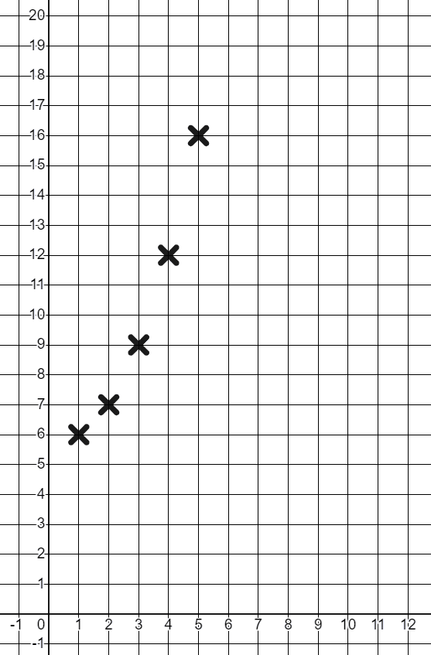
Kordhinta taxanaha (Extrapolating a sequence)
Waxaan arki karnaa inuu jiro isbeddel guud (general trend) oo ku jira qiimayaasha (values). Heerkulku wuu kordhayaa. Heerka ay u kordhayaan ayaa sii kordhaya. Ma u malaynaysaa in tani sii socon doonto?
Bisha xigta waa May, marka heerkulka (temperature) waxaa la filayaa inuu mar kale kordho.
Dhab ahaan, heerkulka (temperature) celceliska bisha May wuxuu ahaa 16°C
Tani wali waxay raacaysaa qaanuunkayga 12 + 4 = 16
Axmed

Slide 25
Kordhinta taxanaha (Extrapolating a sequence)
Tani waxay noqon kartaa kiiska taxanaha (sequences) xisaabeed oo dheeri ah.
Tusaale ahaan, tirooyinka asalka ah (prime numbers) ee ka weyn 2 waxay ku bilaabmaan
3, 5, 7,...
Tani waxay u egtahay taxane xisaabeed (arithmetic sequence) oo leh farqiga guud (common difference) 2
Hase yeeshee, shanta xubnood ee xiga waa
3, 5, 7, 11, 13, 17, 19, 23, ….
+2
+4
+2
+4
+2
+4
Hadda waxaa muuqda qaab cusub oo soo baxaya, ma sii socotaa?
Maya, xubinta xigta waxay noqonaysaa 25 taas oo aan ahayn tiro asal ah (prime).

Slide 26
Kordhinta taxanaha (Extrapolating a sequence)
Jadwalka hoose wuxuu muujinayaa qadarka lacagta ku jirta akoonka kaydka (savings account) dhamaadka bisha.
Maxaad u malaynaysaa inuu dhacayo bishiiba?
Maxaad saadaalisaa qiimaha (value) akoonka inuu noqdo dhamaadka December?
Bilaha | Aug | Sept | Oct | Nov | Dec
Keydinta (£) | 1253 | 1443 | 1633 | 1823
£190 waa la kaydinayaa. Inta badan dadku waxay kaydiyaan qadar isku mid ah bishiiba maxaa yeelay waa boqolkiiba (percentage) dakhligooda.
Waxaan u qaadan karnaa in isbeddelkani sii socdo, marka £2013

Slide 27
Kordhinta (Extrapolating) taxanaha (sequence)
Jadwalka hoose wuxuu muujinayaa lacagta ku jirta akoonka keydinta (savings account) dhamaadka bisha.
3) Qiimaha (value) dhabta ahi waa £1900. Maxay tahay sababta?
Bilaha (Months) | Aug | Sept | Oct | Nov | Dec
Keydinta (£) | 1253 | 1443 | 1633 | 1823 | 1900
Bisha Dec dadku inta badan waxay keydiyaan wax yar, sababtoo ah waxay ku bixiyaan wax badan fasaxyada.
Ma aanan qaadan karin in isbeddelka (trend) uu sii socon doono.

Slide 28
Kordhinta (Extrapolating) taxanaha (sequence)
Waxaad baari doontaa qaababka (patterns) laga helo marka dhibcaha (points) lagu calaamadeeyo goobo (circle) laguna xiro xariiq toosan (straight lines).
Dhibic kasta waxaa lagu xiri doonaa xariiq toosan (straight line) oo mararka qaar waxay abuuri doontaa gobollo (regions) iyo isgoysyo (intersections).
Dhibcaha (Points)
e.g.
×
×
Xariiqyada (Lines)
e.g.
×
×
Gobollada (Regions)
e.g.
Isgoysyada (Intersections)
(halka ay laba xariiq iskaga gudbaan)

Slide 29
Kordhinta (Extrapolating) taxane (sequence)
Waxaad baari doontaa qaababka (patterns) laga helo marka dhibco (points) lagu calaamadiyo goobo (circle) laguna xiro xariiqo toosan (straight lines).
Tusaalahan waxaa ku yaal 4 dhibcood, 6 xariiq, 1 isgoys iyo 8 gobol.
Dhibco (Points)
e.g.
×
×
Xariiqo (Lines)
e.g.
×
×
Gobollo (Regions)
e.g.
Isgoysyada (Intersections)
(halka ay laba xariiq isku gooyaan)

Slide 30
Kordhinta (Extrapolating) taxane (sequence)
Ku bilow goobo (circle) oo leh hal dhibic (point) oo calaamadeysan.
Goobada lafteedu waa 1 gobol.
Sidaas darteed waxaa jira 1 gobol.
×
Maadaama ay jirto hal dhibic oo keliya, ma aanu ku xiri karno dhibcaha xariiq. Sidaas darteed waxaa jira 0 xariiq.
Maadaama aysan jirin xariiqo, ma jiraan dhibco ay xariiqyadu isku gooyaan, sidaas darteed 0 isgoys.

Slide 31
Kordhinta (Extrapolating) taxane (sequence)
Hadda aan eegno laba dhibcood.
×
×
×
Laba dhibcood waxaa lagu xiri karaa xariiq toosan (straight line). Sidaas darteed waxaa jira 1 xariiq.
Ma jiraan dhibco ay xariiqyadu isku gooyaan, sidaas darteed 0 isgoys.
Xariiqdu waxay u kala qaybisaa goobada 2 gobol.

Slide 32
Kordhinta (Extrapolating) taxane (sequence)
1) Waa kuwan shax (table) aad ku duubi waxaad helayso.
×
×
×
Tirada dhibcaha goobada (Number of points on the circle) | 1 | 2 | 3 | 4
Number of lines | 0
Number of intersections | 0
Number of regions | 1
a) Buuxi shaxda 2 dhibcood.
b) Fill in the table for 3 points and 4 points.
c) Describe any patterns you notice.
×
×
×
×
×
×
×

Slide 33
Extrapolating a sequence
1) Fill in this table to investigate patterns found when points around a circle are joined with straight lines.
Tirada dhibcaha goobada (Number of points on the circle) | 1 | 2 | 3 | 4 | 5
Number of lines | 0
Number of intersections | 0
Number of regions | 1
×
d) Samee saadaal waxa tiirka 5aad u eg doono.
e) Use the circle given to fill in the 5th column.
f) Ma sax ahayd? Qaababkaagu ma isbeddeen?
×
×
×
×

Slide 34
Extrapolating a sequence
1) Fill in this table to investigate patterns found when points around a circle are joined with straight lines.
Tirada dhibcaha goobada (Number of points on the circle) | 1 | 2 | 3 | 4 | 5 | 6
Number of lines | 0
Tirada isgoysyada (Number of intersections) | 0
Tirada gobollada (Number of regions) | 1
×
g) Samee saadaal waxa tiirka 6aad u eg doono.
h) Use the circle given to fill in the 6th column.
i) Ma sax ahayd? Qor jumlad sharraxaysa waxaad ogaatay.
×
×
×
×
×

Slide 35
Kordhinta taxanaha (Extrapolating a sequence)
1) Buuxi shaxdan si aad u baarto qaababka laga helo marka dhibco ku wareegsan goobo lagu xiro xariiqo toos ah.
Tirada dhibcaha ee goobada | 1 | 2 | 3 | 4 | 5 | 6
Tirada xariiqyada | 0
Tirada isgoysyada (Number of intersections) | 0
Tirada gobollada (Number of regions) | 1
j) Ma u malaynaysaa inaad heshay qaabab sii soconaya? Qor jumlad sharraxaysa sababta.

Slide 36
Kordhinta taxanaha (Extrapolating a sequence)
1) Waa kuwan shax lagu duubi waxa aad hesho.
×
×
×
Tirada dhibcaha ee goobada | 1 | 2 | 3 | 4
Tirada xariiqyada | 0 | 1
Tirada isgoysyada (Number of intersections) | 0 | 0
Tirada gobollada (Number of regions) | 1 | 2
a) Buuxi shaxda 2 dhibcood. Eeg shaxda

Slide 37
Kordhinta taxanaha (Extrapolating a sequence)
1)
Tirada dhibcaha ee goobada | 1 | 2 | 3 | 4
Tirada xariiqyada | 0 | 1 | 3 | 6
Tirada isgoysyada (Number of intersections) | 0 | 0 | 0 | 1
Tirada gobollada (Number of regions) | 1 | 2 | 4 | 8
×
×
b) Buuxi shaxda 3 dhibcood iyo 4 dhibcood.
c) Sharax qaababka aad dareento.
3
1
4
1
2
3
2
×
×
×
5
6
×
4
7
8
×
Tusaale: tirada khadadka waxay kordhaa 1, markaas 2, markaas 3, …. Ereyga 2 iyo wixii ka dambeeya waa tiro saddex-xagal (triangular numbers).
Tirada gobollada (Number of regions) waa 4-ka erey ee ugu horreeya ee taxane joomatari (geometric sequence).

Slide 38
Kordhinta taxanaha (Extrapolating a sequence)
1)
Tirada dhibcaha goobada (Number of points on the circle) | 1 | 2 | 3 | 4 | 5
Tirada khadadka (Number of lines) | 0 | 1 | 3 | 6 | 10
Tirada is-goysyada (Number of intersections) | 0 | 0 | 0 | 1 | 5
Tirada gobollada (Number of regions) | 1 | 2 | 4 | 8 | 16
×
d) Samee saadaal ku saabsan sida tiirka 5-aad u ekaan doono.
e) Isticmaal goobada la siiyay si aad u buuxiso tiirka 5-aad.
f) Miyaad sax ahayd, qaababkaagu miyay isbeddeen?
Tirada khadadka iyo gobollada (Number of regions) waxay sii wadeen qaab isku mid ah
Ereyo ku filan ma jiraan si loo arko qaab is-goysyada (intersections)
×
×
×
×

Slide 39
Kordhinta taxanaha (Extrapolating a sequence)
Tirada dhibcaha goobada (Number of points on the circle) | 1 | 2 | 3 | 4 | 5 | 6
Tirada khadadka (Number of lines) | 0 | 1 | 3 | 6 | 10 | 15
Tirada is-goysyada (Number of intersections) | 0 | 0 | 0 | 1 | 5 | 13
Tirada gobollada (Number of regions) | 1 | 2 | 4 | 8 | 16 | 30
1)
×
g) Samee saadaal ku saabsan sida tiirka 6-aad u ekaan doono.
h) Isticmaal goobada la siiyay si aad u buuxiso tiirka 6-aad.
i) Miyaad sax ahayd? Ku qor jumlad sharraxaysa waxaad heshay: Jawaabtaadu waxay ku jiri kartaa,
Tirada gobollada (Number of regions) waxay u egtahay joomatari (geometric) laakiin tani kuma sii socon qaabka 6-aad. Tirada khadadka qaabka 2 iyo wixii ka dambeeya waa tiro saddex-xagal (triangular numbers). Tirada is-goysyada (Number of intersections) waxay yeelan kartaa qaab laakiin ereyo dheeri ah ayaa loo baahan yahay.
×
×
×
×
×

Slide 40
Kordhinta taxanaha (Extrapolating a sequence)
1) Buuxi shaxdan si aad u baarto qaababka (patterns) laga helo marka dhibcaha ku wareegsan goobada (circle) lagu xiro xariiqyo toos ah (straight lines).
Tirada dhibcaha ee goobada | 1 | 2 | 3 | 4 | 5 | 6
Tirada xariiqyada (lines) | 0 | 1 | 3 | 6 | 10 | 15
Tirada isgoysyada (intersections) | 0 | 0 | 0 | 1 | 5 | 13
Tirada gobollada (regions) | 1 | 2 | 4 | 8 | 16 | 30
j) Ma waxaad u malaynaysaa inaad heshay qaabab (patterns) sii socon doona? Qor jumlad sharraxaysa sababta.
Tirada xariiqyada (lines) waxay sii ahaan doontaa tirooyinka saddexagalka (triangular numbers) maadaama dhibic kasta lagu xiro dhibic kasta oo kale. Taxanaha tirooyinka saddexagalka waa la mid tirada isku xirka (connections) ee u dhexeeya 2, 3, 4, 5, … shay. Ma cadda sida labada qaab ee kale ay u sii socon doonaan heerkan.

Slide 41
Kordhinta taxanaha (Extrapolating a sequence)
Ma aha dhammaan taxanayaasha tirooyinka (numerical sequences) inay raacaan xeer xisaabeed (mathematical rule).
Taxane tiro (numerical sequence) waa koox tirooyin ah oo loo qoray si nidaamsan.
Haddii aad taqaanid dhawr erey (terms) oo keliya oo taxane ah, waxaa suurtogal ah in taxanuhu sii socdo siyaabo kala duwan.
Xataa haddii qaab (pattern) uu ku dhaco ereyo badan, ma jiro dammaanad ah inuu sii socon doono.
Helista qaababka (patterns) waxay kaa caawin kartaa inaad sameyso saadaal (predictions) laakiin kuwani had iyo jeer ma noqdaan kuwa sax ah.

