Slide 1
Astaamaha isku xigxiga joomatari (geometric sequences)
Xiriirro aan toos ahayn (Non-linear relationships)

Slide 2
sida loo isticmaalo darasyada Oak

Slide 3
Waxaan qiimeyn karaa astaamaha isku xigxiga joomatari (geometric sequence).

Slide 4
Isku xigxiga joomatari (geometric sequence) waa isku xigxig leh xiriir isku dhufasho joogto ah oo u dhexeeya xubnaha isku xigxiga.
Saami guud (common ratio) waa astaan muhiim u ah isku xigxiga joomatari (geometric sequence). Isku dhufashada joogtada ah ee u dhexeysa xubnaha isku xigxiga waxaa loo yaqaan saamiga guud (common ratio).

Slide 5

Astaamaha isku xigxiga joomatari (geometric sequences)
Aqoonsiga isku xigxiga joomatari (geometric sequences)
Abuurista isku xigxiga joomatari (geometric sequences)

Slide 6
Aqoonsiga isku xigxiga joomatari (geometric sequences)
Ma garan kartaa qaababka oo ma heli kartaa saddexda xubnood ee xiga ee isku xigxigan?
7, | 12, | 17, | 22, | 27, | 32, | 37, | 42, …
+5
+5
+5
+5
+5
+5
+5
Kala duwanaanshaha isku darka (additive) ee guud ee u dhexeeya xubnaha ayaa ka dhigaya kuwan isku xigxig xisaabeed (arithmetic) (toosan (linear)).
7, | 17, | 27, | 37, | 47, | 57, | 67, | 77, …
+10
+10
+10
+10
+10
+10
+10
28, | 19, | 10, | 1, | −8, | −17, | −26, | −35, | …
−9
−9
−9
−9
−9
−9
−9

Slide 7
Aqoonsiga isku xigxiga joomatari (geometric sequences)
Ma garan kartaa qaababka oo ma heli kartaa xubnaha xiga?
5, | 10, | 15, | 20, | 25, | 30, | …
Kala duwanaanshaha isku darka (additive) ee guud - Isku xigxig xisaabeed (arithmetic) (toosan (linear)).
+5
+5
+5
+5
+5
5, | 10, | 20, | 35, | 55, | 80, | …
Ma jiro kala duwanaansho isku darka (additive) oo guud.
Kala duwanaansho 2aad oo guud - Kani waa nooc gaar ah oo isku xigxig aan toos ahayn (non-linear sequence).
+5
+10
+15
+20
+25
+5
+5
+5
+5
5, | 10, | 20, | 40, | 80, | 160, | …
Ma jiro kala duwanaansho isku darka (additive) oo guud, laakiin waxaa jira qaab.
+5
+10
+20
+40
+80

Slide 8
Aqoonsiga isku xigxiga joomatari (geometric sequences)
Isku xigxiggan dambe waa nooc gaar ah oo isku xigxig.
5, | 10, | 20, | 40, | 80, | 160, | …
+5
+10
+20
+40
+80
Tan waxay caddaynaysaa in kani yahay nooc aad u gaar ah oo isku xigxig.
+5
+10
+20
+40
+80
+5
+10
+20
+40
+80
5, | 10, | 20, | 40, | 80, | 160, | …
Ma raadin karnaa kala duwanaansho 2aad oo guud?...
+5
+10
+20
+40
+80

Slide 9
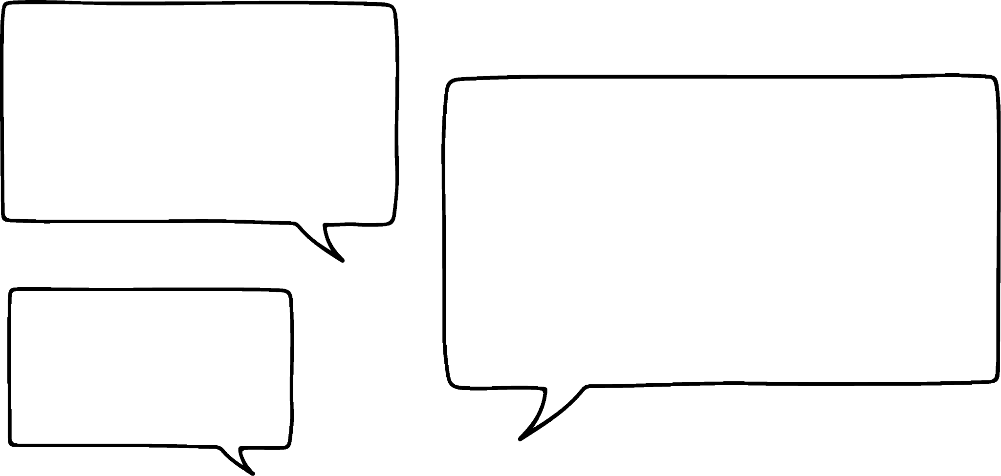


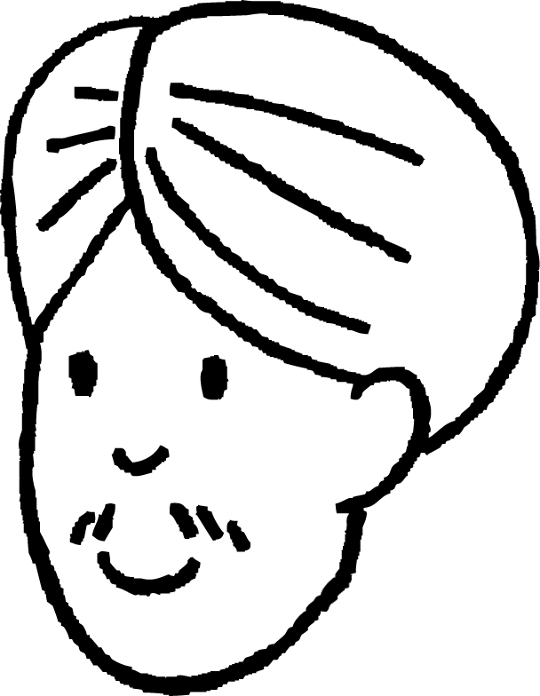
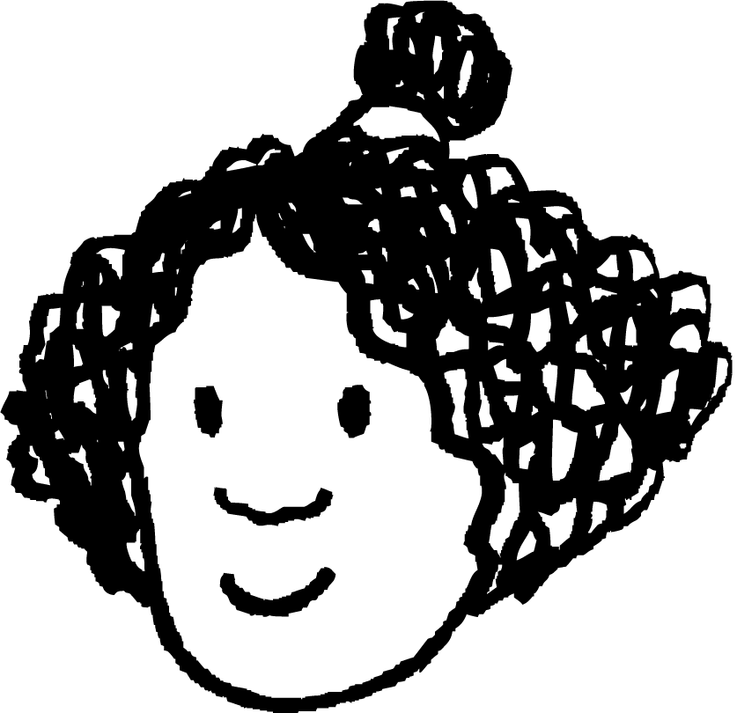


Aqoonsiga taxanaha joomatari (geometric sequences)
Taxanahan ugu dambeeya waa nooc gaar ah oo taxane (sequence) ah.
5 + 5
10 + 10
20 + 20
40 + 40
80 + 80
Waxaan u malaynayaa inaan arko hab ka hufan oo aan ahayn mid isku-darka (additive) ah.
Kan ayaan jeclahay. Waxaan u arkaa taxane "isku-dar nafteeda" (Add itself).
Cali
Isra
5, | 10, | 20, | 40, | 80, | 160, | …
Ma arki kartaa waxa Isra aragtay?
+5
+10
+20
+40
+80

Slide 10
Aqoonsiga taxanaha joomatari (geometric sequences)
Taxanahan ugu dambeeya waa nooc gaar ah oo taxane (sequence) ah.
5 + 5 | = | 5 × 2
10 + 10
20 + 20
40 + 40
80 + 80
5 + 5
10 + 10
20 + 20
40 + 40
80 + 80
5 + 5 | = | 5 × 2
10 + 10 | = | 10 × 2
20 + 20 | = | 20 × 2
40 + 40 | = | 40 × 2
80 + 80 | = | 80 × 2
5 + 5
10 + 10
20 + 20
40 + 40
80 + 80
5 + 5 | = | 5 × 2
10 + 10 | = | 10 × 2
20 + 20
40 + 40
80 + 80
5 + 5 | = | 5 × 2
10 + 10 | = | 10 × 2
20 + 20 | = | 20 × 2
40 + 40
80 + 80
5 + 5 | = | 5 × 2
10 + 10 | = | 10 × 2
20 + 20 | = | 20 × 2
40 + 40 | = | 40 × 2
80 + 80
Dhab ahaantii waa taxane isku-dhufasho (multiplicative sequence)!
Cali
Isra
5, | 10, | 20, | 40, | 80, | 160, | …
+5
+10
+20
+40
+80

Slide 11
Aqoonsiga taxanaha joomatari (geometric sequences)
Taxanahan ugu dambeeya waa nooc gaar ah oo taxane (sequence) ah.
Taasi aad bay u hufan tahay Isra. Si fiican ayaad u aragtay!
5 + 5 | = | 5 × 2
10 + 10 | = | 10 × 2
20 + 20 | = | 20 × 2
40 + 40 | = | 40 × 2
80 + 80 | = | 80 × 2
Dhab ahaantii waa taxane isku-dhufasho (multiplicative sequence)!
Cali
Isra
5, | 10, | 20, | 40, | 80, | 160, | …
×2
×2
×2
×2
×2

Slide 12
Aqoonsiga taxanaha joomatari (geometric sequences)
Isticmaal qaanuunka xilli-ilaa-xilli (term-to-term rule) ee Isra si aad u hesho saddexda xilli ee xiga.
5, | 10, | 20, | 40, | 80, | 160, | 320, | 640, | 1280, | …
×2
×2
×2
×2
×2
×2
×2
×2
Taxanaha leh xiriir isku-dhufasho (multiplicative) oo guud oo u dhexeeya xilliyada is-xiga waxaa loo yaqaan taxanaha joomatari (geometric sequences).

Slide 13

Aqoonsiga taxanaha joomatari (Geometric sequences)
Taxanaha joomatari (Geometric sequences) waxay leeyihiin farqi isku mid ah oo lagu daro (additive) oo u dhexeeya xubnaha isku xiga.
Qaanuunka guud ee xilli-ilaa-xilli (term-to-term rule) ee taxanaha joomatari (geometric sequence) waa isku-dhufasho (multiplicative).
Qaanuunka guud ee xubnaha taxanaha joomatari (Geometric sequences) waa isku darka (additive).

Slide 14
Aqoonsiga taxanaha joomatari (Geometric sequences)
Raadi shanta xubnood ee xiga ee taxanahan joomatari (Geometric sequences).
2, | 6, | 18, | 54, | 162, | 486, | 1458, | 4374, | …
×3
×3
×3
×3
×3
×3
×3
Taxanaha joomatari (Geometric sequences) waxay leeyihiin xiriir isku dhufasho (multiplicative) oo u dhexeeya xubnaha isku xiga.

Slide 15
Aqoonsiga taxanaha joomatari (Geometric sequences)
Waa maxay farqiga u dhexeeya dabeecadda labadan taxane?
2, | 4, | 6, | 8, | 10, | …
Farqi isku mid ah oo lagu daro (additive) oo u dhexeeya xubnaha.
Taxane toosan (arithmetic) (linear (arithmetic) sequence).
+2
+2
+2
+2
2, | 4, | 8, | 16, | 32, | …
Xiriir isku dhufasho (multiplicative) oo u dhexeeya xubnaha isku xiga. Taxane joomatari (geometric sequence).
×2
×2
×2
×2

Slide 16

Aqoonsiga taxanaha joomatari (Geometric sequences)
Cali iyo Isra waxay eegayaan taxanahan.
1, | 2, | 6, | 24, | 120, | 720, | …
×2
×3
×4
×5
×6
Taxanahan waa isku dhufasho (multiplicative) oo u dhexeeya xubnaha. Ma macnaheedu waa inuu yahay joomatari (geometric)?
Maya. Iska jir! Waa inay tahay isku dhufasho (multiplier) isku mid ah oo u dhexeeya xubnaha.
Maxaad u malaynaysaa?
Taxanaha joomatari (Geometric sequences) waxay leeyihiin xiriir isku dhufasho (multiplicative) oo u dhexeeya xubnaha isku xiga.

Slide 17
Aqoonsiga taxanaha joomatari (Geometric sequences)
Taxanaha joomatari (Geometric sequences) waxay leeyihiin __________ xiriir isku dhufasho (multiplicative) oo u dhexeeya xubnaha isku xiga.
mid guud (a common)
koraya (an increasing)
isku mid ah (a common)
isku darka (an additive)

Slide 18
Aqoonsiga taxanaha joomatari (geometric sequences)
1) Kala saar taxanahan (sequences) kuwa joomatari (geometric), xisaabeed (arithmetic) iyo 'kuwa kale'.
a) 1, 2, 3, 4, 5, …
g) 4, 16, 30, 46, 64, …
b) 1, 2, 4, 8, 16, …
h) 10, 15, 20, 30, 40, …
c) 1, 2, 5, 10, 17, …
i) 10, 40, 70, 100, 130, …
d) −1, −2, −4, −8, −16, …
j) 10, 20, 60, 240, 1200, …
e) 1, 4, 16, 64, …
k) 10, 20, 40, 80, 160, …
f) 4, 16, 28, 40, 52, …
l) 10, 100, 1000, 10 000, …

Slide 19
Aqoonsiga taxanaha joomatari (geometric sequences)
1) Kala saar taxanahan (sequences) kuwa joomatari (geometric), xisaabeed (arithmetic) iyo 'kuwa kale'.
Taxanaha joomatari (Geometric sequences)
×4
e) 1, 4, 16, 64, …
×2
b) 1, 2, 4, 8, 16, …
k) 10, 20, 40, 80, 160, …
×2
×2
d) −1, −2, −4, −8, −16, …
×10
l) 10, 100, 1000, 10 000, …
+12
Taxanaha xisaabeed (Arithmetic sequences)
f) 4, 16, 28, 40, 52, …
+1
+30
a) 1, 2, 3, 4, 5, …
i) 10, 40, 70, 100, 130, …
Taxanaha kale (Other sequences)
c) 1, 2, 5, 10, 17, …
h) 10, 15, 20, 30, 40, …
+1
+3
+5
+7
+5
+5
+10
+10
g) 4, 16, 30, 46, 64, …
j) 10, 20, 60, 240, 1200, …
+12
+14
+16
+18
×2
×3
×4
×5

Slide 20
Astaamaha taxanaha joomatari (Features of geometric sequences)
Aqoonsiga taxanaha joomatari (geometric sequences)
Abuurista taxanaha joomatari (Generating geometric sequences)

Slide 21


Abuurista taxanaha joomatari (Generating geometric sequences)
Cabdi iyo Layla waxay abuuraan taxanayaal joomatari (geometric sequences).
Waxaan bilaabayaa xubin koobaad (first term) oo ah 1 oo waxaan adeegsanayaa saami guud (common ratio) oo ah 5 ee u dhexeeya xubnaha (terms).
1, | 5, | 25, | 125, | 625, | …
×5
×5
×5
×5
Waxaan u malaynayaa inaan abuuri karo isla taxanaha (sequence) anigoo ka bilaabaya 1 oo adeegsanaya saamiga (ratio) 1 : 5 ee u dhexeeya xubnaha (terms).
Ma ku raacsan tahay Layla?

Slide 22
Abuurista taxanaha joomatari (Generating geometric sequences)
Cabdi iyo Layla waxay abuuraan taxanayaal joomatari (geometric sequences).
×5
1, | 5, | 25, | 125, | 625, | …
1 | : | 5
5 | : | 25
25 | : | 125
125 | : | 625
×5
×5
×5
×5
Waxaan u malaynayaa inaan abuuri karo isla taxanaha (sequence) anigoo ka bilaabaya 1 oo adeegsanaya saamiga (ratio) 1 : 5 ee u dhexeeya xubnaha (terms).
Waxaan u isticmaali karnaa saami (ratio) si aan u qeexno xidhiidhka isku dhufashada (multiplicative relationships) ee u dhexeeya xubnaha isku xiga (successive terms) ee taxanaha joomatari (geometric sequence).

Slide 23
Abuurista taxanaha joomatari (Generating geometric sequences)
Cabdi iyo Layla waxay abuuraan taxanayaal joomatari (geometric sequences).
×5
1, | 5, | 25, | 125, | 625, | …
1 | : | 5
5 | : | 25
25 | : | 125
125 | : | 625
×5
×5
×5
×5
Isticmaalka isku dhufashada guud ee 5, ama saamiga 1 : 5 ee u dhexeeya xubnaha waxay soo saartaa isku taxane joomatari (geometric sequence). Luuqadda aan u isticmaalno isku dhufashada guud waa in loogu yeedho saamiga guud (common ratio).

Slide 24
Soo saarista taxanayaasha joomatari (geometric sequences)
Cabdi iyo Layla waxay soo saarayaan taxanayaal joomatari (geometric sequences).
×2
Aan hubiyo inaan tan fahmay Layla! Waxaan ka bilaabi karaa 7 oo aan isticmaali karaa saami 1 : 2 si aan u soo saaro taxane.
1 | : | 2
7 | : | 14
14 | : | 28
28 | : | 56
Waa ku mahadsan tahay Cabdi! Taxanaha 7, 14, 28, 56, …
Taxane joomatari (geometric sequence) oo leh saami guud (common ratio) ah 2

Slide 25

Soo saarista taxanayaasha joomatari (geometric sequences)
Cabdi iyo Layla waxay soo saarayaan taxanayaal joomatari (geometric sequences).
Ma yeelan kartid saami guud (common ratio) oo ah hase yeeshee Layla? Waa inuu ka weyn yahay hal, sax?
Ma ka jawaabi kartaa su'aasha Cabdi?
Waa ku mahadsan tahay Cabdi! Taxanaha 7, 14, 28, 56, …
Taxane joomatari (geometric sequence) oo leh saami guud (common ratio) ah 2

Slide 26
Soo saarista taxanayaasha joomatari (geometric sequences)
Cabdi iyo Layla waxay soo saarayaan taxanayaal joomatari (geometric sequences).
Ma yeelan kartid saami guud (common ratio) oo ah hase yeeshee Layla? Waa inuu ka weyn yahay hal, sax?
2 | : | 1
128 | : | 64
64 | : | 32
32 | : | 16
16 | : | 8
Waa suurtagal! Tusaale ahaan, ku bilow xubinta 1aad ee 128 oo isticmaal saami 2 : 1 oo u dhexeeya xubnaha.

Slide 27
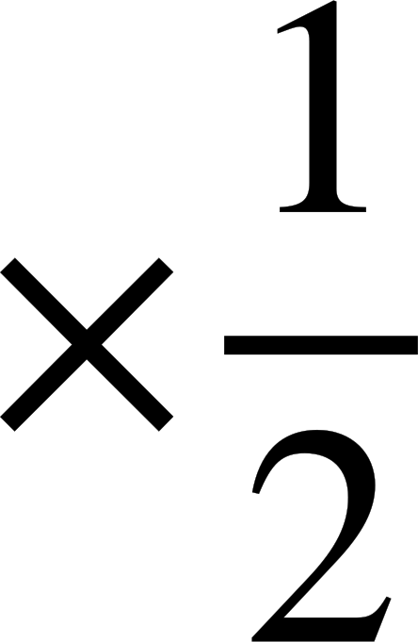
Soo saarista taxanayaasha joomatari (geometric sequences)
Cabdi iyo Layla waxay soo saarayaan taxanayaal joomatari (geometric sequences).
Waa fiican! Taxanaha 128, 64, 32, 16, 8, … Marka isticmaalka saamiga 2 : 1, saami guud (common ratio) oo ah u dhexeeya xubnaha, wuxuu ka dhigayaa taxanaha inuu hoos u dhaco!
2 | : | 1
128 | : | 64
64 | : | 32
32 | : | 16
16 | : | 8
128, 64, 32, 16, 8, …
Waa suurtagal in la yeesho taxanayaal joomatari (geometric sequences) oo hoos u dhacaya.

Slide 28
Soo saarista taxanayaasha joomatari (geometric sequences)
Soo saar shanta xubnood ee ugu horreeya ee taxanaha joomatari (geometric sequence) oo leh xubinta 1aad 81 iyo saami 3 : 4 oo u dhexeeya xubnaha isku xigta.
3 | : | 4
81 | : | 108
108 | : | 144
144 | : | 192
192 | : | 256
81, 108, 144, 192, 256, …

Slide 29
Abuurista taxanaha joomatari (Generating geometric sequences)
Soo saar shanta erey ee ugu horreeya ee taxanaha joomatari (geometric sequence) oo ereyga koowaad yahay 81 iyo saamiga 3 : 4 ee u dhexeeya ereyada isku xiga.
Soo saar shanta erey ee ugu horreeya ee taxanaha joomatari (geometric sequence) oo ereyga koowaad yahay 16 iyo saamiga 2 : 5 ee u dhexeeya ereyada isku xiga.
3 | : | 4
81 | : | 108
108 | : | 144
144 | : | 192
192 | : | 256
2 | : | 5
16 | : | 40
40 | : | 100
100 | : | 250
250 | : | 625
81, 108, 144, 192, 256, …
16, 40, 100, 250, 625, …

Slide 30
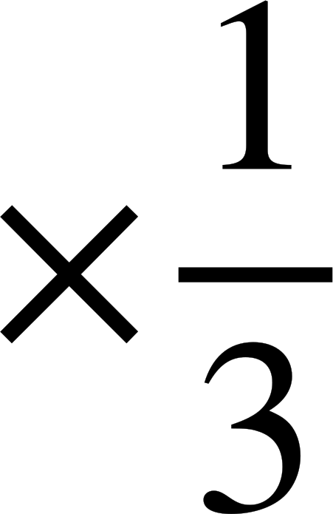
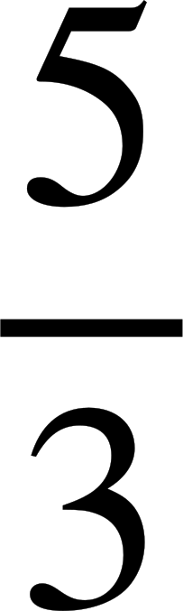
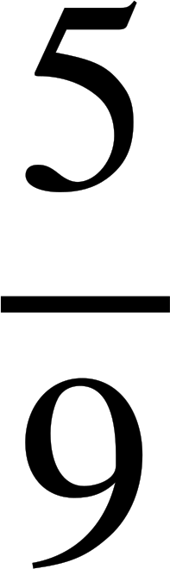
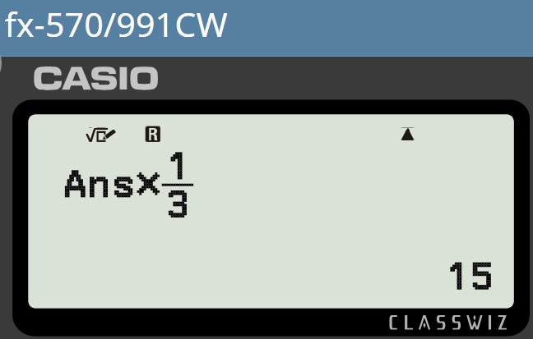
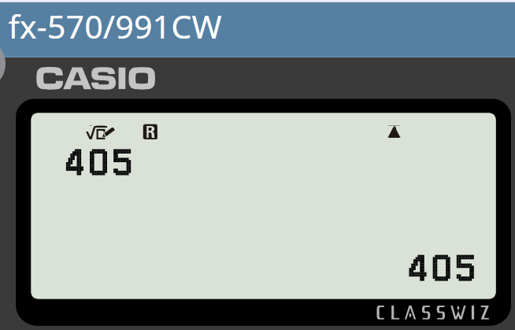
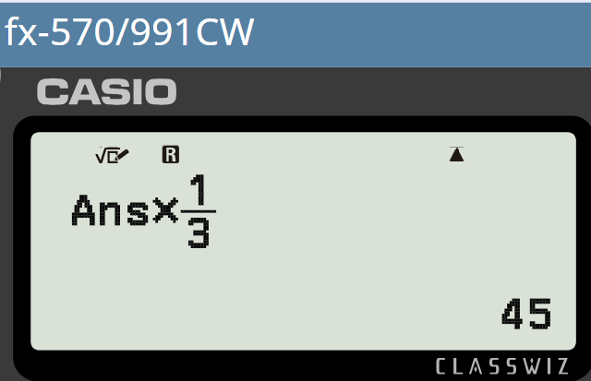
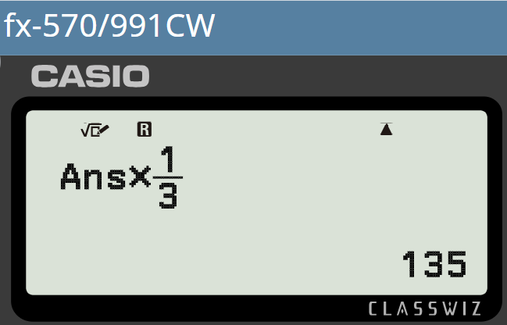
Abuurista taxanaha joomatari (Generating geometric sequences)
Soo saar toddobada erey ee ugu horreeya ee taxanaha joomatari (geometric sequence) oo ereyga koowaad yahay 405 iyo saamiga guud (common ratio) ee
405, 135,
405,
405, 135, 45, 15, 5, , , …
405, 135, 45,

Slide 31
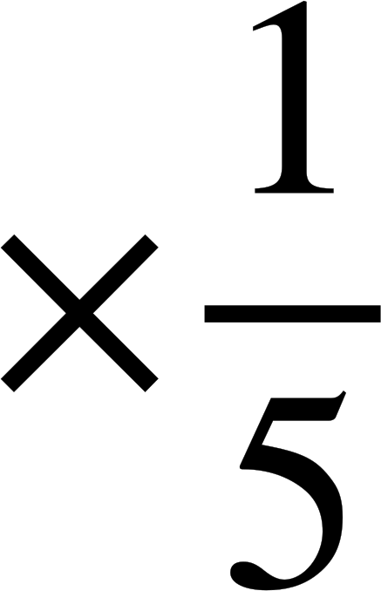
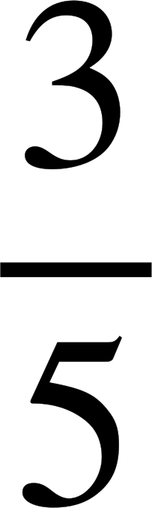
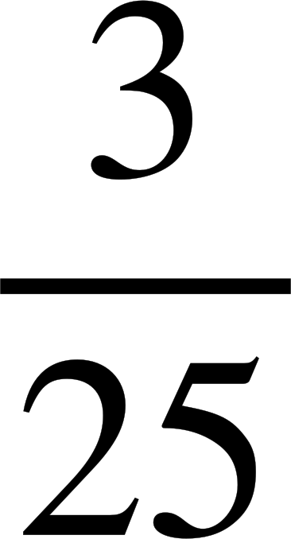
Abuurista taxanaha joomatari (Generating geometric sequences)
Soo saar toddobada erey ee ugu horreeya ee taxanaha joomatari (geometric sequence) oo ereyga koowaad yahay 405 iyo saamiga guud (common ratio) ee
Soo saar lixda erey ee ugu horreeya ee taxanaha joomatari (geometric sequence) oo ereyga koowaad yahay 375 iyo saamiga guud (common ratio) ee
405, 135,
405,
405, 135, 45, 15, 5, , , …
405, 135, 45,
375, 75, 15, 3, , , …
Ereyada aan ahayn tiro dhammaystiran (non-integer) waxaa inta badan si fiican oo sax ah loogu gudbiyaa jajab (fractions).

Slide 32

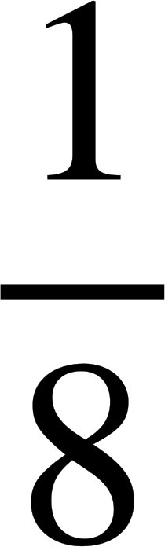
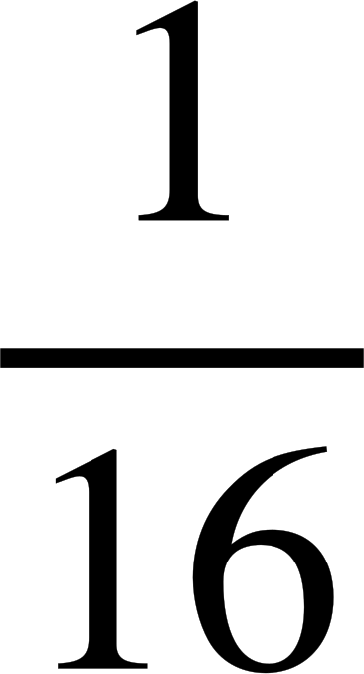
Abuurista taxanaha joomatari (Generating geometric sequences)
Lucas iyo Laura waxay soo saarayaan taxano joomatari (geometric sequences).
128, 64, 32, 16, 8, 4, 2, 1, , , , , …
Waxaan sii waday taxanahan joomatari (geometric sequence) oo waxaan ogaaday wax aad u qurux badan!
Inkastoo ay hoos u dhacayso, weligeed ma gaari doonto eber.
Does that mean we will never see negative terms in geometric sequences?
Maxaad u malaynaysaa?

Slide 33
Abuurista taxanaha joomatari (Generating geometric sequences)
Lucas iyo Laura waxay soo saarayaan taxano joomatari (geometric sequences).
Maya. Waxaan arkay taxane leh saami guud (common ratio) ×2 iyo erey koowaad oo ah −1
It had all negative terms.
−1, −2, −4, −8, −16, …
Waa fiican! Aan tijaabino. Maxaa dhacaya haddii aan isku beddelno? Ka dhigi xubinta koowaad 2 iyo isku dhufashada −1
2, | −2, | 2, | −2, | 2, | −2, | …
×−1
×−1
×−1
×−1
×−1
Maxaad u malaynaysaa inay dhacdo?

Slide 34
Abuurista isku-xigxigyada joomatari (geometric sequences)
Lucas iyo Laura waxay soo saarayaan taxanayaal joomatari (geometric sequences).
Waxay u dhexgashay togan iyo taban! Taasi waa qurux!
Waa fiicantahay! Aynu tijaabino (experiment). Maxaa dhacaya haddii aan isku bedelno? Ka dhigo xubinta koowaad 2 iyo tirada lagu dhufo (multiplier) −1
2, | −2, | 2, | −2, | 2, | −2, | …
×−1
×−1
×−1
×−1
×−1
Maxaad u malaynaysaa inay dhacdo?

Slide 35
Abuurista isku-xigxigyada joomatari (geometric sequences)
Raadi afarta xubnood ee xiga ee isku-xigxigan joomatari (geometric sequence).
3, | −9, | 27, | −81, | 243, | −729, | …
×−3
×−3
×−3
×−3
×−3
Marka saamiga guud (common ratio) uu yahay taban, waxaan helnaa isku-xigxigyo joomatari oo isbeddelaya (oscillating).

Slide 36
Abuurista isku-xigxigyada joomatari (geometric sequences)
1) Soo saar shanta xubnood ee ugu horreeya ee isku-xigxigyadan joomatari (geometric sequences).
a) Xubinta 1aad waa 1, saamiga guud (common ratio) waa 3
b) Xubinta 1aad waa 10, saamiga guud (common ratio) waa 3
c) Xubinta 1aad waa 5, saamiga (ratio) 1 : 3 ee u dhexeeya xubnaha
d) Xubinta 1aad waa 3, saamiga (ratio) 1 : 5 ee u dhexeeya xubnaha
e) Xubinta 1aad waa 64, saamiga (ratio) 2 : 5 ee u dhexeeya xubnaha
f) Xubinta 1aad waa 81, saamiga guud (common ratio) waa
g) Xubinta 1aad waa 1875, saamiga (ratio) 5 : 1 ee u dhexeeya xubnaha
h) Xubinta 1aad waa 3, saamiga (ratio) 3 : 1 ee u dhexeeya xubnaha

Slide 37




Abuurista isku-xigxigyada joomatari (geometric sequences)
2) Axmed wuxuu soo saarayaa isku-xigxigyadan joomatari (geometric sequences).
a) Xubinta 1aad waa 216, saamiga guud (common ratio)
b) Xubinta 1aad waa 216, saamiga guud (common ratio)
c) Xubinta 1aad waa 216, saamiga guud (common ratio)
Sababtoo ah tiro-ku-dhufashadaani (multipliers) waa jajab (fractions), kuwaan oo dhami waxay noqon doonaan taxane (sequences) hoos u dhacaya (decreasing).
Tus Axmed inuu qaldan yahay.

Slide 38
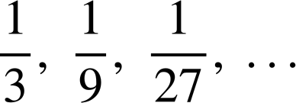
Soo saarista taxanaha joomatari (Generating geometric sequences)
1) Soo saar shanta xubnood ee ugu horreysa taxanahan joomatari (geometric sequences).
a) Xubinta 1aad waa 1, saamiga guud (common ratio) waa 3
1, 3, 9, 27, 81, …
b) Xubinta 1aad waa 10, saamiga guud (common ratio) waa 3
10, 30, 90, 270, 810, …
c) Xubinta 1aad waa 5, saamiga (ratio) 1 : 3 ee u dhexeeya xubnaha
5, 15, 45, 135, 405, …
d) Xubinta 1aad waa 3, saamiga (ratio) 1 : 5 ee u dhexeeya xubnaha
3, 15, 75, 375, 1875, …
e) Xubinta 1aad waa 64, saamiga (ratio) 2 : 5 ee u dhexeeya xubnaha
64, 160, 400, 1000, 2500, …
f) Xubinta 1aad waa 81, saamiga guud (common ratio) waa
81, 27, 9, 3, 1, …
g) Xubinta 1aad waa 1875, saamiga (ratio) 5 : 1 ee u dhexeeya xubnaha
1875, 375, 75, 15, 3, …
3, 1,
h) Xubinta 1aad waa 3, saamiga (ratio) 3 : 1 ee u dhexeeya xubnaha

Slide 39
Soo saarista taxanaha joomatari (Generating geometric sequences)
2) Axmed wuxuu soo saarayaa taxanahan joomatari (geometric sequences).
a) Xubinta 1aad waa 216, saamiga guud (common ratio)
216, 72, 24, 8, …
b) Xubinta 1aad waa 216, saamiga guud (common ratio)
216, 144, 96, 64, …
c) Xubinta 1aad waa 216, saamiga guud (common ratio)
216, 324, 486, 729, …
Tiro-ku-dhufashuhu (multiplier) waa ka weyn yahay 1, sidaa darteed taxanuhu (sequence) wuu kordhayaa (increases).
Sababtoo ah tiro-ku-dhufashadaani (multipliers) waa jajab (fractions), kuwaan oo dhami waxay noqon doonaan taxane (sequences) hoos u dhacaya (decreasing).
Tus Axmed inuu qaldan yahay.

Slide 40
Astaamaha isku xigxiga joomatari (geometric sequences)
Taxanaha joomatari (Geometric sequences) waxay leeyihiin sifo muhiim ah oo ah xiriir isku-dhufasho (multiplicative relationship) oo guud oo ka dhexeeya xubnaha.
Xiriirkan isku-dhufashada (multiplicative relationship) waxaa sidoo kale loo yaqaan saami guud (common ratio).
Tusaale,
3, | 30, | 300, | 3000, | 30 000, | …
×10
×10
×10
×10
Tirada isku dhufashada ×10 waxaan ugu yeernaa saami guud (common ratio) oo ah 10.

