Slide 1
Astaamaha taxanaha tirooyinka gaarka ah (Features of special number sequences)
Xidhiidhada aan tooska ahayn (Non-linear relationships)

Slide 2
sida loo isticmaalo darasyada Oak (how to use Oak lessons)

Slide 3
Waxaan qiimeyn karaa astaamaha taxanaha tirooyinka gaarka ah, sida labajibbaaran, saddexagal iyo saddex jibaaran (square, triangular and cube).

Slide 4
Tiro labajibbaaran (square number) waa wax soo saarka laba tiro oo isku mid ah oo soo noqnoqda.
Tusaale (Example)
8 ✕ 8 = 64
64 waa tiro labajibbaaran (square number)
Tiro saddex jibaaran (cube number) waa wax soo saarka saddex tiro oo togan oo isku mid ah oo soo noqnoqda.
Tusaale (Example)
5 ✕ 5 ✕ 5 = 125
125 waa tiro saddex jibaaran (cube number)

Slide 5
Tiro saddexagal (Triangular number) - lagu qeexay darsiga

Slide 6

Astaamaha taxanaha tirooyinka gaarka ah (Features of special number sequences)
Noocyada taxanaha tirooyinka gaarka ah (Types of special number sequences)
Aqoonsiga taxanaha tirooyinka gaarka ah (Identifying special number sequences)

Slide 7
Noocyada taxanaha tirooyinka gaarka ah (Types of special number sequences)
Tiro labajibbaaran (square number) waa wax soo saarka laba tiro oo isku mid ah oo soo noqnoqda.
Tusaalooyin (Examples):
2 ✕ 2 = 4
5 ✕ 5 = 25
Kuwee ka mid ah kuwan waa tirooyin labajibbaaran (square numbers)?
5
2
2
10
8
5
12
2
1
9
18
5
16
21
30
35
4 iyo 25 waa tirooyin labajibbaaran (square numbers).
36
50
49

Slide 8
Noocyada taxanaha tirooyinka gaarka ah (Types of special number sequences)
Tiro saddex jibaaran (cube number) waa wax soo saarka saddex tiro oo togan oo isku mid ah oo soo noqnoqda.
Tusaalooyin (Examples):
2 ✕ 2 ✕ 2 = 8
3 ✕ 3 ✕ 3 = 27
8 waa tiro laba jibaaran (cube number)
27 waa tiro laba jibaaran (cube number)
2
3
2
3
2
3
8 cubes ayaa loo habeyn karaa si ay u sameeyaan cube leh dherer dhinac 2
27 cubes ayaa loo habeyn karaa si ay u sameeyaan cube leh dherer dhinac 3

Slide 9
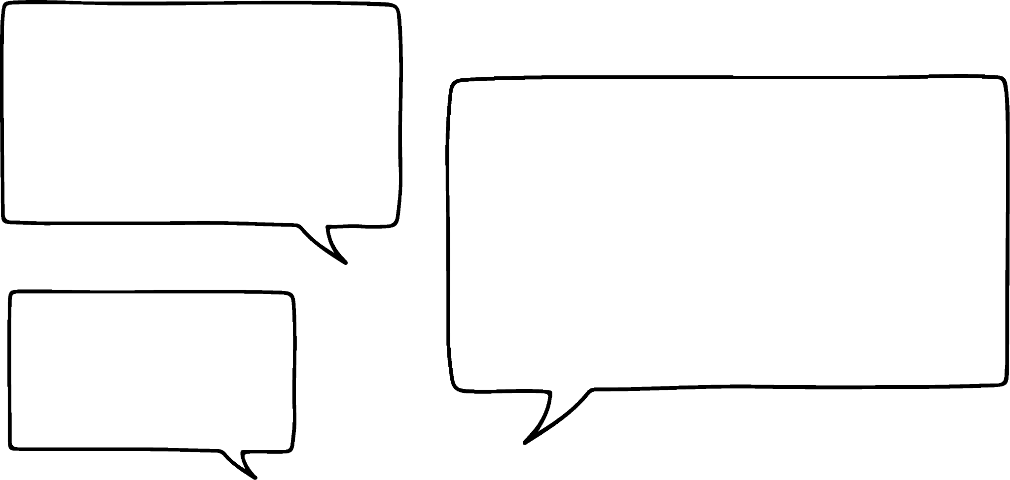











Noocyada taxanaha tirooyinka gaarka ah (special number sequences)
Yaa qori kara taxanaha dhammaan tirooyinka laba jibaaran (cube numbers) ee kor u kaca?
8, 27, 46, 65, 84…
1, 8, 27, 64, 125, …
3, 6, 9, 12, 15 …
Suad
Saciid
Axmed
Taxanaha Axmed wuxuu ku bilaabmaa laba tiro laba jibaaran (cube numbers) laakiin 46 ma aha tiro laba jibaaran (cube number).
Tiro laba jibaaran (cube number) ee kowaad waa 1 ✕ 1 ✕ 1 = 1
Taxanaha Saciid waa tirooyinka 3-ga loo dhufto (multiples of 3), ma aha tirooyinka laba jibaaran (cube numbers).

Slide 10
Noocyada taxanaha tirooyinka gaarka ah (special number sequences)
Waa kuwan shanta erey ee ugu horreeya ee taxanaha dhammaan tirooyinka laba jibaaran (cube numbers) ee kor u kaca.
… | 10
Nambarka ereyga (Term number) (n) | 1 | 2 | 3 | 4 | 5
Ereyga (Term) (T) | 1 | 8 | 27 | 64 | 125
… | n
1000
n³
Sideen u ogaan karnaa ereyga 10aad ee taxanahan?
Ereyga 10aad wuxuu noqonayaa tiro laba jibaaran (cube number) ee 10aad.
10³ = 1000
Waa maxay qaanuunka (rule) lagu helo tiro laba jibaaran (cube number) ee nth?

Slide 11
Noocyada taxanaha tirooyinka gaarka ah (special number sequences)
Dhig tirooyinka soo socda qaybta saxda ah ee jaantuska Venn (Venn diagram):
1 2 4 5 8 9 10
16 25 27 36 49 64
100 125 196 300 1000
Tirooyinka laba jibaaran (square numbers)
Tirooyinka Cube (Cube numbers)

Slide 12
Noocyada taxanaha tirooyinka gaarka ah (Types of special number sequences)
Geli tirooyinka soo socda meesha saxda ah ee jaantuska Venn (Venn diagram):
1 2 4 5 8 9 10
16 25 27 36 49 64
100 125 196 300 1000
Tirooyinka labajibbaaran (Square numbers)
Tirooyinka Cube (Cube numbers)
9
25
100
8
1
2
4
125
27
36
64
16
5
49
196
1000
10
300

Slide 13
Noocyada taxanaha tirooyinka gaarka ah (Types of special number sequences)
Tiro saddexagal (triangular number) waa tiro lagu matali karo qaab dhibco ku habaysan saddexagal. Tirada ereyga waa tirada dhibcaha dhinac kasta oo saddexagalka ah.
1
3
6
10
15

Slide 14



Noocyada taxanaha tirooyinka gaarka ah (Types of special number sequences)
Tirooyinka saddexagalka waxaa loo qori karaa taxane (sequence):
1, 3, 6, 10, 15, …
Taasi waa mid xiiso leh 1 + 3 = 4 iyo 3 + 6 = 9. Labada wadaroodba waxay leeyihiin jawaabo tiro labajibbaaran (square number).
Ma macneheedu waa in ku darista laba tiro saddexagal ay la mid tahay tiro labajibbaaran?
Isra
Axmed
Baar su'aasha Isra adiga oo isku dayaya wadaroyin kale oo tiro saddexagal ah. Maxaad dareensiin?

Slide 15
Noocyada taxanaha tirooyinka gaarka ah (Types of special number sequences)
Baar su'aasha Isra adiga oo isku dayaya wadaroyin kale oo tiro saddexagal ah. Maxaad dareensiin?
1, 3, 6, 10, 15, …
1 + 3 = 4
3 + 6 = 9
6 + 10 = 16
10 + 15 = 25
1 + 6 = 7
1 + 10 = 11
3 + 10 = 13
6 + 15 = 21
Kuwani dhamaantood waxay soo saaraan tirooyin labajibbaaran (square numbers).
Kuwani ma soo saaraan tirooyin labajibbaaran.
Ku darista tirooyin saddexagal oo isku xiga waxay siisaa taxanaha tirooyinka labajibbaaran.

Slide 16
Noocyada taxanaha tirooyinka gaarka ah (Types of special number sequences)
Waxaan u isticmaali karnaa qaababka dhibcaha si aan u muujinno sababta.
1
3
6
10
15
1
+
3
=
4
3
+
6
=
9
Qaababka laba tiro saddexagal oo isku xiga waxaa loo habeeyaa qaab labajibbaaran.
6
+
10
=
16

Slide 17
Noocyada taxanaha tirooyinka gaarka ah
Sharax sababta Saciid uu khalad yahay.
Qaabkan dhibcuhu wuxuu muujinayaa in 16 uu yahay tiro saddex-xagal (triangular number).
Saciid
Tirooyinka saddex-xagalka (triangular numbers) waxaa loo dhisay si saf kasta oo cusubi uu u leeyahay hal dhibic oo ka badan safka kore. Qaabka Saciid, saf kastaa wuxuu leeyahay laba dhibic oo ka badan kan kore.

Slide 18
Noocyada taxanaha tirooyinka gaarka ah
1) Buuxi tirooyinka maqan ee taxanahan tirooyinka gaarka ah.
tirooyinka saddex-xagalka (triangular numbers) | tirooyinka laba-jibbaaran (square numbers) | tirooyinka saddex-jibbaaran (cube numbers)
1, 3, ,10, , 21, 28, , … | , 4, 9, , 25, 36, , , … | 1, , 27, , , 216, …
2) Xisaabi kuwan soo socda:
Tiro laba-jibbaaran (square number) 5aad oo lagu daray tiro saddex-xagal (triangular number) 5aad …
Tiro saddex-xagal (triangular number) 8aad oo lagu daray tiro saddex-jibbaaran (cube number) 4aad …
Tiro saddex-xagal (triangular number) 1aad oo lagu daray tiro saddex-jibbaaran (cube number) 1aad …
Tiro laba-jibbaaran (square number) 3aad laga jaray tiro saddex-jibbaaran (cube number) 2aad …
Tiro saddex-jibbaaran (cube number) 10aad laga jaray tiro laba-jibbaaran (square number) 10aad …
Tiro saddex-xagal (triangular number) 11aad oo lagu daray tiro saddex-xagal (triangular number) 12aad …

Slide 19
Noocyada taxanaha tirooyinka gaarka ah
3) Suad waxay ku raaxaysanaysaa dhisidda taxanayaal kala duwan iyadoo isticmaalaysa tirooyinka laba-jibbaaran (square numbers), saddex-xagalka (triangular numbers) iyo saddex-jibbaaran (cube numbers). Soo jeedi waxa tiro xigta ee taxane kasta noqon karto, adoo sharxaya jawaabtaada.
Qaar ka mid ah kuwan waxaa laga dhisay in ka badan hal nooc oo tiro ah. Qorista bilowga taxanaha tirooyinka laba-jibbaaran (square numbers), saddex-xagalka (triangular numbers) iyo saddex-jibbaaran (cube numbers) waxay kaa caawin kartaa inaad aragto waxa aan sameeyay.
a) 81, 64, 49, 36, …
b) 1, 6, 15, 28, …
c) 2, 7, 15, 26, 40, …
d) 0, 4, 18, 48, 100, …
e) 1, 1, 3, 4, 6, 9, 10, 16, …
f) 0, 1, 3, 6, 10, 15, 21, …
Suad

Slide 20
Noocyada taxanaha tirooyinka gaarka ah
1) Buuxi nambarada maqan ee taxanahan gaarka ah.
nambarada saddexagalka (triangular numbers) | nambarada labajibbaaran (square numbers) | nambarada saddex-jibbaaran (cube numbers)
1, 3, 6, 10, 15, 21, 28, 36, … | 1, 4, 9, 16, 25, 36, 49, 64, … | 1, 8, 27, 64, 125, 216, …
2) Xisaabi kuwan soo socda.
Nambarkii 5-aad ee labajibbaaran (square) oo lagu daro nambarkii 5-aad ee saddexagalka (triangular) 40
Nambarkii 8-aad ee saddexagalka (triangular) oo lagu daro nambarkii 4-aad ee saddex-jibbaaran (cube) 100
Nambarkii 1-aad ee saddexagalka (triangular) oo lagu daro nambarkii 1-aad ee saddex-jibbaaran (cube) 2
Nambarkii 3-aad ee labajibbaaran (square) oo laga jarro nambarkii 2-aad ee saddex-jibbaaran (cube) 1
Nambarkii 10-aad ee saddex-jibbaaran (cube) oo laga jarro nambarkii 10-aad ee labajibbaaran (square) 900
Nambarkii 11-aad ee saddexagalka (triangular) oo lagu daro nambarkii 12-aad ee saddexagalka (triangular) 144

Slide 21
Noocyada taxanaha nambarada gaarka ah
3) Sofia waxay ku raaxaysanaysaa samaynta taxanayaal kala duwan iyadoo isticmaalaysa nambarada labajibbaaran (square), saddexagalka (triangular), iyo saddex-jibbaaran (cube). Soo jeedi nambarka xiga ee taxane kasta, adoo sharaxaya jawaabtaada.
a) 81, 64, 49, 36, …
b) 1, 6, 15, 28, …
c) 2, 7, 15, 26, 40, …
d) 0, 4, 18, 48, 100, …
e) 1, 1, 3, 4, 6, 9, 10, 16, …
f) 0, 1, 3, 6, 10, 15, 21, …
25 - nambarada labajibbaaran (square) oo hoos uga soo degaya 92
45 - nambar kasta oo saddexagal (triangular) oo bilaabaya 1
57 - nambarada labajibbaaran (square) oo lagu daro nambarada saddexagalka (triangular)
180 - nambarada saddex-jibbaaran (cube) oo laga jarro nambarada labajibbaaran (square)
15 - isku beddelka nambarada saddexagalka (triangular) iyo labajibbaaran (square)
28 - nambarada labajibbaaran (square) oo laga jarro nambarada saddexagalka (triangular)

Slide 22
Sifooyinka taxanaha nambarada gaarka ah
Noocyada taxanaha nambarada gaarka ah
Aqoonsiga taxanaha nambarada gaarka ah

Slide 23
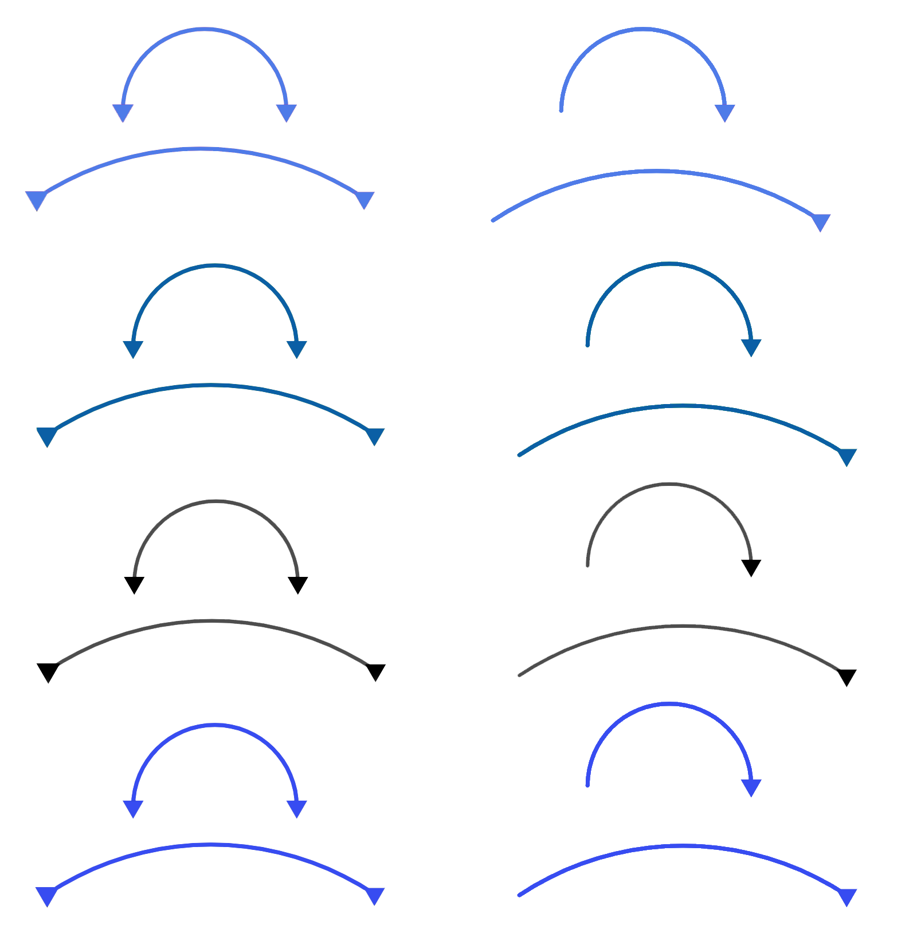
Aqoonsiga taxanaha tirooyinka gaarka ah (Identifying special number sequences)
Si loo sii wado taxane kasta, waxay caawin kartaa in la fahmo sida taxanuhu u koro.
Halkan waxaa ah lixda tiro saddex-xagal (triangular numbers) ee ugu horreeya.
1, 3, 6, 10, 15, 21, …
+2
+3
+4
+5
+6
Kani ma aha taxane toosan (linear sequence)
Sideen u tusi karnaa in Axmed uu sax yahay?
Ereyada isku xiga (Consecutive terms) ma laha kala duwanaansho guud (common difference).
Axmed

Slide 24

Aqoonsiga taxanaha tirooyinka gaarka ah (Identifying special number sequences)
Halkan waxaa ah lixda tiro saddex-xagal (triangular numbers) ee ugu horreeya.
1, 3, 6, 10, 15, 21, …
× 3
× 2
×
Sideen u tusi karnaa in Suad ay sax tahay?
Kan sidoo kale ma aha taxane joomatari (geometric sequence)
3 ÷ 1 = 3
6 ÷ 3 = 2
10 ÷ 6 =
Suad
Ereyada isku xiga (Consecutive terms) ma laha isku-dhufasho guud (common multiplier), oo loo yaqaan saamiga guud (common ratio).

Slide 25

Aqoonsiga taxanaha tirooyinka gaarka ah (Identifying special number sequences)
Halkan waxaa ah lixda tiro saddex-xagal (triangular numbers) ee ugu horreeya
1, 3, 6, 10, 15, 21, …
Taxanuhu ma aha xisaabeed (arithmetic) ama joomatari (geometric).
Maxaad uga dareentaa sida taxanuhu u koro? Ma sharxi kartaa qaacidada erey-erey (term-to-term rule)?
Tani waa hal qaab oo loo sawiro taxanaha oo koraya, erey kasta wuxuu ku darayaa mid ka badan kii hore loo daray.

Slide 26
Aqoonsiga taxanaha tirooyinka gaarka ah (Identifying special number sequences)
Nambarka ereyga (n) (Term number (n)) | 1 | 2 | 3 | 4 | 5
Ereyga (T) (Term (T)) | 1 | 3 | 6 | 10 | 15
+2
+3
+4
+5
farqiga koowaad (first difference)
+1
+1
+1
farqiga labaad (second difference)
Taxanuhu wuxuu ka bilaabmaa 1 ka dibna wuxuu ku darayaa 2, ka dibna 3, ka dibna 4,... mar kasta qaddarka la darayo wuxuu kordhayaa 1
Farqiga u dhexeeya xubnaha isku xigxiga wuxuu sameeyaa taxane toosan oo kordhaya 1.
Waxaan dhihi karnaa inay jirto farqi labaad oo guud oo ah 1.

Slide 27
Aqoonsashada taxanaha tirooyinka gaarka ah
Nambarka xubinta (n) | 1 | 2 | 3 | 4 | 5
Xubinta (T) | 1 | 3 | 6 | 10 | 15
6
21
+2
+3
+4
+5
+6
+1
+1
+1
+1
Si loo helo nambarka xiga ee taxanaha waxaan u baahanahay inaan ku darno 1 farqigii hore.
Marka xubinta xigta waxaa lagu heli doonaa ku darka 6
Haddii xubinta 20aad ay tahay 210, waa maxay xubinta 21aad?
Qiimaha (value) lagu darayo xubinta hore waa had iyo jeer nambarka xubinta
210 + 21 = 231

Slide 28
Aqoonsashada taxanaha tirooyinka gaarka ah
Waa kuwan lixda tiro labajibbaaran ee ugu horreeya
1, 4, 9, 16, 25, 36, …
Maxaad uga fiirsataa sida taxanuhu u kordho? Ma sharxi kartaa qaanuunka xubinta-ilaa-xubinta?
Tani waa hab lagu muujiyo sida taxanuhu u kordho, taxanuhu wuxuu ku kordhayaa tirooyinka khoda ah.

Slide 29
Aqoonsashada taxanaha tirooyinka gaarka ah
Nambarka xubinta (n) | 1 | 2 | 3 | 4 | 5
Xubinta (T) | 1 | 4 | 9 | 16 | 25
+3
+5
+7
+9
farqiga koowaad (first difference)
+2
+2
+2
farqiga labaad (second difference)
Taxanuhu wuxuu ka bilaabmaa 1 ka dibna wuxuu ku darayaa 3, ka dibna 5, ka dibna 7,... markasta qadarka la darayo wuxuu kordhayaa 2
Waxaan dhihi karnaa inay jirto farqi labaad oo guud oo ah 2.

Slide 30

Aqoonsiga taxanaha tirooyinka gaarka ah
Taxanahan waxay ka kooban yihiin isku xigxiga: saddexagal (triangular), labajibbaaran (square), shan-gees (pentagonal) ama cube (cube) tirooyin.
Isku xir taxanaha ikhtiyaarka saxda ah:
169, 196, 225, 256, 289, … tirooyin saddexagal (triangular numbers)
78, 91, 105, 120, 136, … tirooyin labajibbaaran (square numbers)
27, 64, 125, 216, 343, … tirooyin shan-gees (pentagonal numbers)
51, 70, 92, 117, 145, … tirooyin cube (cube numbers)
a
+27
+29
+31
+33
b
+13
+14
+15
+16
c
+37
+61
+91
+127
d
+19
+22
+25
+28

Slide 31
Aqoonsiga taxanaha tirooyinka gaarka ah
Haddii qaab ama dhacdo soo saarto mid ka mid ah taxanaha tirooyinka gaarka ah, waxaan u isticmaali karnaa sifooyinka muhiimka ah si aan u sameyno saadaal.
Tixgeli dhacdadan.
Axmed wuxuu qorsheynayaa tartan netball (netball) oo loogu talagalay dugsiyada hoose ee deegaanka.
Tartanka dhammaan kooxuhu waxay ku ciyaari doonaan hal mar midba midka kale.
Weligiis ma oga inta kooxood ee ka qayb qaadanaya.
Wuxuu rabaa hab degdeg ah oo uu ku ogaan karo inta ciyaarood ee jiri doonta marka uu ogaado tirada kooxaha.
Sidee buu u sahamin karaa fikradan?

Slide 32
Aqoonsiga taxanaha tirooyinka gaarka ah
Bilow adoo dooranaya kiiska ugu fudud.
Immisa ciyaarood ayaa jiri lahaa haddii ay jiraan kaliya laba kooxood?
1 (A vs B)
Immisa ciyaarood ayaa jiri lahaa haddii ay jiraan saddex kooxood?
A vs B
A vs C
B vs C
3 ciyaarood
Immisa ciyaarood ayaa jiri lahaa haddii ay jiraan afar kooxood?
A vs B
A vs C
A vs D
B vs C
B vs D
C vs D
Waxaan taxnay dhammaan ciyaaraha ku lug leh A, ka dibna kuwa ku lug leh B, iyo wixii la mid ah….
6 ciyaarood
Sidee baan u hubinay inaanan wax ka maqnin?

Slide 33
Aqoonsiga taxanaha tirooyinka gaarka ah
Buuxi jaantuska si aad u muujiso tirada ciyaaraha ee 2, 3, 4, 5, iyo 6 kooxood.
Tirada kooxaha | 2 | 3 | 4 | 5 | 6
Tirada ciyaaraha
1
3
6
10
15
A vs B
A vs C
A vs D
A vs E
B vs C
B vs D
B vs E
C vs D
C vs E
D vs E
10 kulan (games)
6 kooxood: A wuxuu la ciyaari doonaa 5 kooxood oo kale. B wuxuu la ciyaari doonaa 5 kooxood oo kale, laakiin waxaan horay u tirinay kulan (match) A, marka 4 kulan (games) cusub, C wuxuu leeyahay 3 kulan (games) cusub, D wuxuu leeyahay 2 kulan (games) cusub, ka dibna 1 kulan (game) E (E vs F)

Slide 34
Aqoonsiga tirooyin gaar ah (special number sequences)
Sannadkii hore waxaa jiray 8 kooxood, waxaan rabaa inaan ogaado inta kulan (game) ay ahayd.
A vs B
A vs C
A vs D
A vs E
A vs F
A vs G
A vs H
B vs C
B vs D……
Axmed
Taasi waxay kaa qaadanaysaa waqti dheer!
Isra
Ma jirtaa hab fudud oo Axmed u xisaabiyo tan?

Slide 35
Aqoonsiga tirooyin gaar ah (special number sequences)
Maxaad ka ogaatay jawaabahaaga?
Tirada kooxaha | 2 | 3 | 4 | 5 | 6
Tirada ciyaaraha | 1 | 3 | 6
10
15
Jawaabahani waa tirooyinka saddexagalka (triangular numbers). Ma u malaynaysaa in qaabkani uu sii socon doono?
Haa, sida aan u soo bandhignay isku darka waxay muujinaysaa in koox kasta oo dheeri ah, tiir cusub oo ciyaaro ah lagu daro, oo mid ciyaar ah oo dheeri ah lagu daro mar kasta.
,
,
, …
A vs B
A vs B
A vs C
B vs C
A vs B
A vs C
A vs D
B vs C
B vs D
C vs D

Slide 36
Aqoonsiga taxanaha tirooyinka gaarka ah
1) Immisa ciyaarood ayaa jiri doona 7 koox iyo 8 koox?
Tirada kooxaha | 2 | 3 | 4 | 5 | 6 | 7 | 8
Tirada ciyaaraha | 1 | 3 | 6 | 10 | 15
21
28
2) Axmed dhab ahaan wuxuu haystaa 10 kooxood oo jawaabaya. Xisaabtee ayaa heli doonta tirada ciyaaraha?
10 kooxood waxay noqon lahaayeen lambarka 9-aad ee saddex-xagalka (triangular number):
1 + 2 + 3 + 4 + 5 + 6 + 7 + 8 + 9 = 45
3) Maxaa Isra ku qaldan?
Haddii koox kasta ay la ciyaarto koox kasta, markaas mid kastaa wuxuu ciyaaraa 9 ciyaarood. Miyaanay ahayn jawaabtu 90 ciyaarood?
A vs B waa isla ciyaartii B vs A. Iyadoo la isticmaalayo habkan, waxay tirisay ciyaar kasta laba jeer
Isra

Slide 37
Aqoonsiga taxanaha tirooyinka gaarka ah (special number sequences)
1) Isra waxay ka dhisaysaa qaabab tallaabo ah (step patterns) gogo'yo (cubes). Halkan waxaa ah 3 qaab ee ugu horreeyay.
…
Lambarka qaabka (Pattern number)
1
2
3
…
a) Buuxi shaxda (table) si aad u muujiso tirada gogo'yaasha (cubes) ee 5 qaab ee ugu horreeyay haddii ay sii waddo sidii oo kale.
b) Maxaad ka dareentaa jawaabahaaga?
c) Immisa gogo' (cubes) ayay u baahan doontaa si ay u dhisto qaabka 10-aad?
Lambarka qaabka (Pattern number) | 1 | 2 | 3 | 4 | 5
Tirada gogo'yaasha (Number of cubes)

Slide 38
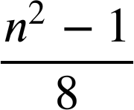
Aqoonsiga taxanaha tirooyinka gaarka ah (special number sequences)
2) Axmed wuxuu ku ciyaarayaa qaababka tirooyinka (number patterns). Wuxuu ogaaday in haddii uu laba jibaaro (square) lambarka 3, ka dibna kala gooyo mid (subtract one), ka dibna u qaybiyo 8 (divides by 8) uu helo lambar laba jibaaran (square number). Wuxuu doonayaa inuu arko haddii tani ay u shaqeyso tirooyinka kale ee khafiifka ah (odd numbers).
a) Buuxi shaxda (table) natiijooyinka 5 tiro ee ugu horreeyay ee khafiifka ah (odd numbers) oo ka weyn 1
b) Maxaad ka dareentaa jawaabahaaga?
c) Qiime (value) intee le'eg ayaad heli lahayd haddii aad ku dabaqdo xisaabtan (calculation) lambarka 19?
Lambarka bilowga (n) (Start number (n)) | 3 | 5 | 7 | 9 | 11
Natiijada (Result ( ))

Slide 39
Aqoonsiga taxanaha tirooyinka gaarka ah (special number sequences)
3) Saciid wuxuu baarayaa tirada ugu badan ee dhibcaha isgoysyada (intersection points) ee u dhexeeya khadadka toosan (straight lines) oo lagu sawiray laba jibaaran (square). Waxay doonayaan inay ogaadaan inta dhibcood oo isgoys ah oo ay jiri karaan haddii ay sawiraan 12 khad oo kala duwan, laakiin sawiridda dhammaantood way adag tahay.
a) Saciid wuxuu marka hore isku dayaa 3 khad, isagoo hubinaya in khadadku isgooyaan tirada ugu badan ee jeer. Immisa dhibcood oo isgoys ah (intersection points) ayaa jira?
b) Buuxi shaxda (table) 2 khad, 3 khad, 4 khad iyo 5 khad, maxaad ka dareentaa jawaabahaaga?
c) Waa maxay tirada ugu badan ee isgoysyada (intersections) 12 xariiq (lines) leh?
Tirada xariiqyada (lines) | 2 | 3 | 4 | 5
Tirada isgoysyada (intersections)

Slide 40
Aqoonsiga taxanaha tirooyinka gaarka ah (special number sequences)
1) Izzy waxay ka dhisaysaa qaabab tillaabo ah (step patterns) cubes. Waa kuwan 3 qaab ee ugu horreeya.
…
Tirada qaabka (Pattern number)
1
2
3
…
a) Buuxi jaantuska (table) si aad u muujiso tirada cubes ee 5 qaab ee ugu horreeya haddii ay sii wado sidii oo kale.
b) Maxaad ka ogaataa jawaabahaaga?
Waa tirooyinka labajibbaaran (square numbers)
c) Immisa cubes ayay u baahan tahay si ay u dhisto qaabka 10aad? 102 = 100
Tirada qaabka (Pattern number) | 1 | 2 | 3 | 4 | 5
Tirada cubes | 1 | 4 | 9 | 16 | 25

Slide 41
Aqoonsiga taxanaha tirooyinka gaarka ah (special number sequences)
2) Alex wuxuu la ciyaarayaa qaabab tiro (number patterns). Wuxuu ogaaday in haddii uu labajibaaro (squares) tirada 3, ka dibna kala gooyo hal, ka dibna u qaybiyo 8, uu helo tiro labajibbaaran (square number). Wuxuu rabaa inuu arko haddii tani ay shaqeyso tirooyinka kale ee khafiifka ah (odd numbers).
a) Buuxi jaantuska (table) natiijooyinka 5 tiro ee ugu horreeya ee khafiifka ah (odd numbers) ee ka weyn 1
b) Maxaad ka ogaataa jawaabahaaga?
Waa tirooyinka saddexagalka (triangular numbers) ee ma aha tirooyinka labajibbaaran (square numbers)
c) Waa maxay qiime (value) aad heli lahayd haddii aad codsato xisaabtan (calculation) tirada 19?
19 waa tiro 9aad ee khafiifka ah (odd number) ee ka weyn 1. Tiro 9aad ee saddexagalka (triangular number) waa 45.
Tirada bilowga (n) | 3 | 5 | 7 | 9 | 11
Natiijada ( ) | 1 | 3 | 6 | 10 | 15

Slide 42
Aqoonsiga taxanaha tirooyinka gaarka ah
3) Saciid wuxuu baarayaa tirada ugu badan ee dhibcaha isgoysyada (intersection points) ee u dhexeeya xariiqyada tooska ah ee lagu sawiray labajibbaaran. Wuxuu rabaa inuu ogaado inta dhibcood oo isgoys ah oo ay jiri karaan haddii uu sawiro 12 xariiq oo kala duwan, laakiin inuu dhammaantood sawiro waa adag tahay.
a) Saciid wuxuu ku tijaabiyaa 3 xariiq (lines) marka hore, isagoo hubinaya in xariiqyadu (lines) isgooyaan tirada ugu badan. Immisa dhibcood oo isgoys (intersection points) ayaa jira?
3
b) Buuxi jaantuska 2 sadar, 3 sadar, 4 sadar iyo 5 sadar, maxaad ka ogaataa jawaabahaaga?
Waa tirooyinka saddexagalka (triangular numbers).
Tirada xariiqyada | 2 | 3 | 4 | 5
Tirada isgoysyada | 1 | 3 | 6 | 10

Slide 43
Aqoonsiga taxanaha tirooyinka gaarka ah
3) Saciid wuxuu baarayaa tirada ugu badan ee dhibcaha isgoysyada (intersection points) ee u dhexeeya xariiqyada tooska ah ee lagu sawiray labajibbaaran. Wuxuu rabaa inuu ogaado inta dhibcood oo isgoys ah oo ay jiri karaan haddii uu sawiro 12 xariiq oo kala duwan, laakiin inuu dhammaantood sawiro waa adag tahay.
c) Waa maxay tirada ugu badan ee isgoysyada marka ay jiraan 12 xariiq?
2 xariiq waxay ahaayeen tiro saddexagal (triangular number) koowaad
3 xariiq tiro saddexagal (triangular number) labaad
Sidaas darteed 12 xariiq waa inay noqdaan tiro saddexagal (triangular number) 11aad, taas oo ah
1 + 2 + 3 + 4 + 5 + 6 + 7 + 8 + 9 + 10 + 11 = 66

Slide 44
Sifooyinka taxanaha tirooyinka gaarka ah
Tirooyinka labajibbaaran (square numbers) iyo kuwa saddex jibaaran (cube numbers) waxaa loo isticmaali karaa inay sameeyaan taxane.
Taxanaha dhammaan tirooyinka labajibbaaran (square numbers) ee kor u kaca waxaa laga soo saari karaa qaacidada nth term n2
Taxanaha dhammaan tirooyinka saddex jibaaran (cube numbers) ee kor u kaca waxaa laga soo saari karaa qaacidada nth term n3.
Tirooyinka saddexagalka (triangular numbers) waxaa lagu samayn karaa kordhinta farqiga hal eray kasta oo isku xiga.
Tirooyinka labajibbaaran (square numbers) iyo saddexagalka (triangular numbers) waxay leeyihiin farqi labaad oo wadaag ah.

