Slide 1
Cabbirka faylka sawirada dijitaalka
Matnaajinta xogta: sawir iyo cod

Slide 2
Sida agabka waxbaridda loogu qaabeeyey fasalka
Darsigani wuxuu ku darayaa agab dheeri ah oo laga soo dejin karo bogga darsiga.

Slide 3
Waxaan qeexi karaa sida cabbirka faylka sawirka loo xisaabiyo iyo sida isbeddelka tayada sawirka iyo saxnaanta midabka uu tan u beddelo.

Slide 4
xallinta (resolution)
wadarta guud ee pixels-ka uu sawirku ka kooban yahay, oo ku salaysan ballaca iyo dhererka, oo lagu muujiyey pixels
qoto dheerida midabka (colour depth)
tirada bits-ka loo isticmaalo in lagu matalo midabka pixel kasta, oo sidoo kale loo yaqaan bit depth
cabbirka faylka (file size)
qiyaasta xogta binary-ga ah ee faylku ka kooban yahay

Slide 5

Cabbirka faylka sawirada dijitaalka
Xisaabinta cabbirka faylka sawirka
Saamaynta isticmaalka xallinta (resolution) kala duwan
Saamaynta isticmaalka qoto dheerida midabka (colour depth) kala duwan

Slide 6
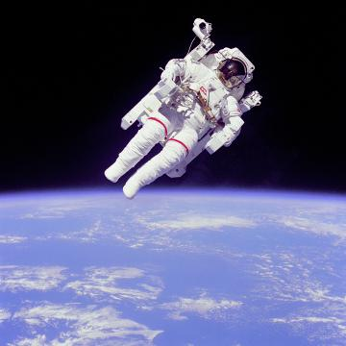
Xisaabinta cabbirka faylka sawirka
Sawirka dijitaalku wuxuu ka kooban yahay walxo gaar ah, oo loo habeeyey shabag leydi ah.
Walxaha sawirka dijitaalka waxaa loo yaqaan pixels.
Tirada pixels-ka ee sawirka dijitaalku waa xallinta (resolution) sawirka.

Slide 7
Xisaabinta cabbirka faylka sawirka
xallinta (resolution) (pixels) = ballaca (pixels) ⨉ dhererka (pixels)
ballaci = 720 pixels
jooggi = 720 pixels
720
pixels
Xallinta (Resolution):
720 ⨉ 720 = 518 400 pixels
720
pixels

Slide 8

Xisaabinta cabbirka faylka sawirka
Xisaabi xallinta (resolution) sawirkan.
112 pixels
ballaci = 8 pixels
jooggi = 14 pixels
Xallinta (Resolution):
8 ⨉ 14 =
112 pixels
14
pixels
22 pixels
100 pixels
8
pixels

Slide 9
Xisaabinta cabbirka faylka sawirka
Si loo xisaabiyo tirada bits-ka ee sawirka isticmaalaya 2 bits per pixel:
00 | 00 | 00 | 00 | 00 | 00 | 00 | 00 | 11 | 11
00 | 00 | 00 | 00 | 00 | 00 | 00 | 10 | 01 | 11
00 | 00 | 00 | 00 | 00 | 00 | 10 | 10 | 10 | 00
00 | 00 | 00 | 00 | 00 | 10 | 10 | 10 | 00 | 00
00 | 00 | 00 | 00 | 10 | 10 | 10 | 00 | 00 | 00
00 | 00 | 00 | 10 | 10 | 10 | 00 | 00 | 00 | 00
00 | 00 | 10 | 10 | 10 | 00 | 00 | 00 | 00 | 00
00 | 01 | 10 | 10 | 00 | 00 | 00 | 00 | 00 | 00
00 | 01 | 01 | 00 | 00 | 00 | 00 | 00 | 00 | 00
11 | 00 | 00 | 00 | 00 | 00 | 00 | 00 | 00 | 00
Waxaa jira 10 ⨉ 10 = 100 pixels (curiyayaasha sawirka).
2 bits ayaa loo isticmaalaa midabka pixel kasta.
Tirada guud ee nambarada binary (binary digits) ee sawirka:
100 pixels ⨉ 2 bits per pixel = 200 bits.

Slide 10
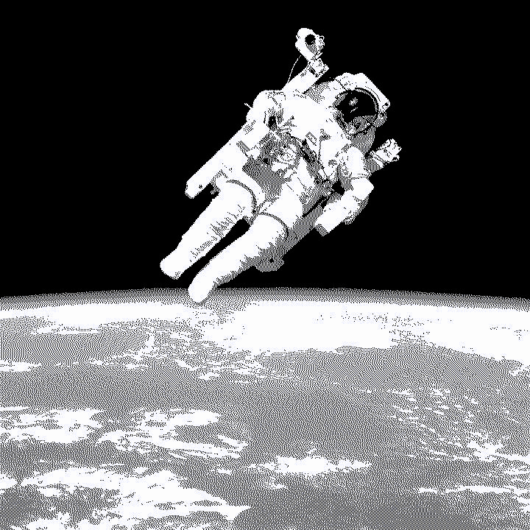
Xisaabinta cabbirka faylka sawirka
Pixel kasta, tixgal ah xuruuf binary ayaa loo isticmaalaa in lagu muujiyo midabkiisa.
0
1
Tirada xuruufaha binary ee loo isticmaalo midabka pixel kasta waa qoto-dheerka midabka (colour depth).
Qaraarka (Resolution): 720 ⨉ 720 = 518 400 pixels
Qoto-dheerka midabka: 1 bit (2 midab oo suurtagal)
1
0

Slide 11
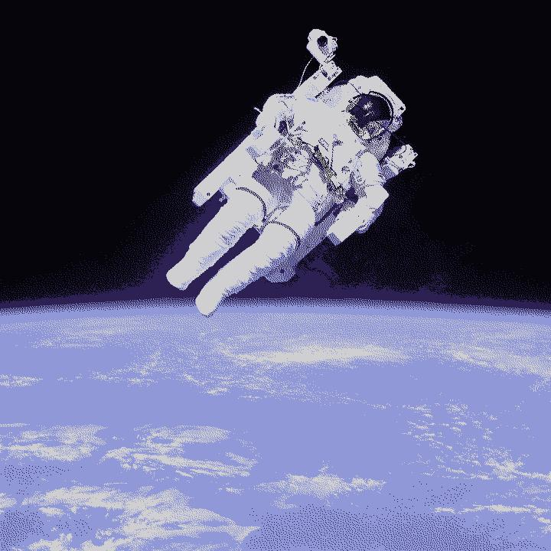
Xisaabinta cabbirka faylka sawirka
Pixel kasta, tixgal ah xuruuf binary ayaa loo isticmaalaa in lagu muujiyo midabkiisa.
00
01
10
11
Tirada xuruufaha binary ee loo isticmaalo midabka pixel kasta waa qoto-dheerka midabka (colour depth).
Qaraarka (Resolution): 720 ⨉ 720 = 518 400 pixels
Qoto-dheerka midabka: 2 bits (4 midab oo suurtagal)
00
11
01
10

Slide 12

Xisaabinta cabbirka faylka sawirka
Pixel kasta, tixgal ah xuruuf binary ayaa loo isticmaalaa in lagu muujiyo midabkiisa.
000
001
010
011
Tirada xuruufaha binary ee loo isticmaalo midabka pixel kasta waa qoto-dheerka midabka (colour depth).
100
101
110
111
Qaraarka (Resolution): 720 ⨉ 720 = 518 400 pixels
Qoto-dheerka midabka: 3 bits (8 midab oo suurtagal)
011

Slide 13

Xisaabinta cabbirka faylka sawirka
Pixel kasta, tixgal ah xuruuf binary ayaa loo isticmaalaa in lagu muujiyo midabkiisa.
Tirada xuruufaha binary ee loo isticmaalo midabka pixel kasta waa qoto-dheerka midabka (colour depth).
Qaraarka (Resolution): 720 ⨉ 720 = 518 400 pixels
Qoto-dheerka midabka: 24 bits
Qiimaha caadiga ah ee qoto-dheerka midabka waa 24 ama 32 xuruuf binary pixel kasta.
110001000001101101010110

Slide 14
Xisaabinta cabbirka faylka sawirka
Maxay qoto-dheerida midabka (colour depth) sawirku sharxaysaa?
joogga sawirka ee pixels
tirada midabbada kala duwan ee uu muujin karo
tirada midabbada kala duwan (sida cas, cagaar iyo buluug) ee lagu daray pixel kasta

Slide 15
Xisaabinta cabbirka faylka sawirka
Si loo xisaabiyo cabbirka faylka sawirka:
cabbirka faylka (bits) = ballaca (pixels) ⨉ joogga (pixels) ⨉ qoto-dheerida midabka (bits)
Cabbirka faylka:
720 pixels ⨉ 720 pixels ⨉ 24 bits = 12 441 600 bits

Slide 16


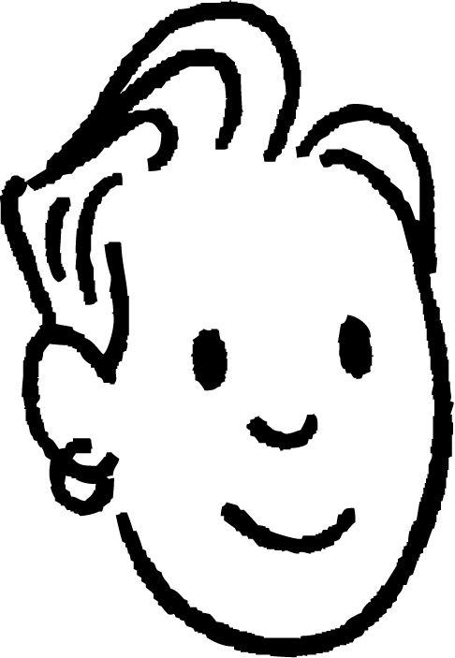

Xisaabinta cabbirka faylka sawirka
12 441 600 bits — taasi waa tiro aad u badan! Ma jirtaa hab loogu beddelo cutubyo kale si ay u fududaato fahamka?
Waxaa jira cutubyo badan oo caadi ah oo kaydinta dhijitaalka ah:
8 bits oo ku jira byte: 12 441 600 ÷ 8 = 1 555 200 bytes
1000 bytes oo ku jira kilobyte (kB): 1 555 200 bytes ÷ 1000 = 1555 kB
1000 kilobytes oo ku jira megabyte (MB): 1555 kB ÷ 1000 = 1.55 MB
Saciid

Slide 17

Xisaabinta cabbirka faylka sawirka
Saciid wuxuu sameeyay logo (logo) ciyaar. Logogu waa sawir bitmap (bitmap image) ah 3000 ⨉ 3000 pixels. Waa maxay xallinta (resolution) logoga?
Saciid wuxuu kaloo sameeyay astaan (icon) ciyaarta xallinta shabagga (maze solving game) uu abuuray. Astaantu waa 32 pixels ballac iyo 32 pixels joog.
Imisa pixels ayuu sawirku
wadar ahaan leeyahay?

Slide 18
Xisaabinta cabbirka faylka sawirka
Ciyaarta Saciid, waxaa jira jilaa (character) ah 32 pixels joog iyo 16 pixels ballac. Console-ka ciyaartu wuxuu matali karaa 64 midab, oo lagu matalo 6 bits pixel kasta. Waa maxay cabbirka faylka jilaaga ee bytes?

Slide 19
Xisaabinta cabbirka faylka sawirka
Saciid wuxuu sameeyay astaan (logo) ciyaar. Astaantu waa sawir bitmap ah oo 3000 ⨉ 3000 pixels. Waa maxay xallinta (resolution) astaanta?
3000 pixels ⨉ 3000 pixels = 9 000 000 pixels

Slide 20
Xisaabinta cabbirka faylka sawirka
Saciid wuxuu kaloo sameeyay astaan (icon) ciyaarta maze ee uu sameeyay. Waa 32 pixels ballac iyo 32 pixels joog.
Imisa pixels ayuu wadarta guud u leeyahay sawirku?
32 pixels ⨉ 32 pixels = 1024 pixels

Slide 21
Xisaabinta cabbirka faylka sawirka
Ciyaarta Saciid, waxaa jira jilaa (character) 32 pixels joog ah iyo 16 pixels ballac ah. Console-ka ciyaartu wuxuu matali karaa 64 midab, oo lagu matalo 6 bits pixel kasta. Waa maxay cabbirka faylka jilaaga ee bytes?
Xallinta (Resolution):
32 ⨉ 16 = 512 pixels
Wadarta bits:
512 pixels (xallin) ⨉ 6 bits (qoto midab) = 3072 bits
U beddel bits-ka bytes:
3072 bits ÷ 8 = 384 bytes

Slide 22
Cabbirka faylka sawirrada dijitaalka ah
Xisaabinta cabbirka faylka sawirka
Saamaynta isticmaalka xallinno (resolutions) kala duwan
Saamaynta isticmaalka qotooyin midab (colour depths) kala duwan

Slide 23

Saamaynta isticmaalka xallinno (resolutions) kala duwan
Marka la dooranayo cabbirka resolution-ka sawirka, waxaa jira dheellitir u dhexeeya tayada (quality) iyo waxtarka (efficiency).
Tayadu waxay loola jeedaa caddaynta iyo faahfaahinta sawirka.
Sawirada tayadoodu sareyso waa kuwa cad oo leh faahfaahin fiican.
tayada (quality)
waxtarka (efficiency)

Slide 24
Saamaynta isticmaalka resolution-yada sawir ee kala duwan
Marka la dooranayo cabbirka resolution-ka sawirka, waxaa jira dheellitir u dhexeeya tayada (quality) iyo waxtarka (efficiency).
Waxtar (Efficiency) macneheedu waa in wax si fiican loo qabto iyada oo aan laga lumiyin kheyraadka sida booska kaydinta, xawaaraha internetka ama awooda kombiyuutarka.
Tusaale ahaan, sawirada waxtarka leh waa la beddelaa oo wanaajiyaa si loo hubiyo inay u muuqdaan kuwo wanaagsan iyada oo aan la isticmaalin boos badan ama aan la gaabin.
tayada (quality)
waxtarka (efficiency)

Slide 25
Saamaynta isticmaalka resolution-yada sawir ee kala duwan
Sababta resolution-ka muhiim u yahay:
ciyaaraha (gaming) iyo naqshadaynta garaafyada (graphic design), resolution-ku wuxuu saameeyaa sida dhabta ah ee ciyaartu u egtahay
sawir qaadista (photography), resolution-ka sare wuxuu ka dhigaa sawirada kuwo faahfaahsan
daawashada (streaming) ama isticmaalka shabakadda (web), doorashada resolution-ka saxda ah waxay dheellitirtaa tayada (quality) iyo waxtarka (efficiency)

Slide 26
Saamaynta isticmaalka resolution-yada sawir ee kala duwan
Waa maxay faa'iidada ugu weyn ee isticmaalka resolution-ka sare ee sawirka?
sawirku wuxuu isticmaali doonaa boos kaydin yar
sawirku wuxuu u muuqan doonaa mid cad oo faahfaahsan
sawirku wuxuu ku soo degan doonaa si dhakhso leh bogga shabakadda

Slide 27
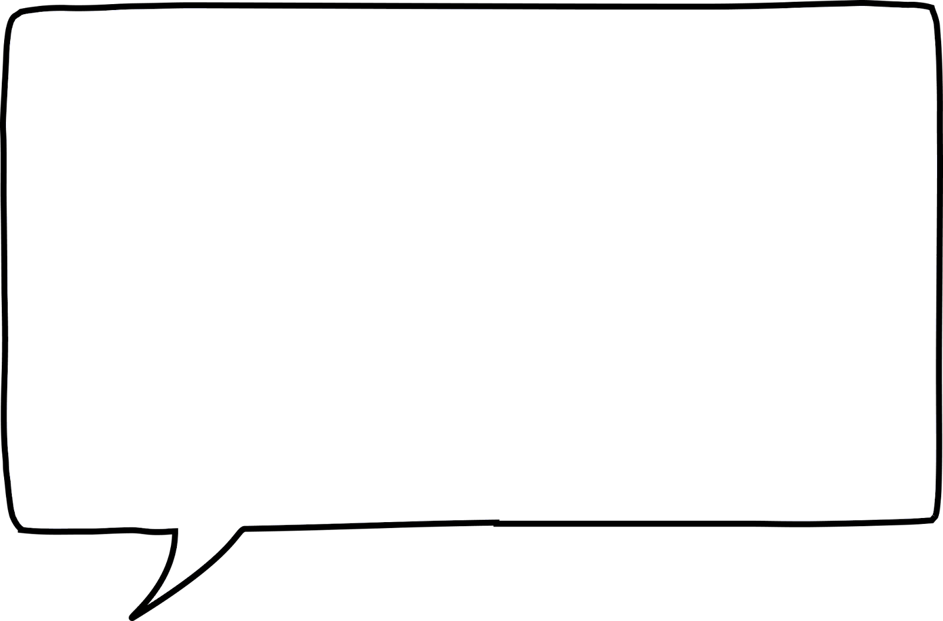
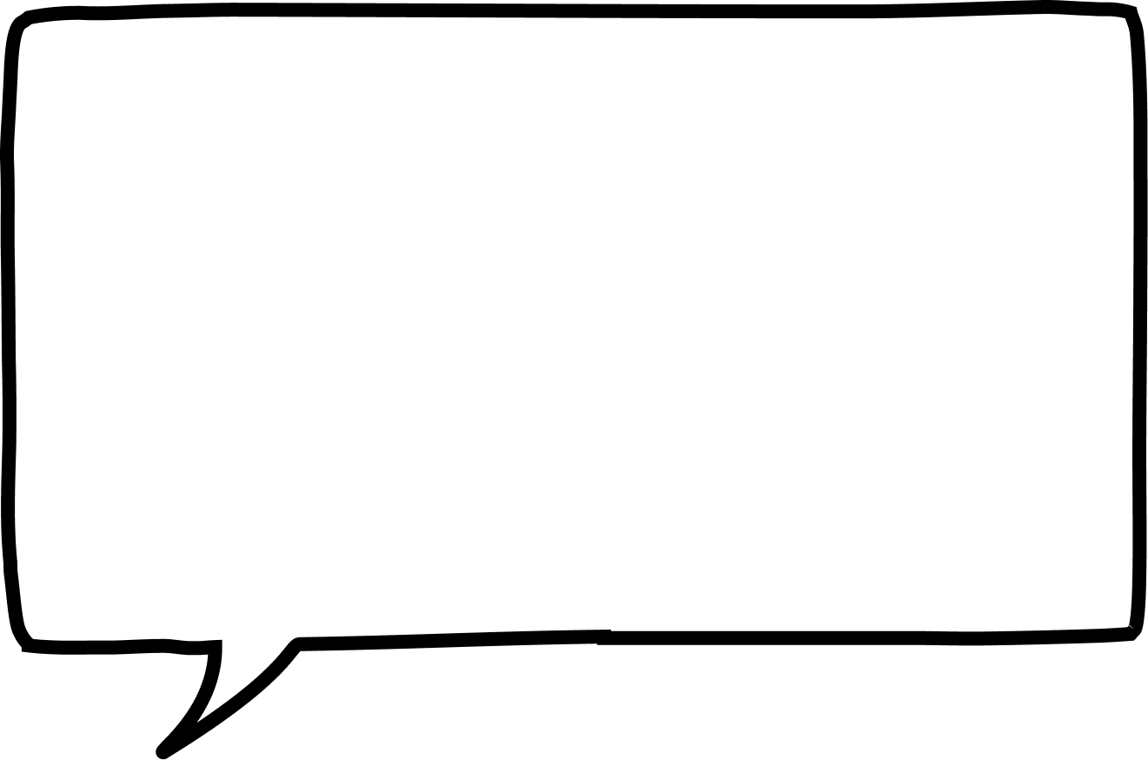

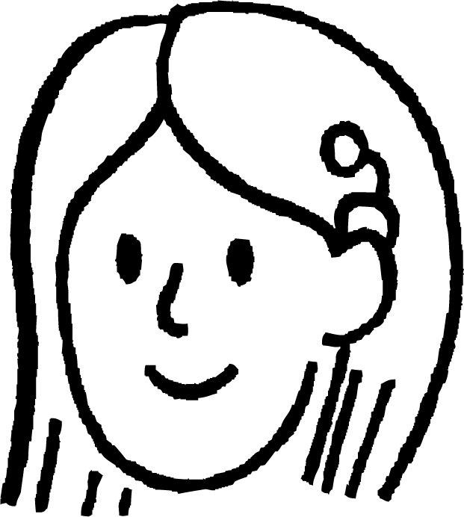

Saamaynta isticmaalka resolution-yada sawir ee kala duwan
Shaqada dugsigayga, ma eego xallinta (resolution) sawirada aan isticmaalo.
Saciid
Waxaan samaynayay soo bandhig (presentation) markii aan weyneeyay sawirka wuxuu noqday mid aan caddayn, sidaas darteed waxaan raadiyay sawir leh xallin (resolution) sare.
Suad

Slide 28
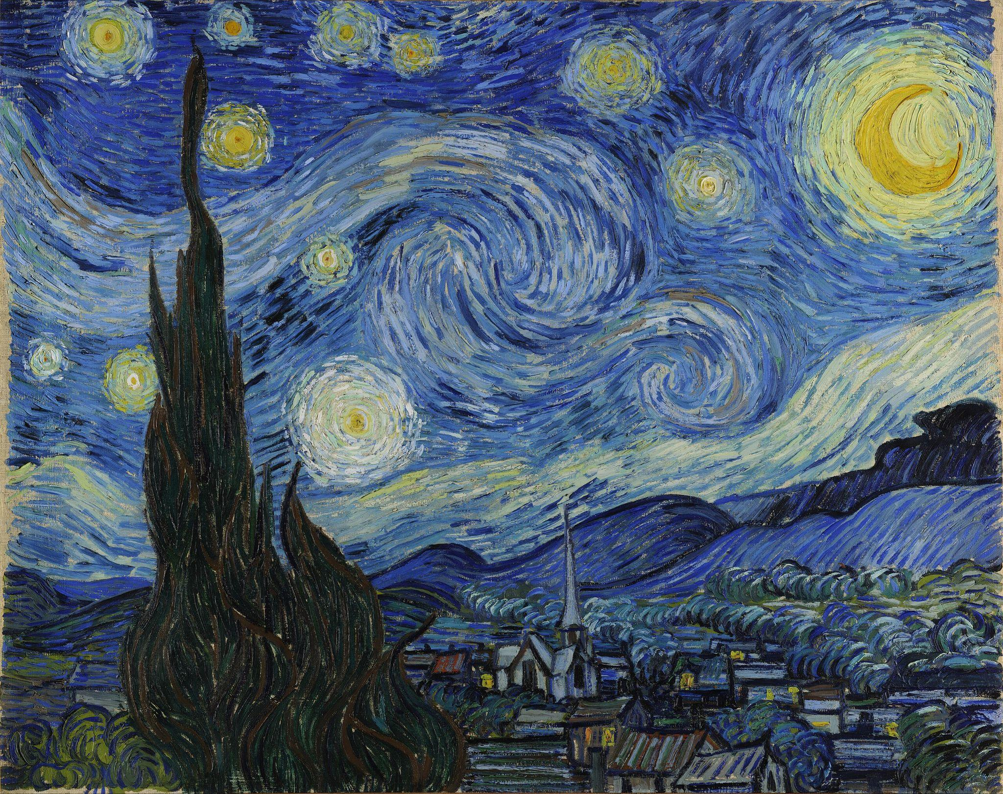
Saamaynta isticmaalka xallinta (resolution) kala duwan ee sawirada
Sawirkani waa 2560 pixels ⨉ 2027 pixels = 5 189 120 pixels.

Slide 29

Saamaynta isticmaalka xallinta (resolution) kala duwan ee sawirada
Sawirkani waa 1280 pixels ⨉ 1014 pixels = 1 297 920 pixels.

Slide 30

Saamaynta isticmaalka xallinta (resolution) kala duwan ee sawirada
Sawirkani waa 970 pixels ⨉ 768 pixels = 744 960 pixels.

Slide 31

Saamaynta isticmaalka xallinta (resolution) kala duwan ee sawirada
Sawirkani waa 757 pixels ⨉ 599 pixels = 453 443 pixels.

Slide 32

Saamaynta isticmaalka xallinta (resolution) kala duwan ee sawirada
Sawirkani waa 606 pixels ⨉ 480 pixels = 290 880 pixels.

Slide 33

Saamaynta isticmaalka xallinta (resolution) kala duwan ee sawirada
Sawirkani waa 250 pixels ⨉ 198 pixels = 49 500 pixels.

Slide 34

Saamaynta isticmaalka xallinta (resolution) kala duwan ee sawirada
Sawirkani waa 100 pixels ⨉ 79 pixels = 7900 pixels.

Slide 35
Saamaynta isticmaalka xallinta (resolution) kala duwan ee sawirada
100 pixels ⨉ 79 pixels = 7900 pixels
2560 pixels ⨉ 2027 pixels = 5 189 120 pixels

Slide 36
Saamaynta isticmaalka xallinta (resolution) kala duwan ee sawirada
Tayada muuqaalka (Visual quality)
Xallinta sare (Higher resolution) waxay wanaajisaa faahfaahinta, gaar ahaan shaashadaha waaweyn.
Sawirada xallinta hoose (low resolution) waxay u ekaan karaan kuwo pixelaysan ama faahfaahin la'aan marka la weyneeyo ama lagu muujiyo kormeerayaasha qeexida sare (high definition).

Slide 37
Saamaynta isticmaalka xallinta sawir ee kala duwan
Cabbirka faylka (File size)
Sawirada xallinta sare (higher resolution) waxay leeyihiin cabbirro fayl oo ka waaweyn sababtoo ah waxay kaydiyaan pixels badan.
Sawirada xallinta hoose (lower resolution) waxay qaataan kaydin yar laakiin tayadoodu hooseysaa.

Slide 38
Saamaynta isticmaalka xallinta sawir ee kala duwan
Tusaalooyin
Sawirada xallinta sare (High resolution) waxay ku habboon yihiin daabacaadda, sawir qaadista xirfadda leh iyo shaashadaha waaweyn.
Sawirada xallinta hoose (Low resolution) waxay ku habboon yihiin isticmaalka shabakadda, wakhtiyada soo dejinta degdega ah iyo aaladaha leh shaashado yaryar.

Slide 39
Saamaynta isticmaalka xallinta sawir ee kala duwan
Suad waxay rabtaa in shabakadeedu si degdeg ah u soo dejiyo. Xallinta sawir ee kee ayay dooranaysaa Suad si ay u hubiso wakhtiyada soo dejinta degdega ah iyadoo ilaalinaysa tayo wanaagsan?
xallinta sare (high resolution), oo inta badan keenta wakhti soo dejinta gaabis ah
xallinta hoose (low resolution), oo laga yaabo inay si degdeg ah u soo dejiso laakiin waxay dhimaysaa tayada sawirka
xallinta la hagaajiyay (optimised resolution), oo isu dheellitirta tayada iyo xawaaraha soo dejinta

Slide 40
Saamaynta isticmaalka xallinta sawir ee kala duwan
Suad waxay u direysaa sawir oo lifaaqan emayl Saciid. Maxaa sabab u noqon kara in Suad u doorato inay u dirto nooca xallinta hoose (low resolution) ee sawirka halkii ay u diri lahayd nooca asalka ah ee xallinta sare (high resolution)?
Saciid waxuu daabacanayaa sawir weyn si uu ugu dhejiyo gurigiisa. Miyuu Saciid dooranayaa sawir xallintiisu sareeyso (high resolution) ama mid hoose (low resolution)? Sharax jawaabtaada.

Slide 41
Saamaynta isticmaalka xallinta sawir ee kala duwan
Suad waxaa laga codsaday inay naqshadeyso sawir lagu dhiirrigelinayo qaab nololeed caafimaad leh oo lagu soo bandhigi doono billboard dhijitaal ah oo ku yaal xarunta magaalada. Waa maxay arrimaha aad tixgelin lahayd markaad dooranayso xallinta sawirada billboard-ka? Sharax sababtaada.

Slide 42
Saamaynta isticmaalka xallinta sawirka ee kala duwan
Suad waxay u direysaa sawir oo lifaaqan emayl Saciid. Maxaa sabab u noqon kara in Suad u doorato inay u dirto nooca xallinta hoose (low resolution) ee sawirka halkii ay u diri lahayd nooca asalka ah ee xallinta sare (high resolution)?
Dirista sawir xallintiisu hooseyso (low resolution) emayl ayaa ka fiican sababtoo ah waxay yeelan doontaa cabbir fayl oo yar. Tani waxay ka dhigan tahay inay si degdeg ah u diri doonto oo ay u yar tahay inay keento dhibaatooyin xadka cabbirka emaylka. Inkasta oo tayadu laga yaabo inay u fiicnayn sida asalka ah, haddana waxay weli fiicnaan doontaa daawashada taleefanka ama shaashadda kombiyuutarka.

Slide 43
Saamaynta isticmaalka xallinta sawirka ee kala duwan
Saciid wuxuu daabacayaa sawir weyn si uu ugu dhejiyo gurigiisa. Saciid waa inuu doortaa sawir xallintiisu sarreyso (high resolution) ama hooseyso (low resolution)? Sharax jawaabtaada.
Saciid waa inuu doortaa sawir xallintiisu sarreyso (high resolution) marka uu daabacayo sawir. Sawirrada xallintoodu sarreyso waxay leeyihiin pixels badan, taas oo macnaheedu yahay in sawirka lagu daabici doono faahfaahin iyo caddayn badan. Sawir xallintiisu hooseyso (low resolution) wuxuu u ekaan karaa mid aan caddayn ama pixels leh marka lagu daabaco cabbir weyn.

Slide 44
Saamaynta isticmaalka xallinta sawirka ee kala duwan
Waa maxay arrimaha aad tixgelin lahayd markaad dooranayso xallinta sawirrada loogu talagalay billboard-ka?
Waxaan dooran lahaa xallin sare (high resolution). Billboard-yadu waa kuwo aad u weyn, sidaas darteed sawirradu waxay u baahan yihiin pixels badan si ay u ekaadaan kuwo cad oo qurux badan marka laga eego meel fog. Billboard-yada waxaa laga eegaa meel fog, sidaas darteed tayada sawirka ayaa mudnaan leh marka loo eego cabbirka faylka.
Si kastaba ha ahaatee, waxaan sidoo kale u baahanahay inaan tixgeliyo awoodda shaashadda (display screen) iyo kaydinta nidaamka kombuyuutarka ee billboard-ka. Waxaa jiri kara xad ku saabsan sida sare ee xallintu noqon karto.

Slide 45
Cabbirka faylka sawirrada dijitaalka ah
Xisaabinta cabbirka faylka sawirka
Saamaynta isticmaalka xallinta sawirka ee kala duwan
Saamaynta isticmaalka qoto-dheerka midabka ee kala duwan

Slide 46
Saamaynta isticmaalka qoto-dheerka midabka ee kala duwan
Qoto-dheerka midabka (colour depth) waxaa loola jeedaa tirada bits-ka
loo isticmaalo in lagu matalo midabka hal pixel oo ku jira sawir ama shaashad.
Qoto-dheerka midabka sare wuxuu u oggolaanayaa midabyo badan, taasoo keenta gradient jilicsan iyo sawirro dhab ah.

Slide 47
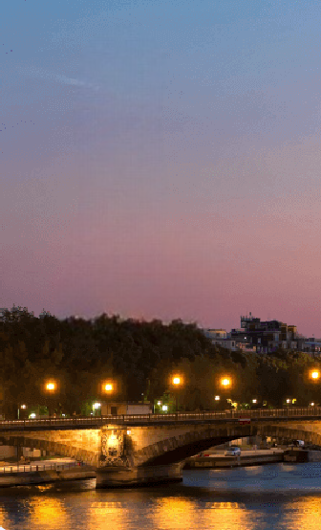
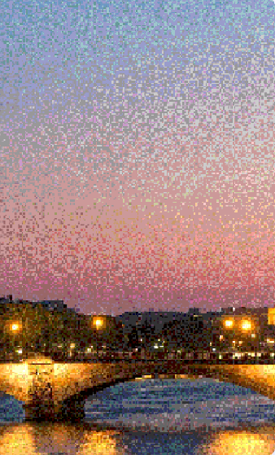
Saamaynta isticmaalka qoto-dheerka midabka ee kala duwan
Sawirkan waxaa loo qaybiyay laba qaybood. Qayb kastaa waxay leedahay qoto-dheer midab oo kala duwan.
24 bit midab
16.7 milyan oo midab
8 bit midab
256 midab

Slide 48
Saamaynta isticmaalka qoto-dheer midab oo kala duwan
Qoto-dheer midab (colour depth) waxaa badanaa loo dejiyaa mid ka mid ah:
8 bit: 256 midab (loo isticmaalo nidaamyada hore)
16 bit: 65,536 midab (midab sare, loo isticmaalo multimedia-ga hore)
24 bit: 16.7 milyan midab (midab run ah, heerka sawirada iyo bandhigyada casriga ah)

Slide 49
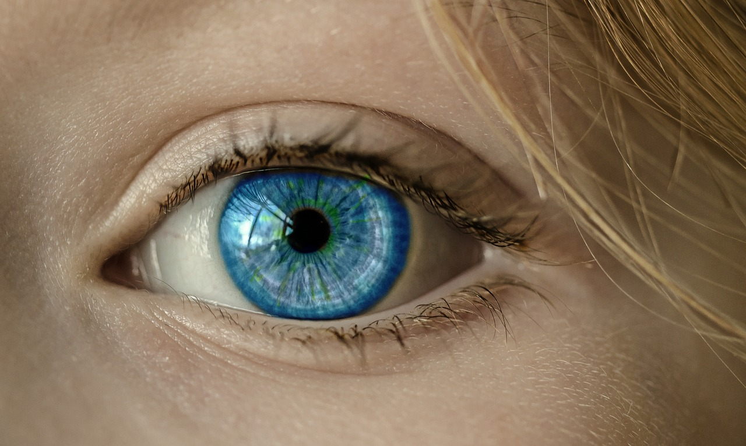
Saamaynta isticmaalka qoto-dheer midab oo kala duwan
Nolosha dhabta ah, waxaan dareemi karnaa kala duwanaansho midab oo aad u badan. Sidaa darteed, inta badan midabka aad ku isticmaasho sawirka, waa sida uu sawirku u ekaan doono xaqiiqda.
Qoto-dheer midab sare wuxuu keenaa midab qani ah oo sax ah.

Slide 50
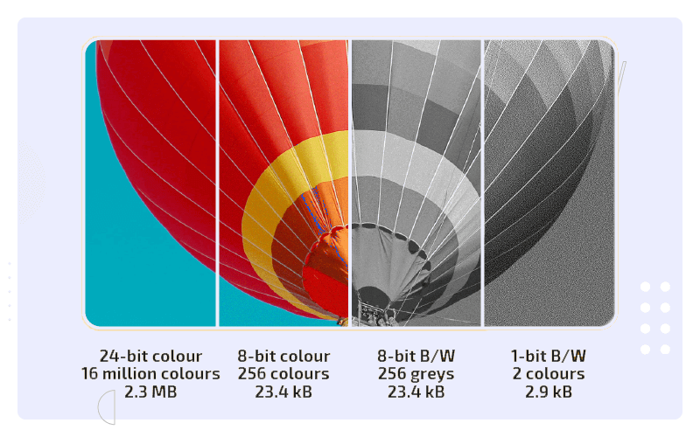

Saamaynta isticmaalka qoto-dheer midab oo kala duwan
Si kastaba ha ahaatee, bits badan oo pixel kii ah waxay ka dhigan yihiin cabbir fayl oo weyn, sababtoo ah pixel kasta wuxuu u baahan yahay xog badan si loo kaydiyo macluumaadka midabkiisa.

Slide 51
Saamaynta isticmaalka qoto-dheer midab oo kala duwan
Waxaad arki kartaa sida cabbirka faylku u yaraado marka qoto-dheer midabka la dhimo.
24 bit
16 milyan midab
2.3 MB
8 bit
256 midab
23.4 kB
8 bit
256 cawl (greys)
23.4 kB
1 bit
2
midabada
2.9 kB

Slide 52
Saamaynta isticmaalka qoto-dheer midab oo kala duwan
Sababta aad u dooran karto inaad yarayso qoto-dheer midabka waa inaad yarayso cabbirka faylka.
Marka la isticmaalo bits badan oo midabada sawirka lagu matalo, waxaa loo baahan yahay meel kaydin ah oo badan si loo kaydiyo sawirkaas.
Dirista sawirro cabbirkiisu yar yahay iyadoo loo marayo fariimaha taleefanka gacanta waxay u oggolaanaysaa in si dhakhso ah loo helo waxayna yaraynaysaa isticmaalka xogta (data) ee diraha.

Slide 53
Saamaynta isticmaalka qoto-dheer midab oo kala duwan
Tusaale:
8 bits: garaafyo fudud, astaamo (icons), ciyaaraha qaabka retro
16 bits: multimedia aasaasi ah, ciyaaraha duugga ah
24 bits/32 bits: sawir qaadis (photography), tafatirka fiidiyowga iyo shaashado tayo sare leh

Slide 54
Saamaynta isticmaalka qoto-dheer midab oo kala duwan
Saciid wuxuu abuurayaa sawir si uu ugu xayeysiiyo munaasabadda samafalka ee dugsigeeda. Waxay haysaa laba nooc oo isku sawir ah.
sawirka A
414 948 midab oo kala duwan
sawirka B
256 midab oo kala duwan
Sawir kee ayaa yeelan doona cabbirka faylka ugu yar? Sabab?
Notes:
414 948 unique colours

Slide 55
Saamaynta isticmaalka qoto-dheer midab oo kala duwan
Haddii Saciid rabo inuu isticmaalo sawirka website-ka dugsiga, sawir kee ayaa ku habboon? Sabab?
Sawir kee ayaa ugu fiican daabacaadda banner weyn oo tayo sare leh oo lagu soo bandhigi doono albaabada dugsiga? Sabab?

Slide 56
Saamaynta isticmaalka qoto-dheer midab oo kala duwan
Sawirka A
414 948 midabyo kala duwan
Sawirka B
256 midabyo kala duwan
Sawirkaas ayaa yeelan doona xajmiga ugu yar (file size)? Sababta.
Sawirka B ayaa yeelan doona xajmiga ugu yar (file size). Tiro hoose oo midabyo ah waxay ka dhigan tahay qoto-dheer midab oo hooseeya (colour depth), taasoo macneheedu yahay in sawirku qaato meel kayd ah oo yar.
Notes:
414 948 unique colours

Slide 57
Saamaynta isticmaalka qoto-dheer midabyo kala duwan
Haddii Saciid uu rabo inuu sawirka isticmaalo website-ka dugsiga, sawirkaas ayaa ku habboon? Sababta?
Sawirka B ayaa ku habboon website-ka. Xajmiyada yar (file sizes) ayaa muhiim u ah websites-ka si ay si degdeg ah u soo galaan. Sawir leh qoto-dheer midab oo sarreeya (high colour depth) wuxuu sababi karaa in bogga website-ku si gaabis ah u soo galo.

Slide 58
Saamaynta isticmaalka qoto-dheer midabyo kala duwan
Sawirkaas ayaa ugu wanaagsan daabacaadda banner weyn oo tayo sare leh (high-quality) oo la dhejin doono albaabka dugsiga? Sababta?
Sawirka A (qoto-dheer midab oo sarreeya) ayaa ugu wanaagsan banner-ka. Sawirrada leh qoto-dheer midab oo sarreeya waxay leeyihiin faahfaahin dheeri ah waxayna u ekaan doonaan kuwo cad marka la daabaco cabbir weyn.

Slide 59
Xajmiga sawirrada dhijitaalka ah (File size of digital images)
Xallinta (Resolution) waxaa loola jeedaa tirada pixels ee sawirka ku jira.
Xallin sare (Higher resolution) waxay ka dhigan tahay pixels badan iyo sawir faahfaahsan.
Qoto-dheer midab (Colour depth) waxaa loola jeedaa tirada bits ee loo isticmaalo in lagu muujiyo midabka pixel kasta. Qoto-dheer midab oo sarreeya (Higher colour depth) waxay ka dhigan tahay kala duwanaansho midab oo ballaadhan.
Waxaa jira is-dheelli-tir u dhexeeya tayada sawirka iyo xajmiga. Sawirrada tayada sare leh (pixels badan, midabyo badan) badanaa waxay leeyihiin xajmiyo weyn (file sizes).

