Slide 1
Hagaajinta wareegyada khaldan
Wareegyada taxanaha ah (Series circuits)

Slide 2
Sida agabkeena waxbarista loogu talagalay fasalka

Slide 3
Waxaan qeexi karaa sida loo dhiso wareeg tijaabo ah oo fudud, u isticmaalo in lagu hubiyo qaybaha khaldan, iyo helista khaladaadka wareegga korontada.

Slide 4
filament
qayb khaldan (faulty component)
wareeg taxane (series circuit)
wareeg dhammaystiran (complete circuit)
wareeg tijaabo (test circuit)

Slide 5
Filament waa silig bir ah oo dhuuban oo ku yaal qaar ka mid ah nalalka, kaas oo iftiima oo siiya iftiin marka la kululeeyo.
Qayb khaldan (faulty component) waa mid dhaawacantay ama aan si fiican u qaadin korontada.
Wareeg taxane (series circuit) waa wareeg koronto oo leh hal loop oo dhammaystiran oo ka bilaabma dhamaadka batteriga ilaa dhamaadka kale.
Wareeg dhammaystiran (complete circuit) waa mid aan lahayn meel bannaan, sidaas darteed korontadu waxay awood u leedahay inay ku wareegto wareegga.
Wareeg tijaabo (test circuit) waxaa loo isticmaalaa in lagu hubiyo haddii qayb (ama wareeg kale) u oggolaanayo korontada inay dhex socoto.

Slide 6

Hagaajinta wareegyada khaldan
Dhibaatooyinka wareegga
Dhismaha iyo isticmaalka wareeg tijaabo
Tijaabinta wareegyada markaad dhisayso

Slide 7
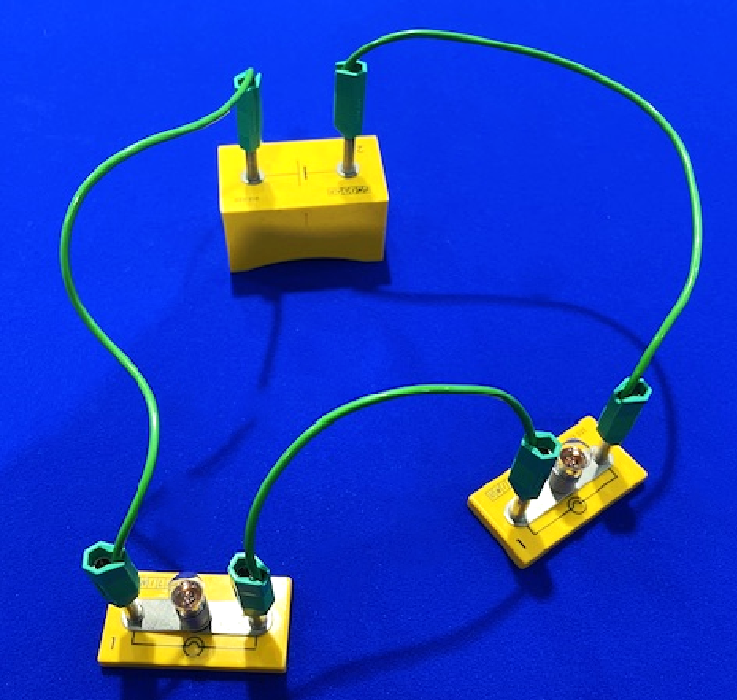
Dhibaatooyinka wareegga
Wareeg taxane (series circuit), haddii qayb midna aan shaqeyn, wareeggu wuu jajabaa, mana aha wareeg dhammaystiran.
Haddii nalkani jajabo …
… koronto ma socon karto, qaybaha kalena ma shaqeyn doonaan.

Slide 8
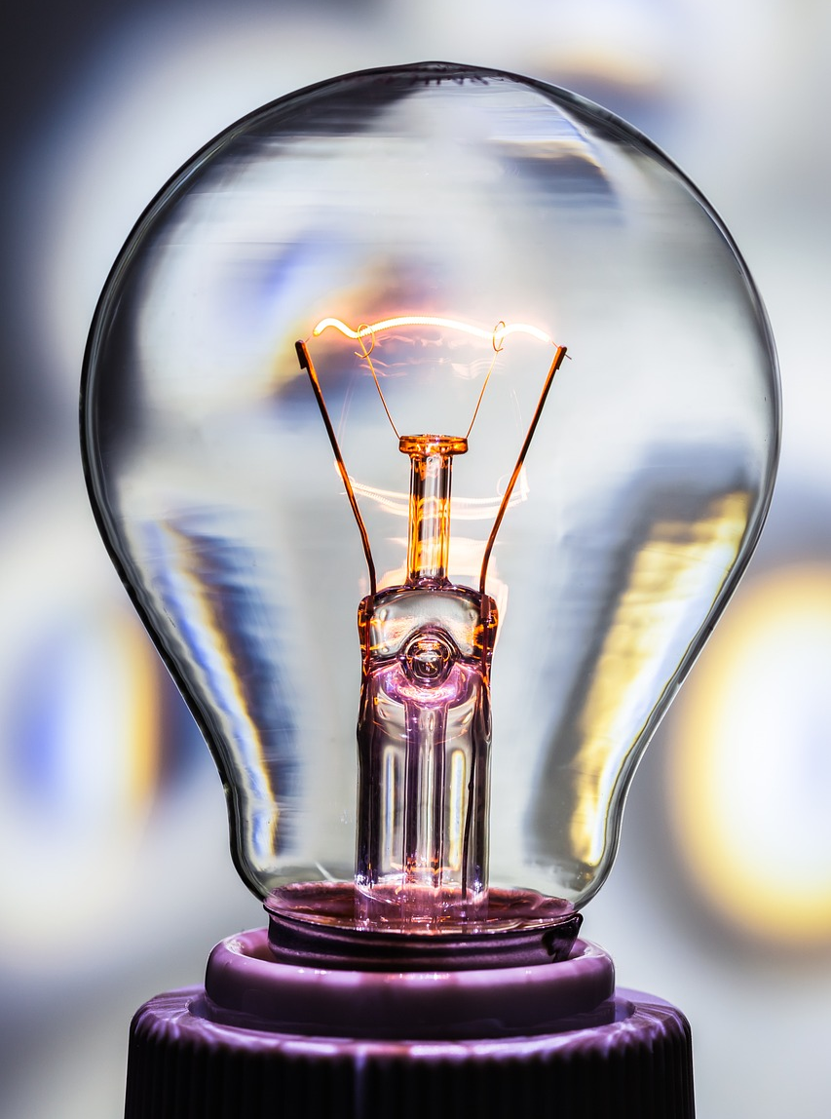
Dhibaatooyinka wareegga (Circuit problems)
Nalka filament-ka wuxuu ka kooban yahay silig dhuuban oo iftiimiya.
filament

Slide 9
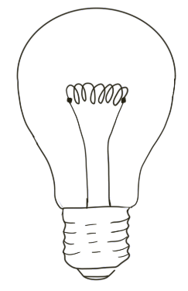
Dhibaatooyinka wareegga (Circuit problems)
Filament-ka waxaa lagu xiraa saldhigga si loo sameeyo wareeg joogto ah (continuous loop).
Korantada (current) waxay mari kartaa filament-ka
Waxaa laga sameeyaa bir (metal) waana koronto-sameeye (conductor).
Xidhiidhada (connections) halkan ayaa la sameeyaa

Slide 10
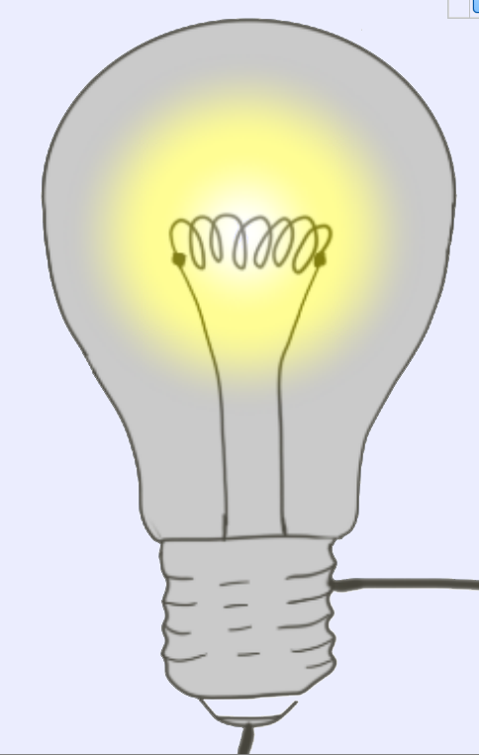
Dhibaatooyinka wareegga (Circuit problems)
Marka korontadu (electricity) ku qulqusho wareegga dhammaystiran (complete loop), filament-ku wuu iftiimiyaa oo nalku wuu shidmaa.

Slide 11
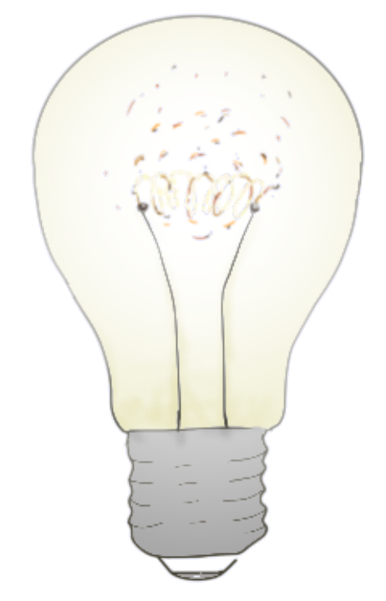
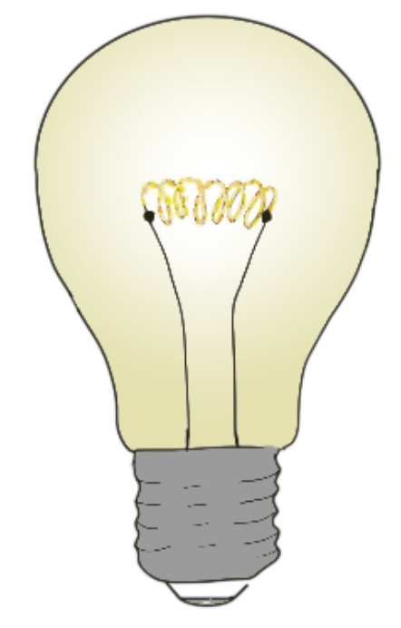
Dhibaatooyinka wareegga (Circuit problems)
Haddii koronto badan (too much electricity) qulqusho,
filament-ku wuu kululaan doonaa oo wuu dhalaali doonaa (melt).

Slide 12
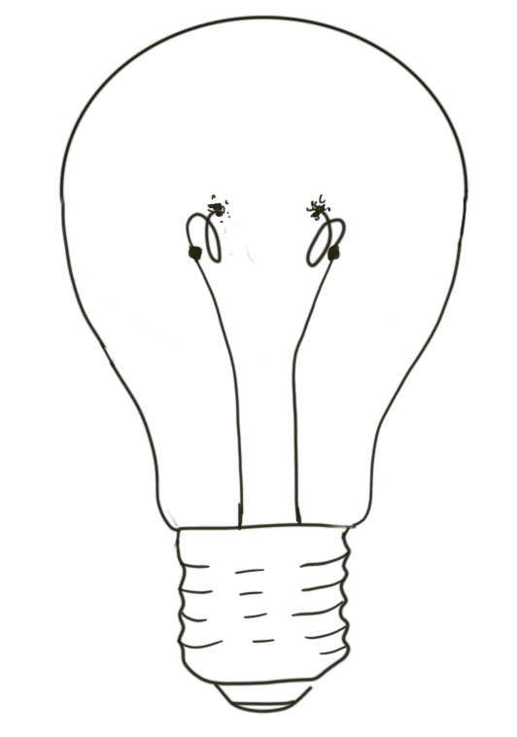
Dhibaatooyinka wareegga (Circuit problems)
farqi (gap)
Wareegga (loop) hadda wuu jabay, korontaduna (electricity) ma qulquli karto.
Mararka qaarkood waxaan nidhaahnaa, “nalkii wuu gubtay (blown)”.
Hadda waa qayb cilladaysan (faulty component).

Slide 13
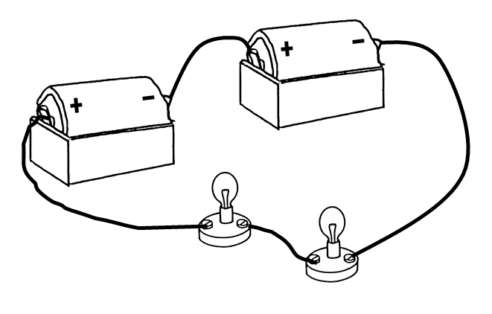

Dhibaatooyinka wareegga (Circuit problems)
Wareeggan (circuit), hal nalkii ayaa gubtay (blows).
Maxaa ku dhici doona kan kale?
wuu sii shidi doonaa (stay lit)
waxay noqon doontaa mid iftiin badan
waxay bakhti doontaa

Slide 14
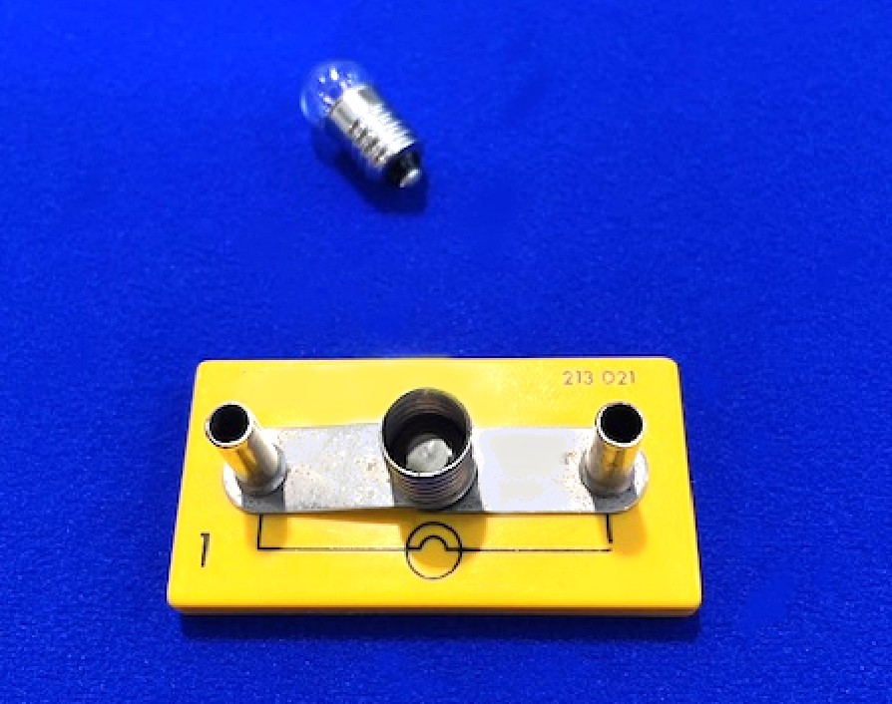
Dhibaatooyinka wareegga (Circuit)
Waxaa jira sababo kale oo wareegga (circuit) uusan u shaqayn karin:
Nalka (bulb) waa mid qiime aad u sarreeya oo u baahan koronto badan si uu u iftiimo. Weli wuxuu u oggolaanayaa korontada inay socoto, laakiin ma iftiimayo.
Nalka (bulb) laga yaabaa inaan si fiican loogu maro gudaha qabaha (holder) oo uusan taaban xiriiriyeyaasha (connectors).

Slide 15
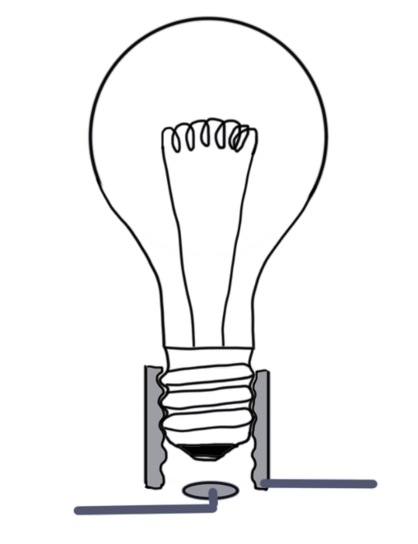
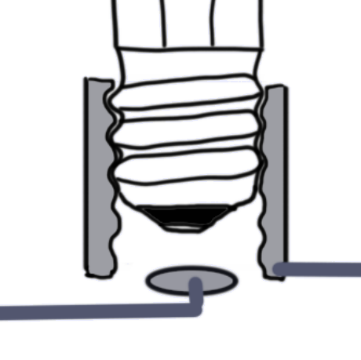
Dhibaatooyinka wareegga (Circuit)
Nalkan (bulb) si fiican looguma marin.
farqi (gap)
qabaha (holder)
Waxaa jira farqi (gap), kaas oo jebiya wareegga (circuit).

Slide 16
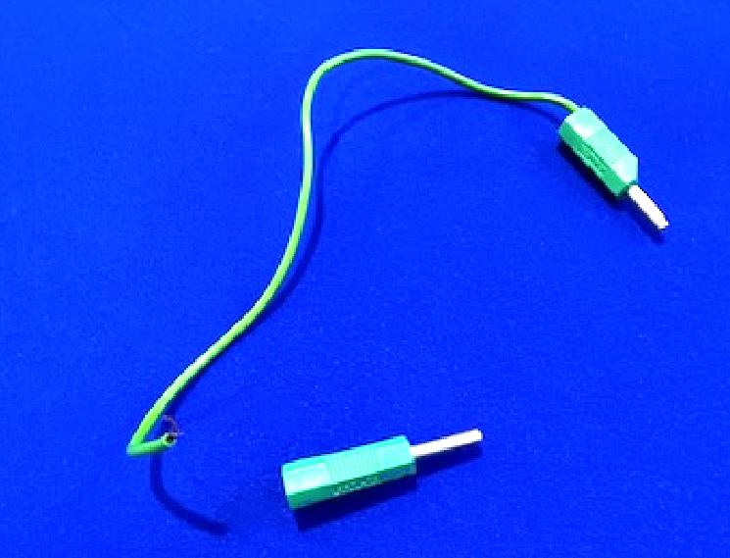
Dhibaatooyinka wareegga (Circuit)
Siligga (wire) birta ah ee gudaha fiilada (lead) wuu jabi karaa ama wuu kala go'i karaa.

Slide 17
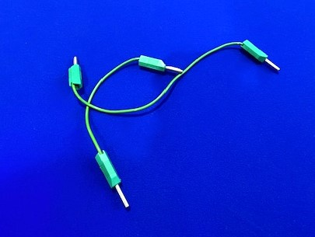
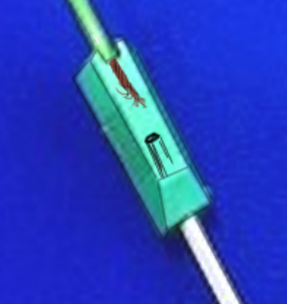
Dhibaatooyinka wareegga (Circuit)
Xataa fiilada (lead) u muuqata mid fiican waxaa laga yaabaa inay gudaha ku xumaatay.
farqi (gap) u dhexeeya siligga (wire) iyo biinka (pin)

Slide 18
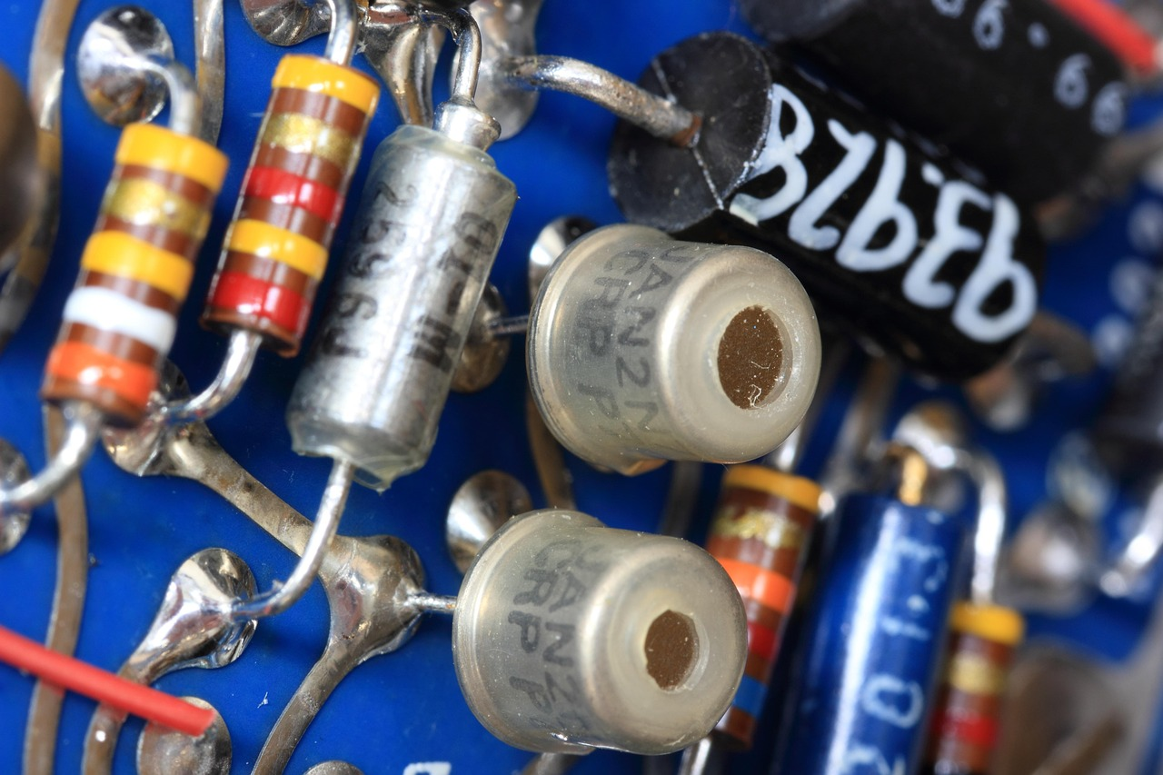
Dhibaatooyinka wareegga (Circuit)
Xirmooyinka birta lagu shubay (soldered joints) waa jabi karaan ama waa dabci karaan.
birta lagu shubo (solder)

Slide 19
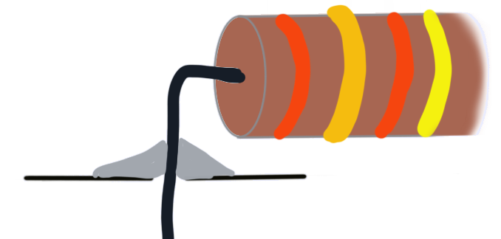
Dhibaatooyinka wareegga (Circuit)
Resistor-kaan wuxuu leeyahay xiriir wanaagsan, isagoo sameynaya wareeg (circuit) dhammaystiran.
farqi (gap) ma jiro

Slide 20
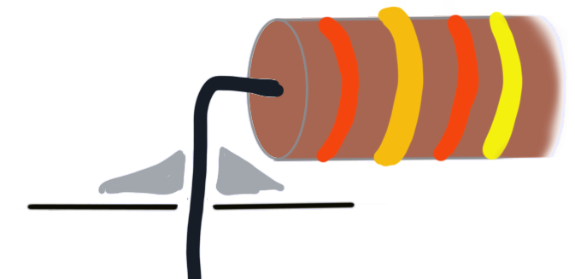
Dhibaatooyinka wareegga (Circuit)
Halkan, birta lagu shubay (solder) way dabacsan tahay oo wareegga (circuit) wuu jabay.
farqiga (gap)

Slide 21
Dhibaatooyinka wareegga (Circuit)
Dhibaatooyinkan midkee aan keenin farqi (gap) ku jira wareegga (circuit)?
fiilada (filament) way dhalaashaa
nalka (bulb) qiimihiisu wuu sarreeyaa oo ma shito
birta lagu shubay (solder) way dabacsan tahay
siliga (wire) ku jira hogaamiyaha (lead) wuu jabaa

Slide 22

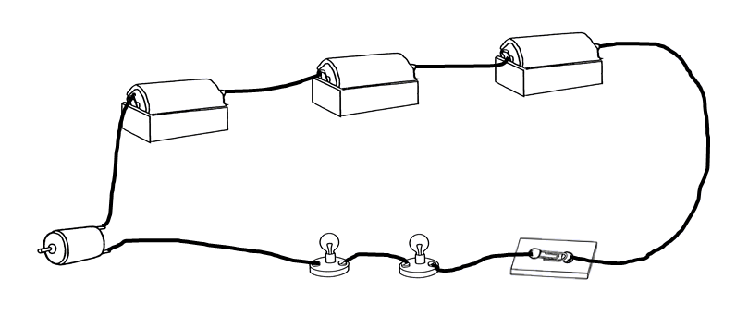
Dhibaatooyinka wareegga (Circuit)
Suad waxay samaysay wareeggan (circuit) si uu u shideeyo matoorka (motor) iyo laba nal (lamps).
Ma shaqeynayo.
Liis garo qaar ka mid ah hubinta (checks) ay samayn karto si ay u hagaajiso dhibaatada.

Slide 23
Dhibaatooyinka wareegga (Circuit)
Qor qaar ka mid ah hubinta ay samayn karto si loo hagaajiyo dhibaatada.
Waxay samayn kartaa qaar ama dhammaan kuwan soo socda:
Hubi in dhammaan unugyada (cells) ku jira baytariyada (battery) ay si sax ah u jihaysan yihiin.
Hubi xidhidh kasta (connection) inuu dabacsan yahay iyo in kale.
Ku beddel nalkasta (bulb), mid ka mid ah, mid aad ogtahay inuu shaqeeyo.
Ku beddel matoorka (motor) mid aad ogtahay inuu shaqeeyo.
Ku beddel hogaamiye kasta (lead), mid ka mid ah, mid aad ogtahay inuu shaqeeyo.
Isku day inaad shidto oo damiso furaha (switch), ku beddel haddii loo baahdo.
Tijaabi qayb kasta (component) adoo ku xidhaya nal (bulb) labada dhinac si aad u aragto haddii ay shaqeyso.
Kala fur wareegga oo dib u dhis, bilow unug shaqeeya iyo nalka, ka dib ku dar hal qayb markiiba.

Slide 24
Hagaajinta wareegyada khaldan
Dhibaatooyinka wareegga (Circuit)
Dhisidda iyo isticmaalka wareeg tijaabo ah
Tijaabinta wareegyada markaad dhisayso

Slide 25
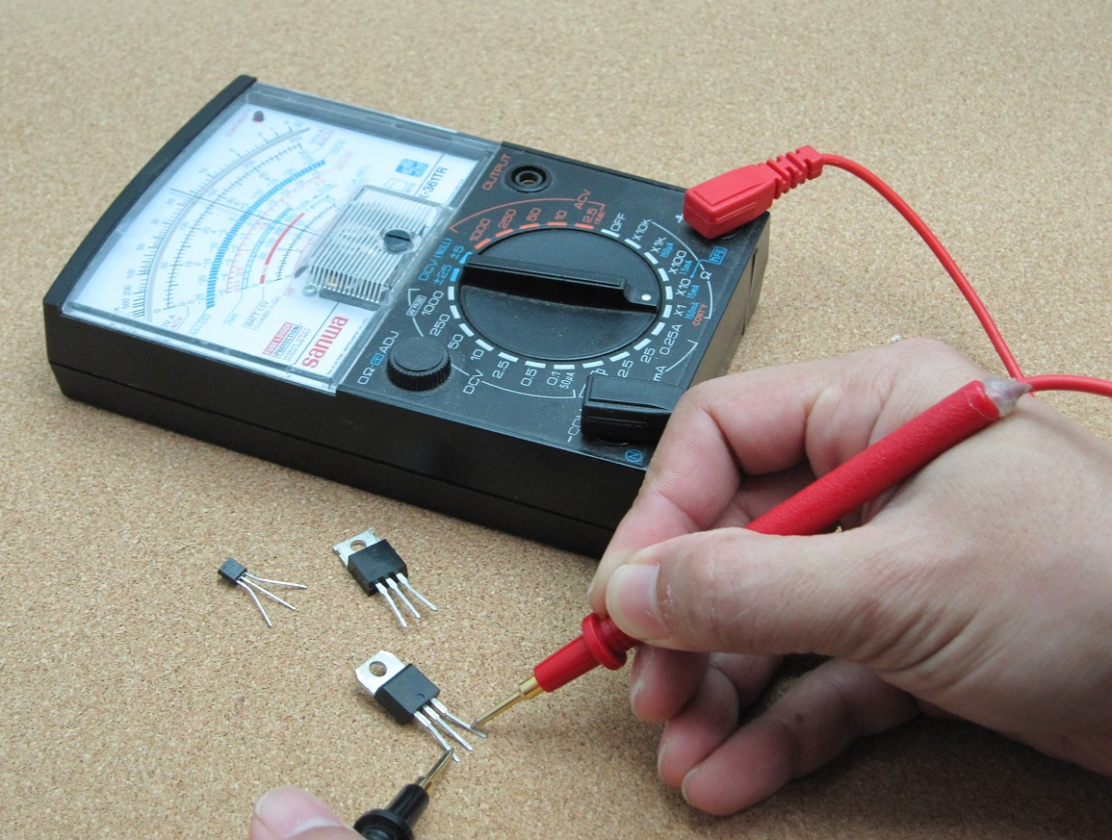
Dhisidda iyo isticmaalka wareeg tijaabo ah
multimeter
Koronto-yaqaannadu waxay tijaabin karaan qaybaha (components) iyagoo isticmaalaya multimeter si ay u arkaan inay si sax ah u shaqeeyaan.
Badanaa, waa in la arko inay u oggolaadaan korontada inay dhex socoto.

Slide 26
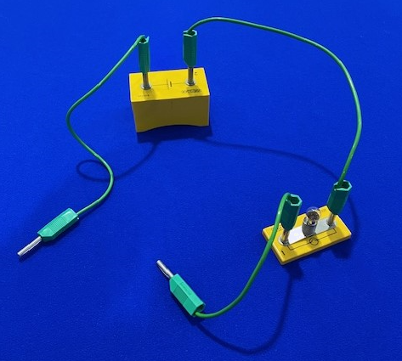
Dhisidda iyo isticmaalka wareeg tijaabo ah
Waxaad dhisi kartaa wareeg tijaabo fudud oo leh unug, nalka, iyo xadhko (leads).
Hubi in wareeggu shaqeeyo adigoo si adag u taabtay xadhkaha (leads).
Nalku waa inuu iftiimaa.
Haddii uusan shaqeyn, beddel qaybaha, mid mid, ilaa uu shaqeeyo.

Slide 27
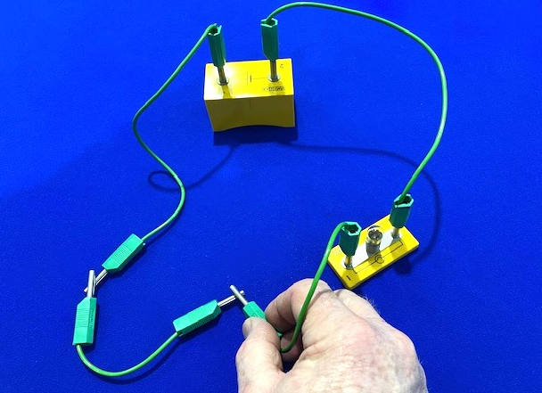
Dhisidda iyo isticmaalka wareeg tijaabo ah
Wareegga tijaabada ah ayaa loo isticmaalayaa in lagu tijaabiyo xadhig (lead).
Nalku ma iftiimin.
Tani waxay noqon kartaa sababtoo ah:
xadhkuhu (leads) si fiican uguma cadaadinayaan
xadhigga la tijaabinayo wuu khaldan yahay

Slide 28
Dhismaha iyo isticmaalka wareegga tijaabada (test circuit)
Waxaad ku tababaran kartaa isticmaalka wareeg tijaabo ah si aad u aragto in qaybaha iyo walxaha kala duwan ay u oggolaadaan korontada inay dhex socoto.
Walxaha sidoo kale waa la tijaabin karaa si loo ogaado haddii ay yihiin kirishtoob (conductors) ama insulators (insulators).
ku dheji qaybta ama shayga halkan

Slide 29
Dhismaha iyo isticmaalka wareegga tijaabada
Laba ka mid ah kuwan soo socda ayaa joojin lahaa laydhka (lamp) wareegga tijaabada inuu shido?
girgirta tijaabada (test bulb) aad loo kudhiiday
xadhkaha (leads) si ku filan looma riixin
filament-ka (filament) girgirta tijaabada wuu dhalaalay
unugga (cell) waa qaab qaldan

Slide 30
Dhismaha iyo isticmaalka wareegga tijaabada
Dhis oo isticmaal wareeg tijaabo ah si aad u hubiso qaybaha iyo walxaha kala duwan inay koronto (electricity) mariyaan iyo in kale.
Ku dheji natiijooyinkaaga miis (table).
shay | kirishtoob (conductor) | insulator (insulator)
girgir (lamp)
xadhig shaybaadh (lab lead)
resistor (resistor)
tusaale balaastiig (plastic ruler)
maqas bir ah (steel scissors)
qalin ‘lead’ (pencil ‘lead’)

Slide 31
Dhisidda iyo isticmaalka wareegga tijaabada (test circuit)
Dhis oo isticmaal wareeg tijaabo ah si aad u hubiso qaybaha iyo walxaha kala duwan inay koronto (electricity) mariyaan iyo in kale.
Ku qor natiijooyinkaaga miis.
shay | wareejiye (conductor) | go'doomiye (insulator)
laambad (lamp) | haa
fiilo shaybaar (lab lead) | haa
iska caabin (resistor) | haa
xisaabta balaastigga (plastic ruler) |  | haa
maqas bir ah (steel scissors) | haa
qalin 'lead' (pencil lead) | haa (si dhib yar)

Slide 32
Hagaajinta wareegyada qaldan
Dhibaatooyinka wareegga (circuit problems)
Dhisidda iyo isticmaalka wareegga tijaabada
Tijaabinta wareegyada markaad dhisayso

Slide 33
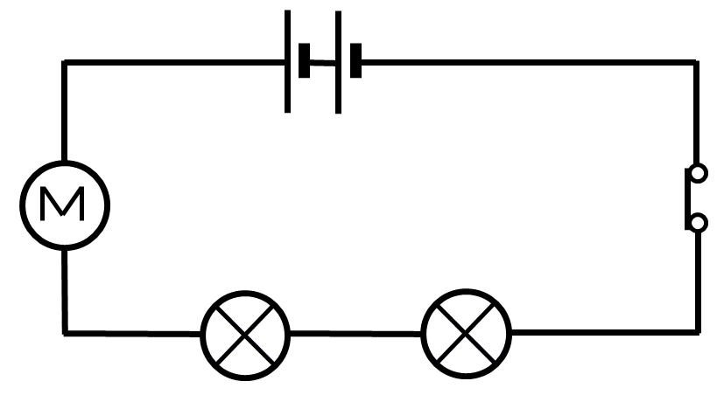
Tijaabinta wareegyada markaad dhisayso
Haddii wareeggu (circuit) ka kooban yahay laydh (lamp), waxaa loo isticmaali karaa in lagu hubiyo in wareeggu (circuit) shaqeynayo sida loo dhisay.
Uma baahnid wareeg (circuit) tijaabo oo gaar ah.
Ku bilow dhisidda wareeggan (circuit) oo leh hal laydh (lamp) iyo hal unug (cell).

Slide 34
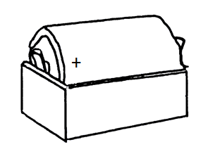
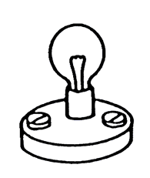
Tijaabinta wareegyada (circuits) inta aad dhisaysid
Haddii laydhku (lamp) shido, waxaad ogaataa in qaybaha (components) si sax ah u shaqeynayaan.

Slide 35
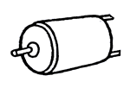
Tijaabinta wareegyada (circuits) inta aad dhisaysid
Ku dar qayb (component) kale, oo hubi in laydhku (lamp) shaqeynayo.

Slide 36
Tijaabinta wareegyada (circuits) inta aad dhisaysid
Ku dar laydhka (lamp) xiga, oo hubi in labaduba shidaan.

Slide 37
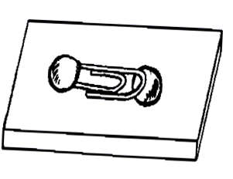
Tijaabinta wareegyada (circuits) inta aad dhisaysid
Ku dar furaha (switch).

Slide 38
Tijaabinta wareegyada (circuits) inta aad dhisaysid
Ku dar furaha (switch). Kadibna ku dar unugga (cell) labaad.
Haddii qayb (component) kasta uu sababo in laydhku (lamp) damiyo, waxaad ogaataa inay qalad tahay oo waa in la beddelaa.

Slide 39
Tijaabinta wareegyada (circuits) inta aad dhisaysid
Haddii wareeggu (circuit) leeyahay cillad (fault), waxaa loo baahan yahay wareeg (circuit) tijaabo ah si loo hubiyo.
Wareegga (circuit) waxaa loo dhisi karaa qayb-qayb (component-by-component), adoo hubinaya inuu shaqeynayo mar kasta.
Ma suurtogeli karo in la ogaado qaybta (component) cilladaysan (faulty) iyada oo aan la helin wareeg (circuit) tijaabo ah.

Slide 40




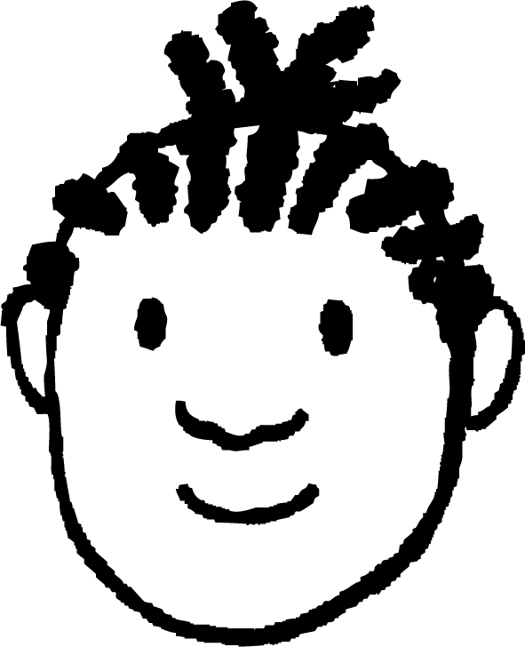
Tijaabinta wareegyada (circuits) inta aad dhisaysid
Layla iyo Yacquub waxay dhisayeen wareegyo (circuits) waxayna heleen qaybo (components) cilladaysan (faulty).
Qaybaha (components) cilladaysan (faulty) waxay iga caawiyeen inaan si fiican u barto.
Qaybaha (components) cilladaysan (faulty) waxay ka dhigeen barashada mid adag.
Sharax sababta labada ardayba u malayn karaan inay sax yihiin. Kadibna soo jeedi inay faa'iido leedahay iyo in kale in qalabka sheybaarka lagu hayo qaybo khaldan.

Slide 41
Tijaabinta wareegyada (circuits) markaad dhisayso
Sharax sababta labada ardayba u malayn karaan inay sax yihiin. Kadibna soo jeedi inay faa'iido leedahay iyo in kale in qalabka sheybaarka lagu hayo qaybo khaldan.
Qaybaha khaldan waxay noqon karaan dhibaato sababtoo ah waxay ka hor istaagi karaan ardayda inay si guul leh u sameeyaan tijaabooyinka, taasoo keenta inay waayaan barashada.
Dhanka kale, waxay siin karaan fursad ardayda ay ku tababartaan xirfadahooda oo ay mas'uuliyadda barashadooda ku qaataan.
Ardayda isku kalsoon waxay u arki karaan qaybaha khaldan fursad ay ku bartaan, halka kuwa aan isku kalsoonayn ay u baahan karaan taageero.

Slide 42
Hagaajinta wareegyada khaldan
Qaybaha khaldan waxay abuuraan farqi (gap) ku dhex jira wareeg (circuit) dhammaystiran, taasoo ka hor istaageysa inuu shaqeeyo.
Nalka (bulb) wuxuu ka kooban yahay fiilo (filament) iftiimaysa, laakiin tani way dhalaali kartaa oo jebin kartaa wareegga.
Wareeg tijaabo (test circuit) ayaa kaa caawin kara inaad aqoonsato qaybaha khaldan.
Haddii wareeggu uusan shaqeyn, qayb kasta waxaa lagu tijaabin karaa si gooni ah iyadoo la isticmaalayo wareeg tijaabo si loo hubiyo inay shaqeyneyso.

