Slide 1
Ilaalinta iftiinka (Focusing light)
Samaynta sawirada (Making images)

Slide 2
Sida agabkeena waxbarista loogu talagalay fasalka

Slide 3
Waxaan sharxi karaa sida iftiinka shayga uu u xoogi karo lens isku soo ururiya (converging lens) si uu u sameeyo sawir (image).

Slide 4
lens (lens)
galaas ama walxo kale oo iftiin u gudbiya oo loo qaabeeyey inay iftiinka u qalloociyaan dhanka xoogga (focus) ama ka fogeeyaan
sawir (image)
matalaad shay
xoog (focus)
(1) meel ay ku kulmaan raajooyin badan oo iftiin ah oo ka yimid shay
(2) habka loo qalloociyo raajooyinka iftiinka si ay u kulmaan
qallooc (refraction)
marka iftiinku beddelo jihadiisa marka uu galo jawi cusub
dhererka xoogga (focal length)
masaafada u dhaxaysa xarunta lenska iyo meesha lensku ku xoogo iftiinka shayga fog

Slide 5

Ilaalinta iftiinka (Focusing light)
Ilaalinta iftiinka si loo sameeyo sawir (image)
Sida lenska qaabka soo ururiya (convex lens) uu u qalloociyo iftiinka

Slide 6
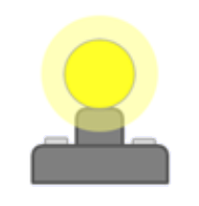
Ilaalinta iftiinka si loo sameeyo sawir (image)
Dhibic kasta oo ka mid ah
shay iftiin leh (luminous object) wuxuu sii daayaa iftiin dhan kasta (all directions).
Dhibic kasta oo ka mid ah
shay aan iftiin lahayn (non-luminous) wuxuu ka tarjumaa iftiinka dhamaan jihooyinka.
Qaar ka mid ah iftiinka shayga ayaa mari kara muraayad (lens) oo la xoojiyey si ay u sameeyaan sawir (image). Inta iftiin ee muraayadda (lens) maraysa, waa inta uu sawirku (image) ka iftiin badan yahay.

Slide 7
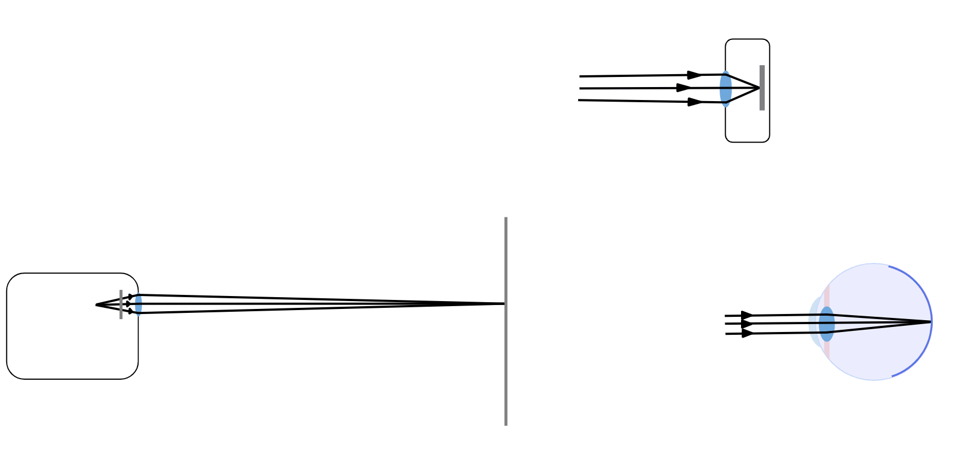
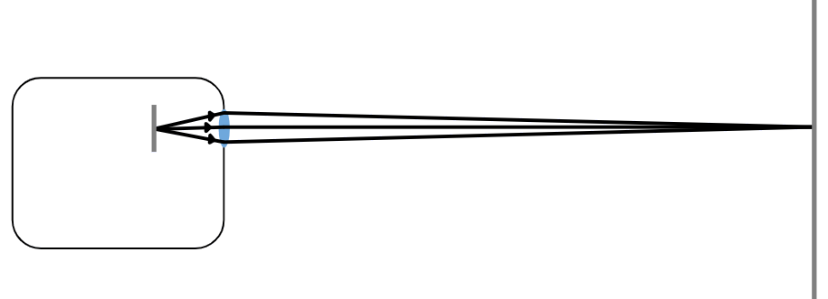
Xoojinta iftiinka si loo sameeyo sawir (Focusing light to form an image)
Kameralada (cameras), mashaariicda (projectors) iyo isha bini'aadamka (human eye) dhamaantood waxay isticmaalaan muraayado (lenses) si ay u xoojiyaan iftiinka oo ay u sameeyaan sawir (image).
Kamarad (camera):
iftiinka shayga (light from objects)
gadaasha kamaradda (back of camera)
muraayad (lens)
Mashruuce (projector):
Isha bini'aadamka (human eye):
muraayad (lens)
iftiinka shayga (light from objects)
shaashadda mashruuca (projection screen)
shaashad yar oo dhalaalaysa (small bright screen)
muraayad (lens)

Slide 8

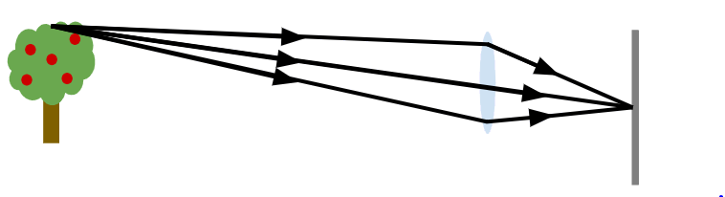
Xoojinta iftiinka si loo sameeyo sawir (Focusing light to form an image)
Maalin dhalaalaysa, muraayad (lens) waxay soo saari kartaa sawir (image) toos ah oo ah muuqaalka bannaanka daaqadda oo lagu soo saaro shaashad madhan.
Sawirkan (image) shaashadda ku yaal waa mid midab buuxa leh, laakiin waa rogan yahay (inverted) (hoos-u-roggan).
daaqad (window)
Sawirka (image) waxaa la soo saaraa sababtoo ah muraayadaha (lenses) waxay u jajabiyaan (refract) (qalloociyaan) iftiinka (light rays).
sawir (image) (shaashadda ku yaal)
muraayad (lens)
shaashad (screen)
muraayad (lens)

Slide 9


Xoog saarista iftiinka si loo sameeyo sawir
Sidee muraayadaha (lenses) u xoog saaraan iftiinka si ay u sameeyaan sawir?
a
Muraayadaha (lenses) waxay ka tarjumaan iftiinka (reflect light).
b
Muraayadaha (lenses) waxay leexiyaan iftiinka (refract light).
c
Muraayadaha (lenses) waxay weyneeyaan iftiinka (magnify light).
d
Muraayadaha (lenses) waxay nuugaan iftiinka (absorb light).
e
Muraayadaha (lenses) waxay soo saaraan iftiin (emit light).

Slide 10
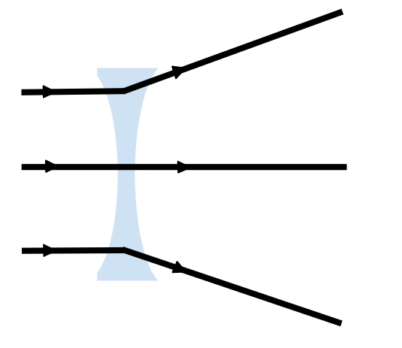
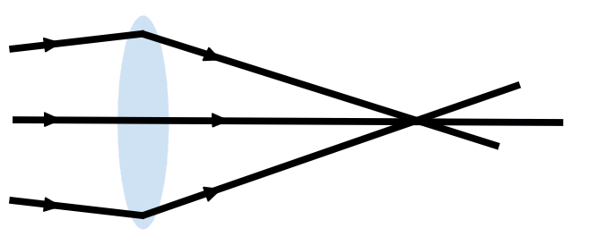
Xoog saarista iftiinka si loo sameeyo sawir
Muraayadaha qaabka dhaca (convex lenses) waxay leexiyaan fallaadhaha iftiinka si ay ugu soo dhawaadaan midba midka kale.
Muraayadaha qaabka godan (concave lenses) waxay kala fidiyaan
fallaadhaha iftiinka.
xoog saar (focus)
Meel ay fallaadhu ku kulmaan waxaa loo yaqaan xoog saar (focus).
Ma samayn karaan sawir shaashad, maxaa yeelay ma keenaan iftiin xoog saaran.
Muraayadaha qaabka dhaca (convex lenses) waxaa sidoo kale loogu yeedhi karaa muraayadaha isku imaanshaha (converging lenses).
Muraayadaha qaabka godan (concave lenses) waxaa sidoo kale loogu yeedhi karaa muraayadaha kala firdhiya (diverging lenses).

Slide 11
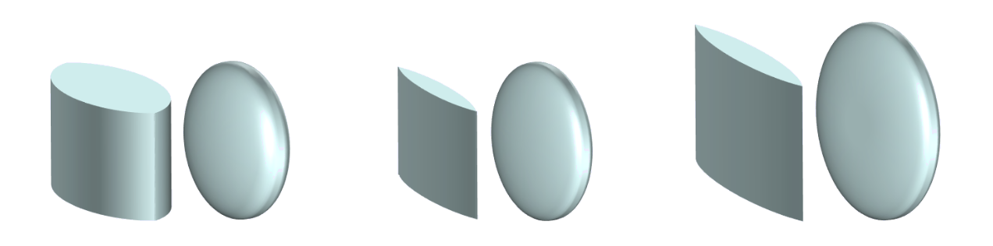
Muraayadaha qaabka dhaca (convex lenses)
Muraayadaha qaabka dhaca (convex lenses) waxay yeelan karaan qaabab kala duwan.
Kani waa muraayad qaabka dhaca oo wareegsan (circular convex lens).
Kani waa muraayad qaabka dhaca oo 'afar gees' ah ('square' convex lens).
Muraayadaha (Convex lenses) waxay ku barari karaan labada dhinac, ama hal dhinac oo kaliya.

Slide 12
Muraayadaha (Convex lenses)
Kuwee ka mid ah kuwan soo socda ayaa muujinaya muraayadaha (convex lenses)?
a
b
c
d
e
f

Slide 13
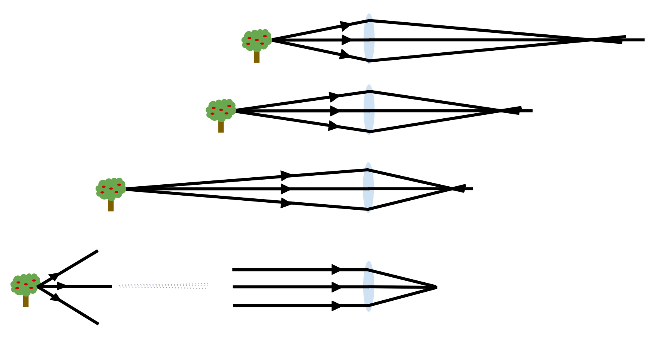
Iftiinka diiradda saarista si loo sameeyo sawir (Focusing light to form an image)
Muraayad (lens) waxay diiradda saari doontaa iftiinka walxaha kala duwan meelo kala duwan, iyadoo ku xiran inta uu fog yahay shay kasta muraayadda (lens).
diirad (focus)
diirad (focus)
diirad (focus)
Jawaabaha:
fogaan weyn (large distance)
diirad (focus)

Slide 14
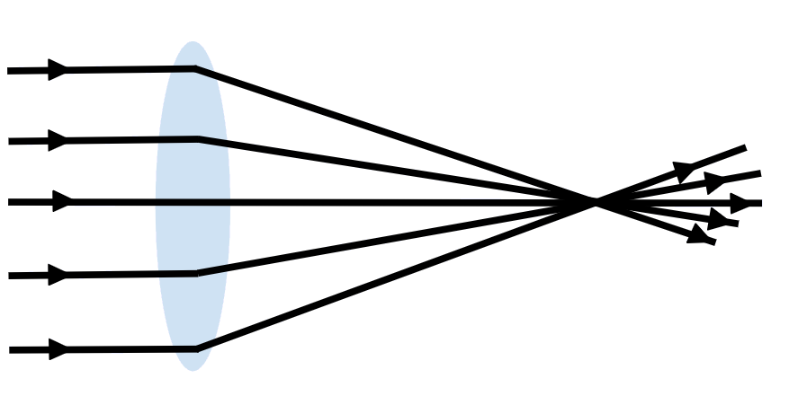
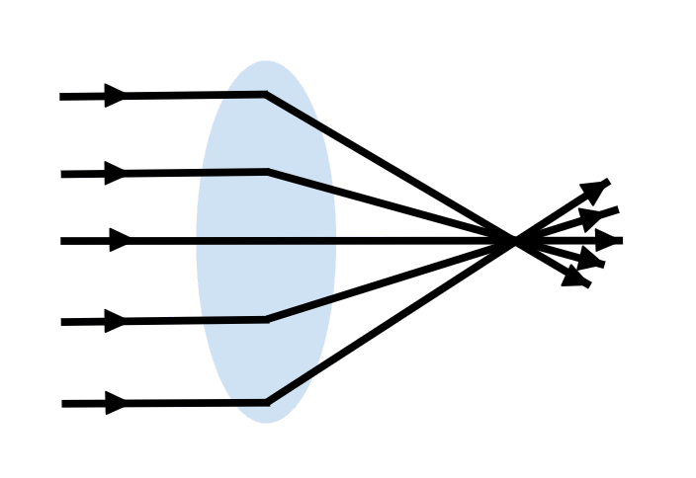
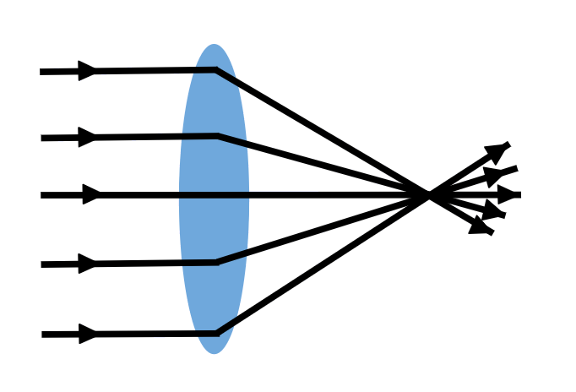
Iftiinka diiradda saarista si loo sameeyo sawir (Focusing light to form an image)
Fogaanta xarunta muraayadda (lens) ilaa meesha uu muraayaddu (lens) ku diiradda saarto iftiinka shay fog waxaa loo yaqaan dhererka diiradda (focal length).
dhererka diiradda (focal length)
Muraayad (lens) ballaadhan ayaa iftiinka u leexiya (refracts) in ka badan muraayad (lens) dhuuban. Tani waxay siisaa dherer diirad (focal length) gaaban, marka waa muraayad (lens) awood badan.
dhererka diiradda (focal length)
Dhammaan muraayadaha (lenses) kama samaysan quraarad (glass).
Qaar ka mid ah walxaha ayaa iftiinka u leexiya (refract) in ka badan quraaradda (glass). Iyadoo la isticmaalayo walxahan, muraayadaha (lenses) leh dherer diirad (focal length) isku mid ah ayaa laga dhigi karaa kuwo dhuuban.
dhererka diiradda (focal length)

Slide 15
Iftiinka diiradda saarista si loo sameeyo sawir (Focusing light to form an image)
Waa maxay sifooyinka ka dhigaya muraayad (lens) mid awood badan?
1)
a
ballaadhan (qaloocsan) (wider (more curved))
b
dhuuban (qalooc yar) (thinner (less curved))
2)
a
wax badan u jajabiya iftiinka (refracts light more)
b
wax yar u jajabiya iftiinka (refracts light less)
3)
a
dherer dheer oo fogaan (longer focal length)
b
dherer gaaban oo fogaan (shorter focal length)

Slide 16
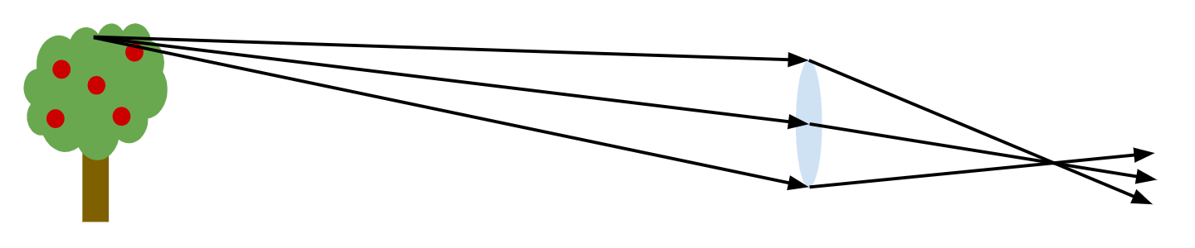

Iftiinka diiradda saarista si sawir loo sameeyo (Focusing light to form an image)
Si sawir cad oo shay ah uu uga sameysmo shaashadda, shaashadda waa in la dhigaa meesha ay raysyada ka yimaada shayga ku kulmaan (focus).
diirad (focus)
Tani waxay u tahay si dhammaan raysyada iftiinka ee ka yimaada hal dhibic oo shayga ah oo dhex mara lens-ka ay ugu kulmaan hal dhibic oo shaashadda ah.
Marka shaashadda meel khaldan tahay, waxaad helaysaa sawir qarqarsan (blurred).
Sababtoo ah iftiinka ka yimaada hal dhibic oo shayga ah wuxuu ku fidaa aag ballaaran oo shaashadda ah oo wuxuu isku daraa iftiinka ka yimaada dhibco kale oo badan
oo shayga ah.

Slide 17
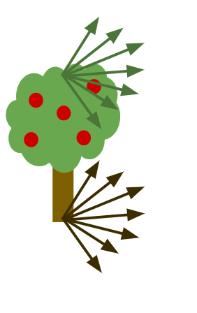
Iftiinka diiradda saarista si sawir loo sameeyo (Focusing light to form an image)
Dhibic kasta oo shayga ah waxay ka tarjumaysaa iftiinka dhammaan jihooyinka. Kaliya jihooyinka qaarkood ayaa la muujiyay.
Qaar ka mid ah iftiinka ka yimaada dhibic kasta
oo shayga ah wuxuu ku dhacaa qayb kasta oo ka mid ah dusha lens-ka.
Rays kasta oo dhex mara lens-ka oo ka yimaada isla dhibicda shayga (tusaale: dusha geedka) waa la jajabiyaa (refracted) si uu ugu kulmo isla dhibicda shaashadda.
Dhibic iftiin ah oo dhalaalaya ayaa halkaas ka soo baxda: qaybta u dhigma ee sawirka.

Slide 18

Iftiinka diiradda saarista si sawir loo sameeyo (Focusing light to form an image)
Sawirka waxaa laga sameeyaa dhammaan dhibcaha iftiinka ee kala duwan ee ka yimaada
dhammaan iftiinka ka yimaada dhibic kasta oo shayga ah oo dhex mara lens-ka.
sawir (image)
Sawirku waa rogan yahay (hoos-u-roggan) sababtoo ah iftiinka ka yimaada dusha shayga waxaa loo jajabiyaa si uu u sameeyo hoosta sawirka, iyo si ka soo horjeeda.

Slide 19
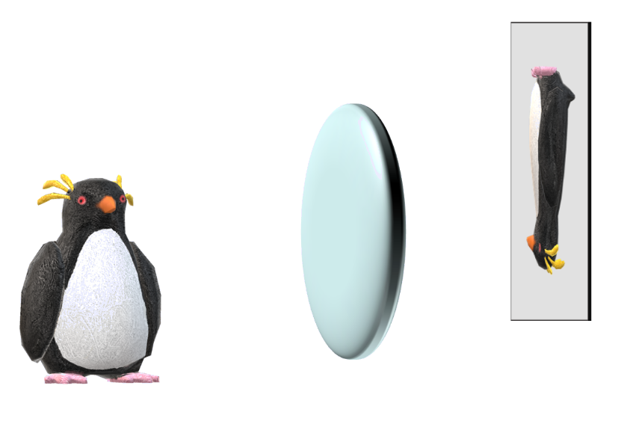
Ifiinka diiradda saarista si loo sameeyo sawir (Focusing light to form an image)
Muraayad (lens) waxay sawir ka sameysaa penguin-ka shaashad cad. Dooro ikhtiyaarka saxda ah si aad u dhamaystirto jumlado kasta.
muraayad (lens)
1) Iftiin (Light) ka imanaya meel kasta oo penguin-ka ah wuxuu u socdaa …
hal jiho oo kaliya oo xagga muraayadda (lens) ah.
jihooyin badan oo xagga muraayadda (lens) ah.
a
b
sawir (image)
penguin
2) Hal dhibic oo sawirka ah waxaa abuura…
a
hal iftiin (ray of light) oo dhex mara muraayadda (lens) penguin-ka.
b
iftiin badan (rays of light) oo dhex mara muraayadda (lens) meelo kala duwan oo penguin-ka ah.
c
iftiin badan (rays of light) oo dhex mara muraayadda (lens), dhamaantood isla meel penguin-ka ah.

Slide 20
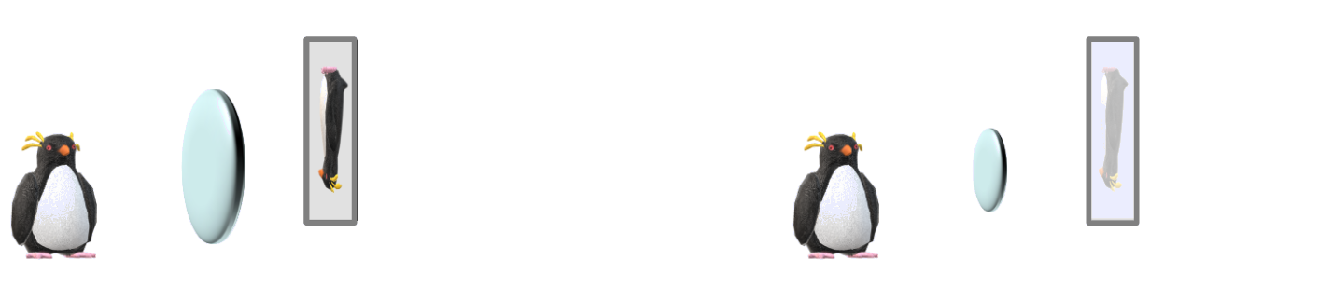
Ifiinka diiradda saarista si loo sameeyo sawir (Focusing light to form an image)
Haddii muraayad (lens) weyn iyo muraayad (lens) yar ay isku dherer diirad (focal length) leeyihiin, oo mid loo beddelo midka kale:
muraayad (lens) yar
muraayad (lens)
sawir (image)
sawir (image) gudcur ah
penguin
penguin
Sawirku (image) wuxuu la mid noqonayaa cabbirka labada muraayadood (lenses).
Sawirku (image) kuma iftiimo sida muraayadda (lens) yar.

Slide 21
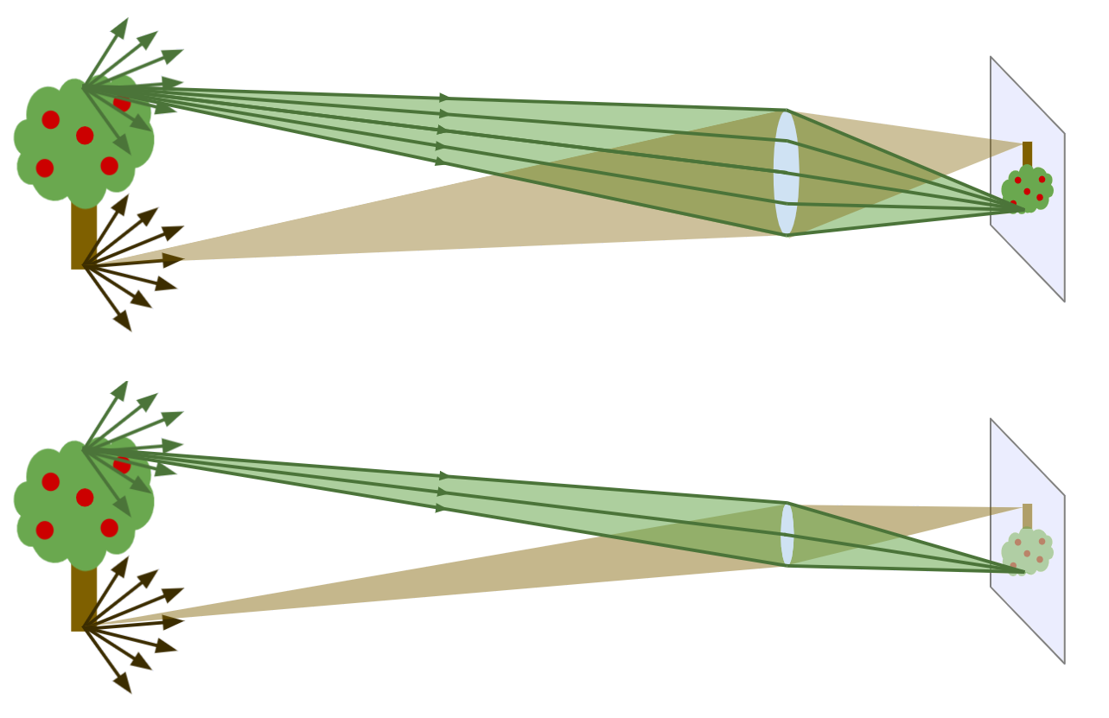
Xoogaynta iftiinka si loo sameeyo sawir (image)
Muraayadaha (lenses) isku dhererka (focal length) leh waxay soo saaraan sawirro (images) isku
cabbir ah, iyadoon loo eegin muraayadda yar. Labada muraayadoodba waxay u jajabiyaan (refract) iftiinka isla qodobka shayga isla qodobka shaashadda.
Si kastaba ha ahaatee, muraayadda (lens) yari waxay ka sameysaa sawir (image) mugdi ah marka loo eego muraayadda weyn, sababtoo ah iftiinka ka yimaada qodob kasta oo shayga ah in yar oo ka mid ah ayaa dhex mari kara una gaari kara shaashadda.

Slide 22

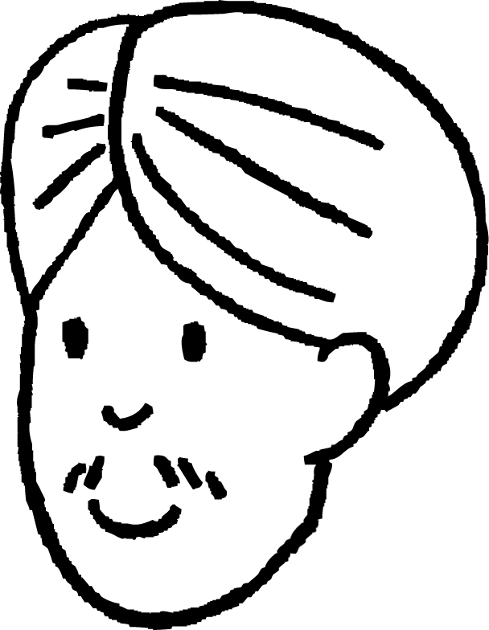
Xoogaynta iftiinka si loo sameeyo sawir (image)
Cali wuxuu ku sameeyaa sawir (image) shaashad iyadoo la adeegsanayo muraayad (convex lens).
Maxaa ku dhaca sawirka (image) haddii la isticmaalo muraayad (lens) yar oo isku dhererka (focal length) leh? (Wax kasta oo kale waa isku mid.)
a
Sawirka (image) cusubi wuu ka yaraan doonaa.
b
Sawirka (image) cusubi wuxuu muujin doonaa shayga in yar.
c
Sawirka (image) cusubi wuu mugdi noqon doonaa.
d
Sawirka (image) cusubi wuxuu ka samaysmi doonaa muraayadda (lens) meel ka fog.

Slide 23
Xoogaynta iftiinka si loo sameeyo sawir (image)
Hoos u dhig iftiinka qolka oo ku dheji warqad gidaarka ka soo hor jeeda daaqadda.
Isticmaal muraayad (convex lens) si aad u soo saarto sawir (image) muuqaalka daaqadda ka baxsan ee warqadda.
Saadaali waxa aad u malaynaysa inaad arki doonto marka kala badh muraayadda (lens) la daboolo.
Sharax sababta aad u malaynaysid inaad arki doonto tan.
Ku dabool kala badh muraayadda (lens) warqad madow oo fiiri waxa dhaca.
Ma sax ahayd saadaashaada iyo sharaxaaddaada?
Qor sharaxaad (explanation) ka fiican waxa aad aragtay.

Slide 24
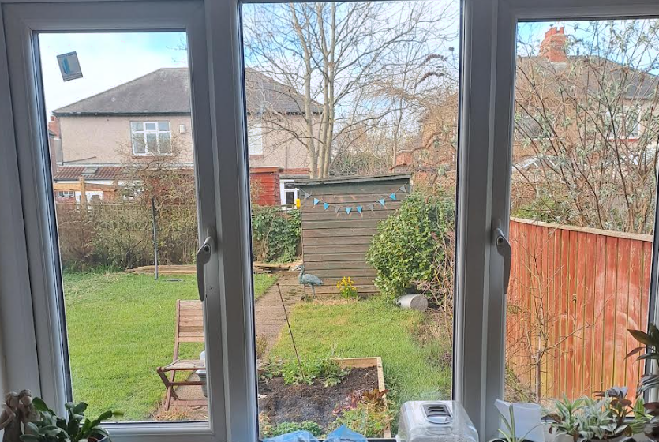
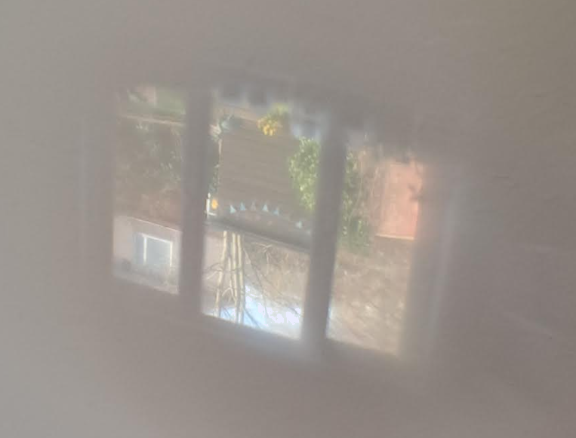
Xoogaynta iftiinka si loo sameeyo sawir (image)
Tusaale muuqaal daaqad ah:
Sawirka (image) uu sameeyo muraayad (convex lens):

Slide 25
Iftiinka diiradda saarista si loo sameeyo sawir (image)
Jawaabaha tusaale ahaan.
Saadaal (Prediction):
Marka muraayadda (lens) badhkeed la daboolo, sawirka (image) oo dhami wuu wali muuqan doonaa. Weli wuu rognaan doonaa (inverted) cabbirkiisuna (size) isma beddeli doono. Si kastaba ha ahaatee, sawirku wuu madmadowgi doonaa (dimmer).
Sharaxaad (Sharraxaad):
Iftiin yar oo ka yimid dhibic kasta oo shayga (object) ku taal ayaa taabta qayb kasta oo muraayadda (lens) ah. Dhammaan fallaadhaha (rays) muraayadda ka soo gala dhibic keliya oo shayga ah ayaa diiradda loo saaraa hal dhibic oo shaashadda (screen) ah, iyagoo sameynaya qaybta u dhigma ee sawirka (image).
Marka muraayadda (lens) badhkeed la daboolo, kaliya badh ka mid ah fallaadhihii (rays) hore ayaa hadda muraayadda ka soo gali kara. Marka qayb kasta oo sawirka (image) ah wali way samaysantaa, si la mid ah sidii hore, marka laga reebo iftiin yar.

Slide 26
Iftiinka diiradda saarista
Iftiinka diiradda saarista si loo sameeyo sawir (image)
Jajabinta (Refraction) iftiinka ee muraayad (lens) qaab-dhisan (convex)

Slide 27
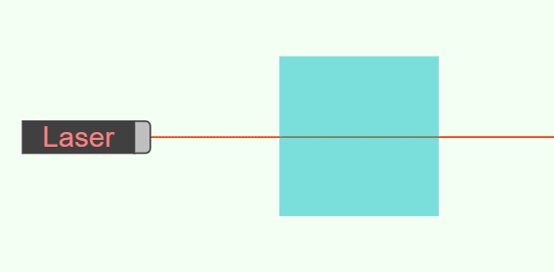
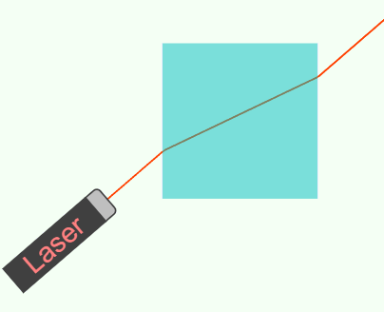
Jajabinta (Refraction) iftiinka ee muraayad (lens) qaab-dhisan (convex)
Muraayadaha (Lenses) waxay sameeyaan sawirro (images) iyagoo jajabinaya (refracting) iftiinka.
Fallaadhahan (beam) iftiinka ah waa la jajabiyey (refracted), hal mar marka uu galo muraayadda (glass) iyo hal mar marka uu ka baxo.
Fallaadhahan (beam) iftiinka ah lama jajabin (refracted):
Taas waxaa u sabab ah in iftiinku la kulmo muraayadda (glass) dhinaca toosan (normal) ee dusha sare ee block-ka.
Khadadka toosan ee dhibic-yar (Dashed normal lines) ayaa laga soo saari karaa 90° dusha sare.
Tijaabada (experiment) Indhaha (Optical) Simulator, https://javalab.org/en/optics_en/

Slide 28
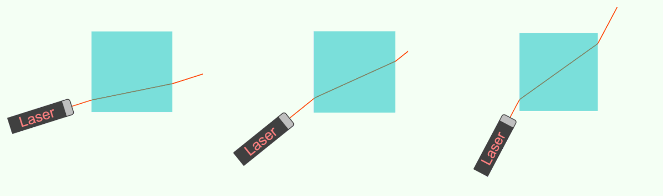
Jajabinta (Refraction) iftiinka ee muraayad (lens) qaab-dhisan (convex)
Marka uu u dhaqaaqo shay (material) kale, inta ugu weyn
xagasha (angle) fallaadha (ray) iftiinka ee khadka toosan (normal line), ayaa inta badan la jajabiyaa (refracted).

Slide 29
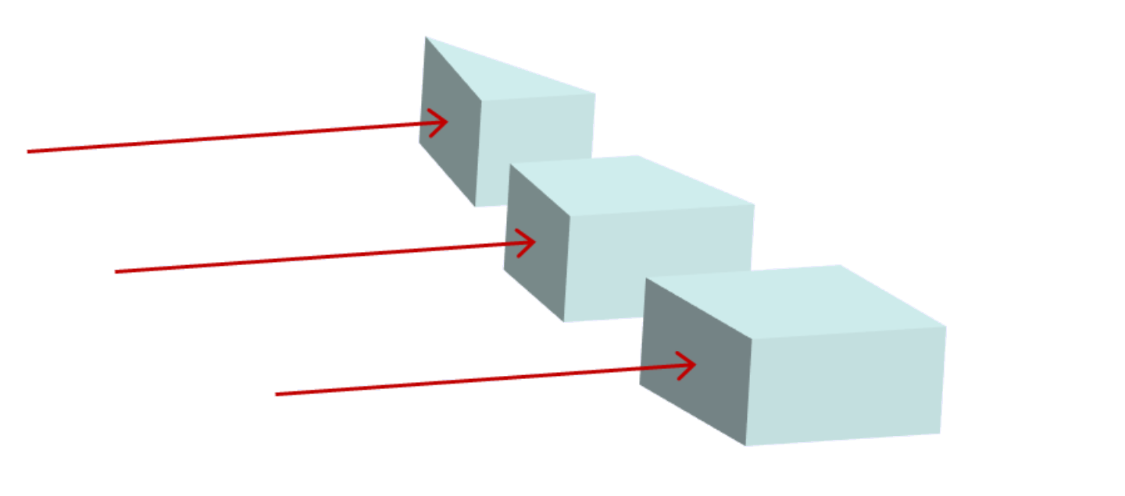
Jajabinta (Refraction) iftiinka ee muraayad (lens) qaab-dhisan (convex)
Block-ka muraayadda (glass) kee ayaa u jajabin doona (refract) fallaadha (ray) ugu badan?
a
Aragtida kore:
a
b
c
b
c

Slide 30
Jajabinta iftiinka (Refraction) ee muraayadda convex (convex lens)
Mid kasta oo ka mid ah muraayadaha dhalada ah wuxuu iftiinka u jajabiyaa (refract) qadar kala duwan.
Iftiinku mar kale wuu jajabaa (refracts) marka uu ka baxo dhalada.
Iftiinku wuu jajabaa (refracts) marka uu galo dhalada.
Marka la wada geeyo, waxay soo jiidi karaan iftiinka (rays) si ay ugu ururaan hal dhibic.

Slide 31
Jajabinta iftiinka (Refraction) ee muraayadda convex (convex lens)
Muraayad convex (convex lens) waxay samayn kartaa wax la mid ah.
dhererka fogaanta (focal length)

Slide 32
Jajabinta iftiinka (Refraction) ee muraayadda convex (convex lens)
Marka iftiin isbarbar socda (parallel rays) uu dhex maro muraayadda:
iftiinka dhex mara qaybta sare ee muraayadda waxaa loo jajabiyaa (refracted) hoos
iftiinka dhex mara qaybta hoose ee muraayadda waxaa loo jajabiyaa (refracted) kor
iftiinka dhex mara bartamaha muraayadda lama jajabiyo (refracted)
iyo inta uu ka fog yahay bartamaha muraayadda, waa inta uu iftiin (ray) badan uu jajabto (refracted).
Sidaas ayay iftiimada (rays) dhamaantood ugu kulmi karaan hal dhibic, masaafo go'an oo ka fog muraayadda oo loo yaqaan dhererka fogaanta (focal length).

Slide 33
Jajabinta iftiinka (Refraction) ee muraayadda convex (convex lens)
Maxay muraayadaha ballaadhan u leeyihiin dherer fogaane (focal length) gaaban marka loo eego muraayadaha khafiifka ah?
Waxaa jira muraayad dheeri ah oo la falgasha iftiinka.
Iftiin badan ayaa dhex mari kara muraayadda.
Iftiinku wuxuu ku dhacaa muraayadda xaglo ka weyn xagasha caadiga ah (normal).
Iftiinku wuxuu qaataa waqti dheer inuu dhex maro muraayadda.

Slide 34
Jajabka iftiinka ee muraayadaha qaabka convex (convex lens)
Dhammeysti rays-ka iftiinka ee muraayad kasta si aad u muujiso sida ay u xoog saaraan (focus) iftiinka.
Inta badan rays-ka waa in la jajabiyo (refract) laba jeer.

Slide 35
Jajabka iftiinka ee muraayadaha qaabka convex (convex lens)
Dhammeysti rays-ka iftiinka ee muraayad kasta si aad u muujiso sida ay u xoog saaraan (focus) iftiinka.

Slide 36
Xoog saarista iftiinka (Focusing light)
Qaar ka mid ah iftiinka shayga ayaa dhex mari kara muraayadda oo la xoog saari karaa (focus) si uu u sameeyo sawir (image) oo shaashadda ku yaal.
Iftiin ka yimid meel kasta oo shayga ah wuxuu dhex maraa qayb kasta oo muraayadda ah.
focus
Muraayad qaabka convex (convex lens) waxay jajabisaa (refract) rays-ka iftiinka si ay ugu socdaan midba midka kale. Meesha rays-yadu ku kulmaan waxaa loo yaqaan focus.
Dhammaan rays-yada ka imanaya hal meel oo shayga ah waxay ku kulmaan hal meel oo shaashadda ah, iyagoo sameynaya qaybta u dhigma ee sawirka (image).

