Slide 1
Sii wadista muujinta aragtida Pythagoras (Pythagoras’ theorem)
Sifooyinka joomatari: isku ekaansho (similarity) iyo aragtida Pythagoras (Pythagoras’ theorem)

Slide 2
sida loo isticmaalo darasyada Oak

Slide 3
Waxaan qiimeyn (value) karaa inuu jiro xiriir ka dhexeeya dhererka dhinacyada saddexagal qumman (right-angled triangle).

Slide 4
Aragtida Pythagoras (Pythagoras’ theorem) waxay tusinaysaa in wadarta labajibbaaranaha (squares) labada dhinac ee gaagaaban ee saddexagal qumman (right-angled triangle) ay la mid tahay labajibbaaranaha (square) dhinaca ugu dheer (hypotenuse).

Slide 5

Sii wadista muujinta aragtida Pythagoras (Pythagoras’ theorem)
Abuurista saddexagallo qumman (right-angled triangles) oo ka soo jeeda labajibbaarro (squares)
Soo bandhigida aragtida Pythagoras (Pythagoras’ theorem)

Slide 6
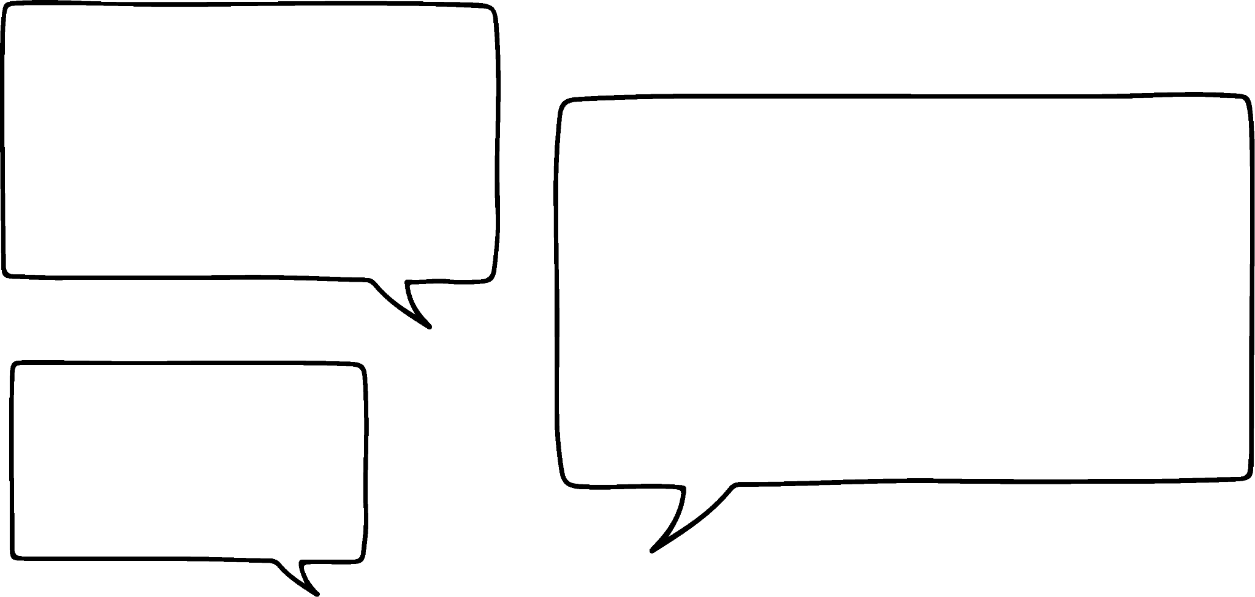
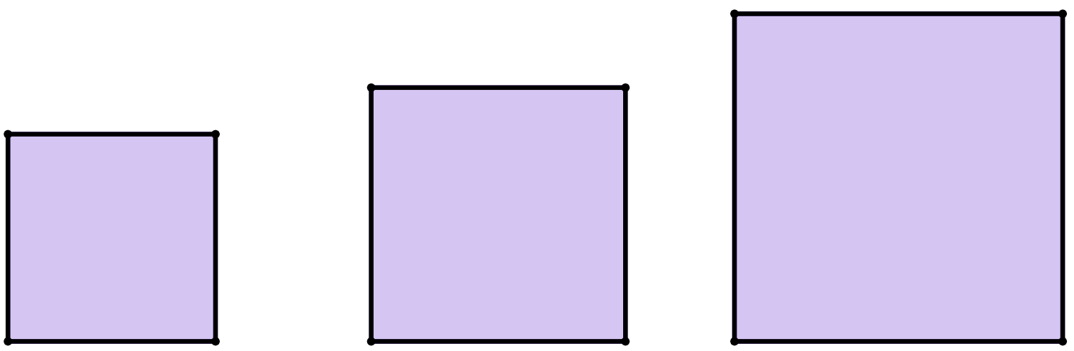



Abuurista saddexagallo qumman (right-angled triangles) oo ka soo jeeda labajibbaarro (squares)
Haddaba, haddii aan ogahay bedka (areas) laba labajibbaaranood (squares), markiiba waxaan ogahay cabbirka labajibbaaranaha (square) saddexaad ee aan u baahanahay si aan u abuuro saddexagal qumman (right-angled triangle)?
40
units²
16 + 24
units²
16
units²
Layla
Bedka (areas) labada labajibbaaranood ee yar waa inay isku daraan si ay u sameeyaan bedka (area) labajibbaaranaha (square) weyn.
24
units²

Slide 7

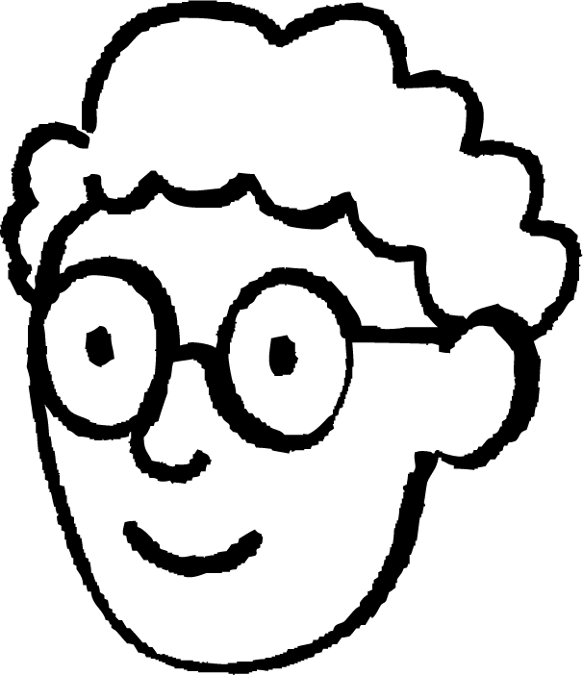

Abuurista saddexagallo qumman (right-angled triangles) oo ka soo jeeda labajibbaarro (squares)
Markaas kaliya qiyaas dhererka (length) mid ka mid ah dhinacyadeeda, ka dibna labajibbaaro (square) dhererkaas si aad u hesho bedkeeda (area) habkaas.
40
units²
16 + 24
units²
16
units²
Layla
Laakiin haddii aadan garanayn bedka (area) labajibbaarannada (squares)?
24
units²
Axmed

Slide 8
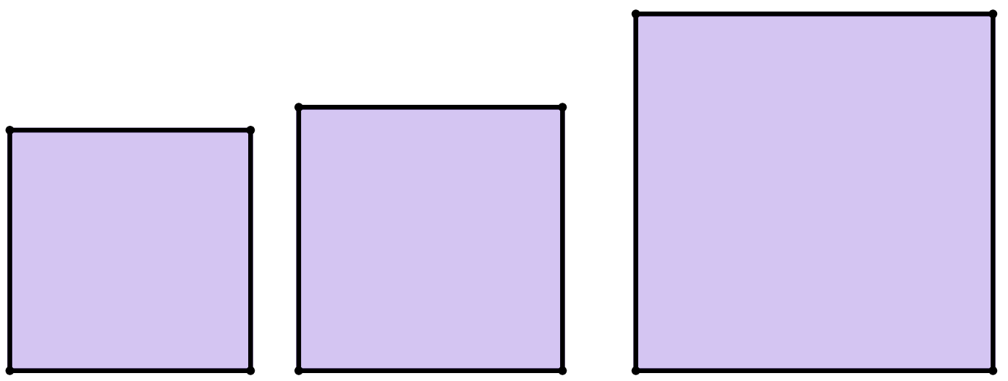
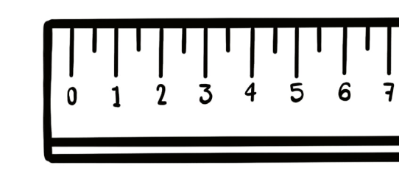
Abuurista saddexagalka qumman (right-angled triangles) laga bilaabo labajibbaarannada (squares)
Markaas kaliya qiyaas dhererka (length) mid ka mid ah dhinacyadeeda, ka dibna labajibbaaro (square) dhererkaas si aad u hesho bedkeeda (area) habkaas.
55
units²
30 + 25
units²
30
units²
Layla
Laakiin haddii aadan garanayn bedka (area) labajibbaarannada (squares)?
5²
units²
25
units²
Axmed
5 units

Slide 9
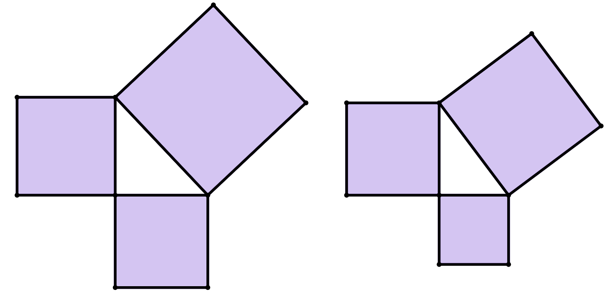
Abuurista saddexagalka qumman (right-angled triangles) laga bilaabo labajibbaarannada (squares)
Waa maxay bedka (area) labajibbaaran B (square B), marka la eego units²?
34
units²
labajibbaaran C (square C)
18
units²
Sidaas awgeed, waa maxay bedka (area) labajibbaaran C (square C), marka la eego units²?
labajibbaaran B (square B)
16
units²
Jawaabaha:
4 units
16 units²
34 units²

Slide 10
Sameynta saddexagal qumman (right-angled triangles) oo ka yimaada labajibbaaranayaal (squares)
Dhammeysti jumladaha soo socda:
16 units²
Bedka (area) labajibbaaran A waa _________
4 units
9 units²
Bedka (area) labajibbaaran B waa _________
16 + 9
Bedka (area) labajibbaaran C waa _________
labajibbaaran (square)
B
Jawaabaha:
3 units
labajibbaaran C (square C)
labajibbaaran A (square A)
25 units²

Slide 11

Sameynta saddexagal qumman (right-angled triangles) oo ka yimaada labajibbaaranayaal (squares)
Waa maxay qiimaha (value) x, dhererka dhinaca labajibbaaran C?
4 units
Dhererka dhinaca laba jibbaaran C waa 5 units.
x units
Jawaabaha:
25 units²
25
= 5
16 units²
9 units²
3 units

Slide 12
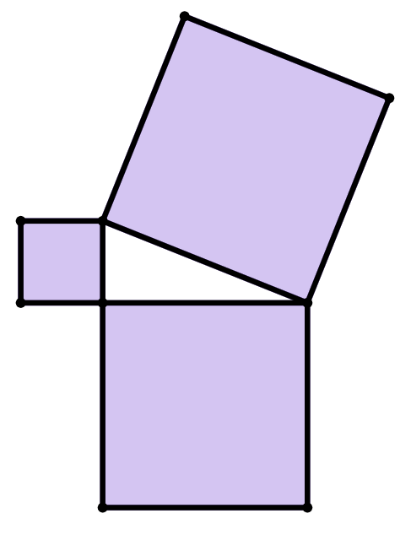
Sameynta saddexagalka xagal-qumman (right-angled triangles) oo laga soo saaray laba jibbaaranayaal (squares)
Dhammeysti weedhaha soo socda:
laba jibbaaran C (square C)
9 units²
laba jibbaaran A (square A)
Bedka (area) laba jibbaaran A waa _________
7 units
49 - 9
40 units²
Bedka (area) laba jibbaaran B waa _________
3 units
49 units²
Bedka (area) laba jibbaaran C waa _________
laba jibbaaran B (square B)

Slide 13
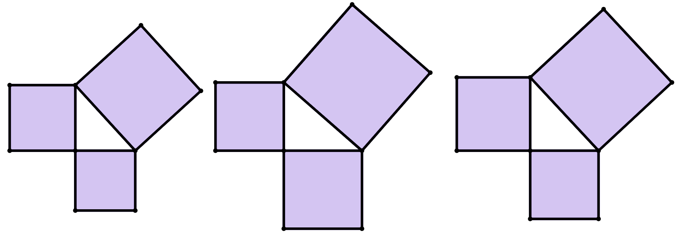
Sameynta saddexagalka xagal-qumman (right-angled triangles) oo laga soo saaray laba jibbaaranayaal (squares)
1) Saddexagal kasta oo xagal-qumman (right-angled triangle) ah, hel bedka (area) laba jibbaaran kasta oo aan calaamad lahayn.
b)
17
units²
c)
a)
13
halbeeg² (units²)
12
units²
13
units²
28
halbeeg² (units²)
10
units²

Slide 14
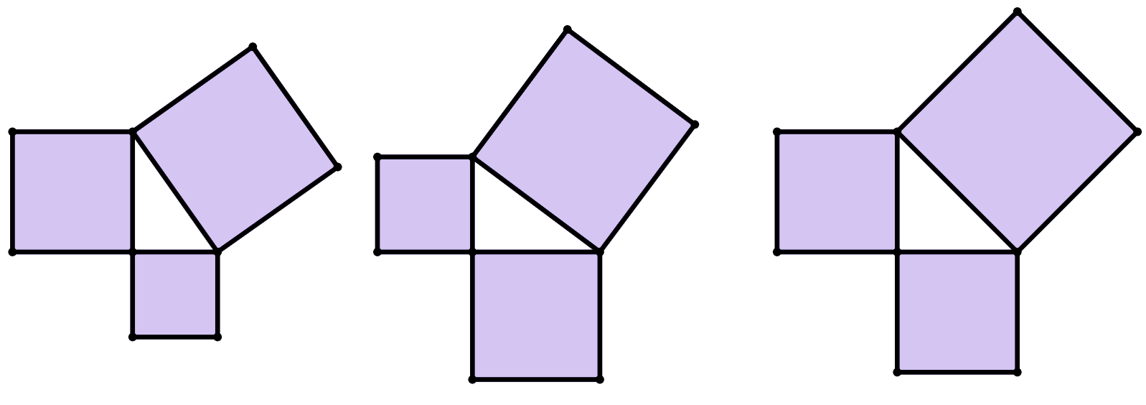
Abuurista saddexagallo xagal-qumman oo ka yimaada labajibbaaranno
2) Saddexagal kasta oo xagal-qumman, hel bedka dhammaan labajibbaarannada.
c)
b)
8
halbeeg² (units²)
a)
8
halbeeg² (units²)
5
halbeeg² (units²)
3 halbeeg (units)
2 halbeeg (units)
4 halbeeg (units)

Slide 15
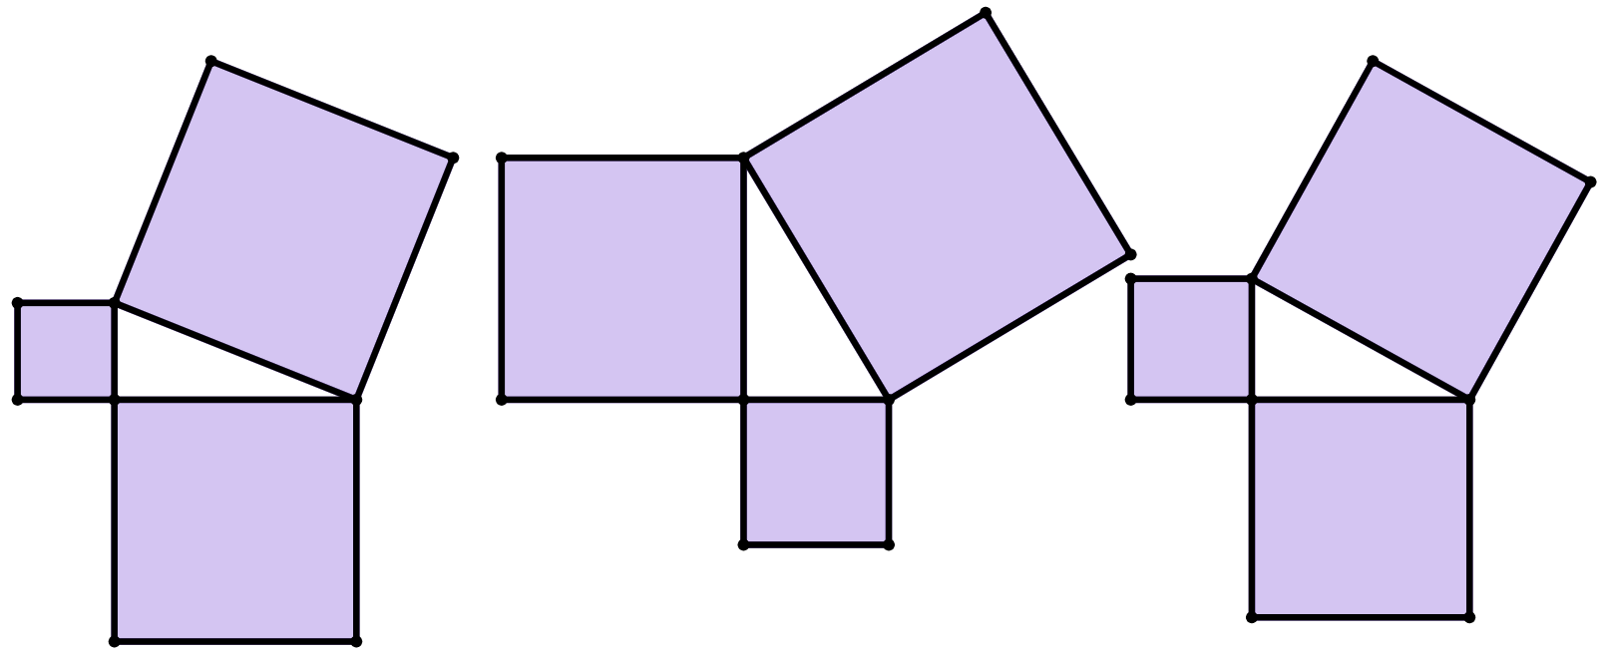
Abuurista saddexagallo xagal-qumman oo ka yimaada labajibbaaranno
3) Saddexagal kasta oo xagal-qumman, buuxi bedka dhammaan labajibbaarannada oo hel dhererka maqan ee labajibbaaran kasta oo xaraf ku qoran.
c)
d halbeeg (units)
c halbeeg (units)
13
halbeeg² (units²)
a halbeeg (units)
169
halbeeg² (units²)
39
halbeeg² (units²)
a)
b)
25
halbeeg² (units²)
e
cutubyo (units)
6 halbeeg (units)
b halbeeg (units)
12 halbeeg (units)

Slide 16
Abuurista saddex-xagalka qumman (right-angled) ee labajibbaaranada (squares)
1) Saddex-xagal kasta oo qumman (right-angled), hel bedka (area) labajibbaaran kasta oo aan la calaamadayn.
b)
17
cutubyo² (units²)
c)
15
cutubyo² (units²)
a)
22
cutubyo² (units²)
13
cutubyo² (units²)
12
cutubyo² (units²)
13
cutubyo² (units²)
30
cutubyo² (units²)
28
cutubyo² (units²)
10
cutubyo² (units²)

Slide 17
Abuurista saddex-xagalka qumman (right-angled) ee labajibbaaranada (squares)
2) Saddex-xagal kasta oo qumman (right-angled), hel bedka (area) dhammaan labajibbaaranada (squares).
c)
b)
8
cutubyo² (units²)
8
units²
a)
14
units²
12
cutubyo² (units²)
8
cutubyo² (units²)
9
units²
16
units²
4
cutubyo² (units²)
5
cutubyo² (units²)
3 units
2 units
4 units

Slide 18
Abuurista saddexagallo xagal-qumman oo ka yimid labajibbaarro (squares)
3) Saddexagal kasta oo xagal-qumman, buuxi bedka (area) labajibbaaran kasta oo hel dhererka (length) maqan ee labajibbaaran kasta oo calaamad u leh xaraf.
a = 7
c = 8
d = 13
c)
d units
c units
13
units²
a units
169
units²
49
units²
39
units²
64
units²
25
units²
a)
b)
25
units²
36
units²
e
units
144
units²
e = 5
6 units
b units
b = 5
12 units

Slide 19
Si dheeri ah oo loo muujiyo aragtida (theorem) ee Pythagoras
Samaynta saddexagalka qumman (right-angled triangles) oo laga soo saaray labajibbaaranayaal (squares)
Soo bandhigida aragtida (theorem) ee Pythagoras

Slide 20
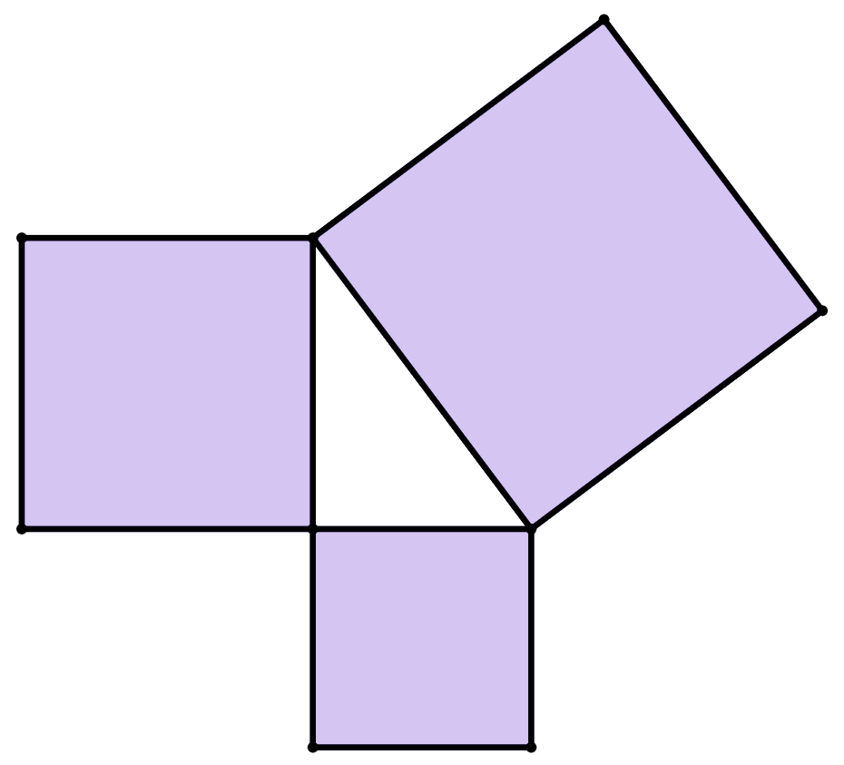

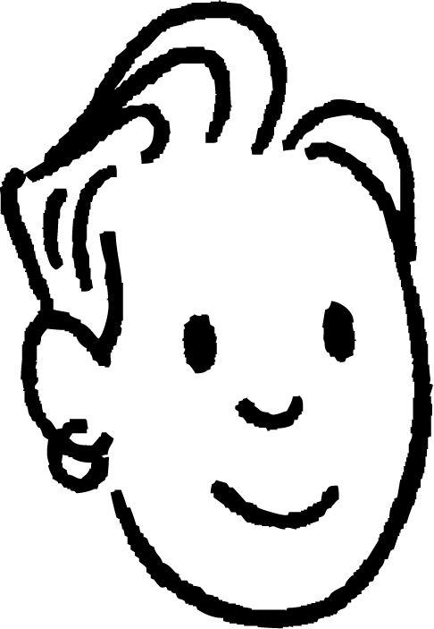

Soo bandhigida aragtida (theorem) ee Pythagoras
Waxaan u malaynayaa inaan hadda sameynay aragtida (theorem) ee Pythagoras.
labajibbaaran (square) C
labajibbaaran (square) A
Saciid
bedka (area) labajibbaaran (square) A
+
bedka (area) labajibbaaran (square) B
=
bedka (area) labajibbaaran (square) C
labajibbaaran (square) B

Slide 21
Soo bandhigida aragtida (theorem) ee Pythagoras
Waxaan u malaynayaa inaan hadda sameynay aragtida (theorem) ee Pythagoras.
Laakiin waxay shaqeysaa oo kaliya haddii saddexda labajibbaaran (squares) ay sameeyaan saddexagal qumman (right-angled triangle).
Saciid
Axmed
Sababtoo ah waxaan aragnay saddexagallo (triangles) leh xaglo fidsan (obtuse angles) halkaas oo bedka (area) labajibbaaran (square) ugu weyn uu aad uga weyn yahay labada labajibbaaran (squares) ee kale!
bedka (area) labajibbaaran (square) A
+
bedka (area) labajibbaaran (square) B
=
bedka (area) labajibbaaran (square) C

Slide 22

Soo bandhigida aragtida (theorem) ee Pythagoras
Waxaan u malaynayaa inaan hadda dhammaystirnay aragtida Pythagoras (Pythagoras’ theorem).
Maxaan samaynaa haddii aynaan aqoon bedka (area) ee squares-ka?
Saciid
Cabdi
bedka (area) square A
+
bedka (area) square B
=
bedka (area) square C
Oh, Layla waxay tiri waxaan kaliya oo labajibbaarin karnaa dhererka (length) dhinaca square si aan u helno bedkiisa (area)!
Axmed

Slide 23
Soo bandhigida aragtida Pythagoras (Pythagoras’ theorem)
bedka (area) square A
+
bedka (area) square B
=
bedka (area) square C
square C
dhererka (length) dhinaca a oo labajibbaaran
+
dhererka dhinaca b labajibbaaran (length of side b squared)
=
dhererka dhinaca c labajibbaaran (length of side c squared)
square A
c units
Marka, ma waxaan u qori karnaa aragtida Pythagoras (Pythagoras’ theorem) sidan oo kale?
square B
a units
Saciid
b units

Slide 24
Soo bandhigida aragtida Pythagoras (Introducing Pythagoras’ theorem)
bedka labajibbaaranaha A (area of square A)
+
bedka labajibbaaranaha B (area of square B)
=
bedka labajibbaaranaha C (area of square C)
labajibbaaranaha C (square C)
a²
b²
c²
c²
dhererka dhinaca a labajibbaaran (length of side a squared)
+
dhererka dhinaca b labajibbaaran (length of side b squared)
=
dhererka dhinaca c labajibbaaran (length of side c squared)
labajibbaaranaha A (square A)
a²
c halbeeg (c units)
Sug, waxaan maqlay aragtida Pythagoras ka hor, miyaanay sidoo kale loo yaqaan tan?
labajibbaaranaha B (square B)
a halbeeg (a units)
b²
Cabdi
b halbeeg (b units)

Slide 25
Soo bandhigida aragtida Pythagoras (Introducing Pythagoras’ theorem)
bedka labajibbaaranaha A (area of square A)
+
bedka labajibbaaranaha B (area of square B)
=
bedka labajibbaaranaha C (area of square C)
a²
b²
c²
dhererka dhinaca a laba jibaaran (squared)
+
dhererka dhinaca b laba jibaaran (squared)
=
dhererka dhinaca c laba jibaaran (squared)
Sug, waxaan maqlay aragtida Pythagoras ka hor, miyaanay sidoo kale loo yaqaan tan?
Inta c² yahay bedka (area) labajibbaaranaha (square) ugu weyn, waxaan u malaynayaa inaad sax tahay!
Cabdi
Layla

Slide 26
Soo bandhigida aragtida (theorem) Pythagoras
Marka, aragtida (theorem) Pythagoras sidoo kale waa tan?
Ma hubnaa inay tani u shaqeyso dhammaan saddexagalka (triangles) qumman (right-angled)?
Waxaan kaliya dhab ahaan muujinay inay u shaqeyso dhowr ka mid ah…
Saciid
a²
+
b²
=
c²
Cabdi
Waxaan hubaa inay jirto caddayn (proof) uu macallinku noo tusi karo oo u shaqeysa dhammaan saddexagalka (triangles) qumman (right-angled)!
Layla

Slide 27
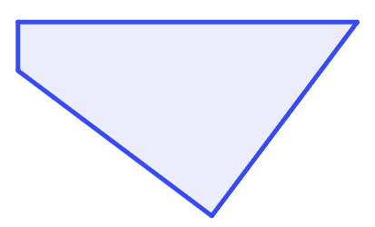
Soo bandhigida aragtida (theorem) Pythagoras
Bedka (area) labajibbaaranaha (square) A waa ka yar ama la eg bedka (area) labajibbaaranaha (square) B, iyo labajibbaaranaha (square) C waa kan ugu weyn.
Labajibbaaranaha (square) C wuxuu ka soo hor jeedaa xagal qumman (right-angle).
labajibbaaranaha (square) C
labajibbaaranaha (square) A
Sababtoo ah saddexagalka (triangle) ku xidhan saddexda labajibbaaranayaal (squares) waa saddexagal qumman (right-angled triangle),
bedka (area) labajibbaaranaha (square) A iyo labajibbaaranaha (square) B waxay si fiican ugu habboon yihiin gudaha labajibbaaranaha (square) C.
labajibbaaranaha (square) B

Slide 28


Soo bandhigida aragtida (theorem) Pythagoras
Dooro weedha dhammays tira jumladan:
“Si aragtida (theorem) Pythagoras loo isticmaalo, waa inay saddex laba jibbaaran (squares) isku xirmaan si ay u sameeyaan __________”
a
laba jibbaaran (square) C, oo ah laba jibbaaran (square) ka ballaaran laba jibbaaran (squares) kale
b
saddex xagal (triangle) isosceles
c
saddex laba jibbaaran (squares) oo isku qaab (congruent)
d
saddex xagal (triangle) qumman (right-angled)

Slide 29
Soo bandhigida aragtida (theorem) Pythagoras
Kuwee ka mid ah kuwan ayaa ah habab ku habboon oo lagu sharaxo aragtida (theorem) Pythagoras ee saddex laba jibbaaran (squares) oo isku xirma geesahooda (vertices) si ay u sameeyaan saddex xagal (triangle) qumman (right-angled)?
a
Wadarta bedka (area) labada laba jibbaaran (squares) ee yar waxay la mid tahay bedka (area) laba jibbaaran (square) weyn.
b
Laba jibaar (square) dhererka dhinac (side length) ee laba jibbaaran (square) kasta, ka dibna ku dar labada tiro ee yar. Wadartu waxay la mid tahay tiro (number) ugu weyn.
c
a² + b² = c²
d
c² = b² + a²

Slide 30
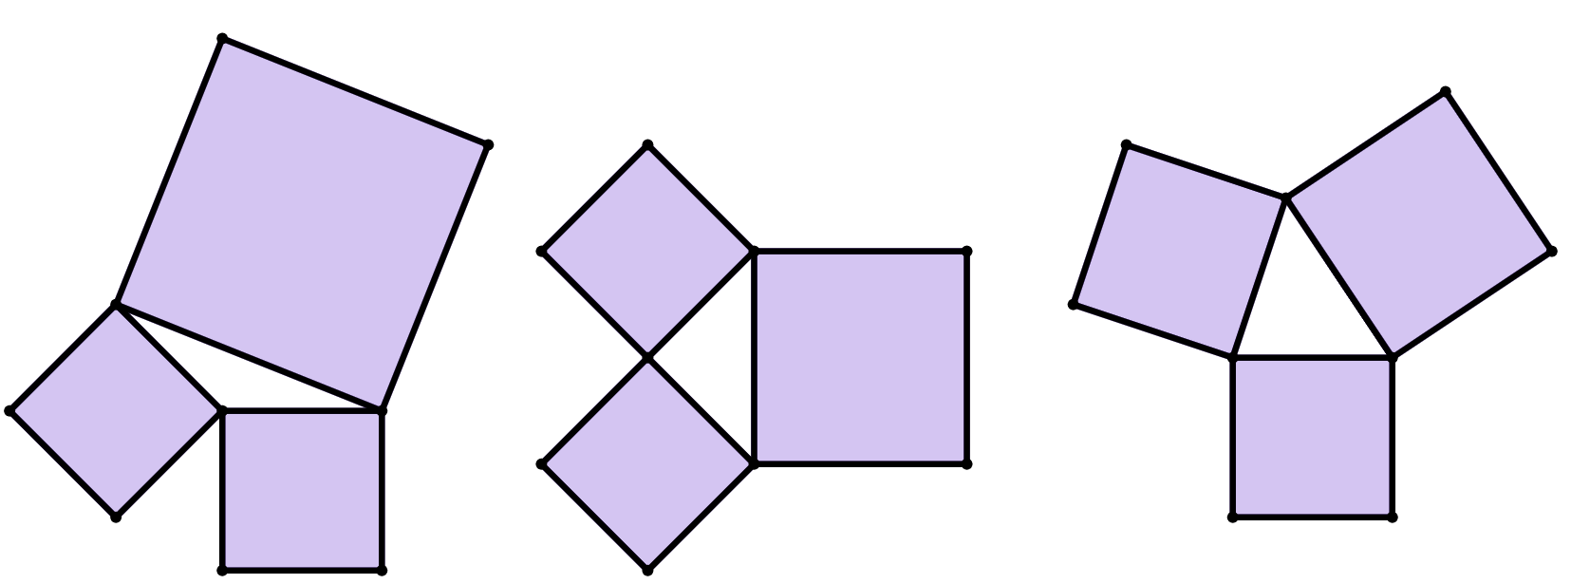
Soo bandhigida aragtida (theorem) Pythagoras
1) Jaantusyada (diagrams) kee ayaa aragtida (theorem) Pythagoras run ku tahay?
c
27
units²
b
21
units²
14
units²
18
units²
a
28
units²
10 units²
16
units²
14
units²
11
units²
2) Sharax sababtaada su'aasha 1), maxayna kugu sheegaysaa saddexagalladaas (triangles)?

Slide 31
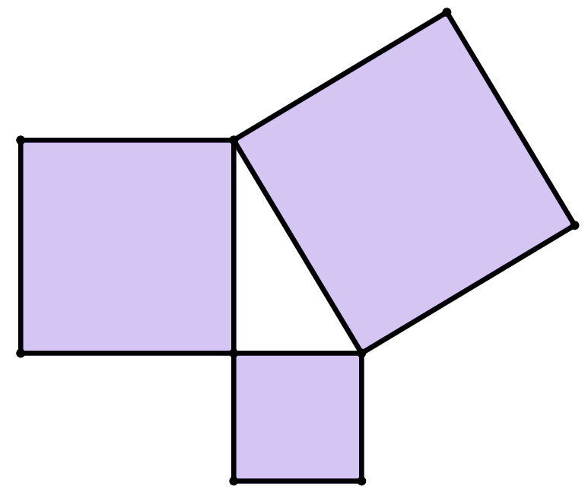
Soo bandhigida aragtida Pythagoras (Pythagoras' theorem)
3) Kuwaas ka mid ah waa matalaad sax ah oo ah aragtida Pythagoras (Pythagoras' theorem) ee saddexda laba jibaaran (squares) ee ku xeeran saddexagal qumman (right-angled triangle)?
laba jibaaran (square) H
h units
bedka (area) laba jibaaran (square) F oo lagu daro bedka (area) laba jibaaran (square) G waxay la mid tahay bedka (area) laba jibaaran (square) H
laba jibaaran (square) F
a
f units
laba jibaaran (square) G
b
f ² + g² = h²
g units
c
f ² = g² + h²
d
h² = g² + f ²

Slide 32
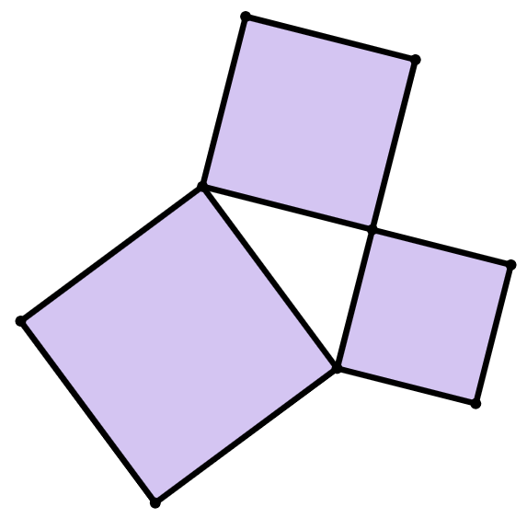
Soo bandhigida aragtida Pythagoras (Pythagoras' theorem)
4) a) Maxay 15² u taagan tahay jaantuskan?
b) Waa maxay bedka (area) laba jibaaran (square) ugu weyn?
c) Buuxi meelaha bannaan ee xisaabinta aragtida Pythagoras (Pythagoras' theorem).
laba jibaaran (square) B
15 units
laba jibaaran (square) A
laba jibaaran (square) C
8 units
2
+
2
=
2
17 units
+
=
bedka (area) laba jibaaran (square) A
bedka (area) laba jibaaran (square) B
bedka labajibbaaranaha C (area of square C)

Slide 33
Soo bandhigida aragtida Pythagoras (Introducing Pythagoras’ theorem)
1) Jaantusyadee ayaa aragtida Pythagoras (Pythagoras’ theorem) run ku tahay?
c
27
units²
21
units²
14
units²
b
18
units²
a
28
units²
10 units²
16
units²
14
units²
11
units²
2) Sharax sababtaada su'aasha 1).
b waa jaantuska kaliya ee wadarta labada bed ee yar ay la mid tahay bedka weyn. Kani waa saddex-xagalka qumman (right-angled triangle) kaliya.

Slide 34
Soo bandhigida aragtida Pythagoras (Introducing Pythagoras’ theorem)
3) Kuwee ka mid ah kuwan ayaa ah matalaad sax ah oo aragtida Pythagoras (Pythagoras’ theorem) ah oo ku saabsan saddexda labajibbaaran ee ku xeeran saddex-xagalka qumman (right-angled triangle)?
labajibbaaranaha H (square H)
h halbeeg (units)
bedka labajibbaaranaha F (area of square F) oo lagu daray bedka labajibbaaranaha G (area of square G) wuxuu la mid yahay bedka labajibbaaranaha H (area of square H)
labajibbaaranaha F (square F)
a
f units
labajibbaaranaha G (square G)
b
f ² + g² = h²
g units
c
f ² = g² + h²
d
h² = g² + f ²

Slide 35
Soo bandhigida aragtida (theorem) Pythagoras
4) a) Maxay 15² ku matali kartaa jaantuskan?
b) Waa maxay bedka (area) labajibbaaranaha (square) ugu weyn?
c) Buuxi meelaha bannaan ee xisaabinta aragtida (theorem) Pythagoras.
15² waa bedka (area) labajibbaaranaha (square) B
labajibbaaranaha (square) B
15 halbeeg (units)
Labajibbaaranaha (square) C wuxuu leeyahay bed (area) 289 halbeeg² (units²)
labajibbaaranaha (square) A
labajibbaaranaha (square) C
8 halbeeg (units)
8
2
+
15
2
=
17
2
17 halbeeg (units)
64
+
225
=
289
bedka (area) labajibbaaranaha (square) A
bedka (area) labajibbaaranaha (square) B
bedka (area) labajibbaaranaha (square) C

Slide 36
Tusmo dheeri ah oo ku saabsan aragtida (theorem) Pythagoras
Saddex labajibbaarane (squares) ayaa lagu xiri karaa meelaha ay isku xigaan si ay u sameeyaan saddexagal (triangle).
Haddii saddex labajibbaarane (squares) isku mid ah la xiro, saddexagalku (triangle) waa siman (equilateral).
Haddii laba labajibbaarane (squares) isku mid ah la xiro, saddexagalku (triangle) waa laba-simane (isosceles).
Haddii dhammaan labajibbaaranayaasha (squares) ay leeyihiin bed (areas) kala duwan, saddexagalku (triangle) waa kala-dhigma (scalene).
Xagasha (angle) ugu weyn ee saddexagalka (triangle) waxay noqon kartaa mid fiiqan (acute), qumman (right), ama fidsan (obtuse), iyadoo ku xiran haddii wadarta bedka (areas) labada labajibbaarane (squares) yar ay ka weyn tahay, la mid tahay, ama ka yar tahay bedka (area) labajibbaaranaha (square) ugu weyn, siday u kala horreeyaan.
Marka wadarta bedka (areas) labada labajibbaarane (squares) yar ay la mid tahay bedka (area) labajibbaaranaha (square) ugu weyn, saddexagalku (triangle) had iyo jeer waa saddexagal (triangle) xagal-qumman (right-angled). Tani waa muujin muuqaal ah oo ku saabsan aragtida (theorem) Pythagoras.

