Slide 1
Waxyaabaha hidaha (Genetic material) iyo DNA
Hidaha (Heredity) iyo DNA

Slide 2
sida loo isticmaalo darasyada Oak

Slide 3
Waxaan qeexi karaa waxa ay tahay waxyaabaha hidaha (genetic material) iyo halka ay ku kaydsan yihiin xayawaanka, dhirta iyo noolaha yaryar (microorganisms).

Slide 4
cytoplasm (cytoplasm)
nucleus (nucleus)
bacteria (bacteria)
DNA (DNA)
koodhka hidaha (genetic code)

Slide 5
Cytoplasm (cytoplasm) waa walaxda jelly-ga ah ee gudaha unugga halkaas oo ay ka dhacaan falcelinta kiimikaad ee unugga.
Nucleus (nucleus) wuxuu kaydiyaa waxyaabaha hidaha (genetic material) ee unugyada dhirta, xayawaanka iyo fangaska.
Bacteria (bacteria) waa noole unug keliya (unicellular microorganisms).
Waxyaabaha hidaha (genetic material) waxay ka samaysan yihiin kiimiko la yiraahdo DNA (DNA).
DNA (DNA) waxay ka dhisan tahay afar molecule oo kala duwan (oo la yiraahdo A, T, C iyo G), kuwaas oo sameeya koodhka hidaha (genetic code) loo isticmaalo tilmaamo lagu dhiso oo lagu xakameeyo noolaha (organisms).

Slide 6

Waxyaabaha hidaha (genetic material) iyo DNA
Kaydinta waxyaabaha hidaha (genetic material)
Doorka waxyaabaha hidaha (genetic material)
DNA (DNA)

Slide 7
Kaydinta walxaha hidde-sidaha (Storage of genetic material)
Dhammaan unugyada dhirta, xayawaanka iyo fangaska waxay ka kooban yihiin qaab-dhismeed ay ka mid yihiin xuubka unugga (cell membrane), cytoplasm (cytoplasm) iyo nucleus (nucleus).
xuubka unugga (cell membrane)
cytoplasm (cytoplasm)
nucleus (nucleus)
Unug xayawaan (Animal cell)

Slide 8
Kaydinta walxaha hidde-sidaha (Storage of genetic material)
Walxaha hidde-sidaha waxaa lagu kaydiyaa xudunta (nucleus) unugyada xayawaanka, dhirta iyo fangaska.
xudunta (nucleus)
xudunta (nucleus)
xudunta (nucleus)
Unug xayawaan (Animal cell)
Unug dhir (Plant cell)
Unug fangas (Fungi cell)

Slide 9
Kaydinta walxaha hidde-sidaha (Storage of genetic material)
Bakteeriyadu waa noole (organism) unug keliya (unicellular).
Ma laha xudun (nucleus). Walxahooda hidde-sidaha waxaa lagu kaydiyaa dheecaanka unugga (cytoplasm).
walxaha hidde-sidaha (genetic material)
dheecaanka unugga (cytoplasm)
Unug bakteeriya (Bacteria cell)

Slide 10

Kaydinta walxaha hidde-sidaha (Storage of genetic material)
Unugyada dhirta (Plant cells)
Unugyada dhirta (Plant cells)
Unugyada xayawaanka (Animal cells)
Unugyada bakteeriyada (Bacterial cells)
Unugyada fangaska (Fungi cells)

Slide 11




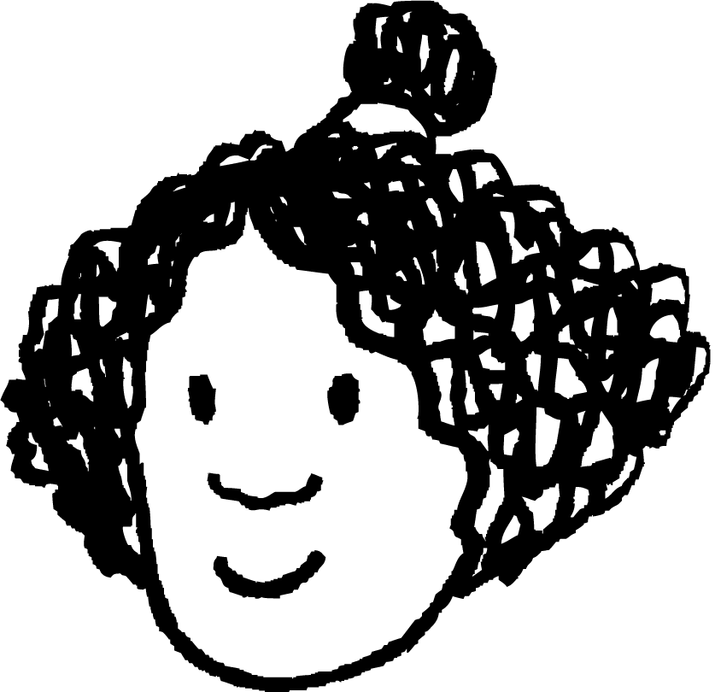



Kaydinta maadada hidde (genetic material)
Izzy, Sam iyo Alex waxay ka wada hadlayaan sida maadada hidde (genetic material) loogu kaydiyo unugyada (cells).
Dhammaan unugyada (cells) waxay maadada hidde (genetic material) ku kaydiyaan xudunta (nucleus) si ay u ilaashaan.
Bakteeriyada (bacteria) iyo fangaska (fungi) ma noolaan, sidaas darteed uma baahna maadada hidde (genetic material). Unugyada xayawaanka iyo dhirta waxay maadada hidde ku kaydiyaan xudunta (nucleus).
Sam
Unugyada bakteeriyada (bacteria) ma laha xudun (nucleus) maxaa yeelay ma laha maadada hidde (genetic material). Waa hal unug oo keliya, sidaas darteed ma laha wax astaamo ah.
Izzy
Alex
Dhammaan fikradaha ardaydu waa qaldan yihiin qaybo ka mid ah.
Qaad hadal kasta oo arday ah oo ku qor sixid.

Slide 12
Kaydinta maadada hidde (genetic material)
Qaad hadal kasta oo arday ah oo ku qor sixid.
Izzy: Bakteeriyada (bacteria) iyo fangaska (fungi) waa noole, sidaas darteed waxay u baahan yihiin maadada hidde (genetic material). Unugyada xayawaanka, dhirta iyo fangaska waxay maadada hidde ku kaydiyaan xudunta (nucleus).
Sam: Unugyada xayawaanka, dhirta iyo fangaska waxay maadada hidde (genetic material) ku kaydiyaan xudunta (nucleus) si ay u ilaashaan, laakiin bakteeriyadu ma kaydiso.
Alex: Unugyada bakteeriyada (bacteria) ma laha xudun (nucleus), laakiin waxay leeyihiin maadada hidde (genetic material). Waxay maadada hidde ku kaydiyaan cytoplasm-ka.

Slide 13
Maadada hidde (genetic material) iyo DNA
Kaydinta maadada hidde (genetic material)
Doorka maadada hidde (genetic material)
DNA

Slide 14
Doorka maadada hidde (genetic material)
Maadada hidde (genetic material) waxay bixisaa tilmaamaha loo isticmaalo in lagu dhiso astaamaha la iska dhaxlo, iyo in lagu xakameeyo hababka nolosha, dhammaan noolaha (organisms).
Inta lagu jiro taranka (reproduction), qalabka hidaha (genetic material) waxaa loo gudbiyaa faraska (offspring) waalidkood (parents).
waalid (parent)
qalabka hidaha (genetic material) waa la nuqulay (copied)
faras (offspring)
Tarmida bakteeriyada (bacterial reproduction)

Slide 15
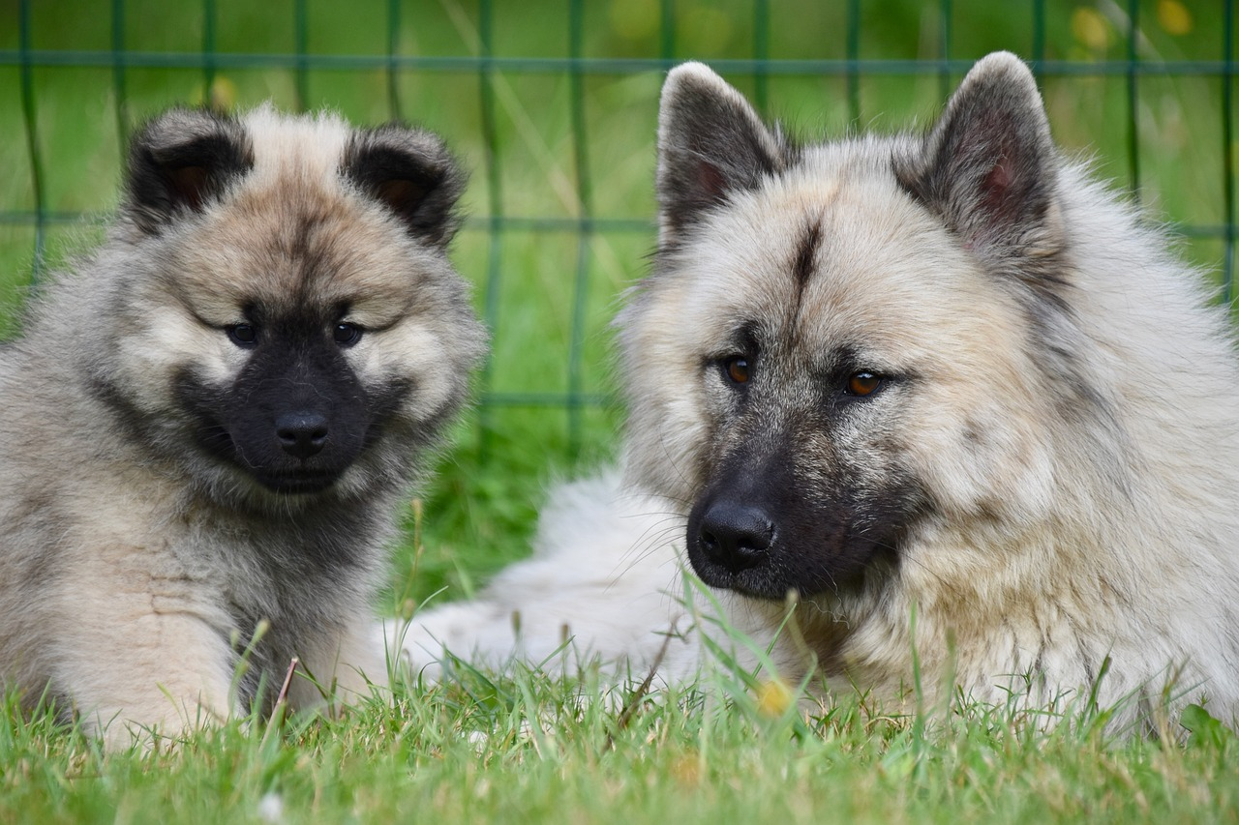
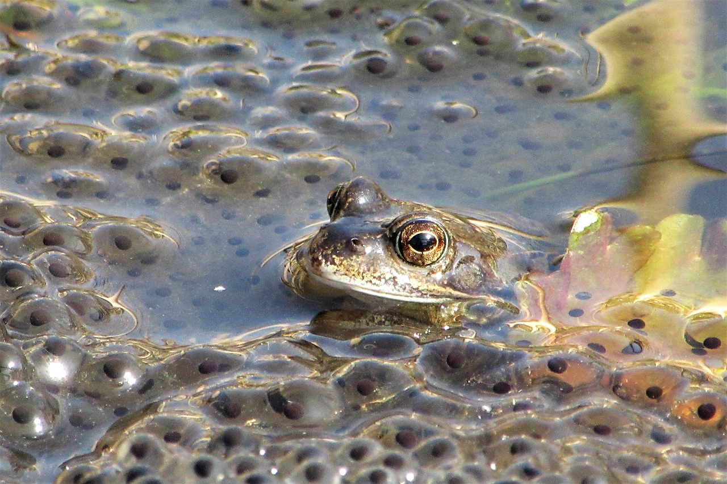
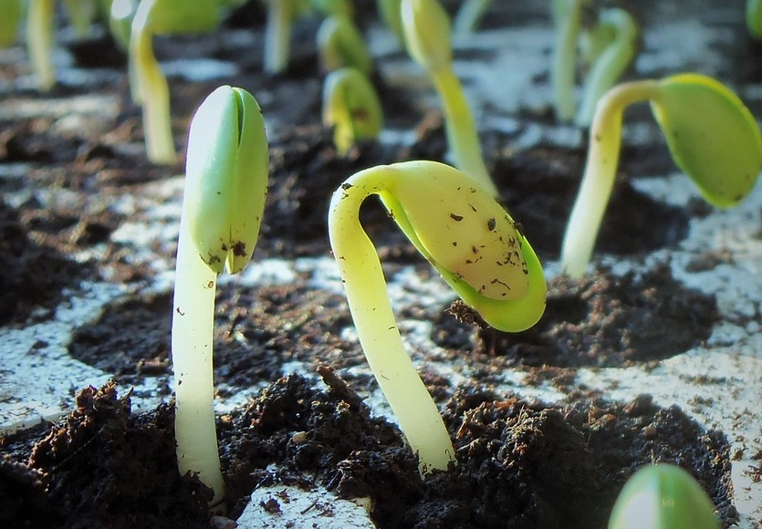
Doorka qalabka hidaha (Role of genetic material)
Qaar badan oo ka mid ah sifooyinka (features) la dhaxlo (inherited) waa la arki karaa marka faraska (offspring) la soo saaro.
Qaar ka mid ah sifooyinka (features) noolaha (organisms) lama arko isla markiiba faraska (offspring).
Qaar ka mid ah qalabka hidaha (genetic material) waa tilmaamo (instructions) hababka (processes) sida dheefshiidka (digestion) ama koritaanka (growth).
ey iyo faras (dog and offspring)
rah iyo faras (frog and offspring)
koritaanka (growth) iniinaha (seedlings)

Slide 16
Doorka qalabka hidaha (Role of genetic material)
Sifooyinka (features) ay faraska (offspring) la wadaagaan waalidkood (parents) waxaa lagu gudbiyaa tilmaamo (instruction) ku jira qalabka hidaha (genetic material).
Dhammaan sifooyinka (features) uu noole (organism) leeyahay waxaa laga soo gudbiyay waalidkood (parents).
Dhammaan sifooyinka (features) iyo hababka (processes) la dhaxlo (inherited) ee uu noole (organism) leeyahay waxaa laga soo gudbiyay waalidkood (parents).

Slide 17

Doorka qalabka hidaha (Role of genetic material)
Waa kuwee bayaannada aad u malaynaysaa inay sax yihiin, iyo kuwa aad u malaynaysaa inay qalad yihiin?
Waxaan ahay
hubaa inay sax tahay (sure this is right)
I
u malaynayaa inay sax tahay (think this is right)
I
u malaynayaa inay qalad tahay (think this is wrong)
Waxaan ahay
hubaa inay qalad tahay (sure this is wrong)
a
Baktiiriyada waxay leeyihiin maado hidde (genetic material).
Maado hidde (genetic material) waxay bixisaa tilmaamo astaamaha iyo hababka.
b
Maado hidde (genetic material) waxaa lagu kaydin karaa oo keliya xudunta (nucleus).
c
Maado hidde (genetic material) waxaa laga gudbin karaa bakteeriyada waalidka ilaa faraca.
d

Slide 18
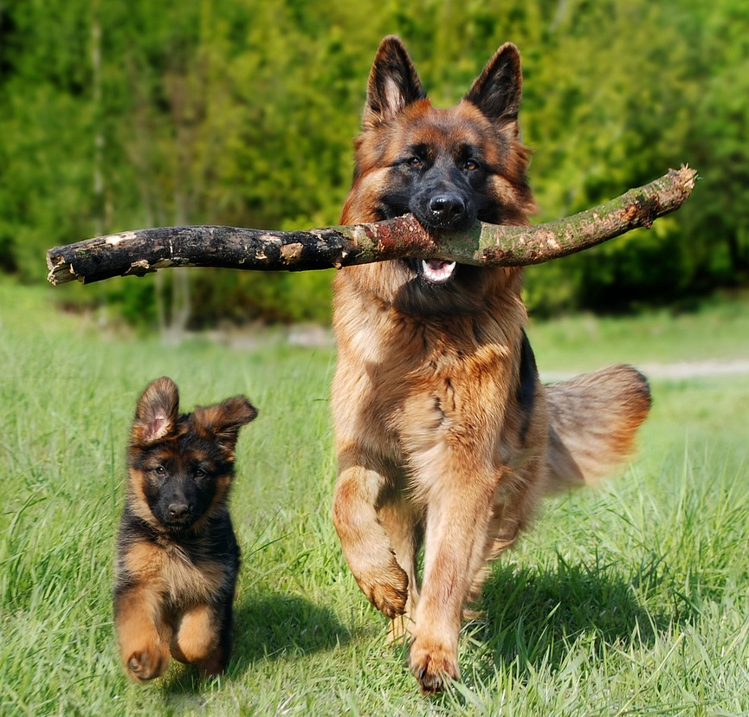
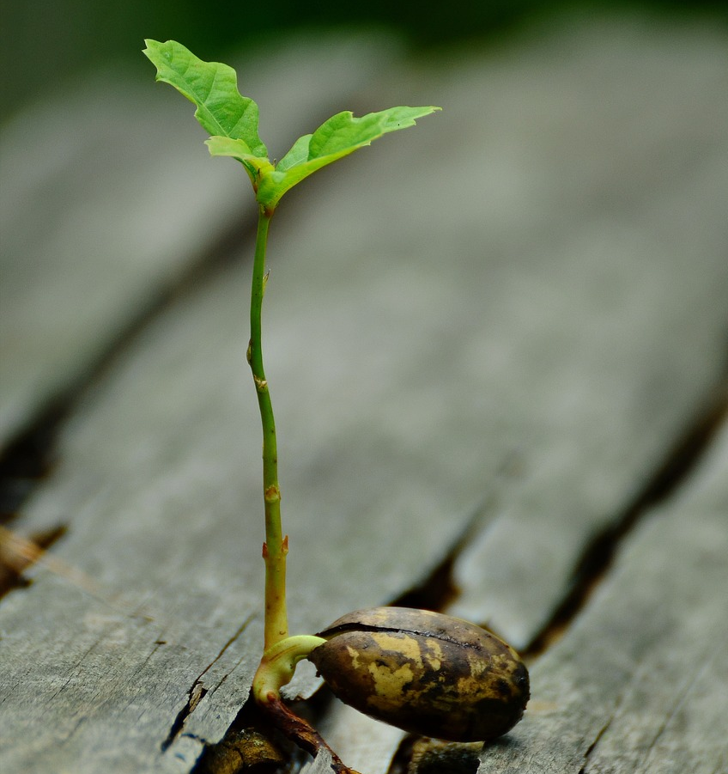
Doorka maadada hidde (genetic material)
1. Sharax doorka maadada hidde (genetic material) ee isku ekaanshaha eeygan iyo eeygiisa yar.
2. Sharax doorka maadada hidde (genetic material) ee soo saarista dhirta cusub.

Slide 19
Doorka maadada hidde (genetic material)
Sharax doorka maadada hidde (genetic material) ee isku ekaanshaha eeygan iyo eeyga yar.
Maadada hidde (genetic material) waxaa laga gudbiyaa eeyga ilaa eeyga yar inta lagu jiro taranka.
Maadada hidde (genetic material) waxay bixisaa tilmaamo dhismaha astaamaha la iska dhaxlo iyo xakamaynta hababka nolosha.
Astaamaha eeyga iyo eeygiisa yar way isku mid yihiin sababtoo ah eeyga yar wuxuu qayb ka helay maadada hidde (genetic material) ee eeyga.
2. Sharax doorka maadada hidde (genetic material) ee soo saarista dhirta cusub.
Maadada hidde (genetic material) waxaa laga gudbiyaa dhirta ilaa iniinta (seed).
Dhirtu waxay ka soo baxdaa iniinta (seed).
Maadada hidde (genetic material) waxay bixisaa tilmaamo astaamaha iyo xakamaynta hababka nolosha ee dhirta cusub.

Slide 20
Maadada hidde (genetic material) iyo DNA
Kaydinta maadada hidde (genetic material)
Doorka maadada hidde (genetic material)
DNA

Slide 21
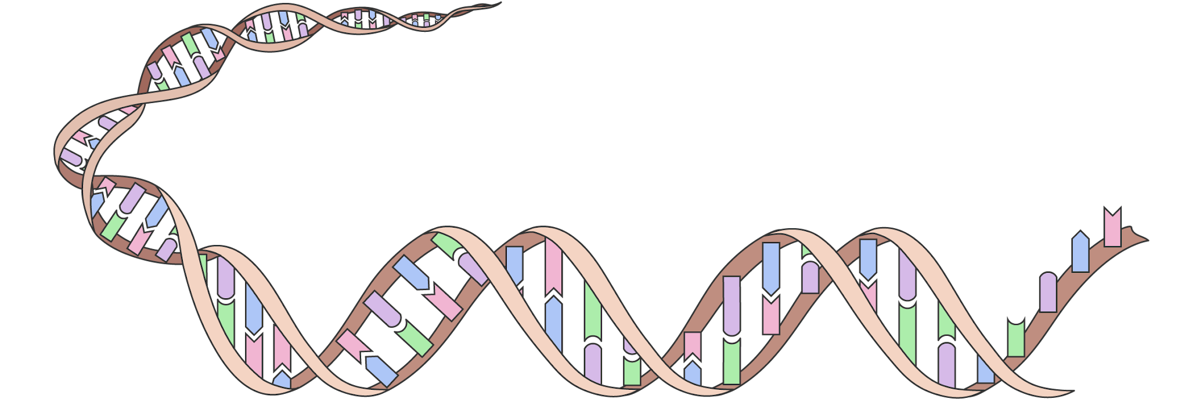
DNA
Walaxda hidaha (genetic material) ee dhammaan noolaha (organisms) waxay ka samaysan tahay walax kiimiko (chemical substance).
Walaxdan waxaa loo yaqaan DNA.
nucleus
unug xayawaan (animal cell)
DNA

Slide 22
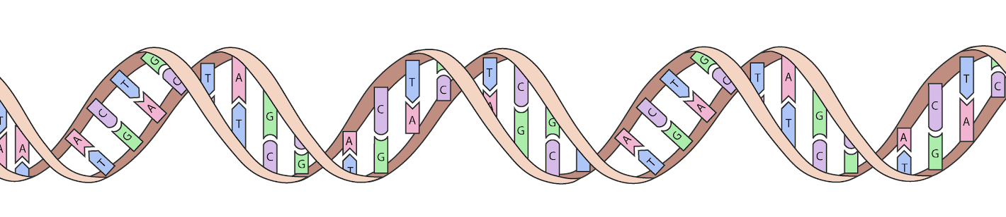
DNA
DNA waa molekyuul dheer (long molecule) oo ka samaysan silsilad (chain) oo ah cutubyo kiimiko oo yaryar (smaller chemical units).
Silsiladda (chain) waxay ka dhisan tahay afar nooc oo kala duwan oo cutubyo kiimiko ah (chemical units), kuwaas oo saynisyahannadu u yaqaannaan A, T, C iyo G.
T, G, A iyo C waxay sameeyaan koodhka hidaha (genetic code)
Koodhka (code) wuxuu bixiyaa tilmaamaha loo isticmaalo in lagu dhiso sifooyinka la dhaxlo (inherited features), oo lagu xakameeyo hababka nolosha (life processes), dhammaan noolaha (living organisms).

Slide 23

DNA
Tusaale (analogy) ayaa naga caawin kara inaan fahanno tan.
Buug cunto karis (recipe book) wuxuu ka samaysan yahay waraaq (paper).
Buugga cunto karista (recipe book) wuxuu kaydiyaa tilmaamo (instructions), oo lagu qoray iyadoo la isticmaalayo xuruuf (letters) (A ilaa Z).
Tilmaamaha cunto karista (recipe instructions) waxaa loo isticmaali karaa in lagu sameeyo keeg (cake).
Walaxda hidaha (genetic material) waxay ka samaysan tahay DNA.
Walaxda hidaha (genetic material) waxay kaydisaa tilmaamo (instructions), oo lagu qoray iyadoo la isticmaalayo molekyuulo (molecules) (A, T, C iyo G).
Tilmaamaha hidaha (genetic instructions) waxaa loo isticmaali karaa in lagu sameeyo noole (living organism).

Slide 24
DNA
DNA iyo koodhka hidaha (genetic code) waa isku shay.
DNA waa walax kiimiko (chemical substance) oo kaydisa koodhka hidaha (genetic code).
DNA waa magac kale oo loo yaqaan koodhka hidaha (genetic code).

Slide 25
DNA
Labo eey oo yaryar mid kasta wuxuu leeyahay koodh hidde oo kala duwan.
1.
jaalle (yellow)
guduudan (purple)
buluug (blue)
bunni (brown)
2.
casaan (pink)
guduud (red)
oranji (orange)
cagaar (green)
sifo (feature) | koodh (code)
indho bunni (brown eyes) | buluug (blue)
indho buluug (blue eyes) | oranji (orange)
dhogor qalloocan (curly fur) | guduud (purple)
dhogor toosan (straight fur) | casaan (red)
sifo (feature) | koodh (code)
dhogor madow (black fur) | cagaar (green)
dhogor casaan (ginger fur) | bunni (brown)
dhego laalaada (floppy ears) | biriin (pink)
dhego fiiqan (pointy ears) | jaalle (yellow)
Isticmaal codes-ka ku jira shaxda si aad u sawirto labada eey (puppies) oo leh astaamahooda saxda ah.

Slide 26
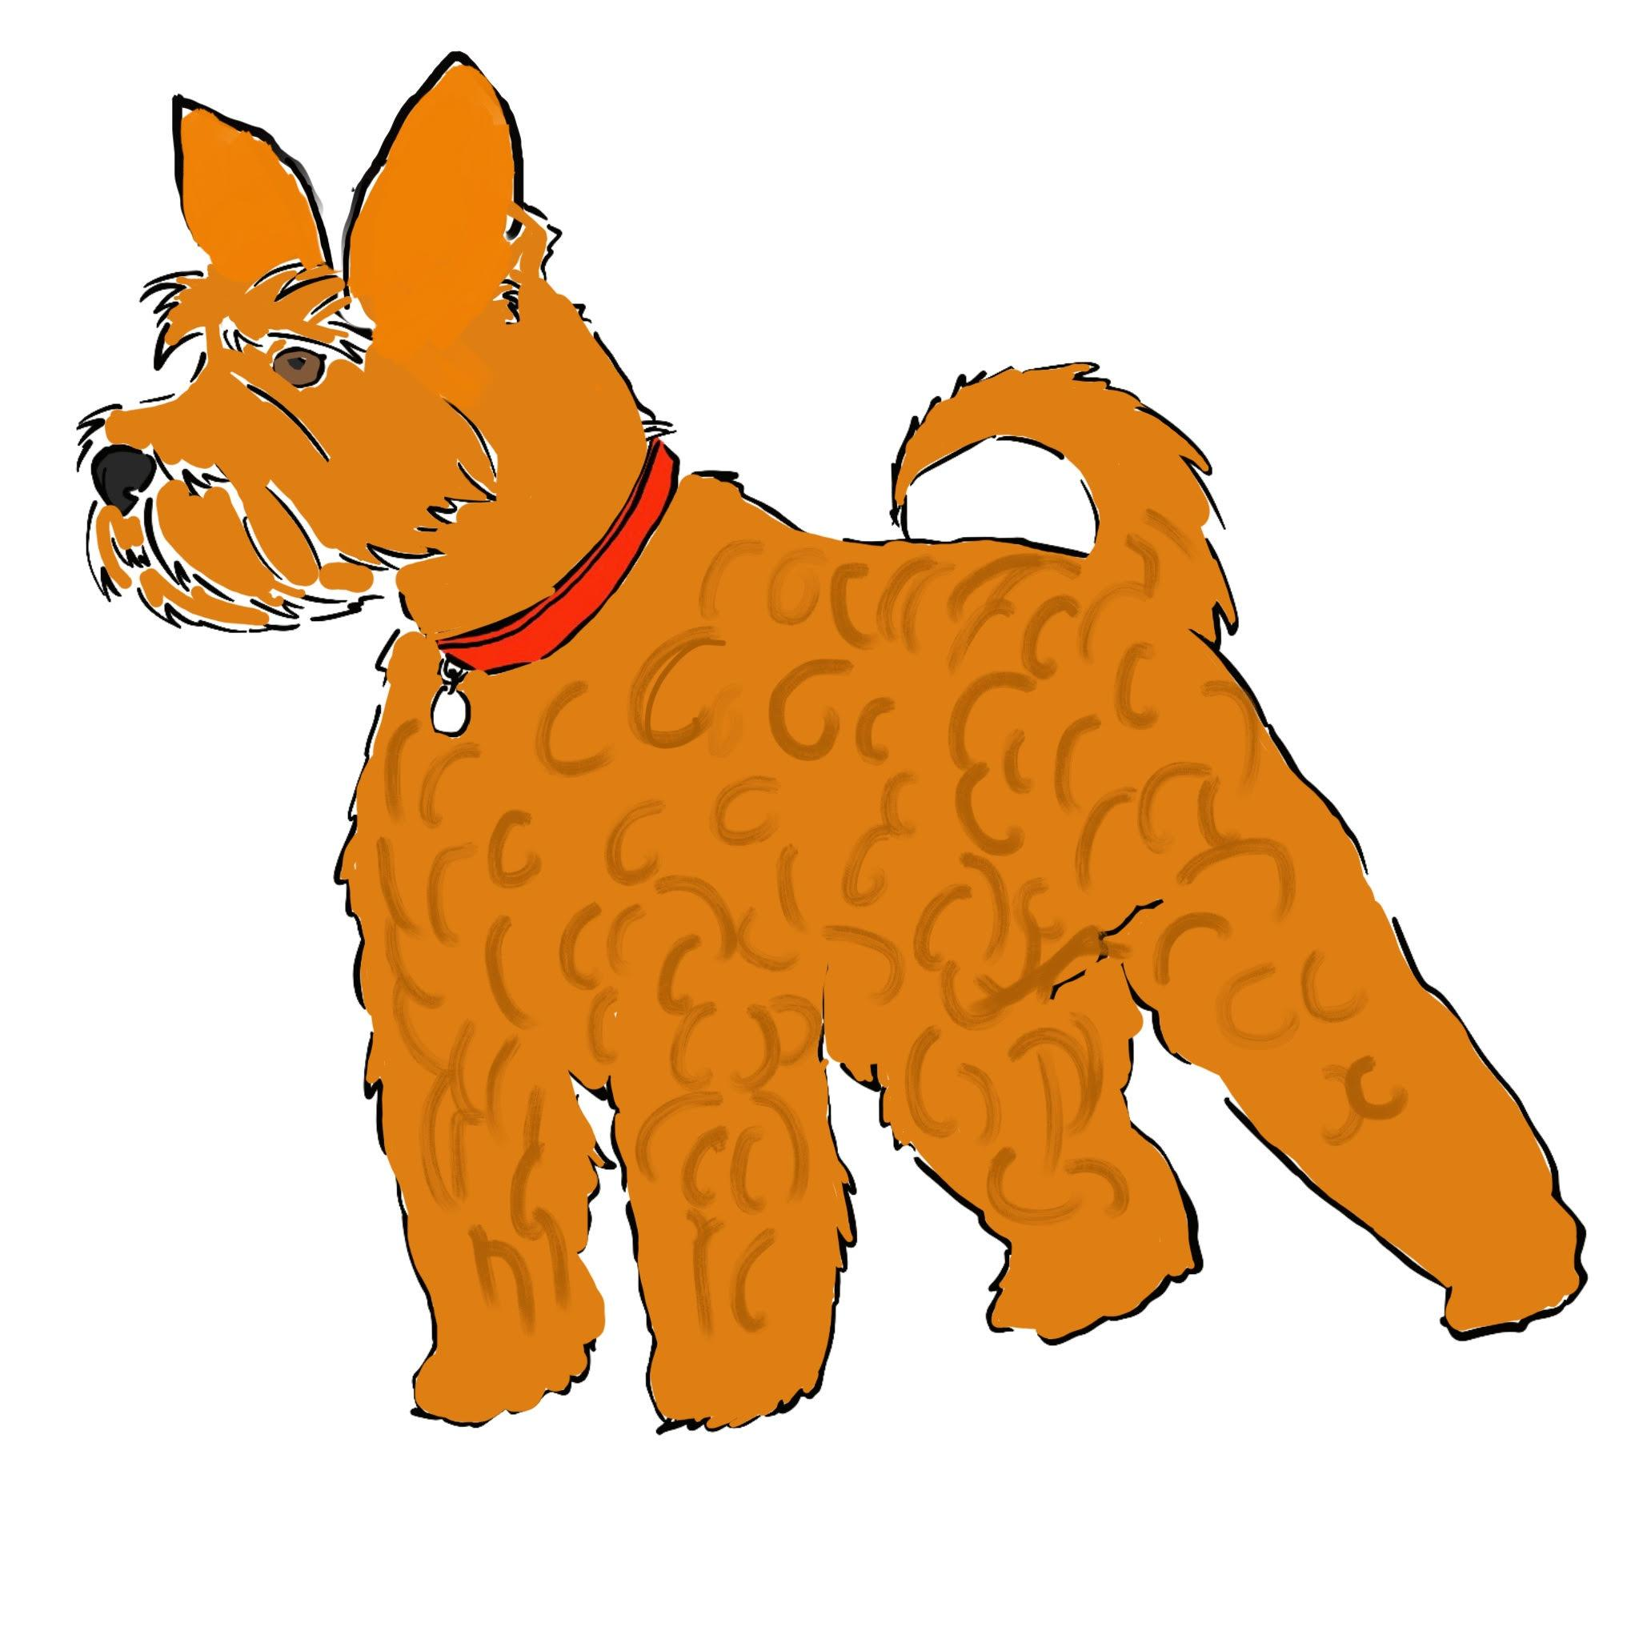
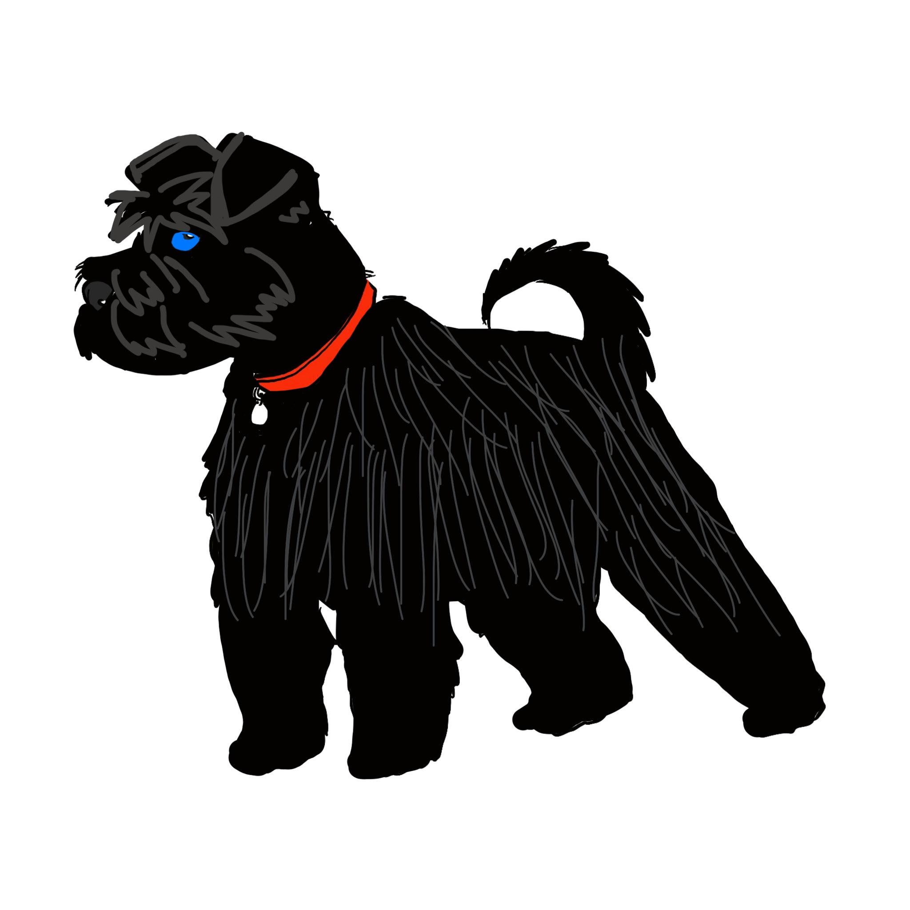
DNA
Eeyga 1 code-kiisa:
Eeyga 2 code-kiisa:
jaalle (yellow)
guduudan (purple)
blue
brown
pink
red
orange
green
dhego fiiqan (pointy ears)
dhego laalaada (floppy ears)
indho bunni (brown eyes)
indho buluug (blue eyes)
dhogor madow (black fur)
dhogor jaalle-casaan (ginger fur)
dhogor qallafsan (curly fur)
dhogor toosan (straight fur)

Slide 27
Kaydinta maadada hidde-side (genetic material)
Dhammaan unugyada dhirta, xayawaanka iyo fangaska waxay ka kooban yihiin qaybo ay ka mid yihiin xuub unug (cell membrane), cytoplasm iyo nucleus; nucleus-ku wuxuu kaydiyaa maadada hidde-side (genetic material) ee noolaha (organism).
Bakteeriyadu waa noole (organism) hal unug ah oo aan lahayn nucleus. Maadadooda hidde-side (genetic material) waxay ku kaydsan tahay cytoplasm-ka unugga.
Maadada hidde-side (genetic material) waxay ka samaysan tahay kiimiko la yiraahdo DNA.
DNA waxay ka dhisantahay afar molecule oo kala duwan (oo la yiraahdo A, T, C iyo G), kuwaas oo sameeya kood hidde-side (genetic code) loo isticmaalo tilmaamo lagu dhiso sifooyin la iska dhaxlo iyo xakamaynta hababka nolosha ee noolaha (organism).

