Slide 1
Naqshadeeye garaafik (Graphic designer)
Xisaab (Xisaab) goobta shaqada

Slide 2
Sida agabkeena waxbarista loogu talagalay fasalka

Slide 3
Waxaan fahmi karaa sida xisaabta (Xisaab) loogu isticmaalo naqshadeeyayaasha garaafik.

Slide 4
Naqshadeeye garaafik (Graphic designer) wuxuu abuuraa muuqaallo (visuals) mashaariic kala duwan sida xayeysiisyo, calaamadayn (branding), joornaal, baakad iyo shabakado.

Slide 5

Naqshadeeye garaafik (Graphic designer)
Saamiga dahabiga ah (Golden ratio)
Wareegto siman (Rotational symmetry) fanka

Slide 6

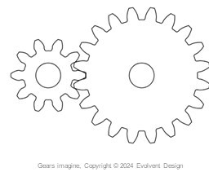

Saamiga dahabiga ah (Golden ratio)
Naqshadeeye garaafik (Graphic designer) wuxuu abuuraa muuqaallo (visuals) mashaariic kala duwan sida xayeysiisyo, calaamadayn (branding), joornaal, baakad iyo shabakado.

Slide 7
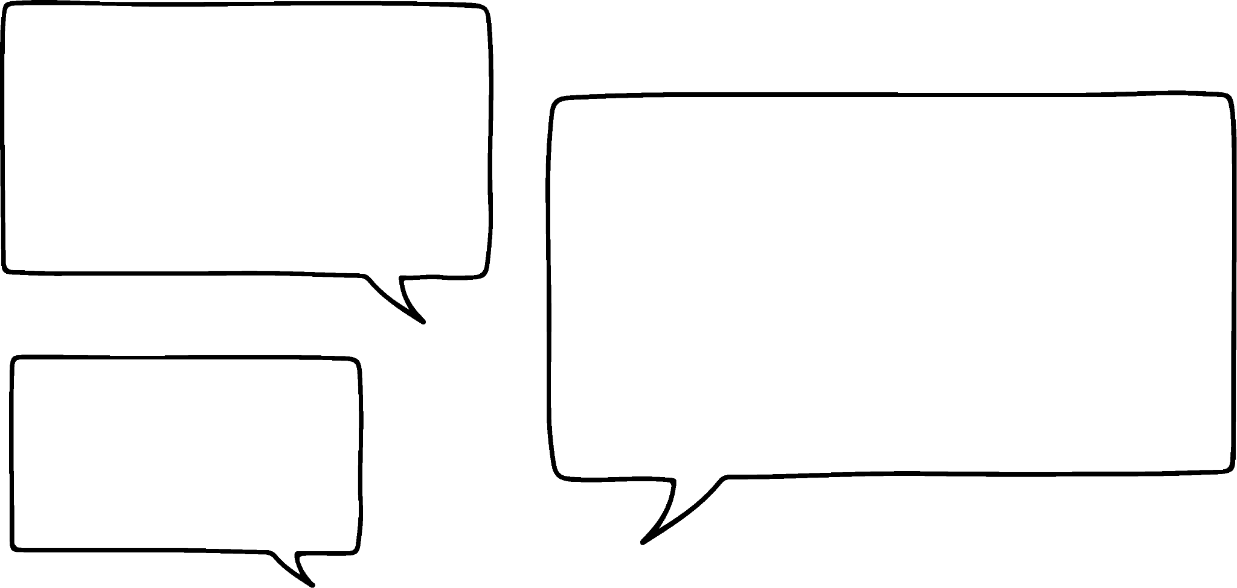
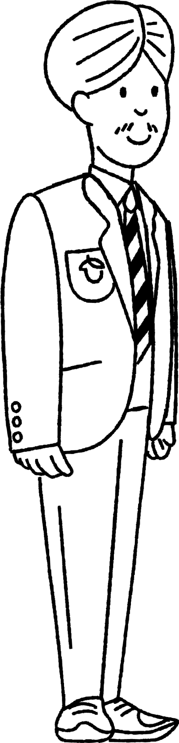
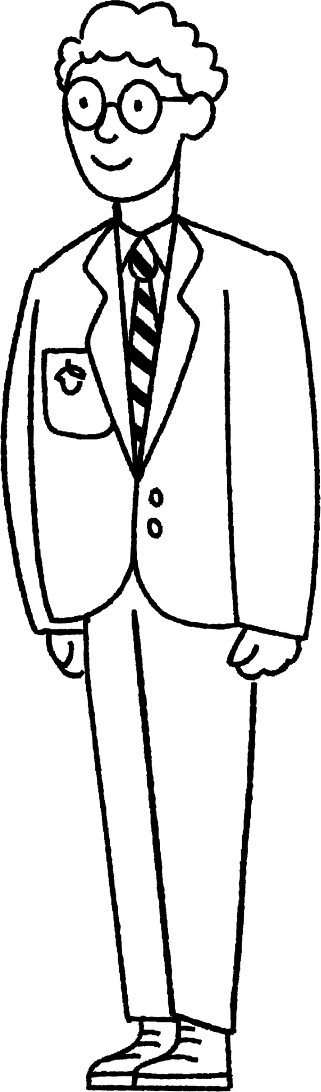
Saamiga dahabiga ah (Golden ratio)
Laakiin sidee xisaabta (Xisaab) loogu isticmaalay in sawirradan la abuuro?
Qayb ka mid ah shaqada naqshadaynta waxay ku lug lahayd xisaab (Xisaab) loo yaqaan 'saamiga dahabiga ah' (Golden ratio).
Cali
Axmed

Slide 8

Saamiga dahabiga ah (Golden ratio)
Laba tiro waxay ku jiraan saamiga dahabiga ah (Golden ratio) haddii saamigoodu la mid yahay saamiga wadartooda iyo tiraha weyn ee labada tiro.
Tusaale ahaan, haddii aan leenahay laba tiro a iyo b, markaas a iyo b waxay ku jiraan saamiga dahabiga ah (Golden ratio) haddii:
a : b = b : a + b
Tan waxa kale oo loo qori karaa sida:

Slide 9
Saamiga dahabiga ah (Golden ratio)
Laakiin sidee taas run ahaantii faa'iido u leedahay?
Hmm, aynu taas u bedelno wax muuqaal ah.
Cali
Axmed

Slide 10
Saamiga dahabiga ah (Golden ratio)
Labada labajibbaaran ee midabka leh waa isku cabbir.
Labajibbaaranaha xiga wuxuu leeyahay dherer qiyaas ahaan 1.618 jeer ka badan dhererka labajibbaaranaha yar ee midabka leh.

Slide 11
Saamiga dahabiga ah (Golden ratio)
Qaabkani wuu sii socdaa, labajibbaaranaha xigana wuxuu leeyahay dherer qiyaas ahaan 1.618 jeer ka badan dhererka labajibbaaranihii hore.

Slide 12
Saamiga dahabiga ah (Golden ratio)
Adoo ku sawiraya gudaha labajibbaaranayaasha, sawirro ayaa la abuuri karaa.

Slide 13
Saamiga dahabiga ah (Golden ratio)
Kani waa sawir si degdeg ah loo soo diyaariyey.
Nashqadeeyayaasha garaafiga (Graphic designers) waxay soo saari karaan sawirro aad u adag iyagoo isticmaalaya 'dhismayaashan aasaasiga ah'.

Slide 14

Saamiga dahabiga ah (Golden ratio)
Nashqadeeye garaafigu wuxuu abuuraa sawirro mashaariic kala duwan sida xayaysiisyada, calaamadaynta (branding), joornaalada, baakadaha iyo mareegaha.
Nashqadeeyayaasha garaafiga waxay ka shaqeeyaan mashaariic kala duwan, xisaabtuna waxay ka caawin kartaa naqshadaynta sawirrada dadka soo jiidan kara.

Slide 15
Saamiga dahabiga ah (Golden ratio)
1) U naqshadee calaamad (logo) shirkad adoo isticmaalaya qaabka saamiga dahabiga ah.
Qor cutub faahfaahinaya sababta calaamaddaadu u matasho shirkadda si fiican.
Tusaale ahaan, haddii aad dooratay silsilad makhaayad ah oo aad naqshadaysey burger, markaa calaamaddani waxay la jaan qaadaysaa waxa silsiladda makhaayaddu u taagan tahay.

Slide 16
Saamiga dahabiga ah (Golden ratio)
Qaab (Template)

Slide 17
Saamiga dahabiga ah (Golden ratio)
1) Tusaale ahaan, anigoo adeegsanaya template-ka, waxaan dhigay goobo qayb kasta oo yar.

Slide 18
Saamiga dahabiga ah (Golden Ratio)
1) Tusaale ahaan, waxaan isticmaalay nuqullo ka mid ah kuwan si aan u naqshadeeyo astaantayda (logo).

Slide 19
Saamiga dahabiga ah (Golden Ratio)
1)
Waxaan naqshadeeyay astaan (logo) shirkad iibisa alaab loogu talagalay carruurta yaryar.
Teddy-ga wuxuu ka samaysan yahay goobo, taasoo ka dhigaysa inuu yeesho muuqaal jilicsan oo 'wareegsan'. Wuxuu u eg yahay mid laabta lagu qaado oo ammaan u ah carruurta.

Slide 20
Naqshadeeye garaafik (Graphic Designer)
Saamiga dahabiga ah (Golden Ratio)
Isku-dhigma wareegto (Rotational Symmetry) fanka

Slide 21
Isku-dhigma wareegto (Rotational Symmetry) fanka
Saamiga dahabiga ah ma aha oo kaliya xisaabta naqshadeeyayaasha garaafikku isticmaali karaan si ay u abuuraan sawiro.
Isku-dhigma wareegto (Rotational Symmetry) ayaa sidoo kale caawin kara.

Slide 22
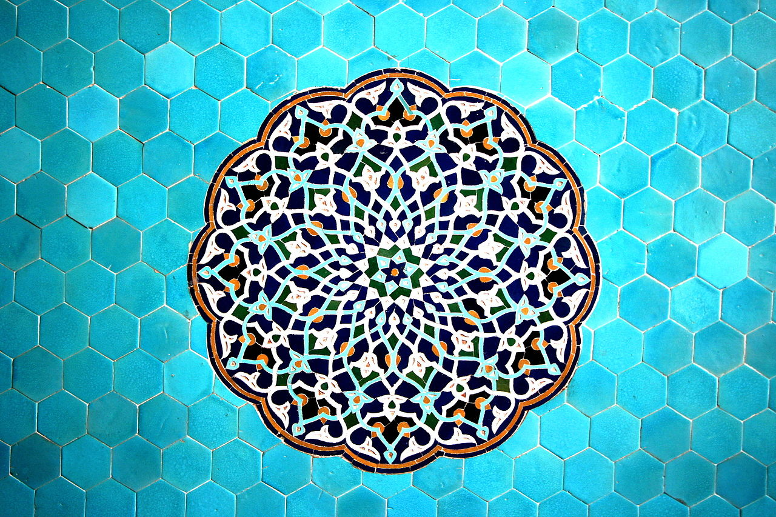
Isku-dhigma wareegto (Rotational Symmetry) fanka
Naqshadaha Islaamiga ah mararka qaarkood waxaa laga abuuraa isticmaalka soo noqnoqda ee qaababka aasaasiga ah. Naqshado qurxoon oo adag ayaa ka dhasha.
Waa kuwee qaababka aad ku aragtaa naqshaddan?

Slide 23
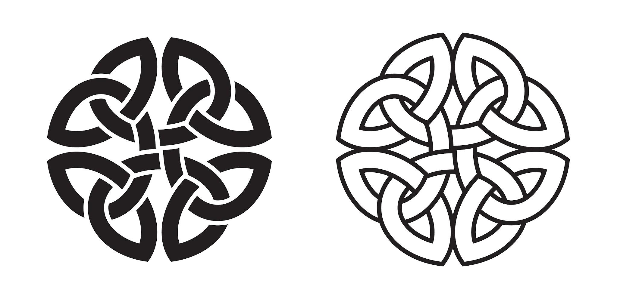
Isku-dhigma wareegto (Rotational Symmetry) fanka
Naqshadaha Celtic-ga, sida noocan guntiga Celtic-ga, sidoo kale waxay ku tiirsan yihiin isku-dhigma wareegto (Rotational Symmetry)

Slide 24
Isku-dhigma wareegto (Rotational Symmetry) fanka
Kaliya dhaqammada reer galbeedka ayaa isticmaala qaabab joomatari (geometric shapes) naqshadahooda.
Dhaqammo badan oo kala duwan ayaa abuura qaabab iyagoo isticmaalaya qaabab joomatari (geometric shapes). Waxaad baari kartaa dhaqammo kale oo sidaas sameeya.

Slide 25
Isku-dhigma wareegto (Rotational Symmetry) fanka
Miyay muhiim tahay inay jirto isku-simmetri wareeg (rotational symmetry)?
Aynu tixgelinno laba naqshad oo gebi ahaan laga sameeyay saddex-xaglo (triangles).
Cali
Axmed

Slide 26
Isku-simmetri wareeg (rotational symmetry) ee farshaxanka
Isku-simmetri wareeg leh Isku-simmetri wareeg la'aan
Kee ayaad door bidaysaa?

Slide 27
Isku-simmetri wareeg (rotational symmetry) ee farshaxanka
1) a) Abuur naqshad adoo isticmaalaya qaabab aasaasi ah (basic shapes). Naqshaddaadu waa inay leedahay isku-simmetri wareeg (rotational symmetry).
b) Abuur nooc labaad oo naqshaddaada ah oo aan lahayn isku-simmetri wareeg (rotational symmetry).

Slide 28
Isku-simmetri wareeg (rotational symmetry) ee farshaxanka
2) Tus labada naqshadood ee aad sameysay saaxiibbadaa/asxaabtaa/qoyskaaga. Weydii iyaga 'Kee sawir ayaa kugu soo jiidasho badan?'
Diiwaangeli natiijooyinka.
3) Abuur jaantus (chart) si aad u soo bandhigto natiijooyinkaaga. Kee sawir ayaa caan ka badan? Maxaad u malaynaysaa sababta?

Slide 29
Isku-simmetri wareeg (rotational symmetry) ee farshaxanka
1) a) Abuur naqshad adoo isticmaalaya qaabab aasaasi ah (basic shapes). Naqshaddaadu waa inay leedahay isku-simmetri wareeg (rotational symmetry).
b) Abuur nooc labaad oo naqshaddaada ah oo aan lahayn isku-simmetri wareeg (rotational symmetry).

Slide 30
Isku-simmetri wareeg (rotational symmetry) ee farshaxanka
Naqshad 1 Naqshad 2

Slide 31
Isku-simmetri wareeg (rotational symmetry) ee farshaxanka
2) Tus labada naqshadood ee aad sameysay saaxiibbadaa/asxaabtaa/qoyskaaga. Weydii iyaga 'Kee sawir ayaa kugu soo jiidasho badan?'
Diiwaangeli natiijooyinka.
Naqshad 1 | Naqshad 2

Slide 32
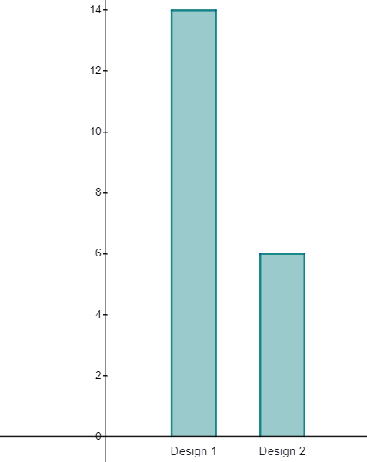
Summeyn wareeg ah (Rotational symmetry) fanka
3) Samee jaantus (chart) si aad u muujiso natiijooyinkaaga. Sawir kee ayaa ka caansan? Maxaad u malaynaysaa inay tahay sababtu?
Tusaale: Naqshad 1 ayaa ka caansan. Waxaan u malaynayaa inay tahay sababta oo ah naqshadda koowaad waxay samaysay qaab soo noqnoqda (repeating pattern) taasina waxay ka soo jiidasho badan tahay qaska naqshadda labaad.

Slide 33
Naqshadeeye (Graphic designer)
Naqshadeeye (graphic designer) wuxuu u sameeyaa muuqaallo mashaariic kala duwan sida xayaysiisyo, calaamadayn (branding), majallado, baakad, iyo shabakado.
Sawirada leh summeyn wareeg ah (rotational symmetry) ayaa inta badan aad u soo jiidasho badan.

