Slide 1
Garaafyada taxanaha tirooyinka gaarka ah iyadoo la adeegsanayo tikniyoolajiyad
Xiriirro aan toos ahayn (Non-linear relationships)

Slide 2
sida loo isticmaalo darasyada Oak

Slide 3
Waxaan awoodi karaa inaan garaaf u sawiro taxane tirooyin gaar ah.

Slide 4
Tiro saddexagal (triangular number) waa tiro lagu matali karo qaab dhibco loo habeeyay saddexagal. Tirada ereyga (term number) waa tirada dhibcood ee dhinac kasta oo saddexagalka ah.
1
3
6
10
15

Slide 5

Garaafyada taxanaha tirooyinka gaarka ah iyadoo la adeegsanayo tikniyoolajiyad
Sawirista taxanaha iyadoo la adeegsanayo Desmos
Sahminta taxanaha tirooyinka gaarka ah

Slide 6
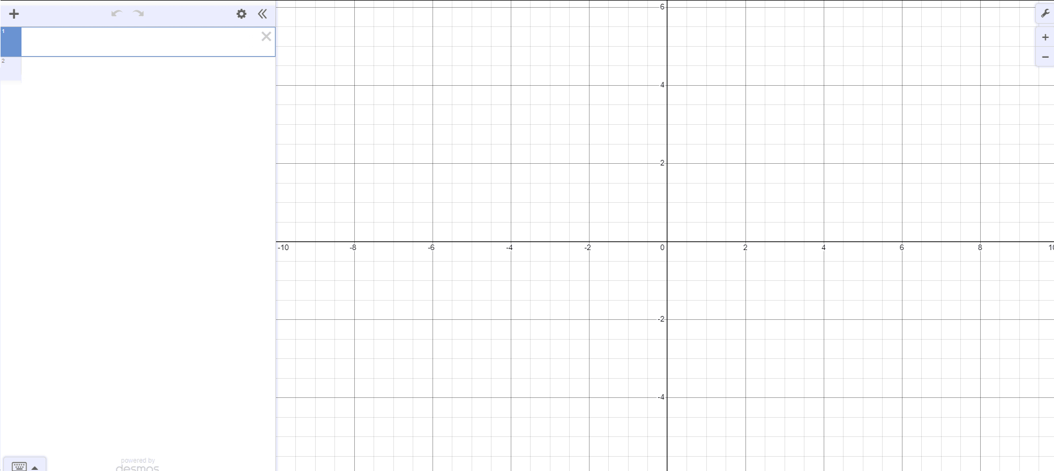
Sawirista taxanaha iyadoo la adeegsanayo Desmos
Waxaan ku sawiri karnaa taxanaha garaafyada adigoo u beddelaya tirooyinka ereyada iyo ereyada isku-duwayaal (coordinates).
Isticmaalka software-ka garaafyada wuxuu noo ogolaanayaa inaan si degdeg ah oo fudud u sawirno dhibco badan.
Waxaan eegi doonnaa sawirista taxanaha iyadoo la adeegsanayo tikniyoolajiyad, si aan u bilowno:
Fur browser-ka shabakadda oo aad tag desmos.com
Raadso oo riix badhanka 'graphing calculator'
Shaashaddaadu waa inay u ekaataa sidan

Slide 7
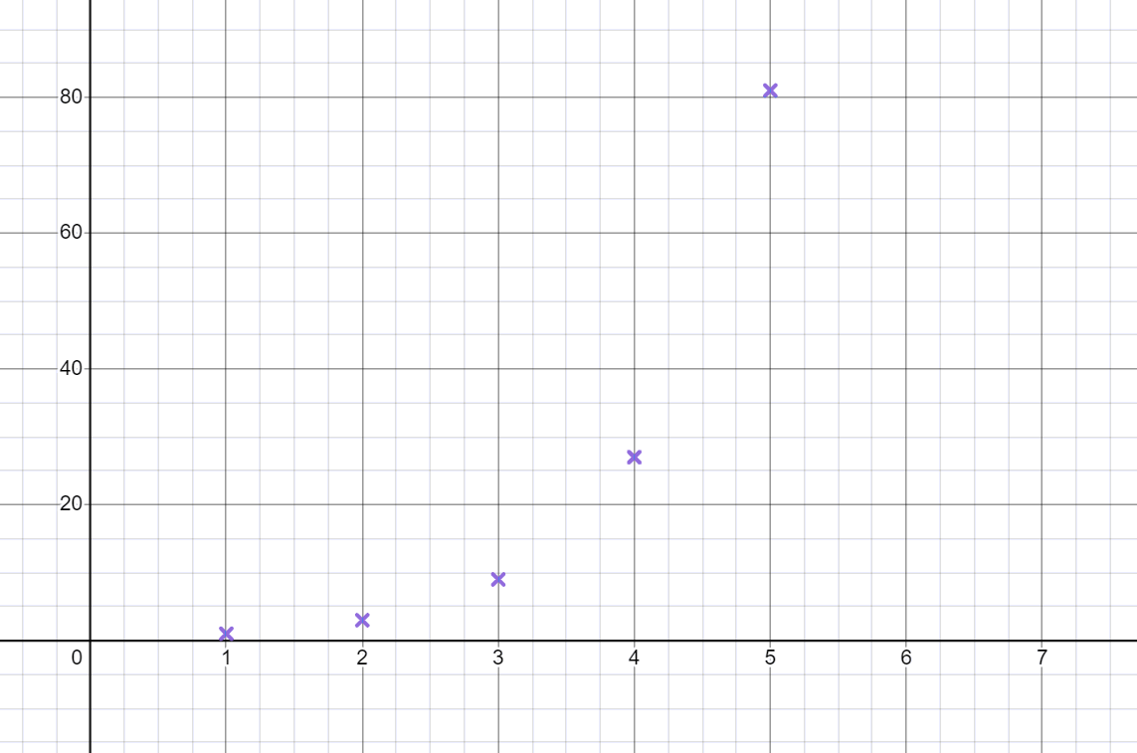
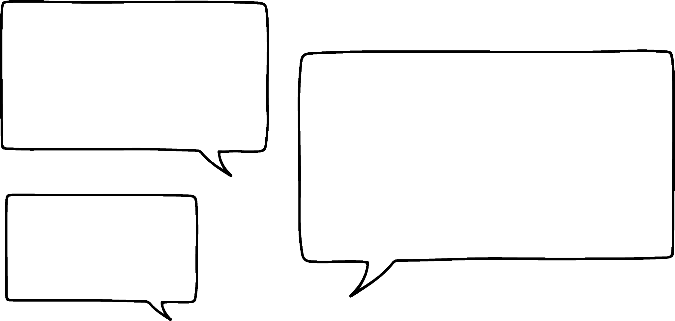



Sawirista taxanaha iyadoo la adeegsanayo Desmos
Waxaan ku bilaabi doonnaa sawirista taxane joomatari (geometric sequence).
Bilow adigoo sawiraya shanta erey ee ugu horreeya 1, 3, 9, 27, 81, … ee Desmos
Waxaad ka bixi kartaa zoom-ka oo aad fidin kartaa miisaanka x-axis si ay u ekaato sidan.
Waxaan u malaynayaa in ereyga nth uu noqon karo 2n − 1
Yacquub
Maxay tahay sababta aan runta ahayn?
2n − 1 waa taxane toosan (linear sequence) marka dhibcuhu waxay ahaan lahaayeen khad toosan (straight line).

Slide 8
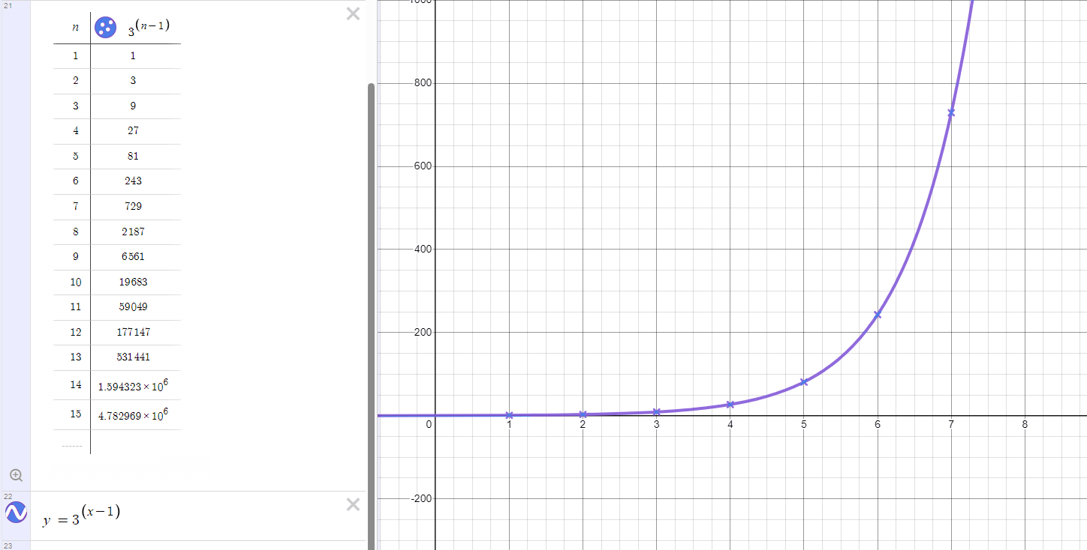
Qorsheynta taxanaha (sequences) iyadoo la isticmaalayo Desmos
Qaanuunka nth term waa 3n − 1
Weligaa ma u baahnid inaad tan hadda xisaabiso.
Ku qor isla'eg (equation) ku habboon Desmos si aad u hubiso inay tan ku habboon tahay taxanahayaga. Waxaa laga yaabaa inaad rabto inaad qorsheysid dhibco dheeri ah si aad u hubiso.
Adigoo ku qoraya isla'egta (equation) y = 3(x − 1) waxaan arki karnaa inay tani dhex marto dhibcaha, marka 3n − 1 waa qaanuunka nth term ee saxda ah.

Slide 9
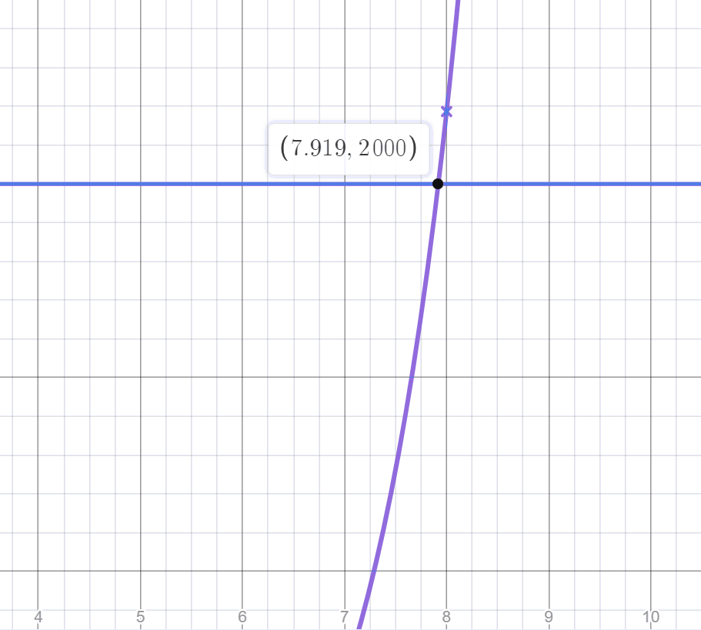
Qorsheynta taxanaha (sequences) iyadoo la isticmaalayo Desmos
Sawiridda garaafka (graph) qaanuunka nth term waxay noo ogolaaneysaa inaan hubino haddii qiimayaasha (values) ereyada waaweyn ay ku jiraan taxanaha.
Ma tiro 2000 ayaa ku jirta taxanaha joomatari (geometric sequence) 1, 3, 9, 27, …. ?
Ku qor isla'egta (equation) y = 2000
Guji barta (point) halka khadkan uu ku gooyo qalooca (curve).
Qiimaha (value) x ma aha tiro (integer) marka 2000 ma aha erey ku jira taxanahayaga.
Qiimahan (value) wuxuu u dhexeeyaa ereyga 7aad iyo 8aad

Slide 10
Qorsheynta taxanaha (sequences) iyadoo la isticmaalayo Desmos
Markaad qorsheynayso taxane (sequence) garaaf (graph) kuma sawirno khad (line) ama qalooc (curve) dhex mara dhibcaha.
Tirooyinka ereyada (term numbers) ee taxanahayaga waa tirooyinka (integers) togan ee ka weyn ama la eg 1.
Khad (line) ama qalooc (curve) wuxuu muujiyaa dhammaan qiimayaasha (values) ku habboon qaanuunka, oo ay ku jiraan qiimayaasha (values) x ee aan ahayn tiro (non-integer), tani kuma habboona taxane (sequence).
Si kastaba ha ahaatee, markaad isticmaalayso software-ka garaafka (graphing software), waxay inta badan faa'iido u leedahay inaad sawirto khadka (line) ama qalooca (curve).
Ka war heer markaad isticmaalayso habkan, ereyada taxanaha (sequence) waxay ku dhacaan oo keliya isku-duwayaasha (coordinates) leh qiimaha (value) x ee tiro (integer) togan.

Slide 11
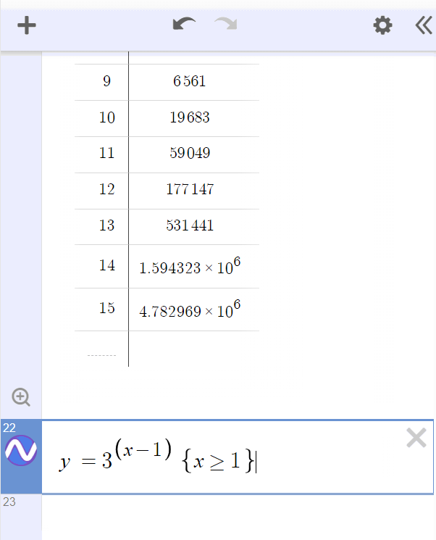
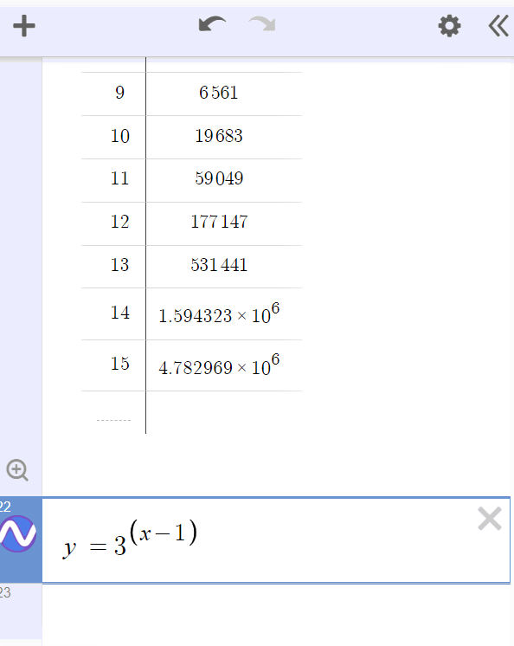
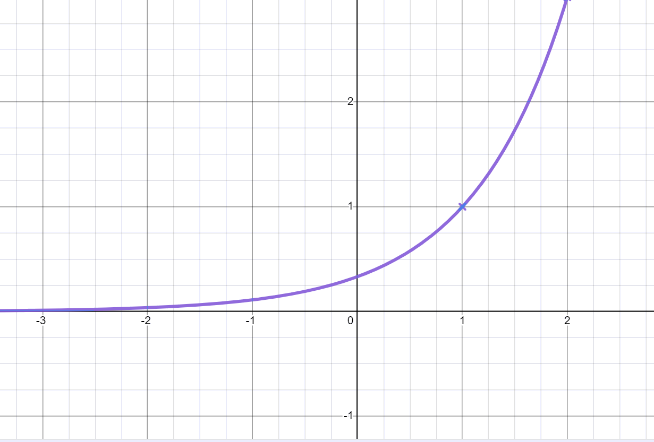
Qorsheynta taxanaha (sequences) iyadoo la isticmaalayo Desmos
Waxaan xaddidi karnaa garaafka (graph) si uu u muujiyo oo keliya qaybta halka tirooyinka ereyada (term numbers) ay yihiin 1 ama ka weyn.
Haddii kani yahay taxane (sequence), waxaan u baahan nahay oo keliya qaybta garaafka (graph) ka dambeeya isku-duwaha (coordinate) (1,1)
Guji isla'egta (equation) aad rabto inaad xaddido.
Isticmaal curly brackets iyo calaamadaha sinnaan-la'aanta (inequality) si aad u xaddiddo waxa geliya.
Isku day inaad ku qorto {x ≥ 1}
(gujista = ka dib > waxay gelisaa astaanta ≥)
Maxaa ku dhacaya garaafkaaga?

Slide 12
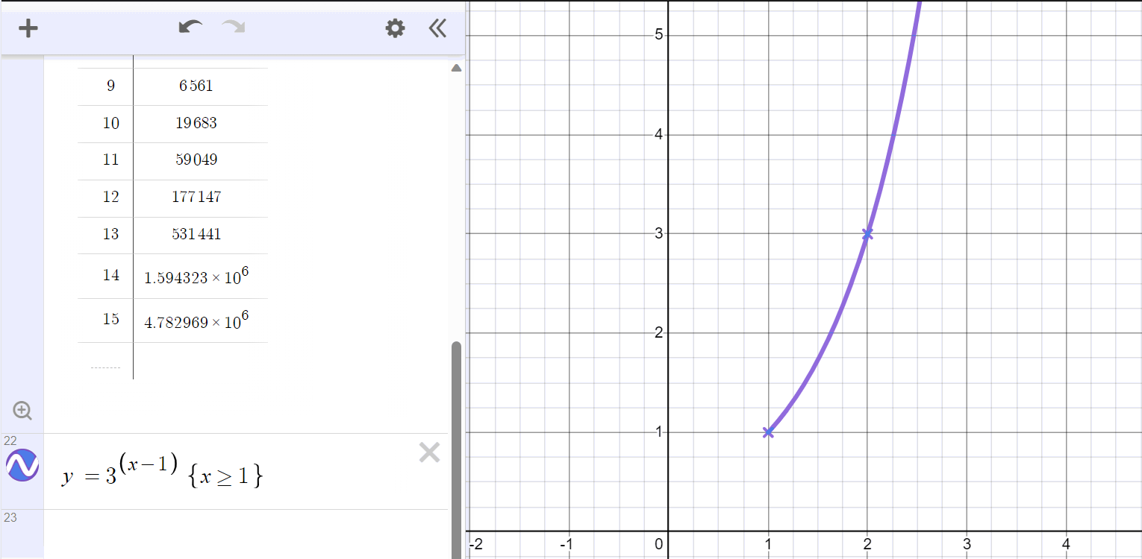
Qorsheynta taxanaha (sequences) iyadoo la isticmaalayo Desmos
Garaafka hadda wuxuu muujinayaa oo kaliya qiimayaasha (values) ku habboon qaanuunka halkaas oo x uu yahay 1 ama ka weyn.
Qaybta garaafka halka x uu ka yar yahay 1 waa la waayay

Slide 13
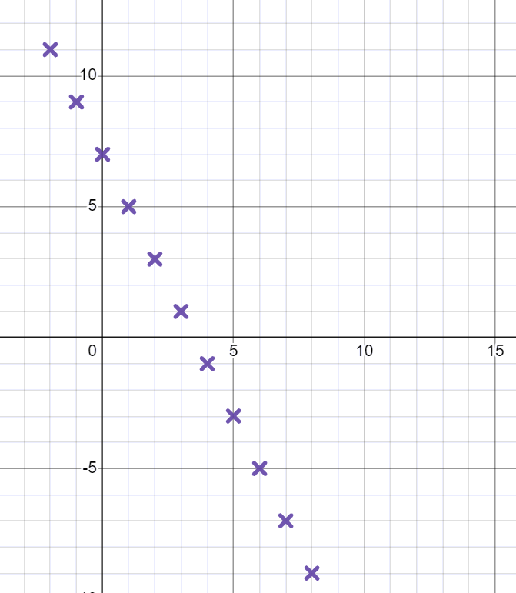
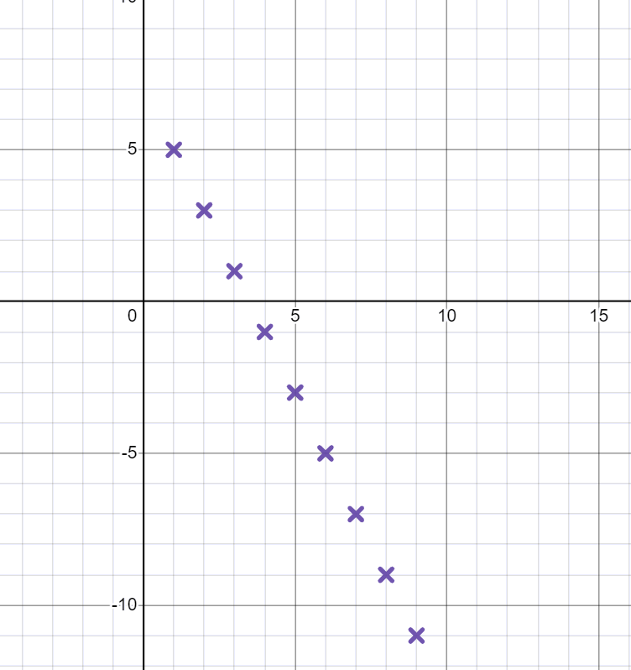
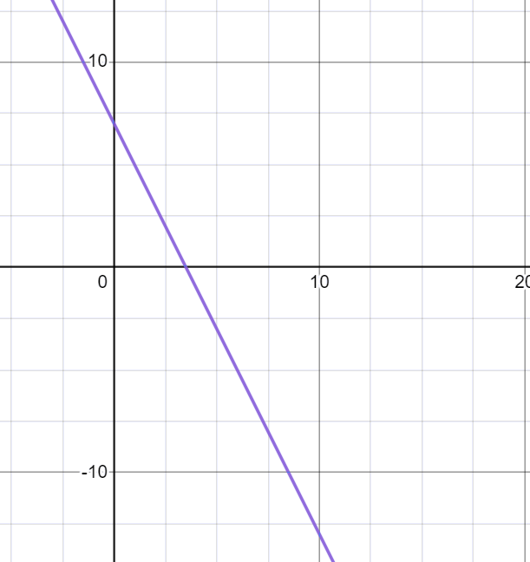
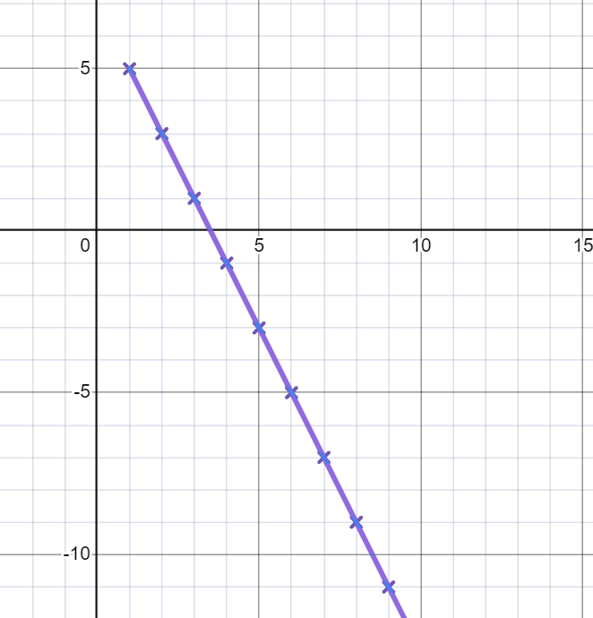


Qorsheynta taxanaha (sequences) iyadoo la isticmaalayo Desmos
Kee mid ka mid ah kuwan soo socda waa garaafka saxda ah ee taxanaha 7 − 2n ?
Sharax jawaabtaada.
Markaad qorsheyneysid taxane (sequence) sidan oo kale, waa inaan la sawirin xariiq. Ereyga koowaad ee taxanahan waa marka n = 1, sidaas darteed waa inaysan jirin isku-duwayaal (coordinates) bidixda x = 1
a
b
c
d

Slide 14
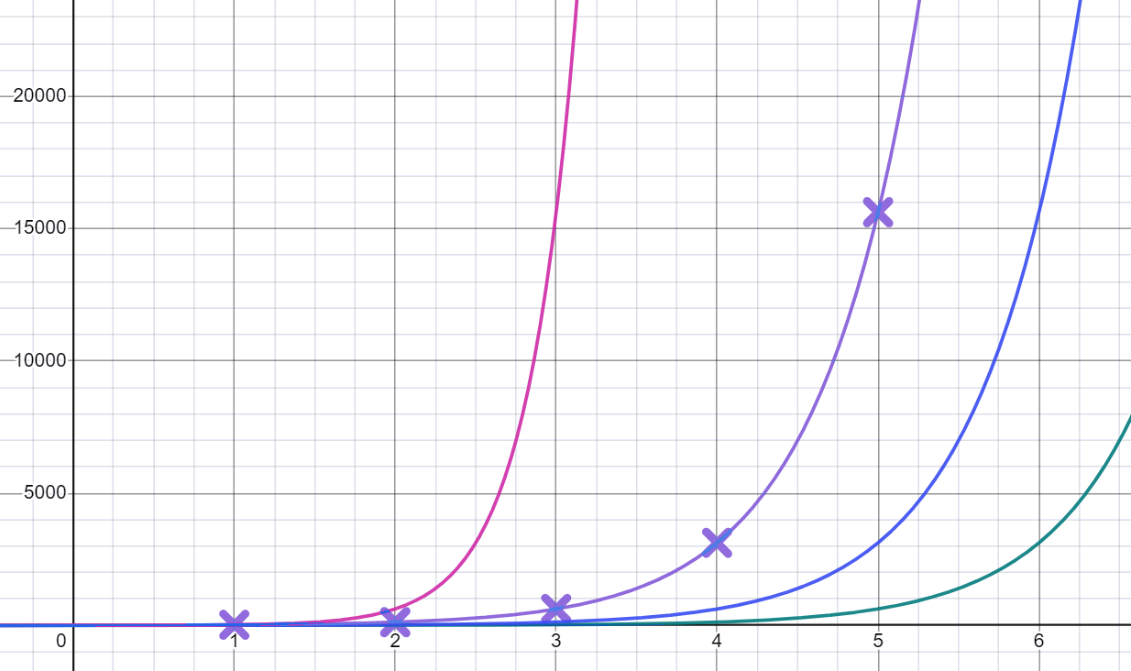
Qorsheynta taxanaha (sequences) iyadoo la isticmaalayo Desmos
Isticmaal Desmos si aad u go'aamiso kee ka mid ah kuwan waa qaanuunka saxda ah ee nth erayga taxanaha joomatari (geometric sequence) kaas oo ka bilaabma 25, 125, 625, 3125, 15625, …
(Tilmaan- waxaad u baahan doontaa inaad kala bixiso miisaanka x-axis-ka oo aad ka baxdo)
a
5^{n − 1}
y = 5^{2x}
y = 5^{(x + 1)}
y = 5^{x}
b
5^{n + 1}
c
5^{n}
d
5^{2n}
y = 5^{(x − 1)}

Slide 15
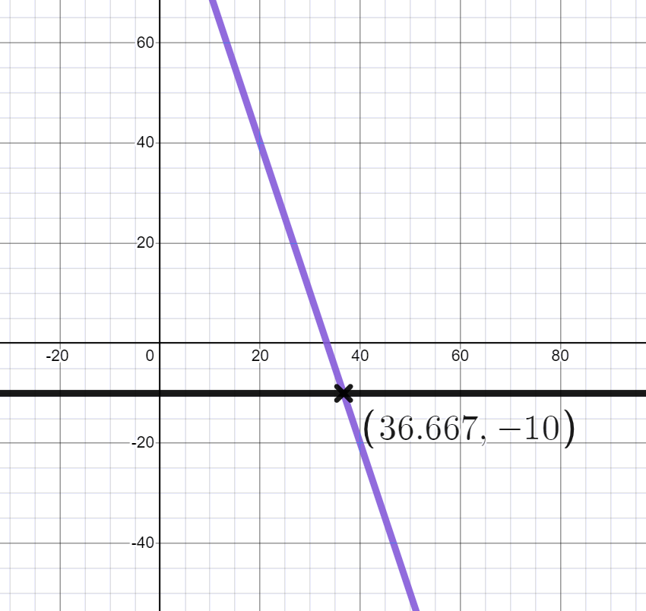
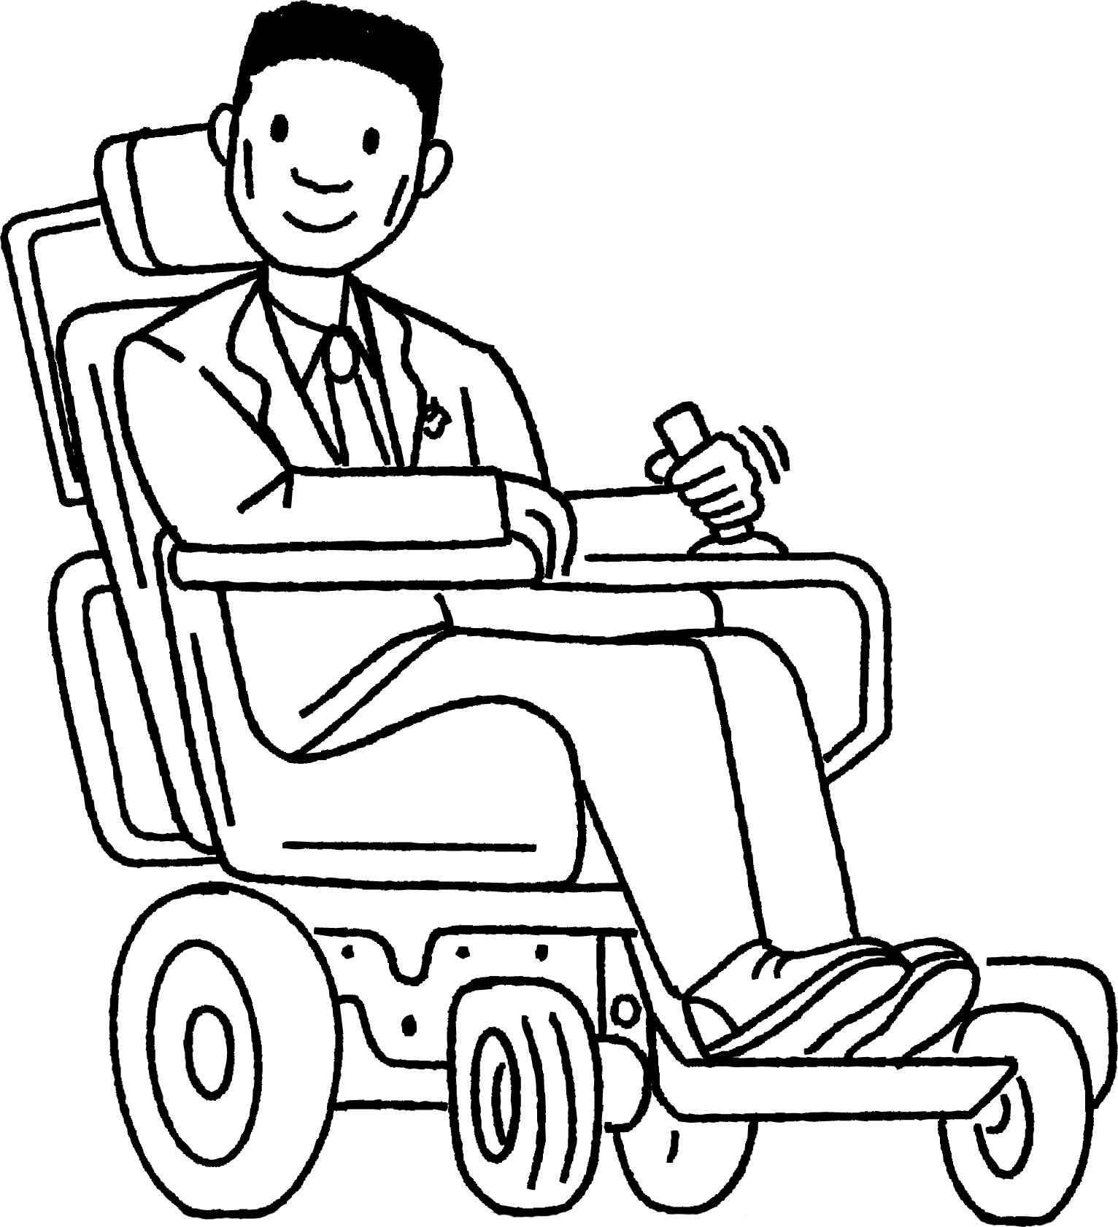
Qorsheynta taxanaha (sequences) iyadoo la isticmaalayo Desmos
Cabdi wuxuu rabaa inuu ogaado haddii −10 uu ku jiro taxanaha 100 − 3n
Waxaan sawiray xariiqyada y = 100 − 3n iyo y = −10. Way isgooyaan marka −10 waa eray ku jira taxanaha 100 − 3n
a) Maxaa Cabdi si sax ah u sameeyay?
Cabdi
b) U sharax Cabdi qaladka uu sameeyay.

Slide 16
Qorsheynta taxanaha (sequences) iyadoo la isticmaalayo Desmos
2) Isticmaal Desmos si aad ugu dhigto taxanahan xeerarkooda nth term
a) Taxane joomateri (Geometric sequence) oo leh shanta koobaad: 2, 4, 8, 16, 32, …
4 × 3^{n}
b) Taxane joomateri (Geometric sequence) oo leh shanta koobaad: 8, 16, 32, 64, 128, …
3 × 2^{n}
c) Taxane joomateri (Geometric sequence) oo leh shanta koobaad: 6, 12, 24, 48, 96, …
2 × 3^{n}
d) Taxane joomateri (Geometric sequence) oo leh shanta koobaad: 6, 18, 54, 162, 486, …
2^{n}
e) Taxane joomateri (Geometric sequence) oo leh shanta koobaad: 12, 36, 108, 324, 972, …
2^{n + 2}

Slide 17
Qorsheynta taxanaha iyadoo la isticmaalayo Desmos
3) Isticmaal software garaafyada si aad uga caawiso su'aalahan soo socda.
Nambarka taxanaha (Term number) | 1 | 2 | 3 | 4 | n
Taxane (Term) | −1.5 | 0.6 | 2.7 | 4.8 | 2.1n − 3.6
a) Ma nambarka 30 ayaa ku jira taxanahan?
Nambarka taxanaha (Term number) | 1 | 2 | 3 | 4 | n
Taxane (Term) | 8 | 24 | 72 | 216 | 8 × 3^{n − 1}
b) Ma nambarka 324 ayaa ku jira taxanahan?
Nambarka taxanaha (Term number) | 1 | 2 | 3 | 4 | n
Taxane (Term) | 10 | 20 | 40 | 80 | 5 × 2^{n}
c) Ma nambarka 1280 ayaa ku jira taxanahan?
Nambarka taxanaha (Term number) | 1 | 2 | 3 | 4 | n
Taxane (Term) | 4 | 16 | 64 | 256 | 4^{n}
d) Ma nambarka 4004 ayaa ku jira taxanahan?

Slide 18
Qorsheynta taxanaha iyadoo la isticmaalayo Desmos
Cabdi wuxuu rabaa inuu ogaado haddii −10 uu ku jiro taxanaha 100 − 3n
Waxaan sawiray xariiqyada y = 100 − 3n iyo y = −10. Waxay isgoysanayaan markaa −10 waa xubin (term) taxanaha 100 − 3n
a) Maxaa Cabdi si sax ah u sameeyay?
Wuxuu sawiray khadadka saxda ah wuxuuna raadiyay barta isgoyska (intersection point).
Cabdi
b) U sharax Cabdi qaladka uu sameeyay.
Si uu ugu jiro taxanaha, isku-duwayaasha x (x coordinate) waa inay ahaadaan tiro dhammaystiran (integer). Isku-duwahaani wuxuu muujinayaa −10 inuu u dhexeeyo xubinta 36aad iyo 37aad, laakiin kuma jiro taxanaha.

Slide 19
Sawirada taxanaha iyadoo la adeegsanayo Desmos
2) Isticmaal Desmos si aad ugu habboonaato taxanahan xeerarka nth term
a) Taxane joomatari (geometric sequence) oo shanta xubnood ee ugu horreeya ay yihiin: 2, 4, 8, 16, 32, …
4 × 3^{n}
b) Taxane joomatari (geometric sequence) oo shanta xubnood ee ugu horreeya ay yihiin: 8, 16, 32, 64, 128, …
3 × 2^{n}
c) Taxane joomatari (geometric sequence) oo shanta xubnood ee ugu horreeya ay yihiin: 6, 12, 24, 48, 96, …
2 × 3^{n}
d) Taxane joomatari (geometric sequence) oo shanta xubnood ee ugu horreeya ay yihiin: 6, 18, 54, 162, 486, …
2^{n}
e) Taxane joomatari (geometric sequence) oo shanta xubnood ee ugu horreeya ay yihiin: 12, 36, 108, 324, 972, …
2^{n + 2}

Slide 20
Sawirada taxanaha iyadoo la adeegsanayo Desmos
3) Isticmaal software-ka garaafyada si aad uga caawiso su'aalahan soo socda.
Nambarka xubinta | 1 | 2 | 3 | 4 | n
Xubin | −1.5 | 0.6 | 2.7 | 4.8 | 2.1n − 3.6
a) Ma 30 ayaa ku jira taxanahan?
Haa ereyga 16-aad
Nambarka xubinta | 1 | 2 | 3 | 4 | n
Erey (Term) | 8 | 24 | 72 | 216 | 8 × 3^{n − 1}
b) Ma 2044 ayaa ku jira taxanahan?
Maya inta u dhaxaysa ereyga 6-aad iyo 7-aad
Nambarka ereyga (Term number) | 1 | 2 | 3 | 4 | n
Erey (Term) | 10 | 20 | 40 | 80 | 5 × 2^{n}
c) Ma 1280 ayaa ku jira taxanahan?
Haa ereyga 8-aad
Nambarka ereyga (Term number) | 1 | 2 | 3 | 4 | n
Erey (Term) | 4 | 16 | 64 | 256 | 4^{n}
d) Ma 4004 ayaa ku jira taxanahan?
Maya inta u dhaxaysa ereyga 5-aad iyo 6-aad

Slide 21
Garaafyada taxanaha tirooyinka gaarka ah iyadoo la isticmaalayo tignoolajiyada
Qorshaynta taxanaha iyadoo la isticmaalayo Desmos
Sahaminta taxanaha tirooyinka gaarka ah

Slide 22

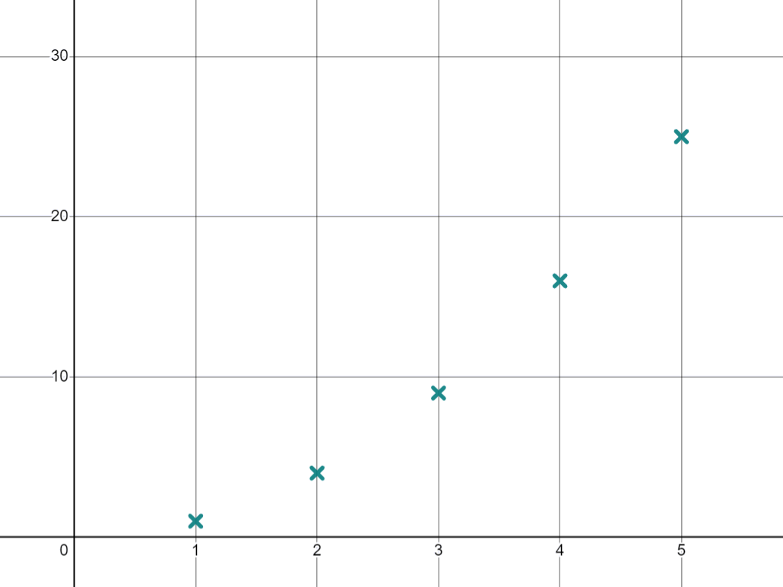


Sahaminta taxanaha tirooyinka gaarka ah
Waxaan la yaabanahay sida tirooyinka laba jibbaaran (square numbers) u ekaadaan marka lagu sawiro garaaf
Waxaan dhisi karnaa taxane ka kooban tirooyin laba jibbaaran (square numbers).
Waa maxay shanta tiro ee ugu horreeya ee laba jibbaaran (square numbers)?
1, 4, 9, 16, 25, …
Nuur
Isticmaal shaqada jaantuska (table function) si aad u qorshayso dhibcahan.
Waxaad kala bixin kartaa dhidibka x (x axis) si aad u hesho fikrad ka fiican qaabka garaafka.
Kani waa bilowga taxanaha dhammaan tirooyinka laba jibbaaran (square numbers) ee u kala horreeya (ascending order).

Slide 23
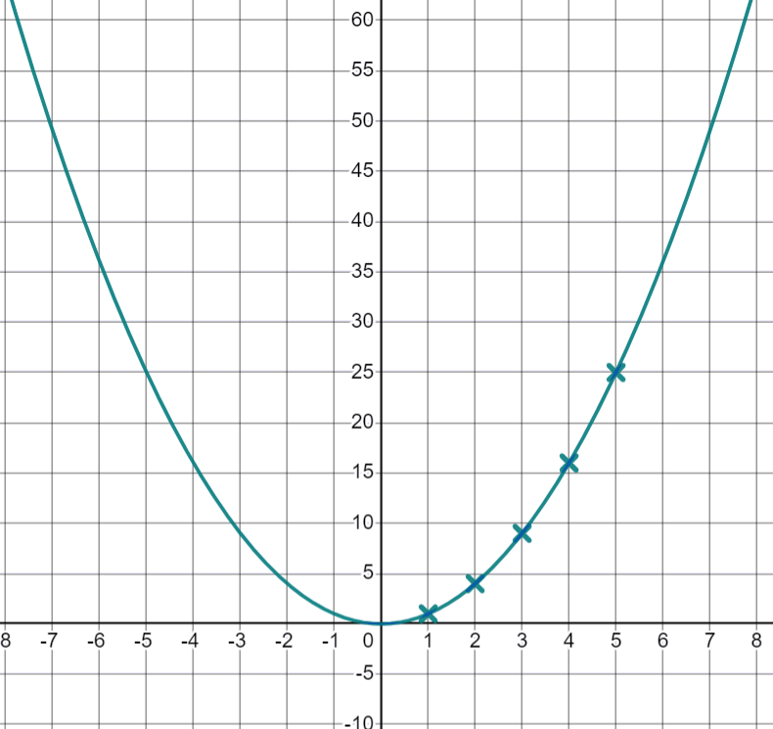
Sahaminta taxanaha tirooyinka gaarka ah
Sidee taxanahan loo soo saaray? Waa maxay ereyga nth (nth term) noqon lahaa?
Tixdan waxaa soo saaraya labajibbaaranaha (squaring) tirada term-ka. Term-ka nth waa n2.
Nuur wuxuu isticmaalaa term-ka nth si uu u sawiro garaafkan
Taasi waa mid xiiso leh, waxay samaynaysaa qaab 'U' ah.
Nuur
Faallooyinka Nuur waxay khuseeyaan garaafka y = x2 Maxaa u baahan inuu xusuusto ee ku saabsan tixda n2?

Slide 24
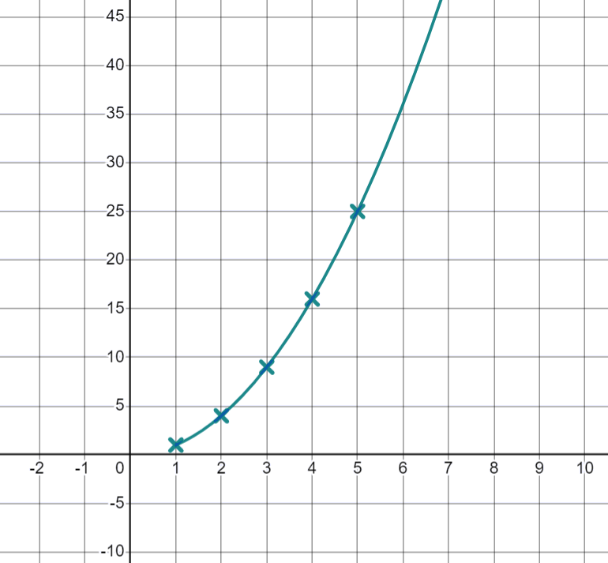

Sahminta tixaha gaarka ah ee tirooyinka
Faallooyinka Nuur waxay khuseeyaan garaafka y = x2 Maxaa u baahan inuu xusuusto ee ku saabsan tixda n2?
Tixdani waxay bilaabataa marka n = 1 sidaas darteed qaybta garaafka ee bidixda x = 1 ma aha qayb ka mid ah tixda.
Isku day inaad isticmaasho xargo qalloocan (curly brackets) si garaafku uusan u muujin qiimaha (values) marka x ka yar yahay 1
Maxaad u malaynaysaa in tixda dhammaan tirooyinka saddex jibaaran (cube numbers) ee kor u kaca ay u ekaan doonto marka la sawiro? Samee saadaal.

Slide 25
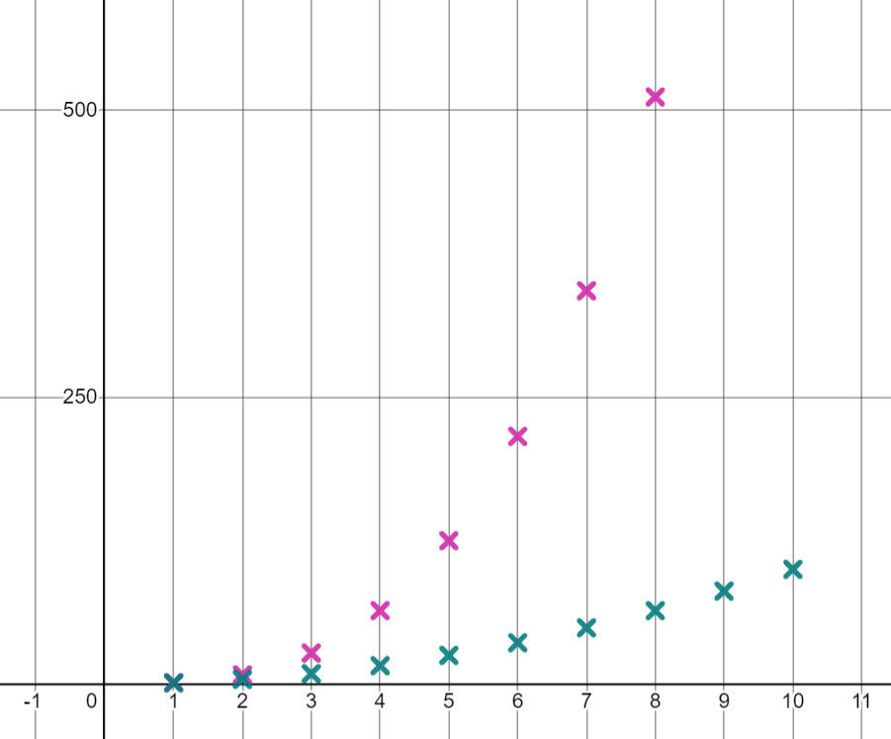


Sahminta tixaha gaarka ah ee tirooyinka
Tixda dhammaan tirooyinka saddex jibaaran (cube numbers) ee kor u kaca waxaa soo saaraya saddex jibaarista (cubing) tirada term-ka, sidaas darteed term-ka nth waa n3?
Isticmaal term-ka nth si aad u soo saartid 10ka term ee ugu horreeya ee tixda n3 ee garaaf.
Tixdani waxay sidoo kale soo saartaa qalooc (curve), waxay kordhisaa heer ka dheereeya n2
Waxaan u malaynayaa in tirada 1 ay tahay mid ku jirta labada tixood
Yacquub
Yacquub ma sax baa? Sidee ku ogaatay?

Slide 26
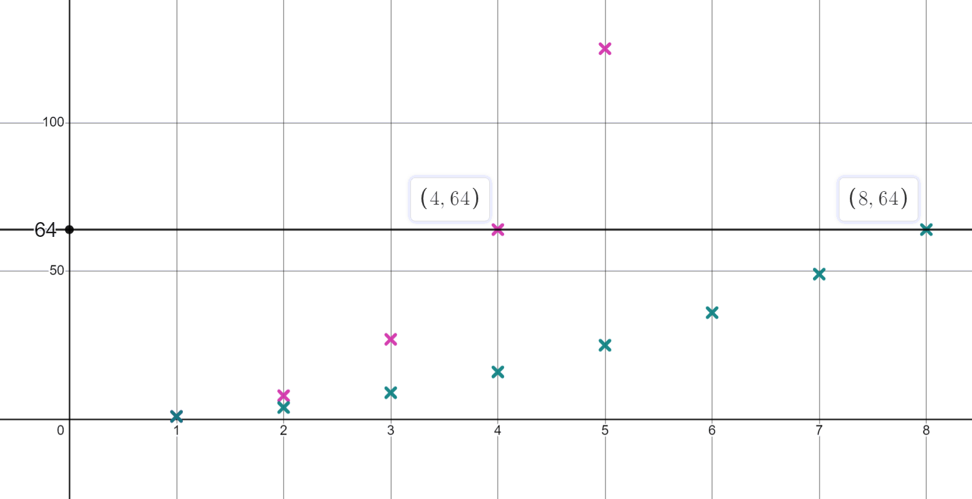
Sahminta tixaha gaarka ah ee tirooyinka
Waxaa laga yaabaa inaad tidhi:
Labada tixoodba waxay leeyihiin isku-duwayaasha (coordinate) (1,1) ee garaafyadooda. Labaduba waxay leeyihiin term-ka koowaad oo ah 1
Waxaa jira termo kale oo ku jira labada tixood, laakiin ma aha isku meel ee tixda.
Adigoo weyneynaya (zooming in), waxaan arki karnaa in 64 uu yahay term-ka 4aad ee tixda n3 iyo term-ka 8aad ee tixda n2
Tirooyinka labada taxane (sequences) waxay ku yaalliin khad isku mid ah oo toosan (horizontal line).

Slide 27

Sahaminta taxanayaasha (sequences) tiro ee gaarka ah
Maxaad u malaynaysaa in taxanaha (sequence) dhammaan tirooyinka saddex-xagalka (triangular numbers) uu u ekaan doono marka la sawiro?
Waxaan u malaynayaa inay sameyn doonaan qalooc (curve) mar kale
Waxaan u malaynayaa inay ka billaabi doonaan meel isku mid ah sida tirooyinka laba jibaaran (square numbers) iyo saddex jibaaran (cube numbers).
Yacquub
Cabdi
Waxaan u malaynayaa inay u dhexayn doonaan tirooyinka laba jibaaran (square numbers) iyo saddex jibaaran (cube numbers)
Midkee oo ka mid ah hadalladan ayaad ku raacsan tahay? U adeegso fikradahan si aad u sameyso saadaashaada.
Nuur

Slide 28
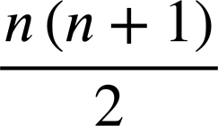
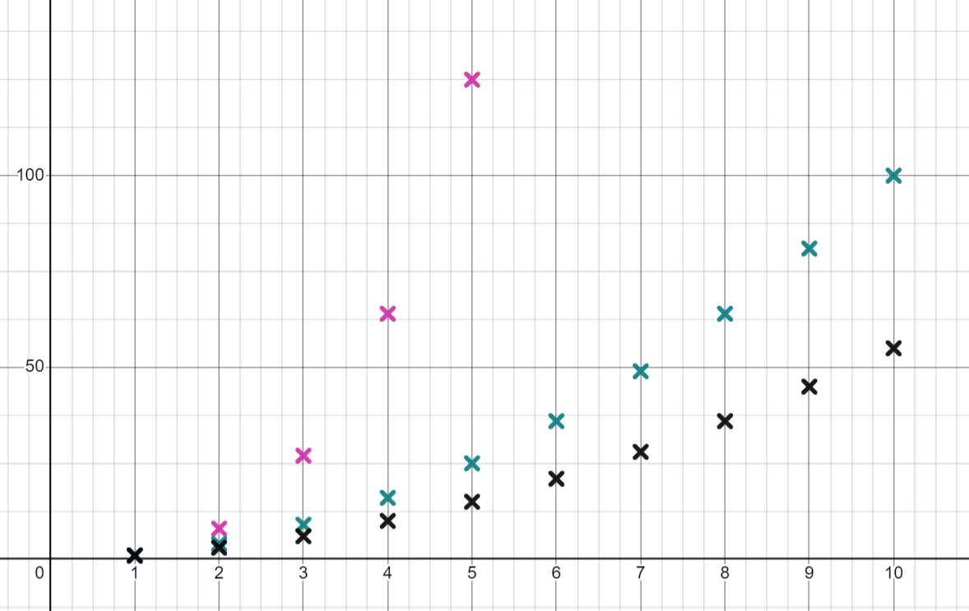
Sahaminta taxanayaasha (sequences) tiro ee gaarka ah
Ereyga nth (nth term) ee tirooyinka saddex-xagalka (triangular numbers) waxaa loo qori karaa sida
U adeegso tan si aad u soo saartid 10-ka erey ee ugu horreeya ee taxanahan (sequence). Miyay u egtahay sidaad saadaashay?
Waxay sameeyaan qalooc (curve) kale oo ka bilaabmaya (1,1) qaloocani wuxuu kordhaa heer gaabis ah.
Ma heli kartaa tiro ku jirta taxanaha (sequence) tirooyinka laba jibaaran (square numbers) iyo taxanaha (sequence) tirooyinka saddex-xagalka (triangular numbers)?
36
36 waa tiro laba jibaaran (square number) 6-aad iyo tiro saddex-xagal (triangular number) 8-aad. 1 waa ereyga 1-aad ee labada taxane (sequences)

Slide 29
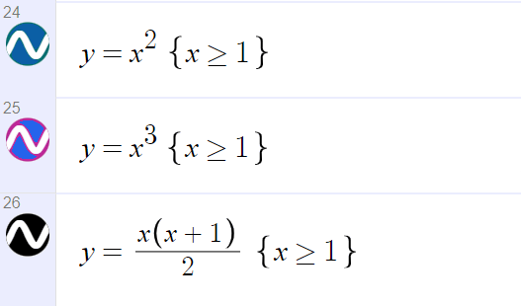
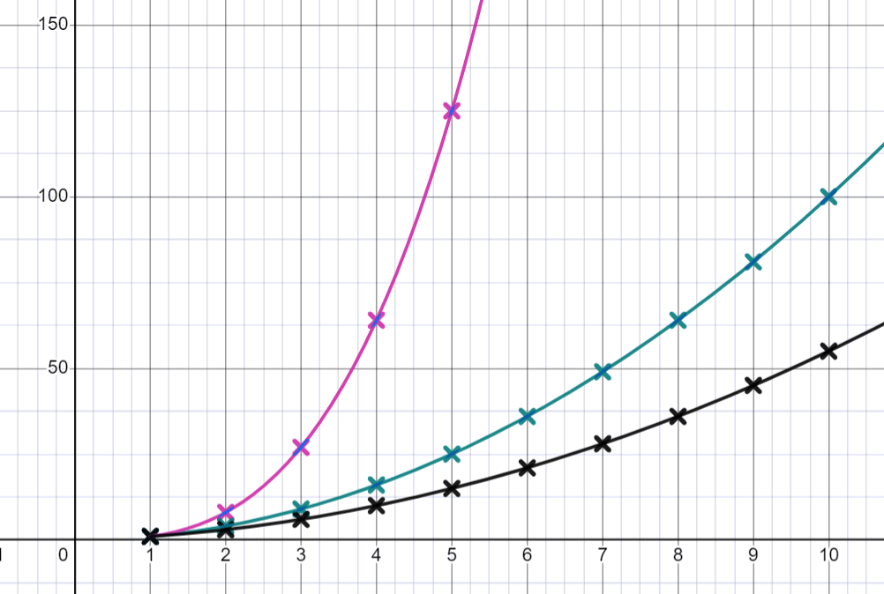
Sahaminta taxanayaasha (sequences) tiro ee gaarka ah
Haddii aadan weli samayn, geli isla'egyada (equations) tirooyinka laba jibaaran (square), saddex jibaaran (cube) iyo saddex-xagalka (triangular) marka x uu ka weyn yahay ama la eg yahay 1 gudaha Desmos.
Garaafkaagu (graph) waa inuu u ekaadaa sidan:

Slide 30
Sahaminta taxanayaasha (sequences) tiro ee gaarka ah
Waxaan sahaminaynaa nooc kale oo taxane (sequence) ah.
Taxanahan (sequence) wuxuu leeyahay labada erey ee ugu horreeya 1, 1, …
Xiga waxaa lagu soo saaraa iyadoo lagu daro labada hore: 1, 1, 2, ..
Waa maxay saddexda xiga?
1, 1, 2, 3, 5, 8, …
Adigoo isticmaalaya shaqada jaantuska ee Desmos, sawir lixdan xubnood.

Slide 31
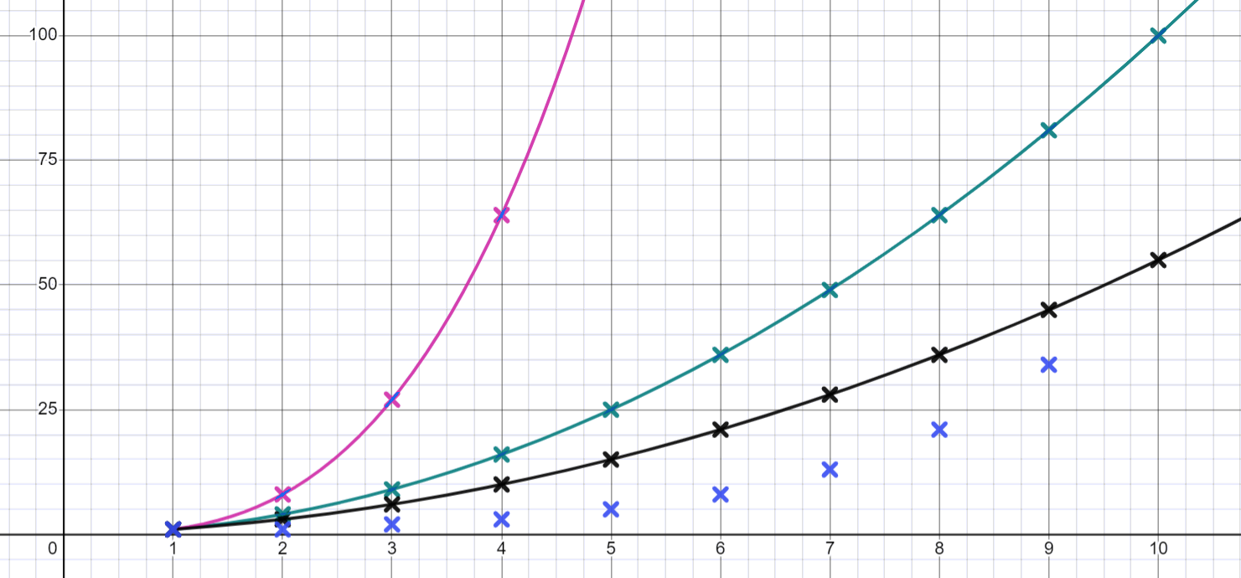
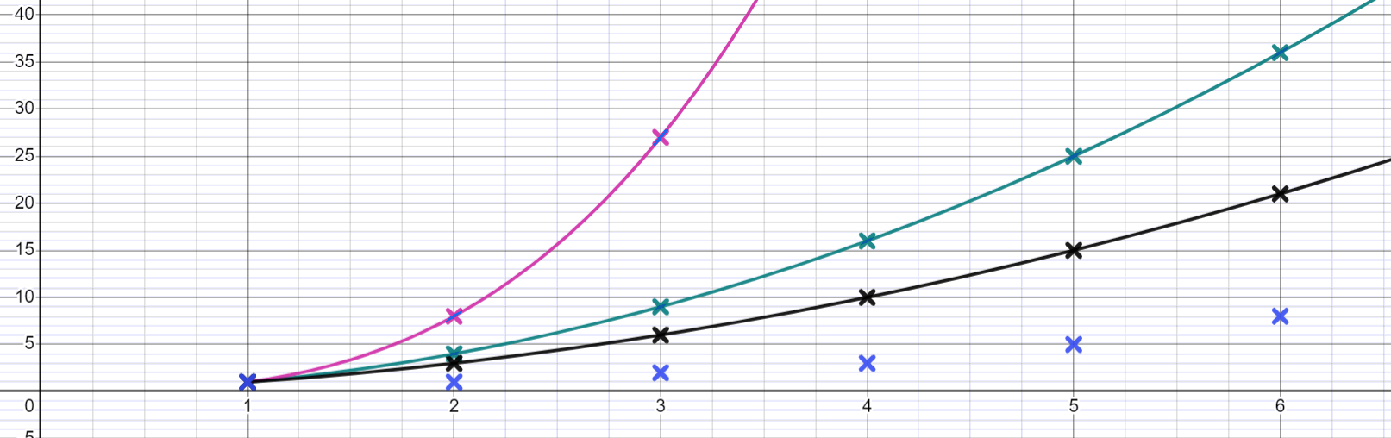
Sahaminta taxanaha tirooyinka gaarka ah
Taxanahan wuxuu u muuqdaa inuu u kacayo heerka ugu gaabiska ah.
Yacquub
Oh, hadda waxaan u malaynayaa inuu dhaafi karo tirooyinka saddexagalka (triangular numbers).
Sawir saddexda xiga si aad u aragto waxa dhacaya.
Sawir xubinta 10aad, maxaad dareensan?
Xubinta 10aad ee taxanahayaga (55) waxay la mid tahay tirsiga saddexagalka (triangular number) 10aad.
Goorma ayuu taxanahayagu dhaafaa tirooyinka labajibbaaran (square numbers)?
Xubinta 12aad ee taxanahayaga (144) waxay la mid tahay tirsiga labajibbaaran (square number) 12aad.

Slide 32
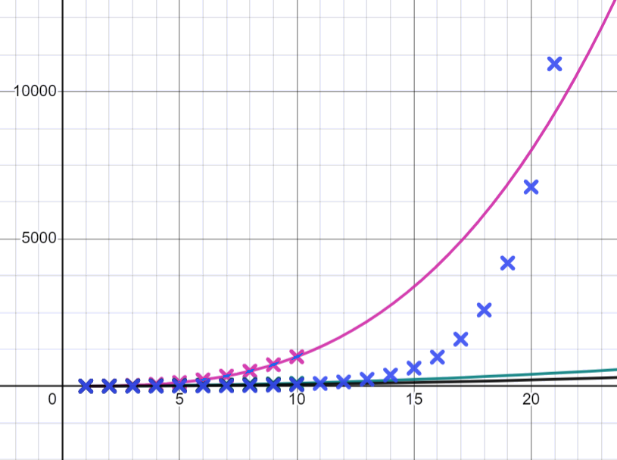
Sahaminta taxanaha tirooyinka gaarka ah
Hubaal taxanahan cusub waligiis ma dhaafi doono tirooyinka saddex jibaaran (cube numbers), waxay ku kordhaan heer aad u dheer.
Maxaad u malaynaysaa?
Buuxi jaantuska ilaa xubinta 20aad si aad u aragto waxa dhacaya.
Yacquub
Waxaa laga yaabaa inaad sii hagaajiso cabirkaaga si aad u aragto dhibcaha cusub.
(Isticmaal xisaabiyaha si aad u caawiso xisaabaha waaweyn marka loo baahdo.)
Taxanahayagu wuxuu dhaafaa tirooyinka saddex jibaaran (cube numbers) inta u dhaxaysa xubnaha 20 iyo 21.

Slide 33
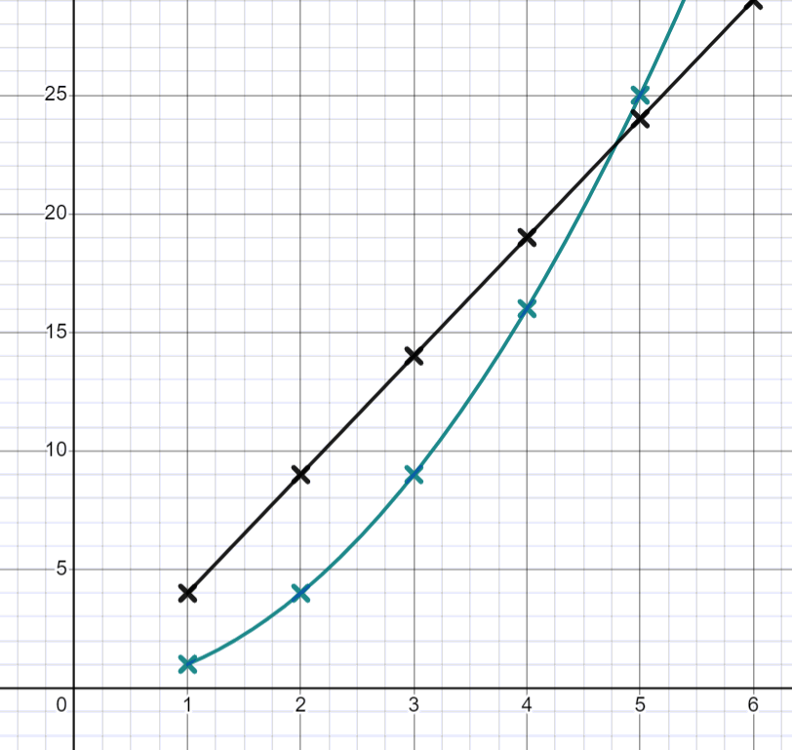

Sahaminta taxanaha tirooyinka gaarka ah
Jaantuskani wuxuu muujinayaa taxanaha tirooyinka labajibbaaran iyo taxanaha
5n − 1. Kee ka mid ah weedhahan waa run?
Labada taxane waxay ka kooban yihiin tiro 4
Both sequences contain the number 9
Both sequences contain the number 14
Labada taxane waxay leeyihiin isla 5-aad term

Slide 34
Exploring special number sequences
1a) Sawir 20-ka dhibcood ee ugu horreeya ee taxanayaasha 2n, n2 iyo 2n
b) Laba ka mid ah taxanayaasha waxay leeyihiin isla term-ka koowaad, kee labada?
c) Maxaa ka dhacaya isku-duwayaasha (2,4) maxay tani ula jeeddaa taxanayaasha?
d) Kee taxane ayaa si degdeg ah u kordhaya?
e) Find four numbers which are in the sequence 2n and 2^{n}
f) What is the 15th term in the sequence 2^{n}?

Slide 35
Exploring special number sequences
2a) Sawir 20-ka dhibcood ee ugu horreeya ee taxanayaasha 5 − n2, 5 + n2 iyo n3− 5
b) Kee taxane ayaa leh term-ka koowaad ee ugu yar?
c) Kee taxane ayaa leh term-ka labaad ee ugu yar?
d) Kee taxane ayaa leh term-ka saddexaad ee ugu weyn?
e) Maxaad ka ogaataa taxanayaasha 5 + n2 iyo 5 − n2?

Slide 36
Exploring special number sequences
3a) Taxanaha dhammaan tirooyinka saddexagalka ah wuxuu leeyahay qaanuunka nth term sawir 20 xubnood ee ugu horreeya.
b) Waa maxay tirsiga saddexagalka 19aad?
c) Taxanaha joomatari ee ka bilaabma 1, 2, 4, 8,... wuxuu leeyahay qaanuunka nth term 2n − 1, lambarka term ee taxanahan uu ku dhaafo tirooyinka saddexagalka waa imisa?
e) Kee baa ka weyn, 8-aad ee taxanaha 2n − 1 mise 16-aad ee tirada saddexagalka (triangular number)?

Slide 37
Sahaminta taxanayaasha gaarka ah (special number sequences)
4a) Taxane wuxuu ku bilaabmaa 1, 3, 4, … xiga waxaa laga helaa isku darka labada xilli ee hore. Sawir 10ka xilli ee ugu horreeya ee taxanahan.
b) Taxane kale wuxuu ku bilaabmaa 1, −3, … xiga waxaa laga helaa isku darka labada xilli ee hore. Sawir 10ka xilli ee ugu horreeya ee taxanahan.
c) Sidee bay qaabka garaafka (graph) taxanahan uga duwan yahay kii hore?

Slide 38
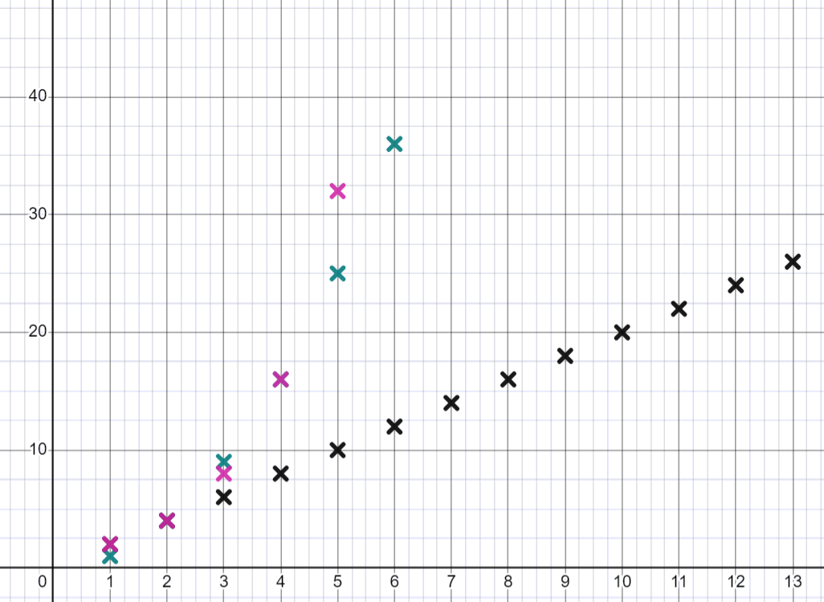
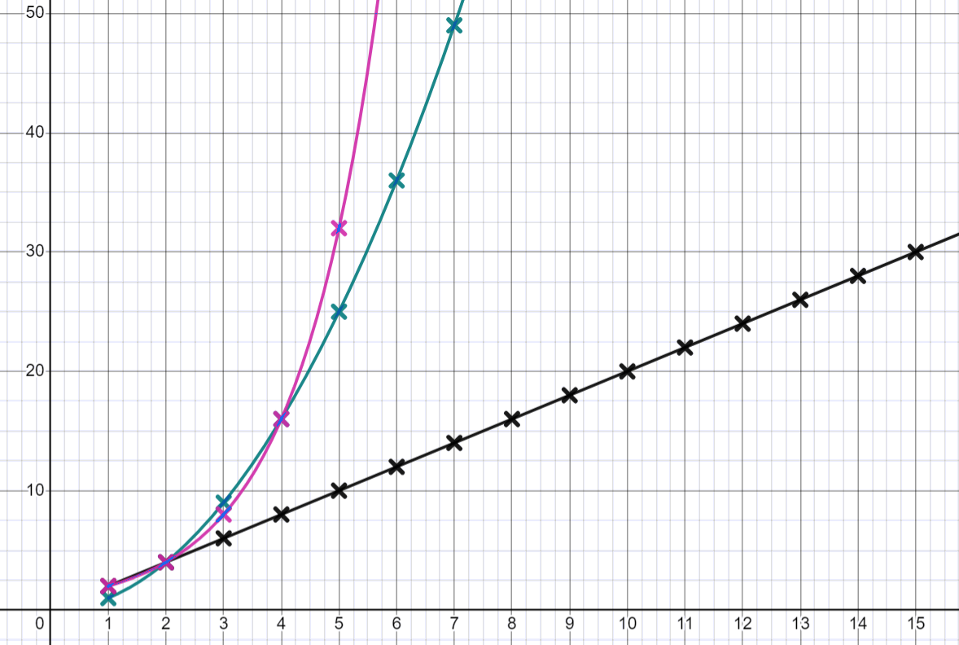
Sahaminta taxanayaasha gaarka ah (special number sequences)
1a) Sawir 20ka dhibcood ee ugu horreeya ee taxanayaasha 2n, n2 iyo 2n
Ku darista qaloocyada (curves) ayaa laga yaabaa inay ka caawiso aragtida sifooyinka muhiimka ah ee taxanayaashan

Slide 39
Sahaminta taxanayaasha gaarka ah (special number sequences)
1b) Laba ka mid ah taxanayaasha ayaa leh xilli koowaad oo isku mid ah, waa kuwee?
2n iyo 2n
c) Maxaa ka dhacaya isku-duwayaasha (coordinate) (2,4) maxay tani ula jeeddaa taxanayaasha? Dhammaan saddexda taxane waxay leeyihiin xilli labaad oo ah 4
d) Kee baa taxane ugu sii kordhaya xawaaraha ugu dheereeya?
2^{n}
e) Raadi afar tiro oo ku jira taxanaha 2n iyo 2n dhammaan tirooyinka 2n waxay sidoo kale ku jiraan 2n sidaas darteed 2, 4, 8, 16, 32, 64, 128,.....
f) Waa maxay xilliga 15-aad ee taxanaha 2n? 32 768

Slide 40
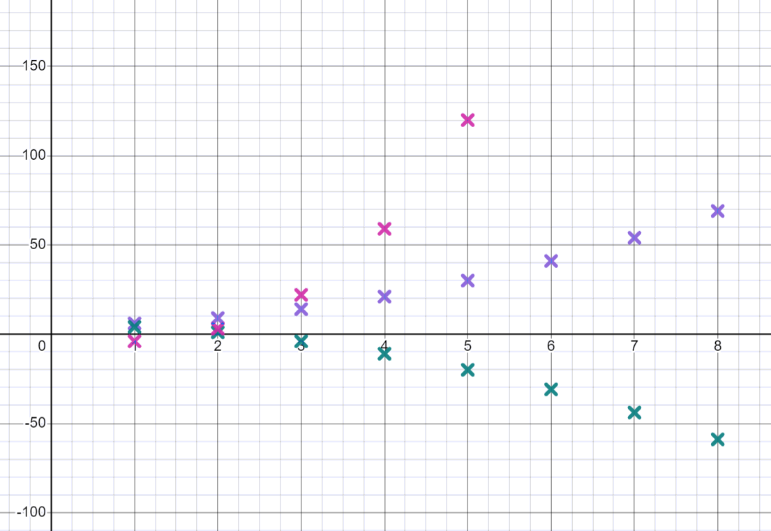
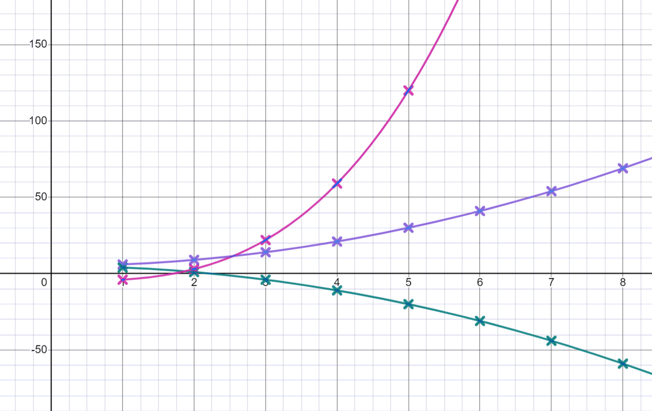
Sahaminta taxanayaasha gaarka ah (special number sequences)
2a) Sawir 20ka dhibcood ee ugu horreeya ee taxanayaasha 5 − n2, 5 + n2 iyo n3− 5
Ku darista qaloocyada (curves) ayaa laga yaabaa inay ka caawiso aragtida sifooyinka muhiimka ah ee taxanayaashan

Slide 41
Sahaminta taxanayaasha gaarka ah (special number sequences)
2b) Kee baa taxane leh xilli koowaad oo ugu yar?
n³− 5
c) Kee baa taxane leh xilli labaad oo ugu yar?
5 − n²
d) Kee baa taxane leh xilli saddexaad oo ugu weyn?
n³− 5
e) Maxaad ka ogaataa taxanaha (sequences) 5 + n2 iyo 5 − n2?
Waxaa laga yaabaa inaad tidhaahdo: waa is-muujin (reflections) midba midka kale, xubnaha (terms) 5 + n2 had iyo jeer way ka weyn yihiin xubnaha (terms) 5 − n2

Slide 42
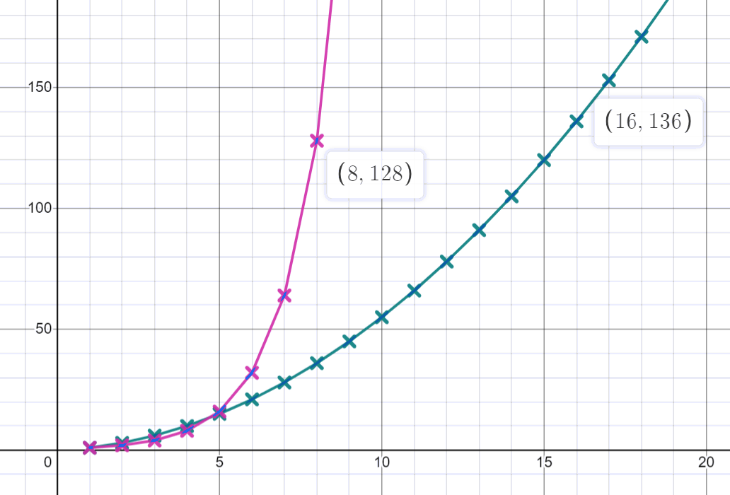
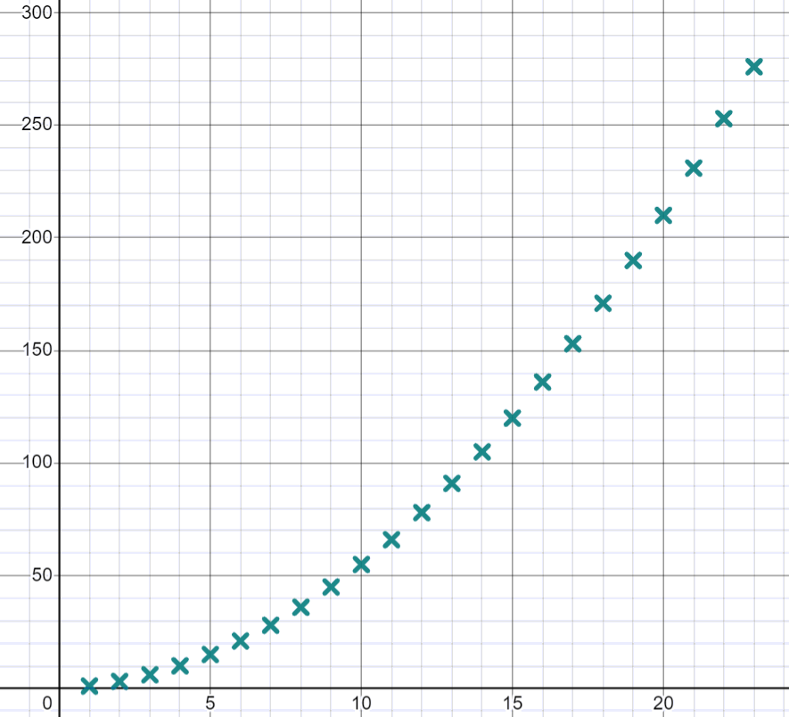
Sahaminta taxanaha (sequences) tirooyinka gaarka ah
3a) Taxanaha (sequence) dhammaan tirooyinka saddex-xagalka (triangular numbers) wuxuu leeyahay qaanuunka nth term (nth term rule) sawir 20 xubnood (terms) ee ugu horreeya.
b) Waa maxay tirada saddex-xagalka (triangular number) 19aad?
c) Taxanaha joomatari (geometric sequence) ee ka bilaabma
1, 2, 4, 8,... wuxuu leeyahay qaanuunka nth term (nth term rule) 2n − 1 lambarka term (term number) ee taxanahan (sequence) ku dhaafo tirooyinka saddex-xagalka (triangular numbers) waa imisa?
e) Kee ka weyn yahay, xubinta (term) 8aad ee taxanaha (sequence) 2n − 1 mise tirada saddex-xagalka (triangular number) 16aad?
190
Xubin (Term) 5
Tirada saddex-xagalka (triangular number) 16aad (136 > 128)

Slide 43
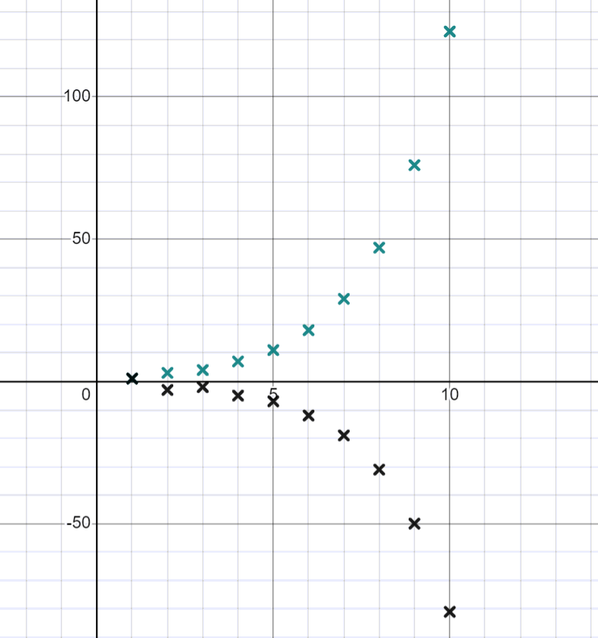
Sahaminta taxanaha (sequences) tirooyinka gaarka ah
4a) Taxane (sequence) ayaa ka bilaabma 1, 3, 4, … xubinta (term) xigta waxaa laga helaa isku darka labada xubnood (terms) ee hore. Sawir 10 xubnood (terms) ee ugu horreeya ee taxanahan (sequence).
b) Taxane (sequence) kala duwan ayaa ka bilaabma 1, −3, … xubinta (term) xigta waxaa laga helaa isku darka labada xubnood (terms) ee hore. Sawir 10 xubnood (terms) ee ugu horreeya ee taxanahan (sequence).
c) Qaabka garaafka (graph) taxanahan (sequence) kuma duwan yahay kii hore?
Tusaale: Ka dib xubinta (term) 3aad garaafka (graph) wuu yaraanayaa. Ka dib dhawr xubnood (terms) oo hore labada garaaf (graphs) waxay noqdaan qaloocyo (curves), garaafka (graph) labaad wuxuu leeyahay qaab qalooc (curve shape) guud oo la mid ah kii hore laakiin wuxuu leeyahay 'hoos u dhac' (dip) la dareemi karo xubinta (term) 2

Slide 44
Garaafyada (Graphing) taxanaha (sequences) tirooyinka gaarka ah iyadoo la isticmaalayo tignoolajiyada
Taxanaha (sequences) waxaa lagu sawiri karaa Desmos iyadoo la isticmaalayo shaqada shaxda (table function).
Haddii qaanuunka nth term (nth term rule) la yaqaan, dhibcaha (points) si fudud ayaa loo soo saari karaa.
Waxaan u isticmaali karnaa software-ka garaafka (graphing software) si aan u aragno haddii xubin (term) ku jirto taxane (sequence).
Taxanaha (sequences) tirooyinka gaarka ah waa la sawiri karaa haddii aan fahmi karno sida loo soo saaray. Kuwani waxay soo saari karaan garaafyo (graphs) xiiso leh.

