Slide 1
Kooxda 0 (Gaasaska Gobta) (Group 0 (Noble gases))
Qaababka shaxda xilliyeedka (periodic table)

Slide 2
Sida ilaha darsiga loogu talagalay fasalka

Slide 3
Waxaan qeexi karaa sifooyinka gaasaska gobta, isticmaalkooda, iyo sharaxaadda sababta ay u yihiin kuwa aan fal-celin (unreactive).

Slide 4
aan fal-celin (inert)
gaas gob (noble gas)

Slide 5
Walax aan fal-celin (inert) waa mid aan kiimiko ahaan fal-celin (reactive) ahayn.
Gaas gob (noble gas) waa curiye (element) ku jira Kooxda 0 ee shaxda xilliyeedka (periodic table).

Slide 6

Kooxda 0 (Gaasaska Gobta) (Group 0 (Noble gases))
Kooxda 0: Gaasaska Gobta (Noble gases)
Sifooyinka iyo isticmaalka

Slide 7
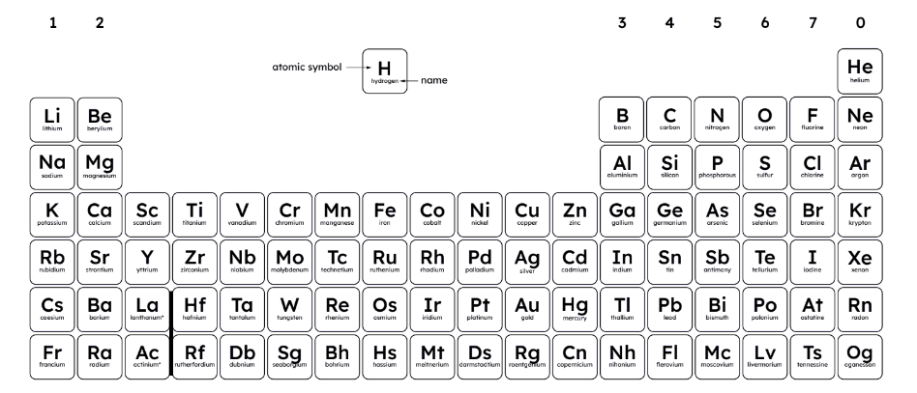
Kooxda 0: Gaasaska Gobta (Noble gases)
Kooxda 0 waxaa loola jeedaa curiyeyaasha (elements) ku yaal tiirka midig ee fog ee shaxda xilliyeedka (periodic table), oo loo yaqaan gaasaska gobta (noble gases).
Curiyeyaasha (elements) Kooxda 0 waa: helium, neon, argon, krypton, xenon, radon iyo oganesson.

Slide 8

Kooxda 0: Gaasaska Gobta (Noble gases)
Summadahee (symbols) ayaa ka dhigan curiyeyaasha (elements) Kooxda 0?
Ne
Rh
Xe

Slide 9
Kooxda 0: Neefsashada Gobta (Noble gases)
Curiyeyaasha (elements) Kooxda 0 waa: helium, nitrogen, argon, krypton, xenon, radium iyo oganesson.
Curiyeyaasha (elements) Kooxda 0 kuma jiraan neon iyo radon.
Curiyeyaasha (elements) Kooxda 0 kuma jiraan nitrogen iyo radium.

Slide 10

Kooxda 0: Neefsashada Gobta (Noble gases)
Curiyeyaasha (elements) Kooxda 0 waa neefsasho (gases) heerkulka qolka iyadoo oganesson yahay ka reeban.
Xaqiiqooyinka ku saabsan oganesson waxaa ka mid ah:
curiye (element) shucaac sare leh (highly radioactive)
la filayo inuu yahay adke (solid) heerkulka qolka
waxaa la isku daray (synthesised) atamyo (atoms) aad u yar
sifooyinkeeda jireed (physical properties) tusaale: barta karkarinta (boiling point) iyo cufnaanta (density) waa la saadaaliyay
sifooyinka kiimikada (chemical properties) waa kuwa aan la garanayn

Slide 11
Kooxda 0: Neefsashada Gobta (Noble gases)
Dhammaan curiyeyaasha (elements) Kooxda 0 waxay leeyihiin qolof sare (outer shell) oo buuxda oo elektaroonno (electrons) ah, taasina waxay ka dhigaysaa kuwo aad u deggan (stable).
He
Ne
Helium (He) wuxuu leeyahay 2 elektaroon (electrons) oo buuxiya qolofta elektaroonka (electron shell) koowaad.
Neon (Ne) wuxuu leeyahay 2 qolof elektaroon (electron shells), qolofta sare (outer shell) waa buuxdaa (8).
Helium (He) wuxuu leeyahay qolof buuxda oo ah 2 elektaroon (electrons), laakiin neon (Ne) iyo argon (Ar) labaduba waxay leeyihiin qolofta sare (outer shells) oo buuxda oo ah 8 elektaroon (electrons).

Slide 12
Kooxda 0: Neefsashada Gobta (Noble gases)
Dhammaan atamka (atoms) curiye kasta (element) ee Kooxda 0 waxay leeyihiin qolof sare (outer shell) oo buuxda oo ah 8 elektaroon (electrons).
Helium (He) wuxuu leeyahay kaliya 2 elektaroon (electrons) qoloftiisa sare (outer shell) (tan waxaa loo tixgaliyaa qolof buuxda (full shell)).
Dhammaan curiyeyaasha (elements) Kooxda 0 ma laha qolofta sare (outer shells) oo buuxda oo elektaroonno (electrons) ah.

Slide 13




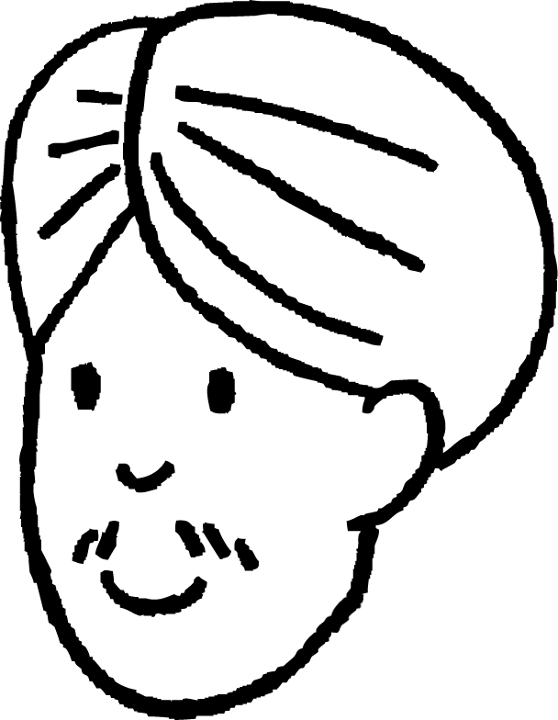







Kooxda 0: Neefsashada Gobta (Noble gases)
Ardayda qaar ayaa ka wada hadlaya neefsashada gobta (noble gases). Gee meesha qofka saxda ah oo cusbooneysii hadal kasta oo qalad ah.
Cali: Kooxda 0 waa tiirka midig ee ugu dambeeya ee shaxda (periodic table). Dhammaantood waxay leeyihiin qolof sare oo buuxda, taasoo ka dhigaysa kuwo deggan (stable).
Cabdi: Helium wuxuu leeyahay 2 electrons qolofkiisa koowaad. Neon wuxuu leeyahay 8 electrons qolofkiisa labaad.
Suad: Curiyeyaasha (elements) kooxda 0 waxay ku yaalliin tiirka koowaad waxayna yihiin kuwo aan degganayn (unstable) sababtoo ah qolof sare oo aan buuxin.
Layla: Helium wuxuu leeyahay 2 electrons taasoo ka dhigaysa mid deggan (stable), sida argon oo kale.
Cali
Cabdi
Suad
Layla

Slide 14
Kooxda 0: Gaasaska goobta (Noble gases)
Qaar ka mid ah ardayda ayaa ka wada hadlaya gaasaska goobta (noble gases). Gee qofka saxda ah oo cusbooneysii hadal kasta oo qalad ah.
Cali: Kooxda 0 waa tiirka midig ee ugu dambeeya ee shaxda (periodic table). Dhammaantood waxay leeyihiin qolof sare oo buuxda, taasoo ka dhigaysa kuwo deggan (stable).
Cabdi: Helium wuxuu leeyahay 2 electrons qolofkiisa koowaad. Neon wuxuu leeyahay 8 electrons qolofkiisa labaad.
Suad: Curiyeyaasha (elements) kooxda 0 waxay ku yaalliin tiirka koowaad waxayna yihiin kuwo aan degganayn (unstable) sababtoo ah qolof sare oo aan buuxin.
Layla: Helium wuxuu leeyahay 2 electrons taasoo ka dhigaysa mid deggan (stable), sida argon oo kale.
Cali
Cabdi
Curiyeyaasha (elements) kooxda 0 waxay ku yaalliin tiirka midig ee ugu dambeeya, ma aha kan koowaad. Waxay aad u deggan yihiin (stable) sababtoo ah qolof sare oo buuxda.
Helium wuxuu leeyahay 2 electrons qolofkiisa sare, laakiin argon wuxuu leeyahay 8 electrons qolofkiisa sare. Labaduba waa kuwo deggan (stable).
Suad
Layla

Slide 15
Kooxda 0 (Neefsasha Gobanimada) (Group 0 (Noble gases))
Kooxda 0: Gaasaska goobta (Noble gases)
Sifooyinka iyo isticmaalka

Slide 16
Guryaha iyo isticmaalka (Properties and uses)
Curiyeyaasha (elements) Kooxda 0 waxay u jiraan sida neefo aan midab lahayn, monatomic (monatomic) ah heerkulka qolka iyo cadaadiska.
monatomic (atam keli ah) (monatomic (single atoms))
Atamka (atoms) uma baahna inay ku xirmaan atamyo kale si ay u sameeyaan molecules (molecules), sababtoo ah waxay leeyihiin qolof sare oo buuxda oo elektaroon ah (electrons) waxayna aad u deggan yihiin.
Tani waxay sidoo kale ka dhigaysaa iyaga kuwo kiimiko ahaan aan falcelin (chemically inert (unreactive)).

Slide 17
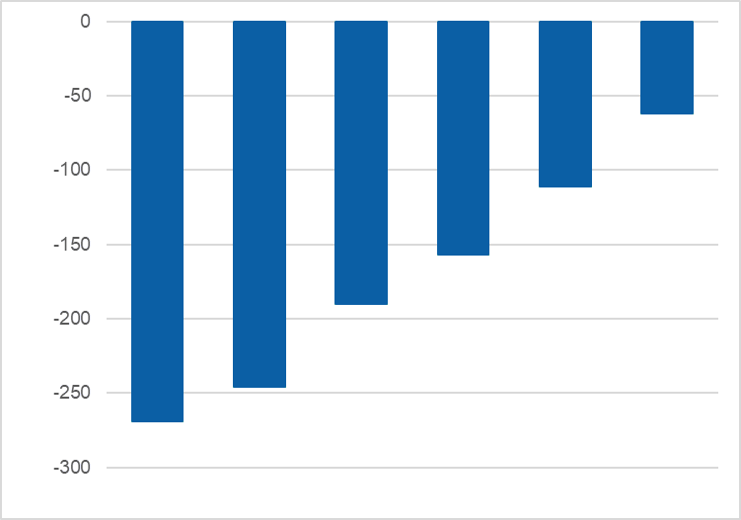
Guryaha iyo isticmaalka (Properties and uses)
Curiyeyaasha (elements) Kooxda 0 waxay muujiyaan isbeddellada (trends) guryaha qaarkood.
He Ne Ar Kr Xe Rn
0
Heerarka karkarinta (Boiling points) waxay kordhaan hoos u dhaca kooxda, tusaale ahaan waxay u dhowaadaan 0oC.
-50
-100
-150
Heerarka karkarinta oC (Boiling points oC)
-200
-250
-300
Curiyeyaasha (elements) Kooxda 0

Slide 18
Guryaha iyo isticmaalka (Properties and uses)
Curiyeyaasha (elements) Kooxda 0 ee heerarka karkarintoodu ka hooseeyaan krypton (krypton) waa kuwee?
helium (helium)
radon (radon)
argon (argon)
neon (neon)

Slide 19
Guryaha iyo isticmaalka (Properties and uses)
Kordhinta heerka karkarinta waxaa u sabab ah:
atamka (atoms) oo ku kordhaya cabbirka hoos u dhaca kooxda
xoogagga soo jiidashada ee u dhexeeya atamka waaweyn ayaa ka xoog badan (forces of attraction)
tamar badan ayaa loo baahan yahay si looga gudbo xoogagga ka xooggan (forces)
xoogagga daciifka ah ee soo jiidashada (weak forces of attraction) ee u dhexeeya atamka (atoms)

Slide 20
Sifooyinka iyo isticmaalka (Properties and uses)
Molekyuulada curiyeyaasha Group 0 waxay leeyihiin xoogag tabar yar oo u dhexeeya atamka (elements)
Curiyeyaasha Group 0 waa monatomic waxayna leeyihiin xoogag tabar yar oo u dhexeeya atamkooda (elements)
Curiyeyaasha Group 0 waa diatomic waxayna leeyihiin xirmo xooggan oo u dhexeeya atamka (elements)

Slide 21
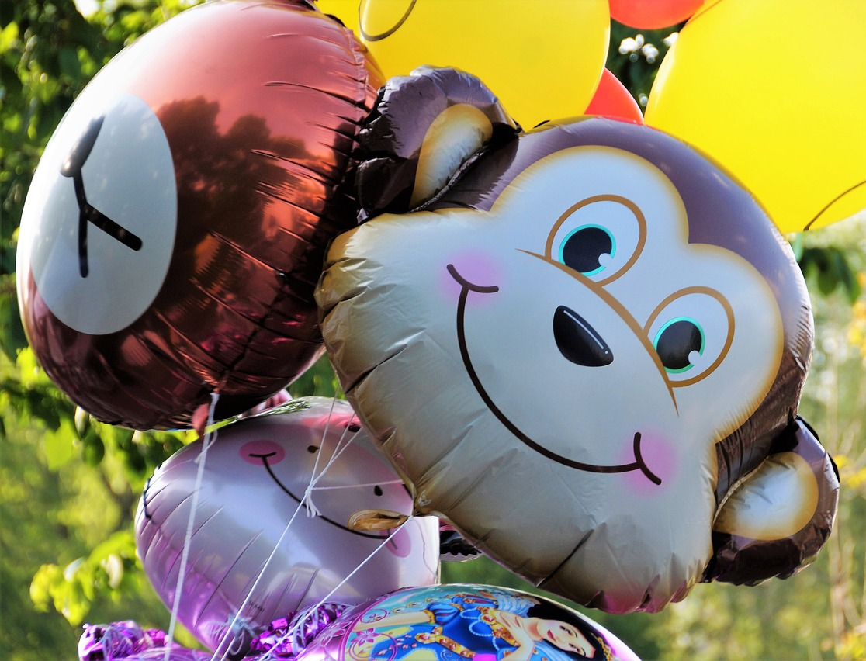
Sifooyinka iyo isticmaalka (Properties and uses)
Curiyeyaasha Group 0 sidoo kale waxay muujiyaan isbeddelka cufnaanta (density)
Maadaama Group 0 ay yihiin gaasas, qaybahoodu waa kala fogaansho, sidaas darteed dhammaantood waxay leeyihiin cufnaan hoose (density)
Cufnaantu waa cufka walaxda qaybkiiba halbeeg (density)
Helium waxaa loo isticmaalaa buufinnada sababtoo ah waa ka cufnaan yar hawada sidaas darteed wuu dhabbi doonaa (density)

Slide 22
Sifooyinka iyo isticmaalka (Properties and uses)
Hoos u dhaca kooxda, cufka atamka curiyeyaasha Group 0 waa ... (mass)
hoos u dhacaa (decreases)
ma muujinayo qaab (shows no pattern)
kor u kacaa (increases)

Slide 23
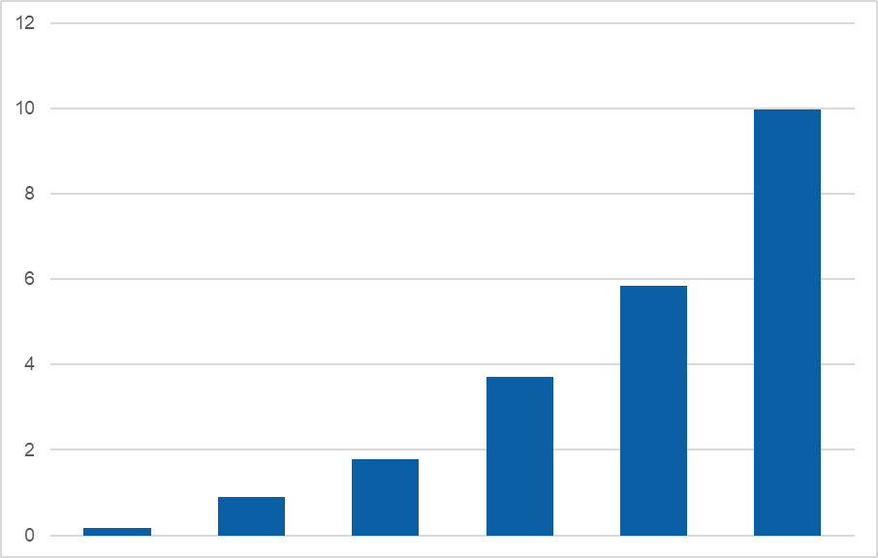
Sifooyinka iyo isticmaalka (Properties and uses)
Cufnaanta curiyeyaasha Group 0 waxay kor u kacdaa hoos u dhaca kooxda (density)
12
10
Cufnaantu waxay kor u kacdaa marka cufka atamkani uu kordho (density)
8
6
Cufnaanta g/dm3 (Density)
4
2
0
He Ne Ar Kr Xe Rn Curiyeyaasha Group 0 (elements)

Slide 24

Sifooyin iyo isticmaalka (Properties and uses)
Buufin ayaa lagu buuxiyay neon. Neon wuxuu leeyahay cufnaan 0.9 g/dm3. Haddii hawadu leedahay cufnaan 1.2 g/dm3 maxaa ku dhacaya buufinka? (density)
Meeshii ku sii nagaada (Remain in one place)
Hoos u dhaca (Sink downwards)
Dhex kora (Float upwards)

Slide 25
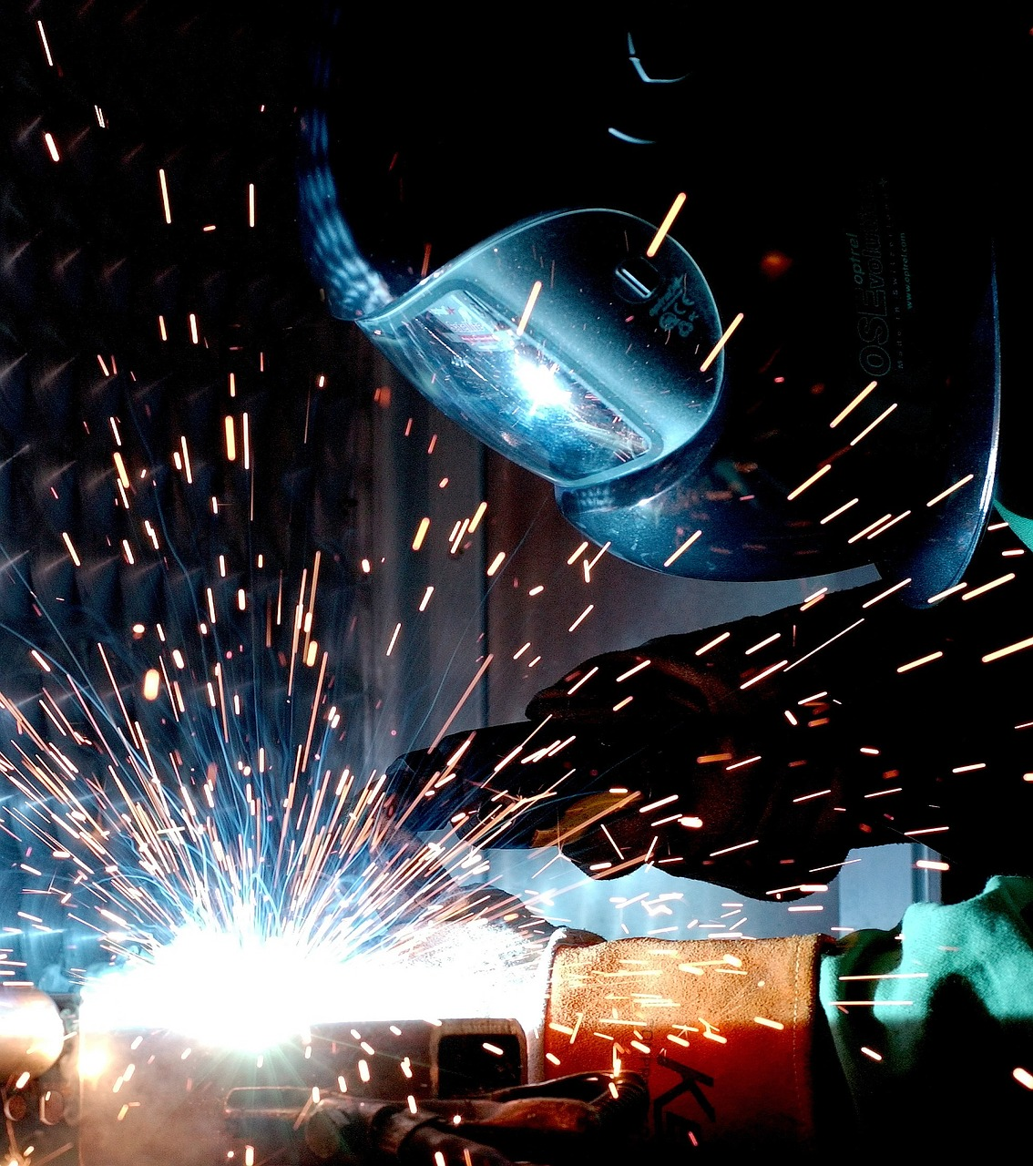
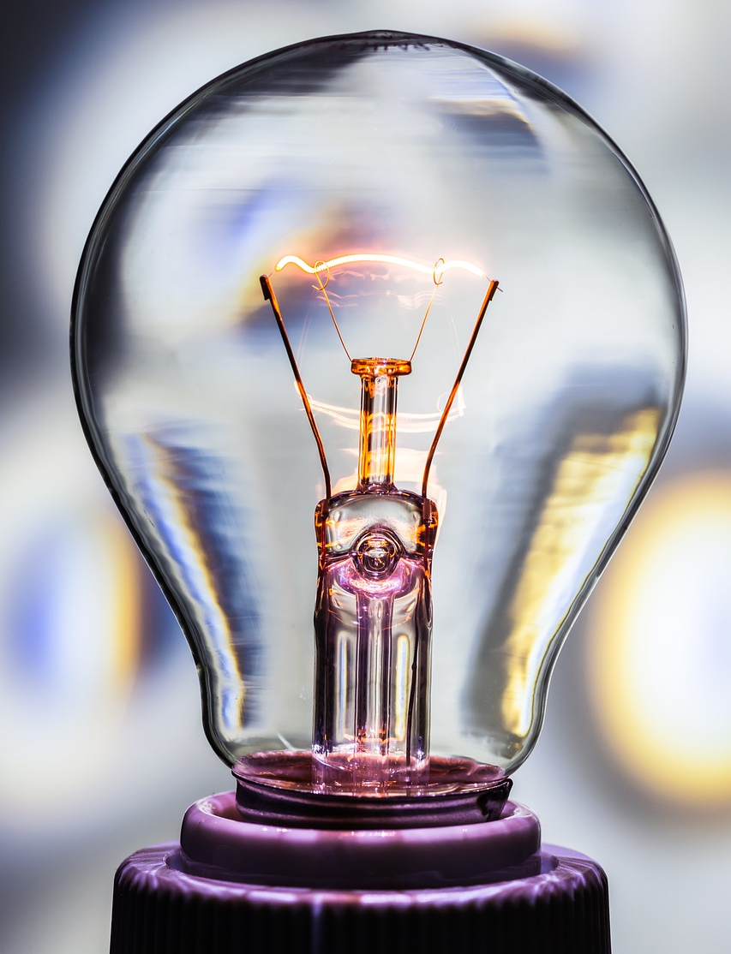
Sifooyin iyo isticmaalka (Properties and uses)
Curiyayaasha (elements) Group 0 waxay leeyihiin sifooyin kiimiko oo isku mid ah.
Dhammaantood waa kuwa aan shidmi karin (non-flammable).
Argon waxaa loo isticmaalaa inuu bixiyo jawi aan falcelin (inert atmosphere) marka la alxanayo (welding).
Argon iyo xenon waxaa loo isticmaalaa nalka (light bulbs) ee aad u kululaada.

Slide 26
Sifooyin iyo isticmaalka (Properties and uses)
Marka shidaal (match) la shiday la geliyo weel helium ah, waxay sababi doontaa qarax (explosion).
Helium wuu shidi doonaa (ignite) wuxuuna siin doonaa iftiin dhalaalaya, laakiin qarax (explosion) ma jiri doono.
Shidaalka (match) wuu dami doonaa, sababtoo ah helium waa aan shidmi karin (non-flammable).

Slide 27
Sifooyin iyo isticmaalka (Properties and uses)
Baadh curiyayaasha (elements) Group 0 ee soo socda oo buuxi shaxda hoose.
 | calaamad (symbol) iyo lambarka atomiga (atomic number) | sifooyinka muhiimka ah (key properties) | isticmaalka caadiga ah (common uses)
helium
neon
argon
krypton
xenon

Slide 28
Astaamaha iyo isticmaalka
Baadh curiyeyaasha (elements) soo socda ee Kooxda 0 oo buuxi shaxda hoose.
 | calaamadda iyo AN | astaamaha muhiimka ah | isticmaalka caadiga ah
helium | He, 2 | gaas fudud, inert, wuxuu iftiimiyaa huruud-cad marka la koronto dhaliyo | buufinnada, isku dhafka neefsashada, qaboojinta
neon | Ne, 10 | gaas fudud, inert, wuxuu iftiimiyaa casaan-cad marka la koronto dhaliyo | calaamadaha neon, tilmaamayaasha danab sare
argon | Ar, 18 | inert, cufnaan la mid ah hawada, wuxuu iftiimiyaa violet marka la koronto dhaliyo | laambadaha, alxanka, gaashaan gaas inert
krypton | Kr, 36 | gaas culus, loo isticmaalo iftiinka, wuxuu iftiimiyaa buluug-cad marka la koronto dhaliyo | iftiinka, sawir qaadista
xenon | Xe, 54 | gaas culus (heavy gas), aan falcelin (inert), wuxuu iftiimiyaa buluug marka la koronto mariyo (glows blue when electrified) | nalalka iftiinka (flash lamps), nidaamyada riixidda ion (ion propulsion systems)

Slide 29
Kooxda 0 (Gaasaska Gobta - Noble gases)
Gaasaska Gobta (Noble gases) waxay ku jiraan Kooxda 0 ee diiwaanka xilliyeedka (periodic table) waana kuwa aan falcelin (unreactive).
Gaasaska Gobta (Noble gases) dhamaantood waa gaas (gases) heerkulka qolka (room temperature).
Waxay leeyihiin qolof (shells) elektaroon oo dhammaystiran (complete), taasoo ka dhigaysa kuwa deggan (stable).
Markaad hoos u dhaqaaqdo Kooxda 0 curiyeyaasha (elements), cufnaanta (density) iyo barta karkarinta (boiling points) way kordhaan.

