Slide 1
Biraha Kooxda 1 iyo 2
Qaababka shaxda xilliyeedka (periodic table)

Slide 2
Sida agabkeena waxbarista loogu talagalay fasalka

Slide 3
Waxaan qeexi karaa qaabka falcelinta (reaction) ee biraha Kooxda 1 ee biyo (water) iyo Kooxda 2 ee asiidhka (acid) khafiifka ah, oo aan isbarbardhigi karaa falcelinta labada kooxood.

Slide 4
alkali (alkali)
alkaline (alkaline)
koox (group)
xilli (period)

Slide 5
Alkali waa sal (base) milma oo pH ka weyn 7.
Alkaline waxaa loola jeedaa walax leh sifooyin alkali ah ama ka kooban alkali. Inta badan waxaa loo adeegsadaa in lagu qeexo milan (solution) salalka (bases) milma oo pH ka weyn 7.
Koox (group) waa tiir ku yaal shaxda xilliyeedka (periodic table) oo u dhigma tirada elektarooniga ee golka kore ee atamka.
Xilli (period) waa saf ku yaal shaxda xilliyeedka (periodic table) oo u dhigma tirada golalka elektarooniga (electron shells) ee atamka.

Slide 6

Biraha Kooxda 1 iyo 2
Kooxda 1: Biraha alkali (alkali metals)
Kooxda 2: Biraha alkaline earth (alkaline earth metals)

Slide 7
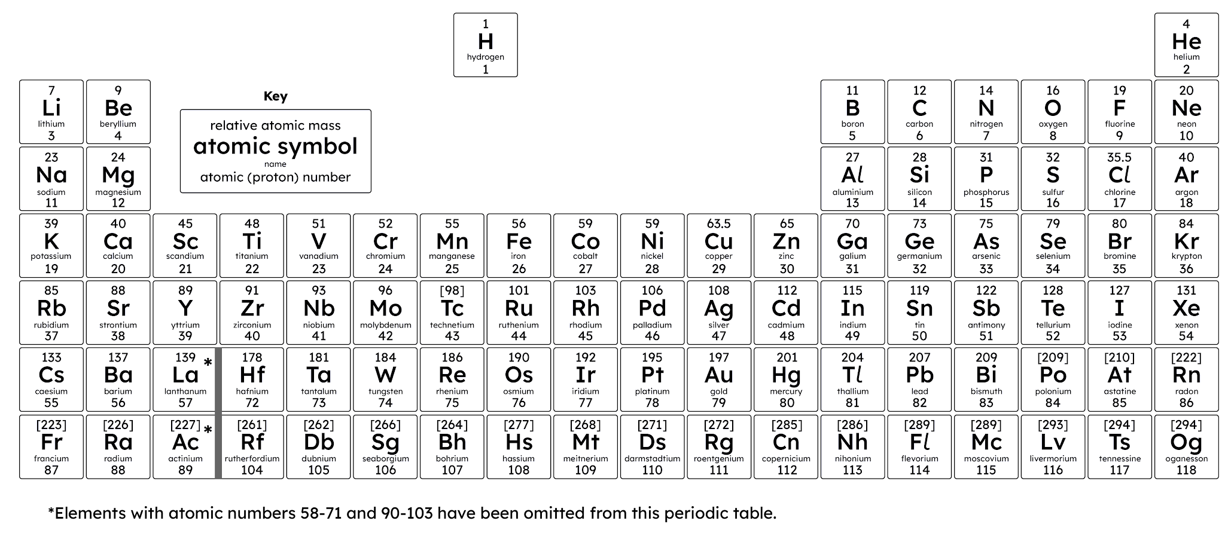
Kooxda 1: Biraha alkali (alkali metals)
Curiyeyaasha (elements) isku kooxda ah waxay leeyihiin sifooyin isku mid ah, oo inta badan waxay muujiyaan isbeddel ku yimaada sifooyinkan inta kooxda oo dhan.

Slide 8
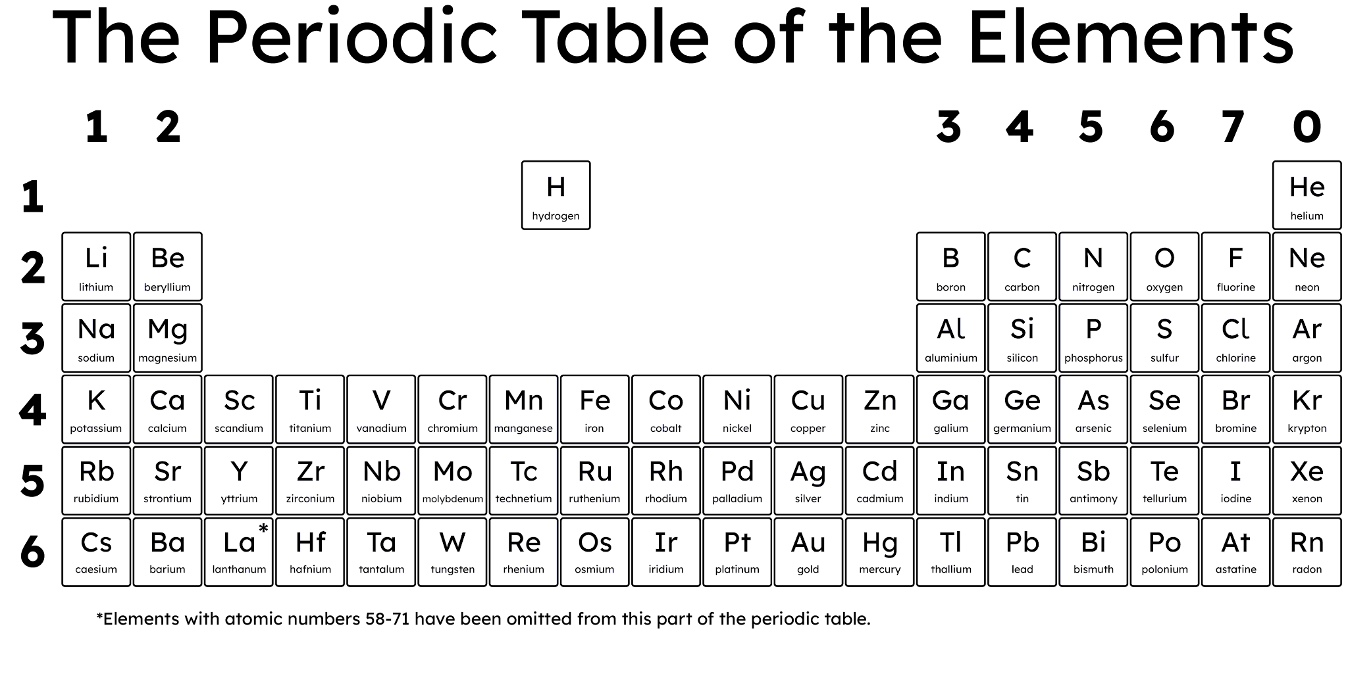
Kooxda 1: Biraha alkali (alkali metals)
Kooxda 1 waxaa loola jeedaa curiyeyaasha (elements) ku yaal tiirka bidixda ugu dambeeya ee shaxda xilliyeedka (periodic table).
Curiyeyaasha (elements) Kooxda 1 waa biro: lithium, sodium, potassium, rubidium, caesium, iyo francium.
Waxaa loo yaqaannaa biraha alkali (alkali metals) sababtoo ah waxay sameeyaan hydroxide-ka birta (alkalis) markay la falgalaan biyo (water), iyagoo abuuraya milan alkaline (alkaline solution).

Slide 9

Kooxda 1: Biraha Alkali
Biyaha (water) ayaa ku milmi doona birta Kooxda 1 si ay u sameeyaan milano (solutions) alkaline ah.
Markay biraha la falgalaan biyo (water) way miraxaan.
Waxay soo saaraan hydroxide-yada birta (alkalis) markay la falgalaan (react) biyaha (water), iyagoo samaynaya milan (solution) alkaline ah.

Slide 10
Kooxda 1: Biraha Alkali
Kooxda 1 waxay ka kooban tahay curiyeyaal (elements) bir ah oo leh sifooyin kiimiko iyo jireed oo aad isugu dhow.
Marka loo barbardhigo inta badan biraha, waxay:
yihiin kuwo jilicsan
leeyihiin dhibco dhalaal hoose
yihiin kuwo falgal (reactive) badan
leeyihiin cufnaan (density) hoose
Biraha Kooxda 1 waxay la falgalaan (react) biyaha (water) si ay u sameeyaan hydroxide-yada birta iyo gaasta hydrogen.
Birta Kooxda 1 + biyo (water) → hydroxide birta + hydrogen

Slide 11
Kooxda 1: Biraha Alkali
Waxaa jira isbeddello dhowr ah oo ku saabsan sifooyinka jireed marka hoos loo dhaco kooxda. Kuwaas waxaa ka mid ah:
kordhinta cufnaanta (density)
hoos u dhaca dhibcaha dhalaalka iyo karkarinta
Li
Na
K
Rb
Cs
Xusuusnow: cufnaantu (density) waa cabbirka cufka (mass) halkii cutub mug (volume) ah; waxay muujinaysaa sida walxaha (particles) walaxda ugu urursan yihiin meel la siiyay.

Slide 12

Kooxda 1: Biro alkali (Alkali metals)
Curiyeyaasha (elements) kooxda 1 dhamaantood waa adag (solids) heerkulka qolka.
Francium waa mid ka mid ah curiyeyaasha (elements) ugu degganaanshaha yar (least stable) uguna falgalka badan (most reactive) ee shaxda xilliyeedka (periodic table).
Xaqiiqooyinka ku saabsan francium waxaa ka mid ah:
Waa curiye (element) aad u shucaac badan (radioactive).
Sifooyinkiisa jireed (physical properties), sida barta dhalaalka (melting point) iyo cufnaanta (density), waa la saadaaliyay waxaana loo malaynayaa inay la mid yihiin kuwa caesium.
Wuxuu ku dhacaa si dabiici ah, sidoo kale waa la sameyn karaa (synthesised).

Slide 13
Kooxda 1: Biro alkali (Alkali metals)
Marka la barbardhigo biraha badankood, yaa run ah oo ku saabsan biraha kooxda 1?
waxay leeyihiin barta dhalaalka (melting point) sare
way ka jilicsan yihiin (softer)
way ka falgal badan yihiin (more reactive)
way ka cufan yihiin (more dense)

Slide 14
Kooxda 1: Biro alkali (Alkali metals)
Biraha kooxda 1 waxay muujiyaan isbeddel (trend) sifooyinka iyada oo loo marayo kooxda.
Cufnaanta (density) biraha waxay kordhisaa kor u kaca kooxda.
Barta dhalaalka (melting point) biraha waxay hoos u dhacdaa hoos u dhaca kooxda.

Slide 15

Kooxda 1: Biro alkali (Alkali metals)
Ama daawo macallinkaaga oo dhamaystiraya muujinta (demonstration) ama daawo fiidiyowga la bixiyay si aad u buuxiso jaantuska.
Curiye (Element) | Muujin (Appearance) | Sidee ayay u fududahay in lagu gooyo mindi? | Maxaa dhacaya marka lagu daro biyo (water)?
lithium (lithium)
sodium (sodium)
potassium (potassium)
Dhamaadka fiidiyowga, milan (solution) tilmaame guud (universal indicator solution) ayaa lagu daraa biyaha (water). Maxay tilmaantu (indicator) u beddeshaa midabkeeda?

Slide 16
Kooxda 1: Alkali metals
Sharax isbeddelka falcelinta (reactivity) curiyeyaasha (elements) hoos u dhaca Kooxda 1.
Soo jeedi sababta alkali metals loogu kaydiyo saliid (oil).
Sharax isbeddelka sifooyinka jireed (physical properties), sida heerarka dhalaalka (melting points) iyo cufnaanta (density), hoos u dhaca Kooxda 1.
Qor isla'egta ereyga (word equation) falcelinta (reaction) u dhaxaysa lithium (lithium) iyo biyaha (water).

Slide 17
Kooxda 1: Alkali metals
Buuxi shaxda hoose.
Curiye (Element) | Muqaal (Appearance) | Sidee u fudud yahay in lagu jaro mindi (knife)? | Maxaa dhacaya marka lagu daro biyaha (water)?
lithium (lithium) | dull bir ah oo dibadda ah, dhalaalaya gudaha | waxaa lagu jari karaa mindi (knife) | wuxuu sameeyaa goobo (sphere) oo dul sabbeeya (floats on surface), wuxuu xumbooyaa
sodium (sodium) | dull bir ah oo dibadda ah, dhalaalaya gudaha | ka fudud in lagu jaro mindi (knife) | isku mid sidii kor ku xusan, laakiin ka dhakhso badan oo laga yaabo inuu soo saaro olol jaalle ah
potassium | dibadda caajis ah, gudaha dhalaalaya | xitaa ka fudud in lagu gooyo mindi | isku mid sidii kor ku xusan, xitaa ka dhakhso badan, oo soo saara olol lilac ah (laga yaabo inuu qarxo)

Slide 18
Kooxda 1: Alkali metals
Dhamaadka fiidiyowga, universal indicator (UI) solution ayaa lagu daray biyaha. Maxay UI beddeshaa midabka?
Universal indicator waa cagaar marka solution-ku yahay neutral, laakiin wuxuu isu beddelaa buluug marka solution-ku yahay alkaline, sida solution-ka soo baxa marka Group 1 metals ay la falgalaan biyaha.
Sharax isbeddelka falgalnimada (reactivity) ee curiyeyaasha (elements) hoos u dhaca Kooxda 1.
Metals-ku waxay noqdaan kuwa ka falgala badan markaad hoos u dhaqaaqdo kooxda.
Soo jeedi sababta alkali metals loogu kaydiyo saliid.
Metals-ku waxay aad u falgala badan yihiin biyaha iyo oxygen-ka hawada, laakiin kuma falgalaan saliidda. Tani waxay ka ilaalisaa inay falgalaan si ay u sameeyaan compounds, taasoo u oggolaanaysa inay ahaadaan metals saafi ah.

Slide 19
Kooxda 1: Alkali metals
Sharax isbeddelka sifooyinka jireed (physical properties), sida heerkulka dhalaalida (melting points) iyo cufnaanta (density), hoos u dhaca Kooxda 1.
Hoos u dhaca kooxda, metals-ku waxay noqdaan kuwa cufan (denser), heerkulkooda dhalaalida iyo karkarinta (boiling points) way hoos u dhacaan.
Qor isla'egta erayada (word equation) ee falgalka (reaction) ee u dhexeeya lithium iyo biyaha.
lithium + biyo → lithium hydroxide + hydrogen

Slide 20
Kooxda 1 iyo 2 metals
Kooxda 1: Alkali metals
Kooxda 2: Alkaline earth metals

Slide 21
Kooxda 2: Alkaline earth metals
Kooxda 2 waxaa loola jeedaa curiyeyaasha (elements) ku jira tiirka labaad ee shaxda xilliyeedka (periodic table).
Curiyayaasha (elements) ku jira Group 2 waa biro (metals): beryllium, magnesium, calcium, strontium, iyo barium.
Waxaa loo yaqaan 'alkaline earth metals' sababtoo ah waxay soo saaraan 'metal hydroxides' (alkalis) markay la falgalaan biyo (water). Erayga "earth" waxaa isticmaali jiray farmashiyeyaashii hore si ay u qeexaan walxaha aan birta ahayn ee aan ku milmin biyaha (water).

Slide 22
Group 2: Alkaline earth metals
Group 2 wuxuu ka kooban yahay curiyayaal bir ah (metallic elements) oo leh sifooyin kiimiko (chemical) iyo jireed (physical) oo aad isugu dhow.
Marka la barbardhigo curiyayaasha (elements) Group 1, waxay:
ka adag yihiin
leeyihiin dhibco dhalaal (melting points) oo sareeya
ka falgal (reactive) yar yihiin
ka cufan (dense) yihiin
… marka loo eego curiyaha (element) Group 1 ee isla muddada (period) ah.
Biyaha (metals) Group 2 waxay la falgali doonaan aashito (acid) si ay u sameeyaan cusbo (salts) iyo gaas hydrogen.
Bir (metal) Group 2 + aashito (acid) → cusbo bir ah (metal salt) + hydrogen

Slide 23
Group 2: Alkaline earth metals
Marka la barbardhigo biraha (metals) Group 1, biraha (metals) Group 2:
ka jilicsan yihiin.
leeyihiin dhibco dhalaal (melting) iyo karkarin (boiling) oo hooseeya.
ka falgal (reactive) yar yihiin.
ka cufan (dense) yar yihiin.

Slide 24


Hanuuninta shaqada ficilka (practical work)
Saddex nooc oo tilmaamo ah oo ku saabsan shaqada wax ku oolka ah ee soo socda ayaa lagu daray slides-ka xiga.
Nooca 1 wuxuu bixiyaa tilmaamo tallaabo-tallaabo ah, iyadoo noocyada 2 iyo 3 ay taageerayaan horumarka ardayda si ay u shaqeeyaan si madaxbannaan oo ay u go'aansadaan habraacyada.
Nooca 1: Tilmaamo tirooyin leh oo ku yaal hal slide
Nooca 2: Tilmaamo tallaabo kasta oo muhiim ah oo ku yaal slides gaar ah
Noqon 3: Tilmaan kooban oo tallaabo kasta oo muhiim ah oo slides gaar ah
Eeg Qalabka Dheeraadka ah (Additional Materials) si aad u hesho macluumaad dheeri ah.

Slide 25
Hanuuninta shaqada ficilka (practical work)
Kuwani waa su'aalo la soo jeediyay in ardayda lagu weydiiyo inta lagu jiro shaqada ficilka:
Su'aalaha waxaa loogu talagalay inay caawiyaan hagista fikirka ardayda iyo inay si firfircoon uga fikiraan sababaha waxay sameynayaan markay qabtaan shaqadooda ficilka, si ay u noqoto mid macno leh.
Su'aalo ku saabsan xirfadaha habka ('samaynta'):
S. Indhahaagu meeday u baahan yihiin inay ahaadaan markaad si sax ah u qiyaasayso 50 cm3 ee dhululubo qiyaas (measuring cylinder)?
S. Maxaad ugu haysaa tuubada tijaabada (test tube) xagal markaad ku shubayso aashito (acid)?
S. Maxaad u istaagtaa, iyadoo kursigaaga hoos yahay, markaad aashito ku shubayso tuubada tijaabada?
Su'aalo ku saabsan fahamka habraaca ('fikirka ka dambeeya samaynta'):
S. Maxay muhiim u tahay inaad isticmaasho qayb bir ah oo isku cabbir ah mar kasta?
S. Maxay muhiim u tahay inaad qorto indha-indheyntaada (observations) isla markiiba?
S. Ma khusaysaa inta aad sugto ka dib markaad ku dartay bir kasta ka hor intaadan samayn indha-indheyntaada?
Eeg Qalabka Dheeraadka ah (Additional Materials) si aad u hesho macluumaad dheeri ah.

Slide 26
Kooxda 2: Biraha dhulka alkaline (Alkaline earth metals)
Baar sida falcelinta (reactivity) ee biraha Kooxda 2 ugu beddelanto hoos u dhaca kooxda adoo isbarbardhigaya laba bir oo Kooxda 2 ah.
Isticmaal dhululubo qiyaas (measuring cylinder) si aad ugu shubto si sax ah 50 cm³ oo aashito hydrochloric ah oo khafiif ah (dilute hydrochloric acid) galaas (beaker).
Isla daqiiqaddaas, bilow timer-ka oo ku dar qayb 4 mm ah oo ribbon magnesium ah.
Sharax sida xawaaraha xumbooyinka loo soo saaro. Qor inta ay socoto falgal (reaction) xooggan ama tiri tirada xumbooyinka la soo saaro hal daqiiqo.
Taabo bannaanka tuubada tijaabada (test tube) si aad u hubiso isbeddel kasta oo heerkulka ah.
Record your observations.
Ku celi tillaabooyinka a)–e) oo leh xabbad 4 mm ah oo birta kalsiyum ah.
Repeat steps a)–f) using water instead of acid.
Noqon 1

Slide 27
Practical work guidance
Nooca 2aad ee tilmaamaha wax-ku-oolka ah wuxuu ku xiga slide-kan (afarta slide):
Nooca 1aad wuxuu bixiyaa tilmaamo tallaabo-tallaabo ah, iyadoo noocyada 2aad iyo 3aad ay taageerayaan horumarka ardayda si ay u shaqeeyaan si madax-bannaan oo ay go'aamo nidaamyeed u gaadhaan.
Nooca 1aad: Qayb tilmaamo tiro ah oo ku yaal hal slide
Nooca 2aad: Tilmaamo tallaabo kasta oo muhiim ah oo ku yaal slides gaar ah
Nooca 3aad: Tilmaamo yar oo tallaabo kasta oo muhiim ah oo ku yaal slides gaar ah
Eeg Qalabka Dheeraadka ah si aad u hesho macluumaad dheeri ah.

Slide 28
Group 2: Alkaline earth metals
Baar sida fal-celinta biraha Group 2 ay u isbeddesho marka hoos loo dhaco, adoo isbarbardhigaya laba bir oo Group 2 ah.
Step 1 – Preparing
Measure out 50 cm³ of dilute hydrochloric acid using a measuring cylinder.
Ku dar aashitada hydrochloric-ka ee jilicsan weel nadiif ah.
Qaad xabbad 4 mm ah oo ribbon magnesium ah iyo timer.
Version 2

Slide 29
Group 2: Alkaline earth metals
Step 2 – first observations
Isla markiiba, bilow timer-ka oo ku dar xabbad 4 mm ah oo ribbon magnesium ah tuubada tijaabada.
Sharax sida xawaaraha ah ee xumbooyinka loo soo saaro.
Record how long a vigorous reaction lasts or count the number of bubbles produced in one minute.
Taabo bannaanka tuubada tijaabada si aad u hubiso isbeddelka heerkulka.
Nooca 2

Slide 30
Kooxda 2: Birta dhulka alkaline
Tallaabada 3 – indha-indheyn dheeri ah
Qor indha-indheyntaada miis.
Ku celi indha-indheynta adigoo isticmaalaya:
  xaddi 4 mm oo birta kalsiyum ah iyo aashito hydrochloric oo khafiif ah
  xaddi 4 mm oo magnesium ah iyo biyo (water)
  xaddi 4 mm oo birta kalsiyum ah iyo biyo (water)
Birta kooxda 2 | indha-indheyn ku saabsan aashitada khafiifka ah | indha-indheyn ku saabsan biyaha (water)
magnesium
kalsiyum
Nooca 2

Slide 31
Hagaha shaqada wax-ku-oolka ah
Nooca 3 ee tilmaamaha wax-ku-oolka ah ayaa ku xiga slide-gan (afarta slide):
Nooca 1 wuxuu bixiyaa tilmaamo tallaabo-tallaabo ah, iyadoo noocyada 2 iyo 3 ay taageerayaan horumarka ardayda si ay u shaqeeyaan si madax-bannaan oo ay go'aanno nidaamyeed u gaadhaan.
Nooca 1: Qayb tilmaamo tiro ah oo ku yaal hal slide
Nooca 2: Tilmaamo tallaabo kasta oo muhiim ah oo ku yaal slides gaar ah
Nooca 3: Tilmaamo kooban oo tallaabo kasta oo muhiim ah oo ku yaal slides gaar ah
Fiiri Qalabka Dheeraadka ah si aad u hesho macluumaad dheeri ah.

Slide 32
Kooxda 2: Alkaline earth metals
Baadh sida falgal (reaction) ee biraha Kooxda 2 u isbeddelo marka kooxda hoos loo maro, adoo is barbar dhigaya laba bir oo Kooxda 2 ah.
Tallaabada 1 – Diyaarinta
Ku shub sax 50 cm³ oo hydrochloric acid (dabacsan) ah weel nadiif ah.
Soo qaad 4 mm oo magnesium ribbon ah iyo timer.
Nooca 3

Slide 33
Kooxda 2: Alkaline earth metals
Tallaabada 2 – indho-indhaynta koowaad
Isla waqtigaas, bilow timer oo ku dar 4 mm oo magnesium ribbon ah tuubbada tijaabada.
Sharax sida xawaaraha xumbooyinka loo soo saaro.
Qor inta uu socdo falgal (reaction) xooggan, ama tiri tirada xumbooyinka la soo saaro hal daqiiqo gudahood.
Taabo dusha sare ee tuubbada tijaabada si aad u hubiso isbeddel kasta oo heerkulka ah.
Nooca 3

Slide 34
Kooxda 2: Alkaline earth metals
Tallaabada 3 – indho-indhaynta dheeraadka ah
Ku qor indho-indhayntaada miis.
Samee indho-indheyn dheeri ah si aad u buuxiso shaxda.
Birta Kooxda 2 | indho-indhaynta acid (dabacsan) | indho-indhaynta biyo (water)
magnesium
calcium
Nooca 3

Slide 35
Kooxda 2: Birta dhulka alkaline (Alkaline earth metals)
Strontium waa bir Kooxda 2 ah oo ka hooseysa calcium ee
shaxda xilliyeedka (periodic table).
Saadaali sida strontium ula falgali lahaa biyo (water) iyo asiidh (acid) khafiif ah, marka la barbar dhigo calcium iyo magnesium.
magnesium
calcium
strontium

Slide 36
Kooxda 2: Birta dhulka alkaline (Alkaline earth metals)
Indho-indheyntaadu waa inay la mid tahay kuwan:
Birta Kooxda 2 | indho-indheyn ku saabsan asiidh (acid) khafiif ah | indho-indheyn ku saabsan biyo (water)
magnesium | fizzing badan 140 ilbiriqsi, tuubada tijaabada ayaa kululaata | 24 xumbo 60 ilbiriqsi gudahood tuubada tijaabada ma kululeyn
calcium | fizzing badan, xoogaa candhuuf ah iyo dhawaaq shidmo ah 90 ilbiriqsi tuubbo tijaabo (test tube) ayaa kululaata (gets hot) | xoogaa xumbo (fizzing) ah in ka badan 3 daqiiqo tuubbo tijaabo (test tube) ayaa diirmaata (gets warm)
Strontium waxay ula falgali lahayd si xoog badan biyo (water) iyo asiidh (acid) khafiif ah.
Biraha Kooxda 2 waxay noqdaan kuwa falgal (reaction) badan marka ay hoos u dhacaan kooxda.

Slide 37
Biraha Kooxda 1 iyo 2 (Group 1 and 2 metals)
Sifooyinka curiyeyaasha (elements) ee koox kasta oo ka mid ah shaxda xilliyeed (periodic table) ayaa si tartiib ah u isbeddela markaad hoos ugu dhaqaaqdo kooxda.
Biraha Kooxda 1 (Group 1 metals) waa jilicsan yihiin waxayna leeyihiin cufnaan (densities) ka hooseeya biraha kale; waxay noqdaan kuwo falgal (reactive) badan markaad hoos ugu dhaqaaqdo kooxda.
Biraha Kooxda 1 (Group 1 metals) waxay la falgalaan (react) biyo (water) si ay u sameeyaan milan alkaline (alkaline solution) iyo hydrogen (hydrogen), taas oo sababta loogu yeedho biraha alkali (alkali metals).
Biraha Kooxda 2 (Group 2 metals) waxay la falgalaan (react) asiidhyo (acids) khafiif ah si ay u soo saaraan cusbo (salt) iyo gaas hydrogen (hydrogen gas).
Biraha Kooxda 2 (Group 2 metals) waxay noqdaan kuwo falgal (reactive) badan markaad hoos ugu dhaqaaqdo kooxda, laakiin waxay ka yar yihiin falgalka (reactive) biraha Kooxda 1 (Group 1 metals) ee xilliga (period) isku midka ah.

