Slide 1
Kooxda 7 (halogens)
Qaababka (Patterns) ee shaxda xilliyeedka (periodic table)

Slide 2
Sida agabkeena waxbarista loogu talagalay fasalka

Slide 3
Waxaan qeexi karaa qaabka falcelinta (reactivity) ee birta aan ahayn (non-metals) ee Kooxda 7, waxaana magacaabi karaa waxsoosaarka falcelinta u dhaxaysa biraha (metals) iyo halogens.

Slide 4
halogen
koox (group)
halide
cusbo (salt)

Slide 5
Halogen waa curiye (element) laga helo Kooxda 7 ee shaxda xilliyeedka (periodic table).
Koox (group) waa saf (column) ku yaal shaxda xilliyeedka (periodic table) oo u dhigma tirada elektaroonada (electrons) ee qolofka sare ee atom-ka.
Halide waa magaca cusbo (salt) ka samaysan halogen iyo curiye kale, tusaale: sodium chloride (NaCl).
Cusbo (salt) waa walax ka samaysma marka bir (metal) ay falceliso bir aan ahayn (non-metal). Falcelintani waxay badanaa soo saartaa walxo adag oo ku mili kara biyo (water), sida cusbada cuntada.

Slide 6

Kooxda 7 (halogens)
Kooxda 7: halogens
Falcelinta (Reactions) ee halogens

Slide 7
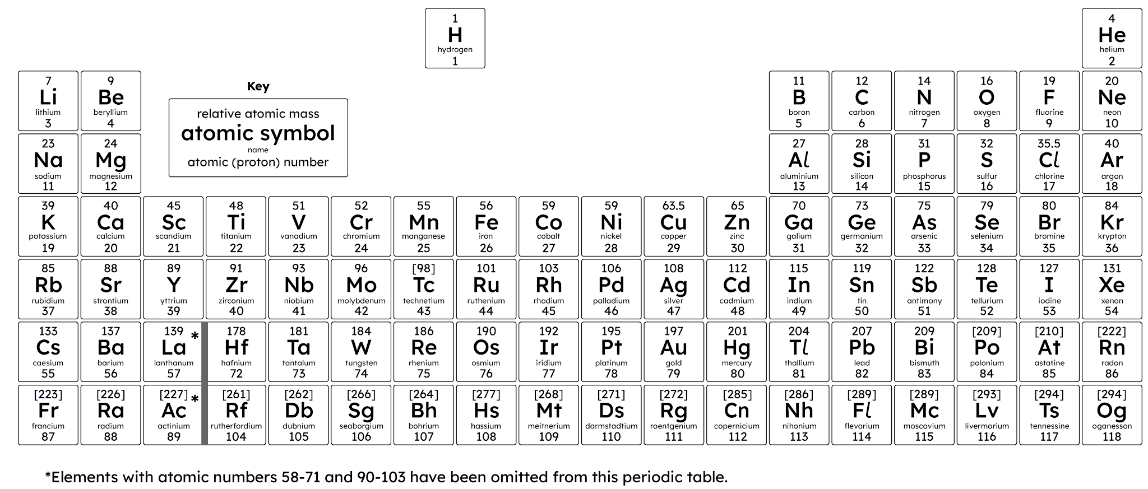
Kooxda 7: halogens
Curiyeyaasha (Elements) isku kooxda ah waxay leeyihiin astaamo (properties) isku mid ah, oo inta badan muujiyaan isbeddel (trend) ku yimaada astaamahaas inta kooxda oo dhan.

Slide 8
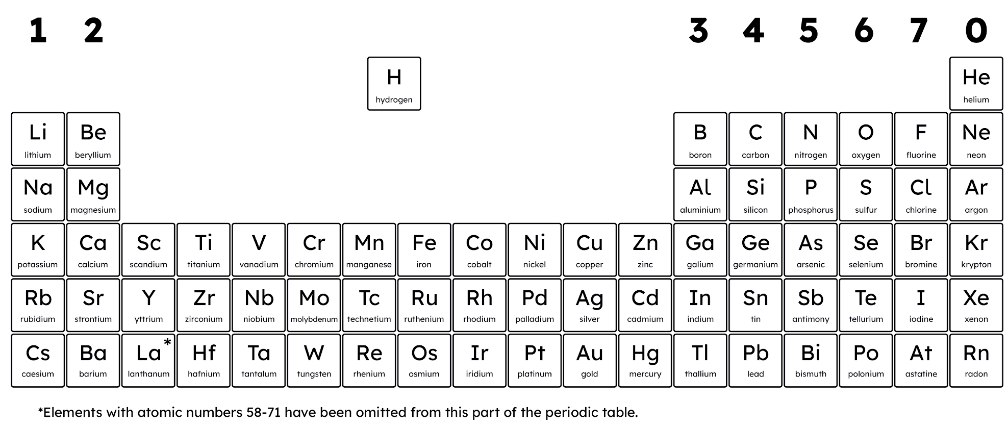
Kooxda 7: halogens
Kooxda 7 waxay tilmaamaysaa curiyeyaasha (elements) ku yaal safka labaad ee midigta shaxda xilliyeedka (periodic table).
Curiyeyaasha (Elements) ee Kooxda 7 waa kuwa aan bir ahayn (non-metals) waxayna kala yihiin: fluorine, chlorine, bromine, iodine, astatine iyo tennessine.

Slide 9

Kooxda 7: halogens
Curiyeyaasha (Elements) ee Kooxda 7 waa biro (metals).
Dhammaantood waxay ku yaalliin dhinaca midig ee shaxda xilliyeedka (periodic table).
Inta badan curiyeyaasha (elements) ku jira miiska xilliyeed (periodic table) waa biraha (metals).

Slide 10
Kooxda 7: halogens
Curiyeyaasha (elements) ku jira Kooxda 7 waxaa loo yaqaan halogens.
halogen
cusbo (salt)
sameeye (maker)
Curiyeyaasha (elements) waxaa loo bixiyay magacan sababtoo ah dhammaantood waxay soo saaraan cusbo (salt) leh astaamo (properties) isku mid ah.
Tusaale ahaan, sodium chloride (‘cusbada miiska’) waa mid ka mid ah cusbada (salts) ugu caansan.

Slide 11

Kooxda 7: halogens
Kooxda 7 waa koox curiyeyaasha (elements) aan bir ahayn (non-metallic) oo leh astaamo (properties) kiimiko (chemical) iyo jireed (physical) oo aad isugu dhow.
F
F
Waxay:
waxay ka samaysan yihiin molecules laba-atom ah (diatomic molecules)
Cl
Cl
mid kastaa wuxuu leeyahay midab curiyeed (elemental colour) gaar ah
waa kuwo falcelin badan (highly reactive)
waa kuwo sun ah (toxic)
Br
Br

Slide 12
Kooxda 7: halogens
Waxaa jira dhawr isbeddel (trends) oo ku saabsan astaamaha jireed (physical properties) marka hoos loo dhaco kooxda. Waxay:
cufnaanta (density) way kordhaa
heerkulka dhalaalidda iyo karkarinta ayaa kordha
F
Cl
Br
I
At
Xusuusnow: cufnaantu (density) waa cabbirka cufka (mass) halkii mug (volume); sida ay ugu dhow yihiin walxaha (particles) ee walaxda meel gaar ah.

Slide 13
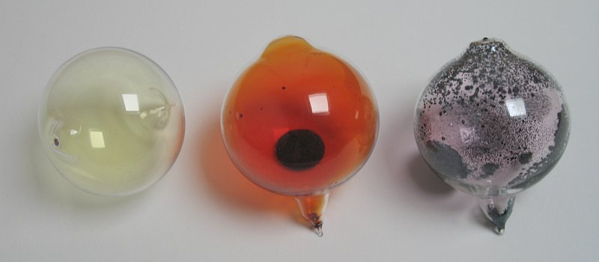
Kooxda 7: halogens
Curiyeyaasha (elements) Kooxda 7 waxay kala duwan yihiin xaaladaha heerkulka qolka:
fluorine waa gaas (gas) huruud khafiif ah
chlorine waa gaas (gas) cagaar khafiif ah
bromine waa dareere (liquid) guduudan-brown oo si dhakhso ah uumi baxa
iodine waa adke (solid) madow-buluug ah (isagoo uumi baxa gaas (gas) buluug ah)
chlorine (Cl₂) | bromine (Br₂) | Iodine (I₂)
Wilco Oelen 2004-2020 / CC BY-SA 3.0

Slide 14


Kooxda 7: halogens
Astatine iyo tennessine waa curiyeyaal (elements) aad u shucaac badan.
Xaqiiqooyinka astatine waxaa ka mid ah:
Xaqiiqooyinka ku saabsan tennessine waxaa ka mid ah:
la sameeyo oo burburo 1 ilbidhiqsi kadib
mid ka mid ah curiyeyaasha (elements) ugu naadirka ah dhulka
dhibcaha dhalaalidda iyo karkarinta ayaa la saadaaliyay
loo isticmaalo daaweynta kansarka
dhibcaha dhalaalidda iyo karkarinta ayaa ka sarreeya I2

Slide 15
Kooxda 7: halogens
Isticmaal isbeddelka (trend) ee sifooyinka Kooxda 7 si aad u saadaalisid midabka iyo xaaladda astatine heerkulka qolka.
dareere cawlan
gaas buluug-casaan
adke buluug-casaan
adke madow

Slide 16
Kooxda 7: halogens
Curiyeyaasha Kooxda 7 ma muujiyaan isbeddel (trend) sifooyinka kooxda dhexdeeda.
Curuurtu waxay noqdaan kuwa cufan yar marka hoos loo socdo kooxda.
Dhibcaha dhalaalidda curiyeyaasha ayaa kordha marka hoos loo socdo kooxda.

Slide 17
Kooxda 7: halogens
Sharax sababta halogens loogu yeedho 'halogens'. Magacani maxay ka tarjumayaa sifooyinkooda kiimikada?
2. Sharax sida midabka iyo xaaladda jireed ee halogens
uga beddelmaan xagga sare ilaa xagga hoose ee kooxda. Bixi
tusaalooyin halogen kasta oo la sheegay.

Slide 18
Kooxda 7: halogens
Sharax sababta halogens loogu yeedho 'halogens'. Magacani maxay ka tarjumayaa sifooyinkooda kiimikada?
"Halogen" waxaa loola jeedaa "cusbo-sameeye" - waxay si fudud u sameeyaan cusbo (salts) birta (metals) la, tusaale ahaan sodium chloride, potassium iodide.
2. Sharax sida midabka iyo xaaladda jireed ee halogens
uga beddelmaan xagga sare ilaa xagga hoose ee kooxda.
Fluorine: huruud khafiif ah oo gaas ah Chlorine: cagaar khafiif ah oo gaas ah
Bromine: casaan-madow oo dareere ah Iodine: guduud-madow oo adag
Heerkulka dhalaalid iyo karkarintoodu wuu kordhaa marka hoos loo dhaco kooxda.

Slide 19
Kooxda 7 (halogens)
Kooxda 7: halogens
Falcelinta halogens

Slide 20
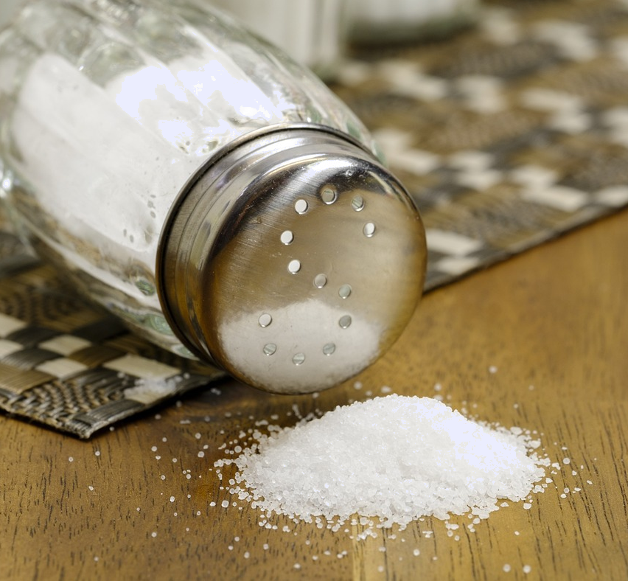
Falcelinta halogens
Kimistariga, cusbo (salt) waa walax ka samaysma marka bir la falceliso non-metal. Falcelintani waxay badanaa soo saartaa walxo adag oo ku milmi kara biyo (water), sida cusbada cuntada.
Cusbada (salts) waxaa badanaa lagu sameeyaa iyada oo acids ay la falceliyaan bases (neutralisation), halkaas oo ay ka sameeyaan cusbo (salt) iyo biyo (water).
Halogens waxay sidoo kale samayn karaan cusbo (salts) markay la falceliyaan curiyeyaasha birta.
Sodium chloride, NaCl ('cusbada cuntada')

Slide 21
Falcelinta halogens
'Cusbada cuntada' (sodium chloride) waa cusbada (salt) kaliya.
Kaliya xeryahooda ay ku jiraan atamka halogen ayaa loo tixgeliyaa cusbo (salts).
Sodium chloride waa tusaale cusbo (salt) ah.

Slide 22
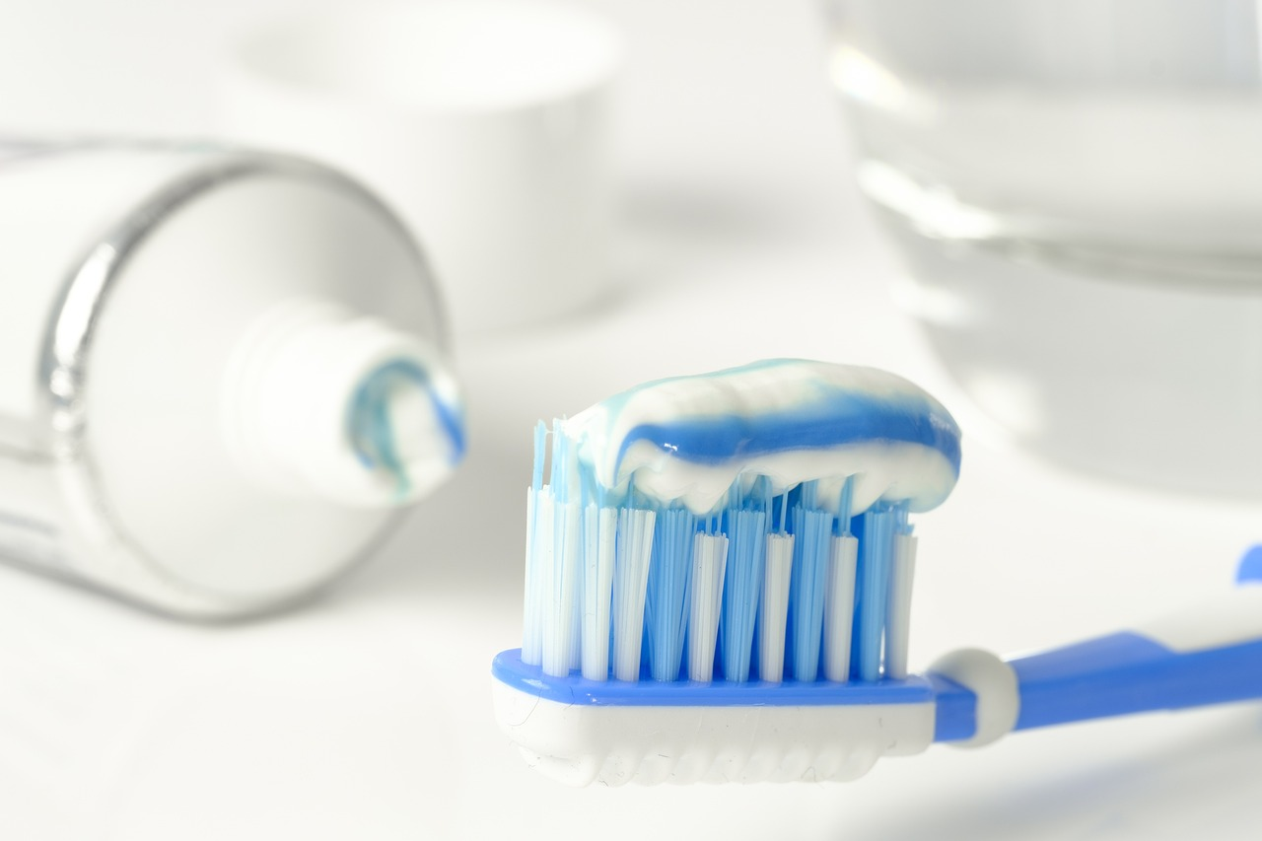
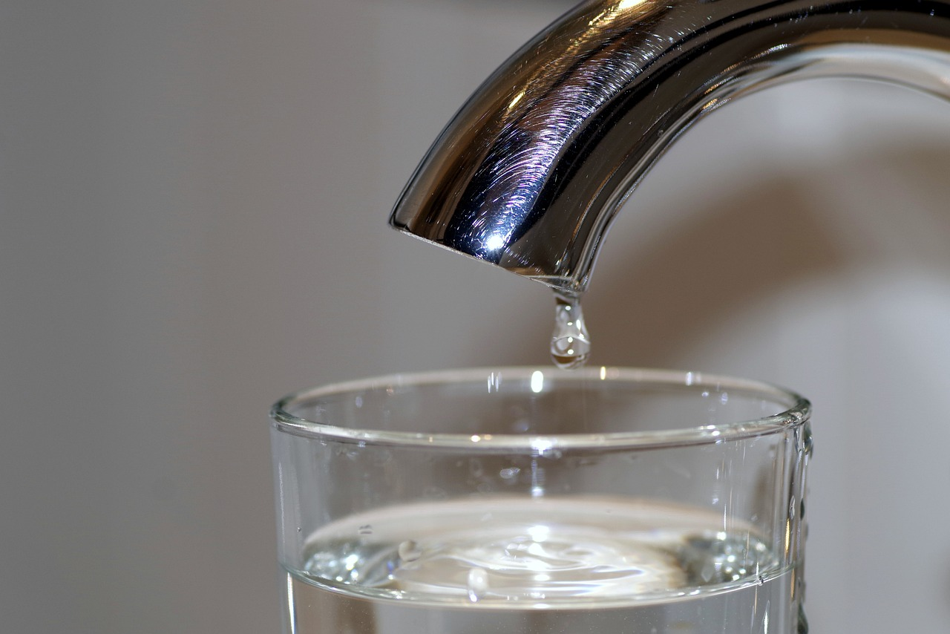
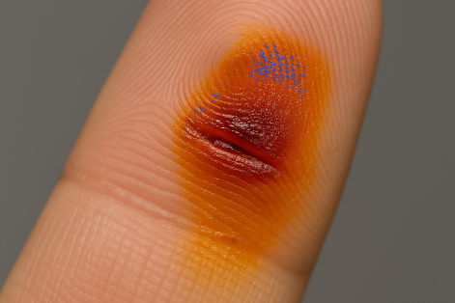
Falcelinta halogens
Curiyeyaasha Kooxda 7 guud ahaan aad bay u falcelin badan yihiin (iyo sun badan) sababtaas awgeed waxaa badanaa loo isticmaalaa qadar yar si loo sameeyo xeryaho badan oo faa'iido leh.
Tusaalooyinka isticmaalka waxaa ka mid ah:
fluoride oo ku jira daawada ilkaha
chlorine si loo nadiifiyo biyaha (water)
iodine si loo daweeyo nabarrada

Slide 23
Falcelinta halogens (halogens)
Marka halogens (halogens) ay la falceliyaan biraha si ay u sameeyaan xeryahooda, waxay noqdaan cusbo halide (halide salts).
bir + halogen (halogen) → halide (halide) bir
sodium (sodium) + chlorine (chlorine) → sodium chloride (sodium chloride)
2Na + Cl₂ → 2NaCl
magnesium (magnesium) + iodine (iodine) → magnesium iodide (magnesium iodide)
Mg + I₂ → MgI₂

Slide 24
Falcelinta halogens (halogens)
Kuwani midkee waxaa loo tixgelinayaa cusbo halide (halide salts)?
sodium iodide (sodium iodide)
chlorine (chlorine)
calcium bromide (calcium bromide)
iron nitride (iron nitride)

Slide 25
Falcelinta halogens (halogens)
Halides (halides) birta ah waxay ku milaan biyo (water).
Si loo baaro isbeddelka falcelinta kooxda 7 (Group 7), milan (solution) cusbo halide (halide salt) ayaa loo isticmaalaa in lagu muujiyo awoodda halogens (halogens) ay uga kaxaystaan atamka halogen (halogen) kale xeryahooda.
A
B
C
B
A
C
Falcelinta kaxaynta (displacement reactions) waxay ku lug leedahay curiye (element) falcelin badan oo bedelaya curiye (element) kale xarun.

Slide 26
Falcelinta halogens (halogens)
Falcelinta kaxaynta (displacement reactions) waxay ku lug leedahay curiye (element) falcelin yar oo bedelaya curiye (element) kale xarun.
Falcelinta kaxaynta (displacement reactions) waxay ku lug leedahay isweydaarsiga curiyeyaasha (elements).
Falcelinta kaxaynta (displacement reactions) waxay ku lug leedahay curiye (element) falcelin badan oo bedelaya curiye (element) kale xarun.

Slide 27

Falcelinta halogens (halogens)
Samee tijaabada (experiment) sida lagu muujiyey.
Ku dar dhawr dhibic oo halojin (halogen) kasta oo aqueous ah safafka saxda ah.
Ku dar dhawr dhibic oo cusbo halide (halide salt) kasta tiirarka saxda ah.
Record your observations in the table provided on the next slide.
sodium chloride solution
sodium bromide solution
sodium iodide solution
chlorine ‘water’
bromine ‘water’
iodine ‘water’

Slide 28
Falcelinta halojenada (halogens)
 |  | Indho-indhaynta marka lagu daro xalalka cusbada halide
 |  | sodium chloride | sodium bromide | sodium iodide
aqueous halogens | chlorine
 | bromine
 | iodine
U kala saar halojenada (halogens) kan ugu falcelinta badan ilaa kan ugu yar, adigoo isticmaalaya natiijooyinkaaga si aad u sharaxdo go'aankaaga.
Sharax sida falcelinta ugu beddelanto dhexdeeda curiyeyaasha Group 7.
Qor isla'egyo ereyo ah (word equations) dhammaan falcelinta barokaca (displacement) ee dhacday.

Slide 29
Falcelinta halogens-ka
 |  | Indho-indhaynta marka lagu daro milan cusbo halide ah
 |  | sodium chloride | sodium bromide | sodium iodide
biyo (water) ah halogens | chlorine | isbeddel la'aan | wuxuu u beddelmaa orange-brown | wuxuu u beddelmaa grey-brown
 | bromine | isbeddel la'aan | isbeddel la'aan | wuxuu u beddelmaa red-brown
 | iodine | isbeddel la'aan | isbeddel la'aan | isbeddel la'aan
1.
Chlorine waa kan ugu falcelinta badan, maxaa yeelay wuxuu la falceliyay sodium bromide iyo sodium iodide labadaba (isbeddelka midabku wuxuu muujinayaa tan).
Bromine waa kan labaad ee ugu falcelinta badan, maxaa yeelay wuxuu la falceliyay kaliya sodium iodide (isbeddelka midabku wuxuu muujinayaa tan).
Iodine waa midka ugu yar falcelinta (reactive) maxaa yeelay kuma falcelin cusbo (salt) kasta.

Slide 30
Falcelinta halogens
Sharax sida falcelinta (reactivity) ugu beddelanto kooxda 7 curiyeyaasha (elements).
3. Qor isla'egta erayada (word equations) dhammaan falcelinta barokaca (displacement reactions) ee
dhacday.
Hoos u dhaca kooxda, curiyeyaasha Group 7 waxay noqdaan kuwa ugu yar falcelinta (reactive). Tan waxaa muujinaya curiyeyaasha hoose oo aan awoodin inay barokacaan (displace) kuwa sare.
sodium bromide + chlorine → sodium chloride + bromine
sodium iodide + chlorine → sodium chloride + iodine
sodium iodide + bromine → sodium bromide + iodine

Slide 31
Group 7 (halogens)
Curiyeyaasha Group 7 dhammaantood waa kuwa aan bir ahayn (non-metals) oo leh uumis midab leh, badankoodna waa sun (toxic).
Xaaladda curiyeyaasha heerkulka qolka waxay ka beddelaysaa gaas (gas) ilaa adag (solid) hoos u dhaca Group 7.
Falcelinta (reactivity) waxay hoos u dhacdaa Group 7.
Halogens waxay la falceliyaan biraha Group 1 iyo 2 si ay u sameeyaan metal halides.
Metal halides waxay ku milaan (soluble) biyo (water).

