Slide 1
Kooxaha curiye (element) ee miiska xilliyeedka (periodic table)
Qaababka miiska xilliyeedka (periodic table)

Slide 2
Sida ilaha waxbarasho ee aan ugu talagalnay fasalka

Slide 3
Waxaan aqoonsan karaa oo sharxi karaa sifooyinka kooxaha kala duwan ee curiye (element) ee miiska xilliyeedka (periodic table).

Slide 4
miiska xilliyeedka (periodic table)
koox (group)
xilli (period)
biro kala-guur ah (transition metals)

Slide 5
Miiska xilliyeedka (periodic table) waa liis dhammaan curiye (element) la yaqaan, oo loo habeeyey kororka tirada atomiga (atomic number). Waxaa loo qaybiyaa tiirar toosan oo la yiraahdo kooxo (groups), iyo safar jiif ah oo la yiraahdo xilli (periods).
Koox (group) waa tiir ku yaal miiska xilliyeedka (periodic table) oo u dhigma tirada elektaroonnada (electrons) ee qolofka kore ee atomka.
Xilli (period) waa saf jiif ah oo ku yaal miiska xilliyeedka (periodic table). Xilli kastaa wuxuu u dhigmaa tirada qolofka elektaroonnada (electrons) ee atomka curiye (element).
Biro kala-guur ah (transition metals) waa koox biro ah oo laga helo qaybta dhexe ee miiska xilliyeedka (periodic table).

Slide 6

Kooxaha curiye (element) ee miiska xilliyeedka (periodic table)
Aasaaska miiska xilliyeedka (periodic table)
Sahminta kooxaha (groups) iyo sifooyinka

Slide 7
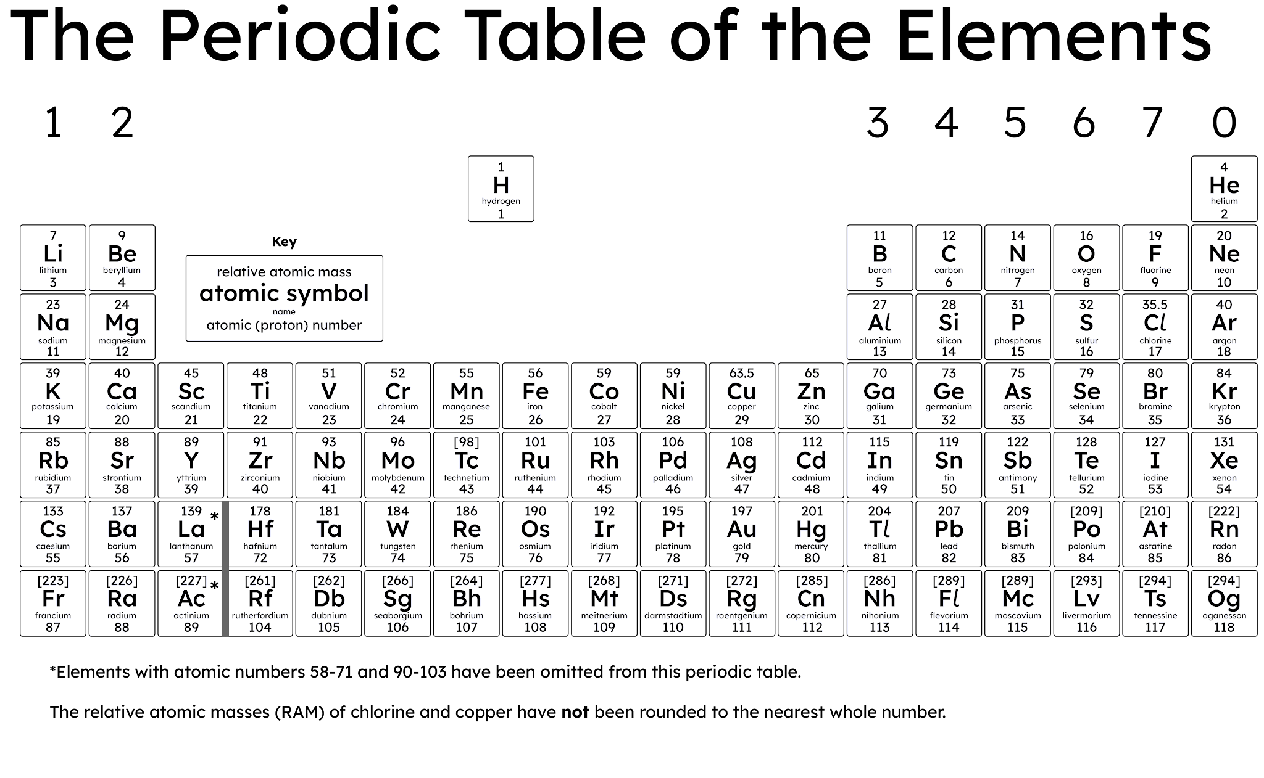
Aasaaska miiska xilliyeedka (periodic table)
Miiska xilliyeedka (periodic table) waa jaantus dhammaan curiye (element) kiimikooyinka la yaqaan, oo hadda gaaraya 118.

Slide 8
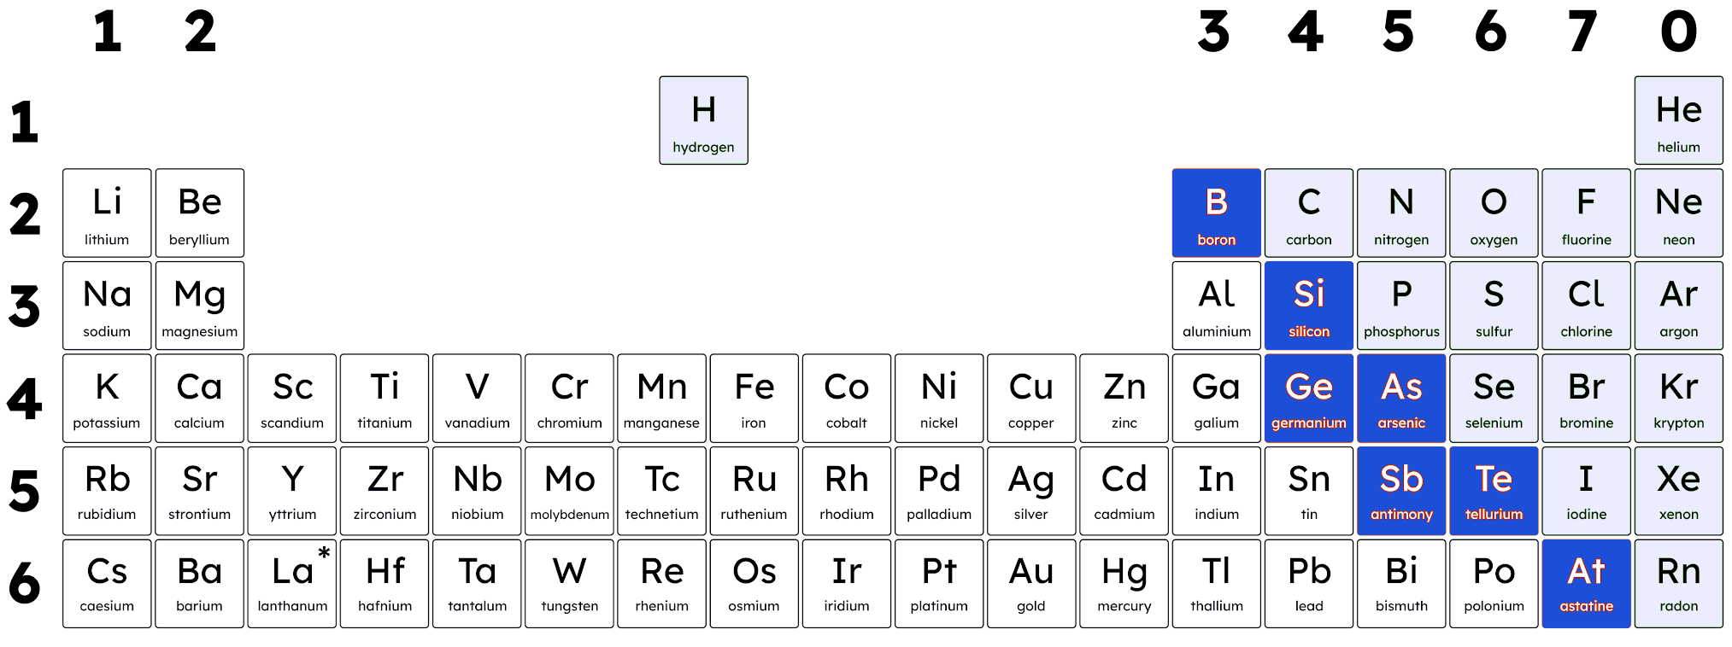
Aasaaska miiska xilliyeedka (periodic table)
Ilaa hadda, waxaad aragtay in miiska xilliyeedka (periodic table) loo qaybin karo biro, aan-biro ahayn, iyo metalloids:
aan-biro ahayn (non-metals)
biro (metals)
metalloids (metalloids)
Si kastaba ha ahaatee, kani ma aha qaabka ugu weyn ee saynisyahannadu u kala qaybiyaan curiye (element) ee miiska xilliyeedka (periodic table).

Slide 9
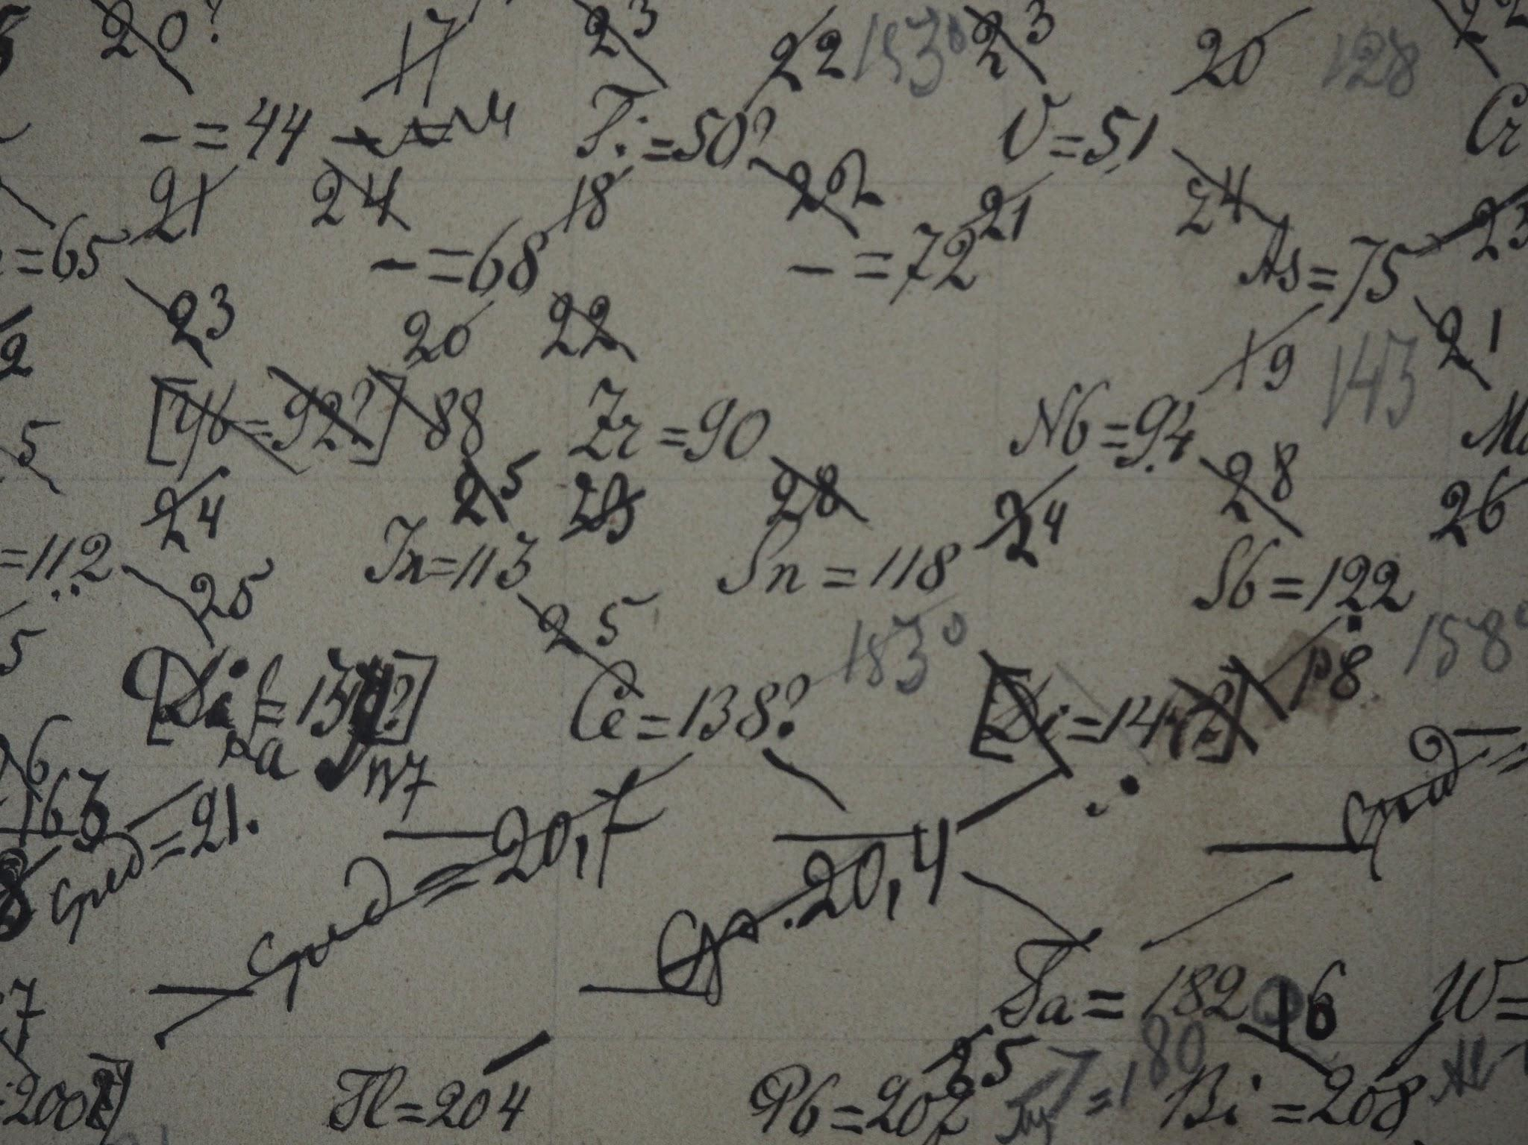
Aasaaska shaxda xilliyeed (Foundations of the periodic table)
Sannadkii 1869, Dmitri Mendeleev wuxuu 10 sano ku qaatay isagoo isku dayaya inuu nidaamiyo curiyeyaasha (elements). Waqtigaas, waxaa jiray 63 curiye (elements) oo la yaqaan.
Sheekadu waxay sheegaysaa inuu shaxdiisa xilliyeed (periodic table) ku abuuray isagoo magaca curiye kasta (element) iyo miisaankiisa atomiga (atomic weight) ku qoray kaar.
Kadib wuxuu ciyaaray ciyaar 'solitaire kiimiko' (chemical solitaire).
Ugu dambayntii, wuxuu ku riyooday nidaamka curiyeyaasha (elements).
Qoraallada Mendeleev ee kala-saarista curiyeyaasha (elements)

Slide 10
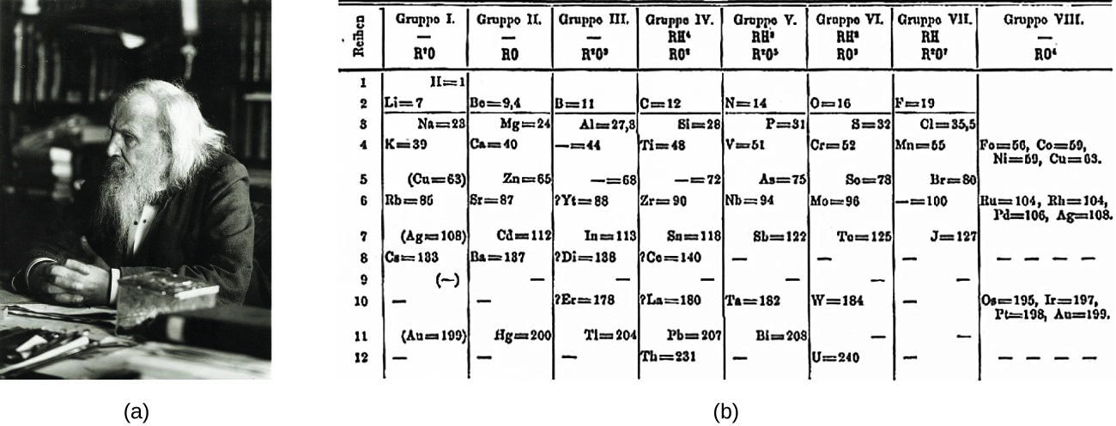
Aasaaska shaxda xilliyeed (Foundations of the periodic table)
Mendeleev wuxuu soo jeediyay qaabka ugu aqbalinta badan ee habaynta curiyeyaasha (elements).
Wuxuu tan ku sameeyay isagoo:
gelinaya curiyeyaasha (elements) shax isagoo adeegsanaya sifooyinkooda iyo miisaannadooda atomiga (atomic weights)
kala-saaraya 7 kooxood (groups)
ka tagaya meelo bannaan oo loogu talagalay curiyeyaasha (elements) aan la helin
saadaalinaya sifooyinka curiyeyaasha (elements) aan la helin
tusaale ahaan eka–aluminium (eka–aluminium), mid ka fog aluminium (aluminium)
Curiyeyaasha (elements) aan la helin waxaa loo magacaabay horgale "eka-" oo ka yimid Sanskrit oo macneheedu yahay "mid".
OpenStax, via Wikimedia Commons CC BY–SA 4.0

Slide 11

Aasaaska shaxda xilliyeed (Foundations of the periodic table)
Mendeleev wuxuu soo jeediyay qaab nidaaminta curiyeyaasha (elements) oo ku lug lahaa isku-gelinta.
Wuxuu u nidaamiyay bir (metals), aan bir ahayn (non-metals) iyo metalloids (metalloids).
Wuxuu u nidaamiyay sifooyinkooda iyo miisaannadooda atomiga (atomic weights).

Slide 12
Aasaaska shaxda xilliyeedka (periodic table)
Curiyeyaasha (Elements) waxay ka kooban yihiin hal nooc oo walxaha (particles) ah oo loo yaqaan atam (atoms). Markii Mendeleev sameeyay shaxdiisa xilliyeed (periodic table), atam (atoms) waa la soo jeediyay, laakiin si buuxda looma fahmin.
Cilmi-baaris (scientific research) ayaa na baray in atamka ay ka kooban yihiin qaybo yaryar oo loo yaqaan:
protons
neutrons
electrons
Curiye (element) kastaa wuxuu leeyahay tiro ka duwan oo ah qaybahan.

Slide 13
Aasaaska shaxda xilliyeedka (periodic table)
Atamku wuxuu ka kooban yahay:
xudun (nucleus) oo ku taal bartamaha atamka
xudunta (nucleus)
neutron
qolofta (shells) ee ku wareegsan xudunta (nucleus)
proton
Shaxda xilliyeedka (periodic table) waxay noo sheegtaa macluumaad ku filan oo ku saabsan curiye (element) kasta si loo ogaado inta proton, neutron iyo electron uu atam kastaa leeyahay.
qolof (shell)
electron
loo sawirin qiyaas (not drawn to scale)

Slide 14
Aasaaska shaxda xilliyeedka (periodic table)
Shaxda xilliyeedka (periodic table) waxay leedahay safaf loo yaqaan periods, iyo tiirar loo yaqaan groups.
tirada elektaroonnada ee qolofka kore (number of electrons in outer shell)
1
2
3
4
5
tirada qolofta (shells) ee ay ku jiraan electrons
6
7
Jawaabaha:
periods
groups

Slide 15
Aasaaska Shaxda Xilliyeedka (Foundations of the periodic table)
Saf kasta oo ka mid ah Shaxda Xilliyeedka (periodic table) waxaa loo yaqaan koox (group).
Shaxda Xilliyeedka (periodic table) waxaa loo kala saarayaa biraha (metals) (dhanka bidix) iyo kuwa aan bir ahayn (non-metals) (dhanka midig).
Saf kasta oo jiif ah oo ku jira Shaxda Xilliyeedka (periodic table) waxaa loo yaqaan xilli (period).

Slide 16
Aasaaska Shaxda Xilliyeedka (Foundations of the periodic table)
Xilli (period) waa saf jiif ah oo ku yaal Shaxda Xilliyeedka (periodic table).
Atamka (atom) dhexdiisa, elektaroonnada (electrons) waxay ku wareegaan xudunta (nucleus) qolof (shells) gudahood.
Xilli kasta (period) wuxuu u dhigmaa tirada qolof (shells) ee elektaroonnada (electrons).
H
He
Kaarboon (Carbon) waxaa laga helaa xilliga labaad (second period) ee Shaxda Xilliyeedka (periodic table).
C
Haydrojiin (Hydrogen) iyo Hiliyaam (Helium) waxay ku yaalliin xilliga koowaad (first period) ee Shaxda Xilliyeedka (periodic table).
halkaas oo × u taagan elektaroonnada (electrons)

Slide 17
Aasaaska Shaxda Xilliyeedka (Foundations of the periodic table)
Koox (group) waa tiir taagan oo ku yaal Shaxda Xilliyeedka (periodic table).
Curiyeyaasha (Elements) isku koox (group) ah waxay leeyihiin tiro isku mid ah oo elektaroonnada (electrons) ah qolofka (shell) ugu fog xudunta (nucleus) (qolofka kore (outer shell)) atamkooda (atoms).
Haydrojiin (Hydrogen) wuxuu leeyahay 1 elektaroon (×) qolofka kore (outer shell), sidaas darteed waxaa laga helaa Kooxda 1 (Group 1).
H
Boron (Boron) wuxuu leeyahay 3 elektaroon (×) qolofka kore (outer shell), sidaas darteed waxaa laga helaa Kooxda 3 (Group 3).
B
halkaas oo × u taagan elektaroonnada (electrons)

Slide 18
Aasaaska Shaxda Xilliyeedka (Foundations of the periodic table)
Akhriska Shaxda Xilliyeedka (periodic table) (bidix ilaa midig iyadoo laga gudbay xilliyada (periods)) wuxuu muujinayaa in curiyeyaasha (elements) loo habeeyey iyadoo la kordhinayo tirada atomiga (atomic (proton) number).
Tani waa tirada borotoonnada (protons) ee xudunta (nucleus) atamka (atom) curiye (element) gaar ah waxayna la mid tahay wadarta tirada elektaroonnada (electrons) ee dhammaan qolof (shells) atamkaas (atom).

Slide 19
Aasaaska shaxda xilliyeedka (periodic table)
Kee ayaa run ah oo ka mid ah weedhahan ku saabsan curiyeyaasha (elements) isku koox ah?
Waxay leeyihiin tiro isku mid ah oo elektaroon ah (electrons).
Waxay leeyihiin tiro isku mid ah oo elektaroon (electrons) ah oo ku yaal qolofkooda sare (outermost shell).
Waxay leeyihiin tiro isku mid ah oo qolof elektaroon (shells of electrons) ah.
Waxay ka samaysan yihiin atomo (atoms) (kuwaas oo ka kooban borotoon (protons), nuyutroon (neutrons) iyo elektaroon (electrons)).

Slide 20
Aasaaska shaxda xilliyeedka (periodic table)
Ku calaamadee shaxda xilliyeedka (periodic table) calaamadahan soo socda:
Kooxaha (Groups) 1, 2, 3, 4, 5, 6, 7, 0
Xilliyada (Periods) 1, 2, 3, 4, 5, 6
biraha (metals)
kuwa aan bir ahayn (non-metals)
kuwa dhexdhexaadka ah (metalloids)

Slide 21
Aasaaska shaxda xilliyeedka (periodic table)
Ku calaamadee shaxda xilliyeedka (periodic table) calaamadahan soo socda:
Kooxaha (Groups)
kuwa aan bir ahayn (non-metals)
Kooxaha (Groups)
biraha (metals)
kuwa dhexdhexaadka ah (metalloids)
Xilliyada (Periods)

Slide 22
Aasaaska shaxda xilliyeedka (periodic table)
2. Sharax waxa loola jeedo erayada 'koox' (group) iyo 'xilli' (period) marka la eego habaynta curiyeyaasha (elements) ee shaxda xilliyeedka (periodic table).
Hubi inaad ku tilmaanto elektaroonnada (electrons) iyo qolofka elektaroonka (electron shells) jawaabtaada.

Slide 23
Aasaaska shaxda xilliyeedka (periodic table)
2. Sharax waxa loola jeedo erayada 'koox' (group) iyo 'xilli' (period) marka la eego habaynta curiyeyaasha (elements) shaxda xilliyeedka (periodic table).
Hubi inaad ku tilmaanto elektaroonnada (electrons) iyo qolofka elektaroonka (electron shells) jawaabtaada.
Xilli (period) waa saf toosan oo ku yaal shaxda xilliyeedka (periodic table). Xilli kastaa wuxuu u dhigmaa tirada qolofka elektaroonka (electron shells) ee atamka curiye (element) ah.
Koox (group) waa tiir toosan oo ku yaal shaxda xilliyeedka (periodic table). Curiyeyaasha (elements) isku kooxda ah waxay leeyihiin tirada elektaroonnada (electrons) isku mid ah ee qolofka ugu fog xudunta (nucleus) atamkooda (qolofka sare).

Slide 24
Kooxaha (groups) curiyeyaasha (elements) ee shaxda xilliyeedka (periodic table)
Aasaaska shaxda xilliyeedka (periodic table)
Sahminta kooxaha (groups) iyo sifooyinka

Slide 25
Sahminta kooxaha (groups) iyo sifooyinka
Sifooyinka curiye (element) waxay ku xiran yihiin booska uu ku yaal shaxda xilliyeedka (periodic table).
Fahamka xiriirradan ayaa kaa caawinaya saadaalinta hab-dhaqanka curiyeyaasha (elements) iyo falgalyada (reactions).
Sifooyinka jireed waxaa ka mid ah:
heerkulka dhalaalida iyo karkarinta
cufnaanta (density)
korantada (conductivity)
midabka
Sifooyinka kiimikada waxaa ka mid ah:
fal-celinta (reactivity)
aashitada / alkalinta
gubashada (combustibility)
iska caabbinta miridhku (corrosion resistance)

Slide 26
Sahminta kooxaha iyo sifooyinka
Kee ka mid ah kuwan soo socda waa tusaalooyin sifooyin jireed (physical properties)?
barta dhalaalida iyo karkarinta (melting and boiling points)
tusmada korantada (conductivity)
falgal (reactivity)
cufnaan (density)

Slide 27
Sahminta kooxaha iyo sifooyinka
Biraha (metals), aan-birahayn (non-metals), iyo metalloids waa saddexda nooc ee ugu muhiimsan ee curiyeyaasha (elements).
Biraha (metals) caadi ahaan waa dhalaalaya, jilicsan, iyo kuwo wanaagsan oo koronto iyo kulayl gudbiya.
biraha (metals)

Slide 28
Sahminta kooxaha iyo sifooyinka
Biraha (metals), aan-birahayn (non-metals), iyo metalloids waa saddexda nooc ee ugu muhiimsan ee curiyeyaasha (elements).
Aan-birahayn (non-metals) inta badan waa caajis, jajaban, iyo kuwo aan wanaagsanayn oo gudbiya.
aan-birahayn (non-metals)
biraha (metals)

Slide 29
Sahminta kooxaha iyo sifooyinka
Metalloids waxay leeyihiin sifooyin dhexdhexaad ah oo u dhexeeya biraha (metals) iyo aan-birahayn (non-metals).
Waxaa badanaa loo isticmaalaa semiconductors, waxaana caadi ahaan loo isticmaalaa qalabka elektarooniga ah.
aan-birahayn (non-metals)
biraha (metals)
metalloids

Slide 30
Exploring groups and properties
Kuwaas ka mid ah waa tusaalooyinka sifooyinka jirka ee birta aan ahayn?
low melting and boiling points
good conductors of electricity
shiny
brittle

Slide 31
Exploring groups and properties
Elements in the same group have the same number of electrons on their outer shell. This causes the elements in the same group to have similar chemical properties, showing a trend throughout the group.

Slide 32
Exploring groups and properties
Elements in the same group have similar chemical properties, as they have the same number of shells of electrons.
Elements in the same group have the same number of electrons on their outermost shell.
Elements in the same period have similar chemical properties, not elements in the same group.

Slide 33
Exploring groups and properties
Kooxda 1 waxaa sidoo kale loo yaqaan biraha alkali. Kooxdan waxaa ka mid ah lithium, sodium, iyo potassium.
Na
Waxay leeyihiin sifooyin kiimiko iyo jir oo isku mid ah:
high reactivity
react vigorously with cold water
low melting points
Li
K

Slide 34
Exploring groups and properties
Kooxda 2 waxaa sidoo kale loo yaqaan biraha alkaline earth. Kooxdan waxaa ka mid ah magnesium iyo calcium.
Kooxda 2 way ka duwan tahay Kooxda 1, sababtoo ah curiyeyaashu (elements) waa:
ka yar falgal (reaction) marka loo eego Kooxda 1
caadi ahaan waxay leeyihiin heerkul dhalaal (melting points) iyo cufnaan (densities) sare marka loo eego Kooxda 1
Mg
Ca

Slide 35
Sahaminta kooxaha iyo sifooyinka
Kooxda 7 waxaa sidoo kale loo yaqaan Halogens. Kooxdan waxaa ka mid ah fluorine, chlorine, bromine iyo iodine.
Kooxda 7 waxaa lagu yaqaan:
ujeeddo ay ku sameeyaan cusbo (salts) birta (metals)
waxay u jiraan sida molecules diatomic
inay yihiin sun (toxic)
F
Cl

Slide 36
Sahaminta kooxaha iyo sifooyinka
Qaybta dhexe ee curiyeyaasha (elements) waxaa loo yaqaan transition metals waxaana ka mid ah curiyeyaasha sida iron iyo copper. Waxay leeyihiin sifooyin caadi ah oo birta (metals), sida inay yihiin kuwo wanaagsan oo gudbiya (conductors) iyo inay yihiin kuwo la qaabayn karo (malleable).

Slide 37
Sahaminta kooxaha iyo sifooyinka
Kee ka mid ah sifooyinka soo socda ma aha sifo jireed (physical property) caadi ah oo transition metals?
heerkul dhalaal (melting points) sare
dull (aan iftiimin)
malleability (la qaabayn karo)
gudbinta wanaagsan ee kulaylka iyo korontada

Slide 38
Sahminta kooxaha iyo sifooyinka
Kuwee ka mid ah weedhahan soo socda waa run?
Curiyeyaasha (elements) isku koox ku jira jaantuska xilliyeedka waxay leeyihiin sifooyin kiimiko (chemical properties) isku mid ah.
Jaantuska xilliyeedka (periodic table) waxaa ku jira oo keliya bir (metals) iyo aan-bir (non-metals).
Shaxda (Periodic Table) waxaa loo habeeyey safaf loo yaqaan kooxo (groups).
Dimitri Mendeleev wuxuu muhiim ka ahaa horumarinta shaxda (Periodic Table).

Slide 39
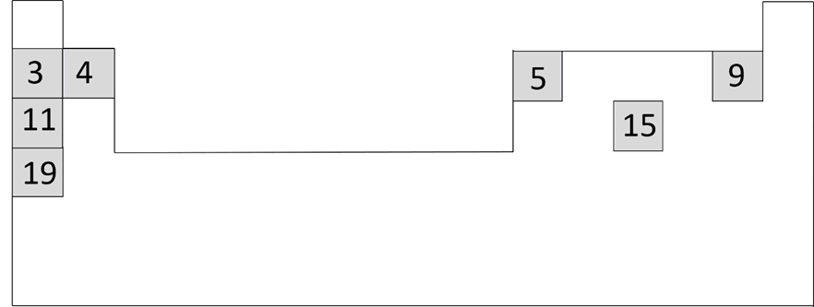
Sahminta kooxaha iyo sifooyinka
Toddoba curiye (element) ayaa lagu muujiyey shaxda (Periodic Table) ee qaabaysan ee midigta.
Buuxi meelaha bannaan si aad u dhamaystirto qoraalka hoose. Waa inaad kaliya isticmaashaa ereyada period iyo group.
Curiyeyaasha (Elements) 3 iyo 4 ma laha sifooyin kiimiko oo isku mid ah sababtoo ah waxay ku jiraan isla period-ka, ma aha isla group-ka.
Tirooyinka atomiga (atomic numbers) 3, 9 iyo 15 waxay kordhaan 6 mar kasta. Curiyeyaashu (elements) ma laha sifooyin kiimiko oo isku mid ah. Shaxda (Periodic Table) kuma ridayso isla group-ka.
Tirooyinka atomiga (atomic numbers) 3, 11 iyo 19 waxay kordhaan 8 mar kasta. Curiye (element) kastaa wuxuu ku jiraa period-ka kala duwan. Curiyeyaashani (elements) waxay leeyihiin sifooyin kiimiko oo isku mid ah. Shaxda (Periodic Table) waxay ku riddaa isla group-ka.

Slide 40
Sahminta kooxaha iyo sifooyinka
Toddoba curiye (element) ayaa lagu muujiyey shaxda (Periodic Table) ee qaabaysan ee midigta.
Buuxi meelaha bannaan si aad u dhamaystirto qoraalka hoose. Waa inaad kaliya isticmaashaa ereyada period iyo group.
Curiyeyaasha (Elements) 3 iyo 4 ma laha sifooyin kiimiko oo isku mid ah sababtoo ah waxay ku jiraan isla period-ka, ma aha isla group-ka.
Tirooyinka atomiga (atomic numbers) 3, 9 iyo 15 waxay kordhaan 6 mar kasta. Curiyeyaashu (elements) ma laha sifooyin kiimiko oo isku mid ah. Shaxda (Periodic Table) kuma ridayso isla group-ka.
Tirooyinka atomiga (atomic numbers) 3, 11 iyo 19 waxay kordhaan 8 mar kasta. Curiye (element) kastaa wuxuu ku jiraa period-ka kala duwan. Curiyeyaashani (elements) waxay leeyihiin sifooyin kiimiko oo isku mid ah. Shaxda (Periodic Table) waxay ku riddaa isla group-ka.

Slide 41
Sahminta kooxaha iyo sifooyinka
2. Fiiri macluumaadka ku saabsan laba qaybood oo curiyeyaasha (elements) ah.
Qaybta 1 | Curiye (Element) X | Curiye (Element) Y | Curiye (Element) Z
Sifada | gaas huruud / cagaar ah | dareere bunni ah | adag cawlan / madow
Falgal (reaction) birta (iron) | si degdeg ah ayuu ula falgalaa (reacts) suuf bir ah oo la kululeeyay | si dhakhso leh ayuu ula falgalaa (reacts) suuf bir ah oo la kululeeyay, haddii la diirriyo | si gaabis ah ayuu ula falgalaa (reacts) suuf bir ah haddii si xoog leh loo kululeeyo
Qaybta 2 | Curiye (Element) J | Curiye (Element) K | Curiye (Element) L
Sifada | gaas aan midab lahayn | gaas aan midab lahayn | gaas aan midab lahayn
Falgal (reaction) birta (iron) | wuxuu ula falgalaa (reacts) suuf bir ah marka la kululeeyo | kuma falgalo (reacts) suuf bir ah, xataa marka la kululeeyo | kuma falgalo (reacts) suuf bir ah, xataa marka la kululeeyo
Kee ka mid ah qaybaha curiyeyaasha (elements) wuxuu muujinayaa isku ekaansho sifooyin kiimiko? Sababta?

Slide 42
Sahaminta kooxaha iyo sifooyinka
2. Eeg macluumaadka ku saabsan laba qaybood oo curiyeyaasha (elements) ah.
Kooxdee curiyeyaasha (elements) ayaa muujinaya isku ekaanshaha sifooyinka kiimikada (chemical properties)? Sababta?
Jawaabtaadu waxay u ekaan kartaa:
Kooxda 1 waxay muujinaysaa curiyeyaasha (elements) leh sifooyin kiimikada (chemical properties) oo isku mid ah, sababtoo ah dhammaantood waxay si isku mid ah u falgalaan (react) birta (iron). Halka, Kooxda 2 ay ku jirto kaliya 1 curiye (element) oo la falgala (reacts) birta (iron) iyo 2 curiye (elements) oo aan la falgalin (don’t react).

Slide 43
Kooxaha curiyeyaasha (elements) ee shaxda xilliyeed (periodic table)
Tiir kasta oo ka mid ah shaxda xilliyeed (periodic table) waxaa loo yaqaan koox (group), saf kastana waxaa loo yaqaan xilli (period).
Shaxda xilliyeed (periodic table) waxaa sameeyay saynisyahan Ruush ah oo la yiraahdo Dimitri Mendeleev.
Shaxda xilliyeed (periodic table) waxaa ku jira dhammaan curiyeyaasha (elements) oo loo habeeyay kooxo (groups) iyo xilliyo (periods), iyadoo loo eegayo sifooyinkooda (properties).
Curiyeyaasha (elements) ku jira isku koox (group) ee shaxda xilliyeed (periodic table) waxay leeyihiin sifooyin (properties) isku mid ah.
Marka lagu daro kooxaha (groups), curiyeyaasha (elements) waxaa loo qaybin karaa kuwa aan bir ahayn (non-metals) iyo biraha (metals), oo ay ku jiraan biraha kala-guurka (transition metals).

