Slide 1
Dhaxalka iyo walxaha hidaha (genetic material)
Dhaxalka iyo DNA

Slide 2
sida loo isticmaalo darasyada Oak

Slide 3
Waxaan sharxi karaa in qaar, laakiin aan dhamaantood ahayn, astaamaha ay dhaxlaan marka walxaha hidaha (genetic material) laga gudbiyo waalidka ilaa ubadka.

Slide 4
deegaanka (environment)
qaab nololeed (lifestyle)
dhaxal (inherited)
walxaha hidaha (genetic material)

Slide 5
Deegaanka (environment) nooluhu waa agagaarkiisa iyo xaaladaha uu ku nool yahay.
Qaab nololeedka (lifestyle) nooluhu waa waxyaabaha uu sameeyo iyo go'aamada uu qaato, tusaale: cuntada iyo jimicsiga.
Qaar ka mid ah astaamaha ubadka waxaa laga dhaxli karaa waalidka, iyada oo loo maro habka taranka (reproduction).
Walxaha hidaha (genetic material) waa walax ku jirta unugyada oo ka kooban tilmaamo astaamo iyo habab nololeed oo kala duwan.

Slide 6

Dhaxalka iyo walxaha hidaha (genetic material)
Astaamaha deegaanka (environmental features)
Walxaha hidaha (genetic material) iyo dhaxalka
Dhaxalka iyo deegaanka (environment)

Slide 7
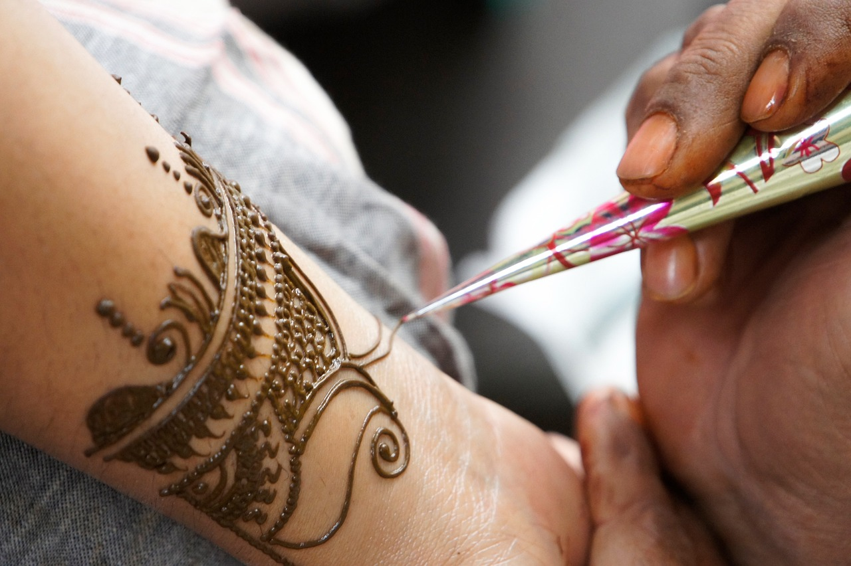
Astaamaha deegaanka (environmental features)
Astaamaha nooluhu waxay noqon karaan kuwo dhaxal ah (laga soo gudbiyay waalidkiis) ama waxaa laga heli karaa inta uu nooluhu nool yahay.
Astaamaha la helo inta nolosha dhexdeeda ah waxay u sabab yihiin deegaanka (environment) ama qaab nololeedka (lifestyle).
henna tattoo (henna tattoo)

Slide 8
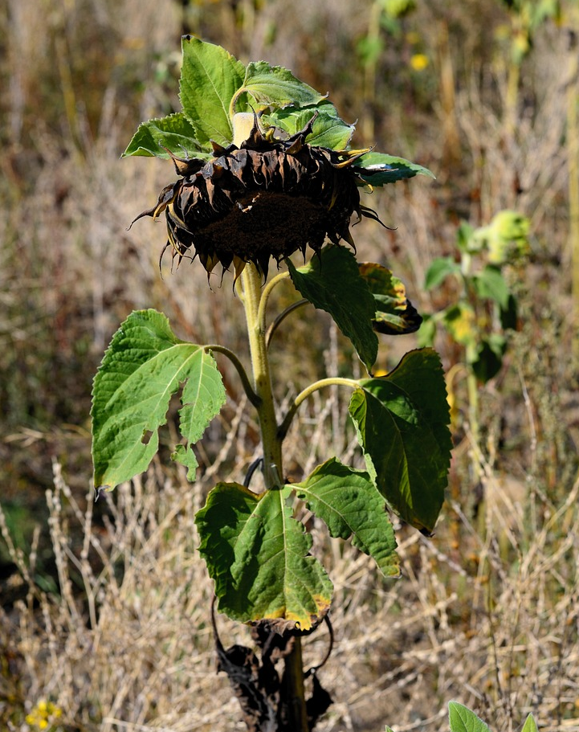
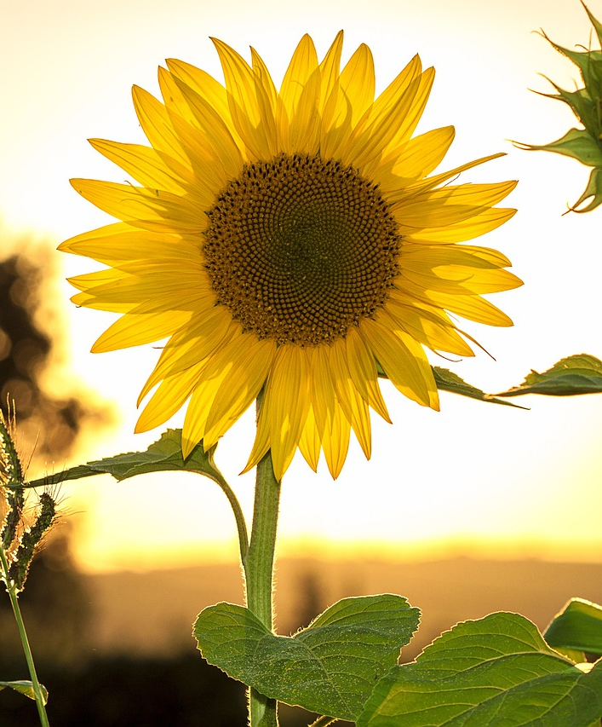
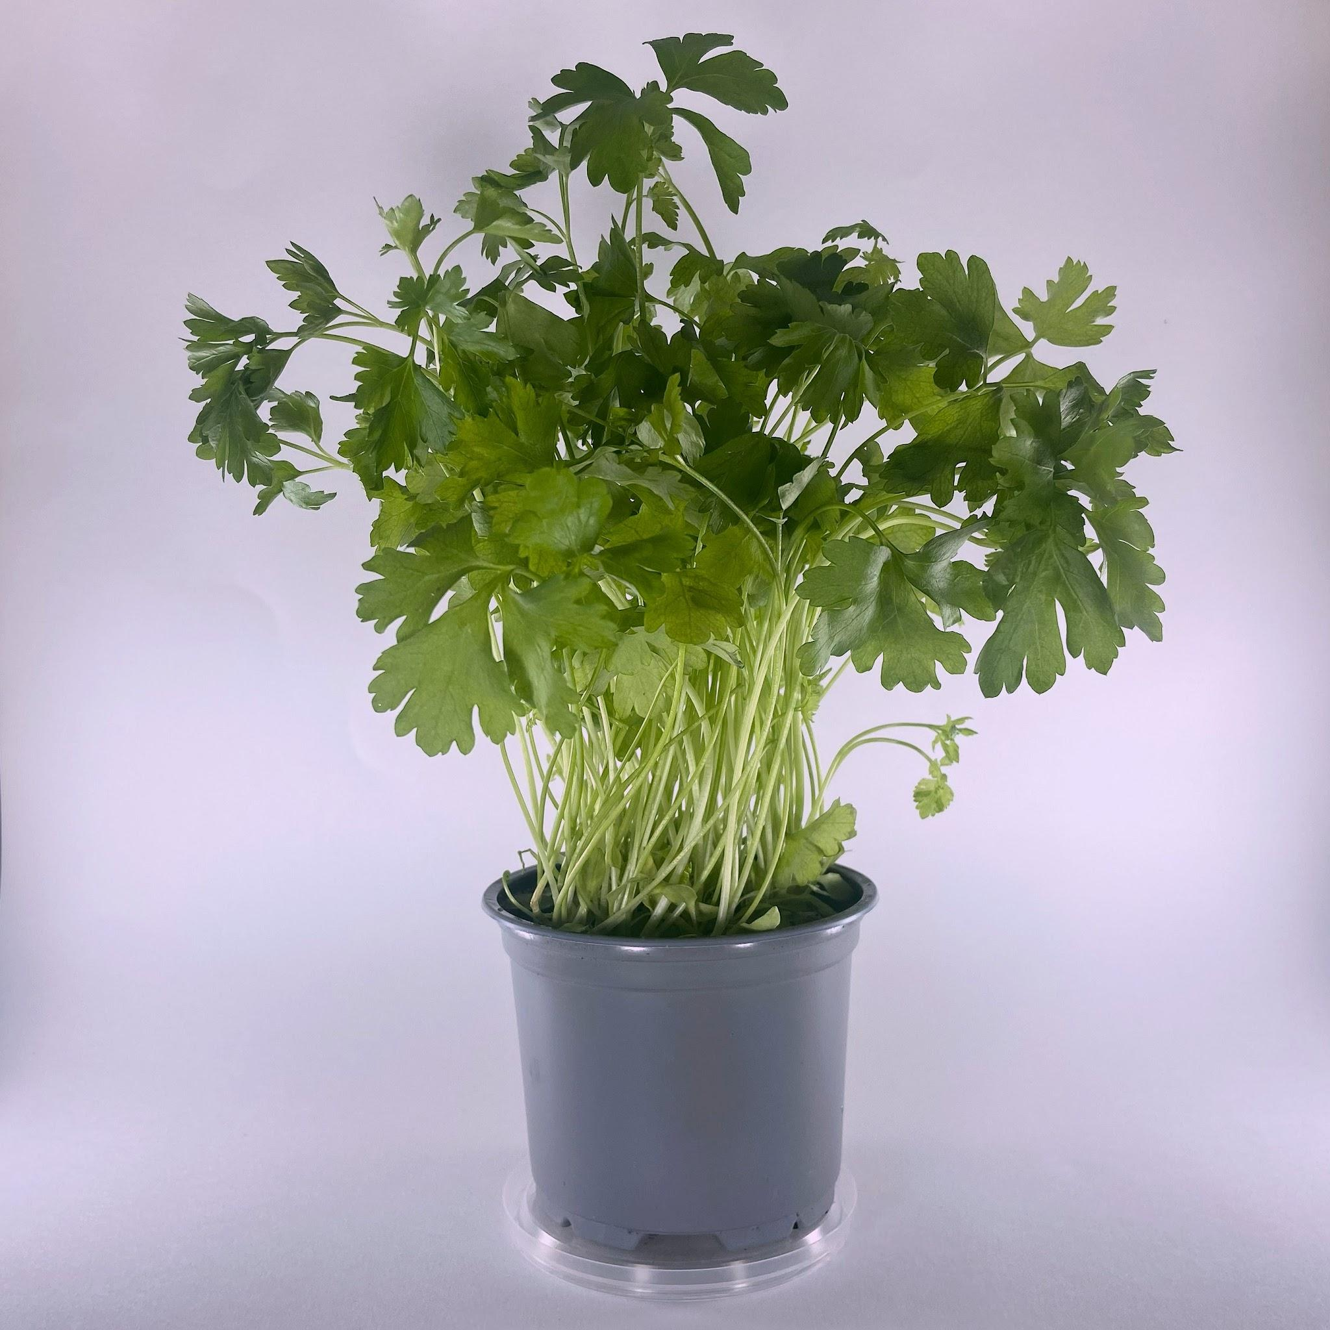
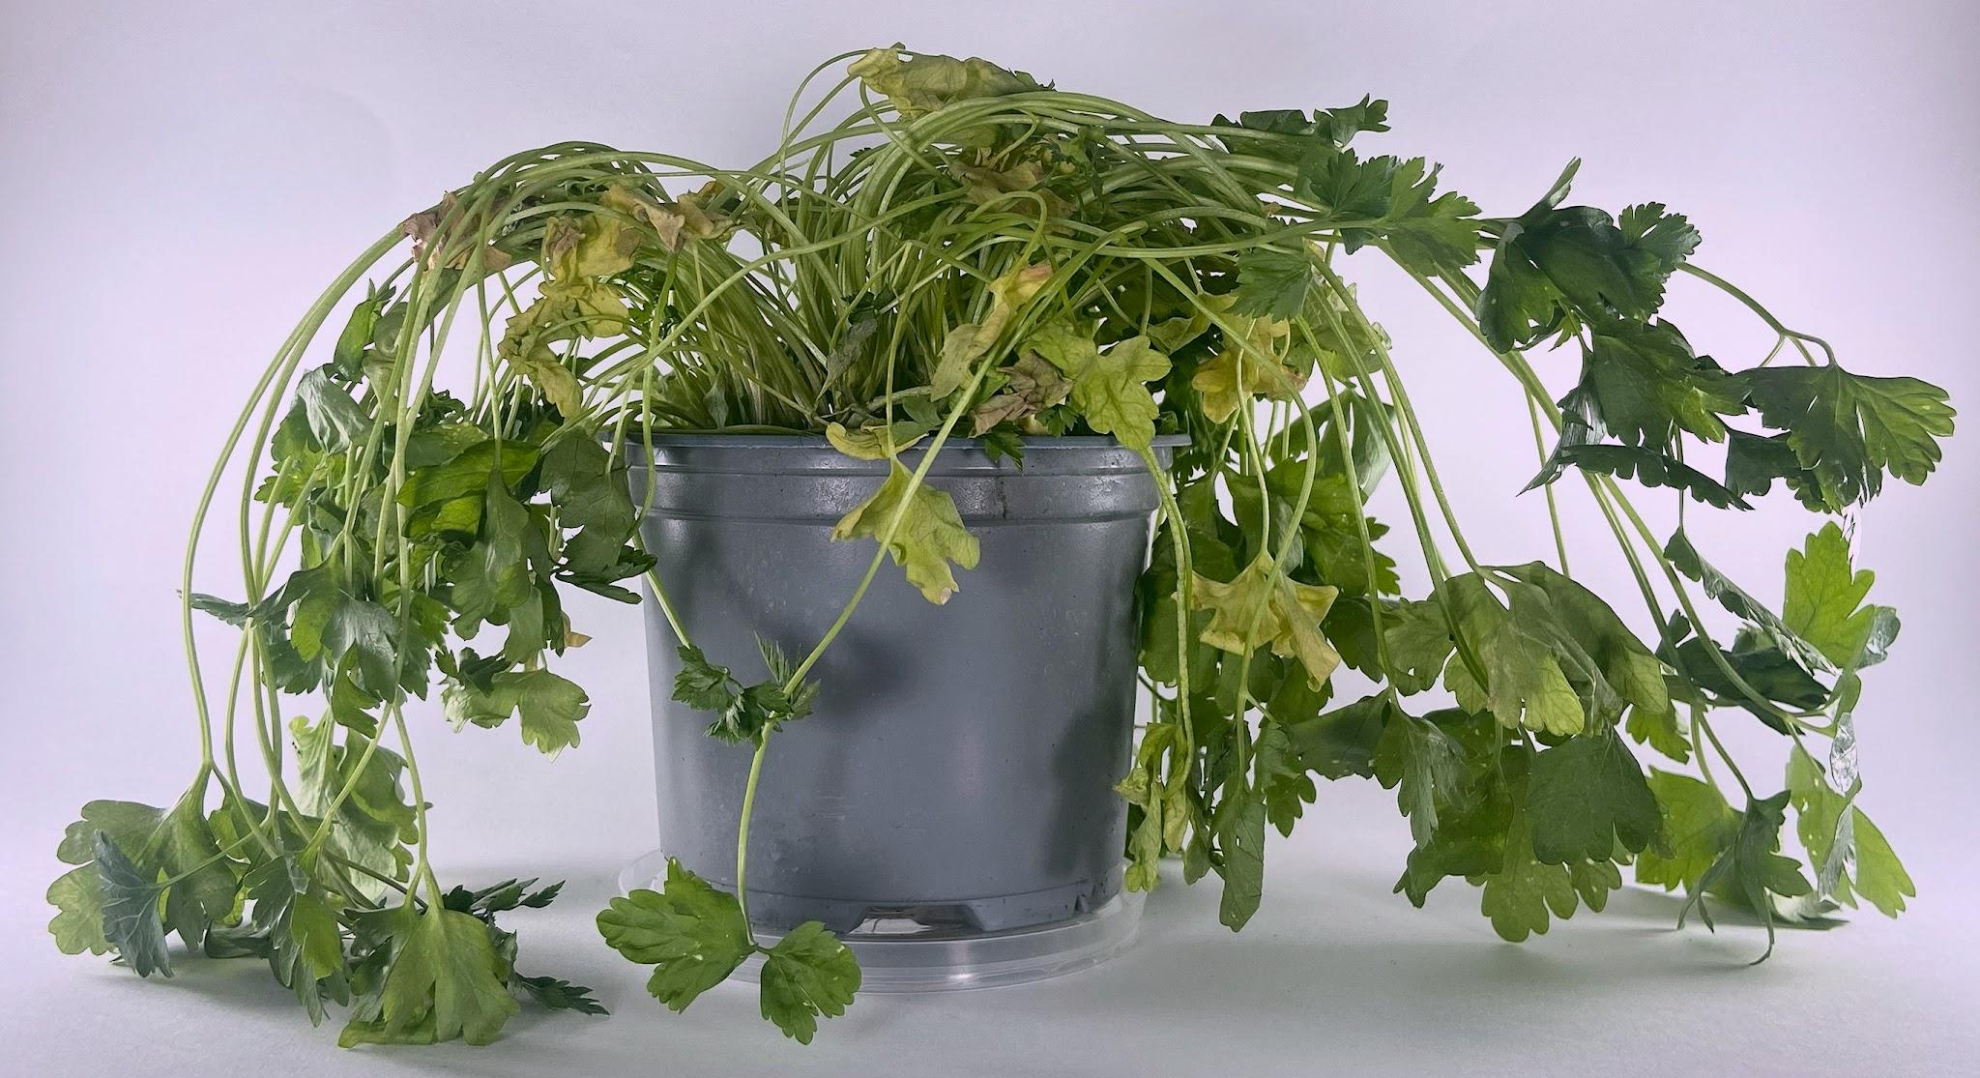
Astaamaha deegaanka (environmental features)
Deegaanku waa agagaarka noolaha shaqsiga ah sida iftiinka qorraxda, wasakhowga ama helitaanka nafaqooyinka.
Gabbaldhac (sunflower) heerkul sare ah marka loo barbardhigo heerkulka ugu fiican (optimum temperature).
Dhir (herb) biyo (water) la'aan ah marka loo barbardhigo biyaha ugu fiican (optimum water).

Slide 9
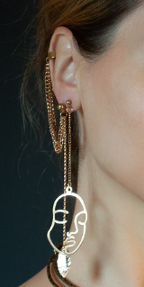
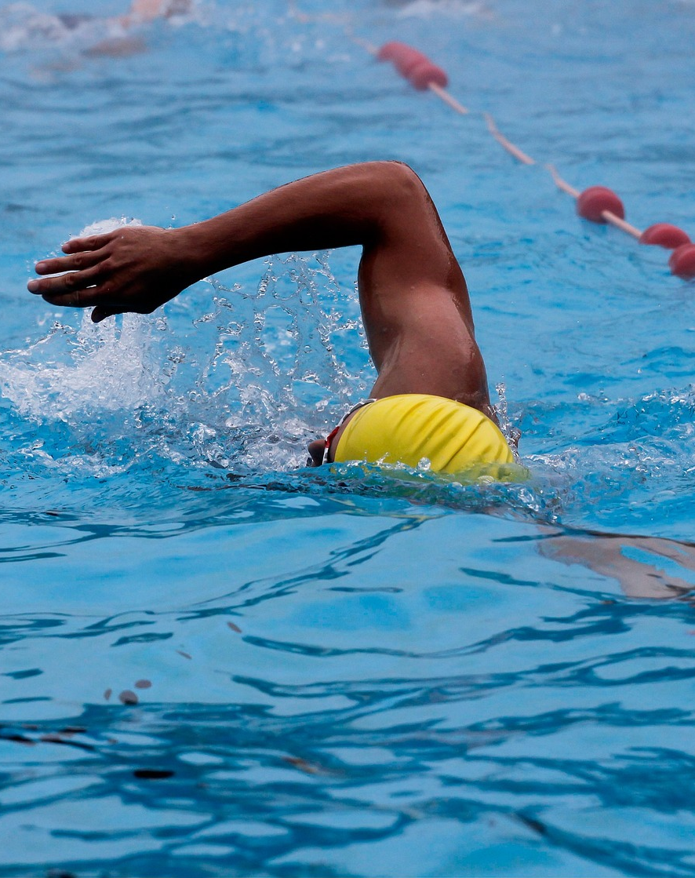
Astaamaha deegaanka (Environmental features)
Qaab nololeedka (lifestyle) qofku waa waxyaabaha uu sameeyo iyo go'aamada uu qaato, sida cuntada (diet), jimicsiga (exercise) iyo moodada (fashion).
Astaamaha lagu soo kordhiyey deegaanka (environment) ama qaab nololeedka (lifestyle) lama dhaxli karo faraca noolaha (organism's offspring).
daloolinta jirka (body piercing)
jimicsiga (exercising)

Slide 10
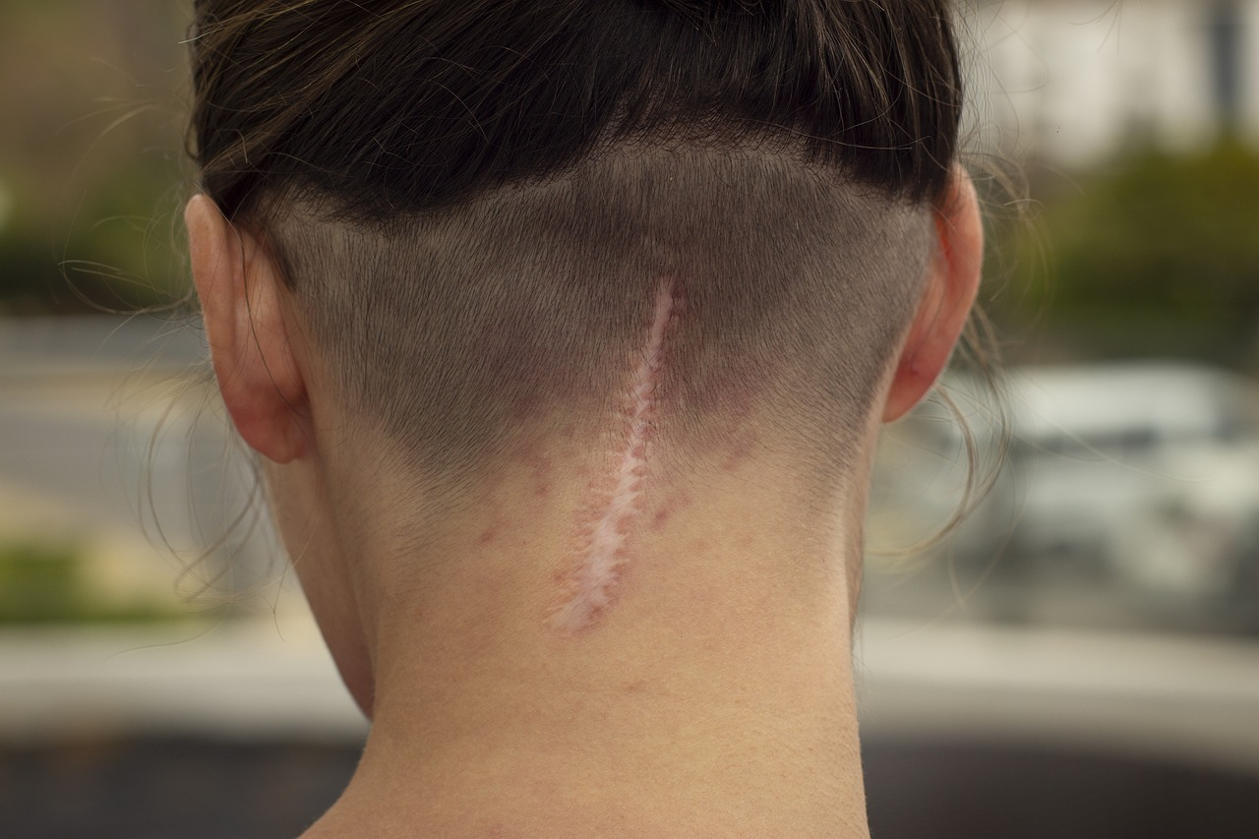
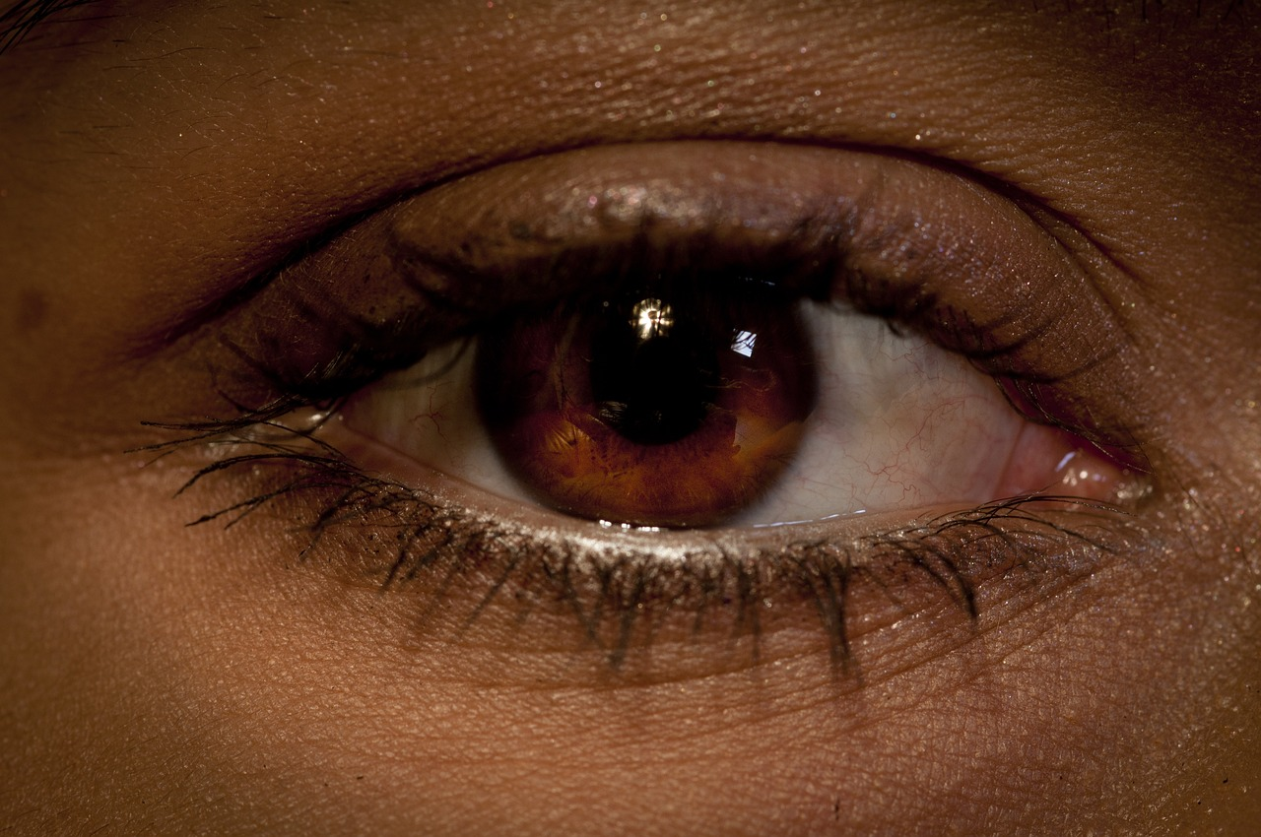

Astaamaha deegaanka (Environmental features)
Astaamaha (features) kee baa lagu helay qaab nololeedka (lifestyle) ama deegaanka (environment) qofka?
nabar (scar)
daloolin (piercing)
midabka indhaha (eye colour)

Slide 11
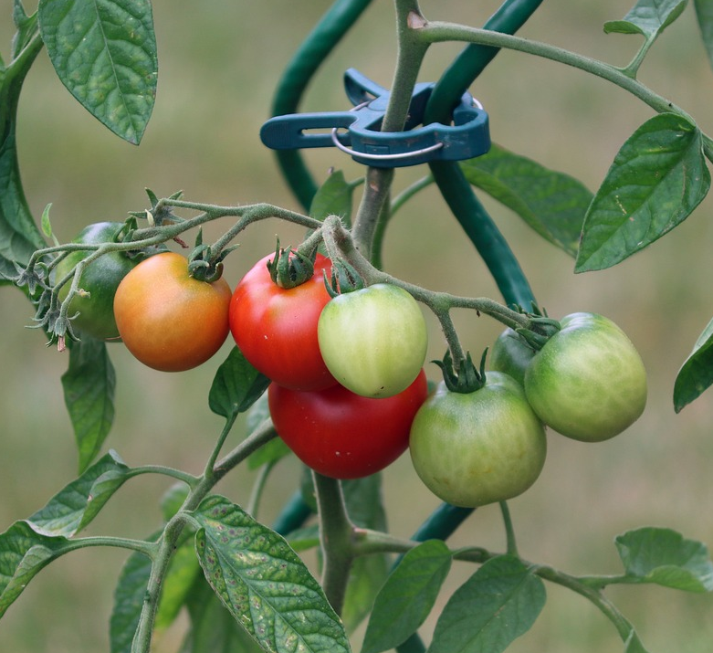
Astaamaha deegaanka (Environmental features)
Si fiican u fiiri sawirkan geed yaanyo (tomato plant).
Ku calaamadee astaamaha (features) laga yaabo inay sababeen deegaanka (environment).
2. Soo jeedi sababta ay uga yaabaan inay
soo baxeen (appeared).

Slide 12
Astaamaha deegaanka (Environmental features)
Calaamadee astaamaha ay sababi karto deegaanku oo sheeg sababta ay u soo bixi karaan.
Dhaawaca jirridda (Damage to stem)
oo ka yimid qaniinyada cayayaanka (from insect bites)
Caleemo engegaya (wilting)
biyo (water) la'aan
Midabka yaanyada (Colour of tomatoes)
kala duwanaanshaha iftiinka qorraxda (difference in sunlight)
Dhibco madow oo caleen ku yaal
caabuq (infection) awgeed
Dhibco jaalle ah oo caleen ku yaal
nafaqo (nutrients) la'aan

Slide 13
Dhaxalka (heredity) iyo hidaha (genetic material)
Astaamaha deegaanka (environmental features)
Hidaha (genetic material) iyo dhaxalka (heredity)
Dhaxalka (heredity) iyo deegaanka

Slide 14
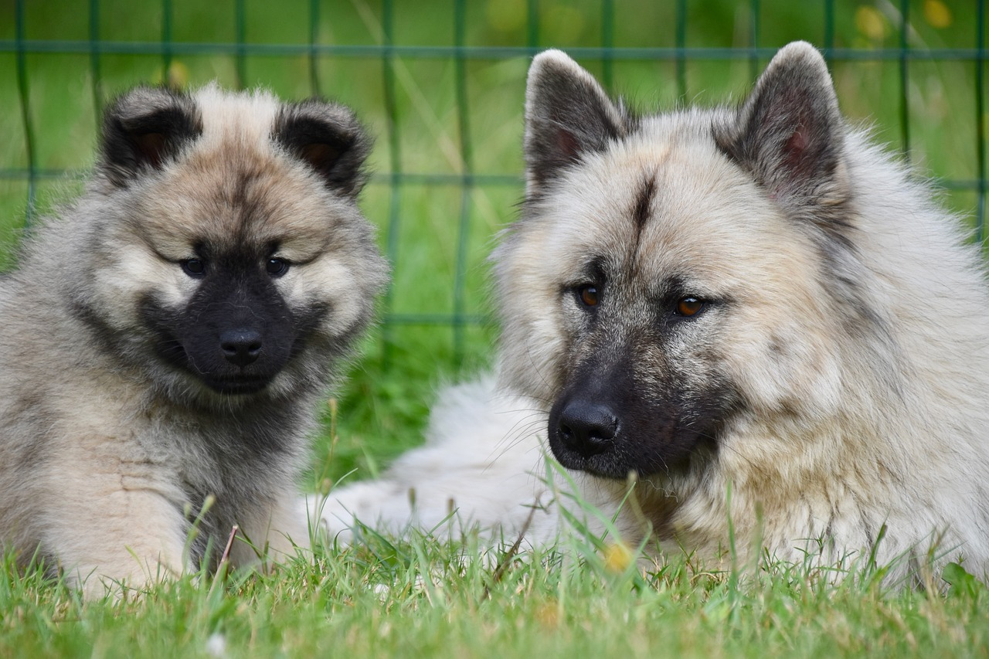
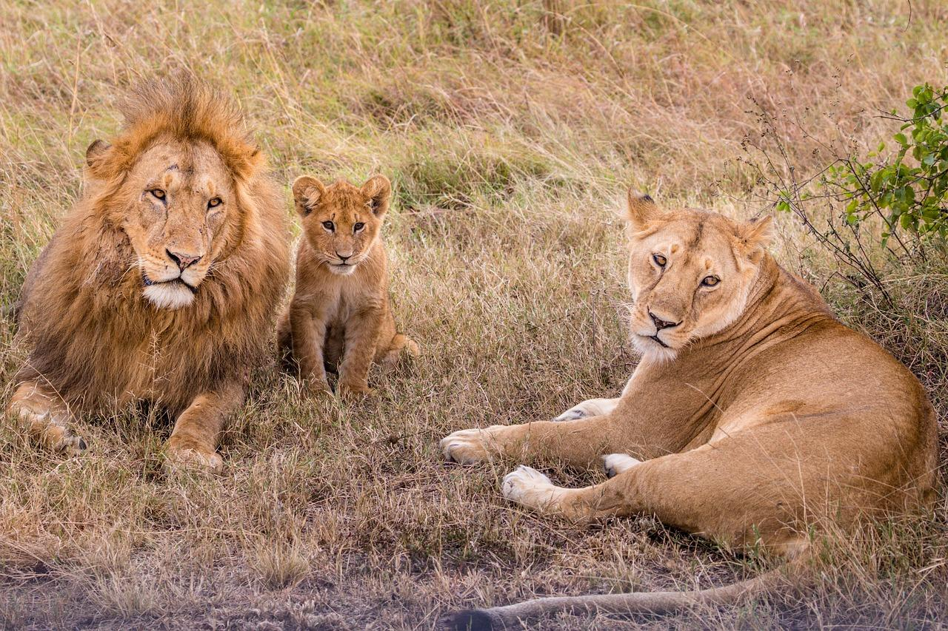
Hidaha (genetic material) iyo dhaxalka (heredity)
Dhaxalka (heredity) waa gudbinta astaamaha labada waalid ilaa ubadkooda.
Astaamahani waxay ka yimaadaan tilmaamo ku jira hidaha (genetic material) ee noolaha (organism).
Hidaha (genetic material) ee waalid kasta waxaa loo gudbiyaa ubadka iyada oo loo marayo taranka (reproduction).
Nooluhu (organism) wuxuu dhaxlaa kala badh hidihiisa (genetic material) waalid kasta.
ey iyo yar (dog and puppy)
libaax, libaaxad iyo curad (lion, lioness and cub)

Slide 15
Hidaha (genetic material) iyo dhaxalka (heredity)
Hidaha (genetic material) waa kiimiko (chemical substance).
Waxaa laga helaa unugyada (cells) ee noolaha (organism) oo dhan ka kooban yahay.
qalabka hidaha (genetic material)
unugga bakteeriyada (bacteria cell)
unug xayawaan (animal cell)
unugga dhirta (plant cell)
Qalabka hidaha (genetic material) wuxuu sidoo kale ka kooban yahay tilmaamaha hababka nolosha sida koritaanka (growth) iyo neefsiga (respiration).

Slide 16
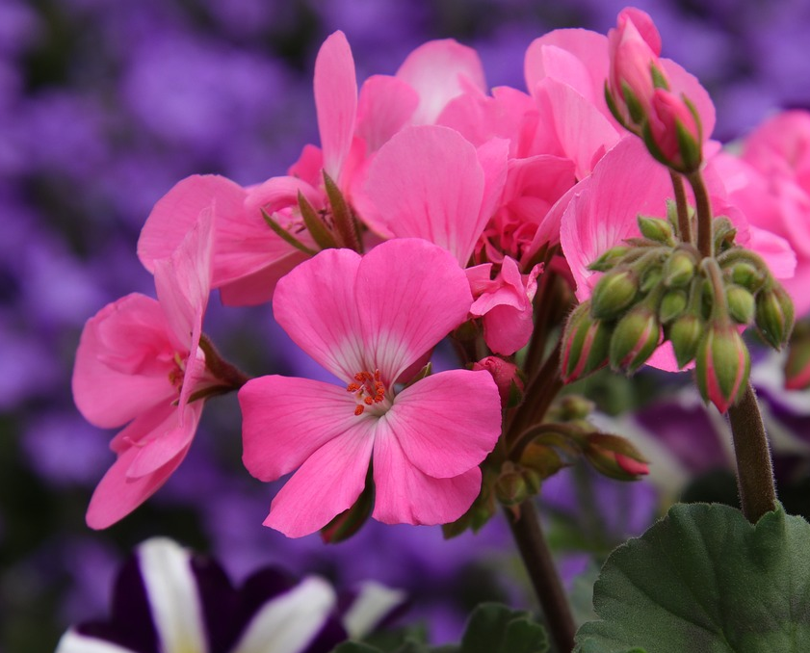
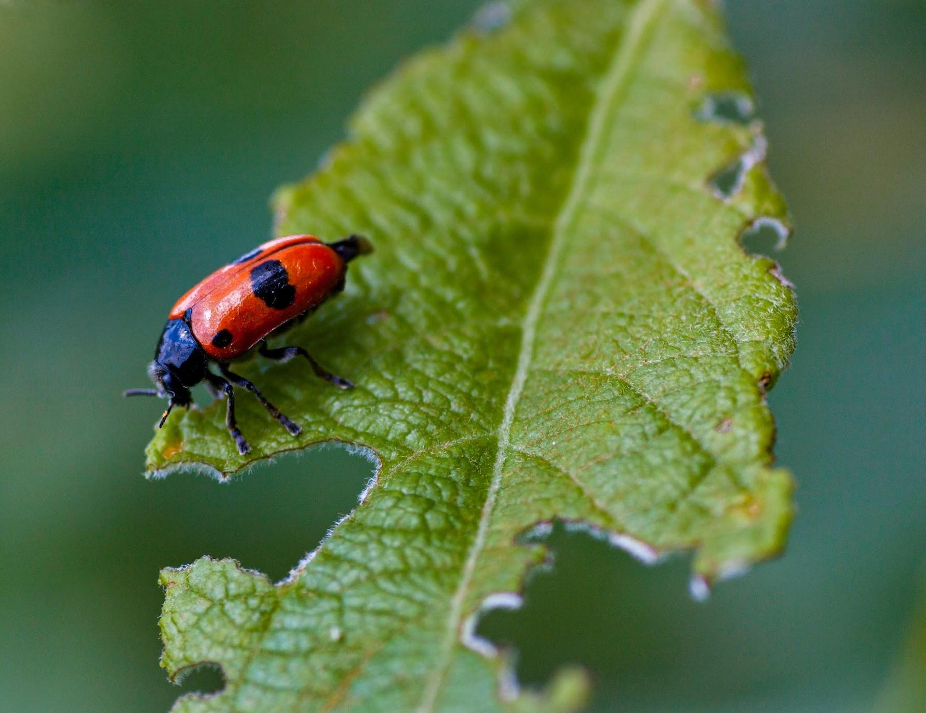
Qalabka hidaha (genetic material) iyo dhaxalka (heredity)
Kaliya sifooyinka ka dhasha tilmaamaha qalabka hidaha (genetic material) ee noolaha (organism) ayaa la dhaxli karaa.
Midabka ubaxa iyo midabka isha waa la dhaxlaa sababtoo ah waxay ka dhashaan tilmaamaha qalabka hidaha (genetic material).
Dhaawaca lama dhaxlo sababtoo ah wuxuu ka dhashaa deegaanka (ama qaab nololeedka).

Slide 17
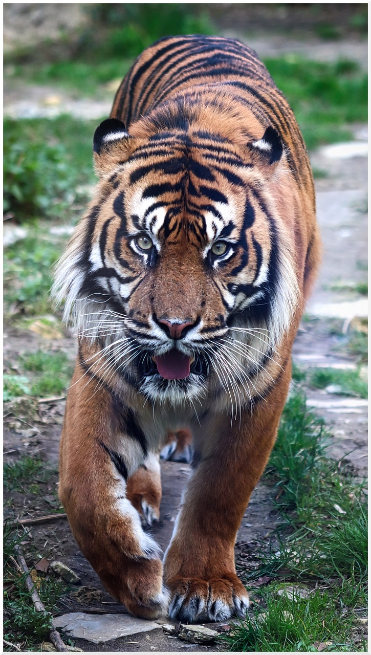
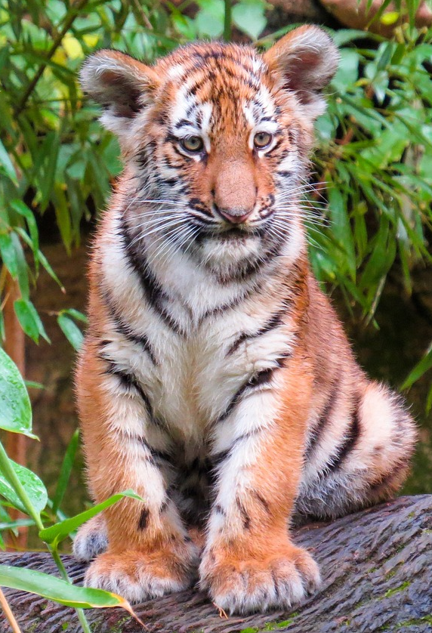
Qalabka hidaha (genetic material) iyo dhaxalka (heredity)
Sifooyinka calaamadeysan ee shabeelka weyn (adult tiger) kee baa loo gudbin karaa dhashiisa (cub)?
indho cagaar (green eyes)
dhegta jeexan (torn ear)
nabar (scar)
dhogor oranji iyo madow (orange and black fur)
shabeel weyn (adult tiger)
dhashi shabeel (tiger cub)

Slide 18






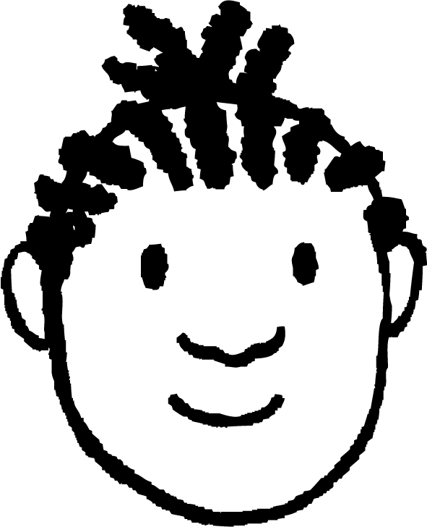


Qalabka hidaha (genetic material) iyo dhaxalka (heredity)
Layla, Caasha iyo Yacquub waxay ka wada hadlayaan dhaxalka (heredity).
Dhammaan sifooyinka jireed waxaa laga gudbiyaa waaliddiinta carruurtooda qalabka hidaha (genetic material).
Tilmaamaha hababka sida koritaanka (growth) waxaa laga gudbiyaa waaliddiinta carruurtooda qalabka hidaha (genetic material).
Layla
Qalabka hidaha (genetic material) wuxuu uun kakooban yahay tilmaamo astaamaha jirka qaarkood, kuwa kalena waxaa keena deegaanka (environment) ama hab-nololeedka (lifestyle).
Yacquub
Caasha
Dhammaan ardaydu waxay leeyihiin fikrado qaar oo sax ah.
Dooro qofka aad u maleyneysaa inuu fahankiisu ka fiican yahay.
Qor sharaxaad ka fiican oo faahfaahsan oo ku saabsan qalabka hidaha (genetic material) iyo dhaxalka (heredity) adigoo isticmaalaya fikradaha ardayda.

Slide 19
Qalabka hidaha (genetic material) iyo dhaxalka (heredity)
Dooro qofka aad u maleyneysaa inuu fahankiisu ka fiican yahay.
Qor sharaxaad ka fiican oo faahfaahsan oo ku saabsan qalabka hidaha (genetic material) iyo dhaxalka (heredity) adigoo isticmaalaya fikradaha ardayda.
Caasha iyo Yacquub waxay muujiyeen faham ka fiican kan Layla.
Dhaxalka (heredity) waa gudbinta qalabka hidaha (genetic material) jiil ilaa jiil.
Qalabka hidaha (genetic material) waxaa dhaxla ubadka labada waalidba.
Qalabka hidaha (genetic material) wuxuu sidaa tilmaamo hababka sida koritaanka (growth).
Qalabka hidaha (genetic material) wuxuu sidaa tilmaamo astaamaha jirka qaarkood.
Astaamaha jirka qaarkood iyo hababka waxaa sidoo kale saameeya hab-nololeedka (lifestyle) iyo
deegaanka (environment).

Slide 20
Dhaxalka (heredity) iyo qalabka hidaha (genetic material)
Astaamaha deegaanka (environmental features)
Qalabka hidaha (genetic material) iyo dhaxalka (heredity)
Dhaxalka (heredity) iyo deegaanka (environment)

Slide 21
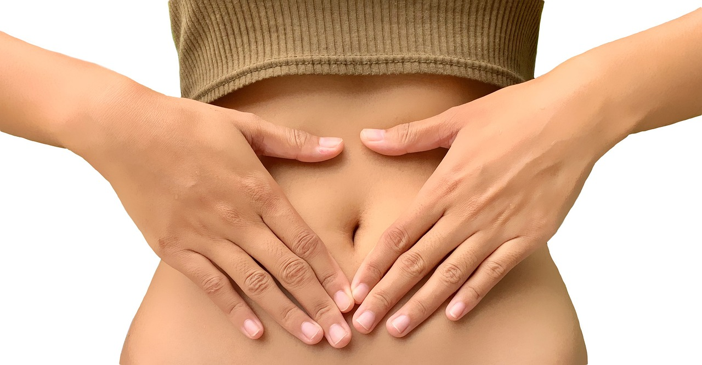
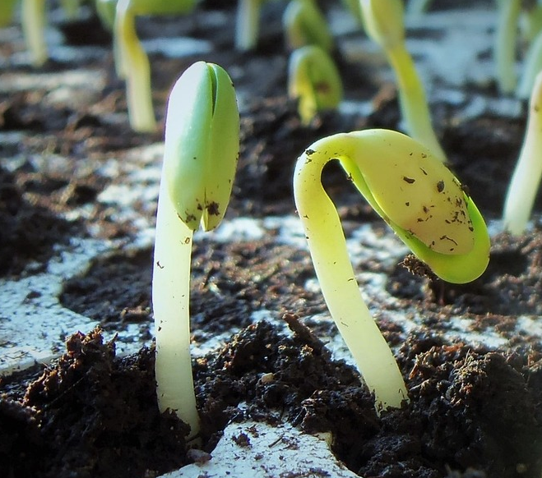
Dhaxalka (heredity) iyo deegaanka (environment)
Astaamaha deegaanka (environmental) iyo kuwa la dhaxlo (inherited) mar walba ma aha kuwo la arki karo.
Isku darka dhaxalka (heredity), hab-nololeedka (lifestyle) iyo deegaanka (environment) ayaa ku lug leh habab badan.
Nidaamyadani waxaa ka mid ah dheefshiidka (digestion) xayawaanka iyo biqilka (germination) dhirta.

Slide 22
Dhaxalka (Heredity) iyo deegaanka (environment)
Qaar ka mid ah sifooyinka waxaa go'aamiya oo keliya tilmaamaha ku jira hiddo-wadaha (genetic material) la dhaxlo oo aan lagu beddeli karin deegaanka (environment) ama qaab nololeedka (lifestyle).
Xataa haddii aad xidhato muraayad indho oo midab leh (coloured contact lens), midabka indhahaaga la dhaxlay waa isku mid.
Dhammaan sifooyinka la dhaxlo ma aha kuwa la arki karo.
Nooca dhiigga (blood type) ee bini'aadamka (A, B, AB ama O) waxaa go'aamiya tilmaamaha ku jira hiddo-wadaha (genetic material) la dhaxlo oo aan lagu beddeli karin.

Slide 23
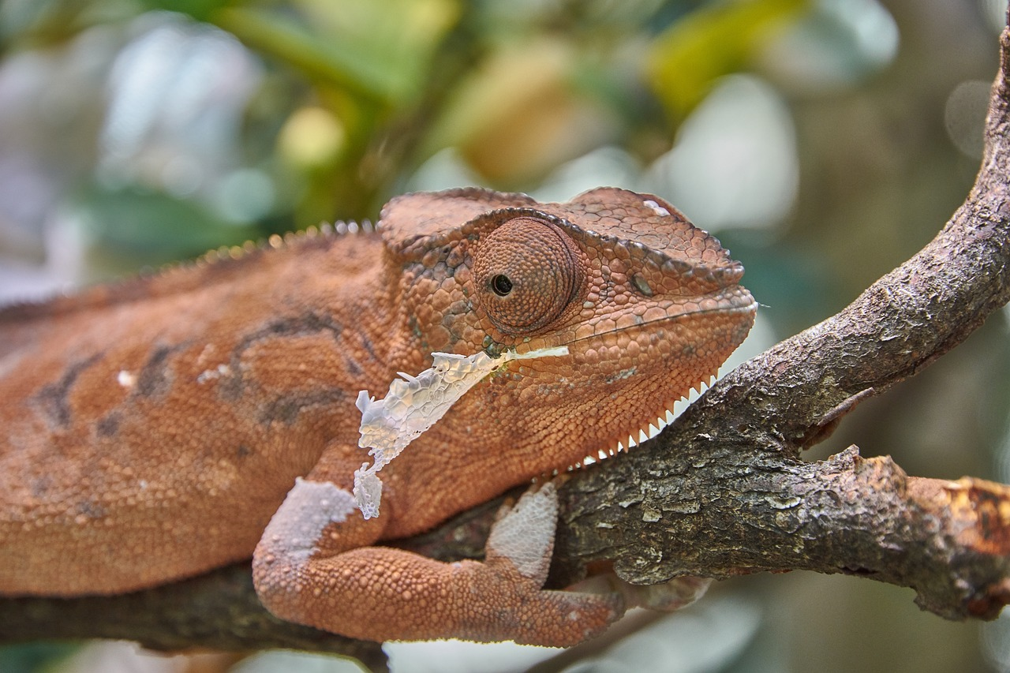
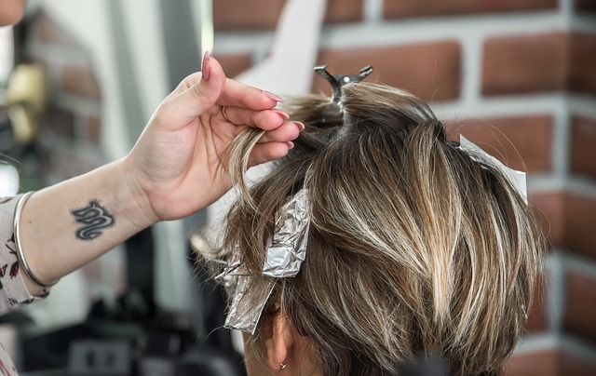
Dhaxalka (Heredity) iyo deegaanka (environment)
Muuqashada sifooyinka jireed (physical features) inta badan waa isku darka dhaxalka (heredity) iyo deegaanka (environment) ama qaab nololeedka (lifestyle).
Chameleons waxay beddeli karaan midabka maqaarkooda si ay ugu ekaadaan deegaankooda (environment).
Waxay dhaxlaan tilmaamo u oggolaanaya inay sidaan sameeyaan.
Midabka timahaaga dabiiciga ah waa natiijada tilmaamaha la dhaxlay.
Laakiin waxaa laga yaabaa in lagu beddelo doorashooyinka qaab nololeedka (lifestyle).

Slide 24
Dhaxalka (Heredity) iyo deegaanka (environment)
Sifooyinkaas oo ay saameeyaan isku darka dhaxalka (heredity) iyo qaab nololeedka (lifestyle) ama deegaanka (environment) waa kuwee?
midabka maqaarka (skin colour)
midabka indhaha (eye colour)
qaabka sanka (nose shape)
dhererka (height)

Slide 25
Heredity iyo deegaanka (Heredity and environment)
Dhig sifooyinka bini'aadamka ee liiska ku qoran meesha saxda ah ee jaantuska Venn (Venn diagram) haddii ay saameeyaan dhaxalka (heredity), deegaanka (environment)/qaab nololeedka (lifestyle) ama labadaba.
Dhaxalka (Heredity)
Deegaanka (Environment)
/ qaab nololeedka (lifestyle)
midabka indhaha (eye colour)
dhererka (height)
midabka timaha (hair colour)
cufnaanta jirka (body mass)
tattoos (tattoos)
dhegaha daloolinta (piercing)
nabarro (scars)
luqadda (language)
nooca dhiigga (blood type)

Slide 26
Heredity iyo deegaanka (Heredity and environment)
Dhig sifooyinka aadanaha ee liiska ku qoran meesha ku habboon ee jaantuska Venn ee ah in ay saameeyaan heredity, deegaanka/qaab nololeed ama labadaba.
Deegaanka (Environment)
/ hab nololeed (lifestyle)
Jawaabaha:
Heredity (Heredity)
cufnaanta jirka (body mass)
tattoos (tattoos)
midabka indhaha (eye colour)
dhegaha daloolinta (piercing)
midabka timaha (hair colour)
nooca dhiigga (blood type)
luqadda (language)
dhererka (height)
nabarro (scars)

Slide 27
Dhaxalka iyo qalabka hidaha (Heredity and genetic material)
Astamaha noolaha (Biological features) waxaa laga dhaxli karaa waalidiinta marka qalabka hidaha (genetic material) laga gudbiyo waalidiinta caruurtooda inta lagu jiro taranka (reproduction).
Qalabka hidaha (Genetic material) wuxuu bixiyaa tilmaamo (instructions) koritaanka iyo hababka nolosha kale.
Astamaha lagu sameeyay deegaanka (environment) ama hab nololeedka (lifestyle), tusaale nabarro (scars), lama dhaxli karo caruurtu. Kaliya astamaha ka yimaada tilmaamaha qalabka hidaha (genetic material), tusaale midabka isha (eye colour), ayaa la dhaxli karaa.
Astamaha jirka (Physical features) inta badan waa isku darka dhaxalka (heredity) iyo deegaanka (environment) ama hab nololeedka (lifestyle).

