Slide 1
Heredity (Heredity)
Heredity iyo DNA (Heredity and DNA)

Slide 2
sida loo isticmaalo darasyada Oak (how to use Oak lessons)

Slide 3
Waxaan qeexi karaa waxa loola jeedo heredity iyo sababta ubadku inta badan ugu ekaato waalidkood.

Slide 4
taranka (reproduction)
ubadka (offspring)
dhaxalka (inherit)
heredity (heredity)
kala duwanaanshaha (variation)

Slide 5
Taranku waa habka samaynta ubadka.
Ubadka noole (organism) waa kuwa yar ee la soo saaro ka dib taranka.
Ubadku waxay dhaxlaan isku darka astaamaha labada waalid.
Heredity waa habka loo gudbiyo astaamaha shakhsiyaadka ilaa ubadka, iyada oo loo marayo taranka.
Farqiga u dhexeeya shakhsiyaadka isku nooca ah waxaa loo yaqaan variation.

Slide 6

Heredity (Heredity)
Samaynta ubadka
Astaamaha la dhaxlo
Kala duwanaanshaha ubadka

Slide 7
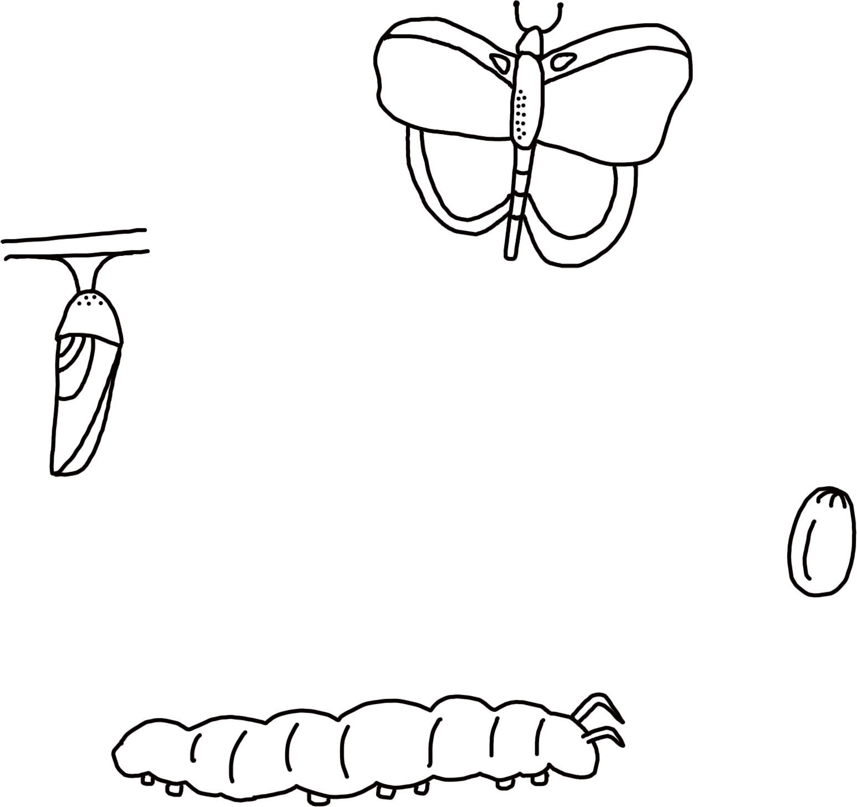
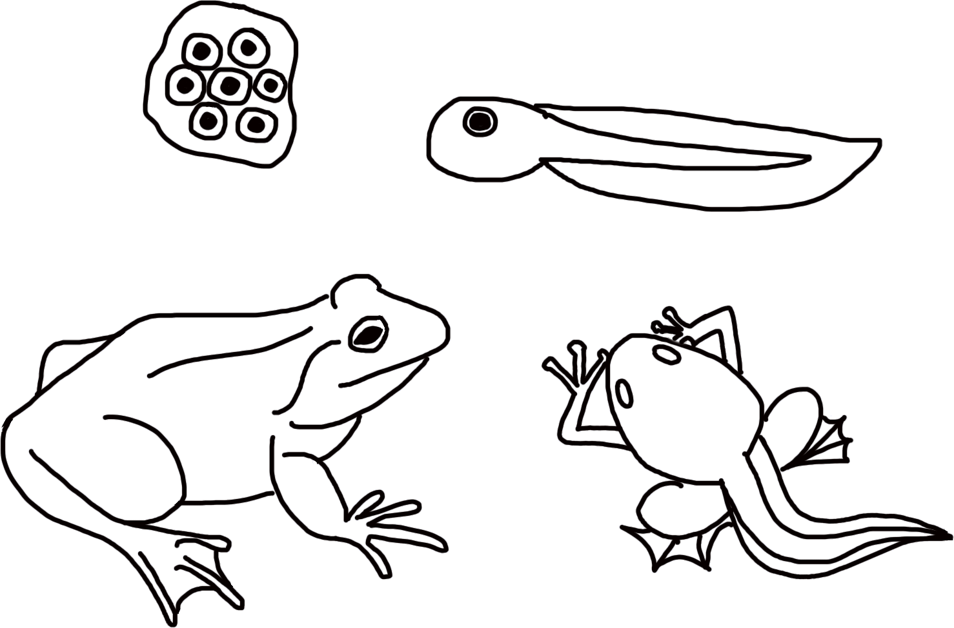
Samaynta ubadka
Taranku waa mid ka mid ah hababka caadiga ah ee noolaha (organisms).
Dhammaan noolaha (organisms) waxay tarmaan (reproduce) waqti ka mid ah wareegga noloshooda (life cycle).
Furaha (Key)
Koritaanka (Growth)
Tarmidda (Reproduction)
wareegga nolosha balanbaalista (butterfly life cycle)
wareegga nolosha rah (frog life cycle)

Slide 8
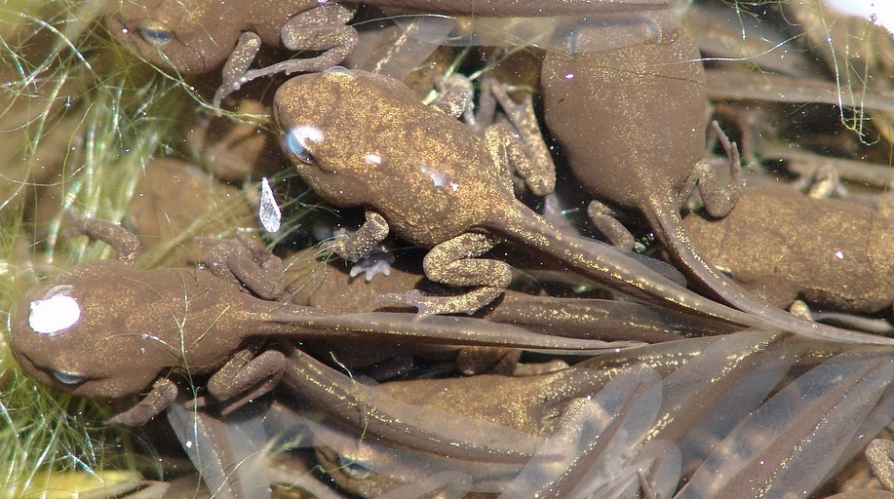
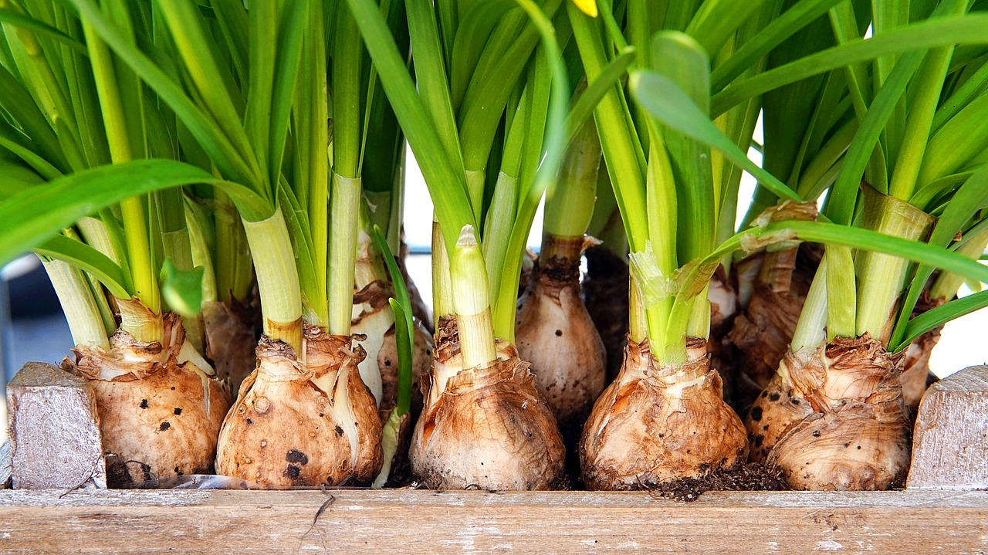
Samaynta faraca (Making offspring)
Marka nooluhu (organisms) tarmaan (reproduce) waxay sameeyaan farac (offspring) isku nooc (species). Faracu wuxuu u ekaadaa waalidiinta waqti ka mid ah wareegga noloshooda (life cycle).
Rah-yar (Froglets) waa faraca (offspring) yar ee rah. Waxay ka koraan ukunta rah (frogspawn).
Daffodil-yar (Young daffodils) waa farac (offspring), waxay ka koraan gogol (bulbs) ay soo saareen daffodil-yada.

Slide 9
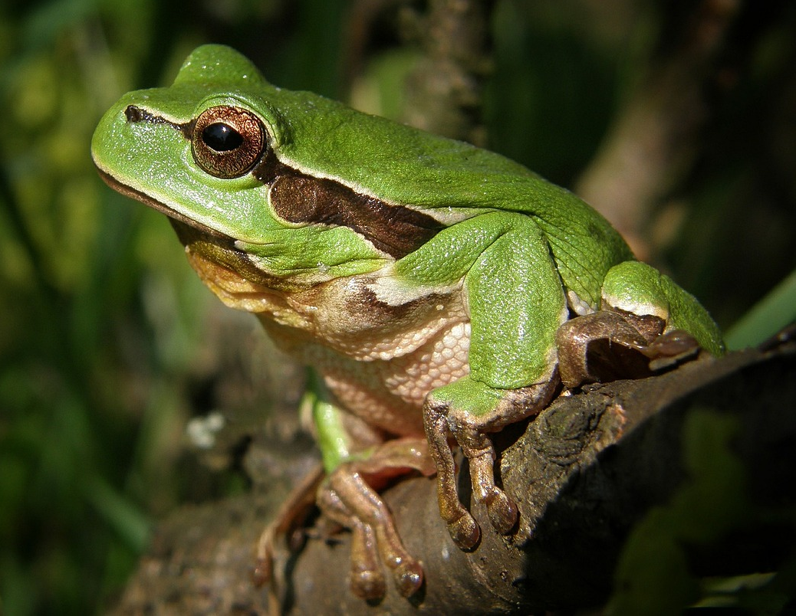
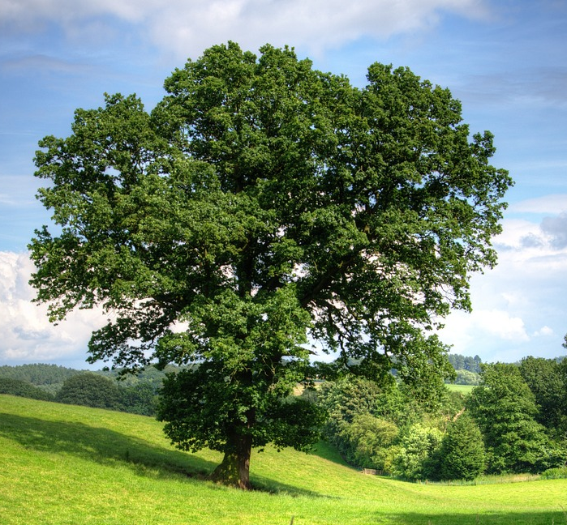
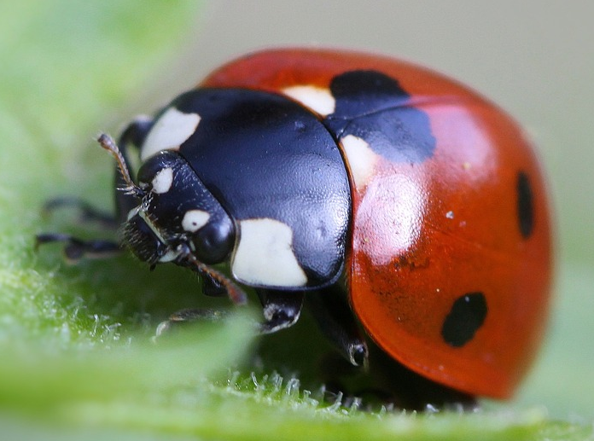

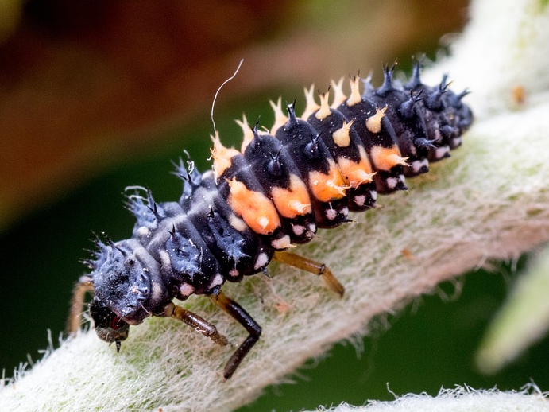
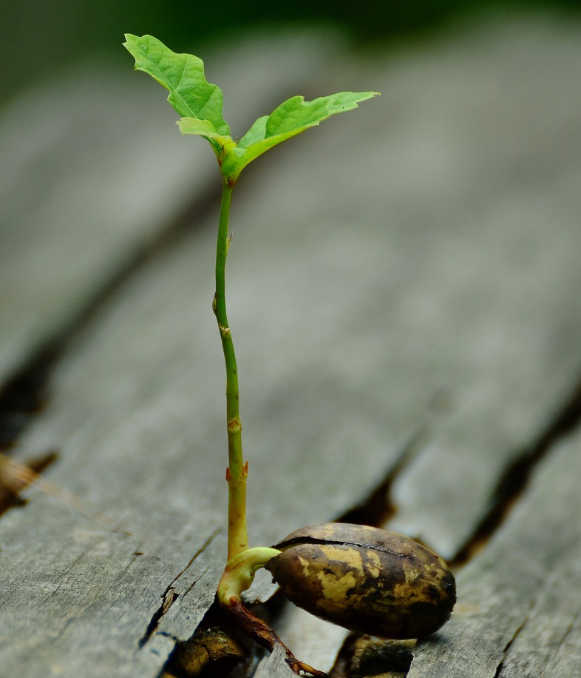
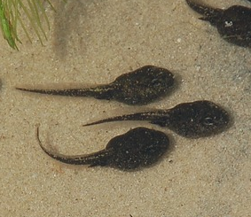
Samaynta faraca (Making offspring)
Isku dhig noolaha qaangaarka ah (adult organism) iyo faraciisa (offspring):
a
b
c
1
2
3

Slide 10
Samaynta faraca (Making offspring)
Isku dhig noolaha qaangaarka ah (adult organism) iyo faraciisa (offspring):
a
b
c
1
3
2

Slide 11
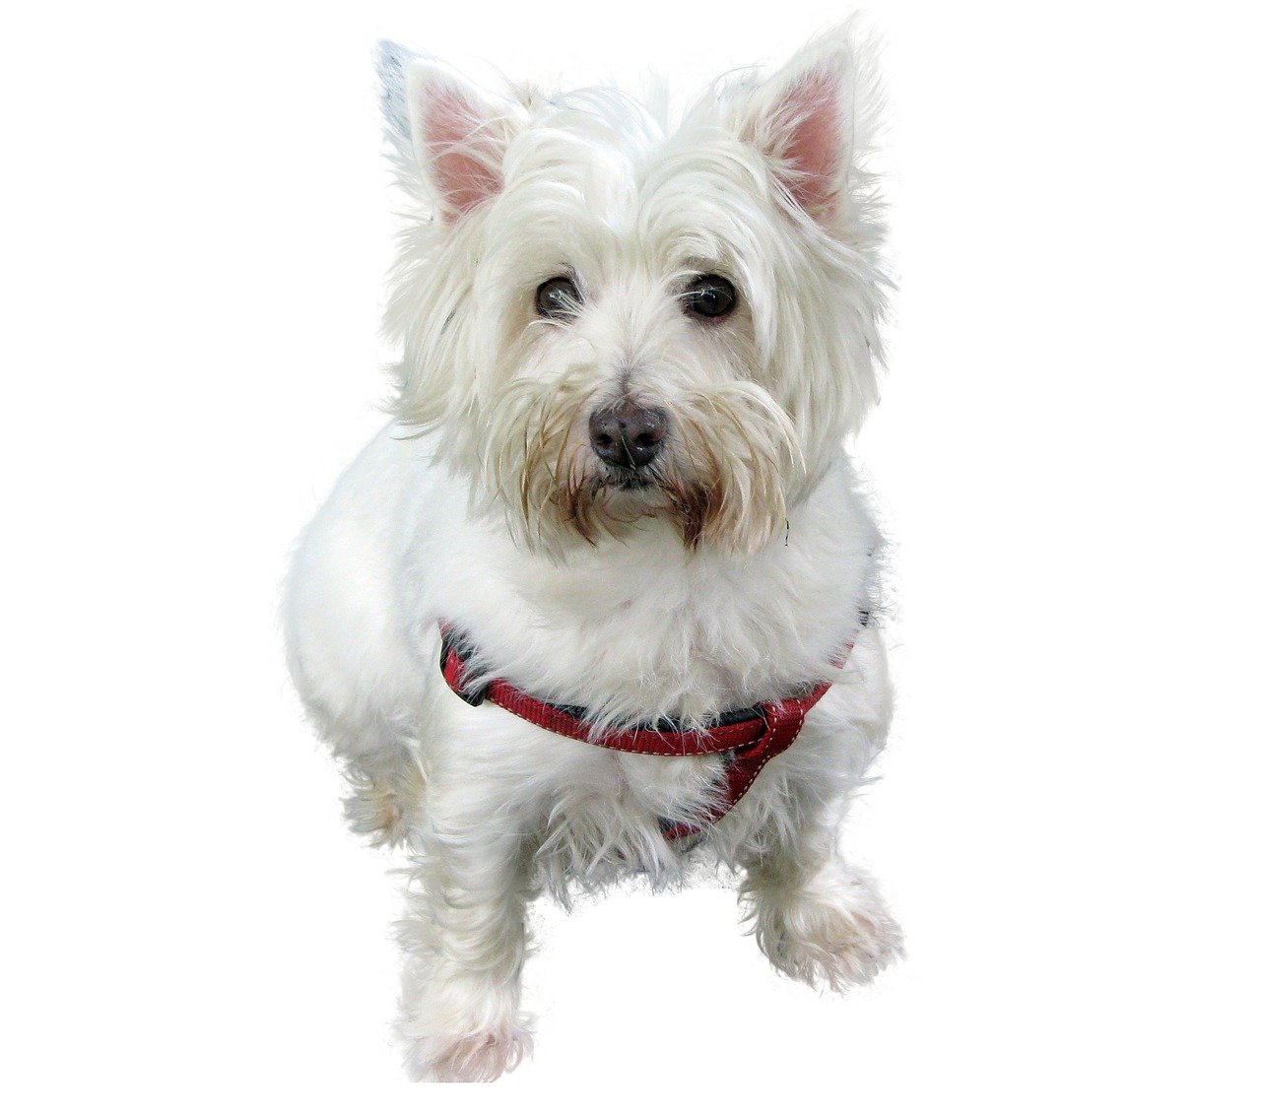


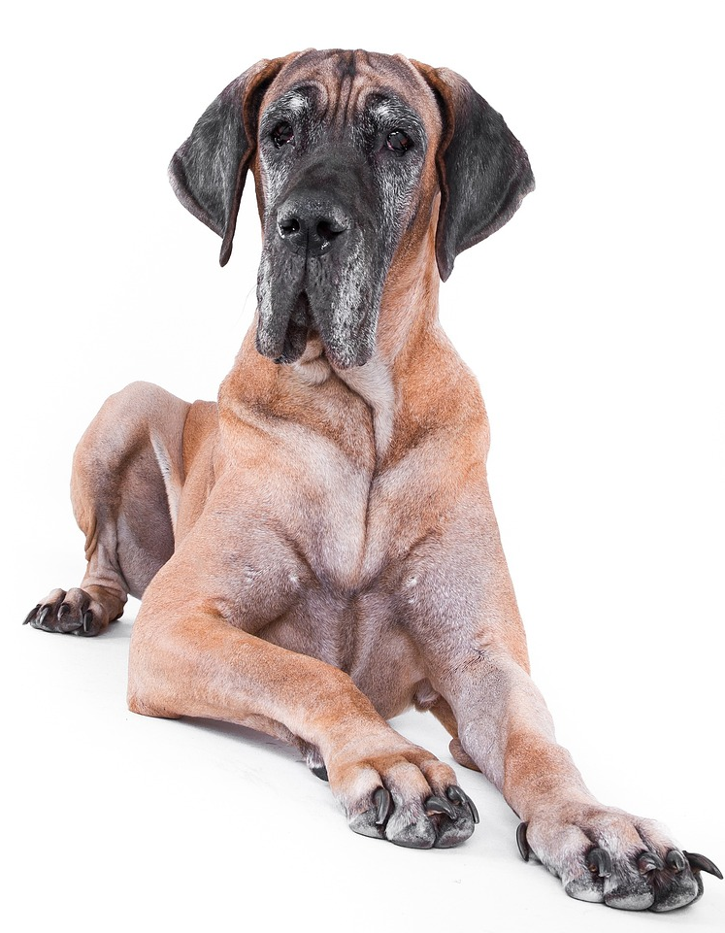





Samaynta faraca (Making offspring)
Cabdi iyo Suad waxay ka hadlayaan sida eey yar (puppy) ee laba terrier u ekaan karo.
Wuxuu u ekaan karaa Great Dane, sababtoo ah eeyadu waxay dhalin karaan nooc kasta oo eey ah.
laba terrier
Cabdi
Wuxuu u ekaan doonaa terrier, sababtoo ah terrier-yadu waxay dhalin karaan oo keliya terrier.
Suad
Sharax sababta Suad uu yahay kan ugu saxsan uguna hadal fikradaha saxda ah iyo kuwa qaldan ee jawaabahooda.
Great Dane

Slide 12
Samaynta farcanka (Making offspring)
Sharax sababta Suad uu yahay kan ugu saxsan uguna hadal fikradaha saxda ah iyo kuwa qaldan ee jawaabahooda.
Suad ayaa ugu saxsan sababtoo ah marka nooluhu (organism) soo saaraan farcan waxay sameeyaan farcan isku nooc ah.
Cabdi waa qaldan, sababtoo ah Great Dane kuma eka terrier si dhow. Laba terrier ayaa soo saari lahaa yaryar leh astaamo la mid ah iyaga.

Slide 13
Dhaxalka (Heredity)
Samaynta farcanka (Making offspring)
Astaamaha la dhaxlo (Inherited features)
Kala duwanaanshaha farcanka (Variation between offspring)

Slide 14
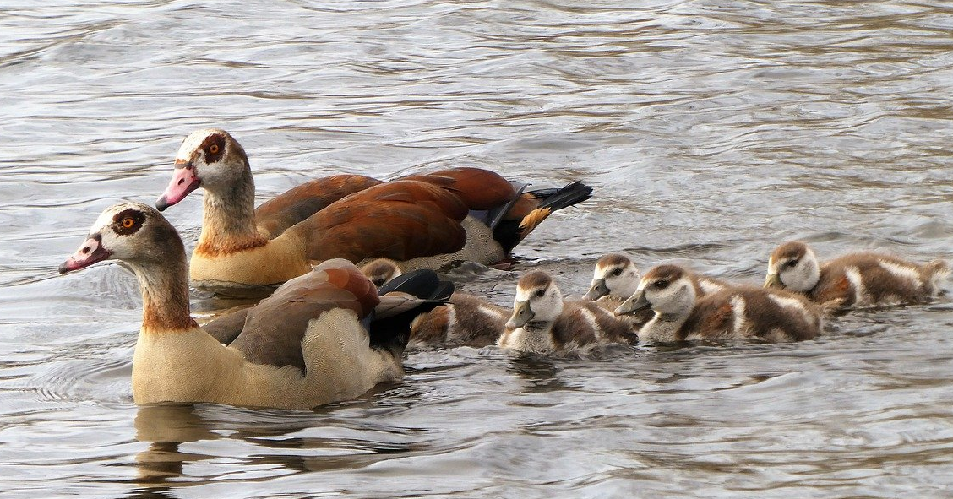
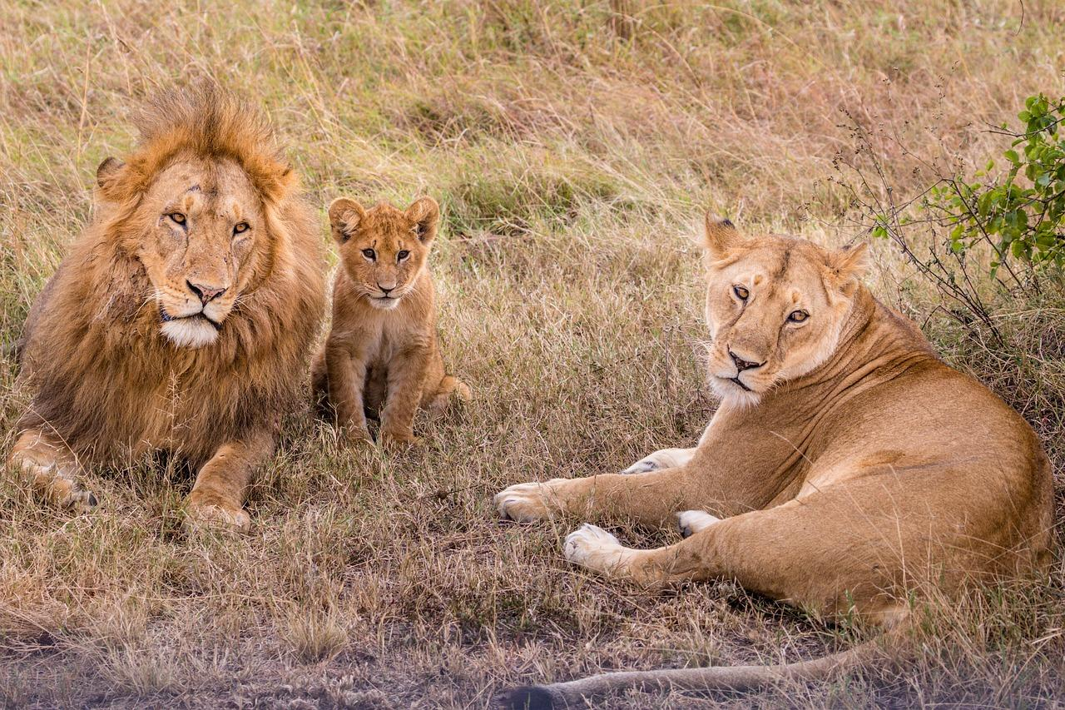
Astaamaha la dhaxlo (Inherited features)
Farcanku wuxuu u ekaadaa labada waalid sababtoo ah astaamaha ayaa laga soo gudbiyay labadoodaba.
Farcanku wuxuu dhaxlay astaamahan.
Dhaxalka (Heredity) waa habka nooluhu (organism) u gudbiyaan astaamaha farcankooda.
waaliddiinta geese oo ay weheliyaan farcankooda
waaliddiinta libaaxa oo ay weheliyaan farcankooda

Slide 15
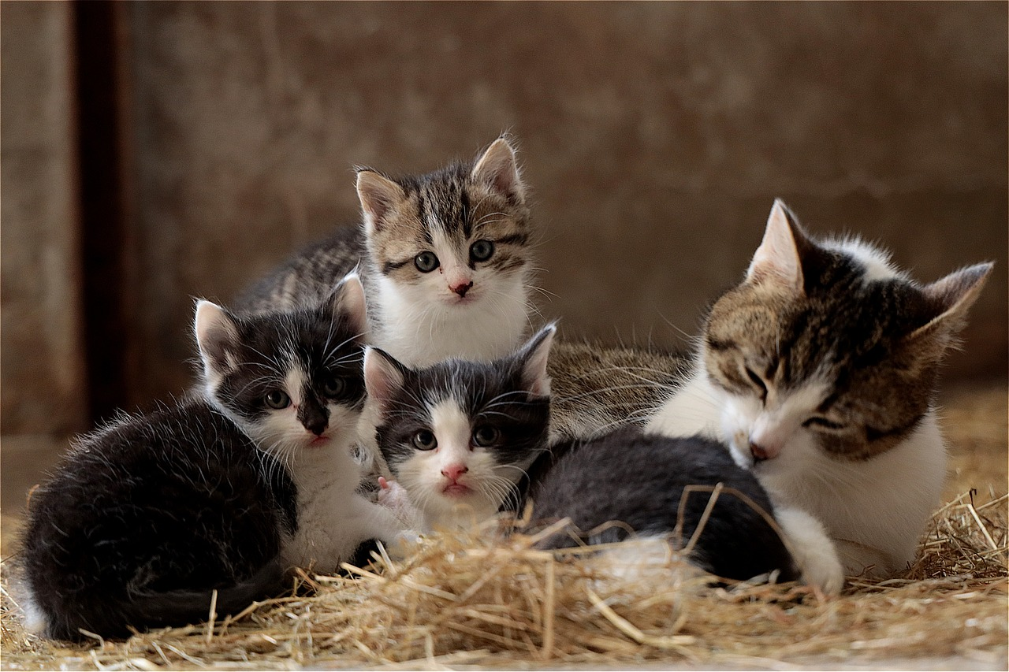
Astaamaha la dhaxlo (Inherited features)
Farcanka isku waalid waxaa loo yaqaan walaalo (siblings).
Walaaluhu waxay u ekaan karaan mid la mid ah, laakiin ma aha isku mid, sababtoo ah waxay dhaxlaan astaamaha labada waalid.
Marka laga reebo mataanaha isku midka ah, kuwaas oo u ekaan kara isku mid.
walaalo bisad ah

Slide 16

Astaamaha la dhaxlo (Inherited features)
Dhammaan astaamaha ilmuhu waxay ka dhaxlaan hooyadiis.
Ilmuhu wuxuu dhaxlaa astaamihiisa hooyadiis iyo ayeeyadiis.
Ilmuhu wuxuu dhaxlaa astaamihiisa labada waalid.

Slide 17
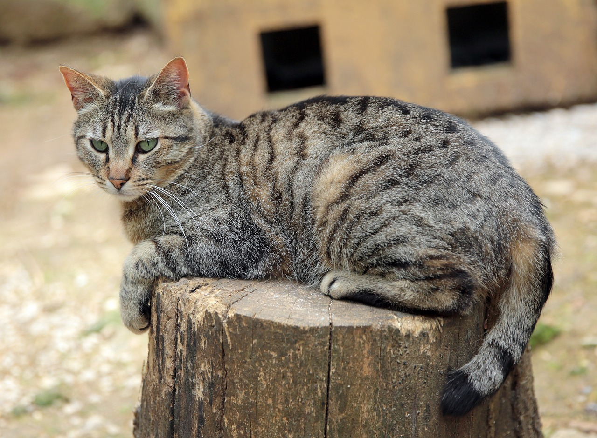
Sifooyinka la dhaxlo (Inherited features)
Sifooyinka la dhaxlo (Inherited features) waa astaamo la arki karo ama habab aan la arki karin oo laga sii gudbiyo waalidka carruurtooda.
Kuwani waa tusaalooyin qaar ka mid ah sifooyinka la arki karo ee la dhaxli karo (inherited):
qaabka dhegta (ear shape)
qaabka dhogorta (fur pattern)
midabka indhaha (eye colour)
midabka dhogorta (fur colour)
dhererka dabada (tail length)

Slide 18
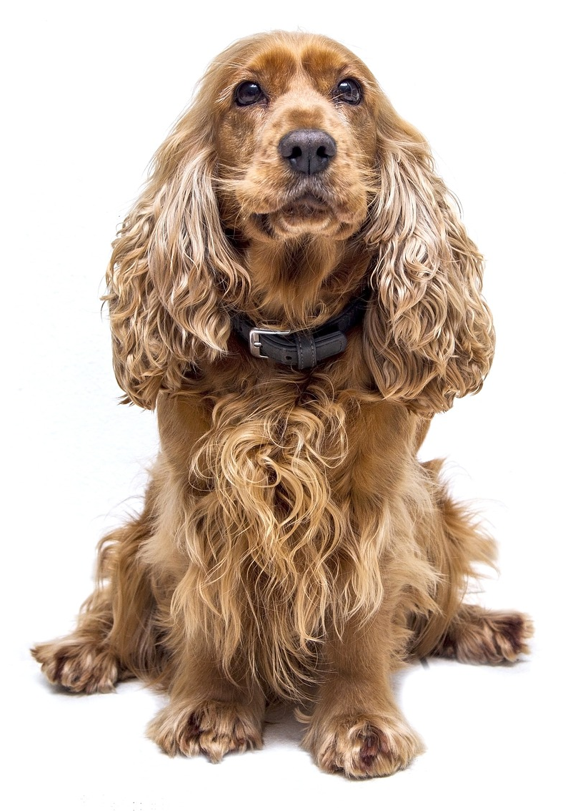
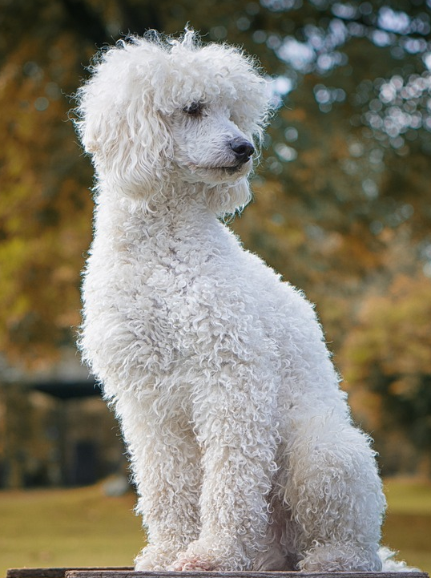
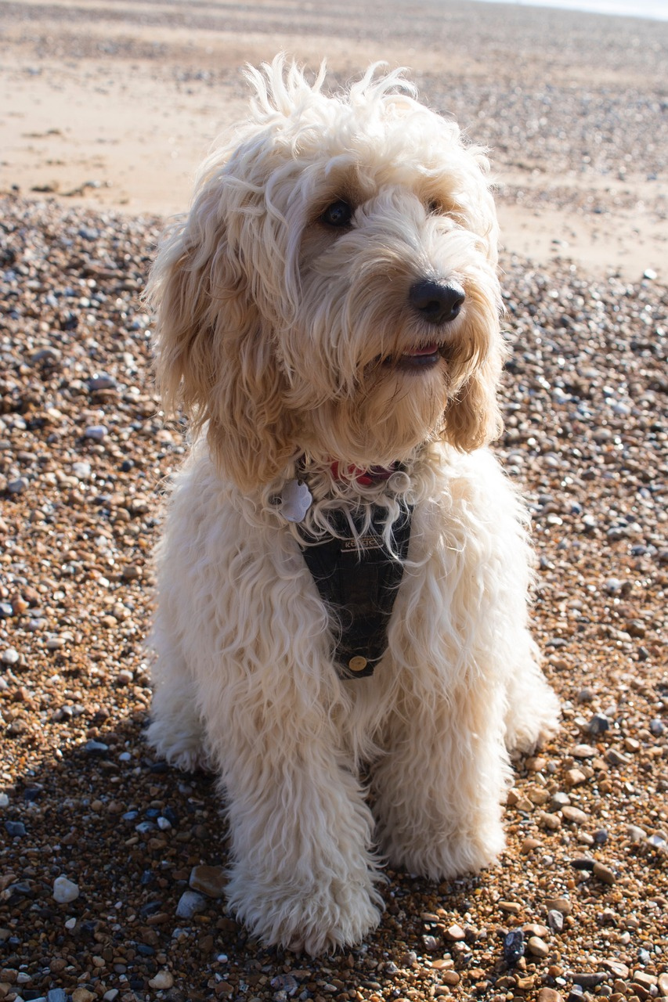
Sifooyinka la dhaxlo (Inherited features)
Cocker spaniel iyo poodle waxay dhalaan yaryar (puppy), kani waa faracooda (offspring). Nooca yaryar waxaa loo yaqaan cockapoo.
Sharax sifooyinka uu cockapoo ka dhaxlay waalidkiis.
cocker spaniel
poodle
cockapoo

Slide 19
Sifooyinka la dhaxlo (Inherited features)
Sharax sifooyinka uu cockapoo ka dhaxlay waalidkiis.
Kuwani waa tusaalooyin qaar ka mid ah sifooyinka:
cocker spaniel
poodle
cockapoo
Cockapoo wuxuu ka dhaxlay dhego gaaban poodle.
Wuxuu ka dhaxlay midabka dhogorta (fur colour) labada waalid sababtoo ah waa isku darka buniga cocker spaniel iyo caddaanka poodle.
Wuxuu ka dhaxlay qaabka indhihiisa cocker spaniel-ka.
Wuxuu ka dhaxlay dhogortiisa hirarka leh labada waalid; waxay ka yar tahay qurxinta poodle-ka laakiin waxay ka badan tahay cocker spaniel-ka.

Slide 20
Dhaxalka (Heredity)
Samaynta farac (offspring)
Astaamaha la dhaxlo (Inherited features)
Kala duwanaanshaha faraca (Variation between offspring)

Slide 21
Kala duwanaanshaha faraca (Variation between offspring)
Faracu (offspring) wuxuu ka dhaxlaa astaamaha labada waalid.
Farac kasta (offspring) wuxuu ka dhaxlaa isku darka astaamaha ee ka duwan waalidkiisa (marka laga reebo mataanaha isku midka ah).
Tani waxay keentaa kala duwanaansho u dhexeeya iyaga.
walaalo bisadood

Slide 22
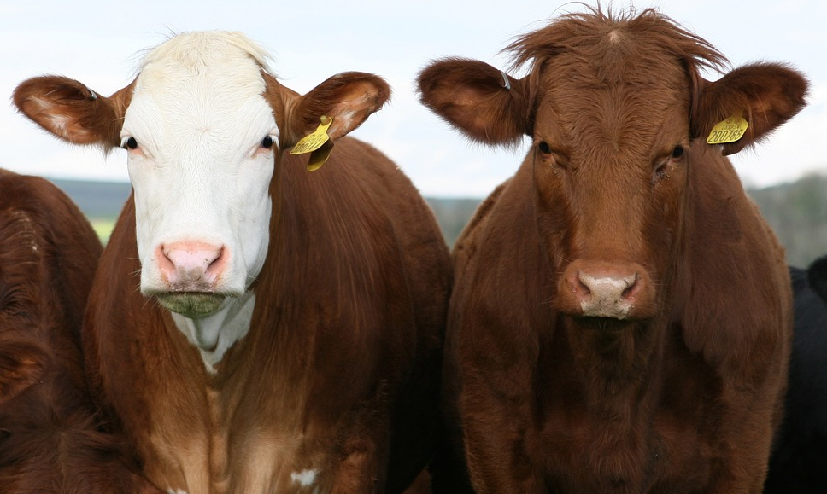
Kala duwanaanshaha faraca (Variation between offspring)
Bisadahan waa walaalo. Sharax sababta ay ugu ekaadeen kuwa kala duwan?
Waalidku waxay lahaayeen midabbo dhogor oo kala duwan. Hal waalid wuxuu lahaan karaa dhogor madow, kan kalena wuxuu lahaan karaa dhogor tabby ama caddaan. Faracu (offspring) wuxuu ka dhaxlaa isku darka midabada dhogorta ee ka duwan waalidkiisa.
Lo'ahani waa walaalo. Sharax sababta ay ugu ekaadeen kuwa kala duwan?
Waalidku waxay lahaayeen midabbo dhogor oo kala duwan. Hal waalid wuxuu lahaan karaa dhogor cad, kan kalena dhogor bunni. Hal waalid wuxuu lahaan karaa sanka cas, kan kalena sanka bunni. Faracu (offspring) wuxuu ka dhaxlaa isku darka midabada dhogorta iyo sanka ee ka duwan waalidkiisa.

Slide 23
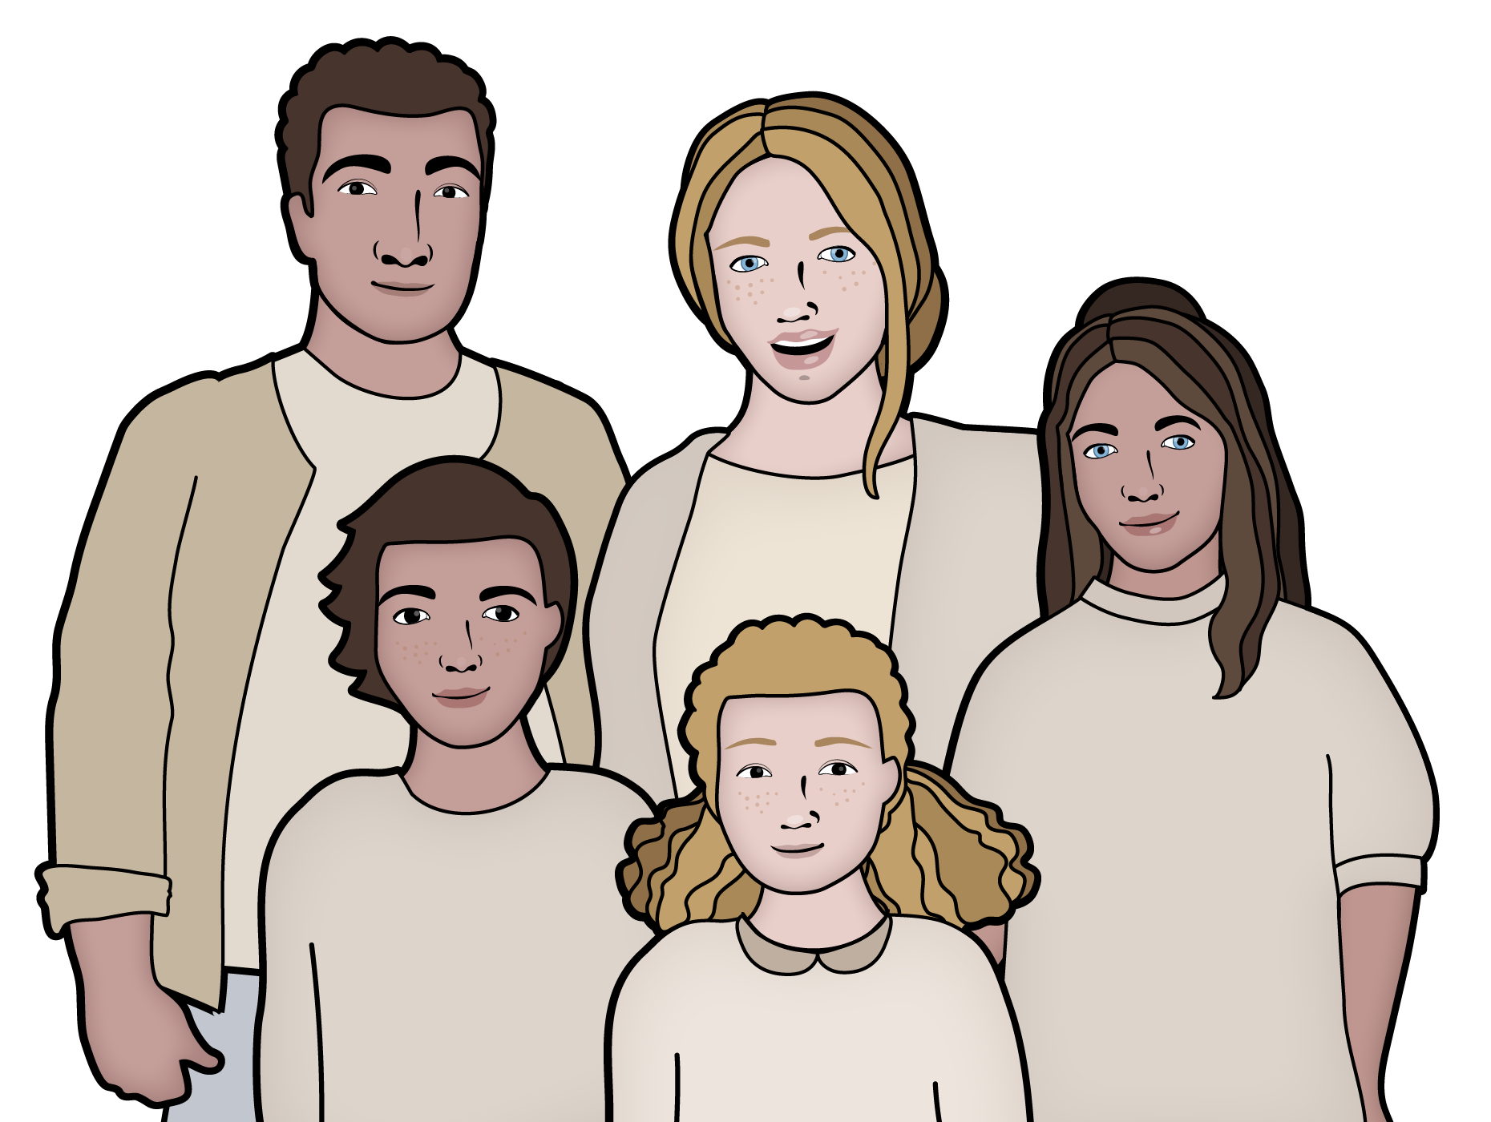
Kala duwanaanshaha faraca (Variation between offspring)
Qoyska sawirkan wuxuu ka kooban yahay hooyo, aabo, iyo saddex carruur oo dhalasho ah.
Cabdi wuxuu u eegyahay laakiin kuma eka walaashiis Louis.
Sharax sababta Harry iyo Louise aan u ekaaneen kuwa isku midka ah.
Ku dar ereyada la dhaxlo (inherited) iyo farac (offspring) jawaabtaada.
Harry
Louise

Slide 24
Kala duwanaanshaha u dhexeeya faraca (offspring)
Sharax sababta Cabdi iyo Louise aan u ekeyn.
Ku dar ereyada la dhaxlay (inherited) iyo faraca (offspring) jawaabtaada.
Cabdi iyo Louise labaduba waa faraca (offspring) isku waalid.
Labaduba waxay ka dhaxleen (inherited) astaamo labada waalid.
Waxay dhaxleen (inherited) astaamo kala duwan.
Louise waxay ka dhaxashay (inherited) timo casaan hooyadeed iyo timo qalloocan aabaheed.
Cabdi wuxuu ka dhaxlay (inherited) timo bunni aabaheed iyo timo toosan hooyadeed.
Cabdi
Louise

Slide 25
Dhaxalka (Heredity)
Tarmidda (Reproduction) waa mid ka mid ah hababka guud ee noolaha (organisms).
Dhammaan noolaha (organisms) way tarmaan (reproduce) waqti ka mid ah wareegga noloshooda oo waxay sameeyaan farac (offspring).
Faraca (offspring) waxay u ekaadaan waalidka waqti ka mid ah wareegga noloshooda.
Faraca (offspring) waxay u ekaadaan labada waalid sababtoo ah waxay ka dhaxlaan (inherit) astaamo labadooda. Habkan waxaa loo yaqaan dhaxalka (heredity).
Faraca (offspring) isku waalid waxaa loo yaqaan walaalo; waxay isu ekaadaan, laakiin kuma eka (waxaan ahayn mataano isku mid ah), sababtoo ah waxay ka dhaxlaan (inherit) astaamo labada waalid.
Farac kasta (offspring) wuxuu dhaxlaa (inherits) isku darka astaamaha kala duwan ee waalidkiis.

