Slide 1
Sida aan wax u aragno
Dhawaaq, iftiin iyo aragga

Slide 2
Sida agabkeena waxbarista loogu talagalay fasalka

Slide 3
Waxaan sharxi karaa sida aan u aragno walxaha nagu xeeran iyadoo la adeegsanayo indhaha.

Slide 4
iftiin leh (luminous)
qeexaysa wax iftiin siiya
aan iftiin lahayn (non–luminous)
qeexaysa wax aan iftiin siinin
kala firdhi (scatter)
kala firdhinta iftiinka waa in iftiinka lagu milicsado jihooyin badan isla mar
muraayadda isha (pupil)
daloolka hore ee isha oo iftiinka u gudbiya isha
xuubka dambe ee isha (retina)
dusha dambe ee isha oo ogaata iftiinka

Slide 5

Sida aan wax u aragno
Dhammaan sagxadaha ayaa milicsada iftiinka
Iftiinku wuxuu galaa indhaha
Layliyada iftiinka

Slide 6
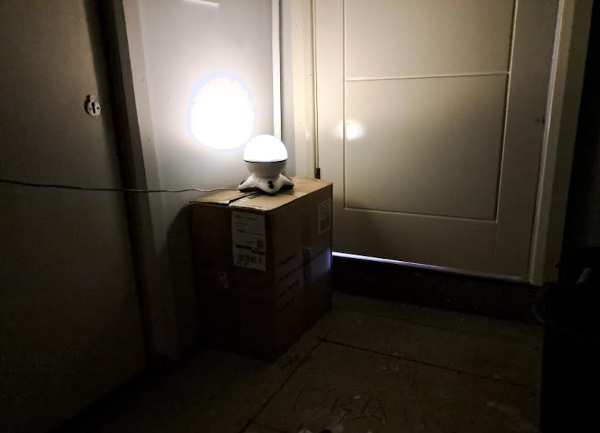
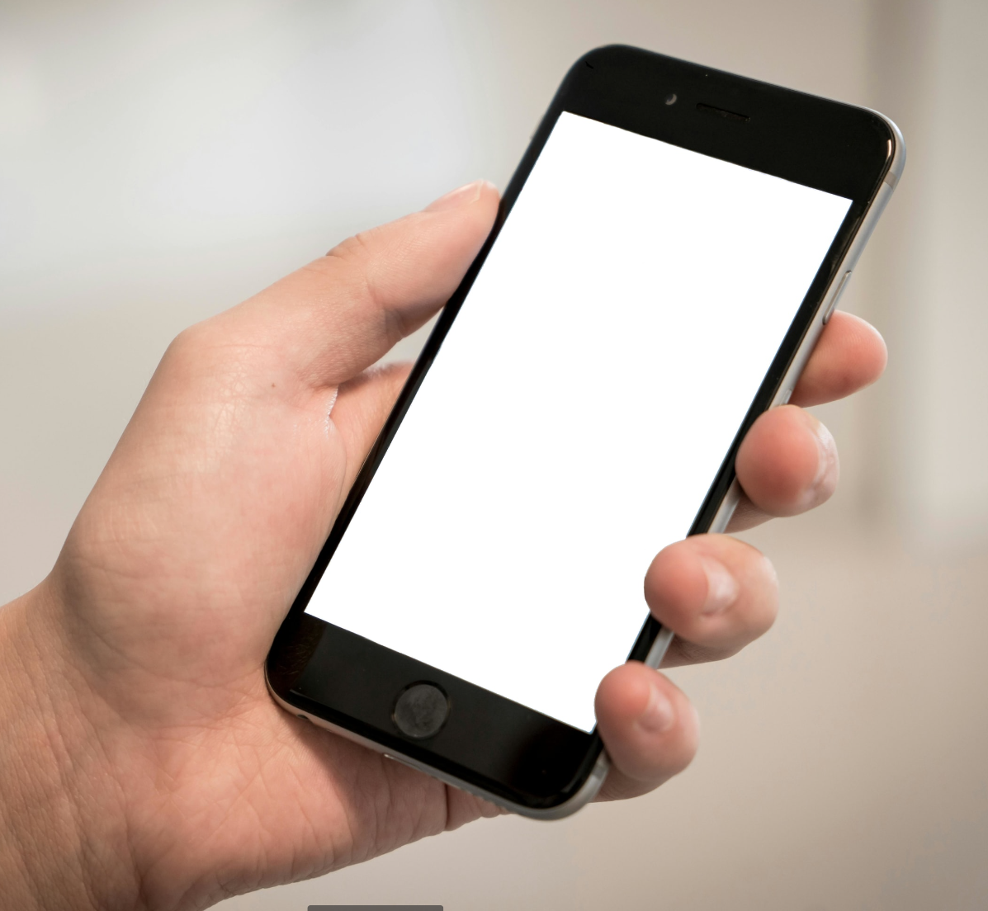
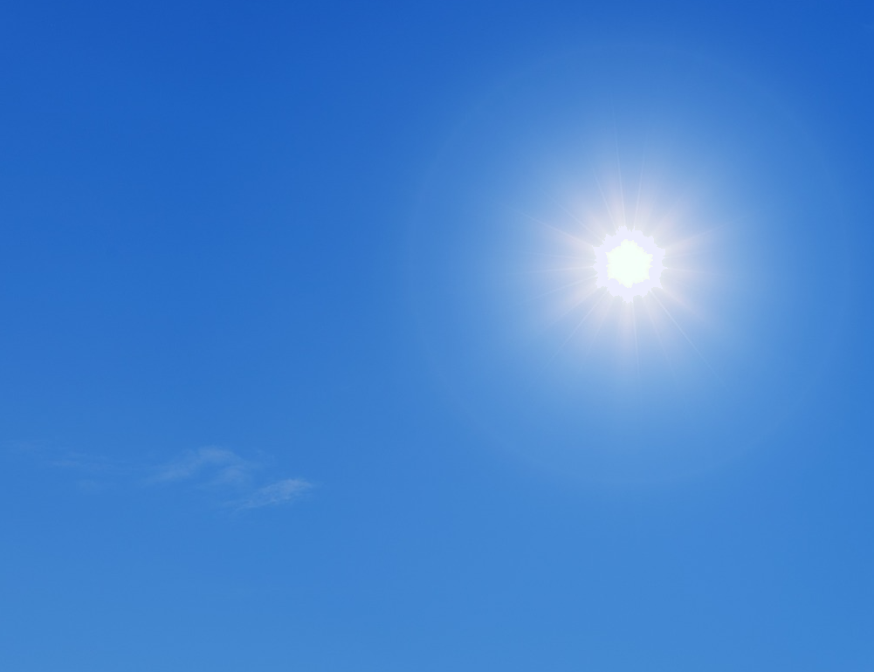
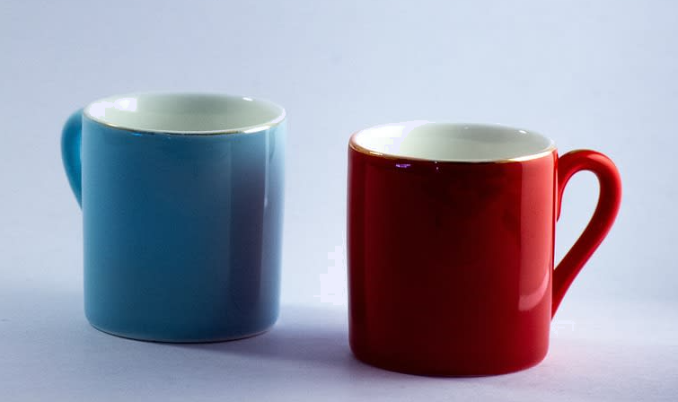
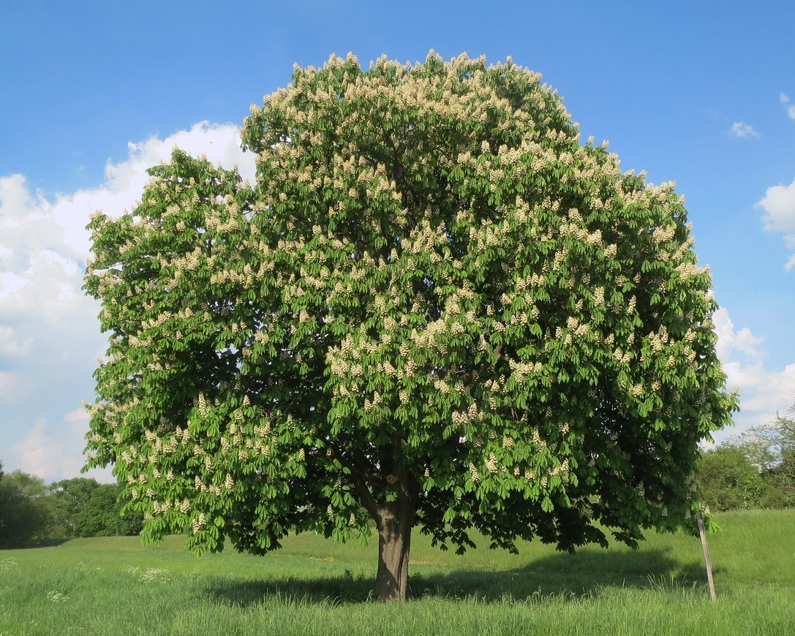
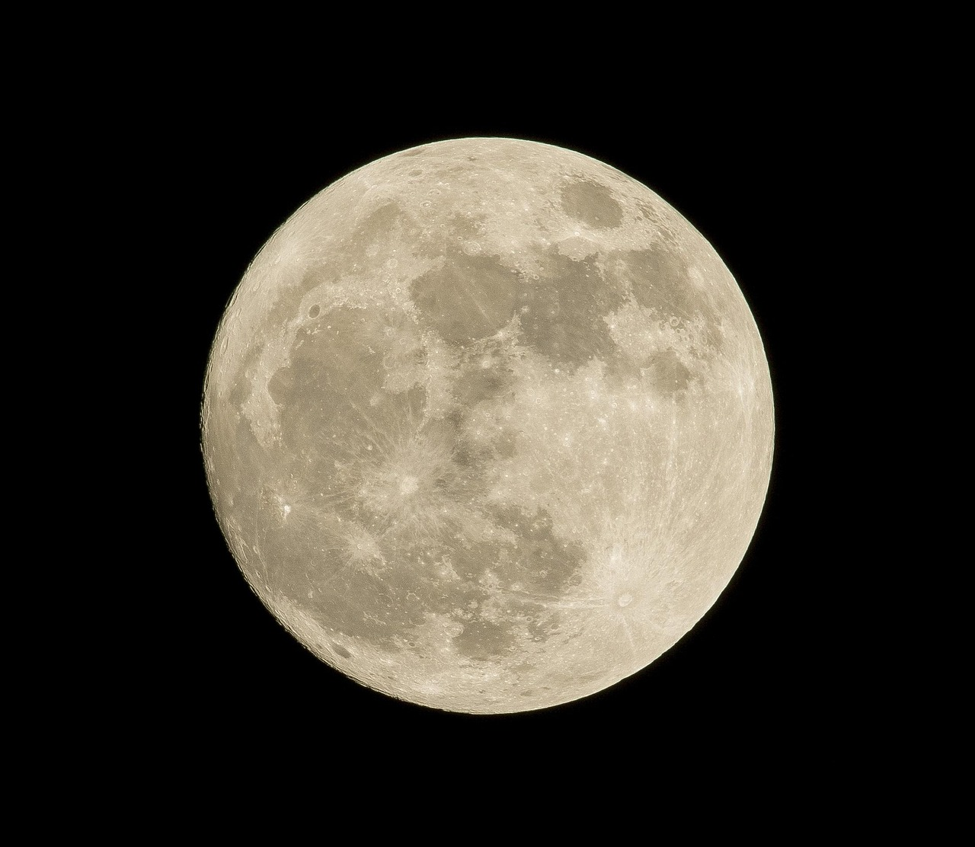
Dhammaan sagxadaha ayaa milicsada iftiinka
Walxaha iftiin siiya waxaa loo yaqaan iftiin leh (luminous).
Walxaha aan iftiin siinin waxaa loo yaqaan aan iftiin lahayn (non–luminous).

Slide 7


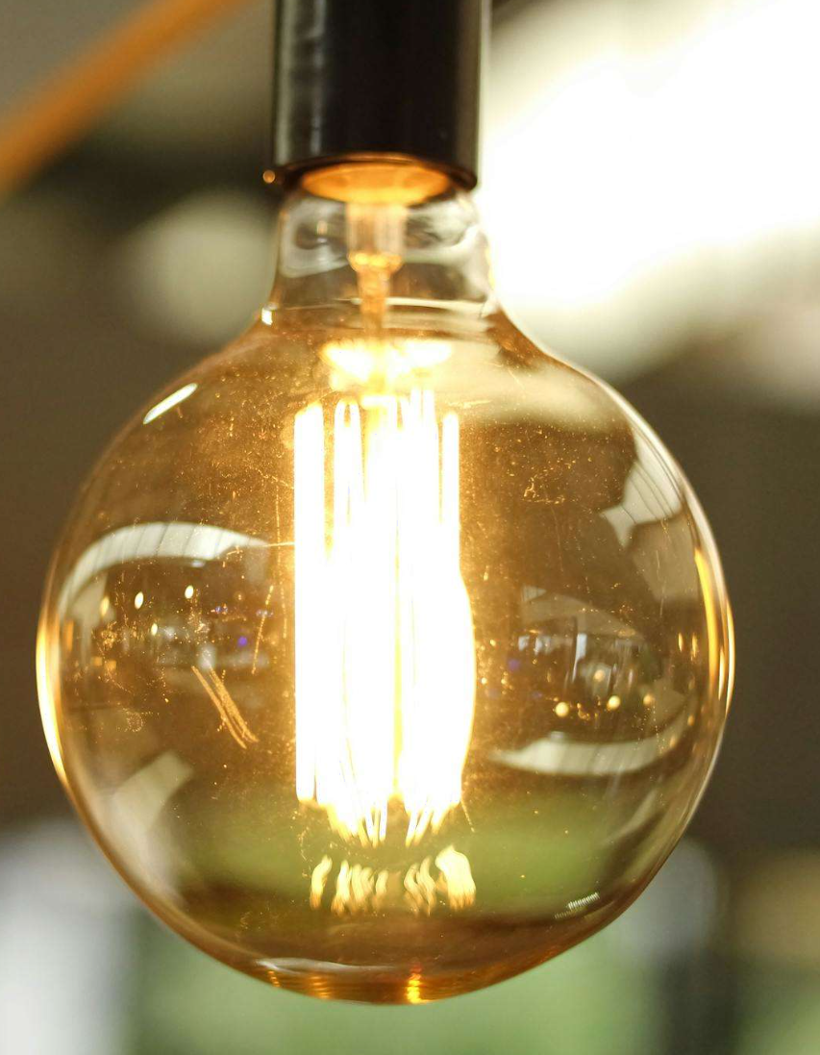


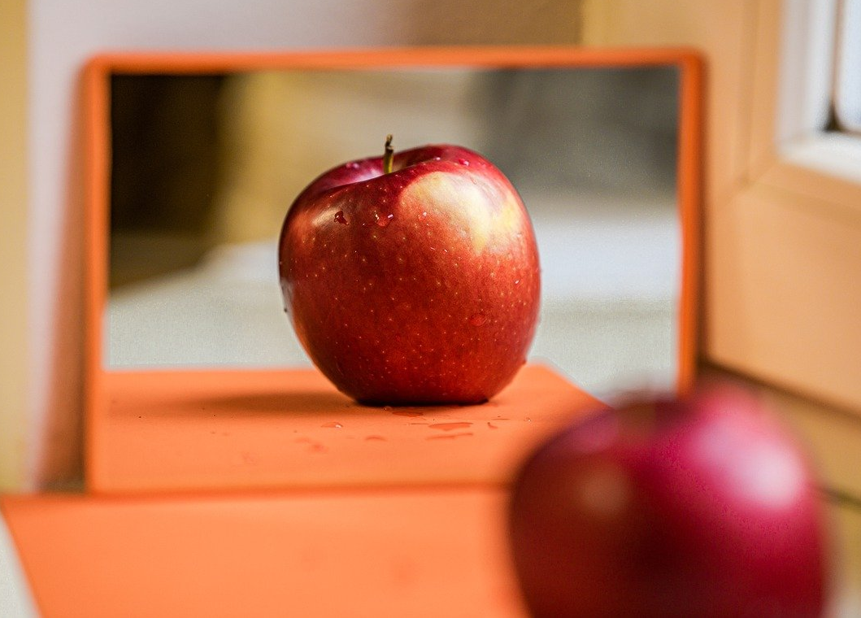
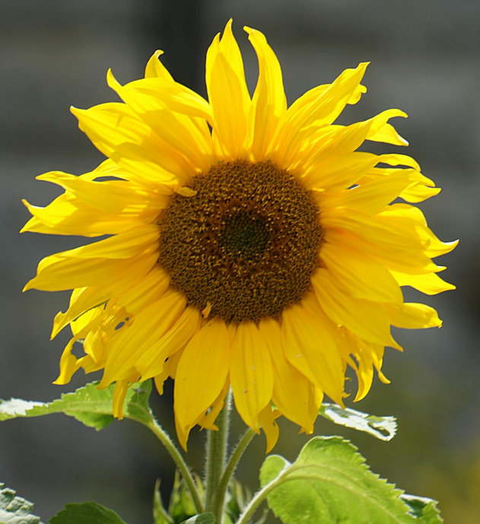
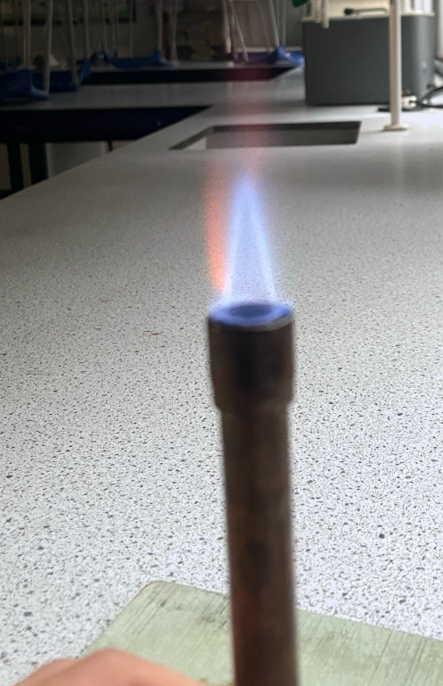
Dhammaan sagxadaha (surfaces) waxay milicsadaan iftiin (light).
Waa kuwee walxaha iftiinka leh (luminous)?
a
b
c
d
e
f

Slide 8
Dhammaan sagxadaha (surfaces) waxay milicsadaan iftiin (light).
Iftiin (light) wuxuu ka soo baxaa dhamaan jihooyinka qayb kasta oo dhalaalaysa oo shay iftiin leh (luminous object).
Fallarada iftiinka (light rays) (fallaro) waxay muujinayaan dhawr waddo oo iftiinku (light) ku socdo.
Iftiin (light) wuxuu ku safraa xawaare aad u sareeya khadadka toosan (straight lines), ilaa uu ka taabto sagxadda (surface) shay.

Slide 9
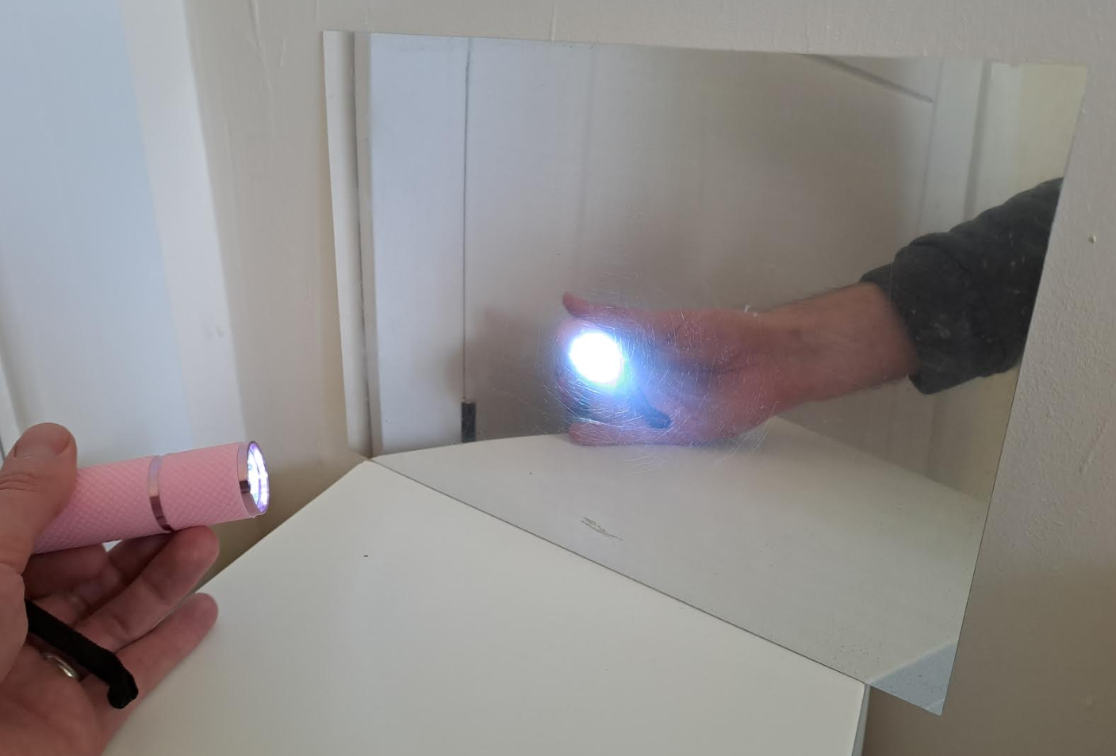
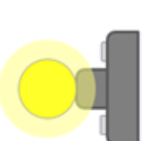
Dhammaan sagxadaha (surfaces) waxay milicsadaan iftiin (light).
Haddii iftiin (light) uu taabto sagxad dhalaalaysa (shiny surface), sida muraayad (mirror), waxaa laga milicsadaa hal jiho. Wuxuu u hogaansamaa sharciyada milicsiga (laws of reflection).
muraayad (mirror)
fallaar soo gasha (incident ray)
i = xagal soo gal (angle of incidence)
r = xagal milicsi (angle of reflection)
i
r
fallaar milicsan (reflected ray)
Xagasha milicsiga (angle of reflection) had iyo jeer waxay la mid tahay xagasha soo gasha (angle of incidence), dhinaca kale ee toosan (normal), isla diyaaradda (plane) gudaheeda.

Slide 10


Dhammaan sagxadaha (surfaces) waxay milicsadaan iftiin (light).
Sagxadaha aan dhalaalaynin (dull surfaces) sidoo kale waxay milicsadaan iftiin (light), laakiin jihooyin badan. Tan waxaa loo yaqaan kala firdhinta iftiinka (scattering light).

Slide 11
Dhammaan sagxadaha (surfaces) waxay milicsadaan iftiin (light).
Sagxadaha dhalaalaya (shiny surfaces) aad bay u siman yihiin (smooth). Waxay iftiinka (light) u milicsadaan si joogto ah (regular way) si ay u sameeyaan sawir cad (clear image).
Sagxadaha qallafsan ama buuraleyda ah (rough or bumpy surfaces) waxay kala firdhiyaan (scatter) iftiinka (light) ku dhaca, taas oo ka dhigaysa kuwo u muuqda kuwo dull ah.
Tani waa sababta nadiifinta, siibista ama simista sagxad (surface) ay uga dhigi karto mid dhalaalaysan (shinier).

Slide 12

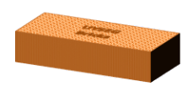

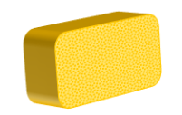
Dhammaan sagxadaha (surfaces) waxay milicsadaan iftiin (light).
Kee ka mid ah shaygan ayaa milicsan kara iftiin (light)?
a
b
Dhammaantood.
muraayad (mirror)
leben (brick)
Shaygan keeba ayaa laga arki karaa milicsi (reflection) (sawir/image)?
c
d
lacag dhalaalaysa (shiny coin)
Muraayadda.
isbuunyo (sponge)
Milicsi (reflection) ayaa laga yaabaa in lagu arko lacagta, laakiin waxaa laga yaabaa inay qalloocdo sababtoo ah qaabka dusha sare ee lacagta.

Slide 13
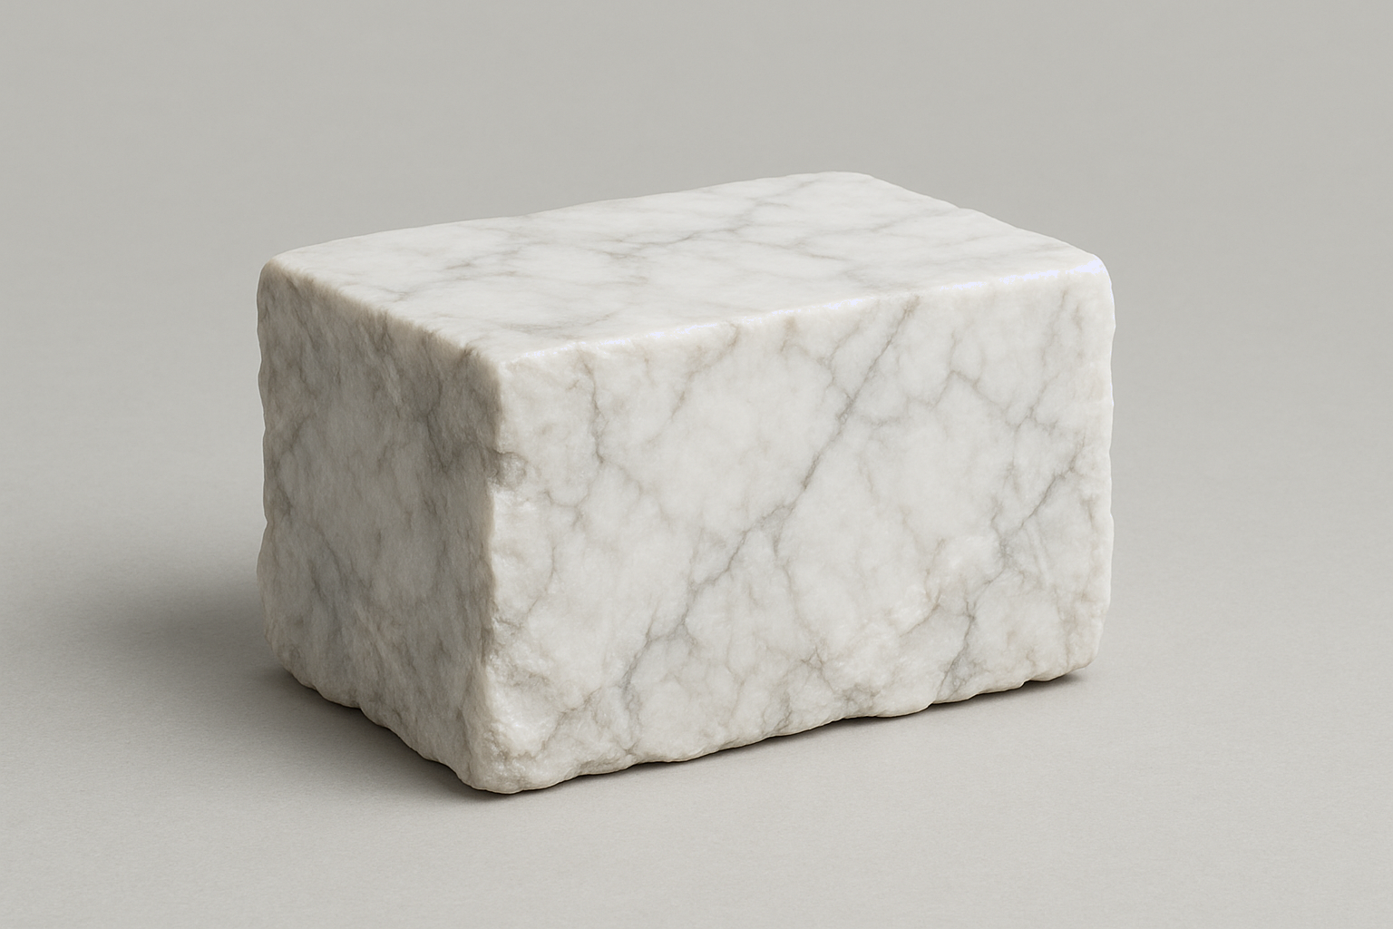
Dhammaan dusha sare waxay ka tarjumaan iftiinka (light)
Qaar ka mid ah dusha sare, sida marmarka cad, had iyo jeer waxay kala firdhiyaan iftiinka (light), xataa haddii aad simaan.
Sinnida dusha sare waxay ka dhigaysaa mid xoogaa dhalaal badan, laakiin weligeed ma noqon karto muraayad (mirror).
Sababtoo ah marmarka, iftiinka (light) waxaa laga tarjumaa meelo badan oo kala duwan oo hooseeya dusha sare.

Slide 14
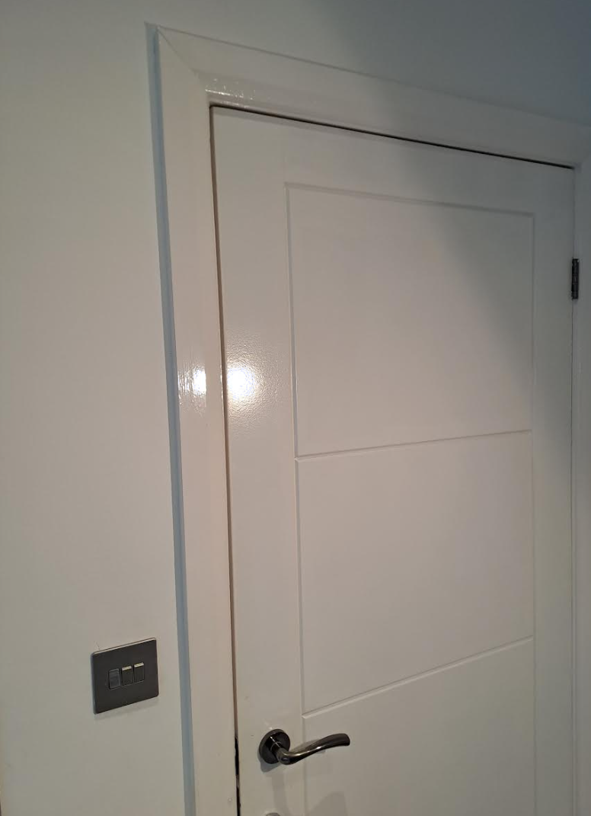
Dhammaan dusha sare waxay ka tarjumaan iftiinka (light)
Qaybaha sawirkan ee ka tarjumaya iftiinka (light) waa kuwee?
a
Dhammaantood.
b
c
d
e

Slide 15
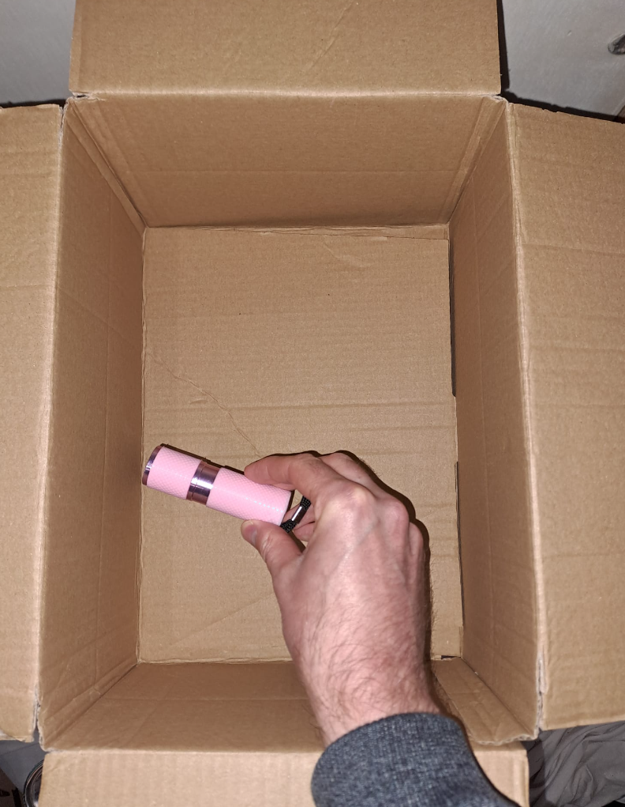

Dhammaan dusha sare waxay ka tarjumaan iftiinka (light)
Tooshan hadda waa dami. Wuxuu ku jeedaa hal dhinac oo sanduuq kartoon ah.
Saadaali dhinacyada sanduuqa (a – e) ee iftiimi doona marka tooshka la shido (iyadoo la damiyay nalalka qolka).
b
a
c
d
Sharax sababta aad u maleyneysay inaad arki doonto tan.
Daawo muujin (demonstration).
e
Ma sax ahayd saadaashaada iyo sharaxaadaada?
Qor sharaxaad ka fiican oo ku saabsan waxa aad aragtay.

Slide 16
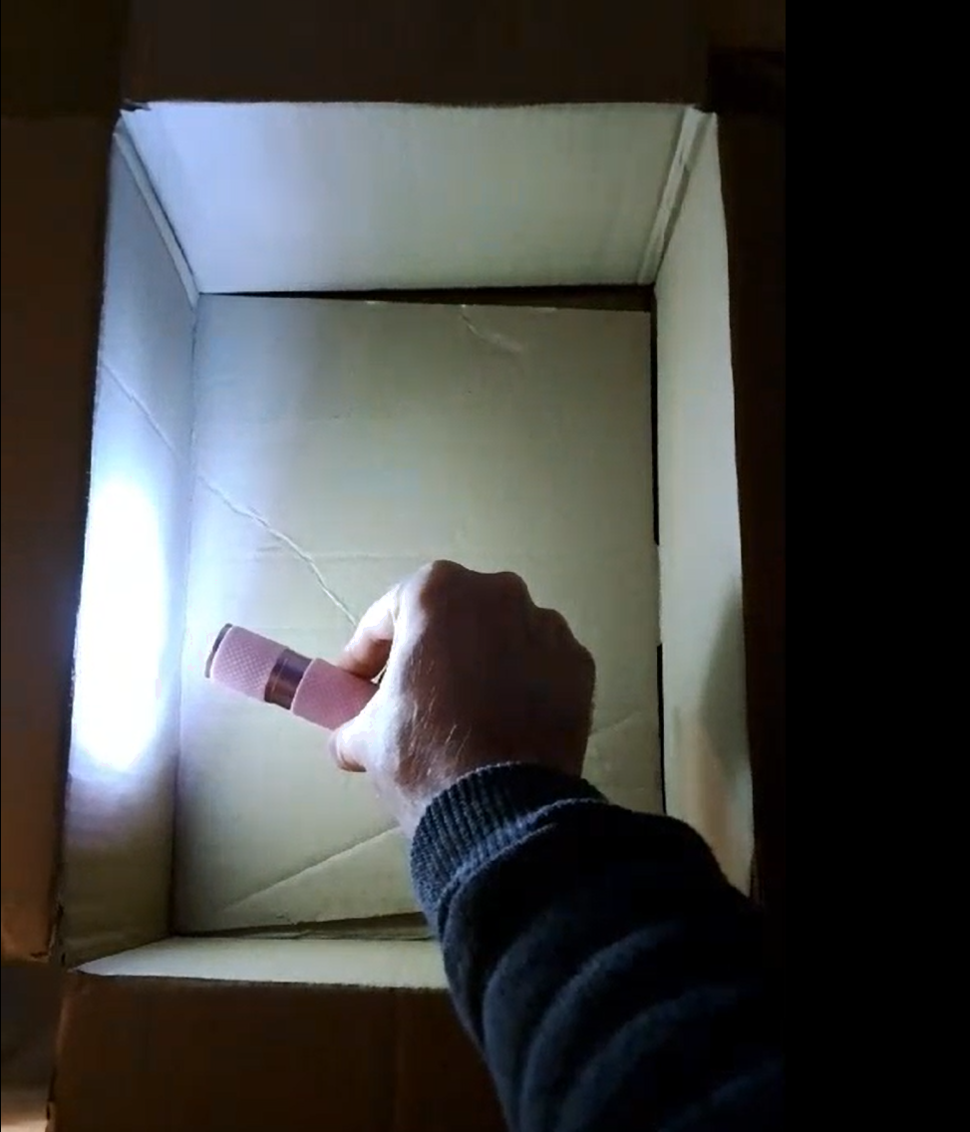
Dhammaan dusha sare waxay ka tarjumaan iftiinka (light)
Jawaabo tusaale ah (Example answers).
Saadaalin (Prediction):
Tooshku wuxuu iftiimin doonaa dhammaan dhinacyada sanduuqa (a – e).
b
Sharaxaad (Sharraxaad):
a
c
Iftiinka (light) tooshka ayaa marka hore ku dhici doona dhinaca a ee sanduuqa, marka waxaa jiri doona bar aad u ifaysa oo dhinaca a ku taal.
d
Iftiinka (light) ayaa markaas ku kala firdhin doona dhinaca a. Tani waxay ka dhigan tahay inuu ka muuqdo (reflected) jihooyin kala duwan. Marka qaar ka mid ah iftiinka (light) ayaa ku dhaca mid kasta oo ka mid ah dhinacyada kale. Taasi waa sababta ay dhammaan u iftiimaan, laakiin aan u ifaysan sida dhinaca a.
e

Slide 17
Sida aan u aragno (see) waxyaabaha
Dhammaan sagxadaha (surfaces) waxay ka tarjumaan (reflect) iftiinka (light)
Iftiinka (light) wuxuu galaa indhaha (eyes)
Laydh-yada (Beams) iftiinka (light)

Slide 18
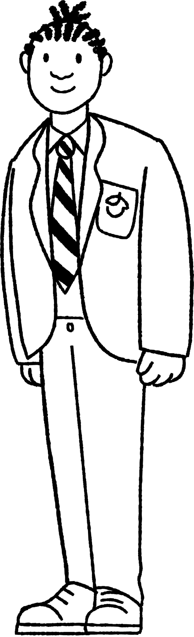
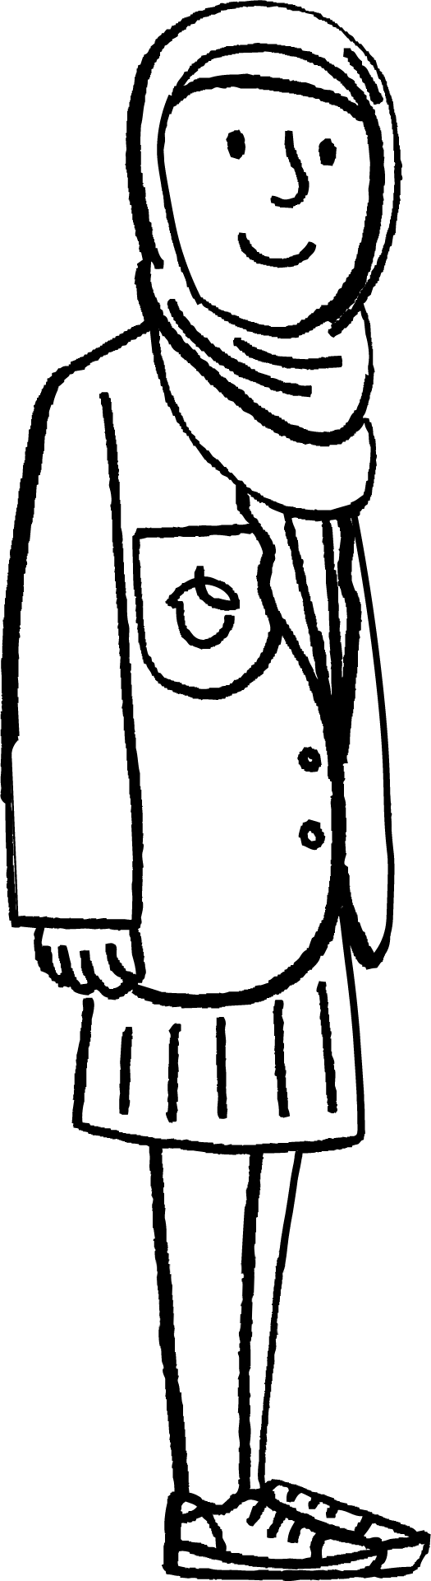
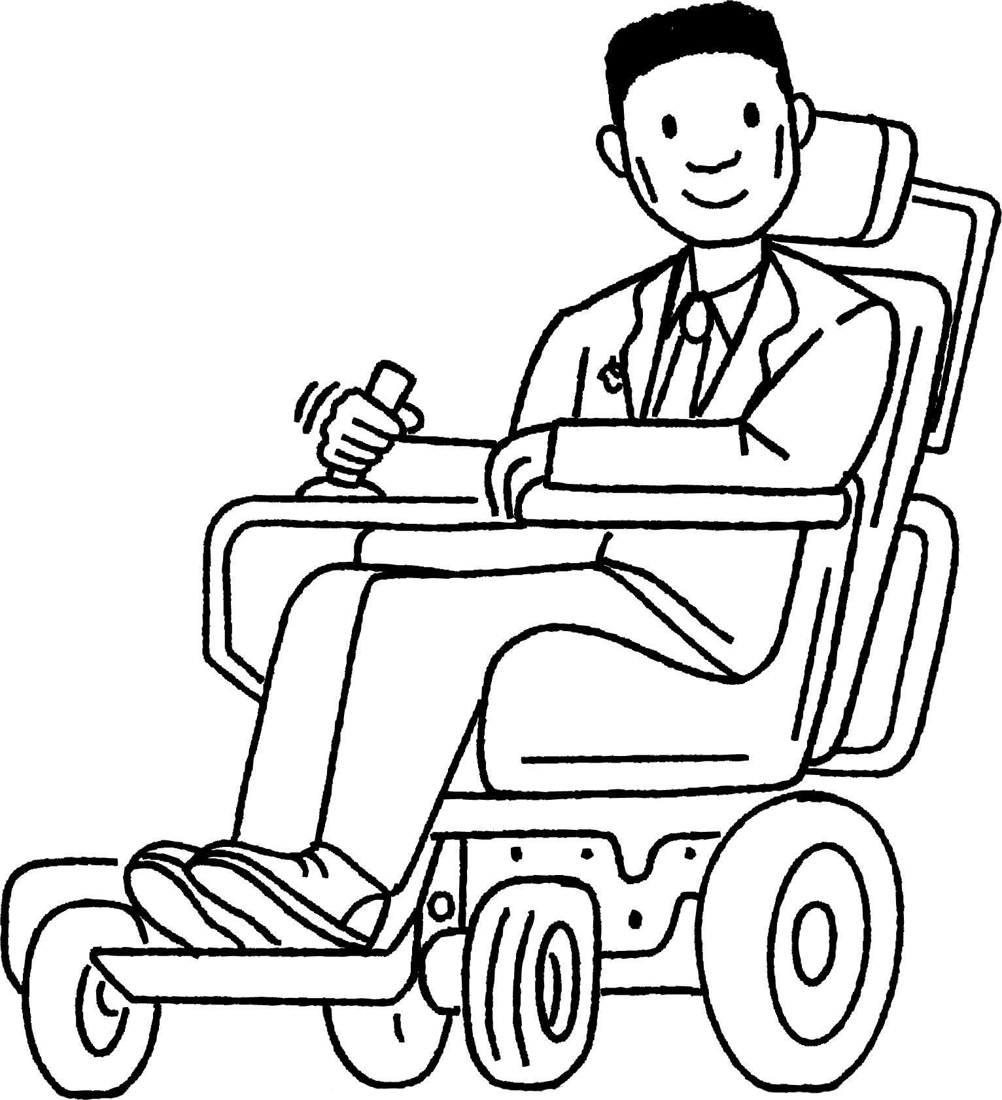


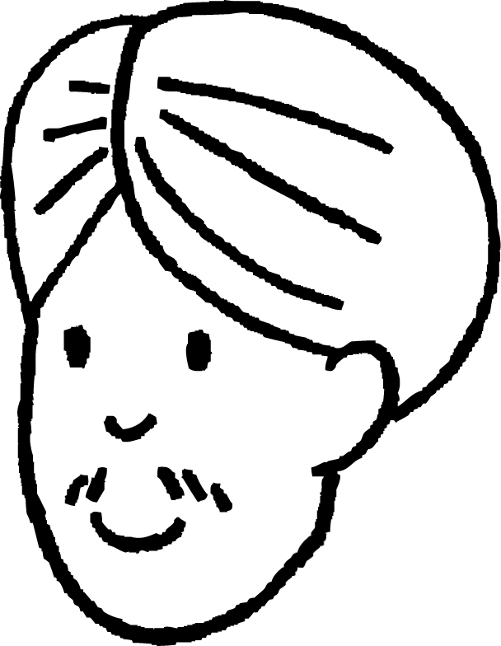
Iftiinka (light) wuxuu galaa indhaha (eyes)
Waxaan u aragnaa (see) walxaha ifaya (luminous objects) marka iftiinka (light) ay soo daayaan (emit) uu galo indhaha (eyes).
Yacquub
Indhuhu (Eyes) ma soo daayaan (emit) iftiin (light).
Caasha
Cabdi

Slide 19
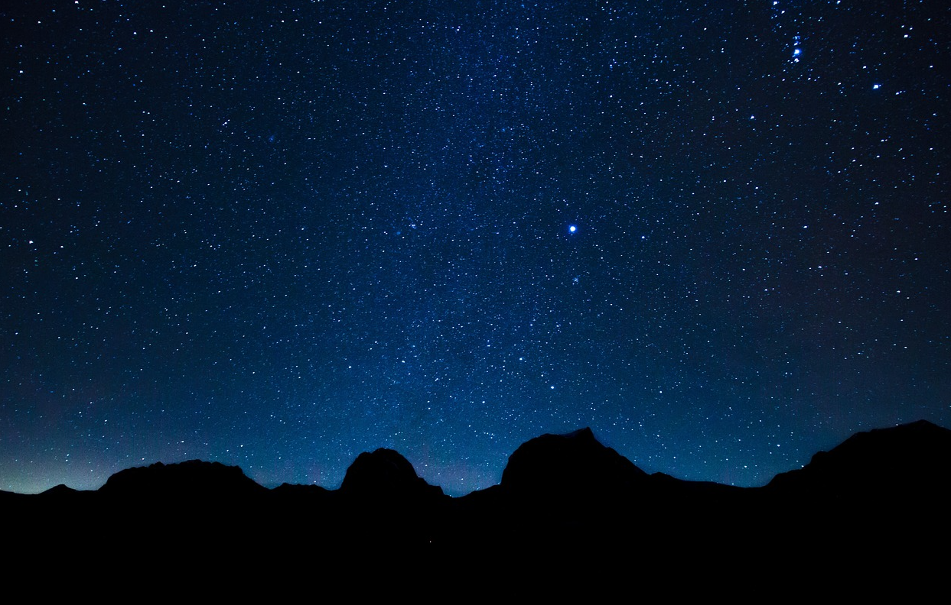
Iftiinka (light) wuxuu galaa indhaha (eyes)
Ibn al-Haytham wuxuu ahaa xiddigiye (astronomer) iyo mufakkir (thinker) oo ku dhashay Ciraaq (Iraq) qiyaastii 1000 sano ka hor. Wuxuu sharxay sababaha iftiinka (light) uu tahay inuu galo indhaha (eyes) (halkii ay indhuhu (eyes) soo daayeen (emit) iftiin (light)).
Walxaha ifaya (Bright objects) ayaa indhaha (eyes) naxa (dazzle), kuwaas oo iskood u xidhma. Marka iftiinka (light) shayga ayaa saameeya (affects) indhaha (eyes), ma aha sidii ka soo horjeedda.
Marka la fiiriyo cirka habeenkii (night sky), xiddigaha (stars) fog ayaa la arki karaa (seen) isla marka indhaha (eyes) la furo. Iftiinka (light) kama socon karo indhaha (eyes) ilaa xiddigaha (stars) wakhtigaas. Taa beddelkeeda, iftiinka (light) ayaa si joogto ah uga imanaya xiddigaha (stars) ilaa indhaha (eyes), marka wuxuu galaa indhaha (eyes) isla marka aan furno.

Slide 20
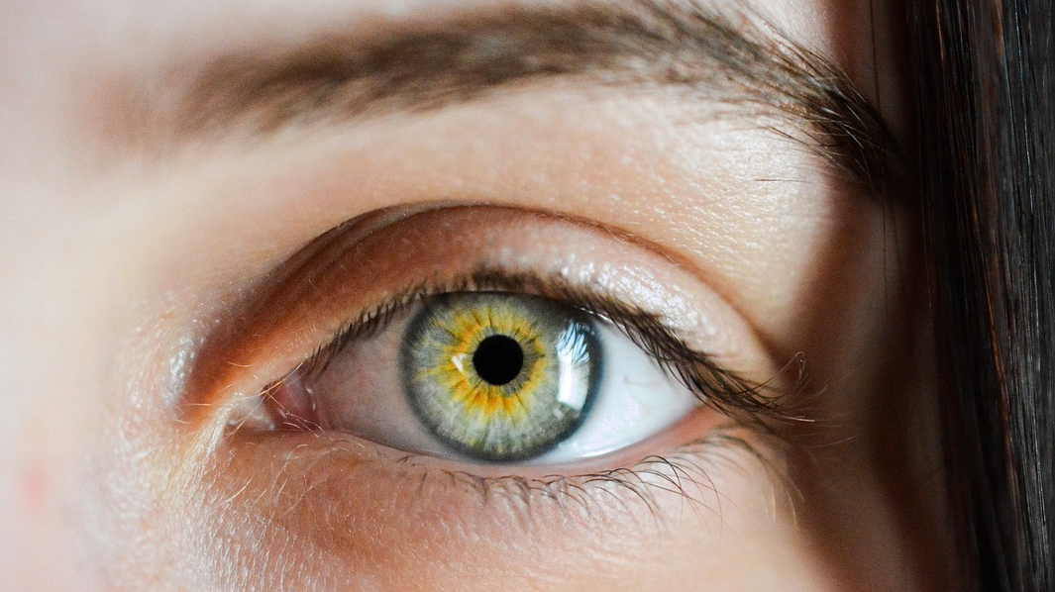
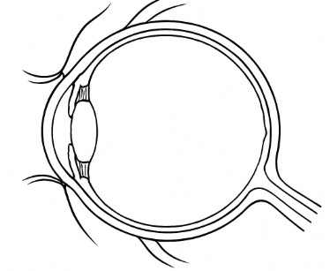
Iftiinka (light) wuxuu galaa indhaha (eyes)
Qaab-dhismeedka (structure) isha (eye) wuxuu muujinayaa in iftiinka (light) uu galo isha (eye). Ma jirto qayb ka mid ah isha (eye) oo soo daysa (emits) iftiin (light).
jaantuska isha (aragti-dhinac)
Dusha dambe ee isha waxaa loo yaqaan 'retina'. Waxaa ku daboolan unugyo (cells) oo dareema iftiinka.
Isir (pupil) waa dalool ku yaal hortiisa isha (hooska dusha cad) oo u oggolaada iftiinka inuu soo galo isha.
muraayadda (lens) (oo diiradda saarta iftiinka soo galaya ee retina)

Slide 21
Iftiinku wuxuu soo galaa indhaha
Kee ka mid ah weedhahan soo socda ayaa ku saabsan:
retina?
isirka (pupil)?
a
b
d
a
Dusha dambe ee isha.
b
Qaybta isha ee dareema iftiinka.
c
Goobo yar oo madow oo iftiin-dareeme ah.
d
Dalool.
e
Qaybta isha ee soo saarta iftiinka.

Slide 22
Iftiinku wuxuu soo galaa indhaha
Waxaan ku aragnaa walxaha aan iftiin lahayn marka iftiinka ay ka tarjumaan/ku kala firdhiyaan uu soo galo indhaha.
Yacquub
Walxaha aan dhalaal lahayn waxay ka tarjumaan (ku kala firdhiyaan) iftiinka dhan kasta, sidaas darteed waxaa laga arki karaa dhan kasta.
Caasha
Cabdi

Slide 23
Iftiinku wuxuu soo galaa indhaha
Dusha dhalaalaysa sida muraayadaha (mirrors) sidoo kale waa kuwa aan iftiin (non–luminous). Marka dusha muraayad (mirror) oo kale ay iftiin (light) ku celiso indhahayaga waxaan aragnaa milicsi (reflection).
Iftiin (ray of light) kaliya ayaa ka soo baxa muraayad (mirror) hal jiho (kuma firdhisan).
Taasi waa sababta milicsiga (reflection) shayga laga arki karo muraayad (mirror) xaglo qaar oo keliya.
Caasha
muraayad (mirror)
Cabdi

Slide 24
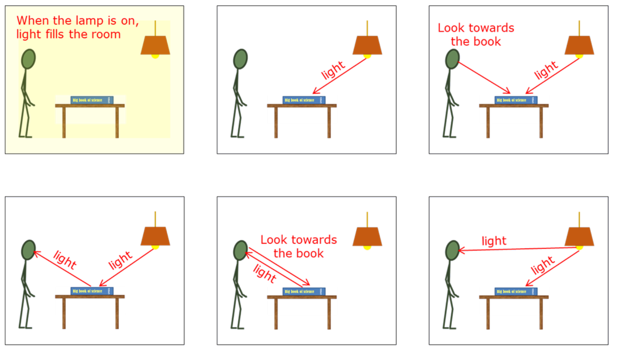
Iftiin (Light) wuxuu galaa indhahayaga
Sawir kee ayaa si fiican u muujinaya sida qofku u arko buugga?
a
b
c
d
e
f

Slide 25
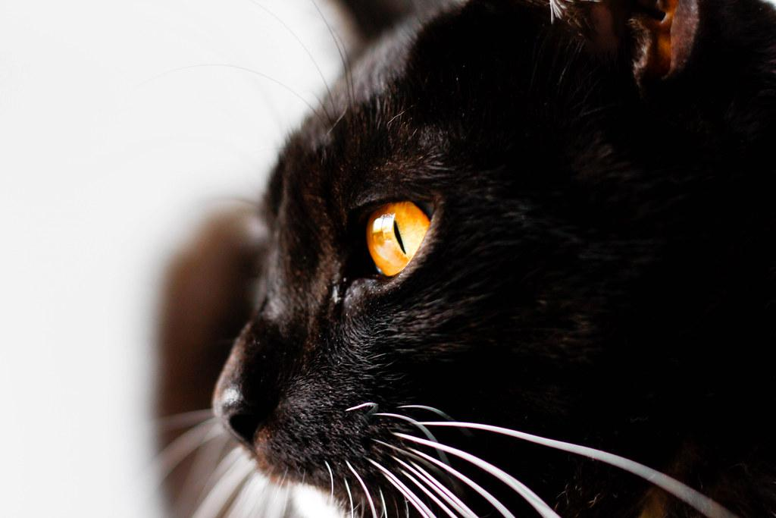
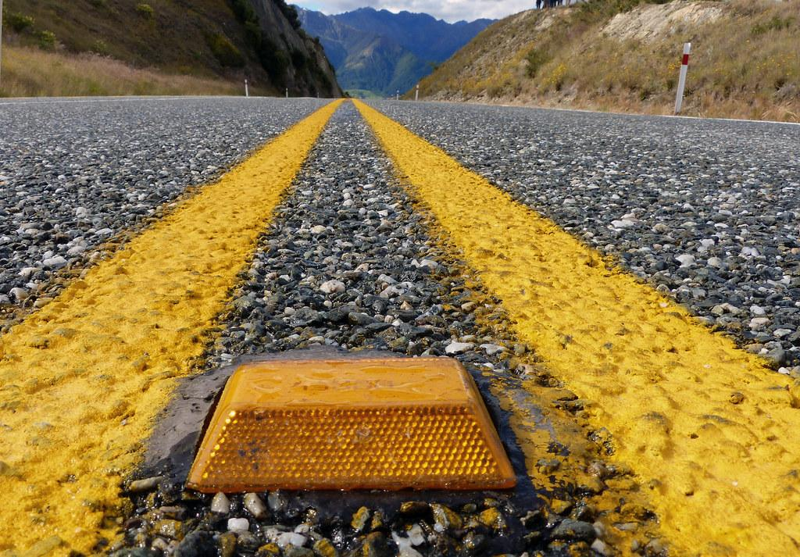
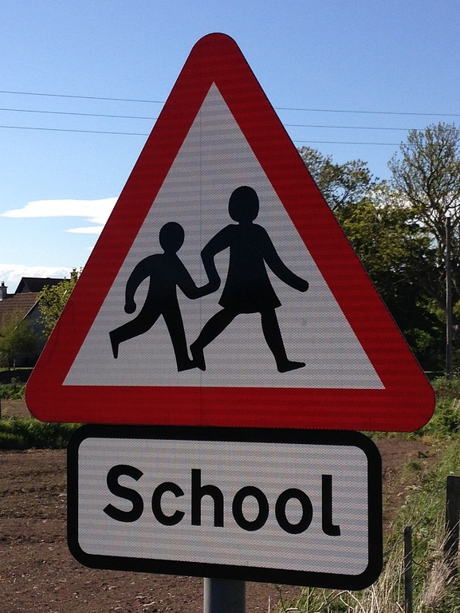
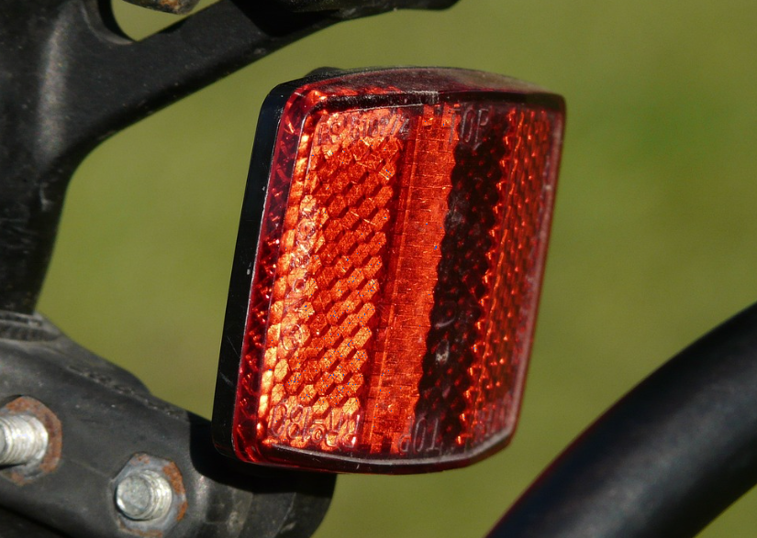
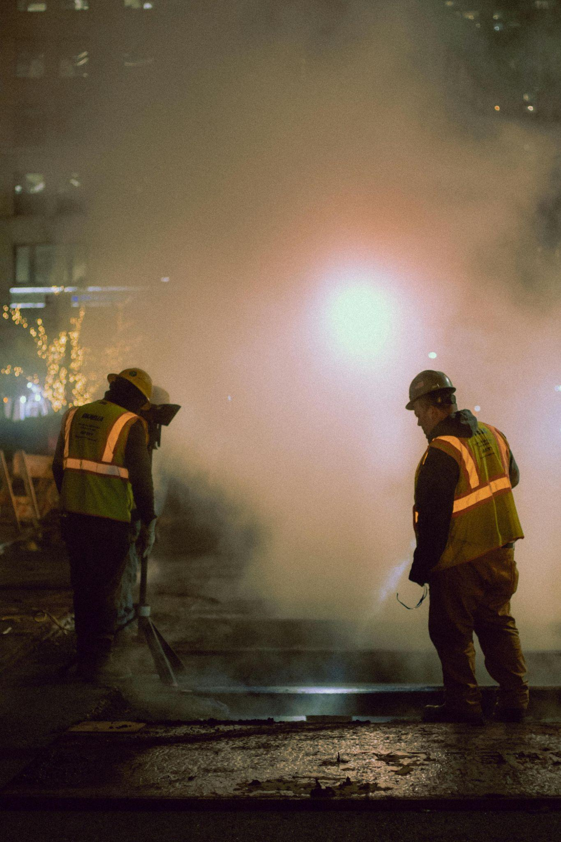
Iftiin (Light) wuxuu galaa indhahayaga
Indhaha bisadda (cats’ eyes) dhab ahaan ma dhalaalayaan. Waxaan uun arki karnaa haddii iftiin (light) ka soo baxo iyaga oo galaya indhahayaga. Waxay u dhacdaa inay aad ugu fiican yihiin milicsiga (reflecting) iftiinka (light) ku soo noqoshada qofka fiirinaya.
Milicsiyaha (reflectors) waddada waxaa la ikhtiraacay England 1934. Waxaa loo yaqaan 'indhaha bisadda (cat’s eyes)' sababtoo ah waxay u shaqeeyaan si la mid ah. Iyagu ma soo daayaan iftiin (emit light); waxay si xooggan u milicsadaan (reflect) iftiinka (incident light) soo gaaraya.
Calaamadaha waddada (road signs), milicsiyaha (reflectors) baaskiilka iyo dharka aragga sare (high–visibility clothing) waxay u shaqeeyaan si la mid ah.
Sawirka Sare: Bisad madow oo leh indho jaalle ah, Marco Verch, shatiyaysan hoos CC-BY 2.0,

Slide 26
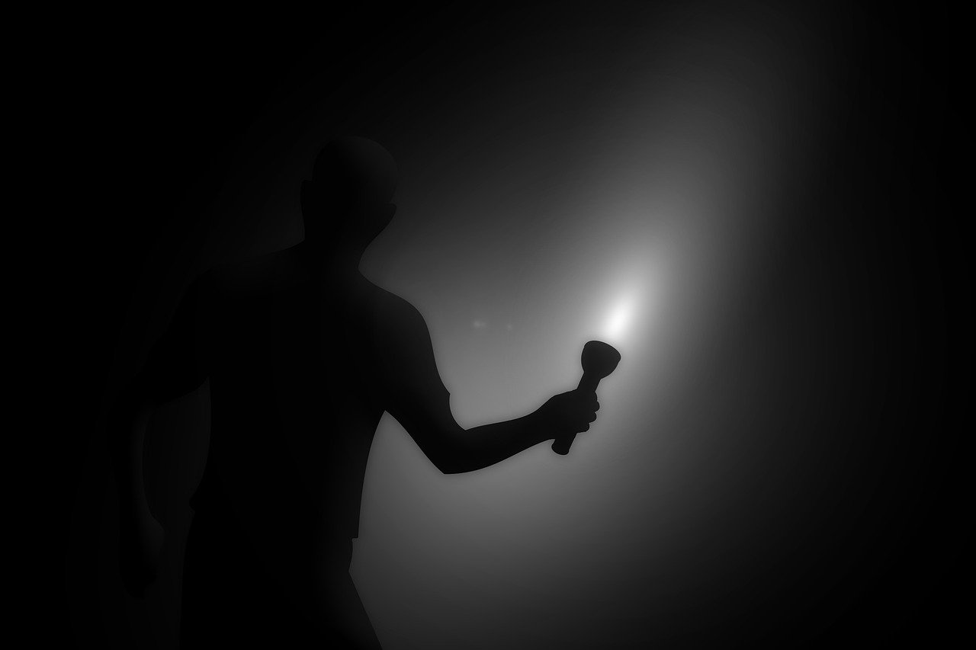
Iftiin (Light) wuxuu galaa indhahayaga
Indhaha bini'aadamka waxay isu hagaajin karaan heerar iftiin (light) aad u hooseeya.
Gudcurka inta badan waxaa jira xaddi yar oo iftiin (light) ah. Wali waxaa laga yaabaa inaan aragno shayada milicsanaya (reflecting) xaddi aad u yar oo iftiin (light) ah.
Si kastaba ha ahaatee haddii aysan jirin iftiin (light) gebi ahaanba, markaas waxba lama arki karo oo indhahayagu weligood 'isuma hagaajiyaan'.
Waa in iftiin (light) yar galo indhahayaga si aan u aragno shay.

Slide 27
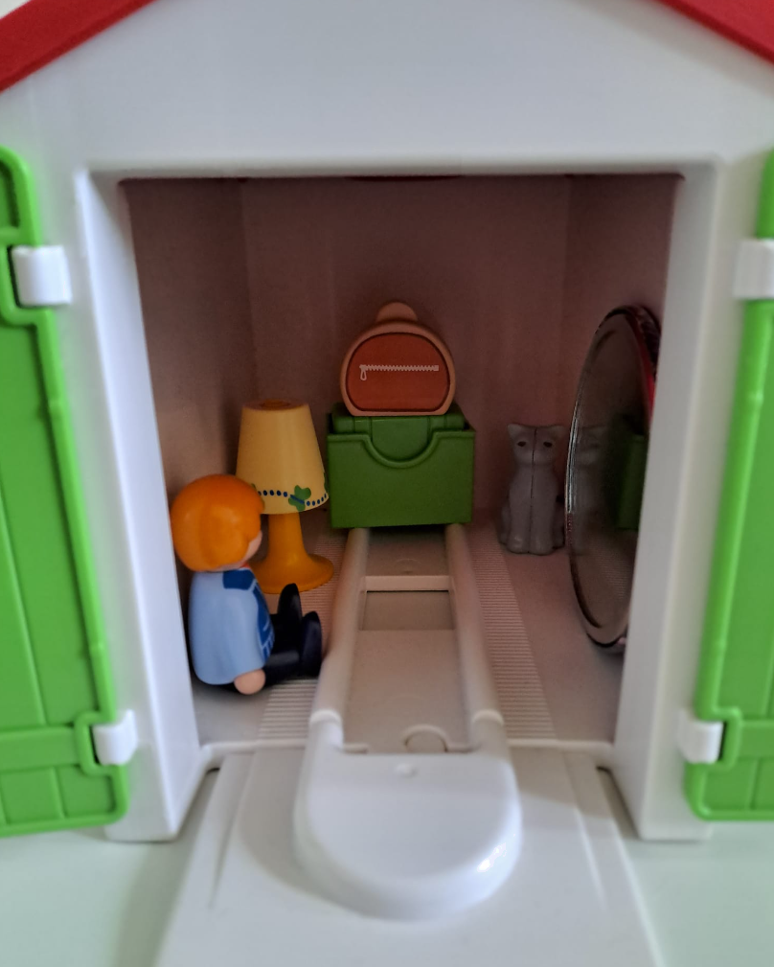
Iftiin (Light) wuxuu galaa indhahayaga
Axmed wuxuu nadiifinayaa garaashkiisa. Iftiinka (lighting) kaliya waa laambad (lamp) duug ah. Waxaa jira muraayad (mirror) duug ah. Bisadda Axmed waxay ku jirtaa geeska.
Axmed wuxuu gudaha uga xidhaa albaabbada garaashka. Way ku dhegan yihiin si aad u adag sidaa darteed iftiin (light) ma soo geli karo. Ma jiraan daaqado ama furanmo kale. Kadib wuxuu damiyaa iftiinka (light). 10 daqiiqo kadib, maxaa Axmed arki karaa?
a
Wax kasta, laakiin waa aad u mugdi (dim).
b
Waxba.
c
Indhaha bisadda oo dhalaalaya.
d
Muraayadda (mirror) oo si mugdi ah u dhalaalaysa.
e
Indihiisa iyo qaar ka mid ah muuqaalkiisa muraayadda.

Slide 28
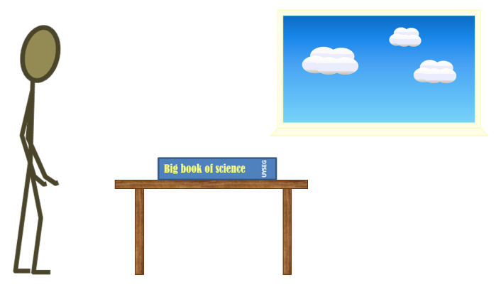
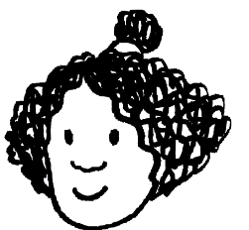
Iftiin (Light) wuxuu galaa indhaha
Dooro jumlada saxda ah ee saf kasta si aad u sharaxdo sida Isra u aragto buugga.
1 | Iftiin (Light) wuxuu ka soo baxaa dhamaan jihooyinka qorraxda.
2 | Iftiinka qorraxdu (Sunlight) wuxuu dhex maraa daaqadda oo wuxuu galay qolka.
3 | Qaar ka mid ah iftiinka qorraxdu (Sunlight) wuxuu ku dhacaa buugga. |  |  |  | Qaar ka mid ah iftiinka qorraxdu (Sunlight) wuxuu galaa indhaha Isra. |  |  |  | Iftiinka qorraxdu (Sunlight) wuxuu buuxiyaa qolka.
4 | Iftiin (Light) waxaa sii daaya buugga. |  |  | Iftiin (Light) waxaa kala firdhiya buugga. |  |  | Iftiin (Light) wuxuu ku degay buugga oo halkaas ayuu joogaa. |  |  | Iftiin (Light) waxaa nuugay buugga.
5 | Qaar ka mid ah iftiinka (Light) wuxuu ka yimaadaa buugga ilaa indhaha Isra. |  |  |  | Isla waqtigaas, qaar ka mid ah iftiinka (Light) wuxuu ka yimaadaa indhaha Isra ilaa buugga. |  |  |  | Buugga hadda waa iftiimay.
6 | Isra waxay aragtaa buugga sababtoo ah waa iftiin (light). |  |  |  |  |  | Isra waxay aragtaa buugga sababtoo ah iftiinkan (light) wuxuu galaa indhaheeda.

Slide 29
If (Light) wuxuu galaa indhaha (eyes)
Ka dooro jumladda saxda ah saf kasta si loo sharaxo sida Isra u aragto buugga (book).
1 | Iftiin (Light) wuxuu ka soo baxaa dhamaan jihooyinka qorraxda.
2 | Iftiinka qorraxdu (Sunlight) wuxuu dhex maraa daaqadda oo wuxuu galay qolka.
3 | Qaar ka mid ah iftiinka qorraxdu (Sunlight) wuxuu ku dhacaa buugga. |  |  |  | Qaar ka mid ah iftiinka qorraxdu (Sunlight) wuxuu galaa indhaha Isra. |  |  |  | Qorraxdu (Sunlight) waxay buuxisaa qolka.
4 | If (Light) waxaa sii daaya buugga (book). |  |  | If (Light) waxaa kala firdhiya (scattered) buugga (book). |  |  | If (Light) wuxuu ku degay buugga (book) oo halkaas ku sii jiraa. |  |  | If (Light) waxaa nuugay (soaked up) buugga (book).
5 | If (Light) qaar ka mid ah wuxuu ka socdaa buugga (book) ilaa indhaha Isra (Izzy). |  |  |  | Isla waqtigaas, if (light) qaar ka mid ah wuxuu ka socdaa indhaha Isra (Izzy) ilaa buugga (book). |  |  |  | Buugga (book) hadda waa iftiimay (lit up).
6 | Isra (Izzy) waxay aragtaa buugga (book) sababtoo ah waa iftiin (light). |  |  |  |  |  | Isra (Izzy) waxay aragtaa buugga (book) sababtoo ah iftiinkan (light) wuxuu galaa indhaheeda.

Slide 30
Sida aan u aragno waxyaabaha (things)
Dhammaan sagxadaha (surfaces) waxay milicsadaan (reflect) iftiinka (light)
If (Light) wuxuu galaa indhaha (eyes)
Laydh (Beams) oo iftiin (light) ah

Slide 31
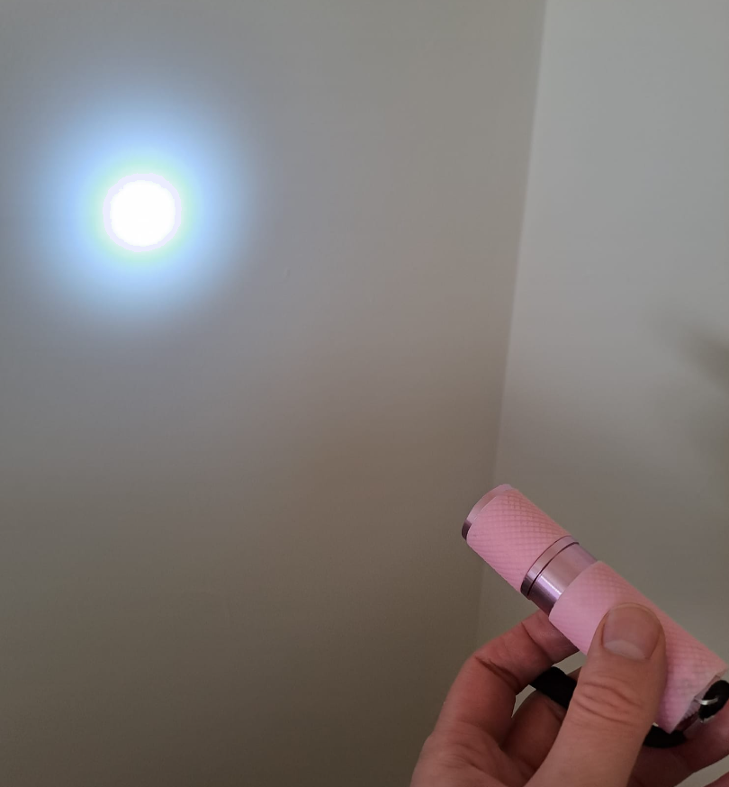
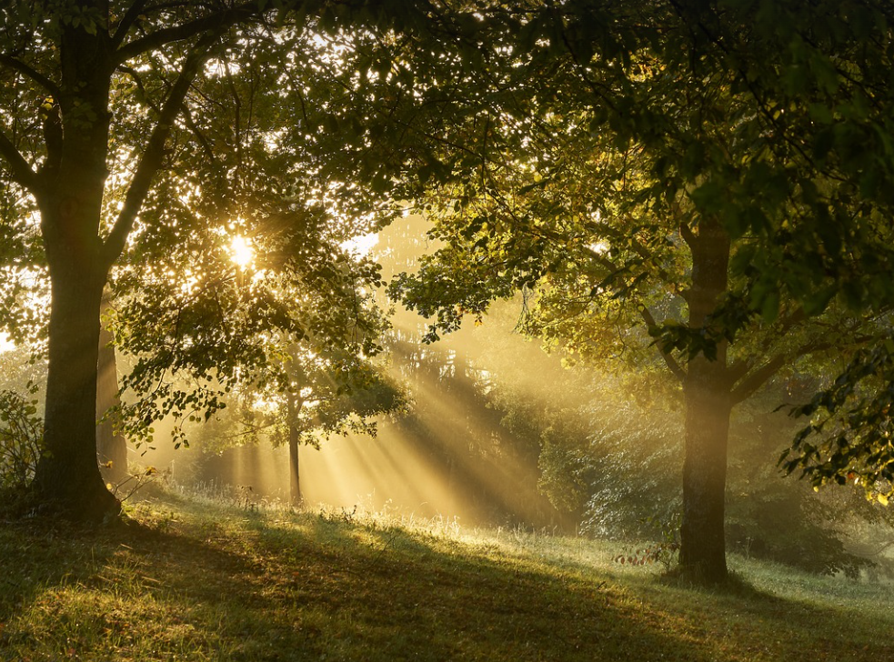
Laydh (Beams) oo iftiin (light) ah
Ma garan kartaa in tooshka (torch) uu shidan yahay ama damiyey?
Waxaad arki kartaa waxyaabaha (things) oo keliya marka iftiin (light) uu galo indhahaaga. Halkan, waxaad arki kartaa oo keliya iftiinka (light) tooshkan (torch) marka gidaarku (wall) qaar ka mid ah uu ku milicsado (reflect) indhahaaga.
Caadi ahaan ma arki kartid iftiin (light) marka uu socdo (travelling).
Laydhyada (Beams) iftiinka (light) waa la arki karaa haddii ay jiraan boodh (dust) ama dhibco biyo (water droplets) ah hawada kuwaas oo qaar ka mid ah iftiinka (light) ku milicsada (reflect) indhahaaga.

Slide 32
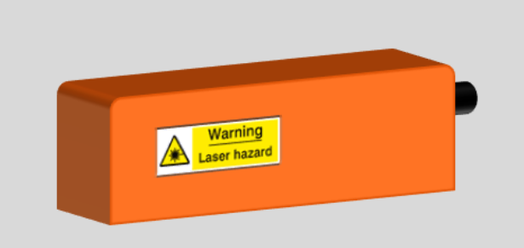
Laydh (Beams) oo iftiin (light) ah
Laser-ku wuxuu soo saaraa iftiin (light) aad u khafiif ah oo aad u xoog badan
hal midab kaliya leh.
Laser beam-ku wuxuu dhaawici karaa indhaha haddii aad si toos ah u eegto. Wuxuu burburiyaa unugyada iftiinka dareema (light sensitive cells) oo wuxuu joojiyaa shaqadooda.

Slide 33
Iftiinka (Beams of light)
Ma jumlada kasta waxay khusaysaa laser light, sunlight, ama labadaba?
Waxay dhaawici kartaa indhahaaga.
labadaba
Waxay ka kooban tahay hal midab oo iftiin (light) ah.
laser light
Waxay ka kooban tahay midabyo badan oo iftiin (light) ah.
sunlight
Waxay kala fidaa wax yar oo kaliya markay safarto.
laser light

Slide 34
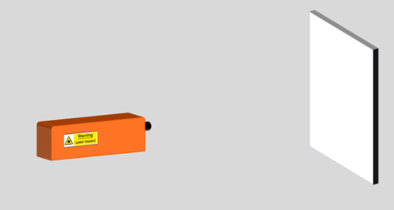
Iftiinka (Beams of light)
Laser cas (red laser) ayaa la dhigay isagoo u jeeda gidaar cad.
Laser-ka waa la shiday. Saadaali waxa aad arki doonto:
  meesha u dhaxaysa laser-ka iyo gidaarka
  gidaarka
Sharax sababta aad u malaynayso inaad arki doonto tan.
Daawo muujin (demonstration).
Ma sax ahayd saadaalintaada iyo sharaxaadaada?
Qor sharaxaad ka fiican waxa aad aragtay.

Slide 35
Fallaaro iftiin (Beams of light)
Jawaabo tusaale (Example answers).
Saadaal (Prediction):
Wax muuqda kama dhex muuqan doono booska u dhexeeya laser-ka iyo derbiga. Dhibic cas (red dot) ayaa ka soo bixi doonta derbiga.
Sharaxaad (Sharraxaad):
Iftiin laser cas (Red laser light) wuxuu ku socon doonaa xariiq toosan (straight line) laga bilaabo laser-ka ilaa derbiga. Inta u dhaxaysa laser-ka iyo derbiga, iftiinka laser-ku wax uu ka milicsado (reflect off) ma laha, sidaas darteed fallaarta (beam) lama arki karo.
Iftiinka laser-ku wuxuu si yar u fidaa (spreads out) markuu socdo, sidaas darteed wuxuu ku dhici doonaa derbiga hal meel oo yar. Derbigu wuxuu ku firdhin doonaa (scatter) fallaarta (beam) dhamaan jihooyinka. Waxaan arki karaa dhibicda (spot) sababtoo ah iftiin ka milicsaday (reflected) ayaa ka imanaya isha. Waxaa laga yaabaa inaan arko xariiqda fallaarta laser-ka (line of the laser beam) haddii ay ka milicsato (reflect off) boqolkiiba hawada (specks of dust in the air).

Slide 36
Sida aan wax u aragno (How we see things)
Walxaha iftiimiya (Luminous objects) waxay siiyaan iftiin (give out light), walxaha aan iftiimin (non–luminous objects) ma siiyaan.
Dhammaan sagxadaha (surfaces) waxay ka milicsadaan (reflect) iftiinka (light). Sagxadaha muraayadaha u eg (Mirror–like surfaces) waa siman yihiin waxayna u milicsadaan (reflect) iftiinka (light) si joogto ah (regular way), taasoo keenta in la arko milicsiga (reflections). Sagxadaha kale (Other surfaces) waxay ku firdhiyaan (scatter) iftiinka soo gaaray (incident light) dhamaan jihooyin badan.
Si wax loo arko (for anything to be seen), iftiinka (light) ka yimid (either emitted or reflected) waa inuu galaa isha (enter the eye).
Iftiinka (Light) wuxuu isha (eye) ku galaa dalool (hole) loo yaqaan 'pupil' waxaana ogaada (detected) sagxadda danbe ee iftiinka u nugul (light–sensitive back surface) loo yaqaan 'retina'.
Fallaaro iftiin (Beams of light) waxaa la arki karaa oo keliya haddii iftiinku (light) ku dhaco wax (hits something) oo uu ka milicsado (reflects) ama ku firdho (scatters) xagga isha (towards an eye).

