Slide 1
Hagaajinta moodelka (Improving a model)
Barashada mashiinka (Machine learning) iyadoo la isticmaalayo micro:bit

Slide 2
Sida agabkeena waxbarista loogu talagalay fasalka

Slide 3
Waxaan beddeli karaa sida moodelkayga loo tababaro si loo hagaajiyo saxnaanta (accuracy) wax soo saarka.

Slide 4
kala saaris khaldan (misclassification)
marka moodelku saadaaliyo fasalka (class) khaldan ee muunad (sample)
nadiifinta xogta (data cleaning)
habka lagu ogaado oo lagu saxo, ama laga saaro, xogta qaldan ama aan sax ahayn ee ku jirta xog ururin (data set)
buuqa (noise)
kala duwanaansho aan loo baahnayn ama random ah oo xogta ku jira oo aan matalayn qaabab macno leh
toon waa (false positive)
muunad (sample) si khaldan loo kala saaray

Slide 5

Hagaajinta moodelka (Improving a model)
Tixgeli xog kala duwan si loo yareeyo eexda (bias)
Nadiifi xogta si loo kordhiyo saxnaanta (accuracy)
Ku dar fasalka null (null class) si looga hortago kala saarista khaldan (misclassification)

Slide 6
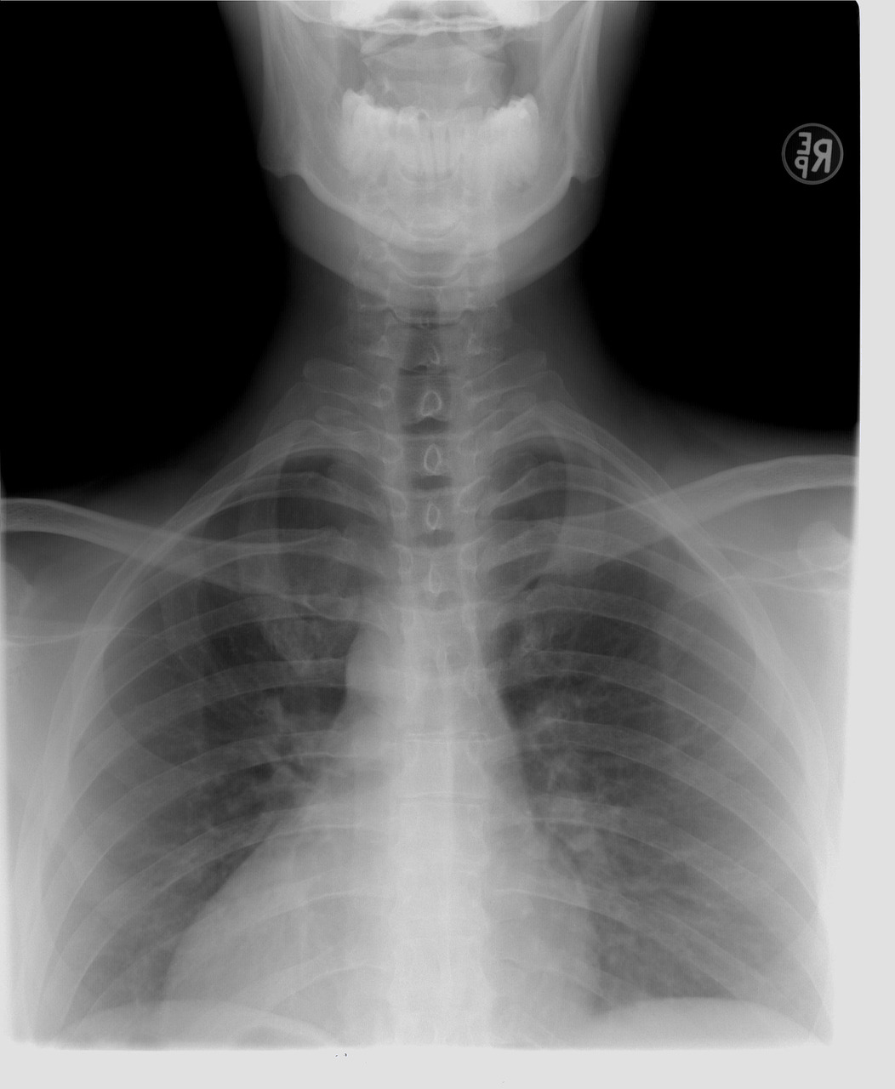
Tixgeli xog kala duwan si loo yareeyo eexda (bias)
Moodel AI ah ayaa lagu tababaray inuu ogaado oof-wareenka (pneumonia) ee raajooyinka laabta (chest X-rays).
Si kastaba ha ahaatee, moodelka si sax ah looguma tababarin astaamaha caafimaad ee la xiriira oof-wareenka (pneumonia). Tababarku wuxuu ku tiirsanaa macluumaadka gaarka ah ee cisbitaalka ee sawirada (sida kala duwanaanshaha noocyada scanner-ka).
Moodelku si fiican ayuu u shaqeeyay xogta tijaabada ee isla cisbitaalka, laakiin wuu guuldarreystay markii lagu tijaabiyay raajooyin ka yimid cisbitaallo kala duwan.

Slide 7







Tixgeli xog kala duwan si loo yareeyo eexda (bias)
Xogta tababarku waa inay kala duwanaataa si loo hagaajiyo matalaadda (representation).
Waxaan isticmaalay kaliya xog (data) dad aan aqoon.
Qaabkaaga (model) ayaa si khaldan u kala saari kara dhaqdhaqaaqyada (movements) saxda ah ee ay sameeyaan dadka kale.
Yacquub
Cabdi

Slide 8

Tixgeli xog (data) kala duwan si loo yareeyo eexda (bias)
Xog (data) kala duwan waa in la soo bandhigaa oo kaliya marka la hagaajinayo qaabka (model).
Sababta?
Xogta (data) aad u baahan tahay qaabka (model) waa in laga fikiraa marxaladda koowaad. Waa inaad ku bilowdaa sidii loo yareyn lahaa eexda (bias) iyo waxyeelada suurtagalka ah.

Slide 9
Tixgeli xog (data) kala duwan si loo yareeyo eexda (bias)
Ma noqon doonto mid waxtar leh in lagu daro xog (data) tababbar (training data) oo ka timid dadka dhaawaca qaba.
Sababta?
Xogta tababbar (training data) waa inay kala duwanaataa. Haddii aadan ku darin xog (data) qof kasta oo ciyaarta ciyaara, dhaqdhaqaaqyadooda (movements) ayaa laga yaabaa in si khaldan loo kala saaro.

Slide 10
Tixgeli xog (data) kala duwan si loo yareeyo eexda (bias)
Dhaqdhaqaaqaaga (movement), ka fikir sida xogta (data) ku jirta qaabkaaga (model) u horseedi karto gunaanad khaldan ama go'aanno caddaalad ah.

Slide 11
Tixgeli xog (data) kala duwan si loo yareeyo eexda (bias)
Dhaqdhaqaaqaaga (movement), ka fikir sida xogta (data) ku jirta qaabkaaga (model) u horseedi karto gunaanad khaldan ama go'aanno caddaalad ah.
Xogtayda tababbar (training data) waxay isticmaashaa oo kaliya xog (data) dadka dhaawaca qaba.
Tani waxay u horseedi kartaa in dadka loo tababbaro (train) inay u dhaqaaqaan (move) qaab aan waxtar lahayn.
Cabdi
Yacquub

Slide 12


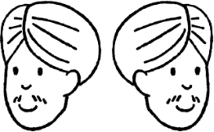

Tixgeli xog (data) kala duwan si loo yareeyo eexda (bias)
Xogtayda tababbar (training data) waxay ka timid oo kaliya dad leh hal qaab orod (running style).
Dadka qaarkood waxay yeelan karaan farsamooyin gaar ah oo waxtar leh laakiin si khaldan loo qoondeeyay inay yihiin 'kuwo xun'.
Cali
Isra

Slide 13
Horumarinta moodeelka (model)
Tixgeli xog kala duwan si loo yareeyo eexda (bias)
Nadiifi xogta si loo kordhiyo saxnaanta
Ku dar fasalka eber (null class) si looga hortago qoondeyn khaldan

Slide 14
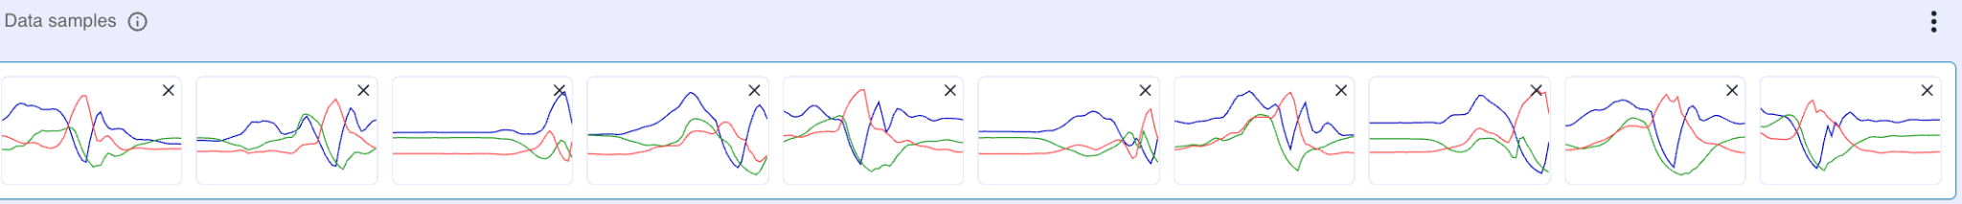
Nadiifi xogta si loo kordhiyo saxnaanta
Ka baxsan (outlier) waa muunad si weyn uga duwan muunadaha kale.
Saddexda muunad ee halkan ku qoran waxay noqon karaan kuwa ka baxsan (outliers).

Slide 15
Nadiifi xogta si loo kordhiyo saxnaanta
Habka loo saaro ama loo beddelo kuwa ka baxsan (outliers) waxaa loo yaqaan nadiifinta xogta (data cleaning).

Slide 16
Nadiifi xogta si loo kordhiyo saxnaanta
Nadiifinta xogta (data cleaning) waxaa lagu gaari karaa …
ku daridda muunado xog oo dheeri ah
beddelidda kuwa ka baxsan (outliers)
dib-u-tababarka moodeelka (model)

Slide 17
Nadiifi xogta si loo kordhiyo saxnaanta
Marka xogtu nadiif tahay, moodeelku (model) wuxuu "bartaa" qaabab dhab ah halkii uu ka bartay buuqa (noise).
Tani waxay yaraynaysaa eexda (bias) ee keentay xog qaldan ama qallafsan, waxayna hubinaysaa in moodeelku (model) si fiican u shaqeeyo xaalado kala duwan.

Slide 18


Nadiifi xogta si loo kordhiyo saxnaanta
Run ama been?
Xogta tababarka halkan waxay ka kooban tahay qiime (value) ka baxsan (outlier).
timestamp | X_acceleration | Y_acceleration | Z_acceleration | label
12:00:01 | 0.2 | -0.1 | 9.8 | jump
12:00:02 | 0.3 | -0.2 | 9.7 | jump
12:00:03 | 0.3 | -0.1 | 9.6 | jump
12:00:04 | 100 | -0.2 | 9.5 | jump
12:00:05 | 0.2 | -0.1 | 9.8 | jump
12:00:06 | 0.1 | 0.1 | 9.6 | walk
12:00:07 | 0.2 | 0.1 | 9.7 | run
Qiimaha (value) X_acceleration ee 12:00:04 waa 100, kaas oo aad uga weyn qiimayaasha (values) kale ee lagu calaamadeeyay 'Jump'.

Slide 19
Nadiifi xogta si loo kordhiyo saxnaanta (accuracy)
Sharax sifooyinka saddexda muunad ee ka dhiga kuwa ka baxsan (outliers).

Slide 20
Nadiifi xogta si loo kordhiyo saxnaanta (accuracy)
Sharax sifooyinka saddexda muunad ee ka dhiga kuwa ka baxsan (outliers).
Meelaha cas (red peaks) kama sarreeyaan sida muunadaha kale.

Slide 21
Nadiifi xogta si loo kordhiyo saxnaanta (accuracy)
2) Fiiri xogta tababarka ee fasalkasta.
Ka saar wax kasta oo ka baxsan (outliers).
Ku dar xog tababbar (training data) badan si aad u hesho ugu yaraan 10 muunadood (samples) fasalkasta.
Dib u tababbar (retrain) oo tijaabi moodelkaaga.

Slide 22
Horumarinta moodelka (model)
Tixgeli xog kala duwan si loo yareeyo eexda (bias)
Nadiifi xogta (data) si loo kordhiyo saxnaanta (accuracy)
Ku dar fasalka null (null class) si looga hortago qalad kala-saarid (misclassification)

Slide 23
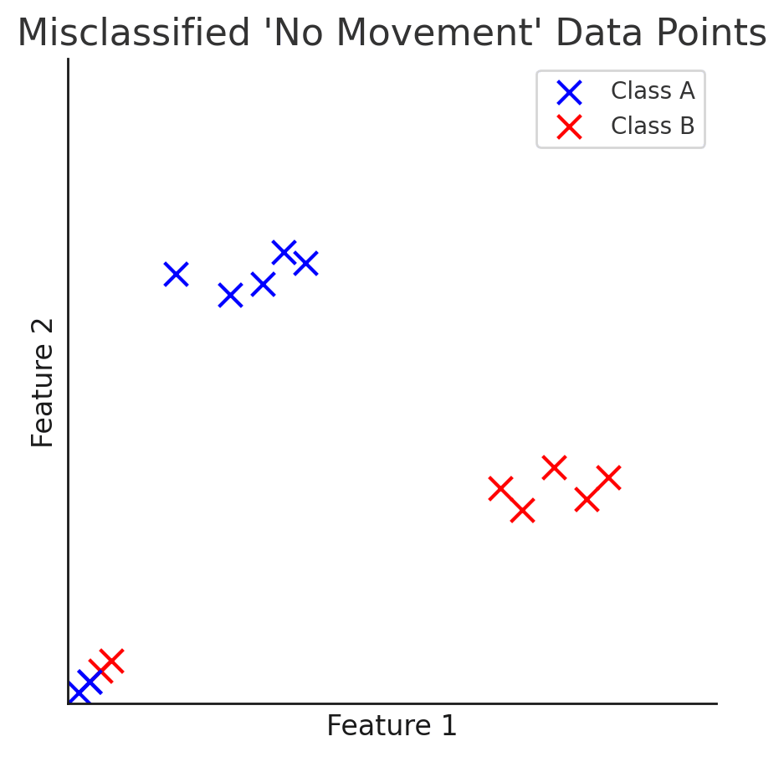
Ku dar fasalka null (null class) si looga hortago qalad kala-saarid (misclassification)
Moodelku wuxuu u kala saaraa wax kasta oo la geliyo mid ka mid ah fasallada jira, xitaa haddii xogtu aanay si fiican ugu habboonayn fasalkaas.
Muunadahan waxaa si qalad ah loo
kala saaray (misclassified).
fasalka A (class A)
fasalka B (class B)
sifo 2 (feature 2)
sifo 1 (feature 1)

Slide 24
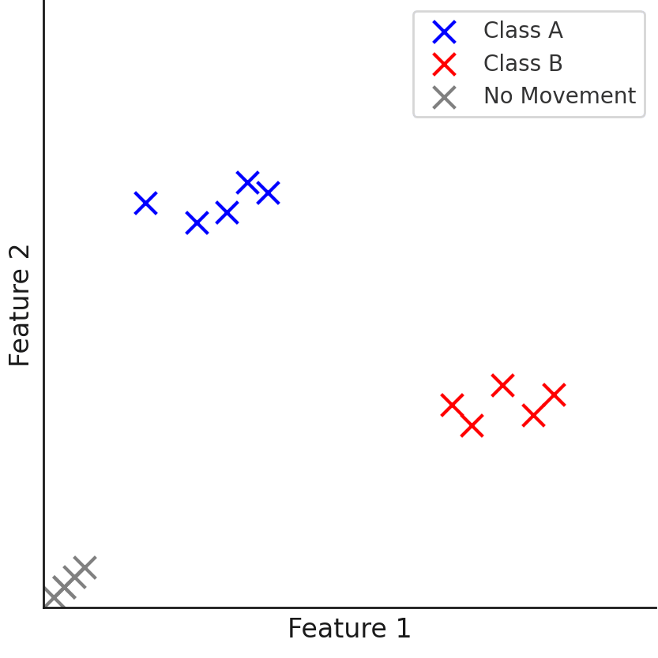
Ku dar fasalka null (null class) si looga hortago qalad kala-saarid (misclassification)
Ku darista fasalka null (null class) waxay u oggolaanaysaa moodelka inuu garto marka xogtu aanay ku habboonayn qaybaha jira, taasoo yaraynaysa fursadda kala-saarid qalad ah ama lagu qasbay.
Muunadahan hadda waxaa loo
kala saaray 'dhaqdhaqaaq (movement) ma jiro',
iyadoo la yaraynayo kuwa
si khaldan loo aqoonsaday fasalka A iyo fasalka B.
fasalka A
fasalka B
dhaqdhaqaaq (movement) ma jiro
sifo 2 (feature 2)
sifo 1 (feature 1)

Slide 25
Ku dar fasalka null (null class) si looga hortago kala-saar qalad (misclassification)
Toon qalad ah (false positive) waa …
xogta soo-saarka (output data) ee u dhigma in ka badan hal fasalka (class)
xogta gelinta (input data) ee si khaldan loo kala saaray (misclassified)
xogta tababarka (training data) ee had iyo jeer ka soo baxda soo-saarka (output)

Slide 26
Ku dar fasalka null (null class) si looga hortago kala-saar qalad (misclassification)
Fasalka null (null class) waxaa loo isticmaali karaa in lagu yareeyo …
shakiga (uncertainty)
gelinta (inputs)
tababarka (training)

Slide 27
Ku dar fasalka null (null class) si looga hortago kala-saar qalad (misclassification)
Ku dar fasalka null (null class) qaabkaaga (model).
Ugu yeer fasalka 'null'.
Ku dar 10 muunadood (samples) oo dhaqdhaqaaq (movement) la'aan ah.
Maxaad dareemeysaa markaad dib u tababarto (retrain) oo tijaabiso (test) qaabkaaga (model)?

Slide 28
Ku dar fasalka null (null class) si looga hortago kala-saar qalad (misclassification)
Ku dar fasalka null (null class) qaabkaaga (model).
Ugu yeer fasalka 'null'.
Ku dar 10 muunadood (samples) oo dhaqdhaqaaq (movement) la'aan ah.
Maxaad u ogaataa markaad dib u tababarto oo aad tijaabiso moodelkaaga?
Moodelkaygu si sax ah ayuu u saadaaliyaa in marka uu jiro dhaqdhaqaaq (movement) la'aan, muunada loo kala saaro 'null'.

Slide 29
Horumarinta moodelka
Nadiifinta xogtu waxay ka saari kartaa qiimayaasha (value) aan caadiga ahayn si moodelku u 'barto' qaabab dhab ah halkii uu ka bartay buuq.
Waxyaabaha si khaldan loo xaqiijiyo (false positives) waxay dhacaan marka xogta si khaldan loo kala saaro.
Abuurista fasalka null waxay yaraynaysaa fursadaha kala saarista khaldan, maadaama moodelku leeyahay qaabab cusub oo xogta la geliyo lala barbar dhigi karo.

