Slide 1
Dhererka dhinaca gaaban (Length of a shorter side)
Sifooyinka joomatari: isku ekaansho iyo aragtida Pythagoras (Geometrical properties: similarity and Pythagoras’ theorem)

Slide 2
sida loo isticmaalo darasyada Oak (how to use Oak lessons)

Slide 3
Waxaan isticmaali karaa aragtida Pythagoras (Pythagoras’ theorem) si aan u helo dhererka mid ka mid ah dhinacyada gaaban.

Slide 4
Saddexagal xagal-qumman (right-angled triangle) wuxuu leeyahay hal xagal 90° oo gudaha ah.
Hypotenuse (hypotenuse) waa dhinaca saddexagalka qumman ee ka soo horjeeda xagasha qumman.
Aragtida Pythagoras (Pythagoras’ theorem) waxay tusinaysaa in wadarta labajibbaaranaha (squares) labada dhinac ee gaaban ee saddexagalka xagal-qumman ay la mid tahay labajibbaaranaha dhinaca ugu dheer (hypotenuse).

Slide 5

Dhererka dhinaca gaaban (Length of a shorter side)
Labajibbaaranayaal (Squares) ka yimid dhinacyada saddexagalka
Isticmaalka aragtida Pythagoras (Pythagoras’ theorem) si loo helo dhinac gaaban

Slide 6
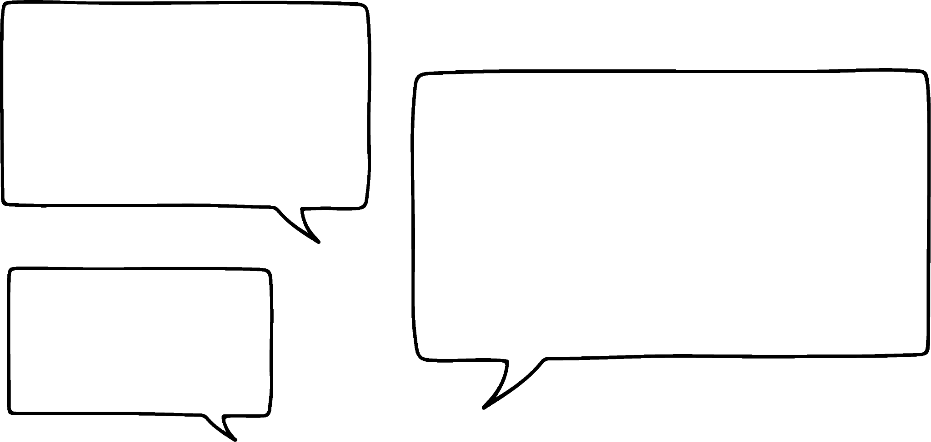


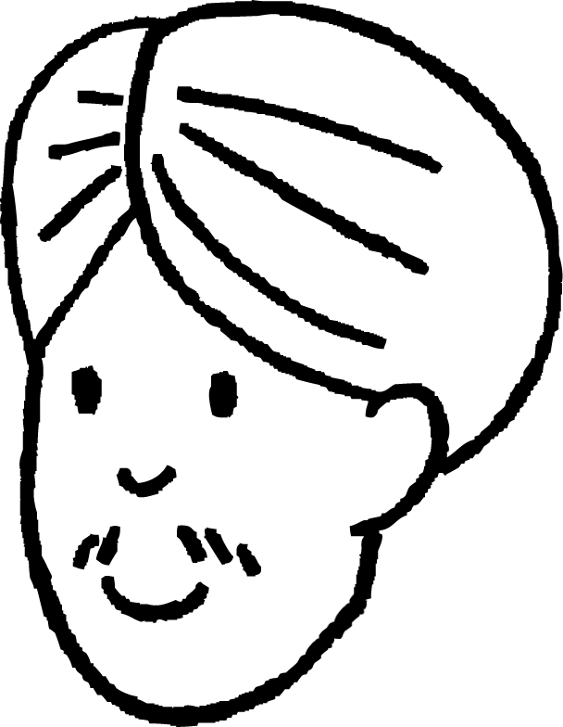

Labajibbaaranayaal (Squares) ka yimid dhinacyada saddexagalka
Waxaan ku sawiri karnaa labo jibaaran (squares) dhinac kasta oo saddex-xagal (triangle) ah.
Oh, waxaanan heli karnaa dhererka (length) hypotenuse adoo xidid labo jibaaran (square root) ka qaadaya bedka (area) labo jibaarkaas!
Oo labo jibaar (square) dhererka dhinac kasta si aad u hesho bedka (area) labo jibaarkaas.
bed (area)
36 + 64 cm²
100 cm²
100
= 10
10 cm
Cali
h cm
6 cm
bed (area)
36 cm²
6 cm
Bedka (area) labo jibaarka (square) ka yimid hypotenuse waa wadarta (sum) labada labo jibaar oo yaryar oo ka yimid labada dhinac ee gaaban ee saddex-xagalka (triangle).
8 cm
bed (area)
64 cm²

Slide 7

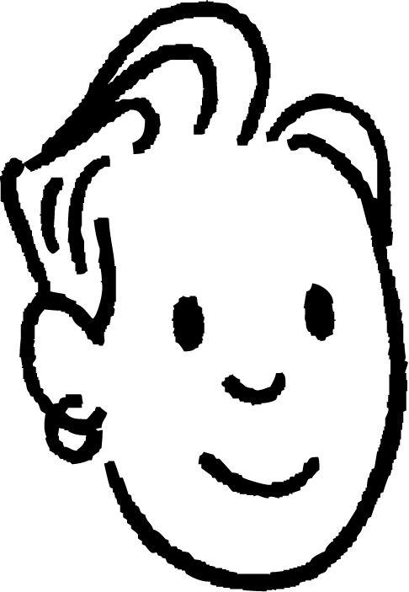

Labo jibaar (Squares) ka yimid dhinacyada saddex-xagal (triangle)
bed (area)
169 cm²
h cm
13 cm
9 cm
bed (area)
81 cm²
a cm
6 cm
6 cm
12 cm
12 cm
bed (area)
144 cm²
Ma heli karo dhererka a iyadoo la isticmaalayo hab la mid ah, miyaan karaa?
bed (area)
144 cm²
Maxaa ku kala duwan labadan jaantus (diagram)?
Saciid
Saciid

Slide 8

Saddexagalka dhinacyadiisa laga sameeyay labajibbaaranayaal (squares)
Saddexagalkan, labajibbaaranaha aan la calaamadin beelkiisa (area) waa kan ka yimid hypotenuse-ka.
bed (area)
81 + 144 cm²
225 cm²
15 cm
h cm
bed (area)
81 cm²
Sidaa darteed, bedka (area) labajibbaaranahan waa wadarta labada labajibbaaran ee kale.
9 cm
6 cm
12 cm
Dhererka hypotenuse-ka waxaa laga heli karaa iyadoo la xisaabinayo xididka labajibbaaranaha (square root) ee bedka (area) labajibbaaranahan.
bed (area)
144 cm²
225
= 15

Slide 9
Labajibbaaranayaal ka yimid dhinacyada saddex-xagalka
Halka, saddex-xagalkan, bedka (area) labajibbaaranaha ka yimid hypotenuse waa la yaqaan.
bed (area)
169 cm²
Sidaa darteed, 169 waa wadarta 144 iyo bedka (area) labajibbaaranaha A.
169 = 144 + bedka (area) labajibbaaranaha A
13 cm
labajibbaaranaha A
a cm
6 cm
12 cm
Marka, sideen u heli karaa bedka (area) labajibbaaranaha A?
bed (area)
144 cm²
Labajibbaaranahan wuxuu ka yimid mid ka mid ah dhinacyada gaagaaban ee saddex-xagalka.
Saciid

Slide 10
Labajibbaaranayaal ka yimid dhinacyada saddex-xagalka
Sidaa darteed, 169 waa wadarta 144 iyo bedka (area) labajibbaaranaha A.
169 = 144 + bedka (area) labajibbaaranaha A
169 − 144 = 144 + bedka (area) labajibbaaranaha A − 144
bed (area)
169 cm²
bed (area)
25 cm²
13 cm
saddexagal A (square A)
a cm
6 cm
169 − 144 = bedka saddexagalka A (area of square A)
25 = bedka saddexagalka A (area of square A)
12 cm
bed (area)
144 cm²
Bedka mid ka mid ah saddexagallada (squares) ee dhinaca gaaban ee saddexagalka waxaa laga helaa kala-goyn, ama helista farqiga, u dhexeeya bedka labada saddexagal ee kale.

Slide 11
Saddexagallo (Squares) ka yimid dhinacyada saddexagal
Sidaa darteed, 169 waa wadarta 144 iyo bedka saddexagalka A.
169 = 144 + bedka saddexagalka A (area of square A)
bed (area)
169 cm²
− 144
− 144
bed (area)
25 cm²
13 cm
laba jibaaran A (square A)
a cm
5 cm
6 cm
169 − 144 = bedka (area) laba jibaaran A (square A)
25 = bedka (area) laba jibaaran A (square A)
12 cm
bed (area)
144 cm²
Dhererka dhinacaas gaaban ee saddex-xagalka waxaa loo helaa si la mid ah.
25
= 5

Slide 12


Laba jibaarannada (Squares) dhinacyada saddex-xagalka
Xisaabintaas (calculation) kee ayaa helaya bedka (area) laba jibaaran B (square B)?
b cm
a
laba jibaaran (square)
B
b
bed (area)
1681 cm²
c
d
bed (area)
1600 cm²
41 cm
Jawaabaha:
1681 + 1600
1681 − 1600
40 cm
41 + 40
41 − 40

Slide 13
Laba jibaarannada (Squares) dhinacyada saddex-xagalka
Dee qayb ka mid ah weedhahan ayaa kaa caawinaya in la fahmo sababta 1681 − 1600 ay tahay xisaabta saxda ah?
b cm
laba jibaaran (square)
B
a
Labajibbaaranaha B waa labajibbaaranaha ka yimid hypotenuse (jifaarka) saddexagalka.
bed (area)
1681 cm²
b
Labajibbaaranaha B waa labajibbaaranaha ka yimid dhinac gaaban oo saddexagalka ah.
bed (area)
1600 cm²
41 cm
40 cm

Slide 14
Labajibbaaranayaal ka yimid dhinacyada saddexagal
Waa maxay dhererka dhinaca b, cm ahaan?
1681 − 1600 = 81
Bedka labajibbaaranaha B waa 81 cm²
b cm
labajibbaaran (square)
B
81 = 9
bed (area)
1681 cm²
b waa 9 cm dherer.
Waa dhererka dhinaca ugu gaaban ee saddexagalka.
bed (area)
1600 cm²
41 cm
40 cm

Slide 15
Squares (Squares) oo ka yimid dhinacyada saddex-xagal (triangle)
Ku dheji dhererka (length) ama bedka (area) maqan qiimihiisa (value) saxda ah.
a
bed (area)
cm²
a
bed (area)
cm²
b
b
16 cm
c
cm
c
bed (area)
60 cm²
Jawaabaha:
316
32
256
17.8
14
196

Slide 16
Squares (Squares) oo ka yimid dhinacyada saddex-xagal (triangle)
Ku dheji dhererka (length) ama bedka (area) maqan qiimihiisa (value) saxda ah.
256
a
bed (area)
cm²
a
bed (area)
cm²
196
b
b
16 cm
14
c
cm
c
bed (area)
60 cm²
316
32
17.8

Slide 17
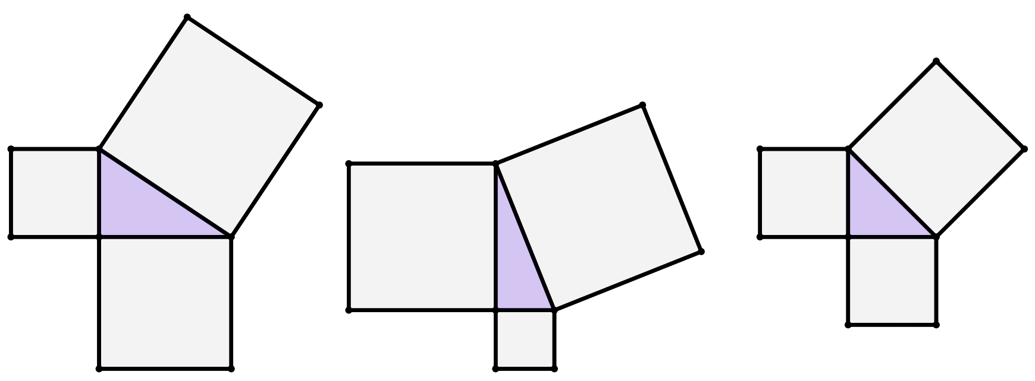
Squares (Squares) oo ka yimid dhinacyada saddex-xagal (triangle)
1) Soo hel bedka (area) square (square) kasta oo aan la calaamadayn.
29 cm
bed (area)
570 cm²
12 cm
20 cm
20 cm
bed (area)
30 cm²

Slide 18
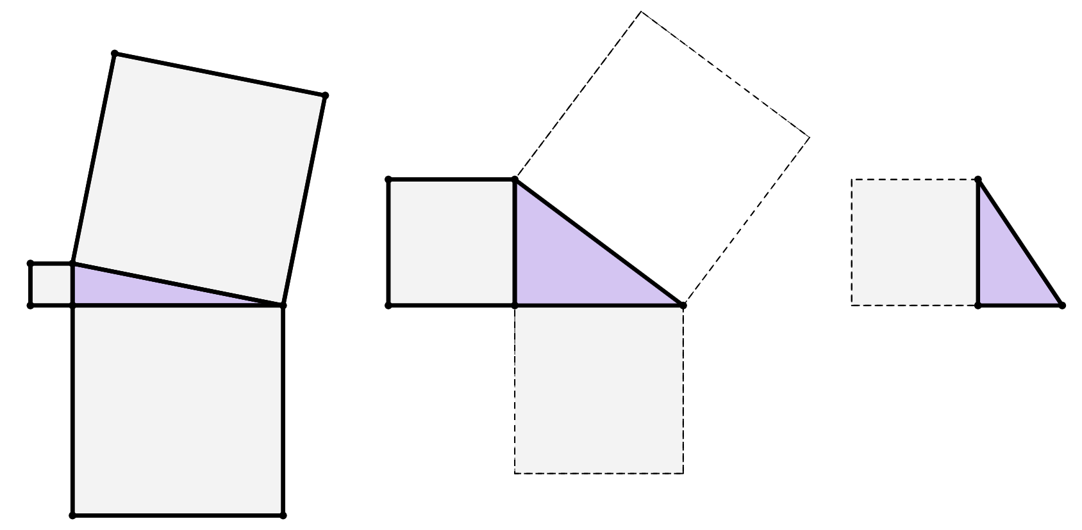
Squares (Squares) oo ka yimid dhinacyada saddexagalka
2) Adigoo marka hore sawiraya squares (squares) kasta oo maqan oo xisaabinaya beddooda (area), raadi dhererka dhinac kasta oo lagu calaamadeeyay xaraf.
bed (area)
29 cm²
bed (area)
275 cm²
b cm
15 cm
25 cm
c cm
a cm
30 cm
15 cm

Slide 19
Squares (Squares) oo ka yimid dhinacyada saddexagalka
1) Raadi bedka (area) square (square) kasta oo aan la calaamadayn.
29 cm
400
cm²
441
cm²
bed (area)
570 cm²
114 cm²
170 cm²
841 cm²
144 cm²
400 cm²
12 cm
20 cm
20 cm
bed (area)
30 cm²

Slide 20
Sadex xagal dhinacyadiisa laga soo saaray labajibbaaran (Squares from the sides of a triangle)
2) Adoo marka hore sawiraya labajibbaaran kasta oo maqan, xisaabiyana bed (area) kooda, hel dhererka dhinac kasta oo xaraf ku calaamadsan.
bed (area)
29 cm²
25 cm
bed (area)
275 cm²
b cm
15 cm
25 cm
c cm
a cm
30 cm
20 cm
15 cm
14 cm
Jawaabaha:
625 cm²
625 cm²
225 cm²
400 cm²
900 cm²
196 cm²
225 cm²

Slide 21
Dhererka dhinaca gaaban (Length of a shorter side)
Labajibbaaranayaasha (Squares) ka imanaya dhinacyada saddexagalka
Isticmaalka aragtida Pythagoras (Pythagoras’ theorem) si loo helo dhinac gaaban

Slide 22



Isticmaalka aragtida Pythagoras (Pythagoras’ theorem) si loo helo dhinac gaaban
Qaaciddada (Pythagoras’ theorem) waxaa loo isticmaali karaa xisaabinta jilib-jilib (hypotenuse) ee saddex-xagal (triangle).
Laakiin ma loo isticmaali karaa in laga helo dhererka dhinaca gaaban?
23 cm
9 cm
x cm
Saciid
Ma hubo, aan ku beddelno dhererka dhinacyada qaaciddada (Pythagoras’ theorem) oo aan soo ogaano.
Layla
Qaaciddada (Pythagoras’ theorem): a² + b² = c²

Slide 23
Isticmaalka qaaciddada (Pythagoras’ theorem) si loo helo dhinac gaaban
Haa, markaa xarafka x ma uu socdaa dhinaca midig ee qaabka (formula) qaaciddada (Pythagoras’ theorem), maadaama uu yahay dhinaca aan la garanayn?
23 cm
9 cm
x cm
Saciid
Maya, hubaal maya!
Xusuusnow, waa inay marwaliba la mid noqotaa laba-jibaar (square) ee jilib-jilib (hypotenuse)! Haddii jilib-jilib (hypotenuse) yahay dherer la yaqaan iyo haddii kale!
Layla
Qaaciddada (Pythagoras’ theorem): a² + b² = c²

Slide 24
Isticmaalka qaaciddada (Pythagoras’ theorem) si loo helo dhinac gaaban
Qaaciddada (Pythagoras’ theorem): a² + b² = c²
23 cm
9
2
+
x
2
=
23
2
9 cm
x cm
Labo-jibaar (Square) labada dhinac ee gaaban, mid kasta si gooni ah.
Wadarta labajibbaaranaha (squares) ayaa had iyo jeer la eg labajibbaaranaha (square) hypotenuse-ka.

Slide 25
Isticmaalka aragtida Pythagoras (Pythagoras’ theorem) si loo helo dhinac gaaban
Aragtida Pythagoras (Pythagoras’ theorem): a² + b² = c²
23 cm
9
2
+
x
2
=
23
2
9 cm
81
+
x²
=
529
x cm
− 81
− 81
=
−
x²
529
81
Labajibbaaranaha (square) dhinaca gaaban ee saddexagalka waxaa lagu helaa kala-goynta, ama helista farqiga, u dhexeeya labajibbaaranaha (square) hypotenuse-ka iyo labajibbaaranaha (square) dhinaca kale ee gaaban.

Slide 26
Isticmaalka aragtida Pythagoras (Pythagoras’ theorem) si loo helo dhinac gaaban
Aragtida Pythagoras (Pythagoras’ theorem): a² + b² = c²
23 cm
9
2
+
x
2
=
23
2
9 cm
81
+
x²
=
529
x cm
− 81
− 81
21.17 cm
=
−
x²
529
81
x²
=
448
x²
=
448
=
21.17

Slide 27
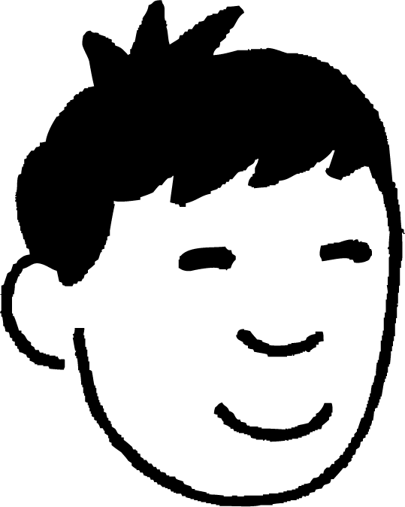
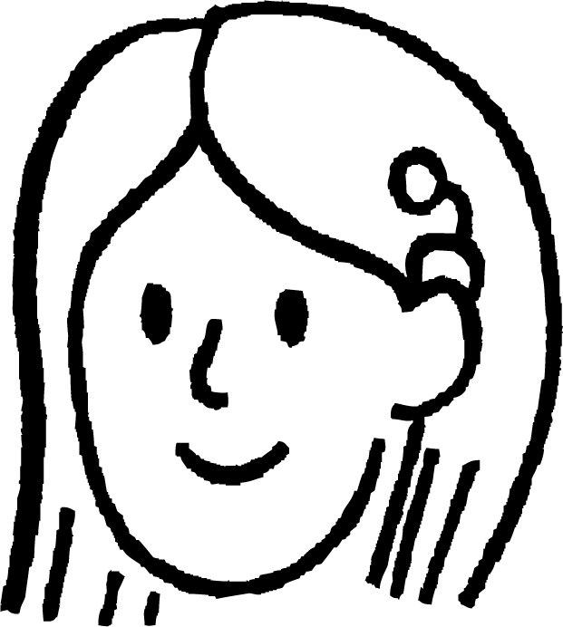
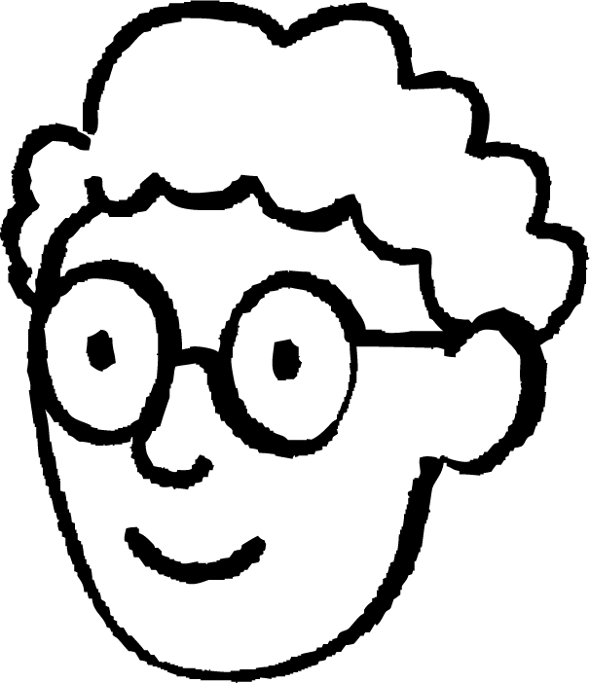
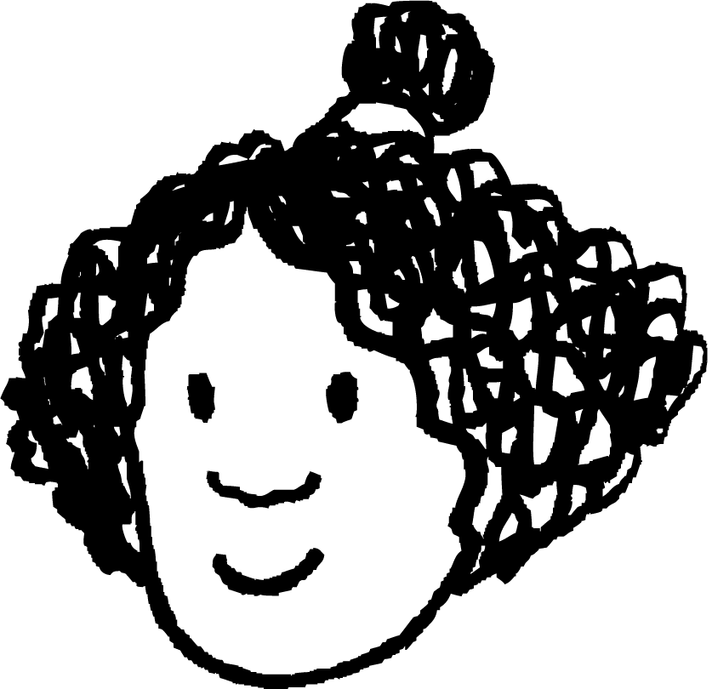

Isticmaalka aragtida Pythagoras (Pythagoras’ theorem) si loo helo dhinac gaaban
Yaa talaabada koowaad u saxan si loo xisaabiyo dhererka r?
r² + 10² = 18²
18 cm
r cm
18² + 10² = r²
Nuur
Suad
10 cm
10² + r² = 18²
Ma ka soo bixi kartaa qaabab kale oo sax ah oo loo qoro tillaabadaan koowaad?
18² = 10² + r²
18² = r² + 10²
10² = 18² + r²
Isra
Axmed

Slide 28
Isticmaalka aragtida Pythagoras (Pythagoras’ theorem) si loo helo dhinac gaaban
Kuwee ka mid ah kuwanu waa xisaabinta saxda ah iyo qiimaha (value) p²?
p cm
15 cm
a
f
24 cm
b
g
c
h
Jawaabaha:
d
24² + 15²
801
24² − 15²
351
24 − 15
9
576 − 225
576 + 225
e

Slide 29
Isticmaalka aragtida Pythagoras (Pythagoras’ theorem) si loo helo dhinac gaaban
Waxaan hubaa in tani tahay xisaabinta saxda ah si loo helo dhererka maqan, c.
c cm
Sababtoo ah dhererka maqan waxaa lagu calaamadeeyay xarafka c, marka waa inuu yahay hypotenuse (hypotenuse).
14 cm
16 cm
Cali
Ma lahan xiriir c ee saddex-xagalka ku jira, kaas oo si cad aan u ahayn hypotenuse (hypotenuse), sababtoo ah si muuqata ugama horjeedo xagasha qumman (right angle).
Waxaan u malaynayaa in taasi khalad tahay.
c ee qaacidada aragtida Pythagoras (Pythagoras’ theorem formula) waxay u taagan tahay hypotenuse (hypotenuse), laakiin waxaa lagu beddeli karaa xaraf kale.
Aragtida Pythagoras (Pythagoras’ theorem): a² + b² = c²
16
2
+
14
2
=
c
2
Layla

Slide 30
Isticmaalka aragtida Pythagoras (Pythagoras’ theorem) si loo helo dhinac gaaban
Yikes, waxay u egtahay qalad sahlan oo la sameyn karo.
Si aan isaga ilaaliyo jahawareerka xarfaha, waxaa laga yaabaa inaan xusuusto aragtida Pythagoras sidan oo kale…
c cm
14 cm
16 cm
Cali
2
2
dhinaca gaaban (shorter side)
+
dhinaca kale ee gaaban (other shorter)
dhinaca (side)
=
2
hypotenuse (hypotenuse)
c
2
+
14
2
=
16
2

Slide 31
Isticmaalka aragtida Pythagoras si loo helo dhinac gaaban (Using Pythagoras’ theorem to find a shorter side)
Hab wax ku ool ah oo lagu helo dhererka dhinaca gaaban ee saddexagal qumman (right-angled triangle) wuxuu ku lug leeyahay isku darka habaynta isla'egta (equation) iyo isticmaalka saxda ah ee xisaabiyaha (calculator).
68 cm
39 cm
t cm

Slide 32
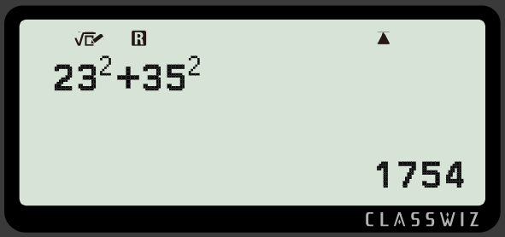
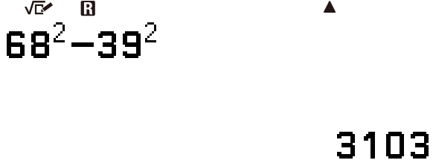

Isticmaalka aragtida Pythagoras si loo helo dhinac gaaban (Using Pythagoras’ theorem to find a shorter side)
t
2
+
39
2
=
68
2
2
2
2
68 cm
t
=
68
−
39
39 cm
t
2
=
3103
t cm
badhamada la riixo (buttons to press)
shaashadda xisaabiyaha (calculator screen)

Slide 33
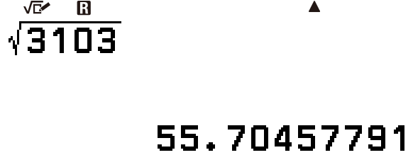

Isticmaalka aragtida Pythagoras si loo helo dhinac gaaban (Using Pythagoras’ theorem to find a shorter side)
t
2
+
39
2
=
68
2
55.7 cm
2
2
2
68 cm
t
=
68
−
39
39 cm
t
2
=
3103
t cm
t
=
55.7
badhamada la riixo (buttons to press)
shaashadda xisaabiyaha (calculator screen)

Slide 34
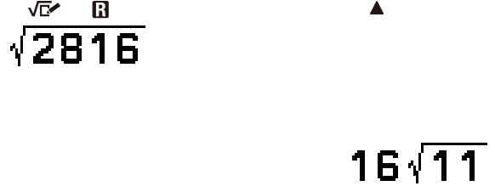
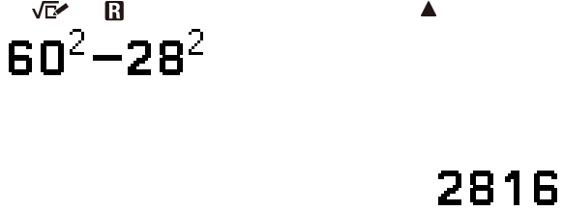
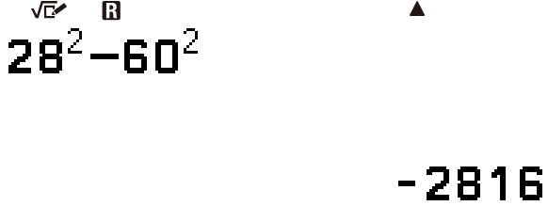
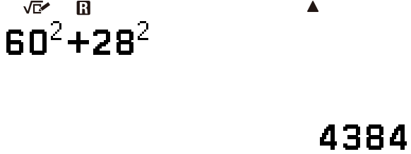
Isticmaalka aragtida (theorem) Pythagoras si loo helo dhinac gaaban (shorter side)
Saddex-xagal (triangle) ayaa leh laba dhinac oo gaaban oo dhererkoodu yahay 28 cm iyo w cm, iyo hypotenuse (hypotenuse) dhererkeedu yahay 60 cm.
Yaa shaashadda xisaabiyihiisa (calculator display) muujinaysa tillaabo sax ah oo lagu xisaabinayo qiimaha (value) w?
Suad
Nuur
Isra
Axmed

Slide 35
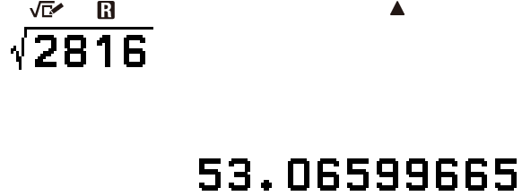

Isticmaalka aragtida (theorem) Pythagoras si loo helo dhinac gaaban (shorter side)
Saddex-xagal (triangle) ayaa leh laba dhinac oo gaaban oo dhererkoodu yahay 28 cm iyo w cm, iyo hypotenuse (hypotenuse) dhererkeedu yahay 60 cm.
Yaa shaashadda xisaabiyihiisa (calculator display) muujinaysa tillaabo sax ah oo lagu xisaabinayo qiimaha (value) w?
Suad
Waxaan u beddeli karnaa qaabkan surd (surd form) ee jawaabta qaab tobanle (decimal form) iyadoo la beddelayo qaabka muujinta (format display) jawaabta.

Slide 36
Isticmaalka aragtida (theorem) Pythagoras si loo helo dhinac gaaban (shorter side)
1) Buuxi dhammaan meelaha bannaan si aad u dhamaystirto habka lagu xisaabinayo dhererka dhinaca e, oo lagu soo koobay (rounded) 1 meel tobanle (decimal place).
2
+
2
=
2
+
=
22 cm
e cm
=
−
=
459
=
=
5 cm

Slide 37
Isticmaalka aragtida Pythagoras si loo helo dhinac gaaban (shorter side)
2) Midkee ka mid ah kuwani waa matalaado (representations) sax ah oo aragtida (theorem) Pythagoras ah si loo helo dhererka dhinaca c?
3) Isticmaalka aragtida Pythagoras, si buuxda u muuji in qiimaha (value) w cm uu yahay 58.52 cm marka lagu soo koobo 2 meelood oo jajab tobanle (decimal places).
81 cm
21 cm
c cm
56 cm
w cm
9 cm
4) Tus (Show) in wareegga (perimeter) saddex-xagalkan (triangle) uu yahay 84 cm.
a
b
c² = 21² + 9²
c² = 21² − 9²
37 cm
c
d
21² = 9² + c²
21² = c² + 9²
e
f
21² = 9² − c²
21² = c² − 9²
12 cm

Slide 38
Isticmaalka aragtida Pythagoras si loo helo dhinac gaaban (shorter side)
5) Isku dhig mid kasta oo ka mid ah saddexagalka (triangle) xisaabinta (calculation) iyo jawaabta si loo helo dhererka dhinaciisa maqan (missing side).
b)
a)
b cm
18 cm
c)
31 cm
2 cm
12 cm
13 cm
c cm
34 cm
a cm
d
e
f
g
xisaabinta (calculation)
34² − 31²
169 − 2²
165
324 − 144
h
i
j
dhererka dhinaca maqan (missing side)
13.96 cm
13.42 cm
12.84 cm

Slide 39
Isticmaalka Aragtida Pythagorean-ga si loo helo dhinac gaaban
1) Buuxi meelaha bannaan si aad u dhamaystirto habka xisaabinta dhererka dhinaca e, oo lagu soo koobay 1 meel tobanle.
e
2
+
5
2
=
22
2
e²
+
25
=
484
22 cm
e cm
e²
=
484
−
25
e²
=
459
e
=
459
=
21.4 (1 d.p.)
5 cm

Slide 40
Isticmaalka Aragtida Pythagorean-ga si loo helo dhinac gaaban
2) Kee ka mid ah kuwani waa matalaad sax ah oo Aragtida Pythagorean-ga ah si loo helo dhererka dhinaca c?
21 cm
c cm
9 cm
Jawaabaha:
a
b
c² = 21² + 9²
c² = 21² − 9²
c
d
21² = 9² + c²
21² = c² + 9²
e
f
21² = 9² − c²
21² = c² − 9²

Slide 41
Isticmaalka Aragtida Pythagorean-ga si loo helo dhinac gaaban
3) Isticmaalka Aragtida Pythagorean-ga, si buuxda u muuji in qiimaha (value) w cm uu yahay 58.52 cm marka lagu soo koobayo 2 meelood oo tobanle.
4) Muuji in wareega (perimeter) saddexagalkaasi yahay 84 cm.
81 cm
37 cm
56 cm
w cm
12 cm
56² + w² = 81²
Dhererka maqan ha la yiraahdo x.
w² = 81² − 56²
x² = 37² − 12² = 1225
w² = 3425
x = 1225 = 35
w = 3425 = 58.5234996
Wareegga (Perimeter) = 12 cm + 37 cm + 35 cm
w = 58.52, ka dib soo koobidda.
Wareega (Perimeter) = 84 cm

Slide 42
Isticmaalka aragtida Pythagoras (Pythagoras’ theorem) si loo helo dhinac gaaban
5) Ku xidh saddexagal kasta xisaab iyo jawaab si aad u hesho dhererka dhinaciisa maqan.
b)
a)
b cm
18 cm
c)
31 cm
2 cm
12 cm
13 cm
c cm
34 cm
a cm
g
d
e
324 − 144
34² − 31²
169 − 2²
i
h
f
13.42 cm
13.96 cm
165
j
12.85 cm

Slide 43
Dhererka dhinaca gaaban
Labo jibbaaran (square) dhinac gaaban oo ka mid ah saddexagal qumman (right-angled triangle) waxay la eg tahay bedka (area) farqiga u dhexeeya labo jibbaaran ee hypotenuse iyo labo jibbaaran ee dhinaca kale ee gaaban.
Aragtida Pythagoras (Pythagoras’ theorem) waxaa loo isticmaali karaa in lagu xisaabiyo dhererka dhinaca gaaban ee saddexagal ka dib marka isla'egta (equation) dib loo habeeyo.

