Slide 1
Dhererka siligga (Length of a wire)
Iska caabbinta (Resistance) iyo wareegyada barbar socda (parallel circuits)

Slide 2
Sida agabkeena waxbarista loogu talagalay fasalka

Slide 3
Waxaan sharxi karaa sababta siligyada dhaadheer ay u leeyihiin iska caabin (resistance) ka sareeya kuwa gaagaaban.

Slide 4
iska caabin (resistance)
ion birta (metal ion)
elektaroon (electron)
saami (proportional)

Slide 5
Iska caabinta (Resistance) waa cabbirka sida ay u adag tahay in korontadu (current) qulqusho.
Ion birta (metal ion) waxaa la sameeyaa marka atom birta uu lumiyo hal ama in ka badan oo elektaroon (electron) ah oo uu leeyahay kharash togan (positive charge).
Elektaroonnada (Electrons) waa kharashyada ku jira gudbiyeyaasha (conductors) kuwaas oo qulqula si ay u bixiyaan koronto (electric current).
Laba doorsoome (variables) waa saami (proportional) haddii midi isbeddelo sida dhufashada (multiple) kan kale.

Slide 6

Dhererka siligga (Length of a wire)
Korontada (Current) maraysa siligyo dherer kala duwan
Iska caabinta (Resistance) siligga dhererkiisu kala duwan yahay

Slide 7
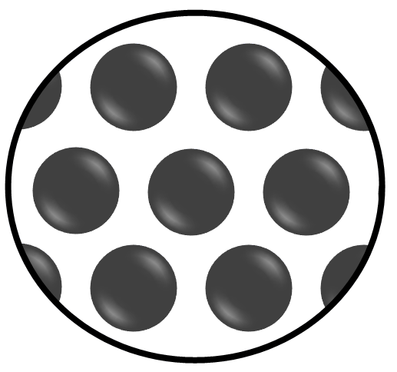
Korontada (Current) maraysa siligyo dherer kala duwan
Silig khafiif ah oo nichrome ah ayaa leh iska caabin (resistance) muhiim ah oo uu hor istaago qulqulka korontada (current).
Iska caabinta (resistance) waxaa keena ion birta (metal ions) ee ku jirta siligga.

Slide 8
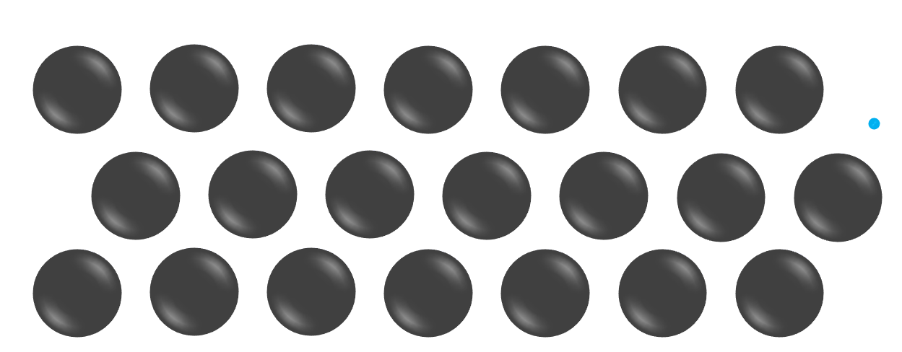
Korontada (Current) maraysa siligyo dherer kala duwan
Hal qaab oo iska caabin (resistance) ah ayaa ah in elektaroon (electron) uu ku dhaco ion birta (metal ions) marka uu dhex marayo siligga.
elektaroon (electron)
ion bir (metal ion)
Tani waxay hor istaagtaa dhaqdhaqaaqa (motion) oo waa sababta iska caabinta (resistance).

Slide 9

Koronto (Current) maraya siligyo dherer kala duwan leh
Waa maxay hadal ku sifeeya sababta iska caabinta (resistance) uga jirta silig bir ah?
elektronnada (electrons) waxay isku dhacaan ion birta (metal ions)
ion birta (metal ions) waxay u dhaqaaqaan jidka elektronnada (electrons)
elektronnada (electrons) iyo ion birta (metal ions) way is soo jiitaan

Slide 10
Koronto (Current) maraya siligyo dherer kala duwan leh
Waxaa jira ion bir (metal ions) oo keena iska caabin (resistance) dhererka oo dhan ee siliga.

Slide 11
Koronto (Current) maraya siligyo dherer kala duwan leh
Qayb kasta oo ka mid ah kuwani waxay keeni doonaan iska caabin (resistance).

Slide 12
Koronto (Current) maraya siligyo dherer kala duwan leh
Waa maxay hadal ku sifeeya iska caabinta (resistance) silig bir ah oo isku mid ah?
iska caabintu (resistance) waxay ugu badan tahay darafyada
iska caabintu (resistance) waxay ugu badan tahay dhexda
iska caabintu (resistance) waa isku mid qayb kasta oo siliga ah

Slide 13
Koronto (Current) maraya siligyo dherer kala duwan leh
Siligu wuxuu la mid yahay qaybo gaaban, mid kastaa wuxuu leeyahay iska caabin (resistance) yar, oo la isku xidhay.
Siliga waxaa sidoo kale loo qaadan karaa inuu yahay iska caabiyeyaal (resistors) badan oo isku xidhan taxane (series).

Slide 14
Koronto (Current) maraya siligyo dherer kala duwan leh
Way fududahay in koronto (current) lagu riixo hal iska caabiye (resistor) …
… marka loo eego in badan.

Slide 15
Koronto (Current) dhex mara silacyo dherer kala duwan
Way fududahay in koronto (current) lagu riixo dherer gaaban oo silig ah …
… marka loo eego dherer badan.

Slide 16
Koronto (Current) dhex mara silacyo dherer kala duwan
Silig gaaban wuxuu leeyahay iska caabin (resistance) hoose …
Waxaa jira bir-ion (metal ions) yar oo lagu shubo siliga gaaban.
… marka loo eego kan dheer.

Slide 17
Koronto (Current) dhex mara silacyo dherer kala duwan
Silig dheer wuxuu leeyahay iska caabin (resistance) hoose marka loo eego silig gaaban.
Waxaa jira bir-ion (metal ions) badan oo ku teedsan siliga dheer.
Waxaa jira elektaroonno (electrons) badan oo ku teedsan siliga dheer.

Slide 18
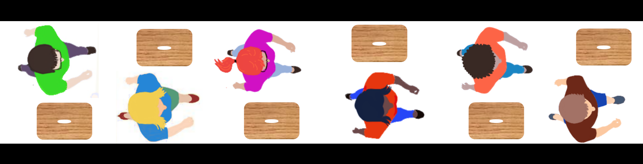
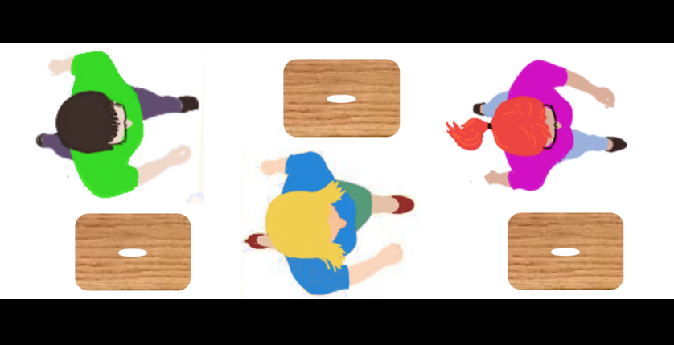
Koronto (Current) dhex mara silacyo dherer kala duwan
Qaabka dadka dhaqaaqaya (moving people model), waxaa jira kuraas (seats) yar oo jidka ku yaal qayb gaaban.
Kordhinta dhererka waxay kordhisaa tirada kuraasta (seats) jidka ku yaal waxayna kordhisaa iska caabinta (resistance).

Slide 19
Koronto (Current) dhex mara silacyo dherer kala duwan
Waa sheegasho (statement) run ah oo ku saabsan qaabka dadka dhaqaaqaya (moving people model)?
meel cidhiidhi ah waxay leedahay kuraas (seats) badan
meel dheer way fududahay in laga gudbo
kuraasta (seats) ayaa jidka isku taalla

Slide 20
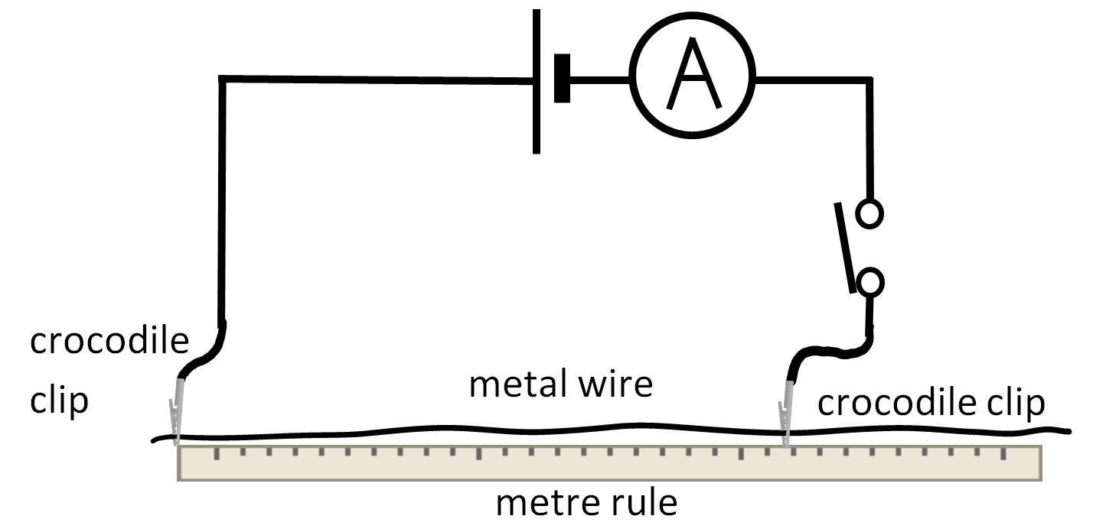
Koronto (Current) dhex mara silacyo dherer kala duwan
Tijaabi inta koronto (current) ee dhex mari karta dherer kala duwan oo isku silig ah.
Ku bilow dherer 100.0 cm, ka dibna hoos u dhig 20.0 cm mar kasta, kuna dhamee 20.0 cm.
Isticmaal ammeter (ammeter) si aad u cabbirto korontada (current).
Ku qiyaas socodka (current) dhex mara dherer kasta saddex jeer, kadibna xisaabi celceliska socodka mid kasta.
length of wire (cm) | current (A)
 | 1 | 2 | 3 | mean
Sharax waxa aad heshay.
Isbarbardhig cabbirada socodka iyo dhererka.

Slide 21
Current through wires of different lengths
Sample results:
length of wire (cm) | current (A)
 | 1 | 2 | 3 | mean
100.0 | 0.085 | 0.089 | 0.089 | 0.088
80.0 | 0.112 | 0.113 | 0.106 | 0.110
60.0 | 0.440 | 0.144 | 0.148 | 0.146
40.0 | 0.219 | 0.223 | 0.219 | 0.220
20.0 | 0.435 | 0.431 | 0.450 | 0.439
Qiimihii ugu horreeyay ee dhererka 60.0 cm wuxuu ahaa mid aan caadi ahayn (anomalous), sidaas darteed looma isticmaalin xisaabinta celceliska.
Sharax waxa aad heshay.
Markii dhererku yaraaday, celceliska socodku wuu kordhay.
Tani waxay ka dhigan tahay in iska caabbintu (resistance) yaraato marka dhererku yaraado.

Slide 22
Current through wires of different lengths
2) Isbarbardhig cabbirada (measurements) ee current-ka iyo dhererka (length).
Markasta oo dhererka la yareeyo, socodku wuu kordhay.
Socodka 80.0 cm wuxuu ahaa 0.110 A, 40.0 cm-na wuxuu ahaa 0.220 A.
Markii dhererka la badh-dhigay (80.0→40.0), socodku wuu labanlaabmay (0.110→0.220).
Socodka 20.0 cm wuxuu ahaa 0.439 A, socodka 40.0 cm-na wuxuu ahaa 0.220 A.
Markii dhererka la labanlaabay (20.0→40.0), socodku wuu badh-dhacay (0.439→0.220).
Iska caabbinta (Resistance) waa nus markii dhererka uu noqday nus.
Iska caabbinta (resistance) ayaa labanlaabmay markii dhererka (length) labanlaabmay.

Slide 23
Dhererka (length) silaca (wire)
Current-ka maraya silacyo (wires) dherer kala duwan
Iska caabbinta (resistance) ee silaca (wire) dhererka kala duwan

Slide 24
Iska caabbinta (resistance) ee silaca (wire) dhererka kala duwan
Marka dhererka (length) silaca (wire) kordho, current-ka wuu yaraadaa. Tani waxay ka dhigan tahay in iska caabbinta (resistance) ay kordhayso.
Labanlaabista dhererka (length) laga bilaabo 20.0 cm ilaa 40.0 cm …
dhererka (length) silaca (cm) | current (A)
20.0 | 0.439
40.0 | 0.220
60.0 | 0.146
80.0 | 0.110
100.0 | 0.088
… waxay keentaa in current-ku 'nuslaado' laga bilaabo 0.439 A ilaa 0.220 A.
(0.220 ⨉ 2 = 0.440)
Haddii current-ku nuslaado, iska caabbinta (resistance) waa labanlaabantay.

Slide 25
Iska caabbinta (resistance) ee silaca (wire) dhererka kala duwan
Marka dhererka (length) silaca (wire) kordho, current-ka wuu yaraadaa. Tani waxay ka dhigan tahay in iska caabbinta (resistance) ay kordhayso.
dhererka (length) silaca (cm) | current (A)
20.0 | 0.439
40.0 | 0.220
60.0 | 0.146
80.0 | 0.110
100.0 | 0.088
Labanlaabista dhererka (length) laga bilaabo 40.0 cm ilaa 80.0 cm …
… waxay keentaa in current-ku nuslaado laga bilaabo 0.220 A ilaa 0.110 A.
Iska caabbinta (resistance) ayaa mar kale labanlaabantay.

Slide 26
Iska caabbinta (resistance) ee silaca (wire) dhererka kala duwan
Kordhinta dhererka (length) saddex jeer laga bilaabo 20.0 cm ilaa 60.0 cm …
dhererka (length) silaca (cm) | current (A)
20.0 | 0.439
40.0 | 0.220
60.0 | 0.146
80.0 | 0.110
100.0 | 0.088
… waxay keentaa in korantada (current) ay hoos uga dhaedo 0.439 A ilaa 0.146 A.
(0.146 ⨉ 3 = 0.438)
Iskaabka (resistance) ayaa ku kordhay saddex jeer (a factor of three).
Marka dhererka (length) iyo iskaabka (resistance) ay isku qodob (factor) ku kordhaan, waxaan niraahnaa iskaabku (resistance) waa u dhiganta (proportional) dhererka (length).

Slide 27
Iskaabka (resistance) siligyada dhererka kala duwan leh
Waa maxay korantada (current) ee silig dhererkiisu yahay 50.0 cm?
dhererka siligga (cm) | korantada (current) (A)
20.0 | 0.439
40.0 | 0.220
60.0 | 0.146
80.0 | 0.110
100.0 | 0.088
0.176 A
0.183 A
Korantada (current) dhererka 100.0 cm waa 0.088 A.
Dhererka 50.0 cm, korantadu (current) waxay noqon doontaa labanlaab (2 ⨉ 0.088 = 0.176 A).
0.200 A

Slide 28
Iskaabka (resistance) siligyada dhererka kala duwan leh
Qaabka dadka socda (moving people model), waxaa jira saddex kursi (seats) oo jidka ku jira qayb gaaban.
Labanlaabista dhererka (length) waxay labanlaabaysaa tirada kursaska (seats) ilaa lix waxayna labanlaabaysaa iskaabka (resistance).

Slide 29
Iskaabka (resistance) siligyada dhererka kala duwan leh
Qaabka dadka socda (moving people model), kordhinta dhererka (length) iyo tirada dadka waxay u oggolaanaysaa koronto (current) sare inay socoto.
Dad badan waxay la mid yihiin koronto (charge) badan ama koronto (current) sare.
Kursaso badan (seats) waxay ka dhigaan dhaqdhaqaaqa mid adag sidaas darteed korantada (current) waa la yareeyaa.

Slide 30
Iskaabka (resistance) siligyada dhererka kala duwan leh
Gooynta silig dheer kala badh …
… waxay yaraynaysaa tirada ion-ka birta (metal ions) ee la isku dhaco waxayna yaraynaysaa iskaabka (resistance).
Iskaabka (resistance) wuu kala badh yimaadaa.

Slide 31
Iska caabinta (resistance) siligga dhererkiisa kala duwan
Maxaa ku dhici doona korontada (current) ee silig dhuuban (thin wire) qaado haddii
Waa la jaray saddex qaybood oo isleeg (oo kaliya hal qayb ayaa la isticmaalaa)?
hadda (current) wuxuu noqon doonaa saddex jeer ka weyn
hadda (current) wuxuu sii ahaan doonaa isku mid
hadda (current) wuxuu noqon doonaa saddex jeer ka yar

Slide 32
Iska caabinta (resistance) siligga dhererkiisa kala duwan
Mid kasta oo ka mid ah resistors-kaani wuxuu leeyahay iska caabin (resistance) ah 1 Ω.
1 Ω
1 Ω
1 Ω
1 Ω
1 Ω
Wadarta iska caabinta (resistance) waa 1 + 1 + 1 + 1 + 1 = 5 Ω.

Slide 33
Iska caabinta (resistance) siligga dhererkiisa kala duwan
Iska caabinta (resistance) 2 resistor waa 2 Ω.
1 Ω
1 Ω
1 Ω
1 Ω
1 Ω
Iska caabinta (resistance) 3 resistor waa 3 Ω.

Slide 34
Iska caabinta (resistance) siligga dhererkiisa kala duwan
Silig 10 cm ah oo leh iska caabin (resistance) 10 Ω ayaa la jaray qaybo 6 cm iyo 4 cm ah. Waa maxay iska caabinta (resistance) qayb kasta oo silig ah?
Iska caabinta (resistance) qaybta 6 cm waa 6 Ω,
iska caabinta (resistance) qaybta 4 cm waa 4 Ω.
Iska caabinta (resistance) qaybta 6 cm waa 4 Ω,
iska caabinta (resistance) qaybta 4 cm waa 6 Ω.
Labada qayboodba waxay leeyihiin iska caabin (resistance) ah 5 Ω.

Slide 35
Iska caabbinta (resistance) silig dhererkiisu kala duwan yahay
Silig nichrome ah oo dhererkiisu yahay 100.0 cm wuxuu leeyahay iska caabin (resistance) sax ah oo ah 200 Ω.
Sharax sida ay suurtogal u tahay in la sameeyo resistors:
100 Ω
50 Ω
3 Ω oo ka yimid dhererka siligga
Waxaad isticmaali kartaa kuwa gooya siligga (wire cutters) iyo mitir-ruler.

Slide 36
Iska caabbinta (resistance) silig dhererkiisu kala duwan yahay
Sharax sida ay suurtogal u tahay in la sameeyo iska caabbiyeyaasha (resistors) ee:
100 Ω
100 Ω waa badh 200 Ω, sidaas darteed haddii siliga la jar jaro badh si loo sameeyo dherer 50.0 cm, wuxuu yeelan doonaa iska caabin (resistance) 100 Ω.
2) 50 Ω
50 Ω waa badh 100 Ω, sidaas darteed haddii dhererka 50.0 cm ee hadhay la jar jaro badh si loo helo 25.0 cm, wuxuu yeelan doonaa iska caabin (resistance) 50 Ω.

Slide 37
Iska caabbinta (resistance) silig dhererkiisu kala duwan yahay
Sharax sida ay suurtogal u tahay in la sameeyo iska caabbiyeyaasha (resistors) ee:
3) 3 Ω oo laga soo qaado dhererka siliga.
100 cm wuxuu bixiyaa 200 Ω
50 cm wuxuu bixiyaa 100 Ω
25 cm wuxuu bixiyaa 50 Ω
1 cm wuxuu bixiyaa 2 Ω
Sidaas darteed, 1.5 cm wuxuu bixin doonaa 3 Ω
Tirada ohms waa laba jibaar tirada cm.

Slide 38
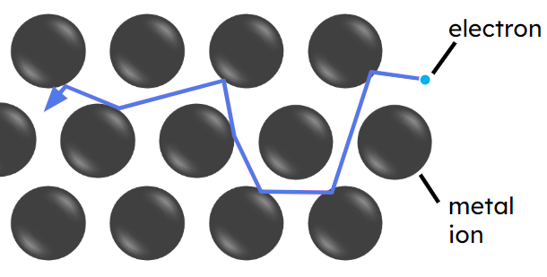
Dhererka siliga
Iska caabbinta (resistance) silig waxaa sababa elektaroonnada (electrons)
oo isku dhaca ion-ka (ions) birta.
Silig dheer wuxuu yeelan doonaa ion (ions) badan oo bir ah, isagoo sababa isku dhacyo. Wuxuu yeelan doonaa iska caabin (resistance) sare.
Laba jibaarista dhererka silig isku mid ah waxay laba jibaaraysaa tirada ion-ka (ions) birta. Waxay laba jibaaraysaa iska caabbinta (resistance) siliga.
Iska caabbinta (resistance) siligu waxay u dhigantaa (proportional) dhererkiisa.

