Slide 1
Dhererka hypotenuse-ka (Length of the hypotenuse)
Sifooyin joomatari (Geometrical properties): isku ekaansho (similarity) iyo aragtida Batagooras (Pythagoras’ theorem)

Slide 2
Sida loo isticmaalo darasyada Oak (Oak lessons)

Slide 3
Waxaan isticmaali karaa aragtida Batagooras (Pythagoras’ theorem) si aan u helo dhererka hypotenuse-ka.

Slide 4
Saddexagalka qumman (right-angled triangle) wuxuu leeyahay hal xagal gudaha ah oo 90° ah.
Hypotenuse-ku waa dhinaca saddexagalka qumman (right-angled triangle) ee ka soo horjeeda xagasha qumman (right-angle).
Aragtida Batagooras (Pythagoras’ theorem) waxay tusinaysaa in wadarta labajibbaaranayaasha (squares) labada dhinac ee gaagaaban ee saddexagalka qumman ay la mid tahay labajibbaaranaha dhinaca ugu dheer (hypotenuse-ka).

Slide 5

Dhererka hypotenuse-ka (Length of the hypotenuse)
Labajibbaaranayaal (Squares) ka soo baxa dhinacyada saddexagalka
Aragtida Batagooras (Pythagoras’ theorem) si loo helo hypotenuse-ka

Slide 6
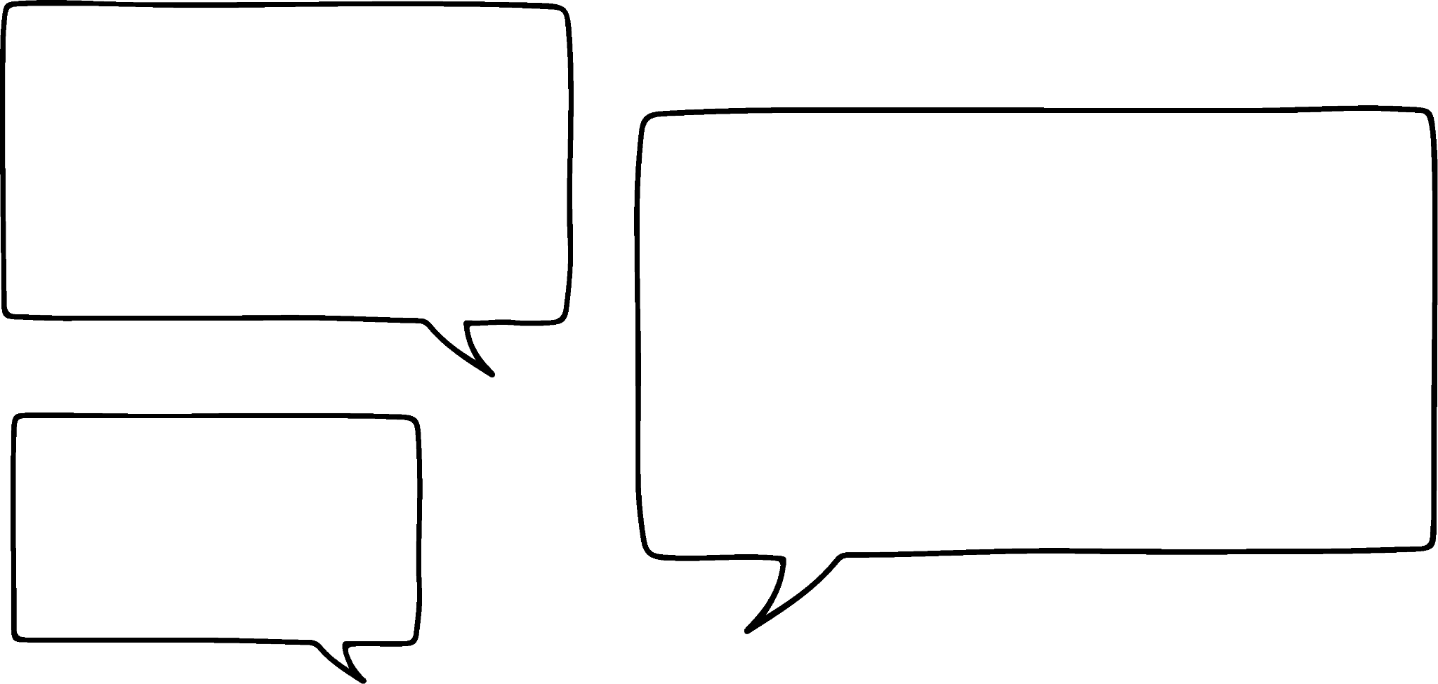


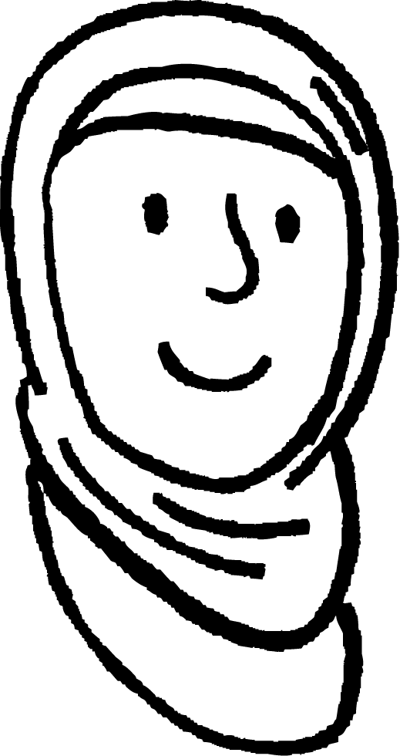
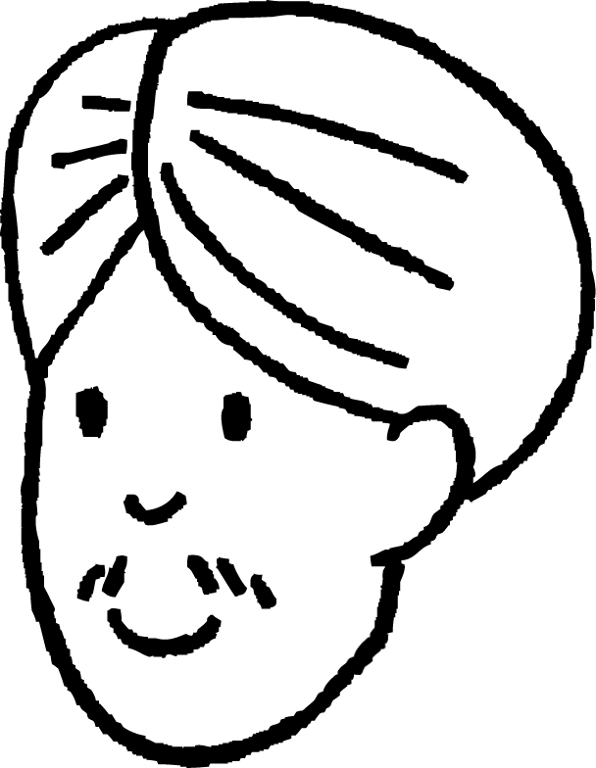


Labajibbaaranayaal (Squares) ka soo baxa dhinacyada saddexagalka
Waxaan xusuustaa inaad ku biiri karto saddex labajibbaaranayaal (squares) meelaha ay isku xirtaan si aad u abuurto saddexagal.
Caasha
Taasi waa fiican tahay, laakiin maxay kani u sameeyay saddexagal qumman (right-angled triangle)?
Cali

Slide 7

Labajibbaaranayaal (Squares) ka soo baxa dhinacyada saddexagalka
Bedka (areas) labada labajibbaaran ee yar waa inay la mid noqdaan bedka labajibbaaranaha ugu weyn.
5 cm
10 + 15
cm²
25 cm²
10 cm²
Caasha
Taasi waa fiican tahay, laakiin maxay kani u sameeyay saddexagal qumman (right-angled triangle)?
Oh, waxaanan xididka laba jibaaran (square root) ka qaadan karnaa bedka (area) laba jibaaran (square) si aan u helno dhererkiisa!
15 cm²
Cali

Slide 8
Laba jibaarannada (Squares) ka yimid dhinacyada saddex-xagalka (triangle)
Taas macneheedu waa in 5 cm uu sidoo kale yahay dhererka dhinaca ugu dheer ee saddex-xagalkaas (triangle).
25 cm²
5 cm
Caasha
hypotenuse (hypotenuse)
Hypotenuse-ga (hypotenuse) waa mid fudud in la garto… Had iyo jeer waa dhinaca ka soo horjeeda xagasha qumman (right angle)!
Dhinaca ugu dheer saddex-xagalka (triangle)?
Waxaan u malaynayaa in taasi loo yaqaan hypotenuse (hypotenuse).
Cali

Slide 9
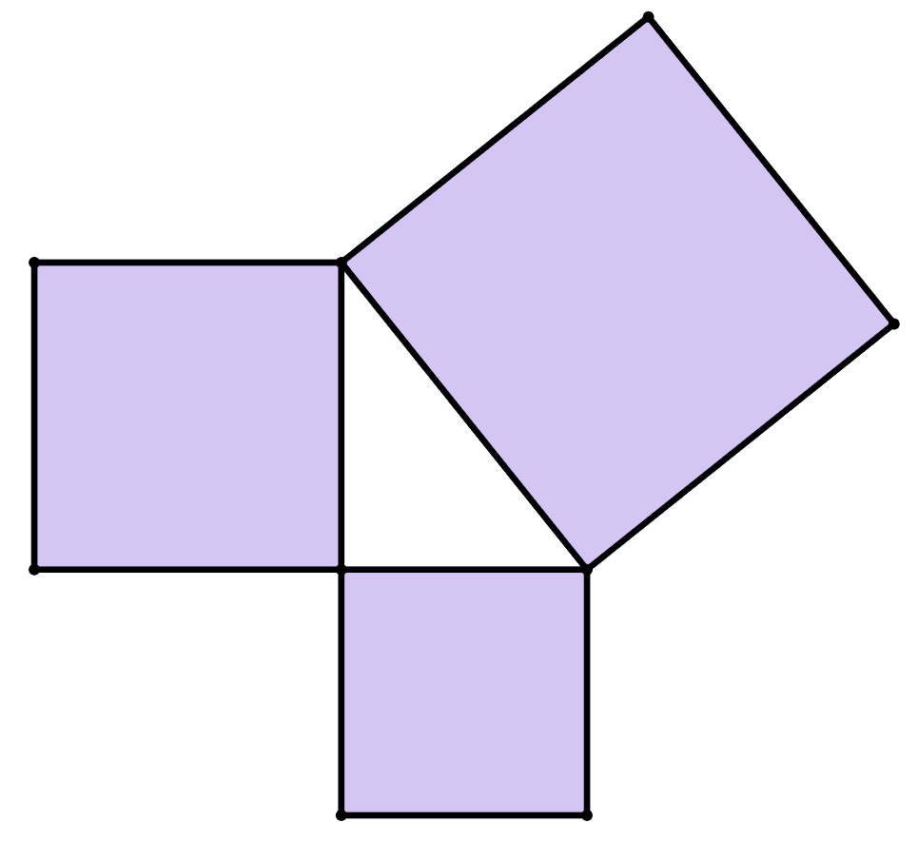


Laba jibaarannada (Squares) ka yimid dhinacyada saddex-xagalka (triangle)
Kee ka mid ah odhaalahan ayaa sax ah?
a
Laba jibaaranka (square) leh bedka (area) ugu weyn had iyo jeer wuxuu ka soo horjeedaa xagasha qumman (right angle).
C laba jibaaran (square C)
laba jibaaran (square) A
b
Laba jibaaranka (square) leh bedka (area) ugu weyn had iyo jeer wuxuu ku yaalaa midigta saddex-xagalka (triangle).
c
Hypotenuse-ga (hypotenuse) saddex-xagalka (triangle) had iyo jeer wuxuu taabtaa xagasha qumman (right angle).
laba jibaaran (square) B
d
Hypotenuse-ga (hypotenuse) saddex-xagalka (triangle) had iyo jeer waa dhinaca ugu dheer saddex-xagalka (triangle).

Slide 10

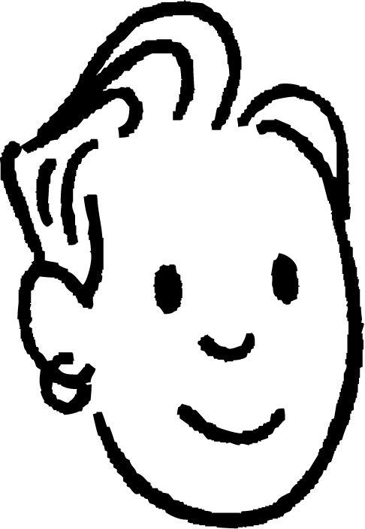

Laba jibaarannada (Squares) ee dhinacyada saddexagalka
Waxaan la yaabanahay in aan weli heli karo dhererka hypotenuse (hypotenuse) haddii aan haysto saddexagalka, laakiin aan haynin dhammaan laba jibaarannada (squares)?
h cm
Cali
6 cm
Haa, waad kartaa.
Waxaad kaliya ku sawiri kartaa laba jibaarannada (squares) aadan haysan.
8 cm
Saciid

Slide 11

Laba jibaarannada (Squares) ee dhinacyada saddexagalka
Haddii aan ognahay labada dhinac ee gaaban, waxaan sawiri karnaa labada labajibbaaran (squares) oo aan heli karnaa bedkooda (area).
bed (area)
36 + 64 cm²
100 cm²
Dhererka hypotenuse (hypotenuse) wuxuu la mid yahay dhinaca labajibbaaranaha (square) ugu weyn.
Si loo helo dhererka hypotenuse (hypotenuse), xidid labajibbaaran (square root) ka qaad bedka (area) labajibbaaranaha (square) ugu weyn.
10 cm
h cm
6 cm
bed (area)
36 cm²
6 cm
8 cm
100
= 10
Hypotenuse (hypotenuse) waa 10 cm dherer.
bed (area)
64 cm²

Slide 12

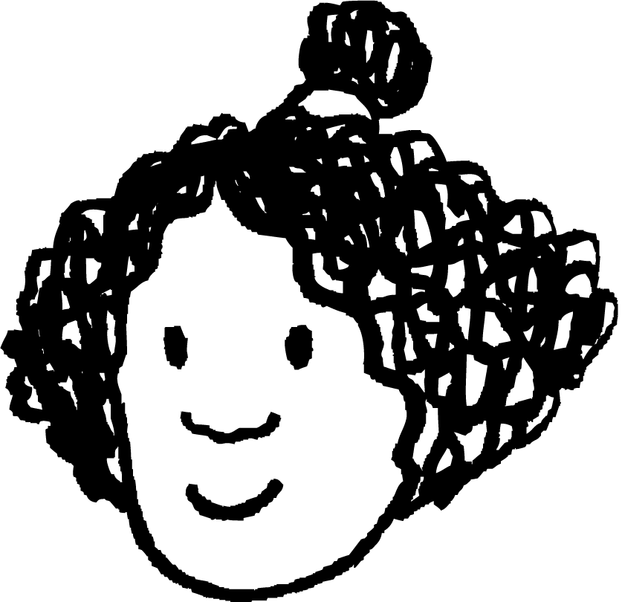
Labajibbaaranayaal (Squares) ka yimid dhinacyada saddexagalka (triangle)
Isra waxay sawirtaa labajibbaarane (square) oo dhinaciisu la wadaago dhinaca 9 cm ee saddexagalka (triangle).
Waa maxay bedka (area) labajibbaaranahan (square)?
bed (area)
40 cm²
Isra waxay markaas sawirtaa labajibbaarane (square) oo dhinaciisu la wadaago hypotenuse (hypotenuse) ee saddexagalka (triangle).
bed (area)
121 cm²
11 cm
Waa maxay bedka (area) labajibbaaranahan (square)?
9 cm
Waa maxay dhererka hypotenuse (hypotenuse) ee saddexagalkan (triangle)?
bed (area)
81 cm²
121
= 11
Hypotenuse (hypotenuse) waa 11 cm dherer.

Slide 13
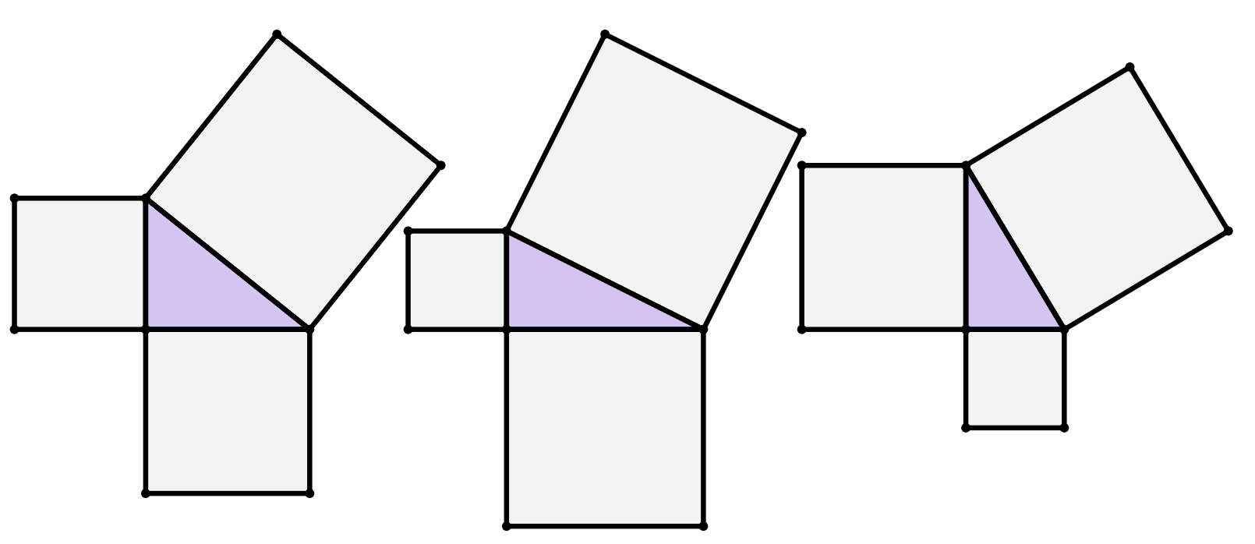
Labajibbaaranayaal (Squares) ka yimid dhinacyada saddexagalka (triangle)
1) Soo hel bedka (area) labajibbaaranaha (square) kasta.
b)
a)
c)
bed (area)
30 cm²
3 cm
bed (area)
42 cm²
bed (area)
15 cm²
1 cm
6 cm

Slide 14
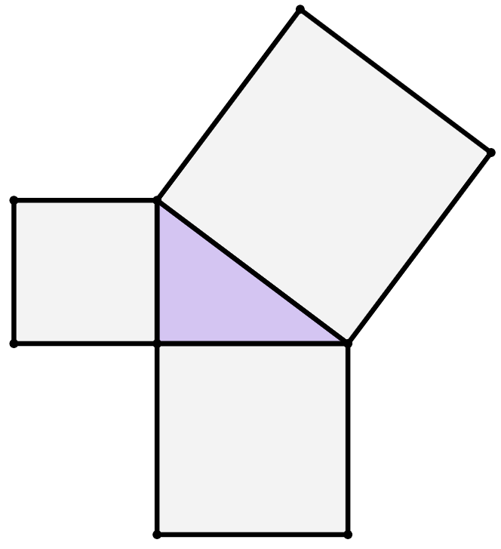
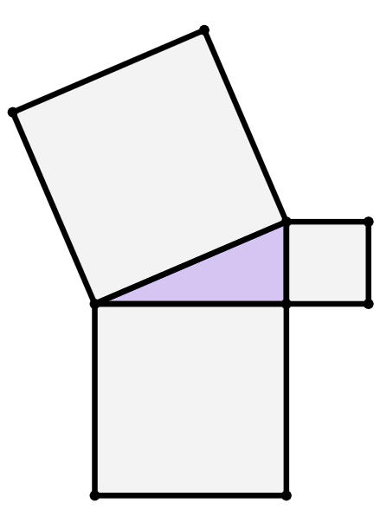
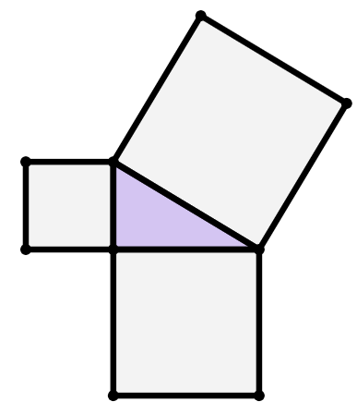
Jajab (Squares) oo ka yimid dhinacyada saddexagalka
2) Raadi dhererka hypotenuse ee saddexagal kasta.
c)
a)
b)
bed (area)
41 cm²
9 cm
12 cm
10 cm
bed (area)
103 cm²
bed (area)
69 cm²

Slide 15
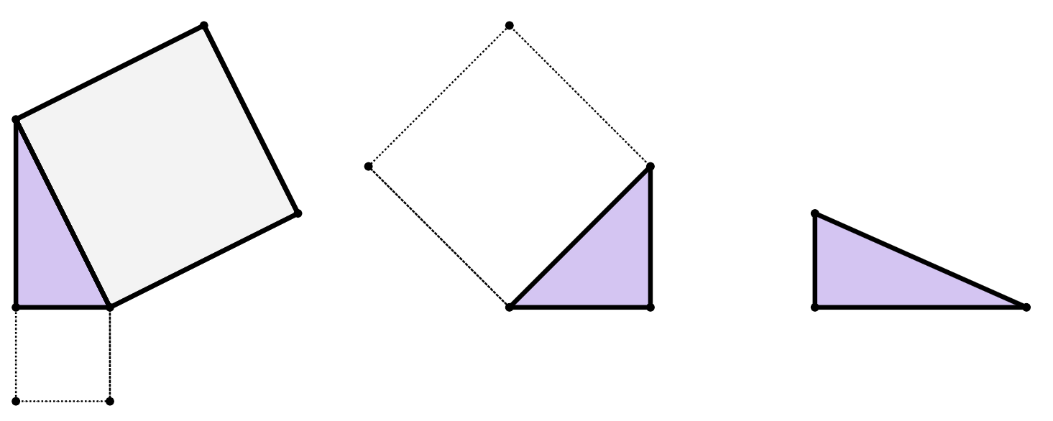
Jajab (Squares) oo ka yimid dhinacyada saddexagalka
3) Adigoo marka hore sawiraya labajibbaaranaha maqan oo xisaabinaya beddooda, raadi dhererka hypotenuse ee saddexagal kasta.
7 cm
a)
24 cm
20 cm
21 cm
18 cm
b)
c)
bed (area)
76 cm²

Slide 16
Labajibbaaranayaasha dhinacyada saddex-xagalka (Squares from the sides of a triangle)
1) Soo hel bedka (area) labajibbaaran kasta.
b)
a)
c)
72 cm²
51 cm²
10 cm²
9 cm²
bed (area)
30 cm²
3 cm
1 cm²
bed (area)
42 cm²
36 cm²
bed (area)
15 cm²
1 cm
6 cm

Slide 17
Jajab (Squares) oo ka yimid dhinacyada saddexagalka
2) Raadi dhererka hypotenuse (hypotenuse) ee saddexagal kasta.
c)
a)
b)
hypotenuse
13 cm
bed (area)
144 cm²
area
144 cm²
bed (area)
81 cm²
area
41 cm²
9 cm
12 cm
hypotenuse
12 cm
area
100 cm²
bed (area)
225 cm²
10 cm
area
169 cm²
area
103 cm²
hypotenuse (hypotenuse)
15 cm
area
69 cm²

Slide 18
Jajab (Squares) oo ka yimid dhinacyada saddexagalka
3) Adigoo sawiraya labo jibbaaran oo maqan marka hore oo xisaabinaya bedkooda (area), soo hel dhererka hypotenuse (hypotenuse) ee saddexagal kasta.
49 cm²
576 cm²
7 cm
a)
400 cm²
441 cm²
bed (area)
400 cm²
24 cm
20 cm
21 cm
jifaarka (hypotenuse)
25 cm
jifaarka (hypotenuse)
20 cm
b)
bed (area)
841 cm²
c)
18 cm
bed (area) 625 cm²
324 cm²
hypotenuse (hypotenuse)
29 cm
bed (area)
76 cm²

Slide 19
Dhererka jifaarka (hypotenuse)
Saddexagalka dhinacyadiisa laga sameeyay labajibbaaran (Squares from the sides of a triangle)
Aragtida Pythagoras si loo helo jifaarka (hypotenuse)

Slide 20
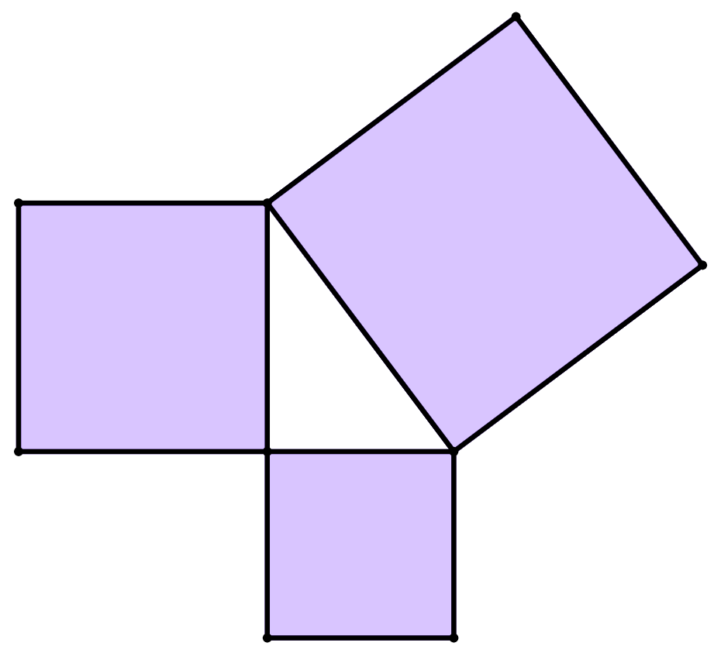
Aragtida Pythagoras si loo helo jifaarka (hypotenuse)
Waxaan xusuustaa in aragtida Pythagoras loo isticmaali karo in lagu helo dhererka dhinacyada saddexagalka qumman (right-angled triangle).
Waxaan u malaynayaa in aragtida (theorem) Pythagoras loo qori karo siyaabo kala duwan.
laba jibaaran (square)
C
Saciid
laba jibaaran (square)
A
bedka (area) labajibbaaran A
+
bedka (area) labajibbaaran B
=
bedka (area) labajibbaaran C
c halbeeg (c units)
a halbeeg (a units)
dhererka dhinaca a oo labajibbaaran (squared)
+
dhererka dhinaca b oo labajibbaaran (squared)
=
dhererka dhinaca c laba jibaaran (length of side c squared)
laba jibaaran B (square B)
b halbeeg (b units)
Aragtida (theorem) Pythagoras: a² + b² = c²

Slide 21
Aragtida (theorem) Pythagoras si loo helo dhinaca ugu dheer (hypotenuse)
Waxaan ku heli karnaa dhererka dhinaca ugu dheer (hypotenuse) ee saddexagalka qumman (right-angled triangle) laba siyood:
Xisaabinta bedka (areas) laba jibaaranayaasha (squares) ku dhegan dhinac kasta oo ka mid ah saddexda dhinac ee saddexagalka.
Ama iyadoo la sawiray ama aan la sawirin laba jibaaranayaasha (squares).
Xisaab ahaan (algebraically), iyadoo la beddelayo dhererka saddexagalka qaacidada (formula) aragtida (theorem) Pythagoras:
a² + b² = c²
Halka a iyo b ay yihiin labada dhinac ee gaaban ee saddexagalka, c-na yahay dhinaca ugu dheer (hypotenuse) ee saddexagalka.

Slide 22
Aragtida Pythagoras si loo helo hypotenuse
Helista bedka (area) labajibbaaranayaasha
Qaacidada (formula) aragtida Pythagoras
Saddexagal qumman (right-angled triangle) ah, haddii aad:
laba jibaar (square) labada dhinac ee gaaban
ku dar (add) natiijooyinka
natiijadu waa laba jibaaranka (square of the)
dhinaca ugu dheer (hypotenuse)
a² + b² = c²
18² + 30² = c²
324 + 900 = c²
1224 = c²
1224 cm²
324 + 900
hypotenuse
18 cm
324
18²
30 cm
900
30²

Slide 23

Aragtida Pythagoras si loo helo hypotenuse
Helista bedka (area) labajibbaaranayaasha
Qaacidada (formula) aragtida Pythagoras
Tusaalahan, 1224 waxay ka dhigan tahay bedka (area) labajibbaaranaha hypotenuse-ka.
Si loo helo dhererka hypotenuse-ka laftiisa, ka soo saar xididka labajibbaaran ee 1224.
a² + b² = c²
18² + 30² = c²
324 + 900 = c²
1224 = c²
1224 = c²
1224
= 34.985711
1224 cm²
hypotenuse
34.985711
= c
34.99 cm
18 cm
c waa hypotenuse, kaas oo ah 34.99 cm marka la soo koobo.
30 cm

Slide 24
Aragtida Pythagoras si loo helo hypotenuse
Buuxi meelaha bannaan ee habka si aad u hesho hypotenuse-ka saddexagalka qumman (right-angled) adigoo isticmaalaya aragtida Pythagoras.
18.03 cm
c cm
2
2
2
10 cm
10
+
15
=
c
100
+
225
=
c²
15 cm
325
=
c²
18.03
=
c

Slide 25
Qaaciddada Baytagoorgas (Pythagoras’ theorem) si loo helo hypotenuse-ka
Qaacidada (formula) Baytagoorgas (Pythagoras’ theorem)
Waan la yaabanahay inay jirto hab ka dhaqso badan oo loo xisaabiyo dhererka hypotenuse-ka iyadoo la adeegsanayo qaacidada Baytagoorgas (Pythagoras’ theorem) iyadoo kalkuleytar (calculator) si ka duwan loo isticmaalo?
a² + b² = c²
18² + 30² = c²
324 + 900 = c²
1224 = c²
1224 = c²
Saciid
34.985711
= c
hypotenuse
34.99 cm
c waa hypotenuse-ka, kaas oo ah 34.99 cm marka la soo koobo (rounded).
18 cm
30 cm

Slide 26
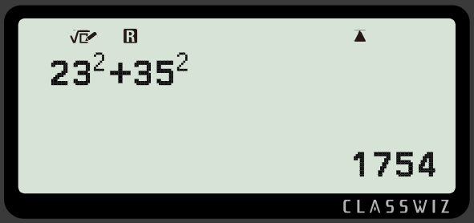

Qaaciddada Baytagoorgas (Pythagoras’ theorem) si loo helo hypotenuse-ka
Qaacidada Baytagoorgas (Pythagoras’ theorem): a² + b² = c²
a iyo b waa dhererka dhinacyada gaagaaban ee saddex-xagalka (kuwaas oo ah lugaha xagasha qumman (right angle)).
hypotenuse
23 cm
1754 waa qiimaha (value) c², bedka (area) laba-jibbaaran ee hypotenuse-ka.
35 cm
badhamada la riixo (buttons to press)
shaashadda kalkuleytarka (calculator screen)

Slide 27
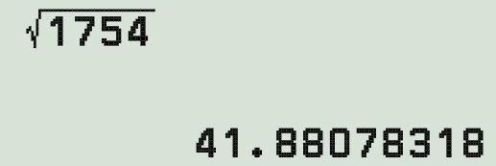

Qaaciddada Baytagoorgas (Pythagoras’ theorem) si loo helo hypotenuse-ka
Qaacidada Baytagoorgas (Pythagoras’ theorem): a² + b² = c²
Si loo helo qiimaha c, dhererka hypotenuse, waxaad u baahan tahay inaad xidid laba jibaaran ka soo saarto 1754.
hypotenuse (hypotenuse)
23 cm
Sidaas darteed, 41.88 cm waa dhererka hypotenuse.
41.88 cm
35 cm
badhamada la riixo (buttons to press)
shaashadda xisaabiyaha (calculator screen)

Slide 28

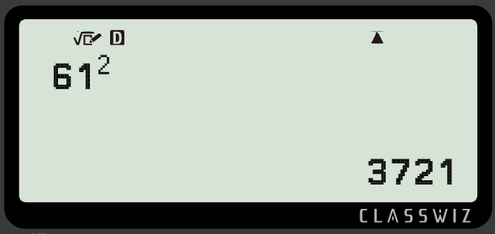
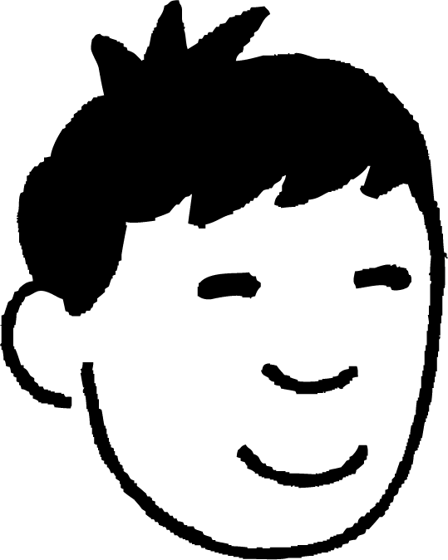
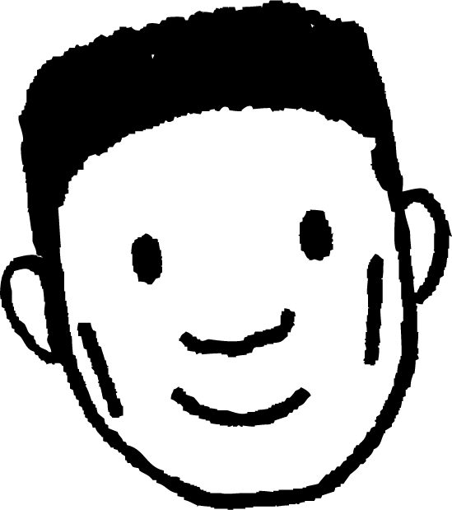
Aragtida Pythagoras si loo helo hypotenuse
Yaa xisaabintiisa ugu horreysay si loo helo hypotenuse saddexagalka qumman?
hypotenuse (hypotenuse)
11 cm
50 cm
Cabdi
Nuur

Slide 29
Aragtida Pythagoras si loo helo hypotenuse
Maxaa laga yaabaa in Nuur uu qaldamay habkiisa?
hypotenuse (hypotenuse)
11 cm
Nuur si khaldan ayuu ugu daray labada dhinac ee gaagaaban ka hor inta uusan laba jibaaran.
Tani waa habka khaldan ee hawlgallada.
50 cm
Nuur

Slide 30
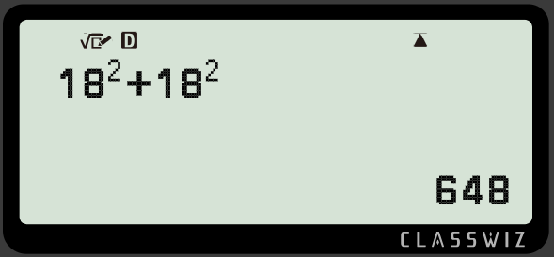

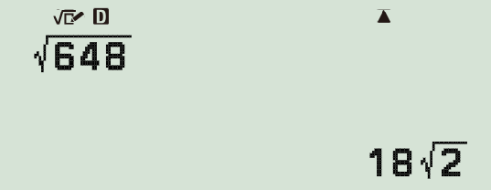

Aragtida Pythagoras (Pythagoras’ theorem) si loo helo hypotenuse-ka (hypotenuse)
Mararka qaarkood, waa inaad beddeshaa qaabka jawaabtaada si hypotenuse-ku (hypotenuse) u noqdo dherer (length) loo qoray tobanle (decimal).
hypotenuse (hypotenuse)
18 cm
18 cm
Tan waxaa loo yaqaan qaabka surd-ka (surd form).
Waxaan dooneynaa inaan u beddelno qaabka tobanle (decimal form).

Slide 31
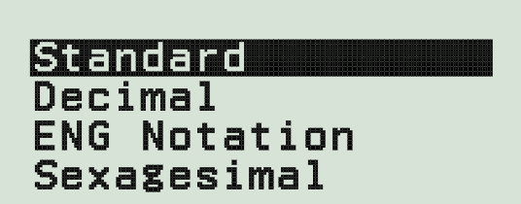
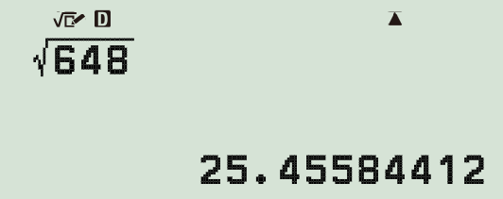
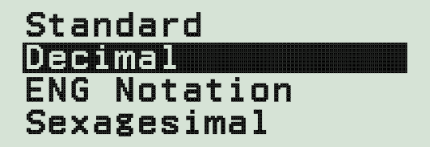

Aragtida Pythagoras (Pythagoras’ theorem) si loo helo hypotenuse-ka (hypotenuse)
Mararka qaarkood, waa inaad beddeshaa qaabka jawaabtaada si hypotenuse-ku (hypotenuse) u noqdo dherer (length) loo qoray tobanle (decimal).
hypotenuse (hypotenuse)
25.5 cm
18 cm
18 cm
Tani waa hadda qaabka tobanle (decimal form) ee dhererka (length) hypotenuse-ka (hypotenuse), kaas oo aan ku soo koobi karnaa 1 meel tobanle (1 decimal place).

Slide 32
Aragtida Pythagoras (Pythagoras’ theorem) si loo helo hypotenuse-ka (hypotenuse)
Soo hel hypotenuse-ka (hypotenuse) saddex-xagalkan qumman (right-angled triangle). Si jawaabtaada qaab tobanle (decimal form) ah oo ku habboon 1 meel tobanle (1 decimal place).
hypotenuse (hypotenuse)
20 cm
20² + 24² = 976
24 cm
976 = 4 61
hypotenuse (hypotenuse) = 31.2 cm (1 d.p.)

Slide 33
Aragtida Pythagoras (Pythagoras’ theorem) si loo helo hypotenuse-ka (hypotenuse)
1) Kani waa saddex-xagal qumman (right-angled triangle).
Aragtida Pythagoras waxaa loo qori karaa c² = a² + b², halkaas oo c ay tahay hypotenuse (hypotenuse) ee saddexagalka.
Buuxi meelaha bannaan si aad u dhamaystirto isla'egta aragtida Pythagoras ee saddexagalkan.
hypotenuse (hypotenuse)
61 cm
11 cm
10 cm
14 cm
60 cm
2) Muuji in hypotenuse (hypotenuse) ee saddexagalkani yahay 17.2 cm (1 d.p.)
2
+
2
2
=
2
+
2

Slide 34
Aragtida Pythagoras si loo helo hypotenuse (hypotenuse)
3) Ku xidh saddexagal kasta labajibbaaranaha hypotenuse (hypotenuse) iyo dhererka hypotenuse (hypotenuse).
b)
a)
5 cm
hypotenuse (hypotenuse)
c)
11 cm
2 cm
7 cm
13 cm
hypotenuse (hypotenuse)
10 cm
d
e
f
labajibbaaranaha hypotenuse (square of the hypotenuse)
146 cm²
173 cm²
149 cm²
dhererka hypotenuse (length of the hypotenuse)
(1 d.p.)
h
g
13.2 cm
i
12.2 cm
12.1 cm

Slide 35
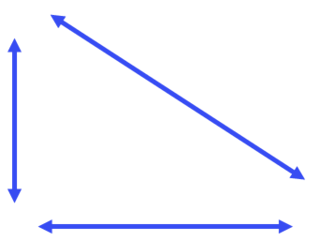
Aragtida (theorem) ee Pythagoras si loo helo hypotenuse-ka (hypotenuse)
4) Saddex-xagallada oo dhami waxay leeyihiin laba dherer (length) oo isku darkoodu yahay 64 cm.
Laga bilaabo kan ugu gaaban, dhig hypotenuse-yada (hypotenuses) saddex-xagallada sida dhererka (length) u kala horreeyaan.
a)
c)
43 cm
hypotenuse w
32 cm
21 cm
hypotenuse y
32 cm
b)
d)
hypotenuse z
hypotenuse x
28 cm
54 cm
36 cm
10 cm

Slide 36
Aragtida (theorem) ee Pythagoras si loo helo hypotenuse-ka (hypotenuse)
1) Kani waa saddex-xagal qumman (right-angled triangle).
Aragtida Pythagoras waxaa loo qori karaa c² = a² + b², halkaas oo c ay tahay hypotenuse (hypotenuse) saddexagalka.
Buuxi meelaha bannaan si aad u dhamaystirto isla'egta aragtida Pythagoras ee saddexagalkan.
61 cm
11 cm
60 cm
Jawaabaha:
2
2
2
=
+
61
60
11
ama
2
2
2
=
+
61
11
60

Slide 37
Aragtida Pythagoras si loo helo hypotenuse (hypotenuse)
hypotenuse (hypotenuse)
10
2
+
14
2
= 296
10 cm
14 cm
296 = 2 74 = 17.20465…
2) Muuji in hypotenuse (hypotenuse) saddexagalkani yahay 17.2 cm (1 d.p.)
hypotenuse (hypotenuse) = 17.2 cm

Slide 38
Aragtida Pythagoras si loo helo hypotenuse (hypotenuse)
3) Isku xidh saddexagal kasta iyo labajibbaaranaha hypotenuse (hypotenuse) iyo dhererka hypotenuse (hypotenuse) ee u dhigma.
b)
a)
5 cm
12.2 cm
c)
11 cm
2 cm
7 cm
13 cm
12.1 cm
10 cm
f
d
149 cm²
173 cm²
146 cm²
e
h
i
13.2 cm
g
12.1 cm
12.2 cm

Slide 39
Aragtida Baytagooras (Pythagoras’ theorem) si loo helo hypotenuse-ka
4) Saddex-xagalladan oo dhan waxay leeyihiin laba dherer oo isku darkoodu yahay 64 cm.
Laga bilaabo kan ugu gaaban, dhig hypotenuse-yada saddex-xagallada sida dhererka u kala horreeyaan.
a)
hypotenuse w
hypotenuse w = 45.25 cm
32 cm
32 cm
b)
hypotenuse x
28 cm
hypotenuse x = 45.61 cm
36 cm

Slide 40
Aragtida Baytagooras (Pythagoras’ theorem) si loo helo hypotenuse-ka
4) Saddex-xagalladan kasta, wadarta dhererka labada dhinac ee gaaban waa isku mid, 64 cm mid kasta.
Laga bilaabo kan ugu gaaban, dhig hypotenuse-yada sida dhererka u kala horreeyaan.
c)
43 cm
jibaabka (hypotenuse) y = 47.85 cm
21 cm
jibaabka (hypotenuse) y
d)
jibaabka (hypotenuse) z
jibaabka (hypotenuse) z = 54.92 cm
54 cm
10 cm

Slide 41
Aragtida Pythagoras (Pythagoras’ theorem) si loo helo jibaabka (hypotenuse)
4) Saddexagal kasta, wadarta dhererka labada dhinac ee gaagaaban waa isku mid, 64 cm midkiiba.
Laga bilaabo kan ugu gaaban, dhig jibaabyada (hypotenuses) sida dhererka u kala horreeyaan.
Sida saxda ah ee loo kala horreeyay waa
w → x → y → z
Marka farqiga u dhexeeya labada dhinac ee gaagaaban uu weynaado, jibaabka (hypotenuse) ayaa weynaada.

Slide 42
Dhererka jibaabka (hypotenuse)
Bedka laba labagoodle (squares) oo dhinacyadoodu yihiin labada dhinac ee gaagaaban ee saddexagal qumman (right-angled triangle) waxay u dhigmaan bedka labagoodle (square) ee jibaabka (hypotenuse) isla saddexagalka.
Qaacidada aragtida Pythagoras (Pythagoras’ theorem formula) (oo badanaa loo arko a² + b² = c², halka c uu yahay dhererka jibaabka (hypotenuse)) waxaa loo isticmaali karaa in lagu xisaabiyo dhererka jibaabka (hypotenuse) ee saddexagal qumman (right-angled triangle), marka la eego labada dherer ee gaagaaban.
Waxaa jira habab wax ku ool ah oo lagu xisaabiyo jibaabka (hypotenuse) ee saddexagal qumman (right-angled triangle) iyadoo la adeegsanayo aragtida Pythagoras (Pythagoras’ theorem) kalkuleytar.

