Slide 1
Wareegyada wareegga barbar socda (Parallel circuit)
Iska caabbinta (Resistance) iyo wareegyada barbar socda (Parallel circuits)

Slide 2
Sida agabkeena waxbarista loogu talagalay fasalka

Slide 3
Waxaan u kala qaybin karaa wareeg barbar socda (Parallel circuit) oo ah wareegyo taxane ah (Series circuits) oo isku xiran.

Slide 4
Wareeg taxane (Series circuit)
Wareeg koronto oo leh hal wareeg oo dhammaystiran laga bilaabo dhamaadka unugga ama batteriga ilaa dhamaadka kale.
Batteri (Battery)
Labo unug ama ka badan oo isku xiran taxane ayaa sameeya batteri.
Wareeg barbar socda (Parallel circuit)
Wareeg koronto oo leh in ka badan hal wareeg oo dhammaystiran laga bilaabo dhamaadka unugga ama batteriga ilaa dhamaadka kale.
Farqiga awoodda (Potential difference)
Erey rasmi ah oo loogu talagalay voltage; waa la isku beddeli karaa.

Slide 5

Wareegyada wareegga barbar socda (Parallel circuit)
Wareegyada wareegga barbar socda (Parallel circuit)
Unugyada wareegyada barbar socda (Parallel circuits)

Slide 6
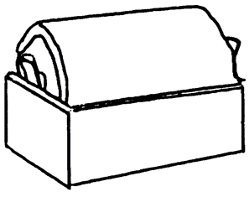

Wareegyada wareegga barbar socda (Parallel circuit)
Wareegga la muujiyay waa wareeg taxane (Series circuit).
Waxaa jira hal wareeg oo isku xira unugga iyo laydhka.

Slide 7
Wareegyada wareegga barbar socda (Parallel circuit)
Wareeg taxane oo labaad ayaa ku xiri kara laydh kale isla unugga.

Slide 8
Wareegyada wareegga barbar socda (Parallel circuit)
Wareeg taxane oo saddexaad ayaa ku xiri kara laydh saddexaad isla unugga.
Saddexdan silig waa la bedeli karaa.

Slide 9
Wareegyada isbarbar socda (Parallel circuit loops)
Hal silig iyo laamo ayaa isku xira nalalka.
Saddexdan silig sidoo kale waa la bedeli karaa.

Slide 10
Wareegyada isbarbar socda (Parallel circuit loops)
Hal silig oo kale iyo laamo ayaa isku xira nalalka.

Slide 11
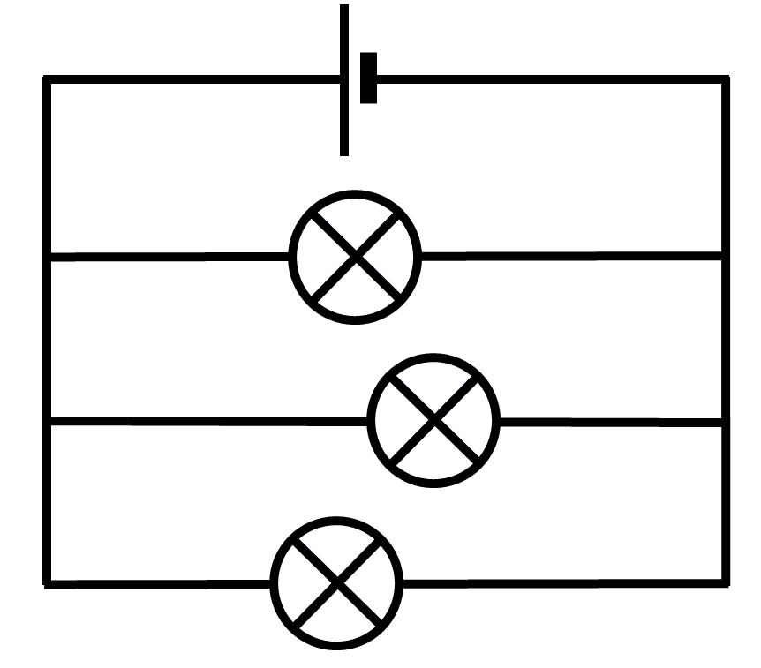
Wareegyada isbarbar socda (Parallel circuit loops)
Wareegtada asalka ah
waa la fududeyn karaa
oo loo rogi karaa jaantus wareeg (circuit diagram).

Slide 12
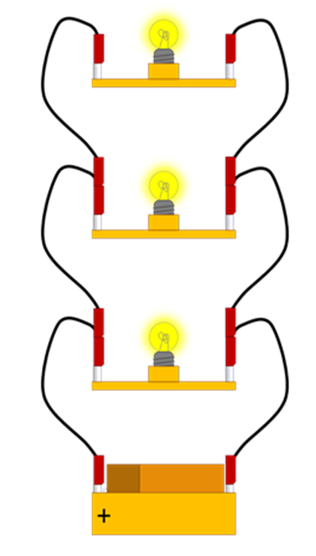

Wareegyada isbarbar socda (Parallel circuit loops)
Dhammaan nalalka wareegtada lagu muujiyey waa isku mid. Kee baa ka mid ah weedhahan soo socda oo sax ah?
Wareegtadu waxay leedahay saddex wareeg oo ka yimaada unugga (cell).
Haddii hal nalku qarxo, kuwa kale waa ay dami doonaan.
Nalka ugu dhow unugga (cell) ayaa heli doona korantada (voltage) ugu sarreysa.
Nal kasta waxa uu si toos ah ugu xiran yahay labada daraf ee unugga (cell).

Slide 13
Wareegyada isbarbar socda (Parallel circuit loops)
Jaantus kasta oo ka mid ah kuwa hoose waxa uu muujinayaa xiriiriyeyaasha unugga (cell) oo si wax ku ool ah isku mid ah.
Haddii aysan jirin qaybo (components) ku teedsan siligyada, xiriiriyeyaashu waxay noqon karaan meel kasta, illaa ay u horseedaan unugga (cell).

Slide 14
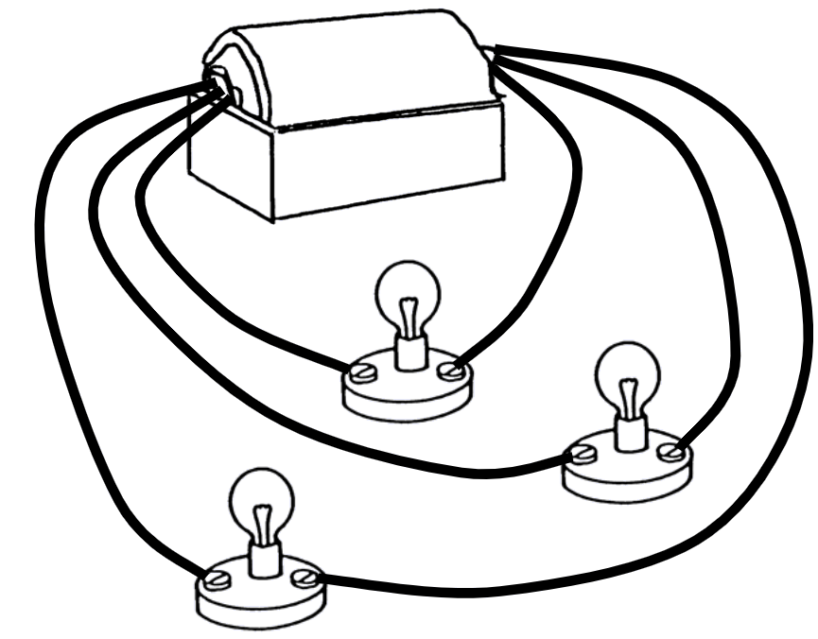
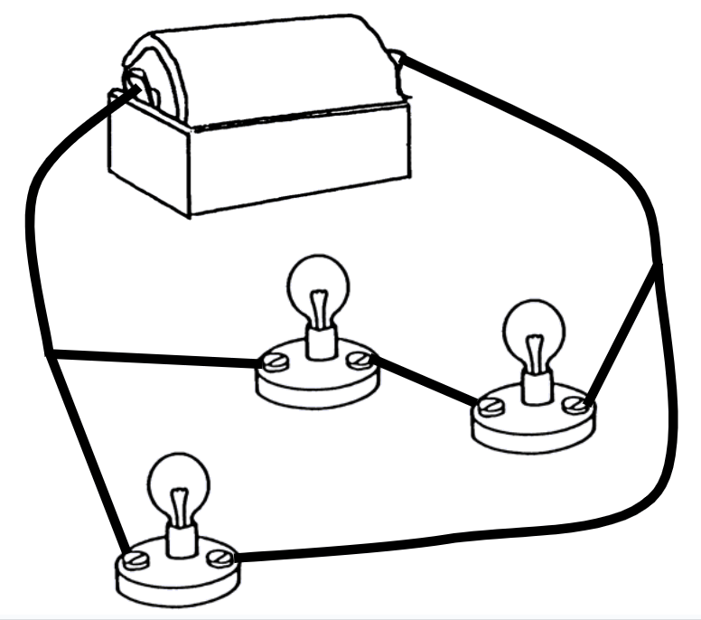
Wareegyada isbarbar socda (Parallel circuit loops)
Kee ka mid ah wareegyada soo socda ayaa ah kan ka duwan?

Slide 15
Wareegyada isbarbar socda (Parallel circuit loops)
Wareeg kasta oo ka mid ah wareegga isbarbar socda (parallel circuit)
wuxuu la mid yahay wareeg taxane oo gooni ah.

Slide 16
Wareegyada isbarbar socda (Parallel circuit loops)
Wareeg kasta oo isbarbar socda (parallel circuit)
wuxuu la mid yahay wareeg taxane oo gooni ah.

Slide 17
Wareegyada isbarbar socda (Parallel circuit loops)
Wareeg kasta oo isbarbar socda (parallel circuit)
wuxuu la mid yahay wareeg taxane oo gooni ah.

Slide 18
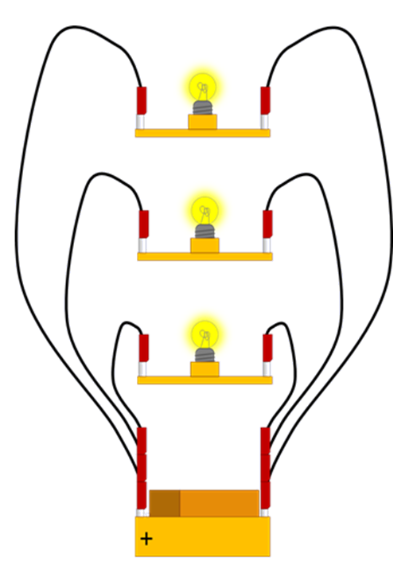
Wareegyada isbarbar socda (Parallel circuit loops)
Labada wareeg ee la muujiyay waa isku mid.
Laydh kasta wuxuu ku xiran yahay wareeg gaar ah oo ku xiran unugga (cell).
Fiilooyinka waxay ku jiraan meelo kala duwan, marka waa wareegyo kala duwan.

Slide 19
Wareegyada isbarbar socda (Parallel circuit loops)
Meesha cusub ee wareeggu ma beddelo sida wareegu u shaqeeyo.
Laydhan waxaa la dhaqaajin karaa iyada oo aan la beddelin xiriirka unugga (cell).

Slide 20
Wareegyada isbarbar socda (Parallel circuit loops)
Wareegan
wuxuu la mid yahay wareegan.

Slide 21
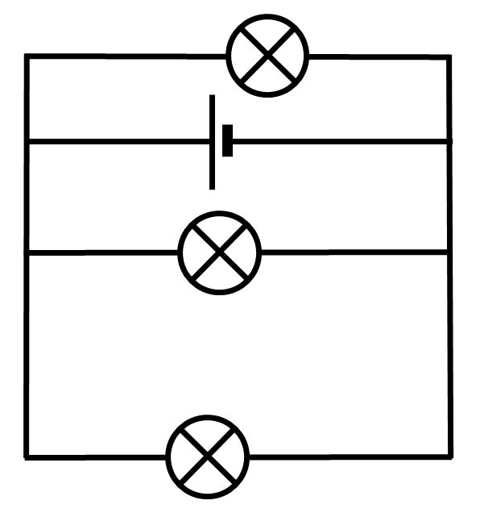
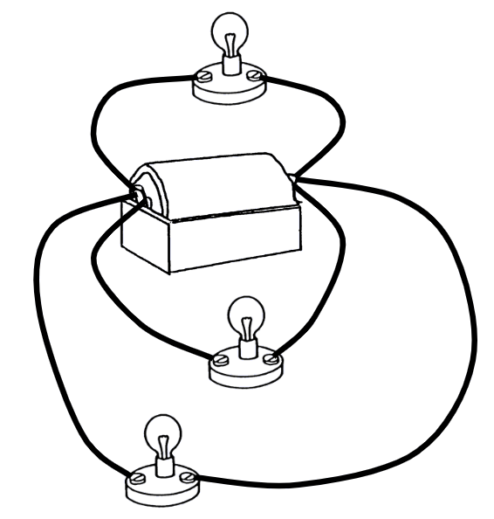
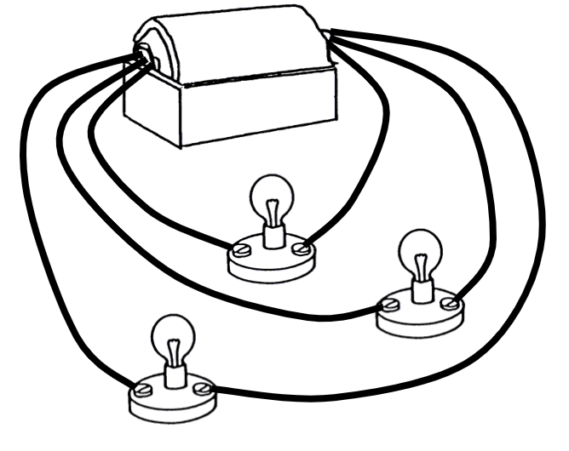
Wareegyada isbarbar socda (Parallel circuit loops)
Wareegyada waxaa loo muujin karaa jaantusyo wareeg (circuit diagrams).

Slide 22
Wareegyada isbarbar socda (Parallel circuit loops)
Kani waa wareegga koowaad.

Slide 23
Wareegyada isbarbar socda (Parallel circuit loops)
Kani waa wareegga labaad. Booska iyo cabbirka wareeggu ma muhiimna.

Slide 24
Wareegyada isbarbar socda (Parallel circuit loops)
Kani waa wareegga saddexaad.

Slide 25
Wareegyada isbarbar socda (Parallel circuit loops)
Mid ka mid ah hadalladan soo socda oo ku saabsan korantada (current) ee wareegyada wareegga la muujiyay waa sax?
Korantada (Current) dhammaan wareegyada waxaa lagu ‘riixaa’ (pushed) isla korantada (voltage).
Korantada (Current) waxaa lagu ‘riixaa’ (pushed) inta badan wareegga ugu dhaw unugga (cell).
Korantada (Current) waxaa lagu ‘riixaa’ (pushed) inta badan wareegga ugu fog unugga (cell).

Slide 26
Wareegyada isbarbar socda (Parallel circuit loops)
Wareegyada isbarbar socda (Parallel circuits), boosaska fiilooyinka iyo qaybaha (components) ma aha kuwo muhiim ah.
Waa sida wareegyada (loops/branches) loogu xidho unugga (cell) ama baytariga (battery) ayaa muhiim ah.
Hab wanaagsan oo lagu falanqeeyo wareegga (circuit) waa in la raaco dhinac kasta oo wareeg ah oo dib loogu celiyo labada dhinac ee unugga (cell) ama baytariga (battery).
Haddii aysan jirin qaybo kale oo jidka ku jira, qaybta (component) waxay heli doontaa korantada (voltage) buuxda ee unugga (cell) ama baytariga (battery).

Slide 27
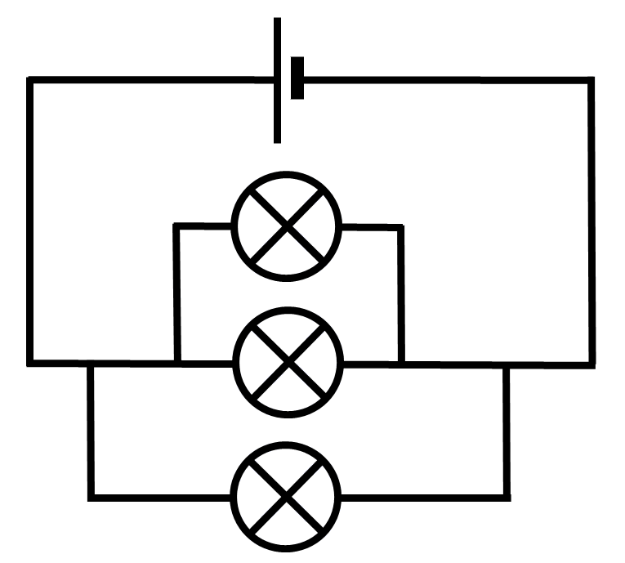
Wareegyada isbarbar socda (Parallel circuit loops)
Labada wareeg (circuits) ee la muujiyay waa isku mid.
Wareegyadu waxay ku jiraan boosas kala duwan.
Nal kasta (lamp) wuxuu si toos ah ugu xidhan yahay unugga (cell).

Slide 28
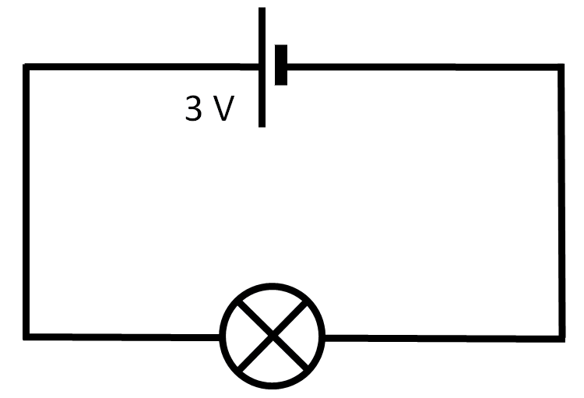
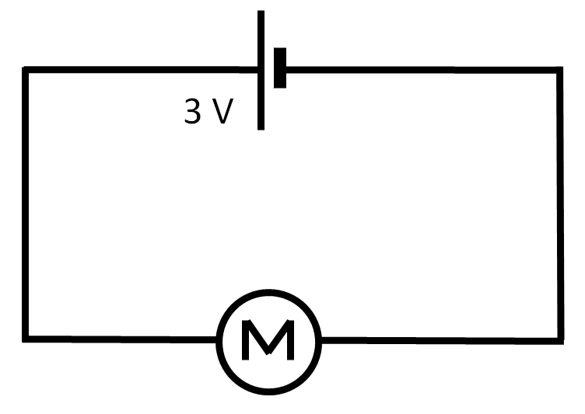
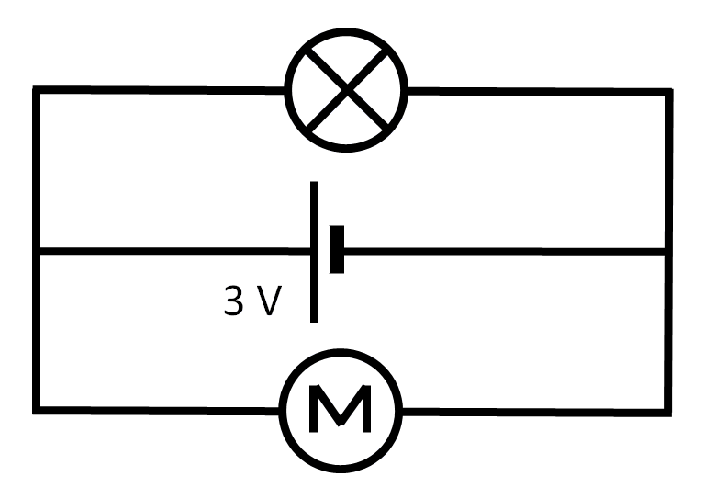
Wareegyada isbarbar socda (Parallel circuit loops)
Dhis wareegyada A iyo B oo hubi inay shaqeeyaan. Qor waxa ku dhaca nalka (lamp) iyo matoorka (motor).
A
B
Saadaali waxa ku dhici doona nalka (lamp) iyo matoorka (motor) haddii aad dhisto wareegga C, adoo isticmaalaya isla baytari 3 V, oo sharax sababta aad u malaynayso.
C
Dhis wareegga C.
Sharax waxa ku dhaca laambadda iyo waxa ku dhaca matoorka.
Ma sax ahayd saadaalintaada iyo sharaxaada 2)? Haddii kale, sharax sababta iyo/ama hagaaji.

Slide 29
Wareegyada (loops) ee circuit-ka barbar socda (parallel)
Dhis circuits A iyo B oo hubi inay shaqeeyaan. Qor waxa ku dhaca laambadda iyo matoorka.
A
B
Laambaddu si buuxda u ifaysaa, matoorkuna si degdeg ah u wareegaa.
Saadaali waxa ku dhacaya laambadda iyo matoorka haddii aad dhisto circuit C, isticmaal isla cell-ka, oo sharax sababta aad u malaynayso.
C
Laambaddu way ifaysaa laakiin kama ifayn doonto sida hore.
Matoorku wuu wareegi doonaa laakiin si ka gaabis ah sida hore.

Slide 30
Wareegyada (loops) ee circuit-ka barbar socda (parallel)
Sharax waxa ku dhaca laambadda iyo waxa ku dhaca matoorka.
Laambaddu waxay u ifaysaa si la mid ah sida circuit A.
Matoorku wuxuu u wareegaa si la mid ah sida circuit B.
Ma sax ahayd saadaalintaada iyo sharaxaada 2)? Haddii kale, sharax sababta iyo/ama hagaaji.
Saadaalintayda circuit C ma ahayn mid sax ah. Laambaddu ma sii yaraan iftiinkeeda, matoorkuna ma sii gaabin.
Waa inaan xusuustaa in laambadda iyo matoorka mid kasta si toos ah ugu xiran yihiin cell-ka wareegyo kala duwan, sidaas darteed waxay helayaan voltage buuxda.
Tani waxay ka dhigan tahay inay u shaqeeyaan si la mid ah haddii ay ku jiraan circuits keli ah, sida A iyo B.

Slide 31
Wareegyada (loops) ee circuit-ka barbar socda (parallel)
Wareegyada (loops) ee circuit-ka barbar socda (parallel)
Cells-ka (batteries) ee circuits-ka barbar socda (parallel)

Slide 32

Cells-ka (batteries) ee circuits-ka barbar socda (parallel)
Marka cells-ka la isku xiro, waxay sameeyaan battery.
Marka cells-ka lagu xiro taxane (series), voltages-ku way isku daraan.
1.5 V + 1.5 V + 1.5 V = 4.5 V

Slide 33

Unugyada (Cells) ee wareegyada barbar socda (parallel circuits)
Kala duwanaanshaha suurtagalka (Potential difference) waa magac kale oo loo yaqaan voltage.
Waxay la mid tahay tamarta kaydka cuf-jiidadka.
tamarta kaydka cuf-jiidadka (gravitational store)
(dartiis joogga)
kala duwanaanshaha suurtagalka (voltage)

Slide 34
Unugyada (Cells) ee wareegyada barbar socda (parallel circuits)
Waxaan isticmaali karnaa tusaalaha (model) joogga si aan u sharaxno waxa loola jeedo kala duwanaanshaha suurtagalka (potential difference).
Kor u qaadista kubbad buur dheer ayaa tamar u wareejisa kubbadda.
Tamarta waxaa loo wareejiyaa kaydka cuf-jiidadka.

Slide 35
Unugyada (Cells) ee wareegyada barbar socda (parallel circuits)
Kor u qaadista kubbad laba jeer oo ka dheer waxay u wareejisaa laba jeer qadarka tamarta.

Slide 36
Unugyada (Cells) ee wareegyada barbar socda (parallel circuits)
Kordhinta joogga waxay kordhisaa tamarta kaydka cuf-jiidadka.
Ku darista unug (cell) taxane ah (series) waxay kordhisaa kala duwanaanshaha suurtagalka (potential difference).
tamarta kaydka cuf-jiidadka (gravitational store)
kala duwanaanshaha suurtagalka (potential difference)

Slide 37
Unugyada (Cells) ee wareegyada barbar socda (parallel circuits)
Labadan unug (cell) ee 1.5 V ah waxay ku xiran yihiin taxane (series) si ay u sameeyaan baytari (battery).
1.5 V
(1.5 + 1.5 = 3.0)
Waxay bixiyaan kala duwanaansho suurtagal (ama voltage) oo isku dhafan oo ah 3.0 V.
1.5 V

Slide 38
Unugyada (Cells) ee wareegyada barbar socda (parallel circuits)
Ku darista unug (cell) barbar socda (parallel) kama kordhinayso 'joogga' kala duwanaanshaha suurtagalka (potential difference).

Slide 39
Unugyada (Cells) ee wareegyada barbar socda (parallel circuits)
Laba unug oo la muujiyay, marka lagu xiro si barbar socda, waxay kaliya siin karaan kala duwanaansho awood (potential difference) ugu badnaan 1.5 V.
1.5 V
1.5 V

Slide 40
Unugyada (Cells) ee wareegyada barbar socda (parallel circuits)
Xataa ku darista unug saddexaad oo barbar socda waxay kaliya siisaa kala duwanaansho awood (potential difference) 1.5 V.
Hase yeeshee, saddex unug waxay ka kooban yihiin kiimikooyin ka badan hal unug, sidaas darteed waxay shaqayn doonaan muddo dheer.
1.5 V

Slide 41
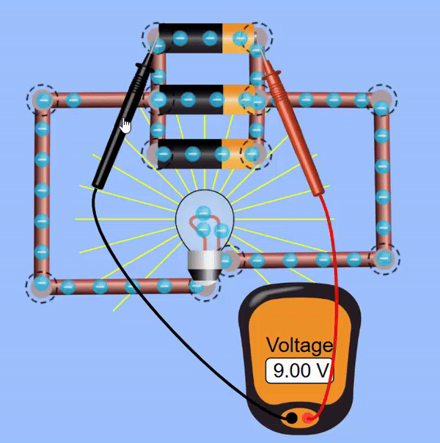
Unugyada (Cells) ee wareegyada barbar socda (parallel circuits)
Jilitaanka (simulation) hoose wuxuu muujinayaa in danabku (voltage) uu isku mid yahay saddexda unug.
Danabka (voltage) unugyada wuxuu ahaan doonaa isku mid.
Jilitaan (Simulation) by PhET Interactive Simulations, University of Colorado Boulder, licensed under CC-BY-4.0 (https://phet.colorado.edu).

Slide 42
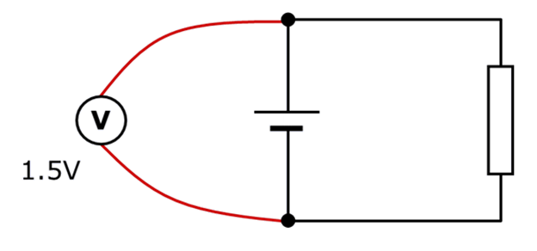
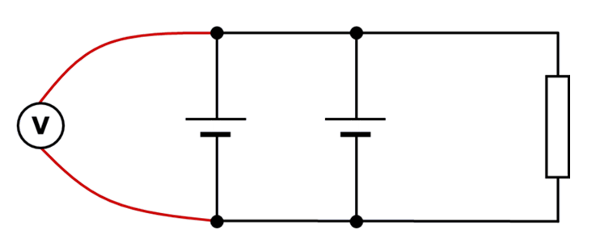
Unugyada (Cells) ee wareegyada barbar socda (parallel circuits)
Waa maxay akhrinta (reading) voltmitirka (voltmeter) ee wareegga hoose?
3.0 V
1.5 V
0.75 V
0.0 V

Slide 43
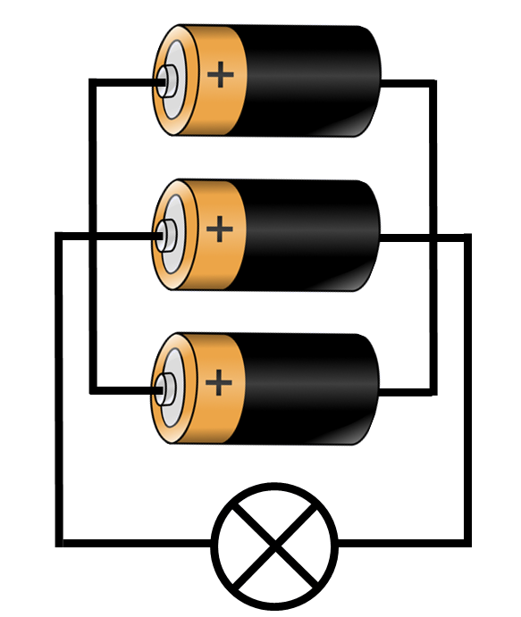
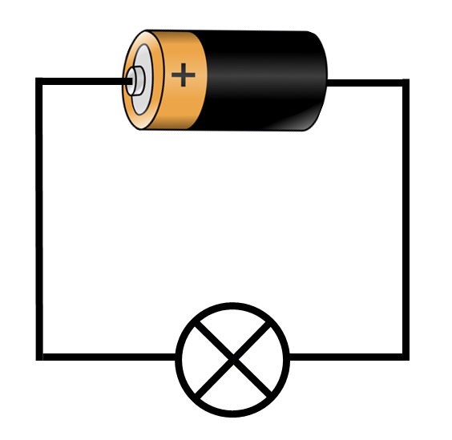
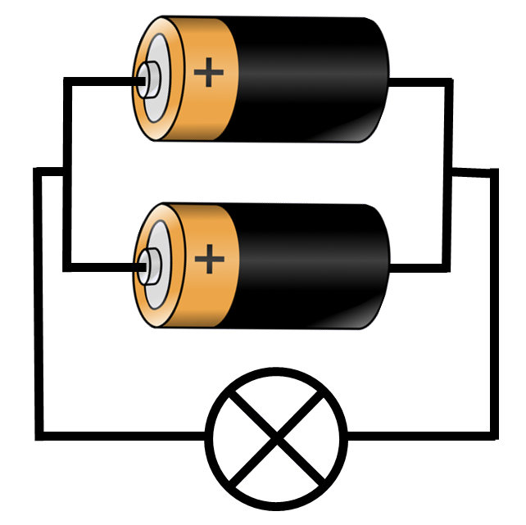
Unugyada (Cells) ee wareegyada barbar socda (parallel circuits)
Laambaddan (lamp) waxay iftiimin doontaa si dhalaalaya.
Laambaddan (lamp) waxay noqon doontaa mid dhalaal isku mid ah.
Laambaddan (lamp) sidoo kale waxay noqon doontaa mid dhalaal isku mid ah.
Danabka (voltage) unug (ama unugyo) oo barbar socda wuxuu ahaanayaa isku mid.

Slide 44
Unugyada (Cells) ee wareegyada barbar socda (parallel circuits)
Keebee ka mid ah laambadahan (lamps) ayaa sii shidi doona muddada ugu dheer?

Slide 45

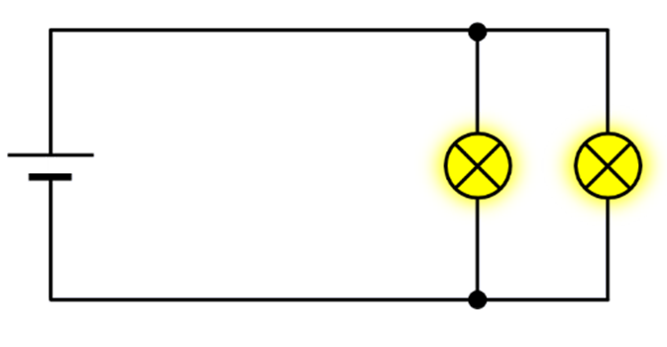
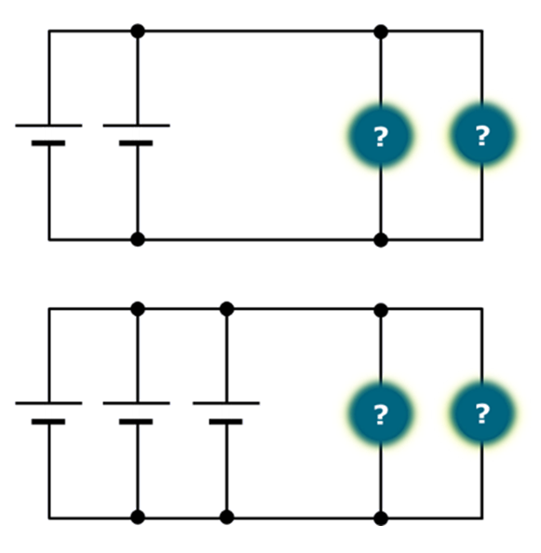






Unugyada (Cells) ee wareegyada barbar socda (parallel circuits)
Saciid iyo Cali waxay dhisayaan wareegyo (circuits) qaar waxayna samaynayaan saadaal.
Nalalka ugu iftiinka badani waxay ku jiraan wareegga 3, kuwa ugu iftiinka yarina waxay ku jiraan wareegga 1.
1
Laambadaha (lamps) waxay noqon doonaan dhalaal isku mid ah dhammaan wareegyada.
2
3
Cali
Saciid
Gee go'aanka in arday kastaa sax yahay iyo in khalad yahay, oo sharax sababta.

Slide 46
Unugyada ku jira wareegyada barbar socda (parallel circuits)
Gee inuu arday kasta sax yahay ama qalad yahay oo sharax sababta.
Cali waa sax, Saciidna waa qalad.
Nalalka dhamaantood waxay yeelan doonaan iftiin isku mid ah, sababtoo ah korantada (voltage) unug kasta waa isku mid.
Tani waxay ka dhigan tahay in korantada (voltage) laamaha wareegyada ay sidoo kale isku mid tahay.
Haddii korantada (voltage) laamaha iyo nalalka mid kasta ay isku mid tahay, markaas nalalka dhamaantood waxay yeelan doonaan iftiin isku mid ah.

Slide 47
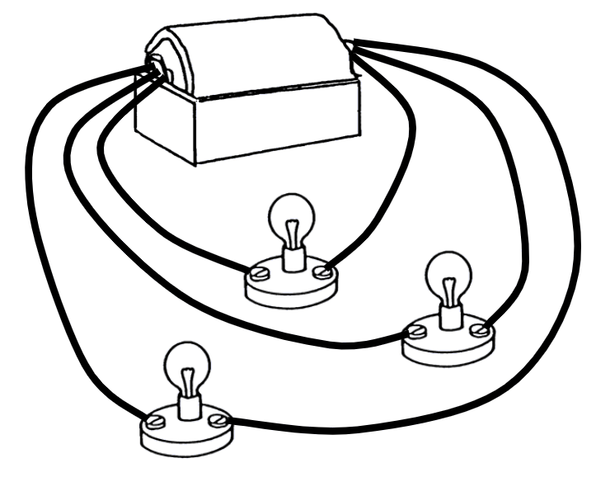
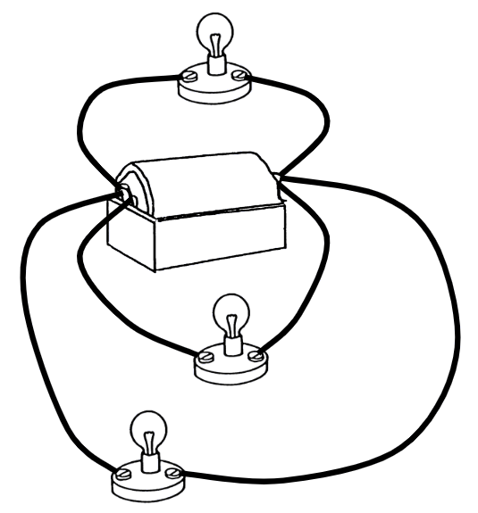
Wareegyada barbar socda (parallel circuit) ee looxyada (loops)
Wareegga barbar socda (parallel circuit) wuxuu ka kooban yahay looxyo (loops) oo ka soo baxa isgoysyada (junctions).
Loox (loop) kasta wuxuu ka bilaabmaa dhamaadka unugga ama batteriga ilaa dhamaadka kale, sida wareeg taxane ah oo gooni ah.
Korantada (voltage) loox (loop) kasta oo qaybaha ah waxay la mid tahay korantada (voltage) unugga ama batteriga.
Unugyada ku jira barbar socod (parallel) waxay bixin doonaan koronto (voltage) la mid ah unug keliya, laakiin waxay sii dheeraan doonaan sababtoo ah waxaa jira kiimikooyin badan oo falcelinaya.

