Slide 1
Ciraad magnetic (Magnetic poles)
Magnets iyo electromagnets

Slide 2
Sida ilaha waxbarista ee aan ugu talagalnay fasalka

Slide 3
Waxaan qeexi karaa sida magnets u soo jiitaan walxaha magnetic, iyo sidoo kale u soo jiitaan iyo u iska celiyaan magnets kale.

Slide 4
cirif magnetic oo raadsada woqooyi (north–seeking magnetic pole)
dhamaadka magnet ee tilmaamaya woqooyi
cirif magnetic oo raadsada koonfur (south–seeking magnetic pole)
dhamaadka magnet ee tilmaamaya koonfur
soo jiidasho (attract)
xoog (force) ka dhiga walxaha inay isu soo dhaqaaqaan
beer magnetic (magnetic field)
meel uu cirif magnetic ku toosi doono jihada gaarka ah
iska celin (repel)
xoog (force) ka dhiga walxaha inay iska fogaadaan

Slide 5

Ciraadaha magnetic
Ciraadaha raadsada woqooyi iyo koonfur
Soo jiidasho iyo iska celin
Walxaha magnetic

Slide 6
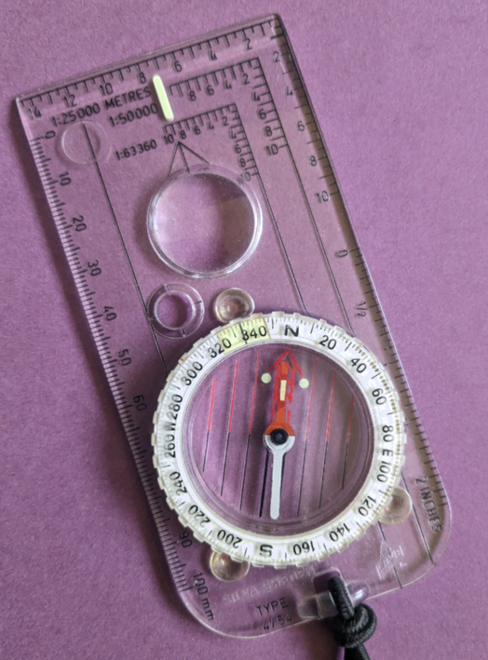
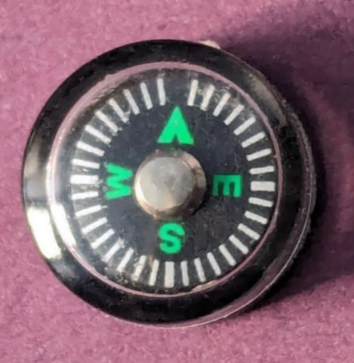
Ciraadaha raadsada woqooyi iyo koonfur
Ciribta compass waxay tilmaamaysaa woqooyi.
Waa birlabeyaal oo iyagu isu toosiyaan jiho woqooyi–koonfureed.
Dhamaadka ciribta magnetized ee tilmaamaya woqooyi waxaa loo yaqaan cirif magnetic oo raadsada woqooyi.
Dhamaadka kale waxaa loo yaqaan cirif magnetic oo raadsada koonfur.

Slide 7
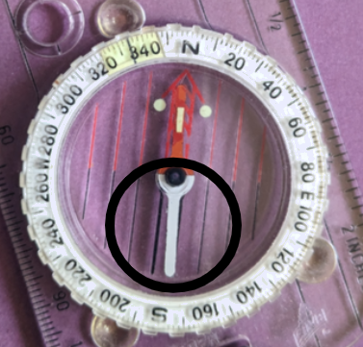

Tiir raadinaysa woqooyiga iyo tiir raadinaysa koonfurta
Mid ka mid ah oraahdan soo socota ayaa si sax ah u sharxaysa dhamaadka cad ee irbadda compass-ka ee la muujiyey?
Dhamaadkanu waa tiir raadinaysa woqooyiga.
Dhamaadkanu waa tiir raadinaysa koonfurta.
Dhamaadkanu ma aha tiir.

Slide 8
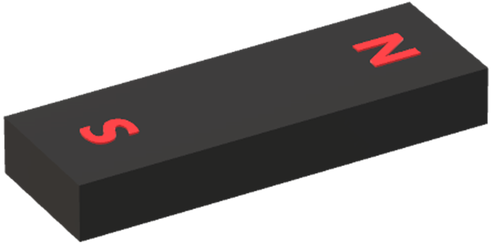
Tiir raadinaysa woqooyiga iyo tiir raadinaysa koonfurta
Birlabeyda waxaa inta badan ku qoran ‘N’ iyo ‘S’.
Dhamaadka N waa tiir raadinaysa woqooyiga, oo macneheedu yahay wuxuu u jeedan doonaa woqooyiga haddii birtu xor u tahay inay dhaqaaqdo.
tiir raadinaysa woqooyiga
tiir raadinaysa koonfurta
Dhamaadka S waa tiir raadinaysa koonfurta, oo macneheedu yahay wuxuu u jeedan doonaa koonfurta haddii birtu xor u tahay inay dhaqaaqdo.

Slide 9
Tiir raadinaysa woqooyiga iyo tiir raadinaysa koonfurta
Waa maxay waxyaabaha soo socda ee uu birtu leedahay?
tiir raadinaysa woqooyiga
tiir raadinaysa koonfurta
tiir togan
tiir taban

Slide 10
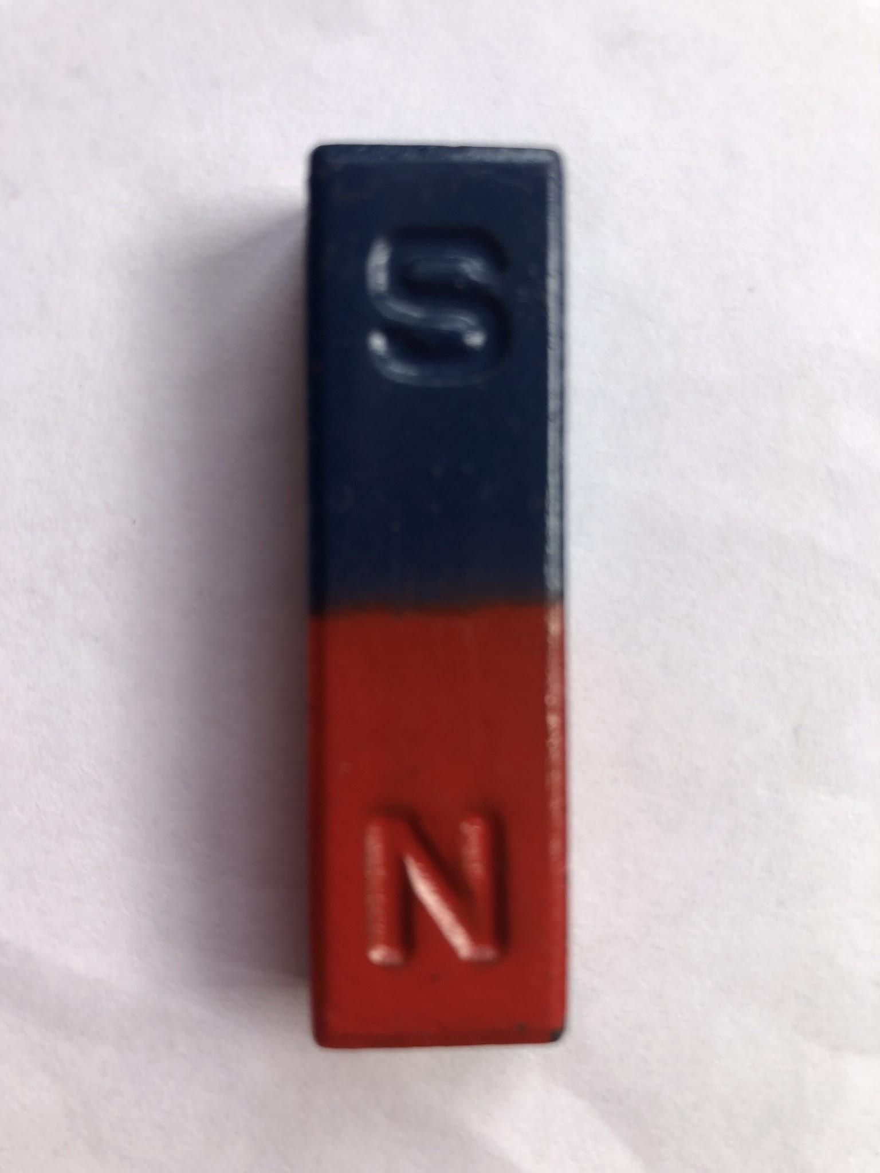
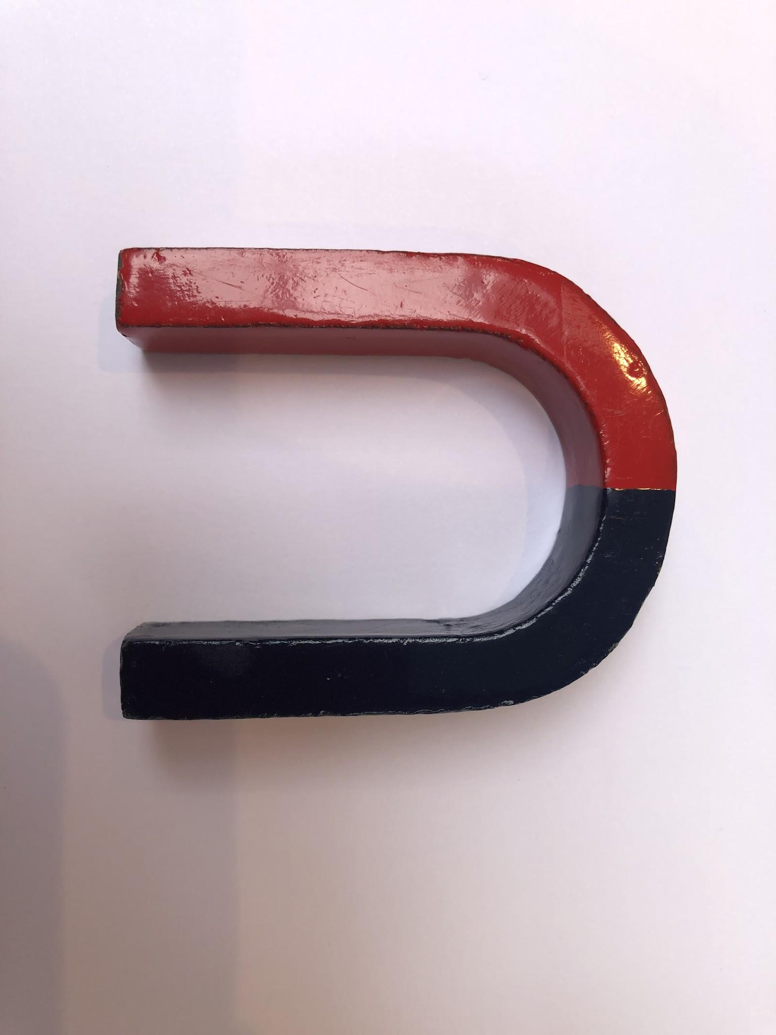
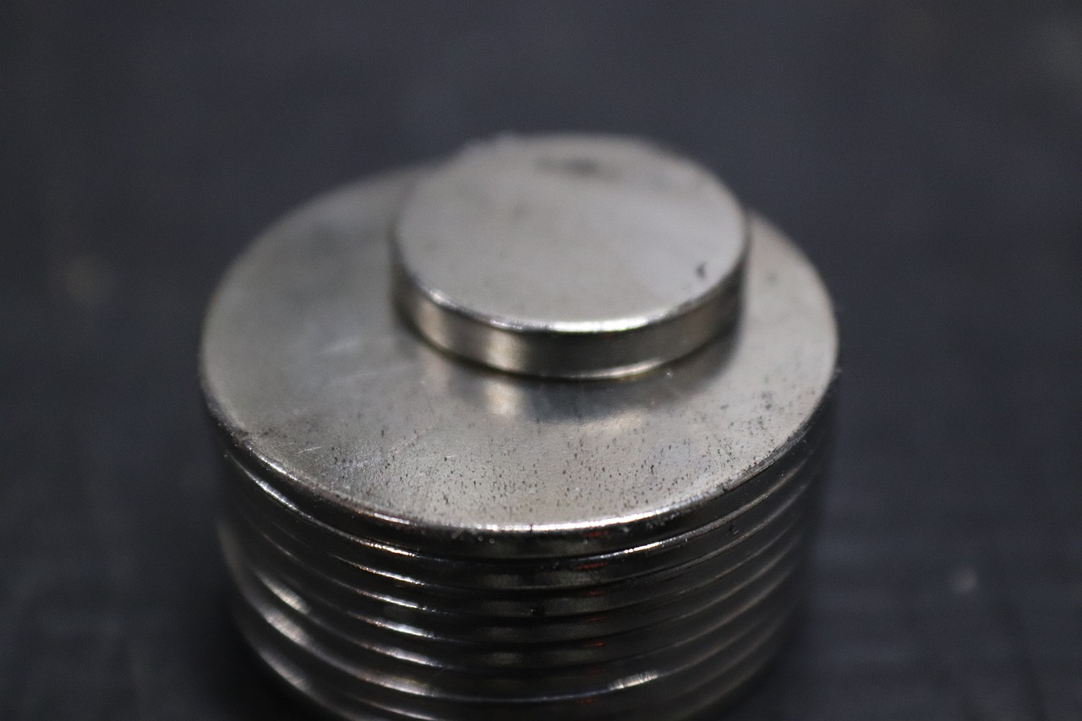
Tiir raadinaysa woqooyiga iyo tiir raadinaysa koonfurta
Birlabeyda waxaa laga heli karaa qaabab iyo cabbiro kala duwan.
Waxaa laga yaabaa inaad isticmaashay birtii (bar magnet-ka) sidan oo kale ah darasyada (science-ka).
Birtu waxay u rogi kartaa qaab faras-koobab.
Magnets-ka sidoo kale waxaa loo qaabayn karaa disk-yo yaryar.

Slide 11
Cirifyada woqooyi-raadsada iyo koonfur-raadsada
Dhammaan magnets-kaan waxay yeelan doonaan cirif woqooyi-raadsada (north-seeking) iyo cirif koonfur-raadsada (south-seeking).
Mararka qaarkood cirifyadan waa la calaamadeeyaa, inta badan ma aha.

Slide 12
Cirifyada woqooyi-raadsada iyo koonfur-raadsada
cirifka woqooyi-raadsada
cirifka koonfur-raadsada

Slide 13

Cirifyada woqooyi-raadsada iyo koonfur-raadsada
Kee ka mid ah weedhahan ayaa sax ah oo ku saabsan cirifka magnet-ka ee la muujiyey?
Waa cirif woqooyi-raadsada.
Waa cirif koonfur-raadsada.
Ma raadsado cirifna.
Wuxuu raadsadaa cirifyada woqooyi iyo koonfur labadaba.

Slide 14
Cirifyada woqooyi-raadsada iyo koonfur-raadsada
Magnet-ka waxaa loo jabin karaa laba qaybood.
N
halkan ku jabi
S

Slide 15
Cirifyada woqooyi-raadsada iyo koonfur-raadsada
Jabku waa inuu kala saaraa labada cirif.
N
cirifka woqooyi-raadsada
Tani ma dhacdo!
S
cirifka koonfur-raadsada

Slide 16
Tiirar raadinaya Waqooyi iyo Tiirar raadinaya Koonfur
Labada qaybood ee kala duwan waxay yeelan doonaan laba tiir oo kala duwan.
N
cirif koonfur-raadsada oo lammaane ah cirifka woqooyi-raadsada
S
N
tiir raadinaya Waqooyi inuu lammaaneeyo tiir raadinaya Koonfur
S

Slide 17
Tiirar raadinaya Waqooyi iyo Tiirar raadinaya Koonfur
Saynisyahannadu kari waayeen inay gooni u soocaan hal tiir oo raadinaya Waqooyi ama Koonfur.
N
Birlabyadu had iyo jeer waxay leeyihiin lammaane tiir ah; tiir raadinaya Waqooyi oo la jira tiir raadinaya Koonfur.
S

Slide 18
Tiirar raadinaya Waqooyi iyo Tiirar raadinaya Koonfur
Mid ka mid ah weedhahan soo socda ayaa sax ah oo ku saabsan tiirarka magnetic?
Qaar ka mid ah birlabyadu waxay leeyihiin hal tiir oo keliya.
Dhammaan birlabyadu waxay leeyihiin laba tiir.
Bir laba geesood leh (bar magnet) wuxuu yeelan karaa laba tiir oo isku nooc ah.

Slide 19
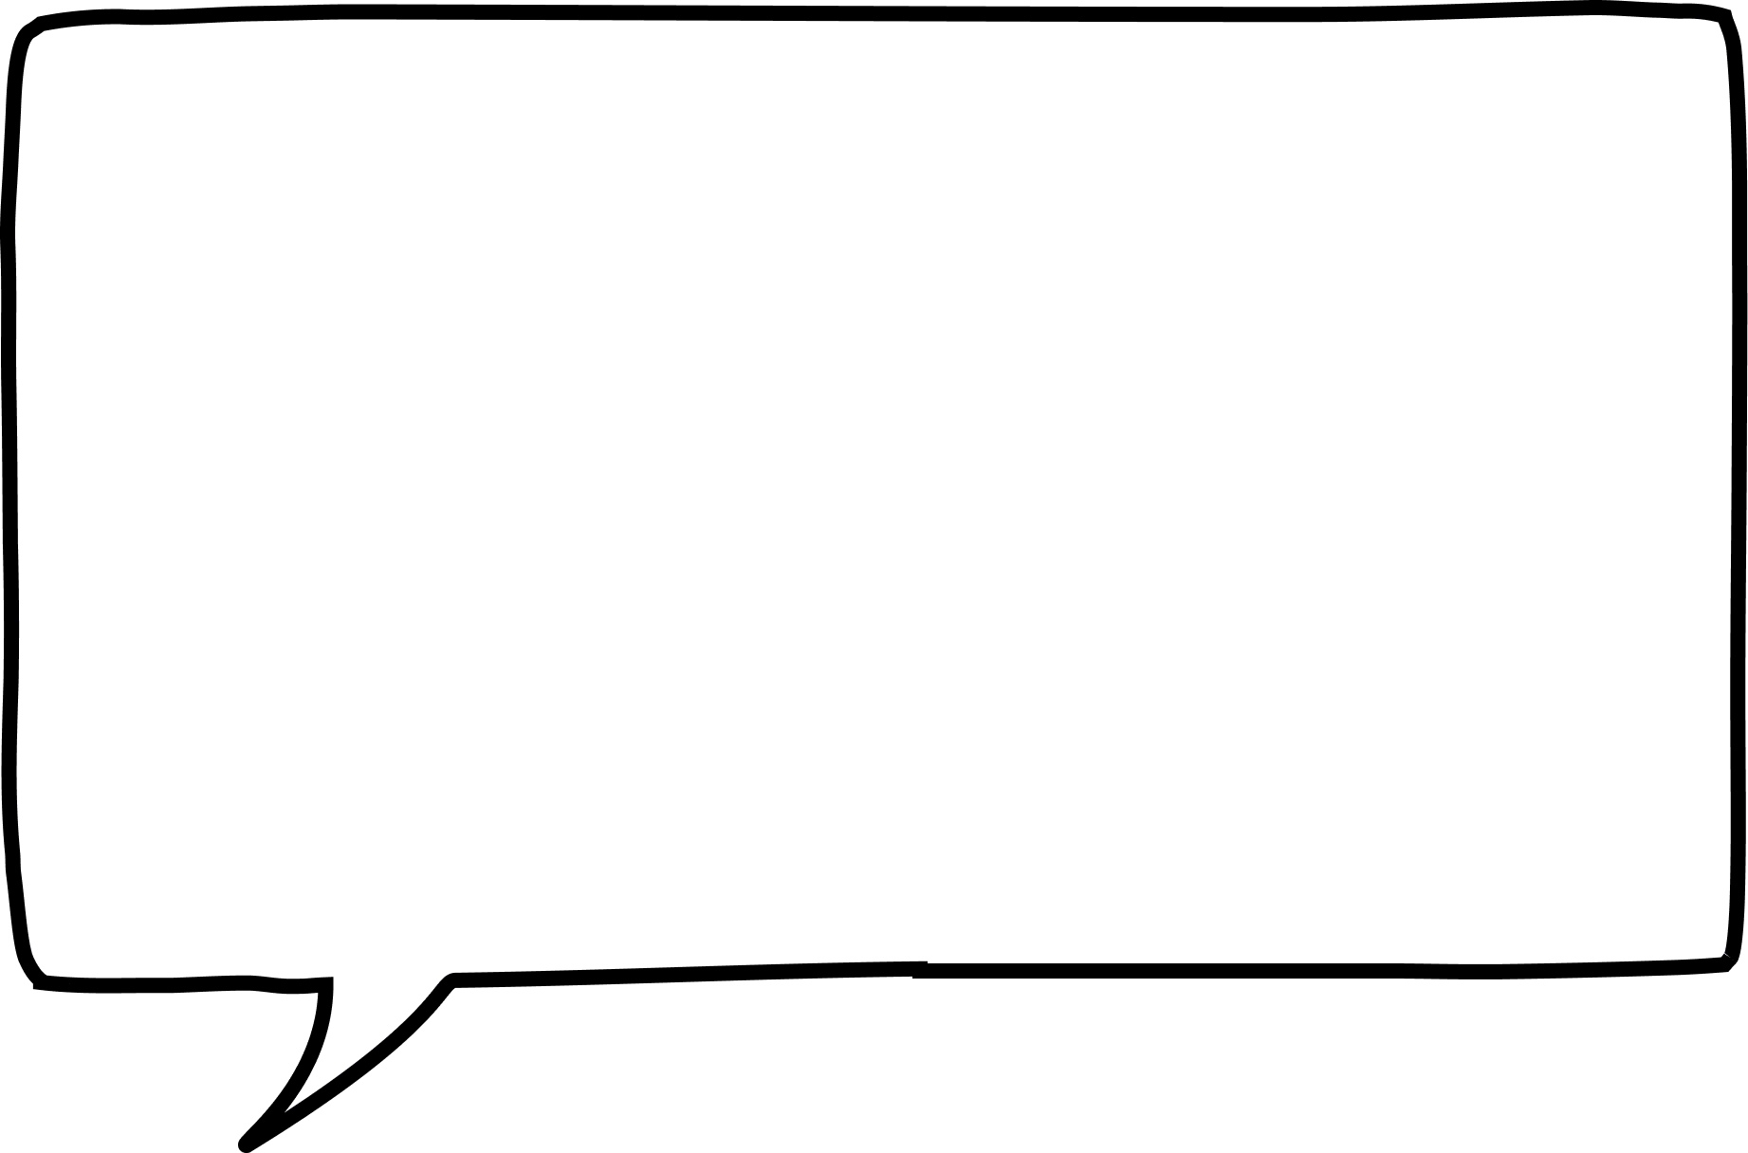




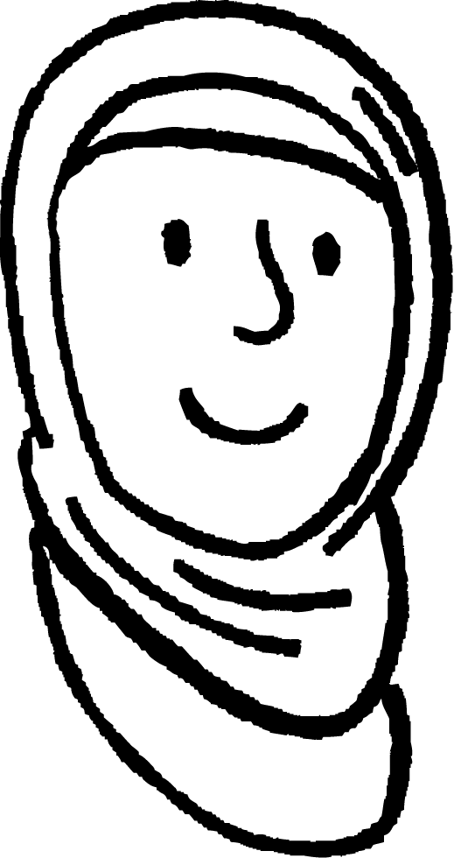


Tiirar raadinaya Waqooyi iyo Tiirar raadinaya Koonfur
Caasha iyo Nuur waxaa loo sheegay in birtan ay jabdo laba qaybood haddii la tuuro, iyo inay u baahan yihiin inay digtoonaadaan markay isticmaalayaan.
Haddii birta jabto, waxay lumin doontaa magnetismkeeda.
Haddii birta jabto, waxaa jiri doona laba qaybood, hal tiir N iyo hal tiir S.
Gee go'aaminta in arday kasta uu sax yahay iyo in khalad yahay, oo sharax sababta.
Caasha
Nuur

Slide 20
Ciribta woqooyi raadisa iyo koonfur raadisa
Gee go'aaminta in arday kasta uu sax yahay iyo in khalad yahay, oo sharax sababta.
Nuur waa khalad.
Waxaa jiri doona laba qaybood, mid kastaa wuxuu yeelan doonaa tiir raadinaya Waqooyi iyo tiir raadinaya Koonfur.
Bir birlabeed (magnet) had iyo jeer waxay yeelan doontaa tiirar raadinaya Waqooyi iyo Koonfur labadaba.
Caasha waa sax qayb ahaan.
Haddii magnet la garaaco, xoogga magnetka ayaa yaraan kara, laakiin haddii laba qaybood la soo saaro, labaduba weli waxay noqonayaan magnet.

Slide 21
Ciribta magnetic
Ciribta woqooyi raadisa iyo koonfur raadisa
Soo jiidasho iyo iska caabin
Walxaha magnetic

Slide 22
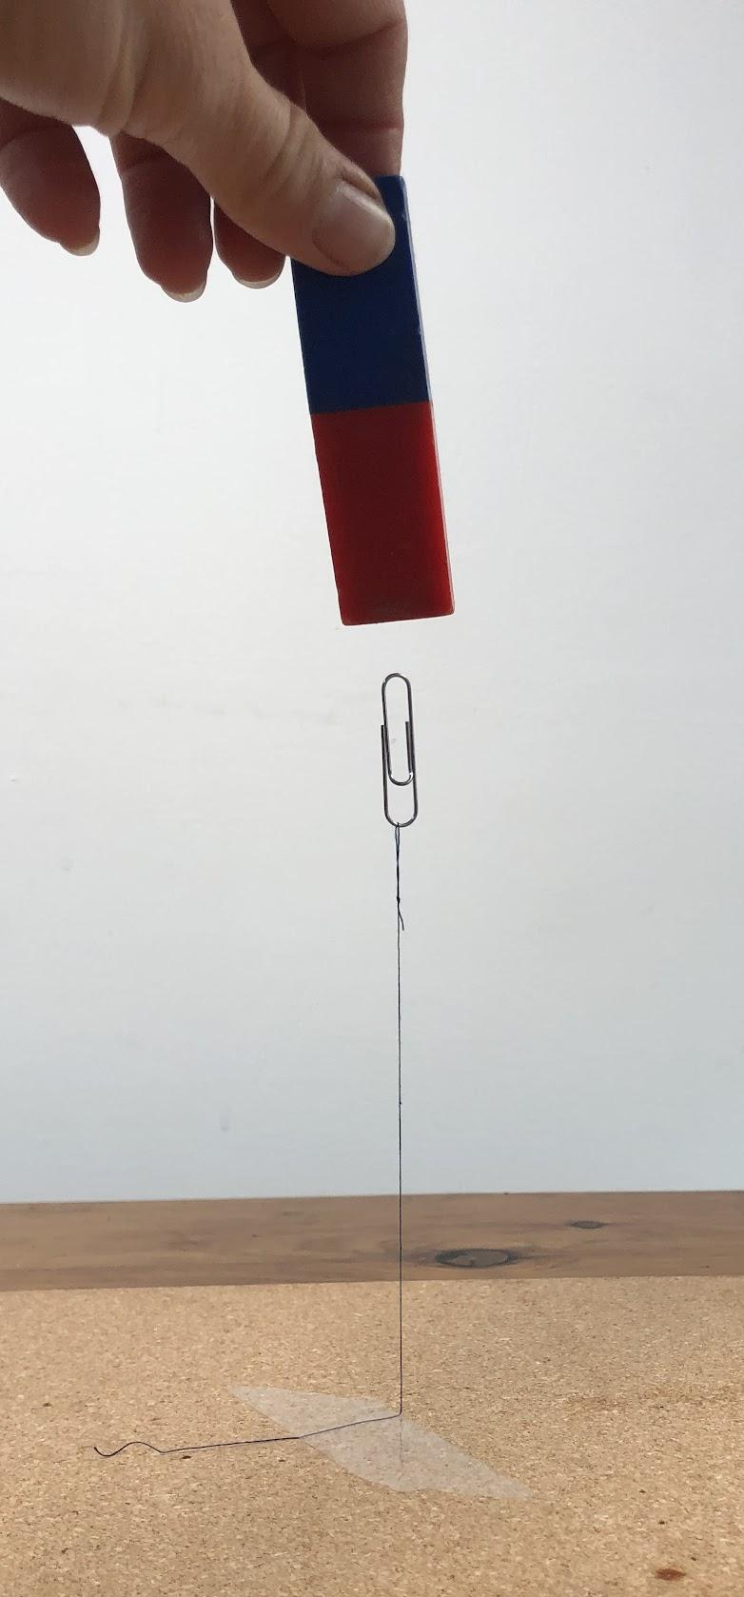
Soo jiidasho iyo iska caabin
Xoogga magnetic waa xoog aan taabasho lahayn.
magnetku uma baahna inuu taabto paperclip si uu u soo jiito

Slide 23
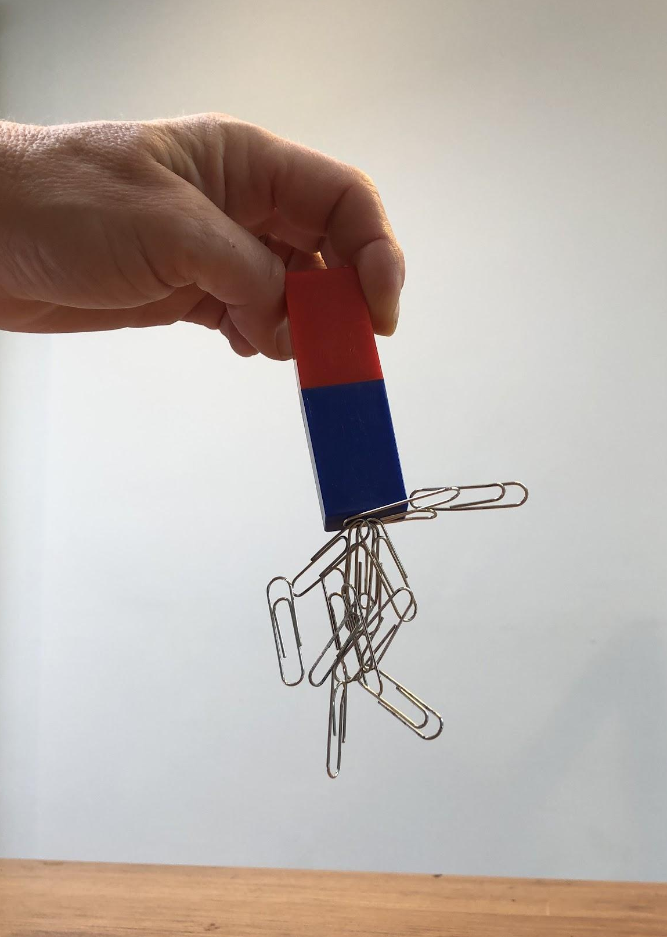
Soo jiidasho iyo iska caabin
Xoogga magnetic wuxuu kaloo awood u leeyahay inuu ku dhaqmo marka uu taabto paperclips.
qaar ka mid ah paperclips waxaa soo jiita paperclips kale

Slide 24
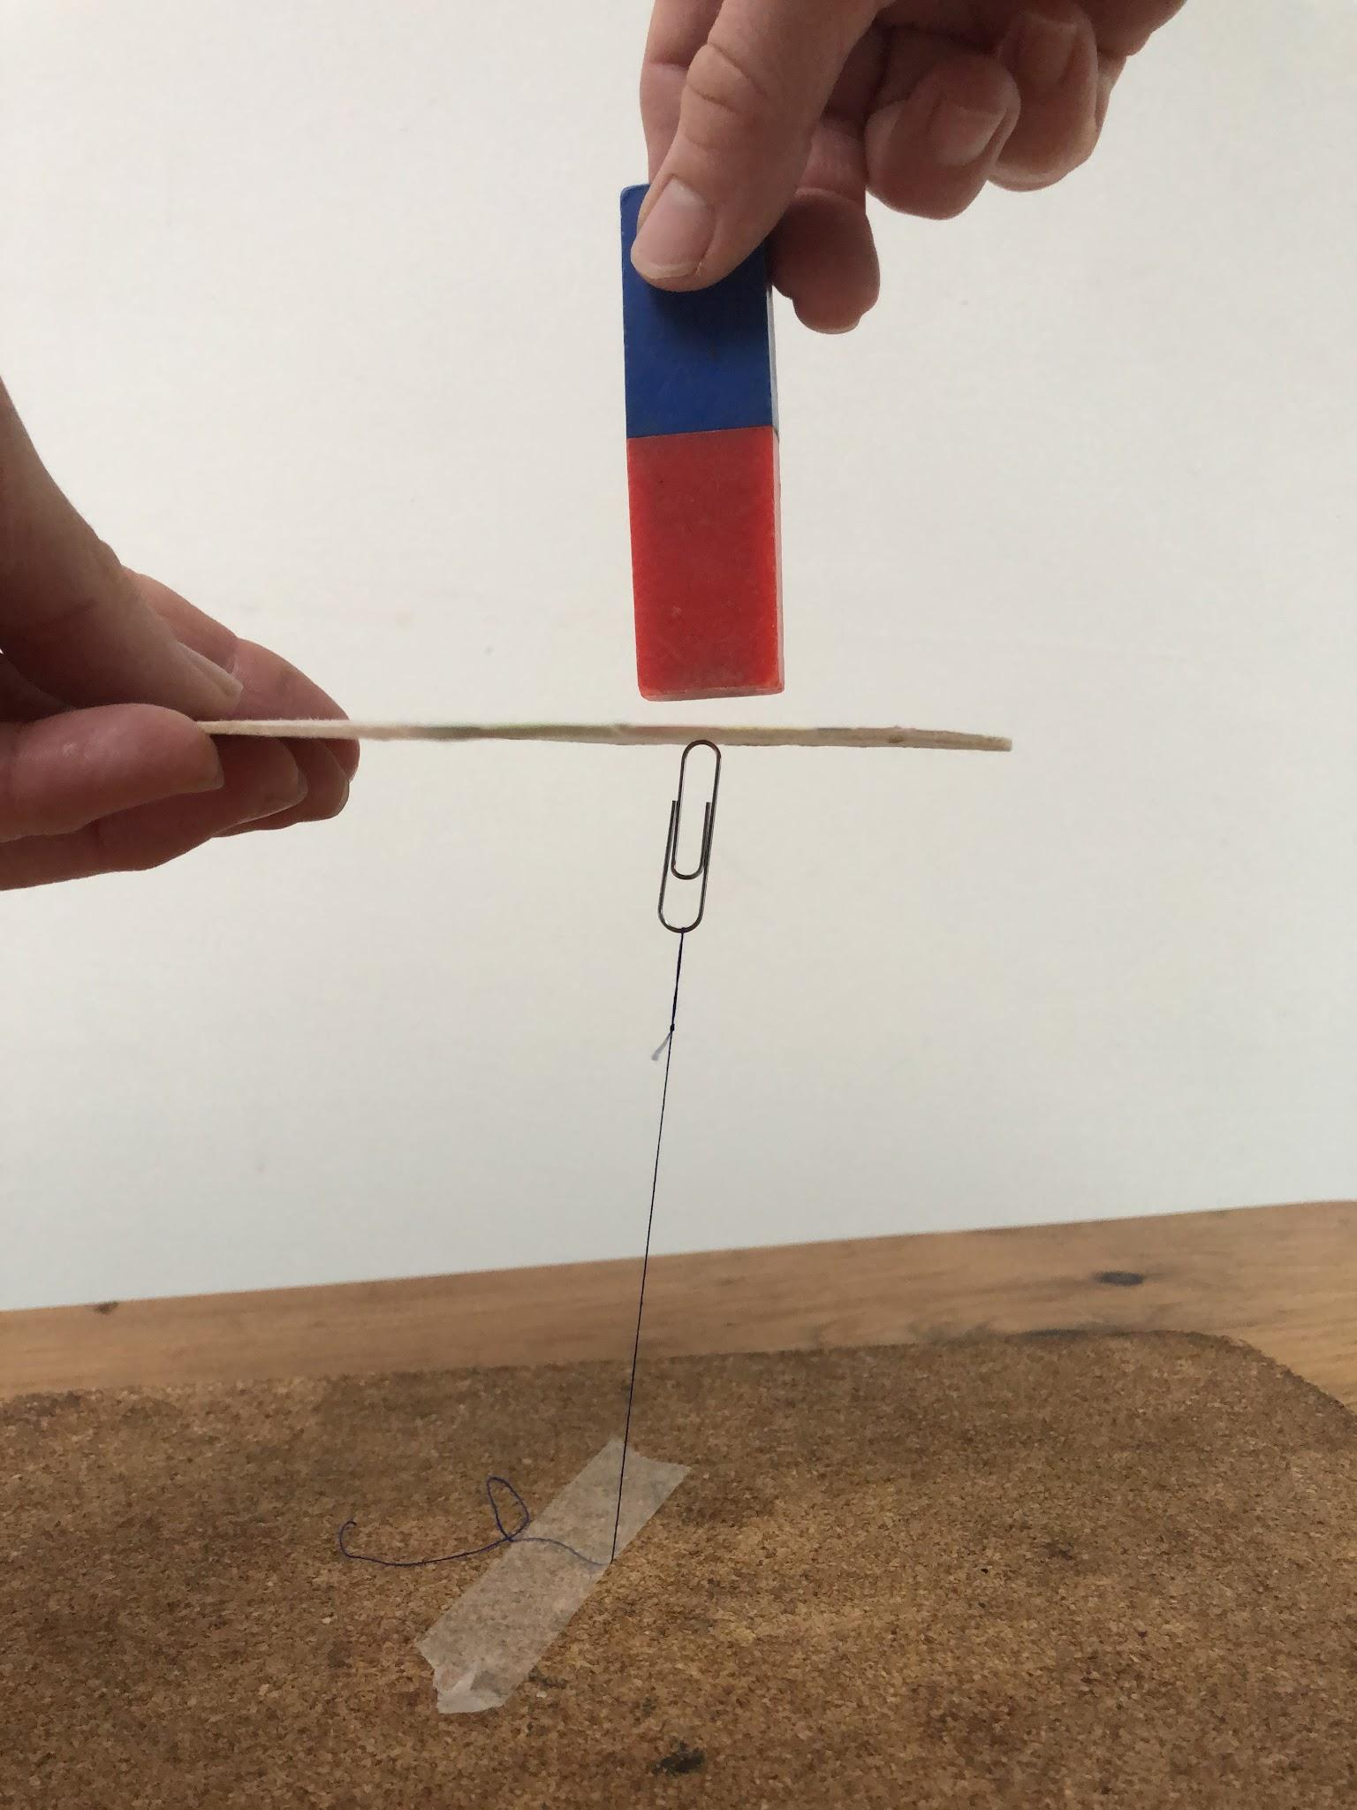
Soo jiidasho iyo iska caabin
Xoogga magnetic wuxuu kaloo dhex mari karaa walxo qaarkood.
kaadhku ma xannibo xoogga magnetic

Slide 25
Soo jiidasho iyo iska caabin
Kee ayaa ka mid ah weedhahan ku habboon?
Walxo qaarkood waxay noqdaan magnet marka ay taabtaan magnet.
Magnet waa inuu taabtaa shay si uu u soo jiito.
Soo jiidashada magnetic waxaa xanniba waraaq.

Slide 26
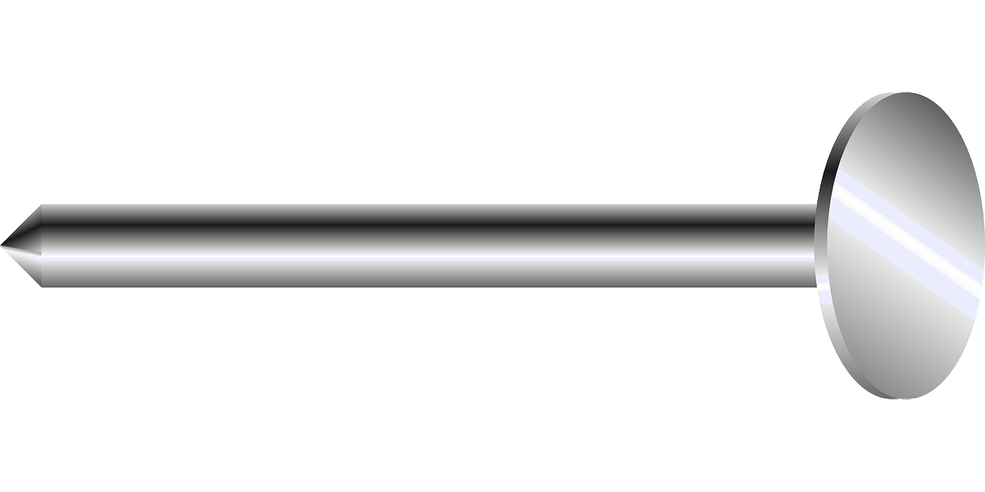




Soo jiidasho iyo is-celcelin (Attraction and repulsion)
Tijaabi isku darka soo socda ee magnets iyo magnets iyo sidoo kale musmaar bir ah, adigoo dhaqaajinaya laba kasta oo isku dhow oo fiirinaya waxa dhacaya.
1)
4)
2)
5)
3)

Slide 27
Soo jiidasho iyo is-celcelin (Attraction and repulsion)
1)
4)
Soo jiidasho (Attraction)
Soo jiidasho (Attraction)
2)
5)
Is-celcelin (Repulsion)
Soo jiidasho (Attraction)
3)
Is-celcelin (Repulsion)

Slide 28
Tiirarka birlabeed (Magnetic poles)
Tiirarka woqooyi iyo koonfureed (North–seeking and south–seeking poles)
Soo jiidasho iyo is-celcelin (Attraction and repulsion)
Walxaha birlabeed (Magnetic materials)

Slide 29
Walxaha birlabeed (Magnetic materials)
Birlabyadu waxay soo jiidan karaan oo is-celin karaan birlabyo kale.
Tiirarka kala duwan ee birlabyadu way soo jiidmaan.
Tiirarka isku midka ah ee birlabyadu way is-celiyaan.
Soo jiidasho (Attraction)
Is-celcelin (Repulsion)
Is-celcelin (Repulsion)

Slide 30
Walxaha birlabeed (Magnetic materials)
Cidhif bir ah oo keliya ayaa soo jiidmaya birlabta.
Soo jiidasho (Attraction)
Soo jiidasho (Attraction)
Cidhifka birta wuxuu ka samaysan yahay walxo magnetic ah.
Walxaha magnetic waxaa soo jiita labada cirif ee magnets.

Slide 31

Walxaha magnetic
Dhulku wuxuu u dhaqmaa sidii 'magnet' gudihiisa ku yaal.
Cirifka woqooyi ee halbeegga compass wuxuu tilmaamaa cirifkan 'magnet-ka'.
S
N
'Magnet-ka' khayaaliga ah wuxuu leeyahay cirifyo ka soo horjeeda cirifyada juqraafiga.

Slide 32

Walxaha magnetic
Kee ka mid ah weedhahan ku saabsan cirifyada magnetic ee magnet-ka la muujiyay waa sax?
N wuxuu soo jiitaa walxaha magnetic, S-na wuxuu soo jiitaa walxaha magnetic.
N wuxuu soo jiitaa S ee magnet kale, N-na wuxuu iska celiyaa N ee magnet kale.
N wuxuu leeyahay koronto togan, S-na wuxuu leeyahay koronto taban.
N wuxuu leeyahay koronto dheeri ah, S-na wuxuu ka yar yahay koronto.

Slide 33
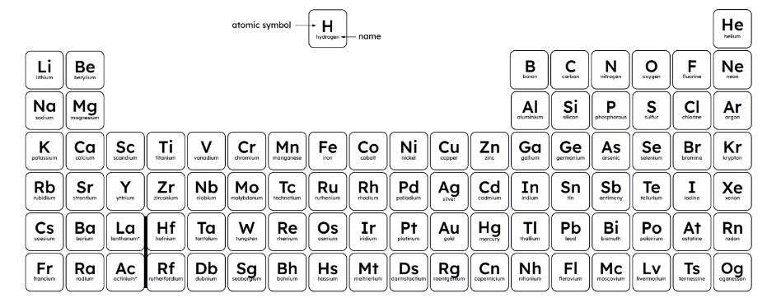
Walxaha magnetic
Waxaa jira saddex walxood oo magnetic ah oo keliya, waa biraha: iron, cobalt iyo nickel. Walxaha kale ma aha magnetic.

Slide 34
Walxaha magnetic
Steel waxaa badanaa loo qoraa inuu yahay walxo magnetic sababtoo ah waa isku darka inta badan iron, oo leh qadar yar oo carbon ah iyo walxo kale.

Slide 35
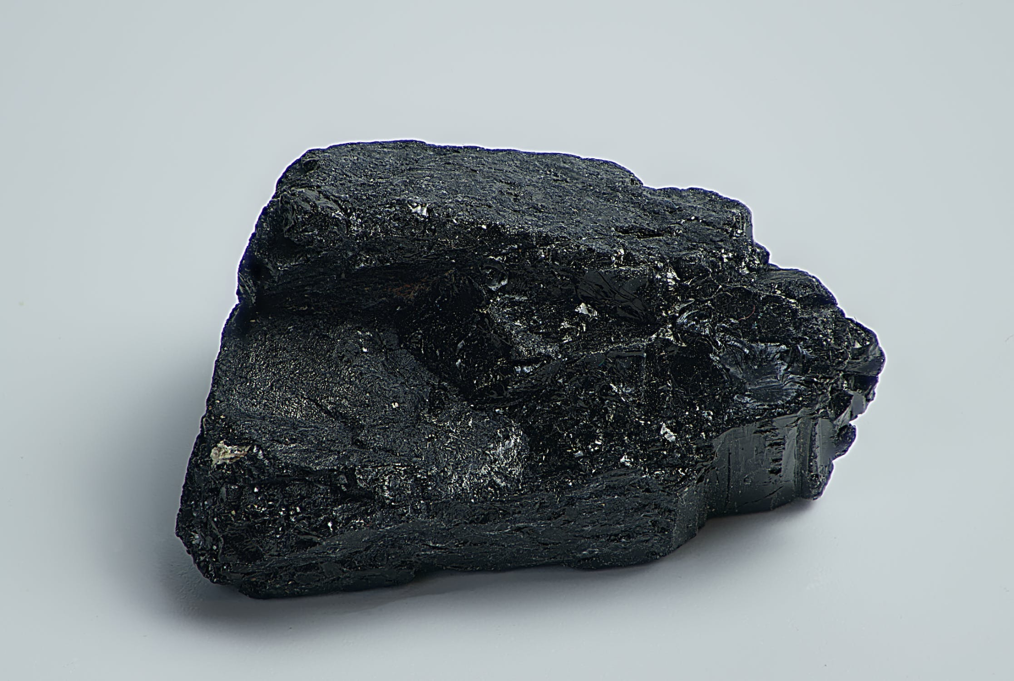
Walxaha magnetic
Lodestone (sidoo kale loo yaqaan magnetite, oo ah isku darka iron iyo oxygen) waa walxo magnetic.
Waxaa markii ugu horreysay wax ka qoray Giriigga Thales of Miletus qarnigii 6aad BC.

Slide 36
Walxaha magnetic
Kee ka mid ah weedhahan soo socda waa sax?
Dhammaan walxaha birta ah waa magnetic.
Dhammaan walxaha aan bir ahayn (non-metal) ma leh xoog magnet ah (magnetic).
Qaar badan oo ka mid ah walxaha birtu (metal) ma leh xoog magnet ah.

Slide 37
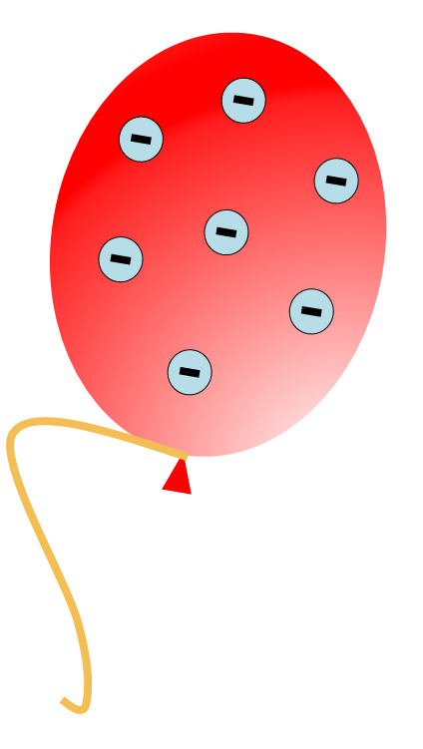
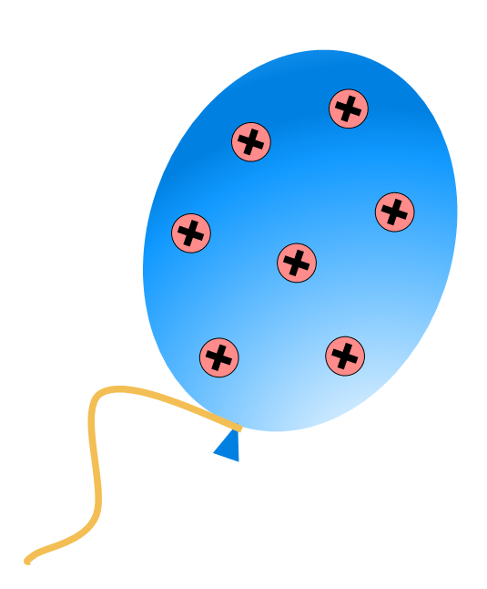
Walxaha magnet-ka (Magnetic materials)
Waxaan isbarbardhigi karnaa xoogga magnet-ka iyo xoogga korantada (electrostatic forces).
dabooyinka aan isku midka ahayn (unlike poles) ayaa is soo jiita
sharjiga aan isku midka ahayn (unlike charges) ayaa is soo jiita

Slide 38
Walxaha magnet-ka
Waxaan isbarbardhigi karnaa xoogga magnet-ka iyo xoogga korantada.
dabooyinka isku midka ah (like poles) ayaa iska celiya
sharjiga isku midka ah (like charges) ayaa iska celiya

Slide 39
Walxaha magnet-ka
Inkasta oo xoogga magnet-ka iyo xoogga korantadu ay isku mid yihiin, haddana waa noocyo kala duwan oo xoog ah.
Ma jiraan xoogag u dhexeeya buufinnada iyo magnet-ka.

Slide 40
Walxaha magnet-ka
Walxaha aan bir ahayn (non-metals) waxay noqon karaan magnet haddii ay leeyihiin sharji koronto (electric charge).
Sharjiga waxaa laga rari karaa iyadoo la isticmaalayo magnet.
Xoogga magnet-ka iyo xoogga korantadu way kala duwan yihiin.

Slide 41
Walxaha magnet-ka
Sharax sida loo isticmaalo magnet si loo garto saddex baloog oo 'qarsoon' oo la rinjiyeeyay si ay u ekaadaan kuwa isku midka ah.
Baloogyadu waa bir (iron), naxaas (copper) iyo magnet.

Slide 42
Maaddooyinka magnetic-ka ah
Sharax sida loo isticmaalo magnet si loo garto saddex xabbo 'qarsoodi' oo la rinjiyeeyay si ay u ekaadaan kuwa isku midka ah.
Marka hore, soo dhowee dabo S (S pole) ee magnet-ka baloogga oo fiiri waxa dhaca.
Kadib, samee wax la mid ah iyadoo la isticmaalayo dabo N (N pole) ee magnet-ka.
Haddii aan jirin soo jiidasho midkoodna S ama N, waa naxaas (copper).
Haddii ay jirto soo jiidasho labadaba S iyo N, waa bir (iron).
Haddii ay jirto soo jiidasho hal cirif (pole) iyo is-celinis (repulsion) kan kale, waa magnet kale.

Slide 43
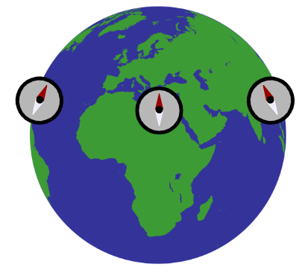
Cirifyada magnetic-ka (Magnetic poles)
Dhammaan magnets-ku waxay leeyihiin cirif waji-woqooyi (north-seeking pole) iyo cirif waji-konfureed (south-seeking pole), cirif keliya ma jiri karo keligiis.
Dhulku wuxuu leeyahay goob magnetic (magnetic field) oo keenta in magnets-yadu isku toosiyaan jihada woqooyi-konfureed.
Cirifyada magnetic-ka isku midka ah way is-celiyaan (repel), kuwa kala duwanaanna way is-jiidaan (attract).
Birta (iron), cobalt-ka iyo nickel-ka ayaa ah saddexda element ee kaliya ee magnetic-ka ah. Alloys-ka iyo xeryahooda (compounds) ayaa mararka qaarkood sidoo kale magnetic ah.
Steel-ku waa alloy bir ah oo ka kooban carbon, waana magnetic.

