Slide 1
Koronto guri (Mains electricity)
Iska caabbin (Resistance) iyo wareegyo barbar socda (parallel circuits)

Slide 2
Sida agabkeena waxbarista loogu talagalay fasalka

Slide 3
Waxaan barbar dhigi karaa awoodda (power) qalabka kala duwan oo aan ogaan karaa inta ay kharash ku baxdo in la isticmaalo.

Slide 4
awood (power)
qadarka tamarta (energy) lagu wareejiyo ilbiriqsi kasta
watts (W)
halbeegga awoodda (power)
kilowatts (kW)
halbeeg awood oo ka weyn; 1 kW = 1000 W
joules (J)
halbeegga tamarta (energy)
kilowatt-saacadood (kWh)
halbeegga isticmaalka tamarta; 1 kWh = 1 halbeeg tamar la isticmaalay

Slide 5

Koronto guri (Mains electricity)
Waa maxay awoodda koronto (electrical power)?
Isticmaalka tamarta iyo kharashka

Slide 6
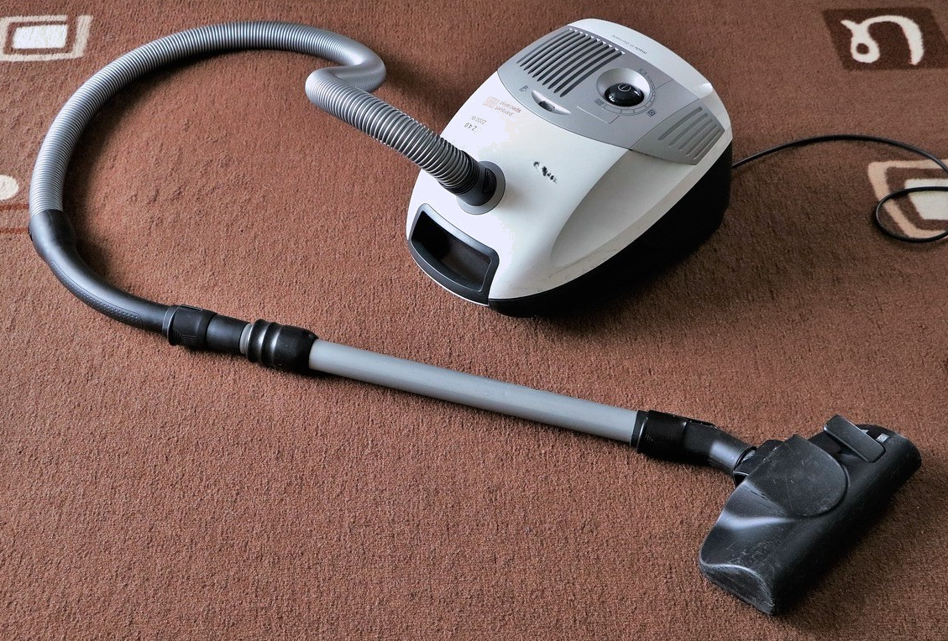
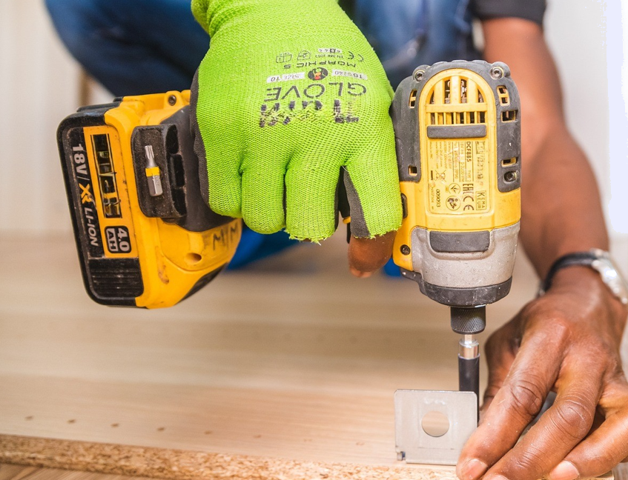
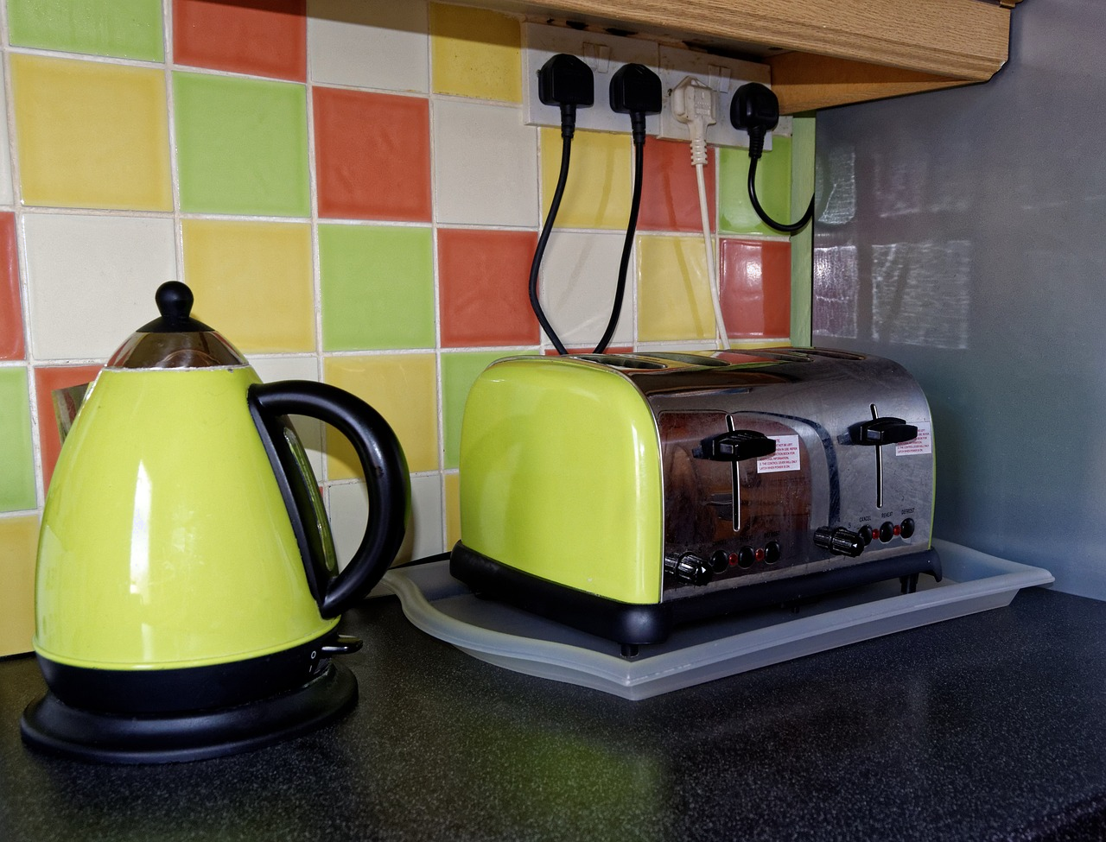
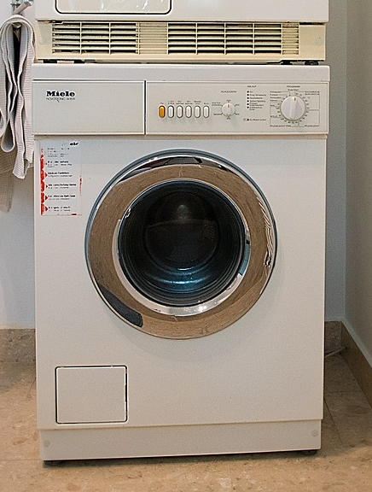
Waa maxay awoodda koronto (electrical power)?
Guryaheena waxaan ku haynaa qalab koronto oo kala duwan iyo aalado noo caawiya inaan shaqo qabanno.
Mid kastaa wuxuu isticmaalaa qadar tamar oo kala duwan ilbiriqsi kasta, waxayna ku xiran tahay shaqada uu qabto. Qadarka tamarta la isticmaalo ilbiriqsi kasta wuxuu la mid yahay awoodda (power) qalabka.

Slide 7
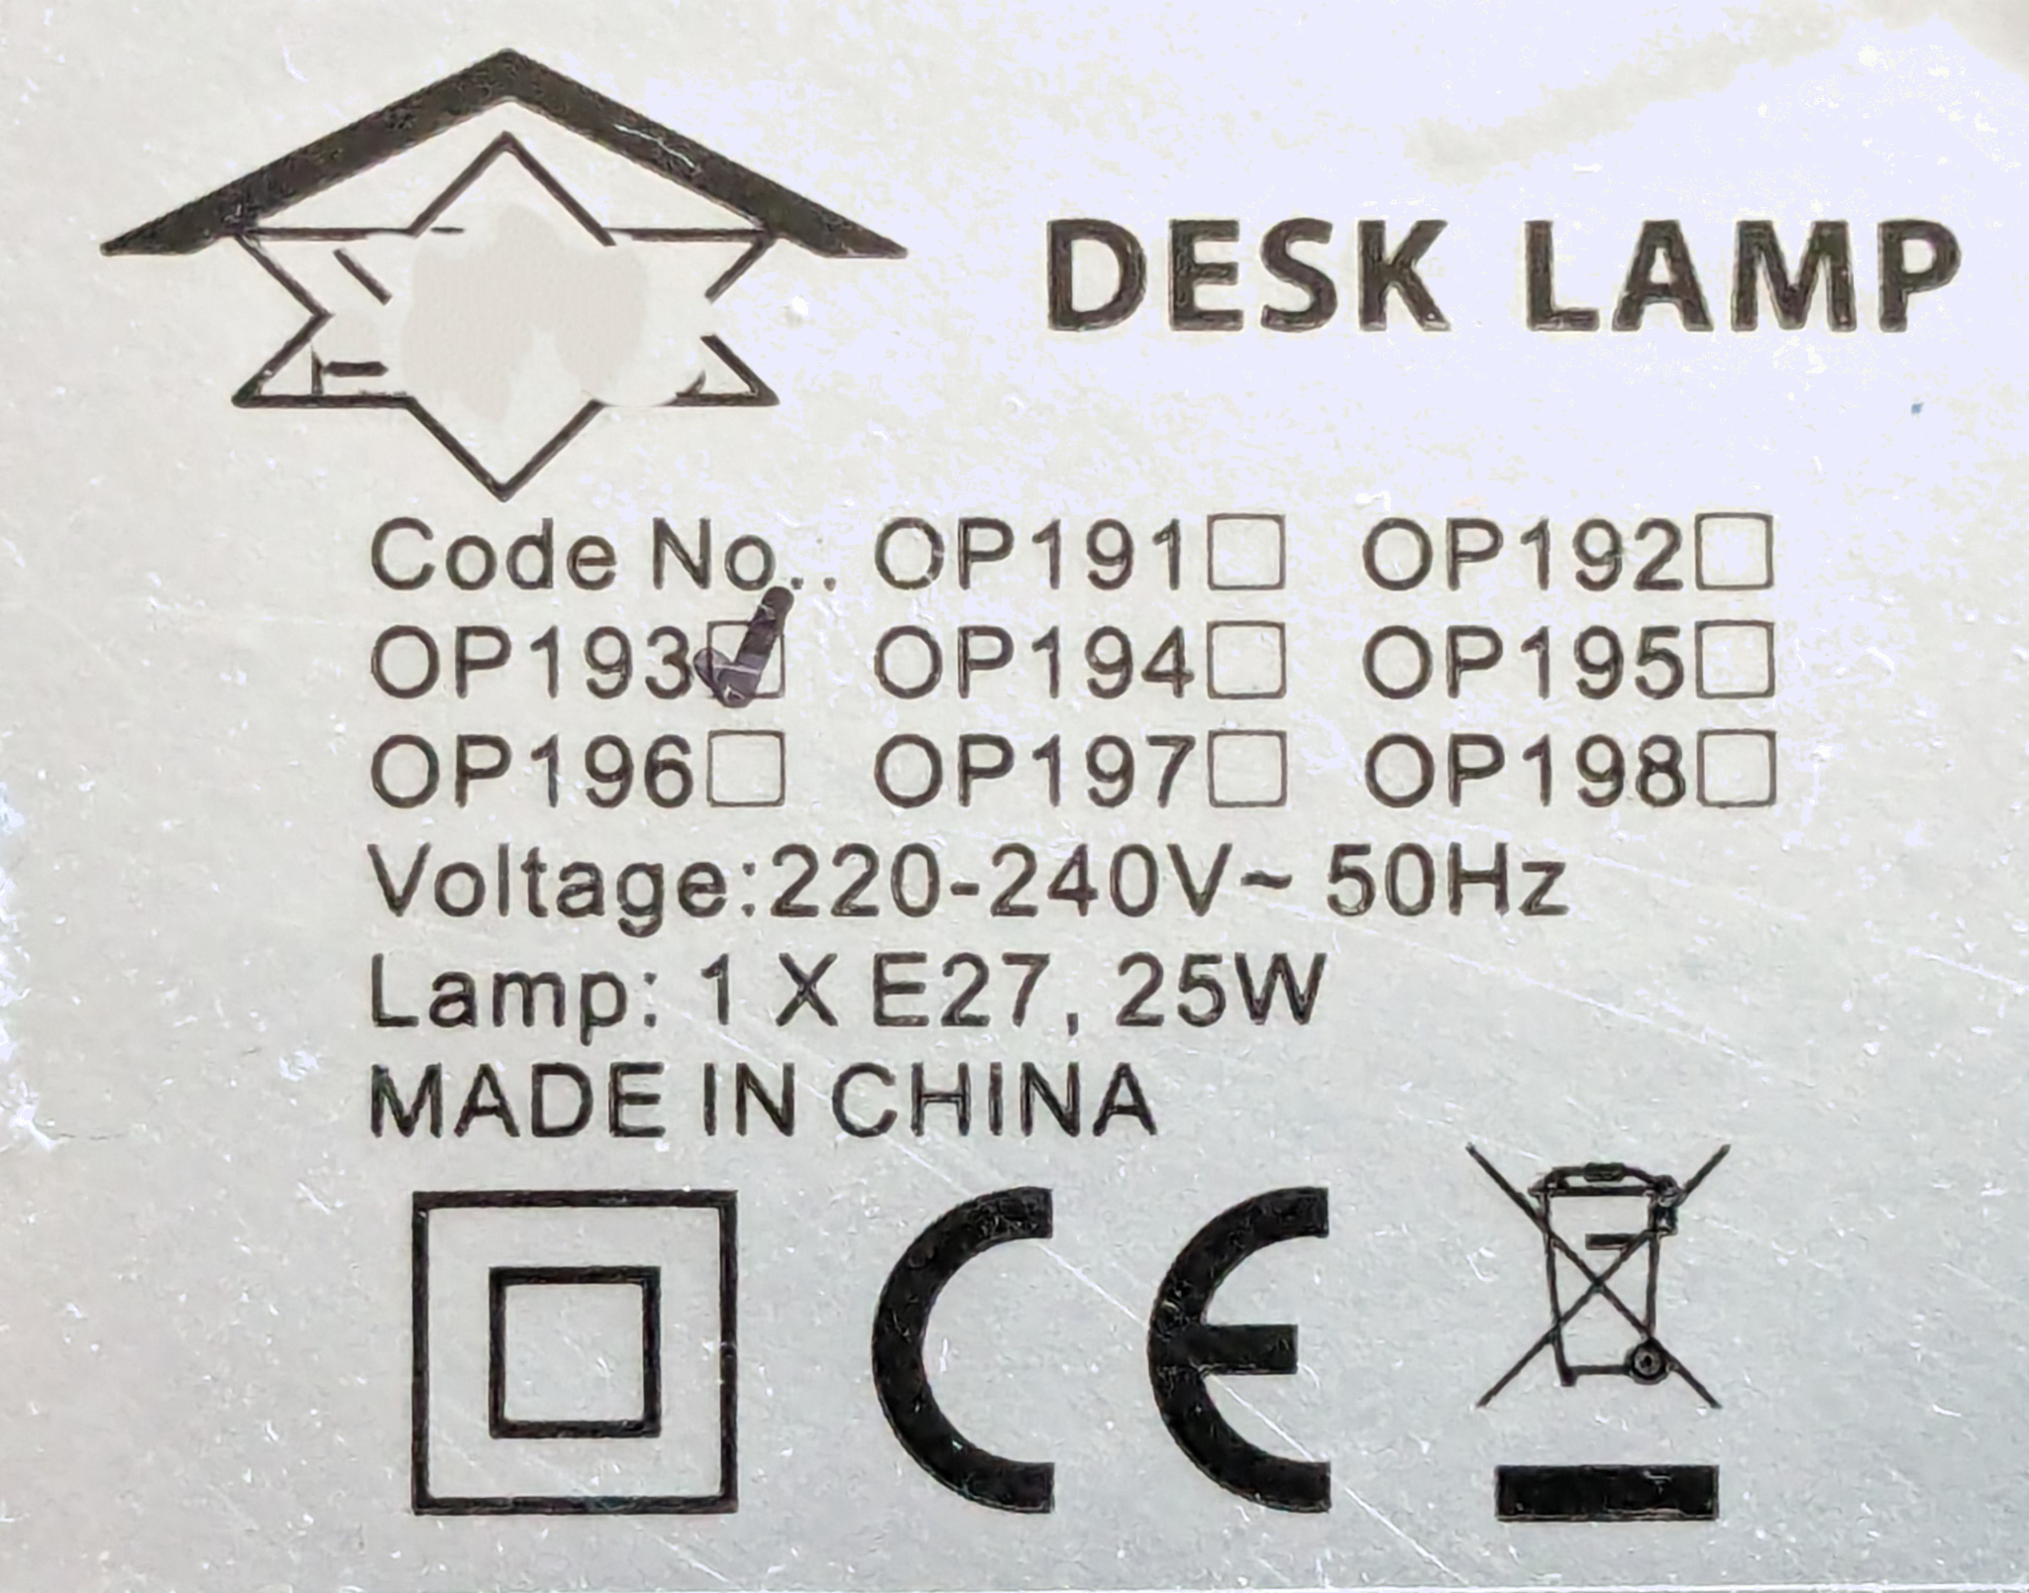
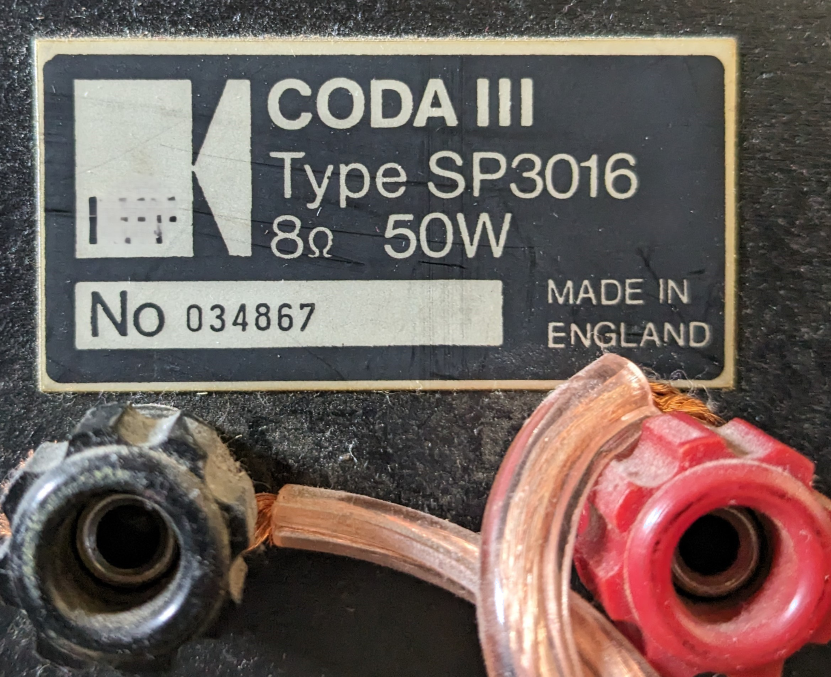
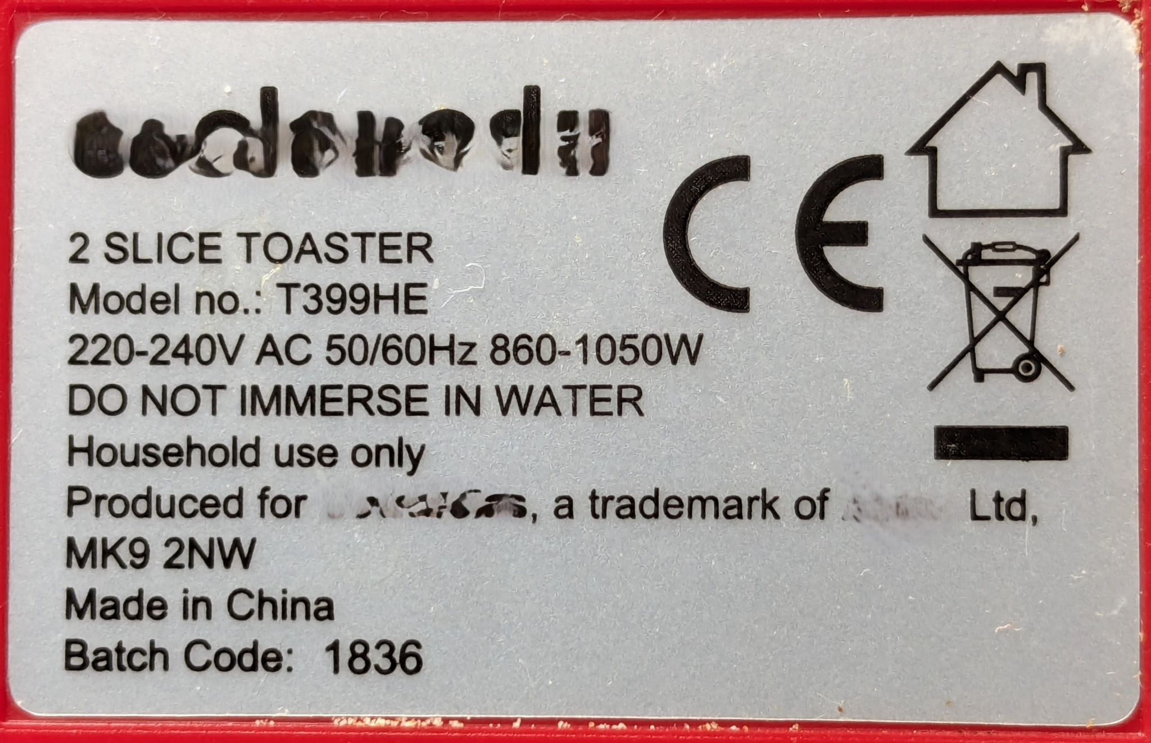
Waa maxay awoodda koronto (electrical power)?
Qiimaha awoodda (power) qalab kasta waxaa badanaa laga helaa istiikar (sticker) dhabarka ama hoostiisa.
Rooti-kulayliyaha (toaster) wuxuu leeyahay qiime (value) awood (power) ah inta u dhaxaysa 860 iyo 1050 W.
Nalkani wuxuu leeyahay qiime (value) awood (power) ah 25 W.
Qalalka codka (loudspeaker) wuxuu leeyahay qiime (value) awood (power) ah 50 W.
W waa calaamadda loo isticmaalo cutubka awoodda (power); waxay u taagan tahay watts.

Slide 8
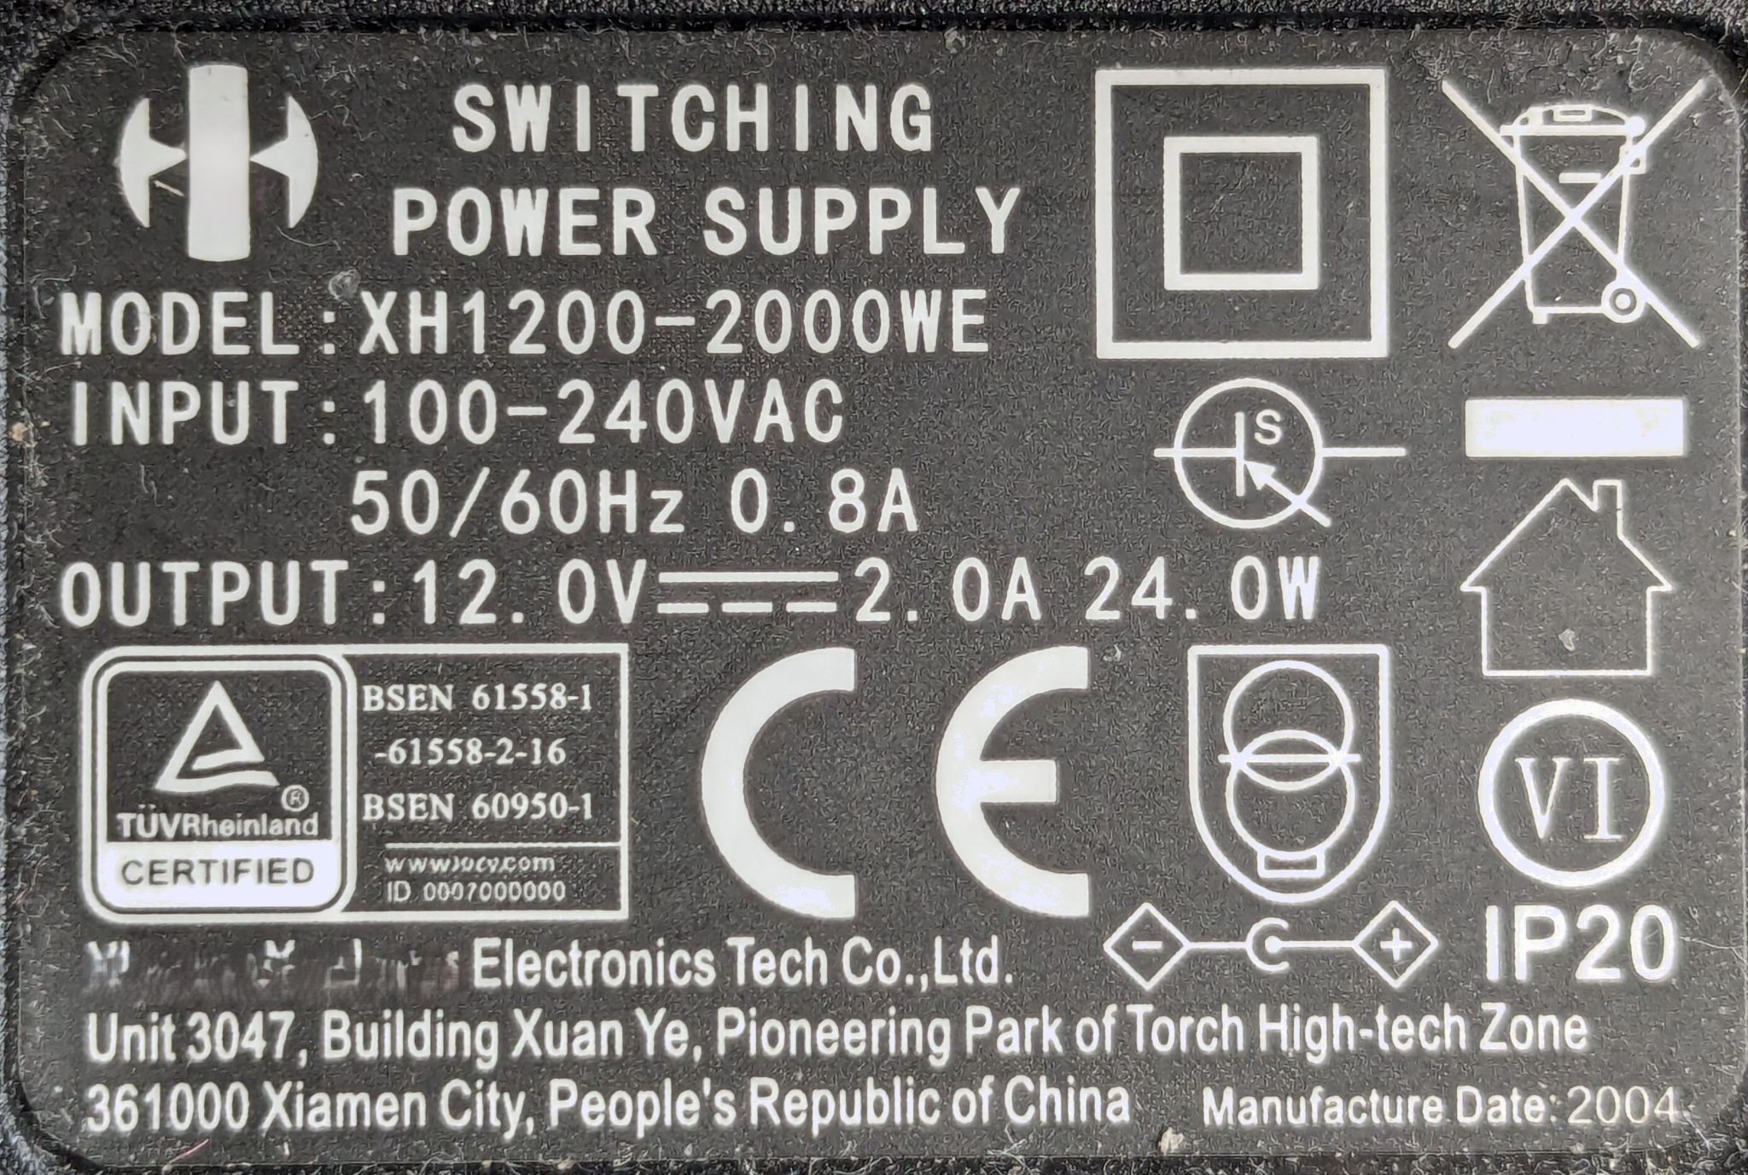
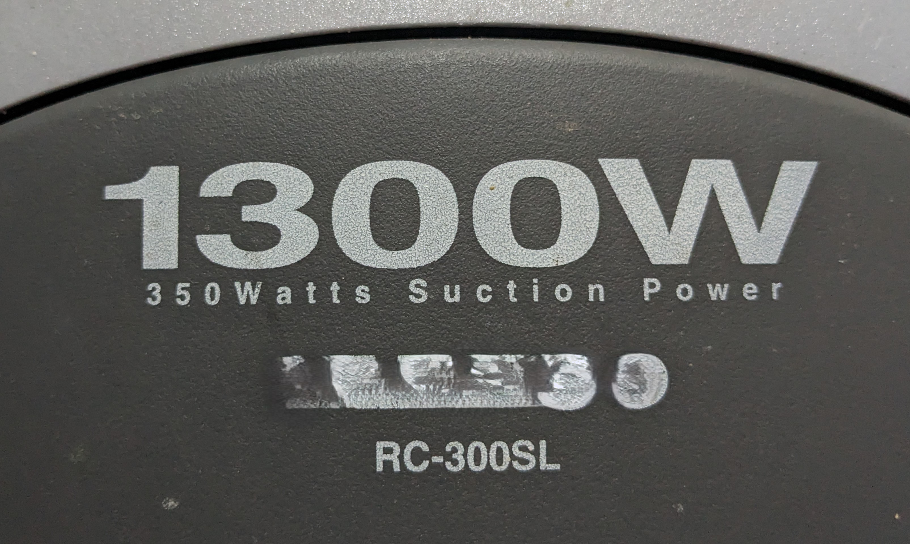
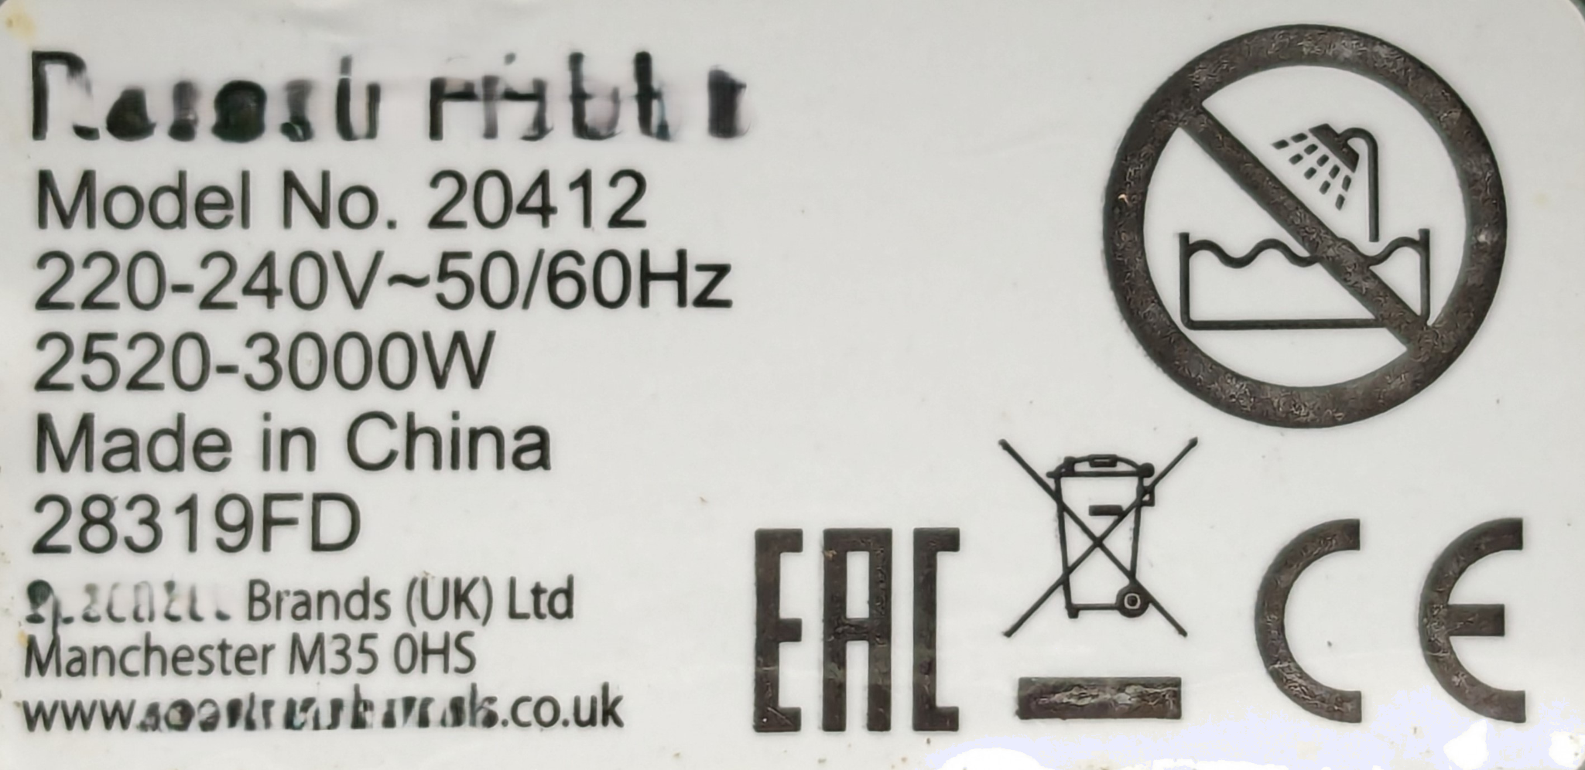

Waa maxay awoodda korantada (electrical power)?
Qiimaha (value) awoodda (power) ee saddex qalab ayaa hoos ku qoran. Qalabkee ayaa leh qiimaha (value) awoodda (power) ugu weyn?

Slide 9
Waa maxay awoodda korantada (electrical power)?
Awoodda (power) waxaa lagu qiyaasaa watts (W).
Waxaad sidoo kale arki kartaa qiimayaasha (values) awoodda (power) oo lagu sheegay:
milliwatts (mW)
kilowatts (kW)
megawatts (MW)
gigawatts (GW)
kumanaan meelood meel watt
kumanaan watts
malaayiin watts
bilyan watts

Slide 10
Waa maxay awoodda korantada (electrical power)?
Qiimayaasha u dhigma ee awoodda (power):
1000 milliwatts = 1 watt
1000 watts = 1 kilowatt
1000 kilowatts = 1 megawatt
1000 megawatts = 1 gigawatt
Tirada waxay isku beddeshaa qodob 1000 markasta.

Slide 11
Waa maxay awoodda korantada (electrical power)?
Awoodda (power) kiinleyda ayaa hoos ku qoran. Immisa kW ayay kiinleyda isticmaashaa markay ku shaqeyso heerka ugu sarreeya?
3
60
240
3000 W = 3 kW
3000

Slide 12
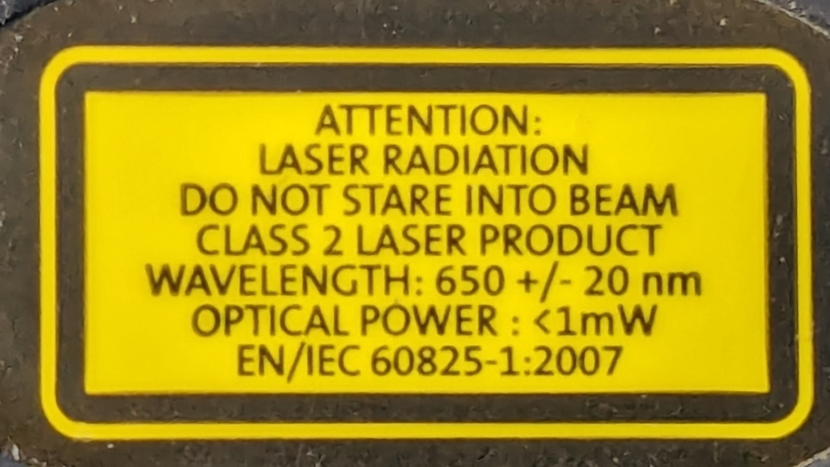
Waa maxay awoodda korantada (electrical power)?
Laydhka laser-ka waxaa lagu qiimeeyaa in ka yar 1 mW ama, 1/1000 watt.
1 mW = 0.001 W

Slide 13

Waa maxay awoodda korantada (electrical power)?
Taleefanka gacanta ee caadiga ah waxaa lagu qiimeeyaa ilaa 10 W, waxay ku xiran tahay waxa taleefanka loo isticmaalayo.
Caadi ahaan, tani waa wax aad uga yar.

Slide 14

Waa maxay awoodda korantada (electrical power)?
Kiinleyda ama rooti-karshe waxaa lagu qiimeeyaa ilaa 3000 W ama 3 kW.
Tani waxay ka badan tahay awoodda (power) uu dhali karo baaskiil-wade xirfadle ah – taas oo ka yar 2 kW.

Slide 15
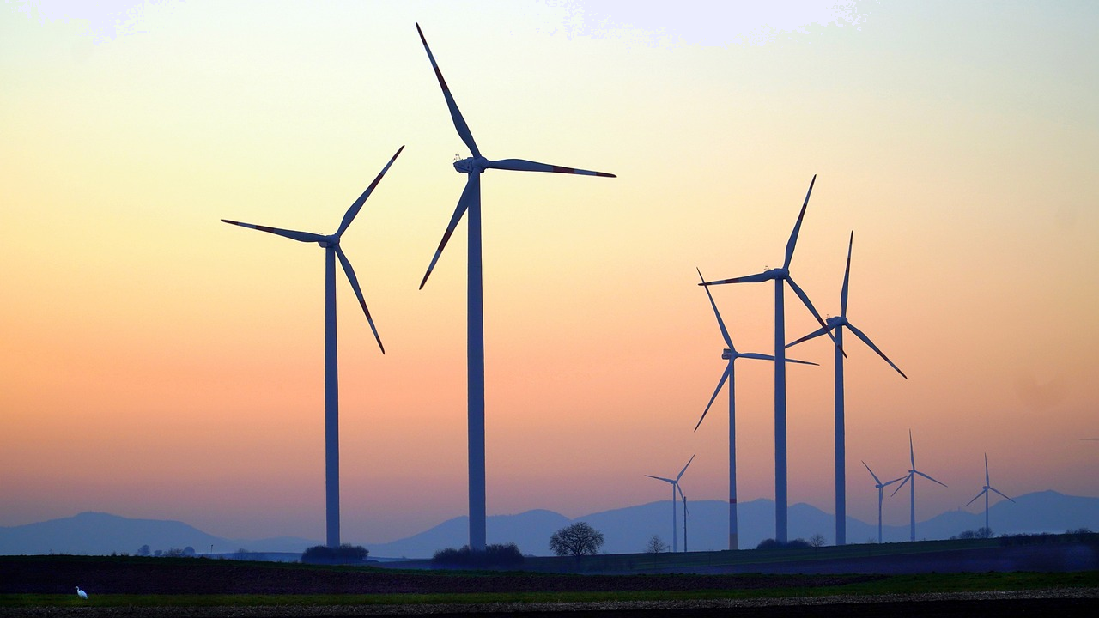
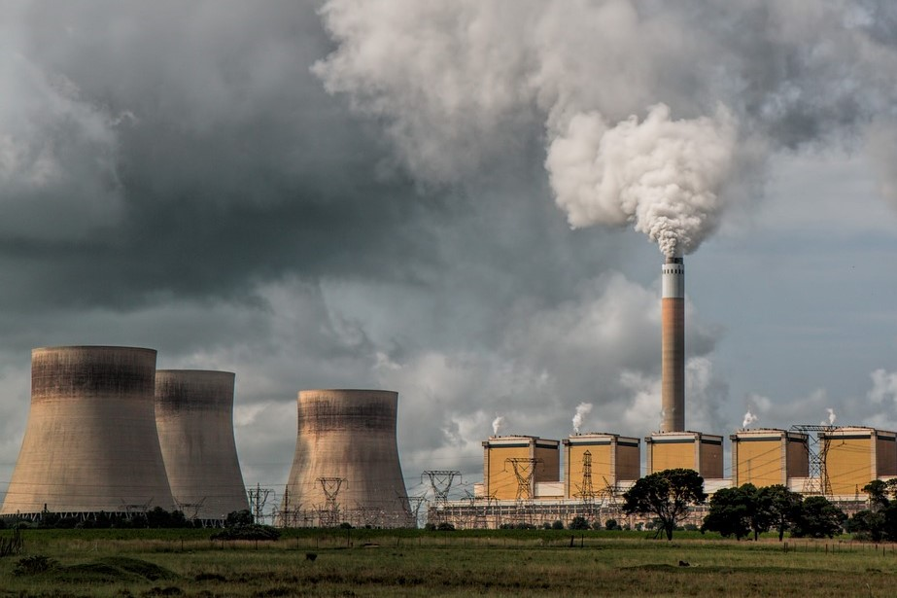
Waa maxay awoodda korantada (electrical power)?
Hal marawaxadaha dabaysha ayaa dhali kara dhawr megawatts (MW).
Xarunta korontada ee shidaalka fosilka ah waxay dhali kartaa laba gigawatts (GW).

Slide 16
Waa maxay awoodda korantada (electrical power)?
Immisa marawaxadaha dabaysha 1 MW ayaa loo baahan yahay si loogu beddelo xarunta korontada ee dhuxusha 1 GW?
10
100
1000
10 000

Slide 17
Waa maxay awoodda korantada (electrical power)?
Beddelka u dhexeeya watts iyo kilowatts:
1000 watts = 1 kilowatt
100 watts = 0.1 kilowatt
10 watts = 0.01 kilowatt
1 watt = 0.001 kilowatt
Si loo beddelo watts una loo beddelo kilowatts, u qaybi 1000.

Slide 18
Waa maxay awood koronto (electrical power)?
Beddelka u dhexeeya kilowatts iyo watts:
Si loo beddelo kilowatts una loo beddelo watts, ku dhufo 1000.
1000 watts = 1 kilowatt
Si loo beddelo watts una loo beddelo kilowatts, u qaybi 1000.

Slide 19
Waa maxay awood koronto (electrical power)?
Beddelka u dhexeeya horgalayaasha (prefixes):
⨉ 1000
⨉ 1000
⨉ 1000
watts kilowatts megawatts gigawatts
÷ 1000
÷ 1000
÷ 1000

Slide 20
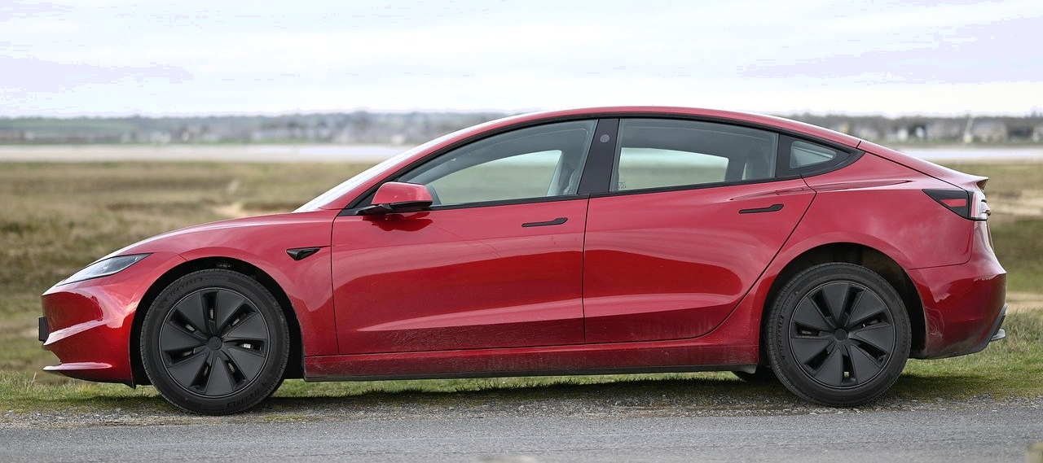
Waa maxay awood koronto (electrical power)?
Kee ka mid ah awoodahan (powers) ayaa u dhigma 200 000 watts?
200 kW
2 000 kW
2 MW
200 000 W ÷ 1000 = 200 kW
0.2 MW
200 kW ÷ 1000 = 0.2 MW

Slide 21
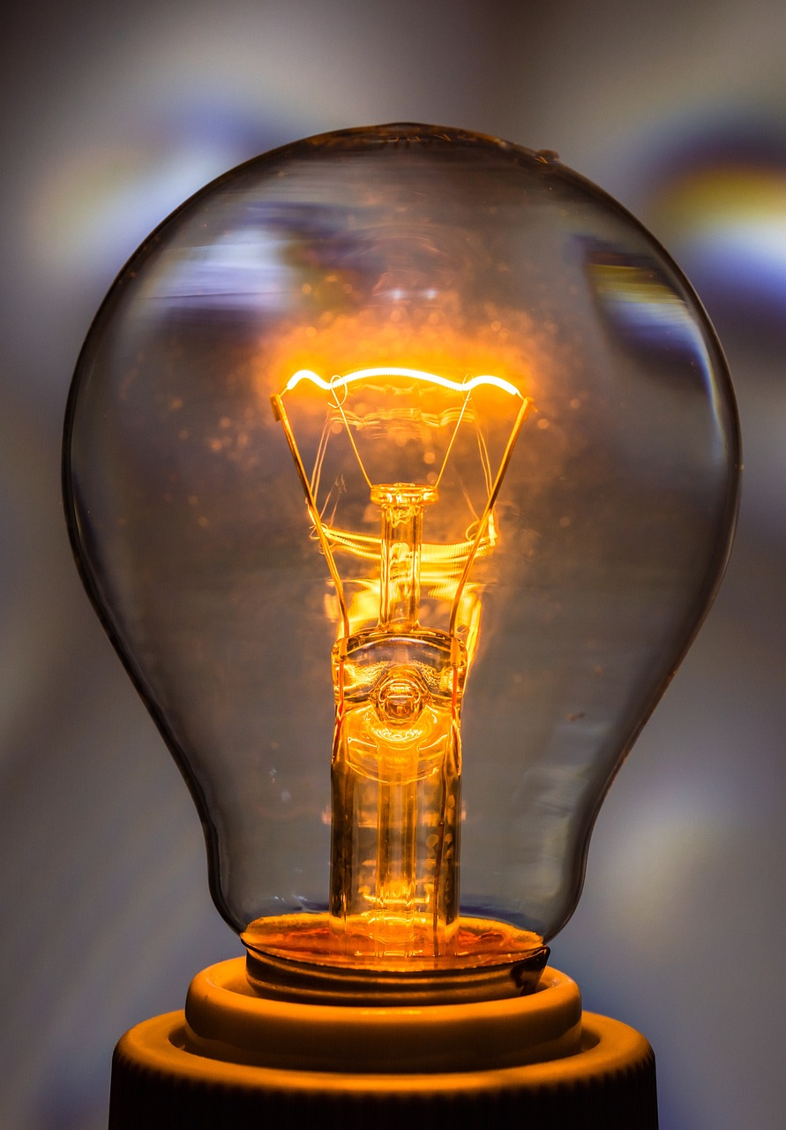
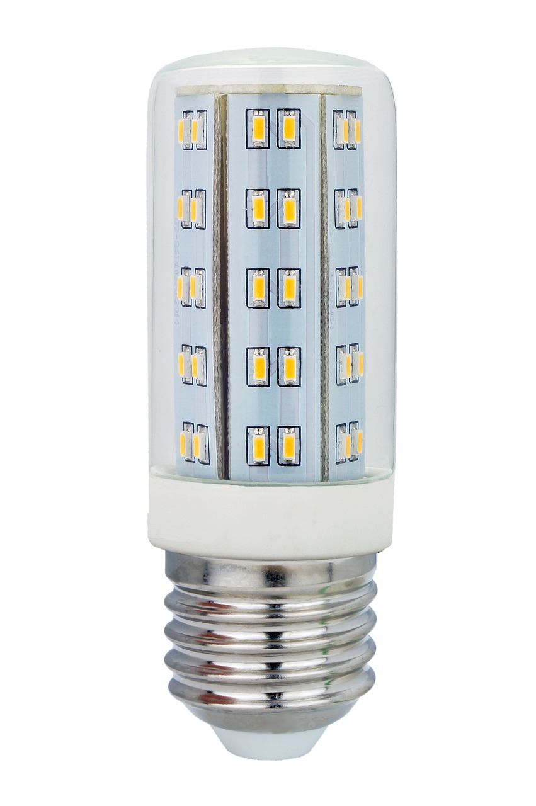
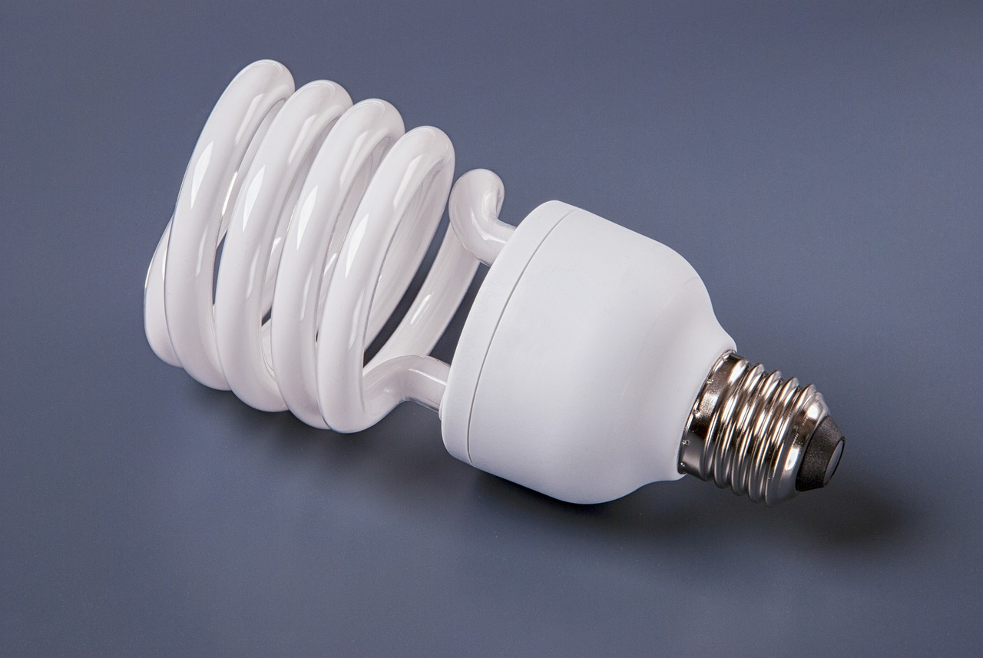
Waa maxay awood koronto (electrical power)?
Nalalka (light bulbs) ka hufan ee leh qiime (rating) awood (power) hoose ayaa bixin (emission) iftiin isku mid ah.
incandescent (incandescent)
nalka (bulb):
60 W
nalka fluorescent ee iftiinka isku midka ah: 20 W
nalka LED ee iftiinka isku midka ah:
4 W

Slide 22
Waa maxay awoodda korantada (electrical power)?
Kee ka mid ah noocyada nalka ayaa u baahan awood (power) badan: nalka fluorescent 20 W ama 4 × 4 W nalka LED?
4 nalka LED
nalka fluorescent
labaduba waxay u baahan yihiin awood isku mid ah
4 ⨉ 4 = 16 W
20 > 16

Slide 23
Waa maxay awoodda korantada (electrical power)?
U beddel awoodahan soo socda kilowatts (kW):
240 000 W
0.030 MW
0.000055 GW
150 000 mW
2) Guriga, qalabkan soo socda ayaa la shiday: 4 nalka LED, mid kastaa wuxuu qiime (value) ku leeyahay
5 W, foornada qiimeheedu yahay 1050 W, qaboojiyaha qiimeheedu yahay 400 W iyo router-ka WiFi
qiimeheedu yahay 0.02 W.
Waa maxay wadarta awoodda (power) ay u baahan yihiin qalabkan oo dhan?

Slide 24
Waa maxay tamarta korantada (electrical power)?
U beddel awoodahan soo socda kilowatts:
240 000 W ÷ 1000 = 240 kW
0.030 MW × 1000 = 30 kW
0.000055 GW × 1000 = 0.055 MW × 1000 = 55 kW
150 000 mW ÷ 1000 = 150 W ÷ 1000 = 0.15 kW
2) Guriga, qalabkan soo socda ayaa la shiday: 4 nal LED, mid walba qiime (value)
ah 5 W, foornada qiime (value) ah 1050 W, qaboojiyaha qiime (value) ah 400 W iyo router-ka WiFi
qiime (value) ah 0.02 W.
Waa maxay wadarta tamarta (power) ay u baahan yihiin dhammaan qalabkan?
4 × 5 = 20 W
tamarta (power) = 20 W (4 nal) + 1050 W (foorno) + 400 W (qaboojiye) + 0.02 W (WiFi) tamarta (power) = 1470.02 W

Slide 25
Korantada guud (Mains electricity)
Waa maxay tamarta korantada (electrical power)?
Isticmaalka tamarta (energy) iyo kharashka

Slide 26
Isticmaalka tamarta (energy) iyo kharashka
Tamarta (Power) waa cadadka tamarta (energy) (oo ku jira joules) la wareejiyo ilbiriqsi kasta.
Nalka 4 watt ee la muujiyey wuxuu isticmaali doonaa 4 joules ilbiriqsi kasta marka uu shidan yahay.
Haddii uu shido 1 daqiiqo (60 ilbiriqsi), wuxuu isticmaali doonaa 4 × 60 = 240 joules.
1 saac gudahood (60 × 60 ilbiriqsi), wuxuu isticmaali doonaa 4 × 60 × 60 = 144 000 joules.
Nalka LED: 4 W

Slide 27
Isticmaalka tamarta (energy) iyo kharashka
Imisa joules oo tamar (energy) ah ayay isticmaali doontaa nalka 60 W ee incandescent haddii la daayo 30 daqiiqo?
1 800 J
54 000 J
108 000 J
waqtiga ilbiriqsi = 30 × 60
60 × 30 × 60 = 108 000 J
216 000 J

Slide 28
Isticmaalka tamarta (energy) iyo kharashka
Biyaha (water) guriga, waxaa naloo dallacaa tamarta (energy) aan isticmaalno cutubyo loo yaqaan kilowatt–saacadood.
Qiyaasida awoodda (power) kilowatt-ka iyo waqtiga saacadaha, tamarta (energy) la isticmaalay waxaa lagu helaa isla'egta (equation):
tamarta (energy) la isticmaalay = tamarta (power) × waqtiga
kWh kW hr
Tamarta (energy) la isticmaalay waxaa lagu qiyaasaa kilowatt-saacadood (kWh).

Slide 29
Isticmaalka tamarta iyo qiimaha (cost)
Kee ka mid ah kuwan soo socda waa halbeega (unit) saxda ah ee isticmaalka tamarta guriga?
MWmin
kWh
GJh
kJ

Slide 30
Isticmaalka tamarta iyo qiimaha (cost)
1 kilowatt-saacadood = 1 kilowatt × 1 saacad
= 1000 watts × 60 daqiiqo
= 1000 watts × 60 × 60 ilbiriqsi
= 3 600 000 joules
Qiyaasidda tamarta (energy) kilowatt-saacadood (kWh) ayaa ku habboon biilasha tamarta (energy bills) maxaa yeelay qiimaha (value) u dhigma ee joules ayaa aad uga weyn oo ka dhigaya mid adag in laga shaqeeyo qiimaha (cost) isticmaalka.
Joules ayaa weli loo isticmaali karaa xaddi yar oo tamar ah.

Slide 31
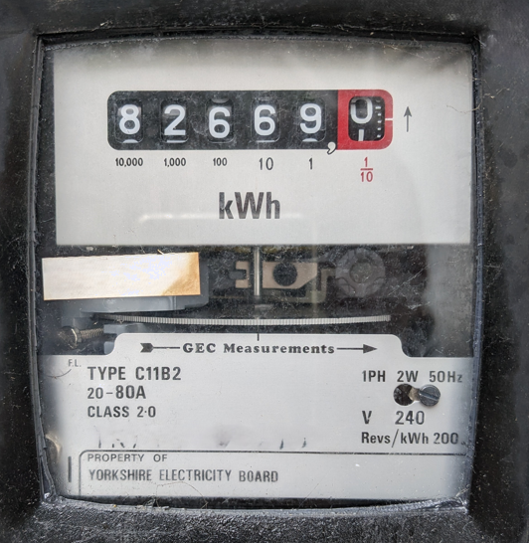
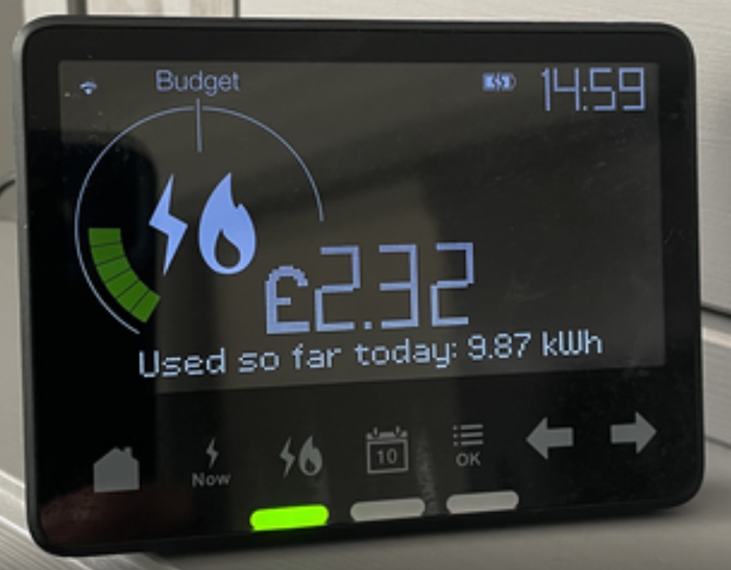
Isticmaalka tamarta iyo qiimaha (cost)
Mitirka korontada (electricity meter) wuxuu muujinayaa inta tamar (energy) la isticmaalay oo ku qiyaasan halbeegyada (units) kWh.
Mitirrada caqliga leh (smart meters) waxay sidoo kale muujin karaan qiimaha (cost), xaddiga tamarta (energy) la isticmaalay waqti go'an, waxayna kuu oggolaanayaan inaad falanqeyso isticmaalkaaga tamarta.
Shirkadaha bixiya korontada (electricity supply companies) waxay dadka ku dallacaan inta halbeeg (units) ay isticmaalaan.

Slide 32
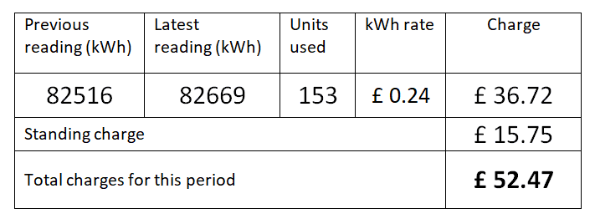
Isticmaalka tamarta iyo qiimaha (cost)
Fahamka biilka korontada (electricity bill):
unugyada la isticmaalay = 82669 – 82516
= 153
kharashka (charge) = 153 × £0.24
= £36.72
kharashka taagan (standing charge) waa kharash go'an oo bixinta sahayda (supply)
£36.72 + £15.75 = £52.47

Slide 33
Isticmaalka tamarta (Energy use) iyo kharashka (cost)
Imisa unug (units) ayaa la isticmaalay inta u dhaxaysa labada akhrin (meter readings) ee la muujiyey?
110
akhrista bilowga (initial reading)
82376
111
82489
akhrista ugu dambeysa (final reading)
112
82489 – 82376 = 113 unug (units)
113

Slide 34
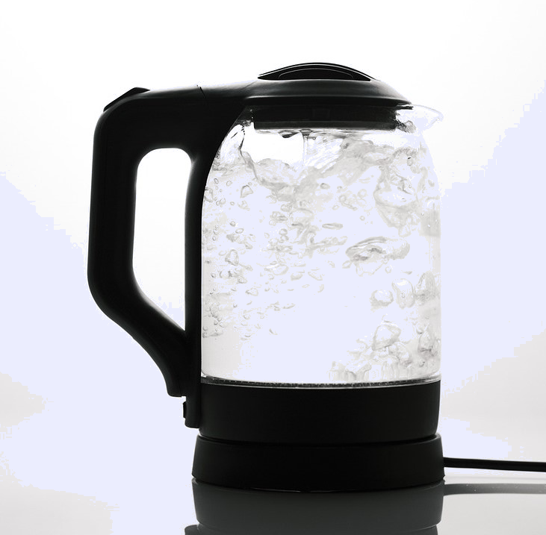
Isticmaalka tamarta (Energy use) iyo kharashka (cost)
Haddii kettel (kettle) 2000 W ah la isticmaalo 15 daqiiqo (¼ saac):
tamarta (energy) = awoodda (power) × waqtiga (time)
= 2000 W × ¼ h
= 500 Wh
= 0.5 kWh
Kettel (kettle) koronto (electric) 2000 W
Haddii 1 kWh uu ku kacayo £0.20, kharashka (cost) isticmaalka kettel-ka (kettle) waa:
0.5 × £0.20 = £0.10 ama 10 p.

Slide 35
Isticmaalka tamarta (Energy use) iyo kharashka (cost)
Ka shaqee qiimaha (cost) hal kWh adoo isticmaalaya macluumaadka ka muuqda mitirka smart-ka (smart meter).
23.5 pence
4.25 pence
12.19 pence
2.32 ÷ 9.87 = 0.235 rodol (pounds)
0.235 rodol = 23.5 pence
7.55 pence

Slide 36
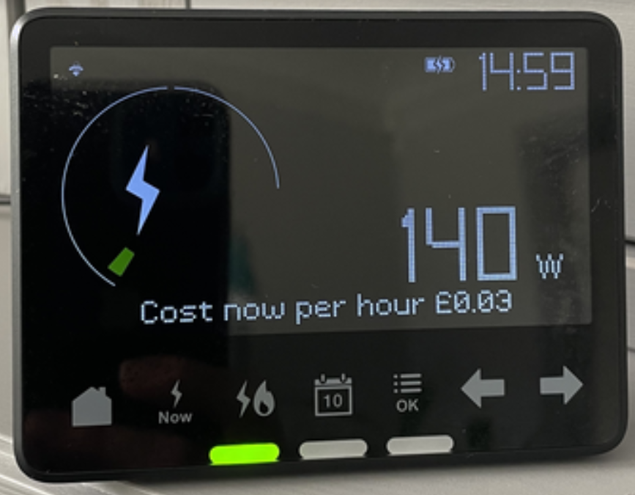
Isticmaalka tamarta iyo qiimaha (cost)
Mitirrada caqliga leh (smart meters) waxaa loo isticmaali karaa in lagu arko inta tamar (energy) aan isticmaalno si aan u noqonno kuwo tamar waxtar leh.
Mitirku wuxuu muujinayaa awoodda (power) iyo qiimaha (cost) 'hadda'.
Xakamaynta sida aan u isticmaalno qalabka tamar badan isticmaala waxay kaa caawinaysaa dhimista biilasha iyo horumarinta isticmaalka tamarta.

Slide 37
Isticmaalka tamarta iyo qiimaha (cost)
Isticmaalka tamar koronto (electrical energy) oo yar waxay badbaadinaysaa lacag waxayna yaraynaysaa bixinta (emission) kaarboon.
Tan waxaa lagu samayn karaa:
isticmaalka qalabka tamar waxtar leh sida nalka LED (halkii laga isticmaali lahaa nalka incandescent)
dami qalabka korontada marka aan loo baahnayn
la socodka isticmaalka tamarta mitir caqli leh (smart meter) iyo samaynta isbeddelo lagu yareynayo.

Slide 38
Isticmaalka tamarta iyo qiimaha (cost)
Inta tamar (energy) uu isticmaalo kettel-ka karkarinaya biyo (water)
7 ilbiriqsi, haddii qiimaha awooddiisu (power rating) yahay 2000 W?
Kettel-yadu waxay karkariyaan biyo (water) ilaa 7 s ka hor inta aanay si toos ah u damin.
2000 J
Waqtiyada gaagaaban, waxaa fiican in la isticmaalo joules halkii kilowatt-saacadood.
tamar (energy) = awood (power) × waqti (time)
= 2000 × 7
= 14 000 J
2007 J
7000 J
14 000 J

Slide 39







Isticmaalka tamarta iyo qiimaha (cost)
Saciid iyo Yacquub waxay naqshadeynayaan buug-gacmeed (poster) si ay uga caawiyaan dadka inay isticmaalaan
tamar (energy) yar oo ay yareeyaan saameynta deegaanka.
Waxaan dadka u sheegi lahaa inay damiyaan kettel-ka (kettle) marka uu bilaabo inuu karsado, halkii ay uga tagi lahaayeen inuu si otomaatig ah u damiyo.
Waxaan dadka u sheegi lahaa inay damiyaan laydhadhka markay qolka ka baxayaan oo cidla ah.
Saciid
Yacquub
Liiso qaar ka mid ah hababka kale ee kaydinta tamarta (energy) ee boodhka (poster) ku xiran.
Isbarbardhig fikradaha Saciid iyo Yacquub adigoo xisaabinaya inta tamar (energy) mid kastaa kaydin karo.

Slide 40
Isticmaalka tamarta (energy) iyo qiimaha (cost)
Liiso hababka kaydinta tamarta (energy).
Jawaabaha la soo jeediyey:
U cusboonaysii qalab tamar (energy) waxtar leh (laakin ka fogow inaad iibsato iyadoon la hubin in isticmaalka qalabka waxtarka yari ilaa uu shaqeynayo uu ka qiimo (value) yar yahay qiimaha (value) iibsashada iyo isticmaalka qalabka cusub muddadaas oo kale).
Dami qalabka, sida TV-yada, oo inta badan lagu daayo standby habeenkii.
Isticmaal wareegga (cycle) maydha heerkul hoose ah mashiinada dharka lagu maydho.
Ka fogow kuleylinta guryaha iyo biyaha (water) in ka badan inta loo baahan yahay.
Isticmaal mitir-ka (smart meter) si aad u aqoonsato qalabka isticmaala tamar (energy) badan.

Slide 41
Isticmaalka tamarta (energy) iyo qiimaha (cost)
Isbarbardhig fikradaha Saciid iyo Yacquub.
Waxaa laga yaabaa inaad samaysay xisaabo la mid ah kuwan:
Fikradda Saciid
Daminta kettel-ka (kettle) marka uu bilaabo inuu karsado (7 ilbiriqsi) waxay kaydin kartaa ilaa: 2000 × 7 = 14 000 J
Fikradda Yacquub
Inaan la daayin laydh LED ah oo 5 W ah 1 saac waxay kaydin kartaa: 5 × 60 × 60 = 18 000 J Inaan la daayin laydh incandescent ah oo 40 W ah 1 saac waxay kaydin kartaa: 40 × 60 × 60 = 144 000 J
.

Slide 42
Koronto (Mains electricity)
Qalabka korontada iyo aaladaha waxay isticmaalaan xaddi kala duwan oo tamar ah ilbiriqsi kasta, sida lagu muujiyey qiimaha awoodda (power rating).
Awooddu (Power) waa cabbirka xaddiga tamarta ee uu isticmaalo ama uu siiyo aalad hal ilbiriqsi gudihiis, lagu qiyaaso watts (W).
Tamarta (energy) ay isticmaalaan qalabka iyo aaladaha guryaheena waxaa lagu qiyaasaa kilowatt-saac (kWh) iyo 1 kWh = 1 halbeeg (unit) oo tamar (energy) ah.
tamarta (energy) la isticmaalay = awood (power) × wakhti (time)
Awoodda waxaa lagu qiyaasaa kilowatts (kW)
Waqtiga waxaa lagu qiyaasaa saacadaha (h)
1 milliwatt = 0.001 W
1 kilowatt = 1000 W
1 megawatt = 1 000 000 W
1 gigawatt = 1 000 000 000 W

