Slide 1
Samaynta safar
Xisaabta iyo deegaanka

Slide 2
Sida agabkeena waxbarista loogu talagalay fasalka

Slide 3
Waxaan qiimeyn karaa saamaynta samaynta safar siyaabo kala duwan.

Slide 4
Socdaal (commute) waa safar joogto ah oo inta badan la sameeyo inta u dhaxaysa guriga qofka iyo goobta uu ka shaqeeyo.

Slide 5
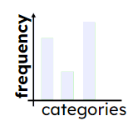
Jaantuska tiirarka (bar chart) waa jaantus ka kooban tiirar oo si muuqaal ah u muujinaya inta jeer ee walxaha ama kooxaha.
Xawaaruhu (Speed) waa heerka uu wax ku socdo. Waxaa lagu qiyaasaa masaafada la socdo qayb wakhti ah.

Slide 6

Samaynta safar
Xisaabinta wakhtiga safarka gaadiidka kala duwan
Xisaabinta bixinta (emission) kaarboon ee safarrada
Xisaabinta kharashka safarka

Slide 7
Xisaabinta wakhtiga safarka gaadiidka kala duwan
Jadwalku wuxuu muujinayaa xogta tirakoobka ee Xafiiska Tirakoobka Qaranka (ONS) ee ku saabsan masaafada ay dadku ku socdaan 2021.
masaafada (d km) | Inta jeer (Frequency)
d < 2 | 3,057,913
2 ≤ d < 5 | 3,499,333
5 ≤ d < 10 | 3,273,927
10 ≤ d < 20 | 2,924,547
20 ≤ d < 30 | 1,127,371
30 ≤ d < 40 | 470,353
40 ≤ d < 60 | 358,932
60 ≤ d | 382,608
Waxaa laga yaabaa inay fududaato in xogtan la fahmo haddii loo muujiyo si muuqaal ah.

Slide 8
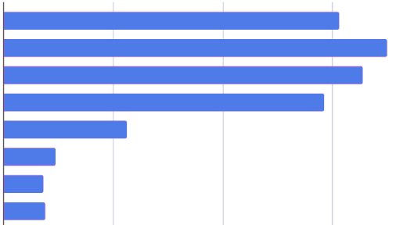
Xisaabinta wakhtiga safarka gaadiidka kala duwan
Jaantuska tiirarka (bar chart) wuxuu muujinayaa isla xogta ku saabsan masaafada ay dadku ku socdaan 2021.
ka yar 2 km
2 km ilaa ka yar 5 km
5 km ilaa ka yar 10 km
10 km ilaa ka yar 20 km
20 km ilaa 30 km ka yar
30 km ilaa 40 km ka yar
40 km ilaa 60 km ka yar
60 km iyo wixii ka badan
1
2
3
tirada dadka (milyan)

Slide 9
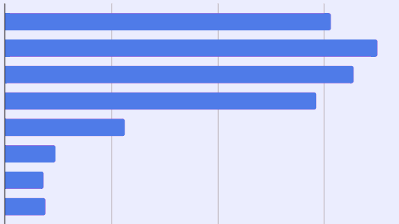
Xisaabinta wakhtiga safarka ee gaadiidka kala duwan
2 km ilaa 5 km ka yar
Waa kuma kooxda mood (modal group)?
2 km ka yar
2 km ilaa 5 km ka yar
5 km ilaa 10 km ka yar
10 km ilaa 20 km ka yar
20 km ilaa 30 km ka yar
30 km ilaa 40 km ka yar
40 km ilaa 60 km ka yar
60 km iyo wixii ka badan
1
2
3
tirada dadka (milyan)

Slide 10
Xisaabinta wakhtiga safarka ee gaadiidka kala duwan
Qiyaas ahaan imisa qof ayaa u safra inta u dhaxaysa 10 km iyo 20 km (ilaa 1 lambar muhiim ah)?
2 km ka yar
2 km ilaa 5 km ka yar
5 km ilaa 10 km ka yar
10 km ilaa in ka yar 20 km
Qiyaastii 3 milyan
20 km ilaa in ka yar 30 km
30 km ilaa in ka yar 40 km
40 km ilaa in ka yar 60 km
60 km iyo wixii ka badan
1
2
3
tirada dadka (milyan)

Slide 11
Xisaabinta waqtiyada safarka ee gaadiidka kala duwan
Run ama been? In ka badan 9 milyan oo dad ah ayaa ku safra in ka yar 10 km si ay u shaqeeyaan. Sharax jawaabtaada.
in ka yar 2 km
in ka badan 3 milyan
2 km ilaa in ka yar 5 km
in ka badan 3 milyan
5 km ilaa in ka yar 10 km
in ka badan 3 milyan
10 km ilaa in ka yar 20 km
20 km ilaa in ka yar 30 km
Run
Koox kasta oo ka hooseeya 10 km waxay leedahay soo noqnoqon (frequency) ka badan 3 milyan.
30 km ilaa in ka yar 40 km
40 km ilaa in ka yar 60 km
60 km iyo wixii ka badan
1
2
3
tirada dadka (milyan)

Slide 12
Xisaabinta wakhtiyada safarka ee gaadiidka kala duwan
Jadwalku wuxuu muujinayaa xawaaraha celceliska (average speeds) ee saddex hababka gaadiidka, marka la safarayo meelaha magaalooyinka ah.
Qof wuxuu ku nool yahay 1.5 km meesha shaqadiisa.
Xisaabi wakhtiga safarka (journey time) ee la filanayo hab kasta oo gaadiid ah.
habka gaadiidka (method of transport) | xawaaraha celceliska (km/h) (average speed)
socod (walk) | 5
baaskiil (cycle) | 20
baabuur (drive) | 35
masaafada (distance)
xawaaraha (speed) =
wakhtiga (time)

Slide 13
Xisaabinta wakhtiyada safarka ee gaadiidka kala duwan
Jadwalku wuxuu muujinayaa xawaaraha celceliska (average speeds) ee saddex hababka gaadiidka, marka la safarayo meelaha magaalooyinka ah.
Qof wuxuu ku nool yahay 1.5 km meesha shaqadiisa.
Xisaabi wakhtiga safarka (journey time) ee la filanayo hab kasta oo gaadiid ah.
habka gaadiidka (method of transport) | xawaaraha celceliska (km/h) (average speed)
socod (walk) | 5
baaskiil (cycle) | 20
baabuur (drive) | 35
fogaansho (distance)
waqti =
xawaare (speed)
socod:
1.5 ÷ 5 = 0.3 saacadood
0.3 × 60 = 18 daqiiqo

Slide 14
Xisaabinta waqtiyada safarka ee gaadiid kala duwan
Jadwalku wuxuu muujinayaa xawaaraha celceliska ah ee saddex hab oo gaadiid, marka lagu safrayo meelaha magaalooyinka.
Qof wuxuu ku nool yahay 1.5 km meesha uu ka shaqeeyo.
Xisaabi waqtiga safarka ee hab kasta oo gaadiid.
habka gaadiidka | xawaaraha celceliska (km/h)
socod | 5
baaskiil | 20
wadista | 35
fogaansho (distance)
waqti =
xawaare (speed)
baaskiil:
1.5 ÷ 20 = 0.075 saacadood
0.075 × 60 = 4.5 daqiiqo

Slide 15
Xisaabinta wakhtiga safarka ee gaadiidka kala duwan
Jadwalku wuxuu muujinayaa xawaaraha celceliska ah ee saddex hab oo gaadiid, marka lagu safrayo meelaha magaalooyinka.
Qofku wuxuu ku nool yahay 1.5 km meesha shaqadiisa.
Xisaabi wakhtiga safarka ee la filayo qaab kasta oo gaadiid ah.
qaabka gaadiidka (method of transport) | xawaaraha celceliska (km/h) (average speed)
socod (walk) | 5
baaskiil (cycle) | 20
baabuur (drive) | 35
masaafo (distance)
wakhti (time) =
xawaare (speed)
baabuur (drive):
1.5 ÷ 35 = 0.042… saacadood (hours)
0.042… × 60 = 3 daqiiqo (minutes) (tirada ugu dhow)

Slide 16
Xisaabinta wakhtiga safarka ee gaadiidka kala duwan
Qofku wuxuu ku nool yahay 4 km meesha shaqadiisa.
Waa imisa wakhti ay filan karaan inay ku qaataan safarka haddii ay baaskiil u tagaanshaqada? Jawaabta ku bixi saacadood (hours).
qaabka gaadiidka (method of transport) | xawaaraha celceliska (km/h) (average speed)
socod (walk) | 5
baaskiil (cycle) | 20
baabuur (drive) | 35
fogaansho (distance)
waqti =
xawaare (speed)
socod:
4 ÷ 20 = 0.2 saacadood

Slide 17
Xisaabinta waqtiyada safarka ee gaadiidka kala duwan
Qof wuxuu ku nool yahay 4 km meesha uu ka shaqeeyo.
Waxay qaadataa 0.2 saacadood inuu baaskiil ku tago shaqada. Inta daqiiqo ayay tahay?
qaabka gaadiidka | xawaaraha celceliska (km/h)
socod | 5
baaskiil | 20
gaari | 35
0.2 × 60 = 12 daqiiqo

Slide 18
Xisaabinta waqtiyada safarka ee gaadiidka kala duwan
Qof wuxuu ku nool yahay 4 km meesha uu ka shaqeeyo.
Inta waqti ayuu filan karaa inuu ku qaato safarka hadduu gaari ku tago? Jawaabta ugu dhow daqiiqada.
fogaanta (distance)
qaabka gaadiidka | xawaaraha celceliska (km/h)
socod | 5
baaskiil | 20
gaari | 35
wakhtiga =
xawaaraha (speed)
wadista (drive):
4 ÷ 35 = 0.1142… saacadood
0.1142… × 60 = 7 daqiiqo
(daqiiqada ugu dhow)

Slide 19
Xisaabinta wakhtiga safarka ee gaadiidka kala duwan
1) Jadwalku wuxuu muujinayaa fogaanta (distance) saddex safar oo shaqo.
Buuxi meelaha bannaan ee jadwalka adigoo xisaabinaya wakhtiga safarka ee qiyaasta ah iyadoo la adeegsanayo hab kasta oo gaadiidka.
habka gaadiidka | xawaaraha celceliska (km/h) | wakhtiga safarka ee qiyaasta ah (daqiiqada ugu dhow)
 |  | safar 2 km | safar 8 km | safar 16 km
socod (walk) | 5
baaskiil (cycle) | 20
wadista (drive) | 35
Habkee baad u dooran lahayd gaadiidka safar kasta oo dhererkiisu kala duwan yahay?

Slide 20
Xisaabinta wakhtiga safarka ee gaadiidka kala duwan
1) Jadwalku wuxuu muujinayaa masaafooyinka saddex safar oo shaqo.
Buuxi meelaha bannaan ee jadwalka adigoo xisaabinaya waqtiyada safarka ee la qiyaasay iyadoo la adeegsanayo hab kasta oo gaadiid.
habka gaadiidka | celceliska xawaaraha (km/h) | waqtiyada safarka lagu qiyaaso (ilaa daqiiqada ugu dhow)
 |  | safar 2 km | safar 8 km | safar 16 km
socod | 5
baaskiil | 20
baabuur | 35
24
6
3
Jawaabaha:
96
192
48
24
14
27

Slide 21




Xisaabinta waqtiyada safarka ee gaadiidka kala duwan
Habkee gaadiidka ayaad dooran lahayd inaad u isticmaasho dherer kasta oo safar ah?
Jawaabuhu way kala duwanaan karaan iyadoo ku xiran doorashada shakhsiga.
habka gaadiidka | celceliska xawaaraha (km/h) | waqtiyada safarka lagu qiyaaso (ilaa daqiiqada ugu dhow)
 |  | safar 2 km | safar 8 km | safar 16 km
socod | 5
baaskiil | 20
baabuur | 35
192
24
96
48
6
24
27
3
14
Waxaan doorbidi lahaa inaan had iyo jeer isticmaalo habka ugu dhaqsaha badan ee gaadiidka.
Layla

Slide 22



Xisaabinta wakhtiga safarka ee gaadiidka kala duwan
Habkee baad dooran lahayd inaad u isticmaasho safar kasta oo dhererkiisu kala duwan yahay?
Jawaabuhu way kala duwanaan karaan iyadoo ku xiran doorashooyinka shakhsiga ah.
habka gaadiidka (method of transport) | xawaaraha celceliska (km/h) (average speed (km/h)) | wakhtiyada safarka ee qiyaasta (daqiiqada ugu dhow) (estimated journey times (to the nearest minute))
 |  | safarka 2 km (2 km journey) | safarka 8 km (8 km journey) | safarka 16 km (16 km journey)
socod (walk) | 5
baaskiil (cycle) | 20
wadista baabuurka (drive) | 35
24
96
192
6
24
48
3
14
27
Waxaan jeclahay socodka. Laakiin socodka in ka badan saac waxaa laga yaabaa inuu noqdo mid aan ku habboonayn safarka shaqada. Sidaa darteed, waxaan baaskiil ku qaadi lahaa safarro dhaadheer.
Yacquub

Slide 23

Xisaabinta wakhtiga safarka ee gaadiidka kala duwan
Habka gaadiidka ee aad dooran lahayd mid kasta oo ka mid ah dhererka safarka?
Jawaabuhu way kala duwanaan karaan iyadoo ku xiran doorashada shakhsiga.
habka gaadiidka (method of transport) | xawaaraha celceliska (km/h) (average speed (km/h)) | wakhtiyada safarka ee qiyaasta (daqiiqada ugu dhow) (estimated journey times (to the nearest minute))
 |  | safarka 2 km (2 km journey) | safarka 8 km (8 km journey) | Safarka 16 km
socod | 5
baaskiil | 20
wadid | 35
24
96
192
6
24
48
3
14
27
Waxaan jeclaan lahaa in aan waqti yar ku qaato safarka, laakiin aan dheerayn. Waqtiga ugu habboon ee aniga waa inta u dhaxaysa 15 iyo 30 daqiiqo.
Caasha

Slide 24
Samaynta safar
Xisaabinta waqtiyada safarka ee gaadiidka kala duwan
Xisaabinta bixinta (emission) kaarboon ee safarrada
Xisaabinta kharashka safarka

Slide 25
Xisaabinta bixinta (emission) kaarboon ee safarrada
Marka gaadiidka shidaalka ama naaftada ay safar sameeyaan, waxay isticmaalaan shidaal.
Waa maxay arrimaha saameyn kara xadiga shidaalka la isticmaalo inta lagu jiro safarka?
Tusaalooyinka waxaa ka mid noqon kara:
dhererka safarka;
haddii lagu wado magaalada ama waddo weyn;
cabirka gaadiidka;
cabirka matoorka;
nooca shidaalka.

Slide 26
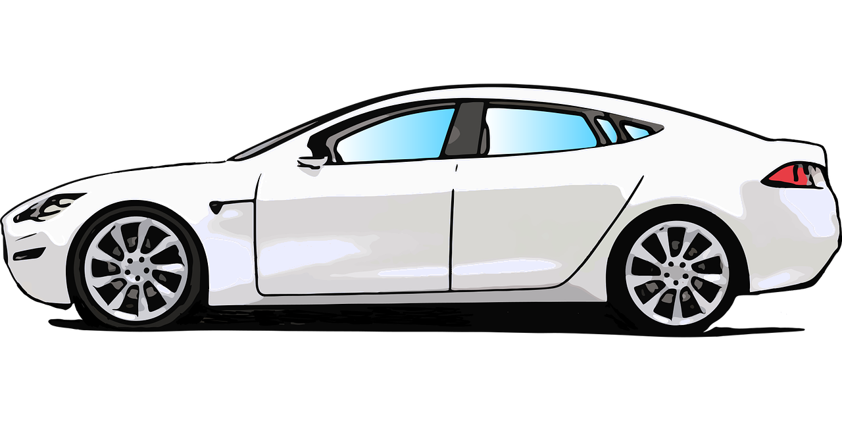
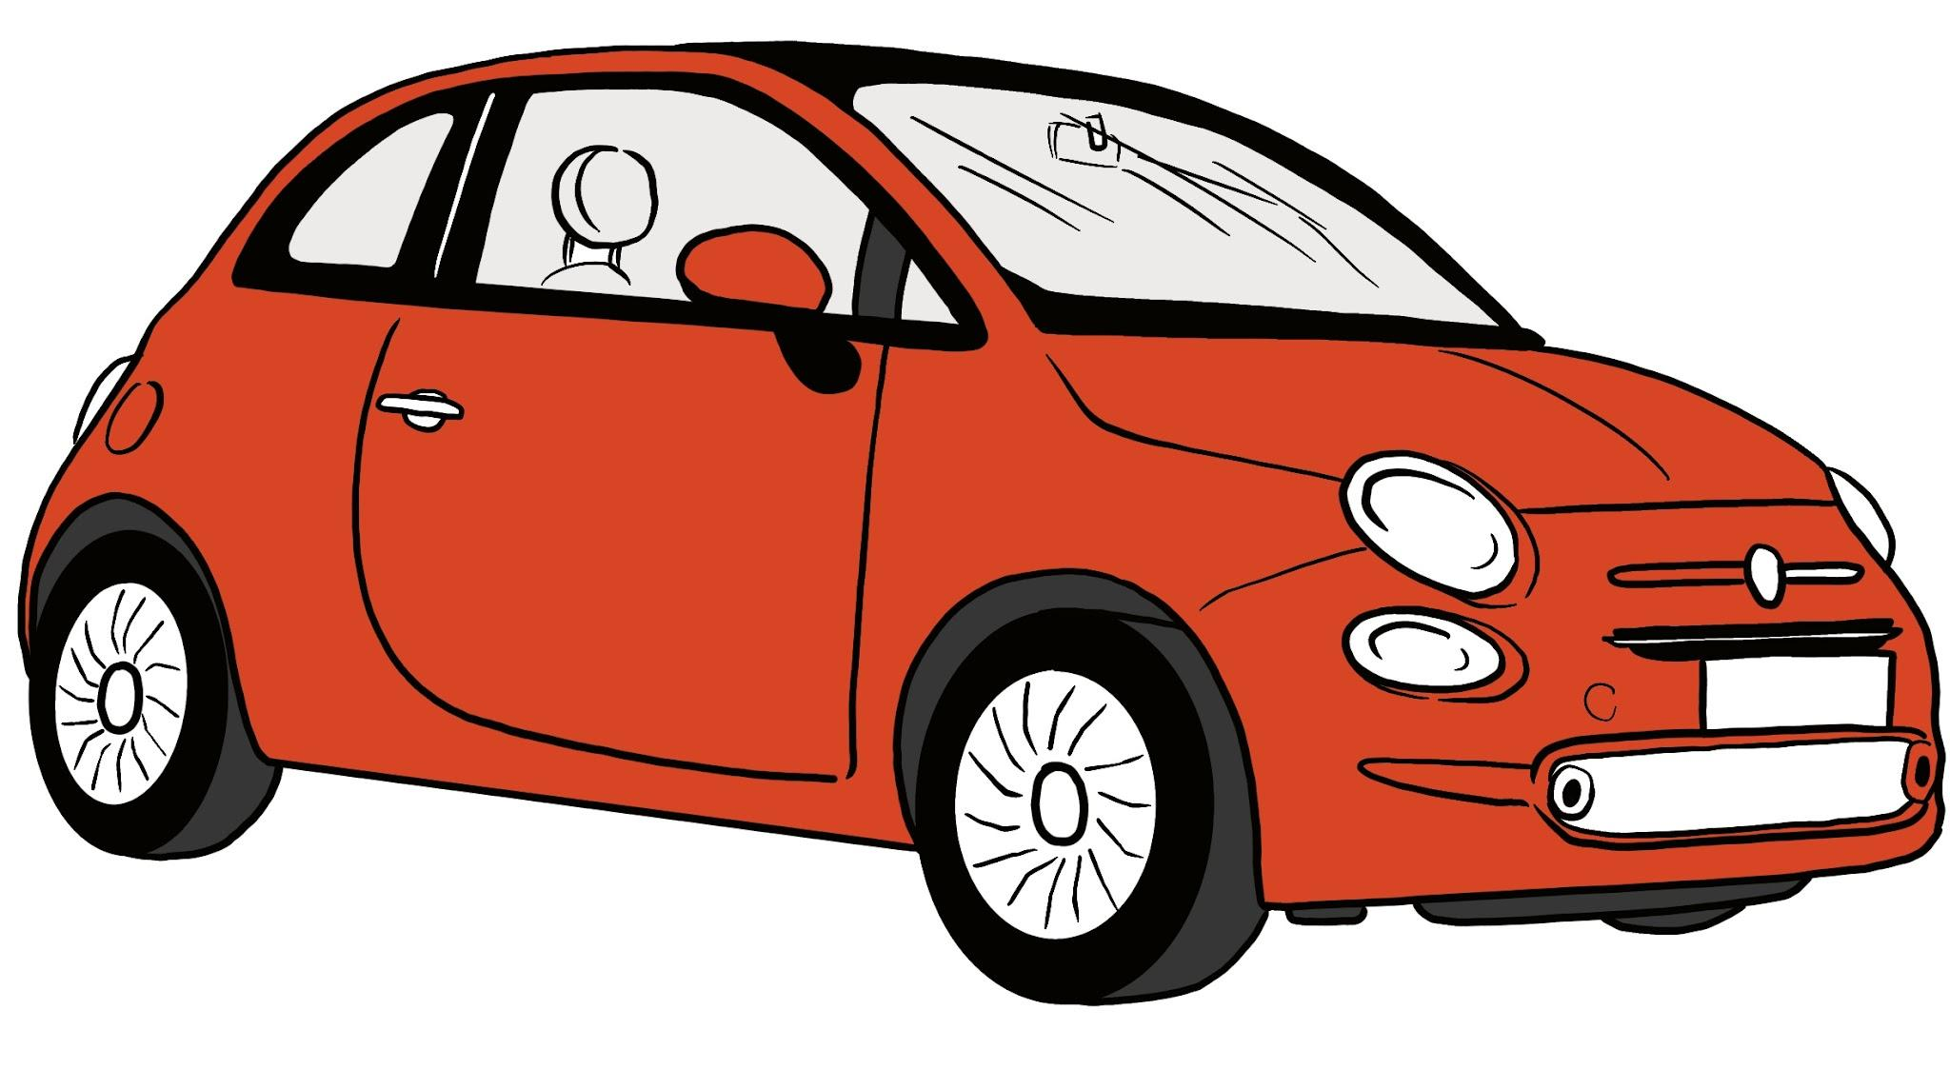
Xisaabinta bixinta (emission) kaarboon ee safarrada (journeys)
Qaar ka mid ah gaadiidka waxay u isticmaalaan shidaalka si hufan marka loo eego kuwa kale.
Hufnaanta shidaalka (fuel efficiency) baabuurka waxaa badanaa lagu muujiyaa (expressed) miles per gallon (mpg). Tani waa celceliska (average) tirada miles ee uu baabuurku safro (travels) isagoo isticmaalaya 1 gallon shidaal. Ingiriiska, gallon-ku waxaa loola jeedaa imperial gallon (taas oo kala duwan US gallon).
E.g.
Baabuur yar (small car) waxa uu celcelis ahaan u safri karaa 50 mpg.
Baabuur weyn (larger car) waxa uu celcelis ahaan u safri karaa 35 mpg.

Slide 27
Xisaabinta bixinta (emission) kaarboon ee safarrada (journeys)
Shidaalka la isticmaalay inta lagu jiro safarka (journey) wuxuu soo saaraa (produces) bixin (emission) CO2.
Waxaan qiyaasi karnaa (estimate) xaddiga bixinta (emission) CO2 halkii mile anagoo adeegsanayna qaaciddadan (formula) soo socota:
CO2 halkii gallon shidaal (grams)
bixinta (emission) halkii mile (grams) =
hufnaanta shidaalka (fuel efficiency) baabuurka (mpg)

Slide 28
Xisaabinta bixinta (emission) kaarboon ee safarrada (journeys)
Celceliska bixinta (emission) CO2 ee baabuurta shidaalka (petrol) waa 9 kg halkii gallon.
Celceliska hufnaanta shidaalka (fuel efficiency) ee baabuurka yari waa 50 mpg.
Imisa bixin (emission) CO2 ayuu soo saaraa halkii mile?
9 kg = 9000 g
CO2 halkii gallon shidaal (grams)
bixinta (emission) halkii mile (grams) =
hufnaanta shidaalka (fuel efficiency) baabuurka (mpg)
9000
=
50
= 180
Baabuurku wuxuu soo saaraa 180 grams oo ah bixin (emission) CO2 halkii mile.

Slide 29
Xisaabinta bixin (emission) kaarboon ee safarrada
Baabuurka qofka wuxuu soo saaraa 180 grams oo ah bixin (emission) CO2 halkii mile.
Waxay ku nool yihiin 9 miles meeshii ay ka shaqeeyaan.
Imisa bixin (emission) ayuu baaburku soo saaraa inta lagu jiro safarka (journey) shaqada?
× 9
fogaanta (mayl) | 1 | 9
bixin (emission) CO2 (garaam) | 180
× 180
× 180
1620
× 9
9 × 180 = 1620 garaam
Safar kastaa wuxuu soo saaraa 1.62 kg oo ah bixin (emission) CO2.

Slide 30
Xisaabinta bixin (emission) kaarboon ee safarrada
Qofku wuxuu sameeyaa 2 safar oo gaari ah maalintii: shaqada tagista; shaqada ka soo noqoshada.
Safar kastaa wuxuu soo saaraa 1.62 kg oo ah bixin (emission) CO2.
Waxay ka shaqeeyaan 225 maalmood sannadkii.
Intee in le'eg ayay gaarigu soo saaraa bixin (emission) CO2 sannadkii, isagoo u socda shaqada iyo ka soo noqoshada?
1.62 × 2 × 225 = 729 kg
Gaarigu wuxuu soo saaraa qiyaastii 729 kg oo ah bixin (emission) CO2 sannadkii inta uu shaqada ku socdo.

Slide 31
Xisaabinta bixin (emission) kaarboon ee safarrada
Celceliska bixin (emission) CO2 ee gaariga shidaalka (petrol) waa 9 kg galaan kii.
Celceliska waxtarka shidaalka ee gaariga weyn waa 35 mpg.
Intee in le'eg ayuu bixin (emission) CO2 soo saaraa mayl kii? Jawaabta sii sax ah ilaa 3 tirooyin muhiim ah.
CO2 galaan kii oo shidaal (garaam)
bixin (emission) mayl kii (garaam) =
waxtarka shidaalka ee gaariga (mpg)
9000 ÷ 35 = 257.142…
Gaarigu wuxuu soo saaraa 257 garaam oo ah bixin (emission) CO2 mayl kii.

Slide 32
Xisaabinta bixinta (emission) kaarboon ee safarrada
Gaariga qofku wuxuu soo saaraa 257 garaam oo ah bixin (emission) CO2 mayl kii.
Waxay ku nool yihiin 13 mayl oo ay u jiraan goobta shaqada.
Intee in le'eg oo bixin (emission) ah ayuu baabuurku soo saaraa safar keliya oo shaqo (hal dariiq)? Jawaabta ku bixi kiilogaraam.
13 × 257 = 3341 garaam
Safar kastaa wuxuu soo saaraa 3.341 kg oo bixin (emission) CO2 ah.

Slide 33
Xisaabinta bixinta (emission) kaarboon ee safarrada
Qofku wuxuu sameeyaa 2 safar oo baabuur ah maalintii: shaqo tagid; shaqo ka soo noqosho.
Safar kastaa wuxuu soo saaraa 3.341 kg oo bixin (emission) CO2 ah.
Waxay shaqeeyaan 192 maalmood sannadkii.
Intee in le'eg oo bixin (emission) CO2 ah ayuu baabuurku soo saaraa sannad dhan isagoo shaqo u socda oo ka soo noqonaya?
3.341 × 2 × 192 = 1282.944 kg
Baabuurku wuxuu soo saaraa qiyaastii 1280 kg oo bixin (emission) CO2 ah sannadkii marka la safarayo.

Slide 34
Xisaabinta bixinta (emission) kaarboon ee safarrada
1) Qadarka bixinta (emission) CO2 ee mayl kasta waxaa lagu qiyaasi karaa iyadoo la isticmaalayo qaacidada:
CO2 gallonkii shidaalka (garaam)
bixinta (emission) maylkii (garaam) =
waxtarka shidaalka baabuurka (mpg)
Qofku wuxuu ku nool yahay 6 mayl meesha shaqadiisa wuxuuna ku safraa baabuur. Bixinta (emission) CO2 celceliska ah ee baabuur shidaal (petrol) waa 9 kg gallonkii. Celcelis ahaan, baabuurkiisu wuxuu safraa 45 mayl gallonkii. Waxay shaqeeyaan 223 maalmood sannadkii.
Xisaabi qadarka bixinta (emission) CO2 ee sannadkii laga soo saaro safarka baabuurka. Jawaabta ku bixi kiilogaraam oo u sax 3 tirooyin muhiim ah (significant figures).

Slide 35
Xisaabinta bixinta (emission) kaarboon ee safarrada
2) Qadarka bixinta (emission) CO2 ee mayl kasta waxaa lagu qiyaasi karaa iyadoo la isticmaalayo qaacidada:
CO2 halkii gallon oo shidaal ah (grams)
bixin (emission) halkii mayl (grams) =
waxtarka shidaalka ee gaariga (mpg)
40 qof ayaa ku nool 6 mayl meesha shaqadooda waxayna ku safraan isla baska. Bixinta (emission) CO2 celceliska ah ee bas naafto (diesel) waa 10 kg gallonkii. Celcelis ahaan, basku wuxuu safraa 8 mayl gallonkii. Waxay shaqeeyaan 223 maalmood sannadkii.
Xisaabi qadarka bixinta (emission) CO2 ee rakaabkiiba sannadkii laga soo saaro safarka baska. Jawaabta ku bixi kiilogaraam oo u sax 3 tirooyin muhiim ah (significant figures).

Slide 36
Xisaabinta bixinta (emission) kaarboon ee safarrada
1) Qadarka bixinta (emission) CO2 halkii mayl waxaa lagu qiyaasi karaa iyadoo la isticmaalo qaacidada:
CO2 halkii gallon oo shidaal ah (grams)
bixin (emission) halkii mayl (grams) =
waxtarka shidaalka ee gaariga (mpg)
Qof wuxuu ku nool yahay 6 mayl oo u jira goobtiisa shaqada wuxuuna ku safraa gaari. Celceliska bixinta (emission) CO2 ee gaariga shidaalka (petrol) waa 9 kg halkii gallon. Celcelis ahaan, gaarigiisu wuxuu socdaa 45 mayl halkii gallon. Wuxuu shaqeeyaa 223 maalmood sannadkii.
Xisaabi qadarka bixinta (emission) CO2 ee la soo saaro sannadkii ee ka imanaya safarka shaqada. Si jawaabtaada ugu bixi kiilogaraam waxaana ku qaab 3 tirooyin muhiim ah.

Slide 37
Xisaabinta bixinta (emission) kaarboon ee safarrada
Qof wuxuu ku nool yahay 6 mayl oo u jira goobtiisa shaqada wuxuuna ku safraa gaari. Celceliska bixinta (emission) CO2 ee gaariga shidaalka (petrol) waa 9 kg halkii gallon. Celcelis ahaan, gaarigiisu wuxuu socdaa 45 mayl halkii gallon. Wuxuu shaqeeyaa 223 maalmood sannadkii.
Habka 1:
Bixinta (emission) halkii mayl:
Bixinta (emission) halkii safar:
Bixinta (emission) halkii maalin:
Bixinta (emission) halkii sannad:
9000 ÷ 45 = 200 grams oo CO2 ah halkii mayl
200 × 6 = 1200 grams oo CO2 ah halkii safar (1.2 kg)
1.2 × 2 = 2.4 kg oo CO2 ah maalintii
2.4 × 223 = 535.2 kg oo CO2 ah sannadkii
= 535 kg oo CO2 ah sannadkii (ilaa 3 s.f.)

Slide 38
Xisaabinta bixin (emission)-ka kaarboon ee safarrada
Qof ayaa 6 mayl u jira meesha shaqadiisa wuxuuna ku safraa baabuur. Bixin (Emission)-ka CO2 celceliska ah ee baabuurta shidaalka waa 9 kg galaan kasta. Baabuurkiisu celcelis ahaan wuxuu ku socdaa 45 mayl galaan kasta. Waxay shaqeeyaan 223 maalin sannadkii.
Habka 2-aad:
Mayl maalintii:
Mayl sannadkii:
Bixin (Emission) maylkii:
Bixin (Emission) sannadkii:
6 × 2 = 12 mayl maalintii
12 × 223 = 2676 mayl sannadkii
9000 ÷ 45 = 200 garaam oo CO2 ah maylkii
2676 × 200 = 535 200 garaam oo CO2 ah sannadkii
= 535 kg oo CO2 ah sannadkii (ilaa 3 s.f.)

Slide 39
Xisaabinta bixin (emission)-ka kaarboon ee safarrada
2) Qadarta bixin (emission)-ka CO2 maylkii waxaa lagu qiyaasi karaa iyadoo la isticmaalayo qaacidada (formula):
CO2 galaan shidaalka (garaam)
bixin (emission) maylkii (garaam) =
waxtarka shidaalka gaariga (mpg)
40 qof ayaa 6 mayl u jira meesha shaqadooda waxayna ku safraan isla bas. Bixin (Emission)-ka CO2 celceliska ah ee baska naaftada (diesel) waa 10 kg galaan kasta. Basku celcelis ahaan wuxuu ku socdaa 8 mayl galaan kasta. Waxay shaqeeyaan 223 maalin sannadkii.
Xisaabi qadarta bixin (emission)-ka CO2 ee soo saaray rakaabkiiba sannadkii iyadoo la safraayo bas. Jawaabta ku bixi kiilogaraam oo sax u ah 3 tirooyin muhiim ah (significant figures).

Slide 40
Xisaabinta bixin (emission)-ka kaarboon ee safarrada
40 qof ayaa 6 mayl u jira meesha shaqadooda waxayna ku safraan isla bas. Bixin (Emission)-ka CO2 celceliska ah ee baska naaftada (diesel) waa 10 kg galaan kasta. Basku celcelis ahaan wuxuu ku socdaa 8 mayl galaan kasta. Waxay shaqeeyaan 223 maalin sannadkii.
Bixin (Emission) maylkii:
Bixin (emission) safar kasta:
Bixin (emission) maalin kasta:
Bixin (emission) sannad kasta:
Bixinta (emission) sannadlaha ah qofkiiba:
10 000 ÷ 8 = 1250 garaam oo CO2 ah maylkiiba (1.25 kg)
1.25 × 6 = 7.5 kg oo CO2 ah safarkii
7.5 × 2 = 15 kg oo CO2 ah maalintii
15 × 223 = 3345 kg oo CO2 ah sannadkii
3345 ÷ 40 = 83.6 kg oo CO2 ah qofkiiba (ilaa 3 s.f.)
Habab kale ayaa sidoo kale loo isticmaali karaa si loo helo jawaab la mid ah.

Slide 41
Samaynta safar
Xisaabinta waqtiyada safarka ee gaadiidka kala duwan
Xisaabinta bixinta (emission) kaarboon ee safarrada
Xisaabinta qiimaha safarka

Slide 42
Xisaabinta qiimaha safarka
Dhaqaalaha shidaalka ee gaariga waxaa badanaa lagu muujiyaa mayl galaan kasta (mpg). Tani waa celceliska tirada maylalka uu gaarigu ku safri karo isagoo isticmaalaya 1 galaan oo shidaal ah.
Ingiriiska, batroolka iyo naaftada waxaa lagu iibiyaa litir.
Waxaan isticmaali karnaa xaqiiqda ah in 1 galaan uu qiyaas ahaan yahay 4.546 litir si loo beddelo unugyada.
1 galaan ≈ 4.546 litir
× 4.546
galaanada litirrada
÷ 4.546
galaanada litirrada

Slide 43
Xisaabinta kharashka safarka
Qof ayaa u kaxaysta 9 mayl shaqada. Celceliska hufnaanta shidaalka gaarigiisu waa 50 mpg. Batroolku wuxuu ku kacayaa 142.9 p litirkiiba. 1 galaan ≈ 4.546 litir.
Waa maxay kharashka shidaalka (petrol) ee safarka?
Qorshe:
1. Xisaabi xaddiga shidaalka (petrol) ee la isticmaalay oo ku jira galaan (gallons).
2. U beddel xaddiga shidaalka (petrol) litir (litres).
3. Xisaabi kharashka shidaalka (petrol).

Slide 44
Xisaabinta kharashka safarka
Qof ayaa wataa 9 mayl (miles) shaqada. Celceliska hufnaanta shidaalka (fuel efficiency) gaarigu waa 50 mpg. Shidaalku (petrol) wuxuu ku kacayaa 142.9 p litirkii. 1 gallon ≈ 4.546 litres.
Waa maxay kharashka shidaalka (petrol) ee safarka?
1. Xisaabi xaddiga shidaalka (petrol) ee la isticmaalay oo ku jira galaan (gallons).
mayl (miles) | 50 | 9
galaan (gallons) | 1
÷ 50
÷ 50
0.18
Safar kasta wuxuu isticmaalaa 0.18 gallon oo shidaal (petrol) ah.

Slide 45
Xisaabinta kharashka safarka
Qof ayaa wataa 9 mayl (miles) shaqada. Celceliska hufnaanta shidaalka (fuel efficiency) gaarigu waa 50 mpg. Shidaalku (petrol) wuxuu ku kacayaa 142.9 p litirkii. 1 gallon ≈ 4.546 litres.
Waa maxay kharashka shidaalka (petrol) ee safarka?
2. U beddel xaddiga shidaalka (petrol) litir (litres).
Safar kasta wuxuu isticmaalaa 0.18 gallon oo shidaal (petrol) ah.
0.18 × 4.546 = 0.81828
Safar kasta wuxuu isticmaalaa 0.81828 L oo shidaal (petrol) ah.

Slide 46
Xisaabinta kharashka safarka
Qof ayaa wataa 9 mayl (miles) shaqada. Celceliska hufnaanta shidaalka (fuel efficiency) gaarigu waa 50 mpg. Shidaalku (petrol) wuxuu ku kacayaa 142.9 p litirkii. 1 gallon ≈ 4.546 litres.
Waa maxay kharashka shidaalka (petrol) ee safarka?
3. Xisaabi qiimaha shidaalka (petrol).
Safarkasta wuxuu isticmaalaa 0.81828 L oo shidaal (petrol) ah.
0.81828 × 142.9 = 116.932212 p
Qiimaha shidaalka (petrol) safar kasta waa qiyaastii £1.17

Slide 47
Xisaabinta qiimaha safarka
Safarka baabuurka ee qofka shaqada wuxuu ku kacayaa £1.17 shidaal (petrol).
Waxay sameeyaan safarka laba jeer maalintii 225 maalmood sannadkii.
Waa maxay qiimaha sannadlaha ah ee shidaalka (petrol) ee shaqada tagista?
1.17 × 2 × 225 = 526.5
Shaqada tagista baabuurka waxay ku kacaysaa qiyaastii £526.50 sannadkii shidaal (petrol).

Slide 48
Xisaabinta qiimaha safarka
Qofku wuxuu ku bixiyaa £526.50 sannadkii shidaal (petrol) si uu u tago shaqada.
Waxa kale oo uu bixiyaa £80 bishiiba caymiska baabuurka (car insurance).
Qiimaha dayactirka sannadlaha ah ee baabuurka waa £650.
U qaad in uu leeyahay baabuurkiisa si uu u kaxaysto shaqada. Immisa ayuu ku bixiyaa wadarta baabuurkiisa sannadkii?
526.5 + 12 × 80 + 650 = 2136.5
Qofku wuxuu ku bixiyaa qiyaastii £2136.50 baabuurkiisa sannadkii si uu u tago shaqada.

Slide 49

Xisaabinta qiimaha safarka
Qofku wuxuu kaxeeyaa 12 mayl (miles) shaqada. Waxay u safraan shaqada iyo guriga 225 maalmood sannadkii. Celceliska hufnaanta shidaalka (fuel efficiency) baabuurkiisu waa 40 mpg. Shidaalku (petrol) wuxuu ku kacayaa 138.9 p litirkiiba. 1 gallon ≈ 4.546 litir.
Isku dheji xisaab kasta waxa ay ka dhigan tahay macnaha guud.
1 ÷ 40 = 0.025
qiimaha safar kasta (£)
a
0.025 × 12 = 0.3
b
qiimaha sannadkii (£)
0.3 × 4.546 = 1.3638
c
gallon oo shidaal (petrol) la isticmaalay safar kasta
1.3638 × 1.389 = 1.894…
d
gallon oo shidaal (petrol) la isticmaalay maylkiiba
1.894… × 2 × 225 = £852.44
e
litir oo shidaal (petrol) la isticmaalay safar kasta

Slide 50
Xisaabinta kharashka safarka
Qof ayaa wata 12 mayl shaqada. Waxay u safraan oo ka soo noqdaan shaqada 225 maalmood oo sanadka ah. Celcelis ahaan shidaalka baabuurka waa 40 mpg. Shidaalku waa 138.9 p litirkiiba. 1 gallon ≈ 4.546 litir.
Isku dhig xisaab kasta waxa ay u taagan tahay macnaha.
12 × 2 × 225 = 5400
a
kharashka shidaalka sanadlaha ah (pence)
1 ÷ 40 = 0.025
b
gallon oo shidaal ah oo la isticmaalay maylkii
0.025 × 5400 = 135
c
gallon oo shidaal ah oo la isticmaalay sanadkii
135 × 4.546 = 613.71
d
litir oo shidaal ah oo la isticmaalay sanadkii
613.71 × 138.9 = 85 244.319
e
mayl la safray sanadkii

Slide 51
Xisaabinta kharashka safarka
1) Qof ayaa ku nool 6 mayl shaqadiisa oo u safra baabuur 225 maalmood sanadkii. Celcelis ahaan baabuurku wuxuu safraa 45 mayl gallonkii. Shidaalka shidaalka ugu dhow waxaa lagu iibiyaa 148.9 p litirkiiba. 1 gallon ≈ 4.546 litir.
a) Immisa ayay ku bixiyaan shidaalka sanadkii safarka shaqada?
b) Caymiska baaburkoodu waa £65 bishii. Dayactirka sanadlaha ahi waa £820. U qaado inay baaburka u isticmaalaan oo kaliya safarka shaqada. Immisa ayay ku bixiyaan wadarta baaburka sanadkii?
c) Waxay ka fikirayaan inay iibiyaan baaburka oo ay safraan bas. Bas bas todobaadle ah oo magaaladooda ah waa £22 todobaadkii. U qaado inay iibsan doonaan bas bas todobaadle ah todobaad kasta oo sanadka ah. Ma kharash badan ama kharash yar bay ku bixi doonaan sanadkii? Sharax jawaabtaada.

Slide 52
Xisaabinta kharashka safarka
1) Qof ayaa ku nool 6 mayl shaqadiisa oo u safra baabuur 225 maalmood sanadkii. Celcelis ahaan baabuurku wuxuu safraa 45 mayl gallonkii. Shidaalka shidaalka ugu dhow waxaa lagu iibiyaa 148.9 p litirkiiba. 1 gallon ≈ 4.546 litir.
a) Immisa ayay ku bixiyaan shidaalka (petrol) sannadkii gaariga (car) markay shaqada u raacaan?
Tusaale xeeladda xallinta:
Mayl sanadkii:
Gallon maylkii:
Gallon sanadkii:
Litir sanadkii:
Kharashka sanadkii:
6 × 2 × 225 = 2700 mayl sanadkii
.
1 ÷ 45 = 0.02 gallon (gallons) halkii mayl (mile)
.
0.02 × 2700 = 60 gallon (gallons) sannadkii
60 × 4.546 = 272.76 litir (litres) sannadkii
272.76 × 1.489 = £406.14 sannadkii

Slide 53
Xisaabinta kharashka safarka (journey)
a) Immisa ayay ku bixiyaan shidaalka (petrol) sannadkii gaariga (car) markay shaqada u raacaan? £406.14
b) Caymiska (insurance) gaarigoodu waa £65 bishii. Dayactirka (maintenance) sannadeedkoodu waa £820. U qaad inay gaariga (car) kaliya u isticmaalaan shaqada. Immisa ayay ku bixiyaan wadarta gaariga (car) sannadkii?
406.14 + 12 × 65 + 820 = £2006.14
c) Waxay tixgelinayaan inay gaariga (car) iibiyaan oo ay bas (bus) ku raacaan shaqada. Bas (bus) todobaadle ayaa ku kacaya £22 todobaadkii. U qaad inay bas (bus) todobaadle kala iibsan doonaan todobaad kasta oo sannadka ah. Ma ku kacayso bas (bus) raaci in ka badan ama ka yar sannadkii? Caddee jawaabtaada.
Kharashka sannadeed ee bas (bus) todobaadle: 22 × 52 = £1144
Waxay ku kacaysaa ka yar sannadkii.

Slide 54
Samaynta safar (journey)
Waxaa jiri kara fursado (options) badan oo loo safro meel.
Qodobo kala duwan ayaa saameeya habka gaadiidka (transport) ee la door bidayo. Tusaale waxaa ka mid ah waqtiga, kharashka iyo saameynta deegaanka (environmental impact).
Xisaabinta (calculations) waxaa loo isticmaali karaa in lagu barbar dhigo hababka gaadiidka (transport) ee kala duwan si loo taageero go'aan qaadashada.
Samaynta safar (journey) isku mid ah marar badan waxay ka dhigan tahay in saameynta safarkaas ay batto.

