Slide 1
Samaynta wareeg taxane ah
Wareegyada taxanaha

Slide 2
sida loo isticmaalo darasyada Oak

Slide 3
Waxaan awoodi karaa inaan isticmaalo jaantuska wareegga si aan u dhiso wareeg taxane ah oo aan sawiro jaantuska wareegga ee wareeg dhammaystiran.

Slide 4
wareeg taxane ah
jaantuska wareegga
calaamadda wareegga
wareeg dhammaystiran

Slide 5
Wareeg taxane ah waa wareeg koronto oo leh hal wareeg oo dhammaystiran oo ka bilaabma dhamaadka batteriga ilaa dhamaadka kale.
Jaantuska wareegga waa qaab fudud oo cad oo muujinaya habaynta qaybaha wareegga korontada.
Calaamadaha wareegga waxaa loo isticmaalaa in lagu muujiyo qaybaha korontada ee wareegga. Way fudud yihiin in la sawiro oo way fudud yihiin in la aqoonsado.
Wareeg dhammaystiran waa mid aan lahayn meel bannaan, sidaas darteed korontadu waxay awood u leedahay inay ku socoto wareegga.

Slide 6

Samaynta wareeg taxane ah
Waa maxay wareeg taxane ah?
Dhismaha wareeg taxane ah
Sawirista wareeg taxane ah

Slide 7
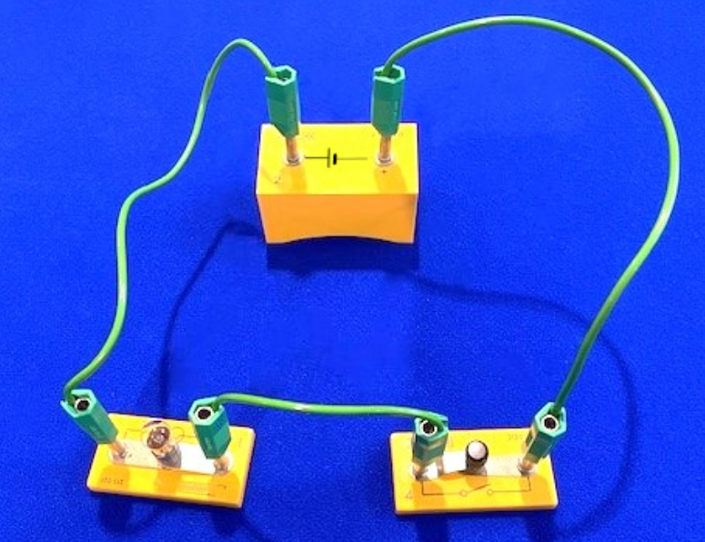
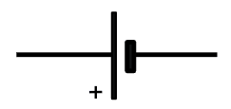

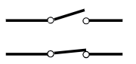
Waa maxay wareeg taxane ah?
Wareeggan taxanaha wuxuu ka kooban yahay saddex qaybood oo koronto iyo xadhko.
unug
xadhko
laambad
fure

Slide 8
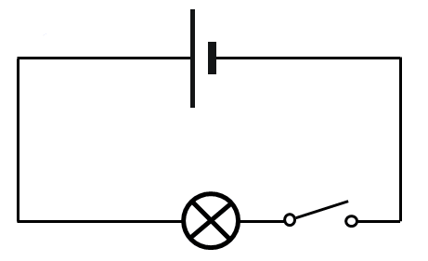
Waa maxay wareeg taxane ah (series circuit)?
Astaamaha wareegga (Circuit symbols) waxaa loo isticmaalaa in lagu sawiro jaantuska wareegga (circuit diagram).
unug (cell)
fiilooyinka (leads)
laambad (lamp)
fure (switch)

Slide 9
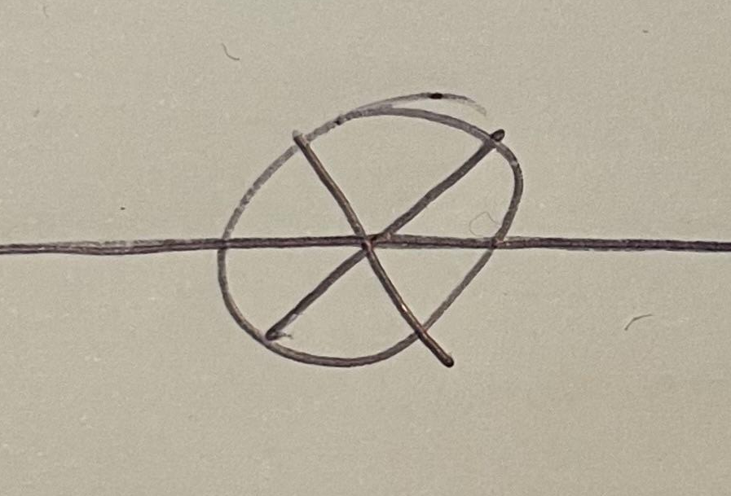
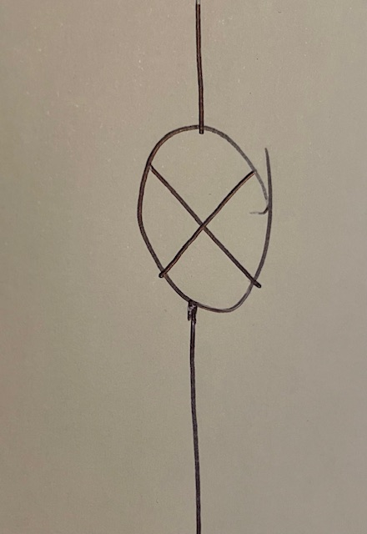
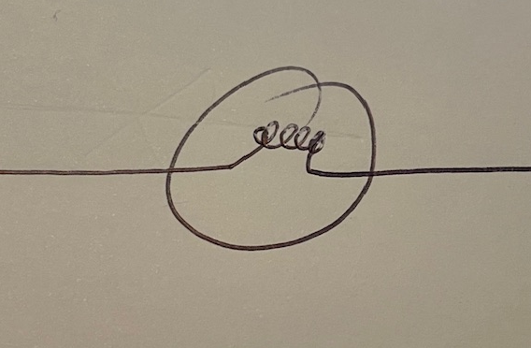

Waa maxay wareeg taxane ah (series circuit)?
Kuwee ka mid ah kuwani waa astaanta saxda ah ee laambadda (lamp)?

Slide 10




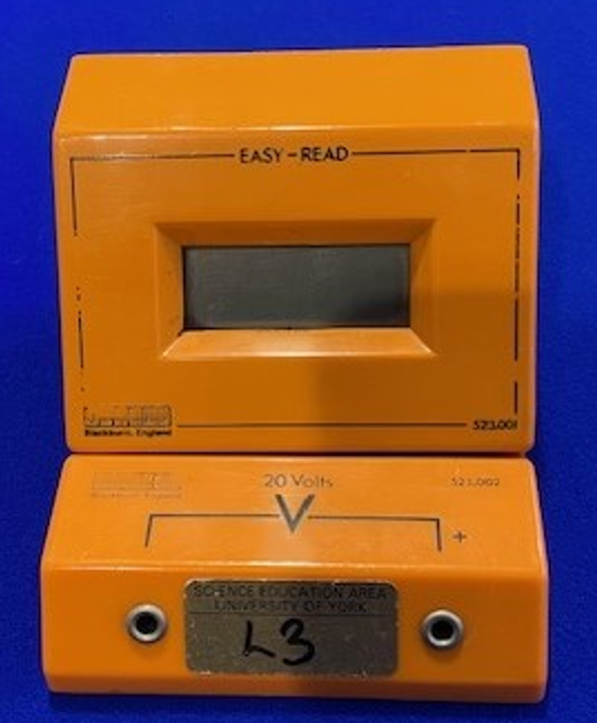
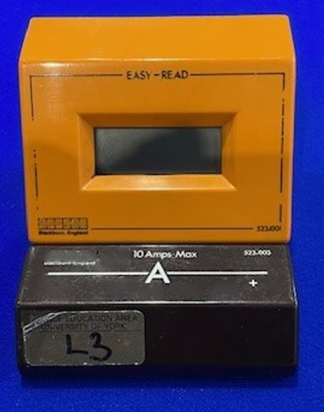
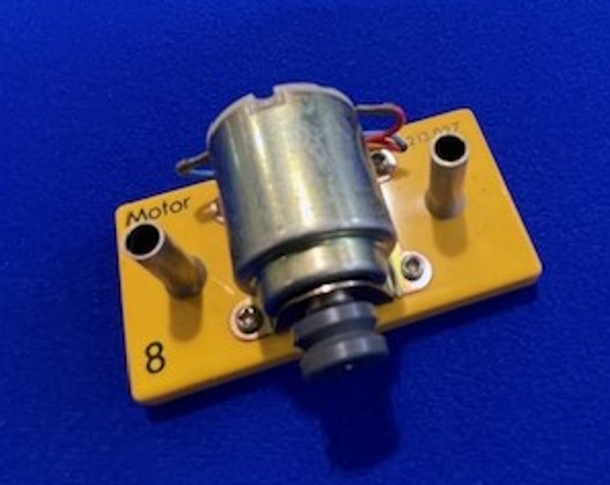
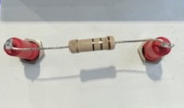
Waa maxay wareeg taxane ah (series circuit)?
Qaybaha kale ee loo isticmaalo wareegyada korantada (electrical circuits):
matoor (motor)
iska-hor-istaag (resistor)
voltmeter (voltmeter)
ammeter (ammeter)

Slide 11
Waa maxay wareeg taxane ah (series circuit)?
Qaybtee ayaa astaanta hoose ku matalan?
matoor (motor)
voltmeter (voltmeter)
multimeter (multimeter)

Slide 12
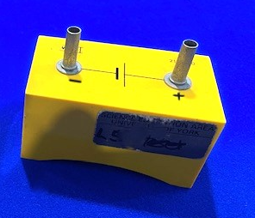
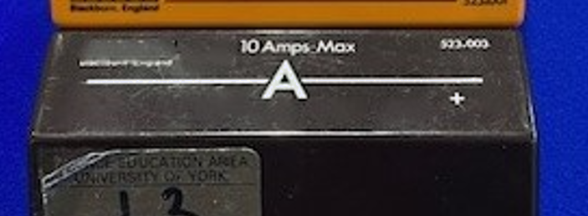
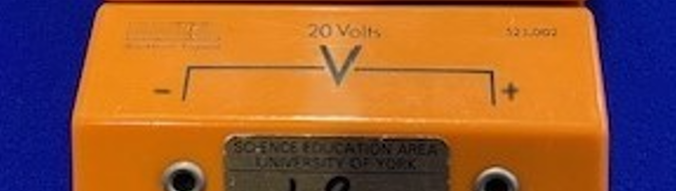
Waa maxay wareeg taxane ah (series circuit)?
Unuggu (cell) wuxuu leeyahay terminal togan (positive) iyo terminal taban (negative).
Ammeter-yada (Ammeters) iyo voltmeter-yada (voltmeters) sidoo kale waxay leeyihiin terminal togan (positive) iyo terminal taban (negative).
Qaybaha waa in lagu xiraa jihada saxda ah ee wareegga (circuit). Waxaad ogaan doontaa sida loo sameeyo wareegyada aad samaysato.

Slide 13
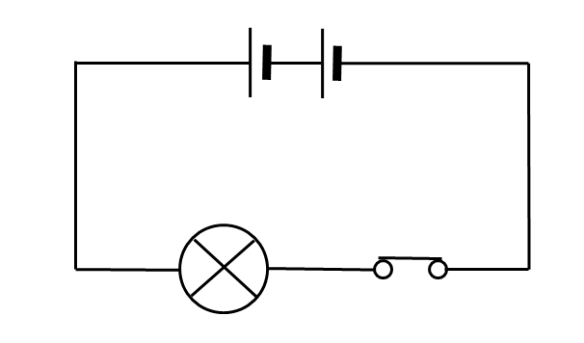
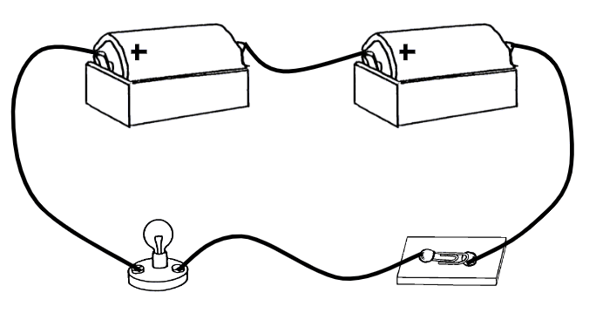
Waa maxay wareeg taxane (series circuit)?
Jaantusyada wareegga (circuit diagrams) waxaa loo isticmaalaa inay bixiyaan matalaad cad oo fudud oo wareeg ah
battery
lamp
switch xiran

Slide 14
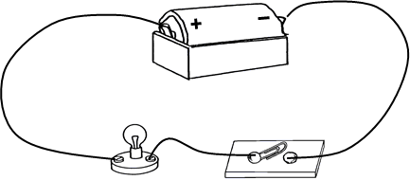
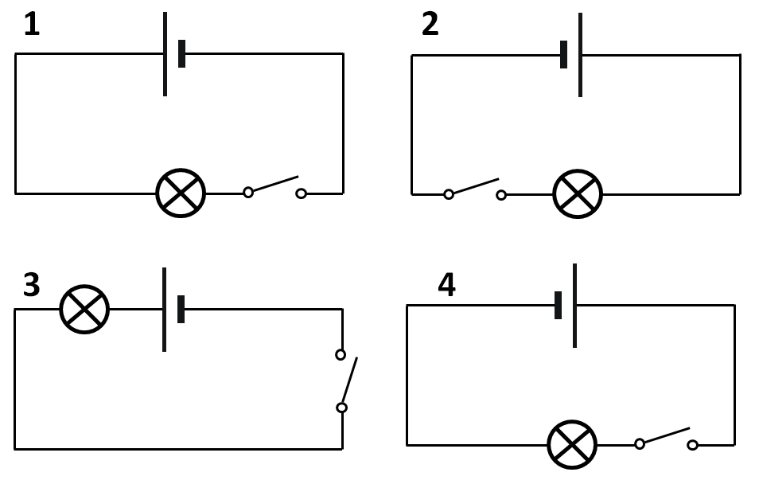
Waa maxay wareeg taxane (series circuit)?
Kee ka mid ah jaantusyada ayaa si sax ah u muujinaya wareegga hoose?
Kaliya jaantuska 1.
Kaliya jaantuska 2.
Jaantuska 1 iyo 3.
Jaantusyada 1, 2 iyo 3.

Slide 15
Waa maxay wareeg taxane (series circuit)?
Kani waa wareeg taxane (series circuit). Waa wareeg dhammaystiran.
Waxaa jira hal loop oo dhammaystiran oo ma jiraan isgoysyo (junctions).
Wareegga taxanaha ah, korontadu waxay martaa dhammaan qaybaha, mid ka mid ah kan kale.

Slide 16
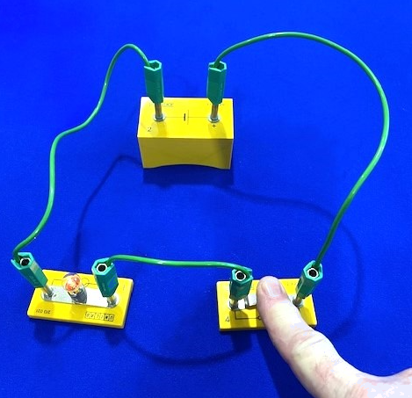
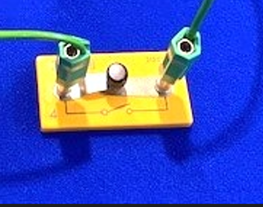
Waa maxay wareeg taxane (series circuit)?
Wareeggu waa inuu dhammaystirnaadaa si koronto u qulqusho.
Haddii uu jiro switch furan, korontadu ma qulquli doonto.
Wareeggan waa in la dhammaystiraa adoo xira switch-ka.

Slide 17
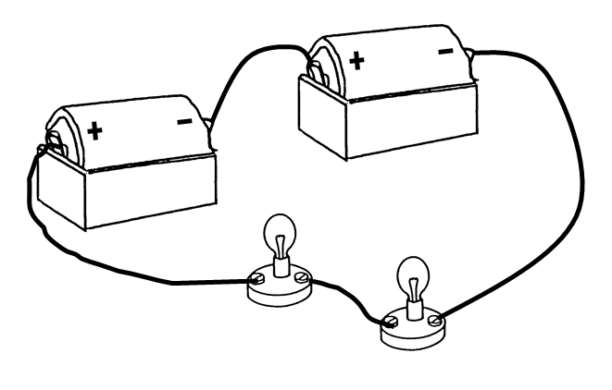
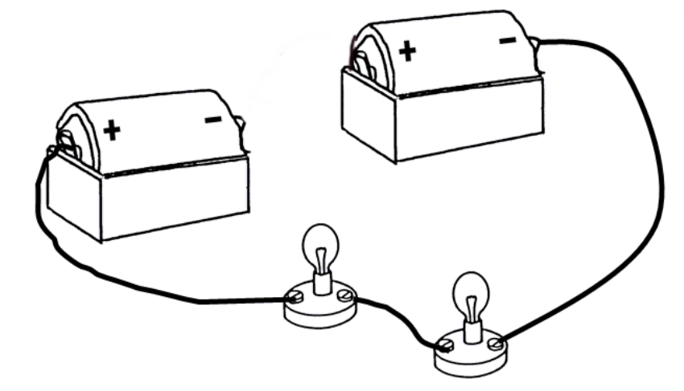
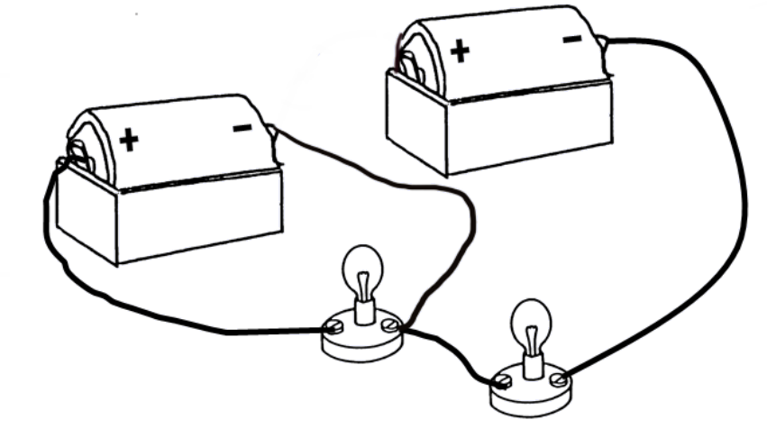
Waa maxay wareeg taxane (series circuit)?
Kee ka mid ah kuwan soo socda ayaa muujinaya wareeg taxane (series circuit) oo dhammaystiran?

Slide 18
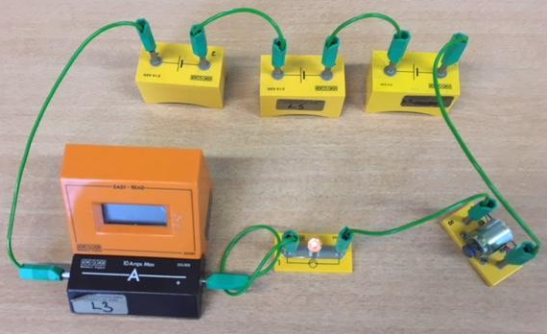
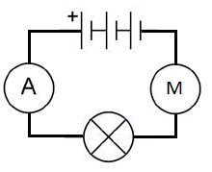
Waa maxay wareeg taxane ah (series circuit)?
1) Liis qaybaha a) ilaa d) ee ku jira wareegga hoose:
2) Jaantuska wareeggu ma sax baa wareegga la muujiyey? Sharax jawaabtaada.
a)
b)
c)
d)

Slide 19
Waa maxay wareeg taxane ah (series circuit)?
1) Liis qaybaha a) ilaa d) ee ku jira wareegga hoose:
battery b) ammeter c) lamp d) motor
2) Jaantuskan wareeggu ma sax baa wareegga la muujiyey? Sharax jawaabtaada.
Jaantuskan wareeggu waa sax. Qaybaha waxay ku xiran yihiin nidaamka saxda ah, mana jiraan farqi (gaps) wareegga dhexdiisa.
FIIRO: ma khaldan haddii qaybaha aysan ku jirin meelaha isku midka ah ee sawirka, illaa iyo inta ay ku jiraan nidaam isku mid ah!

Slide 20
Samaynta wareeg taxane ah (series circuit)
Waa maxay wareeg taxane ah (series circuit)?
Dhisidda wareeg (circuit)
Sawiridda wareeg (circuit)

Slide 21
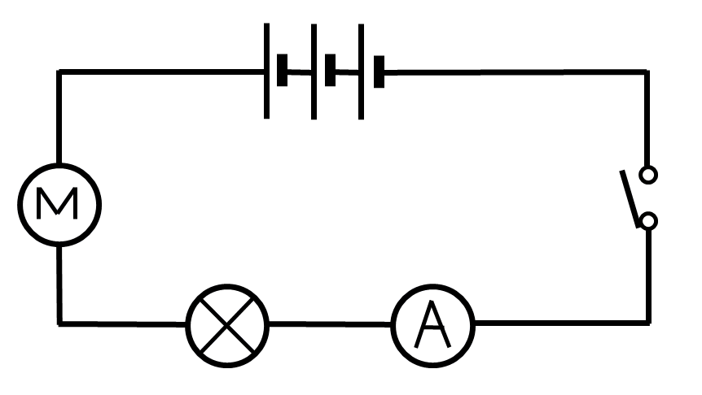
Dhisidda wareeg (circuit)
Si aad u dhisto wareeggan waxaad u baahan tahay:
3 cells
1 switch
1 ammeter
1 lamp
1 motor
5 leads

Slide 22
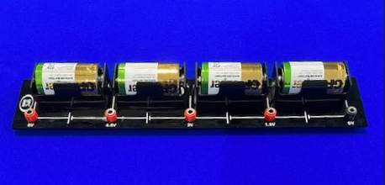
Dhisidda wareeg (circuit)
batarri (battery) oo ka kooban afar unug (cells)
Ku bilow qaadashada meel kasta oo wareegga ah, ka dibna ku dar mid kasta oo ka mid ah qaybaha isku nidaamka sida ay uga muuqdaan jaantuska wareegga.

Slide 23
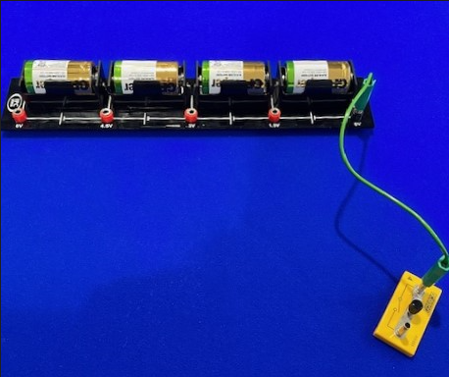
Dhisidda wareeg (circuit)
fure (switch)

Slide 24
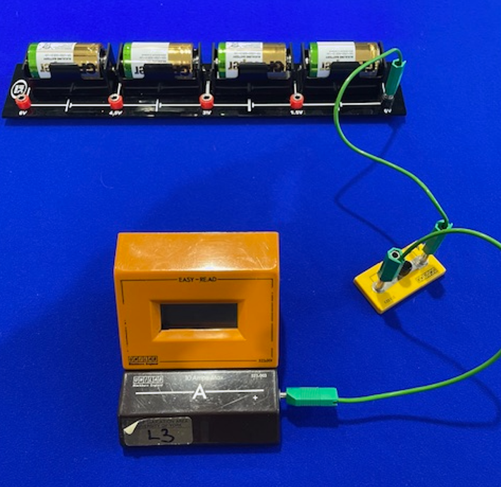
Dhisidda wareeg (circuit)
ammeter (ammeter)

Slide 25
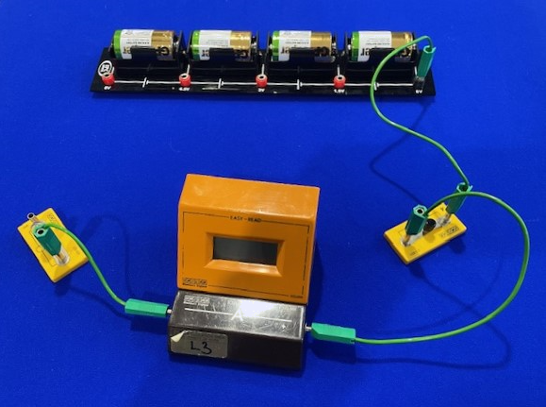
Dhisidda wareeg (circuit)
laambad (lamp)

Slide 26
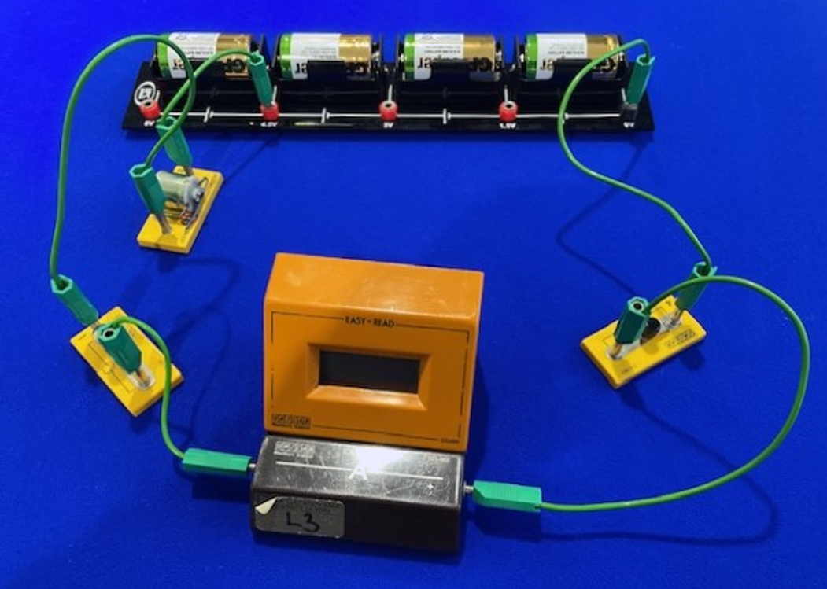
Dhisidda wareeg (circuit)
mooto (motor) oo ku xiran unugga saddexaad ee batariga

Slide 27
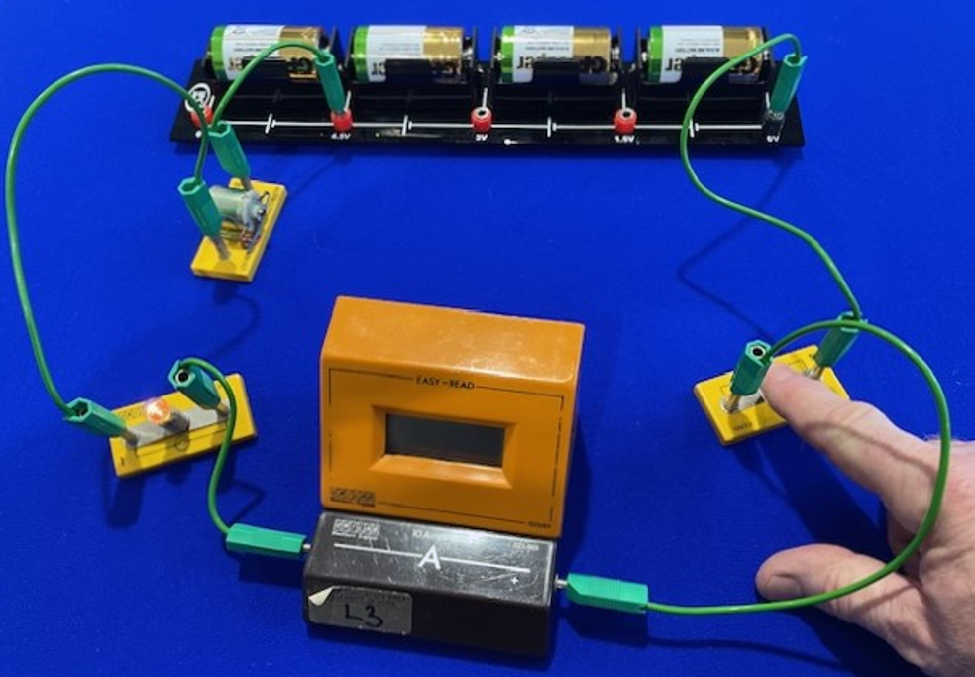
Dhisidda wareeg (circuit)

Slide 28
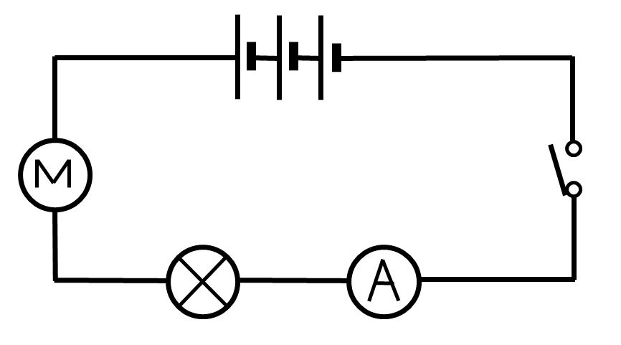
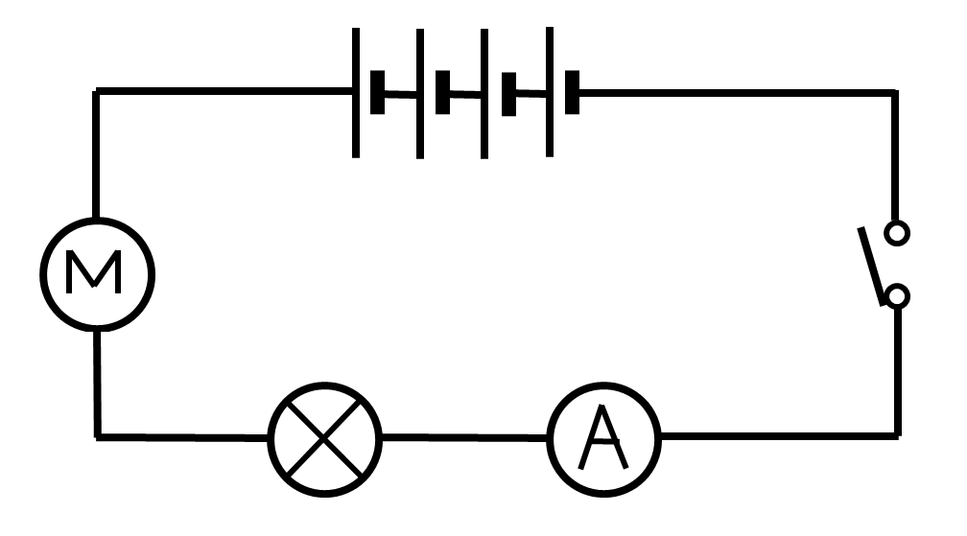
Dhisidda wareeg (circuit)
Markaad dhisayso wareeg, waxaad ka bilaabi kartaa qayb kasta, ilaa inta qaybaha kale lagu daro si sax ah.

Slide 29
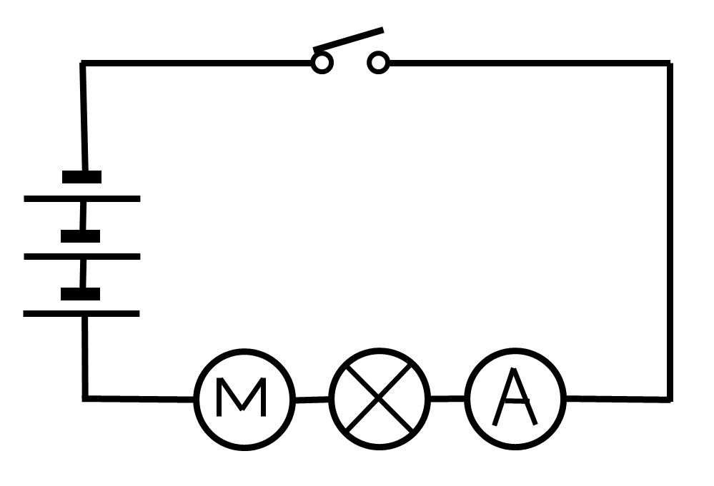
Dhisidda wareeg (circuit)
Qaybaha waxay joogi karaan meelo kala duwan.
Wareegyadan waa isku mid, inkastoo jaantusyada si kala duwan loo sawiray.
Waa nidaamka qaybaha ee muhiimka ah.

Slide 30
Dhisidda wareeg (circuit)
Markaad wareeg ka dhisayso jaantus, waa maxay habka loo isticmaalo?
Ka bilow meel kasta oo ku xir qayb kasta si nidaam ah, adigoo hubinaya inaan midna laga tagin.
Had iyo jeer ka bilow batariga oo ku dhammeeyo halkaas.
Wareegga la dhammeeyo waa inuu u ekaadaa jaantuska si sax ah.

Slide 31
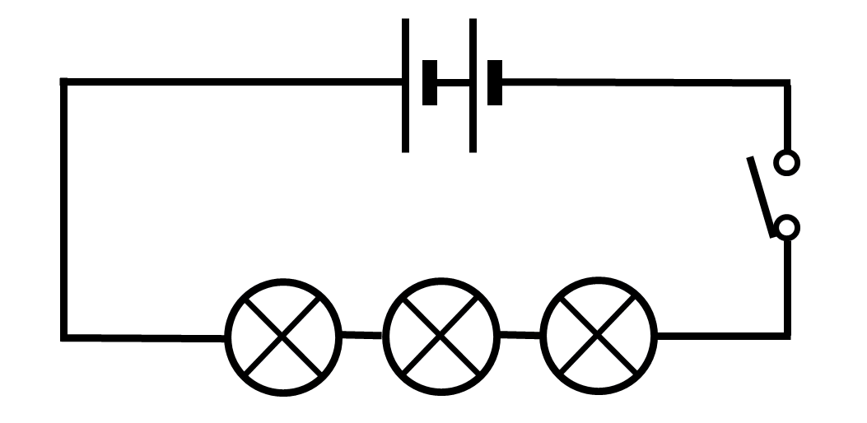
Dhismaha wareegga (circuit)
Taxa tillaabooyinka aad qaadi karto si aad u dhisto wareegga (circuit) la muujiyey:

Slide 32
Dhismaha wareegga (circuit)
Taxa tillaabooyinka aad qaadi karto si aad u dhisto wareegga (circuit) la muujiyey.
Tiri tirada qaybaha (components) iyo fiilooyinka (wires) ee jaantuska wareegga (circuit diagram) kujira oo soo ururi (2 unug (cells), 3 laambadood (lamps), 1 furaha (switch) iyo 5 fiilo (wires)).
Dhig qaybaha (components) sida ay u khusaysaa jaantuska.
Ka bilow qayb (component) kasta, ku xidh qaybta xigta iyadoo la isticmaalayo fiilo (wire) (batariga (battery) inta badan waa meel wanaagsan oo laga bilaabo).
Ku celi tillaabada 3 qayb (component) kasta iyadoo la hubinayo in wareeggu (circuit) u dhigma jaantuska.

Slide 33
Samaynta wareeg taxane ah (series circuit)
Waa maxay wareeg taxane ah (series circuit)?
Dhismaha wareegga (circuit)
Sawiridda wareegga (circuit)

Slide 34
Sawiridda wareegga (circuit)
Jaantusyada wareegga (Circuit diagrams) waxaa loo sawiraa si ay u cad yihiin oo ay u fudud yihiin in la fahmo.
Waxaa loo sawiraa iyadoo la isticmaalayo xeerar fudud:
Qaybaha (Components) waxaa matala calaamadaha wareegga (circuit symbols).
Khadadka toosan (horizontal) ama taagan (vertical) oo toos ah ayaa loo isticmaalaa fiilooyinka (wires).
Fiilooyinka (Wires) waxaa la sawiraa inta u dhaxaysa qaybaha (components) iyadoo aan lahayn bannaan (gaps).
Batariga (battery) (ama korontada (power supply)) inta badan waa kor ama bidix, laakiin waxaad ka bilaabi kartaa sawiridda wareegga (circuit) meel kasta.

Slide 35

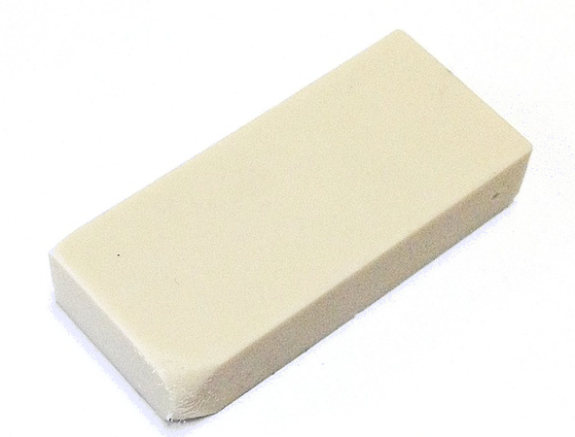
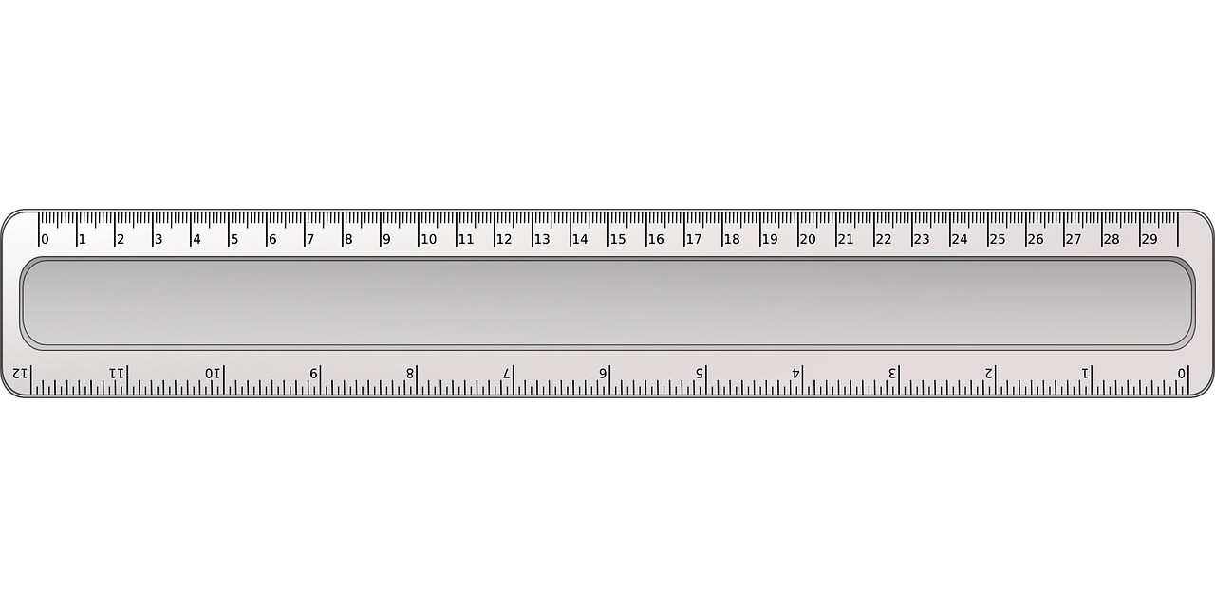
Sawiridda wareegga (circuit)
Markaad sawiraysid jaantuska wareegga (circuit diagram), waxaad u baahan tahay:
qalin fiiqan (sharp pencil)
tako (rubber)
masar (ruler)

Slide 36
Sawirka jaantuska (circuit)
Sawirka jaantuska (circuit diagram) saxda ah:
ku bilow batteriga (battery)
sawir laambadda (lamp)
ku dar furaha (switch)

Slide 37
Sawirka jaantuska (circuit)
Astaamaha (symbols) saxda ah ee jaantuska ayaa la isticmaalaa (laakiin uma baahna inay qumman yihiin).
Xariiq toosan oo jiif ama taagan ayaa la sawiraa inta u dhaxaysa qaybaha, iyada oo aan lahayn meel bannaan.

Slide 38
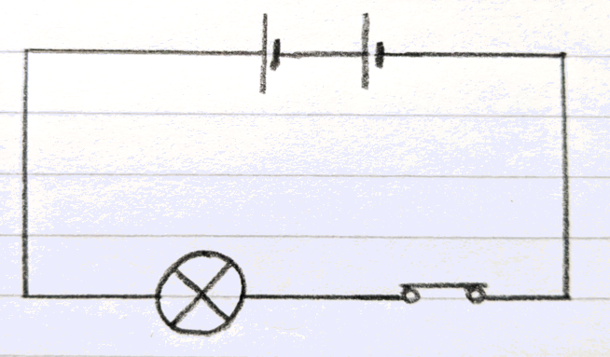
Sawirka jaantuska (circuit)
Jaantuskan (circuit diagram) waa la aqbali karaa.
Astaamaha (symbols) looma sawirin si qumman, laakiin qaybaha ay matalaan waa cad yihiin oo waxay ku jiraan nidaamka saxda ah

Slide 39
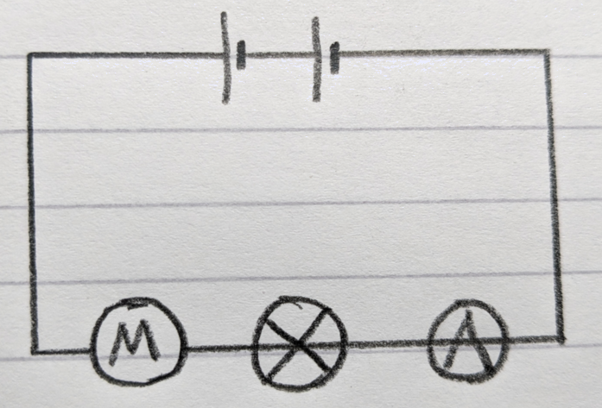
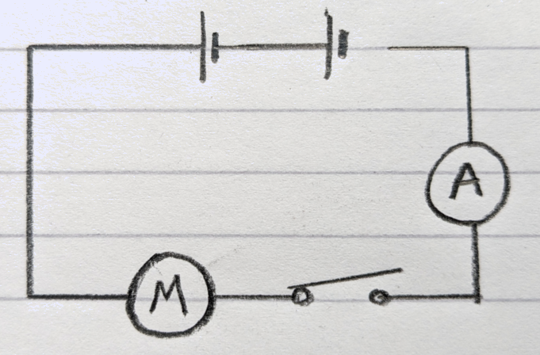
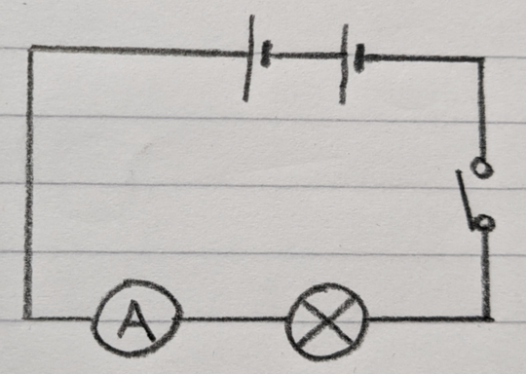
Sawirka jaantuska (circuit)
Jaantusyada (circuit diagrams) hoose, kee baa si sax ah loo sawiray?

Slide 40
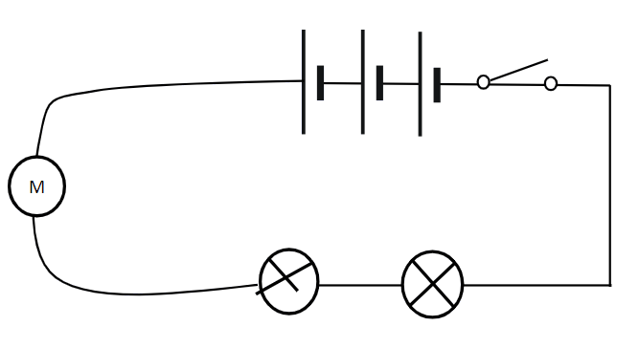
Sawirka jaantuska (circuit)
1) Calaamadee khaladaadka jaantuska (circuit diagram) hoose:
2) Sawir nooc sax ah oo jaantuska ah.

Slide 41
Sawirka jaantuska (circuit)
Calaamadee khaladaadka jaantuska (circuit diagram) hoose:
xariiq dhex mara furaha (switch)
khadadka qalloocan, ma aha toosan
astaanta (symbol) laambadda (lamp) oo qalad ah

Slide 42
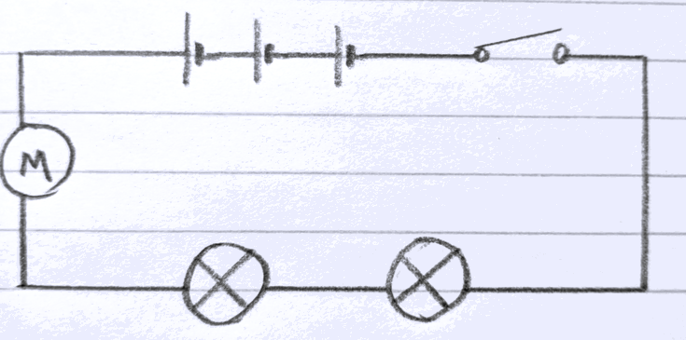
Sawiridda wareeg (circuit)
2) Sawir nooc sax ah oo jaantuska ah.

Slide 43
Samaynta wareeg taxane ah (series circuit)
Wareegyada waxaa lagu muujiyaa jaantusyada wareegyada, kuwaas oo u adeegsada calaamadaha (symbols) qaybaha.
Xeerar fudud oo sawiridda jaantuska wareegga ah ayaa caawiya hubinta caddaynta.
Wareeg taxane ah (series circuit) wuxuu leeyahay hal wareeg oo dhammaystiran oo ka bilaabma dhammaadka batteriga ilaa kan kale.
Marka la dhisayo wareegyada, raacista xeerarkan waxay ka hortagtaa qaladaadka.

