Slide 1
Ka dhigista magaalooyinka cagaaran
Xisaabta iyo deegaanka

Slide 2
Sida agabkeena waxbarista loogu talagalay fasalka

Slide 3
Waxaan fahmi karaa habab kala duwan oo lagu horumarinayo deegaannada maxalliga ah.

Slide 4
Saadaal (forecast) waa sii sheegista dhacdo mustaqbalka ah (oo ku salaysan xog).
Kordhin (extrapolation) waa habka lagu qiyaaso qiimayaal aan la garanayn oo ka baxsan xogta jirta.
Cimilada (climate) waa celceliska qaabka hawada ee aagga muddo dheer.
Magaalo (urban) waa eray lagu qeexo magaalo ama degmo, ama sifooyinka magaalooyinka.

Slide 5

Ka dhigista magaalooyinka cagaaran
Muhiimadda cagaaraynta magaalooyinka
Xisaabta ka dambeysa cagaaraynta magaalooyinka

Slide 6
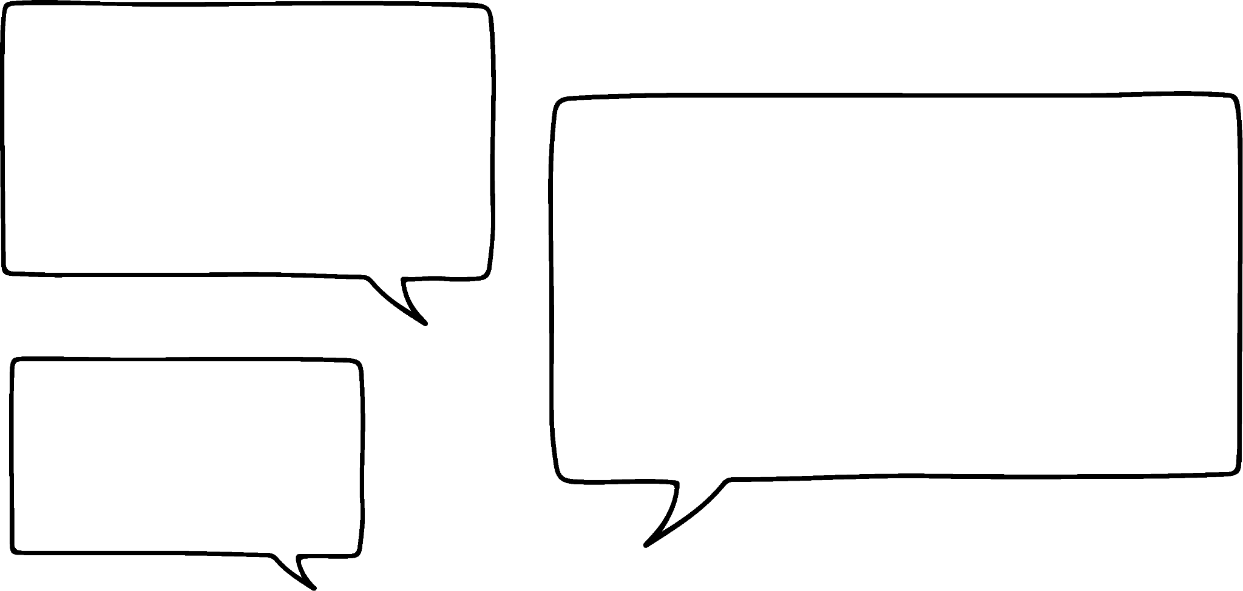


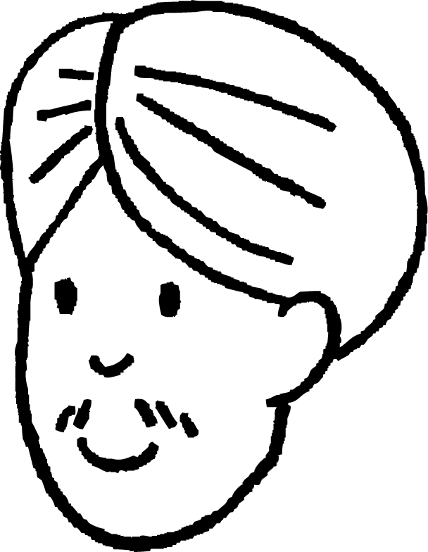



Muhiimadda cagaaraynta magaalooyinka
Waxaa la sheegay in ka dhigista magaalooyinka iyo degmooyinka cagaaran ay aad muhiim u tahay!
Hagaag... Laakiin maxay ka dhigan tahay in meel laga dhigo 'cagaaran'?
Cali
Nuur

Slide 7
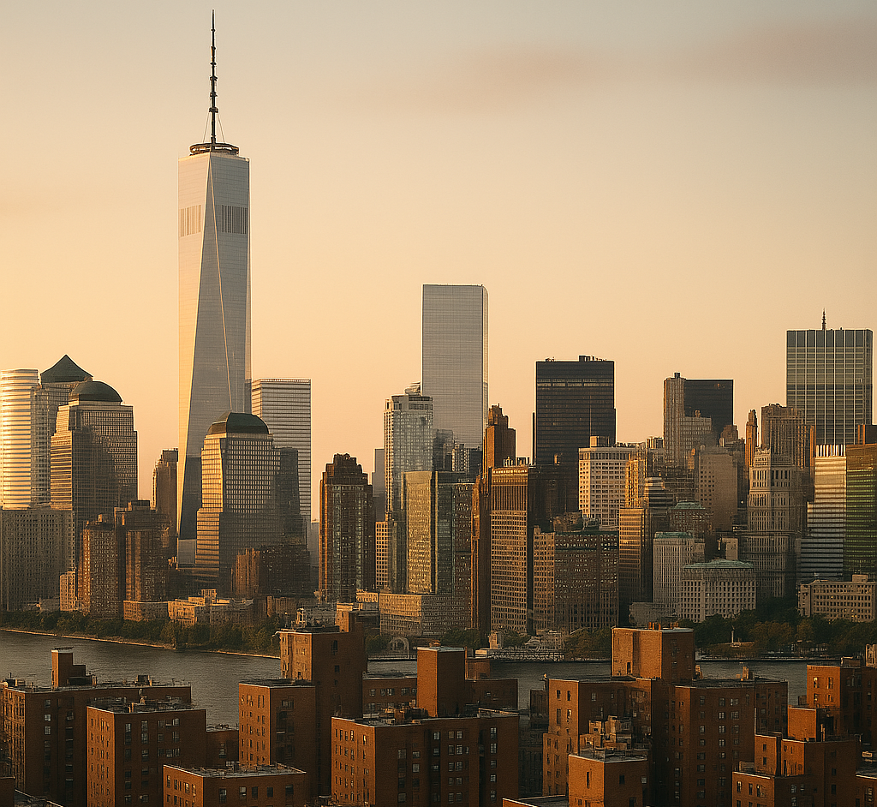
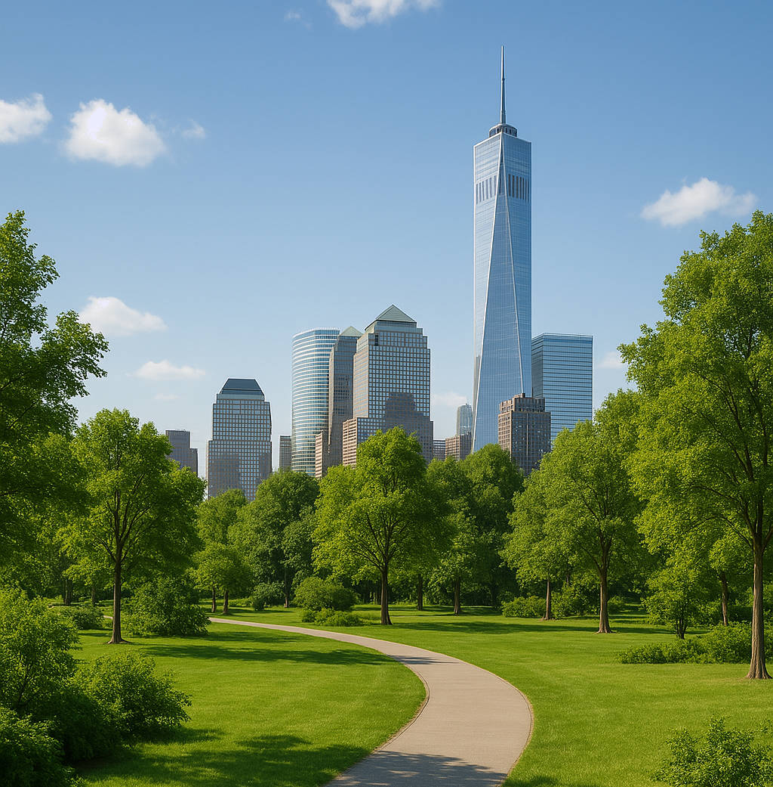
Muhiimadda cagaaraynta magaalooyinka
Waxaa jira waxyaabo badan oo ka mid ah ka dhigista magaalooyinka iyo degmooyinka 'cagaaran' (oo sidoo kale loo yaqaan cagaaraynta magaalooyinka (urban greening)).
Caadi ahaan, deegaanka magaalo (urban) wuxuu leeyahay:
cufnaan sare oo dhismayaasha ah
wadooyin badan (iyo gaadiidka la socda)
qiiqa kaarboon ee baabuurta iyo warshadaha
Cagaaraynta magaalooyinka (urban greening) waxay ujeedkeedu yahay in lagu daro meelo cagaaran (sida jardiinooyinka iyo geedaha) deegaanka magaalo, iyo kor u qaadista sii jirista (sustainability) dadkeeda, kaabayaasheeda, iyo gaadiidkeeda.

Slide 8


Muhiimadda cagaaraynta magaalooyinka
Kee ka mid ah kuwan ayaa ah xeeladaha cagaaraynta magaalooyinka?
a
Adding parks to cities
b
Ku darista dhismayaal badan miyiga (kaas oo cagaar ah)
c
Adding trees to streets in the city
d
Promoting sustainable and public transport options in a city
e
Painting more buildings in the city green

Slide 9
Muhiimadda cagaaraynta magaalooyinka
Marka, cagaaraynta magaalooyinku waa ka dhigista magaalada mid dabiici ah oo waara. Waa maxay sababta ay muhiim u tahay?
Cagaaraynta magaalooyinka waxay leedahay faa'iidooyin badan deegaanka iyo dadka magaaladaas.
Jun
Increasing the amount of green spaces may result in…
an increase in the diversity of wildlife in the city
improving air quality in the city
offsetting carbon emissions (due to the oxygen released by plants and trees)
improving well-being

Slide 10
Muhiimadda cagaaraynta magaalooyinka
Marka, cagaaraynta magaalooyinka (urban greening) waa in magaalada laga dhigo mid dabiici ah oo waaritaan (sustainability) leh. Waa maxay muhiimada ay leedahay?
Cagaaraynta magaalooyinka waxay leedahay faa'iidooyin badan deegaanka iyo dadka magaaladaas.
Jun
Kobcinta waaritaanka (sustainability) waxay keeni karta…
improving air quality in the city
reducing carbon emissions (both due to fewer vehicles being used in the city)
yareynta wasakhda qaylada (noise pollution)
yareynta luminta kheyraadka (resources)

Slide 11
Muhiimada cagaaraynta magaalooyinka (urban greening)
Waqti ka dib, tirada dadka ku nool magaalooyinka (urban areas) aad bay u kordheen.
Waa maxay dhibaatooyinka suurtagalka ah ee ka dhalan kara kordhinta dadka magaalooyinka?
a
Gawaarida badan oo wadada ku yaal, taasoo keenta taraafiko (traffic) joogto ah
b
Gawaarida badan oo wadada ku yaal, taasoo keenta bixin (emission) kaarboon (carbon) sare
c
Gawaarida badan oo wadada ku yaal, taasoo keenta in la dhiso gawaari yaryar
d
Kordhinta dadka leh xirfado muhiim ah oo waxtar leh oo ku yaal aag yar
e
Kordhinta cadaadiska adeegyada deegaanka sida isbitaallada (hospitals) maxalliga ah
f
Dhismayaal badan oo laga dhiso meel xaddidan/kooban

Slide 12
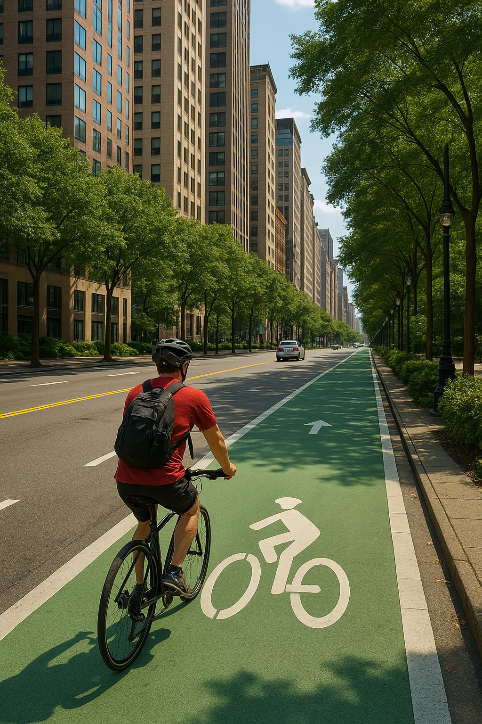
Muhiimada cagaaraynta magaalooyinka (urban greening)
Hal xeelad oo cagaaraynta magaalooyinka (urban greening) ah ayaa ah in la dhiso waddooyin baaskiil (cycle lanes) oo badan oo ku wareegsan magaalada.
Kuwee ka mid ah kuwan ayaa ah faa'iidooyinka waddooyinka baaskiilka (cycle lanes)?
a
Kordhinta duurjoogta (wildlife)
b
Yareynta bixinta (emission) kaarboon (carbon)
c
Wanaajinta caafimaadka iyo ladnaanta (well-being) dadka safarka (commuters)
d
Yareynta wasakhda qaylada (noise pollution)
e
Yareynta qiimaha gawaarida lagu iibiyo magaalooyinka

Slide 13
Muhiimadda cagaaraynta magaalada (urban greening)
Mid ka mid ah kuwani waa qaabab deegaanka magaalada oo noqon kara mid waara (sustainable)?
a
Alwaaxda cadceedda (solar panels) oo saaran dusha dhismayaasha (si loo yareeyo ku tiirsanaanta shidaalka fosilka (fossil fuels))
b
Dhismayaal dhaadheer (si loo kordhiyo tirada dadka dhismaha ku nool)
c
Dhismayaal dahaadh leh (insulated) (si loo yareeyo baahida kulaylka xilliga jiilaalka)
d
Jardiinooyinka saqafka / beero (allotments) (si loo horumariyo beerashada madaxbannaan / korinta cuntada)

Slide 14
Muhiimadda cagaaraynta magaalada (urban greening)
1) Qiyaas inaad tahay duqa (mayor) magaalo dhexdhexaad ah, oo lagugu xilsaaray inaad ku darto laba istaraatiijiyadood oo kala duwan oo cagaaraynta magaalada (urban greening) oo aad dooratay.
a) Labada istaraatiijiyadood ee aad u malaynayso inay noqon karaan kuwa ugu kharash-ku-oolka ah (cost effective) in la hirgeliyo? Sharax sababta.
b) Labada istaraatiijiyadood ee aad u malaynayso inay noqon karaan kuwa ugu waxtarka badan hagaajinta wanaagga (well-being) dadka magaalada? Sharax sababta.
c) Labada istaraatiijiyadood ee aad u malaynayso inay noqon karaan kuwa ugu waxtarka badan hagaajinta waaritaanka (sustainability) magaalada? Sharax sababta.
(Waxaad isticmaali kartaa istaraatiijiyad isku mid ah in ka badan hal su'aal.)

Slide 15
Muhiimadda cagaaraynta magaalada (urban greening)
2) Dhowr magaalo oo qadiimi ah oo UK ah ayaa isku dayay inay hirgeliyaan istaraatiijiyadaha cagaaraynta magaalada (urban greening), laakiin way ku adkaatay inay sidaa sameeyaan.
Sheeg hal sabab oo suurtagal ah oo keentay.

Slide 16
Muhiimadda cagaaraynta magaalada (urban greening)
1) Qiyaas inaad tahay duqa (mayor) magaalo dhexdhexaad ah, oo lagugu xilsaaray inaad ku darto laba istaraatiijiyadood oo kala duwan oo cagaaraynta magaalada (urban greening) oo aad dooratay.
a) Labada istaraatiijiyadood ee aad u malaynayso inay noqon karaan kuwa ugu kharash-ku-oolka ah (cost effective) in la hirgeliyo? Sharax sababta.
(Jawaab kasta waa sax haddii ay leedahay cudurdaar sax ah).
Tusaalooyinka waxaa ka mid ah:
Waddooyinka baaskiilka (cycle lanes) - waddooyinka qaarkood waxaa laga yaabaa inay noqdaan hal-dhinac (one-way) oo keliya, taasoo u oggolaanaysa qaybta kale ee waddada inay u noqoto waddooyin baaskiil. Waddooyin baaskiil oo cusub looma baahna in la dhiso.
Geedaha waddooyinka - geedo yaryar (tree saplings) ayaa lagu beeri karaa waddooyin kala duwan.

Slide 17
Muhiimadda cagaaraynta magaalooyinka (urban greening)
1) Qiyaas inaad tahay duqa magaalo dhexdhexaad ah, oo laguu xilsaaray inaad ku kordhiso laba istaraatiijiyadood oo kala duwan oo cagaaraynta magaalooyinka (urban greening) oo aad doorto magaalada.
b) Labada istaraatiijiyadood ee aad u malaynayso inay ugu waxtarka badan yihiin horumarinta wanaagga dadweynaha magaalada? Sharax sababta.
Tusaalooyinka waxaa ka mid ah:
Jardiinooyinka cagaaran (green parks) - dadka magaalada ku nooli waxay heli doonaan meelo cagaaran oo si fudud loo geli karo si ay ugu raaxaystaan socodka, meel nasasho oo loogu talagalay qadadooda, iwm.
Wanaaji ikhtiyaarada gaadiidka dadweynaha - dadku waxaa laga yaabaa inay ka yara welwelaan inay shaqada ku yimaadaan waqtigooda gaadiidka dadweynaha. Ikhtiyaarada safarka waa la kordhiyay, ama waxay noqdeen kuwo lagu kalsoonaan karo.

Slide 18
Muhiimadda cagaaraynta magaalooyinka (urban greening)
1) Qiyaas inaad tahay duqa magaalo dhexdhexaad ah, oo laguu xilsaaray inaad ku kordhiso laba istaraatiijiyadood oo kala duwan oo cagaaraynta magaalooyinka (urban greening) oo aad doorto magaalada.
c) Labada istaraatiijiyadood ee aad u malaynayso inay ugu waxtarka badan yihiin horumarinta joogtaynta (sustainability) magaalada? Sharax sababta.
Tusaalooyinka waxaa ka mid ah:
Wanaaji ikhtiyaarada gaadiidka dadweynaha - dadka yar ee isticmaala baabuurta kaligood waxay ka dhigan tahay hoos u dhaca bixinta (emission) kaarboonka. Tani waxay si gaar ah run u tahay haddii gaadiidka dadweynaha uu isticmaalo baabuurta korontada ku shaqeeya.
Dhismayaasha dahaarka leh (Insulated buildings) - kharashka iyo isticmaalka tamarta marka la kululeynayo guriga xilliga jiilaalka ayaa aad u sarreeya.

Slide 19
Muhiimadda cagaaraynta magaalooyinka (urban greening)
2) Dhowr magaalo oo qadiimi ah oo ku yaal UK ayaa isku dayay inay hirgeliyaan istaraatiijiyadaha cagaaraynta magaalooyinka (urban greening), laakiin way ku adkaatay inay sidaas sameeyaan.
Bixi hal sabab oo suurtagal ah.
Magaalooyinka qadiimiga ah ee si weyn u kordhay muddo ka dib waxaa laga yaabaa inaysan ku kordhin cagaaraynta magaalooyinka (urban greening) maskaxda.
Tani waxay ka dhigan tahay in magaalooyinkan laga yaabo inaysan lahayn meel ku filan oo loogu talagalay jardiinooyinka cagaaran ee magaalada, ama waddooyinku waxaa laga yaabaa inaysan ku filnayn inay ku habboonaadaan waddooyinka baaskiilka, dariiqyada basaska waaweyn, tareenada ama taraamka, iwm.

Slide 20
Ka dhigista magaalooyinka cagaaran
Muhiimadda cagaaraynta magaalooyinka (urban greening)
Xisaabta ka dambeysa cagaaraynta magaalooyinka (urban greening)

Slide 21
Xisaabta ka dambeysa cagaaraynta magaalooyinka (urban greening)
Sannadkii 2020, magaalada Leeds waxay lahayd heerka ugu sarreeya ee bixinta (emission) gaadiidka ee maamul kasta oo deegaanka ah ee UK, iyadoo ahayd 1471.6 kt (kilotonnes) oo CO2 ah sannadkaas.
Heshiis wax ku ool ah oo cagaaraynta magaalooyinka (urban greening) ah ayaa laga yaabaa inuu keeno hoos u dhaca soo socda ee bixinta (emission) kaarboonka muddo 5 sano ah:
guri (residential) | 5% dhimis (reduction)
warshado (industry) | 12.5% dhimis (reduction)
gaadiid (transport) | 15% dhimis (reduction)

Slide 22
Xisaabta ka dambeeya cagaaraynta magaalooyinka (The maths behind urban greening)
Sanadkii 2020, magaalada Leeds waxay lahayd heerka ugu sarreeya bixinta (emission) gaadiidka (transport) ee dawladda hoose ee UK, oo ah 1471.6 kt (kilotonnes) oo CO2 sanadkaas.
Maxay noqon karaan bixinta (emission) kaarboon ee gaadiidka (transport) ee Leeds sanadka 2025 haddii hindise cagaarayn magaalo (urban greening initiative) la hirgeliyay 2020?
15% dhimis (reduction) macneheedu waa bixinta (emission) kaarboon waxay noqon doontaa (100 – 15)% = 85% wixii hore.
Hindise cagaarayn magaalo (urban greening initiative) oo waxtar leh ayaa keeni kara dhimista bixinta (emission) kaarboon ee soo socota muddo 5 sano ah:
85% = 0.85
guri (residential) | 5% dhimis (reduction)
warshado (industry) | 12.5% dhimis (reduction)
gaadiid (transport) | 15% dhimis (reduction)
Sidaa darteed, bixinta (emission) kaarboon ee gaadiidka (transport) ee Leeds waxay noqon karaan:
(0.85 × 1471.6) kt = 1250.86 kt

Slide 23
Xisaabta ka dambeysa cagaaraynta magaalooyinka
Sida laga soo xigtay ONS (2021), Leeds waxay leedahay tirada dadka ee labaad ee ugu weyn dawladaha hoose ee UK.
Sidaa awgeed, waxay macno samaynaysaa in dadka tirada badan ay soo saari doonaan qadar badan oo ah bixin (emission) gaaska gaadiidka.
Maalgelinta hindiseyaasha cagaaraynta magaalooyinka (urban greening initiatives) ayaa laga yaabaa inay doorbidaan inay beegsadaan dawladaha hoose ee leh celceliska ugu sarreeya bixinta (emission) kaarboon gaadiidka (transport) qofkiiba ee dadweynaha.
 | bixin (emission) gaadiidka | dadka
Leeds | 1471.6 kt | 809 036
Rotherham | 540.7 kt | 266 183
North Warwickshire | 488.2 kt | 65 340
bixin (emission) qofkiiba (per person)
0.0018
0.0020
0.0075
Kee ka mid ah saddexda maamul maxalli ah ayaa laga yaabaa in loo doorbido maalgelinta cagaaraynta magaalooyinka?
North Warwickshire

Slide 24
Xisaabta ka dambeysa cagaaraynta magaalooyinka
Waa maxay celceliska bixin (emission) gaaska gaadiidka qofkiiba ee North Warwickshire sanadka 2025 ka dib qiyaastii 15% hoos u dhaca bixinta (emission) sababtoo ah cagaaraynta magaalooyinka (3 s.f.)?
 | bixin (emission) gaadiidka | dadka
Leeds | 1471.6 kt | 809 036
Rotherham | 540.7 kt | 266 183
Waqooyi (North) Warwickshire | 488.2 kt | 65 340
488.2 × 0.85 = 414.97
Wadarta 414.97 kt oo CO2 ah.
414.97 ÷ 65 340 = 0.00635
0.00635 kt oo CO2 ah qofkiiba.

Slide 25
Xisaabta ka dambeysa cagaaraynta magaalooyinka (urban greening)
Waa maxay celceliska bixinta (emission) gaadiidka kaarboon (carbon) qofkiiba ee North Warwickshire sanadka 2025 ka dib qiyaasta 15% hoos u dhaca bixinta (emission) sababtoo ah cagaaraynta magaalooyinka (urban greening) (3 t. r.)?
Sheeg hal sabab oo suurtogal ah oo qiyaasta bixinta (emission) CO2 mustaqbalka qofkiiba aanu sax ahayn?
Dadka (population) North Warwickshire waxaa laga yaabaa inay isbeddelaan kahor 2025.
 | bixinta (emission) gaadiidka | dadka (population)
Leeds | 1471.6 kt | 809 036
Rotherham | 540.7 kt | 266 183
Waqooyi (North) Warwickshire | 488.2 kt | 65 340
488.2 × 0.85 = 414.97
Wadarta 414.97 kt oo CO2 ah.
414.97 ÷ 65 340 = 0.00635
0.00635 kt oo CO2 ah qofkiiba.

Slide 26
Xisaabta ka dambeysa cagaarka magaalada (urban greening)
Qaar ka mid ah dadaallada cagaaraynta magaalooyinka (urban greening) waxay u baahan yihiin meelo ballaaran.
Beeraha cagaaran ee magaalooyinka (urban green parks) waxay u baahan yihiin aagag ballaaran oo la beddeli karo ama "la cusboonaysiin karo" (renewed).
Tani waxay ka dhigan tahay inay jiraan meelo bannaan oo ballaaran oo loo cusboonaysiin karo (renewed) beeraha. Magaalooyinka qadiimiga ah, tani waa wax dhif ah.
Ama, waxay ka dhigan tahay inay jiraan dhulal ballaaran oo burburay (duug ah oo aan la isticmaalin) oo waa in la dumiyaa ka hor inta aan booska dib loo cusboonaysiin. Tani waa mid aad qaali ah waxayna ku darsataa waqti mashruuca.
Jidadka baaskiilka waxay u baahan yihiin waddooyin iyo waddooyin isku xira si ay u badbaado.
Waddooyinka gudaha magaalada waa inay ku filan yihiin inay u kala qaybsadaan jidadka baaskiilka (ballaca ugu yar 1.5 m, ballaca lagu taliyay 2 m).
Waddooyinka ka baxsan waddada ee u dhexeeya qaybaha magaalada waa inay ahaadaan kuwo aan la xannibin.

Slide 27
Xisaabta ka dambeysa cagaarka magaalada (urban greening)
Sida laga soo xigtay ONS, degmada Doncaster waxay leedahay bed guud oo qiyaastii 569 km².
Qiyaastii 0.75% dhulka degmada Doncaster waxaa loo qoondeeyay 'dhul brownfield', kuwaas oo ah dhulal aan la isticmaalin oo dib loo isticmaali karo.
Beer cagaaran oo magaalo oo dhexdhexaad ah waxay noqon kartaa qiyaastii 3 km².
Ma jiraan dhul 'brownfield' ku filan oo Doncaster ah oo dib loogu cusboonaysiin karo beer cagaaran oo magaalo oo dhexdhexaad ah?
0.75% = 0.0075
Haa, waxaa jira 4.2675 km² oo dhul brownfield ah oo dib loogu cusboonaysiin karo beer cagaaran oo magaalo.
0.0075 × 569 = 4.2675

Slide 28
Xisaabta ka dambeysa cagaarka magaalada (urban greening)
Sida laga soo xigtay ONS, degmada Doncaster waxay leedahay bed guud oo qiyaastii 569 km².
Qiyaastii 0.75% dhulka degmada Doncaster waxaa loo qoondeeyay 'dhul brownfield', kuwaas oo ah dhulal aan la isticmaalin oo dib loo isticmaali karo.
Beer cagaaran oo magaalo oo dhexdhexaad ah waxay noqon kartaa qiyaastii 3 km².
Waa maxay mala-awaalka la sameynayo marka la yiraahdo '4.2675 km² oo dhul ah ayaa dib loogu cusboonaysiin karaa beer cagaaran oo magaalo'?
Mala-awaalku waa in dhulkan uu yahay hal meel, oo aanu ahayn dhowr dhul oo brownfield oo kala firirsan oo ku wareegsan Doncaster. Haddii dhulka brownfield uu kala firirsan yahay, dib looma cusboonaysiin karo hal beer oo dhexdhexaad ah.

Slide 29
Xisaabta ka dambeysa cagaaraynta magaalada (The maths behind urban greening)
1) Magaalada Oakfield waxaa la siiyay £10 000 000 oo maalgelin ah si ay u bilaabaan hindise cagaaran oo magaalo.
Adigoo isticmaalaya jaantuska macluumaadka Oakfield iyo qiimaha istaraatiijiyad kasta oo cagaaran, soo jeedi istaraatiijiyado cagaaran oo waxtar leh (iyo inta magaalada ay khuseyn doonto) oo Oakfield awood u leedahay inay hirgeliso.
gaadiidka kaarboon bixin (emission) | 461.3 kt
tirada dadka | 102 504
bedka guud ee magaalada | 98 km²
bedka loo heli karo (area available for) cusboonaysiinta (renewal) | 23 km²
bedka xarunta basaska (area of bus depot) | 7500 m²
wadarta sanadlaha ah (yearly total) saacadaha qorraxda (sunshine hours) | 1356 hours
dhista geedaha ag waddooyinka (waxay u baahan yihiin celcelis ahaan 3.5 hours oo qorrax maalmeed ah) | £17 000 per km²
waddooyinka baaskiilka (waxaa lagu soo jeediyay oo keliya haddii bixinta (emission) kaarboonka gaadiidka qofkiiba ay ka badan tahay 0.004 kt) | £4 100 000
cusboonaysiinta beerta magaalada (urban park renewal) (waxay u baahan tahay 25% bedka magaalada inuu diyaar yahay) | £35 000 per km²
basaska korantada ah, ee bixin (emission) la'aanta ah (electric, zero-emission buses) (bed 200 m² oo loo baahan yahay baskiiba) | £320 000 baskiiba

Slide 30
Xisaabta ka dambeysa cagaarinta magaalada
2) Ka wada hadla xaddidka suurtagalka ah ee hindisaha cagaarinta magaalada ee su'aasha 1.

Slide 31
Xisaabta ka dambeysa cagaarinta magaalada
1) Magaalada Oakfield waxaa la siiyay £10 000 000 oo lacag ah si ay u bilaabaan hindisaha cagaarinta magaalada.
Adigoo isticmaalaya shaxda macluumaadka Oakfield iyo qiimaha xeelad kasta oo cagaaraynta, soo jeedi xeelado cagaaraynta oo wax ku ool ah (iyo inta magaalada ay khusayn doonto) oo Oakfield awoodi karo inay hirgeliso.
gaadiidka kaarboon bixin (emission) | 461.3 kt
dadka | 102 504
bedka guud ee magaalada | 98 km²
bedka loo heli karo cusboonaysiinta | 23 km²
bedka xarunta basaska. | 7500 m²
wadarta guud ee sanadka saacadaha qorraxda | 1356 saacadood
Qadarka kaarboonka gaadiidka qofkiiba waa: 0.0045 kt (2 s.f.)
Boqolleyda bedka magaalada ee loo heli karo cusboonaysiinta waa 23% (2 s.f.)
Celceliska qadarka maalinlaha ah ee qorraxdu waa 3.7 saacadood (2 s.f.)

Slide 32
The maths behind urban greening
1) Magaalada Oakfield waxaa la siiyay £10,000,000 oo lacag ah si ay u bilaabaan hindise cagaarinta magaalooyinka (urban greening).
Adigoo isticmaalaya shaxda macluumaadka Oakfield iyo qiimaha istaraatiijiyad kasta oo cagaarinta magaalooyinka, ku taliso istaraatiijiyado cagaarinta magaalooyin oo waxtar leh (iyo inta magaalada ay khusayn doonto) oo Oakfield awoodi karo inay hirgeliso.
planting trees along streets (requires average of 3.5 hours of daily sunshine) | £17 000 per km²
cycle lanes (suggested only if transport carbon emissions per person are over 0.004 kt) | £4 100 000
urban park renewal (requires 25% bedka magaalada waa in la helaa) | £35 000 per km²
electric, zero-emission buses (area of 200 m² required per bus) | £320 000 per bus
Marka celcelis ahaan 3.7 saacadood maalintii, xeeladdani waa la heli karaa.
Marka 0.0045 kt qofkiiba, xeeladdani waa la heli karaa.
Iyadoo 23% aag ah oo la heli karo, istaraatiijiyaddan ma heli karto.
A maximum of 37 buses can fit in the depot.

Slide 33

Xisaabta ka dambeysa cagaarka magaalooyinka (urban greening)
1) Magaalada Oakfield waxaa la siiyay £10 000 000 oo maalgelin ah si ay u bilowdo hindisaha cagaarka magaalada (urban greening).
Oakfield ma awoodo saddexda istaraatiijiyad, waayo kharashkooda guud waa £17 606 000.
beerista geedaha ee dhinaca wadooyinka (waxay u baahan tahay celcelis ahaan 3.5 saacadood oo qorraxda maalinlaha ah) | £17 000 km² kii
waddooyinka baaskiilka (lagu soo jeedinayaa kaliya haddii bixinta (emission) kaarboonka gaadiidka qofkiiba uu ka sarreeyo 0.004 kt) | £4 100 000
cusboonaysiinta jardiinooyinka magaalada (waxay u baahan tahay 25% ee aagga magaalada inuu diyaar ahaado) | £35 000 km² kii
basaska koronto ku shaqeeya, ee bixin (emission) la'aan ah (aag 200 m² ah ayaa loo baahan yahay bas kasta) | £320 000 bas kasta
Kharashka magaalada oo dhan (aag 98 km²) waa £1 666 000.
Go'an yahay £4 100 000.
Kharashka dhammaan 37 basasasha waa £11 840 000.

Slide 34
Xisaabta ka dambeysa cagaarka magaalooyinka (urban greening)
1) Magaalada Oakfield waxaa la siiyay £10,000,000 oo lacag ah si ay u bilaabaan hindise cagaarinta magaalooyinka (urban greening).
Hase yeeshee, waxaa suurtogal ah in la helo waddooyinka baaskiilka iyo dhammaan geedaha waddooyinka, oo lagu daro 13 bas oo koronto ah (oo qiimahoodu yahay £4 160 000).
beerista geedaha ee dhinaca wadooyinka (waxay u baahan tahay celcelis ahaan 3.5 hours of daily sunshine) | £17 000 per km²
cycle lanes (suggested only if transport carbon bixin (emission) per person are over 0.004 kt) | £4 100 000
urban park renewal (requires 25% bedka magaalada waa la heli karaa) | £35 000 per km²
electric, zero-bixin (emission) buses (area of 200 m² required per bus) | £320 000 per bus
Cost for whole city £1 666 000.
Fixed £4 100 000.
Qiimaha dhammaan 37 basaska waa £11 840 000.

Slide 35
The maths behind urban greening
1) Magaalada Oakfield waxaa la siiyay £10 000 000 oo maalgelin ah si ay u bilowdo hindise cagaarineed magaalo.
Ama wadada baaskiilka, geedaha waddooyinka, iyo tiro badan oo basaska korantada ah.
planting trees along streets (requires average of 3.5 hours of daily sunshine) | £17 000 per km²
cycle lanes (suggested only if gaadiidka bixin (emission) kaarboon qofkiiba waa in ka badan 0.004 kt) | £4 100 000
dayactirka jardiinooyinka magaalooyinka (wuxuu u baahan yahay 25% ee aagga magaalada in la helo) | £35 000 km² kasta
baska koronto, bixin (emission) eber (aag 200 m² oo loo baahan yahay bas kasta) | £320 000 bas kasta
Qiimaha magaalada oo dhan £1 666 000.
Go'an £4 100 000.
Qiimaha dhammaan 37 bas waa £11 840 000.

Slide 36
Xisaabta ka dambeysa cagaaraynta magaalooyinka
2) Ka hadal xaddidaadyada suurtagalka ah ee hindise cagaarineed magaalo ee su'aasha 1.
Male weyn ayaa ah in dhamaan aagga Oakfield uu yahay "waddo" oo geedo lagu beeri karo.
Xaqiiqda, aagga Oakfield ee "waddada" ah ayaa laga yaabaa inuu aad uga yar yahay 98 km², maxaa yeelay dhul badan waxay noqon doonaan dhismayaal ama waddooyin.
Male kale ayaa ah in dhammaan waddooyinka ay ku filan yihiin ballaadh, iyo in meelaha ka baxsan waddada ay yihiin kuwo ammaan ah oo aan caqabad lahayn, si loogu dhiso waddooyin baaskiil.

Slide 37
Ka dhigista magaalooyinka cagaar
Cagaaraynta magaalooyinka waa habka lagu daro jardiinooyin cagaaran, geedo, waddooyin baaskiil, iyo hindise kale oo wanaajiya joogtaynta magaalo ama degmo, wanaajiya caafimaadka maskaxda ee dadkeeda, iyo kaabis / yareyn raadka kaarboonka.
Saamaynta cagaaraynta magaalooyinka ee yaraynta bixin (emission) kaarboon waa la qiyaasi karaa.
Hindise kala duwan oo cagaarineed magaalo ayaa kharash kala duwan ku bixi doona. Hindise kastaa wuxuu noqon doonaa mid shaqeeya ama aan shaqayn, iyadoo ku xiran sifooyinka gaarka ah ee aag kasta.

