Slide 1
Hawlaha xisaabta ee qaab-dhismeedka xogta (data structures)
Barnaamijyada Python ee taxanaha xogta (sequences of data)

Slide 2
Sida agabkeena waxbarista loogu talagalay fasalka

Slide 3
Waxaan awoodi karaa inaan sameeyo hawlo xisaabeed oo kala duwan oo ku saabsan walxaha liiska (list items) oo aan soo celiyo natiijo (result).

Slide 4
hawlwade (operator)
calaamad ama eray faraysta kombuyuutarka inuu sameeyo xisaab ama ficil gaar ah
liis (list)
qaab-dhismeed xogeed (data structure) oo firfircoon oo ka koobnaan kara walxo noocyo kala duwan leh

Slide 5

Hawlaha xisaabta ee qaab-dhismeedka xogta (data structures)
Samee hawlo xisaabeed oo ku saabsan walxaha liiska (list items)
Abuur ciyaar (game) adoo isticmaalaya liis (list)

Slide 6
Samee hawlo xisaabeed oo ku saabsan walxaha liiska (list items)
Hawlwade (operator) waa calaamad ama eray gaar ah oo faraya kombuyuutarka inuu sameeyo xisaab ama ficil gaar ah.
hawlwade (operator) | magaca hawlgalka (operation name)
+ | isku-dar (addition)
- | kala-goyn (subtraction)
* | isku-dhufasho (multiplication)
/ | qaybin (division)

Slide 7




Samee hawlo xisaabeed oo ku saabsan walxaha liiska (list items)
Liiskani wuxuu hayaa tirooyin taxane ah.
1
numbers = [2, 4, 8, 16]
Sideen ku dari karaa shay kasta oo liiska ku jira?
Nuur

Slide 8

Ku samee hawlo xisaabeed (mathematical operations) shayada liiska
Koodhku (code) wuxuu ku daraa shay kasta oo liiska ku jira.
1
2
3
4
5
6
7
8
9
10
11
numbers = [2, 4, 8, 16]
sum = 0
number = numbers[0]
sum = sum + number
number = numbers[1]
sum = sum + number
number = numbers[2]
sum = sum + number
number = numbers[3]
sum = sum + number
print(sum)
Tani way shaqayn lahayd, laakiin hubi maayo inay tahay habka ugu fiican.
Saciid
Ma ka fikiri kartaa milan (solution) kale?

Slide 9
Ku samee hawlo xisaabeed (mathematical operations) shayada liiska
Barnaamijkan waxaa laga dhigay mid waxtar badan (efficient) iyadoo la isticmaalayo loop-ka for.
1
2
3
4
5
numbers = [2, 4, 8, 16]
sum = 0
for number in numbers:
sum = sum + number
print(sum)
Loop-ga 'for' wuxuu ku dhex maraa shay kasta oo ku jira liiska (list) wuxuuna ku daraa qiimaha (value) uu hayo qiimaha (value) hadda ee sum.

Slide 10
Ku samee hawlo xisaabeed (mathematical operations) shayyada liiska (list items)
Barnaamij ayaa loo isticmaalayaa inuu muujiyo jadwalka isku dhufashada (times table) ee nambar uu isticmaaluhu galiyo:
1
2
3
4
5
6
7
numbers = [1, 2, 3, 4, 5, 6, 7, 8, 9, 10, 11, 12]
total = 0
print("Which multiplication table do you want?")
multiply_by = int(input())
for number in numbers:
total = number * multiply_by
print(f"{number} multiplied by {multiply_by} = {total}")

Slide 11

Ku samee hawlo xisaabeed (mathematical operations) shayyada liiska (list items)
Waa kee astaanta (symbol) loo isticmaalo hawlgalka isku dhufashada (multiplication operator) ee Python?
+
/
*

Slide 12
Ku samee hawlo xisaabeed (mathematical operations) shayyada liiska (list items)
Python-ka, hawlaha max() iyo min() waxaa loo isticmaali karaa inay soo celiyaan qiimaha (value) ugu sarreeya ama ugu hooseeya ee kala duwanaanshaha (range).
1
2
3
numbers = [1, 2, 3, 4, 5, 6, 7, 8, 9, 10, 11, 12]
max_no = max(numbers)
print(max_no)
Maxaad u malaynaysaa in koodhkani soo celin doono?
12, sababtoo ah 12 waa qiimaha (value) ugu sarreeya ee ku kaydsan liiska (list).

Slide 13
Ku samee hawlgallo xisaabeed (mathematical operations) walxaha liiska (list items)
Hawlgeliyeyaasha xiriirka (Relational operators) waxaa loo isticmaalaa in lagu barbardhigo qiimayaasha (values) shuruudaha (conditions).
== | la mid ah (equal to)
!= | aan la mid ahayn (not equal to)
< | ka yar (less than)
<= | ka yar ama la eg (less than or equal to)
> | ka weyn (greater than)
>= | ka weyn ama la eg (greater than or equal to)

Slide 14

Ku samee hawlgallo xisaabeed (mathematical operations) walxaha liiska (list items)
Waa maxay xariiqda koodka (line of code) ee lagu daro line 2 si loo helo qiimaha (value) ugu hooseeya ee ku jira liiska (list) numbers?
1
2
3
numbers = [1, 2, 3, 4, 5, 6, 7, 8, 9, 10, 11, 12]
print(min_no)
a
max_no = max(numbers)
b
min_no = max(numbers)
c
min_no = min(numbers)

Slide 15
Ku samee hawlgallo xisaabeed (mathematical operations) walxaha liiska (list items)
Hawlgallada xisaabeed (Mathematical operations) sidoo kale waxaa loo isticmaali karaa in lagu beddelo ama lagu cusboonaysiiyo qiimayaasha (values) ku jira liiska (list). Barnaamijkani wuxuu qaataa tiro kasta oo ku jirta liiska wuxuuna ku dhufanayaa (multiplies) qiimaha (value) 2.
1
2
3
4
5
6
7
8
9
my_list = [2, 3, 4]
position = 0
for number in my_list:
number = number * 2
my_list[position] = number
booska = booska + 1
daabac(my_list)
Soo-saarka qoraalka (Text output)
[4, 6, 8]

Slide 16
Ku samee hawlgallo xisaabeed (mathematical operations) alaabta liiska (list items)
1) Fur barnaamijka bilowga ah oak.link/test-scores
2) Macallin wuxuu haystaa liiska (list) buundooyinka imtixaanka fasalkiisa oo ku kaydsan liis. Waxay rabaan inay xisaabiyaan:
  buundada ugu sarreysa imtixaanka
  buundada ugu hooseysa imtixaanka
  celceliska buundada imtixaanka

Slide 17
Ku samee hawlgallo xisaabeed (mathematical operations) alaabta liiska (list items)
1
2
3
4
5
6
7
8
9
10
11
12
13
test_scores = [18,32,40,28,12,4,16,15,25,41,
42,44,24,11,22,23,6,38,26,9,
17,43,35,30,19]
highest_score = max(test_scores)
print(f"Buundada ugu sarreysa waxay ahayd {highest_score}")
lowest_score = min(test_scores)
print(f"Buundada ugu hooseysa waxay ahayd {lowest_score}")
total = 0
for score in test_scores:
total = total + score
average = total/len(test_scores)
print(f"Celceliska buundada wuxuu ahaa {average}")
oak.link/test-scores-solution

Slide 18
Ku samee hawlgallo xisaabeed (mathematical operations) alaabta liiska (list items)
3) Saddex arday ayaa maqnaa maalintii imtixaanka. Waxay dhaliyeen 25, 32 iyo 49 calaamadood siday u kala horreeyaan. Ku dar buundadooda liiska.
Tilmaan: Waa inaad isticmaashaa habka list.append() oo aad tan ku qabataa ka hor intaadan xisaabin celceliska.
4) Dib u xisaabi celceliska buundada imtixaanka. Ma isbeddelay?

Slide 19
Perform mathematical operations on list items
3) Saddex arday ayaa maqnaa maalintii imtixaanka. Waxay heleen 25, 32 iyo 49 calaamadood siday u kala horreeyaan. Ku dar buundadooda liiska.
4) Dib u xisaabi celceliska buundada imtixaanka. Ma isbeddelay?
Haa, celceliska buundada ayaa isbeddelay 24.8 ilaa 25.9.
4
5
6
test_scores.append(25)
test_scores.append(32)
test_scores.append(49)

Slide 20
Perform mathematical operations on list items
The teacher has realised the students only had
half the time they were meant to have for the assessment. To make the results fair, they want to double each mark held in the list.
  Add some code to multiply each value held in the list by 2.
  Ku beddel buundada hadda jirta buundada cusub shay kasta oo liiska ah.

Slide 21
Perform mathematical operations on list items
1
2
3
4
5
6
7
8
9
10
11
12
13
14
15
16
17
18
test_scores = [18,32,40,28,12,4,16,15,25,41,
42,44,24,11,22,23,6,38,26,9,
17,43,35,30,19,25,32,49]
position = 0
total = 0
for score in test_scores:
score = score * 2
test_scores[position] = score
position = position + 1
wadarta = wadarta + buundo (score)
buundo_ugu_sareeya = max(test_scores)
print(f"Buundada ugu sareysa waxay ahayd {highest_score}")
buundo_ugu_hooseeya = min(test_scores)
print(f"Buundada ugu hooseysa waxay ahayd {lowest_score}")
celcelis = wadarta/len(test_scores)
print(f"Buundada celceliska waxay ahayd {average}")
buundo = buundo * 2
test_scores[booska] = buundo
booska = booska + 1

Slide 22
Hawlgallo xisaabeed (mathematical operations) ee qaab-dhismeedka xogta (data structures)
Ku samee hawlgallo xisaabeed (mathematical operations) alaabta liiska (list items)
Abuur ciyaar (game) adoo isticmaalaya liis (list)

Slide 23

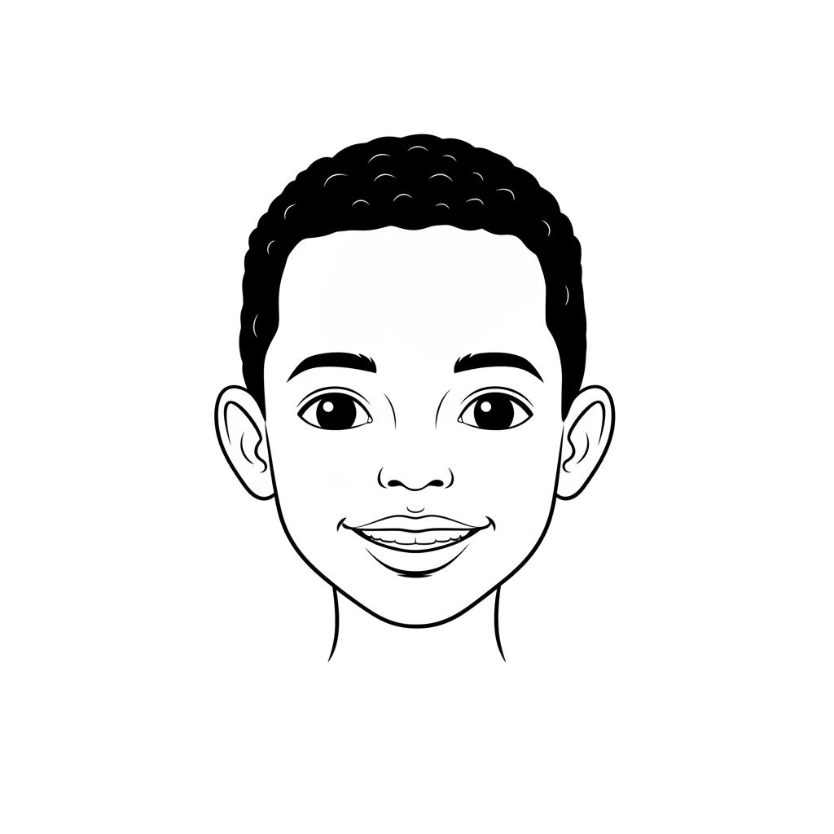
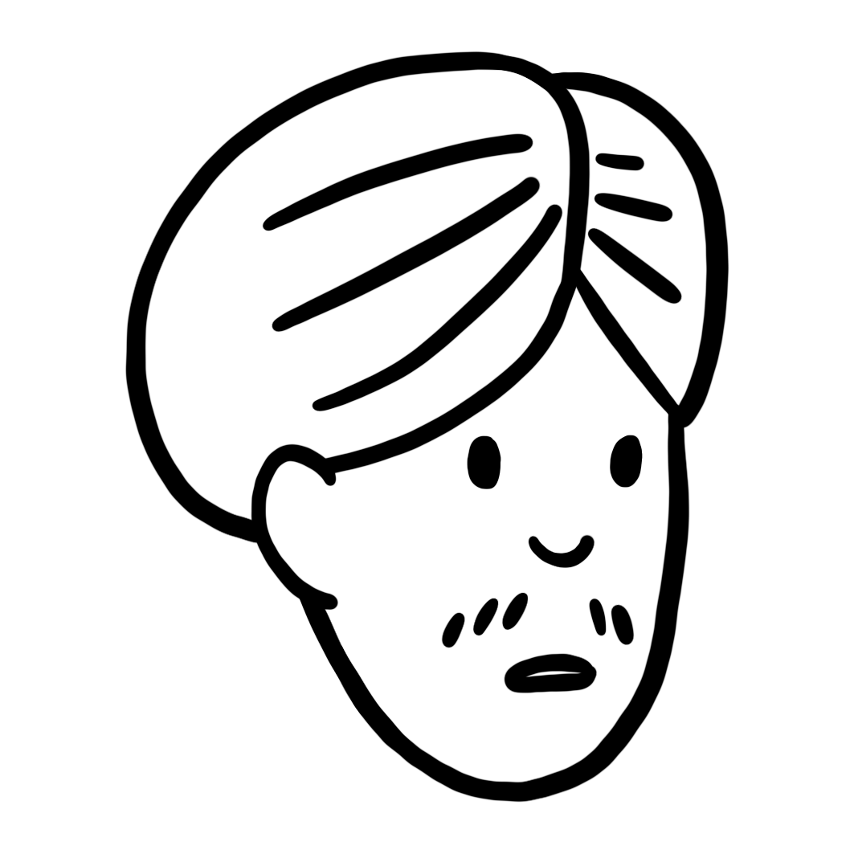

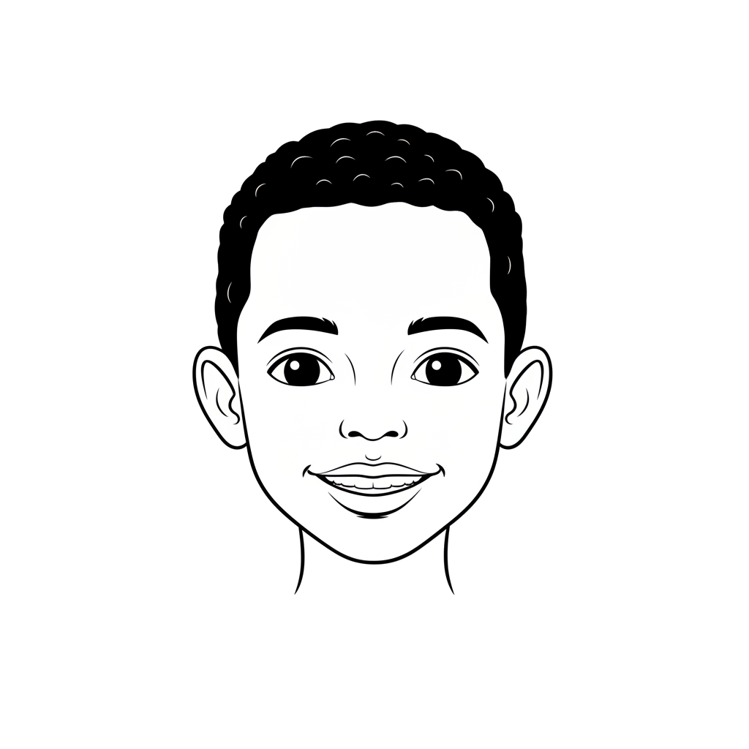
Abuur ciyaar (game) adoo isticmaalaya liis (list)
Waxaan rabaa inaan abuuro ciyaar (game) adeegsata liis (list), laakiin ma iila imanayo fikrado.
Cali
Waxaad kaydin kartaa liis (list) midabada qaanso roobaad (rainbow) oo waxaad weydiisaa isticmaalaha inuu qiyaaso midabka.
Ma waxaad haysaa fikrado kale oo ciyaar (game) ah oo aad u soo jeedinaysid Cali?
Saciid

Slide 24
Abuur ciyaar (game) adoo isticmaalaya liis (list)
Habka shuffle() waa qayb ka mid ah maktabadda random (random library) ee Python. Waxay qaadataa taxane (sequence), sida liis (list), oo waxay dib u habaysaa nidaamka alaabta.
1
2
3
4
5
6
import random
numbers = [1, 2, 3, 4, 5]
random.shuffle(numbers)
print(numbers)
Soo-saar qoraal (Text output)
[1, 4, 2, 3, 5]

Slide 25

Abuur ciyaar isticmaalaya liis (list)
Waa fiican tahay! Anigu waxaan isticmaali kara habka shuffle() si aan u shufeeleeyo liiska midabbada, ka dibna weydii isticmaalaha inuu qiyaaso midabka lagu jira meesha[0].
Cali

Slide 26
Abuur ciyaar isticmaalaya liis (list)
Waxaan qoray barnaamijka, laakiin wuxuu weydiinayaa isticmaalaha inuu qiyaaso midabka xitaa markii uu si sax ah u qiyaasay! Maxaan ku khaldamay?
1
2
3
4
5
6
7
8
9
10
11
12
import random
colours = ["red", "orange", "yellow", "green",
"blue", "indigo", "violet"]
random.shuffle(colours)
while True:
print("Guess the colour of the rainbow")
colour_picked = input()
if colour_picked == colours[0]:
print("You guessed correctly")
else:
print("Try again")
Cali
Ma jiro calaamad (flag) lagu beddelo xaaladda loop-ka 'while', sidaas darteed barnaamijku wuu sii socon doonaa weligiis.

Slide 27
Samee ciyaar adeegsaday liis (list)
1
2
3
4
5
6
7
8
9
10
11
12
13
14
import random
colours = ["red", "orange", "yellow", "green",
"blue", "indigo", "violet"]
random.shuffle(colours)
guess = False
while guess != True:
print("Qiyaas midabka qaanso roogaad")
colour_picked = input()
if colour_picked == colours[0]:
print("Si sax ah ayaad u qiyaastay")
guess = True
else:
print("Mar kale isku day")
Koodhka waa la beddelay si loo joojiyo loop-ka (while loop) marka isticmaaluhu si sax ah u qiyaaso.

Slide 28
Samee ciyaar adeegsaday liis (list)
Waxaad hore u aragtay sida indexing loogu isticmaalo in lagu soo celiyo shay gaar ah oo ku jira liiska.
Koodhkani wuxuu soo bandhigi doonaa "Cali", sababtoo ah waa qiimaha (value) ku jira booska [0] ee liiska.
1
2
names = ["Cali", "Layla", "Nuur"]
print(names[0])
Mararka qaarkood waxaa faa'iido leh in la daabaco xarfo gaar ah oo ka mid ah string-ga ku jira liiska, tusaale ahaan, haddii aad rabto inaad muujiso xarafka ugu horreeya ee magaca koowaad.
Koodhkani wuxuu soo bandhigi doonaa “A”, maadaama ay tahay qiime (value) ku jira booska [0][0] ee liiska.
1
2
names = ["Cali", "Layla", "Nuur"]
print(names[0][0])

Slide 29
Samee ciyaar adigoo isticmaalaya liis
Cali wuxuu rabaa inuu horumariyo barnaamijka si uu u siiyo isticmaalaha tilmaan haddii ay si khaldan u qiyaasaan. Waa kee xariiqda koodhka oo muujin doonta xarafka koowaad ee midabka isticmaalaha?
print(f"Midabku wuxuu ku bilaabmaa {colours[0][0]}")
print(f"Midabku wuxuu ku bilaabmaa {colours[0][1]}")
print(f"Midabku wuxuu ku bilaabmaa {colours[1][1]}")
Xusuusnow, Python indexing wuxuu ka bilaabmaa 0.

Slide 30
Samee ciyaar adigoo isticmaalaya liis
Fur barnaamijka bilowga ah oak.link/card-game
Ujeeddada ciyaartu waa in isticmaaluhu uu qiyaaso kaadhka uu saaxirku hayo.
a) Samee xoogaa koodh ah si aad u qasdid (shuffle) xirmada.
b) Si kadis ah u dooro kaadh ka mid ah xirmada.
Tilmaan: Waxaad u baahan doontaa inaad isticmaasho shaqada random.choice().
c) Haddii isticmaaluhu si sax ah u qiyaaso, muuji “Waxaad si sax ah u qiyaastay”.
d) Haddii isticmaaluhu si khaldan u qiyaaso, weydii inuu mar kale qiyaaso.

Slide 31
Samee ciyaar adigoo isticmaalaya liis
Isticmaaluhu wuxuu u baahan yahay caawinaad dheeri ah. Haddii isticmaaluhu si khaldan u qiyaaso, barnaamijku waa inuu:
  Hubi in kaadhka la doortay uu leeyahay qiime (value) ka weyn qiyaasta isticmaalaha, haddii ay sidaas tahay, muuji “Kaadhku wuu ka sareeyaa”.
  Hubi in kaadhka la doortay uu leeyahay qiime (value) ka hooseeya qiyaasta isticmaalaha, haddii ay sidaas tahay, muuji “Kaadhku wuu ka hooseeyaa”.

Slide 32
Samee ciyaar adigoo isticmaalaya liis
1
2
3
4
5
6
7
8
9
10
11
12
13
14
15
16
17
18
import random
cards = [2, 5, 7, 6, 10, 3, 9]
random.shuffle(cards)
guess = False
picked = random.choice(cards)
while guess != True:
print("Qiyaas kaadida")
card_picked = int(input())
haddii card_picked == picked:
print("Si sax ah ayaad u qiyaastay")
guess = True
haddii kale:
print("Mar kale isku day")
haddii card_picked < picked:
print("Kaadidu way ka sareysaa")
haddii kale:
print("Kaadidu way ka hooseysaa")
oak.link/card-game-solution

Slide 33
Samee ciyaar adoo isticmaalaya liis (list)
Si loogu daro curiye (element) tartan ah ciyaarta, dhibco (score) ayaa lagu dari doonaa.
  Haddii kaadida laga xushay xirmada ay leedahay qiime (value) ka yar 5, markaas dhibcaha la bixiyo waxay la mid yihiin qiimaha kaadida.
  Haddii kaadida laga xushay xirmada ay leedahay qiime (value) la eg ama ka weyn 5, markaas dhibcaha la bixiyo waa laba jibaar qiimaha kaadida.
  Muuji dhibcaha (score) isticmaalaha.
Tusaale ahaan:
kaadhadhka la doortay = 2, dhibcaha (points) = 2
kaadhadhka la doortay = 5, dhibcaha (points) = 10

Slide 34
Samee ciyaar (game) adoo isticmaalaya liis (list)
1
2
3
4
5
6
7
8
9
10
11
12
13
14
15
16
17
18
19
20
21
22
23
24
25
import random
cards = [2, 5, 7, 6, 10, 3, 9]
random.shuffle(cards)
guess = False
score = 0
picked = random.choice(cards)
while guess != True:
print("Qiyaas kaadhadhka")
card_picked = int(input())
if card_picked == picked:
print("Si sax ah ayaad u qiyaastay")
guess = True
if card_picked >= 5:
score = (2 * picked)
else:
score = picked
print(f"Dhibcahaagu waa {score}")
else:
print("Mar kale ku dayo")
haddii card_picked < picked:
print("Kaartu waa ka sareysaa")
haddii kale:
print("Kaartu waa ka hooseysaa")
haddii card_picked >= 5:
score = (2 * picked)
haddii kale:
score = picked
print(f"Dhibcahaagu waa {score}")

Slide 35
Hawlaha xisaabta (Mathematical operations) ee qaab-dhismeedka xogta (data structures)
Hawlaha xisaabta (Mathematical operations) waxaa lagu samayn karaa walxaha liiska (list items) iyadoo la isticmaalayo calaamadaha xisaabta (arithmetic operators). Hawlaha xisaabta sidoo kale waxaa loo isticmaali karaa in lagu beddelo ama lagu cusboonaysiiyo qiimaha (values) ku jira liiska.
Habka shuffle() waxaa loo isticmaalaa si random ah loogu beddelo nidaamka walxaha ku jira liiska.
Calaamad (flag) waxaa loo isticmaali karaa in lagu muujiyo marka while loop uu joogsado.

