Slide 1
Qiyaasida hadda (current) ee wareegga barbar socda (parallel circuit)
Iska caabbinta (Resistance) iyo wareegyada barbar socda (parallel circuits)

Slide 2
Sida agabkeena waxbarista loogu talagalay fasalka

Slide 3
Waxaan qiyaasi karaa sida loo qiyaaso hadda (current) ee laamaha kasta ee wareegga barbar socda (parallel circuit).

Slide 4
ammeter
qalab qiyaasa hadda (current) ku qulqulaya wareegga
amps
halbeegga lagu qiyaaso hadda (current) (oo soo gaabiyay amperes), oo uu matalo calaamadda A
laan (branch)
loop gooni ah oo ka mid ah wareegga barbar socda (parallel circuit)
wareeg barbar socda (parallel circuit)
wareeg leh in ka badan hal loop oo dhammaystiran, oo ka bilaabma dhammaadka batteriga ilaa dhammaadka kale

Slide 5

Qiyaasida hadda (current) ee wareegga barbar socda (parallel circuit)
Qiyaasida hadda (current) ee wareegga barbar socda (parallel circuit)
Qaanuunka hadda (current) ee wareegyada barbar socda (parallel circuits)

Slide 6
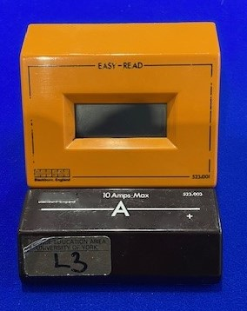

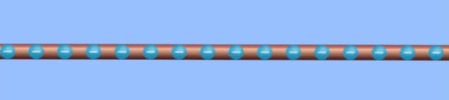
Qiyaasida hadda (current) ee wareegga barbar socda (parallel circuit)
Ammeter wuxuu qiyaasaa hadda (current) ku qulqulaya siligga, oo lagu qiyaaso amps (A).
Hadda (current) ee siligga waa xadiga korantada (electric charge) ee dhaqaaqa laanta siligga ilbiriqsi kasta.
koronto (charges) oo dhaqaaqaya siligga
Gif hoose: Simulation by PhET Interactive Simulations, University of Colorado Boulder, licensed under CC-BY-4.0

Slide 7
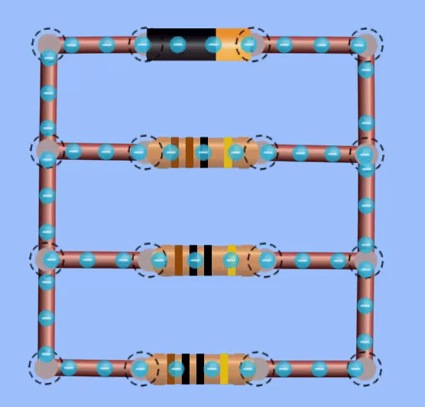
Qiyaasida hadda (current) ee wareegga barbar socda (parallel circuit)
Animation-ka hoose wuxuu muujinayaa sida hadda (current) u qulqulo wareegga barbar socda (parallel circuit).
current (current) weyn ayaa ku qulqulaya laanta batteriga
current-yo (currents) yaryar ayaa ku qulqulaya laamaha kale
Jilitaan (Simulation) by PhET Interactive Simulations, University of Colorado Boulder, shatiyaysan CC-BY-4.0

Slide 8

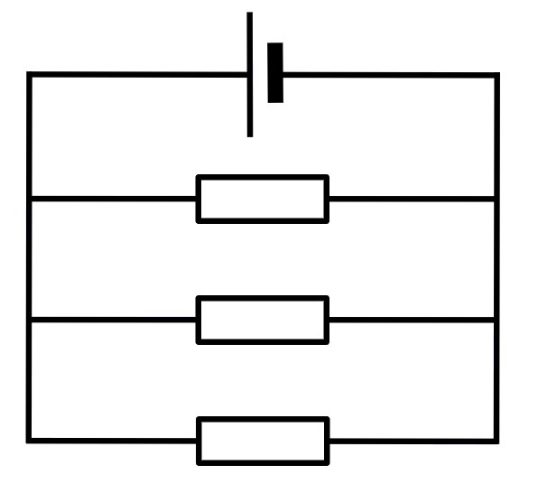
Qiyaasta current-ka (current) ee wareegga barbar-socodka (parallel circuit)
Current-ka (current) qaybaha kala duwan ee wareegga barbar-socodka (parallel circuit) waa isku mid.
Isgoys (junction) dhexdiisa, current-ku (current) wuu kala qaybsamaa oo wuu yaraadaa.
Laan (branch) kastaa waxay leedahay iska-caabin (resistance) isku mid ah, sidaas darteedna current (current) isku mid ah.

Slide 9
Qiyaasta current-ka (current) ee wareegga barbar-socodka (parallel circuit)
Current-ka (current) laan (branch) kasta si kala duwan ayaa loo qiyaasaa.
Si loo qiyaaso current-ka (current) unugga (cell) dhex mara …
jebi wareegga (circuit) …
A
kadib ku xir ammeter-ka (ammeter).

Slide 10
Qiyaasta current-ka (current) ee wareegga barbar-socodka (parallel circuit)
Ammeter-ka (ammeter) waa in si toos ah loogu xiraa unugga (cell).
ama halkan
A
A
Waxaa la dhigi karaa halkan …
ama halkan
A
A

Slide 11
Qiyaasta current-ka (current) ee wareegga barbar-socodka (parallel circuit)
Ammeter-ka (ammeter) waxaa lagu xiri karaa meel kasta oo laanta sare (top branch) ah, isgoysyada (junctions) ka hor.

Slide 12
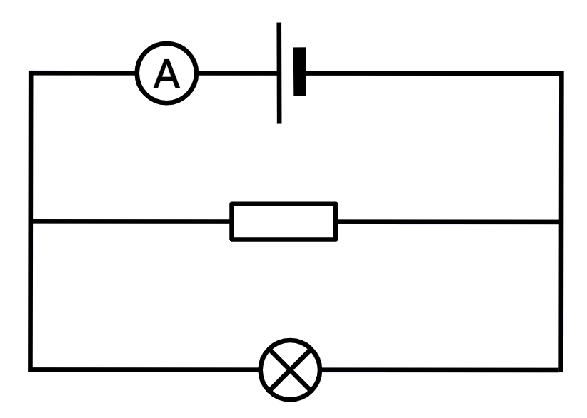
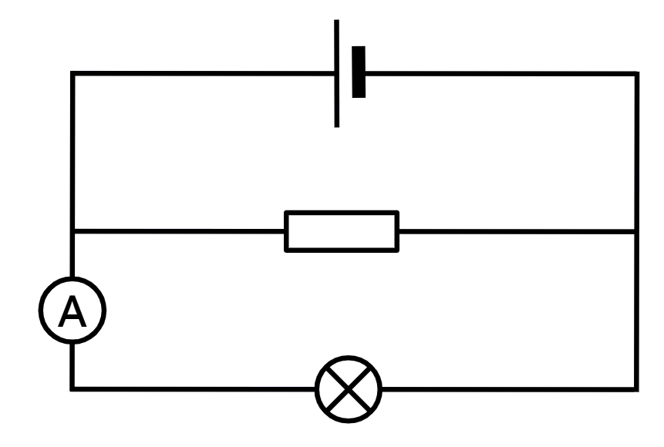
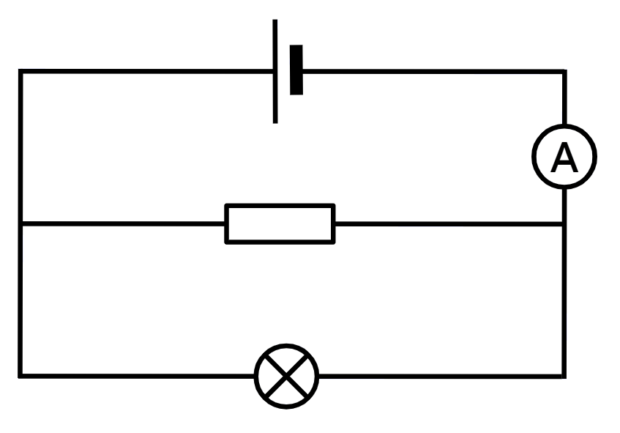
Qiyaasta current-ka (current) ee wareegga barbar-socodka (parallel circuit)
Wareegyada (circuits) soo socda kee baa muujinaya ammeter (ammeter) oo ku jira booska saxda ah si loo qiyaaso current-ka (current) unugga (cell) dhex mara?

Slide 13
Qiyaasta current-ka (current) ee wareegga barbar-socodka (parallel circuit)
Si loo helo hadda (current) ee resistor-ka, ammeter-ka waa in lagu xiraa laanta dhexe.
halkan
ama halkan
A
A

Slide 14
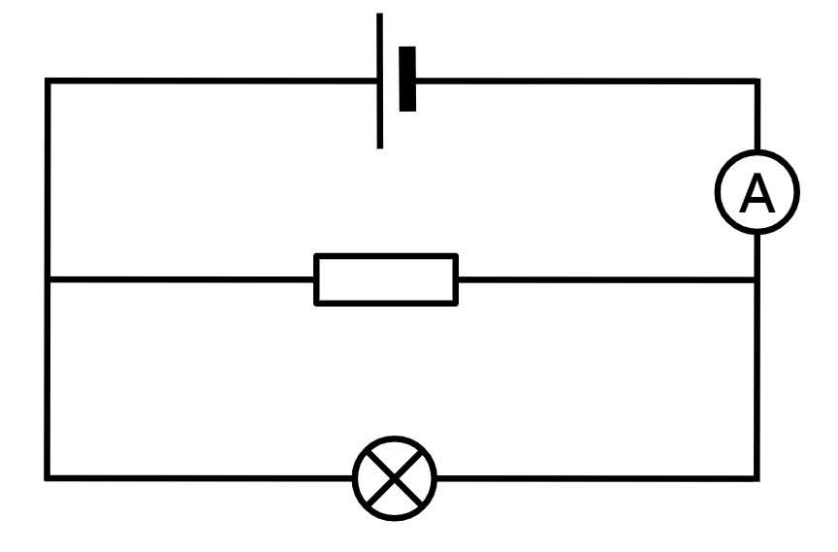
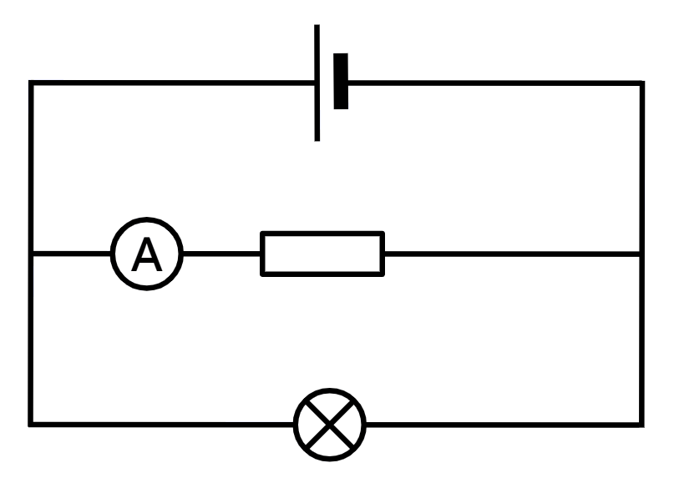
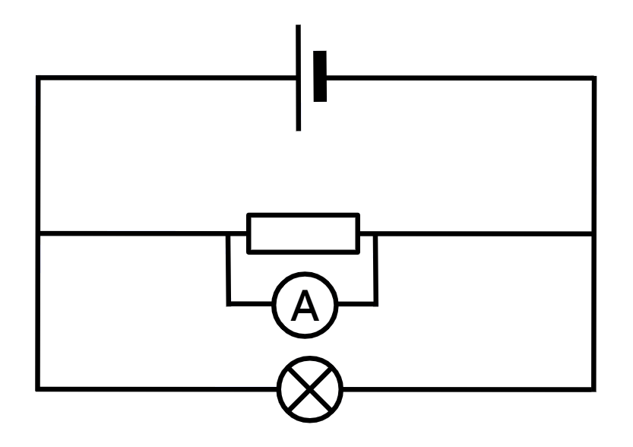
Cabbirka hadda (current) ee wareeg isbarbar (parallel circuit)
Kee ka mid ah wareegyada (circuits) ayaa muujinaya ammeter meel sax ah si loo cabbiro hadda (current) ee resistor-ka?

Slide 15
Cabbirka hadda (current) ee wareeg isbarbar (parallel circuit)
Si loo helo hadda (current) ee laambadda, ammeter-ka waa in lagu xiraa laanta hoose.
meel kasta oo ka mid ah
A
A
A
A

Slide 16
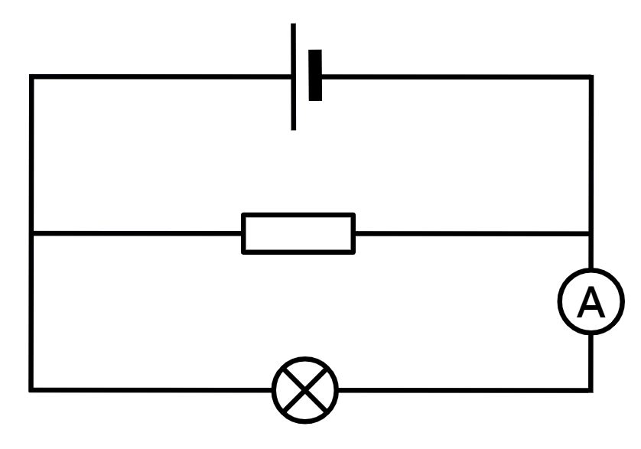
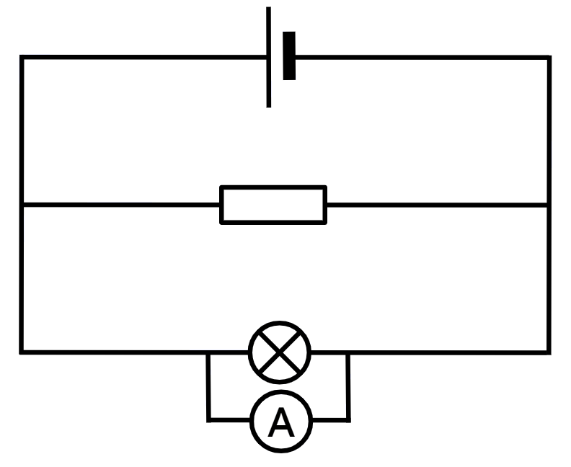
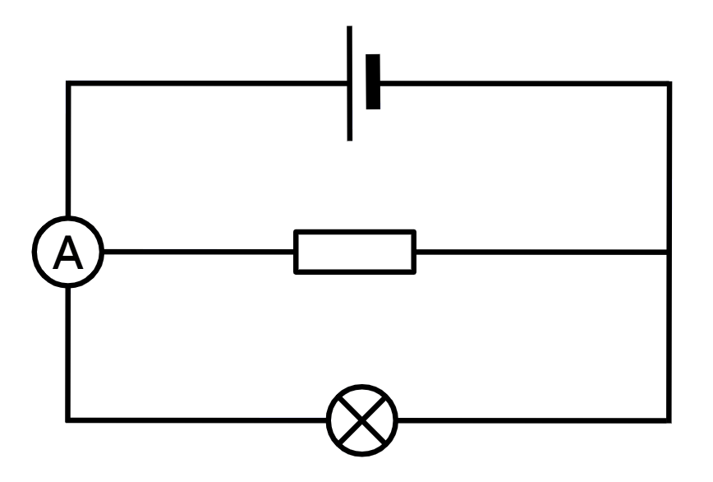
Cabbirka hadda (current) ee wareeg isbarbar (parallel circuit)
Kee ka mid ah wareegyada (circuits) ayaa muujinaya ammeter meel sax ah si loo cabbiro hadda (current) ee laambadda?

Slide 17
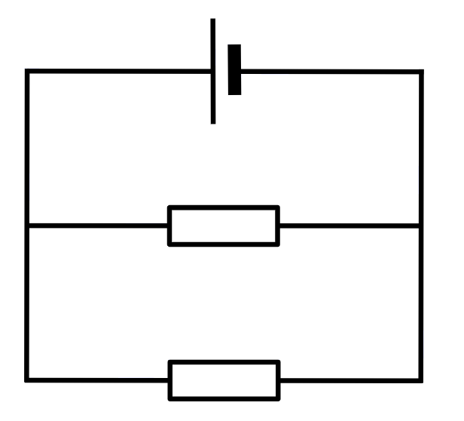
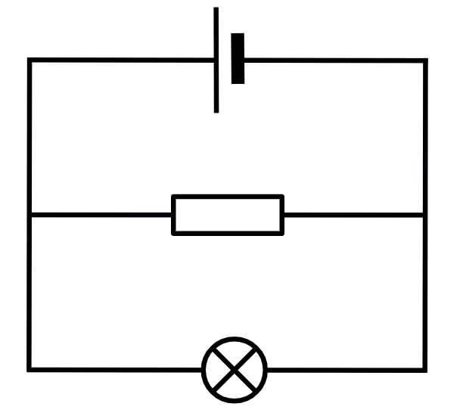
Cabbirka hadda (current) ee wareeg isbarbar (parallel circuit)
Samee wareeg A oo cabbir hadda (current) ee unugga (cell).
Cabbir hadda (current) ee laan kasta.
Qor dhammaan cabbiraadahaaga.
Ku celi tillaabooyinka 1 ilaa 3 wareegyada B iyo C.
A
B
C
5 Ω
5 Ω
10 Ω
10 Ω

Slide 18
Cabbirka hadda (current) ee wareeg isbarbar (parallel circuit)
Natiijooyinka tusaale ee hadda (current) ee laamaha:
A
B
unugga (cell): 0.45 A
5 Ω resistor: 0.30 A
10 Ω resistor: 0.15 A
unugga (cell): 0.50 A
5 Ω resistor: 0.30 A
lamb (Lamp): 0.20 A
5 Ω
5 Ω
10 Ω
C
unug (Cell): 0.35 A
10 Ω resistor (Resistor): 0.15 A
lamb (Lamp): 0.20 A
10 Ω

Slide 19
Qiyaasta haddiyaha (Current) ee wareegga barbar-socda (Parallel circuit)
Qiyaasta haddiyaha (Current) ee wareegga barbar-socda (Parallel circuit)
Qaanuunka haddiyaha (Current) ee wareegyada barbar-socda (Parallel circuits)

Slide 20
Qaanuunka haddiyaha (Current) ee wareegyada barbar-socda (Parallel circuits)
Wareegga A, haddiyayaasha (Currents) ee laamaha (Branches) waxay ahaayeen:
unug (Cell): 0.45 A
0.30 + 0.15 = 0.45 A
5 Ω
0.30 A
Haddiyaha (Current) ee laanta (Branch) unugga (Cell) wuxuu la mid yahay wadarta haddiyaha (Current) ee laamaha (Branches) kale.
10 Ω
0.15 A

Slide 21
Qaanuunka haddiyaha (Current) ee wareegyada barbar-socda (Parallel circuits)
Wareegga B, haddiyayaasha (Currents) ee laamaha (Branches) waxay ahaayeen:
unug (Cell): 0.50 A
0.30 + 0.20 = 0.50 A
5 Ω
0.30 A
Haddiyaha (Current) ee laanta (Branch) unugga (Cell) wuxuu la mid yahay wadarta haddiyaha (Current) ee laamaha (Branches) kale mar kale.
0.20 A

Slide 22
Qaanuunka haddiyaha (Current) ee wareegyada barbar-socda (Parallel circuits)
Wareegga C, haddiyayaasha (Currents) ee laamaha (Branches) waxay ahaayeen:
unug (Cell): 0.35 A
0.15 + 0.20 = 0.35 A
10 Ω
0.15 A
Mar kale, haddiyaha (Current) ee laanta (Branch) unugga (Cell) wuxuu la mid yahay wadarta haddiyaha (Current) ee laamaha (Branches) kale.
0.20 A

Slide 23
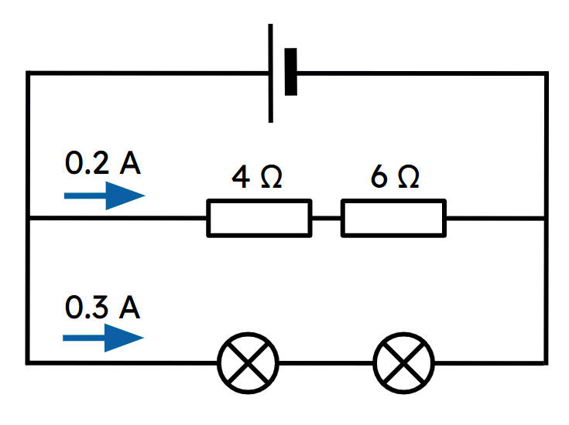
Qaanuunka haddiyaha (Current) ee wareegyada barbar-socda (Parallel circuits)
Waa maxay haddiyaha (Current) uu maro unugga (Cell) ee wareegga (Circuit) la muujiyey?
0.2 A
0.3 A
0.4 A
0.5 A
0.2 + 0.3 = 0.5 A

Slide 24
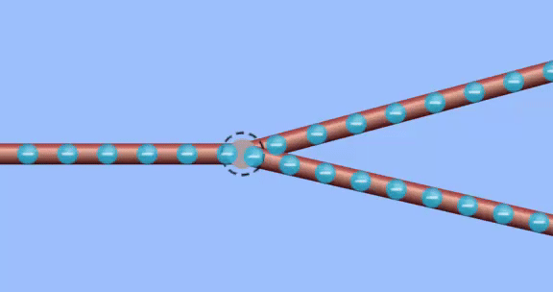
Qaanuunka hadda (current) ee wareegyada barbar socda (parallel circuits)
Qaanuunka haddiyaha (Current) ee isgoysyada (Junctions) waa in wadarta haddiyaha (Current) ee ku shubanaya isgoyska (Junction)
wuxuu la mid yahay wadarta hadda (current) ka soo baxaya isgoyska (junction).
hadda (current) soo gala
wuxuu la mid yahay hadda (current) soo baxa
Jilitaan (Simulation) PhET Interactive Simulations, Jaamacadda Colorado Boulder, shatiyaysan CC-BY-4.0

Slide 25
Qaanuunka hadda (current) ee wareegyada barbar socda (parallel circuits)
Wadarta hadda (current) soo gala iyo ka soo baxa isgoyska (junction) waa isku mid.
0.45 A ayaa ku soo gala isgoyska (junction)
5 Ω
0.30 + 0.15 = 0.45 A ayaa ka soo baxa isgoyska (junction)
0.30 A
0.15 A
10 Ω

Slide 26
Qaanuunka hadda (current) ee wareegyada barbar socda (parallel circuits)
Wadarta hadda (current) soo gala iyo ka soo baxa isgoyska (junction) waa isku mid.
0.45 A ayaa ka soo baxa isgoyska (junction)
5 Ω
0.30 A
0.30 + 0.15 = 0.45 A ayaa ku soo gala isgoyska (junction)
0.15 A
10 Ω

Slide 27
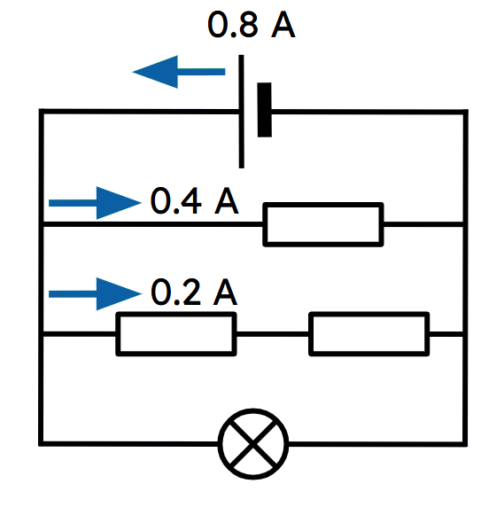
Qaanuunka hadda (current) ee wareegyada barbar socda (parallel circuits)
Waa imisa hadda (current) dhex mara laydhka (lamp) ee wareegga la muujiyey?
0.2 A
0.4 A
0.6 A
0.8 A

Slide 28
Qaanuunka hadda (current) ee wareegyada barbar socda (parallel circuits)
Hadda (current) ee laanta (branch) leh iska caabbin (resistance) hoose ayaa sareeya.
iska caabbin (resistance) hoose
5 Ω
0.30 A
hadda (current) sare
10 Ω
0.15 A

Slide 29
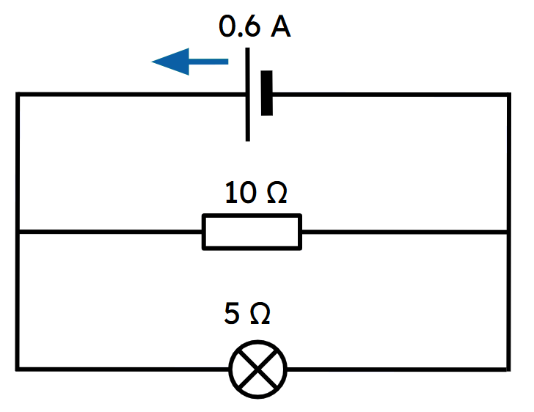
Qaanuunka hadda (current) ee wareegyada barbar socda (parallel circuits)
Kee ka mid ah kuwan soo socda ayaa si sax ah u bixiya hadda (current) dhex mara iska caabbinta (resistor) iyo laydhka (lamp) ee wareegga la muujiyey?
iska caabbinta (resistor) 0.6 A laydhka (lamp) 0.6 A
resistor (iska-horimaad) 0.6 A laydh 0.4 A
resistor 0.3 A laydh 0.3 A
resistor 0.2 A laydh 0.4 A

Slide 30
Qaanuunka hadda (current) ee wareegyada barbar-socda (parallel circuits)
Unug isku mid ah, hadda (current) maraya qaybaha isku midka ah (iska-horimaad (resistance) isku mid ah) waa isku mid.
0.45 A
0.50 A
0.35 A
5 Ω
0.30 A
5 Ω
10 Ω
0.30 A
0.15 A
10 Ω
0.15 A
0.20 A
0.20 A

Slide 31
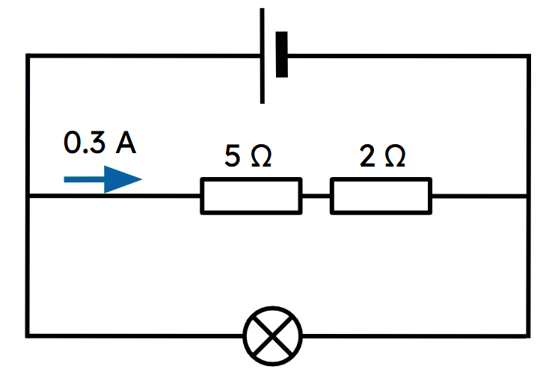
Qaanuunka hadda (current) ee wareegyada barbar-socda (parallel circuits)
Hadda maraya laydhka ee wareegga la muujiyey wuxuu noqon doonaa 0.3 A haddii uu leeyahay iska-horimaad (resistance) ah 7 Ω.
Qaybaha yar ee laan ka mid ah waxay sababi doonaan in hadda (current) isbedelo.
Kalawadhnimada (voltage) ku riixaysa hadda (current) laan kasta waa isku mid.

Slide 32
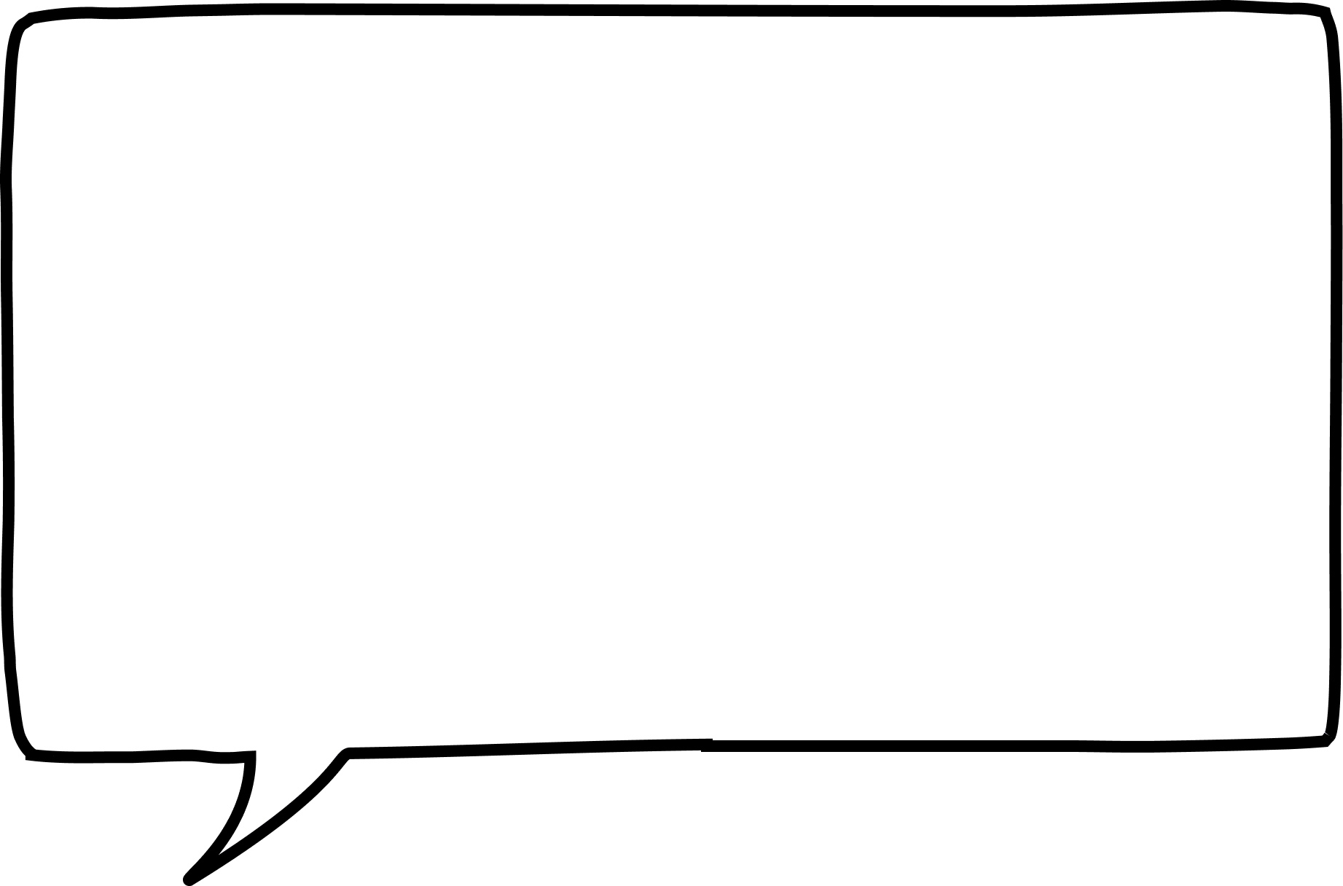
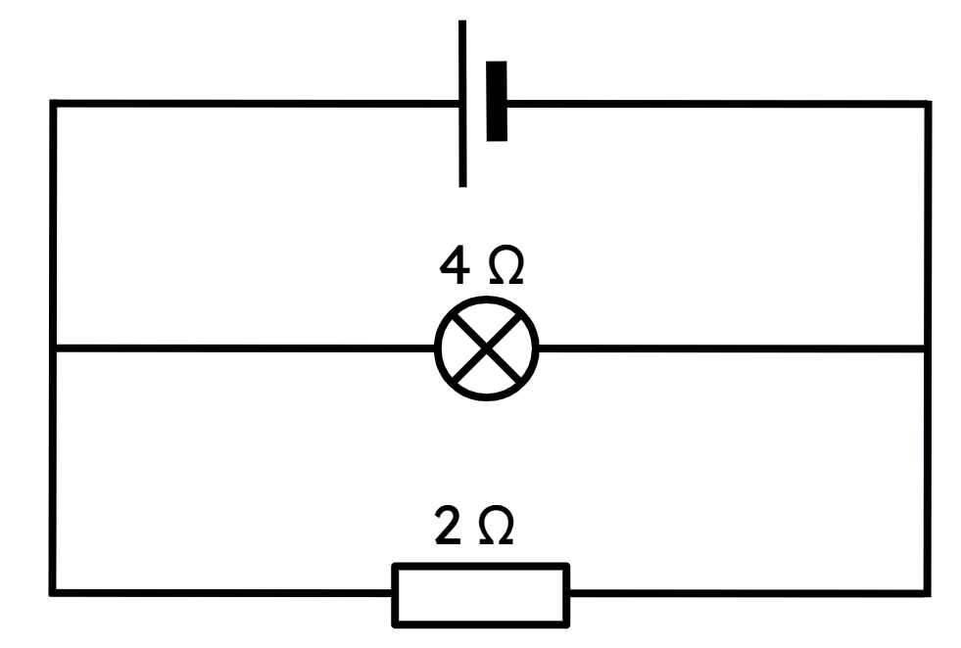






Qaanuunka hadda (current) ee wareegyada barbar-socda (parallel circuits)
Layla iyo Cabdi waxay dhiseen wareegga la muujiyey waxayna saadaalinayaan cabbirka hadda (current) ee maraya laydhka iyo resistor-ka.
Hadda weyn (current) ayaa maraysa resistor-ka marka loo eego laydhka sababtoo ah wuxuu leeyahay iska-horimaad (resistance) yar.
Hadda weyn (current) ayaa maraysa laydhka marka loo eego resistor-ka sababtoo ah waxay u dhowdahay unuga.
Layla
Cabdi
Sheeg in arday kastaa sax yahay iyo in qaldan yahay oo sharax sababta?

Slide 33
Qaanuunka hadda (current) ee wareegyada barbar-socda (parallel circuits)
Sheeg in arday kastaa sax yahay iyo in qaldan yahay oo sharax sababta?
Layla waa sax, Cabdina waa qaldan.
Kalawadhnimada (voltage) labada laan waa isku mid.
Waxaa jiri doonta hadda (current) weyn oo dhex maraysa resistor-ka maadaama uu leeyahay iska-horimaad (resistance) ka yar kan laydhka.
Masaafada qaybaha ka fog unugu saamayn kuma leh hadda (current) sababtoo ah fiilooyinku iskama hortagaan hadda (current).

Slide 34
Cabbirka hadda (current) ee wareegga barbar socda (parallel circuit)
Wareegga barbar socda (parallel circuit), hadda (current) wuxuu ku qulqulaa dhammaan laamaha.
Hadda (current) wuxuu ku kala qaybsamaa isgoysyada (junctions), wadarta hadda ee gasha isgoyska waa la mid ah wadarta hadda ee ka soo baxda isgoyska.
Marka la cabbirayo hadda (current) ee loop-ka, ammeter waa in la dhigaa inta u dhaxaysa isgoysyada (junctions) ee cidhifyada loop-ka.
Loop kastaa wuxuu yeelan doonaa voltage isku mid ah, markaa hadda (current) ee loop-ka wuxuu ku xiran yahay iska caabinta (resistance) ee loop-ka. Iska caabin sare waxay siin doontaa hadda hoose.

