Slide 1
Qiyaasida korontada (Electric Current)
Wareegyada taxan (Series Circuits)

Slide 2
Sida agabkeena waxbarasho loogu talagalay fasalka

Slide 3
Waxaan qiyaasi karaa korontada (Current) oo aan sharxi karaa qaanuunka korontada ee wareegga taxan (Series Circuit).

Slide 4
ammeter (Ammeter)
amps (A)
wareeg taxan (Series Circuit)

Slide 5
Ammeter waa qalab qiyaasa korontada (Current) ku socota wareegga.
Ammeter wuxuu qiyaasaa korontada (Current) cutubyo loo yaqaan amps (A), oo gaaban yahay amperes.
Wareeg taxan (Series Circuit) waa wareeg koronto oo leh hal wareeg oo dhamaystiran oo ka bilaabma dhamaadka batteriga ilaa dhamaadka kale.

Slide 6

Qiyaasida korontada (Electric Current)
Isticmaalka ammeter-ka
Korontada (Current) ee wareegyada leh ammeter

Slide 7
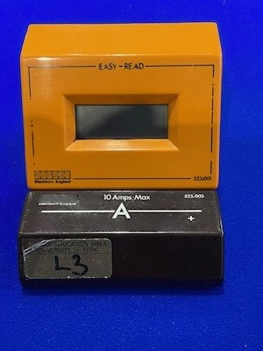

Isticmaalka ammeter-ka
Kani waa ammeter.
Waxaa loo isticmaalaa in lagu qiyaaso korontada (Current) ku socota wareegga.
Wuxuu muujiyaa korontada (Current) amps (A), oo gaaban yahay amperes.
Calaamadda ammeter-ka waa:

Slide 8
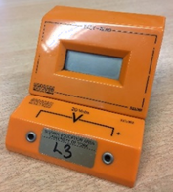
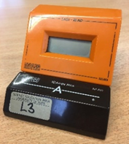
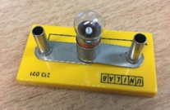

Isticmaalka ammeter-ka
Mid ka mid ah sawirada hoose waa ammeter?

Slide 9
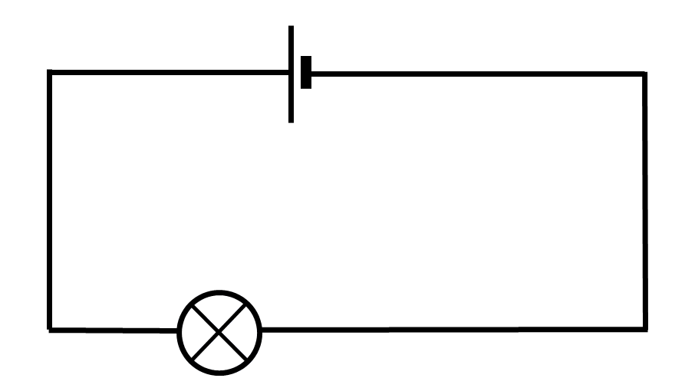

Isticmaalka ammeter-ka (Ammeter)
Ammeter-yada had iyo jeer waxaa la dhigaa si taxan (Series) oo leh qaybaha.
Ammeter-kani waa qayb ka mid ah hal wareegga (Loop) ee wareegga, sidaas darteed dhammaan korontada (Current) waa ay dhex martaa.

Slide 10
Isticmaalka ammeter-ka (Ammeter)
Marka ammeter-ka (Ammeter) la geliyo wareegga (Circuit), hadda (Current) waa isku mid.
Ammeter-yada (Ammeters) waxay cabbiraan hadda (Current) iyagoon saameyn ku yeelan socodkiisa.

Slide 11
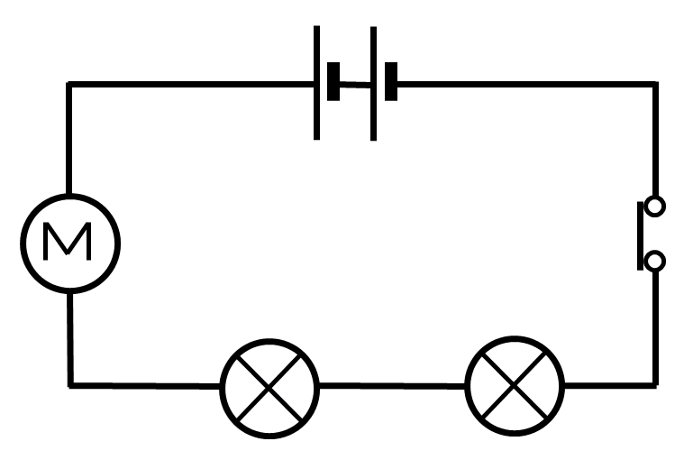
Isticmaalka ammeter-ka (Ammeter)
Ammeter-ka (Ammeter) waxaa la dhigaa taxane (Series) wareeggan (Circuit).
Sheegashadee (Statement) waa sax?
Haddii la dhigo kahor matoorka (Motor), matoorku (Motor) wuu gaabiyaa.
Meel kasta oo la dhigo, saameyn (Effect) ma jirto.
Haddii la dhigo dhexda labada laambad (Lamps), laambadaha (Lamps) kaliya ayaa gudcurma.
Meel kasta oo la dhigo, matoorku (Motor) wuu gaabiyaa, laambaduhuna (Lamps) way gudcurmaan.

Slide 12
Isticmaalka ammeter-ka (Ammeter)
Ammeter-ka (Ammeter) waxaa la dhigi karaa meel kasta oo wareeg taxane (Series Circuit) ah.
Hadda (Current) oo dhan ayaa wali dhex maraysa, marka hadda (Current) uu cabbirayo waa isku mid.

Slide 13
Isticmaalka ammeter-ka (Ammeter)
Ammeter-yadu (Ammeters) saameyn (Effect) kuma laha hadda (Current) wareegga (Circuit).
Laambaddan (Lamp) waxay heshaa isku hadda (Current) waxayna ahaataa mid iftiin isku mid ah, xataa haddii ammeter-yadan (Ammeters) oo dhan lagu daro.

Slide 14
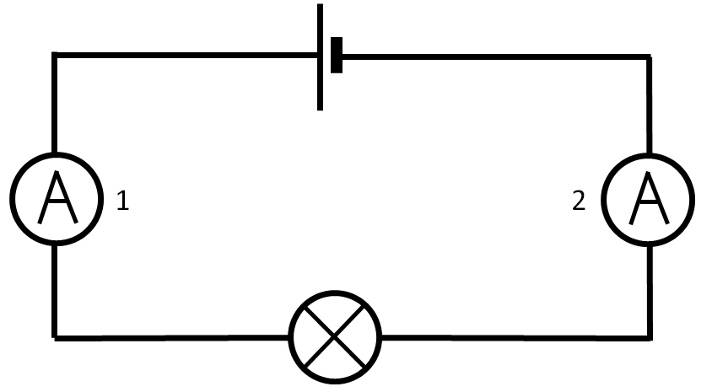
Isticmaalka ammeter-ka (Ammeter)
Akhriska (Reading) ammeter-ka (Ammeter) 1 waa ka weyn yahay kan ammeter-ka (Ammeter) 2.
Hadda (Current) waa isku mid wareegga (Circuit) oo dhan.
Qaar ka mid ah hadda (Current) waxaa isticmaala laambadda (Lamp).

Slide 15
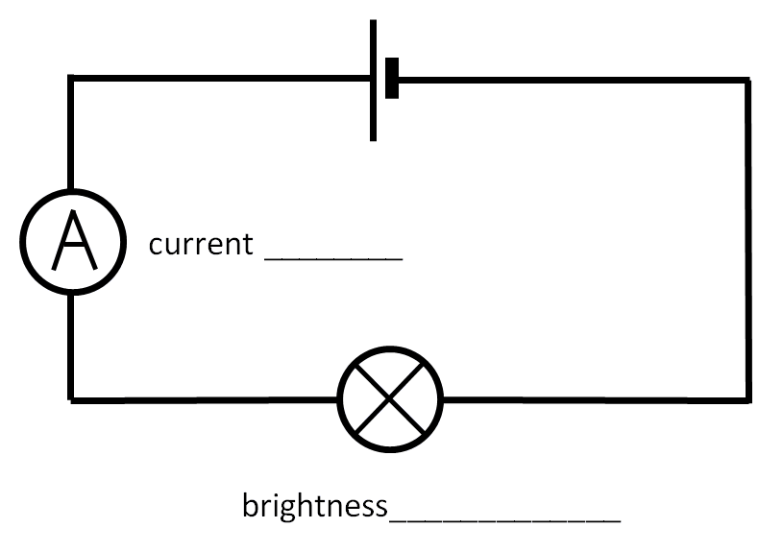
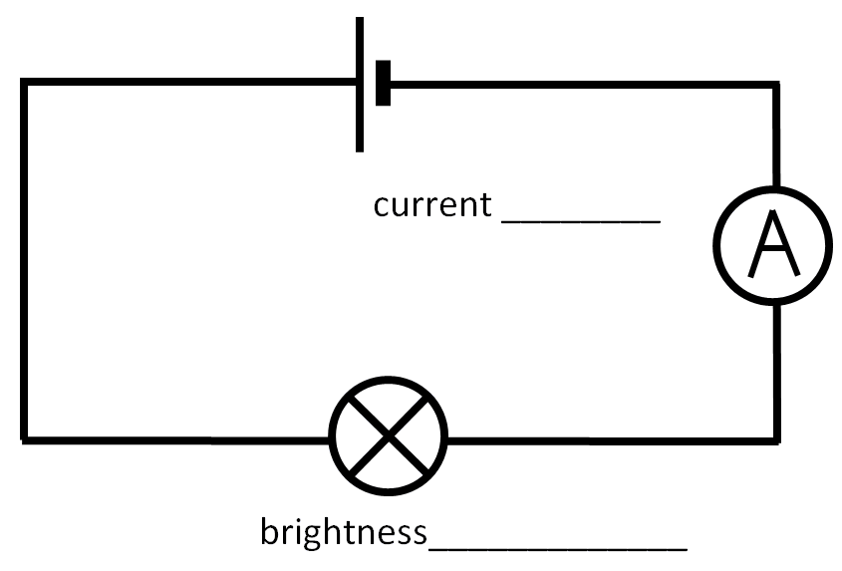
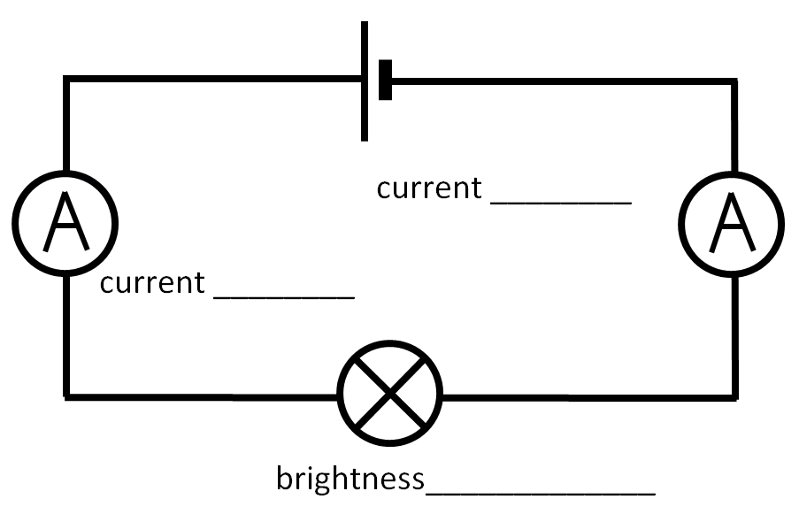
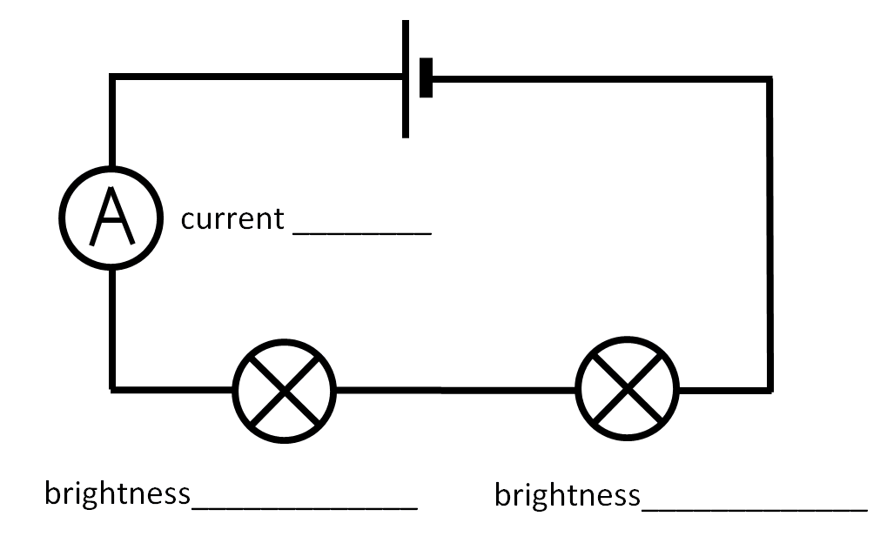
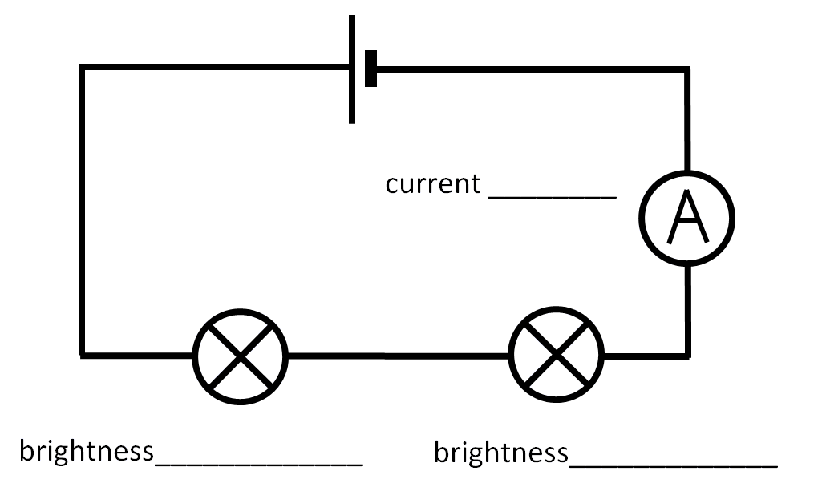
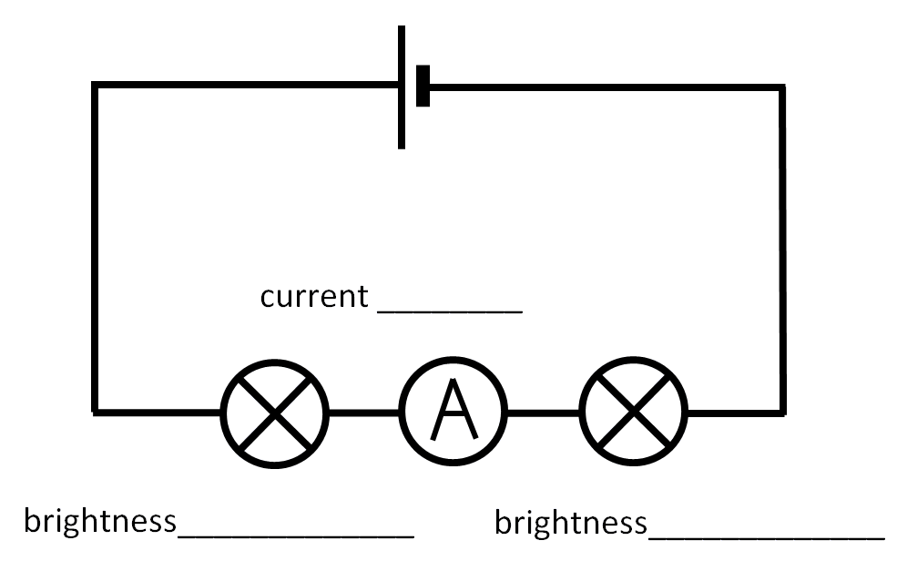
Isticmaal ammeter-ka
Dhis wareegyada (Circuits) soo socda, qor hadda (Current) la cabbiray oo sharax iftiinka laambadaha (Lamps) (tusaale: iftiin leh ama gudcur).

Slide 16
Isticmaal ammeter-ka
Dhis wareegyada soo socda, qor currents-ka la qiyaasay oo sharax iftiinka laambadaha (tusaale, iftiin ama gudcur).
0.14 A
0.15 A
0.15 A
0.15 A
iftiin
iftiin
iftiin
0.07 A
0.07 A
0.07 A
gudcur
gudcur
gudcur
gudcur
gudcur
gudcur

Slide 17
Qiyaasida current-ka korontada
Isticmaal Ammeter-ka
Current-ka wareegyada leh ammeter

Slide 18
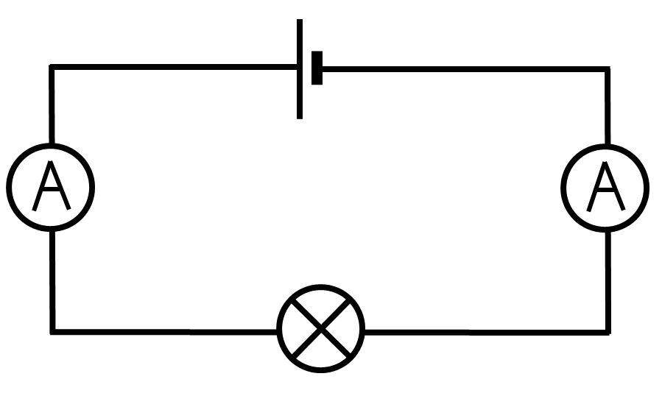
Current-ka wareegyada leh ammeter
Wareeg taxane ah, current-ka ammeter-ku qiyaaso waa isku mid haddii uu meel kasta yaallo.
0.15 A
0.15 A
0.15 A
0.15 A
Current-ka sidoo kale waa isku mid laambadda, cell-ka iyo fiilooyinka.

Slide 19
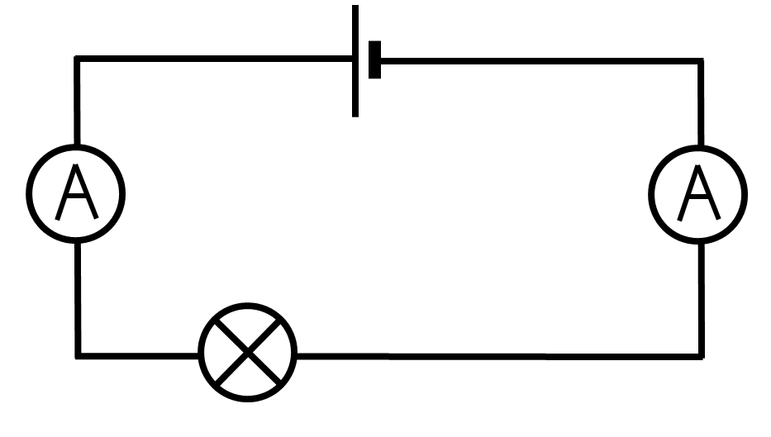


Current-ka wareegyada leh ammeter
Ku darista laambad kale waxay yareysaa current-ka wareegga oo dhan.
0.15 A
0.07 A
0.04 A
0.15 A
0.07 A
0.04 A
Ku darista resistor sidoo kale waxay yareysaa current-ka.

Slide 20
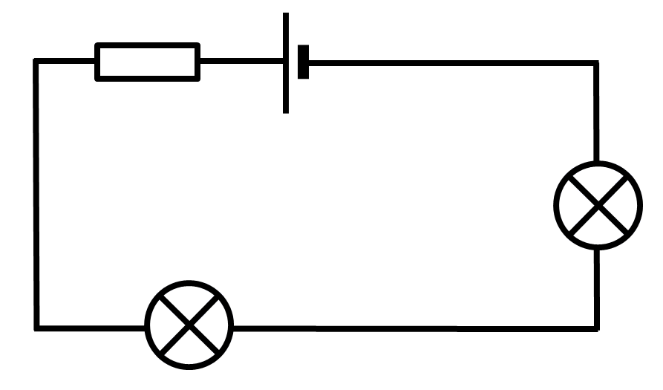
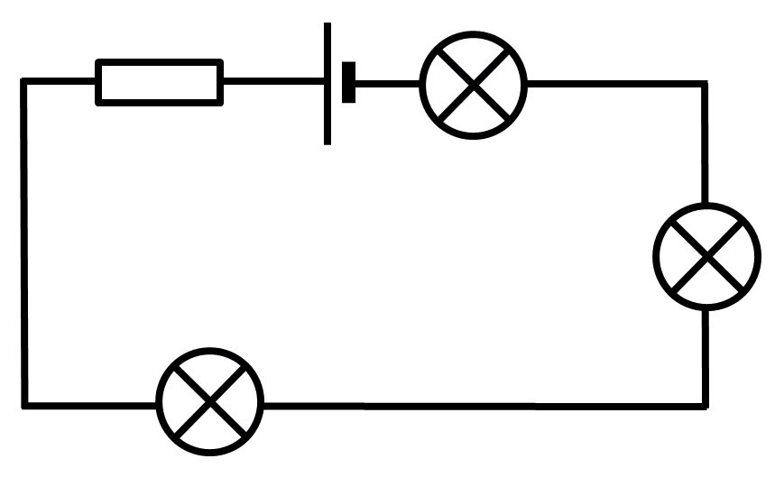
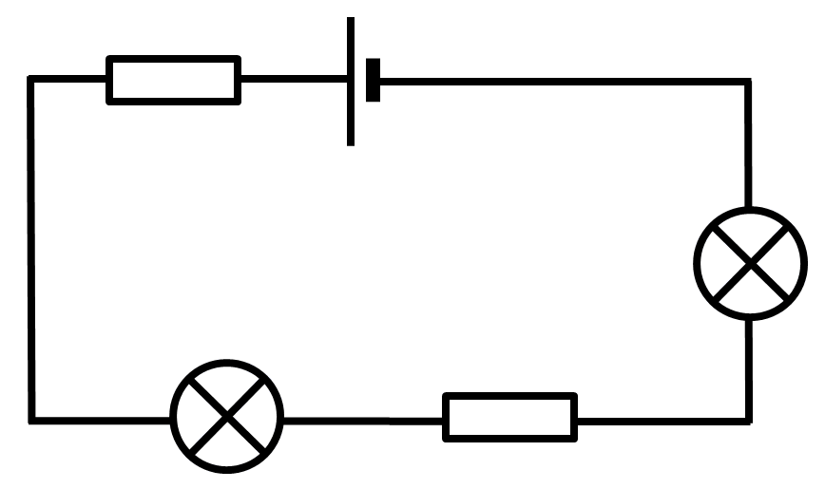
Current (Current) ee wareegyada (circuits) leh ammeter (ammeter)
Kee ka mid ah wareegyadan ayaa leh current-ka ugu weyn?
Qaybuhu waa isku mid (identical).

Slide 21
Current (Current) ee wareegyada (circuits) leh ammeter (ammeter)
Ku darista qayb (component) meel kasta oo wareeg taxane ah (series circuit),
waxay beddeshaa current (current) guud ahaan wareegga (circuit).

Slide 22
Current (Current) ee wareegyada (circuits) leh ammeter (ammeter)
Maxaa dhacaya marka laambad (lamp) lagu daro wareeg taxane ah (series circuit)?
Current (Current) ka hor laambadda (lamp) wuu yaraadaa.
Current (Current) guud ahaan wareegga (circuit) wuu kordhaa.
Current (Current) guud ahaan wareegga (circuit) wuu yaraadaa.
Current (Current) ka dib laambadda (lamp) wuu yaraadaa.

Slide 23
Current (Current) ee wareegyada (circuits) leh ammeter (ammeter)
Beddelidda boosaska labada laambad (lamp) iyo resistor-ka (resistor) kuma saamayso cabbirka current-ka (current).
0.04 A
0.04 A

Slide 24
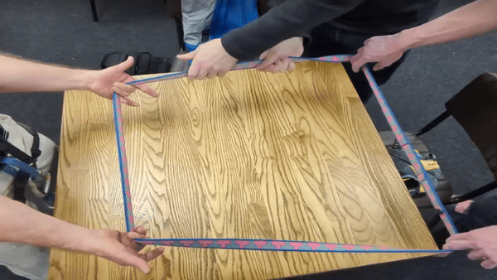
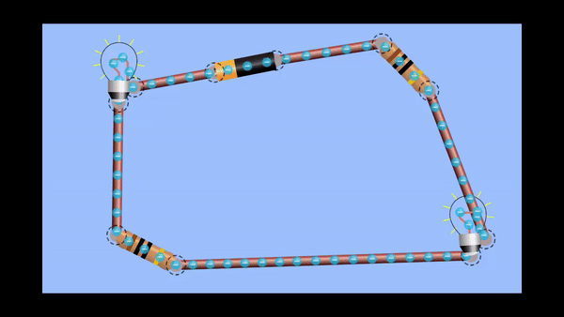
Current (Current) ee wareegyada (circuits) leh ammeter (ammeter)
Arday qaar ayaa sameeyay qaab (model) wareeg taxane ah (series circuit).
Jilitaan (Simulation) by PhET Interactive Simulations, University of Colorado Boulder, shatiyaysan CC-BY-4.0 (https://phet.colorado.edu).

Slide 25
Current (Current) ee wareegyada (circuits) leh ammeter (ammeter)
Arday qaar ayaa sameeyay qaab (model) wareeg taxane ah (series circuit).
gacmaha soo jiidaya ayaa dhaqaajiya cajaladda (tape) wareegga
afarta gacmood oo taagan ayaa u taagan qaybaha (components)
cajaladdu (tape) waxay u taagan tahay current-ka (current) siliga (wire)

Slide 26
Current-ka (Current) ee wareegyada (circuits) oo leh ammeter
Isku xidh qaybaha qaabka cajaladda (tape model) kuwa wareegga (circuit).
gacmaha jiidaya
current-ka (current) ee siliga
gacmaha taagan
cell ama battery
tape
lambiyada (lamps) ama resistors

Slide 27
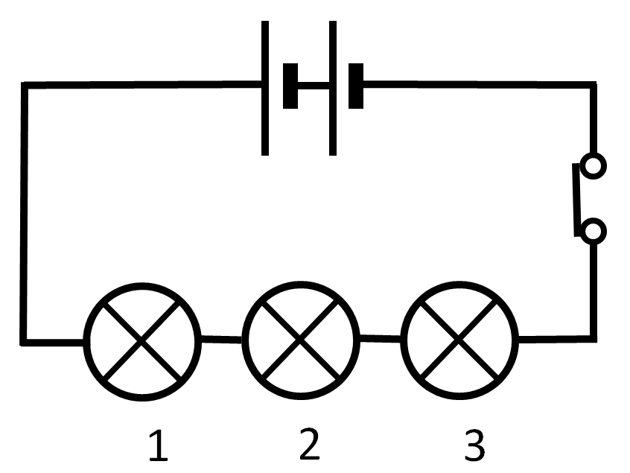



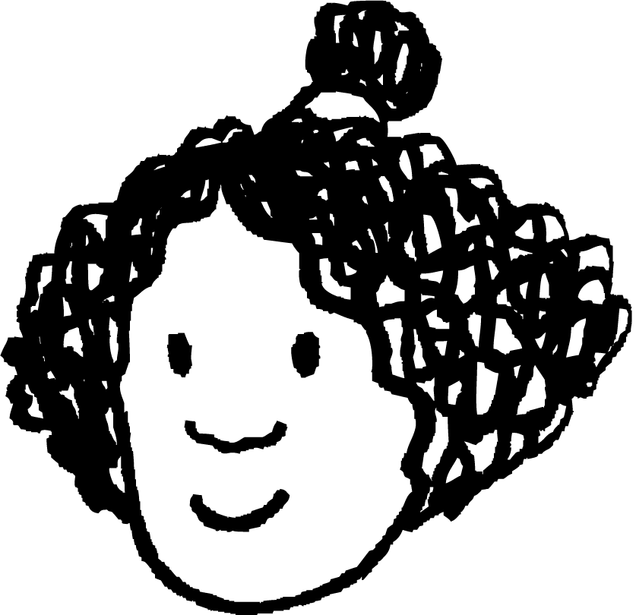
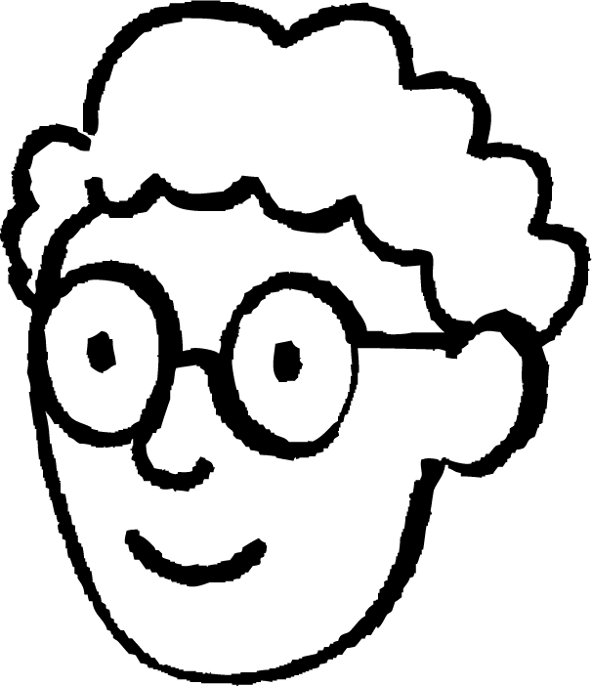
Current-ka (Current) ee wareegyada (circuits) oo leh ammeter
Axmed iyo Isra waxay saadaalinayaan sida wareeg (circuit) ay dhiseen u shaqeyn doono.
Lambiyada 1 iyo 3 waxay noqon doonaan kuwa ifaya, halka lambiga 2 uu noqon doono mid daciif ah.
Lambiga 1 wuxuu noqon doonaa kan ugu ifaya, ka dibna 2, markaas 3.
Sharax sababta aad ugu malaynayso in Axmed iyo Isra ay sameeyeen saadaashooda, ka dibna sharax halka saadaashoodu ay ku kala duwan yihiin natiijada dhabta ah iyo waxa jawaabta saxda ah tahay.

Slide 28
Current-ka (Current) ee wareegyada (circuits) oo leh ammeter
Sharax sababta aad ugu malaynayso in Axmed iyo Isra ay sameeyeen saadaashooda, ka dibna sharax halka saadaashoodu ay ku kala duwan yihiin natiijada dhabta ah iyo waxa jawaabta saxda ah tahay.
Axmed wuxuu u malaynayaa in current-ku (current) uu hoos u dhigi doono marka uu dhex maro lambi kasta, sidaas darteed lambiga koowaad wuxuu helaa kan ugu badan, halka kan ugu dambeeya uu helo kan ugu yar.
Isra waxay u malaynaysaa in lambiyada ugu dhow battery-ga ay helaan current-ka (current) ugu badan, sidaas darteed waxay noqon doonaan kuwa ka ifaya lambiga dhexda ku yaal, kaas oo ah kan ugu fog battery-ga.
Labadooduba waa qalad sababtoo ah current-ku (current) waa isku mid inta uu wareegga (circuit) ku jiro, dhammaan lambiyada waxay helayaan current isku mid ah, taasoo ka dhigaysa inay si isku mid ah u ifaan.

Slide 29
Cabbirka current-ka (electric current)
Ammeter wuxuu cabbiraa current-ka (current) ee wareegga (circuit) waxaana la dhigaa si taxane ah (series).
Current-ka (Current) waxaa lagu cabbiraa unugyo loo yaqaan amps (A), oo ah soo gaabinta amperes.
Ammeters kuma saameeyaan current-ka (current) ay cabbiraan.
Wareegga taxanaha ah (series circuit), current-ku (current) waa isku mid inta oo dhan, iyo ku darista qayb meel kasta oo wareegga (circuit) ah waxay saameyn doontaa current-ka (current) meel kasta oo wareegga (circuit) ah.
Waxaan u isticmaali karnaa moodello si ay noo caawiyaan sharaxaadda sida wareegyada (circuits) u shaqeeyaan.

