Slide 1
Qiyaasida korantada (voltage)
Wareegyo taxane ah (series circuits)

Slide 2
Sida agabkeena waxbarista loogu talagalay fasalka

Slide 3

Waxaan qiyaasi karaa sida loo qiyaaso korantada (voltage) iyo saamaynta korantada unugyada ama baytariyada kala duwan ee wareegga korantada.

Slide 4
voltmitir (voltmeter)
koronto (voltage)
farqiga awoodda (potential difference, p.d.)
volts (V)
baytari (battery)

Slide 5
Voltmitirku (voltmeter) waa aalad qiyaasa korontada (voltage) ay siiso unug ama baytari ama qayb ka mid ah wareegga.
Korontadu (voltage) waa cabbirka 'riixista' unugga ama baytariga ee dhaqaajisa danabka (charge) wareegga.
Farqiga awoodda (potential difference, p.d.) waa erey rasmi ah oo loo isticmaalo korontada (voltage); waxaa la isku beddeli karaa.
Voltmitirku (voltmeter) wuxuu qiyaasaa korontada (voltage) ama farqiga awoodda (potential difference) oo lagu qiyaaso cutubyo la yiraahdo volts (V).
Labo unug ama in ka badan oo isku xiran taxane ayaa sameeya baytari (battery).

Slide 6

Qiyaasida korontada (voltage)
Isticmaalka voltmitirka (voltmeter)
Waa maxay koronto (voltage)?

Slide 7
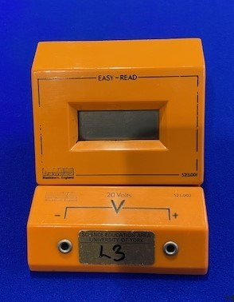
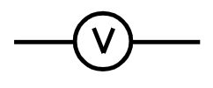
Isticmaalka voltmitirka (voltmeter)
Qaybta la muujiyay waa voltmitir (voltmeter).
Waxaa loo isticmaalaa in lagu qiyaaso danab (voltage) ee qaybaha (components).
Wuxuu muujiyaa korontada (voltage) oo ku qoran volts (V).
Farqiga awoodda (potential difference, p.d.) waa erey rasmi ah oo loo isticmaalo korontada (voltage).
Astaanta voltmitirka (voltmeter) waa:

Slide 8
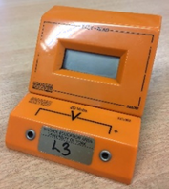
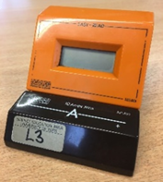
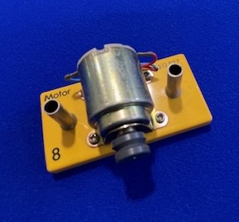

Isticmaalka voltmeter (voltmeter)
Mid ka mid ah sawirradee waa voltmeter (voltmeter)?

Slide 9
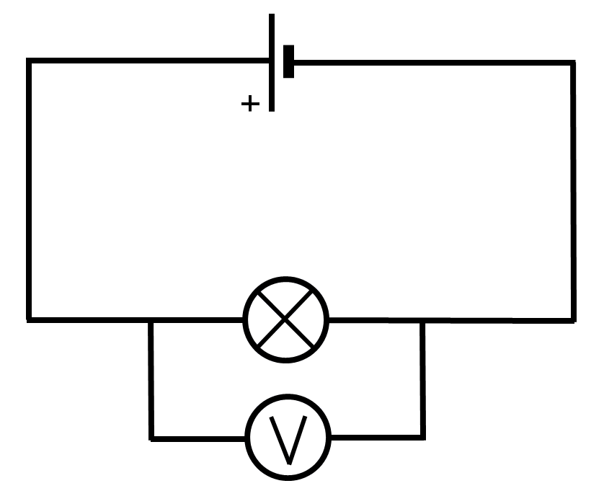
Isticmaalka voltmeter (voltmeter)
Voltmeter (voltmeter) waxaa la dhigi karaa qayb (component) dhinaceeda:

Slide 10
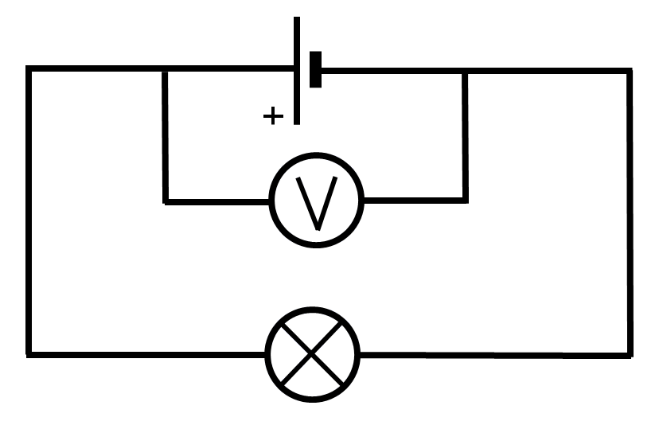
Isticmaalka voltmeter (voltmeter)
Voltmeter (voltmeter) sidoo kale waxaa la dhigi karaa unug (cell) dhinaceeda:

Slide 11
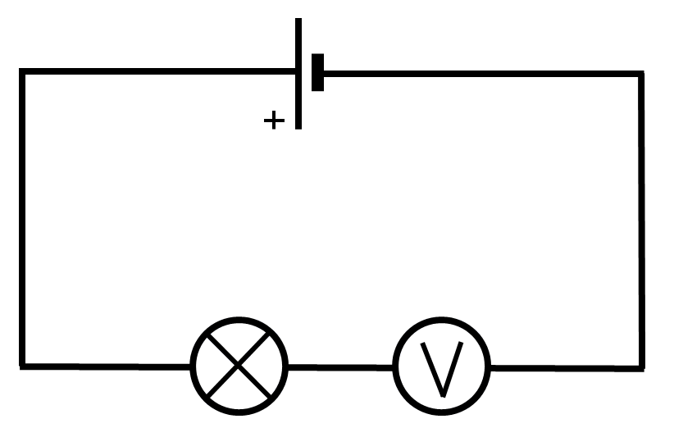
Isticmaalka voltmeter (voltmeter)
Voltmeter (voltmeter) waa in aan la dhigin isku xig (series):
Voltmeter (voltmeter) wuxuu xannibaa socodka (current) oo wuxuu ka hortagaa shidda laambadda (lamp).

Slide 12
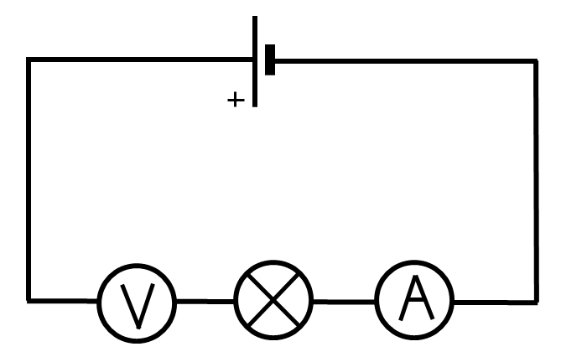
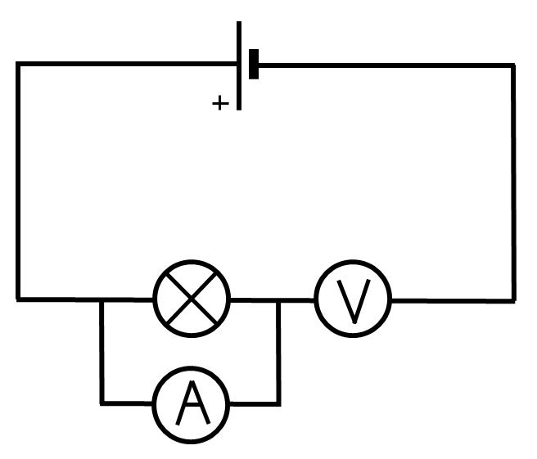
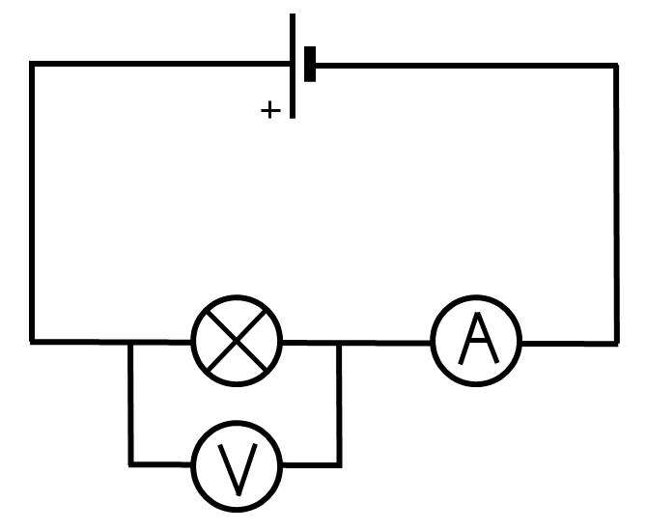
Isticmaalka voltmeter (voltmeter)
Jajabka (circuit diagram) midkee wuxuu muujinayaa voltmeter (voltmeter) oo si sax ah u qiyaasaya danabka (voltage) laambadda (lamp) dhinaceeda?

Slide 13
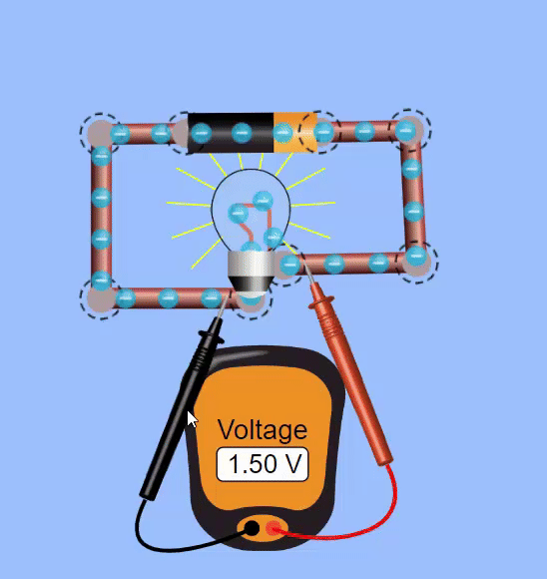
Isticmaalka voltmeter (voltmeter)
Qiyaasta danabka (voltage) siligga (wires) oo aan qaybo (components) lahayn kama beddelo akhrinta voltmeter (voltmeter).
Jilista (simulation) dhexdeeda, akhrintu waxay ku sii haddaa 1.50 V xitaa marka suullada (probes) voltmeter (voltmeter) loo raro boosas kala duwan oo siligga (wires) ah.
siligga (bare wire)
Jilista (Simulation) Gif ee PhET Interactive Simulations, Jaamacadda Colorado Boulder, oo ansaxiyay CC-BY-4.0 (https://phet.colorado.edu)

Slide 14
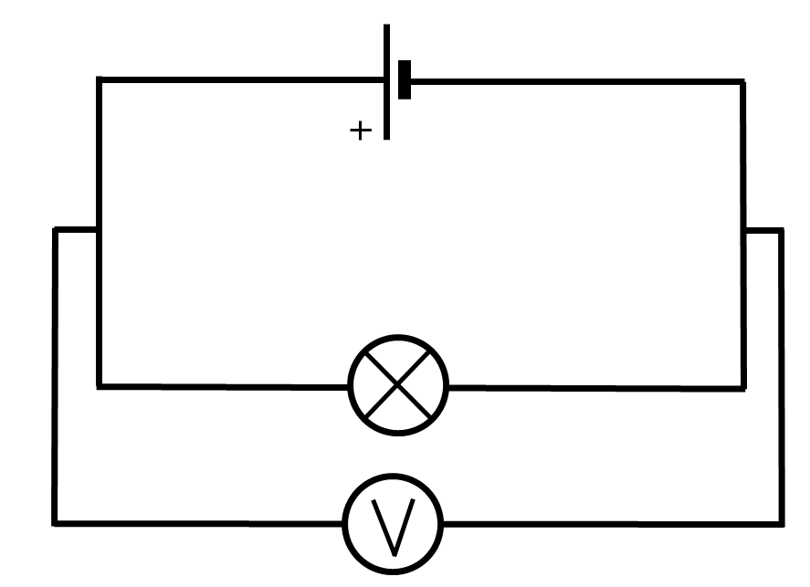
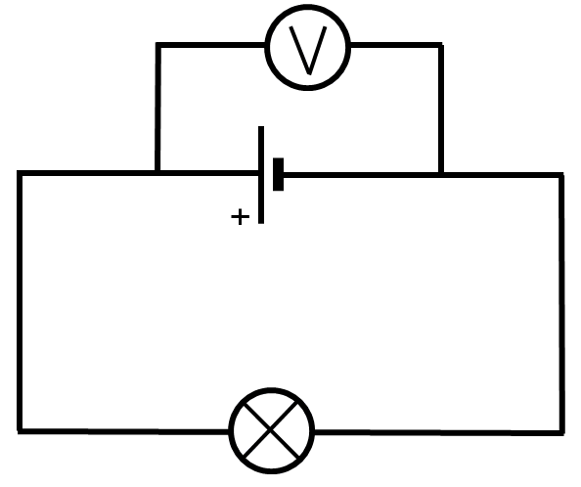
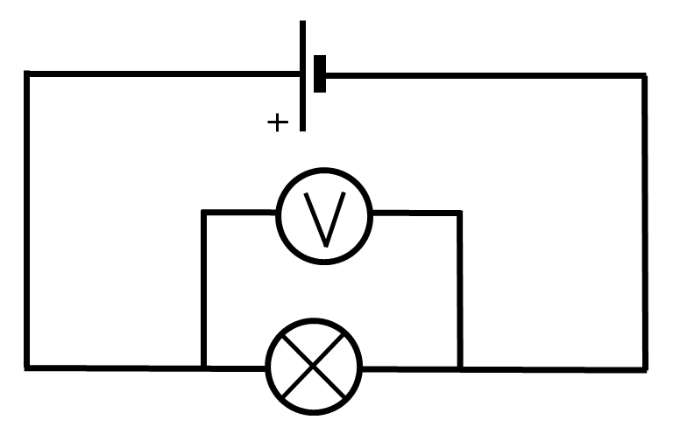
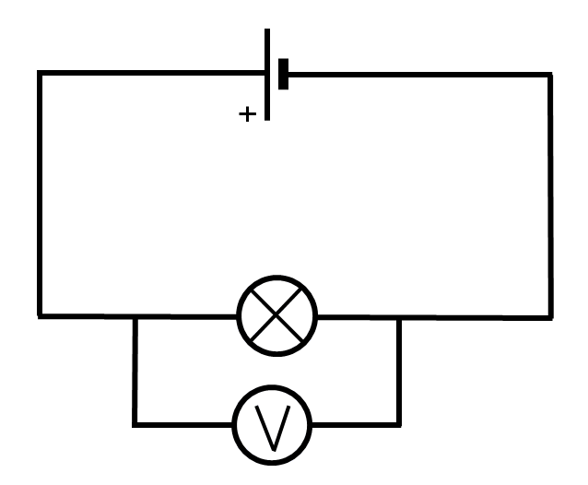
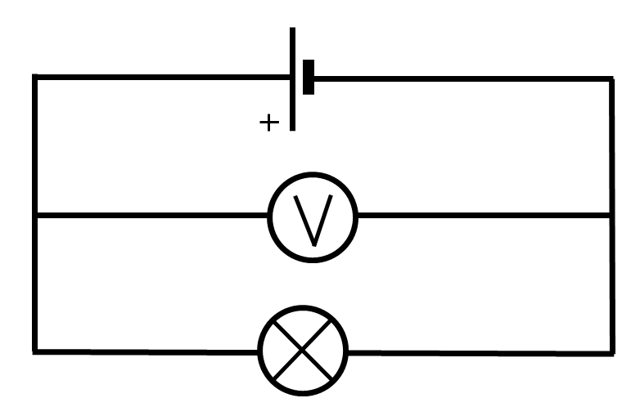
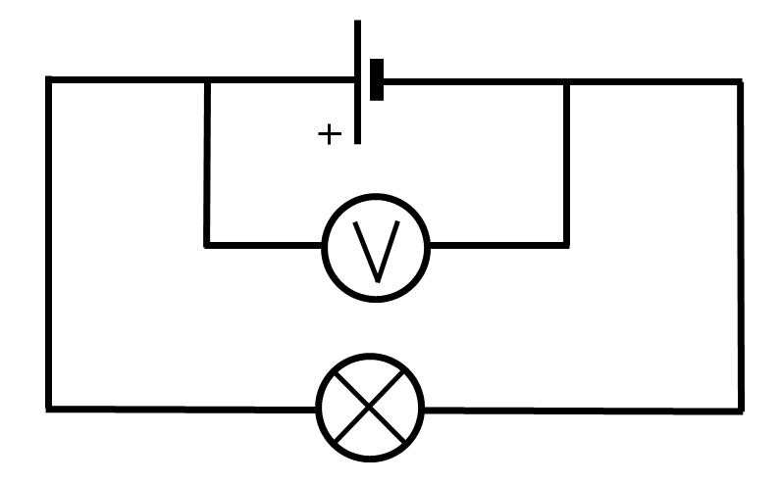
Isticmaalka voltmeter (voltmeter)
Jajabka (circuits) kasta, isku danab (voltage) ayaa la qiyaasayaa voltmeter (voltmeter) ku:

Slide 15
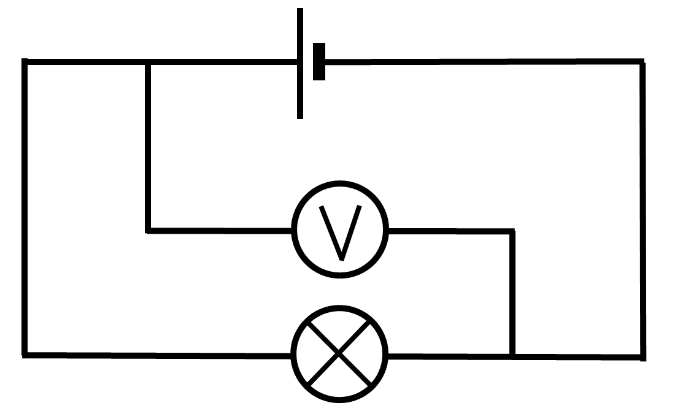
Isticmaalka voltmitir (voltmeter)
Voltmeter (voltmeter) ee jajabka (circuit) ku yaal wuxuu si sax ah u qiyaasayaa danabka (voltage) laambadda (lamp) dhinaceeda.
Silicyada (leads) voltmeter (voltmeter) saamayn kuma laha danabka (voltage) la qiyaasay.
Silicyada (leads) voltmeter (voltmeter) waa in lagu xiraa labada dhinac ee laambadda (lamp).

Slide 16
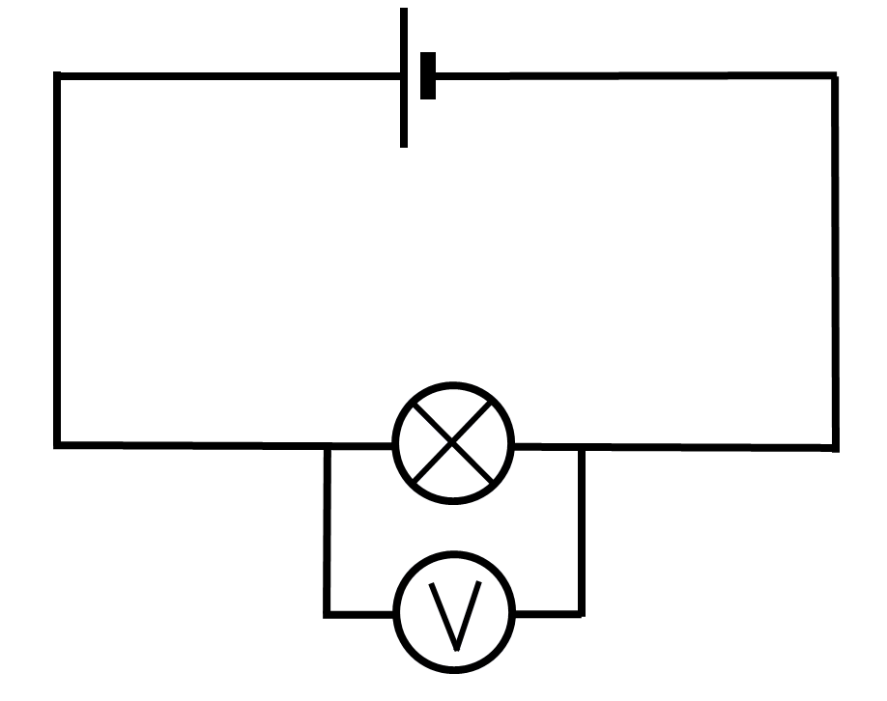
Isticmaalka voltmitir (voltmeter)
Wareegyada dhabta ah waxay noqon karaan kuwo adag, marka jaantusyada wareegyada waa in lagu hayaa kuwo fudud oo cad.
xiriirada waa inay ahaadaan kuwo u dhow iyo labada dhinac ee qaybta
voltmitirka (voltmeter) waa inuu ahaadaa meel u dhow qaybta uu cabbirayo

Slide 17
Isticmaalka voltmitir (voltmeter)
Jaantusyada wareegyada ee soo socda, kee baa si fiican u muujinaya sida loo cabbiro danabka (voltage) korontada lampada?

Slide 18

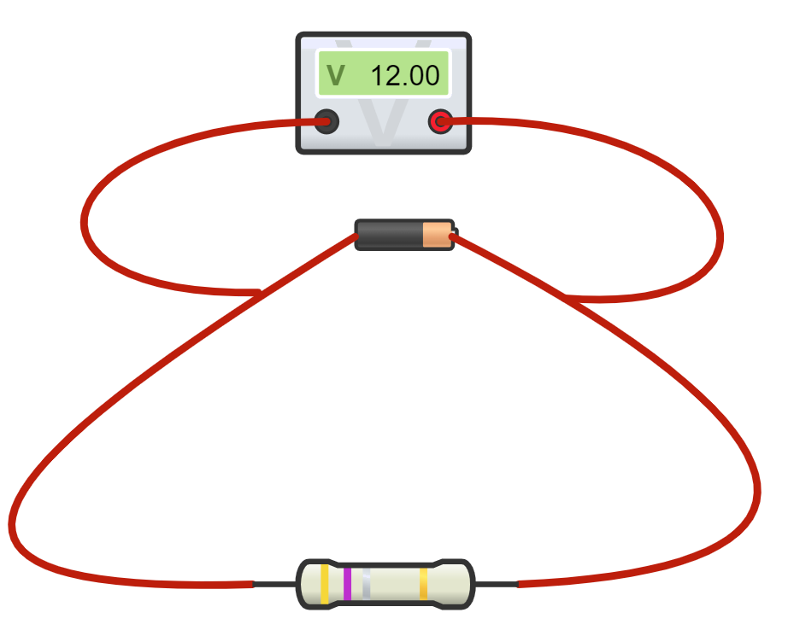






Isticmaalka voltmitir (voltmeter)
Caasha iyo Nuur waxay samaynayaan sawirada wareegyada ay baranayaan.
Maya, waxay cabbirayaan danabka (voltage) unugga (cell).
Sawirkani wuxuu muujinayaa voltmitir (voltmeter) oo cabbiraya danabka (voltage) resistor-ka.
Caasha
Nuur
Sharax haddii arday kastaa sax yahay iyo in kale, oo caddee jawaabtaada.

Slide 19
Isticmaalka voltmitir (voltmeter)
Sharax haddii arday kastaa sax yahay iyo in kale, oo caddee jawaabtaada.
Caasha waa sax in voltmitirku (voltmeter) cabbirayo danabka (voltage) resistor-ka. Meesha xadhkaha voltmitirku (voltmeter) kuma saamayn cabbirka, ilaa ay ka maqan yihiin qaybo dhexdooda iyo resistor-ka. Xadhkuhu kuma saamayn akhrinta danabka (voltage).
Nuur sidoo kale waa sax; voltmitirku (voltmeter) wuxuu cabbirayaa danabka (voltage) unugga (cell).
Danabka (voltage) unugga (cell) wuxuu la mid noqonayaa danabka (voltage) resistor-ka, maadaama resistor-ku yahay qaybta kaliya ee kale ee wareegga. Mar labaad, meesha xadhkaha voltmitirku (voltmeter) kuma saamayn cabbirka danabka (voltage).

Slide 20
Cabbirka danabka (voltage)
Isticmaalka voltmitir (voltmeter)
Waa maxay danab (voltage)?

Slide 21
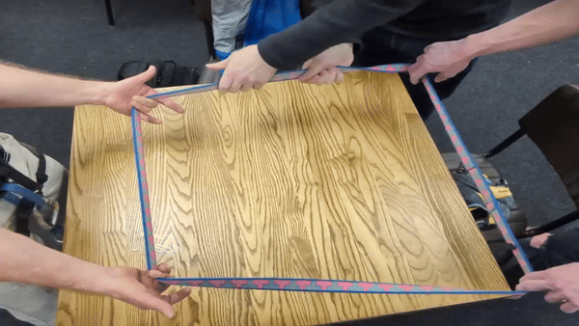
Waa maxay korantada (voltage)?
Korantada (Voltage) waa cabbirka 'riixista' (push) unugga ama batteriga (cell/battery) ee dhaqaajiya korantada (charge) wareegga (circuit).
Si adag u jiidista cajaladda (tape) waxay keentaa in wareeggu (loop) si dhakhso leh u socdo.
Tani waxay matali kartaa kororka korantada (increase in voltage), taasoo keenta korantada sare (higher current).
Si adag u qabashada cajaladda (tape) waxay keentaa in wareeggu (loop) hoos u dhaco.
Tani waxay matali kartaa hoos u dhaca korantada (decrease in current).

Slide 22
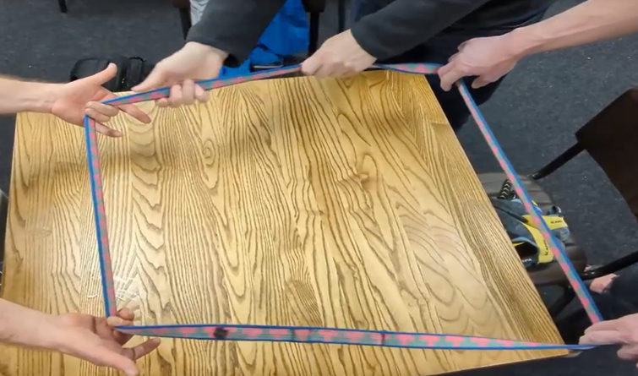
Waa maxay korantada (voltage)?
Marka cajaladda (tape) si tartiib ah loo dhaqaajiyo jilitaanka (simulation), tani waxay matali kartaa labadan mid ee soo socda?
korantada sare (higher voltage)
korantada hoose (lower voltage)
korantada sare (higher current)
korantada hoose (lower current)

Slide 23
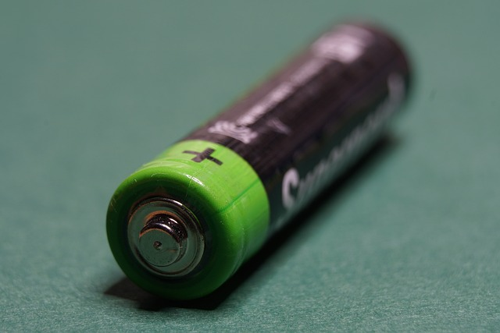
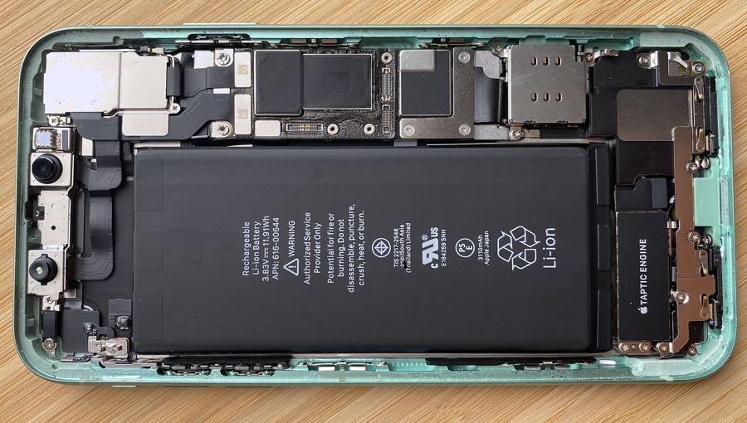
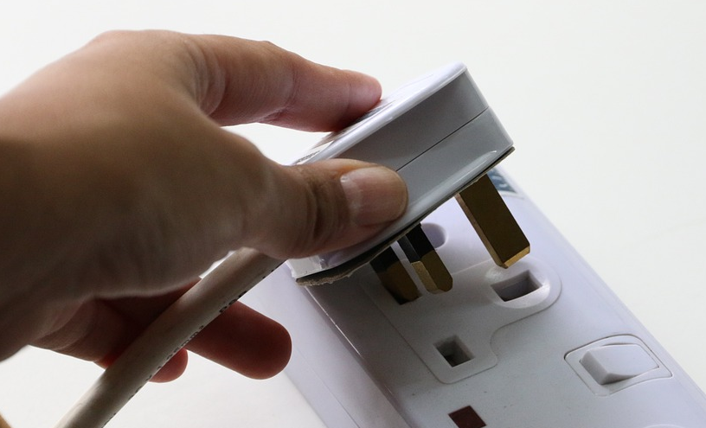
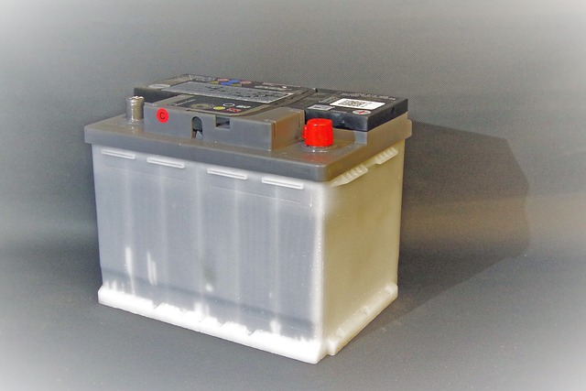
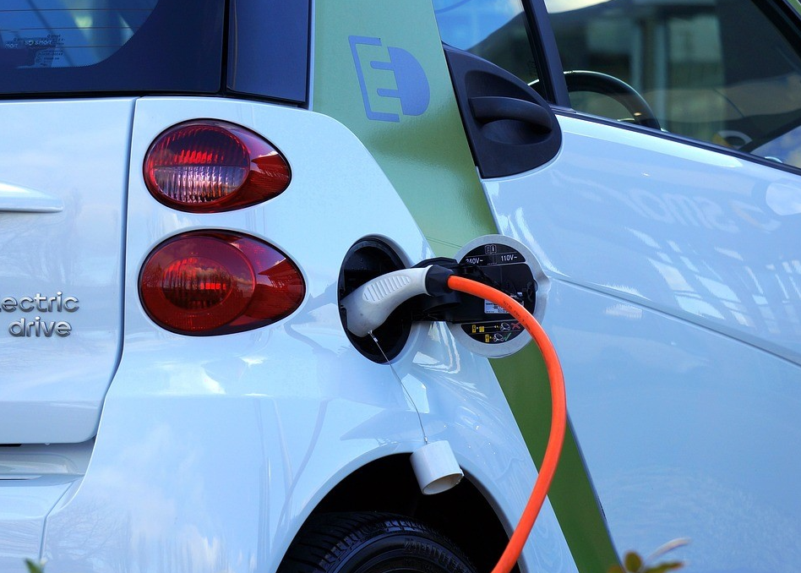
Waa maxay korantada (voltage)?
Halkan waxaa ah korantada (voltages) caadiga ah:
unugga AA (AA cell) – 1.5 V
batteriga lithium-ion (lithium-ion battery) – 4 V
korantada guud (UK) – 230 V
batteriga baabuurka (petrol) – 12 V
batteriga baabuurka (electric) – 400 V

Slide 24
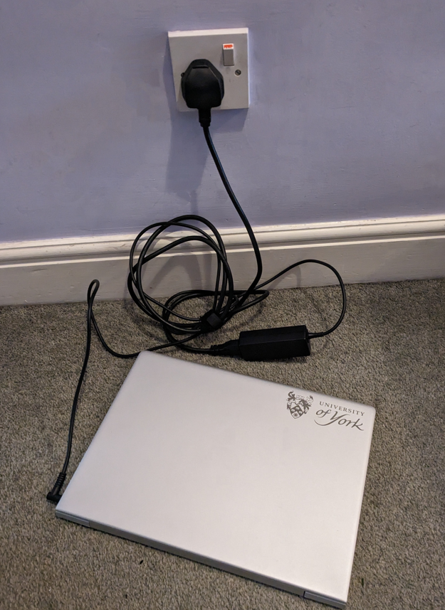
Waa maxay korantada (voltage)?
Qalabka kala duwan waxay u baahan yihiin korantada (voltages) kala duwan si ay si sax ah u shaqeeyaan.
Korantada guud (mains voltage) aad buu u sarreeyaa in lagu dallaco (charge) laptop-kan.
230 V
Adabtar (adaptor) wuxuu hoos u dhigaa voltage-ka ilaa 20 V.
Laptop-ku wuxuu si ammaan ah u shaqeeyaa voltage-kan hooseeya.
20 V
Haddii voltage-ku aad u sarreeyo, wuxuu keeni lahaa current (current) badan oo qulqulaya, taasoo dhaawici karta laptop-ka.

Slide 25
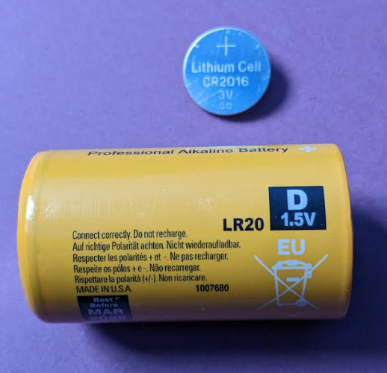
Waa maxay voltage?
Unugyada (cells) yaryar waxay yeelan karaan voltage ka sarreeya kuwa waaweyn.
Voltage-ku wuxuu ku xiran yahay falgalyada (reactions) kiimikaad ee unugga (cell) dhexdiisa.
3 V
1.5 V
Haddii loo baahdo voltage sare, unugyada (cells) waxaa lagu dari karaa si taxane (series) si ay u sameeyaan battery (battery) unugyo ah, taasoo kordhinaysa voltage-ka.

Slide 26
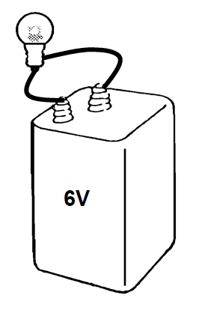
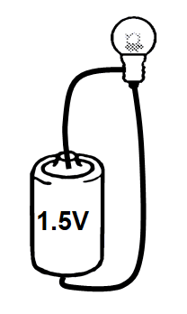
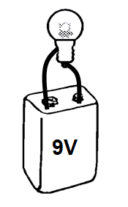
Waa maxay voltage?
Unugga (cell) ama battery-ga (battery) kee baa iftiimiya nalka (bulb) si ugu iftiin badan?
Nooca nalka (bulb) isku mid ah ayaa la isticmaalaa mar kasta.

Slide 27
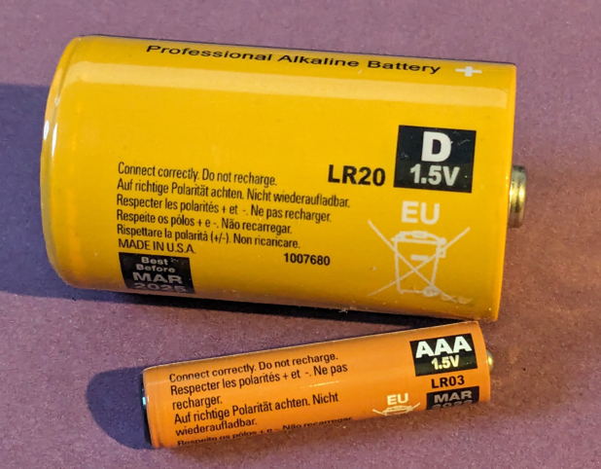
Waa maxay voltage?
Unugyadan (cells) waxay isticmaalaan falgal (reaction) kiimikaad isku mid ah waxayna leeyihiin voltage ah 1.5 V.
Unugga (cell) ka weyn wuxuu ka kooban yahay kiimikooyin badan, taasoo u oggolaanaysa inuu si dheer u shaqeeyo.
1.5 V
Unugga (cell) ka yar wuxuu si dhakhso ah u wareejin doonaa tamartiisa oo dhan sababtoo ah wuxuu leeyahay kiimikooyin yar.

Slide 28
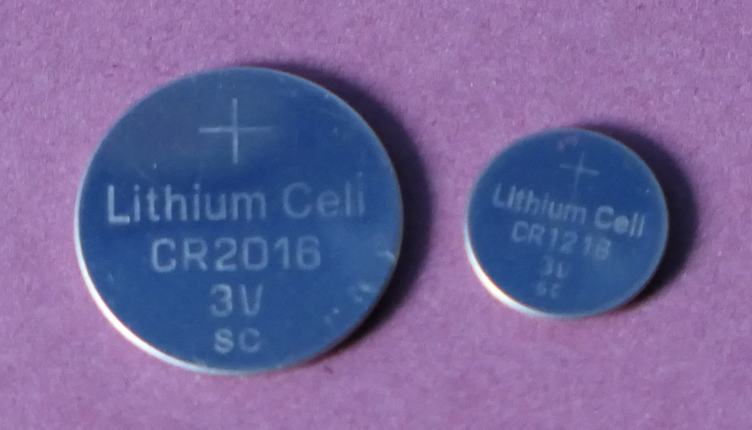
Waa maxay voltage?
Unugyada (cells) A iyo B waxay ku jiraan wareegyo (circuits) isku mid ah oo la isticmaalay waxayna ka kooban yihiin kiimikooyin isku mid ah. Kee baa ka mid ah hadalladan soo socda oo sax ah?
Waxay si isku mid ah u shaqayn doonaan muddo isku mid ah.
A
B
A wuxuu ka sii dheer shaqayn doonaa B.
B wuxuu ka sii dheer shaqayn doonaa A.

Slide 29
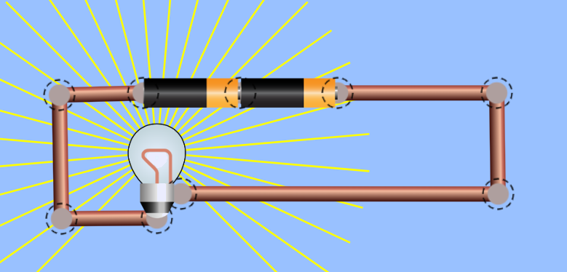
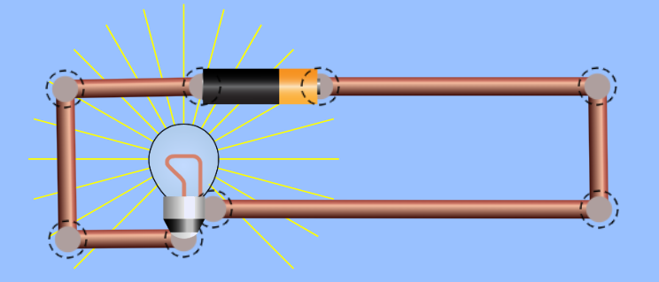
Waa maxay voltage?
Ku darista unug (cell) labaad wareeggan (circuit) si loo sameeyo battery (battery)…
…waxay keentaa riix (push) weyn iyo current (current) badan oo qulqulaya.
Nalka wuu iftiima badan yahay.
Sawirka PhET Interactive Simulations, Jaamacadda Colorado Boulder, oo shatiyaysan CC-BY-4.0 (https://phet.colorado.edu).

Slide 30
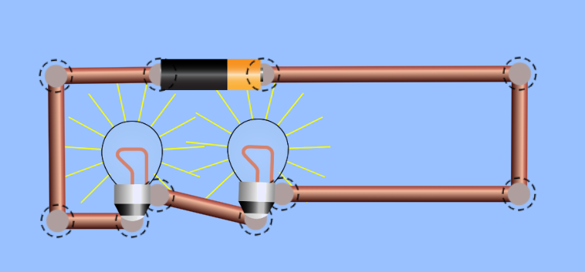
Waa maxay danab (voltage)?
Ku darista nalka wareeggan (circuit)…
…waxay ka dhigaysaa mid adag in korontadu (current) socoto.
Maadaama unuggu (cell) aanu sii riixi karin, nalka wuu yaraadaa.
Sawirka PhET Interactive Simulations, Jaamacadda Colorado Boulder, oo shatiyaysan CC-BY-4.0 (https://phet.colorado.edu).

Slide 31
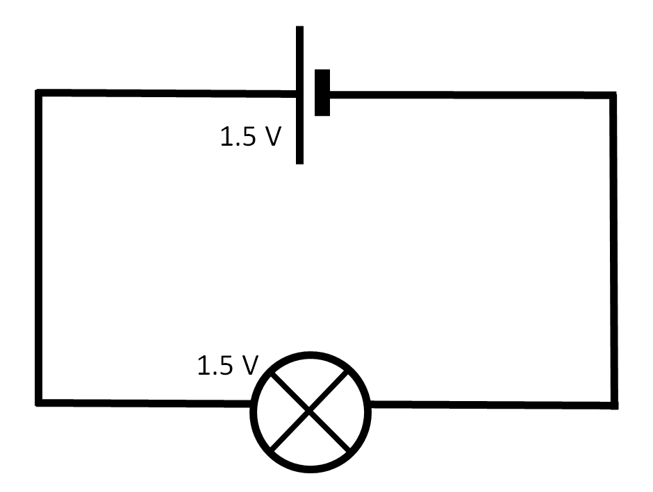
Waa maxay danab (voltage)?
Maxay ku darista unug (cell) 1.5 V oo labaad wareeggan (circuit) u keentaa in korontadu (current) kordho?
Batari 3.0 V wuxuu korontada (current) u dhaqaajin doonaa xoog (force) ka badan unugga (cell) 1.5 V.
Waa adag tahay labada unug (cell) inay korontada (current) u dhaqaajiyaan nalka.
Waxaa jira koronto (current) badan labada batari marka loo eego midka.

Slide 32
Waa maxay danab (voltage)?
Maxay ku darista nalka labaad wareeggan (circuit) u keentaa in korontadu (current) yaraato?
Laba nal ayaa isticmaala koronto (current) ka badan mid.
Unuggu (cell) ma riixi karo si ka sii adag, labada
Nal waxay ka dhigaan mid adag in korontada (current) la dhaqaajiyo.
Unuggu (cell) ma riixo si adag marka ay jiraan laba nal.

Slide 33
Waa maxay danab (voltage)?
Sharax sida jilidda (simulation) xadhigga wareega (rope loop) u muujiso waxa ku dhaca korontada (current) marka danabka (voltage) la kordhiyo.
Sharax sida jilidda (simulation) xadhigga wareega (rope loop) u muujiso waxa ku dhaca korontada (current) marka qaybo (components) badan lagu daro wareegga (circuit).

Slide 34
Waa maxay danab (voltage)?
Sharax sida jilitaanka (simulation) ee xarigga (rope loop) u muujiyo waxa ku dhaca hadda (current) marka korantada (voltage) la kordhiyo.
Jilitaanka (simulation), kordhinta korantada (voltage) waxaa lagu muujiyaa in la adeegsado xoog (force) dheeri ah si loo dhaqaajiyo xarigga. Xoogga kordhay wuxuu sababaa in xariggu u dhaqaaqo si degdeg ah, taasoo muujinaysa kororka hadda (current).
Sharax sida jilitaanka (simulation) ee xarigga (rope loop) u muujiyo waxa ku dhaca hadda (current) marka qaybo dheeri ah lagu daro wareegga (circuit).
Marka qaybo dheeri ah lagu daro wareegga (circuit) ee jilitaanka (simulation), xarigga waxaa qabsada gacmo badan, taasoo ka dhigaysa mid adag inuu dhaqaaqo.
Maaddaama batteriga uusan kordhin karin xoogga (force) uu ku riixo, xariggu wuxuu u dhaqaaqaa si gaabis ah, taasoo muujinaysa hoos u dhaca hadda (current).

Slide 35
Cabbirista korantada (voltage)
Voltmeter-ku wuxuu cabbiraa korantada (voltage) ama
farqiga awoodda (potential difference) ee qaybta.
Halbeegyada korantada (voltage) waa volts (V).
Voltmeter-yadu uma oggolaadaan hadda (current) inuu
dhex maro.
Xadhkaha korontada (electrical leads) ee u dhexeeya qaybaha saamayn kuma laha korantada (voltage).
Korantada (voltage) ee unugga ama batteriga iyo qayb keliya ee isku wareeg (series circuit) isku mid bay ahaan doonaan.

