Slide 1
Warbaahinta (Media) - filimaan iyo ciyaaraha
Xisaabta (Xisaab) goobta shaqada

Slide 2
Sida agabkeena waxbarista loogu talagalay fasalka

Slide 3
Waxaan fahmi karaa sida xisaabta (Xisaab) loogu isticmaalo warshadaha warbaahinta (media).

Slide 4
Aragti qasab ah (Forced perspective) waa farsamo ka dhigaysa shay inuu u muuqdo mid ka weyn, ka yar, ka fog ama ka dhow siduu dhab ahaan u yahay.

Slide 5

Warbaahinta (Media) - filimaan iyo ciyaaraha
Filimaan
Ciyaaraha

Slide 6
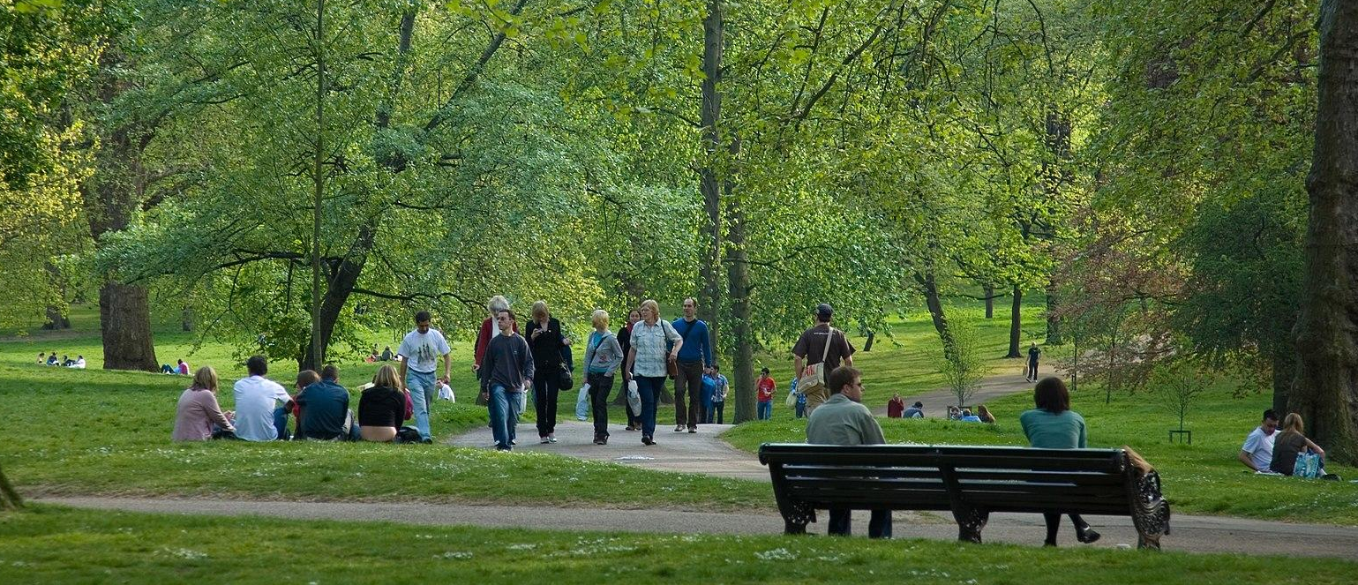
Filimaan
Waa sawir dad ku raaxaysanaya beerta. Maxaad dareensan?

Slide 7
Filimaan
Cabdi wuxuu yidhi: 'Qofka fadhiya waa inuu ka dheeraadaa qofka socda.'

Slide 8
Filimaan
Tani ma aha mid run ah oo lama huraan ah. Qofka socda wuu ka fog yahay kamaradda, sidaas darteed wuxuu u muuqdaa mid ka yar.

Slide 9
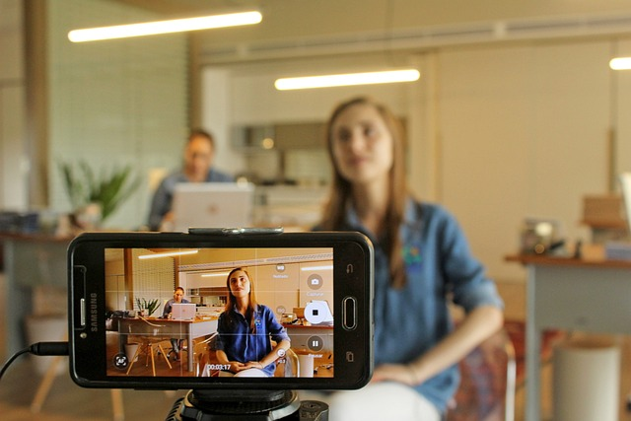

Filimaan
Mid ka mid ah dadkan ayaa ka dheeraada kan kale.
Run - waan arki karnaa tan.
Been - waxay isku dheeryihiin.
Laga yaabee - macluumaad ku filan ma jiro.

Slide 10
Filimaan
Si loo 'dhagro' qof inuu u arko shay qaab gaar ah, aragtidiisa (perspective) waa la maareyn karaa.
Aragti qasab ah (Forced perspective) waa farsamo ka dhigaysa shay inuu u muuqdo mid ka weyn, ka yar, ka fog ama ka dhow siduu dhab ahaan u yahay.

Slide 11
Filimada
Aragtida qasabka ah (forced perspective) aad bay ugu faa'iido badan tahay samaynta filimada, sababtoo ah waa beddelka ugu jaban ee CGI.
Filimada The Lord of the Rings waxay isticmaaleen aragtida qasabka ah (forced perspective) si ay u muujiyaan qaar ka mid ah jilayaasha inay ka dheer yihiin ama ka gaaban yihiin kuwa kale.
Waxa ugu horreeya ee aan u baahan nahay inaan ogaanno waa inta qofku ka dheer yahay ama ka gaaban yahay.

Slide 12
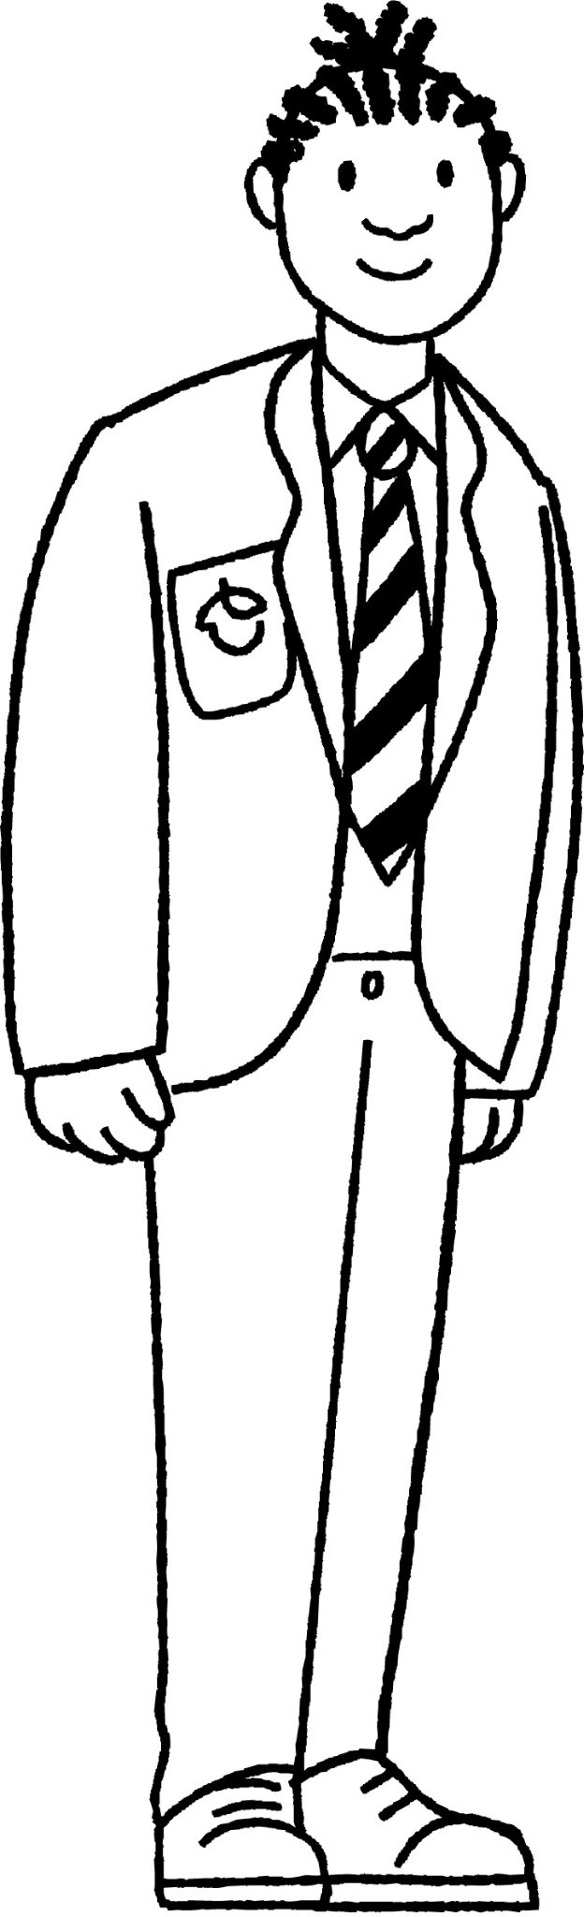
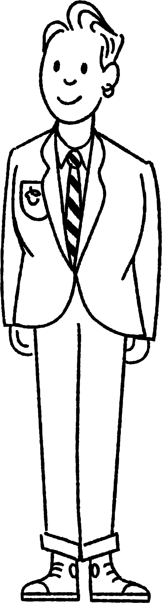
Filimada
Yacquub iyo Saciid waa isku dherer. Waxay rabaan inay duubaan fiidiyoow ka muuqdo in Saciid yahay laba meelood oo saddex meelood ah (two thirds) dhererka Yacquub.

Slide 13
Filimada
Yacquub wuxuu taagan yahay 2 m u jira kamarada.
2 m

Slide 14
Filimada
Si Saciid ugu muuqdo inuu yahay laba meelood oo saddex meelood ah (two thirds) dhererka Yacquub, Saciid waa inuu istaago halkan.
2 m
Maxaad ka ogaataa masaafada?
3 m

Slide 15

Filimada
Si Saciid ugu muuqdo inuu yahay laba meelood oo saddex meelood ah (two thirds) dhererka Yacquub, Saciid waa inuu istaago halkan.
2 m
3 m

Slide 16

Filimada
Si Saciid ugu muuqdo inuu yahay laba meelood oo saddex meelood ah (two thirds) dhererka Yacquub, Yacquub waa inuu istaago masaafo u jira kamarada oo ah laba meelood oo saddex meelood ah (two thirds) masaafada Saciid u jiro kamarada.
2 m
3 m

Slide 17
Filimada
Yacquub iyo Saciid waa isku dherer. Waxay rabaan inay duubaan fiidiyoow ka muuqdo in Yacquub yahay saddex meelood oo afarta meelood ah (three quarters) dhererka Saciid.
Haddii Yacquub istaago 12 m u jira kamarada, imisa ayay tahay masaafada Saciid u jiro kamarada?

Slide 18
Filimada
Yacquub iyo Saciid waa isku dherer. Waxay rabaan inay duubaan fiidiyoow ka muuqdo in Yacquub yahay saddex meelood oo afarta meelood ah (three quarters) dhererka Saciid.
Haddii Yacquub istaago 12 m u jira kamarada, imisa ayay tahay masaafada Saciid u jiro kamarada?
9 m
12 m

Slide 19
Filimada
1) Waqtiga baaritaanka.
Waxaad u baahan doontaa:
laba xisaab (isku cabbir)
hal cabbir (tape measure)

Slide 20
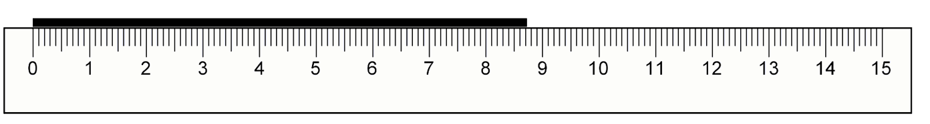
Filimaan
1) Dhig xisaabtaada cidhifka gaaban ee miiska (waxaa laga yaabaa inaad u baahan tahay inaad ku tiiriso buugaag). Dhig xisaabta kale meel ka fog isla jiho.

Slide 21
Filimaan
1) Fadhiiso si indhahaagu u la siman yihiin dusha sare ee xisaabta 'yari'. Isticmaal xisaabta 'weyn' si aad u qiyaasto inta ay dhererka xisaabta 'yari' tahay.

Slide 22
Filimaan
1) Hadda cabbir masaafada u dhaxaysa meesha aad fadhiday iyo xisaab kasta adigoo isticmaalaya cabbirka (tape measure).

Slide 23
Filimaan
1) Waa maxay xiriirka ka dhexeeya labada masaafo iyo dhererka la arkay ee xisaabta 'yari'?
Ku celi baaritaankan marar badan, adigoo dhigaya xisaabaha meelo kala duwan.
Maxaad dareemi kartaa?

Slide 24
Filimaan
1) Waa maxay xiriirka ka dhexeeya labada masaafo iyo dhererka la arkay ee xisaabta 'yari'?
Xisaabta 'weyn' waxay ahayd 10 cm u jirta, xisaabta 'yari'na waxay ahayd 15 cm u jirta.
Xisaabta 'weyn' waxay ahayd laba meelood oo saddex meelood ah masaafada xisaabta 'yari'.
Xisaabta 'yari' waxay ahayd laba meelood oo saddex meelood ah dhererka xisaabta 'weyn'.

Slide 25
Warbaahinta - filimaan iyo ciyaaraha
Filimaan
Ciyaaraha

Slide 26

Ciyaaraha (Games)
Filimaan animasho (animated films) iyo ciyaaraha kombiyuutarka (computer games) waxaa lagu abuuraa xisaab (maths).
Tusaale: Sharax sida geesigu (hero) ugu gaari karo barta B.
X B

Slide 27
Ciyaaraha (Games)
Iyadu waxay tagtaa halkaas.
Kani ma aha jawaab fiican sababtoo ah ma naqaan wadadii uu geesigu (hero) maray. Jilayaasha (characters) waa inay si siman (smoothly) u dhaqaaqaan inta u dhaxaysa dhibcaha, ma aha inay isku milicsadaan (blink) (haddii aysan taasi ahayn awoodooda gaarka ah).
X B

Slide 28
Ciyaaraha (Games)
Waxay u dhaqaaqdaa midig (right) ka dibna kor (up).
Kani wuu ka fiican yahay maadaama aan hadda qabno fikrad ku saabsan wadada. Si kastaba ha ahaatee, iyada oo aan lahayn masaafo (distances), geesigu (hero) wuxuu ku dhaman karaa meel khaldan.
X B

Slide 29
Ciyaaraha (Games)
Adigoo geesiga (hero) saaraya shabakad isku-duwayneed (coordinate grid), dhaqdhaqaaqa (movement) geesiga waxaa lagu sharxi karaa marka loo eego meesha uu ka bilaabay iyo meesha uu ku dhammaaday.
Si kale haddii loo dhigo, waxaan u sharxi doonnaa dhaqdhaqaaqan (movement) sida weyneyn (translation).

Slide 30
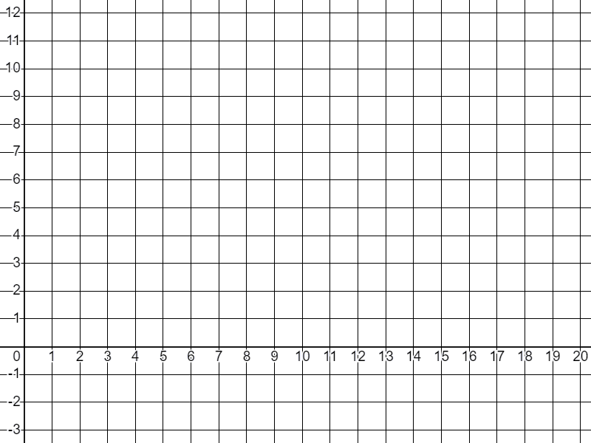
Ciyaaraha (Games)
Geesiga (hero) waxaa la saarayaa shabakad (grid) oo leh dhidibyada x iyo y (x and y axes).
Gees (corner) ka mid ah sawirka ayaa la calaamadeeyay.

Slide 31
Ciyaaraha (Games)
Hadda waxaa suurtogal ah in lagu sharaxo dhaqdhaqaaqa (movement) geesiga (hero) ilaa meel kasta oo la bixiyay.

Slide 32
Ciyaaraha (Games)
Sharax dhaqdhaqaaqa (movement) geesiga (hero) laga bilaabo barta uu ka bilaabay ilaa barta:
a) (8, 2)
b) (4, 8)
c) (9, 6)
d) (10, -1)

Slide 33
Ciyaaraha (Games)
Sharax dhaqdhaqaaqa (movement) geesiga (hero) laga bilaabo barta uu ka bilaabay ilaa barta:
a) (8, 2)
Weyneyn (Translation) oo ah 4 cutub (units) midig (right).

Slide 34
Ciyaaraha (Games)
Sharax dhaqdhaqaaqa (movement) geesiga laga bilaabo barta uu ka bilaabay ilaa barta:
b) (4, 8)
Weyneyn (Translation) oo ah 6 cutub oo kor ah.

Slide 35
Ciyaaraha (Games)
Sharax dhaqdhaqaaqa (movement) geesiga laga bilaabo barta uu ka bilaabay ilaa barta:
c) (9, 6)
Weyneyn (Translation) oo ah 5 cutub midig iyo 4 cutub kor.

Slide 36
Ciyaaraha (Games)
Sharax dhaqdhaqaaqa (movement) geesiga laga bilaabo barta uu ka bilaabay ilaa barta:
d) (10, -1)
Weyneyn (Translation) oo ah 6 cutub midig iyo 3 cutub hoos.

Slide 37
Ciyaaraha (Games)
Animators waxay isticmaalaan isbeddello (transformations) si ay u maareeyaan jilayaasha filimada iyo ciyaaraha.
Weyneyn (Translation) wuxuu dhaqaaqiyaa jilaha.
Weyneyn (Enlargement) wuxuu beddelaa cabbirka (marka jiluhu u soo dhawaado shaashadda ama ka fogaado).
Wareeg (Rotation) wuxuu u oggolaanayaa jilaha inuu leexdo.

Slide 38
Ciyaaraha (Games)
Hadafka - gaar hadafka 3 jeer.
Adigu waxaad tahay ciyaaryahan A.
Qor weyneyn (translation) loo baahan yahay si aad u gaarto hadafka.
Haddii aad u dhaqaaqdo meel isku mid ah sida kombiyuutarka, waxaad joojisaa dhaqdhaqaaqaaga (haddii aadan gaarin hadafka). Dhaqdhaqaaqu waa hal cutub oo kordhin ah.
Waa inaad ka gudubtaa kombiyuutarka oo aad gaartaa hadafka 3 jeer ama ka yar.

Slide 39
Ciyaaraha (Games)
Tusaale: = Hadaf
A
Ciyaaryahanka A
5 cutub hoos
2 cutub bidix
A
Kombuyuutar (B)
4 cutub bidix
3 cutub hoos
A
B
B
B
Maadaama ay isku dhaceen, dhaqdhaqaaq (movement) wuu joogsadaa. Ciyaaryahanka A waa inuu hadda la yimaado turjumaad (translation) cusub si uu u gaaro hadafka.

Slide 40
Ciyaaraha
Tusaale: = Hadafka
Ciyaaryahanka A
4 cutub hoos
2 cutub bidix
A
Kombuyuutar (B)
4 cutub hoos
3 cutub bidix
A
B
A
B
A
B
A
A
A
B
B
B
B
B
Ciyaaryahanka A wuxuu gaaray hadafka oo wuxuu ka adkaaday kombuyuutarka!

Slide 41
Ciyaaraha
1) = Hadafka
A
Ciyaaryahanka A
Kombuyuutar (B)
Wareegga 1: 4 cutub bidix
Wareegga 2: 1 cutub midig, 1 cutub hoos
Wareegga 3: 2 halbeeg oo kor (2 units up)
B

Slide 42
Ciyaaraha (Games)
2) = Goold (Goal)
Ciyaaryahanka A (Player A)
Kombiyuutarka (B) (Computer (B))
Wareegga 1: 2 halbeeg oo bidix, 1 halbeeg oo kor (2 units left, 1 unit up)
Wareegga 2: 1 halbeeg oo bidix (1 unit left)
Wareegga 3: 1 halbeeg oo kor, 2 halbeeg oo midig (1 unit up, 2 units right)
A
B

Slide 43
Ciyaaraha (Games)
3) Naqshadee ciyaartaada. Go'aami meesha A iyo B ay ka bilaabayaan iyo meesha gooldka (goal) uu yahay. Qor tilmaamahaaga kombiyuutarka. Ku beddel saaxiib (peer) oo eeg haddii aad ka adkaan kartaan ciyaarta midba midka kale.

Slide 44
Ciyaaraha (Games)
1) = Goold (Goal)
A
Ciyaaryahanka A (Player A)
E.g.
Wareegga 1: 1 halbeeg oo bidix, 5 halbeeg oo hoos (1 unit left, 5 units down)
Wareegga 2: 1 halbeeg oo midig (1 unit right)
Kombiyuutarka (B) (Computer (B))
Wareegga 1: 4 halbeeg oo bidix (4 units left)
Wareegga 2: 1 halbeeg oo midig, 1 halbeeg oo hoos (1 unit right, 1 unit down)
Wareegga 3: 2 halbeeg oo kor (2 units up)
B

Slide 45
Ciyaaraha (Games)
2) = Goold (Goal)
Ciyaaryahanka A (Player A)
E.g.
Wareegga 1: 1 halbeeg kor, 6 halbeeg midig
Wareegga 2: 1 halbeeg hoos
Kombuyuutar (B)
Wareegga 1: 2 halbeeg bidix, 1 halbeeg kor
Wareegga 2: 1 halbeeg bidix
Wareegga 3: 1 halbeeg kor, 2 halbeeg midig
A
B

Slide 46
Ciyaaraha
3) Naqshadee ciyaartaada. Go'aanso halka A iyo B ay ka bilaabayaan iyo halka uu yahay hadafka. Qor tilmaamahaaga kombuyuutarka. La beddel mid walaal ah oo arag haddii aad iska badin karaan ciyaarta.
Waxaad wax ka beddeli kartaa ciyaarta adigoo u oggolaanaya xeerar ka sii adag haddii aad rabto.

Slide 47
Warbaahinta - filimada iyo ciyaaraha
Aragtida qasabka ah (forced perspective) waa farsamo ka dhigaysa shay inuu u muuqdo mid ka weyn, ka yar, ka fog ama ka dhow siduu yahay.
Weyneyn (Scaling) ayaa loo isticmaalaa in lagu gaaro tan.
Isbeddellada (Transformations) waxaa isticmaala animators-ku si ay u qeexaan dhaqdhaqaaqa (movement) jilayaasha filimada iyo ciyaaraha.

