Slide 1
Xirfadle caafimaad (Medical professional)
Xisaab goobta shaqada (Xisaab in the workplace)

Slide 2
Sida agabkeena waxbarista loogu talagalay fasalka

Slide 3
Waxaan fahmi karaa sida xisaabta loogu isticmaalo xirfadlayaasha caafimaadka.

Slide 4
Qaaciddo (formula) waa xeer isku xira doorsoomayaal jireed (physical variables) oo macne ku leh.
Garaaf xariiq (line graph) waa garaaf dhibcahiisa ay isku xiraan qaybo xariiq ah. Wuxuu muujinayaa sida shay ugu beddelmo qiime (value), badanaa waqti ka dib.

Slide 5

Xirfadle caafimaad (Medical professional)
Xisaabta (Arithmetic) xirfadaha caafimaadka
Isticmaalka qaaciddooyinka (formulae) xirfadaha caafimaadka
Fahamka xogta (data) xirfadaha caafimaadka

Slide 6
Xisaabta (Arithmetic) xirfadaha caafimaadka
Marka bukaan si dhow loola socdo isbitaalka, kalkaaliyayaashu waxay diiwaangelin karaan xaddiga dareeraha (fluid) jirka ku soo gala iyo ka baxa.
Dareeraha jirka soo gala waxaa ka mid ah cabitaannada, daawooyinka dareeraha ah (IV medication), dareeraha IV iyo shubista dhiigga (blood transfusions). Dareeraha jirka ka baxa waxaa ka mid ah kaadi, matag iyo dareere dheecaan ah (fluid drains).
Macluumaadkan waxaa loo isticmaalaa in lagu xisaabiyo dheelitirka dareeraha (fluid balance).
Dheelitirka dareeraha (fluid balance) wuxuu noqon karaa mid togan (positive) ama taban (negative).
Tiro togan (positive) waxay muujinaysaa in dareere ka badan uu jirka soo galay intii ka baxday. Tiro taban (negative) waxay muujinaysaa in dareere ka badan uu jirka ka baxay intii soo gashay.

Slide 7
Xisaabta (Arithmetic) xirfadaha caafimaadka
Kalkaaliye ayaa baaraya jaantuska dheelitirka dareeraha (fluid balance chart) ee bukaan.
soo gelin (input) |  |  | soo bixin (output) |  |  | dheelitirka dareeraha (fluid balance) (ml)
cabitaan (drink) (ml) | dawo dareere ah (ml) | IV fluids (ml) | kaadi (ml) | matagid ama neefsasho (ml) | dheecaan (ml)
100 |  | 500 | 100 |  | 20
Xisaabi dheelitirka dareeraha (fluid balance).
Wadarta gelinta (input): 100 + 500 = 600
Wadarta soo-baxa (output): 100 + 20 = 120
Dheelitirka dareeraha (fluid balance) ee bukaanku waa togan (positive).
Dheelitirka dareeraha (fluid balance): 600 – 120 = 480 ml

Slide 8
Xisaabta (Arithmetic) ee xirfadaha caafimaadka
Kalkaaliso ayaa baaraysa jaantuska dheelitirka dareeraha (fluid balance chart) ee bukaanka.
gelin (input) |  |  | soo-bax (output) |  |  | dheelitirka dareeraha (fluid balance) (ml)
cabitaan (ml) | dawo dareere ah (ml) | IV fluids (ml) | kaadi (ml) | matagid ama neefsasho (ml) | dheecaan (drain) (ml)
150 | 10 |  |  | 200 | 10
Xisaabi wadarta gelinta (input).
150 + 10 = 160 ml

Slide 9
Xisaabta (Arithmetic) ee xirfadaha caafimaadka
Kalkaaliso ayaa baaraysa jaantuska dheelitirka dareeraha (fluid balance) ee bukaanka.
gelin (input) |  |  | soo-saar (output) |  |  | dheelitirka dareeraha (fluid balance) (ml)
cabitaan (drink) (ml) | dawo dareere ah (liquid medication) (ml) | dareeraha IV (IV fluids) (ml) | kaadi (urine) (ml) | matag ama nuugid (vomit or aspiration) (ml) | dheecaan (drain) (ml)
150 | 10 |  |  | 200 | 10
Xisaabi wadarta soo-saarka (output).
200 + 10 = 210 ml

Slide 10
Xisaabta (Arithmetic) ee xirfadaha caafimaadka
Kalkaaliso ayaa baaraysa jaantuska dheelitirka dareeraha (fluid balance) ee bukaanka.
gelin (input) |  |  | soo-saar (output) |  |  | dheelitirka dareeraha (fluid balance) (ml)
cabitaan (ml) | dawo dareere ah (ml) | IV fluids (ml) | kaadi (ml) | matag ama neefsasho (ml) | dheecaan (ml)
150 | 10 |  |  | 200 | 10
Xisaabi dheelitirka dareeraha.
160 – 210 = -50 ml
Dheelitirka dareeraha ee bukaanku waa taban.

Slide 11
Xisaabta xirfadaha caafimaadka
1) Shaxdu waxay tusaysaa diiwaanka gelinta iyo soo-saarka dareeraha ee bukaan intii lagu jiray afar saacadood. a) Xisaabi dheelitirka dareeraha saacad kasta.
waqti | gelin |  |  | soo-saar |  |  | dheelitirka dareeraha (ml)
 | cabitaan (ml) | dawo dareere ah (ml) | IV fluids (ml) | kaadi (ml) | matag ama neefsasho (ml) | dheecaan (drain) (ml)
09:00 | 200 | 0 | 125 | 0 | 0 | 5
10:00 | 0 | 10 | 125 | 300 | 0 | 25
11:00 | 0 | 0 | 125 | 0 | 200 | 15
12:00 | 150 | 0 | 125 | 0 | 0 | 10
b) Xisaabi isku-dheellitirka guud ee dareeraha (fluid balance) muddada 4 saacadood oo dhan.

Slide 12
Xisaabinta (Arithmetic) xirfadaha caafimaadka
1) Jadwalku wuxuu muujinayaa diiwaanka gelinta iyo soo-saarka dareeraha (fluid input and output) ee bukaan muddo afar saacadood ah. a) Xisaabi isku-dheellitirka dareeraha (fluid balance) saacad kasta.
waqti | gelinta (input) |  |  | soo-saarka (output) |  |  | isku-dheellitirka dareeraha (fluid balance) (ml)
 | cabitaan (ml) | dawo dareere ah (liquid medication) (ml) | IV fluids (ml) | kaadi (urine) (ml) | matagid ama nuugid (vomit or aspiration) (ml) | dheecaan (drain) (ml)
09:00 | 200 | 0 | 125 | 0 | 0 | 5
10:00 | 0 | 10 | 125 | 300 | 0 | 25
11:00 | 0 | 0 | 125 | 0 | 200 | 15
12:00 | 150 | 0 | 125 | 0 | 0 | 10
320
-190
-90
265
b) Xisaabi isku-dheellitirka guud ee dareeraha (fluid balance) muddada 4 saacadood oo dhan.
305

Slide 13
Xirfadle caafimaad (Medical professional)
Xisaabinta (Arithmetic) xirfadaha caafimaadka
Isticmaalka qaaciidooyinka (formulae) xirfadaha caafimaadka
Fahamka xogta (data) xirfadaha caafimaadka

Slide 14
Isticmaalka qaaciidooyinka (formulae) xirfadaha caafimaadka
Marka bukaannadu ay isbitaalka ku jiraan, waxaa laga yaabaa in loo qoro daawooyin.
Qadarka la qoro (prescribed) wuxuu ku kala duwan yahay xaaladda bukaanka iyo daawada la isticmaalayo.
Qaar ka mid ah daawooyinka waxaa la siin karaa qaab kiniin ah, qaarna waxay noqon karaan dareere (liquid).
Daawooyinka dareere (liquid) ah waxaa la siin karaa si tartiib ah muddo ka dib iyadoo la isticmaalayo duritaan xidid (intravenous (IV) drip).
Heerka (rate) daawada lagu siiyo iyada oo loo marayo duritaan (drip) wuxuu ku xirnaan karaa arrimo badan, sida qadarka daawada loo baahan yahay, muddada, iyo cufka (mass) bukaanka.
Qiimayaashan (values) waxaa lagu xisaabin karaa iyadoo la adeegsanayo qaaciidooyin (formulae).

Slide 15
Isticmaalka qaaciidooyinka (formulae) xirfadaha caafimaadka
Amiodarone waa daawo loo isticmaali karo in lagu daweeyo xaaladaha qaar ee wadnaha. Bukaan waxaa loo qoray 900 mg oo amiodarone ah. Qadarka daawada ku jira qorshe kasta (vial) waa 150 mg. Mugga dareeraha (liquid) ku jira qorshe kasta (vial) waa 3 ml.
Isticmaal qaaciidada (formula) si aad u xisaabiso qiyaasta daawada (drug dosage) loo baahan yahay.
qadarka la qoray (mg)
qiyaasta daawada (drug dose) =
× mugga qorshe kasta (ml)
qadarka qorshe kasta (mg)

Slide 16

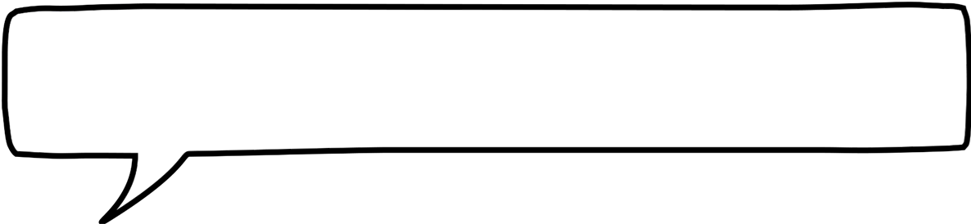
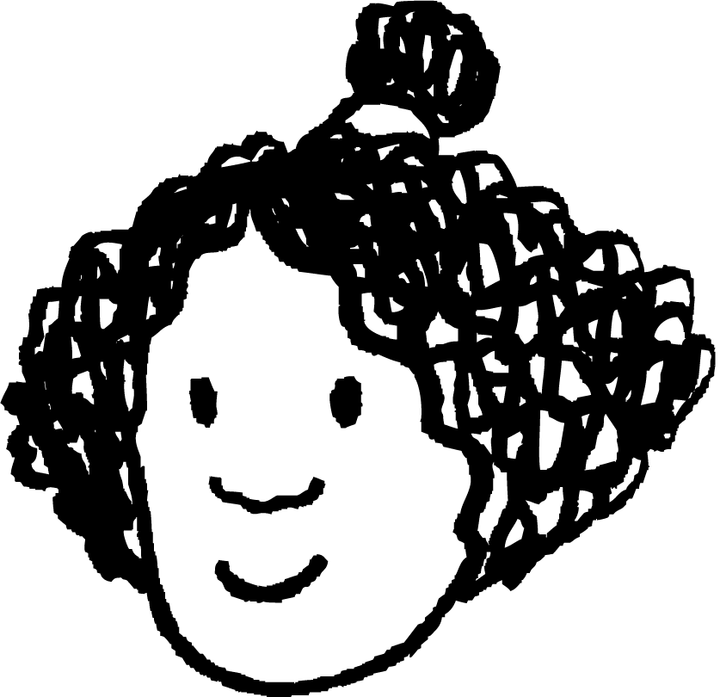

Isticmaalka qaaciidooyinka (formulae) xirfadaha caafimaadka
Amiodarone waa daawo loo isticmaali karo in lagu daweeyo xaaladaha qaar ee wadnaha. Bukaan waxaa loo qoray 900 mg oo amiodarone ah. Qadarka daawada ku jira qorshe kasta (vial) waa 150 mg. Mugga dareeraha (liquid) ku jira qorshe kasta (vial) waa 3 ml.
Isticmaal qaaciidada (formula) si aad u xisaabiso qiyaasta daawada (drug dosage) loo baahan yahay.
qadarka la qoray (mg)
qiyaasta daawada (drug dose) =
× mugga qorshe kasta (ml)
(ml)
qadarka qorshe kasta (mg)
Isra
Halbeegyada (units) qiyaasta daawada (drug dose) waxay noqon doonaan ml.

Slide 17
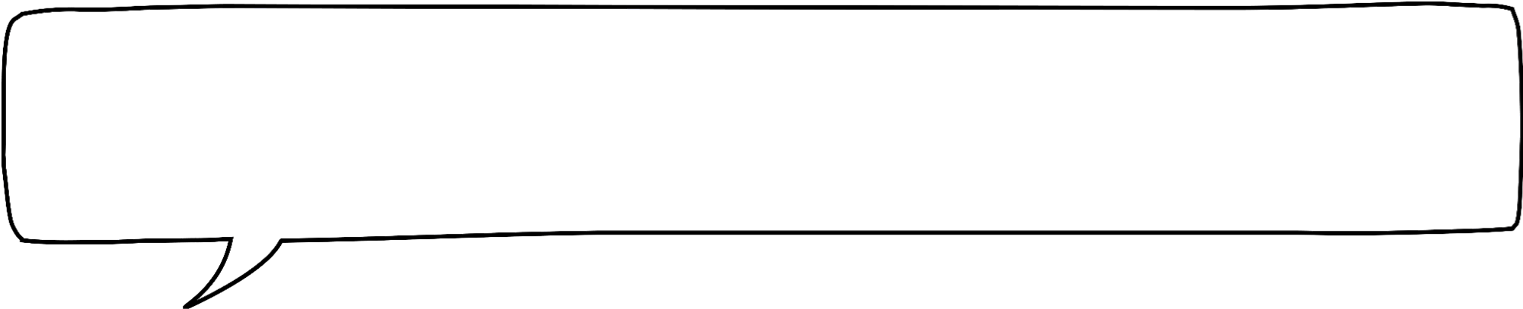
Isticmaalka qaaciidooyinka (formulae) xirfadaha caafimaadka
Amiodarone waa dawo loo isticmaali karo daaweynta xaaladaha wadnaha qaarkood. Bukaanka waxaa loo qoray 900 mg oo amiodarone ah. Qadarka daawada ku jira fiishalkasta (vial) waa 150 mg. Mugga dareeraha ku jira fiishal kasta waa 3 ml.
Isticmaal qaaciidada (formula) si aad u xisaabiso qadarka daawada loo baahan yahay.
qadarka la qoray (mg)
qadarka daawada (drug dose) =
× mugga fiishal kasta (ml)
(ml)
qadarka fiishal kasta (mg)
Isra
Waxaan bedeli karaa qiimaha (values) macluumaadka si aan u xisaabiyo qadarka daawada loo baahan yahay.

Slide 18
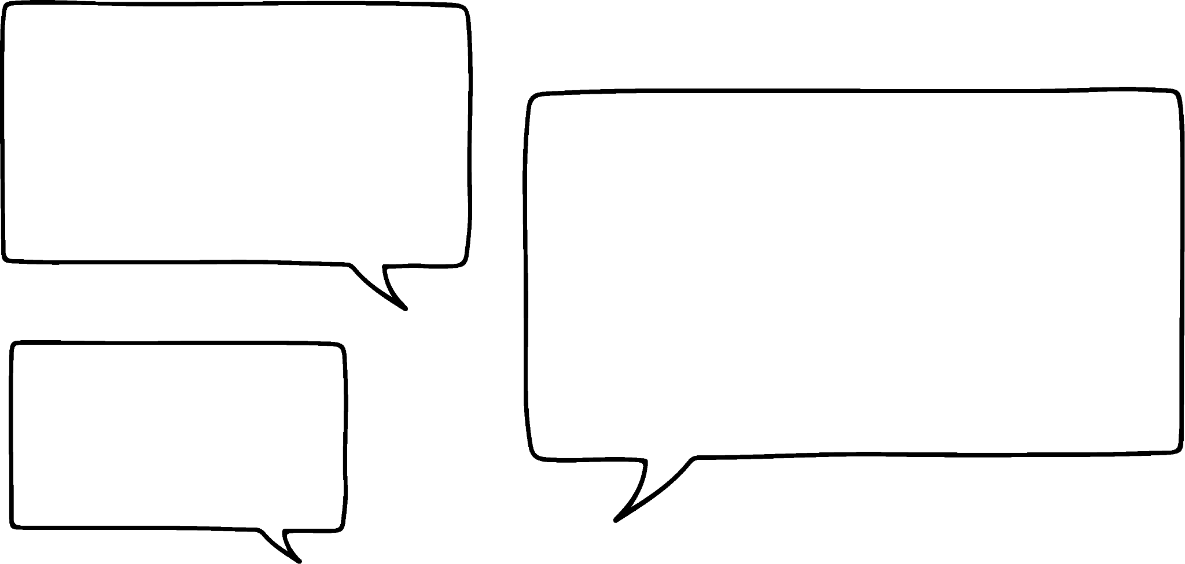
Isticmaalka qaaciidooyinka (formulae) xirfadaha caafimaadka
Amiodarone waa dawo loo isticmaali karo daaweynta xaaladaha wadnaha qaarkood. Bukaanka waxaa loo qoray 900 mg oo amiodarone ah. Qadarka daawada ku jira fiishalkasta (vial) waa 150 mg. Mugga dareeraha ku jira fiishal kasta waa 3 ml.
Isticmaal qaaciidada (formula) si aad u xisaabiso qadarka daawada loo baahan yahay.
qadarka la qoray (mg)
qadarka daawada (drug dose) =
× mugga fiishal kasta (ml)
(ml)
qadarka fiishal kasta (mg)
900
=
× 3
18 ml oo dareere ah ayaa loo baahan yahay si bukaanku u helo 900 mg oo daawada ah.
Isra
150
= 18 ml

Slide 19
Isticmaalka qaaciidooyinka (formulae) xirfadaha caafimaadka
Qaacidada waxaa loo fasiri karaa siyaabo kala duwan marka la eego macnaha.
Bukaanka waxaa loo qoray 900 mg oo amiodarone ah. Qadarka daawada ee vial kasta waa 150 mg. Mugga dareeraha ee vial kasta waa 3 ml.
qadarka la qoray (mg)
qiyaasta daawada =
× mugga vial kasta (ml)
(ml)
qadarka vial kasta (mg)
900 ÷ 150 = 6 vial
Isra
Xaaladdan, qaybintu waxay xisaabisaa tirada vial-yada loo baahan yahay si loo siiyo 900 mg oo daawada ah.

Slide 20
Isticmaalka qaacidada xirfadaha caafimaadka
Qaacidada waxaa loo fasiri karaa siyaabo kala duwan marka la eego macnaha.
Bukaanka waxaa loo qoray 900 mg oo amiodarone ah. Qadarka daawada ee vial kasta waa 150 mg. Mugga dareeraha ee vial kasta waa 3 ml.
qadarka la qoray (mg)
qiyaasta daawada =
× mugga vial kasta (ml)
(ml)
qadarka vial kasta (mg)
900 ÷ 150 = 6 vial
6 × 3 = 18 ml
Isra
Isku dhufashada ayaa markaa noo sheegaysa inta dareere ee ku jira 6 vial.

Slide 21
Isticmaalka qaaciidooyinka (formulae) xirfadaha caafimaadka
Qaacidada (formula) waxaa loo fasiri karaa siyaabo kala duwan marka loo eego macnaha (context) kan.
Bukaanka waxaa loo qoray 900 mg oo amiodarone ah. Qadarka daawada ee qarqaryada (vial) kasta waa 150 mg. Culmiga dareeraha ee qarqaryada (vial) kasta waa 3 ml.
culmiga qarqaryada (vial) kasta (ml)
qadarka daawada (drug dose) =
× qadarka la qoray (mg)
(ml)
qadarka qarqaryada (vial) kasta (mg)
Isra
Haddii aan dib u habeeyno isla'egta (equation), waxaan u fasiri karnaa qaybaheeda si ka duwan.

Slide 22
Isticmaalka qaaciidooyinka (formulae) xirfadaha caafimaadka
Qaacidada (formula) waxaa loo fasiri karaa siyaabo kala duwan marka loo eego macnaha (context) kan.
Bukaanka waxaa loo qoray 900 mg oo amiodarone ah. Qadarka daawada ee qarqaryada (vial) kasta waa 150 mg. Culmiga dareeraha ee qarqaryada (vial) kasta waa 3 ml.
culmiga qarqaryada (vial) kasta (ml)
qadarka daawada (drug dose) =
× qadarka la qoray (mg)
(ml)
qadarka qarqaryada (vial) kasta (mg)
3 ÷ 150 = 0.02 ml wuxuu bixiyaa 1 mg oo daawad ah
Isra
Qaybintu waxay noo sheegaysaa culmiga qarqaryada (vial) ee loo baahan yahay si loo bixiyo 1 mg oo daawad ah.

Slide 23
Isticmaalka qaaciidooyinka (formulae) xirfadaha caafimaadka
Qaacidada waxaa loo fasiri karaa siyaabo kala duwan marka la eego macnahan.
Bukaanka waxaa loo qoray 900 mg oo amiodarone ah. Xaddiga daawada ee qasac kasta waa 150 mg. Culmiga dareeraha ee qasac kasta waa 3 ml.
culmiga qasac kasta (ml)
qiyaasta daawada =
× xaddiga la qoray (mg)
(ml)
xaddiga qasac kasta (mg)
3 ÷ 150 = 0.02 ml wuxuu bixiyaa 1 mg oo daawada ah
0.02 × 900 = 18 ml wuxuu bixiyaa 900 mg oo daawada ah
Isra
Isku dhufashada ayaa markaa kor u qaadaysa ilaa 900 mg oo daawada ah.

Slide 24
Isticmaalka qaacidada xirfadaha caafimaadka
Bukaanka waxaa loo qoray 600 mg oo amiodarone ah. Xaddiga daawada ee qasac kasta waa 150 mg. Culmiga dareeraha ee qasac kasta waa 3 ml.
Isticmaal qaacidada si aad u xisaabiso qiyaasta daawada loo baahan yahay.
xaddiga la qoray (mg)
qiyaasta daawada =
× culmiga qasac kasta (ml)
(ml)
xaddiga qasac kasta (mg)
600
=
× 3
150
= 12 ml
600 ÷ 150 = 4 ama 12 ÷ 3 = 4
Imisa qasac oo daawada ah ayaa loo baahan yahay?

Slide 25
Isticmaalka qaaciidooyinka (formulae) xirfadaha caafimaadka
Bukaanku wuxuu u baahan yahay 18 ml oo amiodarone ah. Waa in lagu milo (dilute) bac (bag) dareere ah ka hor inta aan la siin. Mugga guud ee bacdu waa inuu ahaadaa 50 ml ka dib markii la milo.
Immisa dareere ayaa loo baahan yahay?
50 – 18 = 32
32 ml oo dareere ah ayaa loo baahan yahay

Slide 26
Isticmaalka qaaciidooyinka (formulae) xirfadaha caafimaadka
Mararka qaarkood, qadarka daawada loo baahan yahay lama siin karo dhammaan hal mar. Waxaa laga yaabaa in loo baahdo in si tartiib ah loo siiyo saacado badan.
Qadarka la siiyo saacad kasta waxaa loo yaqaan heerka maamulka (administration rate).
Tusaale: Bukaanka waxaa la siiyaa bac 50 ml oo amiodarone ah oo la milay 24 saacadood gudahood. Waa maxay heerka maamulka (administration rate)?
50 ÷ 24 = 2.0833333…
Bukaanka waa in la siiyaa 2.0833333… ml saacad kasta.
Mashiinka daawada bixiya waxaa lagu programmin karaa oo kaliya qaddarrada lagu sheegay hal meel jajab tobanle (1 decimal place). Sidaas darteed, qadarka waa in la wareejiyaa (rounded).

Slide 27
Isticmaalka qaaciidooyinka (formulae) xirfadaha caafimaadka
Mararka qaarkood, qadarka daawada loo baahan yahay lama siin karo dhammaan hal mar. Waxaa laga yaabaa in loo baahdo in si tartiib ah loo siiyo saacado badan.
Qadarka la siiyo saacad kasta waxaa loo yaqaan heerka maamulka (administration rate).
Tusaale: Bukaanka waxaa la siiyaa bac 50 ml oo amiodarone ah oo la milay 24 saacadood gudahood. Waa maxay heerka maamulka (administration rate)?
50 ÷ 24 = 2.0833333… ≈ 2.1
Bukaanka waa in la siiyaa 2.1 ml saacad kasta.
Mashiinka daawada bixiya waxaa lagu programmin karaa oo kaliya qaddarrada lagu sheegay hal meel jajab tobanle (1 decimal place). Sidaas darteed, qadarka waa in la wareejiyaa (rounded).

Slide 28
Isticmaalka qaaciidooyinka (formulae) xirfadaha caafimaadka
Marka daawada lagu maamulo si joogto ah iyada oo loo marayo IV drip, go'aaminta drip-ka waxaa lagu hagaajiyaa iyadoo loo eegayo arrimo kala duwan, oo ay ku jiraan cufka (mass) bukaanka.
Waxaa lagu xisaabiyaa iyadoo la adeegsanayo qaacidada (formula) soo socota:
go'aaminta drip-ka (drip settings) = (mcg/kg/min)
heerka maamulka (administration rate) (ml/hr) × qadarka la qoray (amount prescribed) (mcg)
mugga bacda (bag volume) (ml) × cufka bukaanka (patient mass) (kg) × 60
Waxaa laga yaabaa inaad u baahato inaad u beddesho inta u dhaxaysa milligram (mg) iyo micrograms (mcg) ka hor intaadan isticmaalin qaacidada.
1 milligram = 1000 micrograms.

Slide 29
Isticmaalka qaacidooyinka (formulae) xirfadaha caafimaadka
drip settings = (mcg/kg/min)
heerka maamulka (ml/hr) × qadarka la qoray (mcg)
mugga bacda (ml) × cufka bukaanka (kg) × 60
Tusaale: Amiodarone waxaa la siiyaa si joogto ah iyadoo la isticmaalayo IV drip.
Bukaanka waxaa loo qoray 900 mg oo amiodarone ah. Waxaa lagu milay ilaa 50 ml oo bac ah. Heerka maamulku waa 2.1 ml/hr. Bukaanku wuxuu leeyahay cuf 75 kg ah.
Xisaabi setting-ga mcg/kg/min ee IV drip-ka.
900 × 1000 = 900 000 mcg
2.1
× 900 000
drip settings (mcg/kg/min) =
= 8.4 mcg/kg/min
50
× 75
× 60

Slide 30
Isticmaalka qaacidooyinka (formulae) xirfadaha caafimaadka
Bukaanka waxaa loo qoray 600 mg oo amiodarone ah.
1 milligram (mg) = 1000 micrograms (mcg).
Imisa micrograms oo amiodarone ah ayaa bukaanka loo qoray?
600 × 1000 = 600 000 mcg

Slide 31


Isticmaalka qaacidooyinka (formulae) xirfadaha caafimaadka
drip settings = (mcg/kg/min)
heerka maamulka (ml/hr) × qadarka la qoray (mcg)
mugga bacda (ml) × cufka bukaanka (kg) × 60
Bukaanka waxaa loo qoray 600 000 mcg oo amiodarone ah. Waxaa lagu milay ilaa 50 ml oo bac ah. Heerka maamulku waa 2.1 ml/hr. Bukaanku wuxuu leeyahay cuf 90 kg ah.
Kee (fraction) ayaa muujinaya dhammaan qiimayaasha (values) si sax ah loo beddelay?
a
b
c
90
× 600 000
2.1
× 50 × 90
2.1
× 600 000
2.1
× 50
× 60
600 000
× 60
50
× 90
× 60

Slide 32
Isticmaalka qaaciidooyinka (formulae) xirfadaha caafimaadka
1) Bukaanku wuxuu leeyahay cuf (mass) 90 kg Waxaa loo qoray 600 mg oo daawada rifampicin ah. Daawadu waxay ku timaadaa weelal (vials) mid kastaa wuxuu leeyahay mug (volume) 10 ml. Weel kastaa wuxuu ka kooban yahay 300 mg oo daawada ah. Waa in lagu milo ilaa 500 ml ee bacda IV. Marka la milo, waa in si joogto ah loo siiyaa muddo 3 saacadood ah.
a) Isticmaal qaaciidada (formula) hoose si aad u xisaabiso qiyaasta (dose) loo baahan yahay.
cadadka daawada la qoray (mg)
qiyaasta daawada (ml) =
× mugga (volume) weel kasta (ml)
cadadka daawada ee weel kasta (mg)
b) 'Heerka qaadista (administration rate)' waa cadadka daawada la milay ee bukaanka la siiyo saacad kasta oo laga soo qaado bacda IV. Xisaabi heerka qaadista (administration rate) xaaladdan.

Slide 33
Isticmaalka qaaciidooyinka (formulae) xirfadaha caafimaadka
1) Bukaanku wuxuu leeyahay cuf (mass) 90 kg Waxaa loo qoray 600 mg oo daawada rifampicin ah. Daawadu waxay ku timaadaa weelal (vials) mid kastaa wuxuu leeyahay mug (volume) 10 ml. Weel kastaa wuxuu ka kooban yahay 300 mg oo daawada ah. Waa in lagu milo ilaa 500 ml ee bacda IV. Marka la milo, waa in si joogto ah loo siiyaa muddo 3 saacadood ah.
c) 1 mg = 1000 mcg. Immisa mcg oo rifampicin ah ayaa bukaanka loo qoray?
d) Isticmaal jawaabahaaga qaybaha (b) ilaa (c) iyo qaaciidada (formula) hoose si aad u xisaabiso dejinta (settings) mcg/kg/min ee duritaanka IV.
heerka qaadista (ml/hr) × cadadka la qoray (mcg)
dejinta duritaanka (drip settings) = (mcg/kg/min)
mugga bacda (ml) × cufka bukaanka (kg) × 60

Slide 34
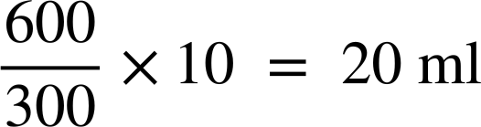
Isticmaalka qaaciidooyinka (formulae) xirfadaha caafimaadka
1) Bukaanku wuxuu leeyahay cuf (mass) 90 kg Waxaa loo qoray 600 mg oo daawada rifampicin ah. Daawadu waxay ku timaadaa weelal (vials) mid kastaa wuxuu leeyahay mug (volume) 10 ml. Weel kastaa wuxuu ka kooban yahay 300 mg oo daawada ah. Waa in lagu milo ilaa 500 ml ee bacda IV. Marka la milo, waa in si joogto ah loo siiyaa muddo 3 saacadood ah.
a) Isticmaal qaaciidada (formula) hoose si aad u xisaabiso qiyaasta (dose) loo baahan yahay.
cadadka daawada la qoray (mg)
qiyaasta daawada (ml) =
× mugga (volume) fiyalkasta (ml)
cadadka daawada ee weel kasta (mg)

Slide 35

Isticmaalka qaaciidooyinka (formulae) xirfadaha caafimaadka
b) 'Heerka qaadista (administration rate)' waa cadadka daawada la qasiyay ee la siiyo bukaanka saacad kasta oo laga soo qaado bacda IV. Xisaabi heerka qaadista (administration rate) xaaladdan.
c) 1 mg = 1000 mcg. Ilaa imisa mcg oo rifampicin ah ayaa loo qoray bukaanka?
d) Isticmaal jawaabahaaga qaybaha (b) ilaa (c) iyo qaaciidada (formula) hoose si aad u xisaabiso goobaha mcg/kg/min ee IV drip.
heerka qaadista (administration rate) (ml/hr) × cadadka la qoray (mcg)
goobaha drip (drip settings) = (mcg/kg/min)
mugga bacda (bag volume) (ml) × cufka bukaanka (patient mass) (kg) × 60

Slide 36
Xirfadle caafimaad (Medical professional)
Xisaabta (Arithmetic) xirfadaha caafimaadka
Isticmaalka qaaciidooyinka (formulae) xirfadaha caafimaadka
Fasiraadda xogta (Interpreting data) xirfadaha caafimaadka

Slide 37
Fasiraadda xogta (Interpreting data) xirfadaha caafimaadka
Hal hab oo ay shaqaalaha caafimaadku ku qiimeeyaan caafimaadka bukaanka waa iyada oo la eego 'calaamadaha nolosha (vital signs)'.
Calaamadaha nolosha (Vital signs) waxaa ka mid ah:
heerka heerkulka jirka (body temperature)
heerka neefsashada (respiratory rate) - inta jeer ee bukaanku neefsado daqiiqaddii
heerka wadnaha (heart rate) - inta jeer ee wadnaha bukaanku garaaco daqiiqaddii
cadaadiska dhiigga (blood pressure) - xoogga (strength) dhiiggu ku cadaadiyo halbowlayaasha (arteries) qofka marka wadnuhu ku shubo jirka.

Slide 38
Fasiraadda xogta (Interpreting data) xirfadaha caafimaadka
Cabbirka cadaadiska dhiigga (blood pressure) wuxuu leeyahay laba qaybood:
dhiig-karka systolic (SBP) waa lambar sare oo muujinaya cadaadiska (pressure) marka wadnuhu is-buunsho;
dhiig-karka diastolic (DBP) waa lambar hoose oo muujinaya cadaadiska (pressure) marka wadnuhu nasado.
Dhiig-karka (blood pressure) waxaa badanaa loo qoraa hal lambar oo kor ku yaal iyo mid kale oo hoos ku yaal. Si kastaba ha ahaatee, qoraalkan ma matalo jajab (fraction).
120
SBP
dhiig-karka (blood pressure) (mmHg)
70
DBP
SBP DBP
120
70
waqti (seconds)

Slide 39
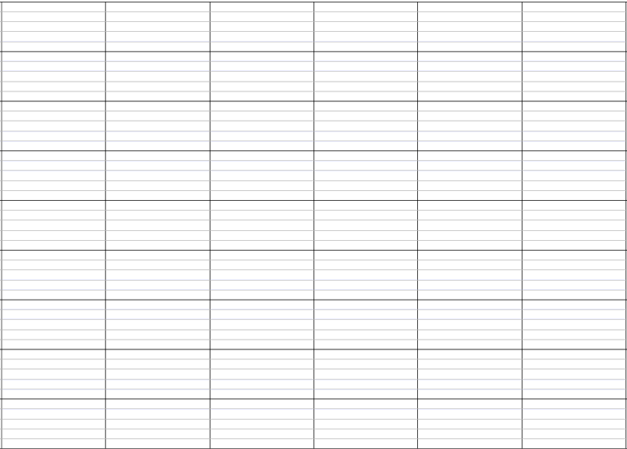
Fahamka xogta (data) ee xirfadaha caafimaadka
Calaamooyin badan oo nolosha muhiim u ah (vital signs) ayaa lagu muujin karaa garaaf (graph) isku mid ah.
180
160
SBP (lambar sare)
140
120
neefsashada heerka (respiratory rate) (breaths/min)
wadnaha garaaca (heart rate) (beats/min)
dhiig-karka (blood pressure) (mmHg)
DBP (lambar hoose)
100
80
60
40
20
0
Isniin
Talaado
Arbaco
Khamiis
Jimce

Slide 40
Fahamka xogta (data) ee xirfadaha caafimaadka
Miisaanno (scales) badan ayaa sidoo kale lagu muujin karaa garaaf (graph) isku mid ah.
180
45
160
40
140
35
120
30
heerka neefsashada (breaths/min)
wadnaha garaaca (heart rate) (beats/min)
cadaadiska dhiigga (mmHg)
100
25
80
20
heerka heerkulka jirka (℃)
60
15
40
10
20
5
0
0
Isniin
Talaado
Arbaco
Khamiis
Jimce

Slide 41
Fahamka xogta ee xirfadaha caafimaadka
Waa maxay heerka wadnaha ee bukaanka maalinta Isniinta?
80 beats/min
180
45
160
40
140
35
120
30
heerka neefsashada (breaths/min)
heerka wadnaha (beats/min)
cadaadiska dhiigga (mmHg)
100
25
80
20
heerka heerkulka jirka (℃)
60
15
40
10
20
5
0
0
Isniin
Talaado
Arbaco
Khamiis
Jimce

Slide 42
Fahamka xogta xirfadaha caafimaadka
Waa maxay heerka neefsashada bukaanka Arbacada?
20 neefsasho/daqiiqo
180
45
160
40
140
35
120
30
heerka neefsashada (breaths/min)
heerka wadnaha (beats/min)
cadaadiska dhiigga (mmHg)
100
25
80
20
heerka heerkulka jirka (℃)
60
15
40
10
20
5
0
0
Isniin
Talaado
Arbaco
Khamiis
Jimce

Slide 43
Fahamka xogta xirfadaha caafimaadka
Waa maxay heerka heerkulka jirka bukaanka Khamiista?
39 °C
180
45
160
40
140
35
120
30
heerka neefsashada (breaths/min)
heerka wadnaha (beats/min)
cadaadiska dhiigga (mmHg)
100
25
80
20
heerka heerkulka jirka (℃)
60
15
40
10
20
5
0
0
Isniin
Talaado
Arbaco
Khamiis
Jimce

Slide 44
Fasiraadda xogta (Interpreting data) ee xirfadaha caafimaadka (medical professions)
Waa maxay isbeddelka lagu arkay cadaadiska dhiigga ee bukaanka?
a
hoos u dhacaya (decreasing)
b
kor u kacaya (increasing)
c
isku mid ah (stays the same)
160
40
140
35
neefsashada (respiratory rate) (breaths/min)
wadnaha garaaca (heart rate) (beats/min)
cadaadiska dhiigga (blood pressure) (mmHg)
120
30
100
25
80
heerka heerkulka jirka (body temperature) (℃)
20
60
15
40
10
20
5
0
0

Slide 45
Fasiraadda xogta (Interpreting data) ee xirfadaha caafimaadka (medical professions)
1) Jaantusku wuxuu muujinayaa astaamaha nolosha (vital signs) ee bukaan shan maalmood.
a) Maalintee ayuu neefsashadiisu (respiratory rate) ahaa midka ugu hooseeya?
180
45
160
40
b) Waa maxay wadnaha garaaca (heart rate) Talaadada?
140
35
120
30
neefsashada (respiratory rate) (breaths/min)
wadnaha garaaca (heart rate) (beats/min)
cadaadiska dhiigga (blood pressure) (mmHg)
100
25
c) Cabdi wuxuu u malaynayaa in heerkulka jirkiisu (body temperature) ahaa 155℃ Isniinta. Waa maxay qaladka uu Cabdi sameeyay?
80
20
heerka heerkulka jirka (body temperature) (℃)
60
15
40
10
20
5
d) Waa maxay heerkulka jirkiisu (body temperature) Isniinta?
0
0
M
Tu
W
Th
F
maalin (day)

Slide 46
Fahanka xogta (Interpreting data) ee xirfadaha caafimaadka
1) Jaantusku wuxuu muujinayaa astaamaha nolosha (vital signs) ee bukaan shan maalmood.
e) Sharax isbeddelka dhiigarkooda (blood pressure) muddada shanta maalmood.
180
45
160
40
140
35
120
30
f) Dhiigarka caafimaadka qaba wuxuu ku saabsan yahay 120/70. Maalmaha(day) ee dhiigarka bukaanku ku yahay heerkaan?
neefsashada (respiratory rate) (breaths/min)
wadnaha garaaca (heart rate) (beats/min)
dhiigarka (blood pressure) (mmHg)
100
25
80
20
heerkulka jirka (body temperature) (℃)
60
15
40
10
20
5
0
0
M
Tu
W
Th
F
maalin

Slide 47
Fahanka xogta (Interpreting data) ee xirfadaha caafimaadka
1) Jaantusku wuxuu muujinayaa astaamaha muhiimka ah ee bukaanka muddada shanta maalmood.
a) Maalintee ayuu neefsashadiisu (respiratory rate) ahaa midka ugu hooseeya?
180
45
160
40
Arbacada
140
35
120
30
neefsashada (respiratory rate) (breaths/min)
wadnaha garaaca (heart rate) (beats/min)
dhiigarka (blood pressure) (mmHg)
100
25
b) Waa maxay wadnaha garaaca (heart rate) Talaadada?
80
20
heerkulka jirka (body temperature) (℃)
60
15
84 garaac daqiiqaddii
40
10
20
5
0
0
M
Tu
W
Th
F
maalin

Slide 48
Fahamka xogta xirfadaha caafimaadka
1) Jaantusku wuxuu muujinayaa astaamaha nolosha ee bukaanka muddo shan maalmood ah.
c) Cabdi wuxuu u malaynayaa in heer kulka jirkiisu ahaa 155℃ Isniinta. Maxaa qalad ah oo uu Cabdi sameeyay?
180
45
160
40
140
35
120
30
Cabdi wuxuu isticmaalay miisaanka bidix halkii uu isticmaali lahaa midka midig.
neefsashada (breaths/min)
wadnaha garaaca (beats/min)
dhiig karka (mmHg)
100
25
80
20
heer kulka jirka (℃)
60
15
40
10
d) Waa maxay heer kulka jirkiisu Isniinta?
20
5
0
0
M
Tu
W
Th
F
39 °C
maalin

Slide 49
Fahamka xogta xirfadaha caafimaadka
1) Jaantusku wuxuu muujinayaa astaamaha nolosha ee bukaanka muddo shan maalmood ah.
e) Sharax isbeddelka cadaadiska dhiiggooda (blood pressure) muddada shanta maalmood.
180
45
160
40
140
35
Cadaadiska dhiigga (blood pressure) ee bukaanku wuxuu si tartiib ah hoos ugu dhacay shanta maalmood.
(Ama eray kasta oo muujinaya inuu hoos u dhacayo.)
120
30
neefsashada (breaths/min)
wadnaha garaaca (beats/min)
dhiig karka (mmHg)
100
25
80
20
heer kulka jirka (℃)
60
15
40
10
20
5
0
0
M
Tu
W
Th
F
maalin

Slide 50
Fasiraadda xogta (data) ee xirfadaha caafimaadka
1) Jaantusku wuxuu muujinayaa calaamadaha nolosha (vital signs) ee bukaan shan maalmood.
f) Cadaadiska dhiigga (blood pressure) ee caafimaadka qaba wuxuu ku saabsan yahay 120/70. Maalmaha (day) ee cadaadiska dhiigga (blood pressure) ee bukaanku ku yahay heerarkan?
180
45
160
40
140
35
120
30
neefsashada (respiratory rate) (breaths/min)
wadnaha garaaca (heart rate) (beats/min)
cadaadiska dhiigga (blood pressure) (mmHg)
100
25
80
20
heerka heerkulka jirka (body temperature) (℃)
Jimcaha ayaa si sax ah u dhigma.
60
15
Cadaadiska dhiigga (blood pressure) ee bukaanku wuxuu sidoo kale ku dhow yahay heerkan Khamiista iyo Arbacada.
40
10
20
5
0
0
M
Tu
W
Th
F
maalin

Slide 51
Xirfadle caafimaad (Medical professional)
Shuqullada xirfadda caafimaadka waxay u baahan karaan isticmaalka qaaciidooyinka (formulae) iyo xisaabinta (calculations).
Tusaale: qiyaasta daawada (drug dosage) ee saxda ah ee bukaanku waa in si sax ah loo xisaabiyaa. Waxaa jira qaaciidooyin (formulae) sida loo xisaabiyo.
Fasiraadda xogta (data) waa xirfad muhiim u ah shaqaalaha caafimaadka.
Tusaale: jaantusyada muujinaya calaamadaha nolosha (vital signs) ee bukaanka ayaa laga yaabaa in la fasiro si loo go'aamiyo tallaabada.

