Slide 1
Dhalaalid (Melting): dhibic dhalaalid iyo dhibic qaboojin (melting and freezing points)
Adag (Solid), dareere (liquid), gaas (gas) xaalado iyo isbeddel xaalad (states and changes of state)

Slide 2
sida loo isticmaalo darasyada Oak (Oak lessons)

Slide 3
Waxaan qiyaasi karaa dhibic dhalaalid (melting point) iyo dhibic qaboojin (freezing point) ee walax (substance).

Slide 4
xaalad dareere (liquid state)
xaalad adag (solid state)
dhibic dhalaalid (melting point)
dhibic qaboojin (freezing point)

Slide 5
Walxaha (Substances) xaalad dareere (liquid state) ah waxay qaadanayaan qaabka weelka ay ku jiraan.
Qaybaha (Particles) walaxda xaalad adag (solid state) ah waxay ku jiraan meel go'an oo kaliya way gariiri karaan.
Dhibic dhalaalid (melting point) ee walax (substance) waa heerkulka (temperature) ay ku beddelanto xaalad adag (solid state) ilaa xaalad dareere (liquid state).
Dhibic qaboojin (freezing point) waa heerkulka (temperature) ay walax (substance) ku beddelanto xaalad dareere (liquid state) ilaa xaalad adag (solid state).

Slide 6

Dhalaalid (Melting): dhibic dhalaalid iyo dhibic qaboojin (melting and freezing points)
Qaboojin (Freezing)
Dhibic qaboojin (Freezing point)
Isbarbardhigga dhalaalid (melting) iyo qaboojin (freezing)

Slide 7
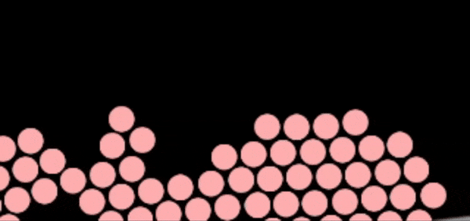

Qaboojin (Freezing)
Marka walax (substance) xaalad adag (solid state) ah la dhalaaliyo waxay isbeddeshaa xaalad dareere (liquid state).
dhalaalid (melting)
Marka walax (substance) xaalad dareere (liquid state) ah la qaboojiyo waxay isbeddeshaa xaalad adag (solid state), tan waxaa loo yaqaan qaboojin (freezing).
qaboojin (freezing)
Jilitaanka (Simulations) PhET Interactive Simulations, University of Colorado Boulder, shatiyaysan CC-BY-4.0 (https://phet.colorado.edu).

Slide 8
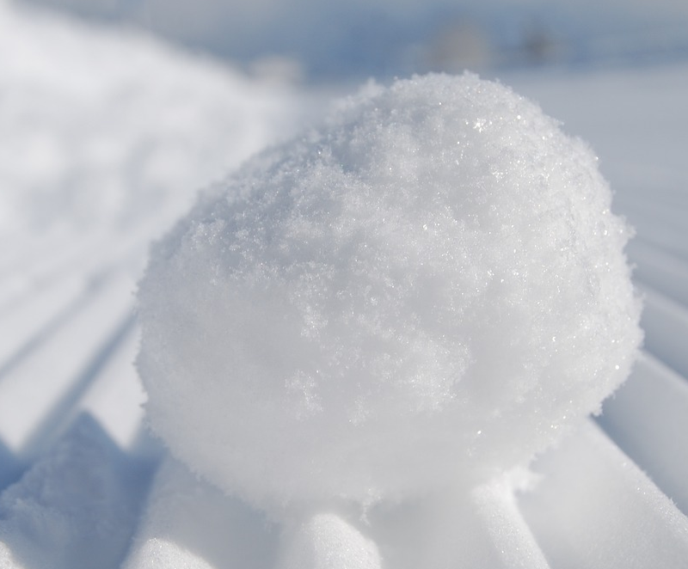
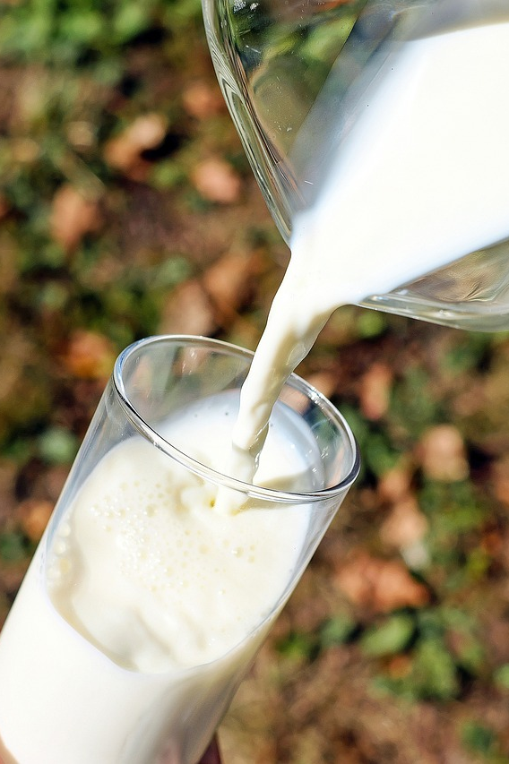
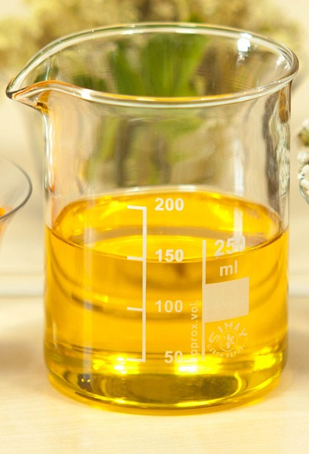

Qaboojin (Freezing)
Aqoonsi walaxda qabowday (frozen).

Slide 9
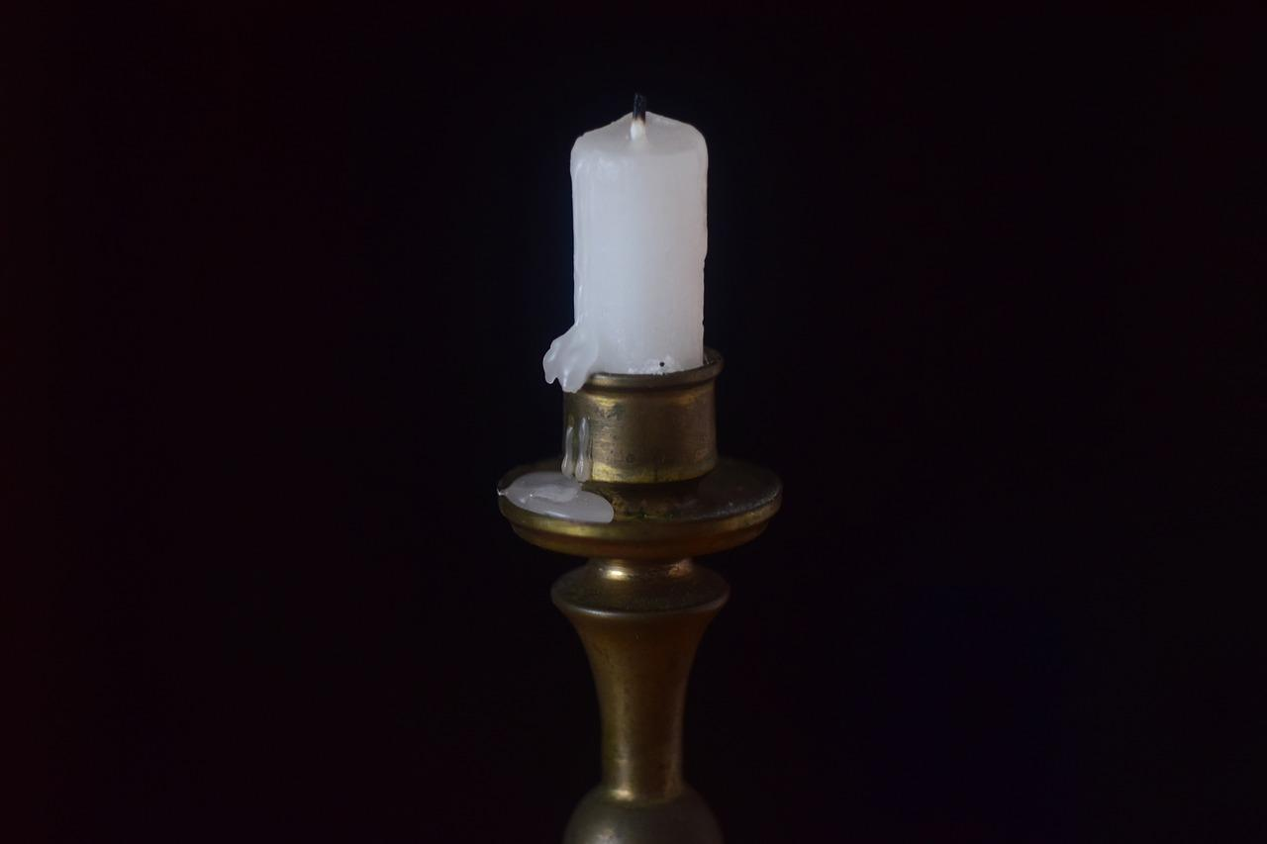
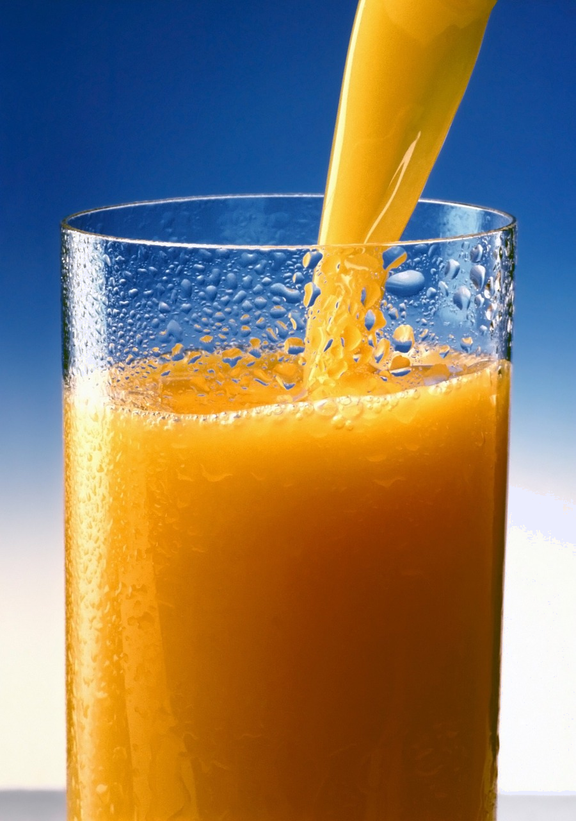
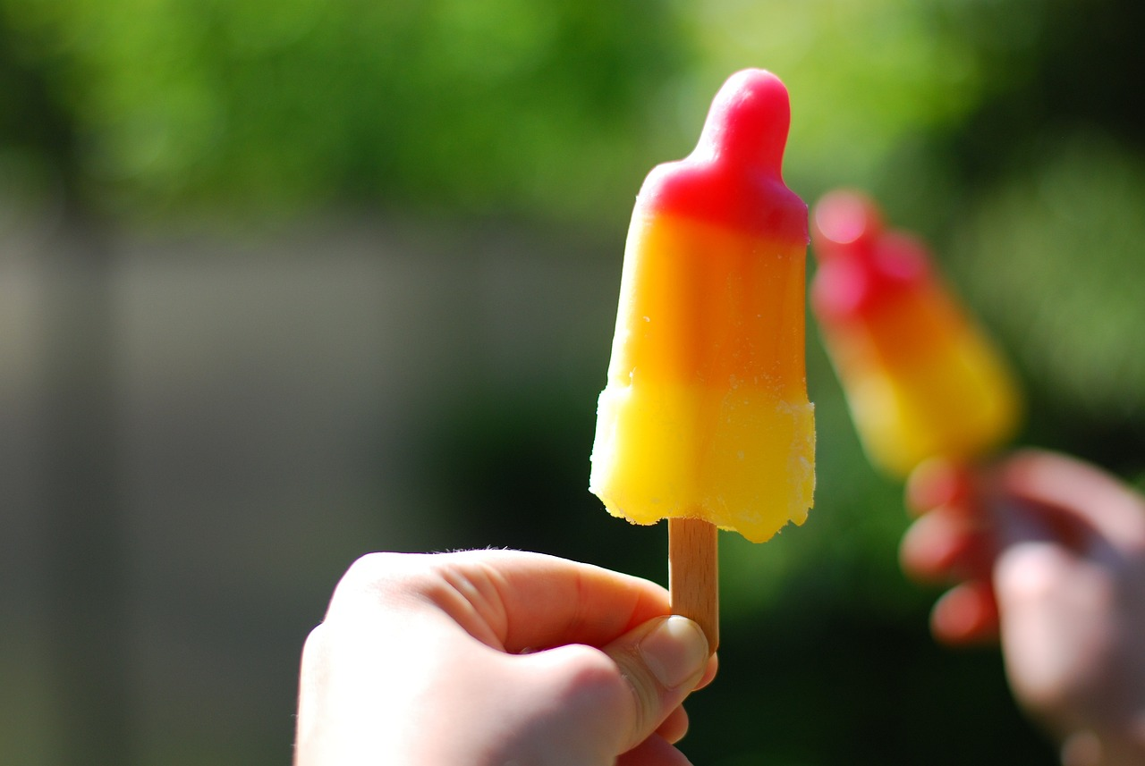
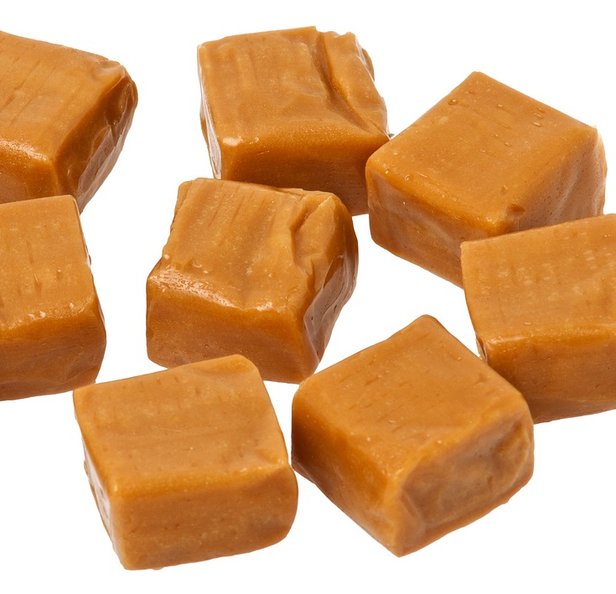
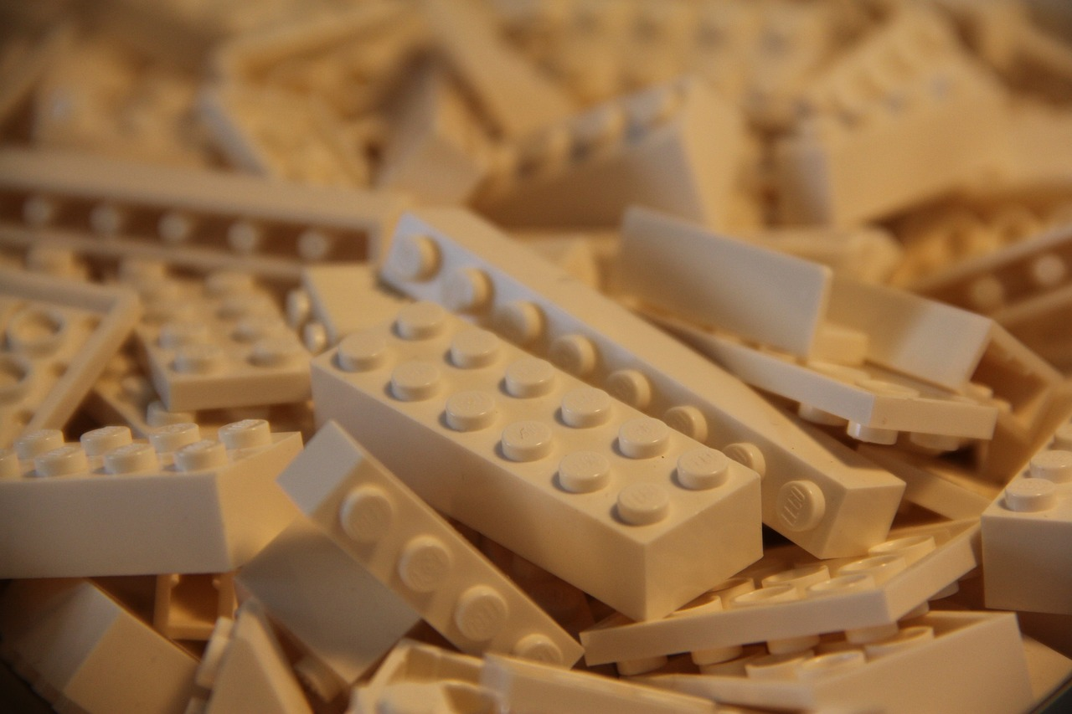
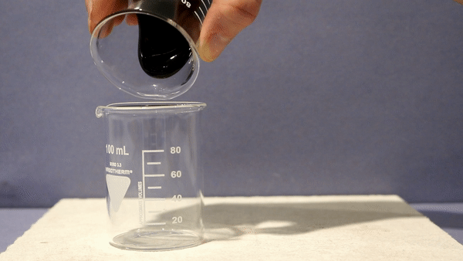
Qaboojin (Freezing)
Sharax sababta walaxdu u qabowday ama aan u qabowin walax kasta.
1.
2.
3.
shumac aan shidan (unlit candle)
casiir liin (orange juice)
lolli baraf (ice lolly)
4.
5.
6.
fudge (fudge)
baloogyad caag ah (plastic blocks)
dareere madow oo cufan (black treacle)

Slide 10

Qaboojin (Freezing)
Sharax sababta walaxdu u qabowday ama aan u qabowin walax kasta.
1.
2.
3.
qabowday - wax (wax) waa xaalad adag (solid state)
aan qabowin - casiirku (juice) waa xaalad dareere (liquid state)
qabowday - lolligu (lolly) waa xaalad adag (solid state)
shumac aan shidan (unlit candle)
casiir liin (orange juice)
lolli baraf (ice lolly)

Slide 11
Qaboojin (Freezing)
Sharax sababta walaxdu u qabowday ama aan u qabowin walax kasta.
4.
5.
6.
la qaboojiyey - fudge waa xaalad adag (solid state)
la qaboojiyey - plastic waa xaalad adag (solid state)
aan la qaboojin - treacle waa xaalad dareere (liquid state)
fudge (fudge)
baloogyad caag ah (plastic blocks)
malaas madow (black treacle)

Slide 12
Dhalaalida: heerkulka dhalaalida iyo qaboojinta (Melting: melting and freezing points)
Qaboojin (Freezing)
Heerkulka qaboojinta (Freezing point)
Isbarbardhigga dhalaalida iyo qaboojinta (Comparing melting and freezing)

Slide 13
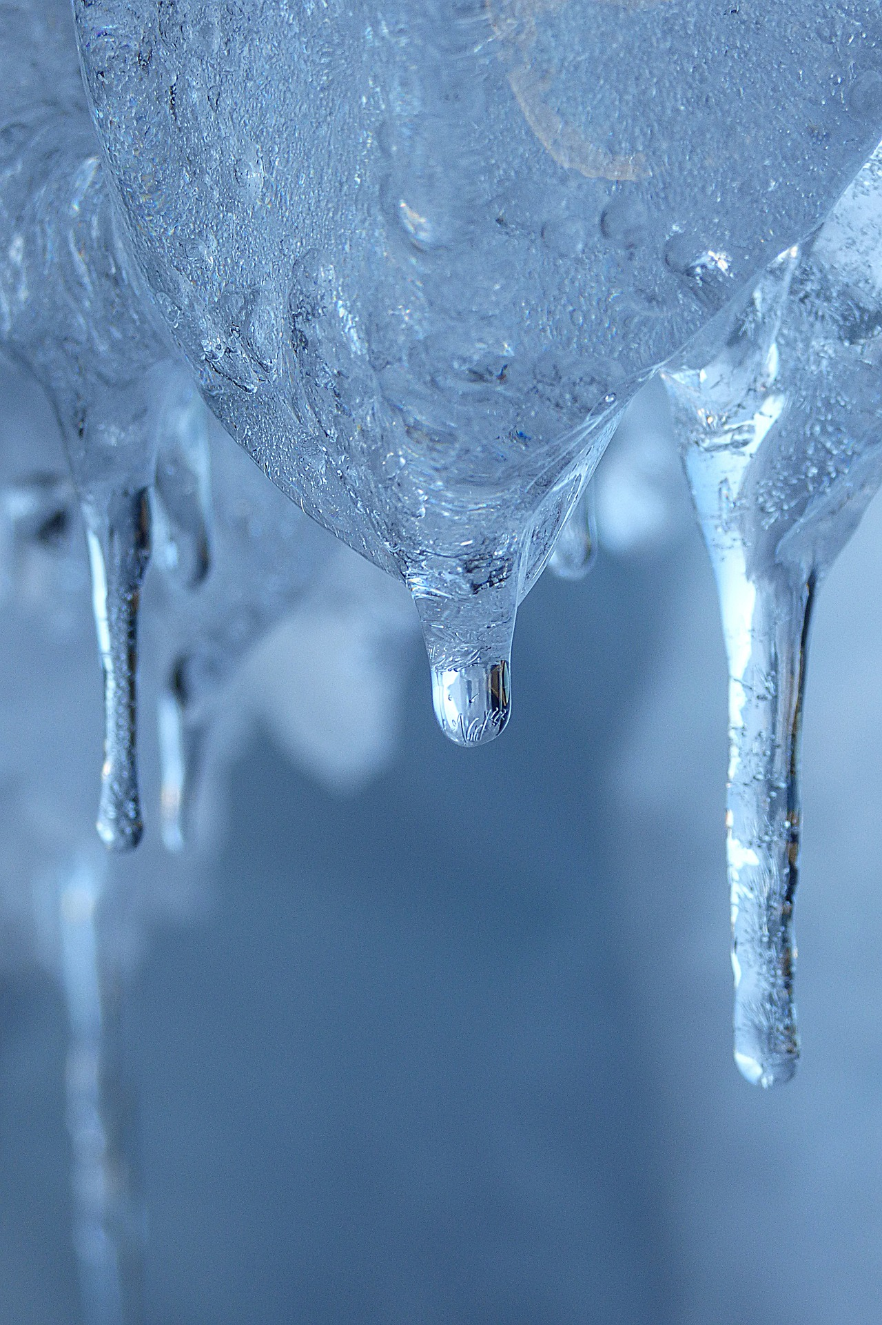
Heerkulka qaboojinta (Freezing point)
Heerkulka uu walax ku beddelo xaalad dareere ah xaalad adag waxaa loo yaqaan heerkulka qaboojinta (freezing point).
Heerkulka uu walax ku beddelo xaalad adag xaalad dareere ah waxaa loo yaqaan heerkulka dhalaalida (melting point).

Slide 14
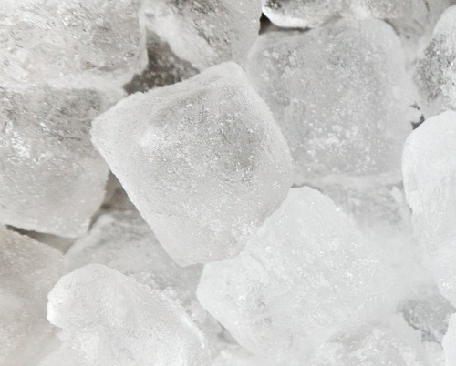
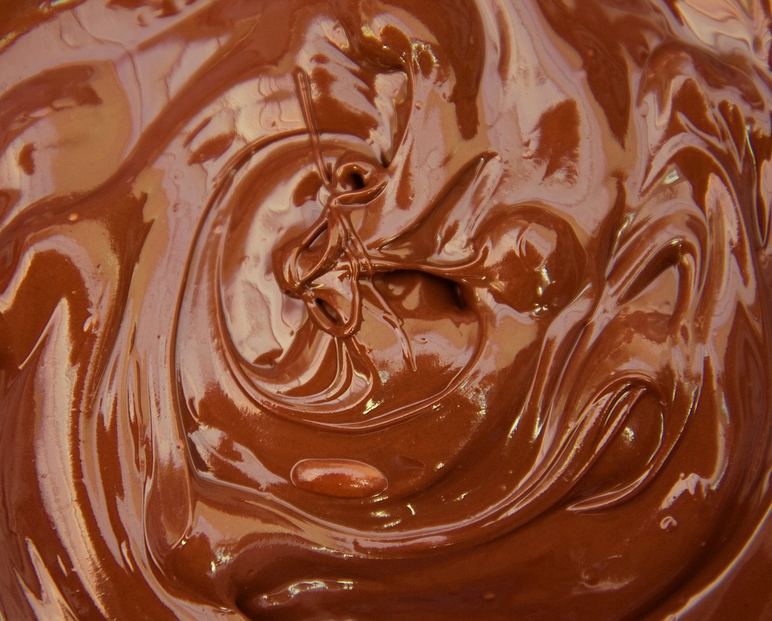
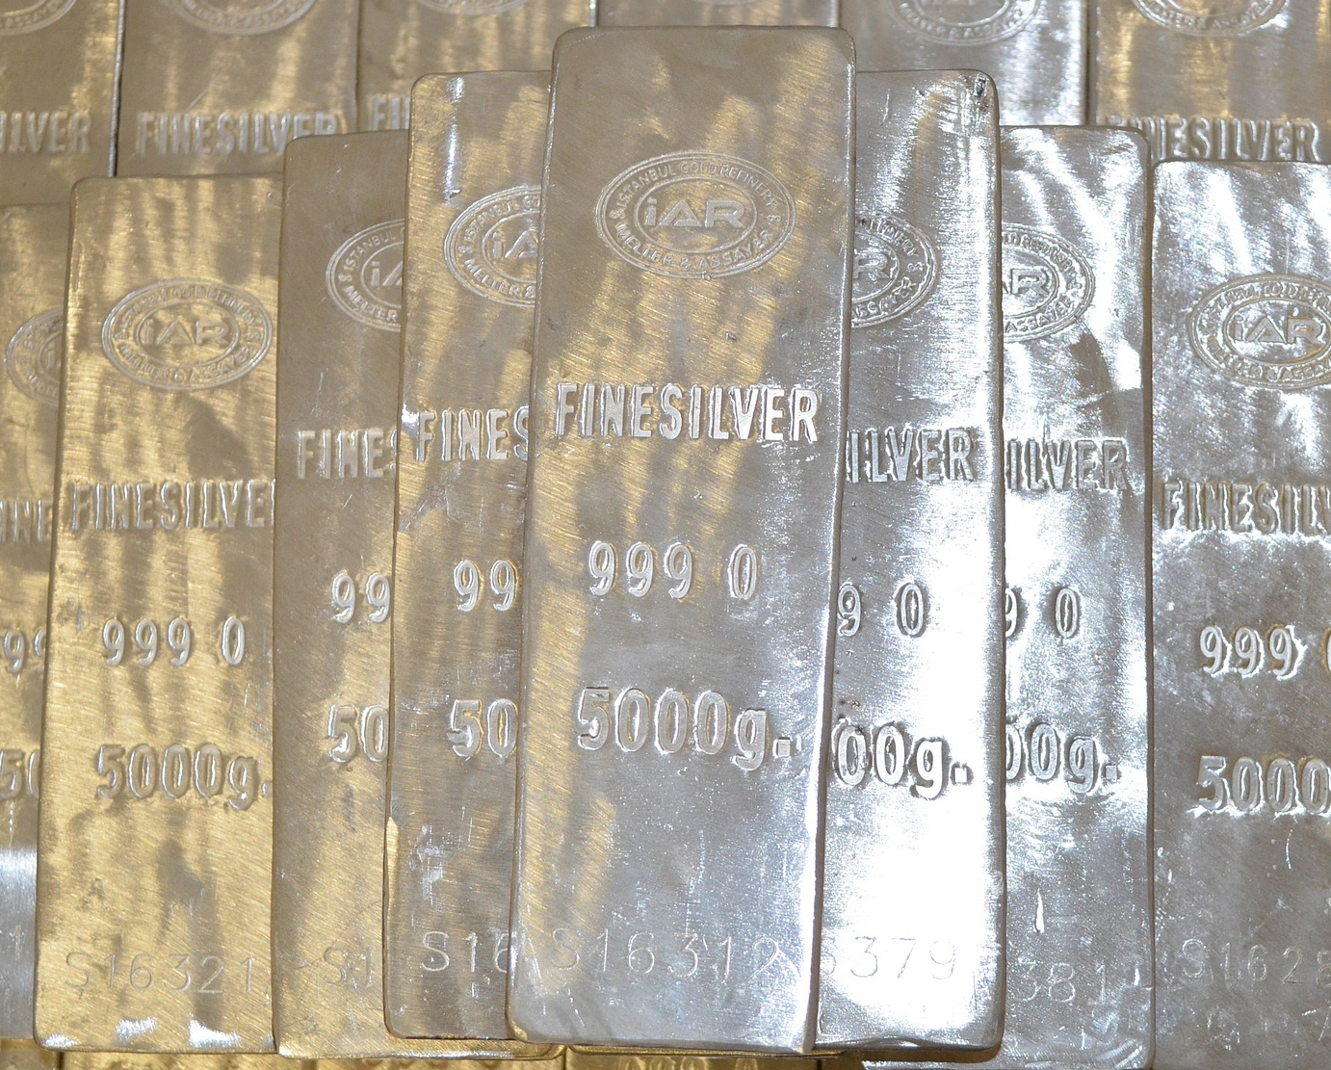
Heerkulka qaboojinta (Freezing point)
Heerkulka dhalaalida iyo heerkulka qaboojinta waa isku heerkul walaxda.
heerkulka dhalaalida baraf = 0°C
heerkulka qaboojinta baraf = 0°C
heerkulka dhalaalida shukulaato = 30°C
heerkulka qaboojinta shukulaato = 30°C
heerkulka dhalaalida silver = 962°C
heerkulka qaboojinta silver = 962°C

Slide 15
Heerkulka qaboojinta (Freezing point)
Heerkulka qaboojinta iyo heerkulka dhalaalida waa isku heerkul walaxda.
Biyuhu waxay noqdaan baraf 0°C waxayna dhalaalaan 0°C.
Qalinka (Silver) wuxuu ku dhalaalaa (melts) heerkul ka duwan kii uu ku qaboobo (freezes).

Slide 16
Barta qaboobida (Freezing point)
Heerkulka ka hooseeya barta dhalaalka (melting point), walaxdu waxay ku jirtaa xaalad adag (solid state).
Heerkulka ka sarreeya barta qaboobida (freezing point), walaxdu waxay ku jirtaa xaalad dareere (liquid state).
barta dhalaalka (melting point)
adag (solid)
dareere (liquid)
barta qaboobida (freezing point)

Slide 17

Barta qaboobida (Freezing point)
Biyo (Water) waxay leeyihiin barta qaboobida (freezing point) 0°C.
Paraffin (Paraffin) waxay leedahay barta dhalaalka (melting point) 67°C
Waa maxay xaaladda walaxda (state of matter) ee paraffin (Paraffin) ku jirto heerkulka qolka?
Hoosta 0°C, biyo (water) waa barafoobay (frozen) sida baraf (ice) xaalad adag (solid state).
Korka 0°C, biyo (water) waa dhalaalay (melted) oo ku jira xaalad dareere (liquid state).
Heerkulka qolku waa 20°C, biyo (water) waxay ku jiri lahaayeen xaalad dareere (liquid state).
xaalad adag (solid state)
biyo (water) xaalad adag (solid state)
biyo (water) xaalad dareere (liquid state)
paraffin (Paraffin) xaalad adag (solid state)
paraffin (Paraffin) xaalad dareere (liquid state)
0°C
20°C
40°C
60°C
80°C
barta dhalaalka (melting point) ee biyo (water)
barta dhalaalka (melting point) ee paraffin (Paraffin)

Slide 18
Heerkulka qaboojinta (freezing point)
Heerkulka qaboojinta (freezing point) ee walaxda A waa 15°C. Heerkulka qolku waa 20°C.
Waa noocee xaaladda (state) ee walaxda A heerkulka qolka?
xaalad adag (solid state)
xaalad dareere (liquid state)
midna ma aha xaalad dareere (liquid state) iyo xaalad adag (solid state) midna

Slide 19
Heerkulka qaboojinta (freezing point)
Heerkulka qaboojinta (freezing point) ee walaxda B waa 30°C. Heerkulka qolku waa 20°C.
Waa noocee xaaladda (state) ee walaxda B heerkulka qolka?
xaalad adag (solid state)
xaalad dareere (liquid state)
midna ma aha xaalad dareere (liquid state) iyo xaalad adag (solid state) midna

Slide 20
Heerkulka qaboojinta (freezing point)
Heerkulka qolka oo ah 20°C, walxahan soo socda ma ahaan doonaan xaalad adag (solid state) ama xaalad dareere (liquid state)?
Gallium wuxuu leeyahay heerkulka qaboojinta (freezing point) oo ah 30°C
Walaxda C waxay leedahay heerkulka dhalaalida (melting point) oo ah 45°C
Walaxda D waxay leedahay heerkulka dhalaalida (melting point) oo ah 19°C
Walaxda E waxay leedahay heerkulka qaboojinta (freezing point) oo ah 21°C
Iron wuxuu leeyahay heerkulka dhalaalida (melting point) oo ah 1003°C
Ice cream waxay leedahay heerkulka qaboojinta (freezing point) oo ah -3°C

Slide 21
Barta qaboobida (Freezing point)
Waa noocee xaaladda (state) ay walxuhu ahaan doonaan heerkulka qolka oo ah 20°C?
Gallium wuxuu leeyahay heerkulka qaboojinta (freezing point) oo ah 30°C
Walaxda C waxay leedahay barta dhalaalka (melting point) 45°C
Walaxda D waxay leedahay barta dhalaalka (melting point) 19°C
Walaxda E waxay leedahay barta qaboobida (freezing point) 21°C
Birta (Iron) waxay leedahay barta dhalaalka (melting point) 1003°C
Jalaatada (Ice cream) waxay leedahay barta qaboobida (freezing point) -3°C
Jawaabaha:
adag (solid)
adag (solid)
dareere (liquid)
adag (solid)
adag (solid)
dareere (liquid)

Slide 22
Dhalaalida (Melting): barta dhalaalka (melting point) iyo barta qaboobida (freezing point)
Qaboobida (Freezing)
Barta qaboobida (Freezing point)
Isbarbardhigga dhalaalka iyo qaboobida (Comparing melting and freezing)

Slide 23
Isbarbardhigga dhalaalka iyo qaboobida (Comparing melting and freezing)
Marka walaxdu dhalaasho, walaxdu waxay ka beddeshaa xaalad adag (solid state) oo ay u gasho xaalad dareere (liquid state), waa lidkeeda qaboobida (freezing).
dhalaalida (melting)
qaboobida (freezing)
xaalad adag (solid state)
xaalad dareere (liquid state)

Slide 24
Isbarbardhigga dhalaalka (melting) iyo qaboobista (freezing)
Marka uu walixu dhalaalo (melts), qaybuhu waxay ka tagaan meelaha go'an, hab joogto ah, waxayna u gudbaan hab aan kala sooc lahayn iyagoo qaybuhu is dhaafsiisanaya.
dhalaalid (melting)
Jilitaanka PhET Interactive Simulations, University of Colorado Boulder, shatiyaysan CC-BY-4.0 (https://phet.colorado.edu).
Marka uu walixu qaboobo (freezes), qaybuhu waxay ka tagaan is dhaafsiinta hab aan kala sooc lahayn, waxayna u gudbaan meelo go'an hab joogto ah.
Jilitaanka PhET Interactive Simulations, University of Colorado Boulder, shatiyaysan CC-BY-4.0 (https://phet.colorado.edu).
qaboobis (freezing)

Slide 25
Isbarbardhigga dhalaalka (melting) iyo qaboobista (freezing)
Walixu wuxuu ku jiraa xaalad adag (solid) hoos ka hooseeya heerkulka qaboobista/dhalaalka, wuxuuna ku jiraa xaalad dareere (liquid) kor ka sarreeya heerkulka qaboobista/dhalaalka.
heerkulka dhalaalka (melting point)
adag (solid)
dareere (liquid)
heerkul (temperature)
heerkulka qaboobista (freezing point)

Slide 26
Isbarbardhigga dhalaalka (melting) iyo qaboobista (freezing)
Marka dhalaalidu dhacdo, isbeddelka xaaladdu waa…
laga soo xaalad adag (solid) una gudub xaalad dareere (liquid).
laga soo xaalad dareere (liquid) una gudub xaalad adag (solid).
ma jiro.

Slide 27
Isbarbardhigga dhalaalka (melting) iyo qaboobista (freezing)
Kadib marka uu walixu dhalaalo, qaybuhu waxay ku kala yaalliin si aan kala sooc lahayn.
Qaybaha xaaladda adag (solid) waxay kaliya gariiri karaan laakiin waxay ku go'an yihiin meel.
Walxaha (Particles) ee xaaladda dareeraha (liquid state) waxay dhaafsan karaan walxaha (particles) ku xiga.

Slide 28

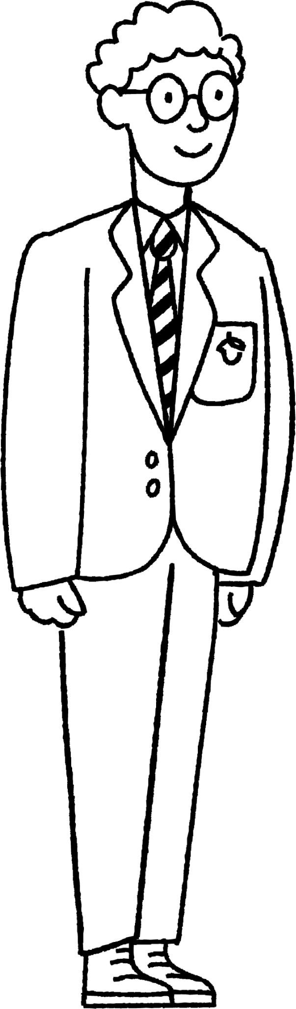

Isbarbardhigga dhalaalidda (melting) iyo barafka (freezing)
Kaalay Axmed u kala saar weedhaha miis leh cinwaannada dhalaalidda (melting) iyo barafka (freezing).
walxaha (particles) waxay ku go'aan booska
dhalaalidda (melting) | barafka (freezing)
xaaladda adag (solid state) → xaaladda dareeraha (liquid state)
walxaha (particles) waxay xor u noqdaan inay ku dhaafsan karaan midba midka kale
xaaladda dareeraha (liquid state) → xaaladda adag (solid state)
walxaha (particles) waxay ku dhamaanayaan habayn joogto ah (regular arrangement)
walxaha (particles) waxay ku dhamaanayaan habayn aan kala sooc lahayn (random arrangement)
Axmed

Slide 29
Dhalaalidda (Melting)
dhalaalidda (melting) | barafka (freezing)
xaaladda adag (solid state) → xaaladda dareeraha (liquid state)
xaaladda dareeraha (liquid state) → xaaladda adag (solid state)
walxaha (particles) waxay xor u noqdaan inay ku dhaqaaqaan midba midka kale
walxaha (particles) waxay ku go'aan booska
walxaha (particles) waxay ku dhamaanayaan habayn aan kala sooc lahayn (random arrangement)
walxaha (particles) waxay ku dhamaanayaan habayn joogto ah (regular arrangement)
Axmed

Slide 30
Dhalaalid (Melting): barta dhalaalidda (melting point) iyo barta qaboobidda (freezing point)
Markay dhalaasho, walaxdu waxay ka beddeshaa xaalad adag (solid state) una beddeshaa xaalad dareere (liquid state).
Markay qaboojiso, walaxdu waxay ka beddeshaa xaalad dareere (liquid state) una beddeshaa xaalad adag (solid state).
dhalaalid (melting)
qaboobid (freezing)
xaalad adag (solid state)
xaalad dareere (liquid state)
Heerkulka hooseeya ee barta dhalaalidda (melting point), walaxdu waxay ku jirtaa xaalad adag (solid state).
Heerkulka sareeya ee barta qaboobidda (freezing point), walaxdu waxay ku jirtaa xaalad dareere (liquid state).
barta dhalaalidda (melting point)
adag (solid)
dareere (liquid)
heerkul (temperature)
barta qaboobidda (freezing point)

