Slide 1
Oksaydhka birta iyo oksaydhka aan-birta ahayn (Metal oxides and non-metal oxides)
Aashito iyo sal (Acids and bases)

Slide 2
Sida agabkeena waxbarista loogu talagalay fasalka

Slide 3
Waxaan qeexi karaa sifooyinka oksaydhka birta iyo aan-birta ahayn oo waxaan qori karaa isla'egyo matalaya falgal (reaction) oo oksaydhka birta la yeesho aashito.

Slide 4
oksaydh bir (metal oxide)
oksaydh aan-bir ahayn (non-metal oxide)
ku darid xad dhaaf (adding to excess)

Slide 5
Oksaydh bir (metal oxide) wuxuu ka kooban yahay atamka birta oo ku xidhan atamka oksijiinta.
Oksaydh aan-bir ahayn (non-metal oxide) wuxuu ka kooban yahay atamka aan-birta ahayn oo ku xidhan atamka oksijiinta.
Ku darid xad dhaaf (adding to excess) waa marka fal-celiye (reactant) uu joogo tiro ka badan inta lagama maarmaanka u ah inuu si buuxda u falgalo (reaction).

Slide 6

Oksaydhka birta iyo oksaydhka aan-birta ahayn (Metal oxides and non-metal oxides)
Oksaydhka birta (Metal oxides)
Oksaydhka aan-birta ahayn (Non-metal oxides)

Slide 7
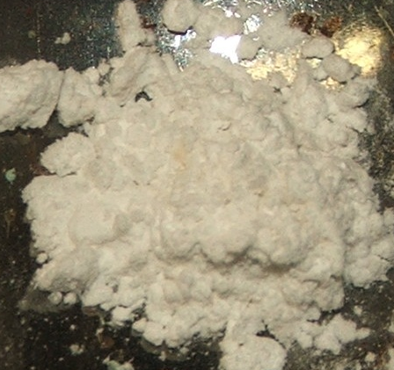
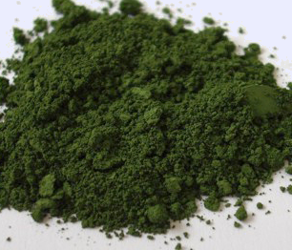
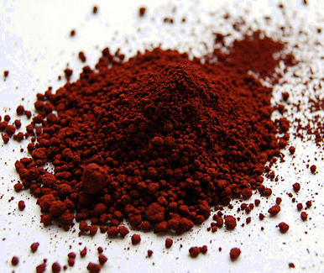
Oksaydhka birta (Metal oxides)
Oksaydh bir (metal oxide) wuxuu ka kooban yahay atamka birta oo ku xidhan atamka oksijiinta. Waxaa jira oksaydh bir (metal oxide) oo badan oo jira.
Tusaalooyinka oksaydhka birta (metal oxides):
oksaydh calcium (calcium oxide)
oksaydh chromium (chromium oxide)
oksaydh bir (iron oxide)

Slide 8

Oksaydhka birta (Metal oxides)
Dooro dhammaan odhaahyada saxda ah.
Oksaydh bir (metal oxide) waa meesha atamka birta ay ku xidhan yihiin oksijiin.
Oksaydh bir (metal oxide) waa halka atamka birta (metal atom) lagu daro oksijiin (oxygen).
Kaarboon laba-oksaydh (Carbon dioxide) waa tusaale oksaydh bir (metal oxide).
Oksaydh qalin (Silver oxide) waa tusaale oksaydh bir (metal oxide).

Slide 9

Oksaydhyaasha birta (Metal oxides)
Oksaydhyaasha birta (Metal oxides) waa saldhigyo (bases); marka lagu milo biyo (water) waxay u rogi doonaan tusiyaha guud (universal indicator) midab buluug (blue colour).
Daawo fiidiyowga (video) si aad u aragto:
Oksaydh magnesium (Magnesium oxide) oo laga sameeyay falgalka (reaction) magnesium iyo oksijiin (oxygen).
Oksaydh magnesium (Magnesium oxide) oo lagu milay biyo (water) ka dibna lagu tijaabiyay tusiyaha guud (universal indicator) si loo muujiyo milan (solution) alkaline ah oo la sameeyay.

Slide 10

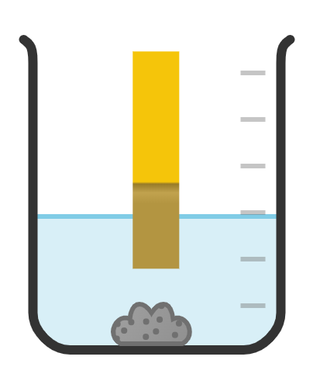

Oksaydhyaasha birta (Metal oxides)
Midabkee ayay tusiyaha guud (universal indicator) u rogi doonaa marka oksaydh bir (metal oxide) la geliyo biyo (water)?
warqadda tusiyaha guud (universal indicator paper)
guduud (red)
cagaar (green)
buluug madow (dark blue)

Slide 11

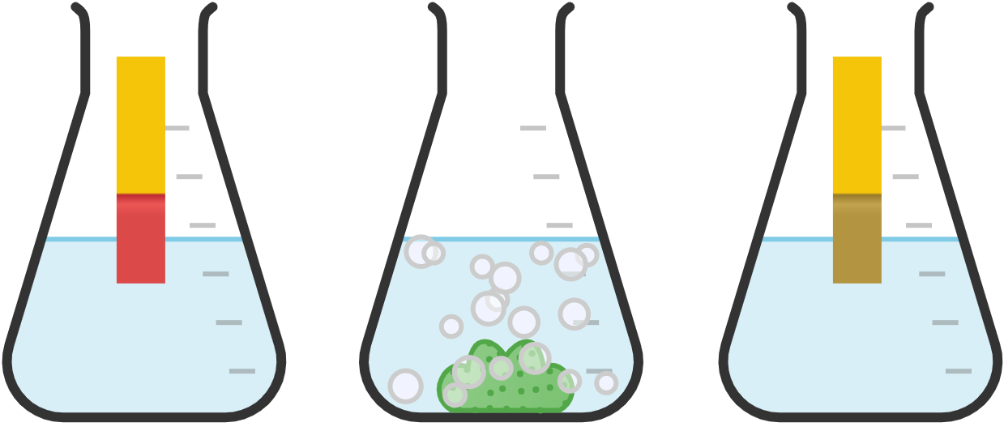
Oksaydhyaasha birta (Metal oxides)
Oksaydhyaasha birta (Metal oxides) waa saldhigyo (bases) waxayna la falgali karaan (react) aashito (acids) si ay u dhex-dhexeeyaan (neutralise).
waraaqda tilmaanta guud (universal indicator paper)
Milan (solution) dhex-dhexaad (neutral) waa cagaar (green), pH7.
cagaar (green)
guduud (red)
aashito (acid)
falgalka (reaction) oksaydh bir (metal oxide) iyo aashito (acid)
milan cusbo dhex-dhexaad (neutral salt solution)

Slide 12
Bir-oksaydh (Metal oxides)
iska'egta guud ee falgalka (reaction) ee u dhexeeya bir-oksaydh (metal oxide) iyo asiidh (acid) waa:
bir-oksaydh + asiidh → cusbo bir ah + biyo
tusaale: magnesium oxide + hydrochloric acid → magnesium chloride + biyo

Slide 13
Bir-oksaydh (Metal oxides)
Magaca cusbada (salt) ee ka soo baxa falgalka dhexdhexaadinta (neutralisation) wuxuu ku xiran yahay nooca asiidhka la isticmaalay.
magaca asiidhka | dhammaadka magaca cusbada birta
hydrochloric | chloride
sulfuric | sulfate
nitric | nitrate
lead oxide + hydrochloric acid → lead chloride + biyo
lead oxide + sulfuric acid → lead sulfate + biyo
lead oxide + nitric acid → lead nitrate + biyo

Slide 14
Bir-oksaydh (Metal oxides)
Magacaabi asiidhka la isticmaalay markii zinc oxide falgalay si loo sameeyo zinc sulfate.
hydrochloric acid
sulfuric acid
sulfate acid
nitric acid

Slide 15
Oksaydhka birta (Metal oxides)
Waa noocee falgal (reaction) oo ka dhex dhaca oksaydhka birta (metal oxides) iyo aashitada (acids)?
oksaydhaynta (oxidation)
aashitaynta (acidification)
dhex-dhexaadinta (neutralisation)

Slide 16
Oksaydhka birta (Metal oxides)
Waxaa jira saddex qaybood oo tijaabada (experiment) ah:
Dhex-dhexaadinta (Neutralising) aashitada (acid) (sulfuric acid) iyadoo la isticmaalayo sal (base) oksaydh bir (metal oxide) (copper oxide).
Shaandhaynta (Filtering) si looga saaro sal (base) aan milmi karin (insoluble) (copper oxide) ee xad-dhaafka ah ee isku dhafka falgalka (reaction mixture).
Kiristaalaynta (Crystallising) sheyga (product) copper sulfate.

Slide 17
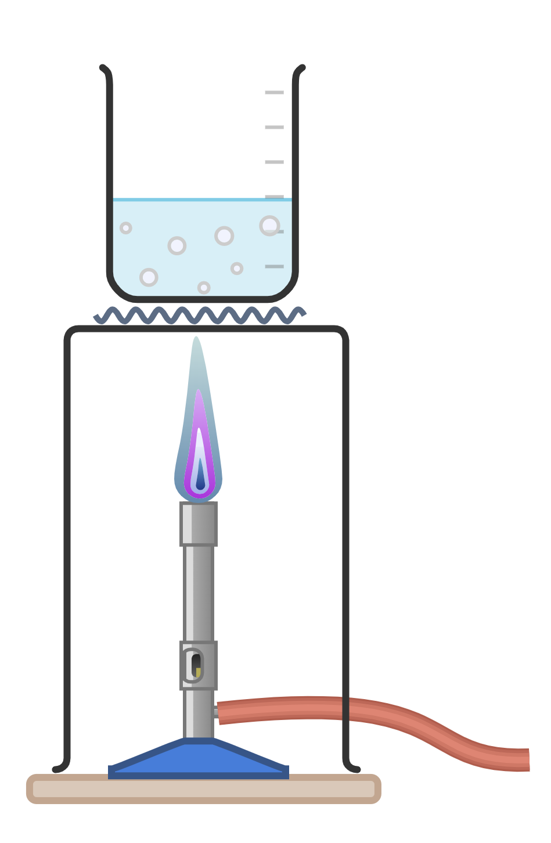
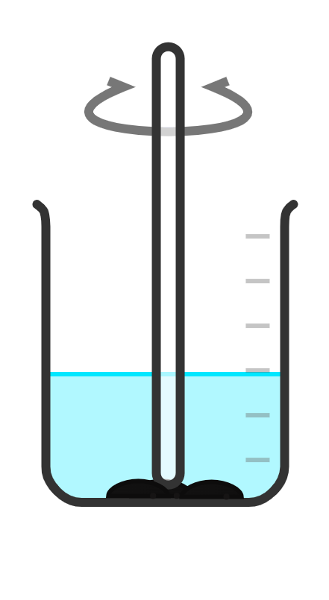
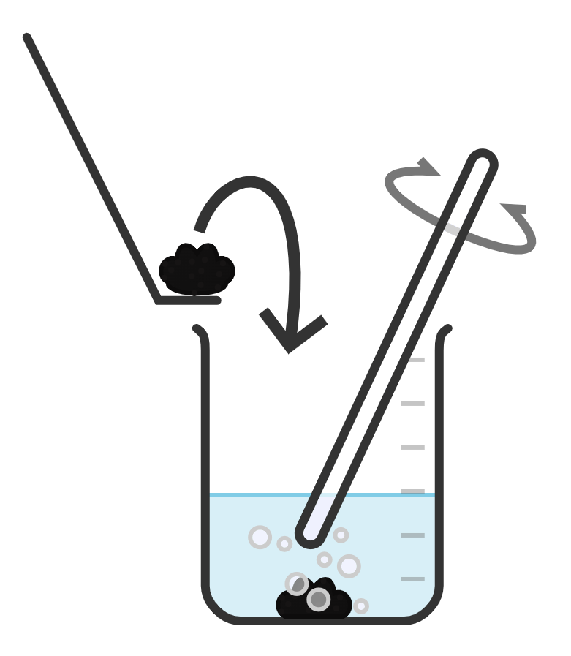
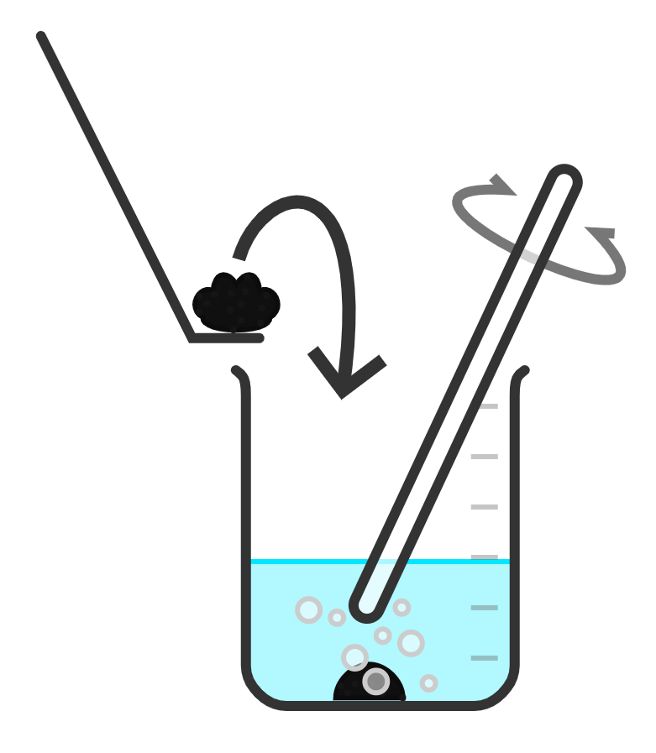
Oksaydhka birta (Metal oxides)
Tallaabada 1: Dhex-dhexaadi (Neutralise) aashitada (acid) iyadoo la isticmaalayo sal (base) oksaydh bir (metal oxide).
2. Ku dar 1 spatula oo copper oxide ah.
4. Ku dar spatula kale oo copper oxide ah.
6. Ku celi (Repeat) tallaabooyinka 4 iyo 5 ilaa aan xumbo (bubbles) kale la arkin oo copper oxide madow hadhay. Copper oxide-ga waxaa lagu daray xad-dhaaf (excess).
1. Si tartiib ah u kululee (warm) sulfuric acid ilaa aad bilowdo inaad aragto xumbo (bubbles), ka dibna dami kulaylka (heat).
3. Walaaq (Stir) ilaa uu joogo fizzing-ga oo aadan arki karin copper oxide madow.
5. Walaaq (Stir) ilaa uu joogo fizzing-ga oo aadan arki karin copper oxide.

Slide 18
Oksaydhka birta (Metal oxides)
Marka la falgaliyo copper oxide iyo sulfuric acid, dhammaan copper oxide waa in hal mar lagu daro.
Waa in la daraa hal spatula mar (one spatula at a time) ilaa laga daro dhammaan copper oxide-ga.
Waa in lagu daro hal qaaddo (spatula) mar kasta ilaa copper oxide uu ka badnaado (excess).

Slide 19
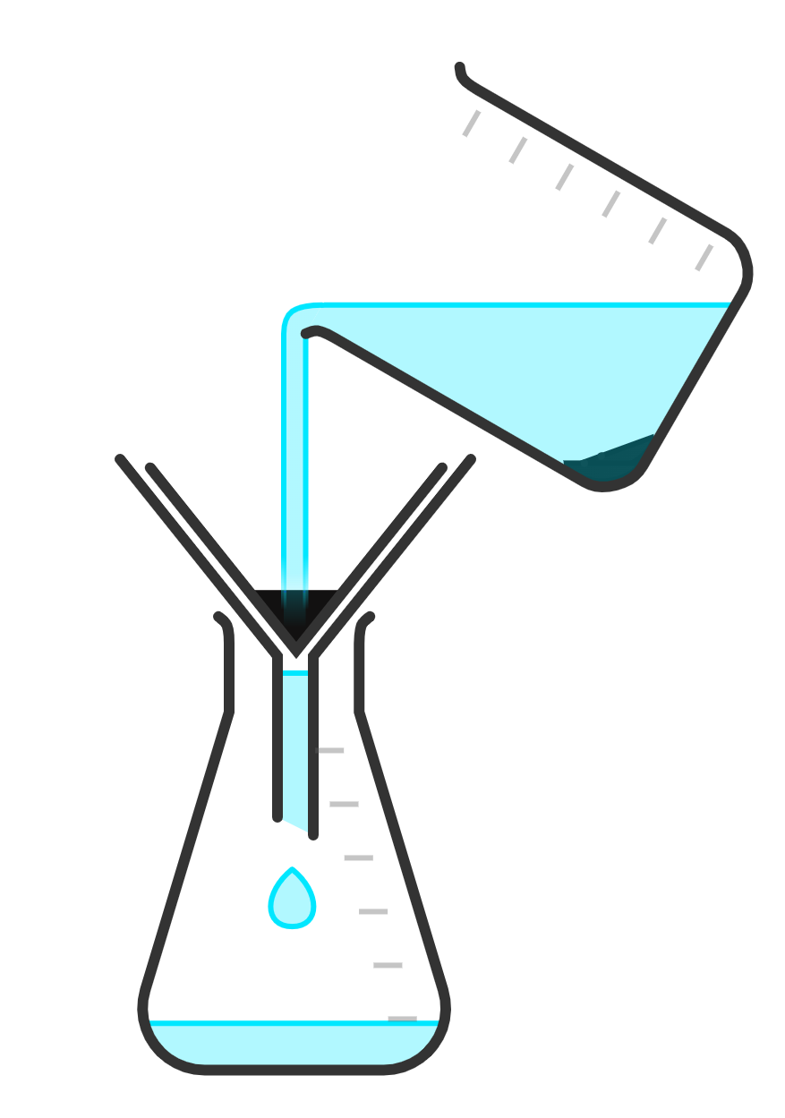
Oksaydhka birta (Metal oxides)
Tallaabada 2: Shaandheey (Filter) si looga saaro copper oxide-ka badan (excess).
1. Shaandheey (Filter) isku darka falgalka (reaction mixture) si looga saaro copper oxide-ka badan (excess).
2. Sii daa copper oxide-ka badan (excess) si ammaan ah.
3. Hayso milanka copper sulfate (copper sulfate solution) tallaabada xigta.

Slide 20
Oksaydhka birta (Metal oxides)
Ka dib shaandhaynta (filtration), maxaa tahay inaad haysato qaybta xigta ee tijaabada (experiment)?

Slide 21
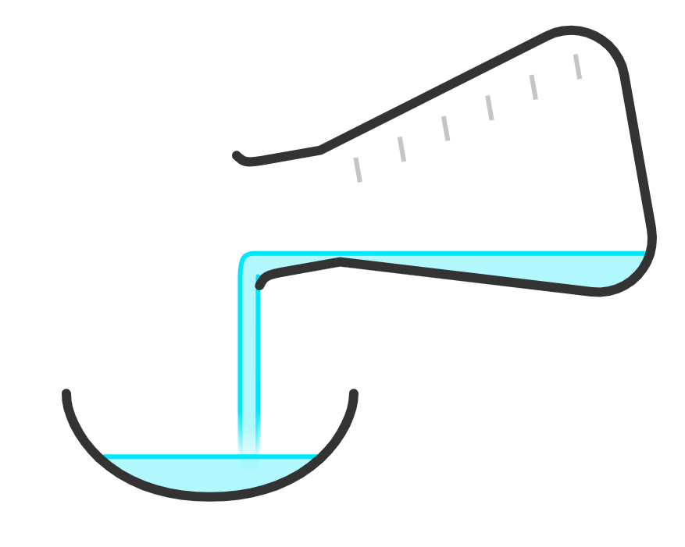
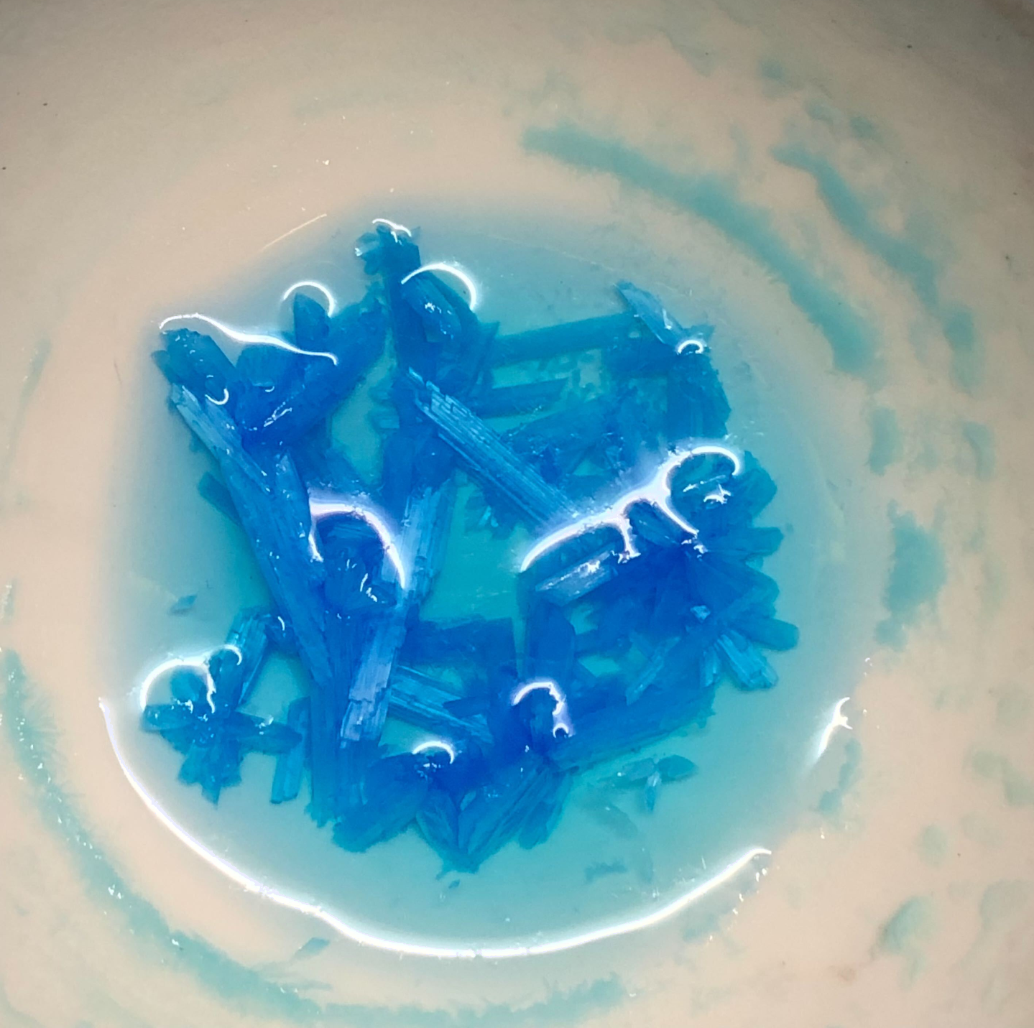

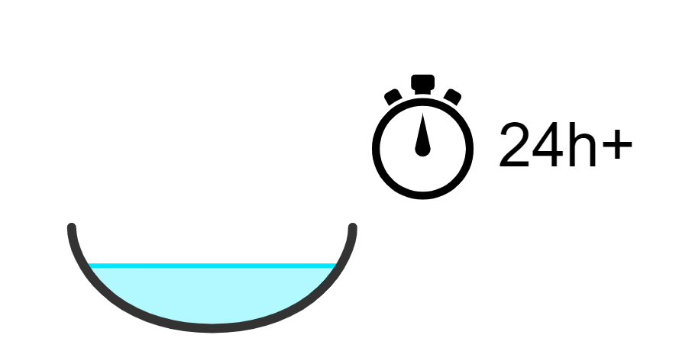
Oksaydhka birta (Metal oxides)
Tallaabada 3: Uumi (Evaporate) biyaha (water) ka baxa milanka copper sulfate (copper sulfate solution) si loo sameeyo kiristaalo copper sulfate (copper sulfate crystals).
3. Kiristaaladaada copper sulfate (copper sulfate crystals) waa inay ku sameeyaan weelka uumista (evaporating basin).
2. Dhig milanka copper sulfate (copper sulfate solution) qol diiran. Ka tag ilaa biyuhu (water) uumiyaan, tani waxay qaadan kartaa dhowr maalmood.
1. Ku shub milanka copper sulfate (copper sulfate solution) weel uumis (evaporating basin).
kiristaalo copper sulfate (copper sulfate crystals)

Slide 22
Oksaydhka birta (Metal oxides)
Magacow habka loo isticmaalo si loo helo kiristaalo copper sulfate (copper sulfate crystals) oo laga soo qaado milanka copper sulfate (copper sulfate solution).
shaandhayn (filtration)
uumis (evaporation)
dhexdhexaadin (neutralisation)

Slide 23
Oksaydhka birta (Metal oxides)
Samee shaybaarka (practical) si aad u samayso kiristaalo copper sulfate (copper sulfate crystals) oo ka yimid copper oxide iyo sulfuric acid.
Qor isla'egta erayada ee falgalka (reaction) copper oxide iyo sulfuric acid si loo sameeyo copper sulfate iyo biyo (water).

Slide 24
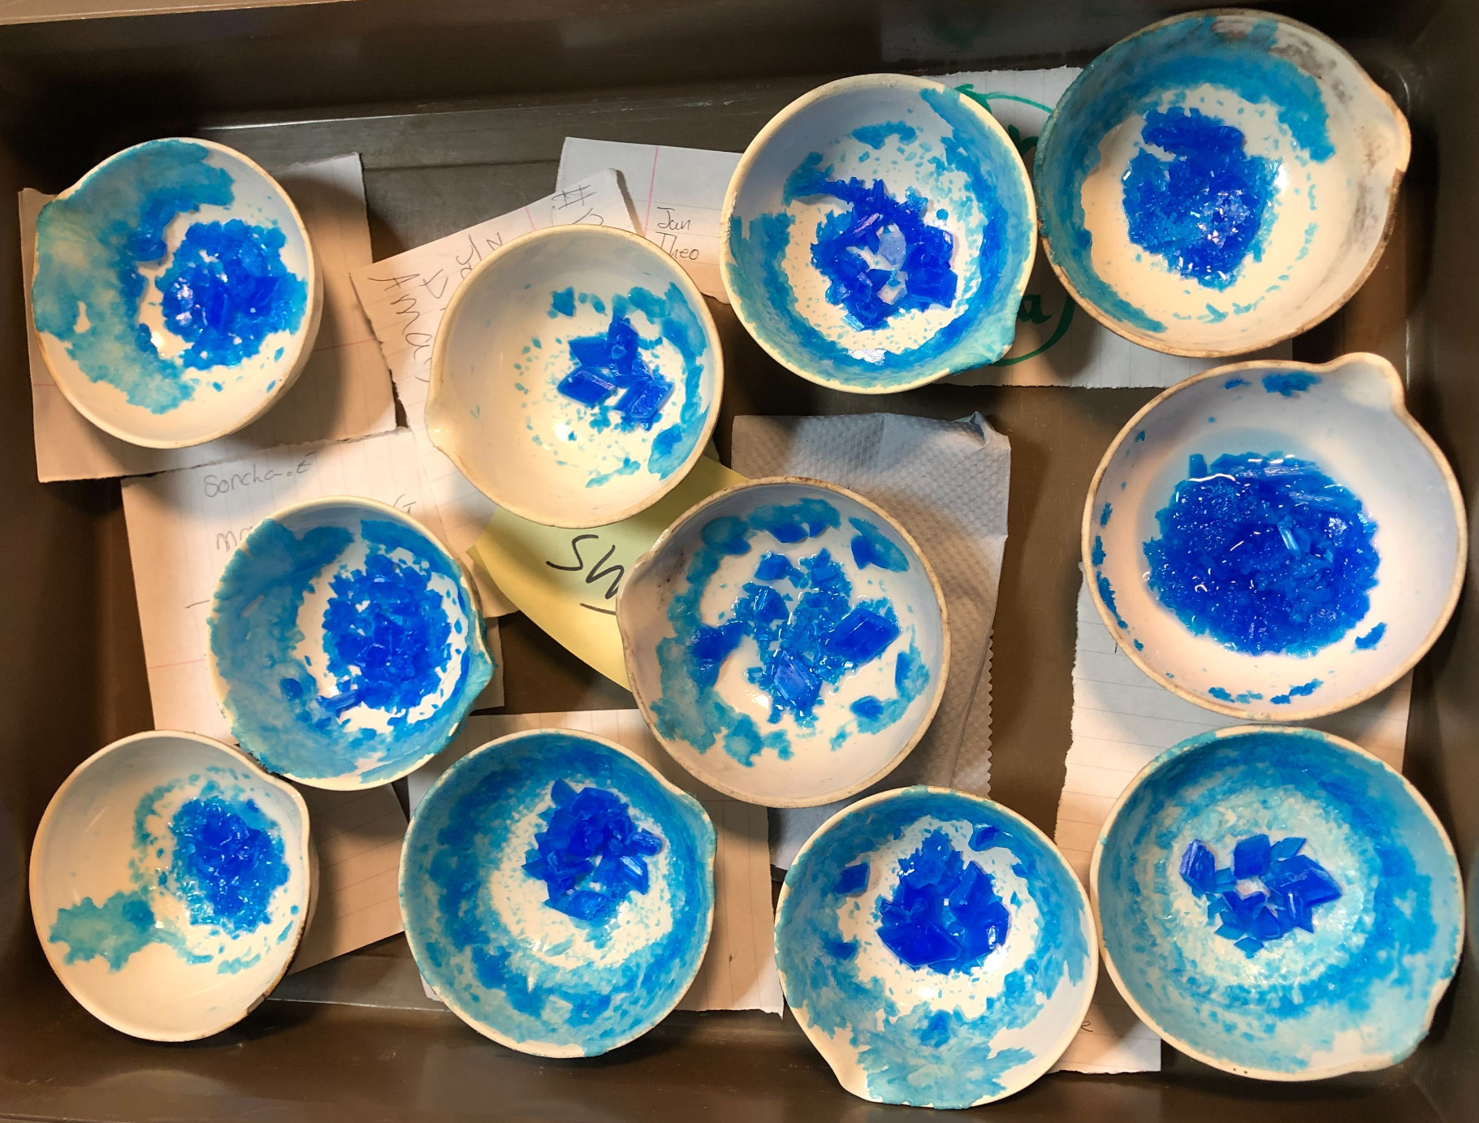
Metal oxides
Natiijooyinkaaga waxay u ekaan karaan kuwan oo kale.
Qor isla'egta erayada ee falgalka (reaction) copper oxide iyo sulfuric acid si loo sameeyo copper sulfate iyo biyo (water).
copper oxide + sulfuric acid → copper sulfate + biyo (water)

Slide 25
Metal oxides
Dhammeystir waxyaabaha ka maqan ee fal-celiyeyaasha iyo waxsoosaarka.
lead oxide + hydrochloric acid →
__________ chloride + biyo (water)
lead oxide + sulfuric acid →
lead __________+ biyo (water)
zinc oxide + __________ acid →
zinc chloride + __________
__________ oxide + ________ acid →
zinc nitrate + biyo (water)
silver _________ + nitric acid →
________ nitrate + biyo (water)

Slide 26
Metal oxides
Dhammeystir waxyaabaha ka maqan ee fal-celiyeyaasha iyo waxsoosaarka.
lead oxide + hydrochloric acid →
__________ chloride + biyo (water)
lead oxide + sulfuric acid →
lead __________+ biyo (water)
zinc oxide + __________ acid →
zinc chloride + __________
__________ oxide + ________ acid →
zinc nitrate + biyo (water)
silver _________ + nitric acid →
________ nitrate + biyo (water)
Jawaabaha:
lead
sulfate
hydrochloric
biyo (water)
zinc
nitric
oxide
silver

Slide 27
Metal oxides iyo non-metal oxides
Metal oxides
Non-metal oxides

Slide 28
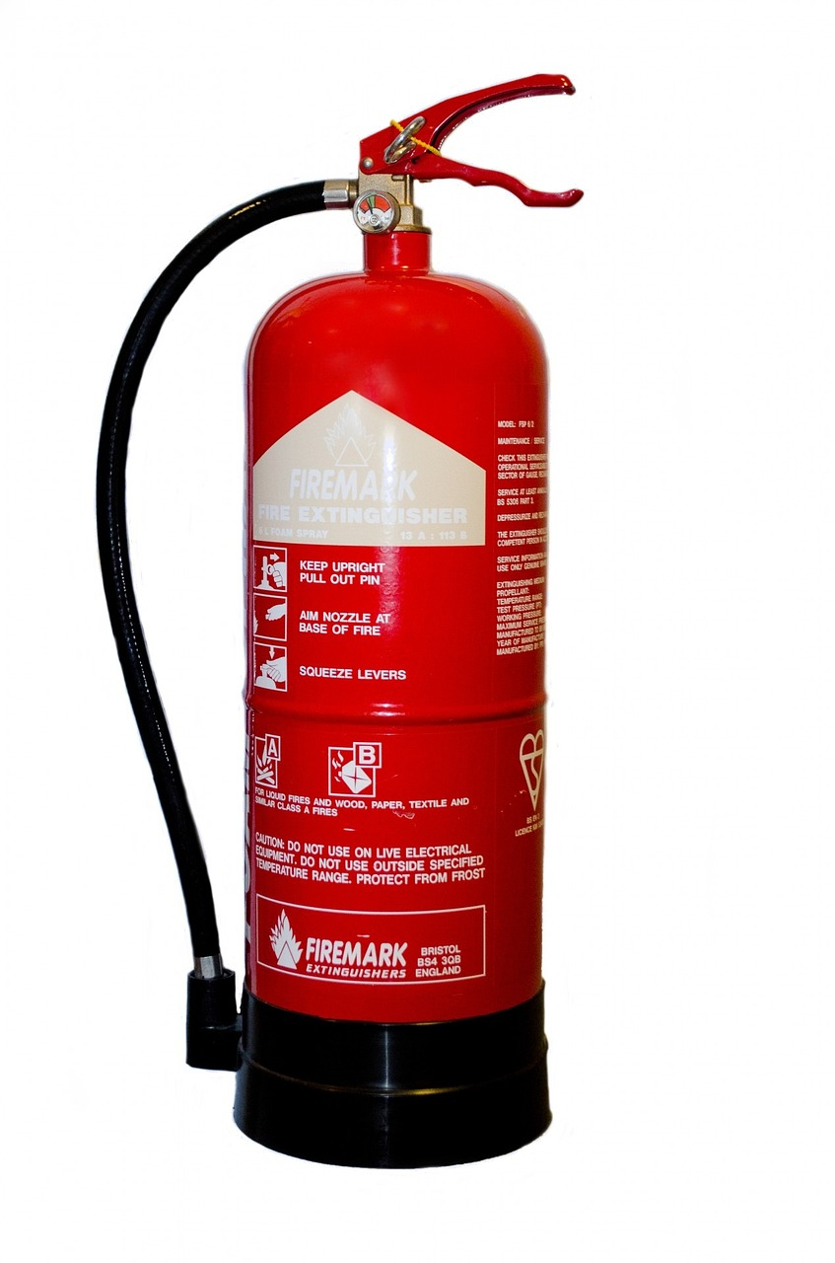
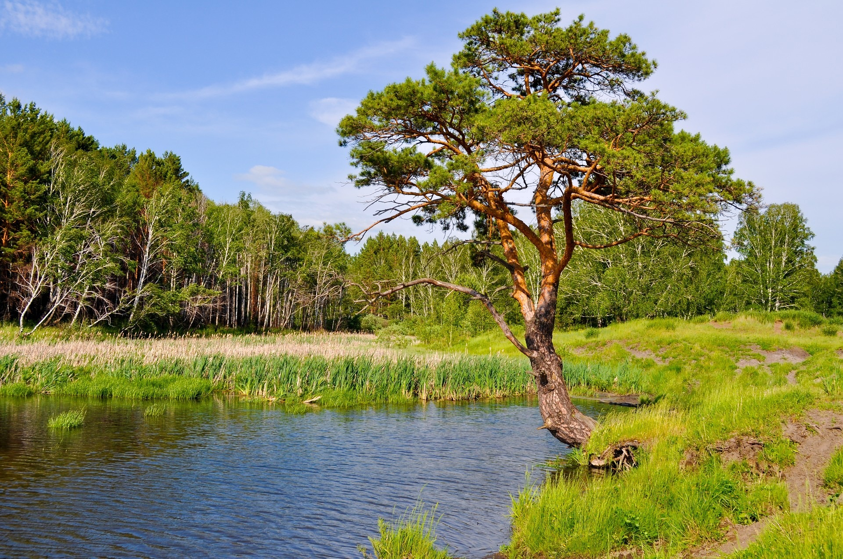
Non-metal oxides
Non-metal oxide wuxuu ka kooban yahay atamka non-metal oo ku xiran atamka oxygen, tusaale: carbon dioxide.
Nooleyaasha harooyinka waxaa saameyn kara roobka ashitada (acid rain) oo uu keeno wasakhowga sulfur dioxide.
Carbon dioxide waxaa loo isticmaalaa dab-demiyeyaasha.

Slide 29
Oksaydh-yada bir-ahaan (Non-metal oxides)
Oksaydh bir-ahaan (non-metal oxide) waa …
atamyo bir ah oo ku xidhan atamyo oksajiin (oxygen).
atamyo bir-ahaan (non-metal) ah oo ku xidhan atamyo oksajiin (oxygen).
atamyo bir-ahaan (non-metal) ah oo ku xidhan atamyo nitrogen.
atamyo bir-ahaan (non-metal) ah oo ku xidhan atamyo bir ah.

Slide 30
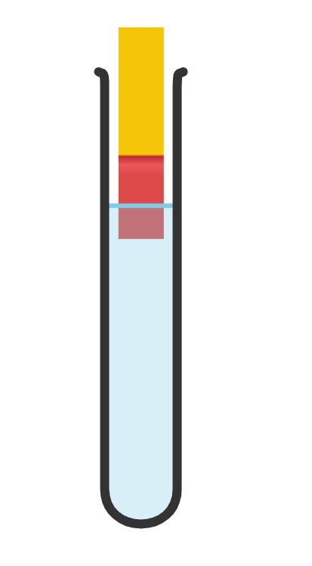
Oksaydh-yada bir-ahaan (Non-metal oxides)
Oksaydh-yada bir-ahaan (Non-metal oxides) ee biyo (water) ku jira waxay sameeyaan milano (solutions) aashito (acidic).
warqadda tusaha guud (universal indicator paper)
guduud (red)
bir-ahaan (non-metal) iyo biyo (water)

Slide 31

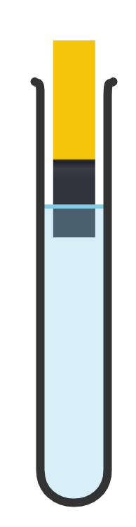
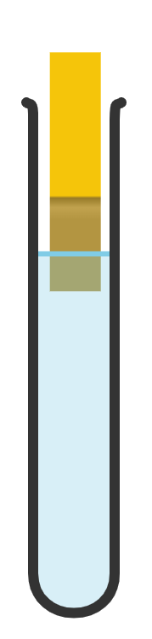
Oksaydh-yada bir-ahaan (Non-metal oxides)
Kee ayaa ku jiri kara oksaydh bir-ahaan (non-metal oxide) oo biyo (water) ku jira?
warqadda tusaha guud (universal indicator paper)
guduud (red)
buluug madow (dark blue)
cagaar (green)

Slide 32
Oksaydh-yada bir-ahaan (Non-metal oxides)
Isticmaal warqadda tusaha guud (universal indicator) si aad u tijaabiso (test) pH-ga saddexda oksaydh bir-ahaan (non-metal oxide) ee la geliyay biyo (water).
Waxaad isticmaali doontaa:
magaca non-metal oxide ee biyo (water) | midabka universal indicator | acid / neutral / alkali
nitrogen oxide
phosphorus oxide
sulfur dioxide
‘oksaydh nitrogen oo biyo (water) ku jira’
‘oksaydh fosforus oo biyo (water) ku jira’
sulfur dioxide ee biyo (water)
Dhammeystir jaantuska natiijooyinka.
Qor gabagabo ku saabsan pH-ga non-metal oxides ee biyo (water) adigoo isticmaalaya natiijooyinka tijaabadaada (experiment). Waxaad isticmaali kartaa bilowga jumladda hoose.
(Qaar / dhammaan / midna) non-metal oxides ee biyo (water) ayaa universal indicator u rogay … sababtoo ah ...

Slide 33
Non-metal oxides
iyo 2) Natiijooyinkaagu waxay u ekaan karaan sidan:
magaca non-metal oxide ee biyo (water) | midabka universal indicator | acid / neutral / alkali
nitrogen oxide
phosphorus oxide
sulfur dioxide
guduud / orange
acid
guduud / orange
aashito (acid)
guduud / orange
aashito (acid)
Dhammaan oksaydhka (oxides) ee birta ah ee biyaha (water) ku jira ayaa universal indicator u rogay cas / oranji, sababtoo ah dhammaantood waa aashito (acidic).

Slide 34
Oksaydhyaasha birta (metal oxides) iyo oksaydhyaasha aan birta ahayn (non-metal oxides)
Oksaydh bir (metal oxide) wuxuu ka kooban yahay atamka birta (metal atoms) oo ku xidhan atamka oksajiinta (oxygen atoms).
Oksaydhyaasha birta (metal oxides) waa saldhigyo (bases) waxayna la falgali karaan (react) aashito (acids) si ay u dhexdhexaadiyaan (neutralise).
Oksaydh bir (metal oxide) + aashito (acid) → cusbo bir (metal salt) + biyo (water)
Oksaydh aan bir ahayn (non-metal oxide) wuxuu ka kooban yahay atamka aan birta ahayn (non-metal atoms) oo ku xidhan atamka oksajiinta (oxygen atoms).
Oksaydhyaasha aan birta ahayn (non-metal oxides) ee biyaha (water) ku jira waxay sameeyaan milano aashito (acidic solutions).

