Slide 1
Curiyeyaasha molecular (Molecular elements)
Atoms, curiyeyaasha iyo xeryahooda (Atoms, elements and compounds)

Slide 2
sida loo isticmaalo darasyada Oak

Slide 3
Waxaan qeexi karaa molecule-ka (molecule) oo sawiri karaa sawirada curiyeyaasha (elements) ee ka samaysan molecules.

Slide 4
molecule (molecule)
monatomic (monatomic)
diatomic (diatomic)

Slide 5
Molecules waxay ka kooban yihiin laba ama in ka badan oo atoms ah oo si kiimiko ah isugu xiran. Kuwani badanaa waa atoms aan bir ahayn (non-metal atoms).
Curiye monatomic (monatomic element) wuxuu ka kooban yahay kaliya atoms keli ah.
Curiye diatomic (diatomic element) wuxuu ka kooban yahay laba atoms oo isku nooc ah oo si kiimiko ah isugu xiran.

Slide 6

Curiyeyaasha molecular (Molecular elements)
Molecules iyo aan-biraha (non-metals)
Matalista molecules (Representing molecules)

Slide 7
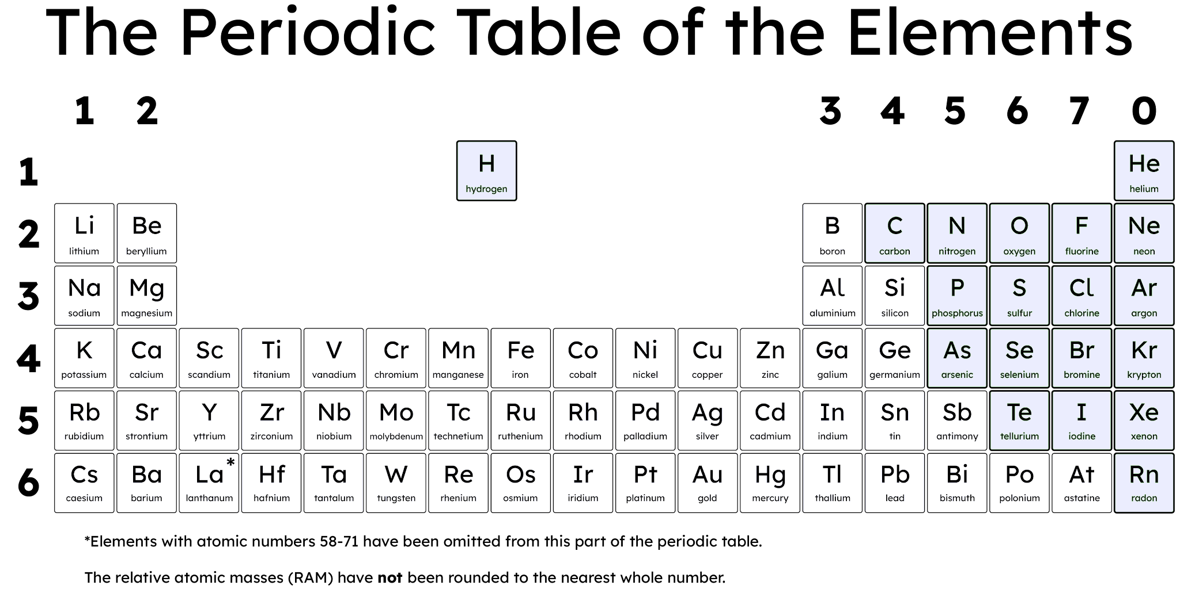
Molecules iyo aan-biraha (non-metals)
Qaar badan oo ka mid ah aan-biraha (non-metals) waxay ku jiraan xaaladda gaas (gas) heerkulka qolka.
g
=gaas (gas)
l
=dareere (liquid)
s
=adag (solid)
g
g
s
g
g
g
g
s
s
g
g
s
s
l
g
s
s
g
g

Slide 8

Molecules iyo aan-biraha (non-metals)
Heerkulka qolka, inta badan aan-biraha (non-metals) waxay ku jiraan xaaladdee?
xaaladda adag (solid state)
xaaladda dareeraha (liquid state)
xaalad gaas (gas state)

Slide 9
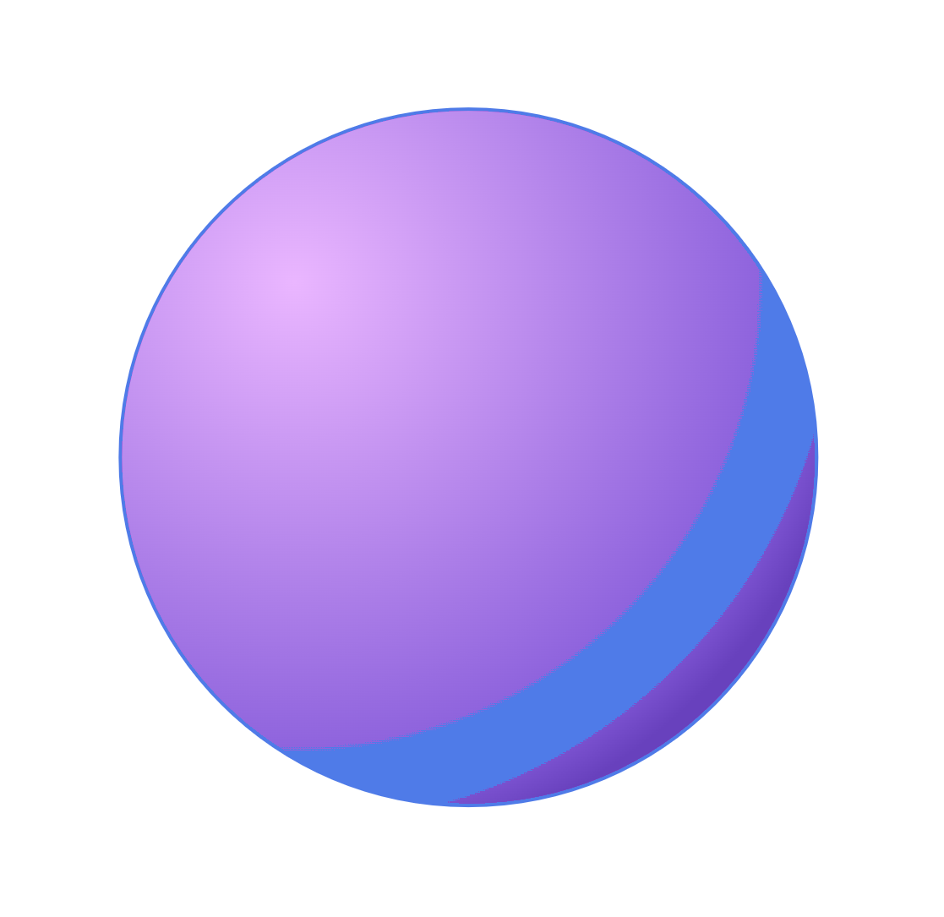
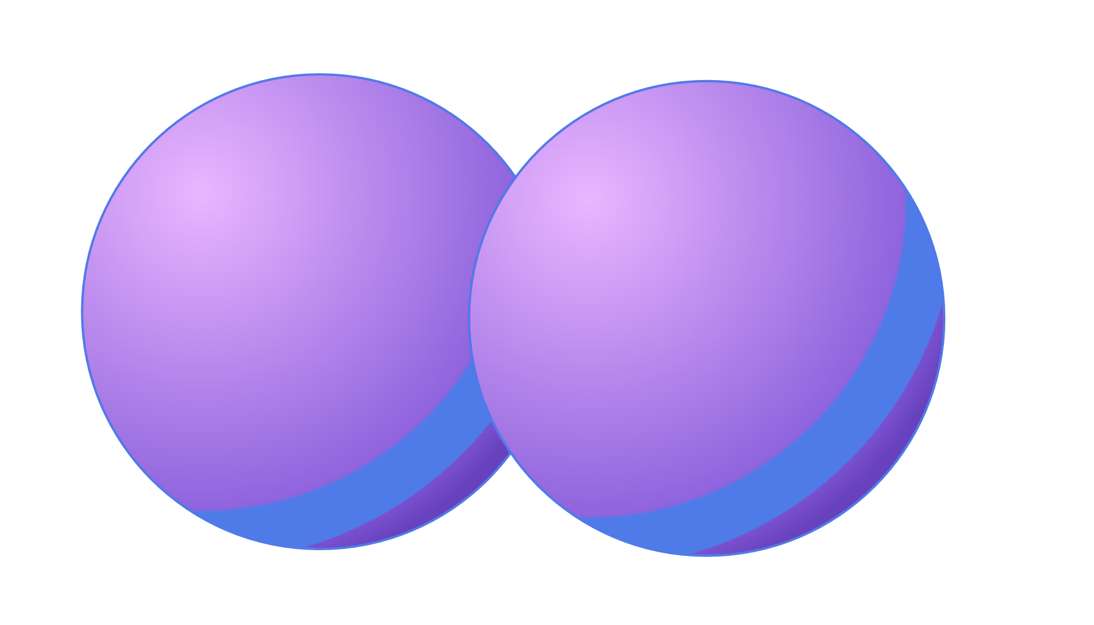
Molecules iyo birta (non-metals)
Curiyayaasha (elements) qaarkood waa:
monatomic waxay ka kooban yihiin atam (atoms) kali ah oo keliya
diatomic waxay ka kooban yihiin laba atam (atoms) oo isku nooc ah oo si kiimiko ah isugu xidhan (chemically bonded).
monatomic
diatomic
one
atom (atom)
two
atoms (atoms)

Slide 10
Molecules iyo birta (non-metals)
Curiye (element) had iyo jeer waa atom (atom) keli ah oo kaligiis ah.
Curiyayaasha (elements) qaarkood waa diatomic.
Dhammaan curiyayaasha (elements) waa diatomic.

Slide 11
Molecules iyo birta (non-metals)
Laba ama in ka badan oo atam (atoms) ah (badanaa birta (non-metals)) oo la isku daray waxaa loo yaqaan molecule. Qaar ka mid ah birta (non-metals) waa monatomic oo ma sameeyaan molecules.
Gaasaska (gases) gobta (Noble) waa:
ku qoran tiirka midig ee shaxda (periodic table)
monatomic.

Slide 12
Molecules iyo birta (non-metals)
Qaar ka mid ah birta (non-metals) waxay sameeyaan molecules diatomic ah oo ka kooban laba atam (atoms) (tusaale: O₂, N₂, H₂, Cl₂).
Nambarka hoose 2 wuxuu muujinayaa in ay jiraan laba atom oo curiye (element) ah oo isku xiran.

Slide 13
Molecules iyo birta aan ahayn (non-metals)
Summada (symbol) kee ka dhigan yahay curiye (element) diatomic ah?
Kr
Ne
Cl2

Slide 14
Molecules iyo birta aan ahayn (non-metals)
Imisa atom ayaa ku jira molecule diatomic ah?
kaliya 1
kaliya 2
1 ama 2
2 ama in ka badan

Slide 15
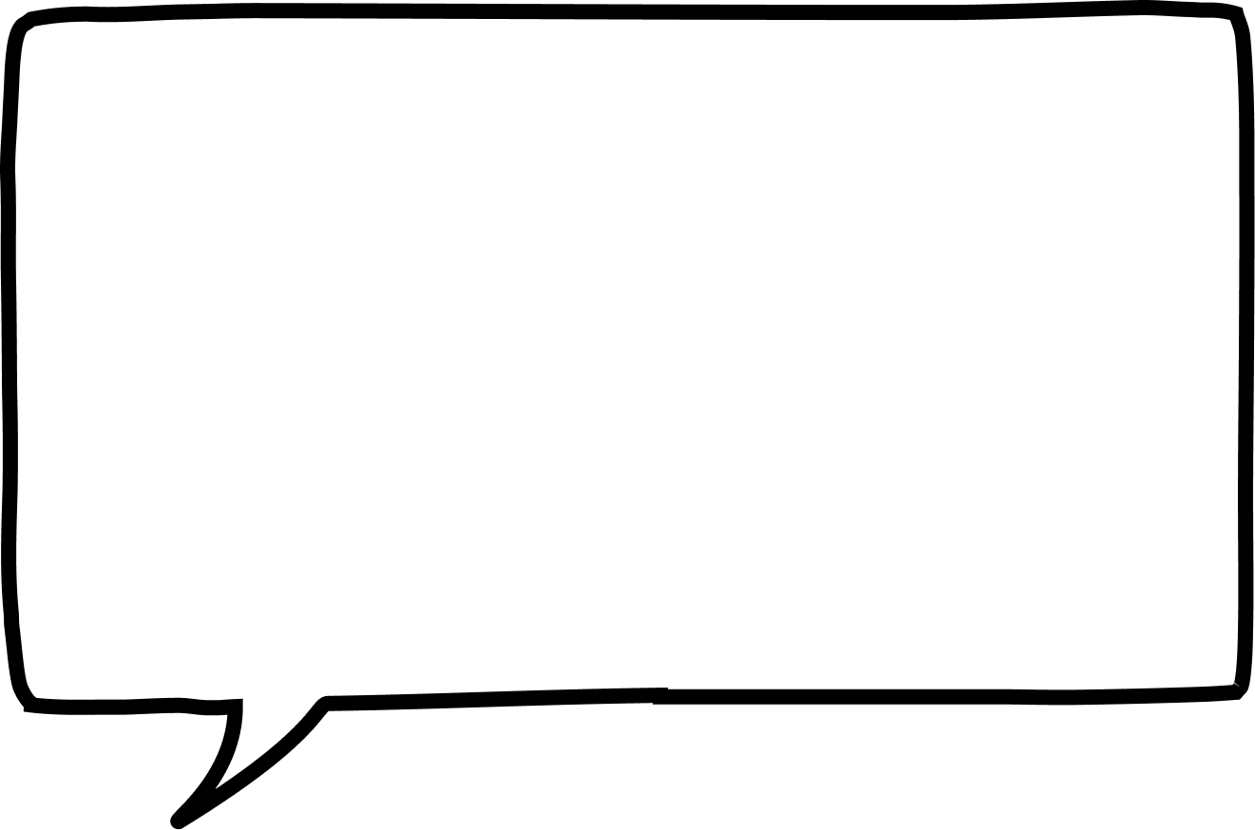
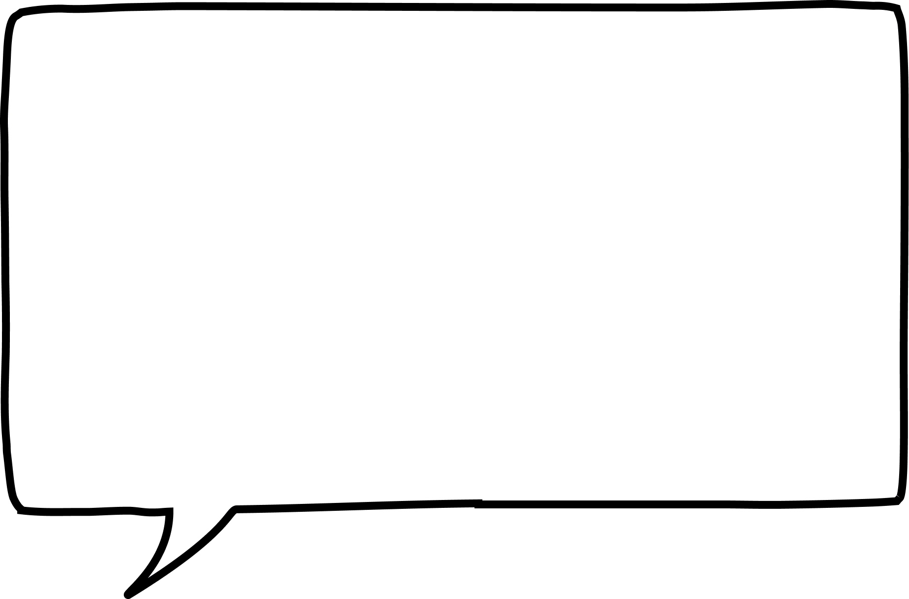





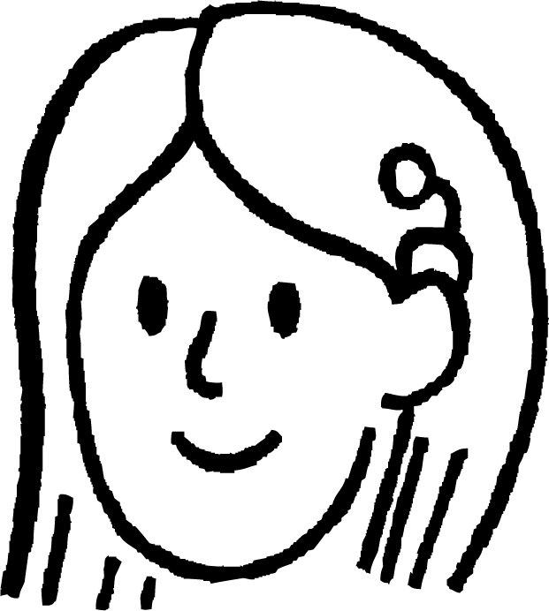



Molecules iyo birta aan ahayn (non-metals)
Ardaydee ka hadlaysa gaasaska (noble gases)?
Waa molecules diatomic ah.
Waxay ku qoran yihiin tiirka midig ee shaxda xilliyeedka (periodic table).
Cabdi
Waxay u jiraan kaliya sida atom monatomic ah.
Layla
Suad

Slide 16
Molecules iyo birta aan ahayn (non-metals)
Buuxi ereyada maqan adigoo kaliya isticmaalaya: monatomic/diatomic/molecules/atoms.
Qaar ka mid ah kuwa aan bir ahayn (non-metals) waxay sameeyaan __________ molecules oo ka kooban laba _________ (tusaale ahaan oxygen O₂).
Qaar ka mid ah kuwa aan bir ahayn (non-metals) waa __________ atoms mana sameeyaan __________.
Noble gases waxay ku qoran yihiin tiirka midig ee diwaanka xilliyeedka (periodic table). Waa __________ __________.
Nitrogen (N₂) waa curiye aan bir ahayn (non-metal) oo sameeya __________ __________.

Slide 17
Molecules iyo kuwa aan bir ahayn (non-metals)
Buuxi erayada maqan adigoo kaliya isticmaalaya: monatomic/diatomic/molecules/atoms.
Qaar ka mid ah kuwa aan bir ahayn (non-metals) waxay sameeyaan __________ molecules oo ka kooban laba _________ (tusaale O₂).
Qaar ka mid ah kuwa aan bir ahayn (non-metals) waa __________ atoms mana sameeyaan __________.
Noble gases waxay ku qoran yihiin tiirka midig ee diwaanka xilliyeedka (periodic table) waa __________ __________.
Nitrogen (N₂) waa curiye aan bir ahayn (non-metal) oo sameeya __________ __________.
diatomic
atoms
monatomic
molecules
monatomic
atoms
diatomic
molecules

Slide 18
Curiyeyaasha molecular (Molecular elements)
Molecules iyo kuwa aan bir ahayn (non-metals)
Matixda (Representing) molecules

Slide 19
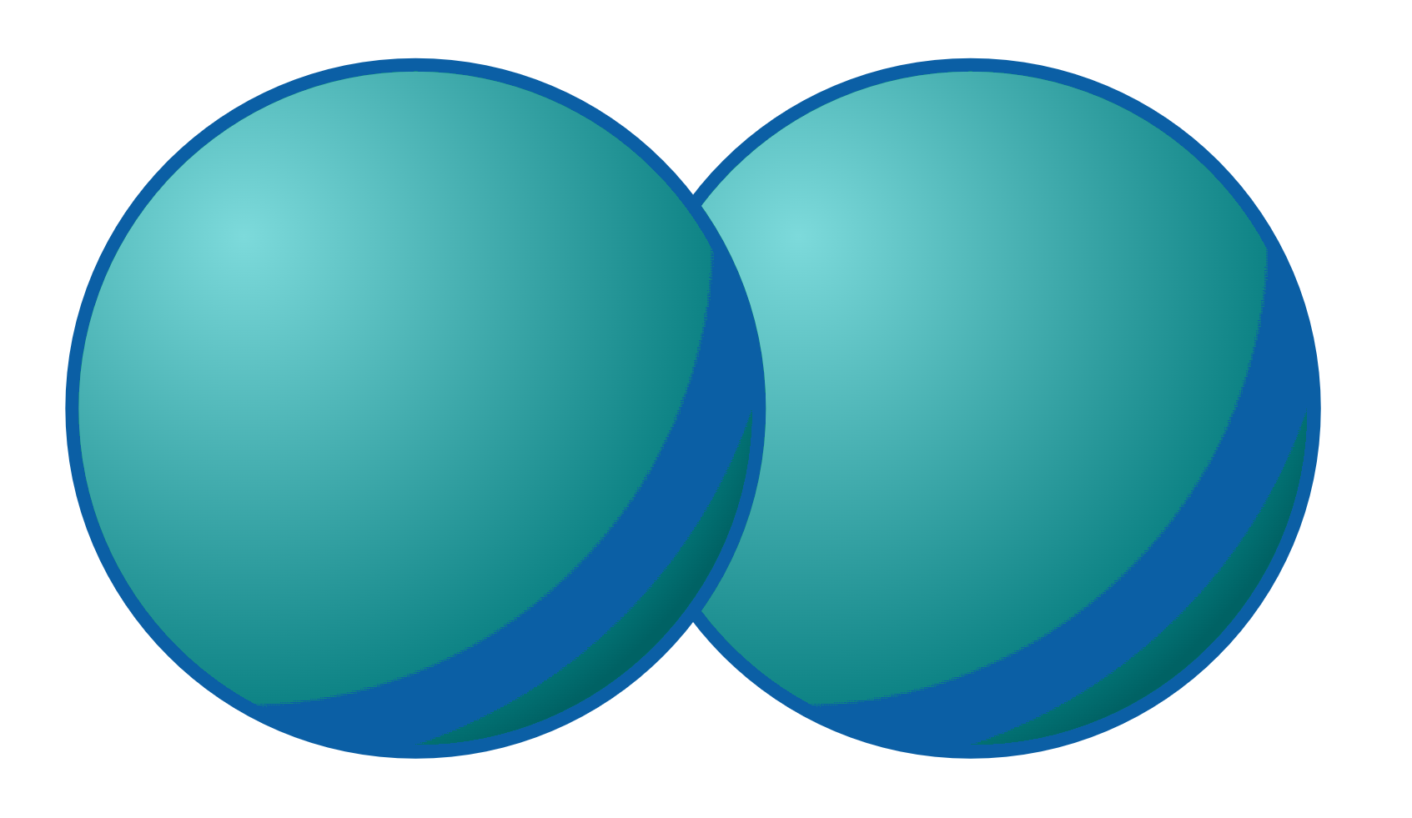

Matixda molecules (Representing molecules)
Molecules waxaa loo matixi karaa (represented) siyaabo kala duwan:
Mararka qaarkood astaamaha curiyaha (element) ayaa la muujiyaa.
H
H
H
H
H
H
3D
2D
qorshe (outline)

Slide 20

Matixda molecules (Representing molecules)
Walxaha monatomic iyo diatomic waxaa lagu matali karaa xaaladahooda (states of matter).
gaas monatomic (monatomic gas)
tusaale: helium
gaas diatomic (diatomic gas)
tusaale: oxygen

Slide 21
Matixda molecules (Representing molecules)
Sawir kee ayaa matalaya molecule diatomic?

Slide 22
Matixda molecules (Representing molecules)
Kala saar weedhaha iyo sawirada laba liis oo cinwaankoodu yahay monatomic iyo diatomic.
gaasaska goobta (noble gases) sida helium iyo argon
atom keli ah oo aan isku xirnayn
gaasaska sida hydrogen iyo oxygen
laba atom oo isku xiran
molecule
N₂
Rn
atom

Slide 23
Matixda molecules (Representing molecules)
hal-atom (monatomic)
diatomic
neefsasho (noble gases) sida helium iyo argon
neefsasho (gases) sida hydrogen iyo oxygen
hal-atom oo aan (single atoms not)
isku xidhnayn (joined together)
laba atom oo isku xidhan (two atoms joined together)
atom (atom)
moleekuul (molecule)
Rn
N₂

Slide 24
Matixinta moleekuullada (Representing molecules)
2. Buuxi macluumaadka maqan.
curiye (element) | calaamad (symbol) | hal-atom ama laba-atom (monatomic or diatomic) | atom ama moleekuul (atom or molecule) | sawir leh calaamad (drawing with symbol)
 | Cl2
neon (neon) | Ne |  | atom (atom)
nitrogen (nitrogen) |  | laba-atom (diatomic)
 | Ar
Cl
Cl
Ar

Slide 25
Matixinta molecules (Representing molecules)
curiye (element) | calaamad (symbol) | hal-atom ama laba-atom (monatomic or diatomic) | atom ama molecule | sawirka calaamadda (drawing with symbol)
 | Cl2
neon | Ne |  | atom
nitrogen |  | laba-atom (diatomic)
 | Ar
Cl
Cl
chlorine
diatomic (diatomic)
molecule (molecule)
Ne
monatomic (monatomic)
N₂
molecule
N
N
argon
Ar
hal-atom (monatomic)
atom

Slide 26
Curyaamaha molecular (Molecular elements)
Birta aan tahay (non-metals) badankoodu waa gaas (gas) heerkulka qolka.
Qaar ka mid ah birta aan tahay (non-metals) waxay sameeyaan molecules diatomic (diatomic molecules) oo ka kooban laba atom (tusaale: O₂, N₂, H₂, Cl₂).
Qaar ka mid ah birta aan tahay (non-metals) waa monatomic (monatomic) oo ma sameeyaan molecules.
Gases gobta (Noble gases) waa monatomic (monatomic) waxayna ku qoran yihiin tiirka midig ee miiska xilliyeedka (periodic table).

