Slide 1
Wax soo saar binomial ah oo ka adag
Tibaaxaha iyo qaaciidooyinka

Slide 2
Sida agabkeena waxbarista loogu talagalay fasalka

Slide 3
Waxaan heli karaa wax soo saar binomial ah oo ka adag.

Slide 4
Binomial waa tibaax aljabra ah oo matalaya wadarta laba eray oo aan isku mid ahayn.
Tusaalooyin
x + 2
5 − 6x
x²− x
a + 2y
Wax soo saar qayb ah (partial product) wuxuu iga jeedaa mid ka mid ah natiijooyinka isku dhufashada ee keena natiijada guud.

Slide 5

Wax soo saar binomial ah oo ka adag
Isticmaalka binomials u dhigma
Tirooyinka (Coefficients) ka weyn 1

Slide 6
Isticmaalka binomials u dhigma
Mararka qaarkood erayada binomials kuma jiraan isku nidaam.
Sideen u heli karnaa wax soo saarka (x + 3)(7 + x)?
Waxaan dib u habayn karnaa erayada binomials si erayada isku midka ah ugu jiraan isku nidaam.
(7 + x) ≡ (x + 7)
Sidaas darteed (x + 3)(7 + x) waxaa loo qori karaa (x + 3)(x + 7)
x 7
x²
7x
≡ x² + 10x + 21
x
3x
21
3

Slide 7
Isticmaalka binomials u dhigma
Sideen u qori karnaa (3 − x)(x − 7) si erayada isku midka ah ugu jiraan isku nidaam labada qaws?
(3 − x) ≡ ( 3 + (−x))
≡ (−x + 3)
Sidaas darteed (3 − x)(x − 7) waxaa loo qori karaa (−x + 3)(x − 7)
x −7
Ka digtoonow markaad ku dhufanayso qiimayaal taban.
−x²
7x
−x × x ≡ −x²
−x
−x × −7 ≡ 7x
(3 − x)(x − 7) ≡ −x² +10x − 21
3 × x ≡ 3x
3x
−21
3
3 × −7 ≡ −21

Slide 8

Isticmaalka binomials u dhigma
Kee ka mid ah binomials-kaan ayaa u dhigma (1 − x)?
(−1 + x)
(−x + 1)
(1 − x) ≡ (1 + (−x)) ≡ (−x + 1)
(− x − 1)
(x − 1)

Slide 9
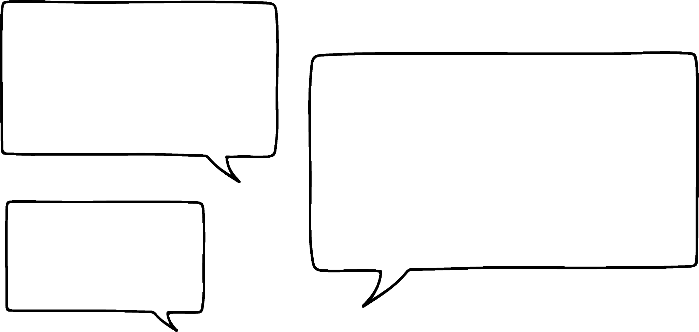







Isticmaalka binomials u dhigma
Ardayda qaar waxay helayaan badeecada (x − 5)(2 − x)
Waxaan dib u qorayaa sidan
(x − 5)(−x + 2)
Waxaan dib u qorayaa sidan
(−5 + x)(2 − x)
Waxaan helayaa badeecada anigoon dib u habayn
Cabdi
Yacquub
Nuur
Hababkan oo dhan miyay soo saari doonaan jawaab isku mid ah?
Habkee ayaad door bidaysaa?

Slide 10
Isticmaalka binomials (binomials) u dhigma
Ardayda qaar waxay helayaan badeecada (x − 5)(2 − x)
−x 2
Waxaan dib u qorayaa sidan
(x − 5)(−x + 2)
(x − 5)(−x + 2)
−x²
2x
≡ x(−x + 2)
− 5(−x + 2)
x
≡ −x² + 2x + 5x − 10
5x
−10
≡ −x² + 7x − 10
−5

Slide 11
Isticmaalka binomials (binomials) u dhigma
Ardayda qaar waxay helayaan badeecada (x − 5)(2 − x)
2 −x
Waxaan dib u qorayaa sidan
(−5 + x)(2 − x)
(−5 + x)(2 − x)
−10
5x
≡ −5(2 − x)
+ x(2 − x)
−5
≡ −10 + 5x + 2x − x²
2x
−x²
≡ −10 + 7x − x²
x
ama −x2 + 7x − 10

Slide 12
Isticmaalka binomials (binomials) u dhigma
Ardayda qaar waxay helayaan badeecada (x − 5)(2 − x)
2 −x
Waxaan helayaa badeecada anigoon dib u habayn
(x − 5)(2 − x)
2x
−x²
≡ x(2 − x)
− 5(2 − x)
x
≡ 2x − x² − 10 + 5x
−10
5x
≡ −x² + 7x − 10
−5
Waxaan helay jawaab isku mid ah anigoon dib u habayn

Slide 13
Isticmaalka binomials (binomials) u dhigma
Sida Nuur, uma baahnid inaad dib u habayn tid ka hor isku dhufashada, laakiin waxay kaa caawin kartaa inaad aragto qaababka (patterns) oo aad si fudud u aqoonsato qaladaadka.
Ereyada jawaabta kama dambaysa waxaa loo qori karaa si kasta oo loo doono.
Waa caado in ereyga leh jibka (exponent) ugu weyn uu hor yimaado, kan joogtada ah (constant)na uu dambee.
≡ −x² + 7x − 10

Slide 14
Isticmaalka binomials (binomials) u dhigma
Wax soo saarka laba binomial (binomials) oo qaabka (a + b)(a − b) ah waxaa loo qori karaa sida
a² − b²
Tani waa sababta labada wax soo saar ee qayb ahi ay yihiin lammaane eber (zero pair).
Waxaan ugu yeernaa qaabkan kala duwanaanshaha laba jibbaaran (difference of two squares).
(x + 7) (x − 7)
≡ x² − 7x + 7x − 49
≡ x² − 49
ama x2 − 72
Maxaad u malaynaysaa in (7 + x) (7 − x) uu noqon doono qaabka la fidiyay?

Slide 15
Isticmaalka binomials (binomials) u dhigma
7 −x
Waxaan u malaynayaa in (x + 7)(7 − x) uu yahay kala duwanaanshaha 2 jibbaaran
Cabdi
(7 + x) (7 − x)
49
−7x
7
≡ 7(7 − x)
+ x(7 − x)
7x
−x²
x
≡ 49 −7x + 7x − x²
Waxaan u malaynayaa in (x − 7)(7 − x) uu yahay kala duwanaanshaha 2 jibbaaran
≡ 49 − x²
Yacquub
(7 + x) (7 − x) ≡ 49 − x²
Waxaan u malaynayaa in (7 + x)(x − 7) uu yahay kala duwanaanshaha 2 jibbaaran
Nuur
Yaa aad la raacsan tahay?

Slide 16
Isticmaalka binomials (binomials) u dhigma
Dib u habaynta si ereyadu isku qaab u noqdaan ayaa caawin doonta.
Waxaan u malaynayaa in (x + 7)(7 − x) uu yahay kala duwanaanshaha 2 jibbaaran
Cabdi
(x + 7)(7 − x) ≡ (x + 7)(−x + 7)
≡ (7 + x)(7 − x)
Waxaan u malaynayaa (x − 7)(7 − x) waa kala duwanaanshaha 2 labajibbaaran (difference of 2 squares)
≡ 7² − x²
Hal xubin (term) oo qaws (bracket) kasta ah waa isku mid, kuwa kalena waa lammaane eber (zero pair).
Yacquub
Waxaan u malaynayaa (7 + x)(x − 7) waa kala duwanaanshaha 2 labajibbaaran (difference of 2 squares)
Nuur

Slide 17

Isticmaalka binomial (binomials) u dhigma (equivalent)
Dib u habaynta si xubnuhu (terms) ugu kala horreeyaan isku mid ayaa kaa caawin doonta.
Waxaan u malaynayaa (x + 7)(7 − x) waa kala duwanaanshaha 2 labajibbaaran (difference of 2 squares)
Cabdi
Waxaan u malaynayaa (x − 7)(7 − x) waa kala duwanaanshaha 2 labajibbaaran (difference of 2 squares)
(x − 7)(7 − x) ≡ (x − 7)(−x + 7)
≡ (−7 + x)(7 − x)
Yacquub
Ma aha kala duwanaanshaha laba labajibbaaran (difference of two squares) sababtoo ah labada xubin (terms) waa lammaane eber (zero pairs).
Waxaan u malaynayaa (7 + x)(x − 7) waa kala duwanaanshaha 2 labajibbaaran (difference of 2 squares)
Nuur
(−7 + x)(7 − x) ≡ −49 + 7x +7x −x²
≡−x² + 14x − 49

Slide 18
Isticmaalka binomial (binomials) u dhigma (equivalent)
Dib u habaynta si xubnuhu (terms) ugu kala horreeyaan isku mid ayaa kaa caawin doonta.
Waxaan u malaynayaa (x + 7)(7 − x) waa kala duwanaanshaha 2 labajibbaaran (difference of 2 squares)
Cabdi
Waxaan u malaynayaa (x − 7)(7 − x) waa kala duwanaanshaha 2 labajibbaaran (difference of 2 squares)
Ka duwan tan Cabdi laakiin wali waa kala duwanaanshaha laba labajibbaaran (difference of two squares).
Yacquub
(7 + x)(x − 7) ≡ (x + 7)(x − 7)
Waxaan u malaynayaa (7 + x)(x − 7) waa kala duwanaanshaha 2 labajibbaaran (difference of 2 squares)
Nuur
≡ x² − 7²

Slide 19
Isticmaalka binomial (binomials) u dhigma (equivalent)
Mid ka mid ah kuwani waxay u dhigmaa (x − 4)(4 − x)?
(−4 + x)(4 − x)
(4 − x)(4 + x)
(x − 4)(x − 4)
(x − 4)(−x + 4)

Slide 20
Isticmaal binomials u dhigma
Balaadhi (x − 4)(4 − x), isticmaal qaabka bedka (area model) haddii aad rabto.
(x − 4)(4 − x) ≡ (x − 4)(−x + 4)
≡ x(−x + 4) − 4(−x + 4)
≡ −x² + 4x + 4x − 16
≡ −x² + 8x − 16
−x 4
−x²
4x
x
−4
4x
−16

Slide 21
Isticmaal binomials u dhigma
1) Balaadhi oo fududee tibaaxahan.
Waxaad isticmaali kartaa qaababka bedka (area models) si ay kuu caawiyaan.
a)
c)
(y + 4) (7 − y)
≡ ,
(15 − y) (y + 5)
≡ ,
b)
d)
(−8 + y) (y − 8)
≡ ,
(x − y) (−y − 10)
≡ ,

Slide 22
Isticmaal binomials u dhigma
2) Kee ka mid ah tibaaxahan waxaa loo qori karaa farqiga laba labajibbaaran (difference of two squares)?
x² − 81
81 − x²
x² − y²
y² − x²
a)
b)
c)
(9 + x) (x − 9)
(x + y) (y + x)
(x + y)(−x + y)
,
(−x + y) (y − x)
(x − y ) (y + x)
(x − y) (y − x)
,
(x + 9) (9 − x)
(x − 9) (9 − x)
(x + 9) (−x − 9)
,
d)
e)
f)
g)
h)
i)
3) Waa kuwee isku dhufashada laba binomials ee bixiya tibaaxaha sanduuqa ku jira?

Slide 23
Isticmaal binomials u dhigma
1) Isticmaal qaababka bedka (area models) si aad u balaadhiso oo u fududayso tibaaxahan.
−y 7
y 5
a)
−y²
7y
c)
−y²
−5y
(y + 4) (7 − y)
(y + 4) (−y + 7)
≡ −y² + 3y + 28
(15 − y) (y + 5)
(−y + 15) (y + 5)
≡ −y² +10y + 75
y
−y
−4y
28
15y
75
4
15
y −8
−10 −y
(x − y) (−y − 10)
(x − y) (−10 − y)
≡ −10x + 10y −xy + y2
Erayada sida ay u kala horreeyaan
b)
y²
−8y
d)
− 10x
−xy
(−8 + y) (y − 8)
(y − 8) (y − 8)
≡ y² − 16y + 64
y
x
−8y
64
10y
y²
−8
−y

Slide 24
Isticmaal binomials u dhigma
2) Kee ka mid ah tibaaxahan waxaa loo qori karaa farqiga laba labajibbaaran (difference of two squares)?
(x + 9) (9 − x)
≡ (9 + x) (9 − x)
(x − 9) (9 − x)
(x + 9) (−x − 9)
,
(9 + x) (x − 9)
≡ (x + 9) (x − 9)
(x + y) (y + x)
(x + y)(−x + y)
(−x + y) (y − x)
(x − y ) (y + x)
≡ (x − y)(x + y)
(x − y) (y − x)
,
a)
b)
c)
d)
e)
f)
g)
h)
i)
≡ (y + x)(y − x)

Slide 25
Isticmaal binomials u dhigma
3) Waa kuwee isku dhufashada laba binomials ee bixiya tibaaxaha sanduuqa ku jira?
x² − 81
81 − x²
x² − y²
y² − x²
(x + 9) (9 − x)
,
(9 + x) (x − 9)
(−x + y) (x + y)
a)
d)
f)
h)
≡ (9 + x) (9 − x)
≡ 81 − x²
≡ (x + 9) (x − 9)
≡ x² − 81
(x − y ) (y + x)
,
≡ (x − y)(x + y)
≡ x² − y²
≡ (y − x)(y + x)
≡ y² − x²

Slide 26
Isku dhufashada binomials ee ka sii adag
Isticmaal binomials u dhigma
Tirooyinka (Coefficients) aan ahayn 1

Slide 27

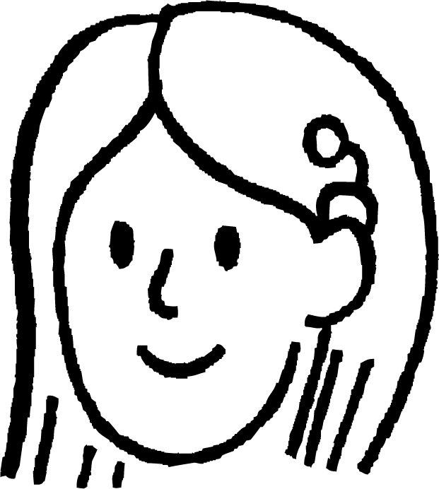

Tirooyinka (Coefficients) aan ahayn 1
Suad waxay helaysay taranta (product) laba binomial oo leh tibaaxyo (expressions) kala duwan.
E.g. (x + 5)(x + 4)
≡ x² + (5 + 4)x + 4 × 5
≡ x² + 9x + 20
Waxaan ku arkay qaab (pattern) qaabka la ballaariyay (expanded form). Isku-dhafka (coefficient) x waa wadarta labada joogto (constants) ee binomials-ka, erayga joogtada ahna waa taranta labadaas joogto.
Suad
(x + 4)(x + 2)
≡ x² + 2x + 4x + 8
≡ x² + 6x + 8
(x + 8)(x − 1)
≡ x² − x + 8x − 8
≡ x² + 7x − 8
Ma raacsan tahay?
Tijaabi tusaalooyin.

Slide 28
Isku-dhafyada (Coefficients) aan ahayn 1
Indha-indhaynta (observation) Suad waxay u muuqataa inay u shaqeyso tusaalooyin badan.
Isku-dhufashada labada eray oo joogto ah (constant terms) waxay keentaa mid ka mid ah badeecadaha qayb ahaan (partial products).
Haddii laba ka mid ah badeecadaha qayb ahaan (partial products) ay yihiin erayo isku mid ah (like terms), waa la fududeyn karaa iyadoo la isku darayo isku-dhafyada (coefficients).
Ma ka fikirteen tusaale kasta oo aan tani ku shaqeyn?
Tusaale ahaan, tusaale kasta oo binomials-ku leeyihiin doorsoomayaal (variables) kala duwan.
(x + 4)(y + 5) ama (x + 4)(x + y)
Tusaale kasta oo mid ama in ka badan oo ka mid ah doorsoomayaasha (variables) uu yahay taban (negative).
(x + 4)(5 − x) ama (4 − x)(5 − x)

Slide 29
Isku-dhafyada (Coefficients) aan ahayn 1
Doorsoomayaasha (variables) ee binomials-ka waxay yeelan karaan isku-dhafyo (coefficients) ka weyn 1
Tusaale ahaan (2x + 4)(2x + 5)
Waxaan heli karnaa qaabka la ballaariyay (expanded form) iyadoo la isticmaalayo qaabka bedka (area model).
2x 5
4x²
10x
2x × 2x ≡ 2 × 2 × x × x
2x
≡ 4x²
2x × 5 ≡ 10x
8x
20
(2x + 4)(2x + 5) ≡ 4x² + 18x + 20
4
4 × 2x ≡ 8x
4 × 5 ≡ 20

Slide 30
Isku-dhafyada (Coefficients) aan ahayn 1
Oh, kan ma raaco qaanuunkayga (rule) sababtoo ah 4 + 5 = 9 ma aha 18.
Suad
(2x + 4)(2x + 5) ≡ 4x² + 18x + 20
Aqoonsiga qaababka (patterns) aad buu u faa'iido u leh xisaabta (mathematics) sababtoo ah wuxuu noo oggolaanayaa inaan fahanno qaab-dhismeedka (structure) tirooyinka iyo xisaabaadka (calculations).
Indheerkii Suad wuxuu naga caawinayaa inaan aragno qaabka alaabta binomial ee qaabka (x + a)(x + b) halkaas oo a iyo b ay yihiin constants.
Laakiin tani kuma shaqeyso alaabta kale ee binomial. Qaabka aagga (area model) ayaa lagu talinayaa si loo hubiyo in aan waxyaabo qayb ah laga seegin ama si khaldan loo xisaabin.

Slide 31
Coefficients aan ahayn 1
Waa maxay qaabka la fidiyay ee (5a + b)(2a − 3b)?
Habka leh qaabka aagga iyo kan aan lahayn ayaa la muujiyay dhinac-ka-dhinac.
5a b
(5a + b)(2a − 3b)
10a²
2ab
2a
≡ 5a(2a − 3b)
+ b (2a − 3b)
−15ab
−3b²
≡ 10a2 − 15ab
+ 2ab − 3b2
−3b
≡ 10a2 − 13ab − 3b2
≡ 10a2 − 13ab − 3b2

Slide 32
Coefficients aan ahayn 1
Fidiy oo fududee:
(5x − 9)(3x − 2)
Fidiy oo fududee:
(4x − 8)(2x − 3)
5x −9
4x −8
15x²
−27x
8x²
−16x
3x
2x
−2
−10x
18
−3
−12x
24
≡ 5x(3x − 2)
− 9(3x − 2)
≡ 4x(2x − 3)
− 8(2x − 3)
≡ 15x² − 10x
− 27x + 18
≡ 8x² − 12x
− 16x + 24
≡ 15x² − 37x + 18
≡ 8x² − 28x + 24

Slide 33
Coefficients aan ahayn 1
Waxaan isticmaali karnaa isla habka si saxda ah si aan ugu dhufano laba binomial oo kasta, si kasta oo ay adag yihiin.
Tusaale ahaan (0.5x − 4y)(0.5x + 4y)
0.5x 4y
0.25x²
2xy
≡ 0.5x(0.5x + 4y) − 4y(0.5x + 4y)
0.5x
≡ 0.25x2 + 2xy
− 2xy − 16y2
−2xy
−16y²
−4y
≡ 0.25x² − 16y²
Maxaad ka ogaatay jawaabteenna?

Slide 34
Tirooyinka (Coefficients) aan ahayn 1
Maxaad ka dareentaa jawaabteena?
(0.5x − 4y)(0.5x + 4y) ≡ 0.25x² − 16y²
Kani waa farqiga laba labajibbaaran (difference of two squares).
Labada binomial mid kasta wuxuu leeyahay eray 0.5x
Erayada kale −4y iyo 4y waa lammaane eber (zero pair)
Waxaan xisaabin karnay jawaabteena anagoo adeegsanayna indha-indhayntan:
(0.5x − 4y)(0.5x + 4y) ≡ (0.5x)² − (4y)²
≡ 0.25x² − 16y²

Slide 35
Tirooyinka (Coefficients) aan ahayn 1
Buuxi qaabka bedka (area model) iyo tibaaxaha fudud ee sheyga (3x − 2y)(3x + 2y)
3x 2y
,
6xy
(3x − 2y)(3x + 2y)
≡ ,
9x²
,
3x
9x² − 4y²
−6xy
−4y²
,
,
−2y

Slide 36
Tirooyinka (Coefficients) aan ahayn 1
1) Balaari oo fududee shey kasta oo laba binomial ah.
(2x − 6) (x + 3)
(3x − 6) (x + 3)
,
(3x − 6) (2x + 6)
(3x − 6) (2x − 6)
,
(3x − 6) (3x − 6)
(3x − 6) (3x + 6)
,
a)
b)
c)
d)
e)
f)
2) Maxaad ka dareentaa jawaabtaada a) iyo f)? Ma sharxi kartaa sababta ay tani u dhacdo.

Slide 37
Tirooyinka (Coefficients) aan ahayn 1
3) Balaari oo fududee shey kasta oo laba binomial ah.
(2x + 3y) (4x + 5y)
(2x + 5y) (4x + 3y)
,
(3y − 4x) (2x − 5y)
(3x − 4y) (5y − 2x)
,sxwq
(−5y + 2x) (3y − 4x)
(5y + 2x) (−3y − 4x)
,
a)
b)
c)
d)
e)
f)
4) Maxaad ka dareentaa jawaabtaada c) iyo e)? Ma sharxi kartaa sababta ay tani u dhacdo.

Slide 38
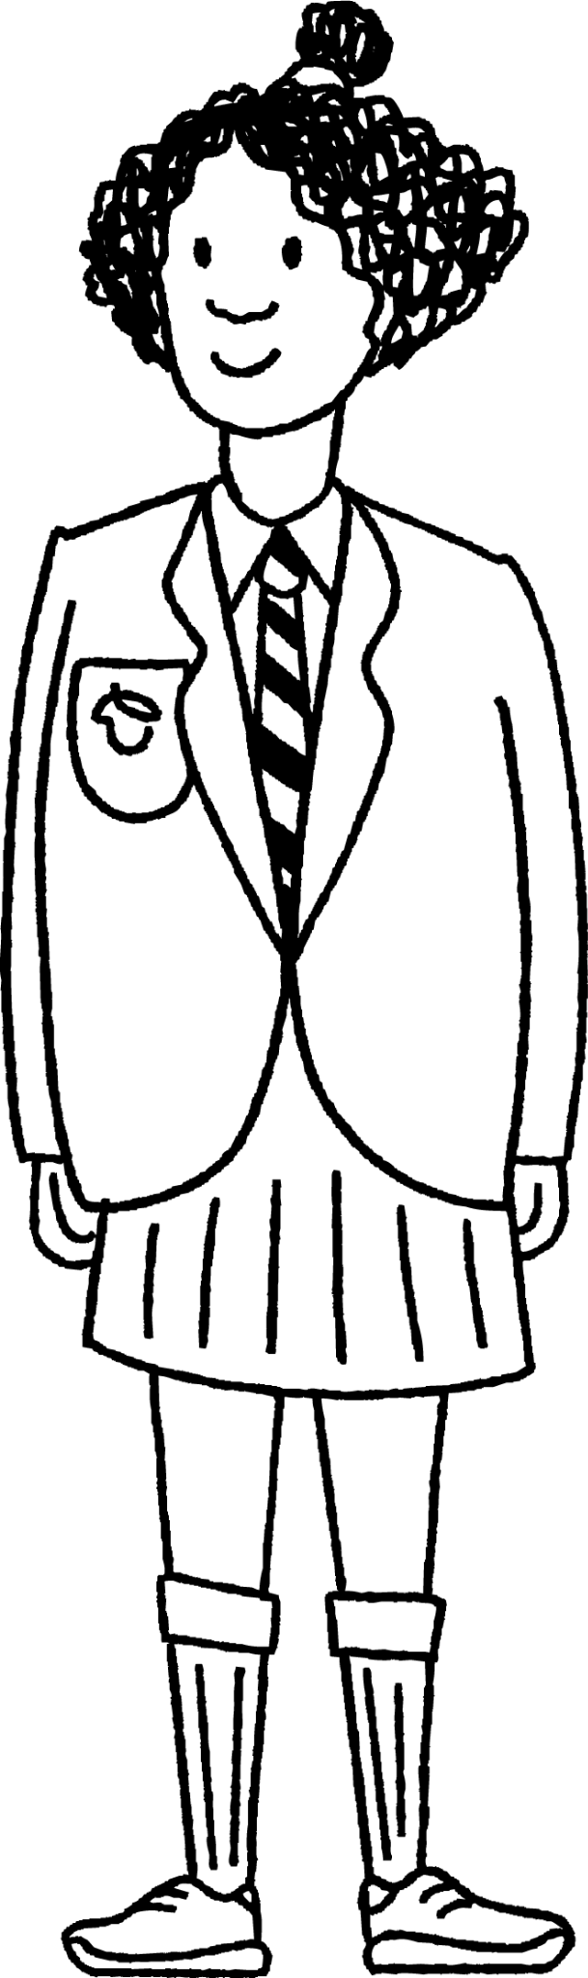
Tirooyinka (Coefficients) aan ahayn 1
5) Isra waxay rabtaa inay hesho qaabka balaaran ee sheyga (2x − 8y)2
a) Soo hel oo sax qalad kasta oo ay samaysay.
2x −8y
4x²
−8y
≡ 4x² − 64y²
2x
8y
−64y²
8y
6) Ma qori kartaa laba binomial oo sheygoodu noqon doono 4x2 − 64y2
Ma jirtaa hab ka badan hal?

Slide 39
Iskudhufashada aan ahayn 1
1) Fidiy oo fududee shey kasta oo laba binomial ah.
(2x − 6) (x + 3)
≡ 2x² + 6x − 6x − 18
≡ 2x² − 18
(3x − 6) (x + 3)
≡ 3x² + 9x − 6x − 18
≡ 3x² + 3x − 18
,
(3x − 6) (2x + 6)
≡ 6x² + 18x − 12x − 36
≡ 6x² + 6x − 36
(3x − 6) (2x − 6)
≡ 6x² − 18x − 12x + 36
≡ 6x² − 30x + 36
(3x − 6) (3x − 6)
≡ 9x² − 18x − 18x + 36
≡ 9x² − 36x + 36
(3x − 6) (3x + 6)
≡ 9x² + 18x − 18x − 36
≡ 9x² − 36
,
a)
b)
c)
d)
e)
f)

Slide 40
Iskudhufashada aan ahayn 1
2) Maxaad ka ogaataa jawaabtaada a) iyo f)? Ma sharxi kartaa sababta ay taasi u dhacdo.
Laba ka mid ah alaabooyinka qayb ahi waa zero pairs, marka tibaaxa ugu dambeeya wuxuu leeyahay oo kaliya laba xubnood.
f) si cad waa farqiga laba labajibbaaran (difference of two squares) maxaa yeelay labada binomial waxay leeyihiin xubnaha 3x iyo xubnaha kale −6 iyo 6 oo ah zero pair.
Binomial-ka koowaad ee a) (2x − 6) dhab ahaan waxaa loo qori karaa 2(x − 3), marka sheygu wuxuu la mid yahay 2(x − 3)(x + 3), kaas oo ah farqiga laba labajibbaaran oo dhammaan lagu dhuftey 2. 2(x2− 32) ≡ 2(x2− 9) ≡ 2x2− 18

Slide 41
Iskudhufashada aan ahayn 1
3) Fidiy oo fududee shey kasta oo laba binomial ah.
a)
b)
(2x + 3y) (4x + 5y)
≡ 8x2 + 10xy + 12xy + 15y2
≡ 8x2 + 22xy + 15y2
(2x + 5y) (4x + 3y)
≡ 8x2 + 6xy + 20xy + 15y2
≡ 8x2 + 26xy + 15y2
,
(3y − 4x) (2x − 5y)
≡ 6xy − 15y2 − 8x2 + 20xy
≡ −8x2 + 26xy − 15y2
(3x − 4y) (5y − 2x)
≡ 15xy − 6x2 − 20y2 + 8xy
≡ −6x2 + 23xy − 20y2
(−5y + 2x) (3y − 4x)
≡ −15y2 + 20xy + 6xy − 8x2
≡ −8x2 + 26xy − 15y2
(5y + 2x) (−3y − 4x)
≡ −15y2 − 20xy − 6xy − 8x2
≡ −8x2 − 26xy − 15y2
c)
d)
e)
f)
4) Maxaad ka ogaataa jawaabtaada c) iyo e)? Ma sharxi kartaa sababta ay taasi u dhacdo. Way isku mid yihiin maxaa yeelay (2x − 5y) ≡ (−5y + 2x)

Slide 42
Tirooyinka (Coefficients) aan ahayn 1
5) Isra waxay rabtaa inay hesho qaabka fidsan ee sheyga (2x − 8y)2
a) Soo hel oo sax qalad kasta oo ay samaysay.
2x −8y
4x²
−8y
≡ 4x² − 64y²
2x
Binomial-ka ku saabsan dhererka laba jibaaranka (square) waa inuu lahaadaa erey 8 taban. Sheyada qayb ahaaneed ee safka hoose waa inay ahaadaan −8y iyo 64y2
8y
−64y²
8y
6) Ma qori kartaa laba binomial oo sheygoodu noqon doono 4x2 − 64y2?
Ma jirtaa hab ka badan hal? (2x − 8y)(2x + 8y) ama (−2x − 8y)(−2x + 8y) iyo dib-u-habayn kasta oo ereyada ku jira binomials.

Slide 43
Sheyada binomial ee ka sii adag
Sheyga labada binomial, ereyada ku jira binomials waxay noqon karaan amarada kala duwan.
Dib-u-habaynta ereyada si ay isku amar ugu noqdaan waxay noqon kartaa mid faa'iido leh.
Way fududahay in la arko sheyada ah kala duwanaanshaha laba laba jibaaran (difference of two squares) haddii ereyada isku amar ku yihiin labada binomial.
Waxaan isticmaali karnaa moodooyinka bedka (area models) si aan ugu dhufano laba binomial oo kasta, oo ay ku jiraan kuwa leh doorsoomayaal badan (multiple variables) iyo tirooyin (coefficients) aan ahayn 1.

