Slide 1
Tirooyinka 10 ee ku lug leh jibbaarada taban (negative exponents)
Qaabka caadiga ah (Standard form)

Slide 2
Sida agabkeena waxbarista loogu talagalay fasalka

Slide 3
Waxaan u qori karaa tiro kasta oo dhammaystiran (integer) qaabab kala duwan.

Slide 4
Marka tiro lagu dhufto nafteeda marar badan, waxaa loo qori karaa si fudud qaab jibbaaran (exponential form).
E.g. 2 × 2 × 2 = 2³

Slide 5

Tirooyinka 10 ee ku lug leh jibbaarada taban (negative exponents)
Soo bandhigida jibbaarada taban (negative exponents)
Qorista tirooyinka dhammaystiran (integers) qaabab kala duwan

Slide 6
Soo bandhigida jibbaarada taban (negative exponents)
Waa maxay 45?
Jibbaarku (exponent) wuxuu noo sheegaa inta qiime ee isku mid ah ee la isku dhufto.
4⁵ = 4 × 4 × 4 × 4 × 4
Waxaad aragtay jibbaarada (exponents) oo loo isticmaalay tirooyinka labajibbaaran (square) iyo saddex-jibbaaran (cube).
Waxaan sidoo kale aragnay jibbaarada (exponents) marka aan tixgelinayno qiimaha meesha (place value).

Slide 7



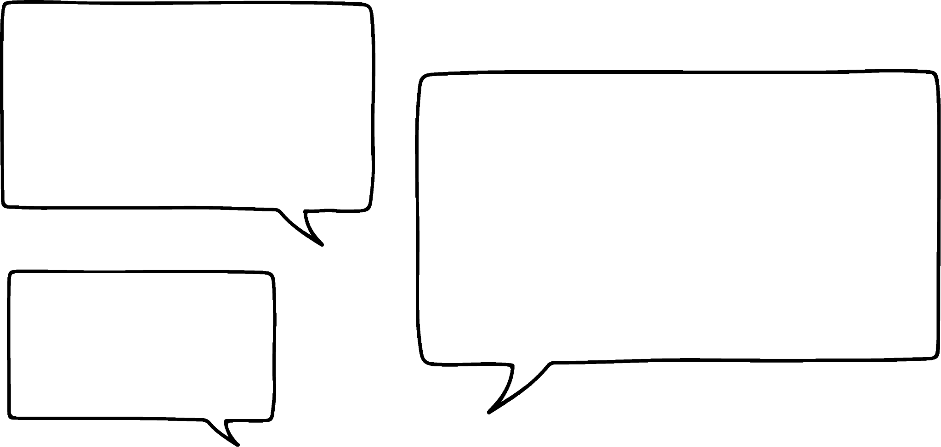






Soo bandhigida jibbaarada taban (negative exponents)
Th | H | T | O | t | h | th
1000 | 100 | 10 | 1
10 × 10 × 10 | 10 × 10 | 10 | 1
10³ | 10² | 10¹ | 10⁰
Haddii aan u qori karno 1000, 100 iyo 10 qaab jibbaaran (exponent form), hubaal waxaan u qori karnaa kuwa kale sidoo kale qaab jibbaaran.
Waxaan u malaynayaa inaad sax tahay.
Cabdi
Caasha

Slide 8
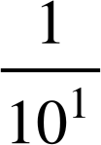
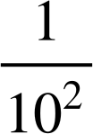
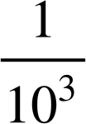
Soo bandhigida jibbaarada taban (negative exponents)
=
=
=
=
×
=
=
×
×
Qaabka jibbaarada (exponent form) macneheedu waa isku dhufasho soo noqnoqota. Maxay isku dhufashooyin soo noqnoqotay halkan ka dhaceen?
Waxaan dib u qori karnaa kuwan sida …
Hagaag, waxaan ognahay in 10 sidoo kale loo qori karo 101, 100 loo qori karo 102 iyo 1000 loo qori karo 103.
Cabdi
Caasha

Slide 9
Soo bandhigida jibbaarada taban (negative exponents)
Th | H | T | O | t | h | th
1000 | 100 | 10 | 1
10 × 10 × 10 | 10 × 10 | 10 | 1
10³ | 10² | 10¹ | 10⁰
×
×
×
Jibbaaradu (exponents) way yaraanayaan markaad dhinaca midig u socoto, laakiin markaad timaaddo qaybaha jajabka tobanle (decimal parts) waxay noqdaan isdhaaf (reciprocal).
Jibbaaradu (exponents) waxay hoos u dhacayaan mid kasta. Ma loo qori karaa 10−1?
Haa sax. Ma waxba ogaatay?
Waxaan eegayay madaxyada tiirarka jibbaarada (exponential).
Cabdi
Caasha

Slide 10
Soo bandhigida jibbaarada taban (negative exponents)
Tirada (Number) | Qaabka jibbaarada (Exponential form)
1000 | 10³
100 | 10²
10 | 10¹
1 | 10⁰
0.1
0.01
0.001
0.0001
Tirada (Number) | Qaabka jibbaarada (Exponential form)
1000 | 10³
100 | 10²
10 | 10¹
1 | 10⁰
0.1 | 10⁻¹
0.01 | 10⁻²
0.001 | 10⁻³
0.0001 | 10⁻⁴
Sii wadida qaabka (pattern) waxay u socotaa, 10−1, 10−2, 10−3, iwm.
Cabdi
Caasha

Slide 11

Soo bandhigida jibbaarada taban (negative exponents)
Tirada (Number) | Qaab jajab (Fractional form) | Qaab jibbaar (Exponential form)
0.1 |  | 10⁻¹
0.01 |  | 10⁻²
0.001 |  | 10⁻³
0.0001 |  | 10⁻⁴

Slide 12
Soo bandhigida jibbaarada taban (negative exponents)
Taas macneheedu waa in iyo 10−2 ay isku mid yihiin.
Taas macneheedu waa 102 waa 100
Cabdi
Caasha

Slide 13
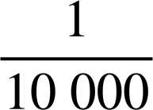
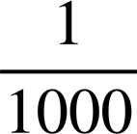
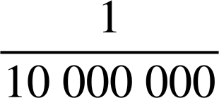

Soo bandhigida jibbaarada taban (negative exponents)
Isku dhig qaababka jajabka (fractional forms) iyo qaabka jibbaarka (exponential form):
10⁻³
10⁻¹
10⁻⁴
10⁻⁷

Slide 14

Soo bandhigida jibbaarada taban (negative exponents)
0 | t | h | th | tth | hth
1
10⁰ | 10⁻¹ | 10⁻² | 10⁻³ | 10⁻⁴ | 10⁻⁵
1
1
Aan eegno sida wax waliba isugu xiran yihiin. Waxaan ku bilaabaynaa tirada 1
Waxaan dhaqaajinayaa tirada 1 hal meel oo midig.
Maxaan ku sameeyay 1?
1 ÷ 10
1 hadda wuxuu ku jiraa tiirka tobanle (tenths).
Sidaas darteed 0.1 = 1 ÷ 10 = = 1 × 10−1

Slide 15
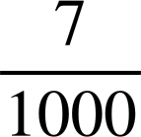
Soo bandhigida jibbaarada taban (negative exponents)
Aan tan ku tijaabino jajab tobanle (decimals) fudud.
E.g. 0.007
0 | t | h | th | tth | hth
1
10⁰ | 10⁻¹ | 10⁻² | 10⁻³ | 10⁻⁴ | 10⁻⁵
0
0
0
7
0.007
= 7 ×
=
= 7 × 10⁻³

Slide 16
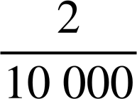
Soo bandhigida jibbaarada taban (negative exponents)
Aan tijaabinno tan iyadoo la adeegsanayo jajab tobanle (decimals) fudud marka hore.
E.g. 0.0002
0 | t | h | th | tth | hth
1
10⁰ | 10⁻¹ | 10⁻² | 10⁻³ | 10⁻⁴ | 10⁻⁵
0
0
0
0
2
0
0.0002
= 2 ×
=
= 2 × 10⁻⁴

Slide 17
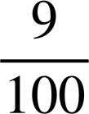
Soo bandhigida jibbaarada taban (negative exponents)
Ku qor 0.09 qaab jibbaaraneed oo fidiyey (expanded exponential form).
0 | t | h | th | tth | hth
1
10⁰ | 10⁻¹ | 10⁻² | 10⁻³ | 10⁻⁴ | 10⁻⁵
0
0
9
0.09
= 9 ×
=
= 9 × 10⁻²

Slide 18
Soo bandhigida jibbaarada taban (negative exponents)
Hore waxaad u isticmaali jirtay shabakadda qiimaha meesha (place value grid) si aad ugu qorto tirooyinka qaabkooda fidiyey (expanded form).
E.g. 8349
HTh | TTh | Th | H | T | O
10⁵ | 10⁴ | 10³ | 10² | 10¹ | 10⁰
HTh | TTh | Th | H | T | O
10⁵ | 10⁴ | 10³ | 10² | 10¹ | 10⁰
 |  | 8 | 3 | 4 | 9
8 × 10³ + 3 × 10² + 4 × 10¹ + 9 × 10⁰

Slide 19
Soo bandhigida jibbaarada taban (negative exponents)
Hore waxaad u isticmaali jirtay shabakadda qiimaha meesha (place value grid) si aad ugu qorto tirooyinka qaabkooda fidiyey (expanded form).
E.g. 20 586
HTh | TTh | Th | H | T | O
10⁵ | 10⁴ | 10³ | 10² | 10¹ | 10⁰
HTh | TTh | Th | H | T | O
10⁵ | 10⁴ | 10³ | 10² | 10¹ | 10⁰
 | 2 | 0 | 5 | 8 | 6
2 × 10⁴ + 5 × 10² + 8 × 10¹ + 6 × 10⁰

Slide 20
Soo bandhigida jibbaarada taban (negative exponents)
Waa immisa tiradan?
2 × 10⁶ + 9 × 10⁴ + 5 × 10² + 8 × 10⁰
Cabdi wuxuu qoray 2958
Qaladkee ayuu Cabdi sameeyay?
Wuxuu kaliya qoray lambarrada 2, 9, 5 iyo 8 isagoon tixgelin qiimaha (value) goobta lambar kasta.
Waa inay ahaataa 2 090 508

Slide 21
Soo bandhigida jibbaarada taban (negative exponents)
Hadda aan ku fidinno tirooyinka jajab tobanle (decimals).
E.g. 0.0487
0 | t | h | th | tth | hth
1
10⁰ | 10⁻¹ | 10⁻² | 10⁻³ | 10⁻⁴ | 10⁻⁵
0
0
4
8
7
0.0487
= 4 × 10⁻² + 8 × 10⁻³ + 7 × 10⁻⁴

Slide 22
Soo bandhigida jibbaarada taban (negative exponents)
E.g. 0.00104
0 | t | h | th | tth | hth
1
10⁰ | 10⁻¹ | 10⁻² | 10⁻³ | 10⁻⁴ | 10⁻⁵
0
0
0
1
0
4
0.00104
= 1 × 10⁻³ + 4 × 10⁻⁵

Slide 23
Soo bandhigida jibbaarada taban (negative exponents)
Ku xidh jajab tobanle (decimal) qaabkiisa fidaysan (expanded form) ee saxda ah.
0.023
2 × 10⁻¹ + 3 × 10⁻²
0.203
2 × 10⁻³ + 3 × 10⁻⁴
0.0023
2 × 10⁻¹ + 3 × 10⁻³
0.00203
2 × 10⁻² + 3 × 10⁻³
0.23
2 × 10⁻³ + 3 × 10⁻⁵

Slide 24
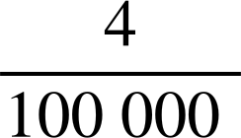

Introducing negative exponents
Buuxi meelaha bannaan:
 | Jajab tobanle (Decimal) | Jajab (Fraction) | Qaab jibbaaran (Exponential Form)
a | 0.09
b
c |  |  | 3 × 10⁻¹
d
e | 0.0007
f |  |  | 8 × 10⁻⁶
g
h |  |  | 5 × 10⁻⁴

Slide 25
Soo bandhigida jibbaarada taban (negative exponents)
2) Khaladkee ayay Caasha samaysay?
Ku qor 0.0003 qaab jibbaaran oo fidaysan (expanded exponential form).
Caasha waxay qortaa:
0.0003 = 3 × 10−3 sababtoo ah waxaa jira 3 eber (zeros) ka dib barta jajabka tobanle (decimal point).
Caasha

Slide 26
Soo bandhigida jibbaarada taban (negative exponents)
3) Ku qor mid kasta oo ka mid ah kuwa soo socda qaabka kale (alternative format):
 | Jajab tobanle (Decimal) | Qaab jibbaaran (Exponential form)
a | 0.34
b |  | 5 × 10⁻¹ + 2 × 10⁻²
c |  | 4 × 10⁻² + 7 × 10⁻³ + 3 × 10⁻⁴
d | 0.049
e | 0.000603
f |  | 2 × 10⁻¹ + 3 × 10⁻⁴ + 3 × 10⁻⁶
g | 17.02
h |  | 2 × 10² + 3 × 10⁻¹ + 5 × 10⁻³ + 8 × 10⁻⁴

Slide 27

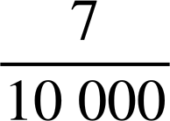
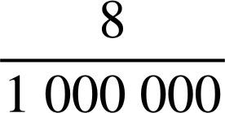
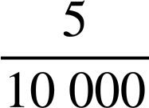
Soo bandhigida jibbaarada taban (negative exponents)
Buuxi meelaha bannaan:
 | Jajab tobanle (Decimal) | Jajab (Fraction) | Qaab jibbaaran (Exponential Form)
a | 0.09 |  | 9 × 10⁻²
b | 0.00004 |  | 4 × 10⁻⁵
c | 0.3 |  | 3 × 10⁻¹
d | 0.2 |  | 2 × 10⁻¹
e | 0.0007 |  | 7 × 10⁻⁴
f | 0.000008 |  | 8 × 10⁻⁶
g | 0.007 |  | 7 × 10⁻³
h | 0.0005 |  | 5 × 10⁻⁴

Slide 28
Soo bandhigida jibbaarada taban (negative exponents)
2) Waa maxay qaladka Caasha sameysay?
Qor 0.0003 qaabka exponential (exponential form) ee la fidiyay.
Caasha waxay qortay:
0.0003 = 3 × 10−3 sababtoo ah waxaa jira 3 eber (zeros) ka dib barta tobanle (decimal point).
3 wuxuu ku jiraa tiirka meel- tobnaad ee kumanka (ten thousandths column).
10−3 waa kunmeel (one thousandth), ma aha meel-tobnaad kumanka (one ten thousandth).
Sidaa darteed, jawaabtu waa inay noqotaa 3 × 10−4
Caasha

Slide 29
Soo bandhigida jibbaarada taban (negative exponents)
3) Qor mid kasta oo ka mid ah kuwan soo socda qaabka kale:
 | Tobanle (Decimal) | Qaabka exponential (Exponential form)
a | 0.34 | 3 × 10⁻¹ + 4 × 10⁻²
b | 0.52 | 5 × 10⁻¹ + 2 × 10⁻²
c | 0.0473 | 4 × 10⁻² + 7 × 10⁻³ + 3 × 10⁻⁴
d | 0.049 | 4 × 10⁻² + 9 × 10⁻³
e | 0.000603 | 6 × 10⁻⁴ + 3 × 10⁻⁶
f | 0.200303 | 2 × 10⁻¹ + 3 × 10⁻⁴ + 3 × 10⁻⁶
g | 17.02 | 1 × 10¹ + 7 × 10⁰ + 2 × 10⁻²
h | 200.3058 | 2 × 10² + 3 × 10⁻¹ + 5 × 10⁻³ + 8 × 10⁻⁴

Slide 30
Tirooyinka 10 ee ku lug leh jibbaarada taban (negative exponents)
Soo bandhigida jibbaarada taban (negative exponents)
Qorista tirooyinka (integers) qaabab kala duwan

Slide 31

Qorista tirooyinka (integers) qaabab kala duwan
Imisa siyaabood oo kala duwan ayaad u qori kartaa 6300?
E.g. 63 × 100
Haddii aan hayno 63, sidee kale loo qori karaa?
63 × 10 × 10
63 × 10²
Ka warran haddii aan 63 ka beddelo 6.3?
6.3 × 1000
6.3 × 10 × 10 × 10
6.3 × 10³
Waxaa jira tiro aan dhamaad lahayn oo siyaabo ah oo loo qori karo tiro kasta (integer).
× 10³

Slide 32


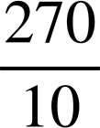

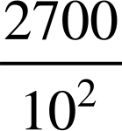
Qorista tirooyinka (integers) qaabab kala duwan
Kee ka mid ah kuwan soo socda waa siyaabo kale oo loo qoro 27 000?
2 700 000 × 10⁻²
× 10⁴
27 × 10³
× 100 000
2.7 × 10³
27 × 10
0.27 × 10⁵
2.7 × 10 000
× 10³
Hadda waxaan eegi doonnaa qaar ka mid ah kuwa ugu adag.

Slide 33
Qorista tirooyin (integers) qaabab kala duwan
× 10⁴
Waxaan dib u qori karnaa sidan: 27 ÷ 10 × 10 000
= 2.7 × 10 000
= 27 000

Slide 34
Qorista tirooyin (integers) qaabab kala duwan
2.7 × 10³
Waxaan dib u qori karnaa sidan: 2.7 × 1000
= 2700

Slide 35
Qorista tirooyin (integers) qaabab kala duwan
× 10³
Waxaan dib u qori karnaa sidan: 2700 ÷ 100 × 1000
= 27 × 1000
= 27 000

Slide 36
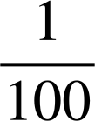
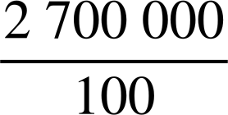
Qorista tirooyin (integers) qaabab kala duwan
2 700 000 × 10⁻²
Waxaan dib u qori karnaa sidan: 2 700 000 ×
= 2 700 000 ×
=
= 27 000

Slide 37
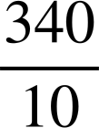
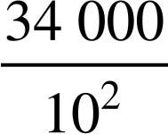
Qorista tirooyin (integers) qaabab kala duwan
Kuwee ka mid ah kuwan soo socda ayaa ah qaabab kale oo loo qoro 340?
3.4 × 10²
3.4 × 100 = 340
× 10
340 ÷ 10 × 10 = 340
34 000 ÷ 100 = 340
34 000 × 10⁻²
× 10⁻¹
34 000 ÷ 100 ÷ 10 = 34

Slide 38

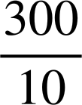
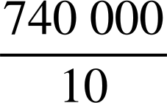
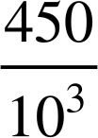
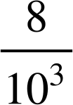
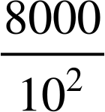
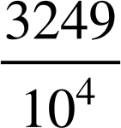
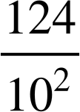
Qorista tirooyin (integers) qaabab kala duwan
Aqoonso beddelka khaldan ee saf kasta. Qor xarafka oo dib u habeey si aad u samaysid eray.
Tirada (Number) | Beddelka 1 (Alternative 1) | Beddelka 2 (Alternative 2) | Beddelka 3 (Alternative 3) | Beddelka 4 (Alternative 4)
3000 | 3 × 10⁴ | 3 × 10² × 10 | × 10³ | × 10²
74 000 | 7.4 × 10⁴ | 74 × 10³ | 7.4 × 10³
120 000 | 12 × 10² × 10² | 1.2 × 10⁵ | 1.2 × 10⁴ | 1.2 × 10⁶ × 10⁻¹
450 | 4500 × 0.1 | × 10³ | 4.5 × 10² | 4.5 × 10⁻²
8 000 000 | 8 × 10³ × 10³ | × 10⁸ | 8 × 10⁶ | × 10⁵
628 000 | 6 280 000 × 10⁻¹ | 6.28 × 10⁵ | 6.28 × 10³ | 628 × 10³
32 490 | 32.49 × 10² | 324.9 × 10² | × 10⁵ | 324 900 × 10⁻¹
12 400 000 | 12.4 × 10⁻³ × 10⁹ | × 10⁷ | 1.24 × 10⁷ | 124 × 10⁻² × 10⁶
N
L
I
Y
A
P
X
C
R
H
E
B
S
E
F
O
T
P
V
D
O
D
N
P
E
M
A
H
N
L
O
T

Slide 39
Qorista tirooyinka (integers) qaabab kala duwan
Aqoonso beddelka khaldan ee saf kasta. Qor xarafka oo dib u habeey si aad u samaysid eray. EXPONENT
Tirada (Number) | Beddelka 1 (Alternative 1) | Beddelka 2 (Alternative 2) | Beddelka 3 (Alternative 3) | Beddelka 4 (Alternative 4)
3000 | 3 × 10⁴ | 3 × 10² × 10 | × 10³ | × 10²
74 000 | 7.4 × 10⁴ | 74 × 10³ | 7.4 × 10³
120 000 | 12 × 10² × 10² | 1.2 × 10⁵ | 1.2 × 10⁴ | 1.2 × 10⁶ × 10⁻¹
450 | 4500 × 0.1 | × 10³ | 4.5 × 10² | 4.5 × 10⁻²
8 000 000 | 8 × 10³ × 10³ | × 10⁸ | 8 × 10⁶ | × 10⁵
628 000 | 6 280 000 × 10⁻¹ | 6.28 × 10⁵ | 6.28 × 10³ | 628 × 10³
32 490 | 32.49 × 10² | 324.9 × 10² | × 10⁵ | 324 900 × 10⁻¹
12 400 000 | 12.4 × 10⁻³ × 10⁹ | × 10⁷ | 1.24 × 10⁷ | 124 × 10⁻² × 10⁶
N
L
I
Y
A
P
X
C
R
H
E
B
S
E
F
O
T
P
V
D
O
D
N
P
E
M
A
H
N
L
O
T

Slide 40
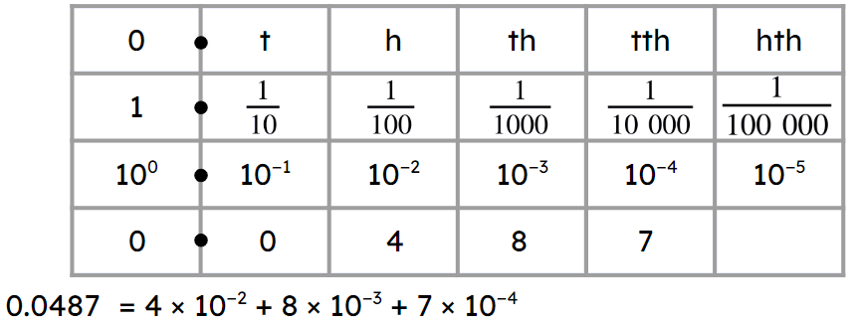
Tirooyinka 10 ee leh jibbaarada (exponents) taban
Madaxyada jadwalka qiimaha (place value chart) ee jibbaarada (exponential) waxaa lagu kordhin karaa qaybaha jajabka (decimal).
10⁻² = 0.01 =
Tirooyinka (integers) waxaa loo qori karaa qaabab kala duwan.
E.g. 450 = 4500 × 0.1 = 4500 × = 4500 × 10⁻¹ = × 10³

