Slide 1
Xiriirro isku dhufasho (Multiplicative) oo u dhexeeya ereyada
Tibaaxaha (Expressions) iyo qaaciidooyinka (Formulae)

Slide 2
sida loo isticmaalo darasyada Oak

Slide 3
Waxaan qiimeyn karaa in xiriir isku dhufasho (Multiplicative) oo u dhexeeya doorsoomayaasha (Variables) loo qori karo siyaabo kala duwan.

Slide 4
Isla'eg (Equation) waxaa loo isticmaalaa in lagu muujiyo laba tibaaxood oo isla eg.
Wax soo saar (Product) aljebrada (Algebra) waa natiijada laba ama in ka badan oo erey ah oo la isku dhuftey.

Slide 5

Xiriirro isku dhufasho (Multiplicative)
Qaab dhismeedka xiriirrada isku dhufashada (Multiplicative)
Dib u habeynta xiriirrada isku dhufashada (Multiplicative)

Slide 6
Qaab dhismeedka xiriirrada isku dhufashada (Multiplicative)
Tani waa sawir muujinaya 4 × 3 = 12
Ka soo noqoshada (Inverse) ×3 waa ÷3
4 × 3 = 12
12 ÷ 3 = 4
3 × 4 = 12
12 ÷ 4 = 3
Ka soo noqoshada (Inverse) ×4 waa ÷4
Isweydaarsiga (Commutativity) ee isku dhufashada.
Waa maxay xaqiiqooyinka kale ee ay noo tusinaysaa?
Waxaa laga yaabaa inaad maqashay tan oo loo yaqaan 'Qoyska Xaqiiqda' (Fact Family).

Slide 7
Qaab dhismeedka xiriirrada isku dhufashada (Multiplicative)
Waxaa laga yaabaa inaad maqashay tan oo loo yaqaan 'Qoyska Xaqiiqda' (Fact Family).
4 × 3 = 12
12 ÷ 3 = 4
3 × 4 = 12
12 ÷ 4 = 3
Waxaad sidoo kale ugu yeeri kartaa qoyska dib-u-habaynta xiriirka isku dhufashada (Multiplicative) 4 × 3 = 12

Slide 8
Qaab dhismeedka xiriirrada isku dhufashada (Multiplicative)
Waxaa laga yaabaa inaad maqashay tan oo loo yaqaan 'Qoyska Xaqiiqda' (Fact Family).
4 × 3 = 12
12 ÷ 3 = 4
3 × 4 = 12
12 ÷ 4 = 3
Aljebrada (Algebra) kuma aragtid xaqiiqooyinka qaybinta (Division) oo sidan loo qoray.

Slide 9
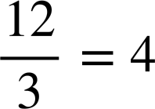
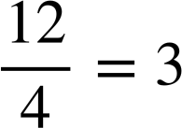
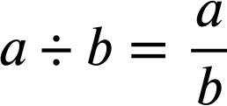
Qaabka xiriirka isku dhufashada (multiplicative relationships)
Waxaa laga yaabaa inaad maqashay tan oo loogu yeero 'Qoyska Xaqiiqda (Fact Family)'.
4 × 3 = 12
12 ÷ 3 = 4
3 × 4 = 12
12 ÷ 4 = 3
Xisaabta (algebra) waxaad arki doontaa xaqiiqooyin qaybin (division) oo lagu qoray xariiq jajab (fraction bar). Waxaan isticmaaleynaa guud ahaan (generalisation):

Slide 10
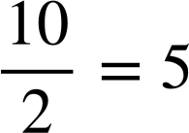
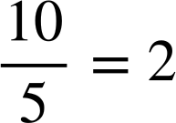
Qaabka xiriirka isku dhufashada (multiplicative relationships)
Dhammeystir qoyskan dib-u-habaynta (rearrangements) xiriirka isku dhufashada (multiplicative relationship) aad halkan ku aragto.
5 × 2 = 10
2 × 5 = 10

Slide 11
Qaabka xiriirka isku dhufashada (multiplicative relationships)
Aynu tixgelinno qaabka qoyskan.
5 × 2 = 10
2 × 5 = 10
Markaan isku dhufano laba tiro (multiply two numbers) waxaan dhihi karnaa…
5 × 2 = 10
qaybiye (factor)
×
qaybiye (factor)
=
wax soo saar (product)

Slide 12
Qaabka xiriirka isku dhufashada (multiplicative relationships)
Aynu tixgelinno qaabka qoyskan.
wax soo saar (product)
5 × 2 = 10
=
qaybiye 1 (factor 1)
qaybiye 2 (factor 2)
2 × 5 = 10
wax soo saar (product)
=
qodax 2
qaybiye 1 (factor 1)
Markaan isku dhufano laba tiro (multiply two numbers) waxaan dhihi karnaa…
5 × 2 = 10
qaybiye 1 (factor 1)
×
qaybiye 2 (factor 2)
=
wax soo saar (product)

Slide 13
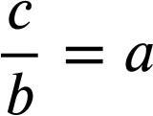
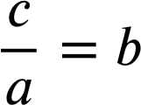
Qaabka xiriirka isku dhufashada
Tani waxay noo ogolaaneysaa inaan guud ahaan (generalise) qaacido.
a × b = c
b × a = c
Guud ahaan (generalisation) dib-u-habaynta xiriirka isku dhufashada (multiplicative relationships).
a, b, iyo c waxay qaadan karaan qaab kasta oo erey ah, ha ahaado tiro ama doorsoome aljabri (algebraic variable).

Slide 14
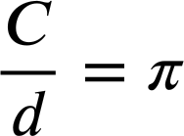
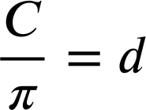
Qaabka xiriirka isku dhufashada
Dhammeystir qoyska dib-u-habaynta ee xiriirkan isku dhufashada.
Wareegga (Circumference) = π × dhexroorka (diameter)
C
d
C = π × d
C = d × π
Ogsoonow in labada dib-u-habayn 'qaybin' (division) C, tirada sare (numerator), ay tahay wax soo saarka xiriirka isku dhufashada asalka ah.

Slide 15
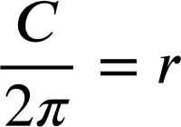
Qaabka xiriirka isku dhufashada
Mararka qaarkood waxaan u baahan doonnaa inaan tixgelinno wax soo saarka laba erey oo ah erey marka dib-u-habayn sameynayno.
Wareegga = 2 × π × gacan (radius)
C
C = 2πr
r
C ÷ π = 2πr ÷ π
C ÷ π = 2r
C ÷ π ÷ 2 = 2r ÷ 2
C ÷ π ÷ 2 = r

Slide 16
Qaabka xiriirka isku dhufashada
Mararka qaarkood waxaan u baahan doonnaa inaan tixgelinno wax soo saarka laba erey oo ah erey marka dib-u-habayn sameynayno.
Wareegga = 2 × π × gacan
C
C = 2πr
C = 2πr
r
C ÷ π = 2πr ÷ π
C = r × 2π
C ÷ π = 2r
C ÷ 2π = r × 2π ÷ 2π
C ÷ π ÷ 2 = 2r ÷ 2
C ÷ 2π = r
C ÷ π ÷ 2 = r
Tani waa mid waxtar badan.

Slide 17
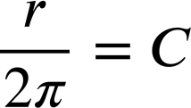

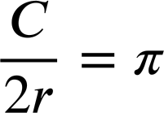

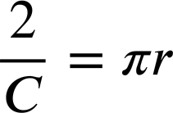
Qaabka xiriirka isku dhufashada
Dib-u-habayn kale oo qoyskan ka mid ah waa kee?
C
C = 2πr
r
C = 2πr
C = π × 2r
C ÷ 2r = π × 2r ÷ 2r
C ÷ 2r = π
Ogsoonow labada dib-u-habayn saxda ah in C, tirada sare, ay tahay wax soo saarka xiriirka isku dhufashada asalka ah.

Slide 18
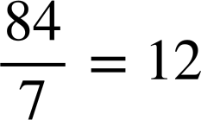
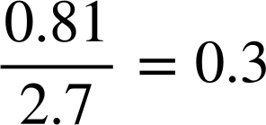
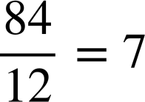
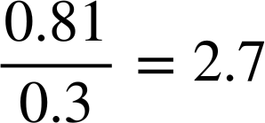
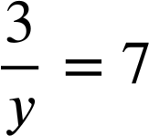
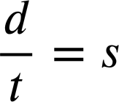
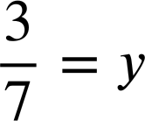
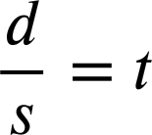
Qaabka xiriirka isku dhufashada
1) Qor qoyska dib-u-habaynta ee isla'egyada hoose.
a)
b)
12 × 7 = 84
0.3 × 2.7 = 0.81
7 × 12 = 84
2.7 × 0.3 = 0.81
c)
d)
7 × y = 3
d = s × t
y × 7 = 3
d = t × s

Slide 19
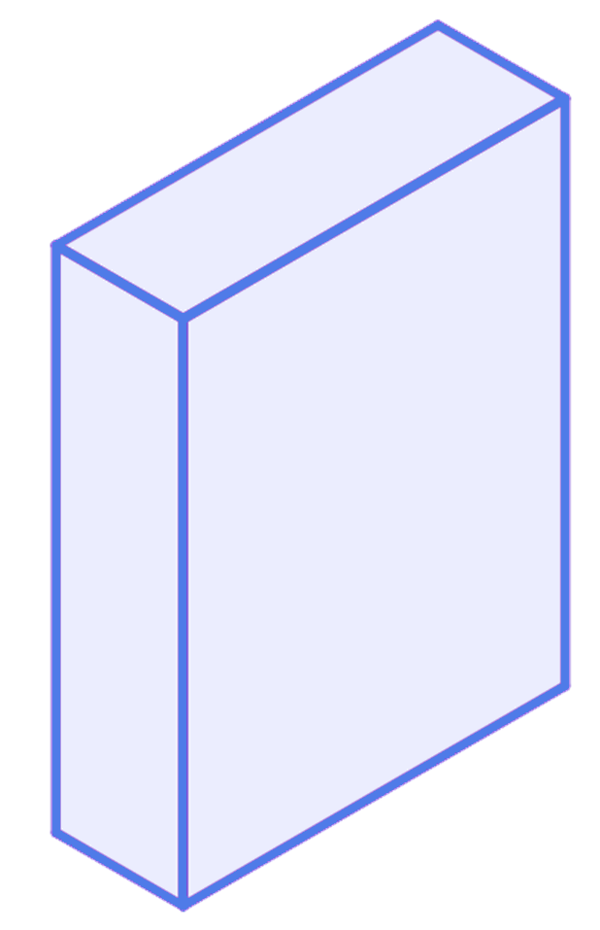
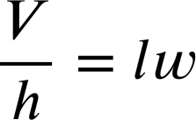
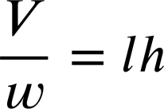
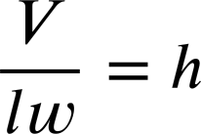
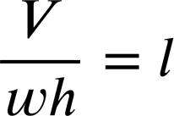
Qaabka xiriirka isku dhufashada (multiplicative relationships)
2) Mugga (volume) cuboid waxaa lagu xisaabin karaa 'dhererka × ballaca × joogga'
Buuxi qaybaha maqan ee dib-u-habayntan.
V = lwh
h
l
w

Slide 20
Qaabka xiriirka isku dhufashada (multiplicative relationships)
1) Qor qoyska dib-u-habaynta ee isla'egyada hoose.
a)
b)
12 × 7 = 84
0.3 × 2.7 = 0.81
7 × 12 = 84
2.7 × 0.3 = 0.81
c)
d)
7 × y = 3
d = s × t
y × 7 = 3
d = t × s

Slide 21
Qaabka xiriirka isku dhufashada (multiplicative relationships)
2) Mugga (volume) cuboid-ka waxaa loo xisaabin karaa 'dherer × ballac × joog'
Buuxi qaybaha maqan ee dib-u-habayntan.
V = lwh
h
V, soosaarka (product) xiriirkii asalka ahaa ee isku dhufashada, ayaa ku sii hadhay tireeyaha (numerator).
l
w

Slide 22
Xiriirka isku dhufashada (multiplicative relationships)
Qaabka xiriirka isku dhufashada (multiplicative relationships)
Dib-u-habaynta xiriirka isku dhufashada (multiplicative relationships)

Slide 23
Dib-u-habaynta xiriirka isku dhufashada (multiplicative relationships)
Xiriirka isku dhufashada (multiplicative relationships) wuxuu ka kooban yahay:
6 × 8 = 48
qaybiyaha 1 (factor 1)
×
qaybiyaha 2 (factor 2)
=
soosaarka (product)
Waxaan dib u habaynaynaa marka hore anagoo beddelaya (commuting)…
Kadibna anagoo samaynayna rogaal celinta (inverse) isku dhufashada.
6 × 8 = 48
6 × 8 = 48
8 × 6 = 48
6 × 8 ÷ 8 = 48 ÷ 8
8 × 6 ÷ 6 = 48 ÷ 6
8 × 6 = 48
6 = 48 ÷ 8
8 = 48 ÷ 6

Slide 24
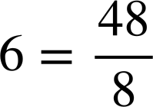
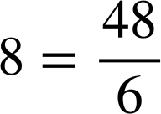
Dib-u-habaynta xiriirka isku dhufashada (multiplicative relationships)
Xiriirka isku dhufashada (multiplicative relationships) wuxuu ka kooban yahay:
6 × 8 = 48
qodob 1
×
qodob 2
=
wax soo saar (product)
Waxaan dib u habeynay marka hore isku beddel…
Kadibna adoo sameynaya rogaal celinta isku dhufashada.
6 × 8 = 48
6 × 8 = 48
8 × 6 = 48
6 × 8 ÷ 8 = 48 ÷ 8
8 × 6 ÷ 6 = 48 ÷ 6
8 × 6 = 48

Slide 25
Dib u habeynta xiriirrada isku dhufashada
Xiriirrada isku dhufashada (multiplicative) waxay ka kooban yihiin:
6 × 8 = 48
qodob 1
×
qodob 2
=
wax soo saar (product)
Waxaan dib u habeynay marka hore isku beddel…
Kadibna adoo sameynaya rogaal celinta isku dhufashada.
6 × 8 = 48
Ogsoonow in wax soo saarka (product) uu ku xidhan yahay booska tirada sare (numerator). Qodobadu waxay beddelaan boosaska.
8 × 6 = 48

Slide 26
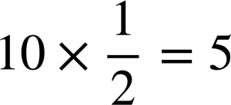
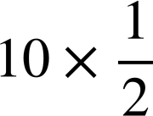
Dib u habeynta xiriirrada isku dhufashada
Mararka qaarkood waa inaan dib u habeynaa min 'wax soo saar (product) korka qodob'.
Tusaale ahaan, dib u habeyn
Waxaa jira siyaabo badan oo loo tixgeliyo.
Nuska 10 waa 5
10 ÷ 2 = 5
Nuska 10 waa 5
10 ÷ 2 × 2 = 5 × 2
× 2 = 5 × 2
Ku dhufo rogaal celinta nuska (reciprocal)
10 = 5 × 2
10 = 5 × 2

Slide 27
Dib u habeynta xiriirrada isku dhufashada
Mararka qaarkood waa inaan dib u habeynaa min 'wax soo saar (product) korka qodob'.
Tusaale ahaan, Dib-u-habayn (Rearrange)
Waxaa jira siyaabo badan oo looga fikiri karo tan.
10 = 2 × 5
Nus 10 waa 5
Nus 10 waa 5
Dhammaan afarta dib-u-habayn.
× 2 = 5 × 2
Ku dhufo isdhaafsiga (reciprocal) nus
10 = 5 × 2

Slide 28
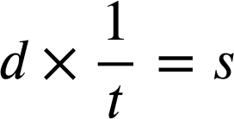
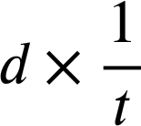
Dib-u-habaynta xiriirrada isku dhufashada (multiplicative relationships)
Dib-u-habaynta 'wax soo saar (product) korka qaybiye (factor)' oo leh doorsoomayaal aljabra (algebraic variables) isku mid bay tahay.
Tusaale ahaan, Dib-u-habayn (Rearrange)
Nus 10 waa 5
Nus 10 waa 5
× t = s × t
× 2 = 5 × 2
Ku dhufo isdhaafsiga (reciprocal) nus
d = s × t
10 = 5 × 2

Slide 29
Dib-u-habaynta xiriirrada isku dhufashada (multiplicative relationships)
Dib-u-habaynta 'wax soo saar (product) korka qaybiye (factor)' oo leh doorsoomayaal aljabra (algebraic variables) isku mid bay tahay.
Tusaale ahaan, Dib-u-habayn (Rearrange)
Mar kale, wax soo saarka (product) wuxuu ku xidhan yahay booska tireeyaha (numerator). Qaybiyeyaashu (factors) waxay beddelaan boosaska.
× t = s × t
d = s × t
d = t × s

Slide 30
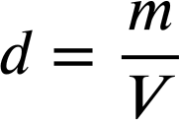
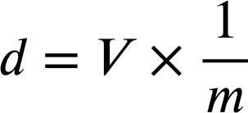
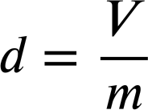
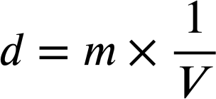
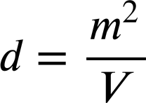
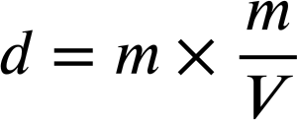
Dib-u-habaynta xiriirrada isku dhufashada (multiplicative relationships)
Kee mid ka mid ah kuwani waa habaynta saxda ah ee isla'egtan?

Slide 31
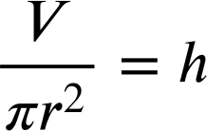
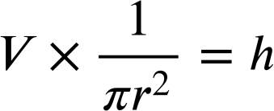
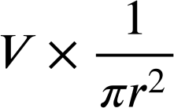
Dib-u-habaynta xiriirrada isku dhufashada (multiplicative relationships)
Dib-u-habaynta 'wax soo saar (product) korka qaybiye (factor)' oo leh ereyo badan oo la isku daray sida hal erey isku mid bay tahay.
Tusaale ahaan, Dib-u-habayn (Rearrange)
V = 𝜋r²h
× 𝜋r² = h × 𝜋r²
V = 𝜋r²h

Slide 32
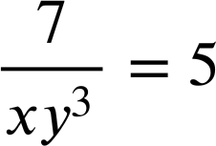
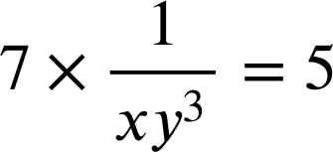
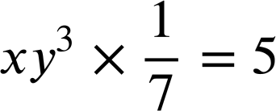
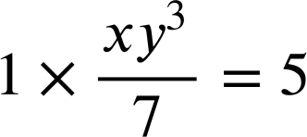
Dib-u-habaynta xiriirrada isku dhufashada (multiplicative relationships)
Mid ka mid ah kuwani waa tillaabada koowaad ee dib-u-habaynta isla'egtan?

Slide 33
Dib-u-habaynta xiriirka isku dhufashada (multiplicative relationships)
Waa maxay tillaabada xigta ee dib-u-habaynta isla'egtan?
labada dhinacba.
labada dhinacba.
dhinaca LHS kaliya.
÷ xy3
× xy3
Ku dhufo labada dhinac isku-dhufashada (reciprocal) xy3
× xy3

Slide 34
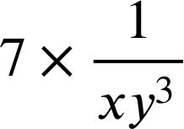
Dib-u-habaynta xiriirka isku dhufashada (multiplicative relationships)
Waa maxay dib-u-habaynta kama dambaysta ah?
5 = 7xy3
7 = 5 × xy3
Si buuxda looma fududeyn
× xy3 = 5 × xy3
7 = 5xy3

Slide 35
Dib-u-habaynta xiriirka isku dhufashada (multiplicative relationships)
Waa maxay dib-u-habaynta kama dambaysta ah?
5 = 7xy3
7 = 5xy3
7 = 5 × xy3
Marka aad noqoto mid aad u kalsoon, waxaad samayn kartaa hal tallaabo oo degdeg ah, × xy3
7 = 5xy3

Slide 36
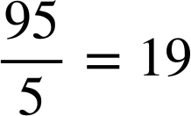
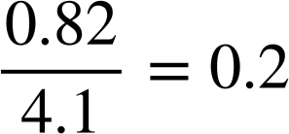
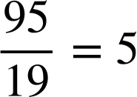
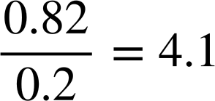




Dib-u-habaynta xidhiidhada isku dhufashada (multiplicative)
1) Qor qoyska dib-u-habaynta isla'egyada hoose.
a)
b)
19 × 5 = 95
0.2 × 4.1 = 0.82
5 × 19 = 95
4.1 × 0.2 = 0.82
c)
d)
7 × y = 56
P = F × A
y × 7 = 56
P = A × F

Slide 37









Dib-u-habaynta xidhiidhada isku dhufashada (multiplicative)
2) Cabdi wuxuu dib u habaynayaa isla'egyada.
a)
Waxaan kaliya 'beddelaa boosaska' isla'egta dhexdeeda.
waxaa loo beddeli karaa
b)
waxaa loo beddeli karaa
Xaalad kasta, go'aami haddii Cabdi sax yahay oo qor jumlad ku caddaynaysa go'aankaaga.
c)
waxaa loo beddeli karaa

Slide 38



Dib-u-habaynta xidhiidhada isku dhufashada (multiplicative)
3) Dib u habeey isla'eg kasta qaab a × b = c
a)
b)
c)

Slide 39
Dib-u-habaynta xidhiidhada isku dhufashada (multiplicative)
1) Qor qoyska dib-u-habaynta isla'egyada hoose.
a)
b)
19 × 5 = 95
0.2 × 4.1 = 0.82
5 × 19 = 95
4.1 × 0.2 = 0.82
c)
d)
7 × y = 56
P = F × A
y × 7 = 56
P = A × F

Slide 40
Dib-u-habaynta xidhiidhada isku dhufashada (multiplicative)
2) Cabdi wuxuu dib u habaynayaa isla'egyada.
a)
Labaduba waa dib-u-habayn 8 × 9 = 72 halkaas oo 72 uu yahay badeecada (product).
waxaa loo beddeli karaa
b)
waxaa loo beddeli karaa
Xaalad kasta, go'aami haddii Cabdi sax yahay oo qor jumlad ku caddaynaysa go'aankaaga.
c)
waxaa loo beddeli karaa

Slide 41
Dib u habaynta xiriirka isku dhufashada (multiplicative relationships)
2) Cabdi wuxuu dib u habeynayaa isla'egyada.
a)
Labaduba waa dib u habayn 8 × 9 = 72 halkaas oo 72 uu yahay natiijada (product).
waxaa loo beddeli karaa
b)
Labaduba waa dib u habayn bh = 5 halkaas oo 5 uu yahay natiijada (product).
waxaa loo beddeli karaa
c)
Mid waa dib u habayn 2x = 13, kan kalena waa dib u habayn 13x = 2
waxaa loo beddeli karaa

Slide 42
Dib u habaynta xiriirka isku dhufashada (multiplicative relationships)
Waxaa laga yaabaa inaad qortay talo Cabdi:
Waa muhiim in si sax ah loo dib u habeeyo isla'egyada.
Ma aha oo kaliya in la beddelo boosaska ereyada.
Waxaan kaliya 'beddelaa boosaska' isla'egta.

Slide 43





Dib u habaynta xiriirka isku dhufashada (multiplicative relationships)
3) Dib u habeey isla'eg kasta qaab a × b = c
a)
b)
c)
× 3yz = 4z2 × 3yz
× 8 = y × 8
× 3y = y × 3y
5x = 12yz3
x = 8y
x = 3y²

Slide 44


Xiriirka isku dhufashada (multiplicative relationships) ee u dhexeeya ereyada
Xiriirka isku dhufashada (multiplicative relationships) ee u dhexeeya doorsoomayaasha waxaa loo qori karaa siyaabo kala duwan.
Tusaale ahaan, isla'egta waxaan ka heli karnaa qoys dib u habayn ah.
15 = c × d
15 = d × c

