Slide 1
Magacaabista xeryahooda (compounds)
Atamka (Atoms), curiyeyaasha (elements) iyo xeryahooda (compounds)

Slide 2
sida loo isticmaalo darasyada Oak

Slide 3
Waxaan magacaabi karaa xeryahooda (compounds) iyadoo laga eegayo qaacidada kiimikada.

Slide 4
salfayt bir ah (metal sulfate)
kaarboonayt bir ah (metal carbonate)
naytarayt bir ah (metal nitrate)

Slide 5
Xarun salfayt bir ah (metal sulfate) waxay ka samaysan tahay bir ku xidhan koox salfayt ah. Kooxda salfaytku waa -SO4.
Xarun kaarboonayt bir ah (metal carbonate) waxay ka samaysan tahay bir ku xidhan koox kaarboonayt ah. Kooxda kaarboonaytku waa -CO3.
Xarun naytarayt bir ah (metal nitrate) waxay ka samaysan tahay bir ku xidhan koox naytarayt ah. Kooxda naytaraytku waa -NO3.

Slide 6

Magacaabista xeryahooda (compounds)
Magacaabista xeryaha birta iyo kuwa aan bir ahayn
Xeryaha ay ku jirto oksijiin (oxygen)
Salfaytyada (sulfates), kaarboonaytyada (carbonates) iyo naytaraytyada (nitrates)

Slide 7
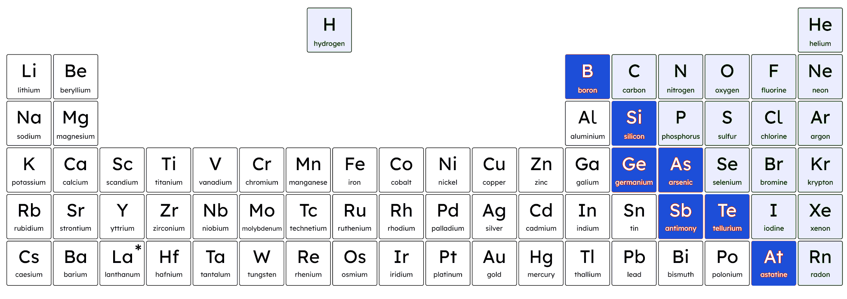
Magacaabista xeryaha birta iyo kuwa aan bir ahayn
Xeryuhu waxay leeyihiin magacyo kala duwan iyadoo ku xiran isku darka curiyeyaasha (elements) ay ka kooban yihiin.

Slide 8
Magacaabista xeryaha birta iyo kuwa aan bir ahayn
Magacaabista xarun ka samaysan bir iyo aan bir ahayn:
magaca birta
magnesium
ox
ide
magnesium + oxygen →
magaca birta ah (non-metal name)
Haddii ay jiraan laba curiye (elements) oo isku xidhaya, dhammaadka magaca aan birta ahayn waxaa loo beddelaa -ide.

Slide 9
Magacawnta isku-dhafka birta (metal) iyo birta ah (non-metal)
Jadwalku wuxuu muujinayaa tusaalooyin kala duwan oo birta ah (non-metals) oo ku jira isku-dhafka (compounds). Dhammaantood waxay ku dhamaanayaan -ide.
magaca birta (metal name) | magaca birta ah (non-metal name) | magaca isku-dhafka (compound name)
silver
oxygen
iron (iron)
sulfur (sulfur)
lithium
chlorine
potassium
fluorine
silver
bromine
zinc (zinc)
iodine (iodine)
Jawaabaha:
silver oxide
iron sulfide
lithium chloride
potassium fluoride
silver bromide
zinc iodide

Slide 10
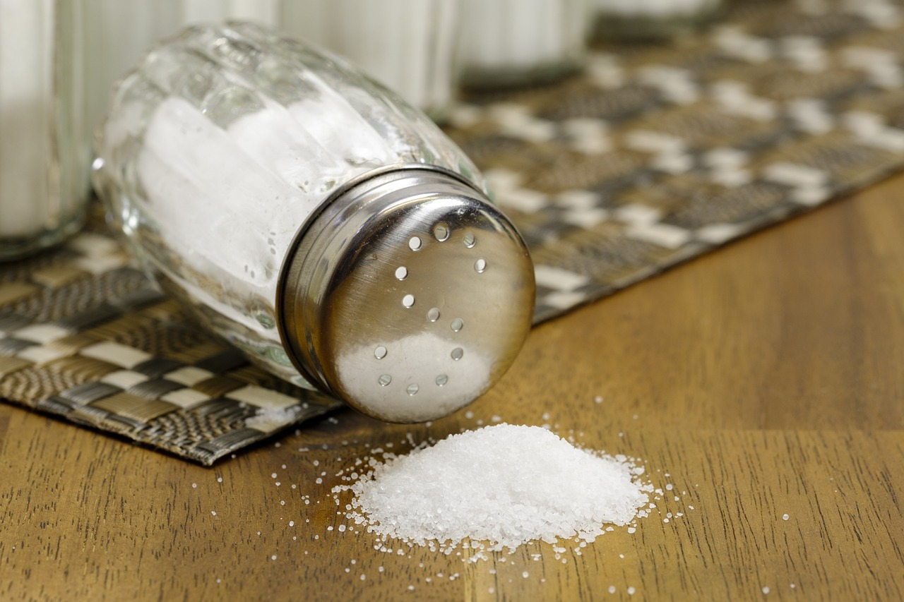

Magacaabista iskudhisyada birta iyo aan-birta ahayn (metal and non-metal compounds)
Sodium (Sodium) wax la falgalaa chlorine (chlorine) si loo sameeyo iskudhis (compound).
Waa maxay magaca iskudhiska (compound)?
sodium (sodium) chlorine (chlorine)
sodium chloride (sodium chloride)
chloride (chloride) sodium (sodium)
cusbo (salt)

Slide 11
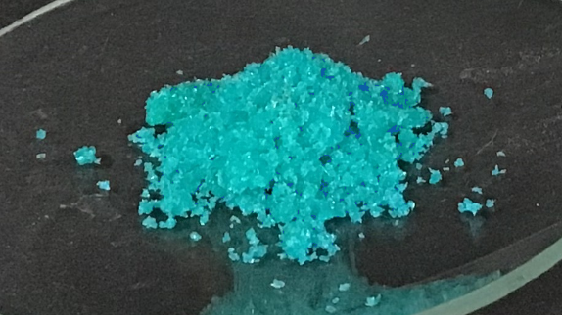
Magacaabista iskudhisyada birta iyo aan-birta ahayn (metal and non-metal compounds)
Waa maxay iskudhiska (compound) copper chloride (copper chloride) laga sameeyay?
copper (copper) iyo fluorine (fluorine)
copper (copper) iyo chloride (chloride)
copper (copper) iyo chlorine (chlorine)
copper chloride (copper chloride)
copper (copper) iyo oxygen (oxygen)

Slide 12
Magacaabista iskudhisyada birta iyo aan-birta ahayn (metal and non-metal compounds)
Buuxi macluumaadka maqan:
magaca birta (metal name) | magaca aan-birta ahayn (non-metal name) | magaca isku-dhafka (compound name)
silver (silver) | oxygen (oxygen) | silver oxide (silver oxide)
iron (iron) | oxygen (oxygen)
sodium (sodium) |  | sulfide (sulfide)
 | iodine (iodine) | potassium _______ (potassium _______ )
zinc (zinc) |  | chloride (chloride)
 |  | sodium fluoride (sodium fluoride)

Slide 13
Magacaabista isku-dhafka birta iyo birta ahayn (Naming metal and non-metal compounds)
magaca birta (metal name) | magaca birta ahayn (non-metal name) | magaca isku-dhafka (compound name)
silver (silver) | oxygen (oxygen) | silver oxide (silver oxide)
iron (iron) | oxygen (oxygen)
sodium (sodium) |  | sulfide (sulfide)
 | iodine (iodine) | potassium (potassium)
zinc (zinc) |  | chloride (chloride)
 |  | sodium fluoride (sodium fluoride)
Jawaabaha:
iron oxide (iron oxide)
sulfur (sulfur)
sodium (sodium)
potassium (potassium)
iodide (iodide)
chlorine (chlorine)
zinc (zinc)
sodium (sodium)
fluorine (fluorine)

Slide 14
Magacaabista xeryaha (Naming compounds)
Magacaabista xeryaha birta iyo kuwa aan birta ahayn (Naming metal and non-metal compounds)
Xeryo ay ku jirto oxygen (Compounds including oxygen)
Sulfates, carbonates iyo nitrates (Sulfates, carbonates and nitrates)

Slide 15
Xeryahooda ay ku jirto oxygen (Compounds including oxygen)
Marka bir ay falgalto (reaction) si ay u samayso xeryo leh non-metal iyo oxygen, qaybta non-metal ee magaca xeryaha waxay ku dhammaataa -ate.
magaca birta (metal name)
bir (iron)
sulf
ate
iron + sulfur + oxygen →
magaca birta ahayn (non-metal name)
oxygen (oxygen)

Slide 16
Xeryahooda ay ku jirto oxygen (Compounds including oxygen)
Jadwalku wuxuu tusaalayaa xeryahooda (compounds) la sameeyo marka falgalku (reaction) uu ku jiro bir (metal), aan-bir ahayn (non-metal) iyo oksijiin (oxygen).
magaca birta (metal name) | magaca birta ahayn (non-metal name) | waxaa sidoo kale ku jira (also includes) | magaca xeryaha (compound name)
bir (iron) | sulfur (sulfur) | oxygen (oxygen) | iron sulfate (iron sulfate)
lithium (lithium) | carbon (carbon) | oxygen (oxygen) | lithium carbonate (lithium carbonate)
potassium (potassium) | nitrogen (nitrogen) | oksijiin (oxygen) | potassium nitrate (potassium nitrate)

Slide 17
Xeryaha ay ku jirto oksijiin (oxygen)
Xeryaha (compounds) kee/kuwee ka kooban yahay oksijiin (oxygen)?
sulfides (sulfides)
sulfates (sulfates)
carbonates (carbonates)
nitrates (nitrates)

Slide 18
Xeryaha ay ku jirto oksijiin (oxygen)
Haddii bir (metal), aan-bir ahayn (non-metal) iyo oksijiin (oxygen) ay falgalaan (react) oo sameeyaan xar (compound), magaca xaruhu (compound) wuxuu ku dhammaanayaa -ide.
Marka bir (metal) iyo oksijiin (oxygen) ay ku lug yeeshaan falgal (reaction), xaruhu (compound) wuxuu ku dhammaanayaa -ate.
Marka bir (metal), aan-bir ahayn (non-metal) iyo oksijiin (oxygen) ay ku lug yeeshaan falgal (reaction), xaruhu (compound) wuxuu ku dhammaanayaa -ate.

Slide 19
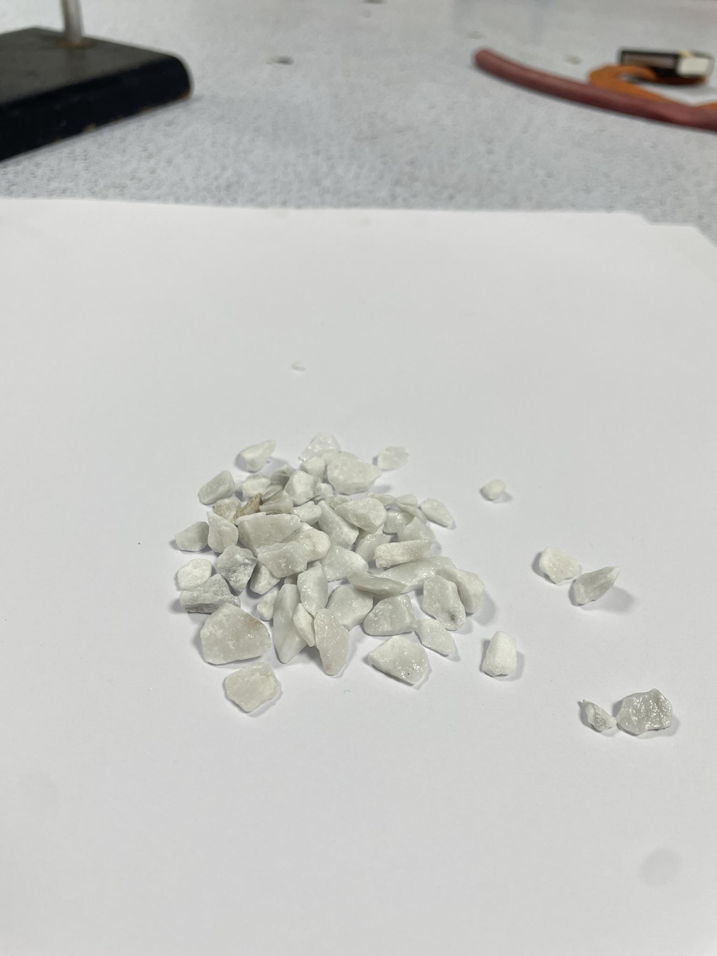

Xeryaha ay ku jirto oksijiin (oxygen)
Waa maxay magaca xaraha (compound) la sameeyo marka calcium, carbon iyo oksijiin (oxygen) ay falgalaan (react)?
calcium carbonite (calcium carbonite)
calcium carbonate (calcium carbonate)
marble chips iyo chalk waxay ka samaysan yihiin calcium carbonate (calcium carbonate)
carbonate calcium (carbonate calcium)
carbon calcate (carbon calcate)

Slide 20
Xeryaha ay ku jirto oksijiin (oxygen)
Buuxi jadwalka.
magaca birta (metal name) | magaca birta ahayn (non-metal name) | waxaa kaloo ku jira (also includes) | Magaca isku-dhafka (Name of the compound)
bir (iron) | nitrojiin (nitrogen) | oksijiin (oxygen)
magnesium (magnesium) | oksijiin (oxygen)
nikel (nickel) | bromiin (bromine) | oksijiin (oxygen)
naxaas (copper) | kloriin (chlorine)
 |  | oksijiin (oxygen) | potassium sulfate (potassium sulfate)
 |  |  | lithium carbonate (lithium carbonate)

Slide 21
Isku-dhafka oo ay ku jirto oksijiin (Compounds including oxygen)
Buuxi shaxda. (Complete the table.)
magaca birta (metal name) | magaca birta ahayn (non-metal name) | waxaa kaloo ku jira (also includes) | Magaca isku-darka (compound)
bir (iron) | nitrojiin (nitrogen) | oksijiin (oxygen)
magnesium | oksijiin (oxygen)
nikel (nickel) | bromine | oksijiin (oxygen)
naxaas (copper) | koloriin (chlorine)
 |  | oksijiin (oxygen) | potassium sulfate
 |  |  | lithium carbonate
Jawaabaha:
iron nitrate
magnesium oxide
nickel bromate
copper chloride
potassium
sulfur
lithium
kaarboon (carbon)
oksijiin (oxygen)

Slide 22
Naming compounds
Naming metal and non-metal compounds
Compounds including oxygen
Sulfates, carbonates and nitrates

Slide 23
Sulfates, carbonates and nitrates
Sulfates, carbonates and nitrates are examples of compounds ending in -ate.
compound ending | general name
sulfate | metal sulfate
carbonate | metal carbonate
nitrate | metal nitrate

Slide 24
Sulfates, carbonates and nitrates
Sulfate, carbonates iyo nitrates waxaa lagu matali karaa astaamo (symbols).
compound ending | compound ending symbol | atoms involved
sulfate | SO₄ | 1 × sulfur, 4 × oxygen
carbonate (carbonate) | CO3 | 1 × carbon, 3 × oxygen
nitrate (nitrate) | NO3 | 1 × nitrogen, 3 × oxygen
copper sulfate waxaa loo qori lahaa CuSO₄
calcium carbonate waxaa loo qori lahaa CaCO3
potassium nitrate waxaa loo qori lahaa KNO3

Slide 25
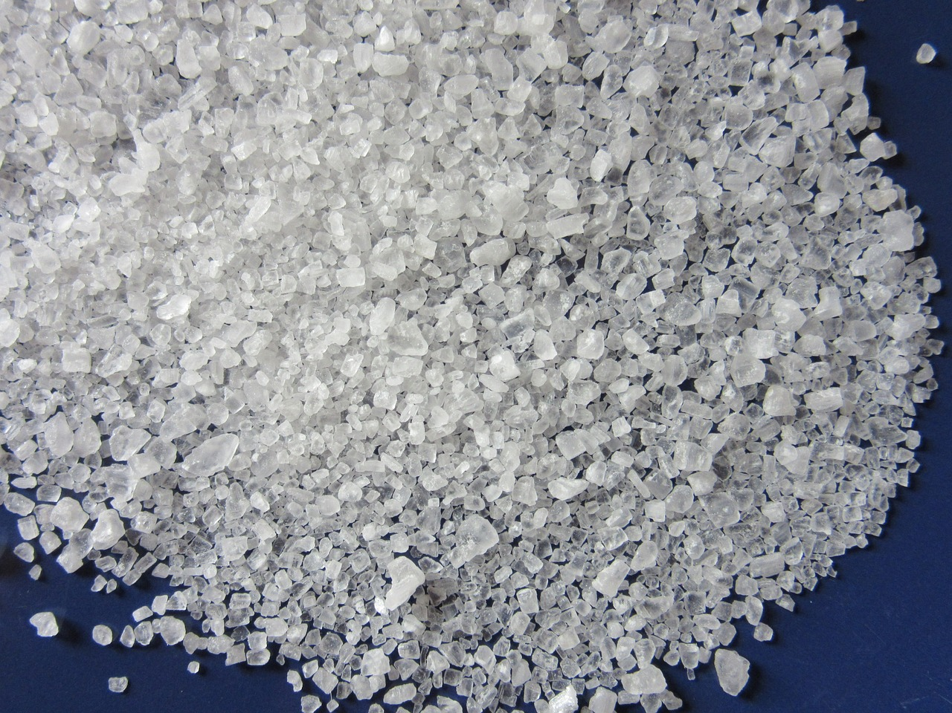
Sulfates, carbonates iyo nitrates
Na waa astaanta sodium. Magacow xarunta NaNO3.
sodium sulfate
sodium nitrate
sodium carbonate
NaNO3

Slide 26
Sulfates, carbonates iyo nitrates
Waa maxay dhammaadka qaacidada zinc sulfate?
SO4
CO3
NO3

Slide 27




Sulfates, carbonates iyo nitrates
Isra waxay qoraysaa xeerar magacaabista xeryahooda (compounds) ay ku jirto oksijiin (oxygen). Dhammaystir ama six fikiradeeda.
Marka bir (metal) falgal (reaction) ku sameyso curiye (element) aan bir ahayn iyo oksijiin (oxygen), xeryaha (compound) wuxuu yeelanayaa magac ku bilaabma -ate.
dhammaadka xeryaha (compound ending) | calaamadda dhammaadka xeryaha (compound ending symbol)
sulfate
 | CO3
nitrate
CuSO4 waa qaacidada (formula) __________
__________ wuxuu leeyahay qaacidada (formula) PbCO3 .

Slide 28
Sulfates, carbonates iyo nitrates
Isra waxay qoraysaa xeerar magacaabista xeryahooda (compounds) ay ku jirto oksijiin (oxygen). Dhammaystir ama six fikiradeeda.
Marka bir (metal) falgal (reaction) ku sameyso bir la'aan (non-metal) iyo oksijiin (oxygen), xeryaha (compound) wuxuu yeelanayaa magac -ate.
dhammaadka xeryaha (compound ending) | calaamadda dhammaadka xeryaha (compound ending symbol)
sulfate
 | CO3
nitrate
CuSO4 waa qaacidada (formula)
wuxuu leeyahay qaacidada (formula) PbCO3 .
Jawaabaha:
xerye (compound)
SO₄
ku dhammaada
carbonate (kaarboonayt)
NO3
Lead carbonate
copper sulfate (naxaas sulfate)

Slide 29
Sulfates (sulfaato), carbonates (kaarboonayt) iyo nitrates (nitraat)
Isku dhig foomka (formula) iyo magaca isku-darka (compound).
PbSO4
lead (leed)
nitrate (nitraat)
NaNO3
copper (naxaas)
BaSO4
potassium (botashiyaam)
sulfate (sulfaat)
CuCO3
sodium (soodhiyaam)
KNO3
barium (baariyaam)
carbonate (kaarboonayt)

Slide 30
Sulfates (sulfaato), carbonates (kaarboonayt) iyo nitrates (nitraat)
PbSO4
lead (leed)
nitrate (nitrate)
NaNO3
copper (copper)
BaSO4
potassium (potassium)
sulfate (sulfate)
CuCO3
sodium (soodhiyaam)
KNO3
barium (barium)
carbonate (carbonate)

Slide 31
Magacaynta iskudhafka (compounds)
Magaca iskudhafka bir-furan ee fudud wuxuu ku dhamaadaa -ide si loo muujiyo in isku-xidhku dhacay.
Magaca iskudhafka bir-furan ee fudud wuxuu ku dhamaadaa -ate haddii oksijiin (oxygen) sidoo kale ku lug leedahay.
Iskudhafka birlaha (metals) ee ku xidhan -CO₃ waxaa loo yaqaan carbonates-ka birlaha (metal carbonates).
Iskudhafka birlaha (metals) ee ku xidhan -SO₄ waxaa loo yaqaan sulfates-ka birlaha (metal sulfates).
Iskudhafka birlaha (metals) ee ku xidhan -NO₃ waxaa loo yaqaan nitrates-ka birlaha (metal nitrates).

